Slide 1
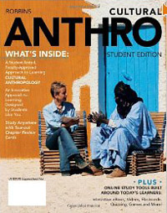
Welcome to
Cultural Anthropology
2012
University of Minnesota Duluth
Tim Roufs
© 2010-2012
http://www.d.umn.edu/cla/faculty/troufs/anth1604/

Slide 2
2012
University of Minnesota Duluth
Tim Roufs
© 2010-2012
http://www.d.umn.edu/cla/faculty/troufs/anth1604/

Slide 3
2012
University of Minnesota Duluth
Tim Roufs
© 2010-2012
http://www.d.umn.edu/cla/faculty/troufs/anth1604/

Slide 4

Textbook
Course Materials ?
2009
2012
University of Minnesota Duluth
Tim Roufs
© 2010-2011
http://www.d.umn.edu/cla/faculty/troufs/anth1604/

Slide 5

First thing . . .
(if you are not already in Moodle)
go to your
course management site
and check it out . . .

Slide 6
How do you find
in the first place?

Slide 7
Further instructions follow,
but if you want,
and your browser permits,
clicking on the URL that follows
in the next slide
will take you to your Moodle home . . .
(your browser may require that you double-click)
There is another link at the end of this program

Slide 8
https://moodle.umn.edu/
(your browser may require that you double-click)
If your browser does not allow you to click on the above URL just enter it in your browser window . . .
Continue on here for further instructions . . .
There is another link at the end of this program

Slide 9
Your Moodle screen will look something like the following . . .

Slide 10
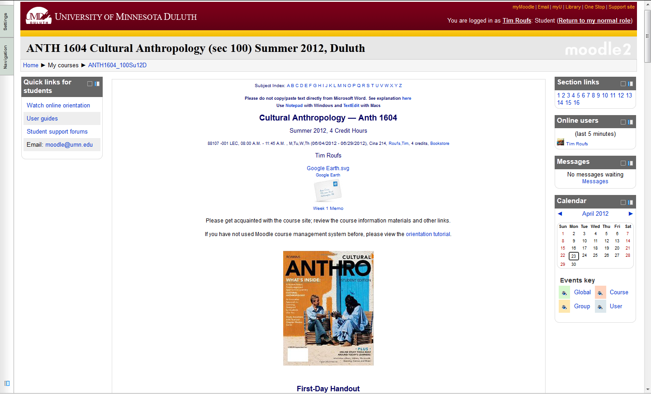
Your Moodle screen will look something like this . . .

Slide 11
Your Moodle screen will look something like this . . .
scroll down

Slide 12

“Block 1” contains the basic information on the course . . .
“Block 1”

Slide 13
And the listing for Week 1 will look something like this . . .

Slide 14
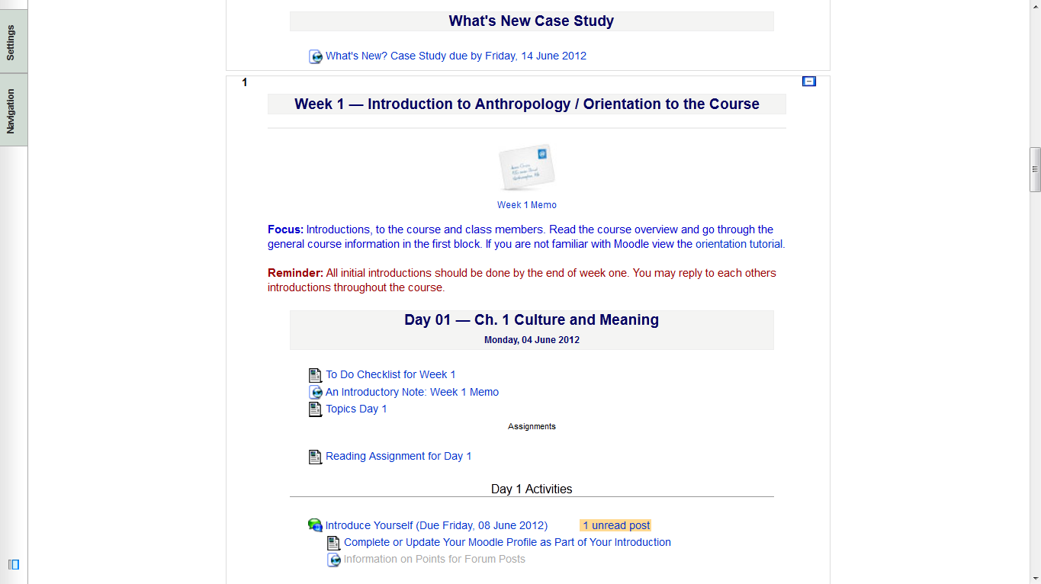
And the listing for Week 1 Day 1 will look something like this . . .

Slide 15

And the listing for Week 1 Day 1 will look something like this . . .
There are usually three main parts to the listing of a day . . .

Slide 16
And the listing for Week 1 Day 1 will look something like this . . .
1. Topic(s) for the Day . . .

Slide 17
And the listing for Week 1 Day 1 will look something like this . . .
2. Reading Assignments . . .

Slide 18
And the listing for Week 1 Day 1 will look something like this . . .
and (sometimes) 3. Activities . . .

Slide 19
And the listing for Week 1 Day 1 will look something like this . . .
The first week . . .
    introduce yourself
    do the Pre-Assessment
    join in on the Forum Discussion
    and, just for the fun of it, have a look around at the rest of the materials

Slide 20
2012
University of Minnesota Duluth
Tim Roufs
© 2010-2012
http://www.d.umn.edu/cla/faculty/troufs/anth1604/

Slide 21
Introduction to You:
Meet Yourselves
http://www.d.umn.edu/cla/faculty/troufs/anth1604/

Slide 24
And the listing for Week 1 Day 1 will look something like this . . .

Slide 25

And the listing for Week 1 Day 1 will look something like this . . .
The first week . . .
    introduce yourself
    do the Pre-Assessment
    join in on the Forum Discussion
    and, just for the fun of it, have a look around at the rest of the materials

Slide 26
And the listing for Week 1 Day 1 will look something like this . . .
The first week . . .
    introduce yourself
    do the Pre-Assessment
    join in on the Forum Discussion
    and, just for the fun of it, have a look around at the rest of the materials
    be sure to Update Your Moodle Profile
    as part of your introduction

Slide 27
And the listing for Week 1 Day 1 will look something like this . . .
    and, just for the fun of it, have a look around at the rest of the materials
The first week . . .
    introduce yourself
    do the Pre-Assessment
    join in on the Forum Discussion
    and, just for the fun of it, have a look around at the rest of the materials

Slide 28
You may also access your Moodle folder via the Main UMD WebPage . . .
www.d.umn.edu

Slide 29
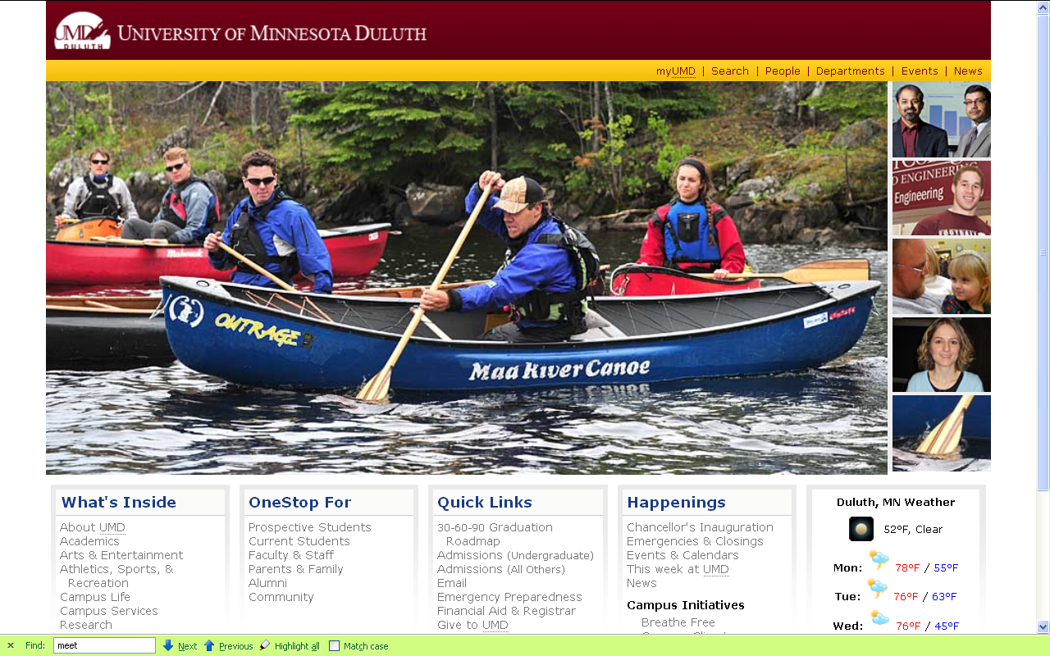
At actual Main UMD WebPage . . .
(not necessarily this images change)
www.d.umn.edu

Slide 30
click on “OneStop For Current Students” . . .
(not the image that will appear)
www.d.umn.edu

Slide 31
At actual Main UMD WebPage . . .
(not necessarily this images change)
www.d.umn.edu

Slide 32
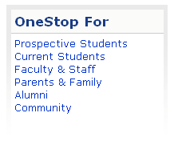
At actual Main UMD WebPage . . .
(not necessarily this images change)
www.d.umn.edu

Slide 33
click on “Technology Resources for Students” . . .
http://www.d.umn.edu/itss/students/

Slide 34
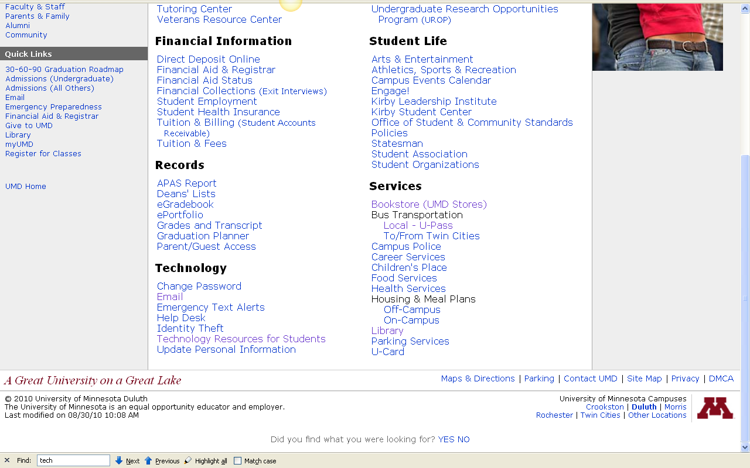
click on “Technology Resources for Students” . . .
http://www.d.umn.edu/itss/students/

Slide 35

click on “Technology Resources for Students” . . .
http://www.d.umn.edu/itss/students/

Slide 36
click on “Moodle Support” . . .
http://www.d.umn.edu/itss/students/

Slide 37
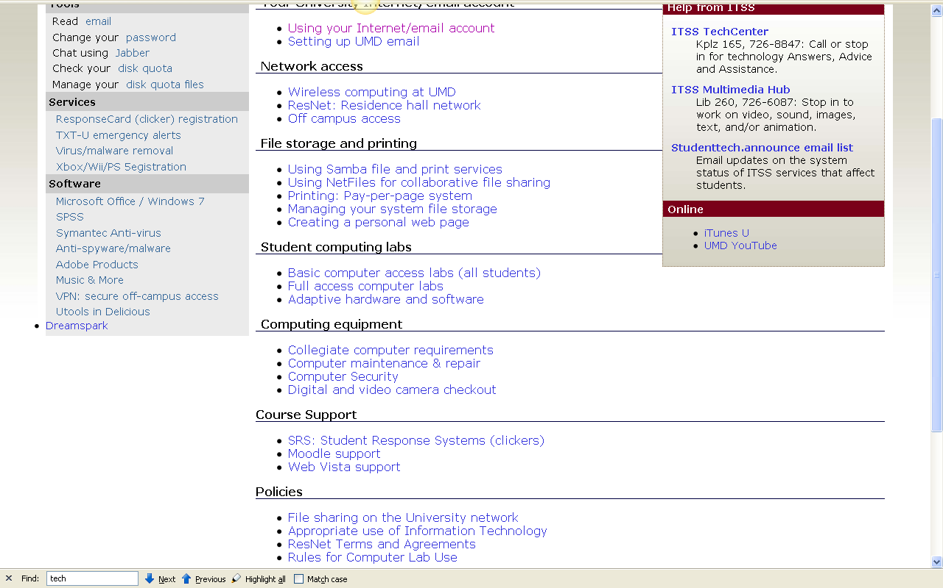
click on “Moodle Support” . . .
http://www.d.umn.edu/itss/students/

Slide 38

click on “Moodle Support” . . .
http://www.d.umn.edu/itss/students/

Slide 39
Your log-in page will look something like the following . . .
Log in using your “x.500” information . . .
(that’s the log-in information you use for your e-mail)
https://moodle.umn.edu/

Slide 40
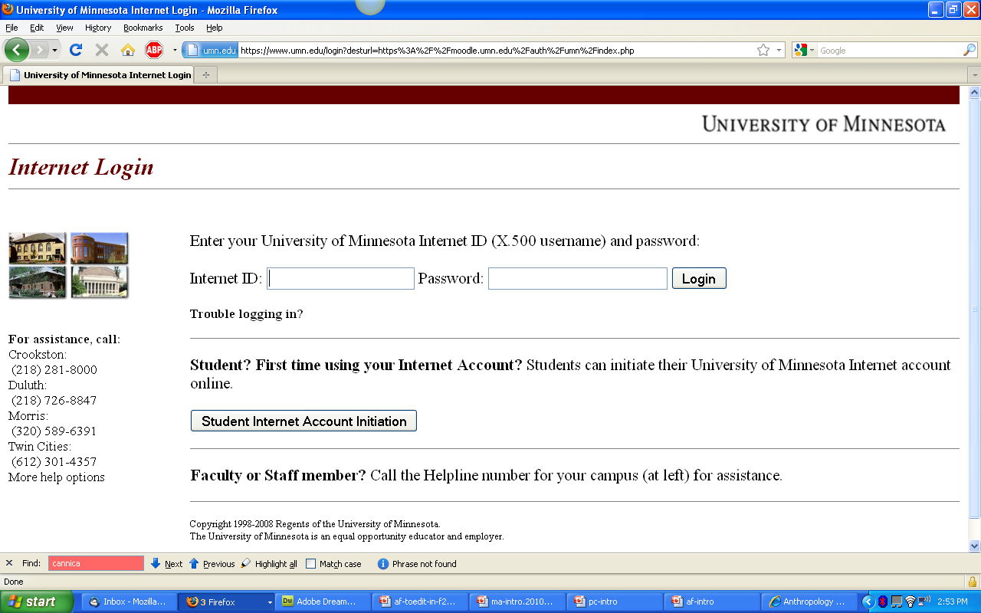
Log in using your “x.500” information . . .

Slide 41
Your Moodle “home” will look something like the following . . .
https://moodle.umn.edu/

Slide 42
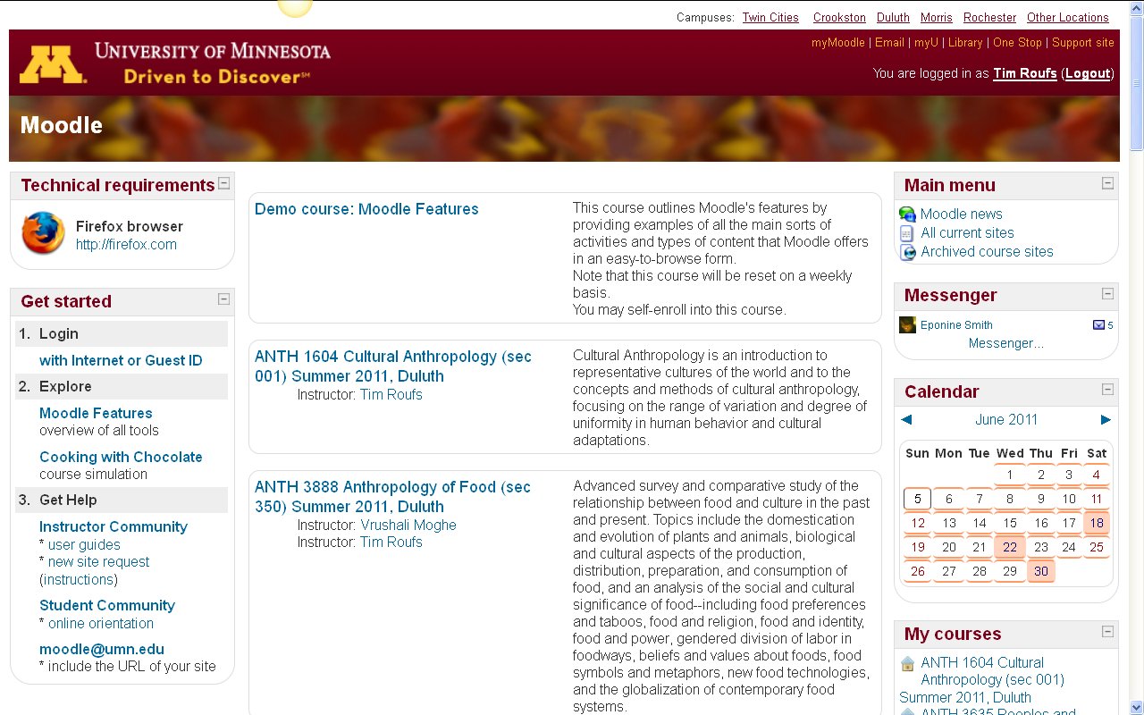
Your Moodle “home” will look something like this . . .
https://moodle.umn.edu/

Slide 43
Select Cultural Anthropology . . .
https://moodle.umn.edu/

Slide 44
Your Moodle “home” will look something like this . . .
https://moodle.umn.edu/

Slide 45

The “First-Day” Handout information below the texts . . .
https://moodle.umn.edu/

Slide 46
Select Prehistoric Cultures . . .
The “First-Day” Handout information contains the basic information . . .
It look something like the following . . .
https://moodle.umn.edu/

Slide 47
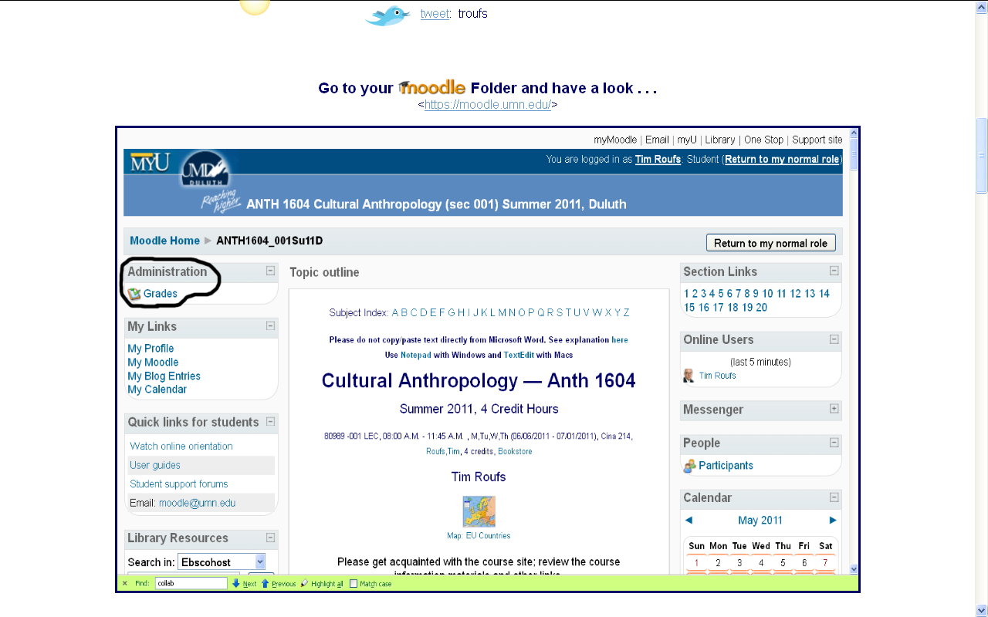
“First-Day” Handout information . . .
http://www.d.umn.edu/cla/faculty/troufs/anth3635/cehandout_first-day.html

Slide 48
“First-Day” Handout information . . .
scroll down
http://www.d.umn.edu/cla/faculty/troufs/anth3635/cehandout_first-day.html

Slide 49
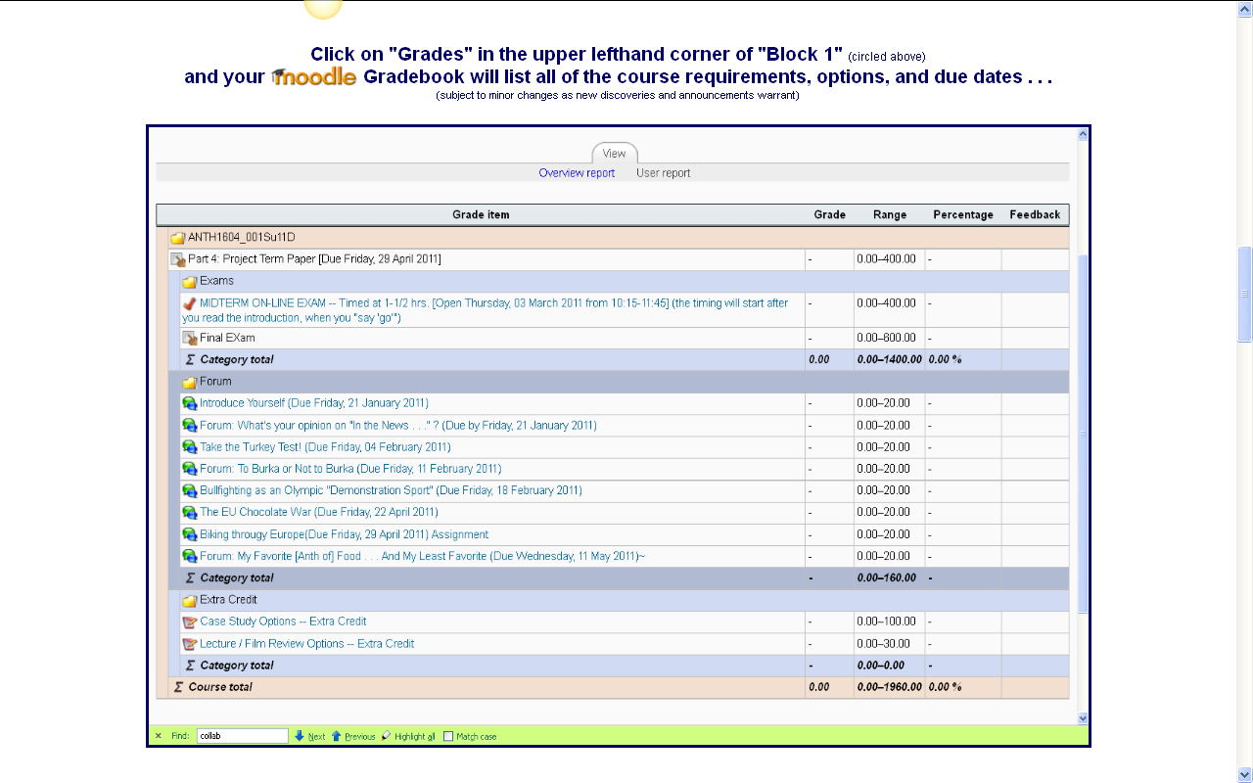
“First-Day” Handout information . . .
http://www.d.umn.edu/cla/faculty/troufs/anth3635/cehandout_first-day.html

Slide 50
“First-Day” Handout information . . .
scroll down
http://www.d.umn.edu/cla/faculty/troufs/anth3635/cehandout_first-day.html

Slide 51
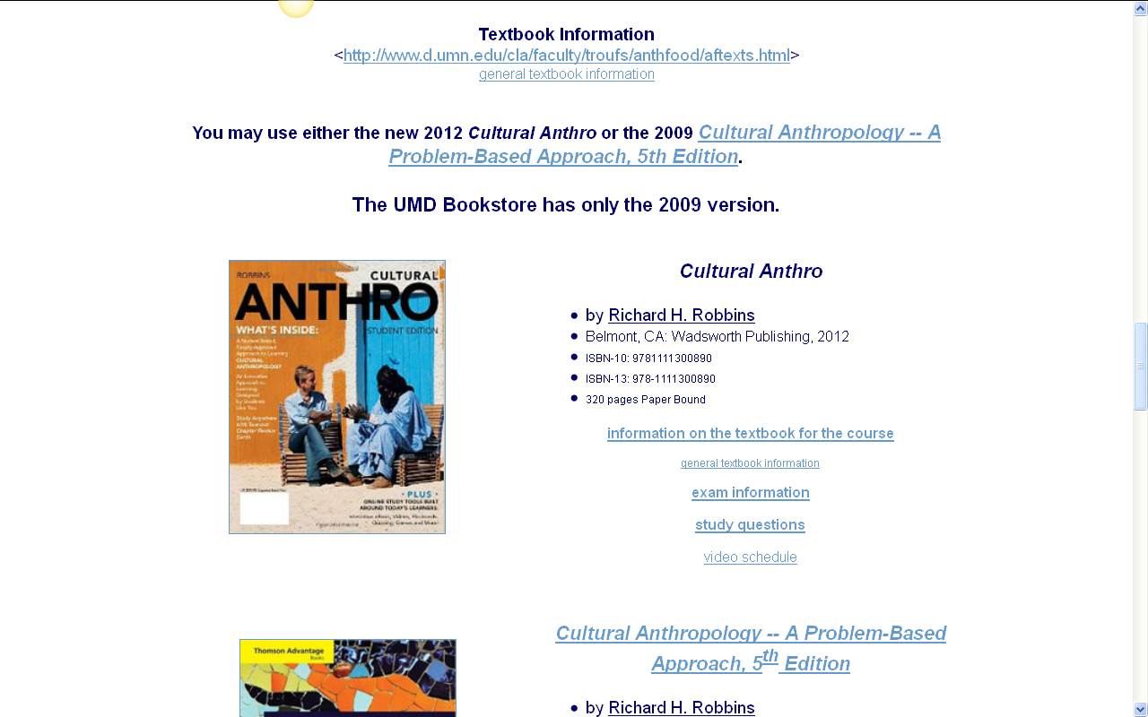
“First-Day” Handout information . . .
Basic Text Information
http://www.d.umn.edu/cla/faculty/troufs/anth3635/cehandout_first-day.html

Slide 52
“First-Day” Handout information . . .
including information on purchasing texts . . .
http://www.d.umn.edu/cla/faculty/troufs/anth3635/cehandout_first-day.html

Slide 53

“First-Day” Handout information . . .
Governing Procedures
http://www.d.umn.edu/cla/faculty/troufs/anth3635/cehandout_first-day.html

Slide 54
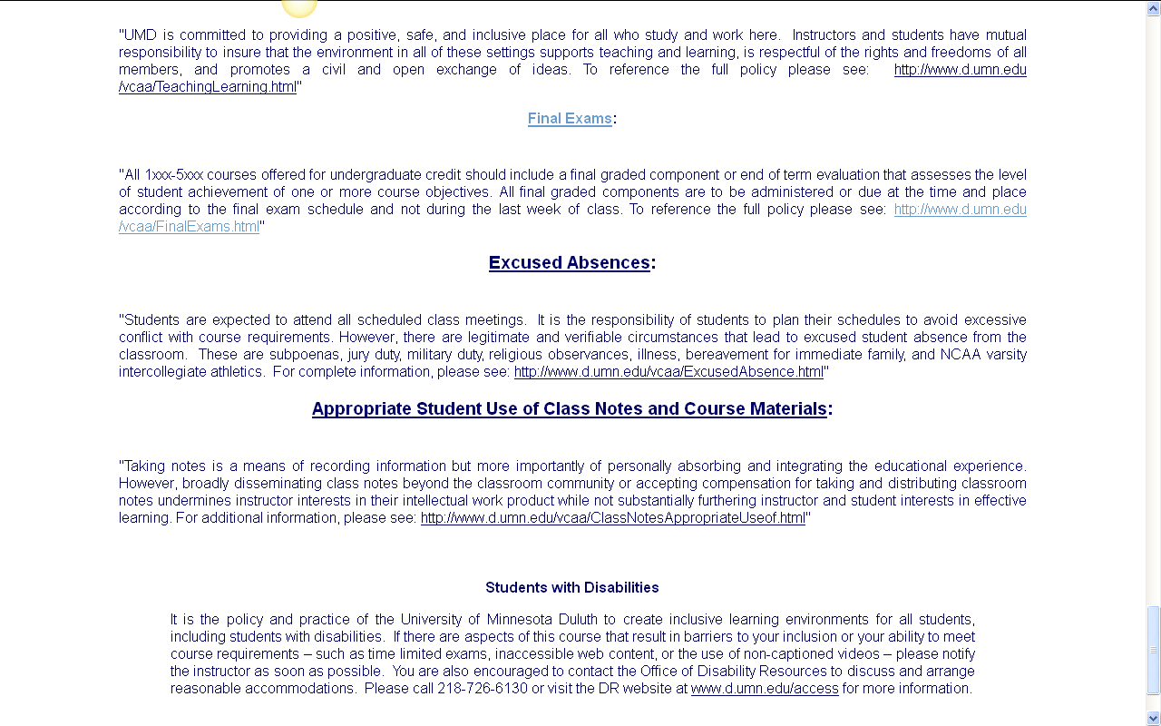
“First-Day” Handout information . . .
http://www.d.umn.edu/cla/faculty/troufs/anth3635/cehandout_first-day.html

Slide 55
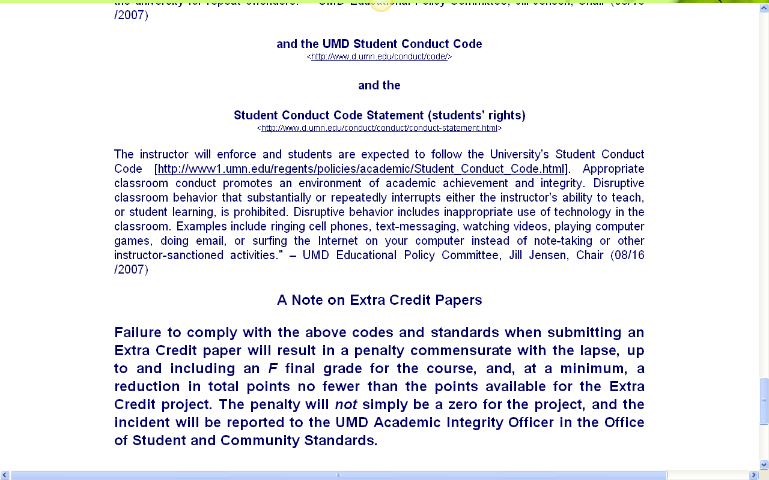
Governing Procedures
note on Extra Credit Papers
http://www.d.umn.edu/cla/faculty/troufs/anth3635/cehandout_first-day.html

Slide 56

Special Facilities
Information
http://www.d.umn.edu/cla/faculty/troufs/anth3635/cehandout_first-day.html

Slide 57
“First-Day” Handout information . . .
scroll down
http://www.d.umn.edu/cla/faculty/troufs/anth3635/cehandout_first-day.html

Slide 58
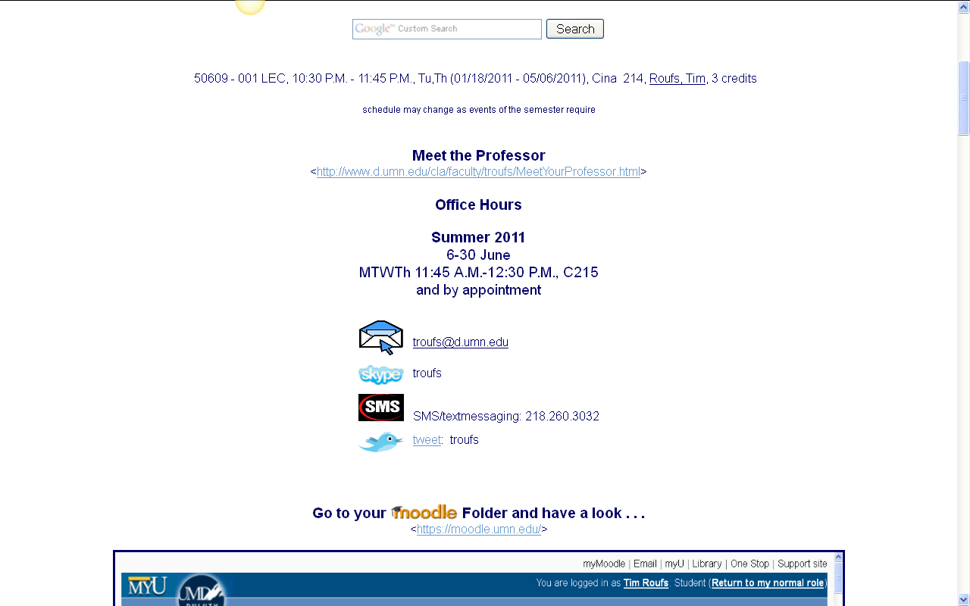
Basic Contact Information
http://www.d.umn.edu/cla/faculty/troufs/anth3635/cehandout_first-day.html

Slide 59
Basic Contact Information
http://www.d.umn.edu/cla/faculty/troufs/anth3635/cehandout_first-day.html

Slide 60
Basic Contact Information
Why?
http://www.d.umn.edu/cla/faculty/troufs/anth3635/cehandout_first-day.html

Slide 61
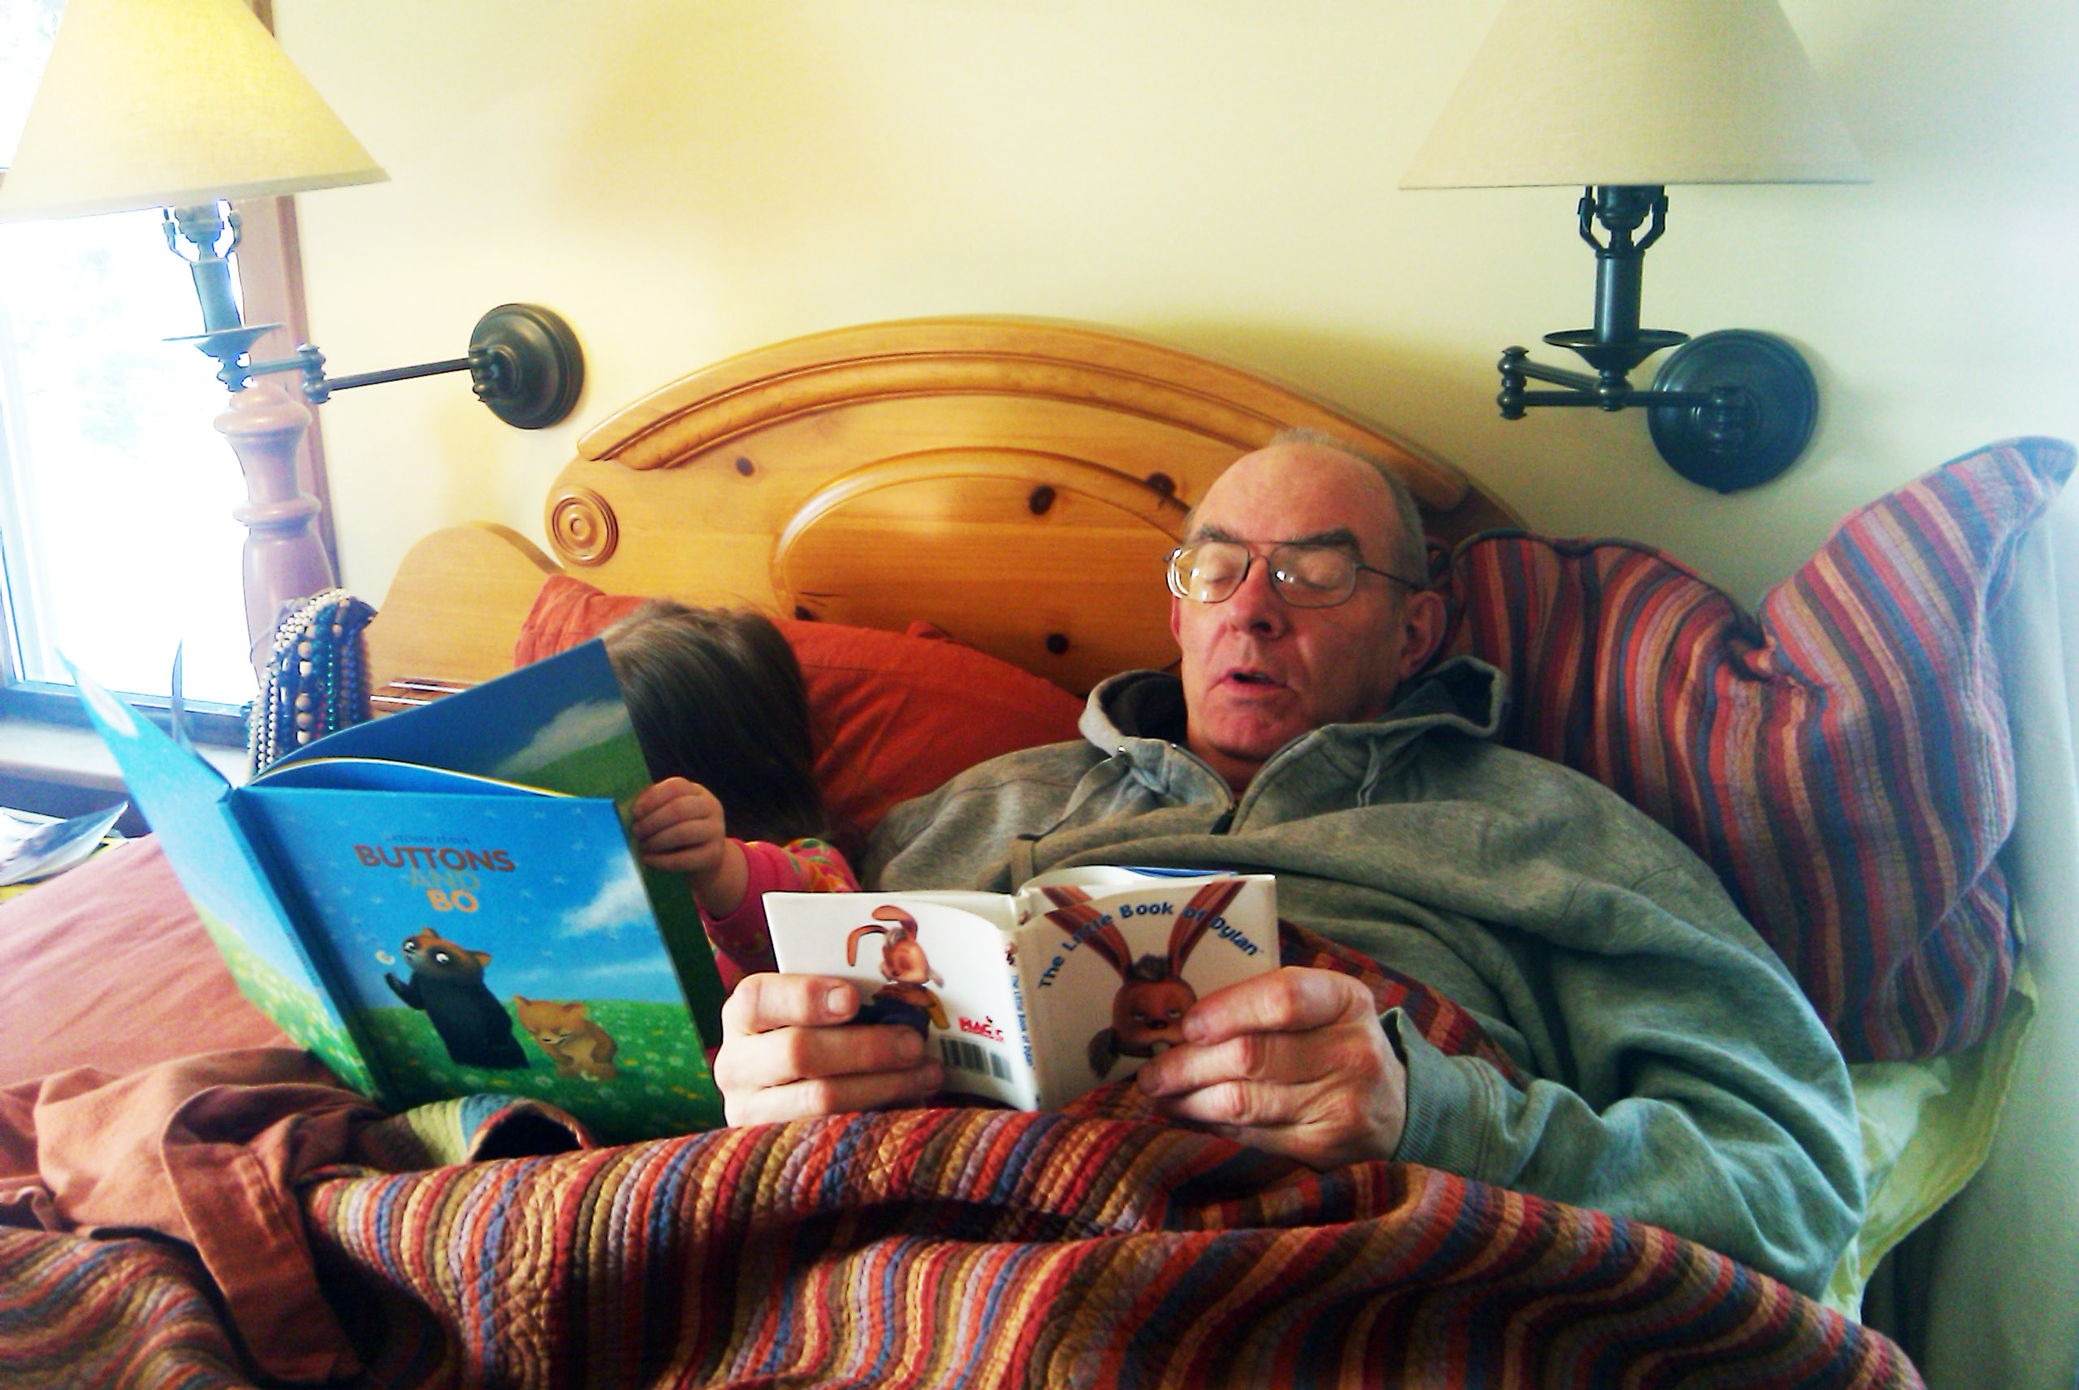
Meet Your Professor . . .
University of Minnesota Duluth
Tim Roufs
© 2010

Slide 63
Hi.
I'm Tim Roufs.

Slide 64
What would you like to know about your profs?
University of Minnesota Duluth
Tim Roufs
© 2010-2012
http://www.d.umn.edu/cla/faculty/troufs/anth1604/

Slide 65
When I ask students in face-to-face (f2f) classes "What would you like to know about your professor?"
they usually uniformly ask "safe" questions
(which anthropologically-speaking is probably a good approach, although it's difficult for the last person to think of a "safe" question that hasn't been asked by one of the other students)

Slide 66
They ask questions like
"Where were you born?" . . .
"Where did you go to school?" . . .
"How long have you been teaching at UMD?" . . .
“Where have you been?” . . .
and that sort of thing . . .

Slide 67
To me, (judging by the looks on the faces of most in class) those questions, while safe, are actually pretty boring
But one or two folks seem to like to know about that sort of thing.
If you do, more than you probably really want or need to know is on
my UMD biography page . . .

Slide 68
FAQs
Where did you grow up ?
Where did you go to school ?
How long have you been at UMD ?
What are your favorite things to do?
How did you get into anthropology?
Where have you been?
            What are your pet peeves?
boring ???

Slide 69
To me, (judging by the looks on the faces of most in class) those questions, while safe, are actually pretty boring.
But one or two folks seem to like to know about that sort of thing
If you do, more than you probably really want or need to know is on
my UMD biography page . . .

Slide 70
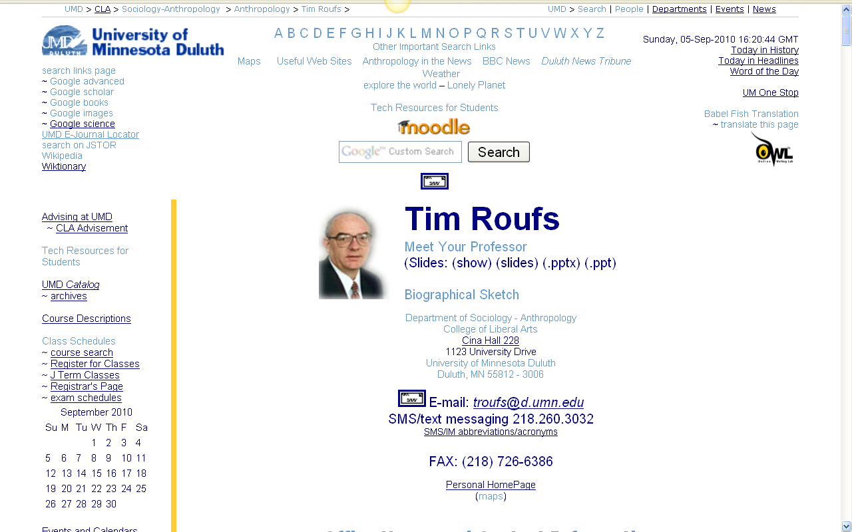

Slide 71
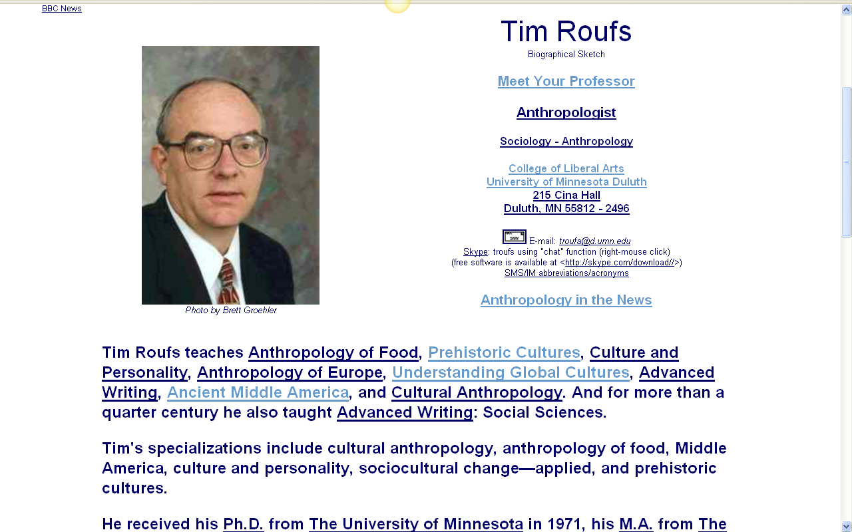

Slide 72
My "career" in American-style Anthropology began in second grade
Most students are curious about that.

Slide 73
My "career" in American-style Anthropology began in second grade
Most students are curious about that

Slide 74
One of the
Main Characteristics of American Anthropology
is that it encompasses a
"four-fields approach" incorporating
Socio-Cultural Anthropology
Bio-Physical Anthropology
Archaeology
and Linguistics

Slide 75
It was in second grade of Holy Trinity Grade School that I really began to learn some of the important things in life
—and important things in anthropology

Slide 76
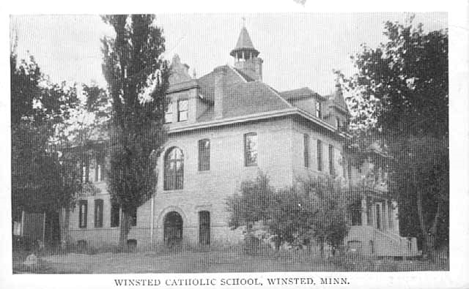
Winsted Catholic School, Winsted.
Minnesota Historical Society Photograph Collection, Postcard
ca. 1915
Location no. MM1.9 WN r4

Slide 77
By the end of third grade I had done fieldwork in all four fields of anthropology

Slide 78
These "Introduction" slides will talk about these "early" days in anthropology and, why I'm here

Slide 79
And you will hopefully see in this course why in more recent years I have been called one of the
"Pioneers in Online Instruction"
(Surfing the Syllabi: Online Resources for Teaching Archaeology)

Slide 80
Why should you care?
(And why do I tell you this stuff
when I really don't like to do it
--being a Lake Wobegon type person?)

Slide 81
Why should you care?
(And why do I tell you this stuff
when I really don't like to do it
--being a Lake Wobegon type person?)

Slide 82
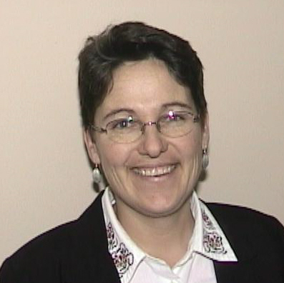
A long-time mentor, Helen Mongan-Rallis, says that research shows that three good things happen when you take time to find out a little about your teacher as a person
You learn more
You remember it better
And — equally important, I think—
you have more fun learning

Slide 83
A long-time mentor, Helen Mongan-Rallis, says that research shows that three good things happen when you take time to find out a little about your teacher as a person
You learn more
You remember it better
And — equally important, I think—
you have more fun learning

Slide 84
So it’s a good idea for you to have a look at these "Introduction" materials to according to Helen . . .
help you learn more
remember it longer
and (at least eventually) to have more fun

Slide 85
So back to some questions . . .

Slide 86
FAQs
Where did you grow up?
Where did you go to school?
How long have you been at UMD?
What are your favorite things to do?
How did you get into anthropology?
Where have you been?
            What are your pet peeves?

Slide 87
One of my very favorite things is being out in the yard putzing around,
talking to animals . . .
and to trees and plants too

Slide 88
One of my very favorite things is being out in the yard putzing around,
talking to animals . . .
and to trees and plants too

Slide 89
And they talk back
(and scientists have recently discovered that they “talk” to one another – at least the trees do . . .)

Slide 90
And they talk back
(and scientists have recently discovered that
they “talk” to one another – at least the trees do . . .)

Slide 91
And I love doing anthropology

Slide 92
Here’s a picture of me doing anthropology . . .

Slide 93
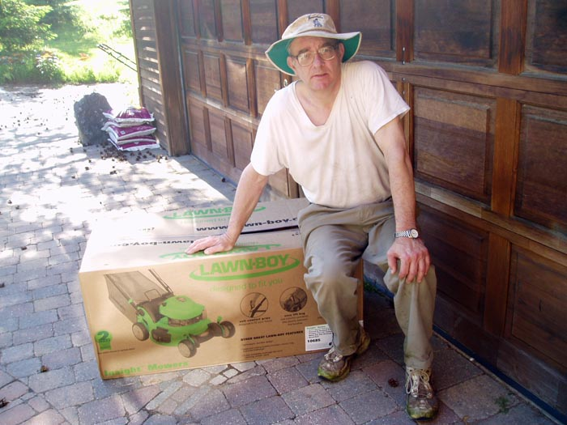

Slide 94
It may not look like anthropology,
but it is . . .
I’m contemplating my new lawn mower, a Lawn Boy . . .
Designed with the help of anthropologists.

Slide 95
It may not look like anthropology,
but it is . . .
I’m contemplating my new lawn mower,
a Lawn Boy . . .
Designed with the help of anthropologists.

Slide 96
It may not look like anthropology,
but it is . . .
I’m contemplating my new lawn mower,
a Lawn Boy . . .
Designed with the help of anthropologists

Slide 97
What can anthropologists do to design lawn mowers?
They do what anthropologists do . . .
go live with the “natives”
(that’s called “participant observation”)
they ask a lot of questions
(“interviewing”)
they take a lot of pictures
(ethnophotography)

Slide 98
What can anthropologists do to design lawn mowers?
They do what anthropologists do . . .
go live with the “natives”
(that’s called “participant observation”)
they ask a lot of questions
(“interviewing”)
they take a lot of pictures
(ethnophotography)

Slide 99
What can anthropologists do to design lawn mowers?
They do what anthropologists do . . .
they go live with the “natives”
(that’s called “participant observation”)
they ask a lot of questions
(“interviewing”)
they take a lot of pictures
(“ethnophotography”)

Slide 100
And so the anthropologists went out and studied the “tribe” of lawnmowers
And they watched them mow lawns
And they mowed some lawns themselves
And they administered questionnaires about lawn mowers and lawn mowing
They interviewed the lawnmower people
And they took a lot of videos and still photographs

Slide 101
And they discovered that women often mow lawns
And the women often had a different relationship than the men to the gas engines
(For e.g., they didn’t particularly get a thrill out of gapping the plugs, changing the oil, stabilizing the fuel, and the like.
And, they didn’t have a “cylinder index” of manhood to have to worry about.)
And they found out that the ladies liked a starting “handle” rather than a little knob, and a handle that adjusted to their (generally) smaller height
And they liked a mower that cut close to
the trees and buildings . . .
as, for some reason the mowing men
didn’t trim grass there.

Slide 102
And, in general, they learned a lot about the lawnmower people
And Toro, who now owned Lawn Boy, redesigned the mower, and the anthropological artifact arrived . . .
an anthropological masterpiece
ready to become part of that talking to trees and animals

Slide 103
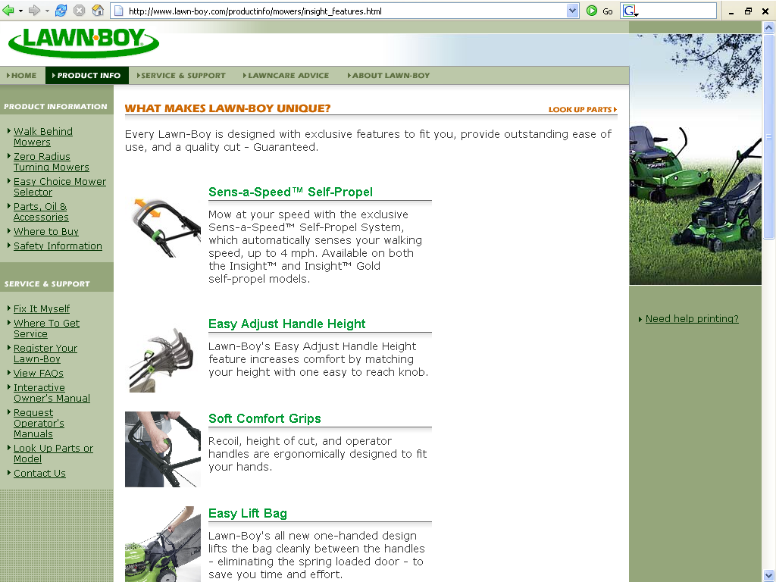
www.lawn-boy.com/productinfo/mowers/insight_features.html

Slide 104
And, one of the best listener-animals
is “Duncan” a pretty big Newfoundland . . .
well, actually, just a “normal” Newfoundland
Normal Newfoundlands are bred as water-rescue dogs, and they have webbed feet, and a second coat of hair so they can swim in Lake Superior in the winter, and all of that sort of thing.
Basically, Newfondlands LOVE water.

Slide 105
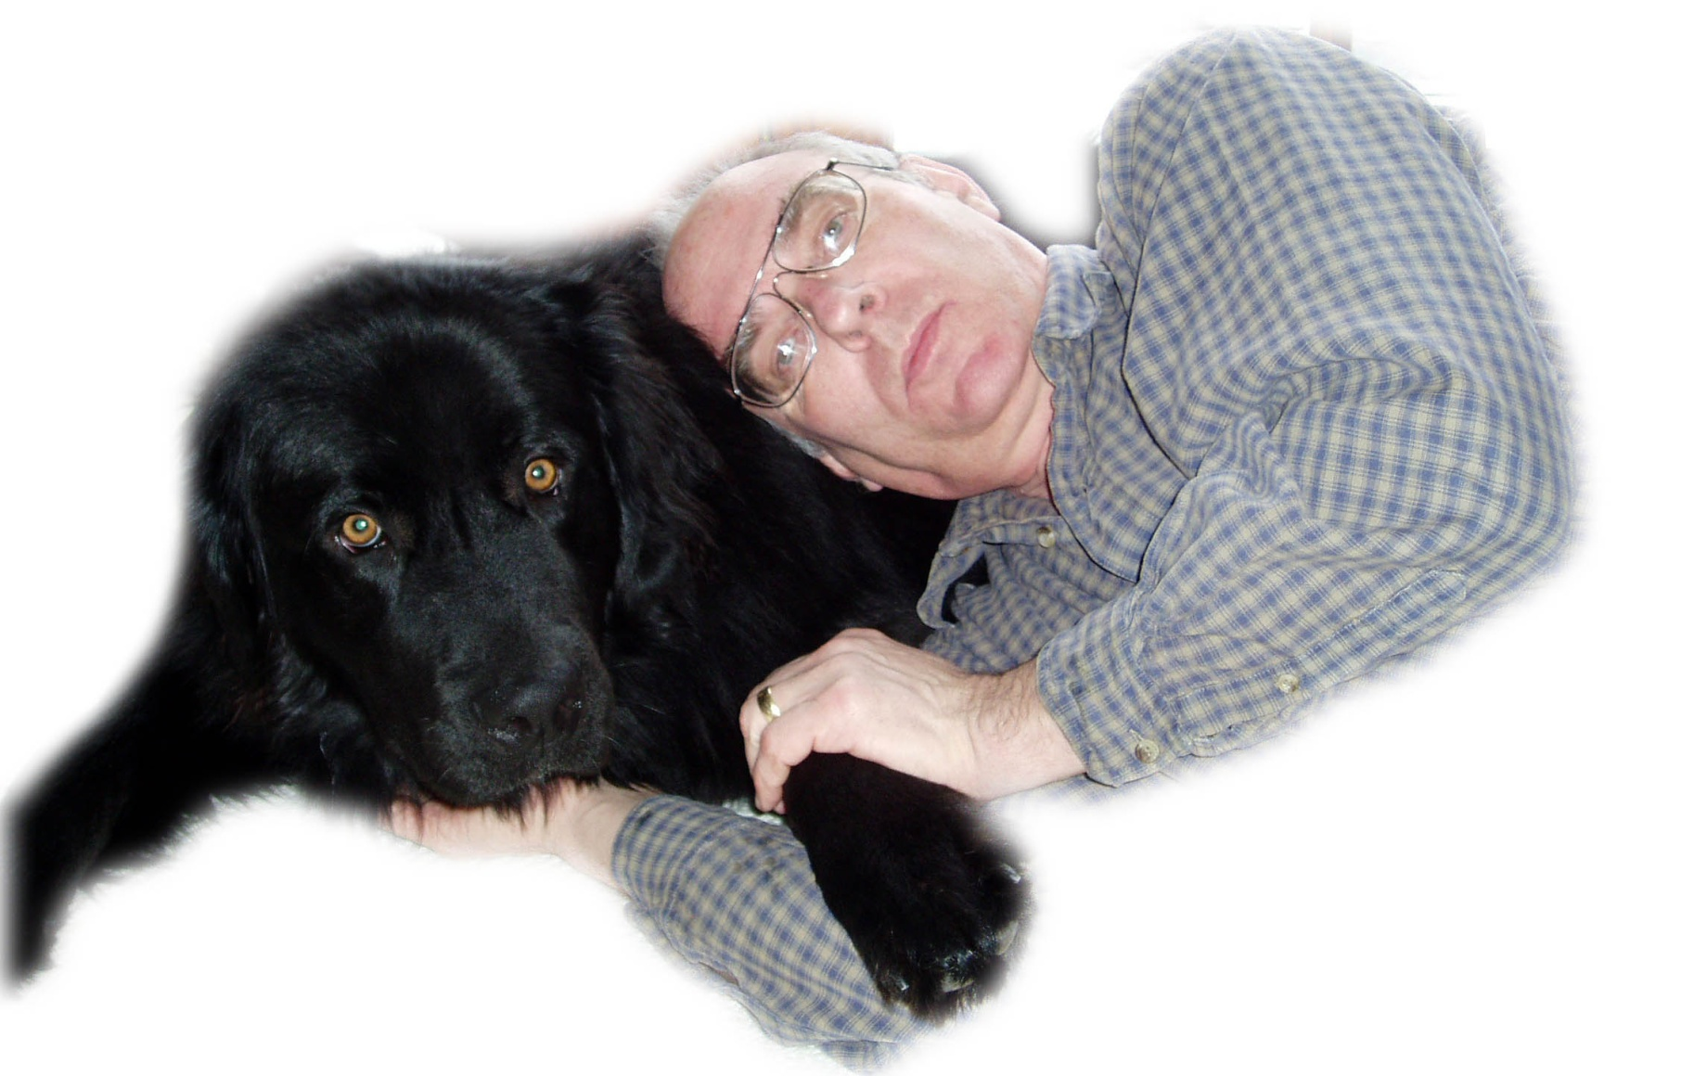

Slide 106
And, one of the best listener-animals
is “Duncan” a pretty big Newfoundland . . .
well, actually, just a “normal” Newfoundland
Normal Newfoundlands are bred as water-rescue dogs, and they have webbed feet,
and a second coat of hair
so they can swim in Lake Superior in the winter,
and all of that sort of thing
Basically, Newfoundlands LOVE water

Slide 107
And, the best-listener-animal, Duncan, has his own “Newfoundland Crossing” sign, right by “Stonehenge”
“Stonehenge” is my prehistoric Irish version of the English Stonehenge
(but that Stonehenge is actually pre-British)
“Stonehenge” Duluth has a dozen standing-stones (menhir), just like the real thing.
And a wood-fired oven (with a 6 foot X ca. 3 foot baking chamber).
And a nine-ton lintel on top of the oven.

Slide 108
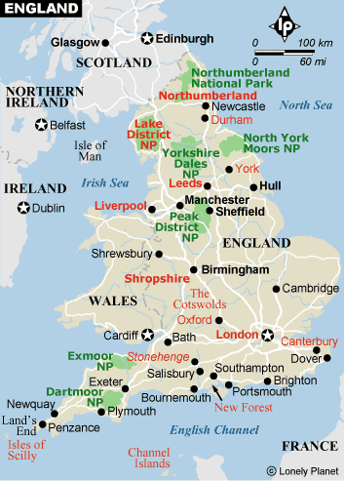
Stonehenge
the original

Slide 109
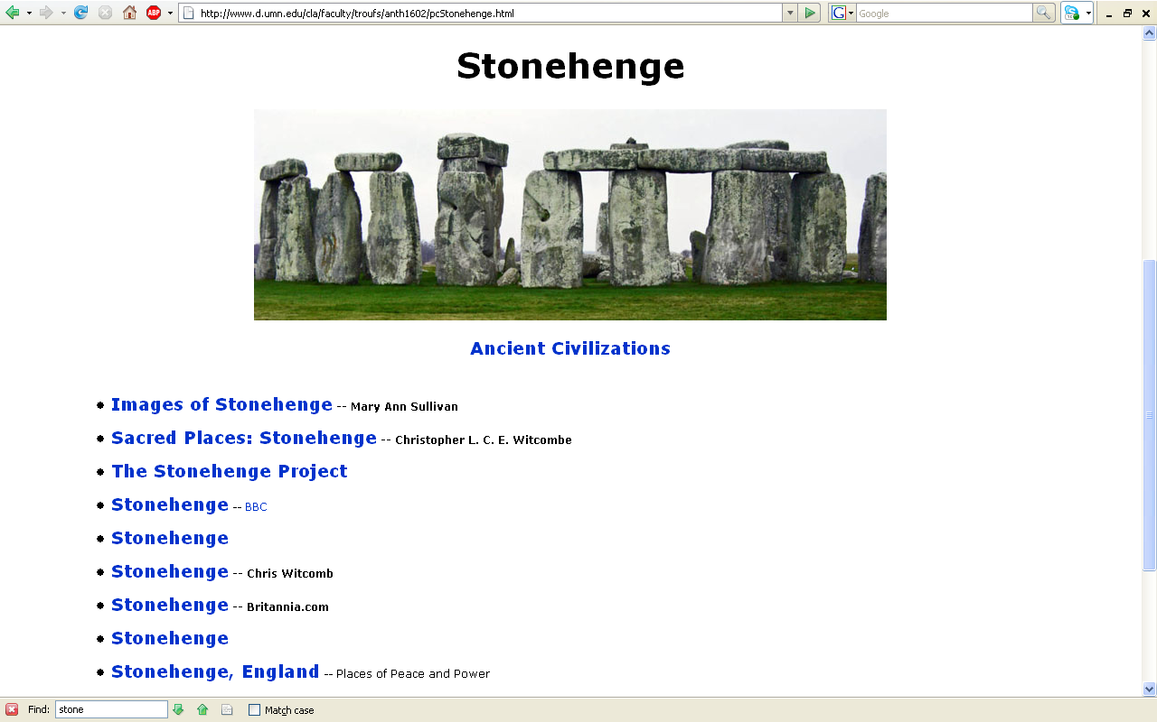
www.d.umn.edu/cla/faculty/troufs/anth1602/pcStonehenge.html

Slide 110
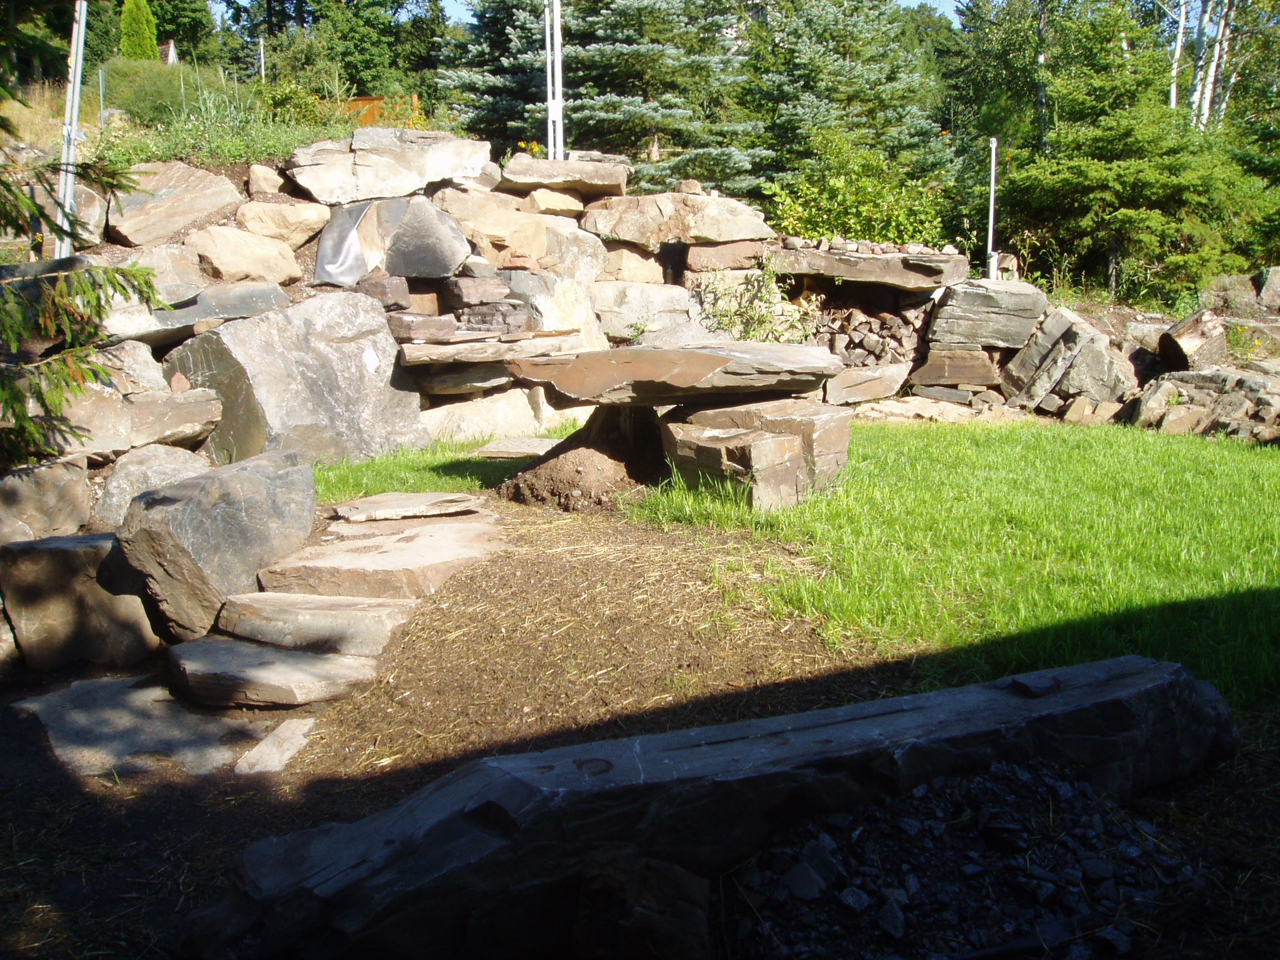
“Stonehenge”
Duluth
www.d.umn.edu/cla/faculty/troufs/anth1602/pcoven.html#title

Slide 111
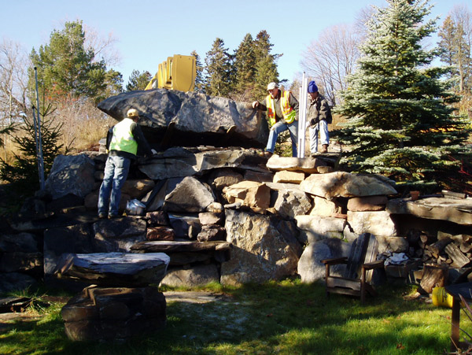
www.d.umn.edu/cla/faculty/troufs/anth1602/pcoven.html#title

Slide 112
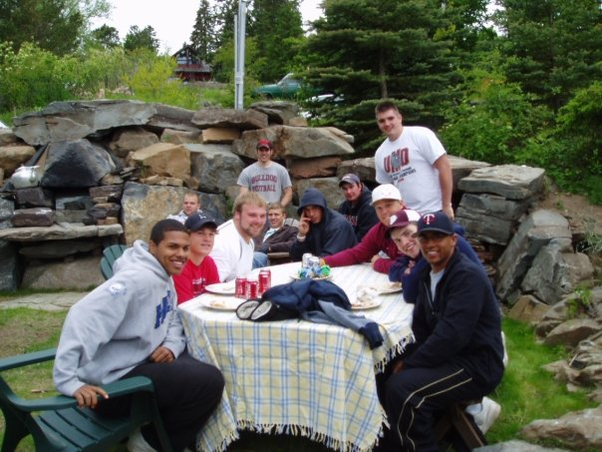
www.d.umn.edu/cla/faculty/troufs/anth1602/pcoven.html#title

Slide 113
And, the best-listener-animal, Duncan, has his own “Newfoundland Crossing” sign, right by “Stonehenge”
“Stonehenge” is my prehistoric Irish version of the English Stonehenge
(but that Stonehenge is actually pre-British)
“Stonehenge” Duluth has a dozen standing-stones (menhir), just like the real thing
And a wood-fired oven
(with a 6 foot X ca. 3 foot baking chamber)
And a nine-ton lintel on top of the oven

Slide 114
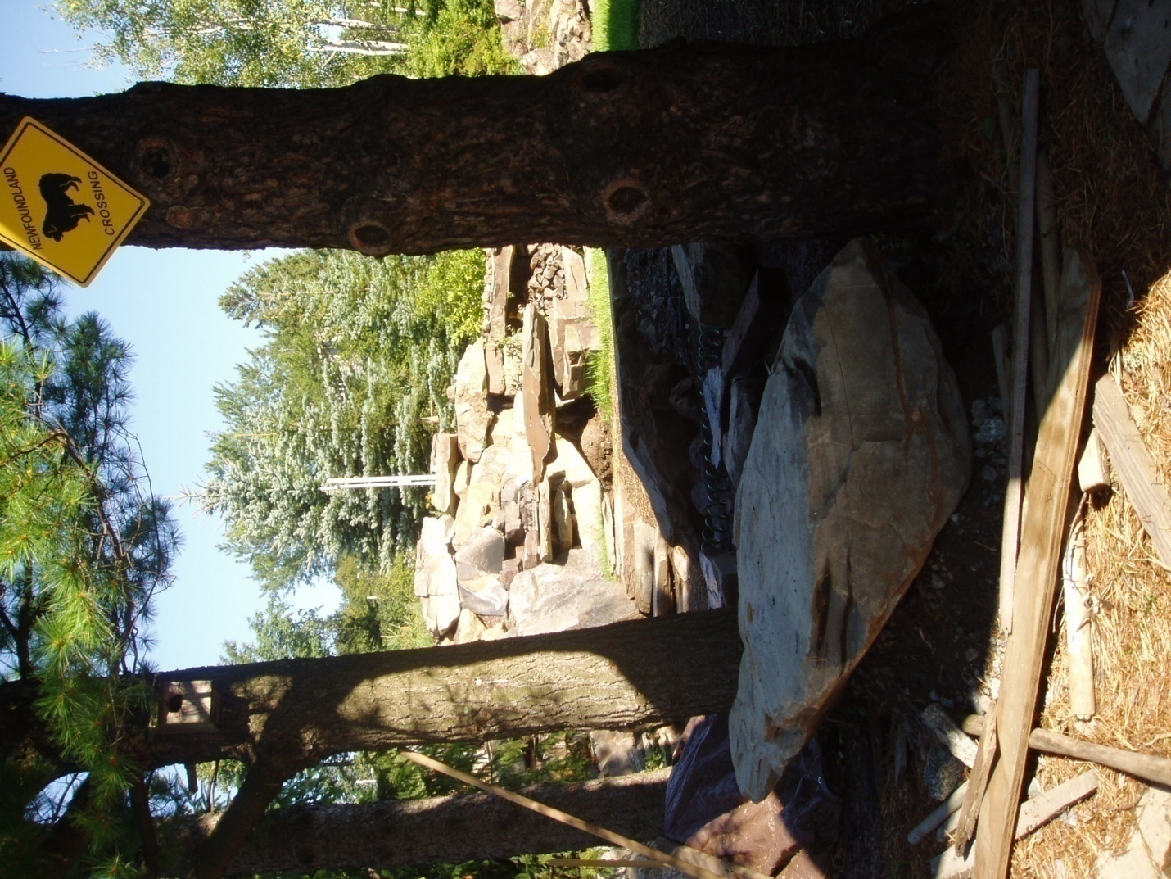
www.d.umn.edu/cla/faculty/troufs/anth1602/pcoven.html#title

Slide 115
One day I came by the “Newfoundland Crossing” sign heading by “Stonehenge” on the way to the back yard to talk to the animals and trees
Passing by the “Newfoundland Crossing” sign one would expect to pass by a Newfoundland, so when I caught what I though was “Duncan” (who actually lives in Lakeside, normally) in the little pond that we have to water the deer and ducks and other animals, I didn’t think twice—as after all, Newfoundlands are bred to be water dogs
But still, for a split second I though it was unusual as Duncan does not usually go in the pond

Slide 116
www.d.umn.edu/cla/faculty/troufs/anth1602/pcoven.html#title

Slide 117
But it was a really hot August day, and even people were acting a little funny . . .
so only for a split second did I worry about Duncan in the pond
Until, a second split second later, I thought . . .
“What the hell . . .
Duncan doesn’t have peaked ears!!!!
His ears are big and floppy like every other Newfoundland . . .

Slide 118
www.d.umn.edu/cla/faculty/troufs/anth1602/pcoven.html#title

Slide 119
As it turns out,
it was so hot a bear arrived early to soak in the little pond
(they usually don’t arrive until about October)

Slide 120
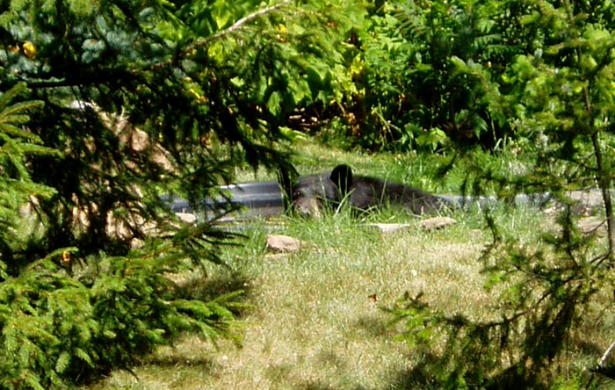

Slide 121
And for almost an hour the bear soaked in the little pond, and wouldn’t get out . . .
Until he decided to have some sunflower seeds . . .

Slide 122
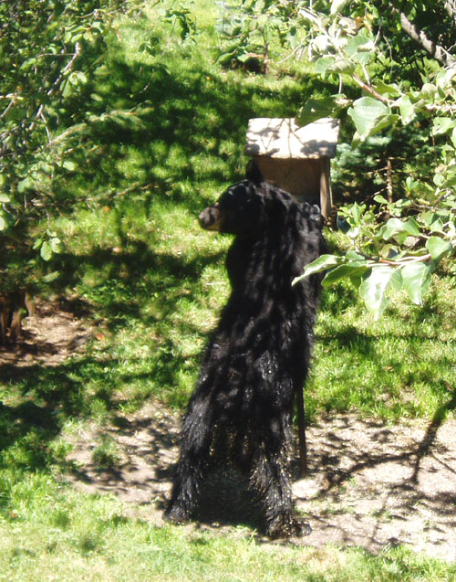

Slide 123
And he must have liked it all
because the next day he brought his friends over

Slide 124
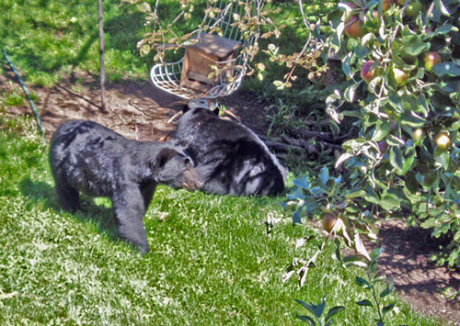

Slide 125
This is all happening, by the way,
less than the length of a football field away from UMD’s Parking Lot W
So if you live in the dorms
you too could one day be talking with the bears

Slide 126
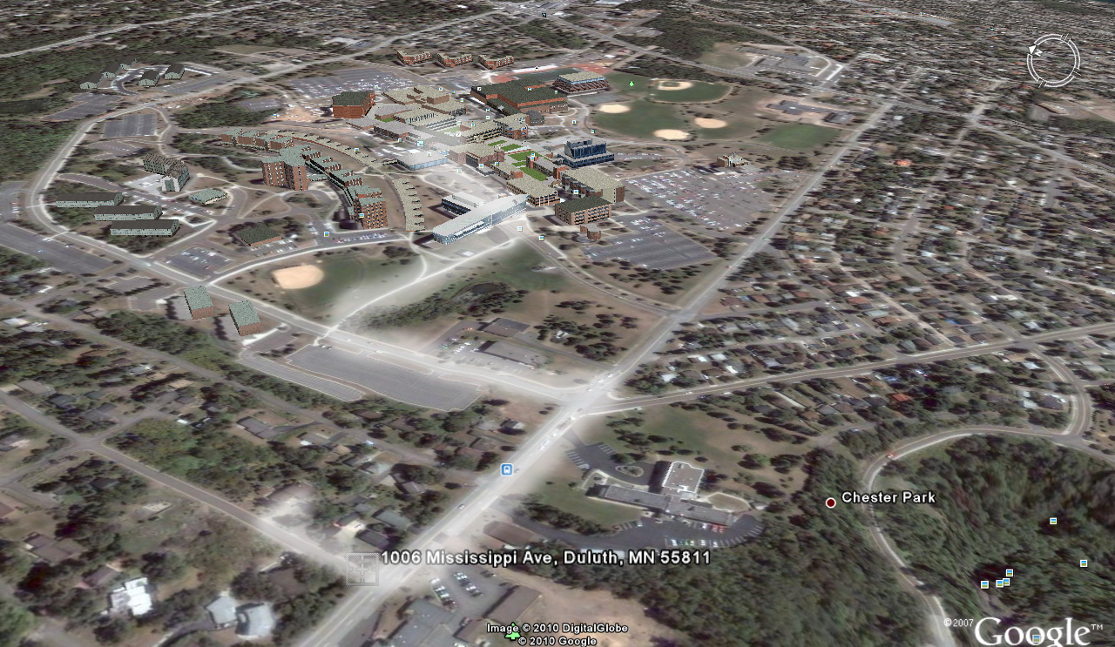
UMD’s Parking Lot W
Bears

Slide 127
And who knows, maybe you’ll be lucky and see some of the other animals that hang around the back yard,
presumably waiting to hear a little lecture on anthropology or something like that
There area a LOT of animals, mostly friendly . . .
Two of my favorites were “Fawzi” the pheasant
(who local “birders” think was an escapee from a game farm)
and a beautiful stag that came every year
until the third season of the fall bow-and-arrow hunt in the City of Duluth . . .

Slide 128
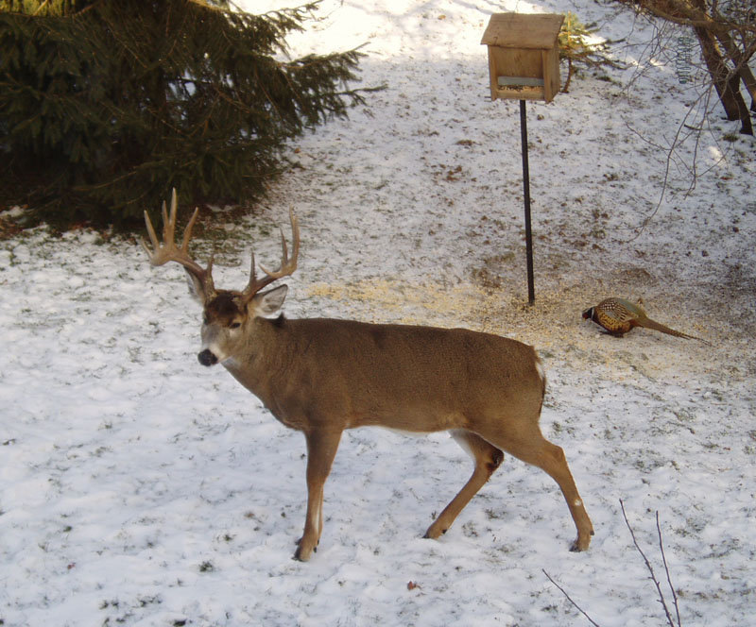

Slide 129
X

Slide 130
In the end, my friends will tell you . . .
I really like the chickens best
My wife and I are licensed urban chicken farmers
The license to have 5 chickens in Duluth costs $10.00 a year,
which, if my math is correct, is $2 per chicken per year
The chickens themselves cost $2.35,
and you only have to pay for them once

Slide 131
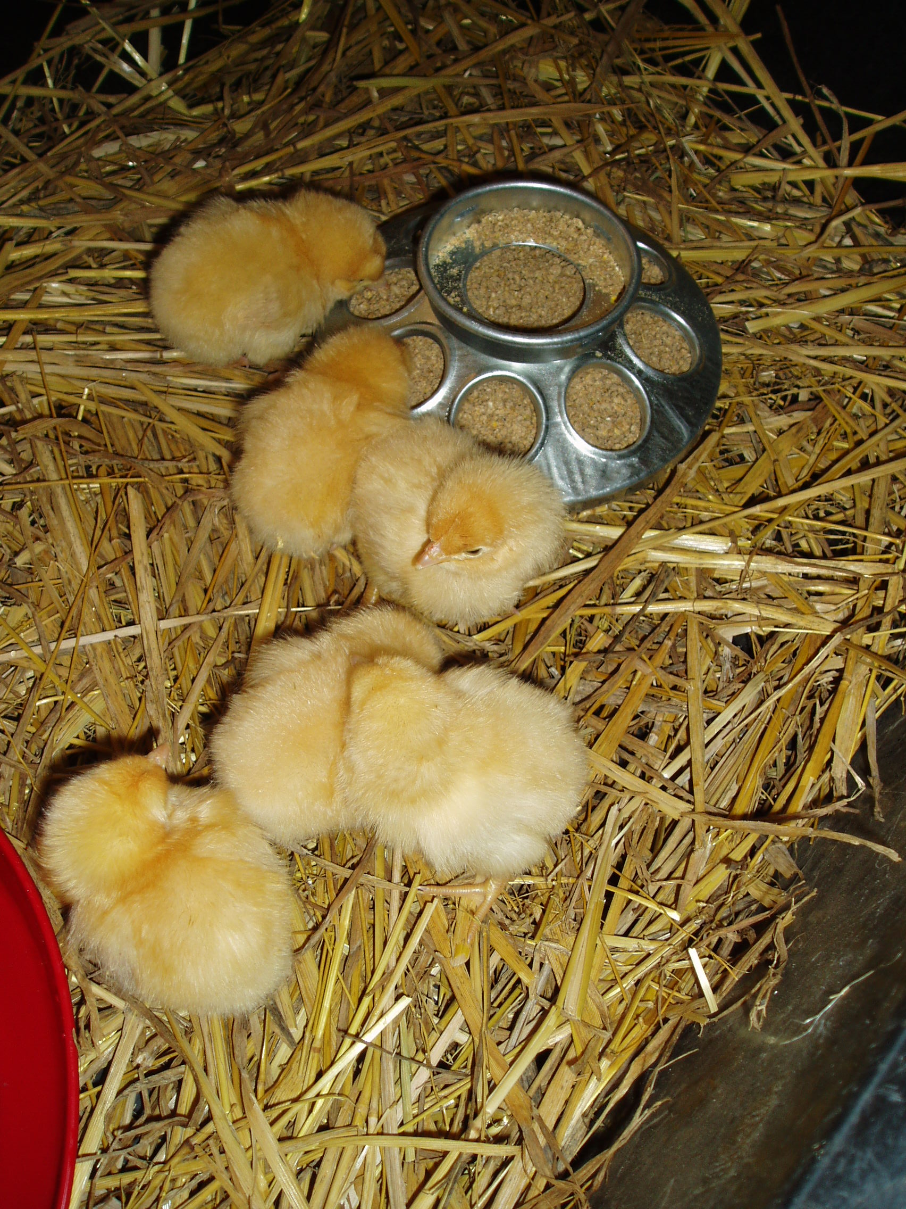

Slide 132
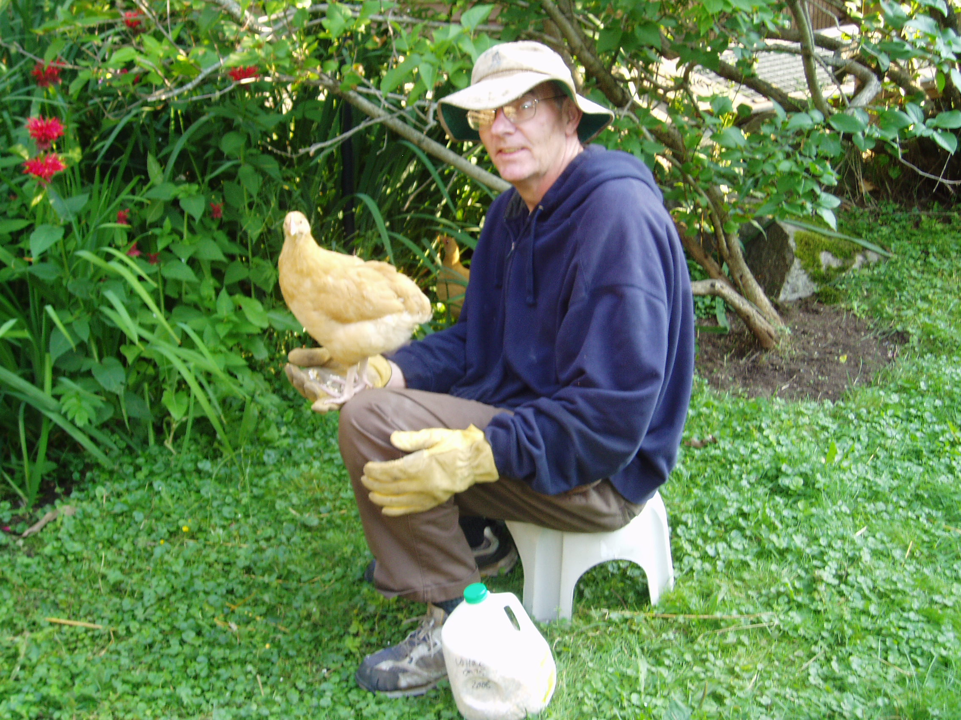

Slide 133
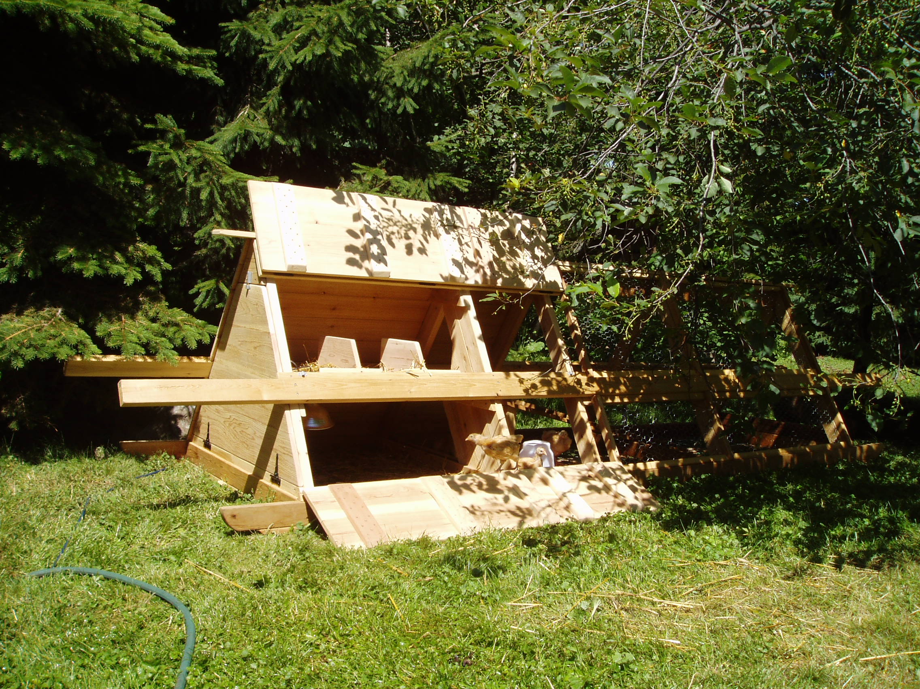

Slide 134
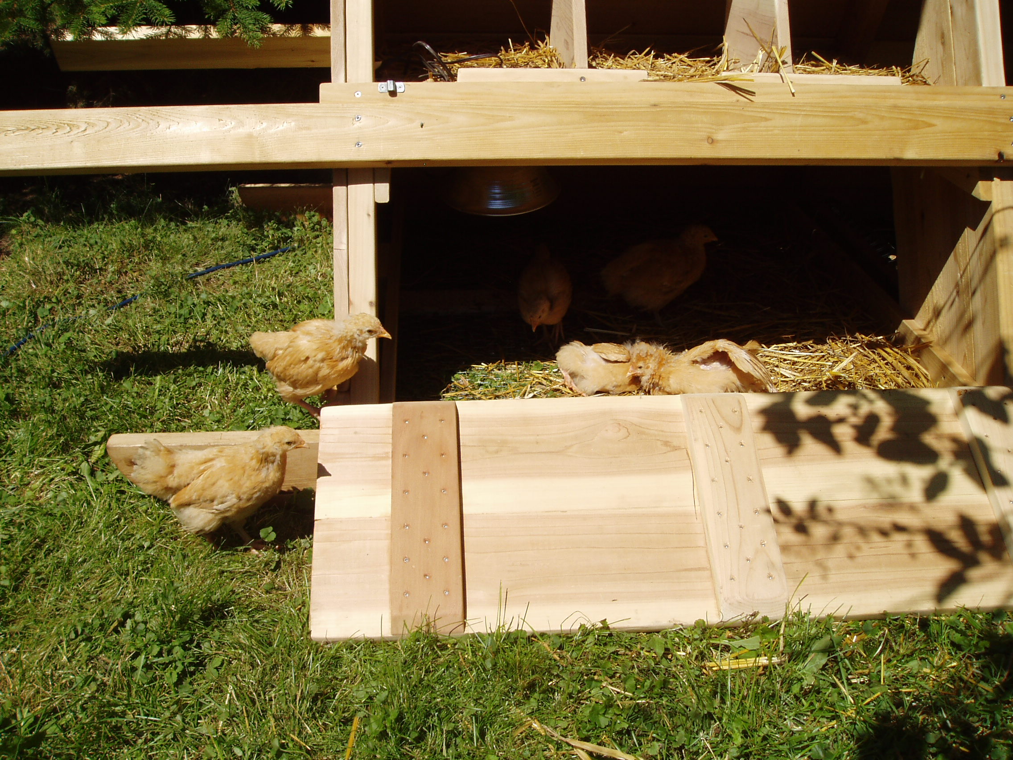

Slide 135
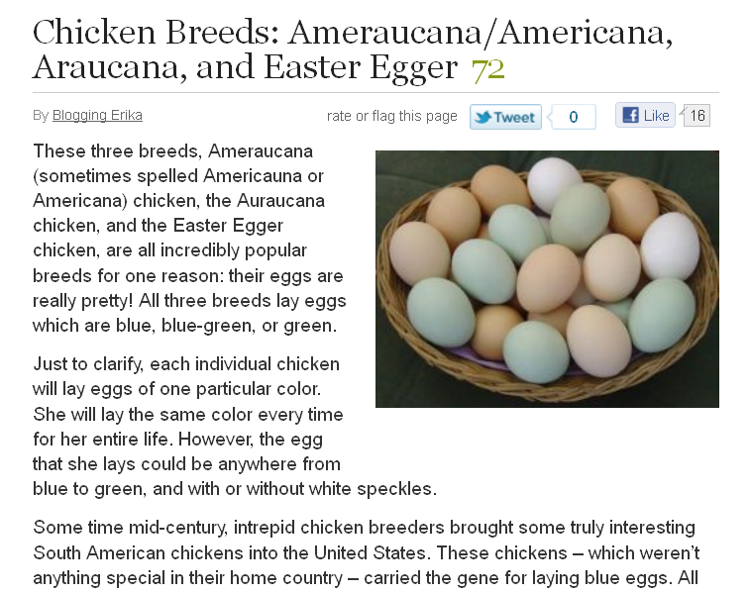
http://hubpages.com/hub/Chicken-Breeds-Ameraucana-Araucana-and-Easter-Egger

Slide 136
EVERYBODY seems to like the chickens
Even Duncan . . .

Slide 137
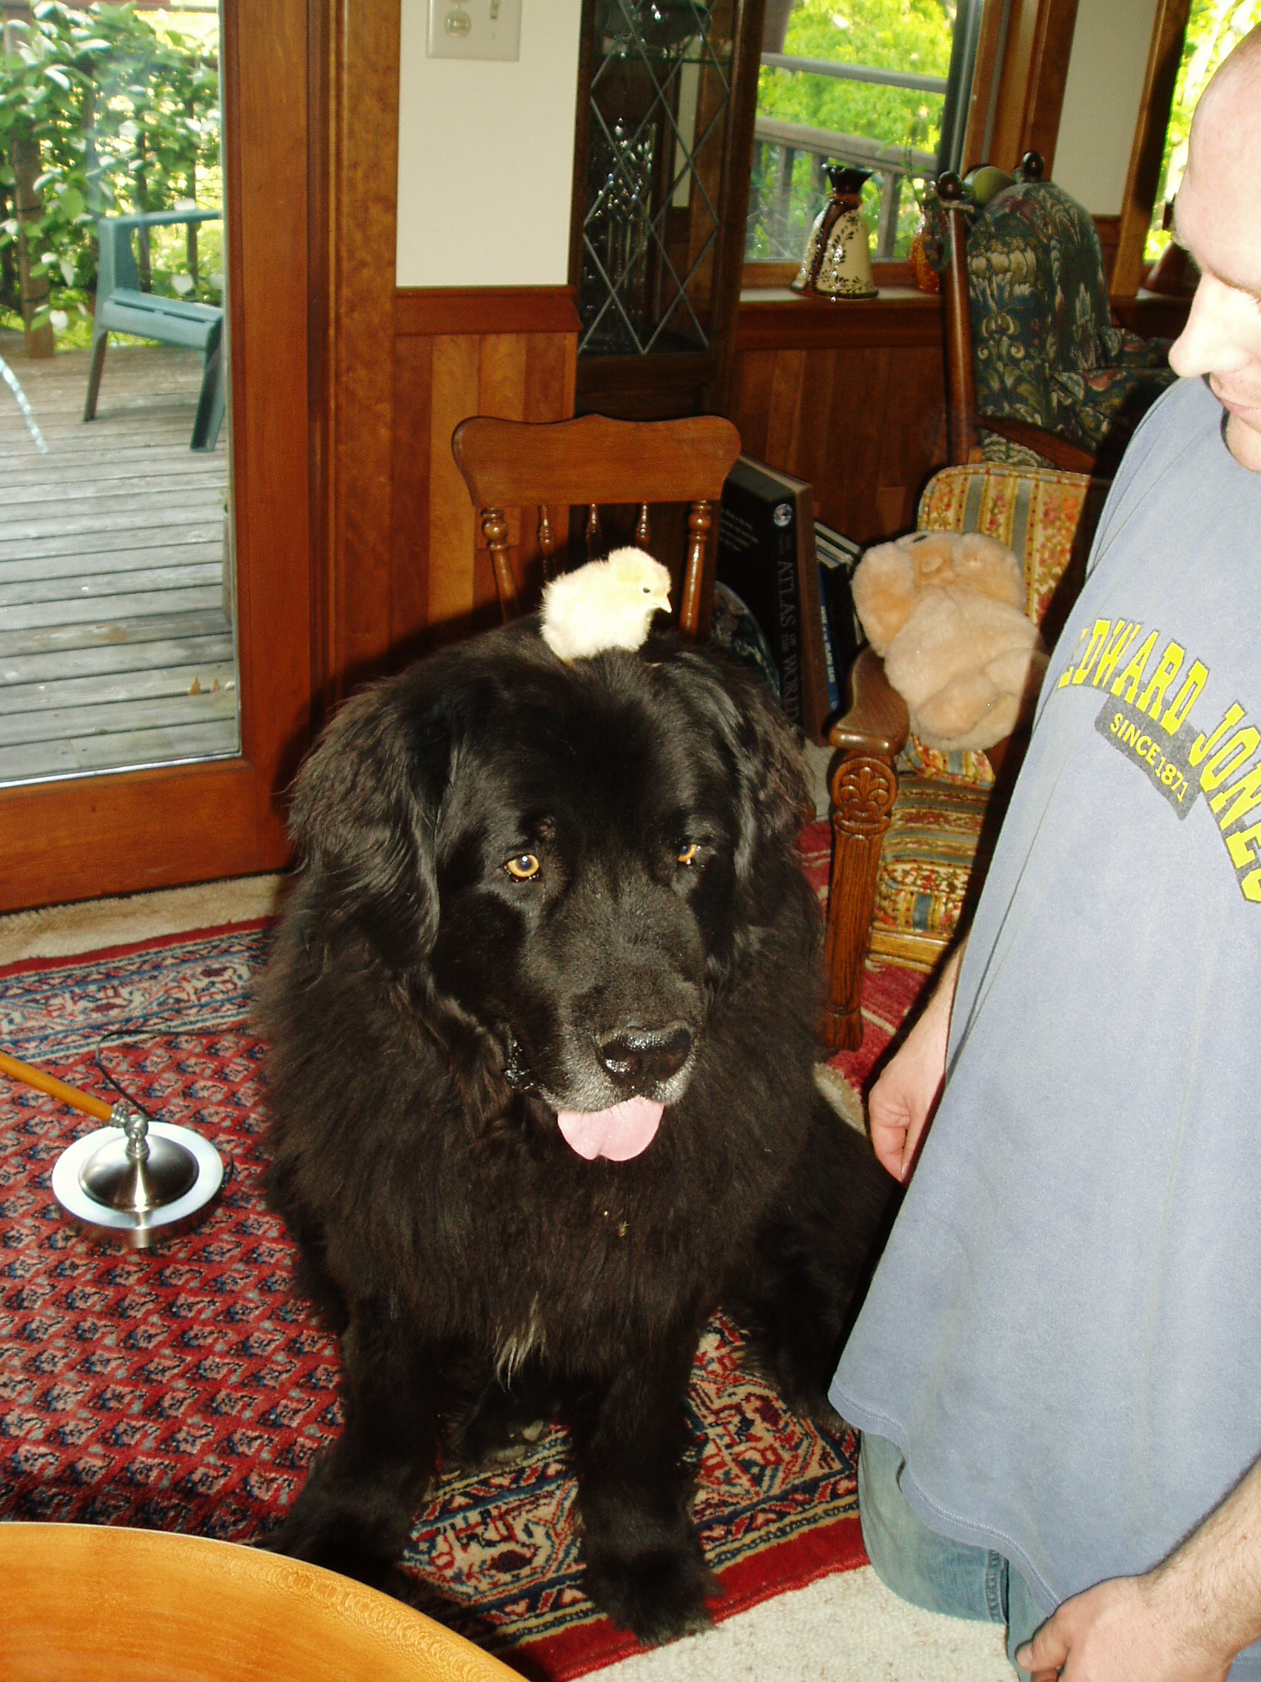

Slide 138
Duncan is pretty good at protecting people,
but he was NOWHERE in sight
the day the cougar came by
to check things out . . .

Slide 139
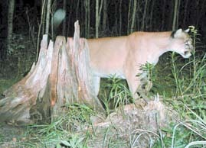
Duluth News Tribune
(Thursday, October 11, 2007, pp. A1, A5)

Slide 140
I have to say, to be honest about it, that although the cougar was a stunningly beautiful animal . . .
it scared the living cr.. right out of me
when I looked up
and it was looking me in the eye
from about twenty feet away
But it must not have liked the little anthropology stories that I was telling it because it hasn’t been back, and it’s been five or so years now since the first visit

Slide 141
But lots of other animals make up for it . . .
including a nice pair of greenhead mallards that stop by every once in awhile in the spring
and the raccoon.
But the fox, well, the fox got a chicken. It was a sad day all around the neighborhood. It took the chicken as I was working on a new chicken house door—not forty feet away. It’s indeed a sly fox, but a sly fox without the least bit of fear of humans.
But enough . . . on to more pleasant things.

Slide 142
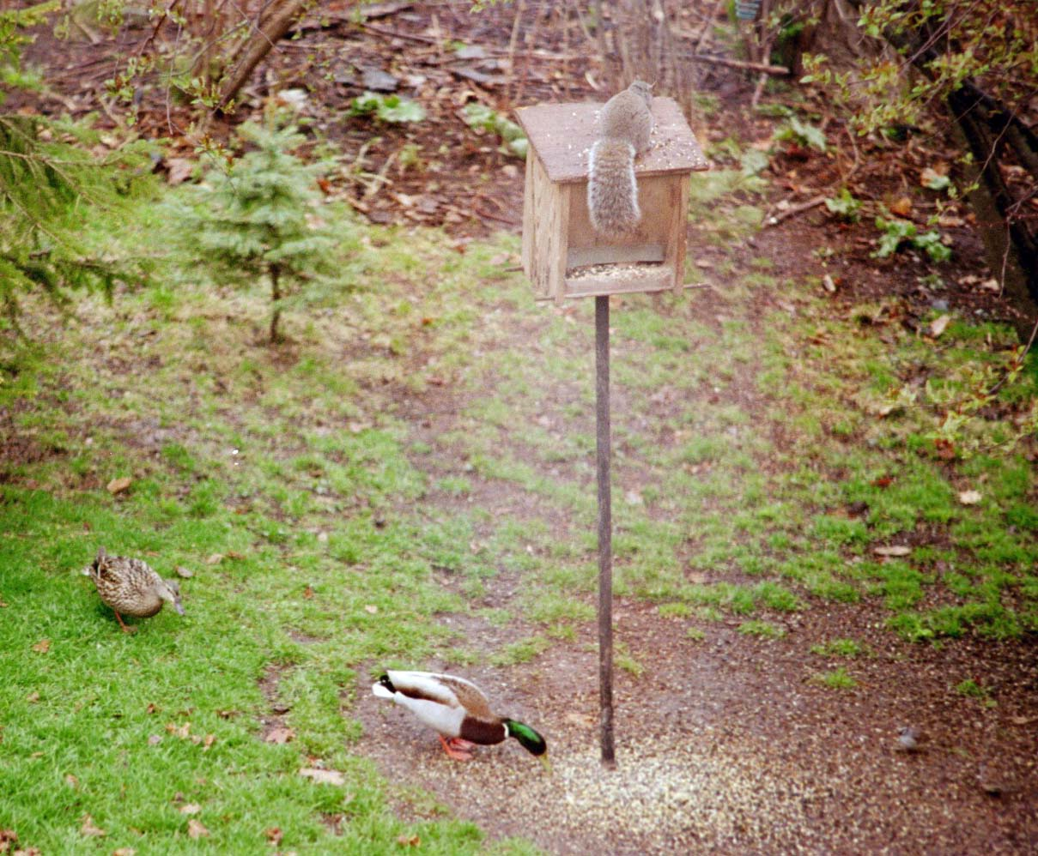

Slide 143
But lots of other animals make up for it . . .
including a nice pair of greenhead mallards that stop by every once in awhile in the spring
and the raccoon

Slide 144
But the fox, well, the fox got a chicken
It was a sad day all around the neighborhood. It took the chicken as I was working on a new chicken house door—not forty feet away. It’s indeed a sly fox, but a sly fox without the least bit of fear of humans.
But enough . . . on to more pleasant things.

Slide 145
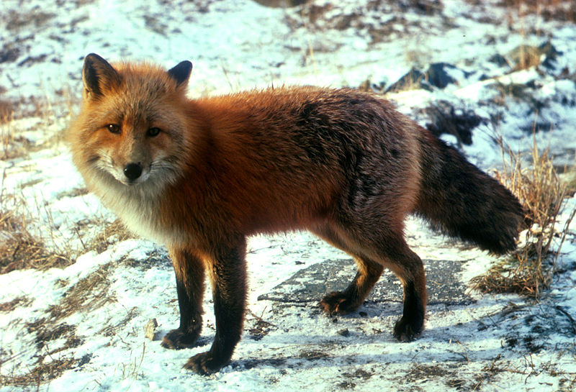
Wikipedia

Slide 146
But the fox, well, the fox got a chicken
It was a big-sad day all around the neighborhood
The fox took the chicken as I was working on a new chicken house door—not forty feet away
It’s indeed a sly fox . . .
but a sly fox without the least bit of fear of humans
But enough . . . on to more pleasant things

Slide 147
But the fox, well, the fox got a chicken
It was a big-sad day all around the neighborhood
The fox took the chicken as I was working on a new chicken house door—not forty feet away
It’s indeed a sly fox . . .
but a sly fox without the least bit of fear of humans
But enough! . . . on to more pleasant things

Slide 148
FAQs
Where did you grow up?
Where did you go to school?
How long have you been at UMD?
What are your favorite things to do?
How did you get into anthropology?
Where have you been?
            What are your pet peeves?

Slide 149
I grew up in Winsted, Minnesota, in the valley of the
Jolly . . .

Slide 150


Slide 151
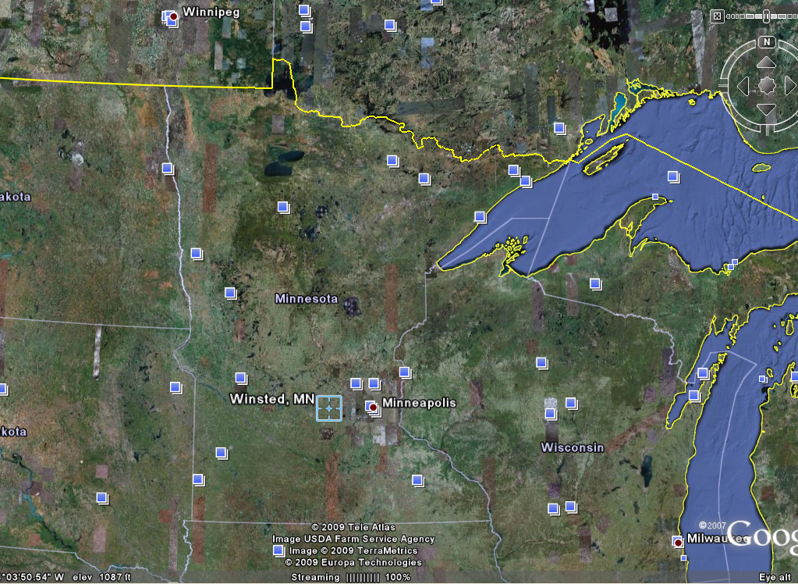

Slide 152
Winsted was a wonderful place to grow up,
except that I had a little problem once in awhile
with the adults,
especially my grandmother who loved me dearly
When I was growing up the Green Giant had a canning factory in Winsted,
where they canned their #1 “Niblets” corn . . .

Slide 153
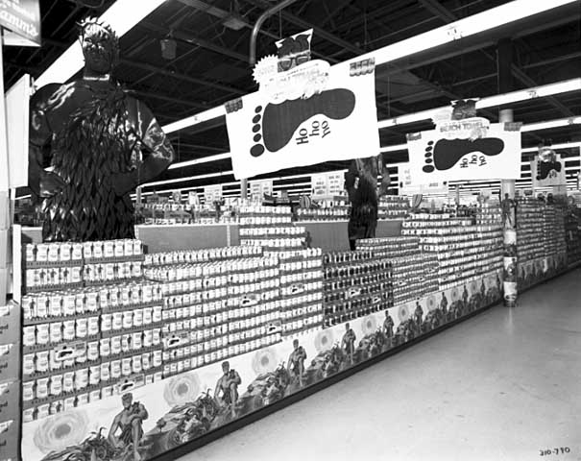
Green Giant display of canned goods in a grocery store
Photographer: Norton & Peel
Photograph Collection 1969
Location no. Norton & Peel 310790
Negative no. NP310790
http://collections.mnhs.org/visualresources/search.cfm?bhcp=1

Slide 154
Those were the days before mechanical corn pickers, and to pick corn the Jolly Green Giant imported people “from Jamaica”
I didn’t have the foggiest idea where Jamaica might be (I was only in the second grade when I started to take notice of all of this)
but I knew Jamaica must be pretty far away as they Jamaicans didn’t look like anybody local . . .

Slide 155
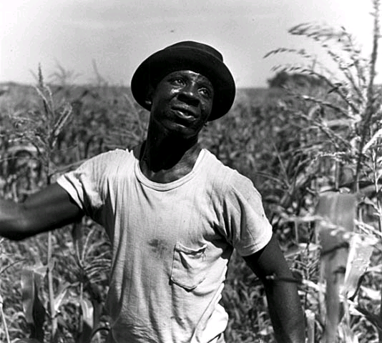
Minnesota Historical Society
Visual Resources Database
Migrant, Green Giant, LeSueur, Minn. 1953
Location no. AV1988.151.12
Photographer: Jerome Liebling
Fine Art Photo Collection 1953
http://collections.mnhs.org/visualresources/search.cfm?bhcp=1

Slide 156
And this is where I got my start in Anthropology . . .
in the 2nd Grade . . .
Remember?
American Anthropology is Four-Fold:
Cultural Anthropology
Physical Anthropology
Archaeology
Linguistics

Slide 157
And this is where I got my start in Anthropology . . .
in the 2nd Grade . . .
Remember?
American Anthropology is Four-Fold:
Cultural Anthropology
Physical Anthropology
Archaeology
Linguistics

Slide 158
My cultural career in Cultural Anthropology began when my grandmother
backed up by lots of other adults
said that I shouldn't talk to the Jamaicans
“because they kidnap little boys”
Now I was only in the 2nd grade
so it didn’t occur to me that there were no little boys missing in Winsted . . .

Slide 159
I lived about the length of a football field
from the city park
which was on the lake
and that was where
most of the Jamaicans
came at evening to cool off . . .

Slide 160
They came down by the lake because they only had little shacks to live in, with only a little light bulb in the room and not much of anything else
And it was really hot in those little shacks
I don’t remember too many details of the shacks as they existed at the time, but after the mechanical corn pickers arrived on the scene in Winsted the father of a girl in my class bought two of those little shacks and moved them to another lake and made a little cabin out of them
It was a popular place for lots of folks, especially high school students;
and by then we were sophomores in high school and could appreciate a cabin on the lake even if it didn’t have a lot of things, like running water, at first

Slide 161
So anyway, the Jamaican corn pickers
came down by the lake
right close to where I lived, to cool off
and to sing, and to tell stories, and to laugh, and to have lunch
The next picture is an aerial photo of the Winsted Lake (actually, technically, Lake Eleanor, but nobody called it that, and most probably didn’t even know that it was “supposed” to be Lake Eleanor)
and the yellow arrow is where the
Jamaican corn pickers would spend their evenings . . .
and the green arrow is where I lived . . .

Slide 162
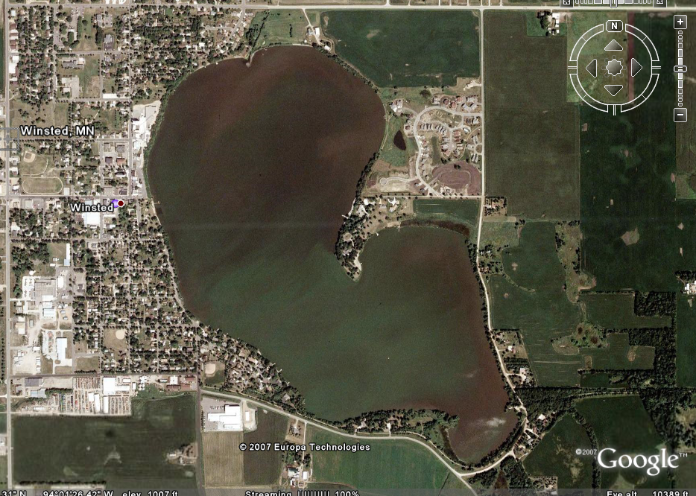
“archaeology” …

Slide 163
So anyway, you can see how it was almost inevitable that a curious young second-grader would sneak down and peek through the bushes
to see what these guys were up to
EVEN THOUGH that meant possibly being kidnapped

Slide 164
I wasn’t sure what kidnappers looked like, exactly,
but after watching the Jamaican corn pickers
for a long long time
when they weren’t picking corn
it slowly began to seem to me that these people
that the adults told us never to talk to
were actually pretty much like real human beings

Slide 165
Well you know how it is with 2nd grade boys,
and before I knew it I was actually talking with them
I don’t remember exactly the first one I talked with,
but it was probably one of them who was going to the bathroom near the bushes that I used to hide behind
Anyway, eventually I just went over and joined them
I really liked to hear them sing
(And this was long before Harry Belefonte was singing “Day-O”
[“Jamaica Farewell”]
—at least long before he was singing it in Winsted, MN.)

Slide 166
I got to know the Jamaican corn pickers about as well as any young boy could know an adult.
I loved to hear them sing,
and talk and laugh with one another
I went there—snuck down there—for several years, during the “corn pack” (aka “the pack”) in the fall
But you can see, I really had a big problem
Years later I learned in Introduction to Psychology as a sophomore at Notre Dame University that I had been experiencing what is called “cognitive dissonance”

Slide 167
I got to know the Jamaican corn pickers about as well as any young boy could know an adult.
I loved to hear them sing,
and talk and laugh with one another
I went there—snuck down there—for several years, during the “corn pack” (aka “the pack”) in the fall
But you can see, I really had a big problem
Years later I learned in Introduction to Psychology as a sophomore at Notre Dame University that I had been experiencing what is called “cognitive dissonance”

Slide 168
But chances are that even if I had known I was experiencing “cognitive dissonance,”
at that time, in 1950,
I wouldn't really have understood what it meant
What I did understand, even in the 2nd and 3rd grades, was that I had a big problem
—and that was that I was beginning to see that what my grandmother and her friends were telling me
wasn’t true
but that I couldn’t tell them it wasn’t true because I wasn’t supposed to be down there in the city park talking to “the Jamaicans” to know about it

Slide 169
One time, in the 3rd grade, I had one of those life-changing experiences. Probably my first, I don’t know.
I remember one of the Jamaican men talking to me about his “boy” “back home.”
I still had no idea where “back home” was,
but I knew that it must be at least someplace on the other side of Minneapolis.
I remember the man telling me about his boy,
and about how I reminded him of his son.
After a little bit of that he started to cry.

Slide 170
One time, in the 3rd grade, I had one of those life-changing experiences. Probably my first, I don’t know.
I remember one of the Jamaican men talking to me about his “boy” “back home.”
I still had no idea where “back home” was,
but I knew that it must be at least someplace on the other side of Minneapolis
I remember the man telling me about his boy,
and about how I reminded him of his son
After a little bit of that he started to cry.

Slide 171
That was the first adult male I ever saw cry
—other than my father who cried a lot
when my sister died
when she was just a day old
And everybody cried about that

Slide 172
Even at that young age I concluded that a man that cries like Mr. Jamaica isn’t going to kidnap anybody, and especially not anyone that reminds him of his son
(I know now that that was faulty logic,
the part about “especially not anyone that reminds him of his son.)
Literally from that day onward, every time I heard one of the adults say we shouldn’t talk with the Jamaicans because they would kidnap us or “who knows what” (and we kids didn’t know exactly “what” was “who knows what” in those days,
at least not in Winsted, but in retrospect, the adults probably did)
I thought . . .
“When I grow up I’m going to tell them what the Jamaicans are really like. They’re nice.”

Slide 173
Even at that young age I concluded that a man that cries like Mr. Jamaica isn’t going to kidnap anybody, and especially not anyone that reminds him of his son
(I know now that that was faulty logic,
the part about “especially not anyone that reminds him of his son.)
Literally from that day onward, every time I heard one of the adults say we shouldn’t talk with the Jamaicans because they would kidnap us or “who knows what” (and we kids didn’t know exactly “what” was “who knows what” in those days,
at least not in Winsted, but in retrospect, the adults probably did)
I thought . . .
“When I grow up I’m going to tell them what the Jamaicans are really like. They’re nice.”

Slide 174
But I was afraid to say that because then my grandmother and the other adults would know that I had been disobedient
And since 2nd graders didn’t go to Confession in those days, I was pretty much stuck with my big secret of knowing that what the adults were saying about the Jamaicans wasn’t true, but not being able to say it
I was in a real double bind!

Slide 175
But I was afraid to say that because then my grandmother and the other adults would know that I had been disobedient
And since 2nd graders didn’t go to Confession in those days, I was pretty much stuck with my big secret of knowing that what the adults were saying about the Jamaicans wasn’t true, but not being able to say it
I was in a real double bind!

Slide 176
By the time I was in the 3rd grade, I knew that when I grew up I was going to tell people that the Jamaicans were just like everybody else— that they laughed, they cried (even the MEN), they sang, they told stories, they kidded one another . . . and they even peed in the bushes like the Winsted menfolk did when they went hunting and fishing
And I thought that even though I still didn’t know at that time where Jamaica was

Slide 177
And, of course, I had no idea what anthropology was, or even that there were adults who had a job where they could tell others about how other people were humans too

Slide 178
Now it was also with the Jamaicans that I got my start as a “Physical Anthropologist”
REM: American Anthropology is Four-Fold:
Cultural Anthropology
Physical Anthropology
Archaeology
Linguistics

Slide 179
Now it was also with the Jamaicans that I got my start as a “Physical Anthropologist”
REM: American Anthropology is Four-Fold:
Cultural Anthropology
Physical Anthropology
Archaeology
Linguistics

Slide 180
One time I was down in the city park sitting with the Jamaicans in the shade of the old wooden bandstand that was there, not too far from the lake,
listening to the men sing
It was wonderful
And as they sang I remember wondering what that fuzzy hair they had felt like
I had often wondered that before, by this time, but I recall it was at that time when they were all singing and eating some kind of luncheon meat on plain crackers
(I loved plain crackers as a young boy)
that I asked one of them if I could feel his fuzzy hair

Slide 181
He more or less hollared out something like,
“D’ja hear that? Timmy wants to feel my hair?”
And I remember they all laughed out loud
and that I wished I hadn’t asked
But then he stood up, tall, took off his hat, and made a big bow and said it would be OK
And I felt his hair
It felt funny
And I felt funny
Scared . . . actually

Slide 182
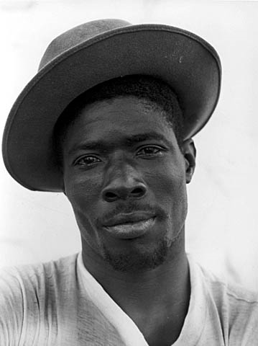
Minnesota Historical Society
Visual Resources Database
Migrant, Green Giant, LeSueur, Minn. 1953
Location no. AV1988.151.12
Photographer: Jerome Liebling
Fine Art Photo Collection 1953
http://collections.mnhs.org/visualresources/search.cfm?bhcp=1

Slide 183
But then they all started laughing some more
And I remember several of them took off their hats
and put their heads down
and called me over to feel their hair

Slide 184
Those are the specific things and times that I remember, but I also remember this general feeling of whatever sadness is to a grade school kid anytime I heard an adult say bad things about my friends
And when I ever felt that way I knew that when I grew up I would be able to explain to people how nice the Jamaicans really were

Slide 185
Yes, I remember thinking even then
that when I grew up
I was going to tell everybody about how nice the Jamaicans are,
and as a “participant-observer” (of sorts)
I felt pretty confident that they would listen

Slide 186
And, in a sense, my “career” in anthropology was launched,
and several events and situations
in subsequent years built upon that wonderful foundation set forever
by the shores of “Winsted Lake”
And, I thought,
“If I ever get to Minneapolis
(which on a really dark night we could see faintly glowing in the skies behind “The Point” of Winsted Lake)
I’m going to find out just where Jamaica is.”

Slide 187
And, in a sense, my “career” in anthropology was launched,
and several events and situations
in subsequent years built upon that wonderful foundation set forever
by the shores of “Winsted Lake”
And, I thought,
“If I ever get to Minneapolis
(which on a really dark night we could see faintly glowing in the skies behind “The Point” of Winsted Lake)
I’m going to find out just where Jamaica is”

Slide 188
It wasn’t only the Jamaicans that
some people in Winsted said bad things about
They also said things about
“The Gypsies”
We had what the adults always called “The Gypsies” come to town with the Carnival,
for “Winsted Homecoming Days” in those days

Slide 189
And once in awhile, at other times of the year,
“The Gypsies are in Town”
would spread faster than the “Gypsies” themselves
as they went from door to door selling wooden outdoor furniture
I don’t know much about the people selling furniture
—probably hand-made woven willow furniture—
but I do know a lot about “The Gypsies” who came to town with “The Carnival”

Slide 190
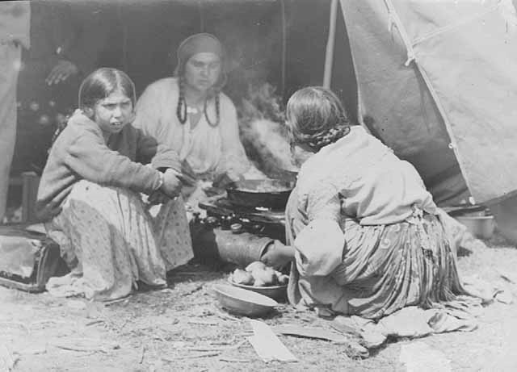
Minnesota Historical Society
Visual Resources Database
Scene in a gypsy camp, Jefferson Highway.
Photograph Collection 1933
Location no. GT3.19 r4
Negative no. 88510
http://collections.mnhs.org/visualresources/search.cfm?bhcp=1

Slide 191
And I know about them for the very same reason I know about the Jamaicans . . .
I used to sneak out and talk with them
I used to sneak down to where they were “setting up” [the carnival rides] and talk with them,
and with the families that lived in little trailers that travelled with “The Carnival”

Slide 192
“The Gypsies”
—as I remember—
weren’t as gentle as the Jamaicans,
and they didn’t sing, and joke,
and things like the Jamaicans,
but in retrospect that was probably because when I was down watching them “set up” they were working, not relaxing after work
But I don’t really know; that’s just a guess

Slide 193
I was older then, too. I was in the 3rd grade, but I talked with them even in the 4th grade
I remember the “Gypsy” moms and grandmothers looking after their children like my mom and grandmother did
—and I can only now imagine what “The Gypsy” grandmothers were telling their grandchildren about us . . .

Slide 194
I remember less about the people with “The Carnival”
I didn’t spend as much time there as with the Jamaicans by the lake. And they were only in town for a week or two
And they also spoke in a way that I couldn’t understand much of what they were saying

Slide 195
But I do remember that one of “The Gypsy” girls about my age was very kind . . .
and kind of cute,
or as cute as a girl can be to a 3rd grader
AND I remember she took my hand, right there by the concession stand of the little league ball park, and told my fortune
For free
I don’t remember what she said the future would bring

Slide 196
And, of course, I didn’t know ‘till college that they weren’t and didn’t want to be “Gypsies”
I didn’t know that until I left Winsted
I didn’t know that they were, and wanted to be . . .
“The Romani”

Slide 197
But my future in archaeology was clearer
Crystal-ball clear . . .
I was older at the time
But I was still in 3rd grade.

Slide 198
But my future in archaeology was clearer
Crystal-ball clear . . .
I was older at the time
But I was still in 3rd grade

Slide 199
My career in Archaeology,
the third of the four-fold disciplines
of American Anthropology,
began precisely on . . .

Slide 200
The early years . . .
“archaeology”
Good Friday
1952
at about
10:30 a.m.

Slide 201
The early years . . .
“archaeology”
Good Friday
1952
at about
10:30 a.m.

Slide 202
The reason that I remember that my
“Archaeological career” began about 10:30 a.m. on Good Friday in 1952 had to do with local customs . . .
Winsted was a German Catholic village at the time, and EVERYONE was expected to go to Church from 12:00 noon until 3:00 p.m. on Good Friday

Slide 203
In 1952 I was old enough to figure out that not everyone in Winsted could fit in the Catholic Church
(My father’s mother—a very kind, quiet woman who was in fact one of the town’s grandmas, and the whole town called here “Grandma Roufs”—was one of the very few people in town who were not Catholic, in 1952, so it was easy to see that with “the whole town Catholic,” the people of the town simply wouldn’t fit in the Church)
I honestly don’t remember if I or my good friend Bobby figured that out, but one of us did, and we essentially reasoned that since the whole town wouldn’t fit in the Church for the three-hour Good Friday service,
it might as well be us who were among those who couldn’t fit in

Slide 204
So, needing some place to go (or to hide out?) we decided to “dig for Indian graves”
over at “Old Man Littfin’s” farm
Now one might think that is sort of a wild thing to for two 3rd graders to be thinking of,
but it wasn’t—at least in Winsted
“Old Man Littfin” (whose title, by the was a term of endearment, and well-liked—sort of the male version of “Grandma Roufs”) had a private museum of “Indian relics” that he picked up on his farm while plowing. Eventually his granddaughter gave several five-gallon pails of arrowheads, for e.g., to the McLeod County Historical Society in Hutchinson

Slide 205
And over at the
McLeod County Historical Society
in Hutchinson those items are still known as
“The Littfin Collection”

Slide 206
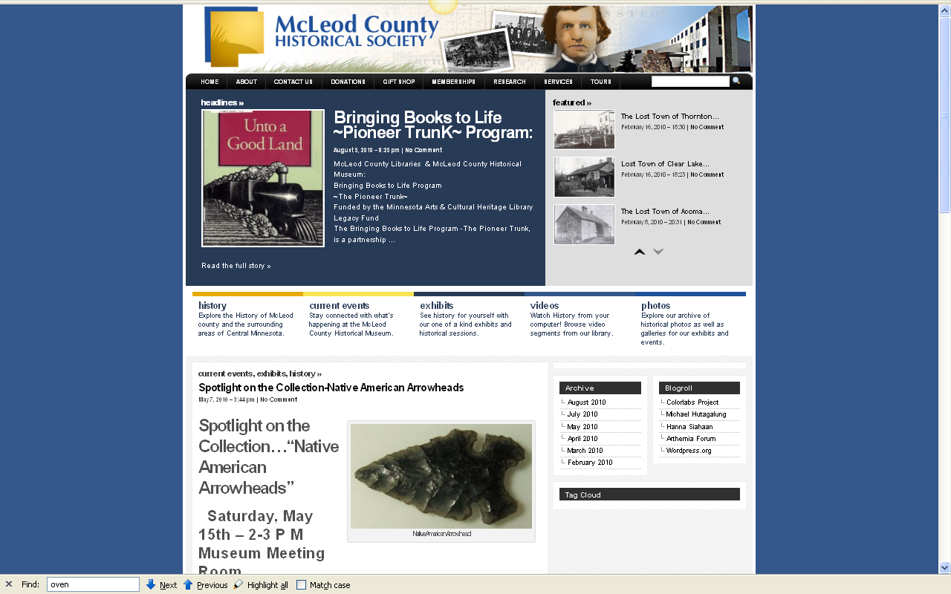
http://www.mcleodhistory.org/

Slide 207

And Old Man Littfin’s farm was the “place to go” to look for arrowheads, anytime, but especially in the spring when he was plowing the fields and when they were percolating up
His farm was on the site of a Lakotah Village. And my oldest cousins told of how they remember the old people in town talking about the last Indian people who lived “on the point.”
http://www.mcleodhistory.org/

Slide 208
And Old Man Littfin’s farm was the “place to go” to look for arrowheads, anytime, but especially in the spring when he was plowing the fields and when they were percolating up
His farm was on the site of a Lakotah Village.
And my oldest cousins even told of how they remember the old people in town
talking about
“the last Indian”
who lived “on the point”

Slide 209
And one of the Indians in everyone’s memory,
if only from local folklore,
was “Chief Little Crow,”
who everyone said “was shot in the back by a farmer while picking berries over by ‘Hutch”’
“Hutch” was Hutchinson, the same place where part of “Old Man Littfin’s” arrowhead collection ended up
And every now and then one would hear the rumor
that Little Crow’s body was on display
someplace in “The Cities”

Slide 210

“archaeology” . . .
www.mnsu.edu/emuseum/history/mncultures/littlecrow.html

Slide 211

Winsted
Hutchinson

Slide 212
So everyone knew at least about Chief Little Crow,
and, of course everyone knew of the old Indian Village that used to be on “The Point,”
and everyone knew of the really wonderful “Indian artifact” collection of Old Man Littifin
And there was this not-too-often mentioned mystery of where Little Crow’s bones were
And they were someplace on display!

Slide 213
So everyone knew at least about Chief Little Crow,
and, of course everyone knew of the old Indian Village that used to be on “The Point,”
and everyone knew of the really wonderful “Indian artifact” collection of Old Man Littifin
And there was this not-too-often mentioned mystery of where Little Crow’s bones were
And they were someplace on display!

Slide 214
So it was only natural for a couple of 3rd graders who wanted to help ease the overcrowding in church to think about “digging up Indian graves”
(NOTICE: This sort of thing is ILLEGAL nowadays)
So we got a couple of shovels of some kind
and set off for “The Point.”

Slide 215
So it was only natural for a couple of 3rd graders who wanted to help ease the overcrowding in church to think about “digging up Indian graves.”
(NOTICE: This sort of thing is ILLEGAL nowadays)
So we got a couple of shovels of some kind
and set off for “The Point”

Slide 216
It hadn’t occurred to us
that at about precisely 3:04
somewhere around 450 people
would be coming out of the overcrowded church
and walking down the front stairs
with a view straight on of . . .
“The Point”
. . . and two little kids digging something

Slide 217
“archaeology” …
“Old Man
Littfin’s”
farm
Church
“The Point”
“Grandma Roufs’”
mother was born
in this little farm
house

Slide 218

“archaeology” …
Modern-day view
of the church
from “The Point”

Slide 219
And, of course, as is normal in little villages,
it didn’t take long at all before all of the “inquisitive” villagers knew WHO the two little guys were,
and—we were told later, several times a year, for the duration of our days in Winsted—
that “the whole town” was curious
about what we were doing
And we were told—another untruth it turned out—that “the whole town was watching”
In reality it was probably
only about 450 people.

Slide 220
And, of course, as is normal in little villages,
it didn’t take long at all before all of the “inquisitive” villagers knew WHO the two little guys were,
and—we were told later, several times a year, for the duration of our days in Winsted—
that “the whole town” was curious
about what we were doing
And we were told—another untruth it turned out—that “the whole town was watching”
In reality it was probably
only about 450 people

Slide 221
My first encounter with
Linguistics
—the fourth of the four-fold American Anthropology focus—
was by comparison rather straightforward . . .

Slide 222
In that same year as
the great Good Friday excavation
1952
little Timmy takes up Latin with Sister Orentia
to become an altar boy
(thereby assuring his folks
that he will be
at the next year’s Good Friday services)

Slide 223
In the meantime, other events “transpire” . . .

Slide 224
It must have been about two or three years later we were over by Maple Plain at a Pee-Wee baseball tournament
It was the kind of tournament where you play a game in the morning and if you win you sit around waiting for the next game, sometimes two, to get over,
so you can play for “The Championship”
[the “championship” of the weekend Pee-Wee tournament,
not the championship of the state or region]

Slide 225
It happened that on that weekend
we won the first game
I was roaming around the nearby railroad tracks
in between games and came upon “a bum” making lunch on an open fire in a little woods near the tracks
We were also warned about
“The Bums” who stopped off in Winsted
[The Luce Line train still came through Winsted in those days]

Slide 226
But “Bums” didn’t seem to be so intent on “kidnapping little boys,” so we didn’t pay too much attention
And there weren’t many “bums” in Winsted anyway, and those that came didn’t seem to follow any calendar, like the Jamaicans and “Gypsies” did
I forget exactly how I got to talking with “The Bum” over by Maple Plain, but before long I was sitting next to the fire having a sandwich with him

Slide 227
I don’t remember too much about the conversation, but I still remember that he told me that he was “a bum”
He told me that he was from the “Eddy’s Bread family,” and at one time was “well to do”
He told me that alcohol was his problem
He told me never to let alcohol “get a hold” of me
And he cried
Like the Jamaican

Slide 228
I don’t remember too much about the conversation, but I still remember that he told me that he was “a bum”
He told me that he was from the “Eddy’s Bread family,” and at one time was “well to do”
He told me that alcohol was his problem
He told me never to let alcohol “get a hold” of me
And he cried
Like the Jamaican

Slide 229
I don’t remember how we did in the final game of that week’s Pee-Wee “championships”
But even when I got to college
I remembered the “Eddy’s Bread guy”
And I remembered the other bums that would stop by a diner-type café that my dad owned,
— run for my entire life in Winsted by a German lady from town —
asking for (and getting) a meal from my dad,
usually in exchange for a little wood splitting
those “bums” were really nice also . . .

Slide 230
And the “bums” I met personally
really never seemed to be like
the “bums” that people talked about . . .

Slide 231
And at Notre Dame
one of my very first college papers,
in sociology was on
Nels Anderson’s book
The Hobo: The Sociology of the Homeless Man
-- for my mentor William V. “Bill” D’Antonio,
later a long-time CEO of the American Sociological Association . . ..

Slide 232

Occasionally
we had “bums”
passing through
on the Luce Line Railroad . . .

Slide 233
and while doing that paper,
arguing that Anderson argued
that real-life bums aren’t “bums,”
that I remembered well
the real-life “bums” in my real-life past
And, thought I, if this is sociology,
then I guess I’m a sociologist.

Slide 234
and while doing that paper,
arguing that Anderson argued
that real-life bums aren’t “bums,”
that I remembered well
the real-life “bums” in my real-life past
And, thought I, if this is sociology,
then I guess I’m a sociologist

Slide 235
And at Notre Dame I studied internationally-oriented sociology, graduating with a degree in Sociology
William Liu
— U.S.A. representative for the social sciences to China, after the ping-pong diplomacy of Richard M. Nixon —
was my senior honors director, my research mentor, and good friend . . .

Slide 236

William T. Liu, Ph.D.
Professor Emeritus
1930 - 2008

Slide 237

The Essence of Chinese Cuisine.
1970. William T Liu and May L. Liu.
Nashville/London: Aurora.

Slide 238

The Essence of Chinese Cuisine.
1970. William T Liu and May L. Liu.
Nashville/London: Aurora.

Slide 239
and at Notre Dame . . .
Julian Samora
— an anthropologist, and the first U.S. recipient of Mexico’s Aguila Azteca Award, the highest award given to foreiners by that country —
was my advisor and
primary anthropology professor . . .

Slide 240


Slide 241
and later at the University of Minnesota
— as a National Institutes of General Medical Sciences Graduate Fellow in Anthropology —
I studied with . . .
Frank C. Miller
Pertti J. Pelto
E. Adamson Hoebel
Robert F. Spencer
Robert C. Kiste
Michael Z. Salovesh
Don Martindale
Richard E. W. Adams
Ward J. Barrett

Slide 242
All the while I was growing up my father, and godfather-uncle, the assistant priests, and other gentlemen of the town would help Father Cassian Osendorf, OSB, of the Red Lake Catholic Indian Mission, “collect clothing for the Indians”
They were, I am told, helping out by playing poker and drinking whiskey at my godfather-uncle’s cabin,
to help everyone relax, or something like that

Slide 243
But in the serious times when Father Cassian was around the family, we learned an awful lot about the conditions of life at Red Lake,
conditions that were not widely reported on
or known about in those days

Slide 244

Father Cassian Osendorf, OSB
was a missionary at
Red Lake Mission, 1956 –
Indian children at Red Lake
.
Minnesota Historical Society Photograph Collection 1956
Location no. E97.1 r95
Negative no. 58528

Slide 245

Indian family at Redby
Minnesota Historical Society Photograph Collection 1956
Location no. E97.1 r93
Negative no. 58529

Slide 246
And in the last few years, since going deaf, I thought a lot about Sharon, the tall, classmate, “the deaf girl” I sat behind in an early grade—during my early years as a cultural-physical-archaeological explorer
And I remember that in those days some people thought that Sharon, the gangly “deaf girl” with stringy red hair, who was always kind to me in the second grade, couldn’t hear because of god’s punishment for what one or other of her parents or some other relative had done. . . .

Slide 247
And that bothered me even then,
but probably mostly because
my mom and dad said it should bother me

Slide 248
Sharon didn’t stay with our class long. I think she came and went in the second grade . . .
or maybe it was the third
But I remember that some people weren’t kind to her
And I know, but I don’t know why, she never returned.
Perhaps she went to the School for the Deaf at Faribault . . .

Slide 249


Slide 250
OH . . . !
The questions . . .

Slide 251
FAQs
Where did you grow up?
Where did you go to school?
How long have you been at UMD?
What are your favorite things to do?
How did you get into anthropology?
Where have you been?
            What are your pet peeves?

Slide 252
Lots of places . . .
like 30 or 40 cultures/countries . . .
the number depending on
what your “units of analysis” are
[more on “units of analysis” Week 1]
I’ll talk about these places and peoples as it seems fitting and appropriate as we go along in the semester . . .

Slide 253
FAQs
Where did you grow up?
Where did you go to school?
How long have you been at UMD?
What are your favorite things to do?
How did you get into anthropology?
Where have you been?
            What are your pet peeves?

Slide 254
Somebody asked me for the first time about my pet peeves in class about five years ago,
and I though it was a good questions because I couldn’t think of any
—or rather it took me a full day of thinking to come up with a genuine “pet peeve” . . .

Slide 255
. . . you know when you buy two half-gallon cartons of milk in those paper cartons, and they’re glued together with a waxed cardboard strip?
Well, my pet peeve is when people put the two half-gallon cartons of milk into the refrigerator without taking that glued-on strip off.

Slide 256
. . . you know when you buy two half-gallon cartons of milk in those paper cartons, and they’re glued together with a waxed cardboard strip?
Well, my pet peeve is when people put the two half-gallon cartons of milk into the refrigerator without taking that glued-on strip off

Slide 257
Oh ya . . .
To those of you who may know one or more of the elders from Winsted, MN . . .
for the record I should say . . .
I did NOT “burn the town hall down” . . .

Slide 258
Oh ya . . .
To those of you who may know one or more of the elders from Winsted, MN . . .
for the record I should say . . .
I did NOT “burn the town hall down” . . .

Slide 259
But there was a cute small little white New England type “town hall” right across from the Catholic Church, and it DID catch on fire . . .
But it was an accident as I was cleaning up the backyard and “burning leaves” . . .
In those days most everyone “burned leaves” in the fall
The smell of burning leaves was a big part of the fall
in small-town America

Slide 260

East side First Street, Winsted.
Photograph Collection, Postcard ca. 1915
Visual Resources Database
Minnesota Historical Society
Location no. MM1.9 WN r5

Slide 261
And the later years?
later
(maybe . . .)

Slide 262
And the later years?
later
(maybe . . .)

Slide 263
And the later years?
later
(maybe . . .)

Slide 266

Back to the main
Moodle page

Slide 268
requirements, due dates, options, and grades

Slide 270

Your Gradebook
will look something like this
“First-Day” Handout information . . .
http://www.d.umn.edu/cla/faculty/troufs/anth3635/cehandout_first-day.html

Slide 271
Your Gradebook
will look something like this
“First-Day” Handout information . . .
it lists course requirements, due dates, options, and grades . . .
http://www.d.umn.edu/cla/faculty/troufs/anth3635/cehandout_first-day.html

Slide 272
Back to the main
Moodle page

Slide 273
Back to the main
Moodle page
REM

Slide 274
And the listing for Week 1 Day 1 will look something like this . . .
2. Reading Assignments . . .

Slide 275

Reading Assignment
for Week 1 Day 1 will look something like this . . .
Reading Assignments for Week 1

Slide 276
And the listing for Week 1 Day 1 will look something like this . . .
and (sometimes) 3. Activities . . .
REM: Don’t‘ forget the Activities . . .

Slide 277
Other Useful Sites
2012
University of Minnesota Duluth
Tim Roufs
© 2010-2012
http://www.d.umn.edu/cla/faculty/troufs/anth1604/

Slide 278
At the very top of “Block 1” you will see an alphabet. Clicking on a letter will bring you to a page that indexes course WebPages for virtually all of the scheduled topics and items in the course.

Slide 279
At the very top of “Block 1” you will see an alphabet. Clicking on a letter will bring you to a page that indexes course WebPages for virtually all of the scheduled topics and items in the course.

Slide 280
This information is very useful

Slide 281
Useful ?

Slide 282
How useful?

Slide 283

the Cultural Anthropology course site has had almost a half million site visits to date . . .
516,403

Slide 284
to access a topic simply click on a letter to go to an index page . . .

Slide 285

and from the index page click on the item you want . . .

Slide 286
and from the index page click on the item you want . . .
scroll down for more items

Slide 287

click on item . . . and . . .

Slide 288

voilà

Slide 290


Slide 291


Slide 292
What do you expect to get out of this class?
2012
University of Minnesota Duluth
Tim Roufs
© 2010-2012
http://www.d.umn.edu/cla/faculty/troufs/anth1604/

Slide 293

Laptops
Welcome
(in fact, they’re encouraged)

Slide 295
Welcome to
Cultural Anthropology
Enjoy Your Stay !
Tim Roufs
© 2010-2011
http://www.d.umn.edu/cla/faculty/troufs/anth1604/

Slide 296
Thanks for joining in
I hope you enjoy your stay.
If you have any questions, You will find the normal Instructor Contact Information in the General Block of the course.
Tim Roufs

Slide 297
Thanks for joining in
I hope you enjoy your stay
If you have any questions, you will find the normal Instructor Contact Information in the General Block of the course
Tim Roufs

Slide 298
Thanks for joining in
I hope you enjoy your stay
If you have any questions, you will find the normal Instructor Contact Information in the General Block of the
course management system
Tim Roufs

