Slide 1
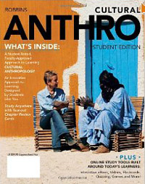
Main Characteristics
of
Anthropology: re Cultural Anthroplogy
2012
University of Minnesota Duluth
Tim Roufs
© 2010-2012
http://www.d.umn.edu/cla/faculty/troufs/anth1604/

Slide 2
The Fields of General Anthropology
archaeology
physical or biological anthropology (bioanthropology)
linguistic anthropology
socio / cultural anthropology

Slide 3
The Fields of General Anthropology
archaeology
physical or biological anthropology (bioanthropology)
linguistic anthropology
socio / cultural anthropology

Slide 4
BEGIN
MAIN CHARACTERISTICS

Slide 5
MAIN CHARACTERISTICS OF ANTHROPOLOGY

Slide 6
Main Characteristics
1. culture as a primary concept
2. comparative method as major approach to the study of human behavior
3. holism or the study of "humankind" as a whole, as a primary theoretical goal
4. fieldwork as a primary research technique, involving “participant observation”

Slide 7
Main Characteristics
1. culture as a primary concept
2. comparative method as major approach to the study of human behavior
3. holism or the study of "humankind" as a whole, as a primary theoretical goal
4. fieldwork as a primary research technique, involving “participant observation”

Slide 8
Main Characteristics
1. culture as a primary concept
2. comparative method as major approach to the study of human behavior
3. holism or the study of "humankind" as a whole, as a primary theoretical goal
4. fieldwork as a primary research technique, involving “participant observation”

Slide 9
Main Characteristics
“culture”
learned
shared
transmitted from generation to generation
based on symbols
integrated

Slide 10
Main Characteristics
“culture”
learned
shared
transmitted from generation to generation
based on symbols
integrated
“shared understanding”

Slide 11
Main Characteristics
“culture”
is not inherited
(i.e., is not biological)
is not “instinct”

Slide 12
Main Characteristics
“cultures”
are integrated
interact and change

Slide 13
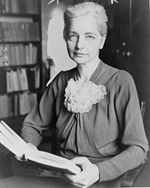
Main Characteristics
“cultures”
are integrated
interact and change
Ruth Fulton Benedict
1887-1948
Patterns of Culture
1934

Slide 14
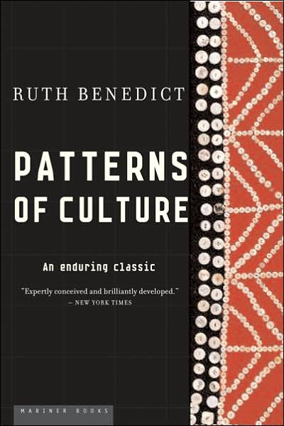
“Culture is personality writ large”
Ruth Fulton Benedict
1887-1948
Patterns of Culture
1934

Slide 15
The Concept of Culture
Microculture
a distinct pattern of learned and shared behavior and thinking found within larger cultures such as ethnic groups in localized regions
local cultures

Slide 16
The Concept of Culture
Microculture
a distinct pattern of learned and shared behavior and thinking found within larger cultures such as ethnic groups in localized regions
local cultures

Slide 17
The Concept of Culture
microcultures can include ethnic groups within nations
e.g., Anishinabe (Chippewa; Ojibwa)
e.g., Irish “Travellers”
sometimes incorrectly called “Gypsies”
e.g., Rom (Gypsies)
e.g., Basques
e.g., Kurds
e.g., Australian Aboriginals

Slide 18
The Concept of Culture
microcultures can include ethnic groups within nations
e.g., Anishinabe (Chippewa; Ojibwa)
e.g., Irish “Travellers”
sometimes incorrectly called “Gypsies”
e.g., Rom (Gypsies)
e.g., Basques
e.g., Kurds
e.g., Australian Aboriginals

Slide 19
The Concept of Culture
microcultures can include ethnic groups within nations
e.g., Anishinabe (Chippewa; Ojibwa)
e.g., Irish “Travellers”
sometimes incorrectly called “Gypsies”
e.g., Rom (Gypsies)
e.g., Basques
e.g., Kurds
e.g., Australian Aboriginals
local groups generally strive to preserve their cultural identity

Slide 20
The Concept of Culture
microcultures can include ethnic groups within nations
e.g., Anishinabe (Chippewa; Ojibwa)
e.g., Irish “Travellers”
sometimes incorrectly called “Gypsies”
e.g., Rom (Gypsies)
e.g., Basques
e.g., Kurds
e.g., Australian Aboriginals
local groups generally strive to preserve their cultural identity . . .
language
food
religion

Slide 21
www.duluthnewstribune.com/articles/index.cfm?id=73293&section=homepage
Notes:
21

Slide 22
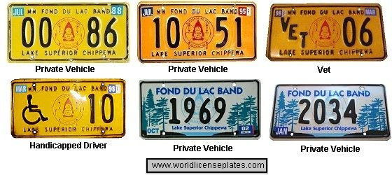
www.worldlicenceplates.com/usa/US_MNXX.html

Slide 23
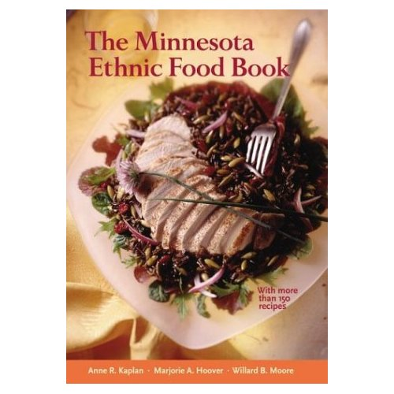
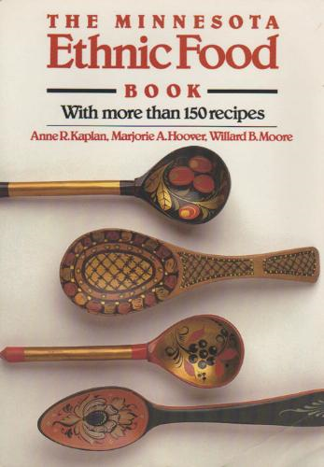
Minnesota Historical Society Press
Notes:
23

Slide 25
Notes:
25

Slide 26
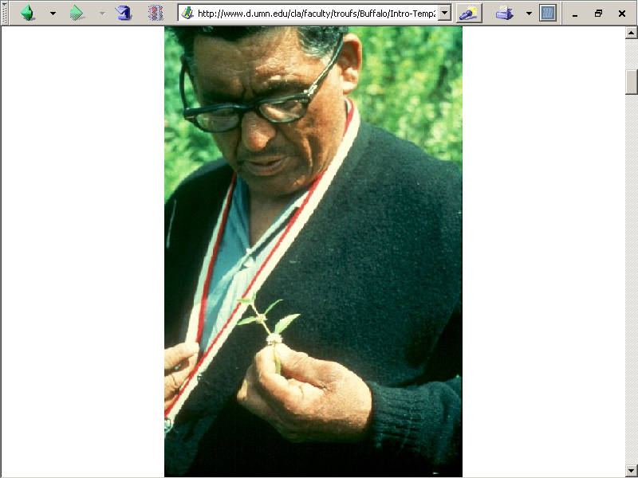
Paul Buffalo
Meditating
Medicine
http://www.d.umn.edu/cla/faculty/troufs/Buffalo/Intro-Temp2.html

Slide 27
Notes:
27

Slide 28
The Concept of Culture
microcultures can include ethnic groups within nations
e.g., Hmong in Minnesota and Wisconsin, and California, and elsewhere

Slide 29
Appleton, Wisconsin
Notes:
29

Slide 30
like the group in Wisconsin
Notes:
30

Slide 31
The Concept of Culture
microcultures can include ethnic groups within nations
e.g., “Black Indians” of New Orleans

Slide 32
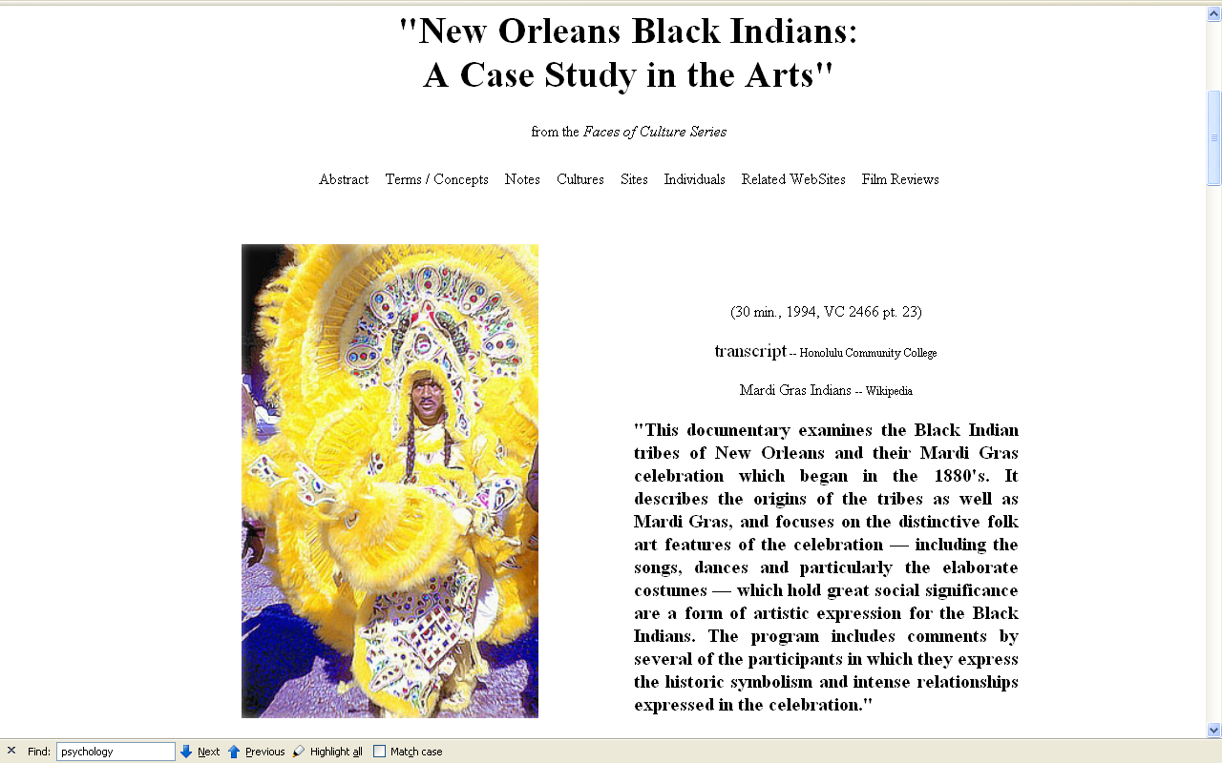
Notes:
32

Slide 33
The Concept of Culture
microcultures can include ethnic groups within nations
e.g., Yanomamö of Venezuela and Brazil

Slide 34
Notes:
34

Slide 36
The Concept of Culture
Microculture
a distinct pattern of learned and shared behavior and thinking found within larger cultures such as ethnic groups in localized regions
local cultures
Macroculture
a distinct pattern of learned and shared behavior and thinking that crosses local boundaries, such as transnational culture and global culture

Slide 37
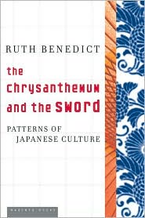
Ruth Fulton Benedict
1887-1948
Patterns of Culture
1934

Slide 38
Ruth Fulton Benedict
1887-1948
Patterns of Culture
1934

Slide 39
The Concept of Culture
macrocultures can include groups across nations
e.g., Basques
e.g., Rom (Gypsies)
e.g., ? Al Qaeda
. . . sometimes a people can be either a microculture or a macroculture, depending on how they are viewed . . .

Slide 40
The Concept of Culture
microcultures can include ethnic groups within nations
e.g., Hmong in Minnesota and Wisconsin, and California, and elsewhere

Slide 41
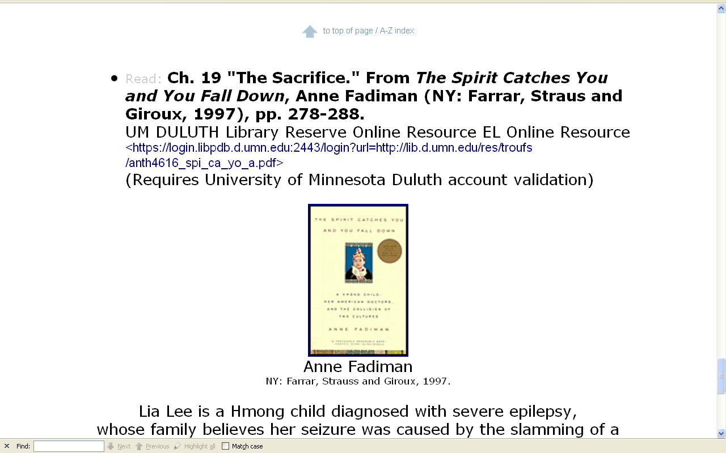

Slide 42
The Concept of Culture
macrocultures can include groups across nations
e.g., Basques

Slide 43
The Concept of Culture
macrocultures can include groups across nations
e.g., Basques
e.g., Rom (Gypsies)

Slide 44
The Concept of Culture
microcultures can include ethnic groups within nations
e.g., Anishinabe (Chippewa; Ojibwa)
e.g., Irish “Travellers”
sometimes incorrectly called “Gypsies”
e.g., Australian Aboriginals
e.g., Cajun
e.g., Rom (Gypsies)
e.g., Basques
e.g., Kurds

Slide 45
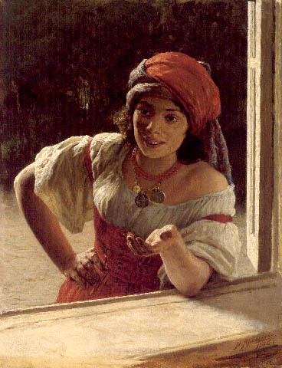
Gypsy Woman . 1886
Nikolai Yaroshenko. 1846 - 1898. Russia .
http://www.serpukhov.su/museum/yarosh_e.htm

Slide 46
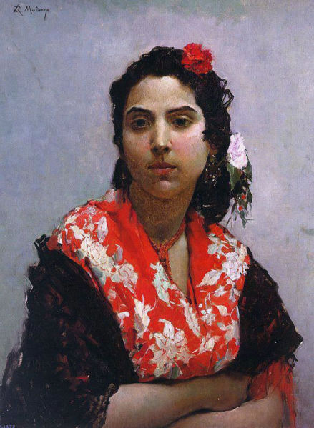
Gitana
Raimundo Madrazo
1841-1920
http://en.wikipedia.org/wiki/Main_Page

Slide 47
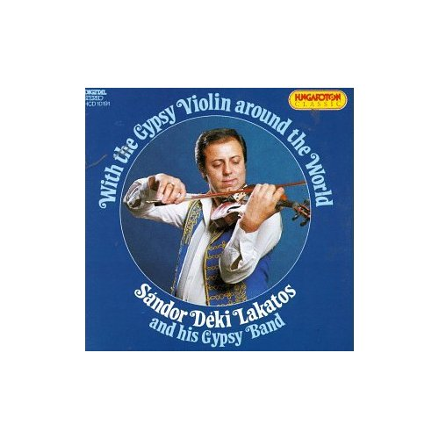
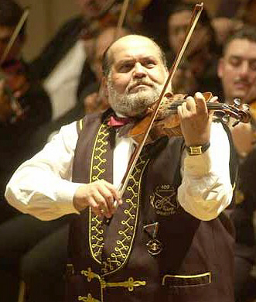
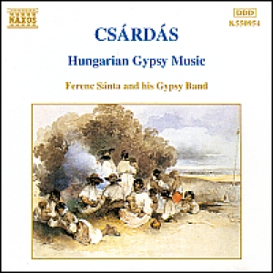
Sándor Buffo Rigó
Tata Gypsy Band
Budapest Gypsy Orchestra
www.romaniworld.com/gal41.htm

Slide 48
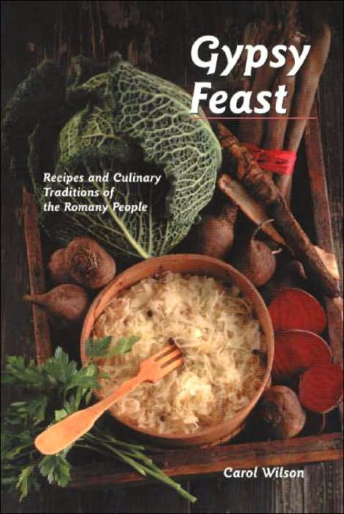
(Hippocrene 2004)

Slide 49
The Concept of Culture
microcultures can include ethnic groups within nations
e.g., Anishinabe (Chippewa; Ojibwa)
e.g., Irish “Travellers”
sometimes incorrectly called “Gypsies”
e.g., Australian Aboriginals
e.g., Rom (Gypsies)
e.g., Basques
e.g., Kurds

Slide 50
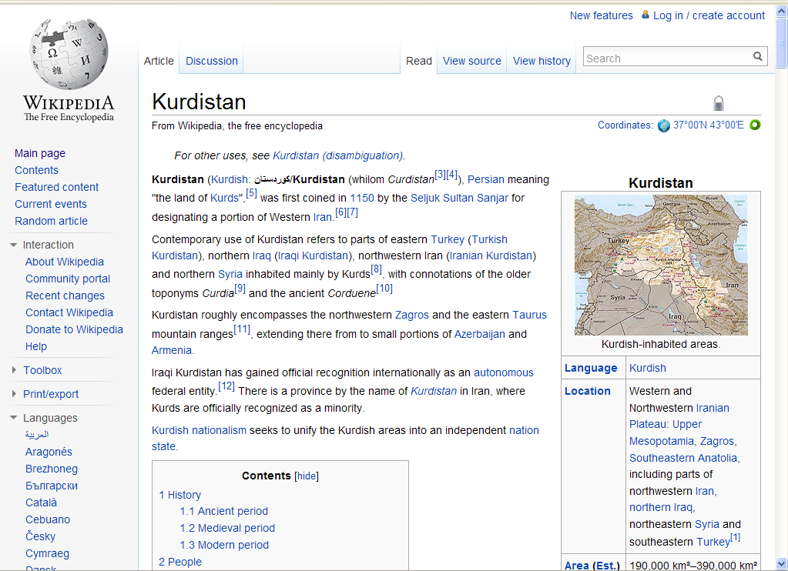
http://en.wikipedia.org/wiki/Kurdistan

Slide 51
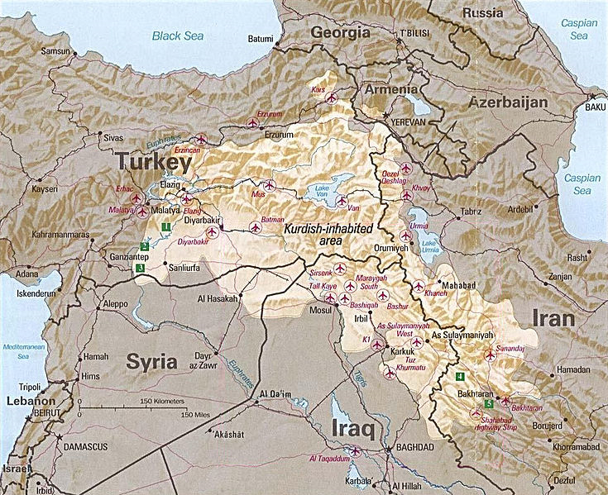
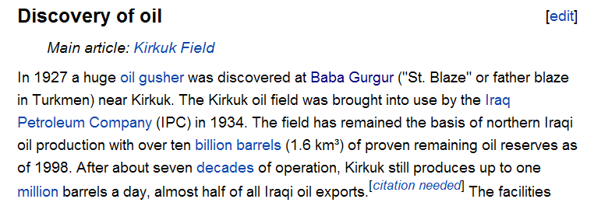
http://en.wikipedia.org/wiki/Kurdistan
http://en.wikipedia.org/wiki/Kirkuk

Slide 52
BEGIN
MAIN CHARACTERISTICS
#2 COMPARATIVE METHOD

Slide 54
Main Characteristics
1. culture as a primary concept
2. comparative method as major approach to the study of human behavior development and structure
3. holism or the study of "humankind" as a whole, as a primary theoretical goal
4. fieldwork as a primary research technique, involving “participant observation”

Slide 55
Compare . . .
Main Characteristics
comparative method
as a major approach to the study of human behavior
the comparative method compares things

Slide 56
Compare . . .
Main Characteristics
comparative method
One form of comparative method was pioneered by Fred Eggan
(University of Chicago)
“Social anthropology and the method of controlled comparison”
American Anthropologist, 56:743-61 (1954)

Slide 57
Compare . . .
Main Characteristics
comparative method
One form of comparative method was pioneered by Fred Eggan
(University of Chicago)
“Social anthropology and the method of controlled comparison”
American Anthropologist, 56:743-61 (1954)

Slide 58
Compare . . .
Main Characteristics
comparative method
Other methods . . .
compare things regionally
in an attempt to understand process

Slide 59
Compare . . .
Main Characteristics
comparative method
Other methods . . .
compare things regionally
in an attempt to understand process

Slide 60
Compare . . .
Main Characteristics
the comparative method compares things
for e.g. . . .

Slide 61
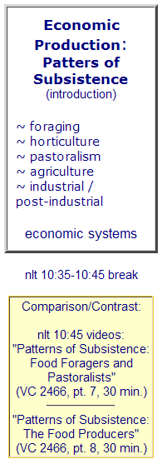
comparing subsistence patterns
Notes:
61

Slide 62
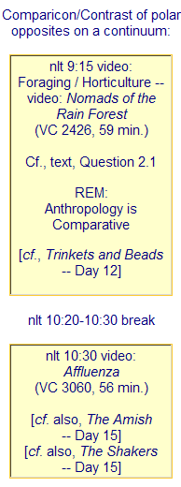
comparing polar opposites of a continuum
Notes:
62

Slide 63
comparing kinship systems
Notes:
63

Slide 64
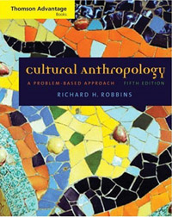
comparing family relations
Notes:
64

Slide 65
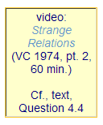
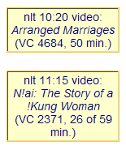
comparing romantic love
with arranged marriages
Notes:
65

Slide 66
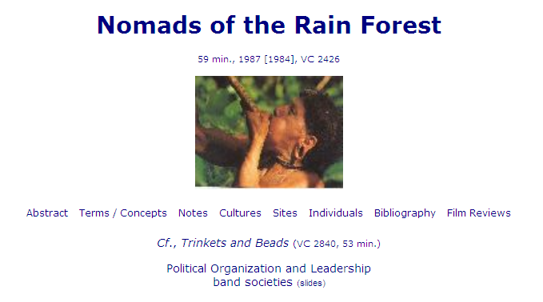
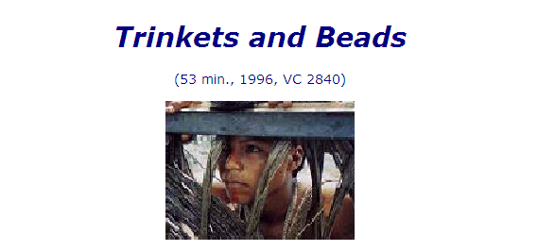
diachronic comparisons
(Huaorani/Waorani Indians of the Amazon in Ecuador)
Notes:
66

Slide 67
comparing twins
Notes:
67

Slide 68
comparing patients
Notes:
68

Slide 69
comparing order of birth
Notes:
69

Slide 70
comparing children with adults
Notes:
70

Slide 71
Compare . . .
Main Characteristics
the comparative method compares things, for e.g., “culture-bound syndromes”
maize – Mexico
wheat – Turkey
rice – China
manioc – Brazil
millet – Africa

Slide 72
Compare . . .
Main Characteristics
the comparative method compares things, trying to understand
process and the very “nature” of things
e.g., “culture-bound syndromes”

Slide 73
comparing psychological “illnesses” that are specific to individual cultures
Notes:
73

Slide 74
Compare . . .
Main Characteristics
and items like “culture bound syndromes” are compared with similar phenomena that are thought to be “universal” . . .

Slide 75
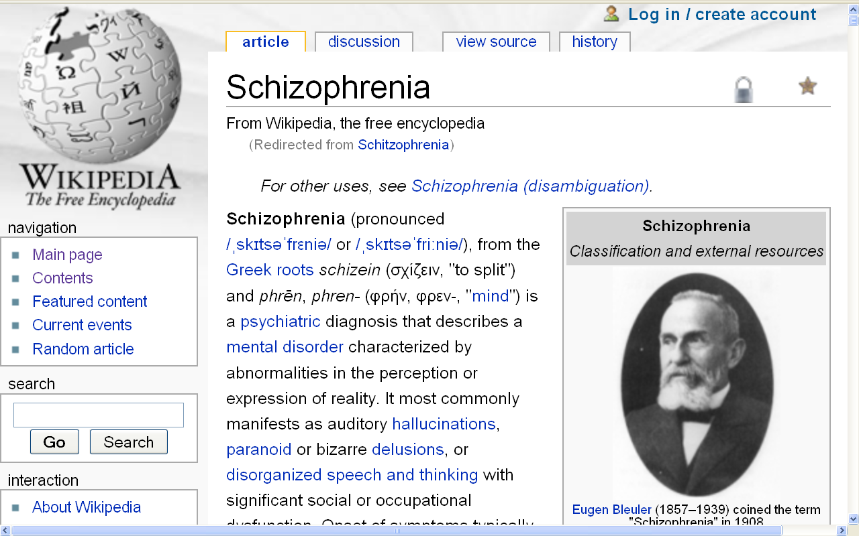
Notes:
75

Slide 77
Compare . . .
Main Characteristics
comparative method
Other methods . . .
compare things regionally
in an attempt to understand process

Slide 78
Compare . . .
Main Characteristics
the comparative method compares things, for e.g., process of domestication / civilization
maize – Mexico
wheat – Turkey
rice – China
manioc – Brazil
millet – Africa

Slide 79
Compare . . .
Main Characteristics
the comparative method compares things, for e.g., process of domestication / civilization
maize – Mexico
wheat – Turkey
rice – China
manioc – Brazil
millet – Africa

Slide 80
Compare . . .
Main Characteristics
the comparative method compares things, for e.g., process of domestication / civilization
maize – Mexico
wheat – Turkey
rice – China
manioc – Brazil
millet – Africa

Slide 81
Compare . . .
Main Characteristics
the comparative method compares things, for e.g., process of domestication / civilization
maize – Mexico
wheat – Turkey
rice – China
manioc – Brazil
millet – Africa

Slide 82
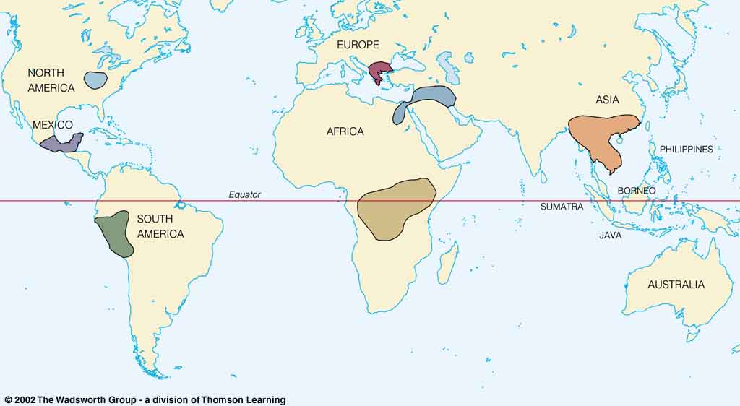
Origin of Domestication for Selected Plants
Compare . . .
wheat
10,500 ybp
maize
4,200 ybp
rice
7,000 ybp
manioc
4,200 ybp
millet
4,000 ybp
Understanding Physical Anthropology and Archaeology, 9th Ed., p. 342.

Slide 83
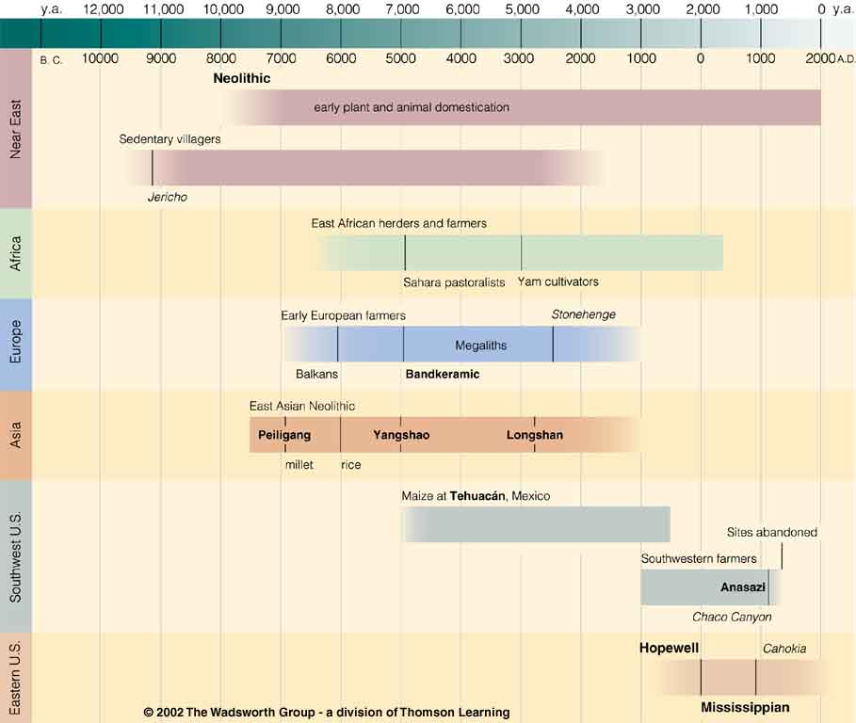
Chapter 14
Understanding Physical Anthropology and Archaeology, 9th Ed.
“Food Production”
A Biocultural Revolution
Neolithic
Time line for Ch. 14 Food Production.
Understanding Physical Anthropology and Archaeology, 9th Ed., p. 333.

Slide 84
Neolithic
Tehuacán
Time line for Ch. 14 Food Production.
Understanding Physical Anthropology and Archaeology, 9th Ed., p. 333.

Slide 85
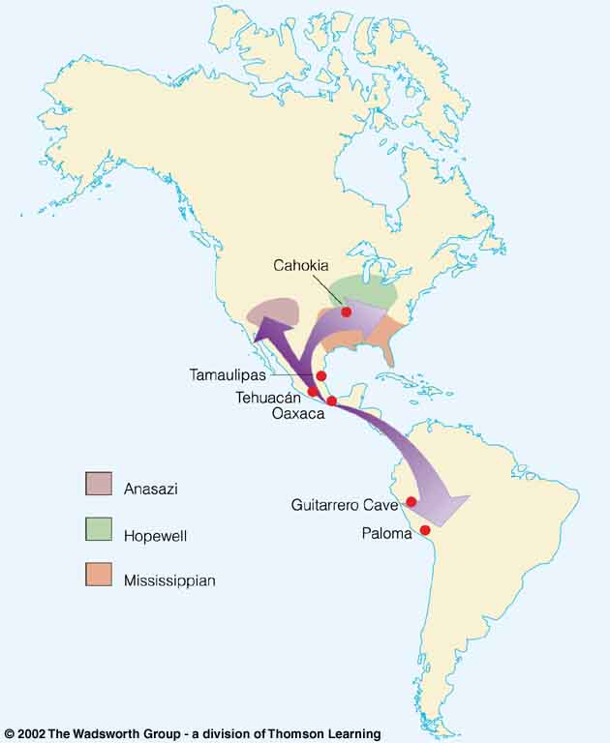
Compare . . .
Tehuacán Valley, Puebla, Mexico
maize
4,200 ybp
Understanding Physical Anthropology and Archaeology, 8th Ed., p. 432.

Slide 86
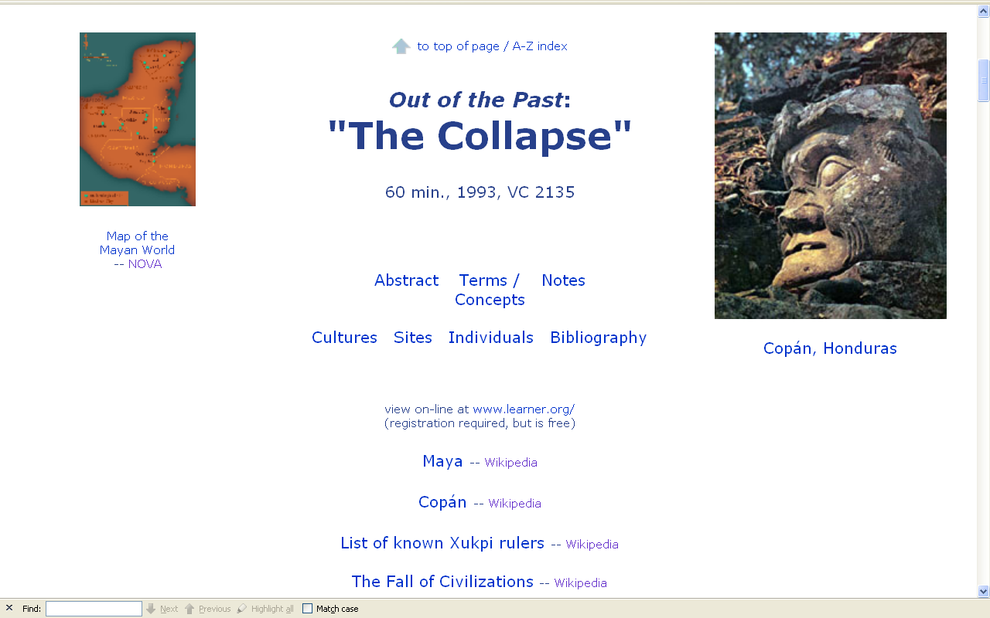
Compare . . .
www.d.umn.edu/cla/faculty/troufs/anth3618/video/Collapse.html#title

Slide 87
www.d.umn.edu/cla/faculty/troufs/anth3618/video/Fall_Maya.html#title

Slide 88
END
MAIN CHARACTERISTICS
#2 COMPARATIVE METHOD

Slide 89
BEGIN
MAIN CHARACTERISTICS
#3 WHOLISM

Slide 92
Main Characteristics
1. culture as a primary concept
2. comparative method as major approach to the study of human behavior
3. holism or the study of "humankind" as a whole, as a primary theoretical goal
4. fieldwork as a primary research technique, involving “participant observation”

Slide 93
American Anthropology
cultural / social
physical
archaeology
linguistics

Slide 94
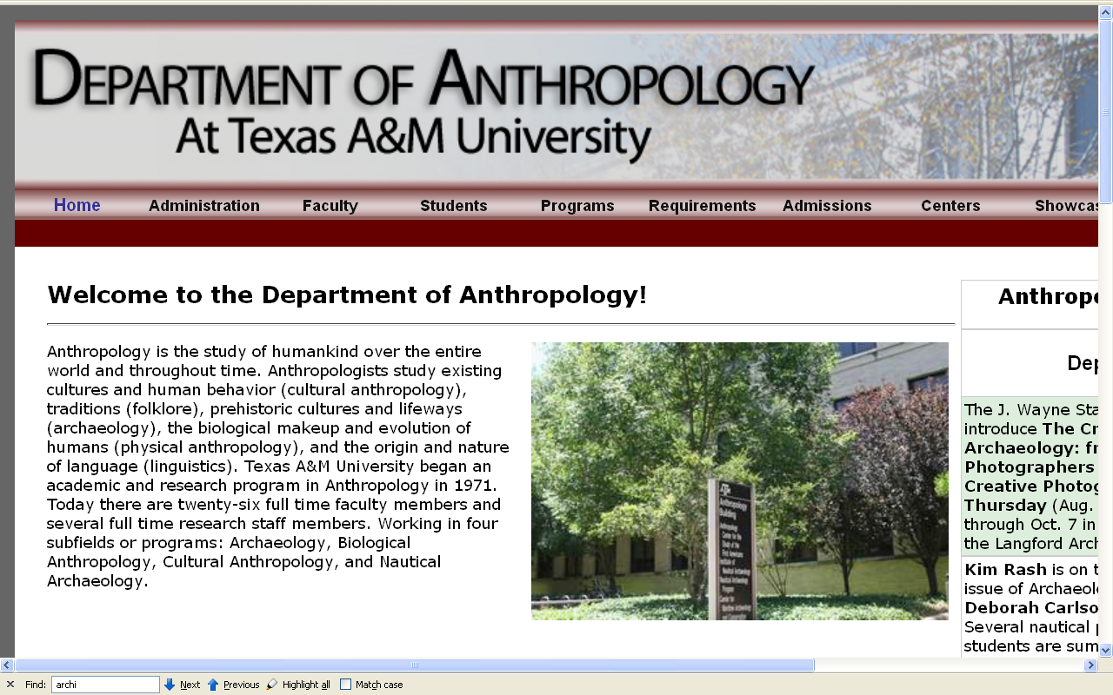
The main fields
of general anthropology
http://anthropology.tamu.edu//

Slide 95
The Fields of General Anthropology
socio / cultural anthropology
physical or biological anthropology (bio-physical anthropology)
archaeology
linguistics

Slide 98
holism

Slide 99
holism
holism

Slide 100
Anthropology
Bio-physical
Cultural

Slide 101
http://news.bbc.co.uk/2/hi/health/8490937.stm
Notes:
101

Slide 102
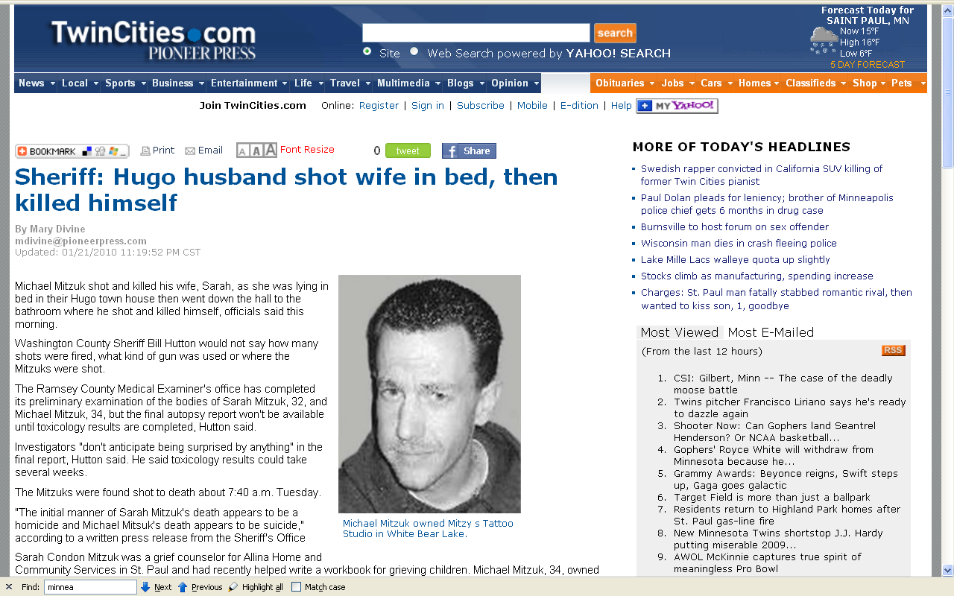
http://www.twincities.com/ci_14238759
Notes:
¹⁰²

Slide 103
Anthropology
Bio-physical |
Cultural
body
size /
shape,
. . .
body
structure /
function
DNA,
. . .
prehistoric
cultures
. . .
industrial-
age
. . .
art /
literature,
museums
. . .
kinship,
economics,
religion,
politics . . .
. . .
. . .
structural
and
historic
linguistics
. . .
physical
measuring
excavation,
preservation,
reconstruction . . .
participant /
observation

Slide 104
Anthropology
Bio-physical |
Cultural
body
size /
shape,
. . .
body
structure /
function
. . .
evolutionary
development
. . .
industrial-
age
. . .
art /
literature
. . .
kinship . . .
. . .
language. . .
. . .
physical
measuring
ethnographic
analogy
participant /
observation

Slide 105
holism
holism

Slide 106
Anthropology
Bio-physical |
Cultural
body
size /
shape,
. . .
body
structure /
function
. . .
evolutionary
psychology
. . .
industrial-
age
personality
. . .
personality
in art /
literature
. . .
world view,
child training,
national
character . . .
. . .
cognitive
anth
. . .
physical
measuring
ethnographic
analogy
participant /
observation

Slide 107
theory
holism
including
results of
interdisciplinary study,
esp. with comparative psychology, social psychology, philosophy,
sociology, women’s studies . . .

Slide 108
END
MAIN CHARACTERISTICS
#3 HOLISM

Slide 110
BEGIN
DIFFICULT TERMS

Slide 111
difficult terms

Slide 112
Glossary
ethnography
scientific description of cultures
(“a portrait of a people”)

Slide 113
Glossary
ethno – graphy
graph from the Greek, meaning something “written” or “drawn”

Slide 114
Glossary
ethnology
comparative study of cultures

Slide 115
Glossary
ethn – ology
comparative study of cultures

Slide 116
Glossary
ethnology
comparative study of cultures

Slide 117
Glossary
ethology
comparative study of cultures

Slide 118
Glossary
ethology
comparative study of cultures
scientific study of the social behavior of animals, especially in their natural environments

Slide 119
Glossary
primatology
scientific study of the social behavior of primates, especially (non-human primates) apes and monkeys

Slide 120
Grand Central Publishing, 2006

Slide 122
END
DIFFICULT TERMS

Slide 123
BEGIN
MAIN CHARACTERISTICS
#4 FIELDWORK

Slide 124
xxxxBEGIN
MAIN CHARACTERISTICS
#xxx participant observation

Slide 125
Main Characteristics
1. culture as a primary concept
2. comparative method as major approach to the study of human behavior
3. holism or the study of "humankind" as a whole, as a primary theoretical goal
4. fieldwork as a primary research technique, involving “participant observation”

Slide 126
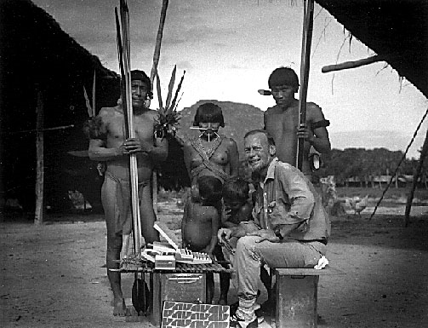
NAPOLEON A. CHAGNON
photo from author

Slide 127
NAPOLEON A. CHAGNON
photo from author

Slide 129
Main Characteristics
1. culture as a primary concept
2. comparative method as major approach to the study of human behavior
3. holism or the study of "humankind" as a whole, as a primary theoretical goal
4. fieldwork as a primary research technique, involving “participant observation” = how you get information
= tool

Slide 130
Main Characteristics
1. culture as a primary concept
2. comparative method as major approach to the study of human behavior
3. holism or the study of "humankind" as a whole, as a primary theoretical goal
4. fieldwork as a primary research technique, involving “participant observation” = how you get information
data gathering technique —
participant observation
(field work)
= tool

Slide 131
Main Characteristics
Anthropologists use other tools . . . like questionnaires, interview schedules, psychological tests, documentary filming . . . but “participant observation” is a characteristic technique use by anthropologists, especially cultural anthropologists (ethnologists)
1. culture as a primary concept
2. comparative method as major approach to the study of human behavior
3. holism or the study of "humankind" as a whole, as a primary theoretical goal
4. fieldwork as a primary research technique, involving “participant observation” = how you get information
= tool

Slide 132
Main Characteristics
Anthropologists use other tools . . . like questionnaires, interview schedules, psychological tests, documentary filming . . . but “participant observation” is a characteristic technique use by anthropologists, especially cultural anthropologists (ethnologists)
1. culture as a primary concept
2. comparative method as major approach to the study of human behavior
3. holism or the study of "humankind" as a whole, as a primary theoretical goal
4. fieldwork as a primary research technique, involving “participant observation” = how you get information
= tool

Slide 133
Main Characteristics
1. culture as a primary concept
2. comparative method as major approach to the study of human behavior
3. holism or the study of "humankind" as a whole, as a primary theoretical goal
4. fieldwork as a primary research technique, involving “participant observation” = how you get information
= tool

Slide 134
Main Characteristics
1. culture as a primary concept
2. comparative method as major approach to the study of human behavior
3. holism or the study of "humankind" as a whole, as a primary theoretical goal
4. fieldwork as a primary research technique, involving “participant observation”
?

Slide 135
Main Characteristics
1. culture as a primary concept
2. comparative method as major approach to the study of human behavior
3. holism or the study of "humankind" as a whole, as a primary theoretical goal
4. fieldwork as a primary research technique, involving “participant observation” = how you get information
= approach
how you use information
= tool

Slide 137
Glossary
Other important terms include . . .

Slide 139
Glossary
ethnocentrism
judging other cultures by the standards of one’s own culture rather than by the standards of that particular culture

Slide 140
Glossary
cultural relativism
the perspective that each culture must be understood in terms of the values and ideas of that culture and should not be judged by the standards of another

Slide 141
Glossary
cultural relativism
absolute cultural relativism
critical cultural relativism

Slide 142
Glossary
cultural relativism
absolute cultural relativism
critical cultural relativism

Slide 143
Glossary
absolute cultural relativism
the perspective that says a person from one culture should not question the rightness or wrongness of behavior or ideas in other cultures because that would be ethnocentric

Slide 144
Glossary
?
absolute cultural relativism
World War II Holocaust
arranged “underage” marriage
female genital mutilations
withholding of medical treatment of children for religious reasons
polygyny. . . .

Slide 145
Glossary
?
absolute cultural relativism
Doctor Assisted Suicide
arranged “underage” marriage
female genital mutilations
withholding of medical treatment of children for religious reasons
polygyny. . . .

Slide 146
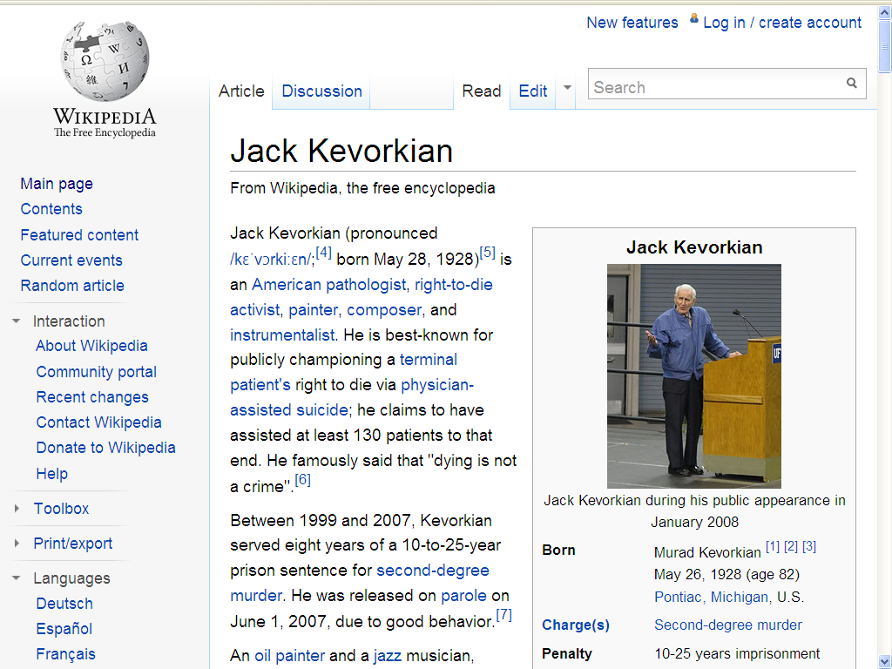

Slide 147
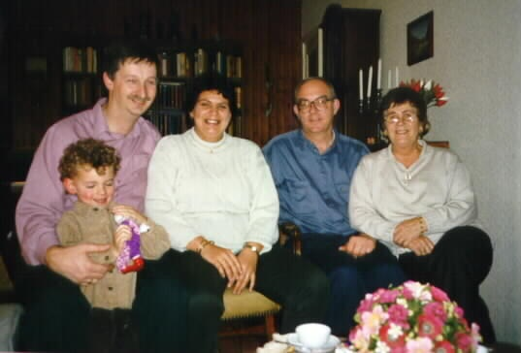

Slide 148
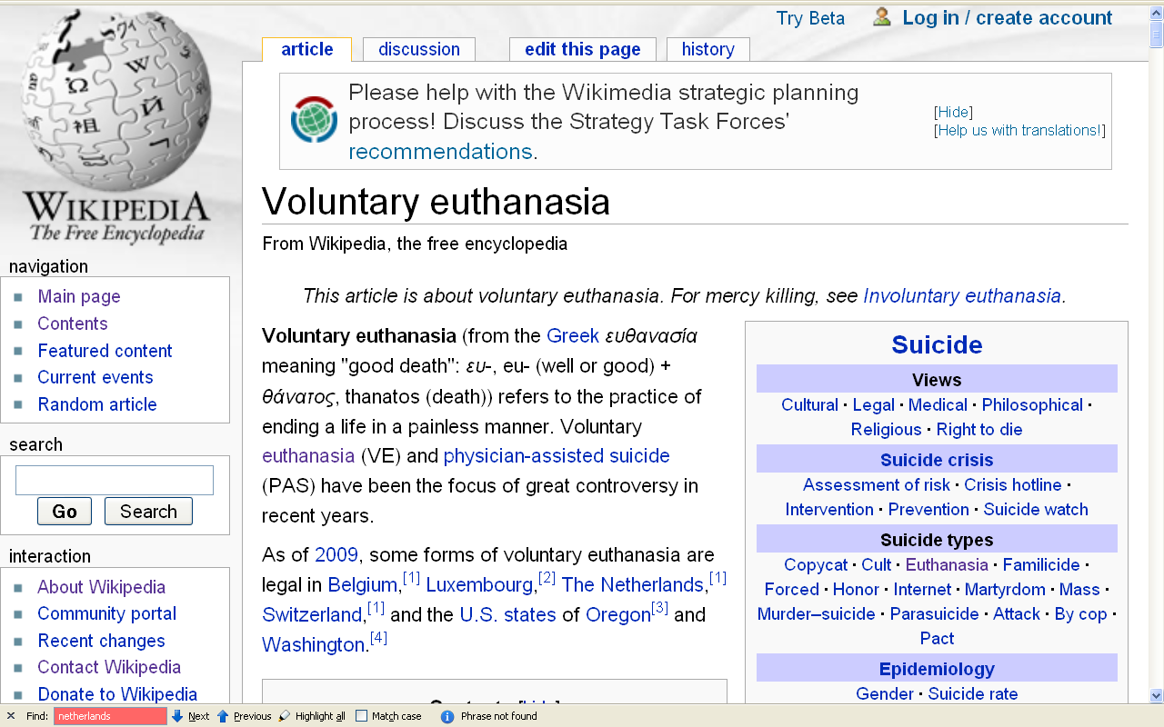
\ http://en.wikipedia.org/wiki/Voluntary_euthanasia

Slide 149
Glossary
absolute cultural relativism
World War II Holocaust
arranged “underage” marriage
female genital mutilations
withholding of medical treatment of children for religious reasons
polygyny. . . .

Slide 150
www.usatoday.com/news/health/2009-05-15-forced-chemotherapy_N.htm

Slide 151
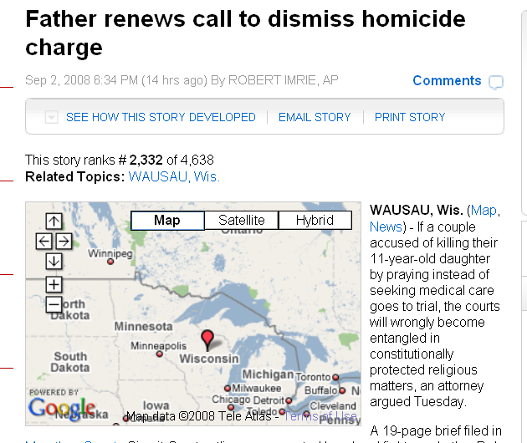
www.examiner.com/a-1567034~Father_renews_call_to_dismiss_homicide_charge.html

Slide 152
www.wuwm.com/programs/news/view_news.php?articleid=2242

Slide 153
Glossary
?
absolute cultural relativism
Honor Killings
arranged “underage” marriage
female genital mutilations
withholding of medical treatment of children for religious reasons
polygyny. . . .

Slide 154
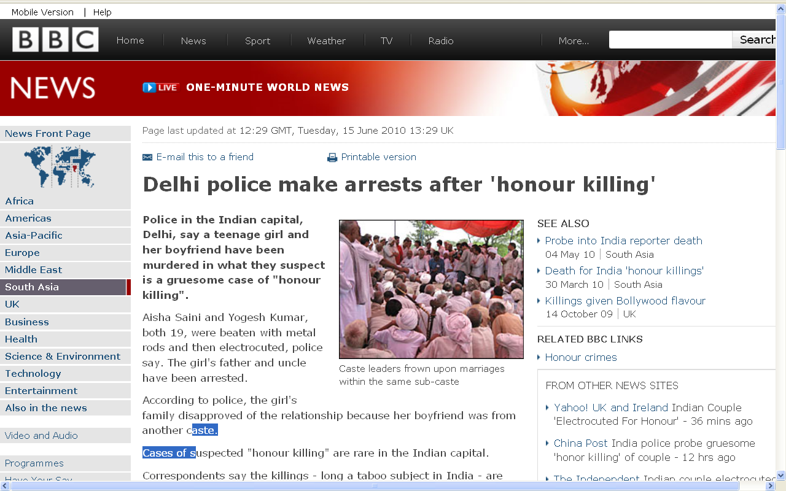
://news.bbc.co.uk/2/hi/world/south_asia/10316249.stm

Slide 155
Glossary
?
absolute cultural relativism
World War II Holocaust
arranged “underage” marriage
female infanticide
withholding of medical treatment of children for religious reasons
polygyny. . . .

Slide 156
Glossary
?
absolute cultural relativism
World War II Holocaust
arranged “underage” marriage
female infanticide
female genital mutilations
withholding of medical treatment of

Slide 157
Glossary
?
absolute cultural relativism
World War II Holocaust
arranged “underage” marriage
female genital mutilations
withholding of medical treatment of children for religious reasons
polygyny. . . .

Slide 158
Glossary
absolute cultural relativism
World War II Holocaust
arranged “underage” marriage
female genital mutilations
withholding of medical treatment of children for religious reasons
polygyny . . .

Slide 159
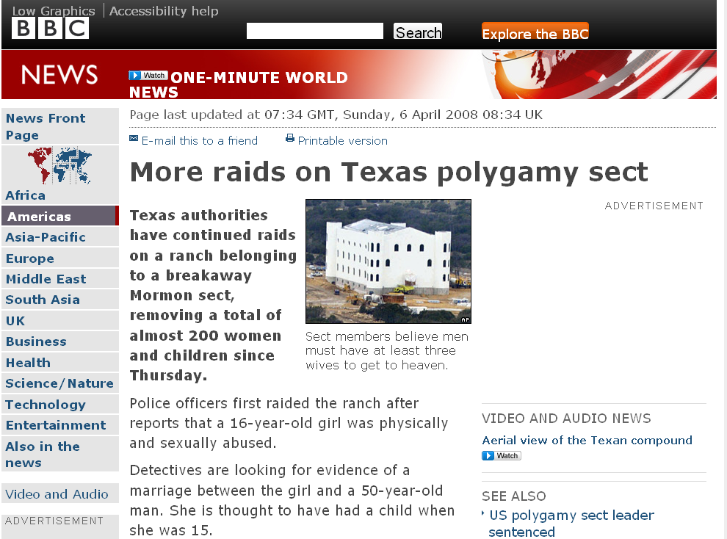
http://news.bbc.co.uk/2/hi/americas/7333004.stm

Slide 160
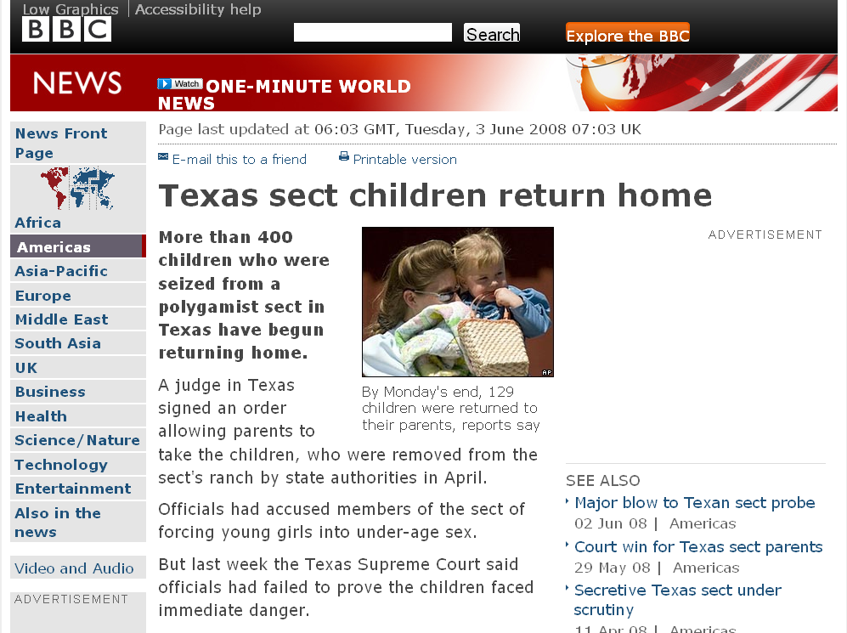
http://news.bbc.co.uk/2/hi/americas/7431848.stm

Slide 161
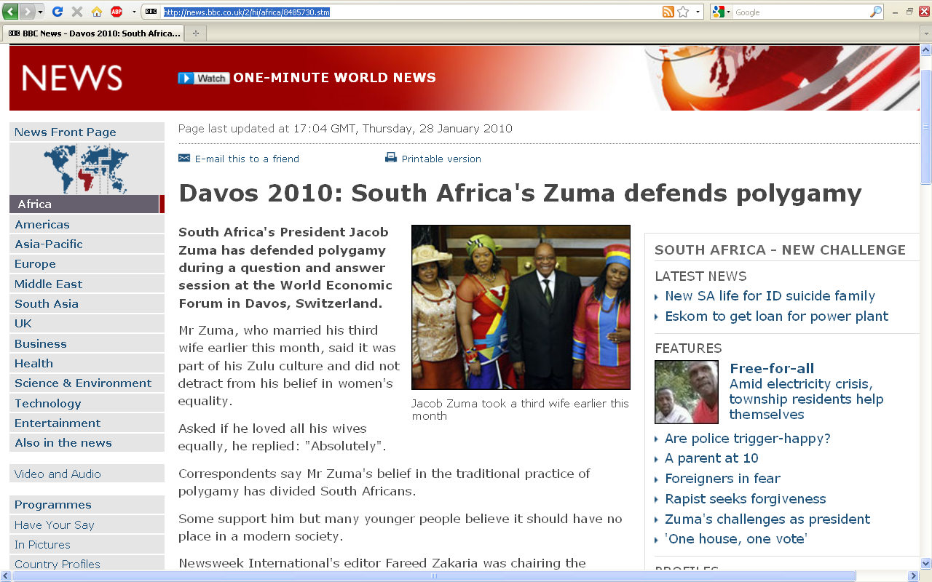
http://news.bbc.co.uk/2/hi/africa/8485730.stm
Notes:
161

Slide 162
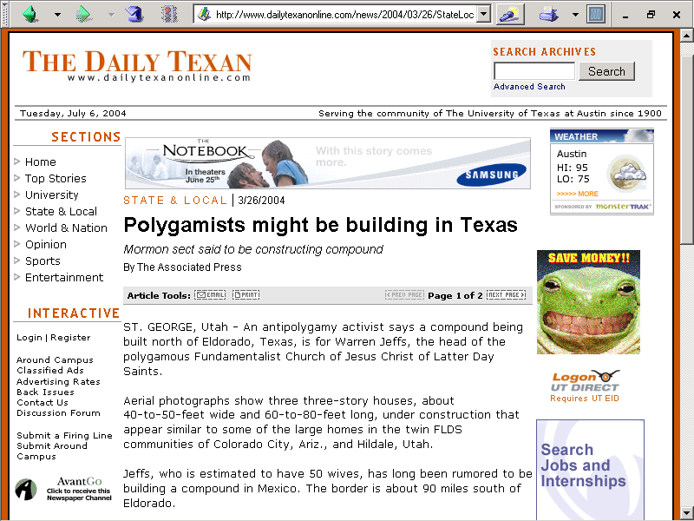
http://www.dailytexanonline.com/news/2004/03/26/StateLocal/Polygamists.Might.Be.Building.In.Texas-642621.shtml

Slide 163
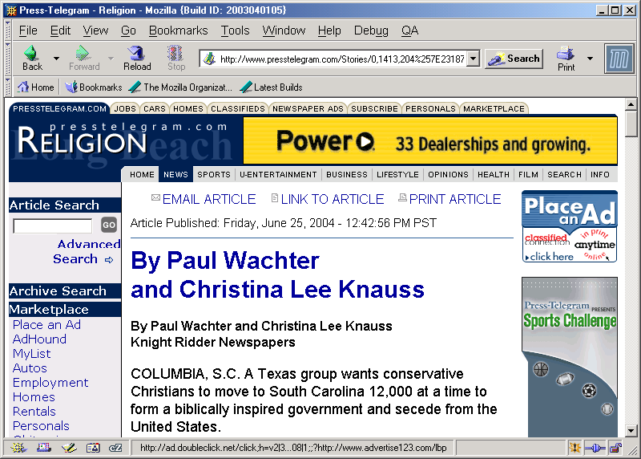
http://www.presstelegram.com/Stories/0,1413,204%257E23187%257E2235392,00.html

Slide 164
Glossary
cultural relativism
absolute cultural relativism
critical cultural relativism

Slide 165
Glossary
critical cultural relativism
offers an alternative view that poses questions about cultural practices and ideas in terms of who accepts them and why, and who they might be harming or helping

Slide 166
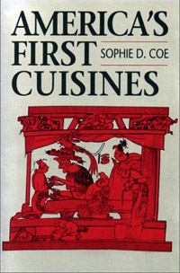
Glossary
cultural relativism
stealing peoples’ land and property
infant cranial deformation
Aztec human heart sacrifice
cannibalism
selling and eating children
eating insects
eating dogs
. . .

Slide 167
Glossary
cultural relativism
stealing peoples’ land and property
infant cranial deformation
Aztec human heart sacrifice
cannibalism
selling and eating children
eating insects
eating dogs
. . .
e.g., Aztecs must sacrifice and eat humans
in order to please the gods
in order that the gods allow
the sun to rise each day,
so that the world doesn’t end

Slide 168
Glossary
cultural relativism
stealing peoples’ land and property
infant cranial deformation
Aztec human heart sacrifice
cannibalism
selling and eating children
eating insects
eating dogs
. . .

Slide 169
Glossary
cultural relativism
Aztec human heart sacrifice
cannibalism
selling children
eating insects
eating dogs
stealing peoples’ land and property
infant cranial deformation
…

Slide 170
Glossary
critical cultural relativism
What is “normal” / “abnormal” ?

Slide 171
Notes:
171

Slide 172
Notes:
172

Slide 173
Glossary
cultural relativism
Aztec human heart sacrifice
cannibalism
selling and eating children
eating insects
eating dogs
stealing peoples’ land and property
infant cranial deformation
…

Slide 174
Multiple Cultural Worlds
people live in
multiple cultural worlds

Slide 175
multiple cultural worlds
class
race
ethnicity
gender
age
institutions

Slide 176
END
OTHER IMPORTANT TERMS

Slide 177
BEGIN
UNITS OF ANALYSIS

Slide 178
UNITS OF ANALYSIS

Slide 179
BEGIN
UNITS OF ANALYSIS
CATHERINE DE MEDICI
PETER THE GREAT
Birdseye
napoleon--canning
JULIA CHILD
PAUL PRUDHOMME
two fat ladies
TELL ME…
IOWA LADIES
fois gras wars
tuscan ear
hopi cookery

Slide 180
INSERT SLIDES

Slide 181
“units of analysis”
one person
the family
the community
a region
a “culture area”
a culture / “subculture”
a nation
an item or action itself
a “cultural metaphor”

Slide 182
“units of analysis” may include:
one person
the family
the community
a region
a “culture area”
a culture / “subculture”
a nation
an item or action itself
a “cultural metaphor”

Slide 183
“units of analysis” may include:
one person
the family
the community
a region
a “culture area”
a culture / “subculture”
a nation
an item or action itself
a “cultural metaphor”

Slide 184
www.d.umn.edu/cla/faculty/troufs/anth3618/video/Chamula.html#title

Slide 185
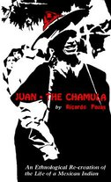
Pozas, Ricardo. 1952. Juan Pérez Jolote. México: Colección Popular, Fondo de Cultura Económica (FCE).
Film: Juan Perez Jolote (1975)
Juan the Chamula: An Ethnological Recreation of the Life of a Mexican Indian. 1962. University of California Press.
www.d.umn.edu/cla/faculty/troufs/anth3618/video/Appeals.html

Slide 186
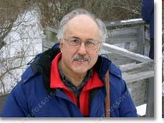
Compare . . .
Between Two Cultures:The Life of an American-Mexican, As Told to John J. Poggie, Jr.
Gonzales, Ramón, and John J. Poggie. 1973.
University of Arizona Press.

Slide 187
Compare . . .
www.d.umn.edu/cla/faculty/troufs/anth4616/video/A_Mamani.html#title

Slide 188
Paul Buffalo
Meditating
Medicine
http://www.d.umn.edu/cla/faculty/troufs/Buffalo/Intro-Temp2.html

Slide 189
Paul Buffalo
Meditating
Medicine
www.d.umn.edu/cla/faculty/troufs/anth4616/video/Jimmy_Jackson.html#title

Slide 190
www.d.umn.edu/cla/faculty/troufs/anth4616/video/N!ai.html#title

Slide 191
Compare . . .
Sharon Gmelch
Nan: The Life of an Irish Traveling Woman, Revised Edition.
Long Grove: IL: Waveland Press, 1991.
(ISBN: 0881336025)
http://www.d.umn.edu/cla/faculty/troufs/anth3635/cetexts.html#Nan

Slide 192
This was earlier advocated by:
Oscar Lewis
Bronislow Malinowski
Edward Sapir (“Sapir-Whorf” hypothesis)
Margaret Mead

Slide 193
“units of analysis” may include:
one person (e.g., Paul Buffalo)
the family (e.g., Strodtbeck)
the community
a region
“culture area”
a culture / “subculture”
Chicanos
“Irish”
“Irish Travellers” (“Gypsies”)
“Rom” (“Gypsies”)
“Basques”
Catalans

Slide 194
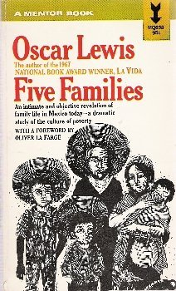
Compare . . .
Oscar Lewis

Slide 195
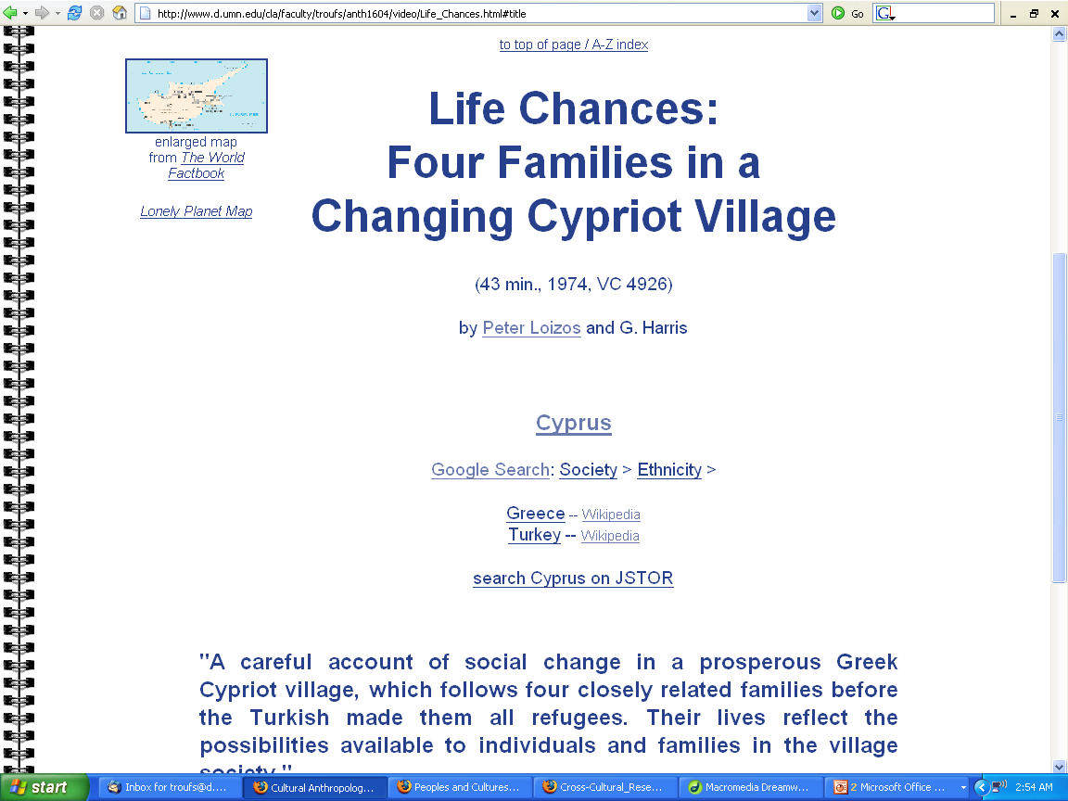
Compare . . .
http://www.d.umn.edu/cla/faculty/troufs/anth1604/video/Life_Chances.html#title

Slide 196
Notes:
196

Slide 197
Notes:
197

Slide 198
5 families
Penguin Avery, 2009

Slide 199
The Popkins, 1950s
“typical multigenerational American family”
and 3 children
Superior, WI, U.S.A.
The “Jones, ” 2006
and 2 children
Suburban Cleveland, U.S.A.
Cesar and Ana Garcia
and 4 children
Immigrant Mexicans from Chiapas Mexico
Suburban Los Angeles
Rahul Desai and His Wife
and 4 children
Uttar Pradesh, Northern India
Gopal and Noopur Patel
and 3 children
Uttar Pradesh, Northern India
Penguin Avery, 2009

Slide 200
“units of analysis” may include:
one person (e.g., Paul Buffalo)
the family (e.g., Strodtbeck)
the community
a region
“culture area”
a culture / “subculture”
Chicanos
“Irish”
“Irish Travellers” (“Gypsies”)
“Rom” (“Gypsies”)
“Basques”
Catalans

Slide 201
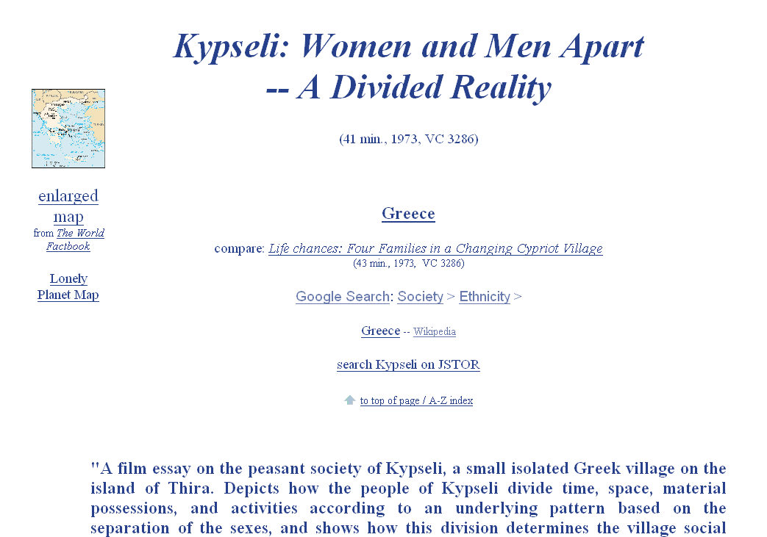
www.d.umn.edu/cla/faculty/troufs/anth1604/video/Kypseli.html#title

Slide 202
www.d.umn.edu/cla/faculty/troufs/anth4616/video/Ocamo.html#title

Slide 203
“Classics" in Anthropology
1930 Tepoztlan, a Mexican Village: A Study of Folk Life
Chicago: University of Chicago Press
1941 Folk Culture of Yucatan
Chicago: University of Chicago Press
Robert Redfield

Slide 204
“Classics" in Anthropology
1930 Tepoztlan, a Mexican Village: A Study of Folk Life
Chicago: University of Chicago Press
1941 Folk Culture of Yucatan
Chicago: University of Chicago Press
Robert Redfield
Continuum analysis:
village ----------------------------------------------- city
rural ----------------------------------------------- urban

Slide 205
1930 Tepoztlan, a Mexican Village: A Study of Folk Life
Chicago: University of Chicago Press
Continuum analysis:
village ----------------------------------------------- city
rural ----------------------------------------------- urban

Slide 206
Wednesday
09 June 2010

Slide 207
“Classics" in Anthropology
Wednesday
09 June 2010
1930 Tepoztlan, a Mexican Village: A Study of Folk Life
Chicago: University of Chicago Press
1941 Folk Culture of Yucatan
Chicago: University of Chicago Press
Robert Redfield
Continuum analysis:
village ----------------------------------------------- city
rural ----------------------------------------------- urban

Slide 208
Compare . . .
Lewis - Refield debate
Robert Redfield
Tepoztlan, a Mexican Village: A Study of Folk Life
Oscar Lewis
Life in a Mexican Village: Tepoztlan Restudied

Slide 209
www.d.umn.edu/cla/faculty/troufs/anth3618/video/Appeals.html#title

Slide 210
www.d.umn.edu/cla/faculty/troufs/anth3618/video/Copan.html#title

Slide 211
Compare . . .
Inis Beag
Gaelic: "Little Island"
John C. Messenger
Inis Beag: Isle of Ireland.
Long Grove: IL: Waveland Press, 1983.
(ISBN: 0881330515)
http://www.d.umn.edu/cla/faculty/troufs/anth3635/cetexts.html#InisBeag

Slide 212
“units of analysis” may include:
one person (e.g., Paul Buffalo)
the family (e.g., Strodtbeck)
the community
a region
“culture area”
a culture / “subculture”
Chicanos
“Irish”
“Irish Travellers” (“Gypsies”)
“Rom” (“Gypsies”)
“Basques”
Catalans

Slide 213
Notes:
213

Slide 214
“units of analysis” may include:
one person
the family
the community
a region
“culture area”
a culture / “subculture”
Chicanos
“Irish”
“Irish Travellers” (“Gypsies”)
“Rom” (“Gypsies”)
“Basques”
Catalans
the Aran Islands

Slide 215
Compare . . .
. . Man of Aran
(77 min, 1934, B&W)
Robert J. Flaherty,
Colman “Tiger” King,
Maggie Dirrane, and
Michael Dirrane

Slide 216
Compare . . .
. . Man of Aran
(77 min, 1934, B&W)
Robert J. Flaherty,
Colman “Tiger” King,
Maggie Dirrane, and
Michael Dirrane

Slide 217
“units of analysis” may include:
one person (e.g., Paul Buffalo)
the family (e.g., Strodtbeck)
the community
a region
“culture area”
a culture / “subculture”
Chicanos
“Irish”
“Irish Travellers” (“Gypsies”)
“Rom” (“Gypsies”)
“Basques”
Catalans
Valley of Mexico
Soconusco
El Bajío
Huasteca
Yucatán. . .

Slide 218
County Clare

Slide 219
Tuscany is one of
about 30 regions in Italy . . .
http://healthmap.files.wordpress.com/2009/12/tuscany-map.gif

Slide 220
North Point Press, 989)

Slide 221
“units of analysis” may include:
one person (e.g., Paul Buffalo)
the family (e.g., Strodtbeck)
the community
a region
“culture area”
a culture / “subculture”
Chicanos
“Irish”
“Irish Travellers” (“Gypsies”)
“Rom” (“Gypsies”)
“Basques”
Catalans
Valley of Mexico
Soconusco
El Bajío
Huasteca
Yucatán. . .
= Xoconusco

Slide 222
www.d.umn.edu/cla/faculty/troufs/anth3618/video/Copan.html#title

Slide 223
www.d.umn.edu/cla/faculty/troufs/anth3618/matehuac.html#title

Slide 224
www.d.umn.edu/cla/faculty/troufs/anth3618/video/Copan.html#title

Slide 225
Compare . . .
Tehuacán Valley, Puebla, Mexico
maize
4,200 ybp
Understanding Physical Anthropology and Archaeology, 8th Ed., p. 432.

Slide 226
“Classics" in Anthropology
1930 Tepoztlan, a Mexican Village: A Study of Folk Life
Chicago: University of Chicago Press
1941 Folk Culture of Yucatan
Chicago: University of Chicago Press
Robert Redfield

Slide 227
Paul Buffalo
Meditating
Medicine
www.d.umn.edu/cla/faculty/troufs/anth1604/Trobriands.html#title

Slide 228
“units of analysis” may include:
one person (e.g., Paul Buffalo)
the family (e.g., Strodtbeck)
the community
a region
“culture area”
a culture / “subculture”
Chicanos
“Irish”
“Irish Travellers” (“Gypsies”)
“Rom” (“Gypsies”)
“Basques”
Catalans

Slide 229
some areas are “officially”
anthropological
“cultural areas” . . .

Slide 230
Compare . . .
http://eclectic.ss.uci.edu/~drwhite/worldcul/atlas.htm

Slide 232
“Mesoamerica”
(cultural)
“Middle America”
(geological)

Slide 233
http://en.wikipedia.org/wiki/Culture_areas_of_North_America

Slide 234
not “culture areas”
http://en.wikipedia.org/wiki/Culture_areas_of_North_America

Slide 236
Compare . . .
Parman, Susan.
Europe in the Anthropological
Imagination.
Upper Saddle River, NJ: Prentice Hall,
1998.
http://www.d.umn.edu/cla/faculty/troufs/anth3635/cetexts.html#title

Slide 237
Grub Street Cookery (2008)
Grub Street Cookery (2010)

Slide 238
Amazonia
http://en.wikipedia.org/wiki/Amazonia

Slide 239
http://en.wikipedia.org/wiki/Amazonia

Slide 240
http://en.wikipedia.org/wiki/Amazonia

Slide 241
“units of analysis” may include:
one person (e.g., Paul Buffalo)
the family (e.g., Strodtbeck)
the community
a region
“culture area”
a culture / “subculture”
Maya
Chamula
Lancandon
Tzotzil
Tzeltal
Zoque
Yaqui
Otomi
Tarascan
Mixtec
Zapotec
Olmec
Toltec
Aztec
Teotihuacanos
Tarahumara

Slide 242
www.d.umn.edu/cla/faculty/troufs/anth1604/Inuit_Yupik.html#title

Slide 243
Waorani (Ecuador)
Paul Buffalo
Meditating
Medicine
www.d.umn.edu/cla/faculty/troufs/anth1604/video/Nomads.html#title

Slide 244
Huaorani (Ecuador)
Paul Buffalo
Meditating
Medicine
www.d.umn.edu/cla/faculty/troufs/anth1604/video/Trinkets_and_Beads.html#title

Slide 245
Paul Buffalo
Meditating
Medicine
www.d.umn.edu/cla/faculty/troufs/anth4616/video/Amish.html#title

Slide 246
Paul Buffalo
Meditating
Medicine
www.d.umn.edu/cla/faculty/troufs/anth1604/video/Shakers.html#title

Slide 247
www.d.umn.edu/cla/faculty/troufs/anth1604/video/Dead_Birds.html#title

Slide 248
www.d.umn.edu/cla/faculty/troufs/anth1604/video/Nuer.html#title

Slide 249
www.d.umn.edu/cla/faculty/troufs/anth1604/video/Two_Girls.html#title

Slide 250
http://en.wikipedia.org/wiki/Indigenous_peoples_of_Mexico#History_of_the_indigenous_peoples

Slide 251
http://en.wikipedia.org/wiki/Indigenous_peoples_of_Mexico#History_of_the_indigenous_peoples

Slide 252
http://en.wikipedia.org/wiki/Indigenous_peoples_of_Mexico#History_of_the_indigenous_peoples

Slide 253
63
http://en.wikipedia.org/wiki/Indigenous_peoples_of_Mexico#History_of_the_indigenous_peoples

Slide 254
Aztec
Maya
Inca
Sophie D. Coe America's First Cuisines Austin: University of Texax Press, 1994. 288 pages ISBN-10: 029271159X ISBN-13: 978-0292711594
www.d.umn.edu/cla/faculty/troufs/anthfood/aftexts.html#title

Slide 256
www.d.umn.edu/cla/faculty/troufs/anth3618/matext.html#title

Slide 257
www.d.umn.edu/cla/faculty/troufs/anth3618/matext.html#title

Slide 258
“units of analysis” may include:
one person (e.g., Paul Buffalo)
the family (e.g., Strodtbeck)
the community
a region
“culture area”
a culture / “subculture”
Maya
Chamula
Lancandon
Tzotzil
Tzeltal
Zoque
Yaqui
Otomi
Tarascan
Mixtec
Zapotec
Olmec
Toltec
Aztec
Teotihuacanos
Tarahumara
aka a “microculture”

Slide 259
“units of analysis” may include:
one person (e.g., Paul Buffalo)
the family (e.g., Strodtbeck)
the community
a region
“culture area”
a culture / “subculture”
Maya
Chamula
Lancandon
Tzotzil
Tzeltal
Zoque
Yaqui
Otomi
Tarascan
Mixtec
Zapotec
Olmec
Toltec
Aztec
Teotihuacanos
Tarahumara

Slide 260
www.d.umn.edu/cla/faculty/troufs/anth3618/video/Maya_Lords.html#title

Slide 261
www.d.umn.edu/cla/faculty/troufs/anth3618/video/Chamula.html#title

Slide 262
www.d.umn.edu/cla/faculty/troufs/anth3618/video/Appeals.html#title

Slide 263
“units of analysis” may include:
one person (e.g., Paul Buffalo)
the family (e.g., Strodtbeck)
the community
a region
“culture area”
a culture / “subculture”
Chicanos
“Irish”
“Irish Travellers” (“Gypsies”)
“Rom” (“Gypsies”)
“Basques”
Catalans

Slide 264
Unites of analysis may include ethnic groups within and across nations
e.g., Anishinabe (Chippewa; Ojibwa)
e.g., Rom (Gypsies)
e.g., Irish “Travellers”
sometimes incorrectly called “Gypsies”
e.g., Kurds (in Turkey)
e.g., Basques

Slide 265
Compare . . .
The Irish Tinkers: The Urbanization of an Itinerant People
by George Gmelch
1985

Slide 266
Unites of analysis may include ethnic groups within and across nations
e.g., Anishinabe (Chippewa; Ojibwa)
e.g., Rom (Gypsies)
e.g., Irish “Travellers”
sometimes incorrectly called “Gypsies”
e.g., Kurds (in Turkey)
e.g., Basques

Slide 267
Compare . . .
Mark Kurlansky
The Basque History of the World.
NY: Penguin Books, 1999.
(ISBN: 0140298517)
http://www.d.umn.edu/cla/faculty/troufs/anth3635/cetexts.html#BasqueHistory

Slide 268
“units of analysis”
may also include:
a nation
(“national character studies”)
the item or action itself
(including “processes”)
a “cultural metaphor”

Slide 269
“national character studies”
Japan
Ruth Fulton Benedict
1887-1948
Patterns of Culture
1934

Slide 270
www.d.umn.edu/cla/faculty/troufs/anth1095/America.html#title

Slide 271
www.d.umn.edu/cla/faculty/troufs/anth1604/video/Affluenza.html#title

Slide 272
www.d.umn.edu/cla/faculty/troufs/anth3618/video/Appeals.html#title

Slide 273
Paul Buffalo
Meditating
Medicine
www.d.umn.edu/cla/faculty/troufs/anth1095/Malaysia.html#title

Slide 274
Compare . . .
Elizabeth L. Krause
A Crisis of Births:
Population Politics and Family-Making in Italy
Belmont, CA: Thompson Wadsworth, 2005.
http://www.d.umn.edu/cla/faculty/troufs/anth3635/cetexts.html#CrisisofBirths

Slide 275
www.d.umn.edu/cla/faculty/troufs/anth3618/matext.html#title

Slide 276
“units of analysis”
may also include:
a nation
(“national character studies”)
the item or action itself
(including “processes”)
a “cultural metaphor”

Slide 277
“units of analysis”
may also include:
a nation
(“national character studies”)
the item or action itself
(including “processes”)
a “cultural metaphor”
and there’s almost no end . . .

Slide 278
“units of analysis”
may also include:
a nation
(“national character studies”)
the item or action itself
(including “processes”)
a “cultural metaphor”

Slide 279
personality
Notes:
279

Slide 280
the brain
Notes:
280

Slide 281
any of the many
culture-bound syndromes
Notes:
281

Slide 282
Notes:
282

Slide 283
specific rituals
Notes:
283

Slide 284
“units of analysis”
may also include:
a nation
(“national character studies”)
the item or action itself
(including “processes”)
a “cultural metaphor”
in psychological anthropology
these often deal with
“national character studies”
and
“modal personality” traits

Slide 287
www.d.umn.edu/cla/faculty/troufs/anth1604/video/Strange_Relations.html#title

Slide 288
www.d.umn.edu/cla/faculty/troufs/anth3618/video/Appeals.html#title

Slide 289
www.d.umn.edu/cla/faculty/troufs/anth3618/video/Appeals.html#title

Slide 290
www.d.umn.edu/cla/faculty/troufs/anth3618/video/Appeals.html#title

Slide 291
www.d.umn.edu/cla/faculty/troufs/anth1604/video/New_Orleans_Black_Indians.html#title

Slide 292
www.d.umn.edu/cla/faculty/troufs/anth1604/video/Trinkets_and_Beads.html#title

Slide 293
demography / population
gender
ethnicity
nationalism
globalization
“development”
social / cultural change
decision-making
peasants
urbanism / urbanization
stratification
internal and transnational migration
“transnationalism”
networks
honor / shame values
patron-client relationships
literacy
“we” vs. “other”
rural / urban continuum
Parman's classic picks -- Tony Galt

Slide 295
Texts
Sidney W. Mintz Sweetness and Power:
The Place of Sugar in Modern History. NY: Penguin Books, 1986. 274 pages ISBN-10: 0140092331 ISBN-13: 978-0140092332
www.d.umn.edu/cla/faculty/troufs/anthfood/aftexts.html#title

Slide 296
Compare . . .
Cod: A Biography of the Fish That Changed the World
NY: Penguin Books, 1998
www.d.umn.edu/cla/faculty/troufs/anth3635/cetexts.html#Cod

Slide 297
Compare . . .
Salt: A World History
NY: Penguin Books, 2003
www.d.umn.edu/cla/faculty/troufs/anth3635/cetexts.html#Cod

Slide 298
Compare . . .
The Big Oyster: History on the Half Shell
NY: Random House, 2007
www.d.umn.edu/cla/faculty/troufs/anth3635/cetexts.html#Cod

Slide 299
Compare . . .
Apples
NY: North Point Press, 2000
www.d.umn.edu/cla/faculty/troufs/anth3635/cetexts.html#Cod

Slide 300
demography / population
gender
ethnicity
nationalism
globalization
“development”
social / cultural change
decision-making
peasants
urbanism / urbanization
stratification
internal and transnational migration
“transnationalism”
networks
honor / shame values
patron-client relationships
literacy
“we” vs. “other”
rural / urban continuum
Parman's classic picks -- Tony Galt

Slide 301
www.d.umn.edu/cla/faculty/troufs/anth3618/video/Fall_Maya.html#title

Slide 302
“units of analysis”
may also include:
a nation
(“national character studies”)
the item or action itself
(including “processes”)
a “cultural metaphor”

Slide 303
“units of analysis”
may also include:
a nation
(“national character studies”)
the item or action itself
(including “processes”)
a “cultural metaphor”
in anthropology
these often deal with
“national character studies”
and
“modal personality” traits

Slide 304
“units of analysis”
may also include:
a nation
(“national character studies”)
the item or action itself
(including “processes”)
a “cultural metaphor”
they can be from
a single
“cultural area”
such as
[the anthropological]
Europe

Slide 305
http://www.d.umn.edu/cla/faculty/troufs/anth1095/index.html#text

Slide 306
Compare . . .
www.d.umn.edu/cla/faculty/troufs/anth1095/index.html#text

Slide 307
REM
Change to 4th Ed.
Chapter Numbers

Slide 308
Gannon’s European Cultural Metaphors include
Ch. 12. Irish Conversations
Ch. 17. The Traditional British House
Ch. 21. The Italian Opera
Ch. 22. Belgian Lace
Ch. 24. The Russian Ballet
Ch. 25. The Spanish Bullfight
Ch. 26. The Portuguese Bullfight

Slide 309
http://www.carn.com/IrishTales.htm

Slide 310
Gannon’s European Cultural Metaphors include
Compare . . .
Ch. 12. Irish Conversations
Ch. 17. The Traditional British House
Ch. 21. The Italian Opera
Ch. 22. Belgian Lace
Ch. 24. The Russian Ballet
Ch. 25. The Spanish Bullfight
Ch. 26. The Portuguese Bullfight
“machismo”
“fatalism”

Slide 312
Gannon’s Cultural Metaphors include
Compare . . .
Ch. 6 "The Turkish Coffehouse"
Ch. 9 "Kimchi and Korea"
Ch. 14 "The Danish Christmas Luncheon"
Ch. 15 "French Wine"
Ch. 29 "The Singapore Hawker Centers"
5 / 28 cultures have food as their metaphor

Slide 313
Compare . . .
www.d.umn.edu/cla/faculty/troufs/anthfood/aftexts.html#title

Slide 314
Compare . . .
Gannon’s Cultural Metaphors include
Ch. 6 "The Turkish Coffehouse"
Ch. 9 "Kimchi and Korea"
Ch. 14 "The Danish Christmas Luncheon"
Ch. 15 "French Wine"
Ch. 29 "The Singapore Hawker Centers"
5 / 28 cultures have food as their metaphor

Slide 315
An Ottoman coffeehouse, 19th century
www.superluminal.com/cookbook/essay_coffee.html

Slide 316
Gannon’s Cultural Metaphors include
Compare . . .
Ch. 6 "The Turkish Coffehouse"
Ch. 9 "Kimchi and Korea"
Ch. 14 "The Danish Christmas Luncheon"
Ch. 15 "French Wine"
Ch. 29 "The Singapore Hawker Centers"
5 / 28 cultures have food as their metaphor

Slide 317
Kimchi in Korea
www.asianinfo.org/asianinfo/korea/food.htm#KIM%20CHI

Slide 318
Gannon’s Cultural Metaphors include
Compare . . .
Ch. 6 "The Turkish Coffehouse"
Ch. 9 "Kimchi and Korea"
Ch. 14 "The Danish Christmas Luncheon"
Ch. 15 "French Wine"
Ch. 29 "The Singapore Hawker Centers"
5 / 28 cultures have food as their metaphor

Slide 319
Danish Julefrokost
http://commons.wikimedia.org/wiki/File:Julefrokost.jpg

Slide 320
Gannon’s Cultural Metaphors include
Compare . . .
Ch. 6 "The Turkish Coffehouse"
Ch. 9 "Kimchi and Korea"
Ch. 14 "The Danish Christmas Luncheon"
Ch. 15 "French Wine"
Ch. 29 "The Singapore Hawker Centers"
5 / 28 cultures have food as their metaphor

Slide 321
www.winebow.com/france/france.html

Slide 322
Gannon’s Cultural Metaphors include
Compare . . .
Ch. 6 "The Turkish Coffehouse"
Ch. 9 "Kimchi and Korea"
Ch. 14 "The Danish Christmas Luncheon"
Ch. 15 "French Wine"
Ch. 29 "The Singapore Hawker Centers"
5 / 28 cultures have food as their metaphor

Slide 323
Lucky Chicken Rice food stall in the Newton Hawker Center
Singapore

Slide 324
www.sciencedaily.com/releases/2008/07/080721152000.htm
Notes:
324

Slide 325
Gannon’s Cultural Metaphors include
Ch. 16 “American Football“
Notes:
325

Slide 326
Gannon’s Cultural Metaphors include
Ch. 6 "The Turkish Coffehouse"
Ch. 9 "Kimchi and Korea"
Ch. 14 "The Danish Christmas Luncheon"
Ch. 15 "French Wine"
Ch. 29 "The Singapore Hawker Centers“
Ch. 16 “American Football“

Slide 327
. . . but at least one professor thinks
the metaphor for America should be . . .
www.sciencedaily.com/releases/2008/07/080721152000.htm
Notes:
327

Slide 328
www.sciencedaily.com/releases/2008/07/080721152000.htm
Notes:
328

Slide 329
Penguin Avery, 2009

Slide 330
www.sciencedaily.com/releases/2008/07/080721152000.htm
Notes:
330

Slide 331
www.eurekalert.org/pub_releases/2008-07/iu-gai072108.php
Notes:
331

Slide 332
. . . but it could just as easily be . . .
www.sciencedaily.com/releases/2008/07/080721152000.htm
Notes:
332

Slide 333
. . . and its related
cultural-bound syndrome . . .
Notes:
333

Slide 334
. . . and its related
cultural-bound syndrome . . .
Notes:
334

Slide 335
and the
Units of Analysis
can be combined . . .
and as with
the item or action itself
there’s almost no end . . .

Slide 336
a family
a village
“fate”
http://www.d.umn.edu/cla/faculty/troufs/anth1604/video/Life_Chances.html#title

Slide 337
Compare . . .
a community
sex-related patterns
www.d.umn.edu/cla/faculty/troufs/anth1604/video/Kypseli.html#title

Slide 338
a microculture / macroculture
traditional food
(Hippocrene books, 2004)

Slide 339
a region
the annual food cycle (including locavorism)
North Point Press, 989)

Slide 340
a country
demography
Elizabeth L. Krause
A Crisis of Births:
Population Politics and Family-Making in Italy
Belmont, CA: Thompson Wadsworth, 2005.
http://www.d.umn.edu/cla/faculty/troufs/anth3635/cetexts.html#CrisisofBirths

Slide 341
the family
the item itself
Notes:
341

Slide 342
demography / population
gender
ethnicity
nationalism
globalization
“development”
social / cultural change
decision-making
peasants
urbanism / urbanization
stratification
internal and transnational migration
“transnationalism”
networks
honor / shame values
patron-client relationships
literacy
“we” vs. “other”
rural / urban continuum
Parman's classic picks -- Tony Galt

Slide 343
in summary . . .

Slide 344
“units of analysis” may include:
one person
the family
the community
a region
a “culture area”
a culture / “subculture”
a nation
an item or action itself
a “cultural metaphor”

Slide 345
END
UNITS OF ANALYSIS

