Slide 2
Use your up/down arrow keys and/or
your space bar to advance the slides

Slide 3
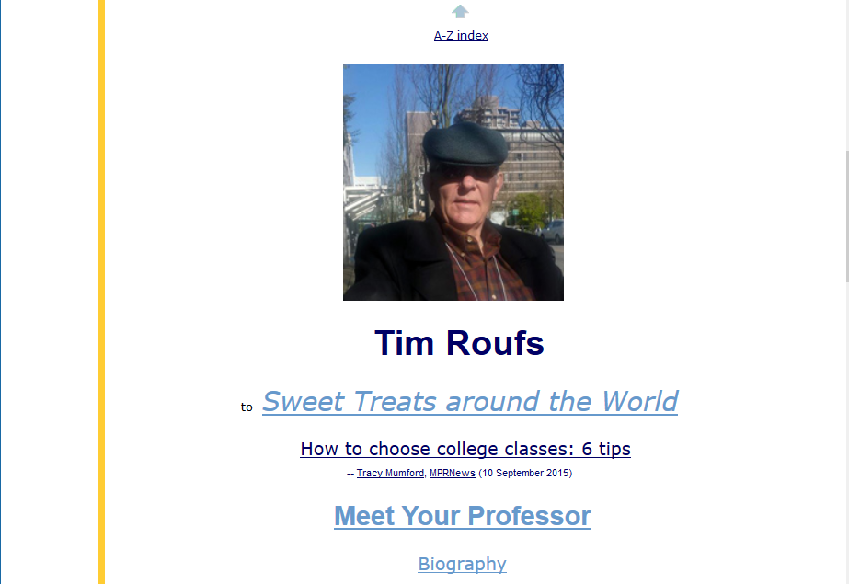
http://www.d.umn.edu/cla/faculty/troufs/index.html
0

Slide 4
Welcome to
Ancient Middle America

Slide 5
Welcome to
Ancient Middle America
This will be a great course . . .
you will see . . .

Slide 6
Orientation to
Ancient Middle America
University of Minnesota Duluth
Tim Roufs
© 2010-2019
http://www.d.umn.edu/cla/faculty/troufs/anth3618/

Slide 7
First thing . . .
(if you are not already in Canvas)
go to your
course management site
and check it out . . .

Slide 8
How do you find
in the first place?

Slide 9
Further instructions follow,
but if you want,
and your browser permits,
clicking on the URL that follows
in the next slide
will take you to your Canvas home . . .
(your browser may require that you double-click)
There is another link at the end of this program

Slide 10
https://canvas.umn.edu
(your browser may require that you double-click)
If your browser does not allow you to click on the above URL just enter it in your browser window . . .
Continue on here for further instructions . . .
There is another link at the end of this program

Slide 11
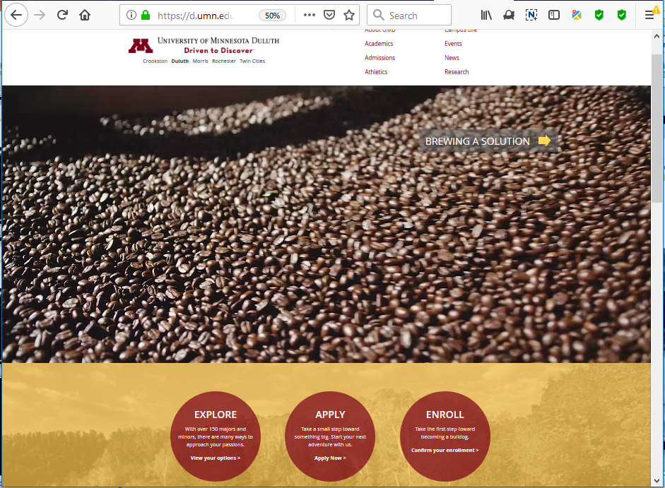

Slide 12
or enter:
canvas.umn.edu

Slide 13
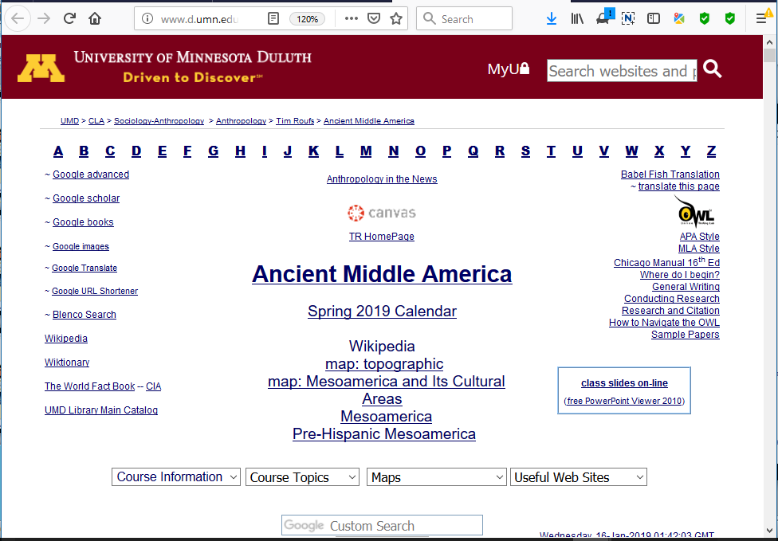

Slide 14
or enter:
canvas.umn.edu

Slide 15
or click link

Slide 16
You may also access your Canvas folder from any of the many
course index and content
web pages . . .

Slide 17
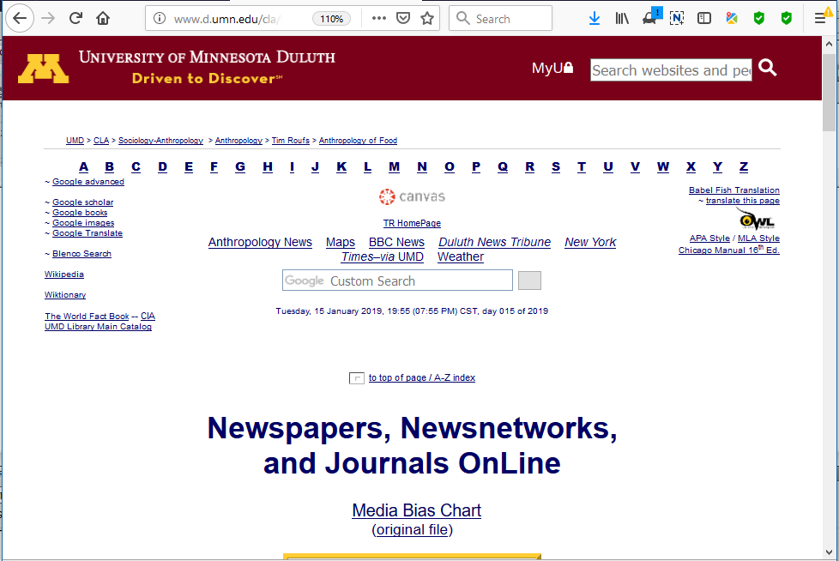
click link

Slide 18
Your log-in page will then look something like the following . . .
Log in using your “x.500” information . . .
(that’s the log-in information you use for your e-mail)

Slide 19
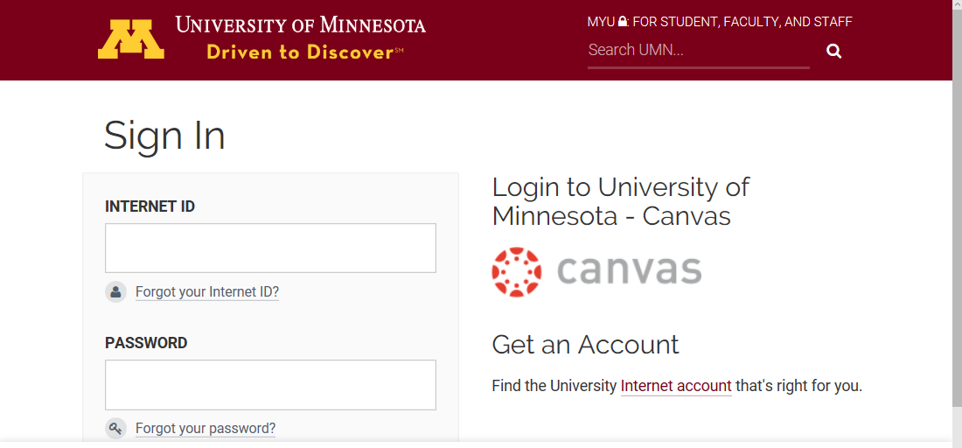
Log in using your “x.500” information . . .
(that’s the log-in information you use for your e-mail)

Slide 20
Log in using your “x.500” information . . .
(that’s the log-in information you use for your e-mail)
Log in using your “x.500” information . . .

Slide 21
Your Canvas “Dashboard”
will look something like the following . . .
https://canvas.umn.edu/

Slide 22
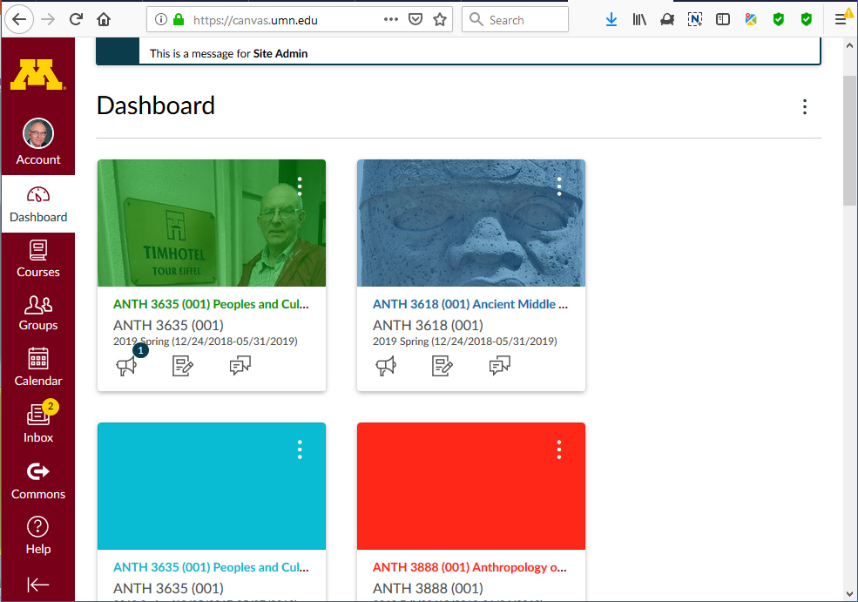
Your Canvas “Dashboard” will look something like this . . .

Slide 23
Select ANTH 3635
Ancient Middle America

Slide 24
Your Canvas “Home” screen
will look
something like the following . . .

Slide 25
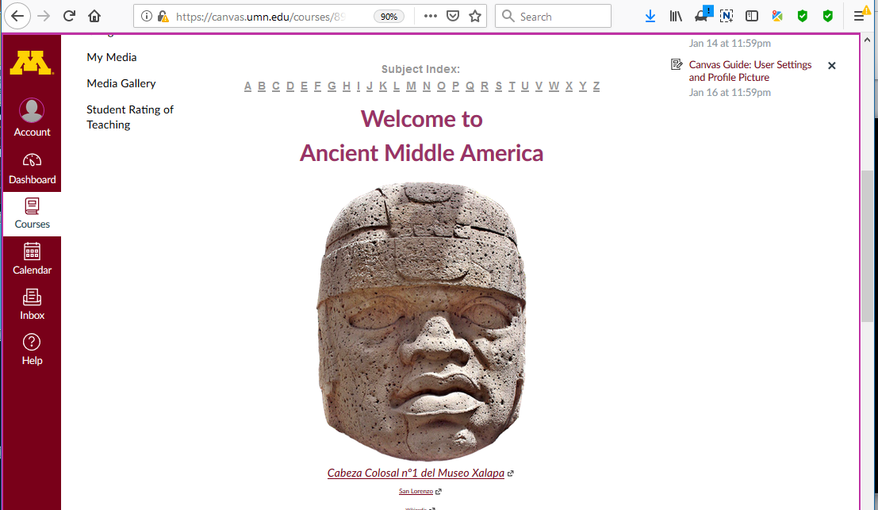
Your Canvas “Home” screen will look something like this . . .

Slide 26
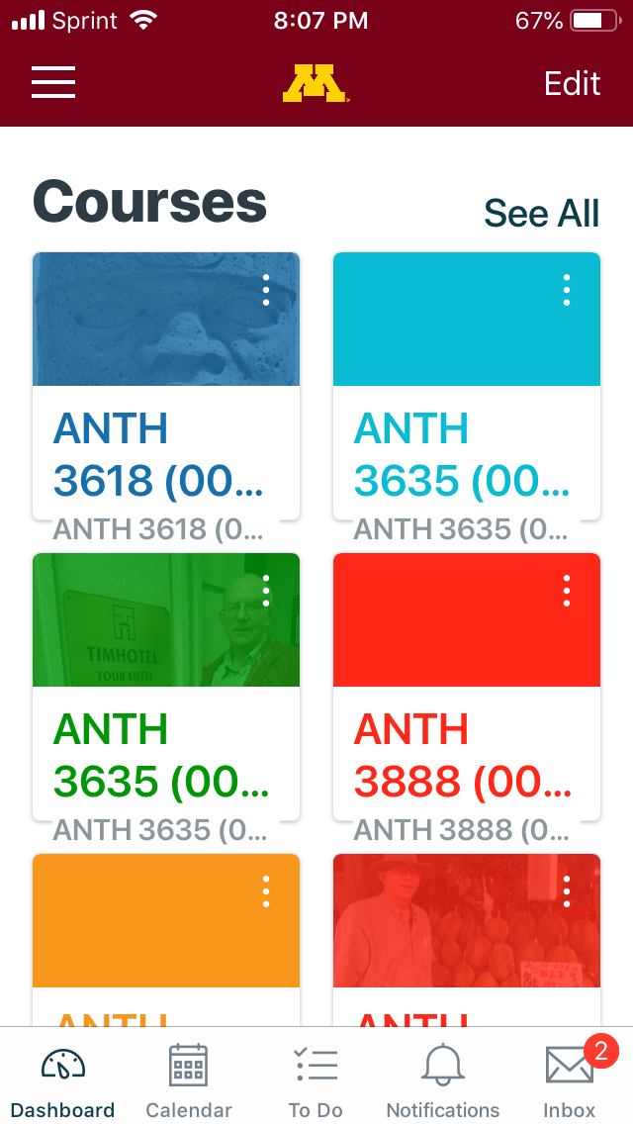
Your Canvas iPhone app
Dashboard screen, for e.g.,
will look
something like this . . .

Slide 27
click on ANTH 3618

Slide 28
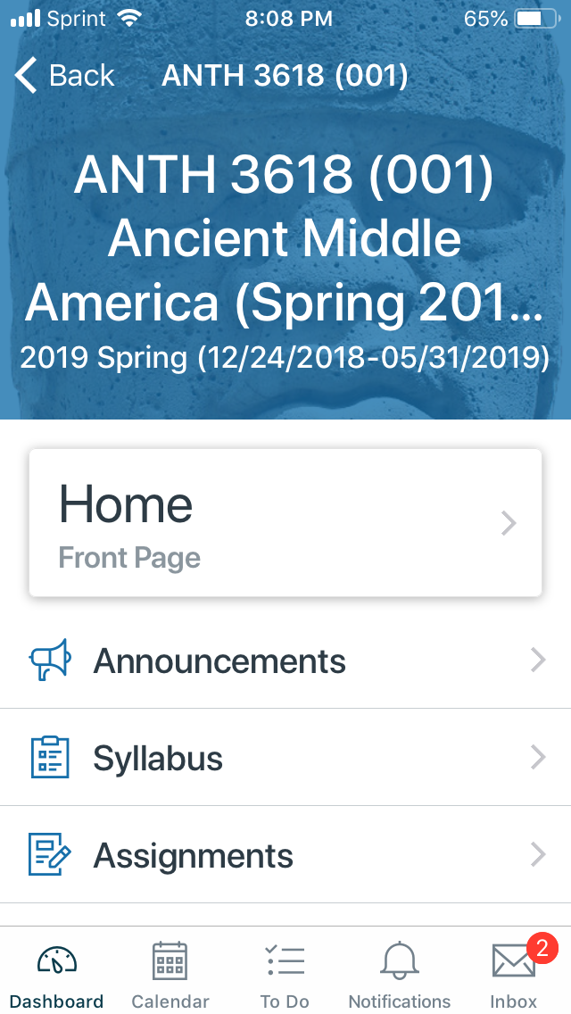
Your Canvas iPhone app
“Home” screen, for e.g.,
will look
something like this . . .

Slide 31
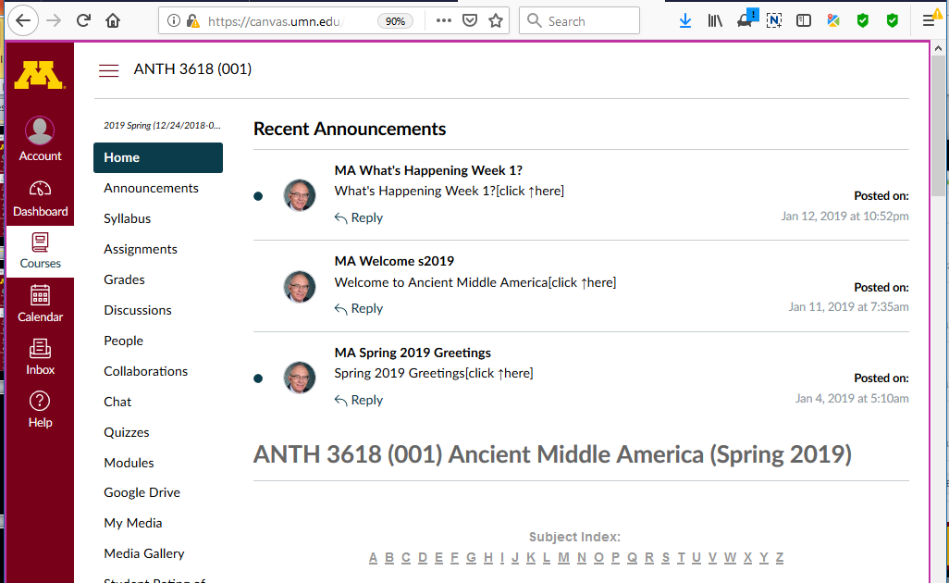
Course “Home” Page
Your Canvas “Home” screen will look something like this . . .

Slide 32
course navigation
global navigation

Slide 33
course navigation

Slide 34
global navigation

Slide 35
Which option should you use to keep track of the semester?

Slide 36
It depends on your style . . .

Slide 37
Use one of these:
“Calendar”
or “Syllabus”
or “Assignments”

Slide 38
Use one of these:
“Calendar”
or “Syllabus”
or “Assignments”

Slide 39
Calendar

Slide 40
Personally, I like the
calendar version (even though it is slower)
Calendar

Slide 41
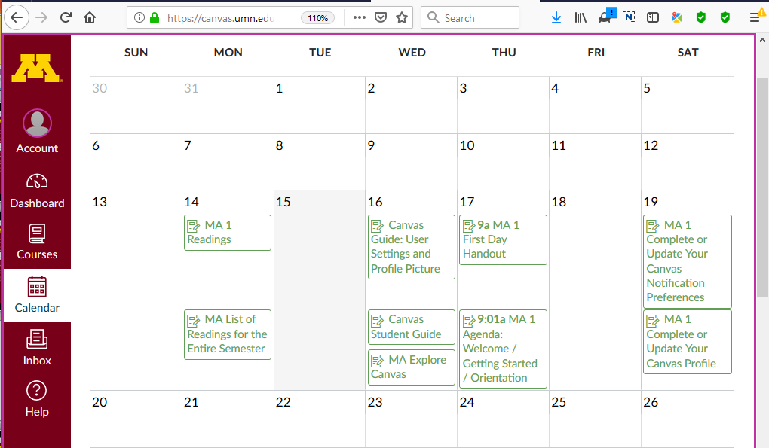
The Week 1 Calendar segment looks like this:
Ancient Middle America Calendar

Slide 42
And if you have more than one course using Canvas
you can have all of the information on one calendar . . .
and . . . in addition . . .
you can have it on your Google calendar too

Slide 43
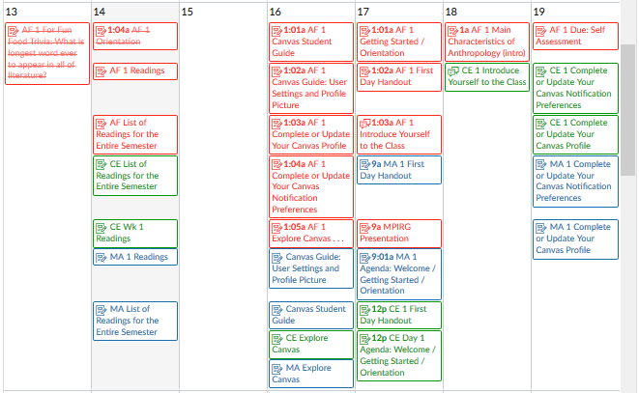
All Courses Calendar

Slide 44
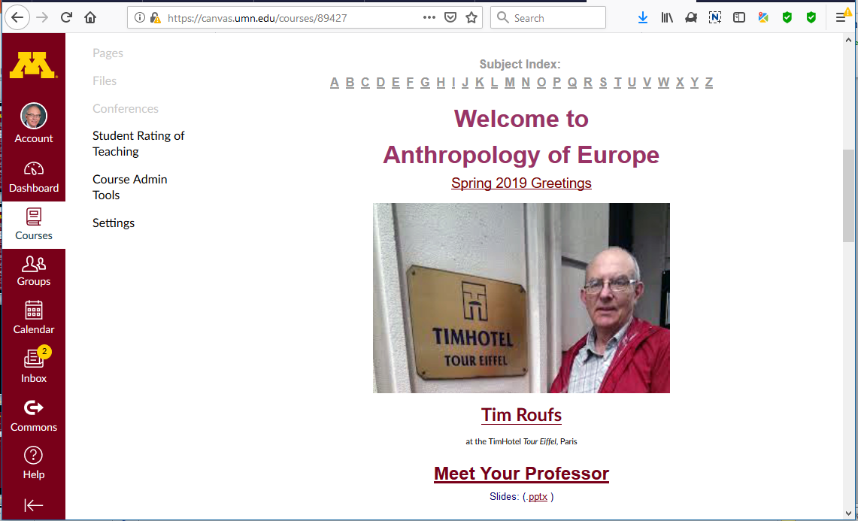
And if you have more than one course using Canvas
you can have all of the information on one calendar . . .
and . . . in addition . . .
you can have it on your Google calendar too

Slide 45
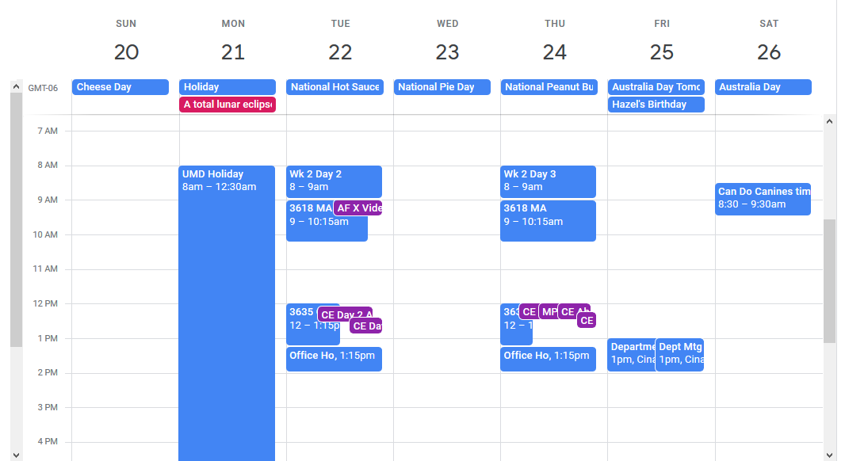
UM Google Calendar

Slide 46
Use one of these:
“Calendar”
or use the “Syllabus”
or “Assignments”

Slide 47
Syllabus

Slide 48
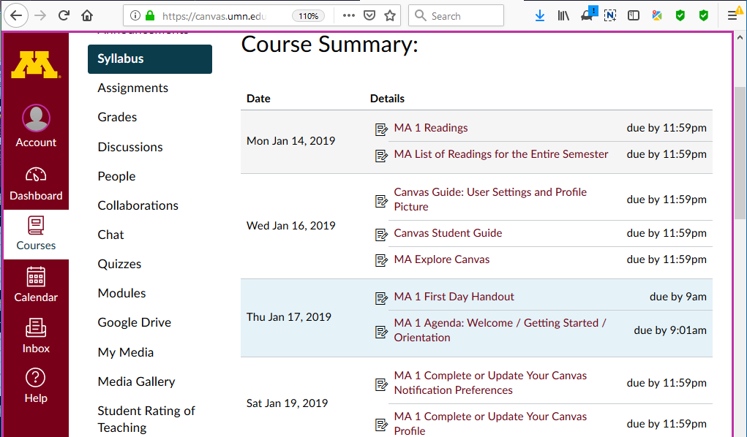
The Week 1 “Syllabus” segment looks like this:

Slide 49
The Week 1 “Syllabus” segment looks like this:
Scroll down for basic information . . .

Slide 50
Use one of these:
“Calendar”
or “Syllabus”
or use the “Assignments”

Slide 51
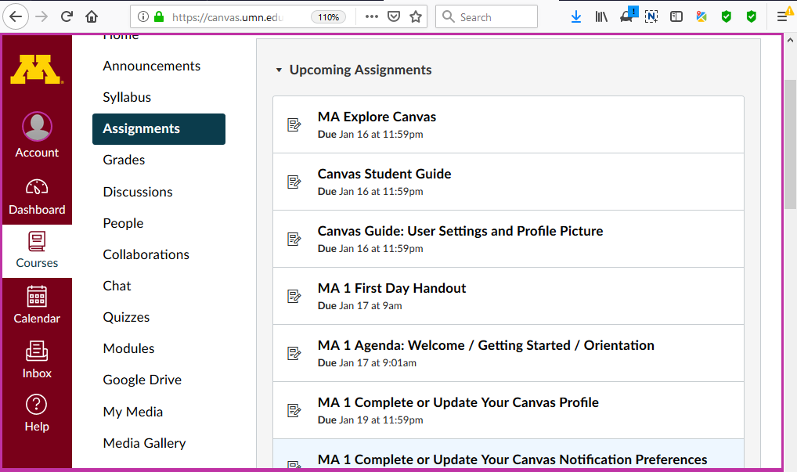
The Week 1 “Assignments” segment looks like this:

Slide 52
course navigation

Slide 53
hide course navigation panel here

Slide 54
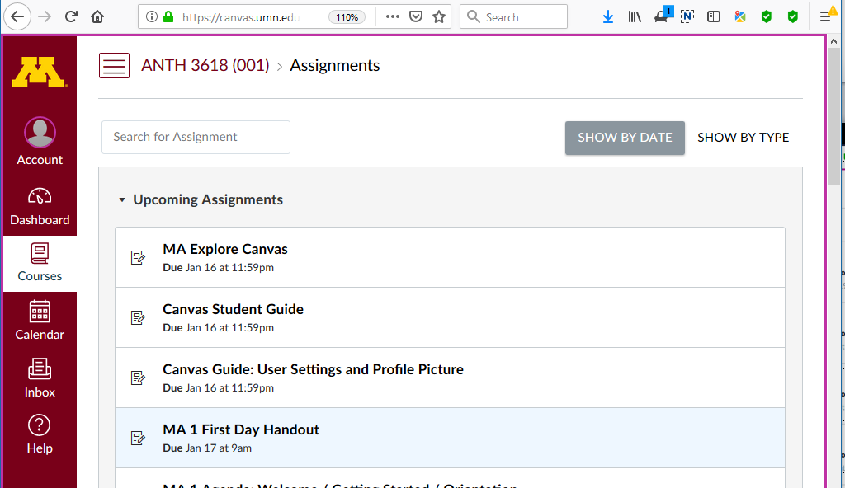

Slide 55
global navigation remains

Slide 56
unhide course navigation panel

Slide 57
course navigation returns

Slide 58
Scroll down for basic information . . .

Slide 59
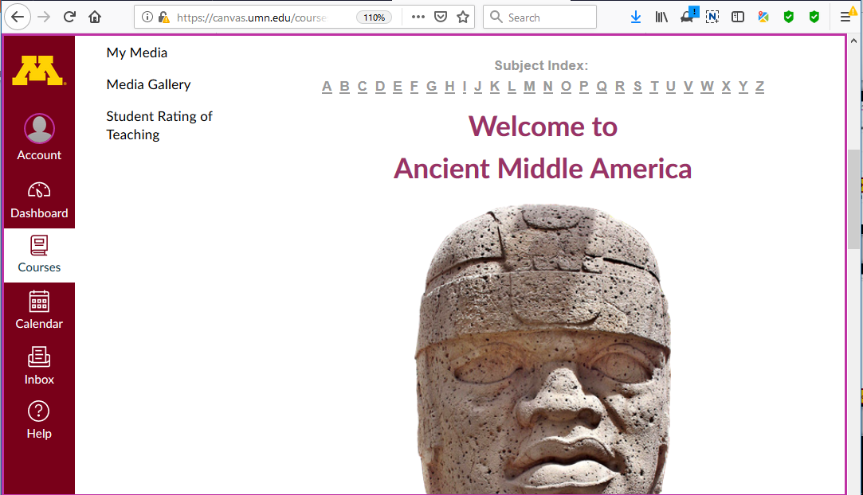

Slide 60
Scroll down for basic information . . .

Slide 61
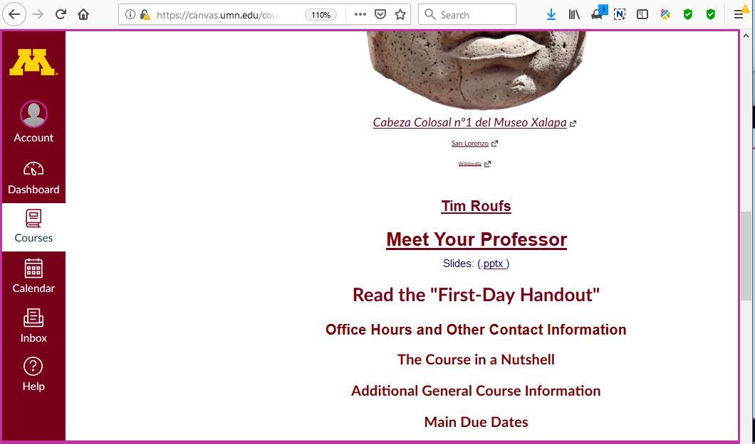
Basic information . . .

Slide 62
Have a look at the
“First Day Handout” . . .

Slide 63
The “First-Day” Handout information contains the basic information . . .
It’s the syllabus
It look something like the following . . .
https://canvas.umn.edu/

Slide 64
The “First-Day” Handout information contains the basic information . . .
It’s the “syllabus”
It look something like the following . . .
https://canvas.umn.edu/

Slide 65
The “First-Day” Handout information contains the basic information . . .
It’s the “syllabus”
It look something like the following . . .
https://canvas.umn.edu/

Slide 66
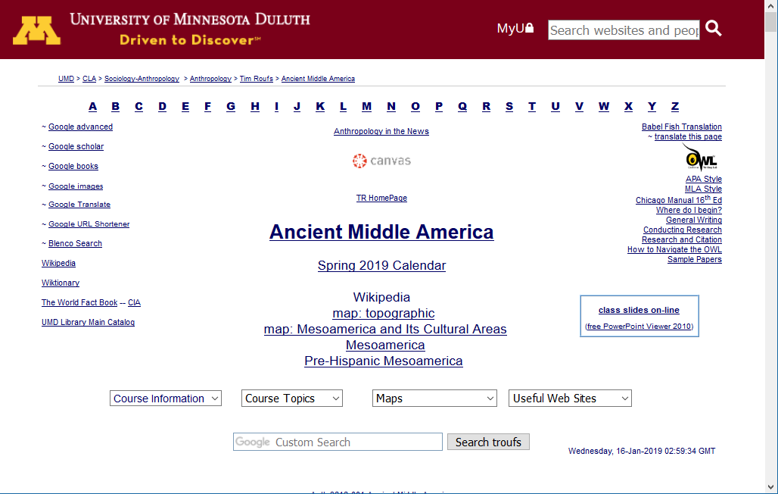
“First-Day Handout” Information . . .

Slide 67
scroll down

Slide 68
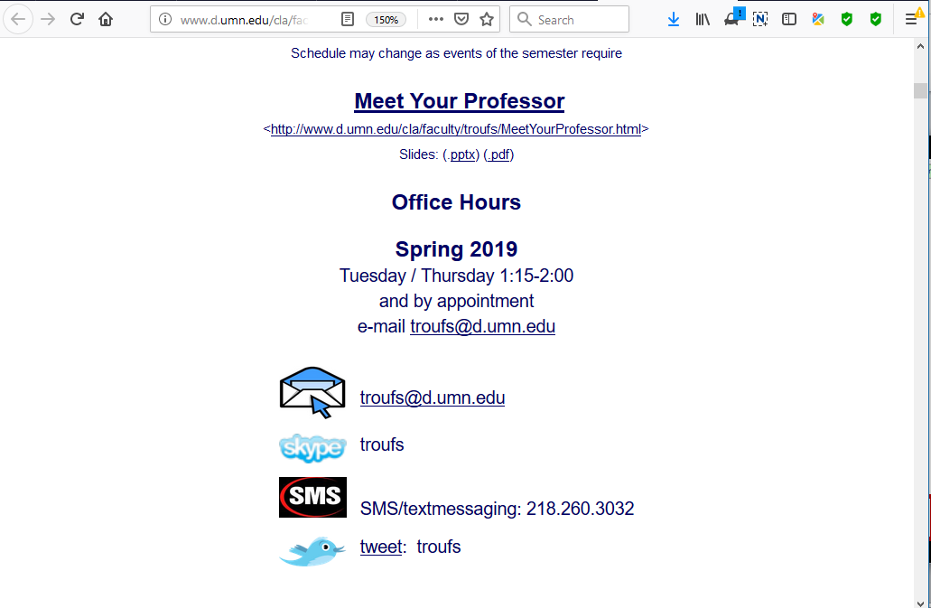
Basic Contact Information . . .

Slide 69
scroll down

Slide 70
Textbook Information . . .

Slide 71
scroll down

Slide 72
REM
The Course Outline in a Nutshell

Slide 73
The Course Outline in a Nutshell

Slide 74
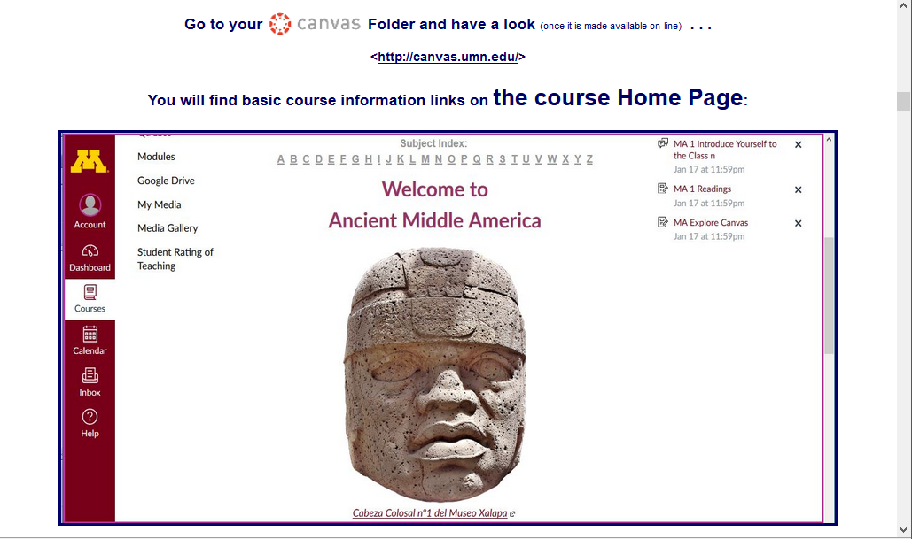
Your Canvas “Home” screen will look something like this . . .

Slide 76
Basic information . . .

Slide 78
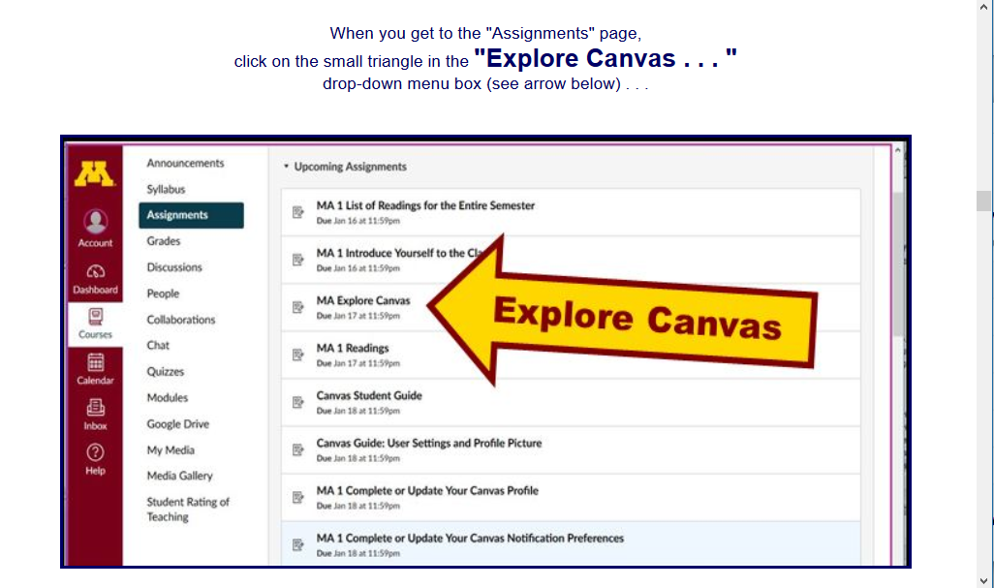

Slide 80
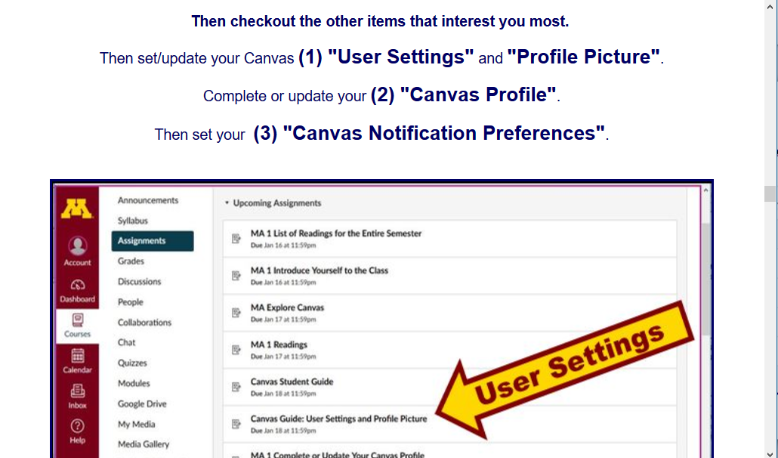

Slide 81
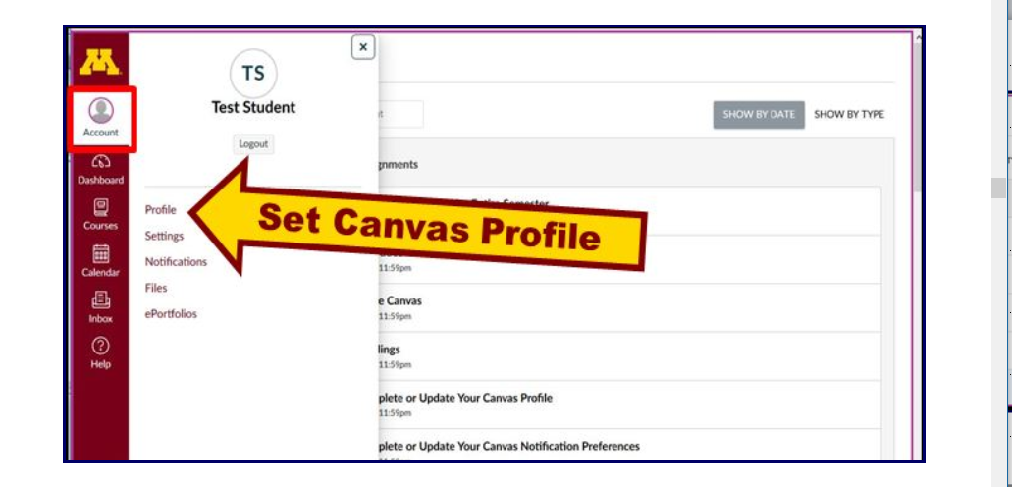

Slide 82
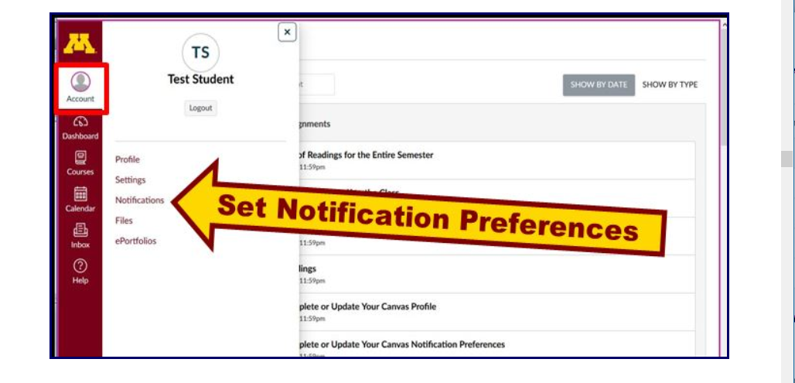

Slide 83
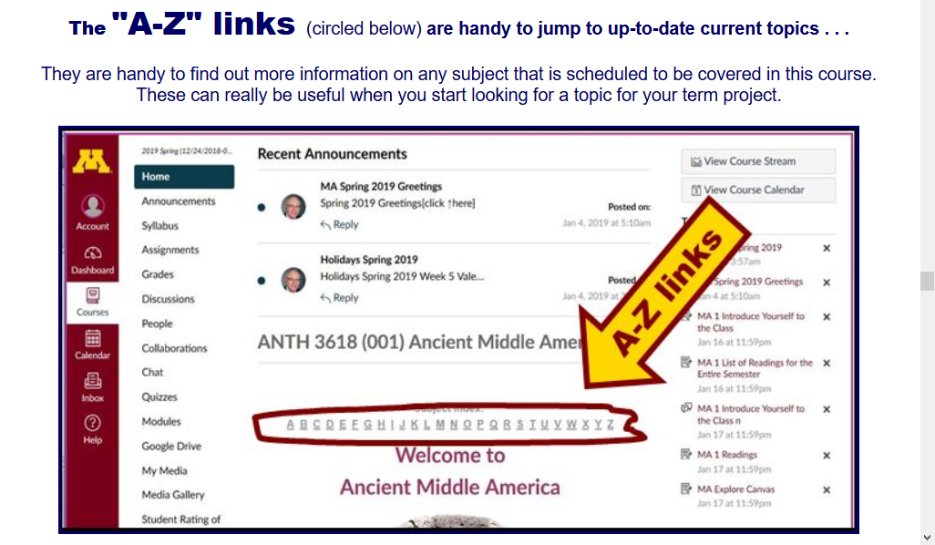

Slide 85
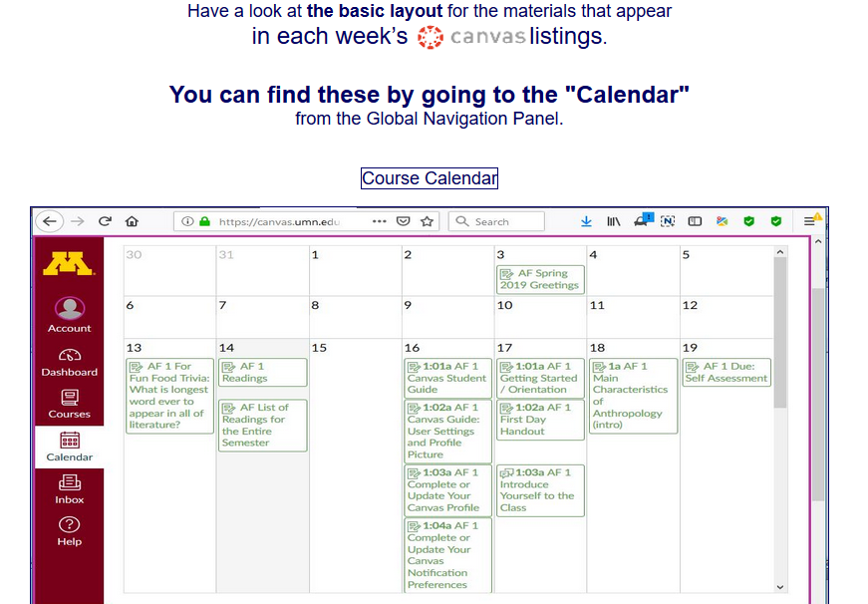

Slide 88
Welcome

Slide 89
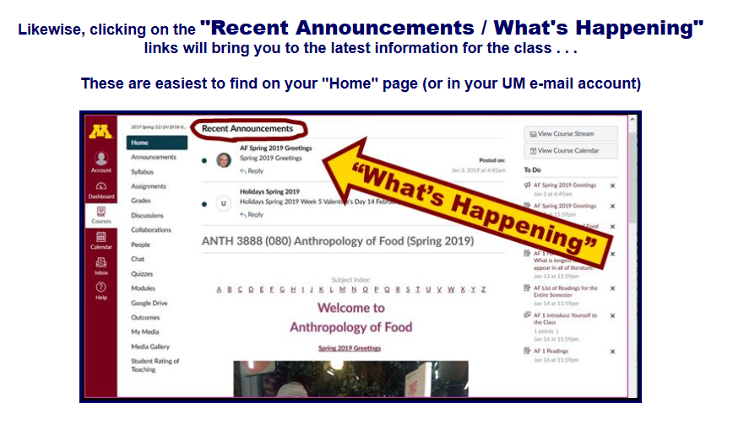
“What’s Happening?”

Slide 92
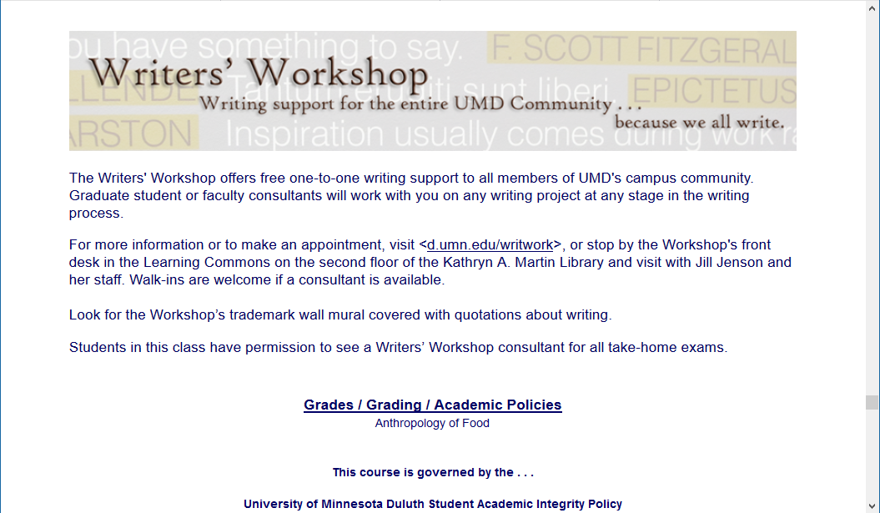

Slide 93
Governing Procedures
pay attention . . .

Slide 94
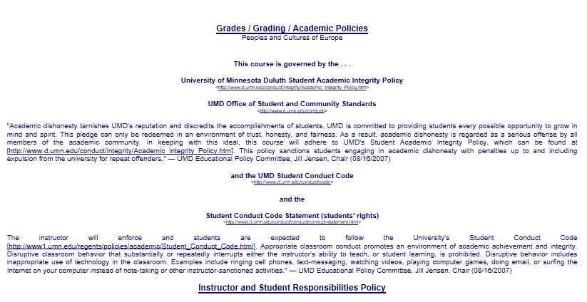

Slide 95
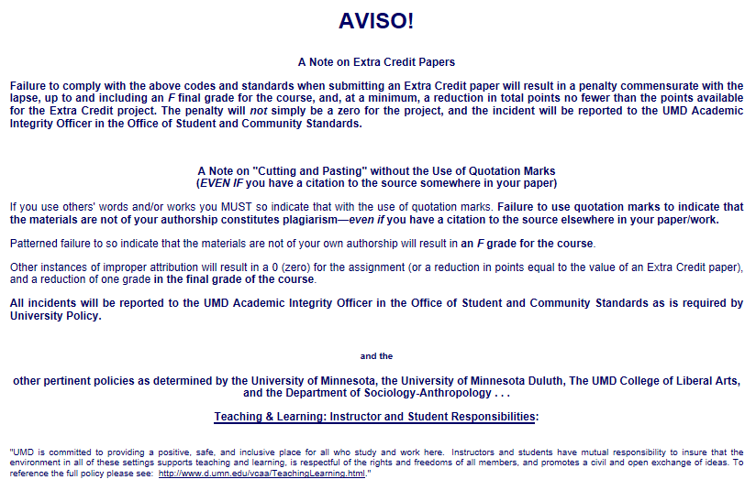

Slide 96
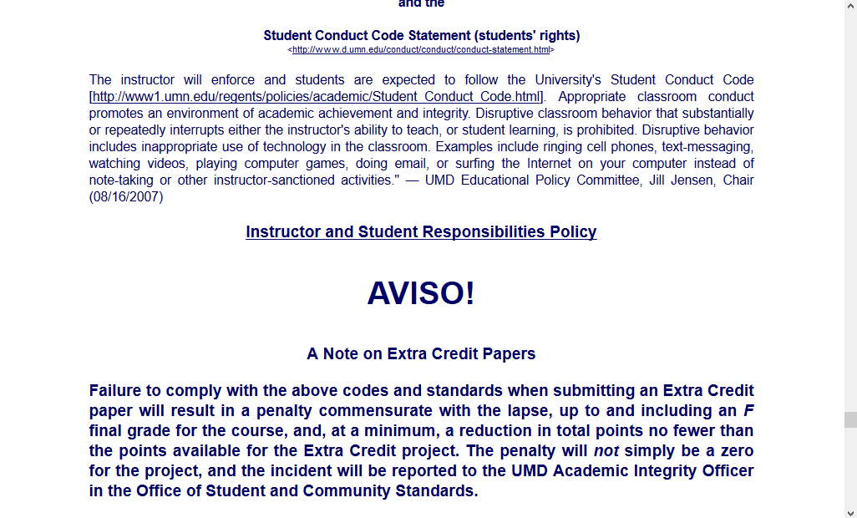
NB: Governing Procedures
note on Extra Credit Papers

Slide 98
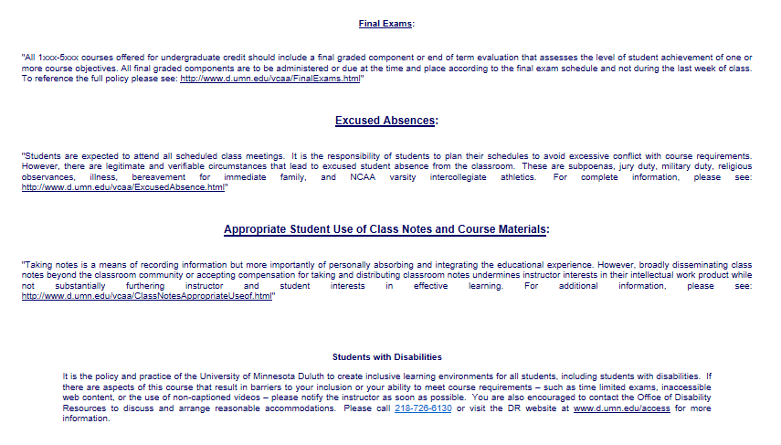

Slide 99
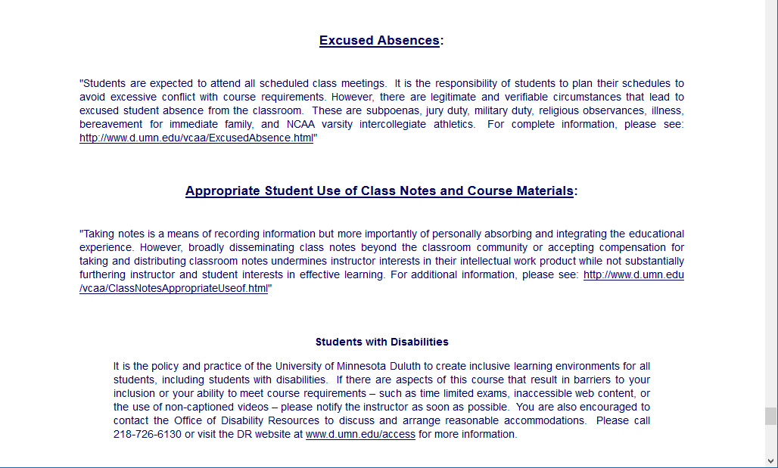
Special Facilities Information

Slide 101
Just for the fun of it, have a look around at the rest of the materials in Canvas . . .

Slide 102
Have a look at
“Meet Your Professor”
Just for the fun of it, have a look around at the rest of the materials in Canvas . . .

Slide 103
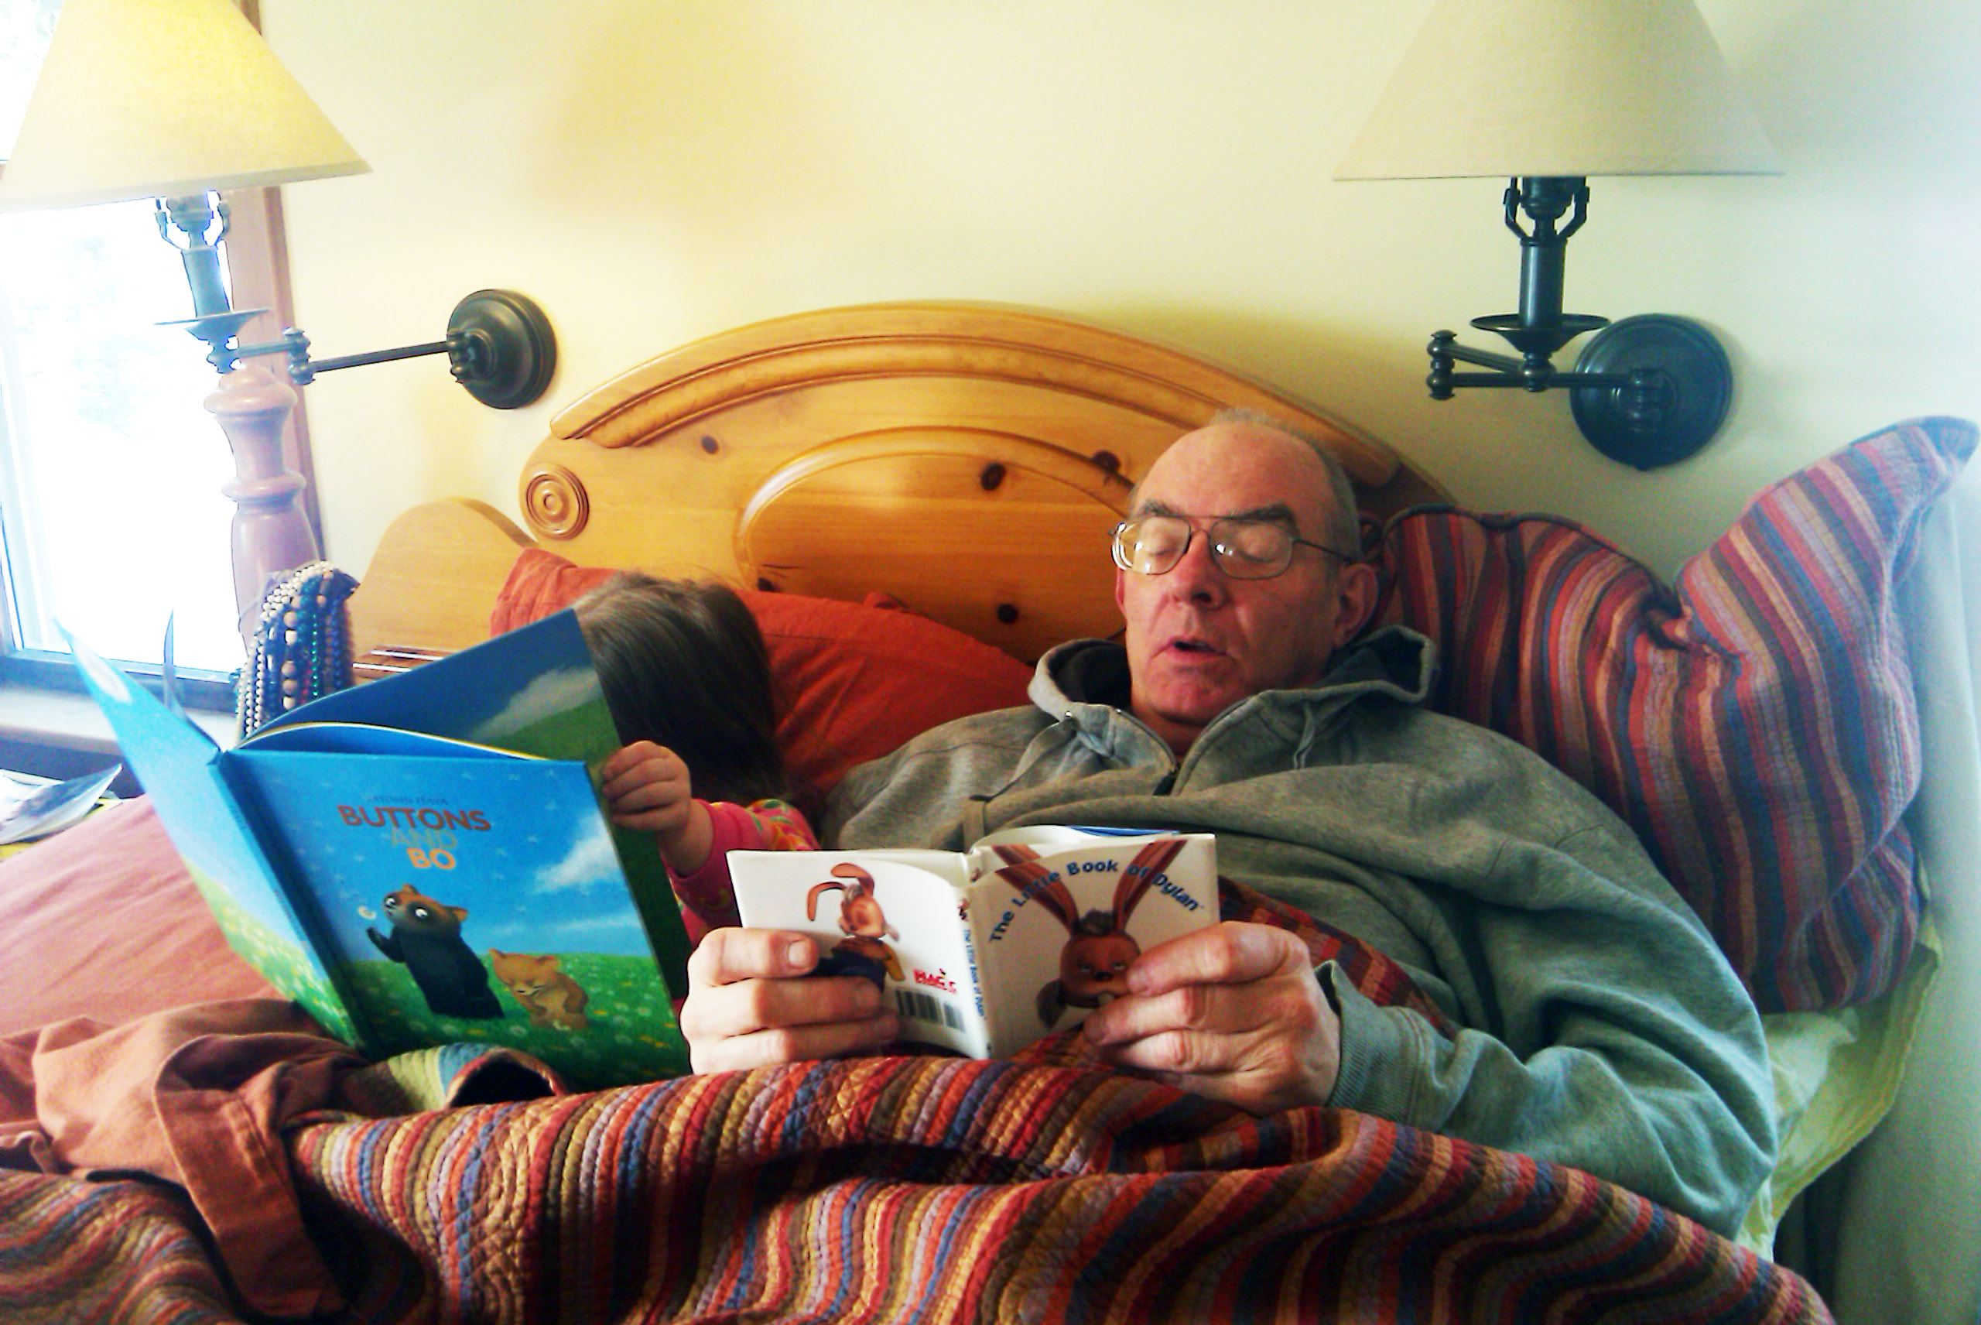
Yes, for the fun of it,
have a look at the
“Meet Your Professor” Materials

Slide 104
Why?

Slide 105
Research shows that people who know a little about their teachers . . .

Slide 106
Research shows that people who know a little about their teachers . . .
Learn more . . .

Slide 107
Research shows that people who know a little about their teachers . . .
Learn more . . .
Remember it better . . .

Slide 108
Research shows that people who know a little about their teachers . . .
Learn more . . .
Remember it better . . .
Have more fun learning . . .

Slide 109
one more piece
of useful information . . .

Slide 112
At the top of your “Home” page you will see an alphabet.
Clicking on a letter will bring you to a page that indexes course WebPages for virtually all of the scheduled topics and items in the course.

Slide 113
At the top of your “Home” page you will see an alphabet.
Clicking on a letter will bring you to a page that indexes course WebPages for virtually all of the scheduled topics and items in the course.

Slide 114
This information is very useful

Slide 117
Lots of people
find these topics interesting . . .
There have over a 2-1/4 million
page views of the UMD
Ancient Middle America
WebPages in the last couple of years . . .

Slide 118
There have been 2,234,925 +
page views of the UMD
Ancient Middle America
WebPages in the last seven+ years . . .

Slide 119
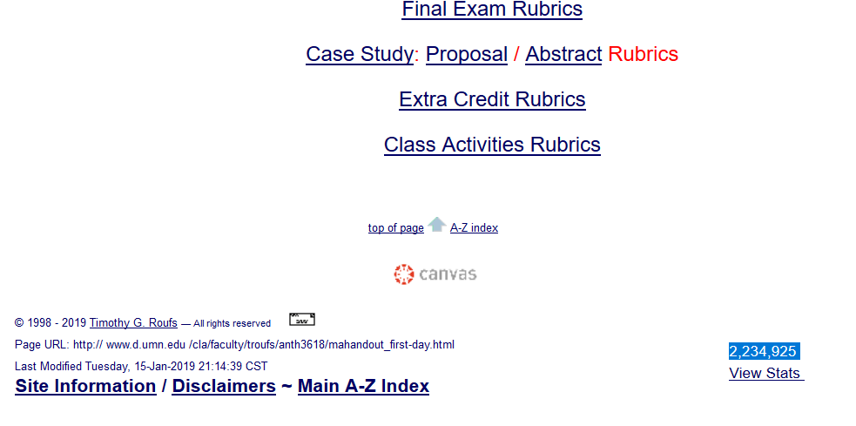

Slide 121
to access a topic simply click on its first letter to go to an index page . . .

Slide 122
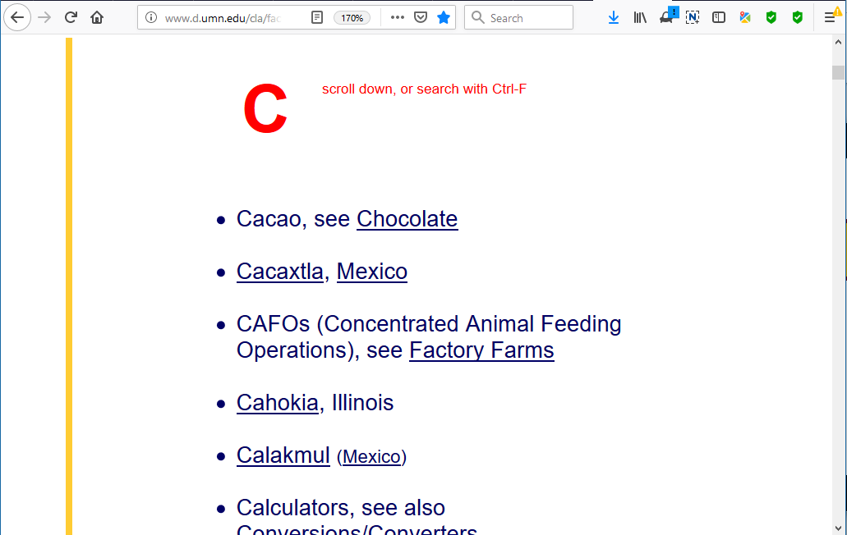

Slide 123
on the index page, search for item using Ctrl + F

Slide 124
on the index page, search for item using Ctrl + F
or scroll down for the item

Slide 125
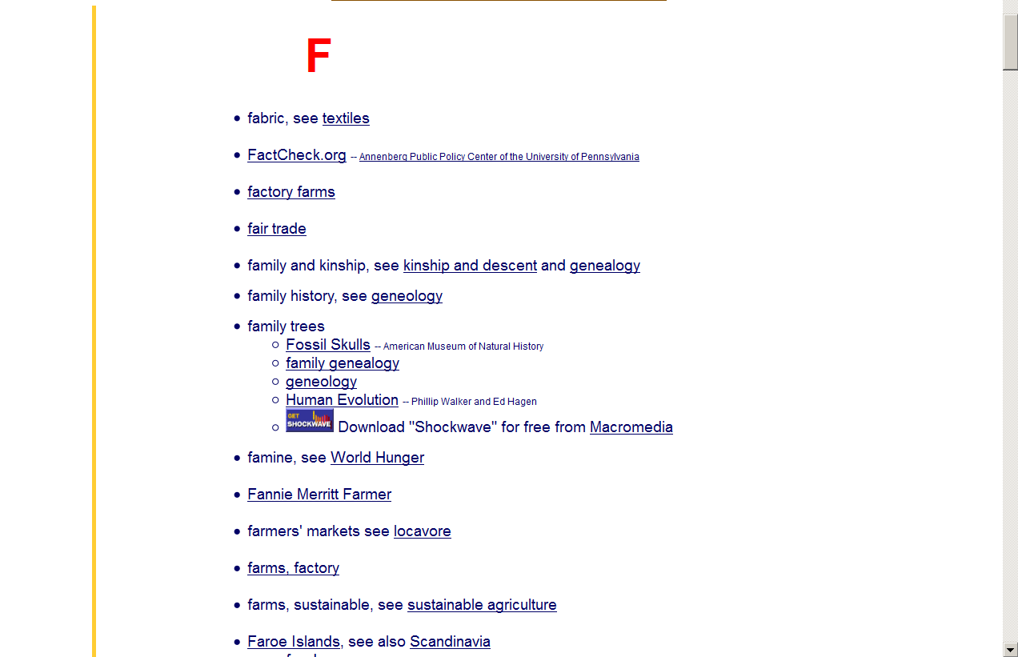
on the index page, search for item using Ctrl + F
or scroll down for the item

Slide 126
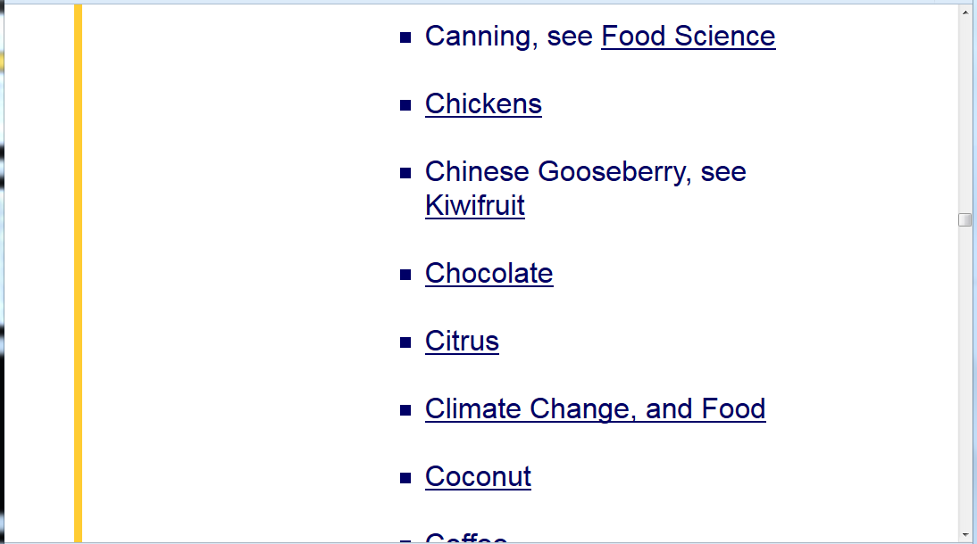
click on item . . . and . . .

Slide 127
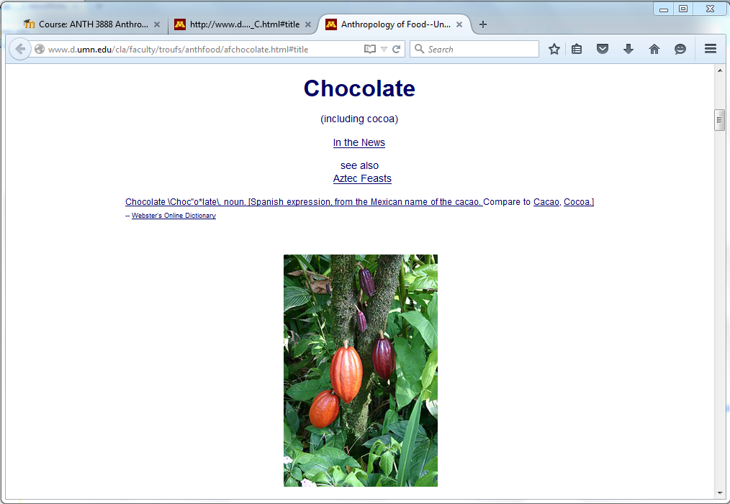
voilá

Slide 129
The A - Z information should also be very useful when it comes time to start thinking about your class project

Slide 130
REM . . .

Slide 131
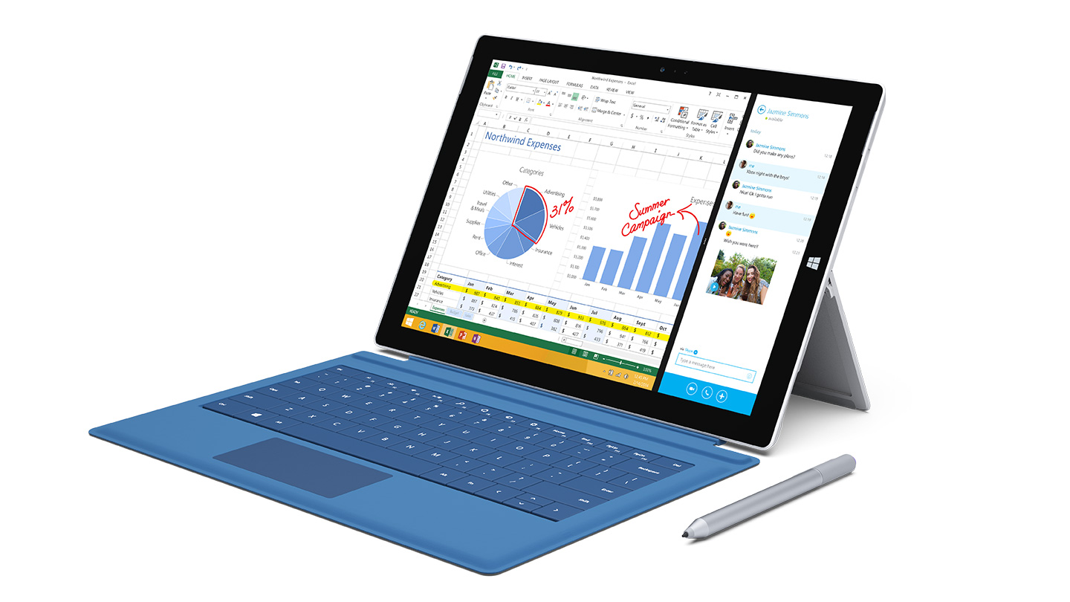
Laptops
Welcome

Slide 133
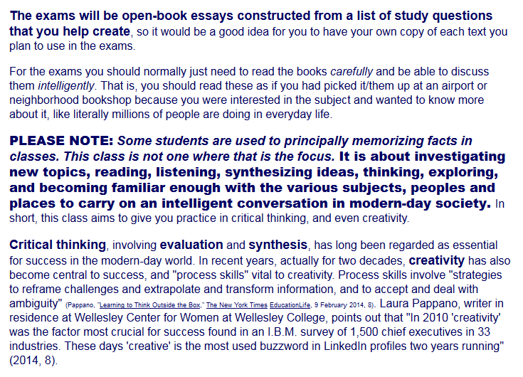
Be sure to read the note on exams from the Welcome Memo . . .

Slide 134
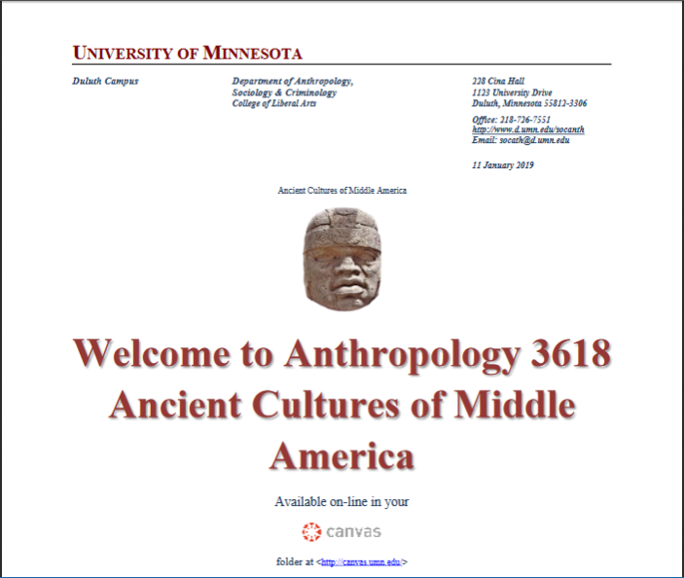

Slide 135
Weekly Memos are available here on the “Home” page . . .
and you will receive one via e-mail (usually on Sunday)

Slide 136
Weekly Memos are available here . . .
and here . . . with the
“Announcements”

Slide 137
University of Minnesota Duluth
Tim Roufs
© 2010-2019
http://www.d.umn.edu/cla/faculty/troufs/anth3618/

Slide 138
Enjoy Your Stay!
University of Minnesota Duluth
Tim Roufs
© 2010-2019
http://www.d.umn.edu/cla/faculty/troufs/anth3618/

Slide 139
One item you will see often (and often repeated) is that
American Anthropology traditionally has a
four-fold approach
to the study of humans and closely related species.
These four fields include . . .

Slide 140
One item you will see often (and often repeated) is that
American Anthropology traditionally has a
four-fold approach
to the study of humans and closely related species.
These four fields include . . .

Slide 141
American Anthropology
cultural / social
physical
archaeology
linguistics

Slide 142
so why study
Ancient Middle America?

Slide 143
for most,
it’s mainly to find out about many fascinating prehistoric topics relating to people like the ancient Mayans and the Aztecs . . .

Slide 144
and you already know about a lot of those sorts of things . . .

Slide 145
just have a look at the little pictures on the web class materials,
for e.g., . . .

Slide 148
and lots of people find these topics interesting . . .
There have been close to 2 million page views of the UMD
Ancient Middle America WebPages . . .

Slide 149
and lots of people find these topics interesting . . .
there have been over 2 million page views of the UMD
Ancient Middle America WebPages . . .

Slide 150
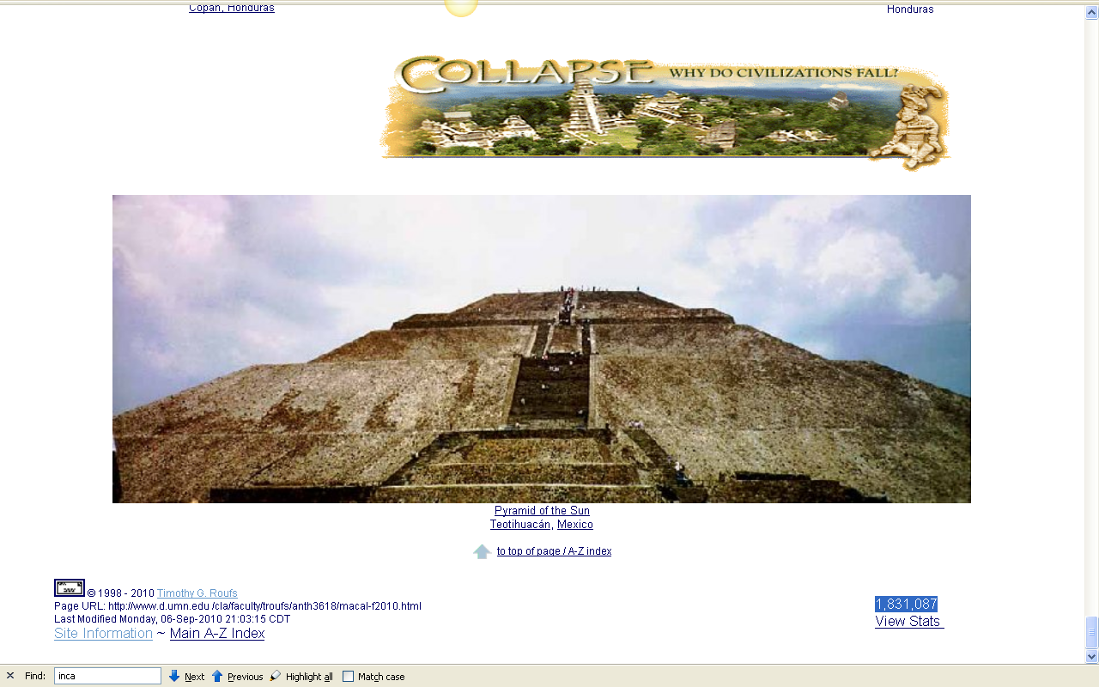
2,234,925+

Slide 151
but Middle America is also a wonderful place to explore all four of the disciplines of American Anthropology . . .

Slide 152
American Anthropology
cultural / social
physical
archaeology
linguistics

Slide 153
so . . .
we’re going to have a look at . . .

Slide 154
so . . . we’re going to have a look at . . .
Ancient Middle America and its . . .
cultural / social
physical
archaeology
linguistics
aspects

Slide 155
So . . . we’re going to have a look at . . .
Ancient Middle America and its . . .
sociocultural
biophysical
archaeological
linguistical
cultural / social
physical / biological
archaeological
linguistical
aspects

Slide 156
and you’ll visit these same fields as you go through your texts . . .

Slide 158
and you’ll visit these same fields and you go through your and other class materials . . .

Slide 160
and to study Middle America in this tradition there are a few basic characteristics of anthropology to keep in mind . . .

Slide 161
Main Characteristics
1. the four fields of general anthropology
2. culture as a primary concept
3. comparative method as major approach to the study of human behavior
4. holism or the study of "humankind" as a whole, as a primary theoretical goal
5. fieldwork as a primary research technique, involving “participant observation”

Slide 162
Main Characteristics
1. the four fields of general anthropology
2. culture as a primary concept
3. comparative method as major approach to the study of human behavior
4. holism or the study of "humankind" as a whole, as a primary theoretical goal
5. fieldwork as a primary research technique, involving “participant observation”
more on this later . . .

Slide 163
finally, to round off our theoretical perspectives, we’ll have
a brief look at . . .

Slide 164
a few “Important Terms” including . . .

Slide 165
a few “Important Terms” include . . .
1. ethnocentrism
cultural relativism
absolute cultural relativism
critical cultural relativism
3. “multiple cultural worlds”

Slide 166
a few “Important Terms” include . . .
1. ethnocentrism
cultural relativism
absolute cultural relativism
critical cultural relativism
3. “multiple cultural worlds”
more about terminology at a later date . . .

Slide 167
and “Units of Analysis” including . . .

Slide 168
“units of analysis” may include:
one person
the family
the community
a region
a “culture area”
a culture / “subculture”
a nation
an item or action itself
a “cultural metaphor”

Slide 169
“units of analysis” may include:
one person
the family
the community
a region
a “culture area”
a culture / “subculture”
a nation
an item or action itself
a “cultural metaphor”
more on this later . . .

Slide 170
and we’ll have a brief look at Three Major Perennial Debates including . . .

Slide 171
three major contemporary debates
Biological Determinism vs. Cultural Constructionism
Ideationism vs. Cultural Materialism
Individual Agency vs. Structuralism (“free will” vs. “power structures”)

Slide 172
three major contemporary debates
Biological Determinism vs. Cultural Constructionism
Ideationism vs. Cultural Materialism
Individual Agency vs. Structuralism (“free will” vs. “power structures”)
more on this later . . .

Slide 173
and so, to study Middle America in the American Anthropological tradition we’ll further consider the items you see listed in the
Week 1 “Topics” . . .

Slide 174
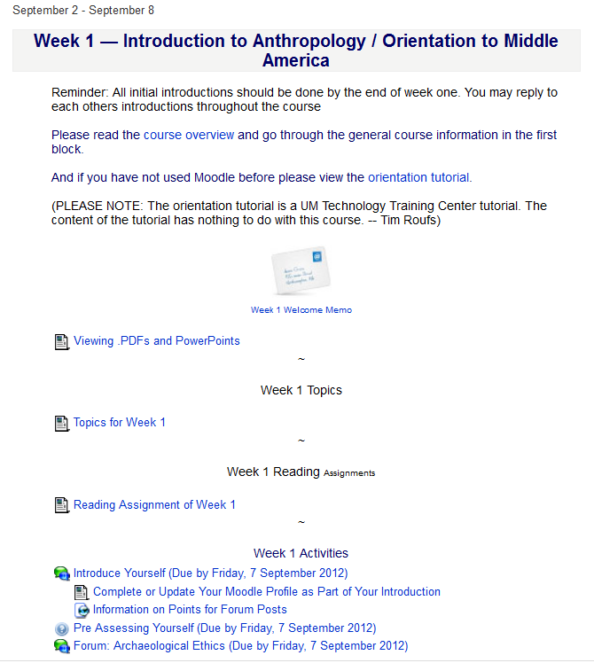
topics . . .

Slide 175
topics . . .

Slide 177
and all along the way
we’ll look at a lot of maps . . .
. . . starting with
two map handouts . . .

Slide 178
and all along the way
we’ll look at a lot of maps . . .
. . . starting with
two map handouts . . .

Slide 179
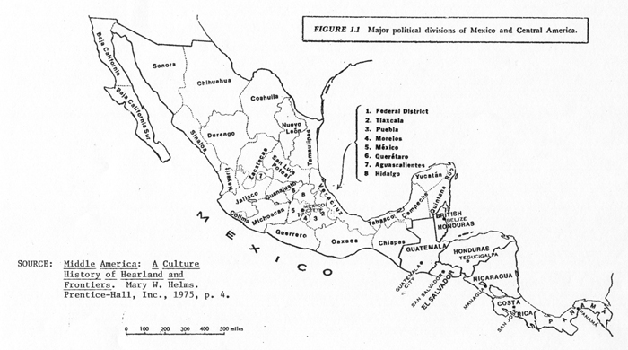

Slide 180
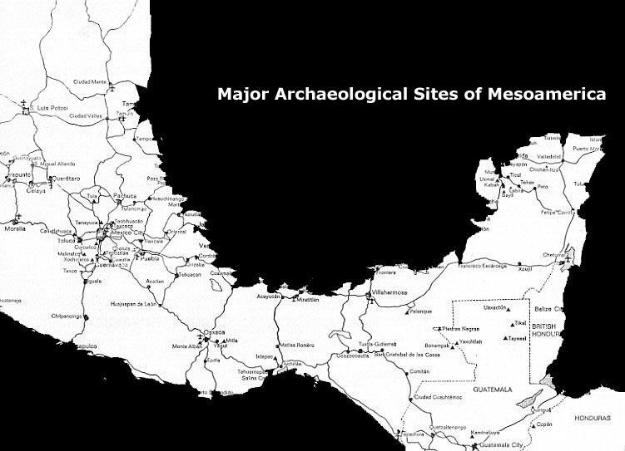

Slide 181
and we’ll start right off with a look at a wonderful little
(more-or-less homemade)
movie . . .

Slide 182
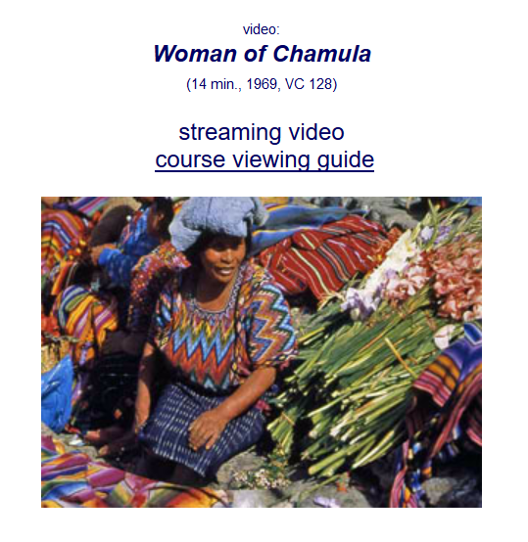

Slide 183
when I say it’s a “wonderful” little film I mean the content is wonderful . . .
the technical quality of the film is
horrible (and that’s a Spanish word)

Slide 184
so bear with the quality and focus on the content. It’s an important little film . . .
. . . almost everything you see in it, and some things you “view” but don’t “see” will re-appear quite often this semester . . .

Slide 185
so bear with the quality and focus on the content. It’s an important little film . . .
. . . almost everything you see in it, and some things you “view” but don’t “see” will re-appear quite often this semester . . .

Slide 186
next . . .
that wonderful little
(more-or-less homemade)
movie . . .

Slide 188
our first “field trip” . . .
Woman of Chamula

Slide 189
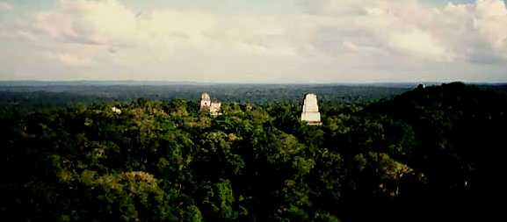
our second “field trip” . . . (to visit . . .)
Tikál
and seven other Ancient Mesoamerican sites

Slide 190
our third “field trip” . . . (to visit . . .)

Slide 191
University of Minnesota Duluth
Tim Roufs
© 2010-2019
http://www.d.umn.edu/cla/faculty/troufs/anth3618/

