Slide 1
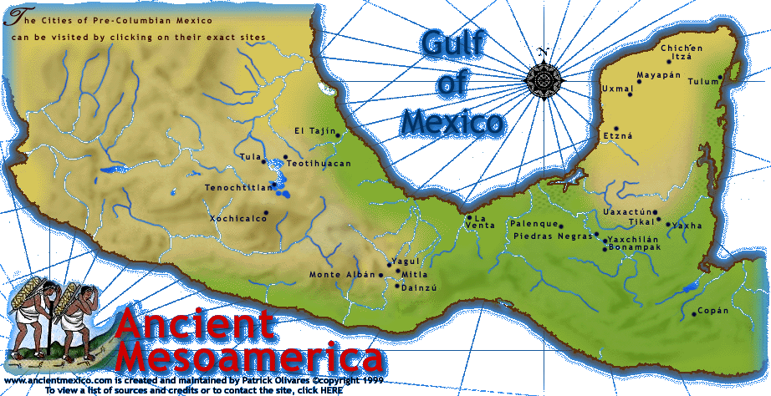
Tim Roufs
University of Minnesota Duluth
Natural Areas
of
Mesoamerica

Slide 3
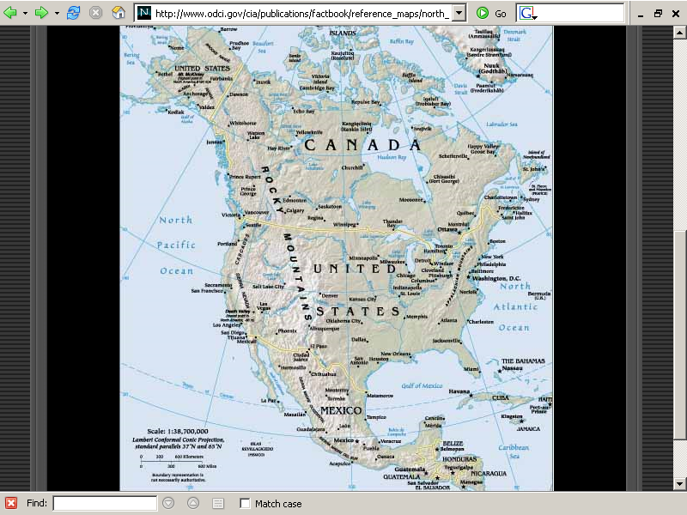
http://www.odci.gov/cia/publications/factbook/reference_maps/north_america.html

Slide 4
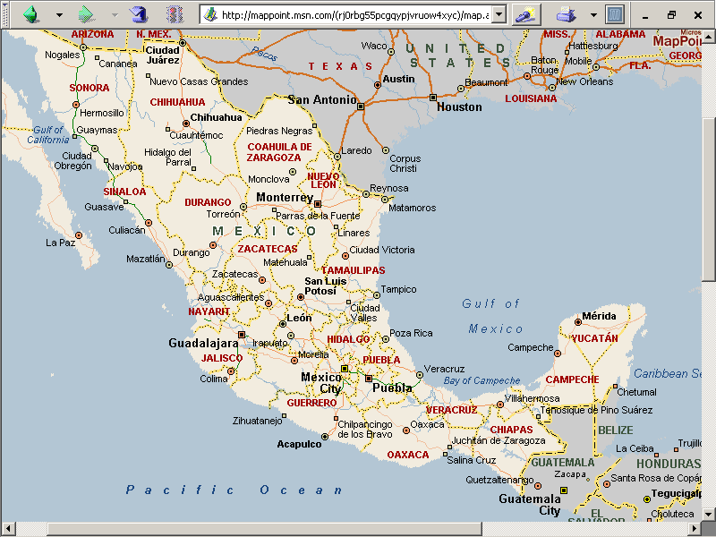

Slide 5
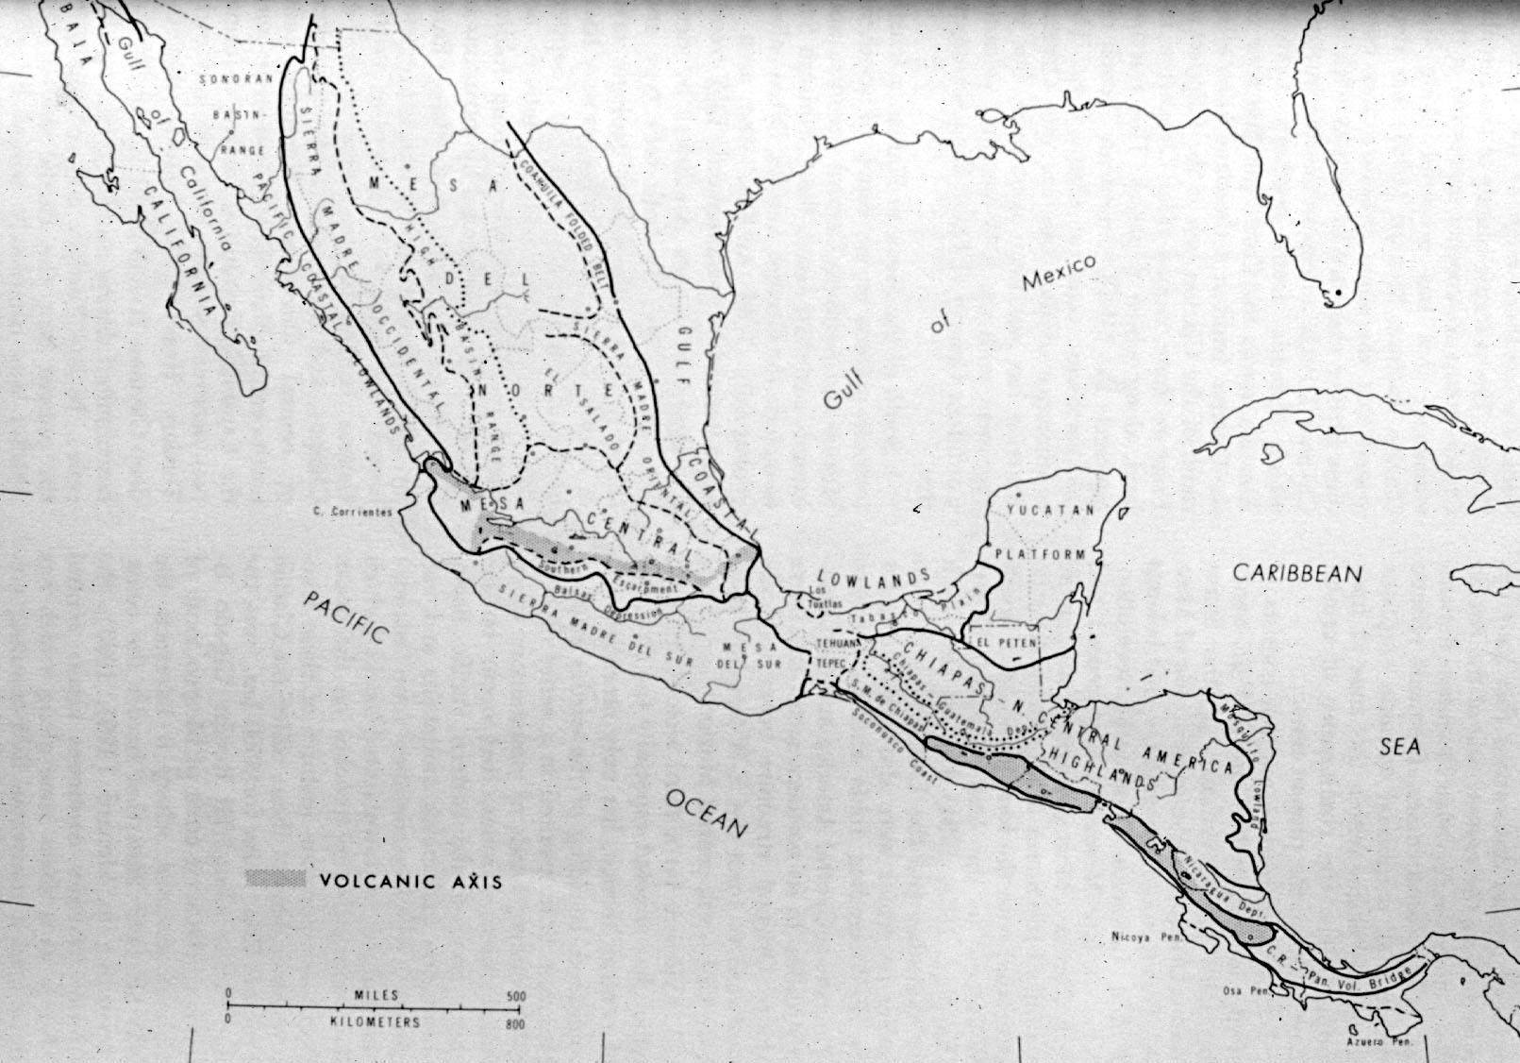
Source: Handbook of Middle American Indians: Natural Environment and Early Cultures, VoL. 1,
Robert Wauchope and Robert C. West, University of Texas Press, 1964
Physiographic Regions of Middle America

Slide 6
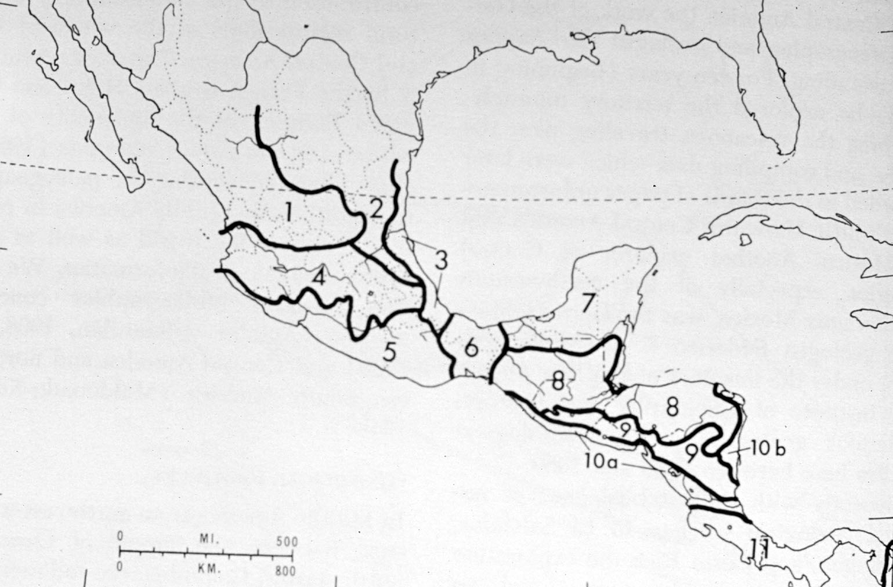
Source: Handbook of Middle American Indians: Natural Environment and Early Cultures, VoL. 1,
Robert Wauchope and Robert C. West, University of Texas Press, 1964
Central High Plateau
Western Sierra Madre
Coastal Plain of the Gulf of Mexico
Yucatán Peninsula
Neovolcanic Axis
Mountains of
northwestern
Central America
Southern Sierra Madre
Isthmus of Tehuantepec
Volcanoes of El Salvador and Nicaragua
Isthmus of
Costa Rica-
Panama
Coastal Plains of the Pacific Ocean
Coastal Plains of the Caribbean Sea
Principal Geological Provinces of Middle America

Slide 7
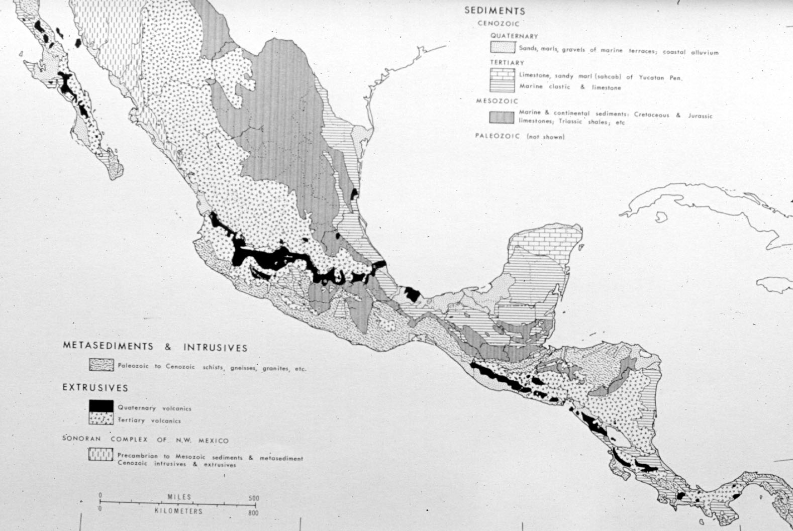
Source: Handbook of Middle American Indians: Natural Environment and Early Cultures, VoL. 1,
Robert Wauchope and Robert C. West, University of Texas Press, 1964
Surface Geology of Middle America

Slide 8
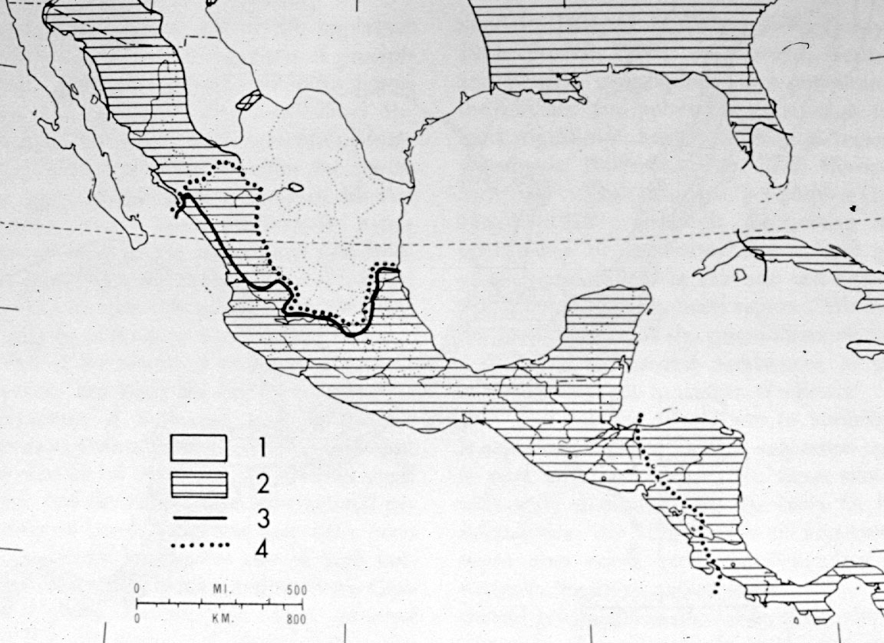
nonagricultural areas
agricultural areas
limit of high cultures
limits of “Mesoamerican”
Culture (Kirchoff, 1943)
Source: Handbook of Middle American Indians: Natural Environment and Early Cultures, VoL. 1,
Robert Wauchope and Robert C. West, University of Texas Press, 1964
Major Cultural Areas of Middle America, ca. A.D. 1500

Slide 9
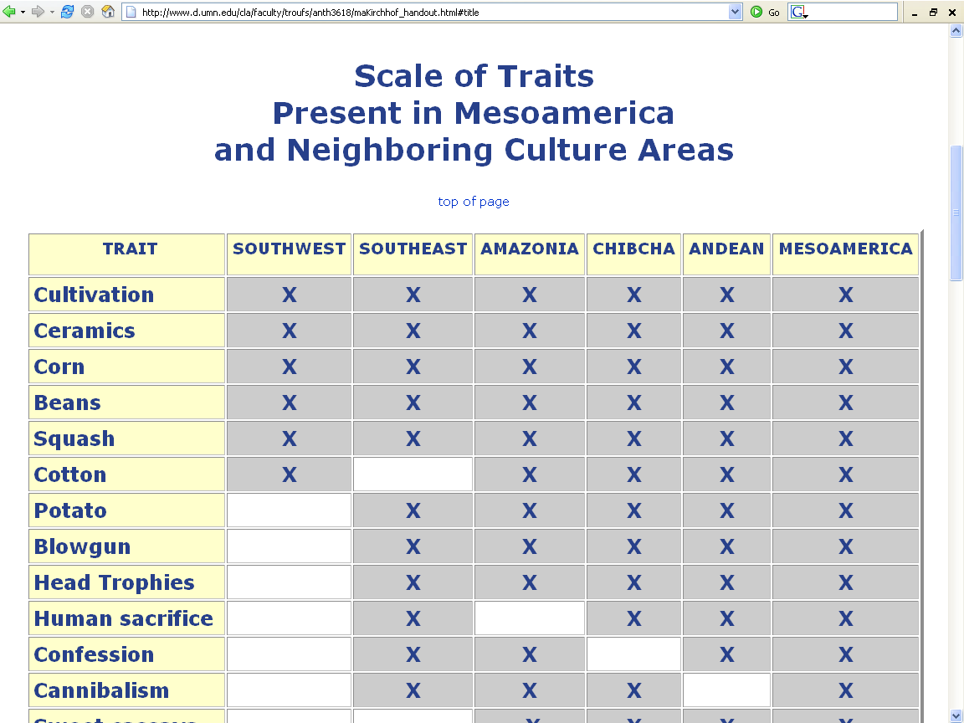
http://www.d.umn.edu/cla/faculty/troufs/anth3618/maKirchhof_handout.html#title

Slide 10
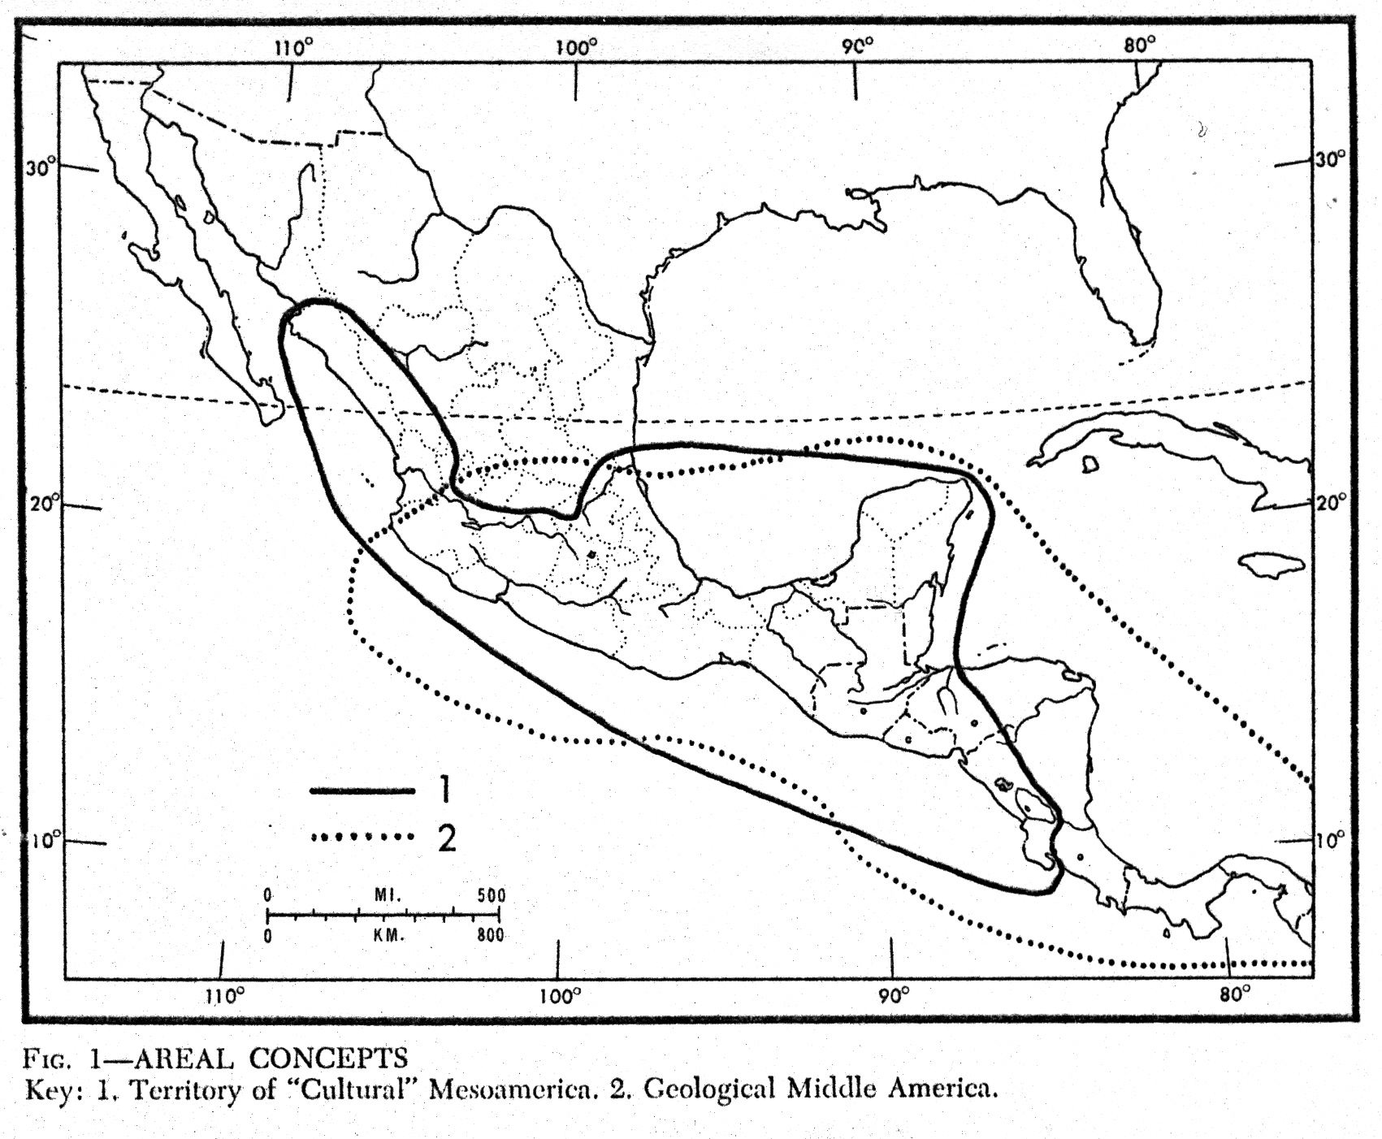
“Middle America”
(geological)
“Mesoamerica”
(cultural)
Source: Handbook of Middle American Indians: Natural Environment and Early Cultures, VoL. 1,
Robert Wauchope and Robert C. West, University of Texas Press, 1964

Slide 11
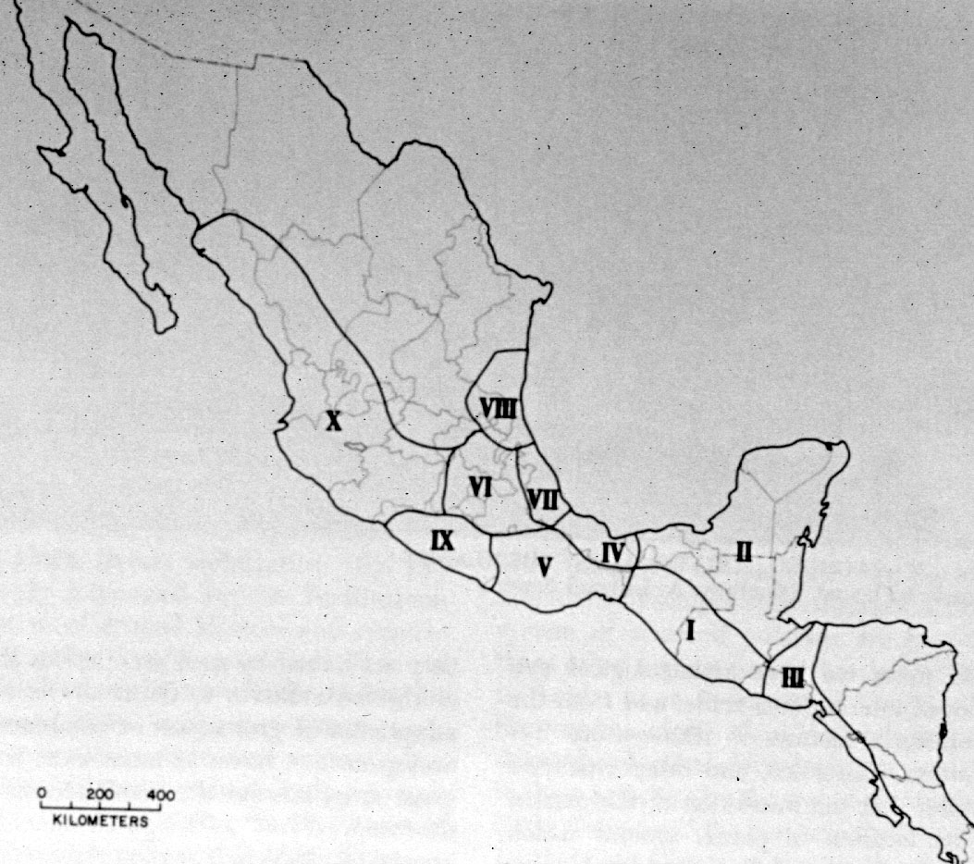
The Huasteca
Central Highlands
Central Veracruz
Western Mexico
and the
Northern Frontier
Southern
Veracruz-Tobasco
Central Mexico
Maya
Lowlands
Guerrero
Oaxaca
Maya Highlands
Southern Periphery
Source: Handbook of Middle American Indians: Natural Environment and Early Cultures, VoL. 1,
Robert Wauchope and Robert C. West, University of Texas Press, 1964
Regional Divisions of the Mesoamerican Cultural Area

Slide 12
Central Highlands

Slide 13
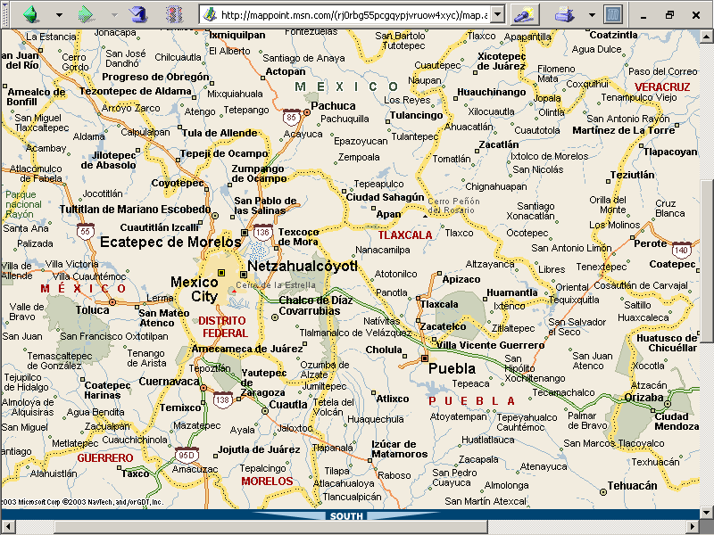

Slide 14
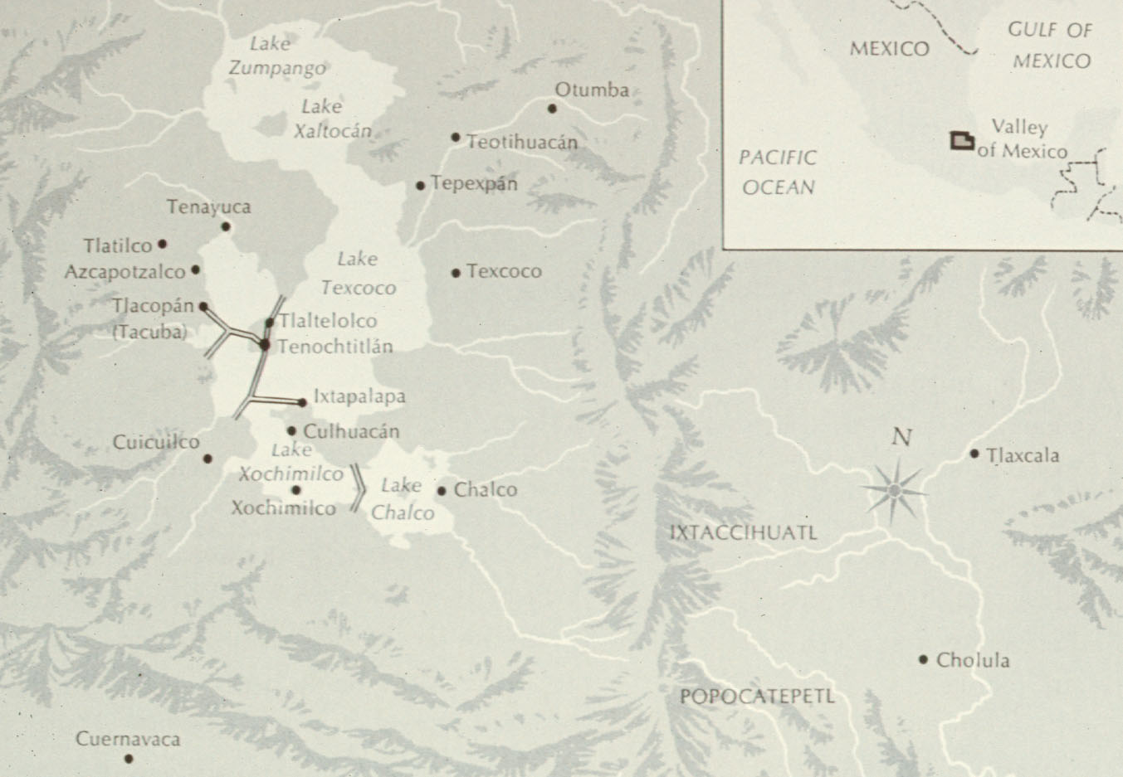
Valley of Mexico

Slide 15
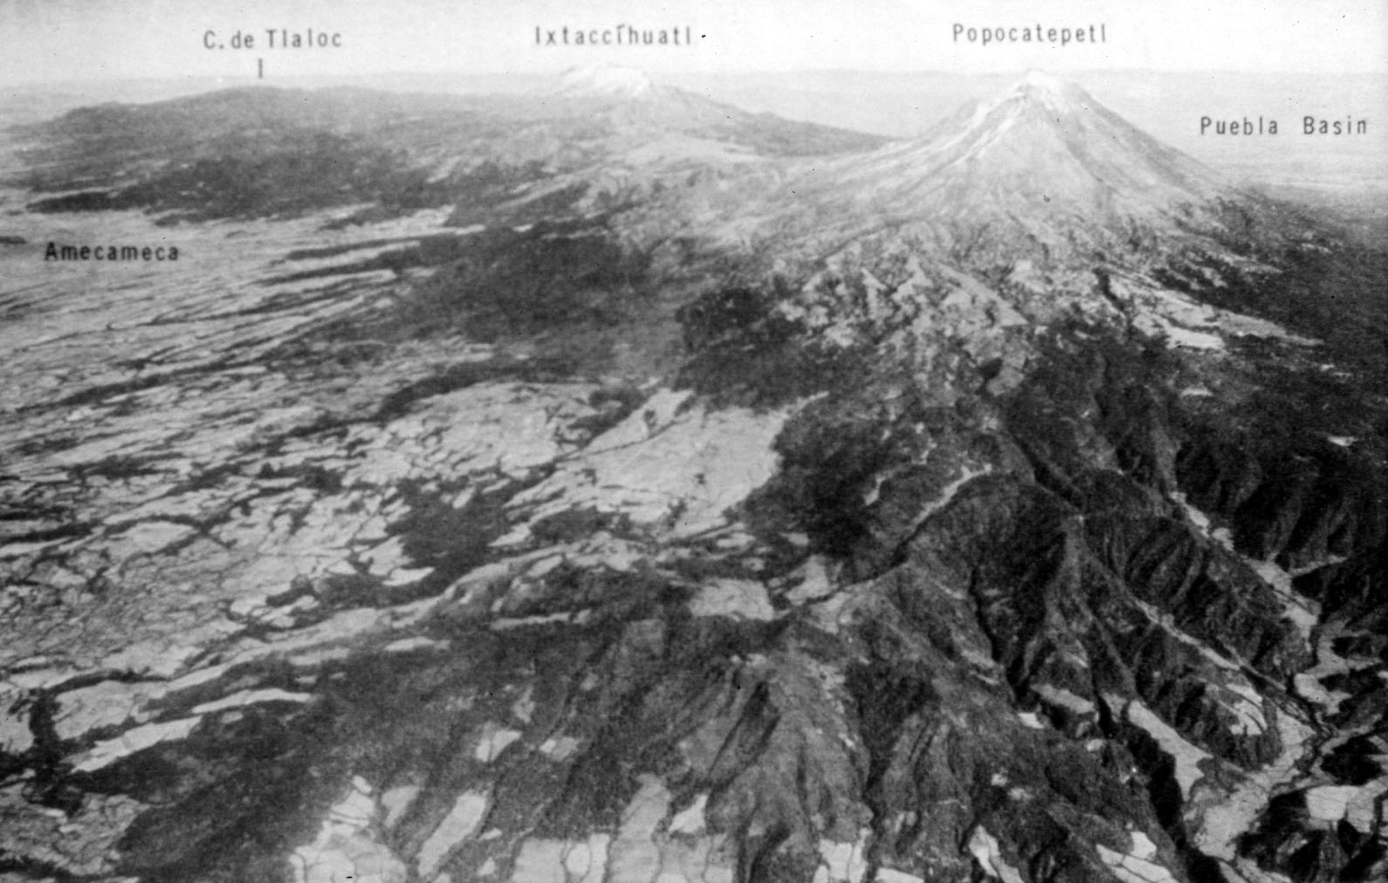
Source: Handbook of Middle American Indians: Natural Environment and Early Cultures, VoL. 1,
Robert Wauchope and Robert C. West, University of Texas Press, 1964
Istaccihuatl and Popocatepetl

Slide 16
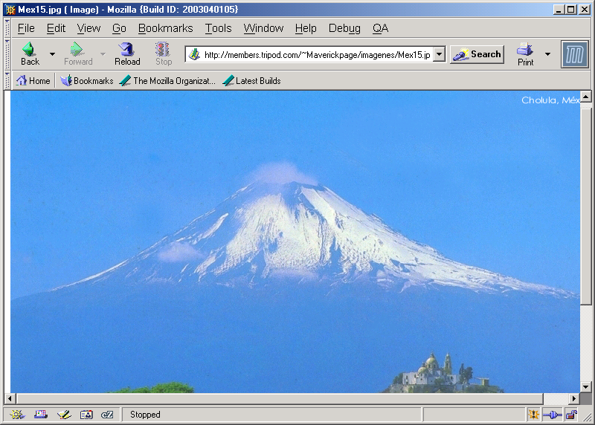
Popocatepetl
http://members.tripod.com/~Maverickpage/imagenes/Mex15.jpg

Slide 17
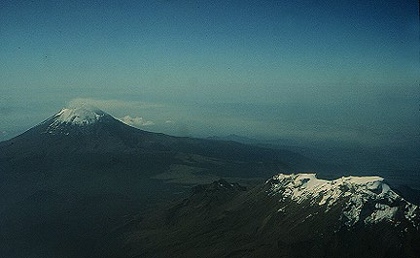
Popocatepetl and Istaccihuatl
http://volcano.und.nodak.edu/vwdocs/kids/legends.html#mexico

Slide 18
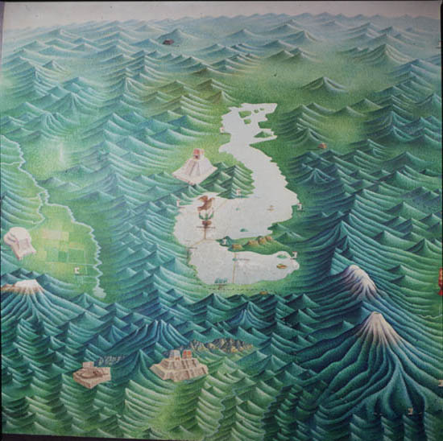
http://archaeology.la.asu.edu/tm/pages2/mtm04.htm

Slide 19
Source: Handbook of Middle American Indians: Natural Environment and Early Cultures, VoL. 1,
Robert Wauchope and Robert C. West, University of Texas Press, 1964
Schematic Diagram of the Central Highland Area – Patrick F. Gallagher

Slide 20
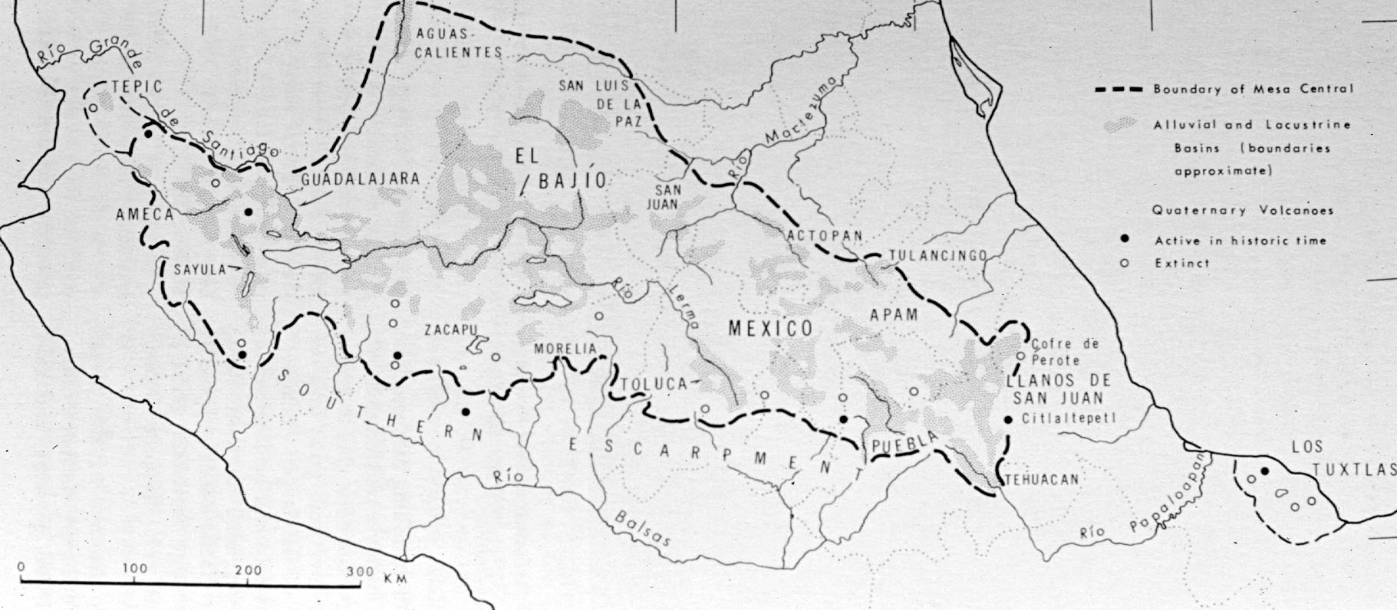
Source: Handbook of Middle American Indians: Natural Environment and Early Cultures, VoL. 1,
Robert Wauchope and Robert C. West, University of Texas Press, 1964
The Mesa Central of Mexico

Slide 21
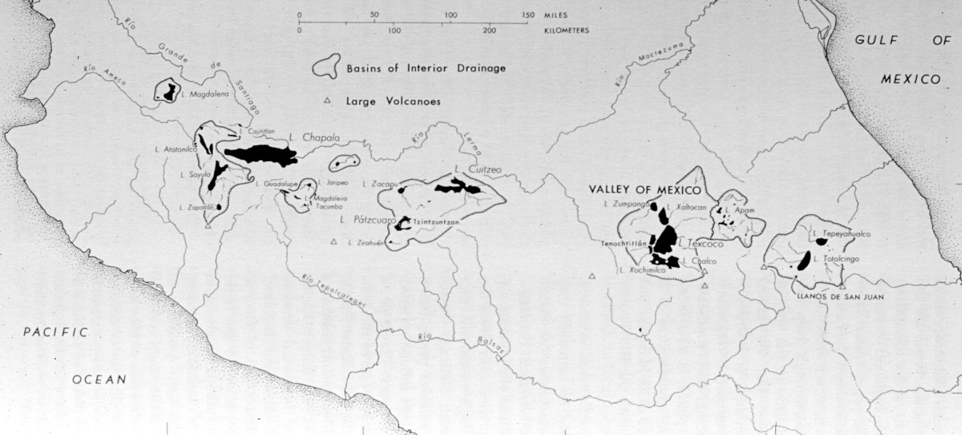
Source: Handbook of Middle American Indians: Natural Environment and Early Cultures, VoL. 1,
Robert Wauchope and Robert C. West, University of Texas Press, 1964
Interior Drainage and Lakes of the Central Plateau of Mexico, ca. A.D. 1500

Slide 23
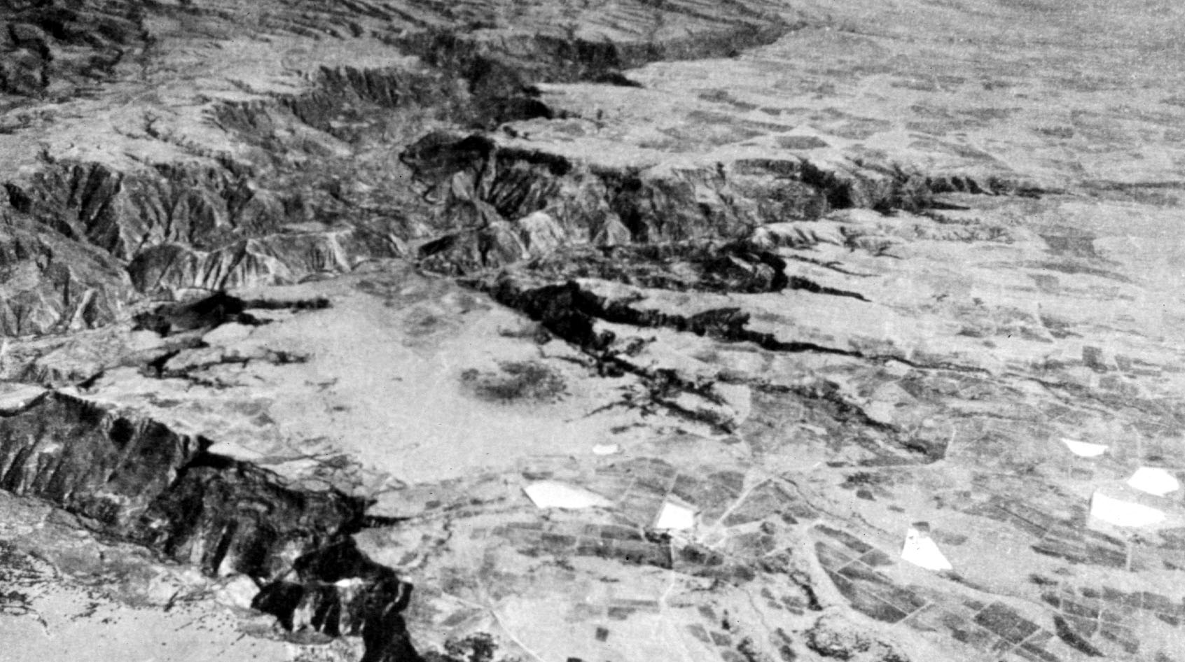
Source: Handbook of Middle American Indians: Natural Environment and Early Cultures, VoL. 1,
Robert Wauchope and Robert C. West, University of Texas Press, 1964
The Northern Portion of Tulancingo Basin, Northeastern Mesa Central

Slide 25
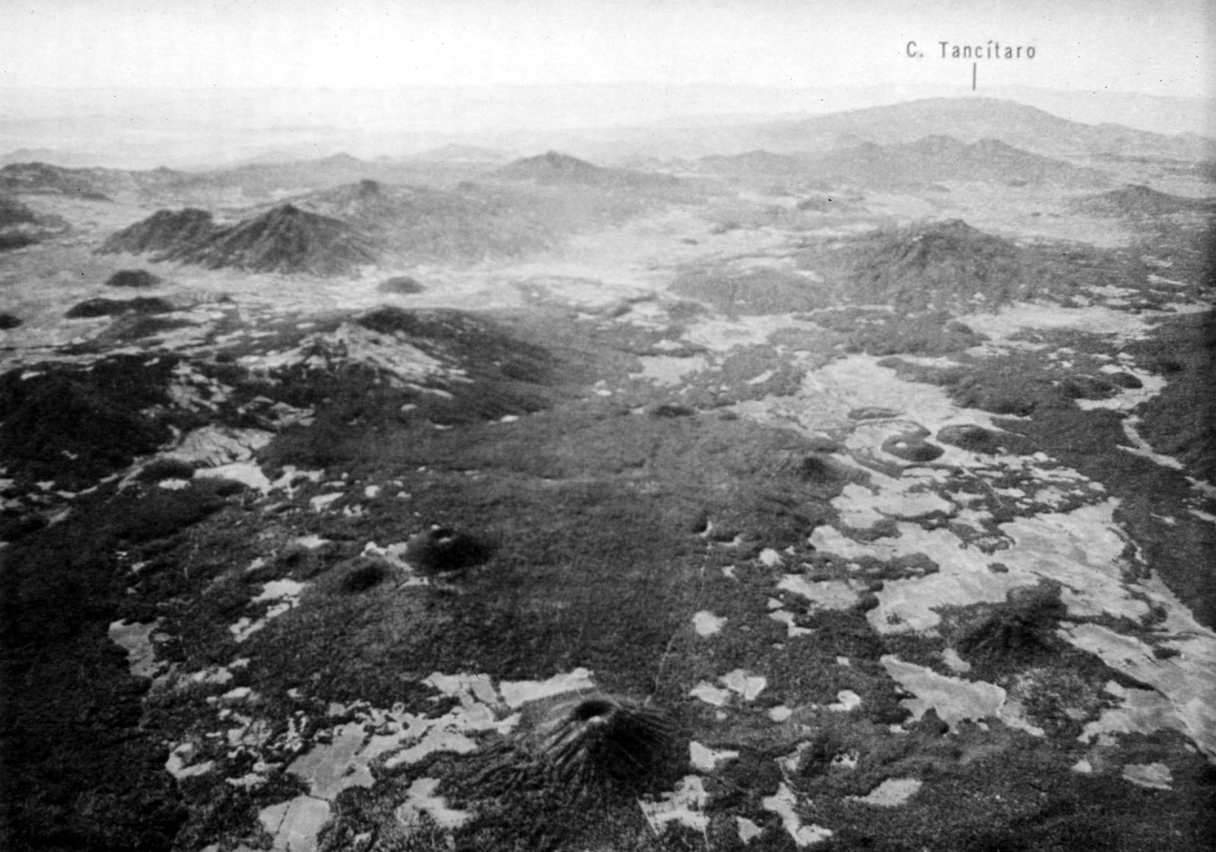
Source: Handbook of Middle American Indians: Natural Environment and Early Cultures, VoL. 1,
Robert Wauchope and Robert C. West, University of Texas Press, 1964
A Portion of the Tarascan Sierra, Michoacan

Slide 27
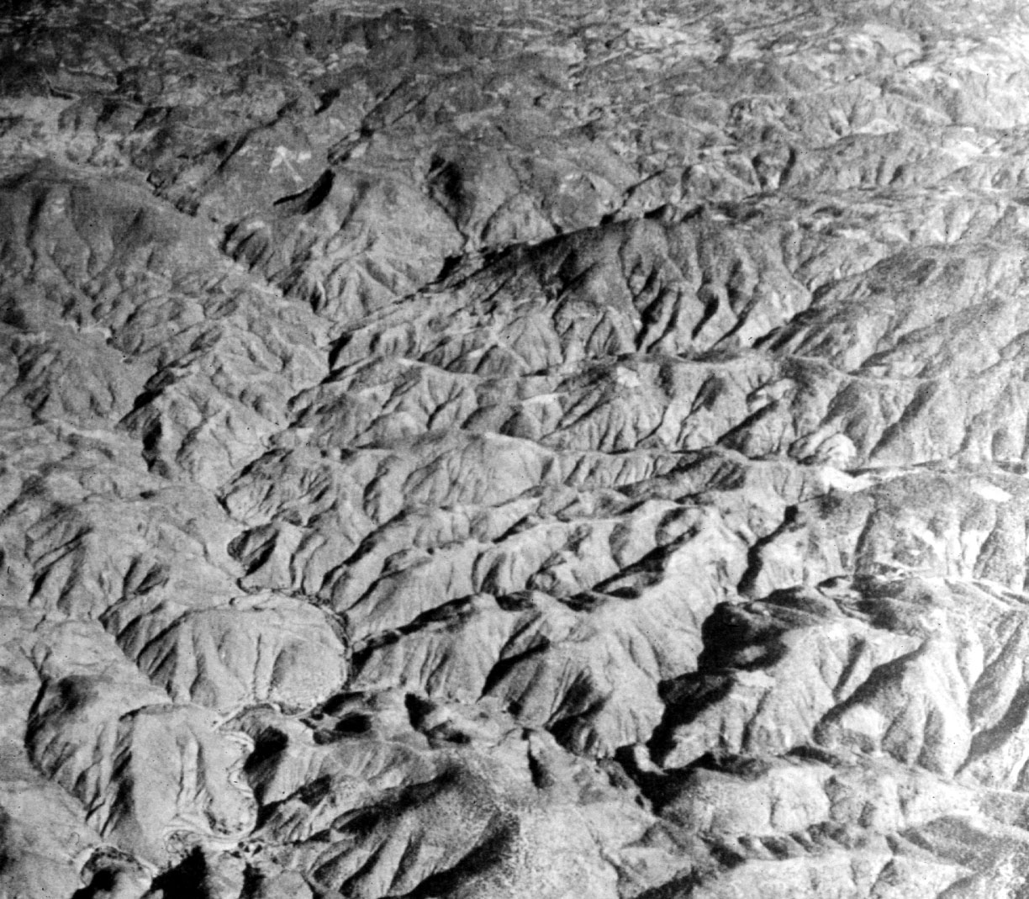
Source: Handbook of Middle American Indians: Natural Environment and Early Cultures, VoL. 1,
Robert Wauchope and Robert C. West, University of Texas Press, 1964
A Portion of the Highly Dissected Mesa Del Sur, East of Oaxaca City

Slide 29
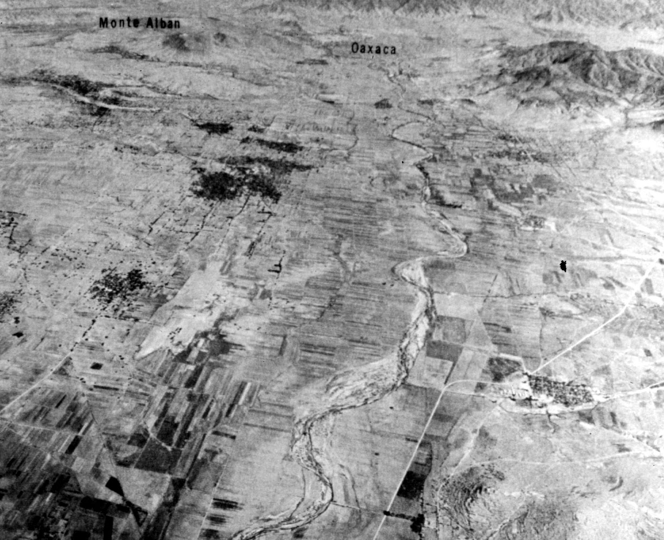
Source: Handbook of Middle American Indians: Natural Environment and Early Cultures, VoL. 1,
Robert Wauchope and Robert C. West, University of Texas Press, 1964
Northern Part of the Valley of Oaxaca

Slide 30
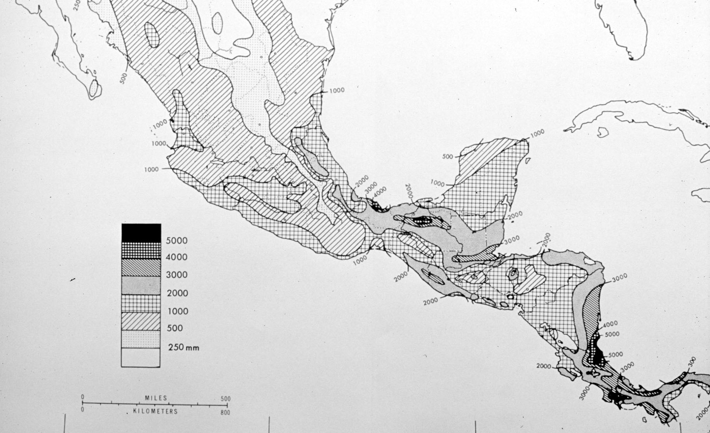
Source: Handbook of Middle American Indians: Natural Environment and Early Cultures, VoL. 1,
Robert Wauchope and Robert C. West, University of Texas Press, 1964
Mean Annual Precipitation, Mexico and Central America

Slide 31
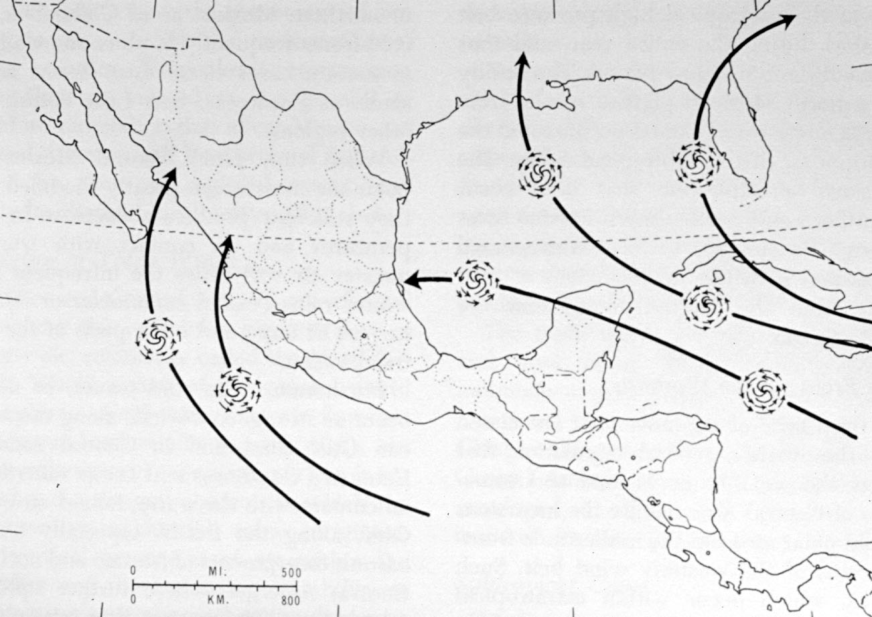
Source: Handbook of Middle American Indians: Natural Environment and Early Cultures, VoL. 1,
Robert Wauchope and Robert C. West, University of Texas Press, 1964
Normal Hurricane Tracks

Slide 32
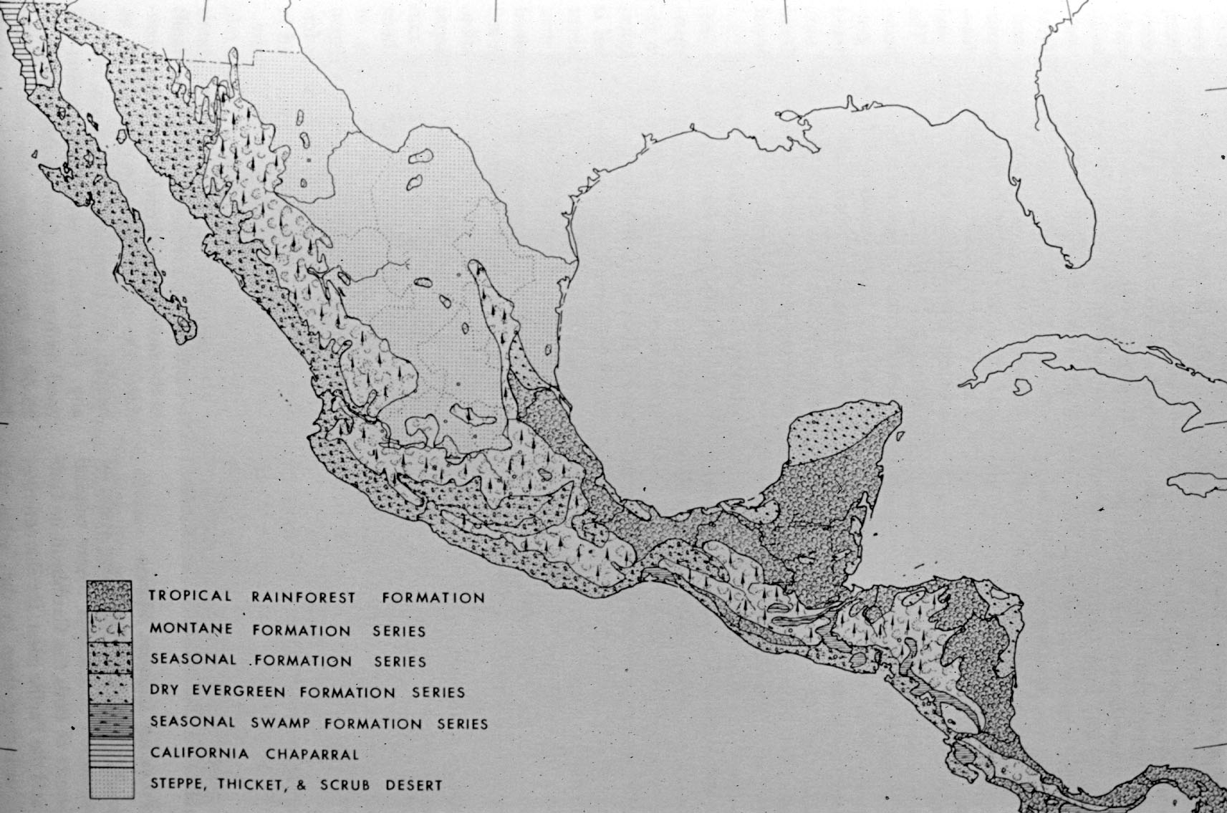
Source: Handbook of Middle American Indians: Natural Environment and Early Cultures, VoL. 1,
Robert Wauchope and Robert C. West, University of Texas Press, 1964
Vegetation

Slide 33
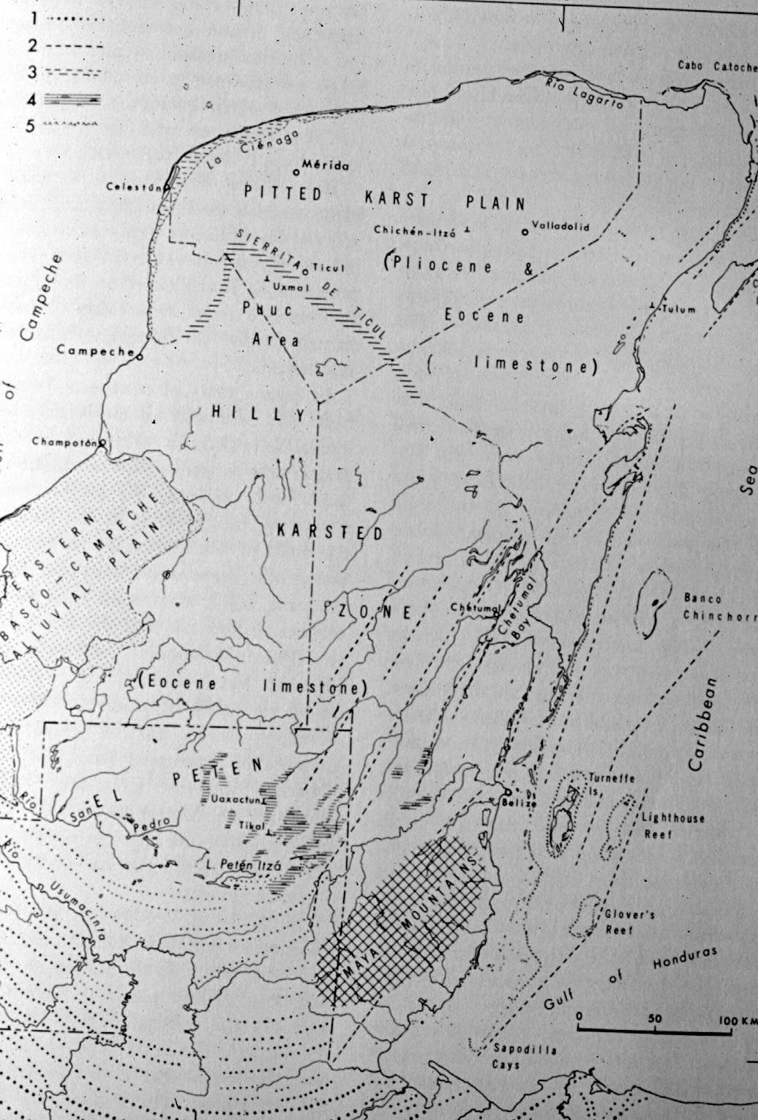
Source: Handbook of Middle American Indians: Natural Environment and Early Cultures, VoL. 1,
Robert Wauchope and Robert C. West, University of Texas Press, 1964
Surface Configuration of the Yucatán Penninsula

Slide 34
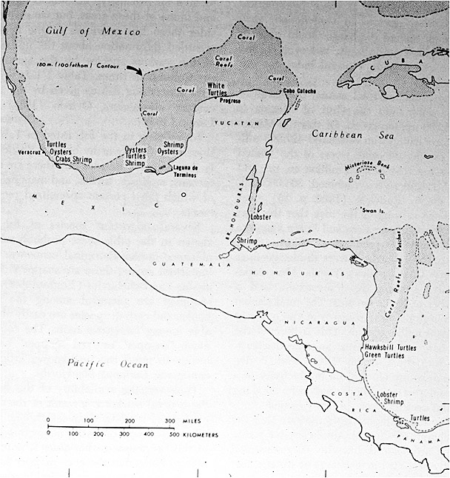
Source: Handbook of Middle American Indians: Natural Environment and Early Cultures, VoL. 1,
Robert Wauchope and Robert C. West, University of Texas Press, 1964
The Continental Shelf and Areas of Certain Fisheries

Slide 35
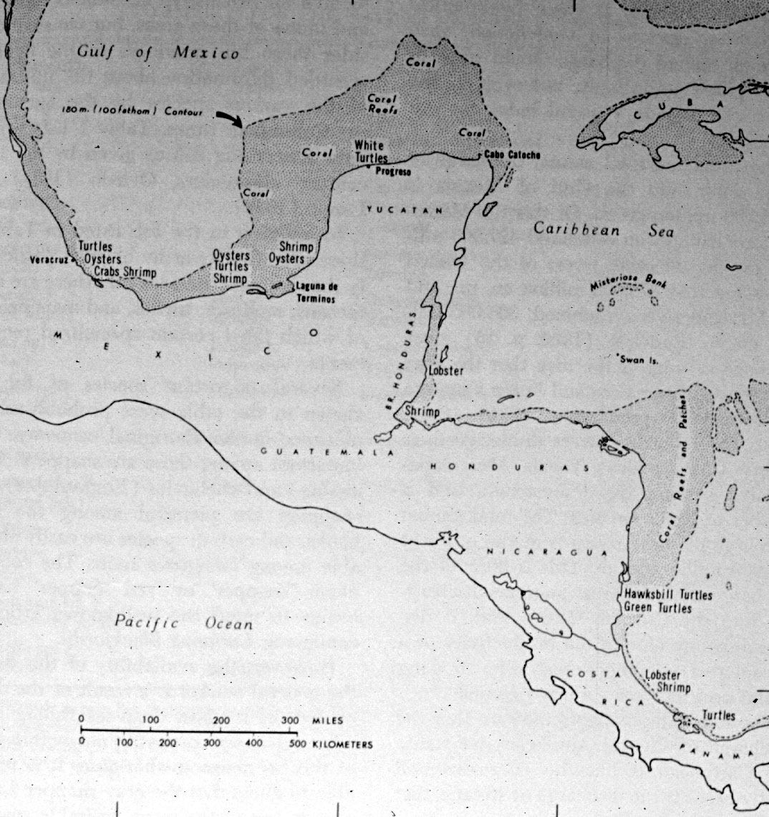
Source: Handbook of Middle American Indians: Natural Environment and Early Cultures, VoL. 1,
Robert Wauchope and Robert C. West, University of Texas Press, 1964
The Continental Shelf and Areas of Certain Fisheries

Slide 36
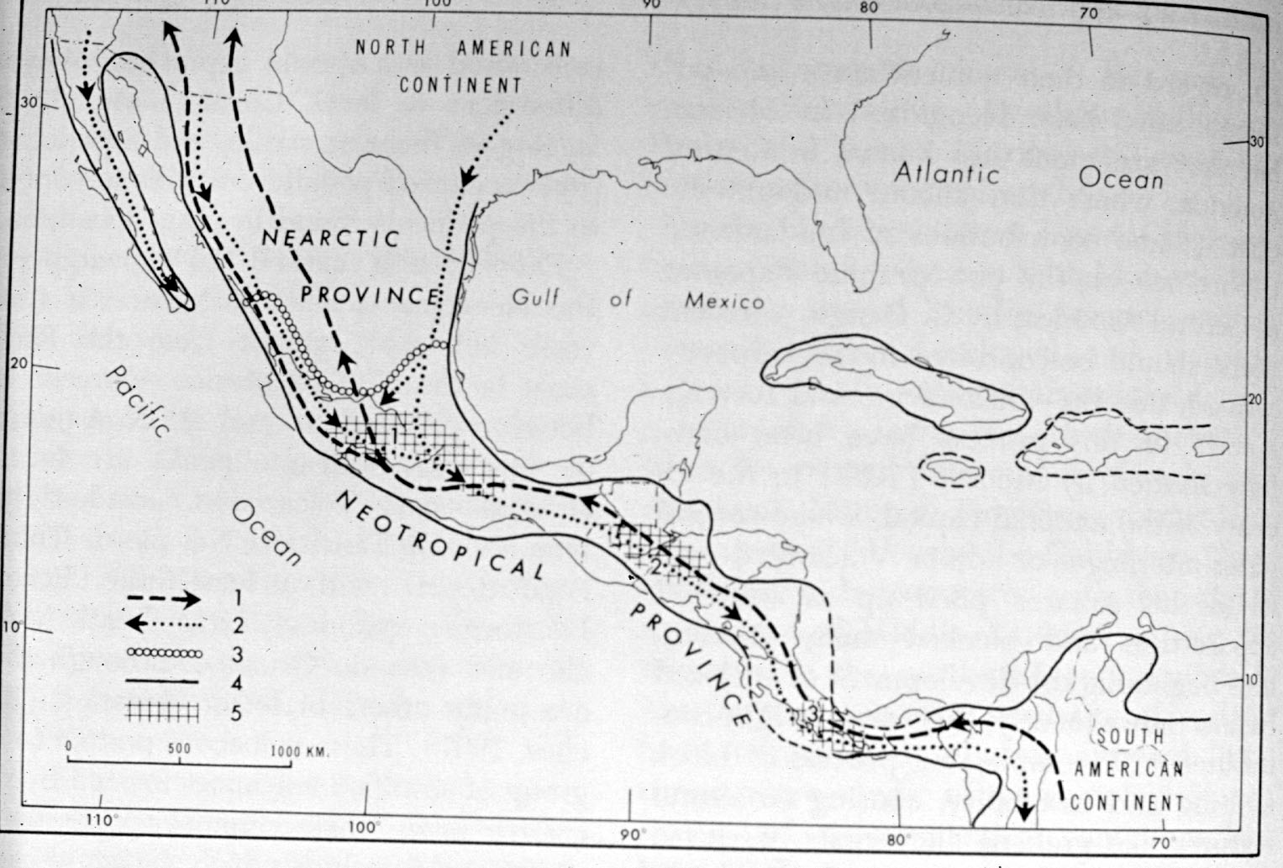
Source: Handbook of Middle American Indians: Natural Environment and Early Cultures, VoL. 1,
Robert Wauchope and Robert C. West, University of Texas Press, 1964
Miocene-Pliocene Routes of Animal Migrations

Slide 37
Tim Roufs
University of Minnesota Duluth
Who Were the First Americas?

Slide 38
Tim Roufs
University of Minnesota Duluth

Slide 39
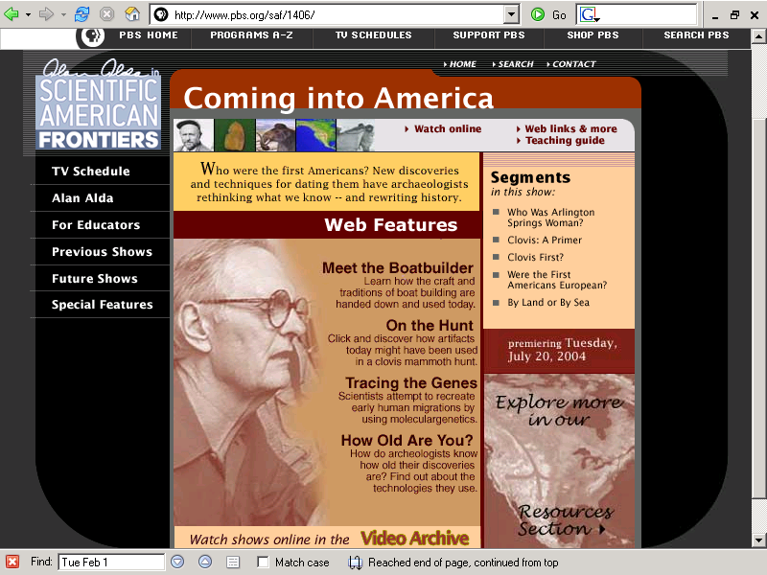
http://www.pbs.org/saf/1406/

Slide 40
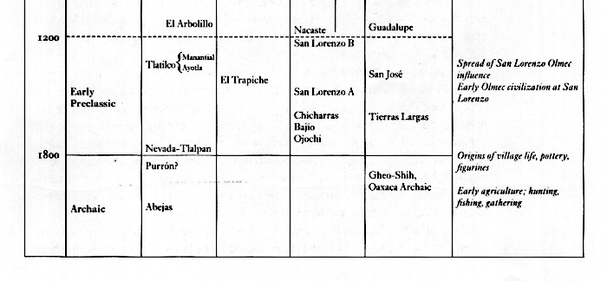
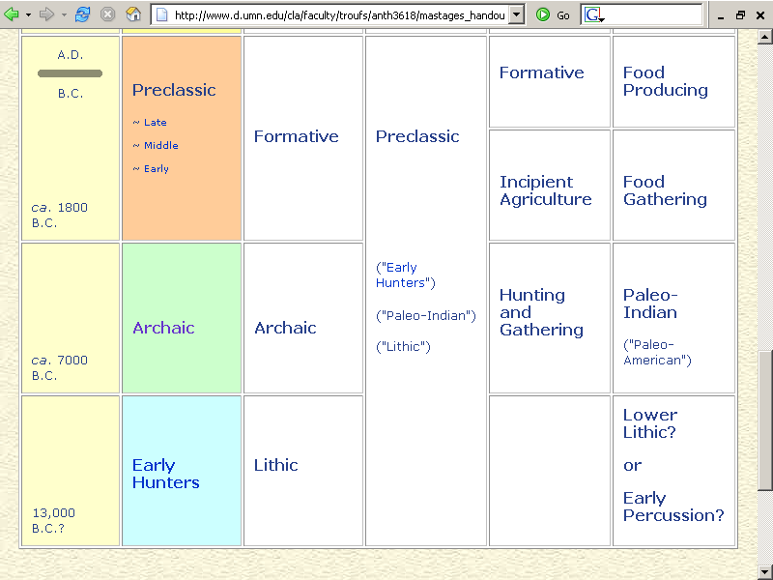
http://www.d.umn.edu/cla/faculty/troufs/anth3618/mastages_handout.html

Slide 41
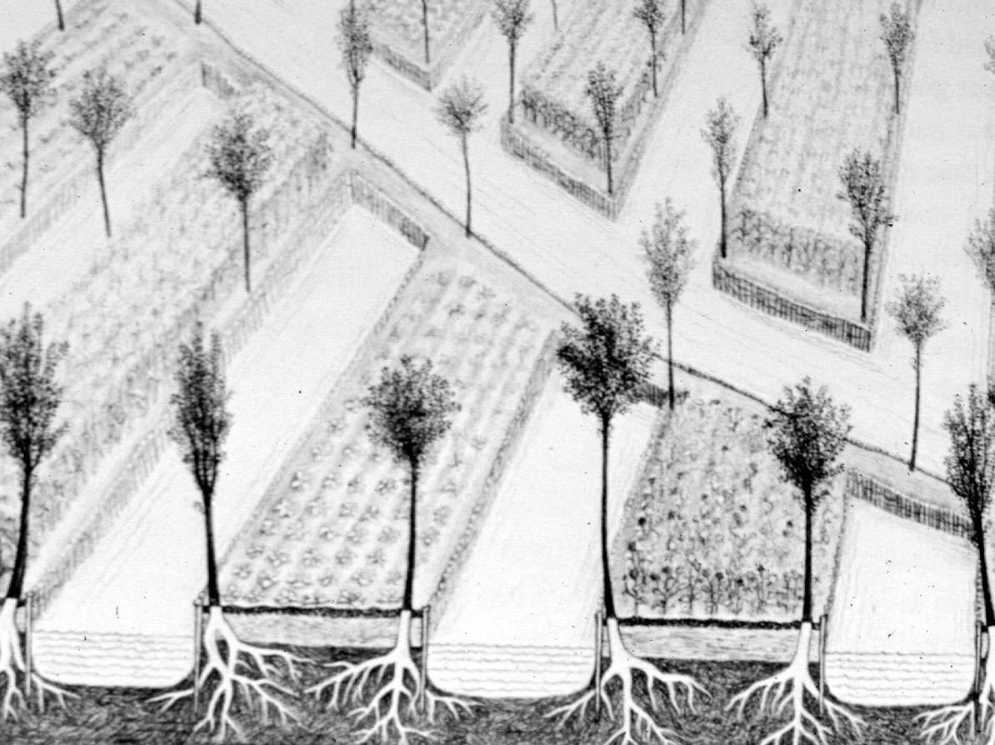
Chinampas

