Slide 1
Before we return to
the “basics”, let’s take
A
Short Walk
Through Vasililka
2006
Ernestine Friedl Vasilika: A Village in Modern Greece Belmont, CA: Thompson Wadsworth, 2002

Slide 2
Before we return to
the “basics”, let’s take
A
Short Walk
Through Vasililka
2006
Ernestine Friedl Vasilika: A Village in Modern Greece Belmont, CA: Thompson Wadsworth, 2002

Slide 3
Main
Characteristics of
Anthropology
Peoples and Cultures of Europe
Tim Roufs
© 2010-2024

Slide 4
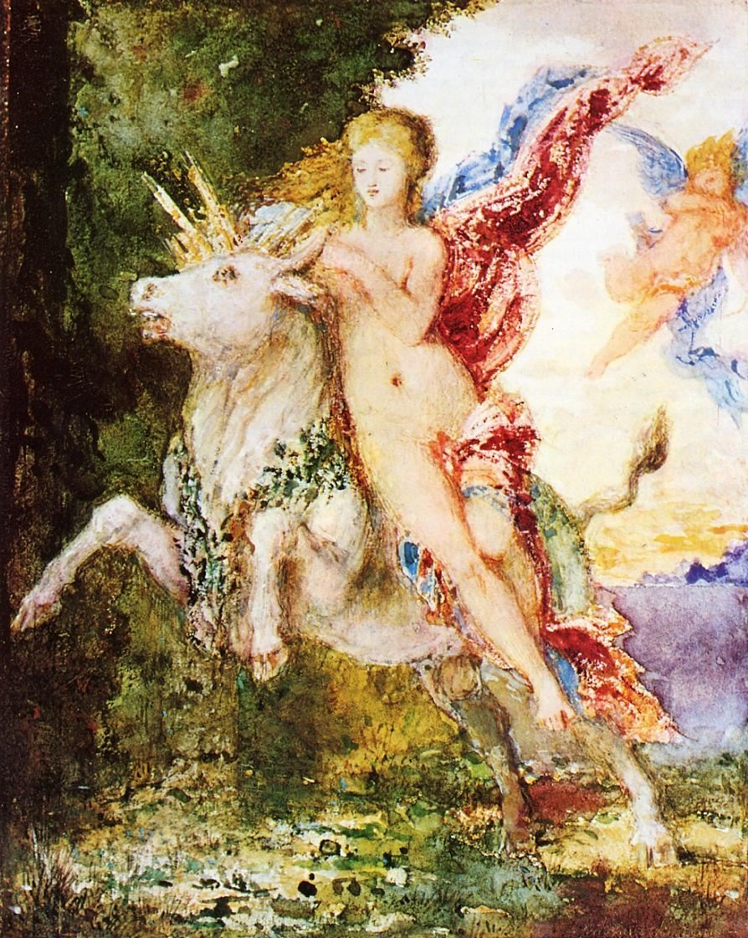
And, once again . . .
Other
Important
Terms
Peoples and Cultures of Europe
Europa and the Bull Gustave Moreau,
c.1869
University of Minnesota Duluth
Tim Roufs’ ©2009-2017
http://www.d.umn.edu/cla/faculty/troufs/anth3635/

Slide 5
Units of Analysis
and Anthropological Concepts of Europe
©Timothy G. Roufs 2009-2017

Slide 6
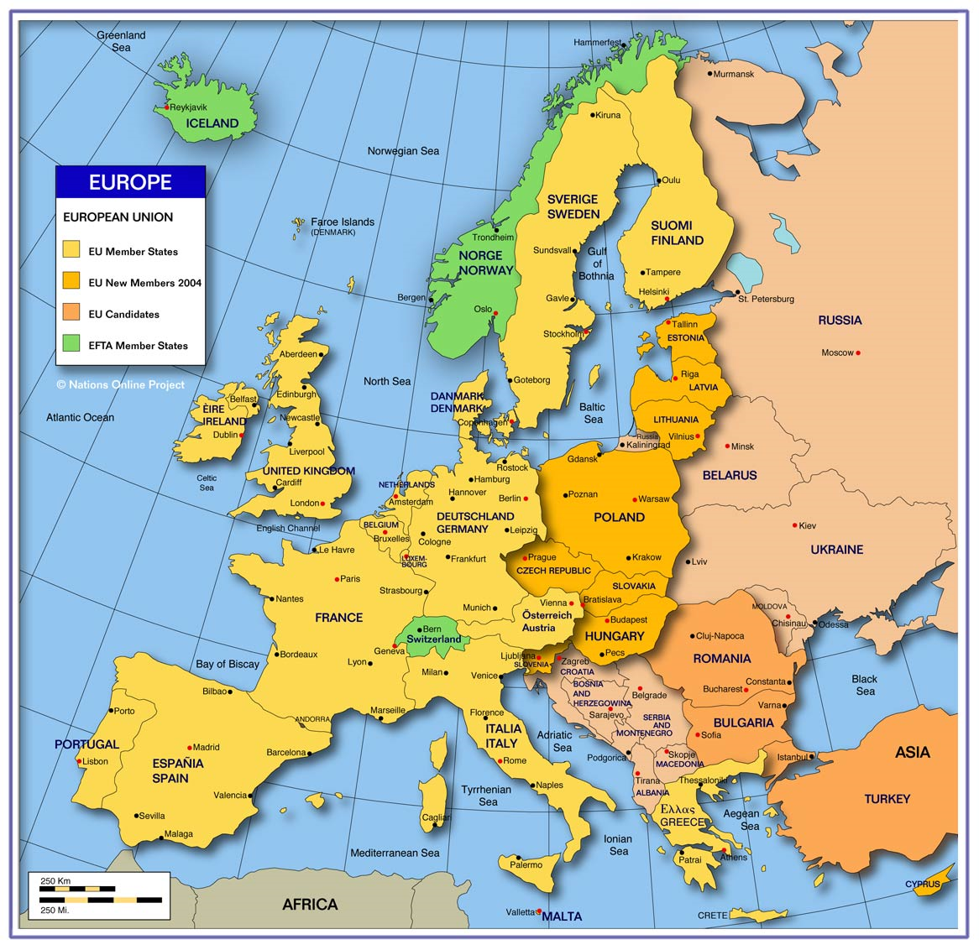
Three Major
Perennial
Debates
Peoples and Cultures of Europe
Tim Roufs
© 2010-2024
http://www.ezilon.com/european_maps.htm

Slide 7
“Master Ethnographic Texts”
“Classics” in the Anthropology of Europe and related studies
Tim Roufs
© 2010-2024

Slide 8
Main
Characteristics of
Anthropology
Peoples and Cultures of Europe
Tim Roufs
© 2010-2024

Slide 9
Main Characteristics of Anthropology
1. the four fields of general anthropology
culture as a primary concept
comparative method as major approach development and structure
holism as a primary theoretical goal
fieldwork as a primary research technique

Slide 10
Compare . . .
Main Characteristics
comparative method
One form of comparative method was pioneered by Fred Eggan
(University of Chicago)
“Social anthropology and the method of controlled comparison”
American Anthropologist, 56:743-61 (1954)

Slide 11
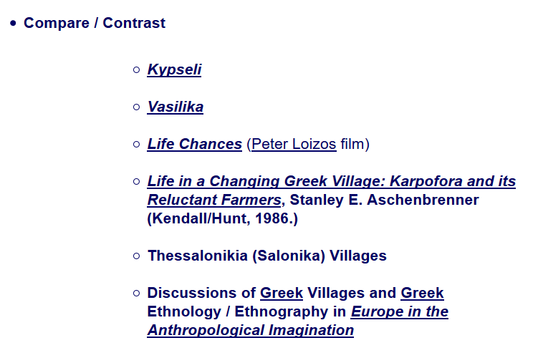

Slide 13
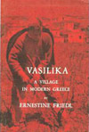
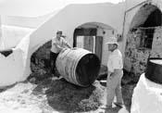
for e.g., we’re going to compare three Greek villages . . .
Kypseli
Vasilika
Peter Loizos’ village in Crete

Slide 14
and . . .
Karporfora (Stan Aschenbrenner)
Thessalonikia (Salonika)
Duluth, Minnesota (Greek-Americans)

Slide 15
and . . .
Villages in the Republic of Ireland (the textbook, Nan)
Villages in Italy (A Crisis of Births, by Krause)

Slide 16
and . . .
Inish Óirr, in the Aran Islands, off the west coast of Ireland
Gyönk, and other villages in Hungary
Italy

Slide 17
Ernestine Friedl Vasilika: A Village in Modern Greece Belmont, CA: Thompson Wadsworth, 2002

Slide 18
A
Short Walk
Through Vasililka
2006
Ernestine Friedl Vasilika: A Village in Modern Greece Belmont, CA: Thompson Wadsworth, 2002

Slide 19
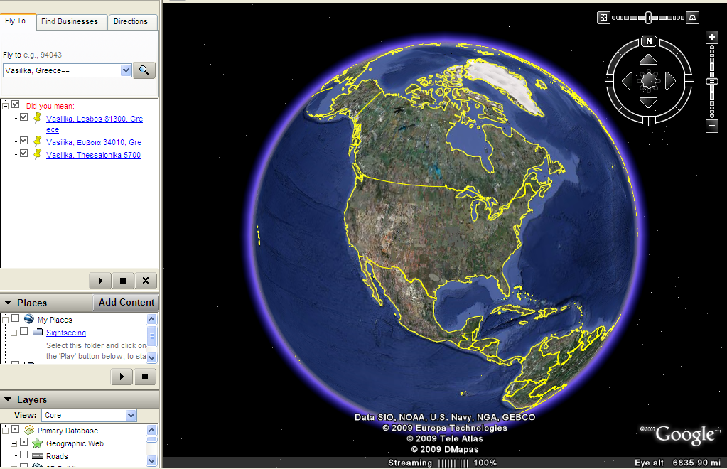
Notes:
19

Slide 20
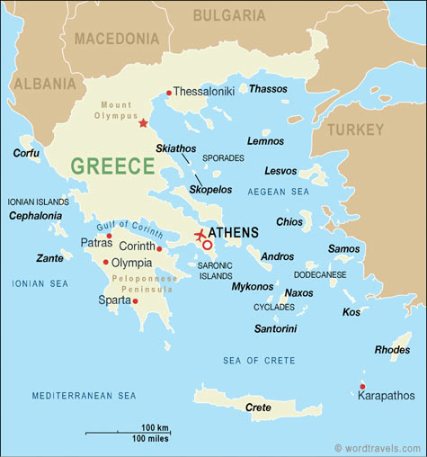
“Our”
Vasilika
Delphi

Slide 21
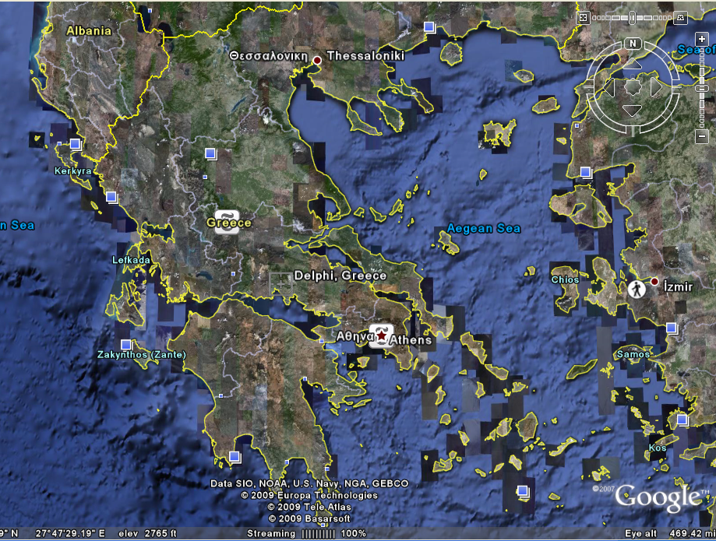

Slide 22
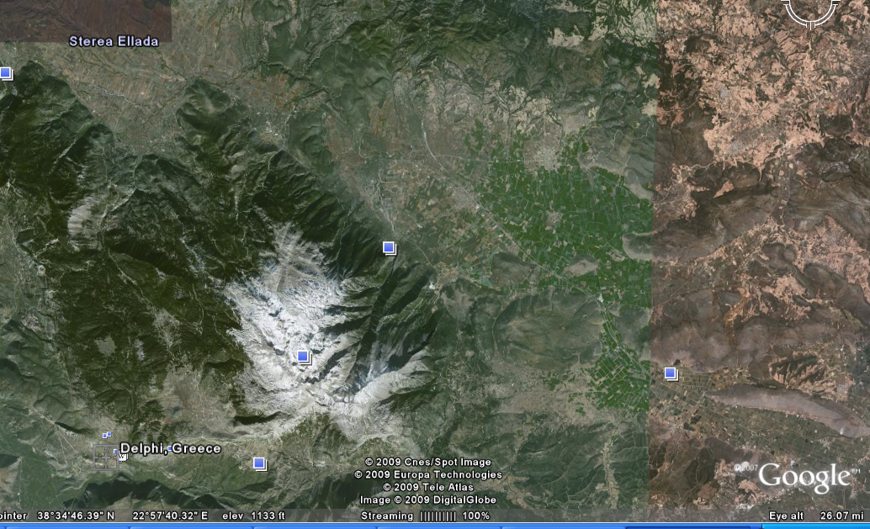
Mount Parnassus

Slide 23
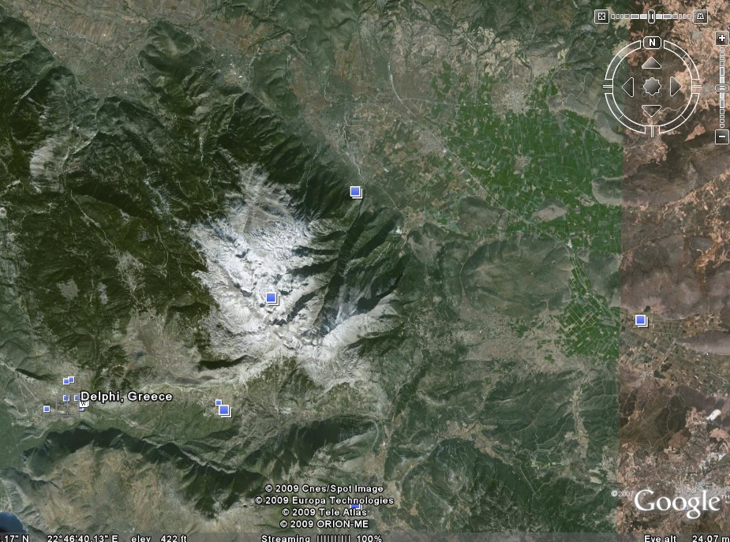
Mount Parnassus

Slide 24
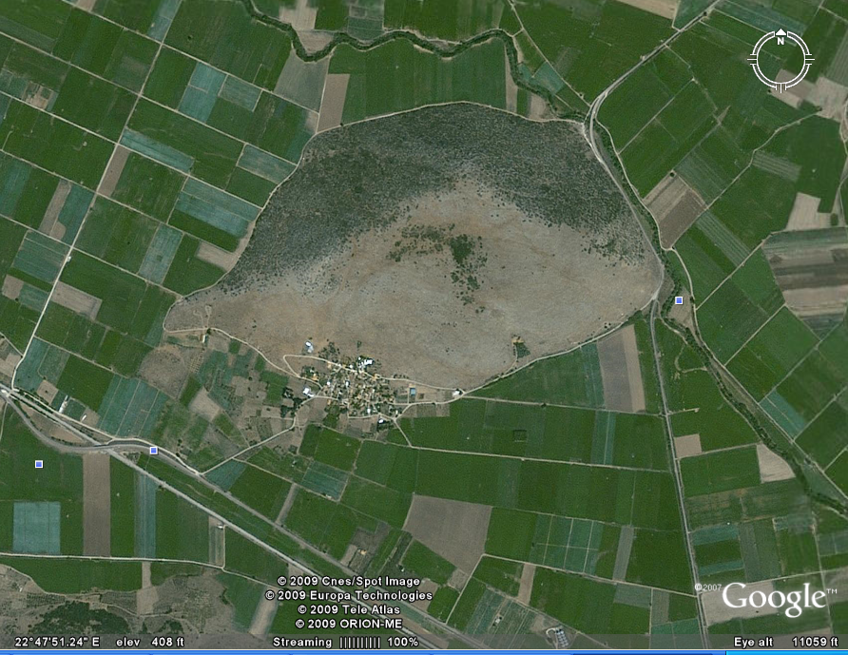

Slide 25
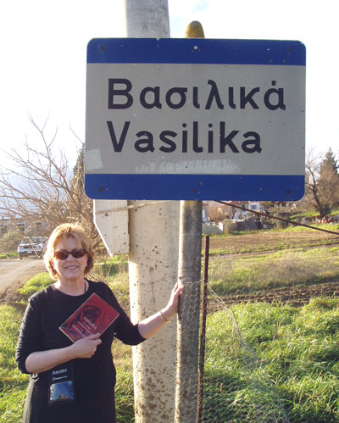
Vasilika, Greece
2006

Slide 26
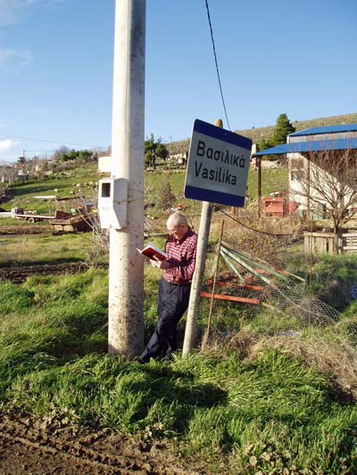
Vasilika, Greece
2006

Slide 27
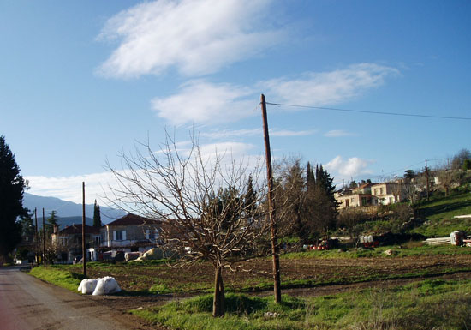
Vasilika, Greece
2006

Slide 28
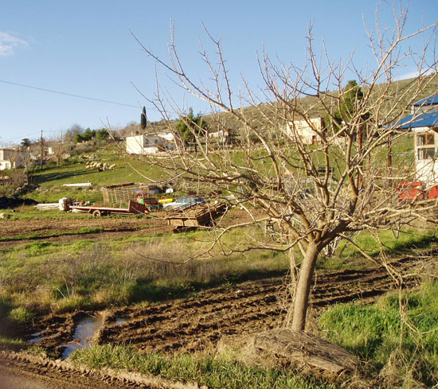
Vasilika, Greece
2006

Slide 29
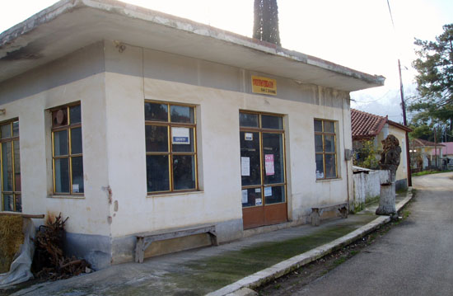
Vasilika, Greece
2006

Slide 30
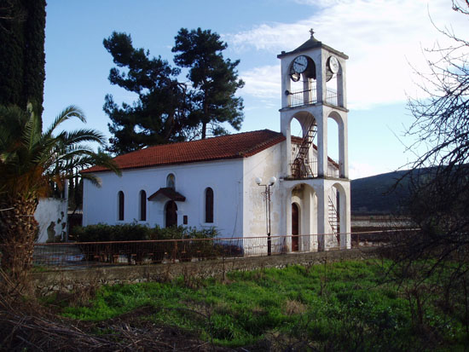
Vasilika, Greece
2006

Slide 31
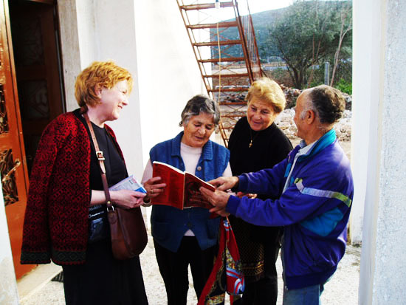
Vasilika, Greece
2006

Slide 32
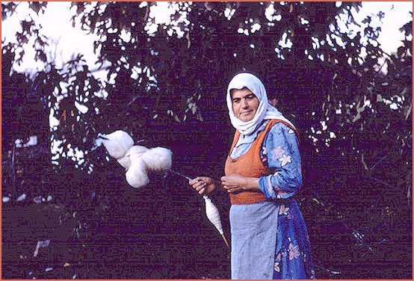
Vasilika, Greece
Ernesting Friedl 1962
(SAE)
www.h-net.org/~sae/sae/slides/index.htm

Slide 33
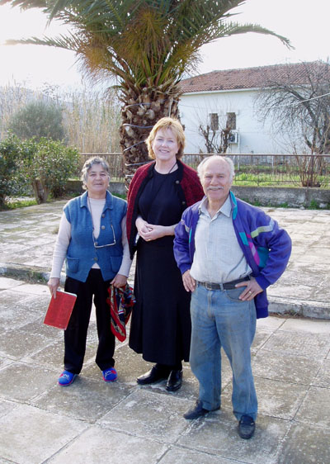
Vasilika, Greece
2006
Vasilika

Slide 34
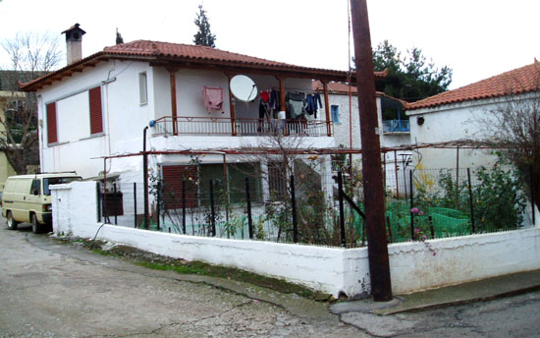
Vasilika, Greece
2006

Slide 35
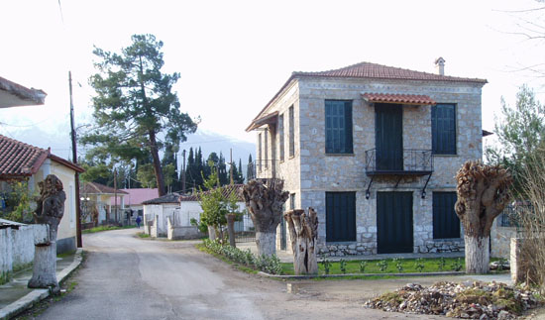
Vasilika, Greece
2006

Slide 36
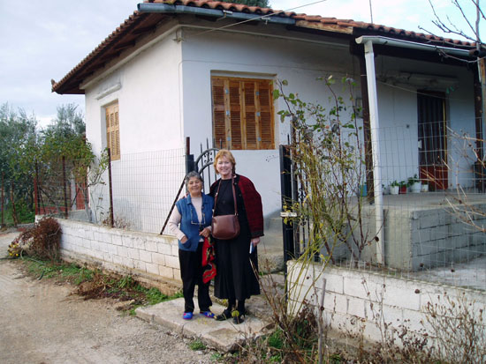
Vasilika, Greece
2006

Slide 37
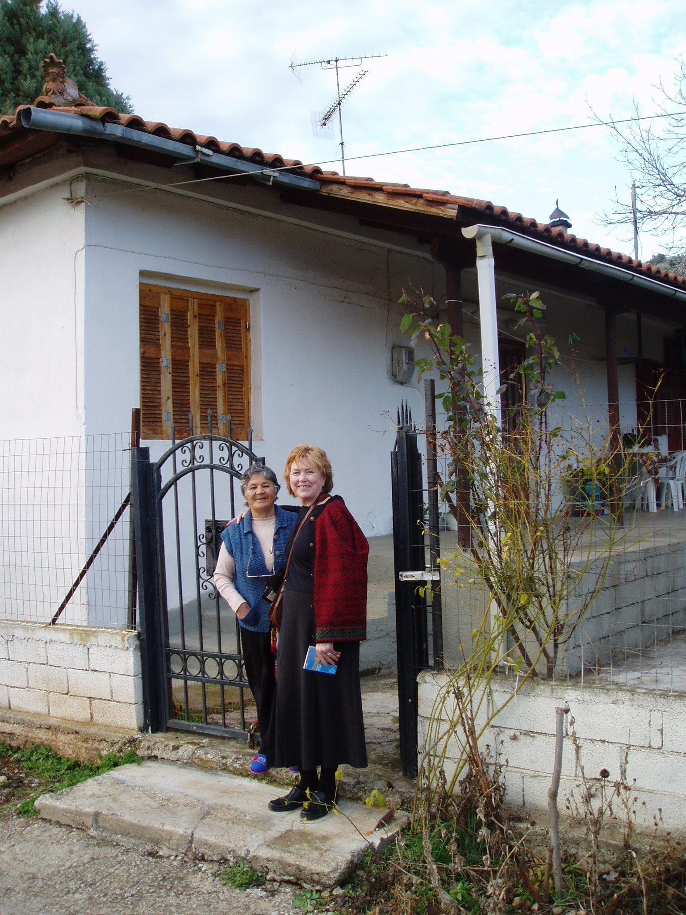
Vasilika, Greece
2006
Vasilika

Slide 38
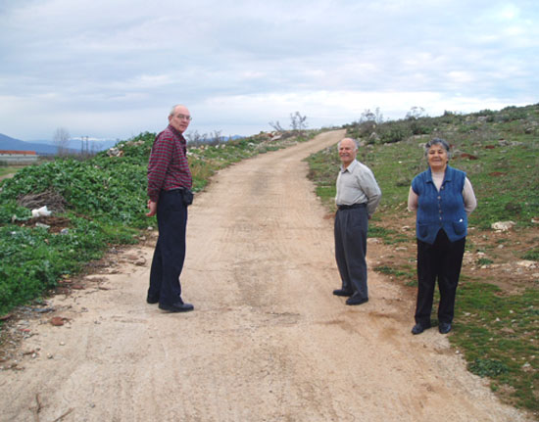
Vasilika, Greece
2006

Slide 39
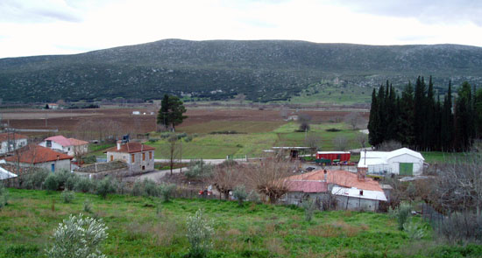
Vasilika, Greece
2006

Slide 40
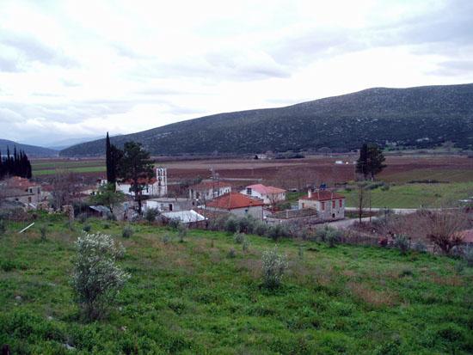
Vasilika, Greece
2006

Slide 41
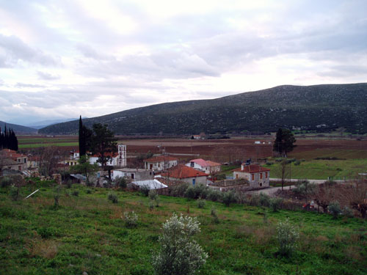
Vasilika, Greece
2006

Slide 42
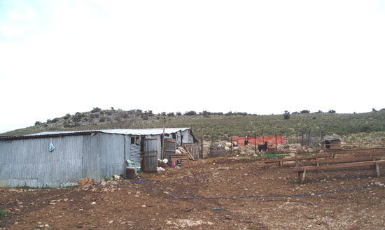
Vasilika, Greece
2006

Slide 43
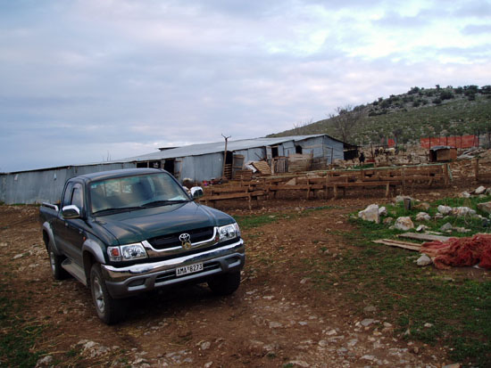
Vasilika, Greece
2006

Slide 44
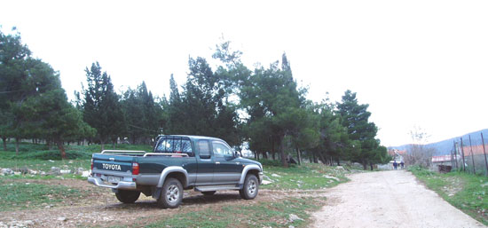
Vasilika, Greece
2006

Slide 45
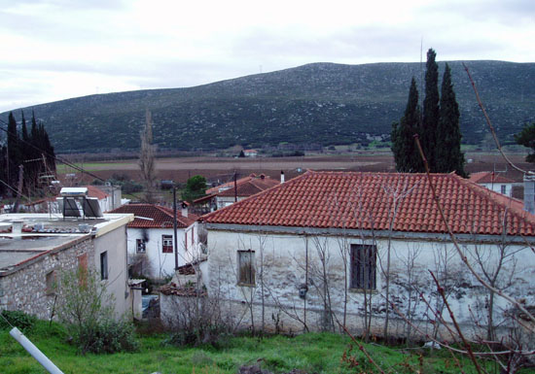
Vasilika, Greece
2006

Slide 46
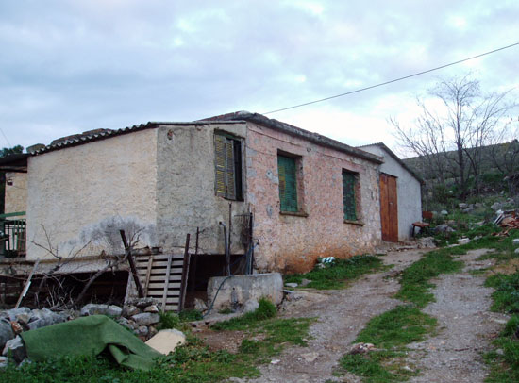
Vasilika, Greece
2006

Slide 47
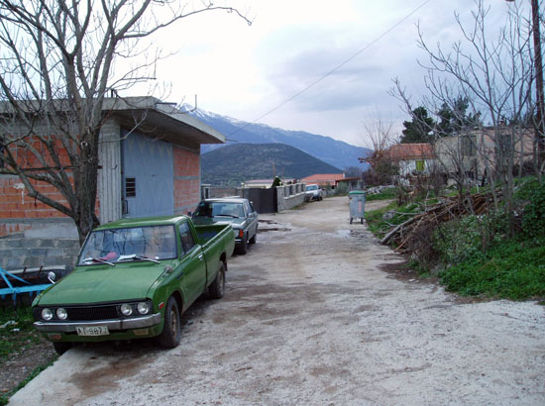
Vasilika, Greece
2006

Slide 48
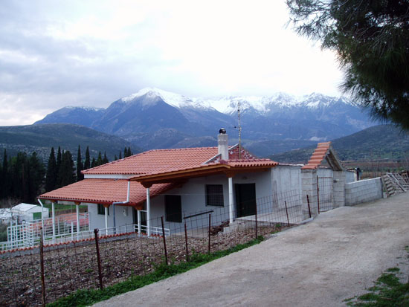
Vasilika, Greece
2006

Slide 49
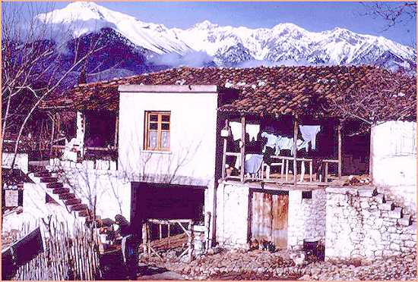
Vasilika, Greece
Ernesting Friedl 1962
(SAE)
www.h-net.org/~sae/sae/slides/index.htm

Slide 50
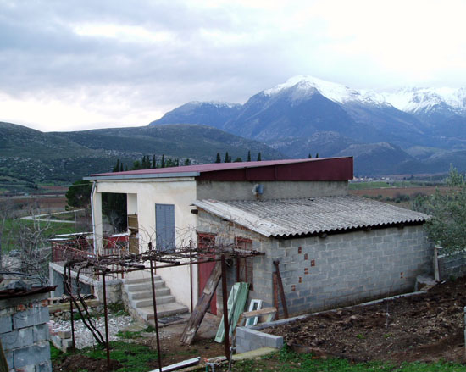
Vasilika, Greece
2006

Slide 51
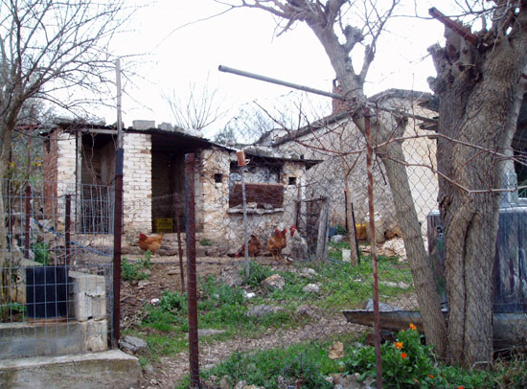
Vasilika, Greece
2006

Slide 52
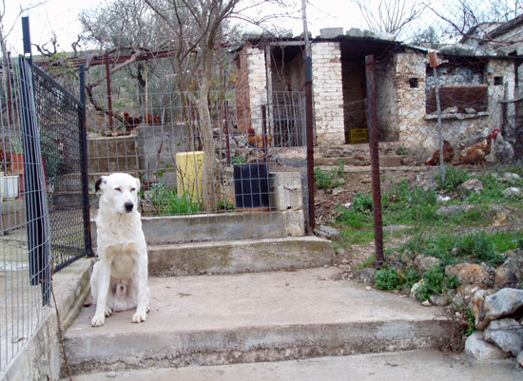
Vasilika, Greece
2006

Slide 53
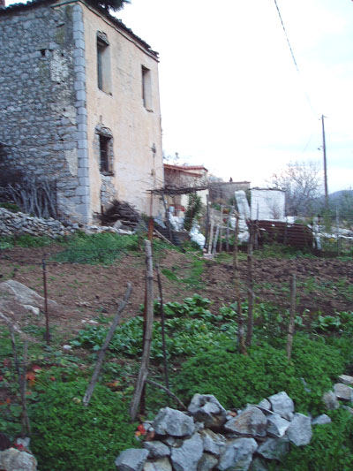
Vasilika, Greece
2006

Slide 54
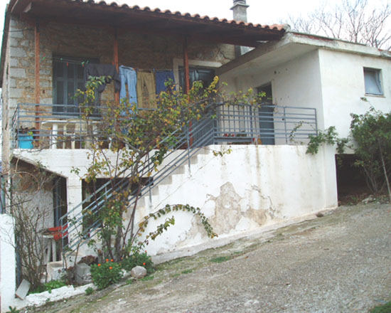
Vasilika, Greece
2006

Slide 55
Vasilika, Greece
Ernesting Friedl 1962
(SAE)
www.h-net.org/~sae/sae/slides/index.htm

Slide 56
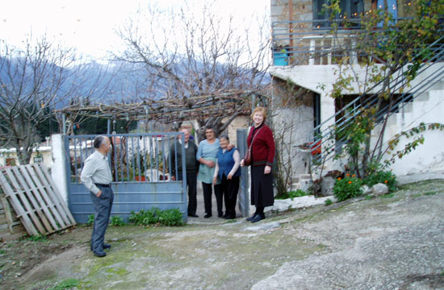
Vasilika, Greece
2006

Slide 57
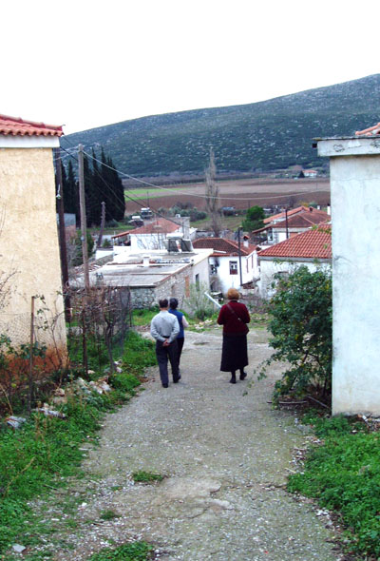
Vasilika, Greece
2006

Slide 58
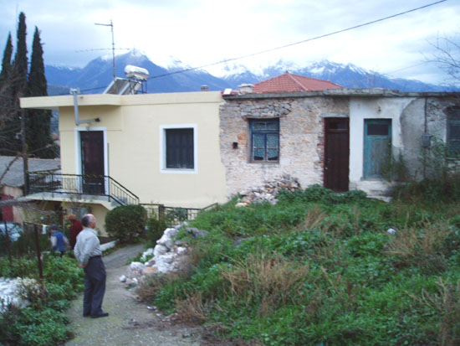
Vasilika, Greece
2006

Slide 59
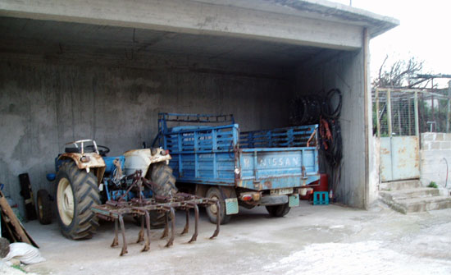
Vasilika, Greece
2006

Slide 60
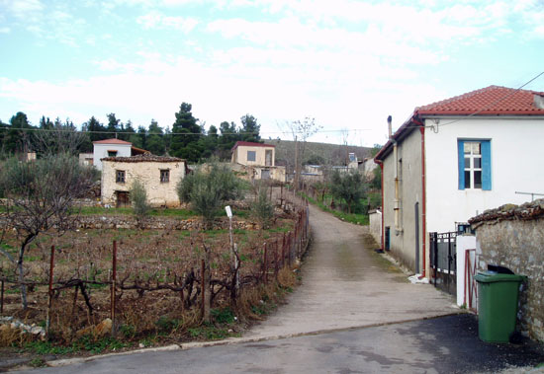
Vasilika, Greece
2006

Slide 61
Vasilika, Greece
2006

Slide 62
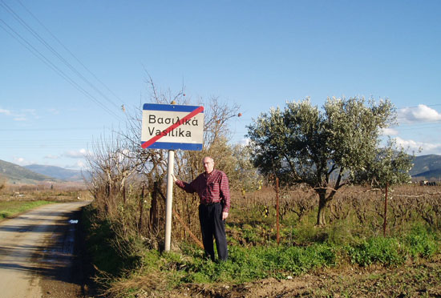
Vasilika, Greece
2006

Slide 63
Vasilika, Greece
2006

Slide 64
Ernestine Friedl Vasilika: A Village in Modern Greece Belmont, CA: Thompson Wadsworth, 2002

Slide 65
Ernestine Friedl Women and Men: An Anthropologist's View. Holt, Rinehart and Winston, 1975
Waveland Press, 1984.

Slide 66
Ernestine Friedl "Society and Sex Roles," Human nature

Slide 67
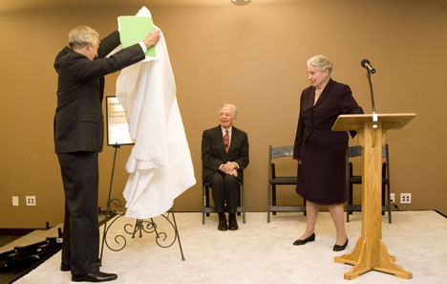
“Friedl’s fieldwork in a Greek village was the first published study on modern Greece. Other pathbreaking works uses the tools of anthropology
to explore gender roles.”
Humanities Building Named after Ernestine Friedl Duke University 20 February 2008

Slide 68
Ernestine Friedl Vasilika: A Village in Modern Greece Belmont, CA: Thompson Wadsworth, 2002

