Slide 1
A Note on
Anthropology in Europe
or
Anthropology of Europe ?
. . . Some Trends
After Susan Parman, Europe in the Anthropological Imagination, pp. 11 - 14
©Timothy G. Roufs 2010

Slide 2
in the 1970s anthropologists became caught up in a surge of interest in world systems, processes that could be described independent of particular “culture areas”
Susan Parman, Europe in the Anthropological Imagination, pp. 14 - 16

Slide 3
in the 1970s anthropologists became caught up in a surge of interest in world systems, processes that could be described independent of particular “culture areas”
Susan Parman, Europe in the Anthropological Imagination, pp. 14 - 16

Slide 4
urbanism
transnationalism
gender issues
migration
Susan Parman, Europe in the Anthropological Imagination, pp. 14 - 16

Slide 5
these were universal processes, and anthropology was conceived of as a universal science of humankind
not just of the exotic, non-Western, savage “Other”
Susan Parman, Europe in the Anthropological Imagination, pp. 14 - 16

Slide 6
these were universal processes, and anthropology was conceived of as a universal science of humankind
not just of the exotic, non-Western, savage “Other”
Susan Parman, Europe in the Anthropological Imagination, pp. 14 - 16

Slide 7
as Caroline B. Brettell notes, urban anthropology began to appear as a distinct subdiscipline in the early 1970s, as indicated by the appearance of a new journal in 1972, and the publication of edited collections
Susan Parman, Europe in the Anthropological Imagination, pp. 14 - 16

Slide 8
as Caroline B. Brettell notes, urban anthropology began to appear as a distinct subdiscipline in the early 1970s, as indicated by the appearance of a new journal in 1972, and the publication of edited collections
Susan Parman, Europe in the Anthropological Imagination, pp. 14 - 16

Slide 9
another topic of interest was
migration
Susan Parman, Europe in the Anthropological Imagination, pp. 14 - 16

Slide 10
William A. Douglass argues that despite the appearance of the isolated peasant community as the typical focus of early Europeanist anthropology, the theme of migration was a constant thread . . .
Susan Parman, Europe in the Anthropological Imagination, pp. 14 - 16

Slide 11
William A. Douglass argues that despite the appearance of the isolated peasant community as the typical focus of early Europeanist anthropology, the theme of migration was a constant thread . . .
Susan Parman, Europe in the Anthropological Imagination, pp. 14 - 16

Slide 12
Douglass extracts comments from ...
Arensberg’s Irish Countryman
the earliest example of anglophone Europeanist anthropology
Pitt-Rivers’s People of the Sierra
“anglophone Europeanist anthropology’s quintessential and most influential little community study”
Susan Parman, Europe in the Anthropological Imagination, pp. 14 - 16

Slide 13
Caroline Brettell notes that the 1970s also saw the beginning not only of urban anthropology but also of gender studies
e.g., Rosaldo and Lamphere 1974
Susan Parman, Europe in the Anthropological Imagination, pp. 14 - 16

Slide 14
Caroline Brettell notes that the 1970s also saw the beginning not only of urban anthropology but also of gender studies
e.g., Rosaldo and Lamphere 1974
Susan Parman, Europe in the Anthropological Imagination, pp. 14 - 16

Slide 15
today issues of gender in Europe vary from
honor and shame in the Mediterranean to . . .
general issues of the status of women
their power
their role in migration
the construction of gender identity
the poetics of genders
Susan Parman, Europe in the Anthropological Imagination, pp. 14 - 16

Slide 16
thus from one point of view, one could argue that during the 1970s the anthropological study of Europe (or any culture area, for that matter) was irrelevant in “the anthropological imagination”
Susan Parman, Europe in the Anthropological Imagination, pp. 14 - 16

Slide 17
processes were universal
where they took place was of interest only in providing additional evidence about the nature of the processes themselves
Susan Parman, Europe in the Anthropological Imagination, pp. 14 - 16

Slide 18
processes were universal
where they took place was of interest only in providing additional evidence about the nature
of the processes themselves
Susan Parman, Europe in the Anthropological Imagination, pp. 14 - 16

Slide 19
on the other hand, going to Europe was essential in “the anthropological imagination” because it validated the universality of anthropological models
thus separating it from its image as a discipline relevant only to the study of the exotic, the “primitive,” and the non-West
Susan Parman, Europe in the Anthropological Imagination, pp. 14 - 16

Slide 20
on the other hand, going to Europe was essential in the “anthropological imagination” because it validated the universality of anthropological models
thus separating it from its image as a discipline relevant only to the study of the exotic, the “primitive,” and the non-West
Susan Parman, Europe in the Anthropological Imagination, pp. 14 - 16

Slide 21
in choosing to go to Europe, Susanna Hoffman, producer of the film Kypseli, was testing the question of universality of anthropological models
Susan Parman, Europe in the Anthropological Imagination, pp. 14 - 16

Slide 22
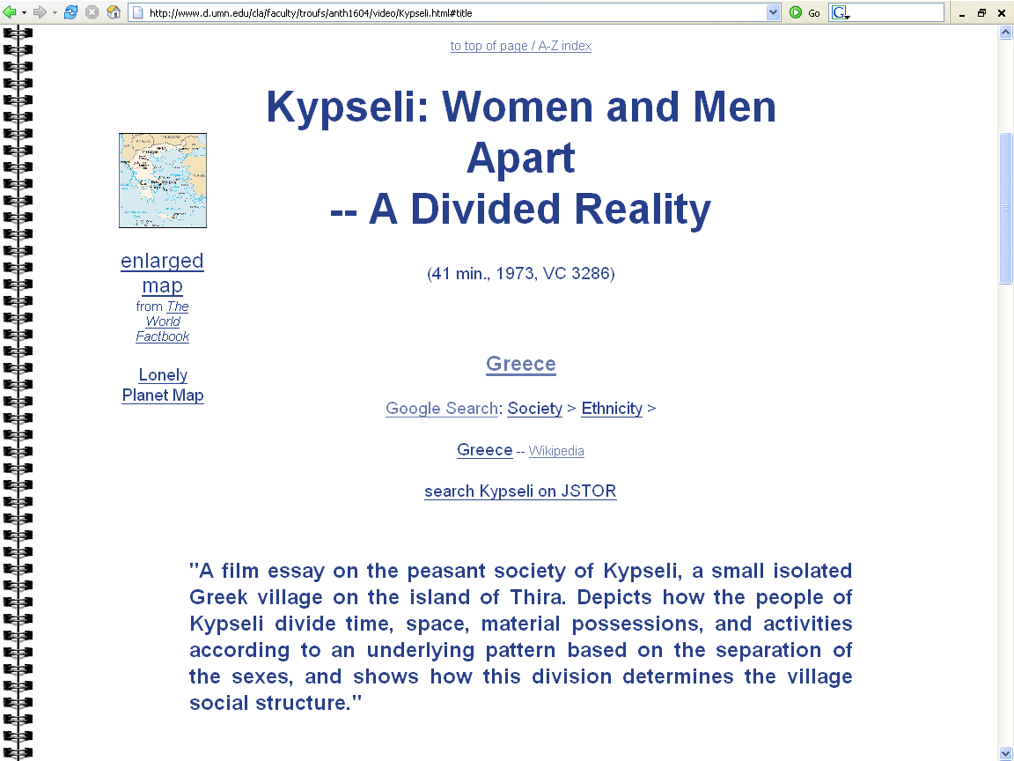

Slide 23
the “point of anthropology,” she said, was “to roll like a juggernaut across all landscapes toward the goal of describing the cross-cultural process of humankind”
Susan Parman, Europe in the Anthropological Imagination, pp. 14 - 16

Slide 24
according to Mark T. Shutes, this same motivation lay behind George Peter Murdock attempting to add more European material to the Human Relations Area Files, so as to expand the scope of ethnographic examples
Susan Parman, Europe in the Anthropological Imagination, pp. 14 - 16

Slide 25
according to Mark T. Shutes, this same motivation lay behind George Peter Murdock attempting to add more European material to the Human Relations Area Files, so as to expand the scope of ethnographic examples
Susan Parman, Europe in the Anthropological Imagination, pp. 14 - 16

Slide 27
You will read more about this in
Ch. 12 “The Place of Europe in
George P. Murdock's Anthropological Theory”
Mark T. Shutes, pp. 157-168
Which is on the reading schedule for
Tuesday 20 April 2010

Slide 28
we sometimes include Europe in anthropology as a “Culture Area” specifically because we want
to test the universality of anthropological models
Hoffman
Shutes
Susan Parman, Europe in the Anthropological Imagination, pp. 14 - 16

Slide 29
we sometimes include Europe in anthropology as a “Culture Area” specifically because we want
to test the universality of anthropological models
Hoffman
Shutes
Susan Parman, Europe in the Anthropological Imagination, pp. 14 - 16

Slide 31
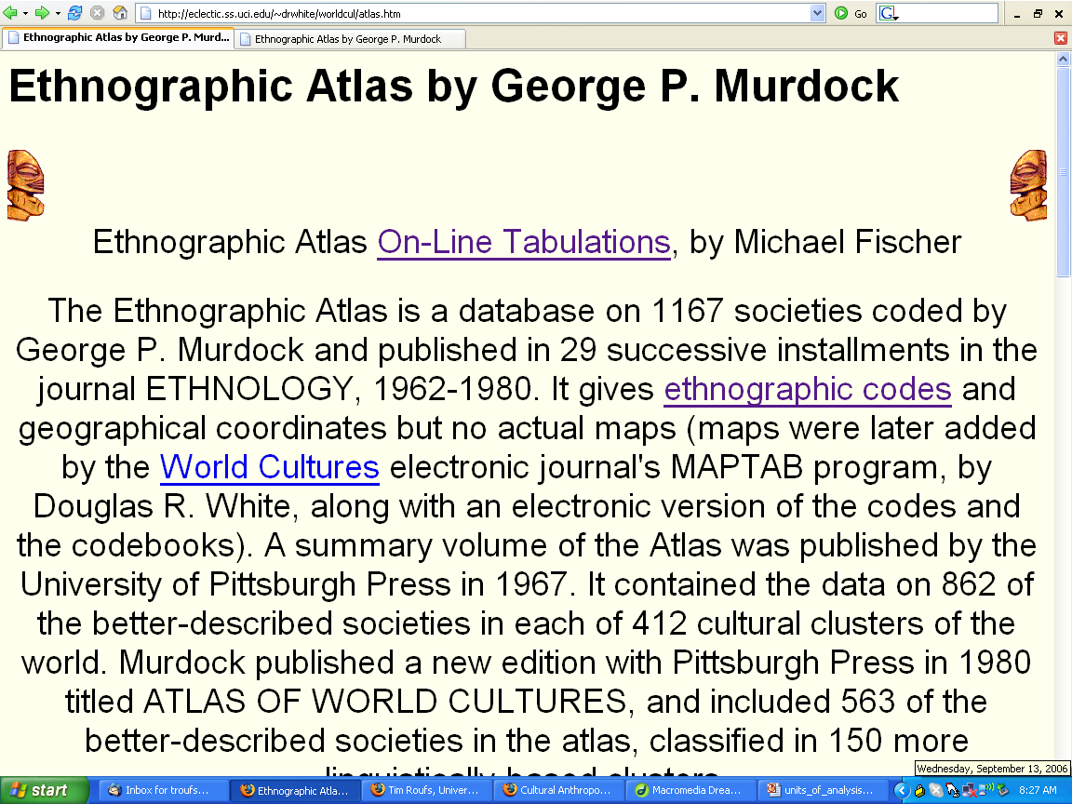
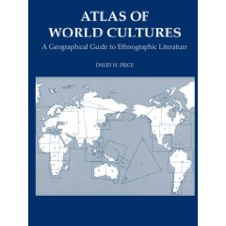
http://eclectic.ss.uci.edu/~drwhite/worldcul/atlas.htm

Slide 32
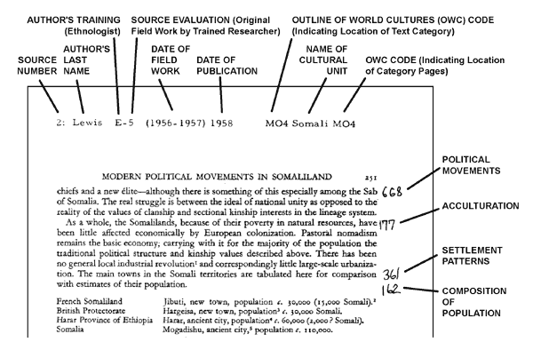
www.library.uiuc.edu/edx/gif/PaperFileKey_forWeb.gif

Slide 33
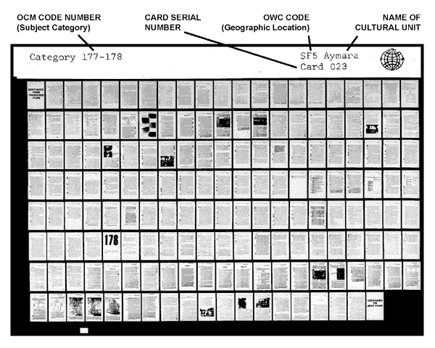
www.library.uiuc.edu/edx/gif/PaperFileKey_forWeb.gif

Slide 34
http://lucy.ukc.ac.uk/cgi-bin/uncgi/Ethnoatlas/atlas.vopts

Slide 35
http://lucy.ukc.ac.uk/cgi-bin/uncgi/Ethnoatlas/atlas.vopts

Slide 36
http://lucy.ukc.ac.uk/cgi-bin/uncgi/Ethnoatlas/atlas.vopts

Slide 37
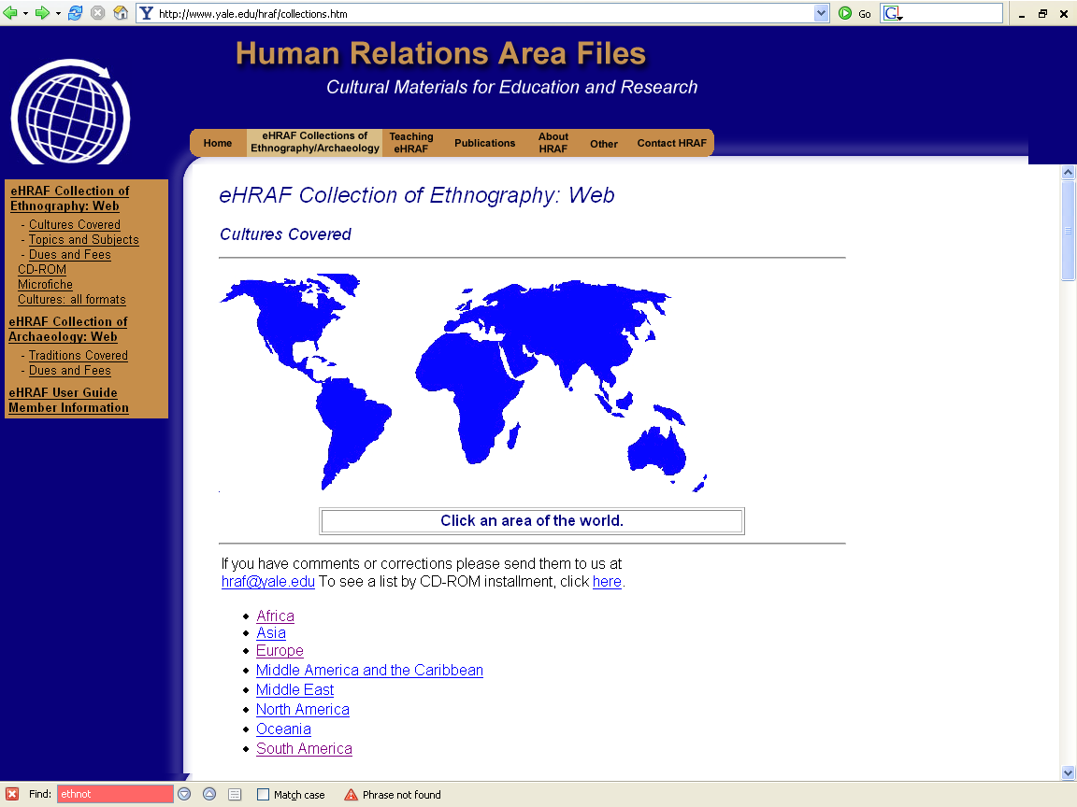
http://www.yale.edu/hraf/collections.htm

Slide 38
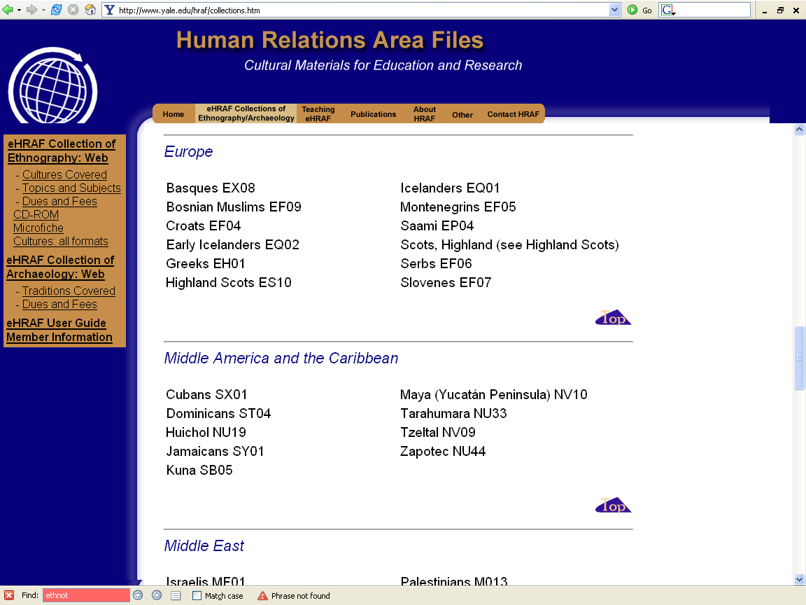
http://www.yale.edu/hraf/collections.htm

Slide 39
http://www.perpetualvisions.com/nativeamericans/short-talk/overview-of-talk.html

Slide 40
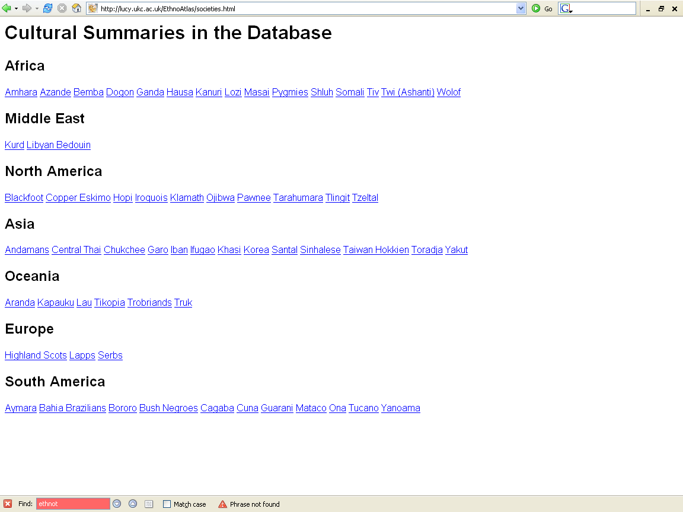
Mesoamerica
http://lucy.ukc.ac.uk/cgi-bin/uncgi/Ethnoatlas/atlas.vopts

Slide 41
on the other hand, going to Europe was essential in the anthropological imagination because it validated the universality of anthropological models
thus separating it from its image as a discipline relevant only to the study of the exotic, the “primitive,” and the non-West
Susan Parman, Europe in the Anthropological Imagination, pp. 14 - 16

Slide 42
on the other hand, going to Europe was essential in the “anthropological imagination” because it validated the universality of anthropological models
thus separating it from its image as a discipline relevant only to the study of the exotic, the “primitive,” and the non-West
Susan Parman, Europe in the Anthropological Imagination, pp. 14 - 16

Slide 43
on the other hand, going to Europe was essential in the anthropological imagination because it validated the universality of anthropological models
thus separating it from its image as a discipline relevant only to the study of the exotic, the “primitive,” and the non-West
Susan Parman, Europe in the Anthropological Imagination, pp. 14 - 16

Slide 44
according to Mark T. Shutes, this same motivation lay behind George Peter Murdock attempting to add more European material to the Human Relations Area Files, so as to expand the scope of ethnographic examples
Susan Parman, Europe in the Anthropological Imagination, pp. 14 - 16

Slide 47
one can argue that studying Europe was a byproduct of the expanding interest of anthropologists in all cultures, including those of the West
Susan Parman, Europe in the Anthropological Imagination, pp. 14 - 16

Slide 48
as David I. Kertzer notes, “Studying peoples in the ‘west’ ... promises a way to recapture the generalizing aspirations of our discipline”
Susan Parman, Europe in the Anthropological Imagination, pp. 14 - 16

Slide 49
but it is also important to point out that the very fact of studying Europe made it easier to ask certain kinds of questions . . .
Susan Parman, Europe in the Anthropological Imagination, pp. 14 - 16

Slide 50
for example, given assumptions about Westerners, it may be easier to pose research problems emphasizing decision-making individuals . . .
Susan Parman, Europe in the Anthropological Imagination, pp. 14 - 16

Slide 51
for example, given assumptions about Westerners, it may be easier to pose research problems emphasizing decision-making individuals ...
Susan Parman, Europe in the Anthropological Imagination, pp. 14 - 16

Slide 52
it is also possible that new areas of interest can be more easily explored in Europe
because Europe was not recognized as an acceptable, fully authentic, legitimate place for an anthropologist to do anthropological fieldwork …
the European Union (EU) for example
Susan Parman, Europe in the Anthropological Imagination, pp. 14 - 16

Slide 53
therefore, if an anthropologist works in Europe, it is more likely that s/he would borrow from other disciplines
Susan Parman, Europe in the Anthropological Imagination, pp. 14 - 16

Slide 54
through their work on Europe, anthropologists have become more interdisciplinary, drawing on …
history (Brettell, Rogers; Kertzer ...)
political economy (Brettell, Kertzer)
political science (Wilson)
demography (Douglass)
Susan Parman, Europe in the Anthropological Imagination, pp. 14 - 16

Slide 55
“Orientalizing the occident, or exoticizing the familiar,” has been represented in a negative light in Parman ...
Susan Parman, Europe in the Anthropological Imagination, pp. 14 - 16

Slide 56
V
… many of the authors make a good case for anthropology to move out of the exotic margins and into the familiar centers of power, complexity, and hugeness
to use Rogers’s example, to ‘move from Vasilika to Versailles’
Susan Parman, Europe in the Anthropological Imagination, pp. 14 - 16

Slide 57
... many of the authors make a good case for anthropology to move out of the exotic margins and into the familiar centers of power, complexity, and hugeness
to use Rogers’s example, to ‘move from Vasilika to Versailles’
Susan Parman, Europe in the Anthropological Imagination, pp. 14 - 16

Slide 58
... many of the authors make a good case for anthropology to move out of the exotic margins and into the familiar centers of power, complexity, and hugeness
to use Rogers’s example,
to ‘move from Vasilika to Versailles’
Susan Parman, Europe in the Anthropological Imagination, pp. 14 - 16

Slide 59
Susan Parman, however, suggests that “wherever we pitch our tents (in small island peasant communities or in the back offices of high-powered Eurocrats), we should do our best to preserve the sense of the strange in the heart of the familiar — to disorient (not to Orient)” . . .
Susan Parman, Europe in the Anthropological Imagination, pp. 14 - 16

Slide 60
Susan Parman, however, suggests that “wherever we pitch our tents (in small island peasant communities or in the back offices of high-powered Eurocrats), we should do our best to preserve the sense of the strange in the heart of the familiar — to disorient (not to Orient)” . . .
Susan Parman, Europe in the Anthropological Imagination, pp. 14 - 16

Slide 61
“This is not to argue with Kertzer, Davis, or Herzfeld (who were attacking the tendency, born of colonial power differentials, to create boundaries of essential otherness between Us and Them, Occident and Orient) ...”
Susan Parman, Europe in the Anthropological Imagination, pp. 14 - 16

Slide 62
“In the process of making the familiar strange, by engaging Europe in the calculus of a universalizing cultural critique, Anthropologists have the potential to turn the paradigmatic House of the Other into a common Global Home”
Susan Parman, Europe in the Anthropological Imagination, pp. 14 - 16

Slide 63
“The ability of anthropologists to . . .
apply a cross-cultural perspective
turn the familiar on edge
develop a sense of distance from and cultural critique of what we take for granted
. . . is what will make or break a
successful anthropology of Europe”
Susan Parman, Europe in the Anthropological Imagination, pp. 14 - 16

Slide 64
“The ability of anthropologists to . . .
apply a cross-cultural perspective
turn the familiar on edge
develop a sense of distance from and cultural critique of what we take for granted
. . . is what will make or break a
successful anthropology of Europe”
Susan Parman, Europe in the Anthropological Imagination, pp. 14 - 16

Slide 65
“... by studying Europe, anthropologists are in a position to dissolve the binary opposition of
“Us” / “Other”
with which anthropology has been engaged as part of its cultural heritage”
Susan Parman, Europe in the Anthropological Imagination, pp. 14 - 16

Slide 66
Anthropology in Europe
or
Anthropology of Europe?
. . . Some Trends
. . . Noted
©Timothy G. Roufs 2010

