Slide 1
Start deck in “Slide Show” mode,
and use your up/down arrow keys and/or
your space bar to advance the slides
© 2010-2024 Timothy G. Roufs, University of Minnesota Duluth

Slide 2
REM
indicates that the materials
are a REMinder
and are thus being repeated . . .
REMinder

Slide 3
ANTH 3635
Anthropology of Europe
© 2010-2024 Timothy G. Roufs, University of Minnesota Duluth

Slide 4
ANTH 3635
Anthropology of Europe
Main
Characteristics of
Anthropology
© 2010-2024 Timothy G. Roufs, University of Minnesota Duluth

Slide 5
ANTH 3635
Anthropology of Europe
Fieldwork
as a
Primary Research
Technique
© 2010-2024 Timothy G. Roufs, University of Minnesota Duluth

Slide 6
American
Main Characteristics of˄Anthropology
1. the four fields of general anthropology
culture as a primary concept
comparative method as major approach
holism as a primary theoretical goal
fieldwork as a primary research technique

Slide 7
And finally,
we have the last
main characteristic of American Anthropology . . .

Slide 8
American
Main Characteristics of˄Anthropology
1. the four fields of general anthropology
culture as a primary concept
comparative method as major approach
holism as a primary theoretical goal
fieldwork as a primary research technique

Slide 9
Most of all (generally)
Anthropologists
LOVE . . .

Slide 10
Main Characteristics of Anthropology
1. the four fields of general anthropology
culture as a primary concept
comparative method as major approach
holism as a primary theoretical goal
fieldwork as a primary research technique -- involving “participant observation”

Slide 11
Note two terms in the
“Main Characteristics
of Anthropology”
listing . . .

Slide 12
Main Characteristics
1. culture as a primary concept
2. comparative method as major approach to the study of human behavior
3. holism or the study of "humankind" as a whole, as a primary theoretical goal
4. fieldwork as a primary research technique, involving “participant observation”

Slide 13
Main Characteristics
1. culture as a primary concept
2. comparative method as major approach to the study of human behavior
3. holism or the study of "humankind" as a whole, as a primary theoretical goal
4. fieldwork as a primary research technique, involving “participant observation”
what’s the difference?

Slide 14
Main Characteristics
1. culture as a primary concept
2. comparative method as major approach to the study of human behavior
3. holism or the study of "humankind" as a whole, as a primary theoretical goal
4. fieldwork as a primary research technique, involving “participant observation” = how you get information
= tool

Slide 15
Main Characteristics
1. culture as a primary concept
2. comparative method as major approach to the study of human behavior
3. holism or the study of "humankind" as a whole, as a primary theoretical goal
4. fieldwork as a primary research technique, involving “participant observation” = how you get information
data gathering technique —
participant observation
(fieldwork)
= tool

Slide 16
Main Characteristics
Anthropologists use other tools . . . like questionnaires, interview schedules, psychological tests, documentary filming . . . but “participant observation” is a characteristic technique use by anthropologists, especially cultural anthropologists (ethnologists)
1. culture as a primary concept
2. comparative method as major approach to the study of human behavior
3. holism or the study of "humankind" as a whole, as a primary theoretical goal
4. fieldwork as a primary research technique, involving “participant observation” = how you get information
= tool

Slide 17
Main Characteristics
Anthropologists use other tools . . . like questionnaires, interview schedules, psychological tests, documentary filming . . . but “participant observation” is a characteristic technique use by anthropologists, especially cultural anthropologists (ethnologists)
1. culture as a primary concept
2. comparative method as major approach to the study of human behavior
3. holism or the study of "humankind" as a whole, as a primary theoretical goal
4. fieldwork as a primary research technique, involving “participant observation” = how you get information
NOTE:
= tool

Slide 18
Main Characteristics
1. culture as a primary concept
2. comparative method as major approach to the study of human behavior
3. holism or the study of "humankind" as a whole, as a primary theoretical goal
4. fieldwork as a primary research technique, involving “participant observation” = how you get information
= tool

Slide 19
Main Characteristics
1. culture as a primary concept
2. comparative method as major approach to the study of human behavior
3. holism or the study of "humankind" as a whole, as a primary theoretical goal
4. fieldwork as a primary research technique, involving “participant observation” = how you get information
= approach
how you use information
= tool

Slide 20
Main Characteristics of Anthropology
1. the four fields of general anthropology
culture as a primary concept
comparative method as major approach
holism as a primary theoretical goal
fieldwork as a primary research technique -- involving “participant observation”

Slide 21
Main Characteristics
1. culture as a primary concept
2. comparative method as major approach to the study of human behavior
3. holism or the study of "humankind" as a whole, as a primary theoretical goal
4. fieldwork as a primary research technique, involving “participant observation” = how you get information
= tool

Slide 22
Main Characteristics
1. culture as a primary concept
2. comparative method as major approach to the study of human behavior
3. holism or the study of "humankind" as a whole, as a primary theoretical goal
4. fieldwork as a primary research technique, involving “participant observation” = how you get information
other tools include
things like . . .
= tool

Slide 23
Main Characteristics
“24-hour activity survey”
(self-reported, diary)
“interview schedules”
(interviewer asks questions and records answers)
“questionnaire” (person records own information retrospectively)
1. culture as a primary concept
2. comparative method as major approach to the study of human behavior
3. holism or the study of "humankind" as a whole, as a primary theoretical goal
4. fieldwork as a primary research technique, involving “participant observation” = how you get information
= tool
after Marion Nestle, Food Politics, Rev. Ed., 2007, pp. 401-405

Slide 24
Main Characteristics
1. culture as a primary concept
2. comparative method as major approach to the study of human behavior
3. holism or the study of "humankind" as a whole, as a primary theoretical goal
4. fieldwork as a primary research technique, involving “participant observation” = how you get information
and in Anthropology of Europe there are lots of other tools and approaches . . .
= tool

Slide 25
studies of humans and non-humans in the laboratory
biochemical research
(“test tube”)
epidemiological research (deals with populations data and trends)
clinical studies of humans
(generally medical)
after Marion Nestle, Food Politics, Rev. Ed., 2007, pp. 401-405

Slide 26
Anthropologists often like to use a research “technique” based on
“unobtrusive measures” . . .
(either in the field or elsewhere)

Slide 27
“unobtrusive measures”
analysis of data on availability in government, commerce, industry, markets . . .
things like supply data analysis . . .
chemical composition analysis . . .
after Marion Nestle, Food Politics, Rev. Ed., 2007, pp. 401-405

Slide 28
But most of all (generally)
Anthropologists
LOVE . . .

Slide 29
Main Characteristics of Anthropology
1. the four fields of general anthropology
culture as a primary concept
comparative method as major approach
holism as a primary theoretical goal
fieldwork as a primary research technique -- involving “participant observation”

Slide 30
And of all of the subfields of Anthropology, fieldwork in the area of the Anthropology of Europe is one of the very best . . .

Slide 31
Unfortunately, in this class we cannot travel to European locations far and wide in person, so we’ll do the next best thing and go there
via videos and slides.
In class we’ll . . .

Slide 32
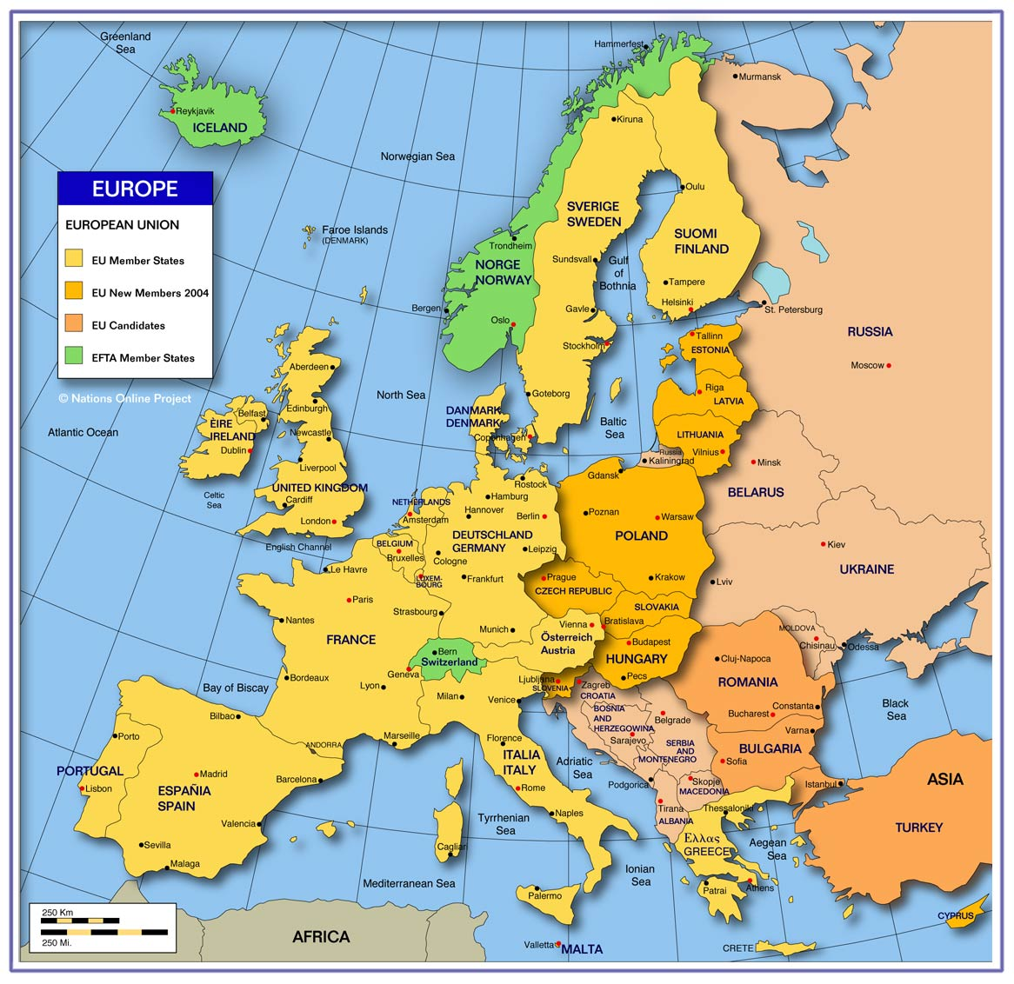
. . . we’ll go
around Europe
and beyond
via videos and slides

Slide 33
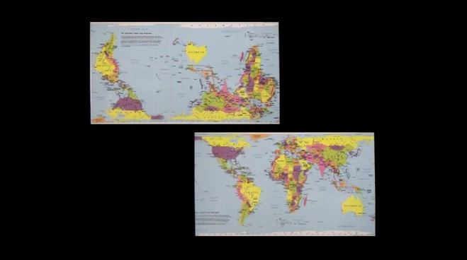
Films and Videos

Slide 34
Villages and Village life . . .
Kypseli, Greece
Argaki, Cyprus
Rural France
Aran Islands, Ireland
Faroe Islands (Denmark)
Gyönk, Hungary

Slide 35
Villages and Village life . . .
Kypseli, Greece
Argaki, Cyprus
Rural France
Aran Islands, Ireland
Faroe Islands (Denmark)
Gyönk, Hungary

Slide 36
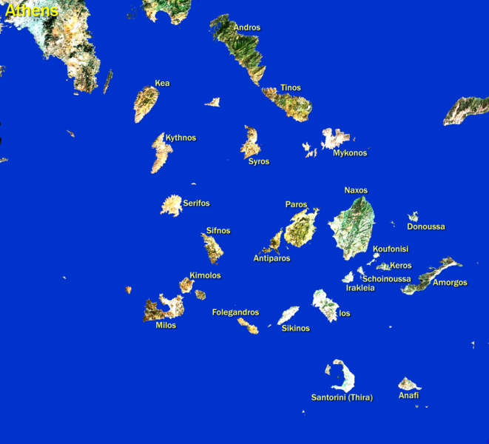
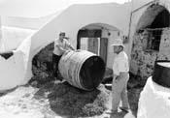
Kypseli, Santorini, Greece

Slide 37
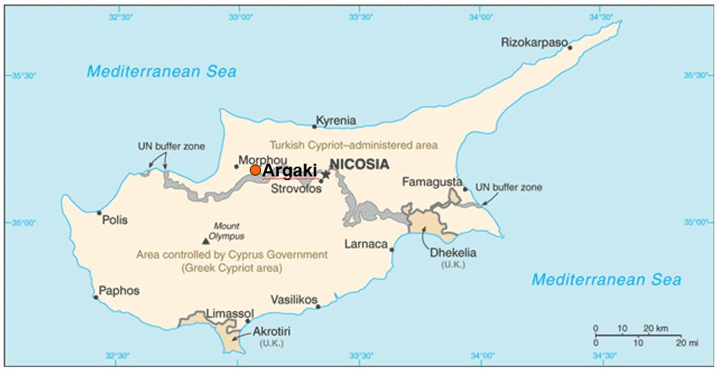
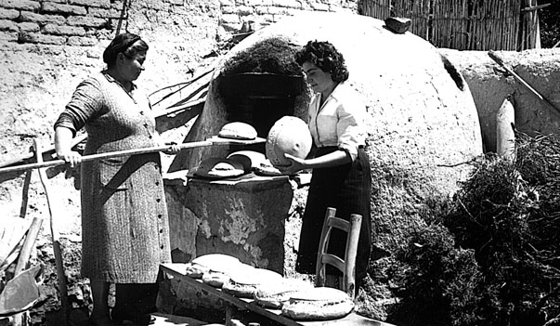
Cyprus
Bread Baking in Cyprus

Slide 38
Ireland . . .

Slide 39
Knitting on Inis Oírr, the smallest of the Irish Aran Islands

Slide 40
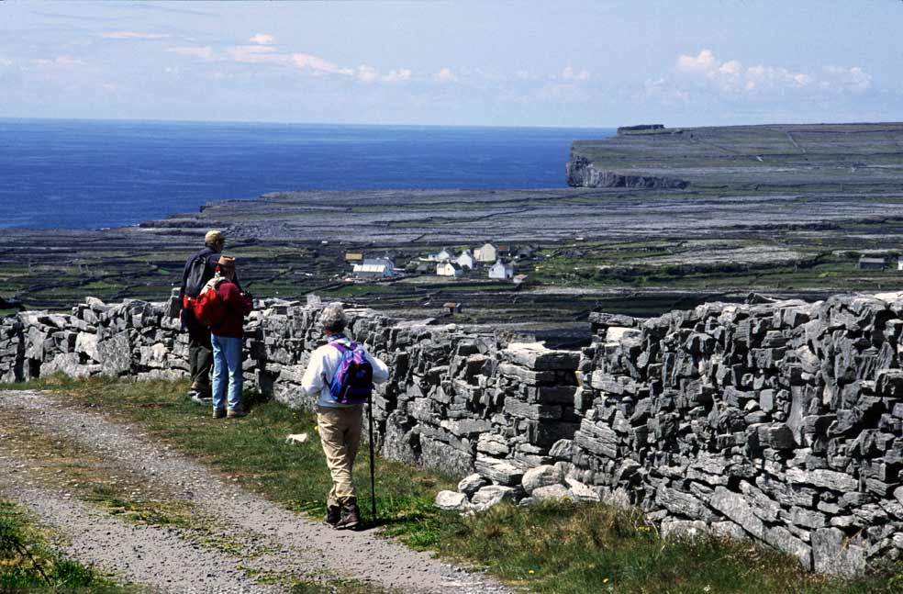
http://www.irishways.com/Aran-Islands-1.jpg

Slide 41
Taking Irish language lessons from an expert on Inis Oírr, the smallest of the Irish Aran Islands

Slide 42
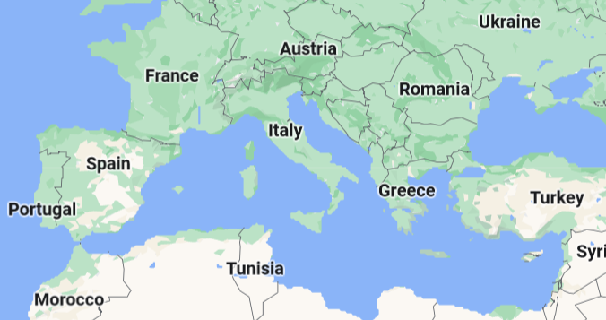
We’ll have a look at Life Chances on Argaki, Cyprus

Slide 43
And we’ll go to . . .
France . . .

Slide 44
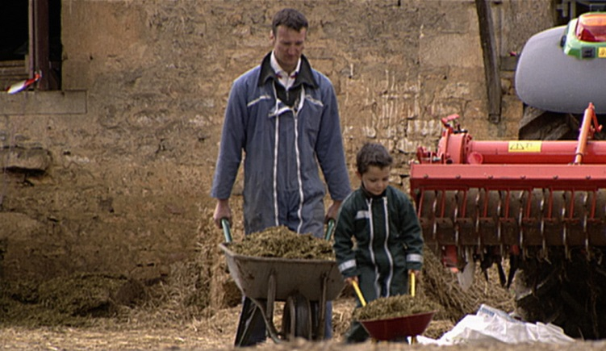
. . . this including,
Après l'hiver, le printemps
(After Winter, Spring)

Slide 45
. . . and to
Niger
(West Africa)
Nepal
France / England
Canada . . .

Slide 46
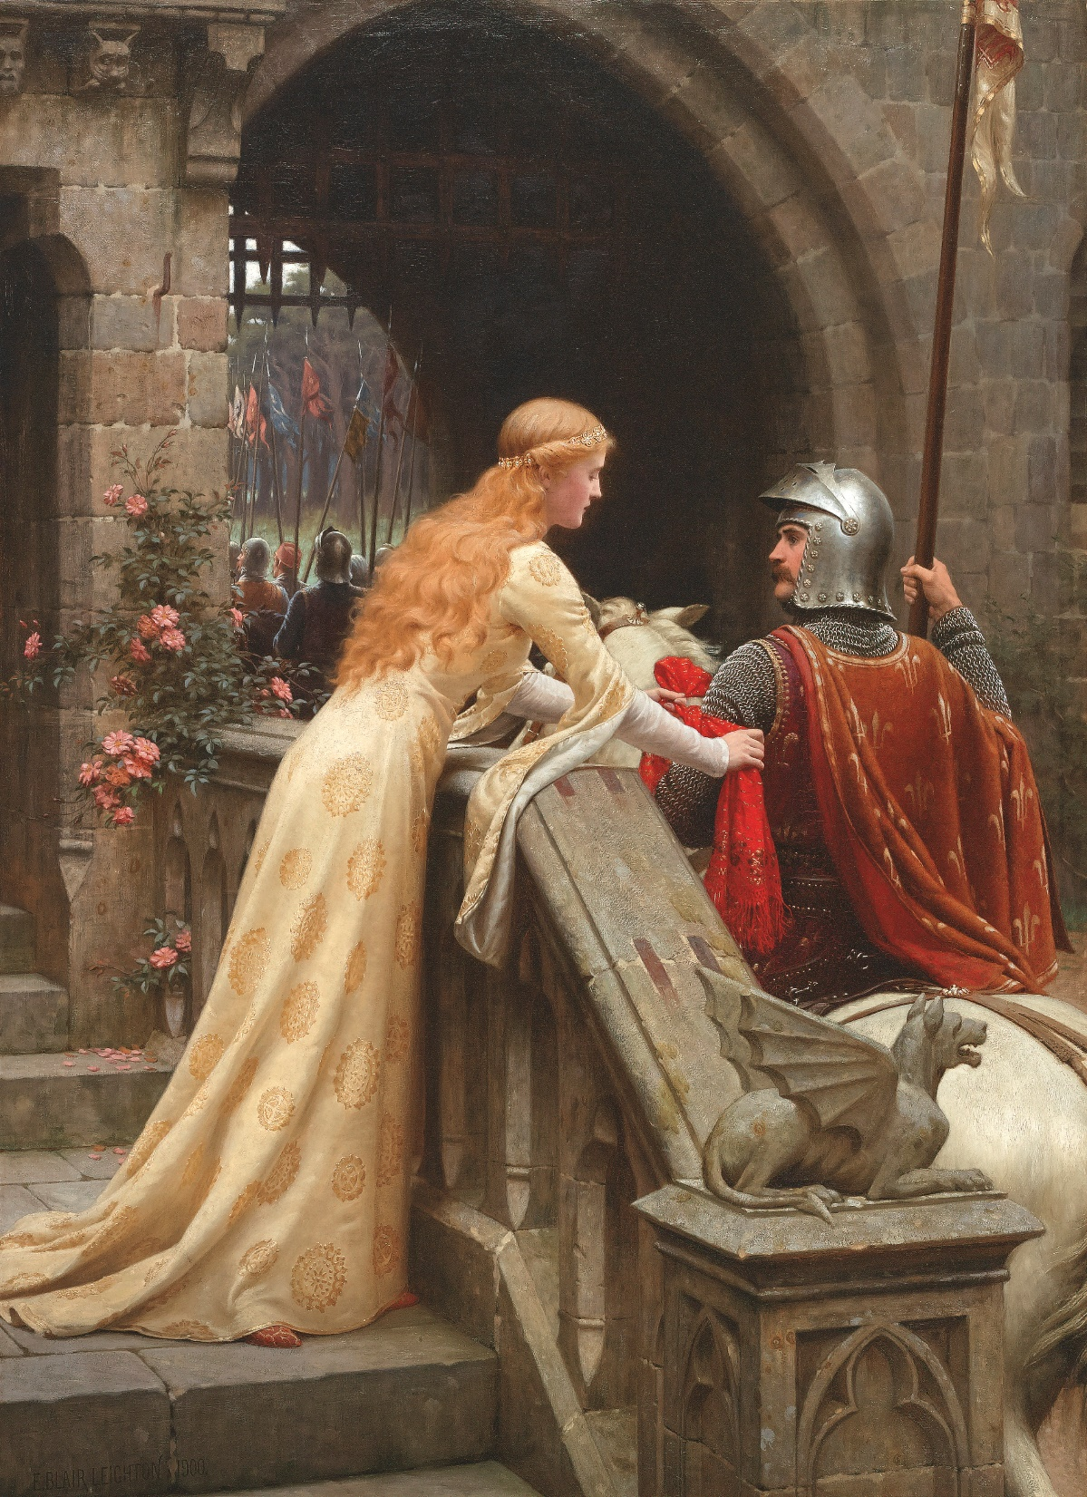
. . . with a little "Romantic Love" -- Strange Relations Millennium: Tribal Wisdom and the Modern World, by David Maybury-Lewis
God Speed
Edmund Leighton (1852–1922)

Slide 47
And City life . . .

Slide 48
Budapest Castle
http://commons.wikimedia.org/wiki/Main_Page

Slide 49
we’ll visit immigrants to Spain . . .
We’re going to visit immigrants to Spain

Slide 50
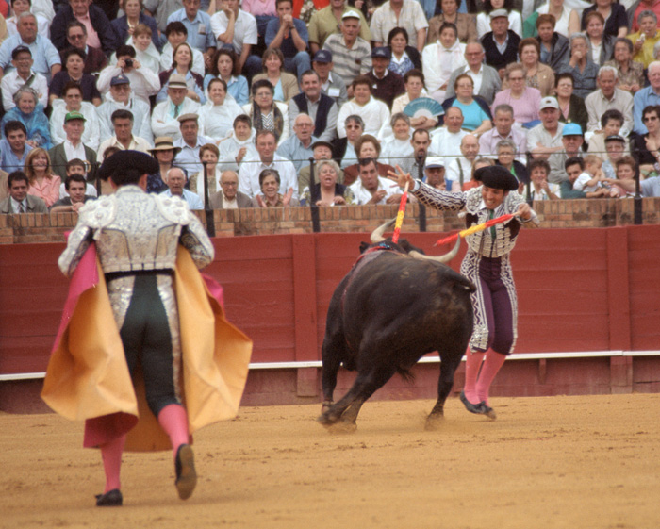
. . . and visit Spain and Portugal . . .

Slide 51
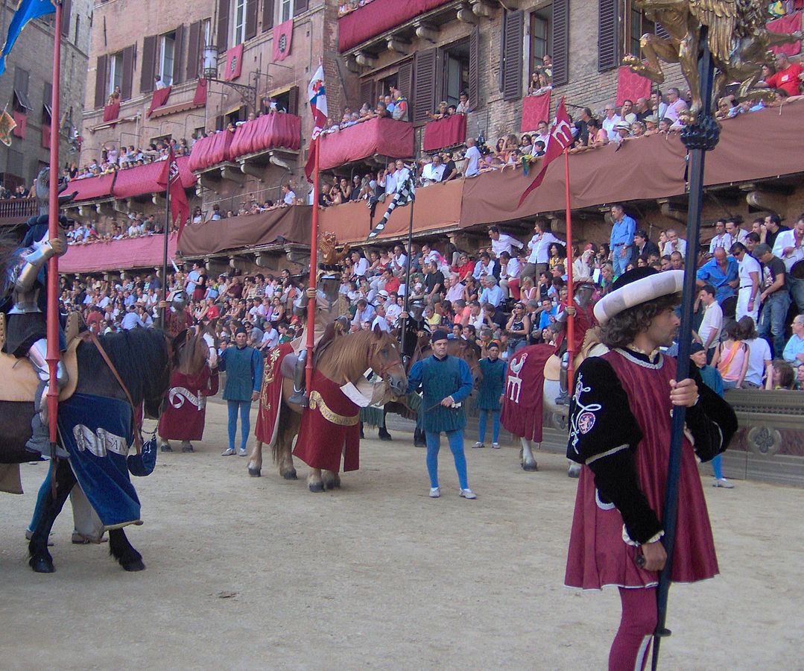
. . . and check out the Palio di Siena, Italy.
A “Great Gathering”

Slide 52
And we’ll visit the
hinterlands . . .

Slide 53
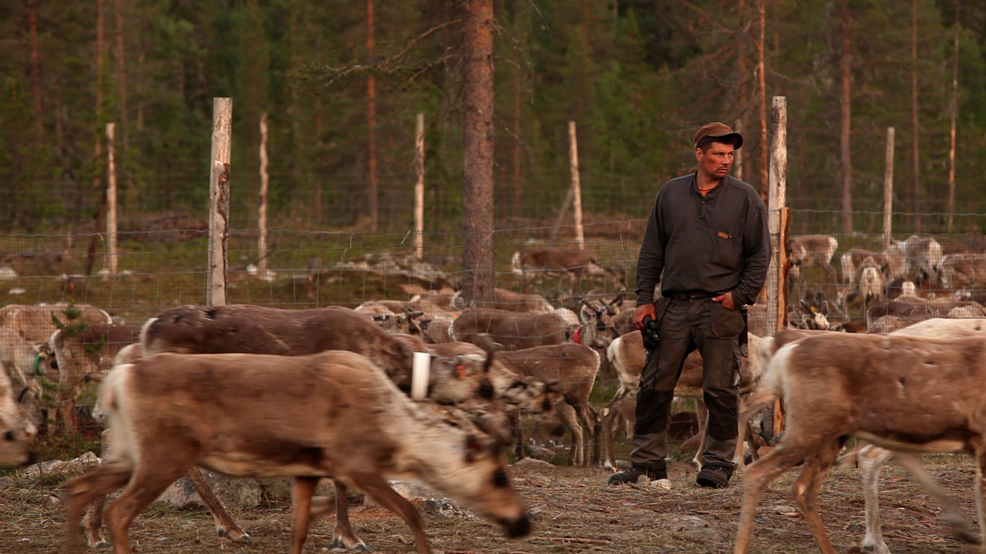
. . . to get to know
Aatsinki . . . Arctic Cowboys
of the frozen forests of Finnish Lapland

Slide 54
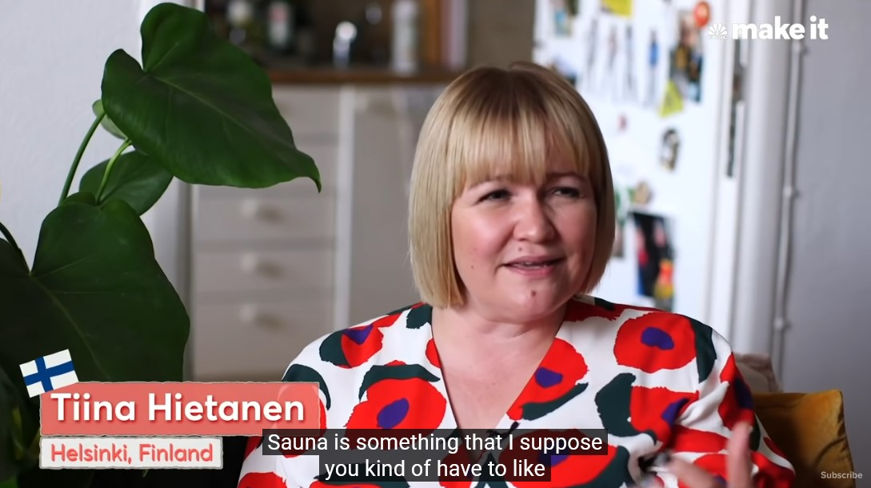
Finland, the “Happiest Country in the World”

Slide 55
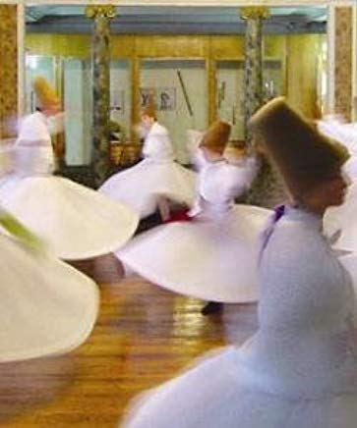
. . . we’ll visit with
with the
“whirling Dervishes”
in Türkiye
fka Turkey

Slide 56
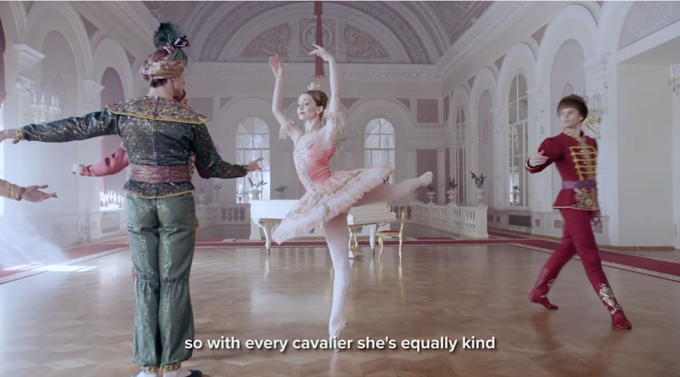
. . . and we’ll have a look at The Sleeping Beauty of the Bolshoi Ballet

Slide 57
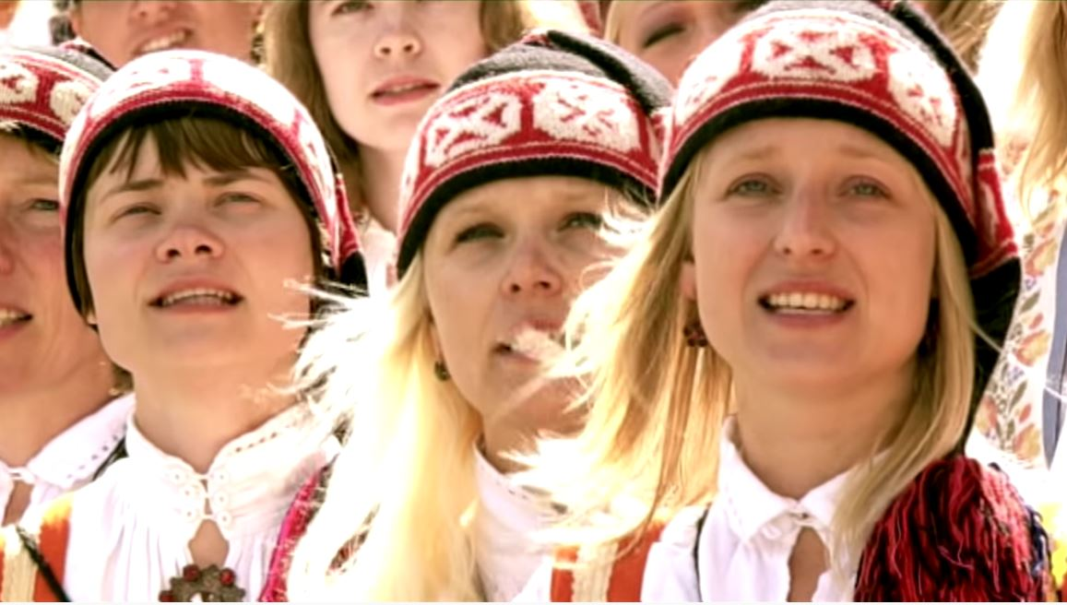
. . . and join in the Estonian Song Celebration . . .

Slide 58
Main Characteristics
comparative method
We’ll have a look at
a few Commonwealth Nations
(fka the British Commonwealth)
of the former British Empire . . .

Slide 59
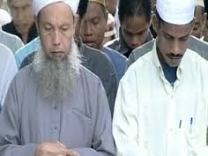
. . . and visit China and Malaysia . . .

Slide 60
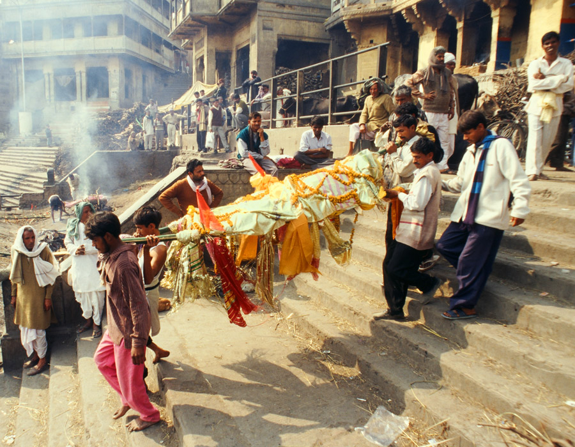
. . . and India . . .

Slide 61
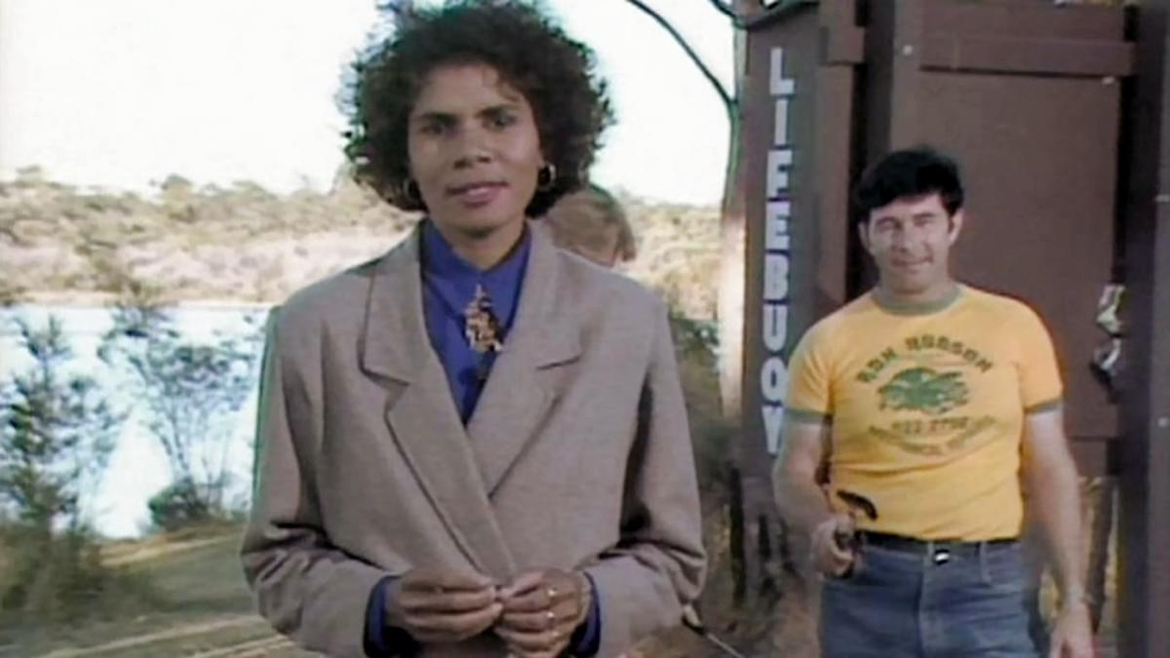
. . . and we’ll visit
native cultural reformers
in Australia

Slide 62
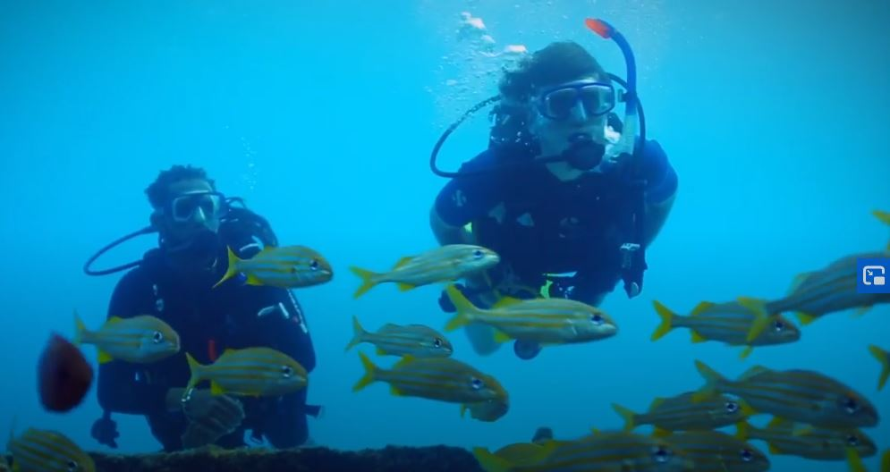
. . . and we’ll check out
The Caribbean with Simon Reeve

Slide 63
And as I mentioned earlier and in the “An Important Note on Videos and Visual Anthropology,” we would LOVE to take you along with us around the world, but the next best thing we can do is bring the world to you in the form of films and videos.
And we’ll do a lot of that.

Slide 64
So films and videos make up a very large part of this class . . .
In the best of all possible worlds, we would head off to the countries and cultures and meet and talk with the people.
That is simply not practical for this class
(but one can always sign up for one or more study abroad experiences).

Slide 65
So films and videos make up a very large part of this class . . .
In the best of all possible worlds, we would head off to the countries and cultures and meet and talk with the people.
That is simply not practical for this class
(but one can always sign up for one or more study abroad experiences).

Slide 66
So films and videos make up a very large part of this class . . .
In the best of all possible worlds, we would head off to the countries and cultures and meet and talk with the people.
That is simply not practical for this class
(but one can always sign up for one or more study abroad experiences).

Slide 67
REM
Main Characteristics in a Nutshell

Slide 68
Main Characteristics of Anthropology
1. the four fields of general anthropology
culture as a primary concept
comparative method as major approach
holism as a primary theoretical goal
fieldwork as a primary research technique -- involving “participant observation”

Slide 69
ANTH 3635
Anthropology of Europe
The End
Fieldwork
as a
Primary Research
Technique
© 2010-2024 Timothy G. Roufs, University of Minnesota Duluth

