Slide 1
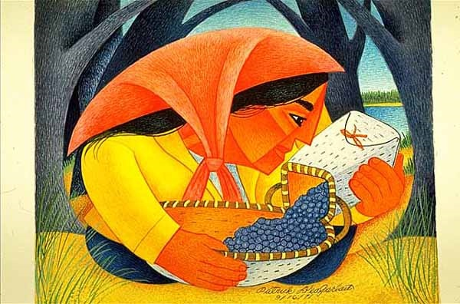
Start deck in “Slide Show” mode,
and use your up/down arrow keys and/or
your space bar to advance the slides
University of Minnesota Duluth
Tim Roufs
© 2010-2024

Slide 2
ANTH 3888
Anthropology of Food
University of Minnesota Duluth
Tim Roufs
© 2010-2024

Slide 3
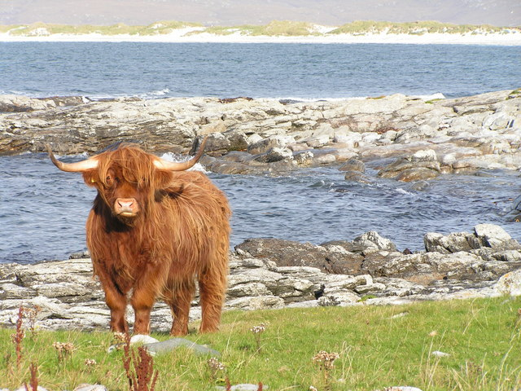
A Very Brief Outline
of the Course Structure
Anthropology of Food
University of Minnesota Duluth
Tim Roufs
© 2010-2024
http://en.wikipedia.org/wiki/Highland_cattle

Slide 4
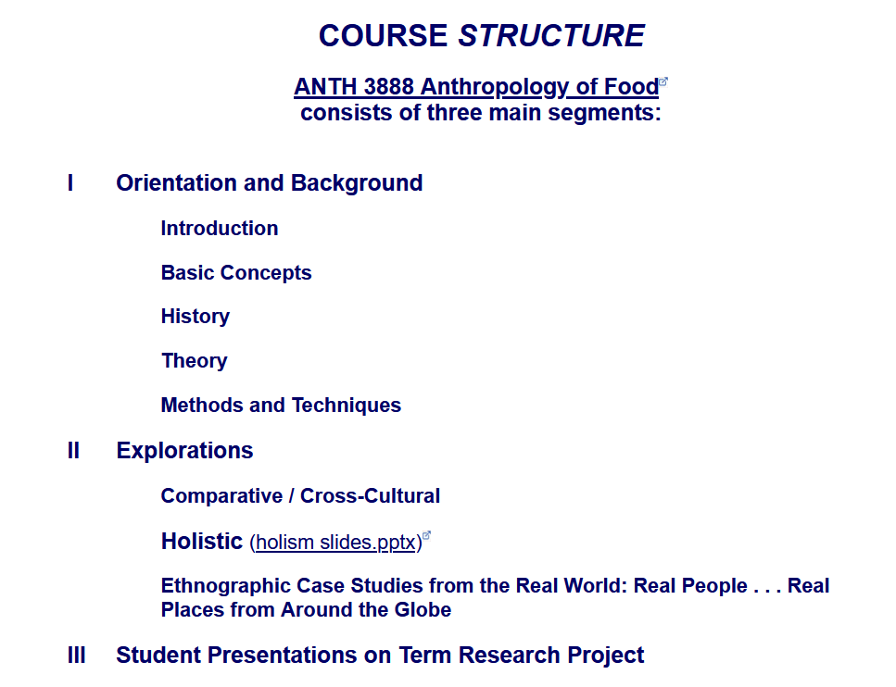

Slide 5
The Course Outline in a Nutshell
Course Structure
Course Structure

Slide 6
The Course Outline in a Nutshell
Course Structure . . .
Course Content

Slide 7
In a nutshell, ANTH 3888 Anthropology of Food
consists of three main segments:
I Orientation and Background
  Introduction
  Basic Concepts
  History
  Theory
  Methods and Techniques
II Explorations
Comparative / Cross-Cultural
Holistic
Ethnographic Case Studies from the Real World: Real People . . . Real Places from Around the Globe
III Student Presentations on Term Research Project
http://www.d.umn.edu/cla/faculty/troufs/anthfood/afproject.html

Slide 8
In a nutshell, ANTH 3888 Anthropology of Food
consists of three main segments:
I Orientation and Background
  Introduction
  Basic Concepts
  History
  Theory
  Methods and Techniques
II Explorations
Comparative / Cross-Cultural
Holistic
Ethnographic Case Studies from the Real World: Real People . . . Real Places from Around the Globe
III Student Presentations on Term Research Project
http://www.d.umn.edu/cla/faculty/troufs/anthfood/afproject.html

Slide 9
In a nutshell, ANTH 3888 Anthropology of Food
consists of three main segments:
I Orientation and Background
  Introduction
  Basic Concepts
  History
  Theory
  Methods and Techniques
II Explorations
Comparative / Cross-Cultural
Holistic
Ethnographic Case Studies from the Real World: Real People . . . Real Places from Around the Globe
III Student Presentations on Term Research Project
http://www.d.umn.edu/cla/faculty/troufs/anthfood/afproject.html

Slide 10
In a nutshell, ANTH 3888 Anthropology of Food
consists of three main segments:
I Orientation and Background
  Introduction
  Basic Concepts
  History
  Theory
  Methods and Techniques
II Explorations
Comparative / Cross-Cultural
Holistic
Ethnographic Case Studies from the Real World: Real People . . . Real Places from Around the Globe
III Student Presentations on Term Research Project
http://www.d.umn.edu/cla/faculty/troufs/anthfood/afproject.html

Slide 11
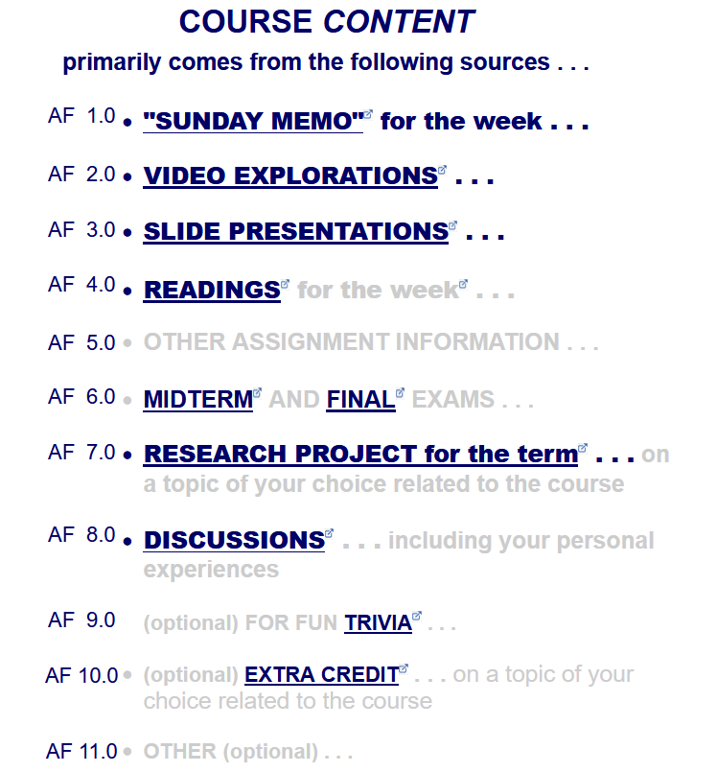
The Course Outline in a Nutshell
Course Structure . . .
Course Content . . .

Slide 13
This is the way your
Canvas Modules
are organized . . .

Slide 15
The End
An Outline
of the Course Structure
Anthropology of Food
University of Minnesota Duluth
Tim Roufs
© 2010-2024
http://en.wikipedia.org/wiki/Highland_cattle

