Slide 1
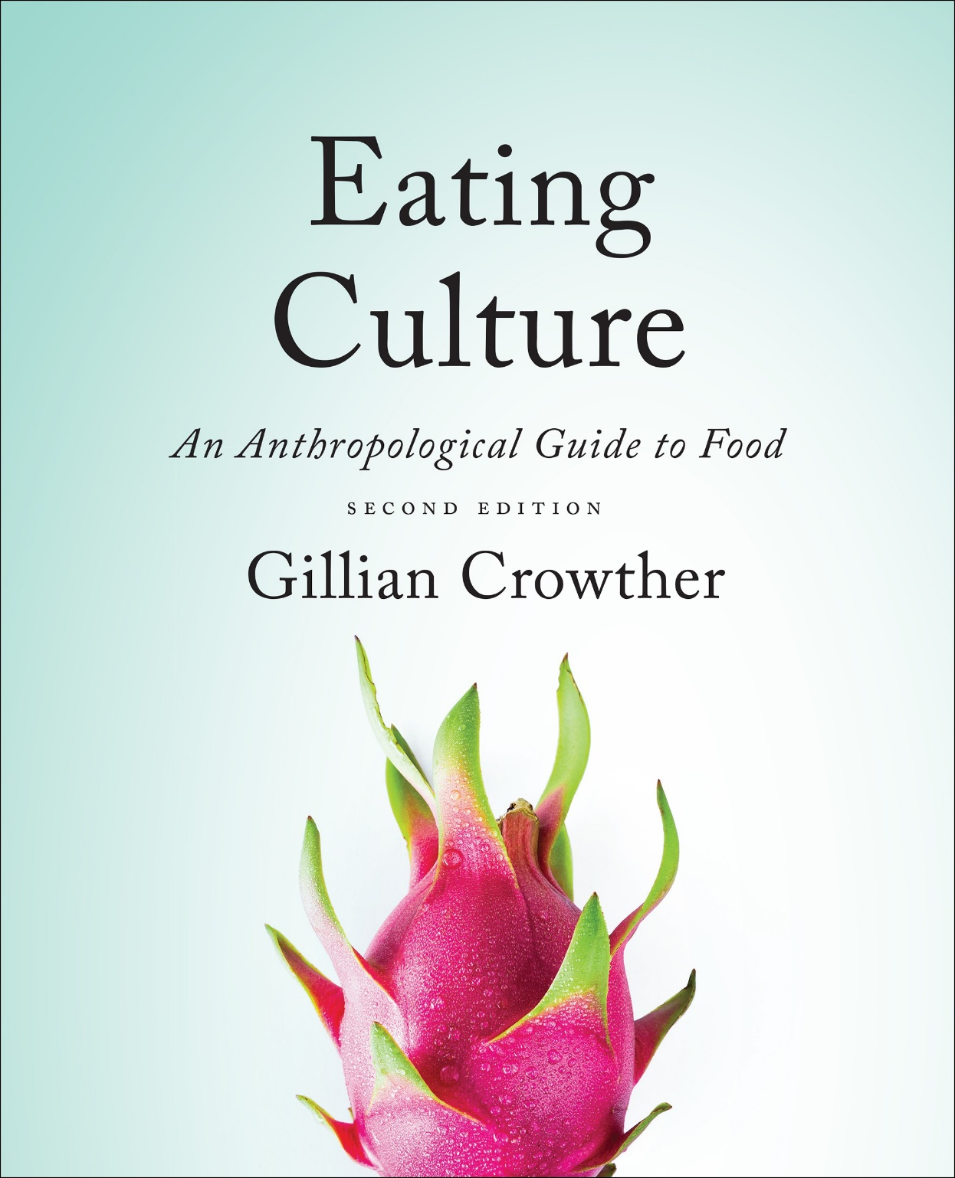
Food Systems
use your up/down arrow keys and/or
your space bar to advance the slides
Tim Roufs
© 2010-2024

Slide 2
Food Systems
Tim Roufs
© 2010-2024

Slide 3
Tim Roufs
© 2010-2024
www.d.umn.edu/cla/faculty/troufs/anthfood/aftexts.html#title

Slide 4
Biocultural Framework
for the Study of Diet and Nutrition
Food Systems
Next Steps

Slide 5
Food System
“A chain of interconnected activities that take place in order to get food from the environment into the mouths of people”
The Cultural Feast, 2nd ed., p. 14

Slide 6
Food System
includes . . .
food production
processing
distribution
marketing
preparation . . .
The Cultural Feast, 2nd ed., p. 14

Slide 7
Food System
also includes . . .
the knowledge and customs that surround food and food consumption
The Cultural Feast, 2nd ed., p. 14

Slide 8
Food System
“. . . it is convenient to view the components in our model as a food system —
a set of mutually interacting components.”
The Cultural Feast, 2nd ed., p. 14

Slide 9
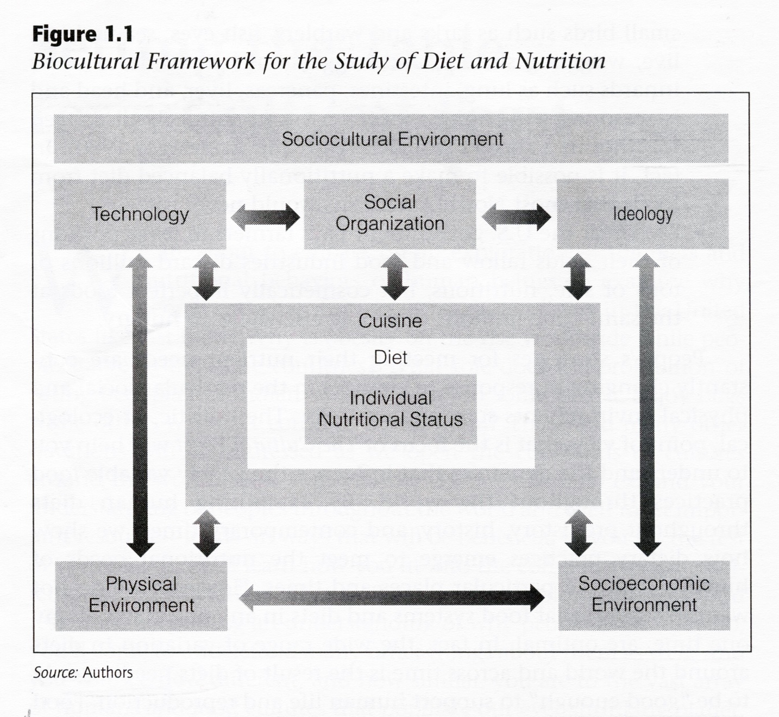
The Cultural Feast, 2nd ed., p. 4

Slide 10
The Cultural Feast, 2nd ed., p. 4

Slide 11
Food System
“If change occurs in one component, the others must change in order for the system to maintain balance.”
  e.g., pigs and pork in the Scottish
  cuisine
The Cultural Feast, 2nd ed., p. 14

Slide 12
Food System
“If change occurs in one component, the others must change in order for the system to maintain balance.”
  e.g., pigs and pork in the Scottish cuisine
The Cultural Feast, 2nd ed., p. 14

Slide 13
  “The rise and fall of pig raising and pork consumption
  [in Scotland from prehistoric times to the present]
  and the changing value place on pork as a food in Scottish cuisine, suggests the important interactions between several factors . . .”
The Cultural Feast, 2nd ed., p. 15

Slide 14
          the physical environment
          the technologies used to exploit the environment
          the relationship between colonizers and the colonized
          the meanings and values placed on foods
The Cultural Feast, 2nd ed., p. 15

Slide 15
          no one factor alone
          accounts for the presence or absence of pork on the dinner plates of Scots either currently or in the past
The Cultural Feast, 2nd ed., p. 15

Slide 16
          however,
          all factors have contributed
          to patterns of food production, distribution, and consumption that influence Scottish diets
The Cultural Feast, 2nd ed., p. 15

Slide 17
One of the main messages of
Frances Moore Lappé is . . .
“solve for pattern”
(to borrow a term from Wendell Berry)
Lappé is famous in the food world
— in the whole world, for that matter —
for her work Diet for a Small Planet, and,
more recently, for
Hope’s Edge: The Next Diet for a Small Planet
Lappé gave the closing lecture at the
Nobel Conference 46
Making Food Good

Slide 18
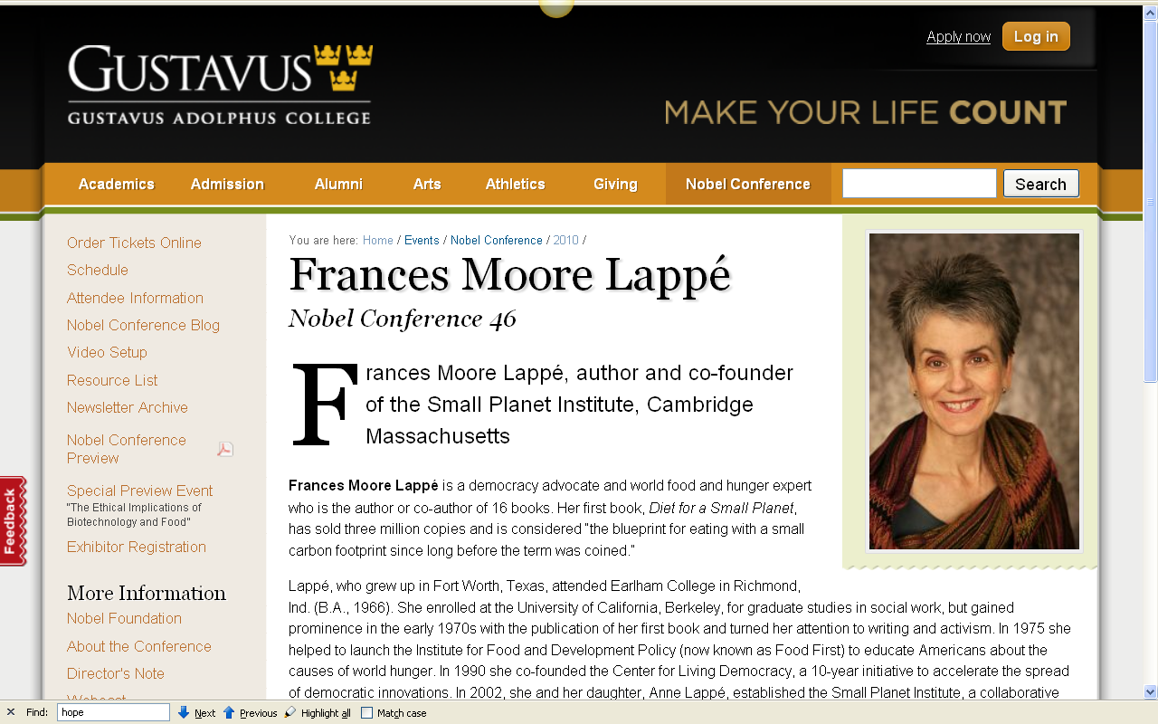

Slide 19
Frances Moore Lappé’s
“solving for pattern”
emphasizes the whole-systems approach in formulating the
“Next Diet for a Small Planet”
“solving for pattern” is one of her main “Liberating Ideas” fundamental to her proposed solutions
to today’s major food issues . . .

Slide 20
if Lappé’s talk was about
“solving for pattern”
and she focused on
“Food Systems”

Slide 21
Food System
“. . . it is convenient to view the components in our model as a food system —
a set of mutually interacting components” . . .
The Cultural Feast, 2nd ed., p. 14

Slide 22
Food System
and “if change occurs in one component, the others must change in order for the system to maintain balance”
The Cultural Feast, 2nd ed., p. 14

Slide 23
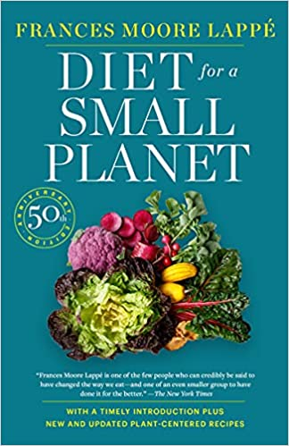
50th Anniversary Edition
2021

Slide 24


Slide 25
Food Systems
Tim Roufs
© 2010-2024

