Slide 1
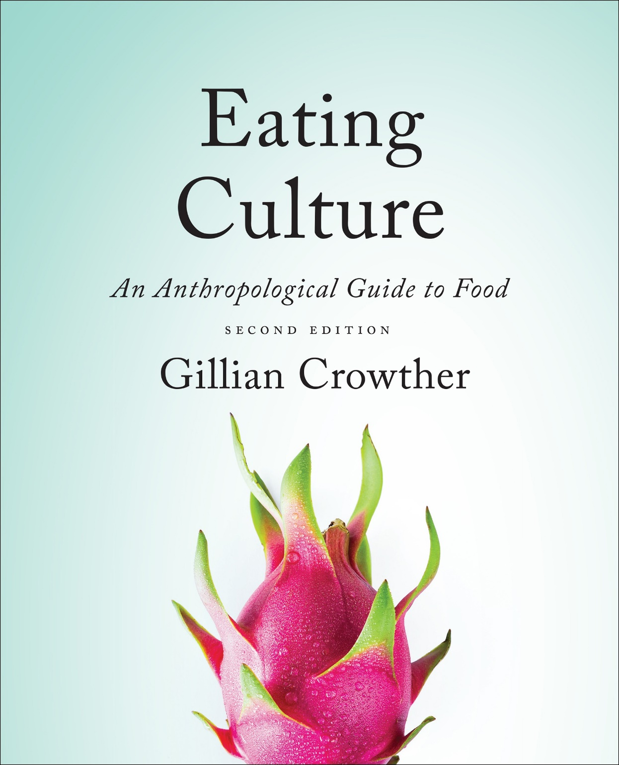
Human Nutrient
Needs
use your up/down arrow keys and/or
your space bar to advance the slides
Tim Roufs
© 2010-2024

Slide 2
Human Nutrient
Needs
Tim Roufs
© 2010-2024

Slide 3
Tim Roufs
© 2010-2024
www.d.umn.edu/cla/faculty/troufs/anthfood/aftexts.html#title

Slide 4
the
Biocultural Framework
for the Study of Diet and Nutrition
includes
Nutritional Status
Biological Makeup
Human Nutrient Needs
Diet
Cuisine
The Environment
Physical Environment
Sociocultural Environment
Economic and Political Environment
individual
nutritional
needs
The Cultural Feast, 2nd ed., p. 6

Slide 5
“Within a narrow range of variation, humans around the world share similar nutrient requirements and restrictions”
no human can digest cellulose
no human can avoid toxic reactions caused by eating certain poisonous plants
all humans require the same “50 or so” essential nutrients to stay healthy
The Cultural Feast, 2nd ed., p. 6

Slide 6
“Within a narrow range of variation,
humans around the world share similar nutrient requirements and restrictions”
no human can digest cellulose
no human can avoid toxic reactions caused by eating certain poisonous plants
all humans require the same 50 or so essential nutrients to stay healthy
The Cultural Feast, 2nd ed., p. 6

Slide 7
“Within a narrow range of variation, humans around the world share similar nutrient requirements and restrictions”
no human can digest cellulose
no human can avoid toxic reactions caused by eating certain poisonous plants
all humans require the same 50 or so essential nutrients to stay healthy
The Cultural Feast, 2nd ed., p. 6

Slide 8
“Although there have been some specific adaptations of populations in particular environments, on the whole, humans are physiologically the same animals we were 10,000 years ago before the adoption of agriculture, animal husbandry, and food production technology”
The Cultural Feast, 2nd ed., p. 6

Slide 9
“Although there have been some specific adaptations of populations in particular environments, on the whole, humans are physiologically the same animals we were 10,000 years ago before the adoption of agriculture, animal husbandry, and food production technology”
The Cultural Feast, 2nd ed., p. 6

Slide 10
“Although there have been some specific adaptations of populations in particular environments, on the whole, humans are physiologically the same animals we were 10,000 years ago before the adoption of agriculture, animal husbandry, and food production technology”
note the date
The Cultural Feast, 2nd ed., p. 6

Slide 11
ca. 10,000 years ago (ca. 10,000 ybp)
or
10,000 B.C. (10,000 B.C.E)
is one of those
“Dates to Remember” . . .

Slide 12
as an aside . . .
ca. 10,000 years ago (ca. 10,000 ybp)
or
10,000 B.C. (10,000 B.C.E)
is one of those
“Dates to Remember” . . .
this is
an abbreviation of
“circa”
meaning
“about”

Slide 13
as an aside . . .
ca. 10,000 years ago (ca. 10,000 ybp)
or
10,000 B.C. (10,000 B.C.E)
is one of those
“Dates to Remember” . . .
this is
an abbreviation of
“years before present”

Slide 14
as an aside . . .
ca. 10,000 years ago (ca. 10,000 ybp)
or
10,000 B.C. (10,000 B.C.E)
is one of those
“Dates to Remember” . . .
this is
an abbreviation of
“before common era” (it may be used with or without periods)

Slide 15
ca. 10,000 B.C. is usually one of the very first dates that you will see on any food timeline . . .
and it virtually always appears on any prehistoric timeline chronicling events of that era . . .

Slide 16
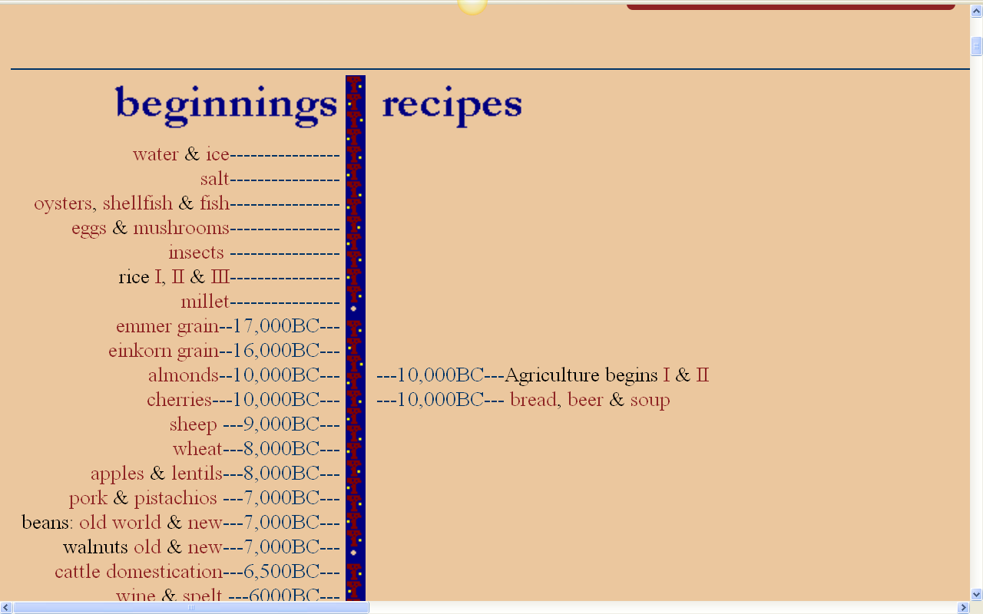
and 10,000 B.C. represents the
commonly accepted date for the “beginnings of agriculture”, i.e.,
the beginnings of
“The Agricultural Revolution”
http://www.foodtimeline.org/

Slide 17
as an aside . . .
outside of the U.S.A.
beer and wine are often
considered a food
http://www.foodtimeline.org/

Slide 18
there are “. . . some interesting implications regarding the impact that diets based on agriculture, animal husbandry, and food technology have on humans’ health and nutritional status”
The Cultural Feast, 2nd ed., p. 6

Slide 19
that is to say
. . . agriculture, animal husbandry, and food technology have [changed] humans’ health and nutritional status”
The Cultural Feast, 2nd ed., p. 6

Slide 20
“Diet and Human Evolution, highlights the importance of
lactose intolerance / lactase deficiency
in both human evolution and in contemporary populations”
The Cultural Feast, 2nd ed., pp. 40-47

Slide 21
“Diet and Human Evolution, highlights the importance of
lactose intolerance / lactase deficiency
in both human evolution and in contemporary populations”
and we’ll have a close look at this change later . . .
The Cultural Feast, 2nd ed., pp. 40-47

Slide 22
“Diet and Human Evolution, highlights the importance of
lactose intolerance / lactase deficiency
in both human evolution and in contemporary populations”
in the meantime, let’s look closer at . . .
The Cultural Feast, 2nd ed., pp. 40-47

Slide 23
calories

Slide 24
before we can have a look at
human nutrient needs
we need to review
calories
— and what they’re all about
. . .

Slide 25
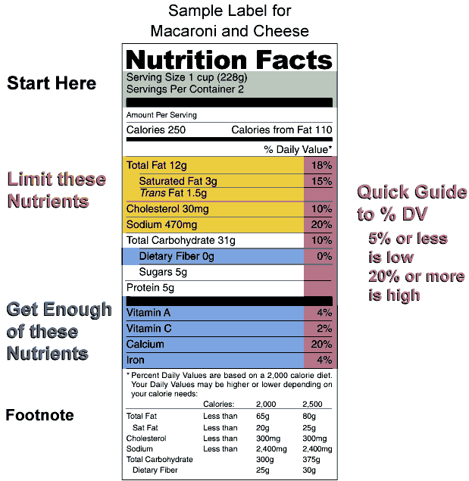
you “see”
(but probably don’t actually look at)
calorie information on almost every food item you buy
(in a store)
. . .
Wikipedia

Slide 26
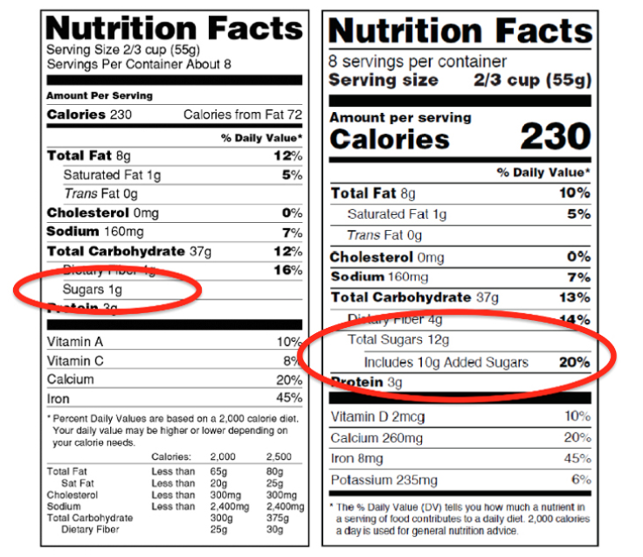
Comparison of Old (left) and New (right) Nutrition Facts Labels
old
new
NOTE: Consult a competent licensed health professional for personal details
http://www.d.umn.edu/cla/faculty/troufs/anthfood/afnutritionlabels.html#title

Slide 27
when checking out at the grocery store you see
(and more than likely look at)
calorie and glamour information galore . . .

Slide 28
those “calories” in the U.S.A. are
“food calories”. . .
or what in Europe and in laboratories and other places around the world are known as
“kilocalories”
abbreviated
kcal

Slide 29
so one “food calorie”
=
1 kcal
or 1,000 calories

Slide 30
let’s have a look at the
calorie and nutrition information on the “Nutrition Facts” labels of almost every food item you buy (in a store) . . .
Wikipedia

Slide 31
Comparison of Old (left) and New (right) Nutrition Facts Labels
old
new
NOTE: Consult a competent licensed health professional for personal details
http://www.d.umn.edu/cla/faculty/troufs/anthfood/afnutritionlabels.html#title

Slide 32
have a look at any
Nutrition Facts label
and you will see that they all have the same categories of information
the first sample here is from a package of macaroni and cheese, an all-American food . . .
Wikipedia

Slide 33
Wikipedia

Slide 34
the “Daily Value”
— DV (or DVI [“Daily Value Index”]) —
is a nutrition recommendation . . .
Wikipedia

Slide 35
Comparison of Old (left) and New (right) Nutrition Facts Labels
old
new
NOTE: Consult a competent licensed health professional for personal details
http://www.d.umn.edu/cla/faculty/troufs/anthfood/afnutritionlabels.html#title

Slide 36
the “Daily Value”
is determined by “Reference Daily Intake”
( or “Recommended Daily Intake”)
Wikipedia

Slide 37
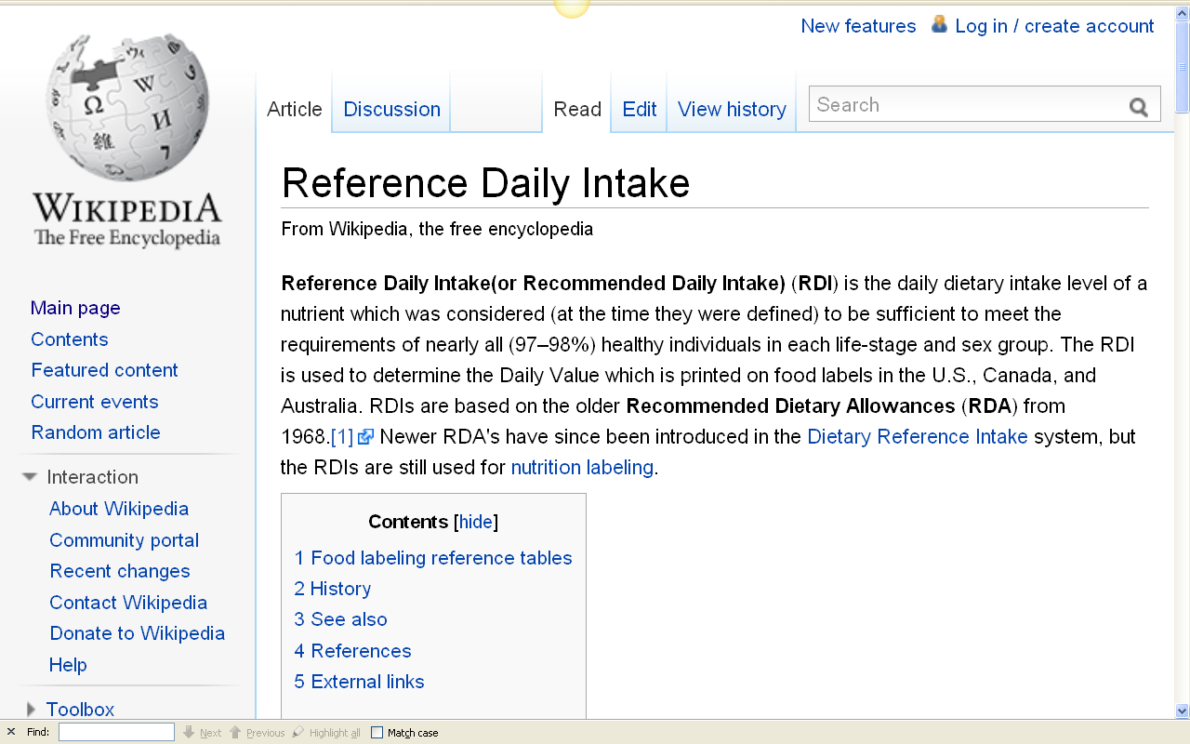
“Reference Daily Intake”
(or Recommended Daily Intake — RDI)
“. . . is the daily dietary intake level of a nutrient which was considered
(at the time they were defined)
to be sufficient to meet the requirements of nearly all (97–98%) healthy individuals in each life-stage and sex group”

Slide 38
the Daily Values
are based on the
Recommended Daily Allowances
from 1968
Wikipedia

Slide 39
A newer
Dietary Reference Intake
(or DRI)
system of nutrition recommendations from the Institute of Medicine (IOM) of the U.S.A. National Academy of Sciences
was introduced in 1997
to broaden the Reference Daily Allowances
(RDAs of the Daily Values),
but these are not used for nutritional labeling
Wikipedia

Slide 40
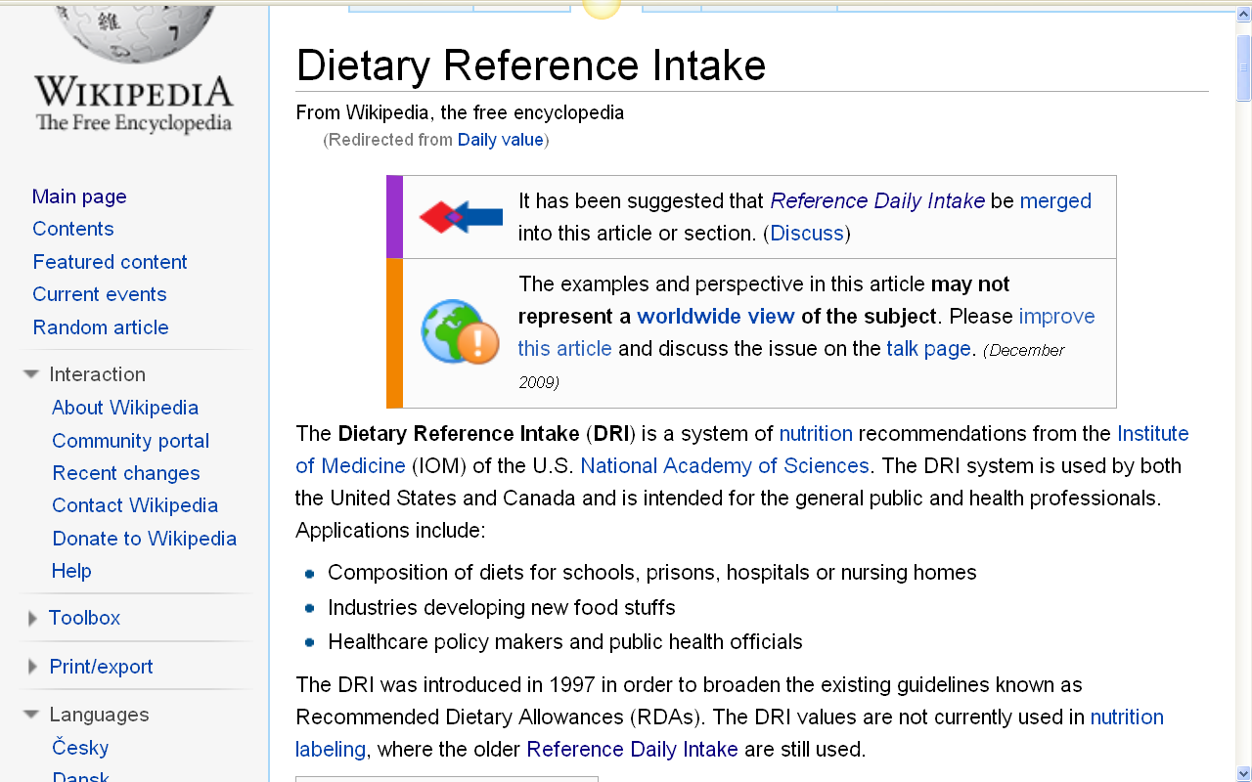
http://en.wikipedia.org/wiki/Daily_value

Slide 41
the Dietary Reference Intakes (DRIs)
developed by the Food and Nutrition Board
are set at levels
to accommodate the
range of variation
among healthy adults
The Cultural Feast, 2nd ed., p. 9

Slide 42
the Dietary Reference Intakes (DRIs)
developed by the Food and Nutrition Board
are set at levels
to accommodate the
range of variation
among healthy adults
The Cultural Feast, 2nd ed., p. 9

Slide 43
let's compare our
macaroni and cheese
with a package of animal crackers

Slide 44
your mac ‘n cheese was originally introduced to the United States by Thomas Jefferson
(along with Crème Brûlée)

Slide 45
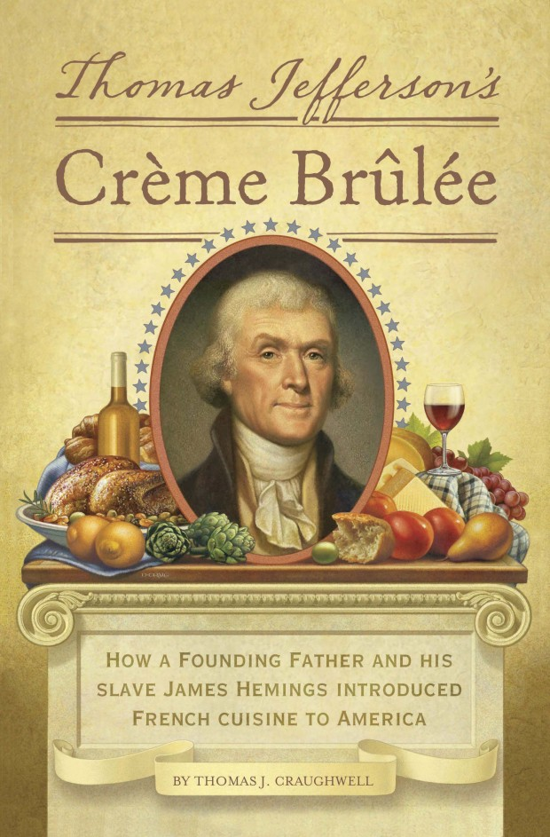

Slide 46
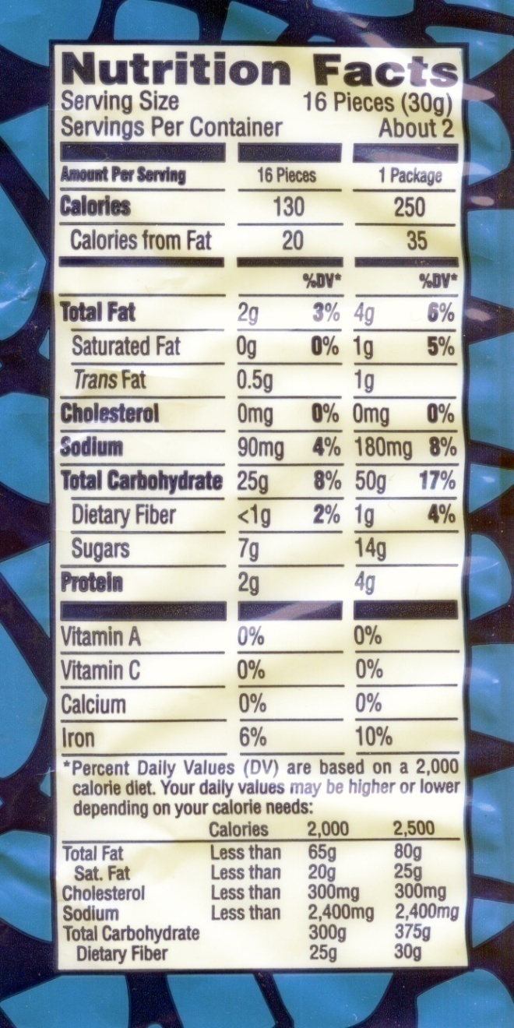
Austin Animal Crackers
Wikipedia

Slide 47
Austin Animal Crackers
Wikipedia

Slide 48
Comparison of Old (left) and New (right) Nutrition Facts Labels
old
new
NOTE: Consult a competent licensed health professional for personal details
http://www.d.umn.edu/cla/faculty/troufs/anthfood/afnutritionlabels.html#title

Slide 49
Austin Animal Crackers
Wikipedia

Slide 50
Austin Animal Crackers
note that each package contains
2 or “About 2” servings . . .
[Question: Who do you know that eats
only half of a small package of animal crackers?]
Wikipedia

Slide 51
Austin Animal Crackers
note that each package contains
2 or “About 2” servings . . .
[Question: Who do you know that eats
only half of a small package of animal crackers?]
Wikipedia

Slide 52
Austin Animal Crackers
Wikipedia

Slide 53
Comparison of Old (left) and New (right) Nutrition Facts Labels
old
new
NOTE: Consult a competent licensed health professional for personal details
http://www.d.umn.edu/cla/faculty/troufs/anthfood/afnutritionlabels.html#title

Slide 54
Austin Animal Crackers
The notation “Percentage Daily Values
are based on a 2,000 calorie diet”
means “food calories”
or 2,000 kcal
or 2,000,000 “real” calories
(i.e., the kind of calories chemists talk about in the lab)
Wikipedia

Slide 55
Comparison of Old (left) and New (right) Nutrition Facts Labels
old
new
NOTE: Consult a competent licensed health professional for personal details
http://www.d.umn.edu/cla/faculty/troufs/anthfood/afnutritionlabels.html#title

Slide 56
Austin Animal Crackers
since “Servings Per Container” for the macaroni and cheese is 2,
and each serving contains 250 food calories,
each package contains 500 food calories,
or 500,000 “real” calories
(i.e., the kind of calories chemists talk about in the lab)
so if you eat the whole package of mac and cheese you’ve used up one-fourth of your allotted calories for the day
and what about the nutrients?
NOTE: Consult a competent licensed health professional for personal details
Wikipedia

Slide 57
Austin Animal Crackers
since “Servings Per Container” for the macaroni and cheese is 2,
and each serving contains 250 food calories,
each package contains 500 food calories,
or 500,000 “real” calories
(i.e., the kind of calories chemists talk about in the lab)
so if you eat the whole package of mac and cheese you’ve used up one-fourth of your allotted calories for the day
and what about the nutrients?
NOTE: Consult a competent licensed health professional for personal details
Wikipedia

Slide 58
Austin Animal Crackers
since “Servings Per Container” for the macaroni and cheese is 2,
and each serving contains 250 food calories, each package contains 500 food calories,
or 500,000 “real” calories
(i.e., the kind of calories chemists talk about in the lab)
so if you eat the whole package of mac and cheese you’ve used up one-fourth of your allotted calories for the day
but what about the nutrients?
NOTE: Consult a competent licensed health professional for personal details
Wikipedia

Slide 59
Wikipedia

Slide 60
Comparison of Old (left) and New (right) Nutrition Facts Labels
old
new
NOTE: Consult a competent licensed health professional for personal details
http://www.d.umn.edu/cla/faculty/troufs/anthfood/afnutritionlabels.html#title

Slide 61
Comparison of Old (left) and New (right) Nutrition Facts Labels
old
Added
Sugars
is one
main
new item
new
NOTE: Consult a competent licensed health professional for personal details
http://www.d.umn.edu/cla/faculty/troufs/anthfood/afnutritionlabels.html#title

Slide 62
so what does that all mean?
let’s have a look . . .
Wikipedia

Slide 63
so what does that all mean?
let’s have a look . . .
Wikipedia

Slide 64
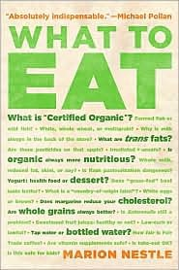
this is an excellent book . . .
and thoroughly explains the implications of nutrition labels . . .
but let’s just have a look at the basics . . .

Slide 65
if you’re interested in
what to eat, have a look at the class nutrition page . . .

Slide 66
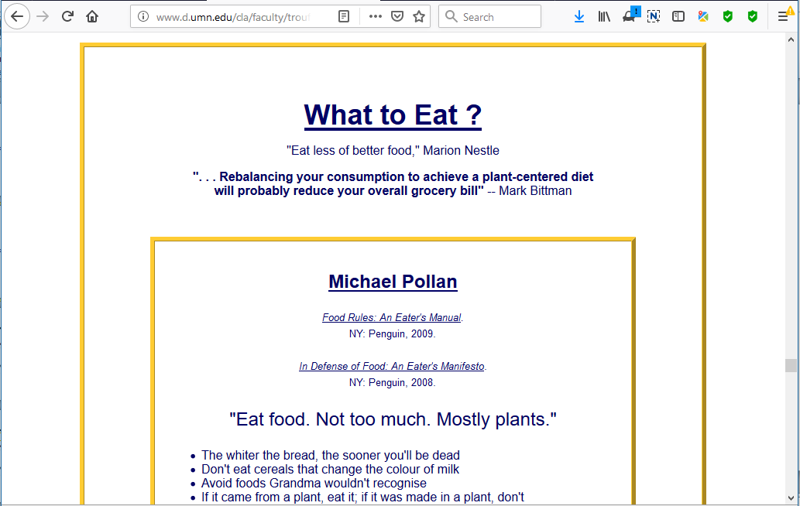
http://www.d.umn.edu/cla/faculty/troufs/anthfood/afnutrition.html#whattoeat

Slide 67
this is an excellent book . . .
and thoroughly explains the implications of nutrition labels . . .
but for now
let’s just have a look at the basics . . .

Slide 68
REM:
one “food calorie”
=
1 kcal
or 1,000 calories

Slide 69
Austin Animal Crackers
2000 food Calories
=
2,000 kilocalories
or 2,000,000 calories
Wikipedia

Slide 70
Austin Animal Crackers
250 / 2000 = 12.5%
250 / 2500 = 10.0%
250 / 2300 = 10.9%
recommended daily intake varies by individual, so the 250 kcal on these packages would be different percentages of a person’s recommended daily intake depending on what their individual recommended daily intake was
for e.g. . .
Wikipedia

Slide 71
Comparison of Old (left) and New (right) Nutrition Facts Labels
total
[food]
calories
are now
easier to
read . . .
BUT
remember
this is
PER
SERVING,
or
1,840
total,
almost a
day’s total
for some
old
new
NOTE: Consult a competent licensed health professional for personal details
http://www.d.umn.edu/cla/faculty/troufs/anthfood/afnutritionlabels.html#title

Slide 72
Austin Animal Crackers
250 / 2000 = 12.5%
250 / 2500 = 10.0%
250 / 2300 = 10.9%
so for simplicity, let’s use a 2300 kcal diet,
although the food industry usually uses 2000
Wikipedia

Slide 73
Austin Animal Crackers
250 / 2000 = 12.5%
250 / 2500 = 10.0%
250 / 2300 = 11%
so one serving of the mac and cheese,
or one package of animal crackers would
“use up” about 11% of your total daily recommended calories
Wikipedia

Slide 74
Austin Animal Crackers
250 / 2000 = 12.5%
250 / 2500 = 10.0%
the next big question is how many of the 48-50 nutrients
that you need
to stay alive and healthy
does your 11% of calories provide?
Wikipedia

Slide 75
Austin Animal Crackers
you can do the math,
but so far, you only have 11% or more of calcium with the mac and cheese,
and about 10% of the iron you need with the Animal Crackers
Wikipedia

Slide 76
but keep in mind that . . .
“. . . within particular populations there is
significant individual variation
in the need
for specific nutrients . . .”
The Cultural Feast, 2nd ed., p. 8

Slide 77
“As a result of genetic differences among people and the effects of differences in health, activity levels, gender, and personal dietary experiences, individuals may differ dramatically in the amounts of specific nutrients they need to remain healthy.”
The Cultural Feast, 2nd ed., p. 8

Slide 78
“As a result of genetic differences among people and the effects of differences in health, activity levels, gender, and personal dietary experiences, individuals may differ dramatically in the amounts of specific nutrients they need
to remain healthy.”
note this very important fact . . .
The Cultural Feast, 2nd ed., p. 8

Slide 79
and . . .
“. . . people with
higher levels of activity
need more energy (calories) than those with lower activity levels”
The Cultural Feast, 2nd ed., p. 8

Slide 80
and “. . . for some nutrients, such as vitamin C, people who have higher intakes excrete more of those nutrients and may need higher levels in their diet to maintain health”
The Cultural Feast, 2nd ed., p. 9

Slide 81
and . . .
“. . . women need more of some nutrients,
such as iron and calcium,
than men”
The Cultural Feast, 2nd ed., p. 9

Slide 82
and “it may [even] be that
each individual
has a virtually unique set of specific nutrient requirements”
The Cultural Feast, 2nd ed., p. 9

Slide 83
“It may be that
each individual has a virtually unique set of specific nutrient requirements”
but this is not generally a problem as most diets provide enough of any particular nutrient to satisfy the needs of most people
The Cultural Feast, 2nd ed., p. 9

Slide 84
and there are also
“population-level differences”
in energy metabolism
The Cultural Feast, 2nd ed., p. 8

Slide 85
and there are also
“population-level differences”
in energy metabolism
The Cultural Feast, 2nd ed., p. 8

Slide 86
population-level differences . . .
“in biological terms, these are differences in the frequency of genetic traits”
an example is energy metabolism
(studied in the field of bioenergetics)
The Cultural Feast, 2nd ed., p. 8

Slide 87
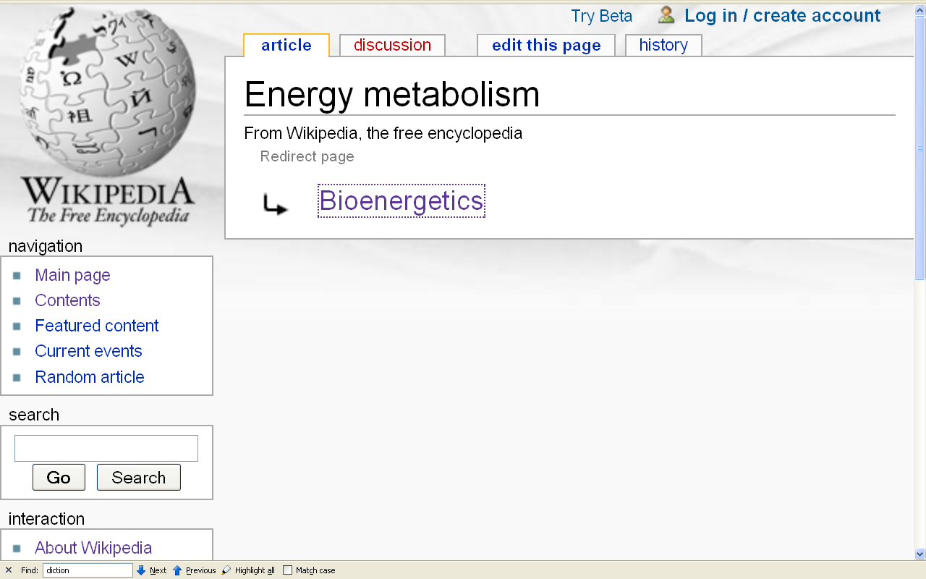

Slide 88
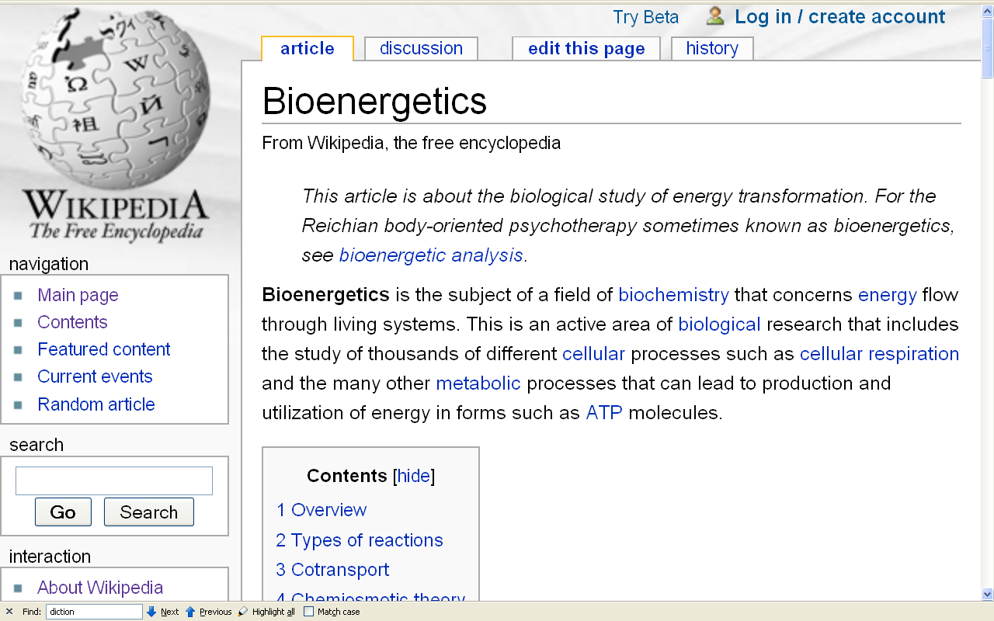

Slide 89
population-level differences . . .
“in biological terms, these are differences in the frequency of genetic traits”
another example:
lactose intolerance
The Cultural Feast, 2nd ed., p. 6

Slide 90
population-level differences . . .
“in biological terms, these are differences in the frequency of genetic traits”
an example:
lactose intolerance
we’ll have a look at the
“Lactose Intolerance” slide set
later on . . .
The Cultural Feast, 2nd ed., p. 6

Slide 91
population-level differences . . .
“in biological terms, these are differences in the frequency of genetic traits”
a third example:
distribution of skin color
The Cultural Feast, 2nd ed., p. 6

Slide 92
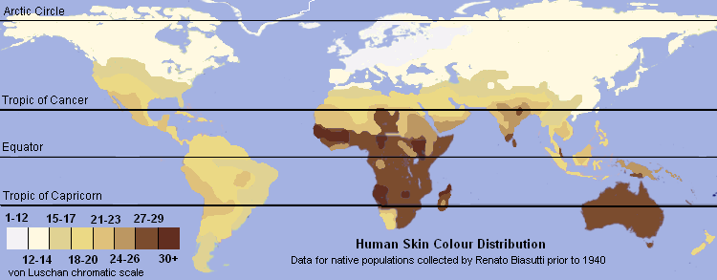
population-level differences . . .
http://en.wikipedia.org/wiki/Skin_color

Slide 93
with regard to energy metabolism
population-level differences exist
“in the need for, and the ability
to access or synthesize,
nutrients among groups of humans who have adapted to different ecological and dietary conditions”
The Cultural Feast, 2nd ed., p. 8

Slide 94
population-level difference
exist “in the need for,
and the ability
to access or synthesize,
nutrients among groups of humans who have adapted to different ecological and dietary conditions”
The Cultural Feast, 2nd ed., p. 8

Slide 95
population-level difference
exist “in the need for, and the ability to access or synthesize, nutrients among groups of humans who have adapted to different ecological and dietary conditions”
The Cultural Feast, 2nd ed., p. 8

Slide 96
Austin Animal Crackers
250 / 2000 = 12.5%
250 / 2500 = 10.0%
250 / 2300 = 10.9%
so while the food industry uses
2000 “food calories” as a standard,
it could just as well be
something like 2300
NOTE: Your own recommended intake should be determined in consultation with a qualified health professional
Wikipedia

Slide 97
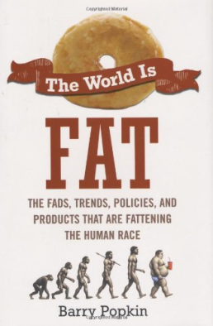
an important related term . . .
“energy density”
refers to
“the term for the number of calories in a given weight of food”
(for e.g., each 100 grams)
The World is Fat, 2010, p. 33

Slide 98
related term . . .
“energy density”
. . . pizza with extra cheese,
French fries . . .
have a
high “energy density”
The World is Fat, 2010, p. 33

Slide 99
related term . . .
“energy density”
higher energy density foods contain more fat, protein, and sugar,
but less water
The World is Fat, 2010, p. 34

Slide 100
related term . . .
“energy density”
. . . generally, reducing energy density is a good thing
with foods containing more
fiber and water we tend to eat less
and feel sated more readily
The World is Fat, 2010, p. 147

Slide 101
related term . . .
“energy density”
pecans = ca. 700 calories per 100 grams
broiled lean steak = ca. 300-400 calories per 100 grams
Austin Animal crackers = ca. 420 calories per 100 grams
(83.% from carbohydrates)
The World is Fat, 2010, p. 34

Slide 102
related term . . .
energy expenditure
dusting or vacuuming = ca. 170 calories per hour
The World is Fat, 2010, p. 76

Slide 103
related term . . .
energy expenditure
working off a piece of pecan pie . . .
(500 [food] calories)
takes . . .
— ca. 2-½+ hrs. normal walking
— almost 1-½ hrs. running
— several hours of fast biking
— 1 hr. of the most vigorous aerobics
The World is Fat, 2010, p. 81

Slide 104
related term . . .
energy expenditure
working off 2 beers . . .
at least 300 calories / @ 12 fluid oz. (per bottle)
— ca. 1-½+ hrs. normal walking
Cf., The World is Fat, 2010, p. 81

Slide 105
related term . . .
energy expenditure
working off a Starbucks caffe latte . . .
340 calories / venti, 20 fluid oz.
— ca. 1-½+ hrs. normal walking
Cf., The World is Fat, 2010, p. 82

Slide 106
related term . . .
energy expenditure
working off a Burger King vanilla shake . . .
820 calories, medium
— ca. 2-½ hrs. running
Cf., The World is Fat, 2010, p. 82

Slide 107
related term . . .
energy expenditure
working off a Burger King
“Ultimate Double Whopper”
(fka “The Extreme Whopper”) . . .
1,110 calories
— ca. 3-½ hrs. running
Cf., The World is Fat, 2010, p. 143

Slide 108
related term . . .
energy expenditure
working off a Burger King
“Ultimate Double Whopper”
and the shake . . .
1,920 calories
— ca. 5-¾+ hrs. running
Cf., The World is Fat, 2010, p. 143

Slide 109
related term . . .
energy expenditure
working off a Burger King “Ultimate Double Whopper” and the shake . . .
1,920 calories
— ca. 5-¾+ hrs. running
having a Burger King
“Ultimate Double Whopper”
and a shake leaves you about
380 calories for the rest of the day on a 2300 calorie/day intake schedule
Cf., The World is Fat, 2010, p. 143

Slide 110
related term . . .
energy expenditure
working off a bag of Austin animal crackers . . .
500 calories / 60 grams
— 2-½+ hrs. normal walking
— almost 1- ½ hrs. running
— several hours of fast biking
— 1 hr. of the most vigorous aerobics
Cf., The World is Fat, 2010, p. 81

Slide 111
another important related term . . .
“energy balance”
refers to
energy “consumed” (—) energy expended
(absorbed)
a positive energy balance results in body fat
The World is Fat, 2010, p. 119

Slide 112
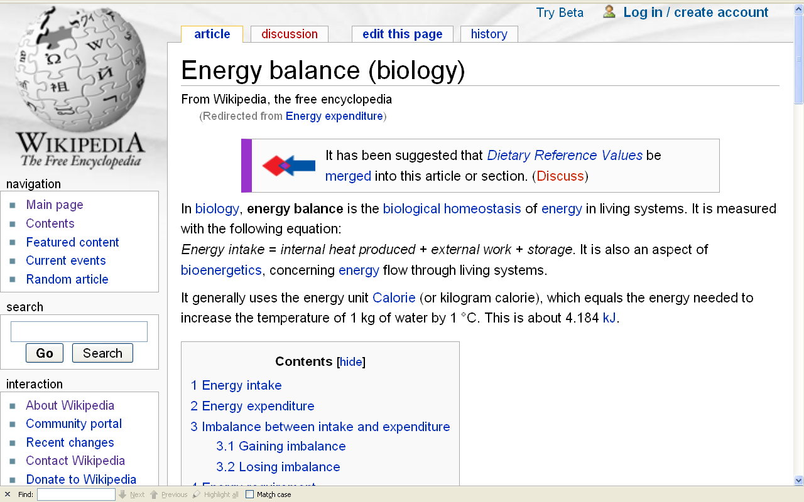
http://en.wikipedia.org/wiki/Energy_expenditure

Slide 113
and finally, one should note, from the anthropological point of view, humans are biologically programmed
to really like . . .
salty foods
sweet foods
fatty foods
and this probably had something to do with
their survival value in prehistoric times,
when salt, sweets, and fat was at a premium

Slide 114
but too much salt, fat, sweet food
is not good for you,
and in industrial countries (for most people) there now is easy access to it . . .
often yielding health problems . . .
so you need to try to limit
salty food
sweet food
fatty food (especially foods with saturated fats)

Slide 115
you know all that . . .

Slide 116
and you can keep tabs on the
salts, sweets, and fats with the
Nutrition Facts labels . . .

Slide 117
Austin Animal Crackers
Wikipedia

Slide 118
Comparison of Old (left) and New (right) Nutrition Facts Labels
Limit
these
Nutrients
Limit
added
Sugars
get
enough
of these
old
NEW
new
NEW
NEW
NOTE: Consult a competent licensed health professional for personal details
http://www.d.umn.edu/cla/faculty/troufs/anthfood/afnutritionlabels.html#title

Slide 119
Austin Animal Crackers
and especially watch the trans fats . . .
salt (sodium) . . .
and added sugars . . .
NOTE: Consult a competent licensed health professional for personal details
Wikipedia

Slide 120
Comparison of Old (left) and New (right) Nutrition Facts Labels
old
new
NOTE: Consult a competent licensed health professional for personal details
http://www.d.umn.edu/cla/faculty/troufs/anthfood/afnutritionlabels.html#title

Slide 121
Austin Animal Crackers
but note:
“. . . unlike in many other countries, trans fat levels of less than 0.5 grams per serving can be listed as 0 grams trans fat on the food label”
in the United States Trans Fat -- Wikipedia
Wikipedia

Slide 122
Austin Animal Crackers
and “. . . there is no requirement to list
trans fats on institutional food packaging;
thus bulk purchasers such as schools, hospitals, and cafeterias are unable to evaluate the trans fat content of commercial food items”
Trans Fat – Wikipedia
Wikipedia

Slide 123
Austin Animal Crackers
but in your everyday life
you’re beginning to see
other warning signs . . .
Wikipedia

Slide 124
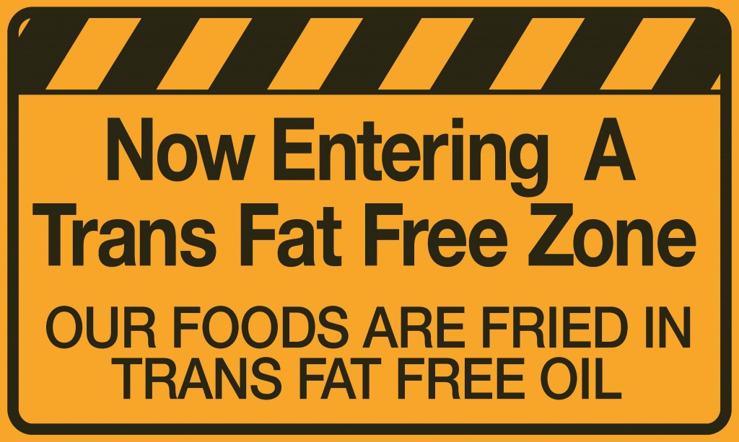
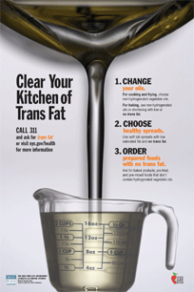
New York CIty
Wikipedia

Slide 125
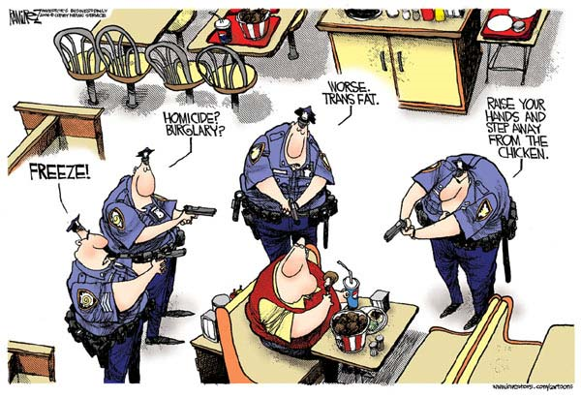
http://www.cagle.com/news/TransFatBan/main.asp

Slide 126
http://www.cagle.com/news/TransFatBan/main.asp

Slide 127
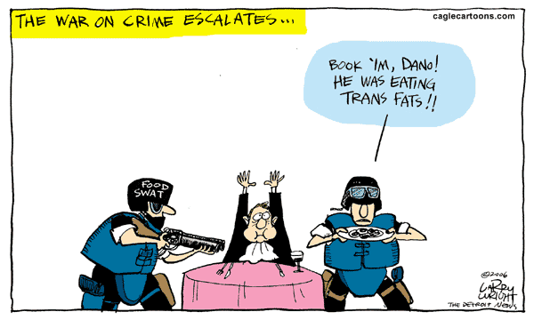
http://www.cagle.com/news/TransFatBan/main.asp

Slide 128
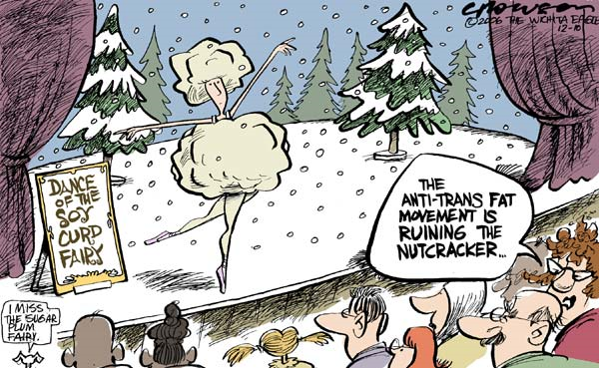
http://www.cagle.com/news/TransFatBan/main.asp

Slide 129
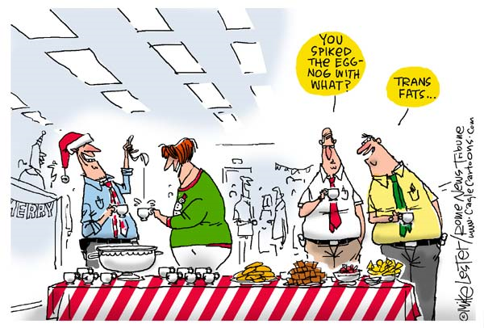
http://www.cagle.com/news/TransFatBan/main.asp

Slide 130
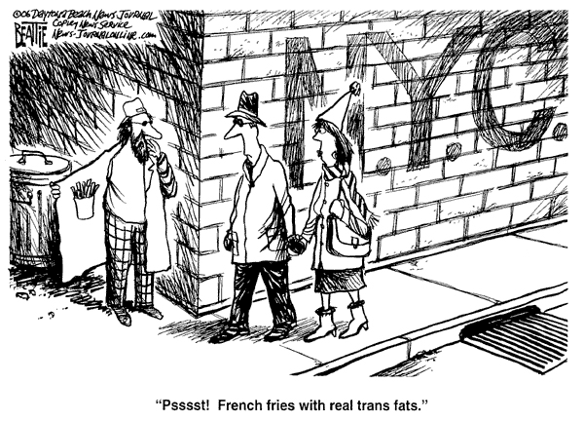
http://www.cagle.com/news/TransFatBan/main.asp

Slide 131
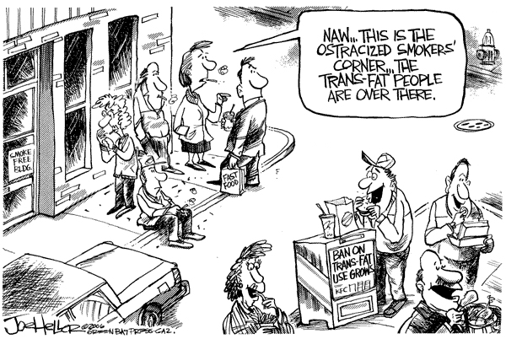
http://www.cagle.com/news/TransFatBan/main.asp

Slide 132
http://www.cagle.com/news/TransFatBan/main.asp

Slide 133
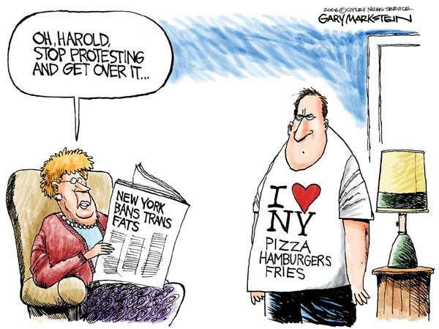
http://www.cagle.com/news/TransFatBan/main.asp

Slide 134
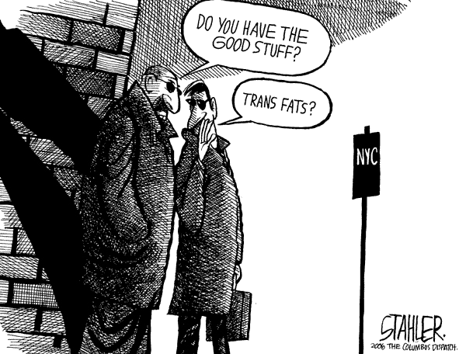
http://www.cagle.com/news/TransFatBan/main.asp

Slide 135
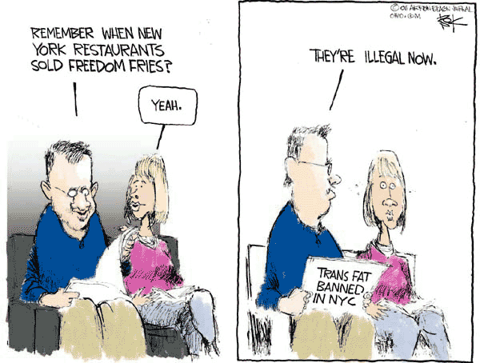
http://www.cagle.com/news/TransFatBan/main.asp

Slide 136
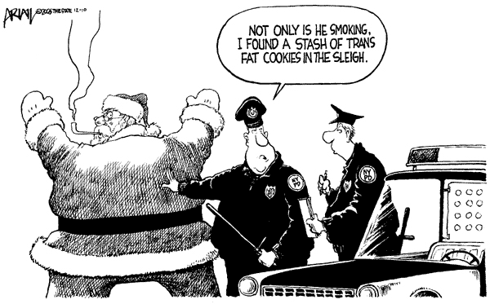
http://www.cagle.com/news/TransFatBan/main.asp

Slide 137
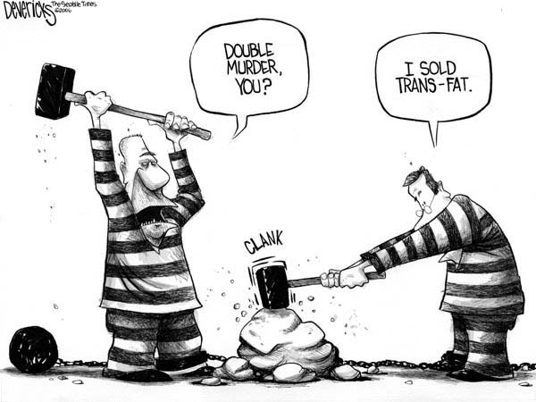
http://www.cagle.com/news/TransFatBan/main.asp

Slide 138
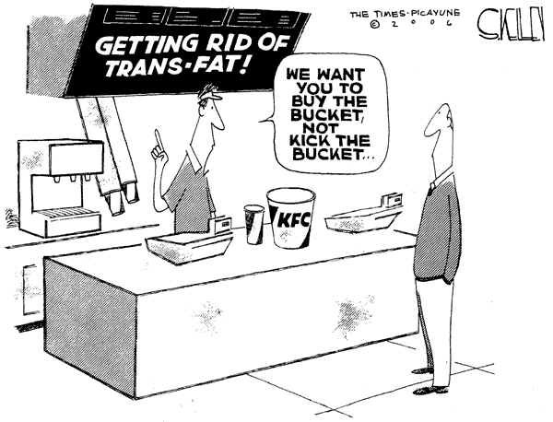
http://www.cagle.com/news/TransFatBan/main.asp

Slide 139
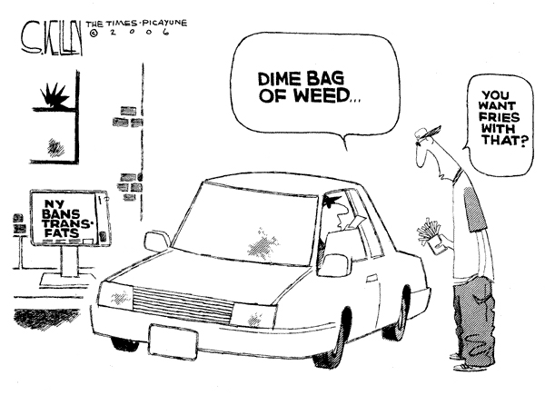
http://www.cagle.com/news/TransFatBan/main.asp

Slide 140
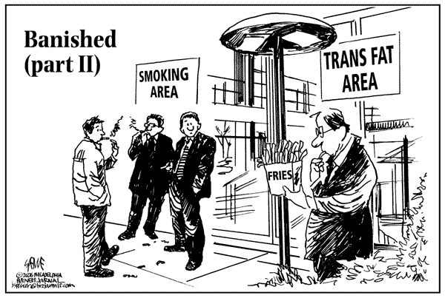
http://www.cagle.com/news/TransFatBan/main.asp

Slide 141
http://www.cagle.com/news/TransFatBan/main.asp

Slide 142
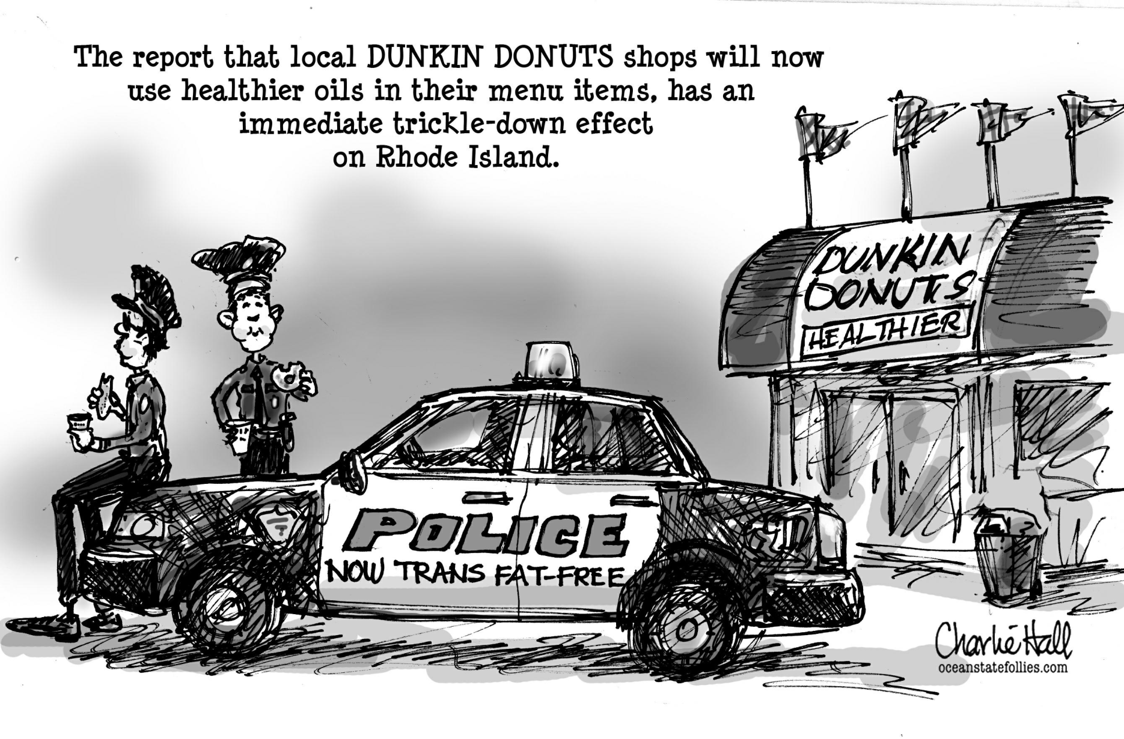
http://www.insidepolitics.org/images/cops-%20trans%20fat.jpg

Slide 143
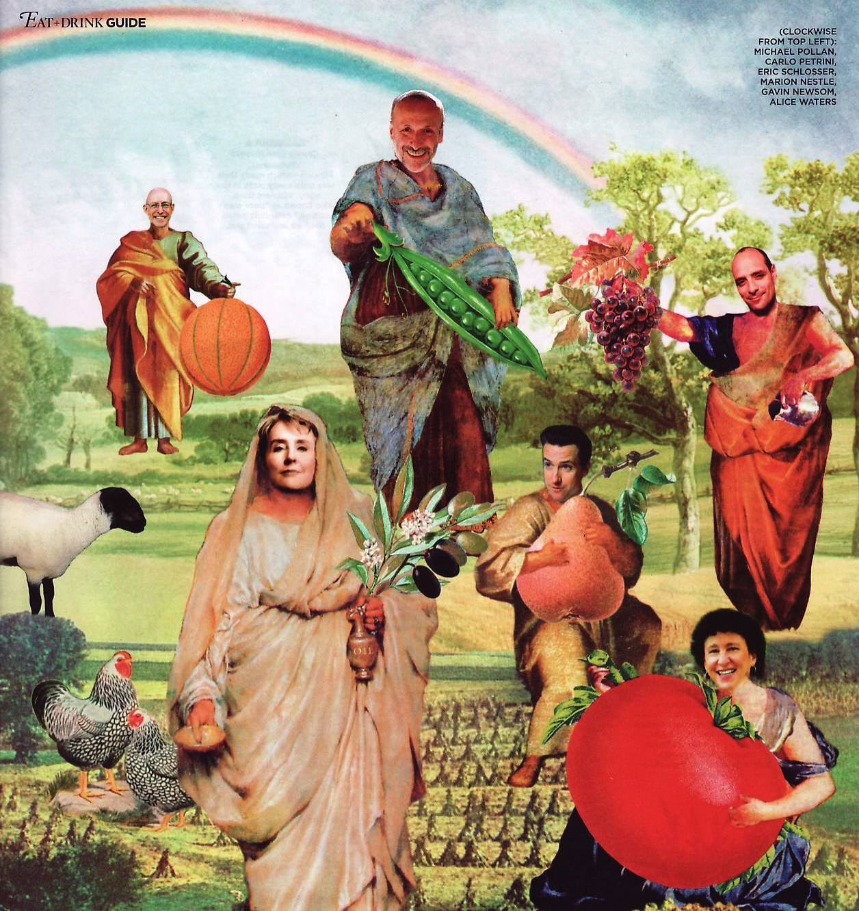
http://www.foodpolitics.com/photos/marion_cartoon_3/

Slide 144
Michael
Pollan
Carlo
Petrini
Eric
Schlosser
Gavin
Newsom
Alice
Waters
Marion
Nestle
http://www.foodpolitics.com/photos/marion_cartoon_3/

Slide 145
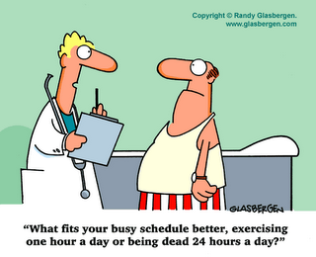
http://www.foodpolitics.com/photos/marion_cartoon_3/

Slide 146
Austin Animal Crackers
and keep an eye on the added sugars . . .
you know that . . .
— they’re “empty calories” —
that means they have calories but no/few nutrients (and you now know that means they count towards your total of 2,300,000 calories but deliver virtually none of the 48-50 nutrients
you need to stay healthy and alive)
NOTE: Consult a competent licensed health professional for personal details
Wikipedia

Slide 147
Comparison of Old (left) and New (right) Nutrition Facts Labels
old
calories
without
significant
nutrients
NOTE: Consult a competent licensed health professional for personal details
http://www.d.umn.edu/cla/faculty/troufs/anthfood/afnutritionlabels.html#title

Slide 148
Comparison of Old (left) and New (right) Nutrition Facts Labels
old
calories
without
significant
nutrients
NOTE: Consult a competent licensed health professional for personal details
http://www.d.umn.edu/cla/faculty/troufs/anthfood/afnutritionlabels.html#title

Slide 149
that’s that

Slide 150
Human Nutrient
Needs
Tim Roufs
© 2010-2024

