Slide 1

Use your up/down arrow keys and/or
your space bar to advance the slides
University of Minnesota Duluth
Tim Roufs
© 2010-2015

Slide 2
Welcome to
Anthropology of Food
University of Minnesota Duluth
Tim Roufs
© 2010-2013

Slide 3
Welcome to
Anthropology of Food
This will be a great course . . .
you will see

Slide 6

First thing . . .
(if you are not already in Moodle)
go to your
2
course management site
and check it out . . .

Slide 7
How do you find
2
in the first place?

Slide 8
Further instructions follow,
but if you want,
and your browser permits,
clicking on the URL that follows
in the next slide
will take you to your Moodle home . . .
(your browser may require that you double-click)
There is another link at the end of this program

Slide 9
https://moodle2.umn.edu/
(your browser may require that you double-click)
If your browser does not allow you to click on the above URL just enter it in your browser window . . .
Continue on here for further instructions . . .
There is another link at the end of this program

Slide 10
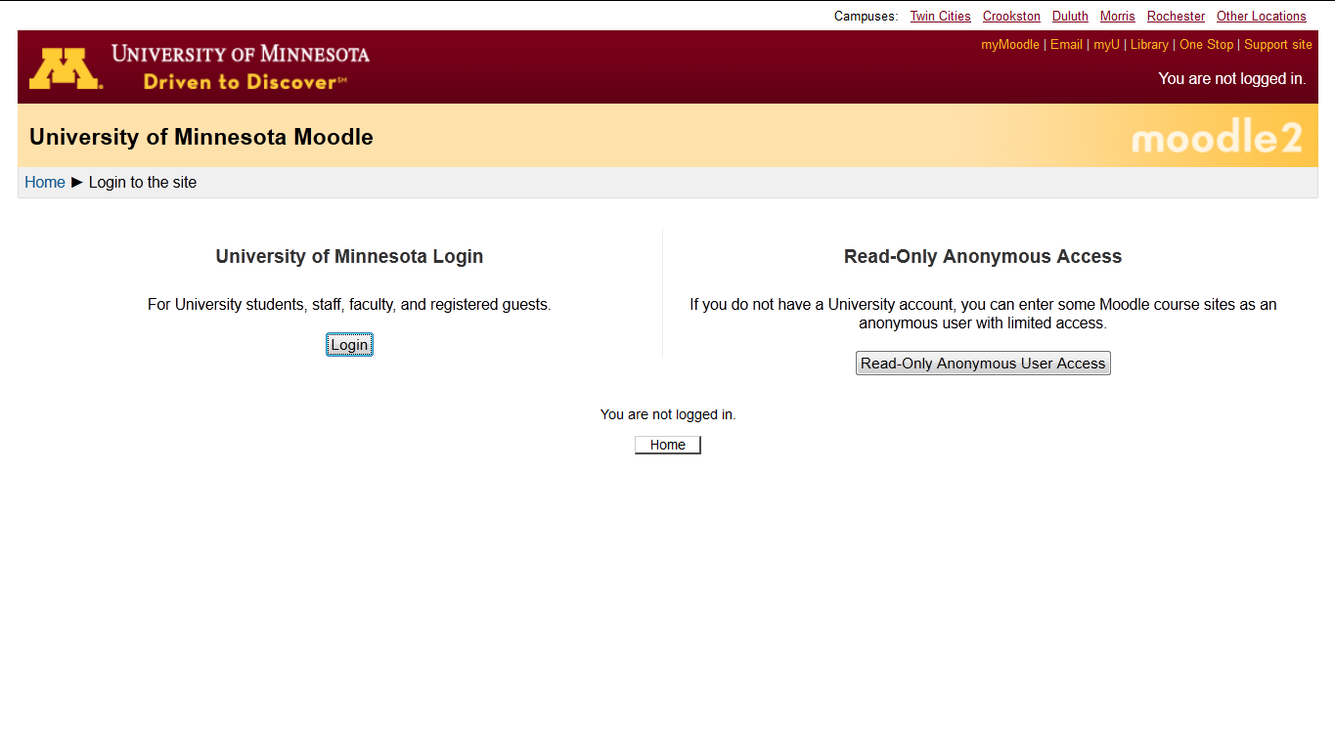
Your Moodle screen may look something like this . . .

Slide 11
Your Moodle screen may look something like this . . .

Slide 12
If you get this screen, go to “University of Minnesota Login” . . .
Be sure to log in

Slide 13
Your log-in page will then look something like the following . . .
Log in using your “x.500” information . . .
(that’s the log-in information you use for your e-mail)
https://moodle.umn.edu/

Slide 14
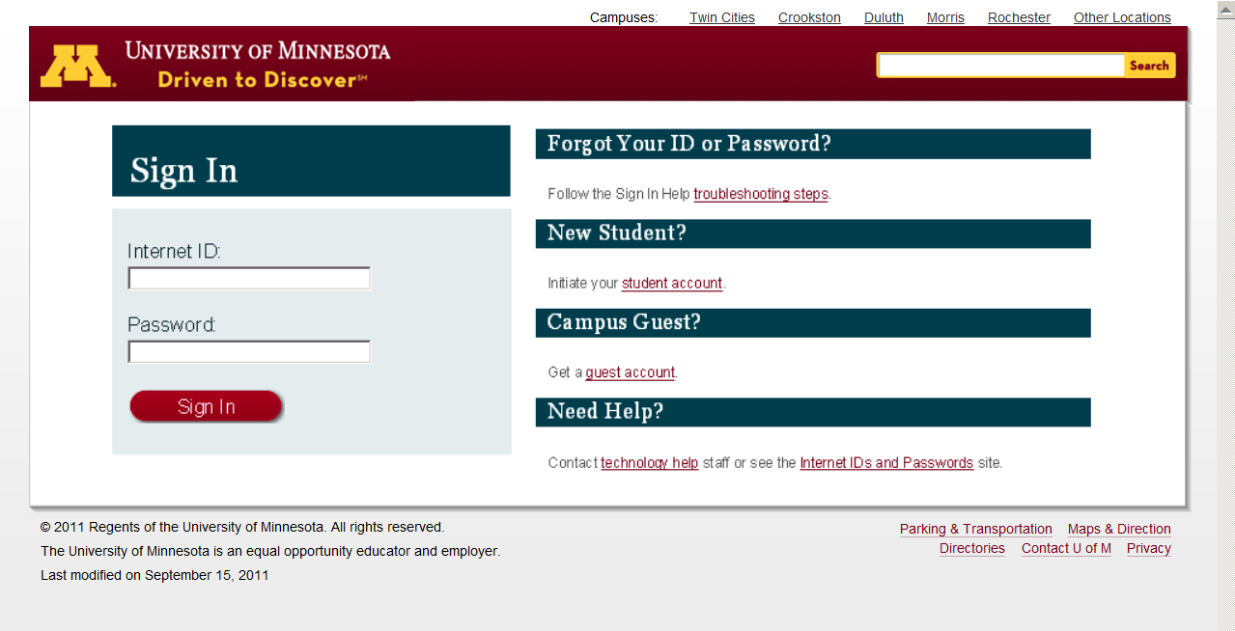
Log in using your “x.500” information . . .

Slide 15
You may also access your Moodle folder from any of the many
course index and content
web pages . . .

Slide 16
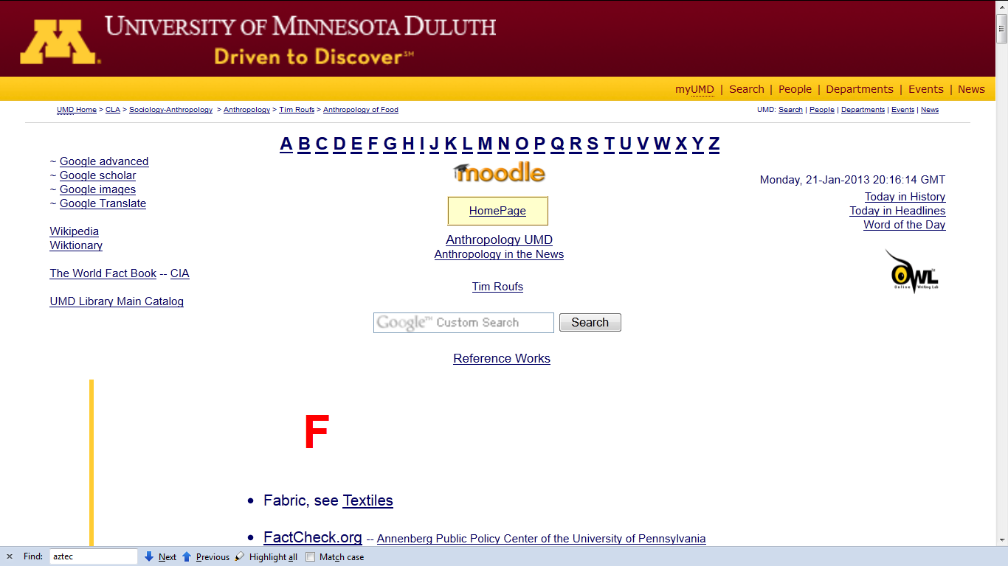

Slide 17
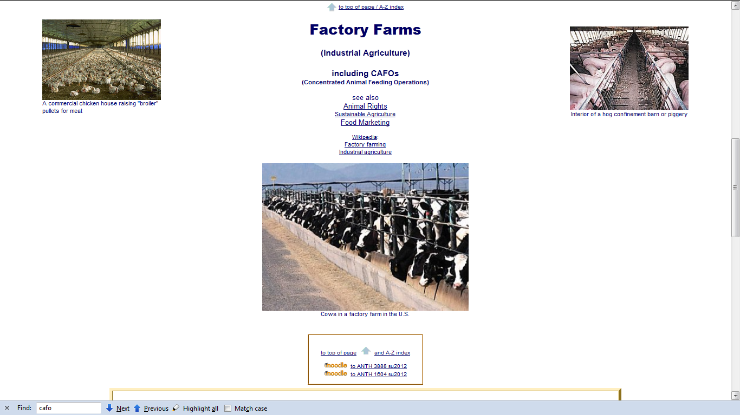

Slide 18
Or you may also access your Moodle folder via the Main UMD WebPage . . .

Slide 19
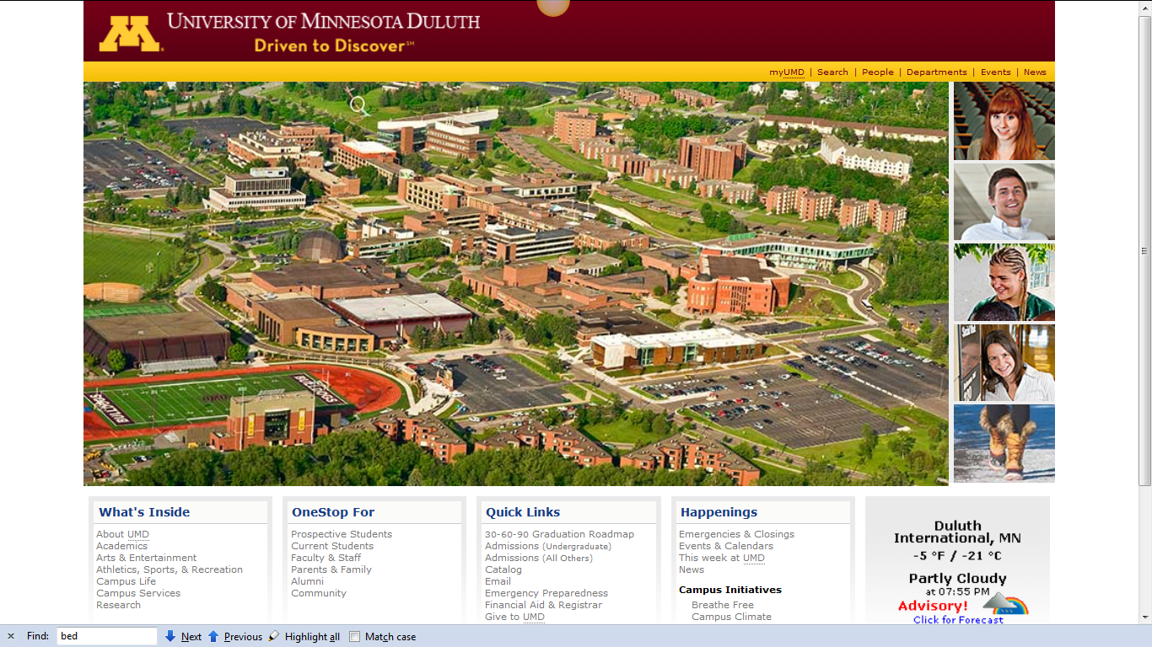
Main UMD WebPage . . .
(this image changes)
www.d.umn.edu

Slide 20
click on “OneStop For Current Students” . . .
(not the image that will appear)
www.d.umn.edu

Slide 21
Main UMD WebPage . . .
(this image changes)
www.d.umn.edu

Slide 22
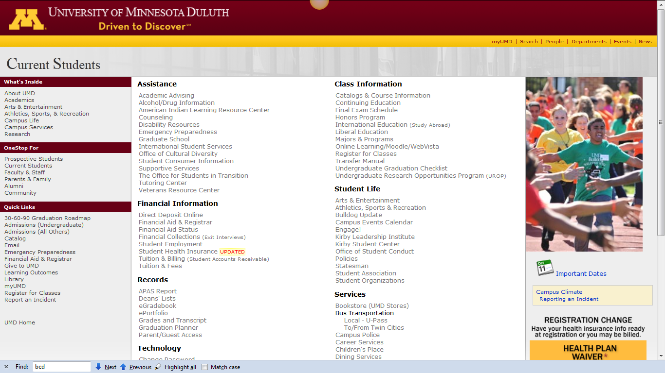
scroll down
http://www.d.umn.edu/students/

Slide 23
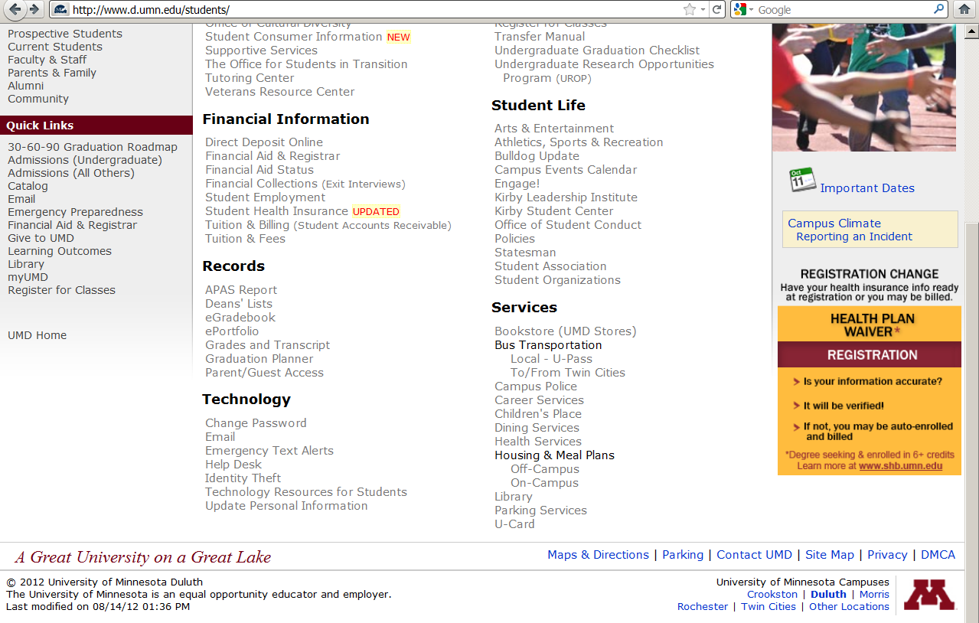
click on “Technology Resources for Students” . . .

Slide 24
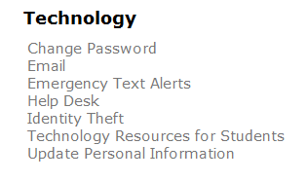
click on “Technology Resources for Students” . . .
http://www.d.umn.edu/itss/students/

Slide 25
then click on “Moodle Support” . . .
http://www.d.umn.edu/itss/students/

Slide 26
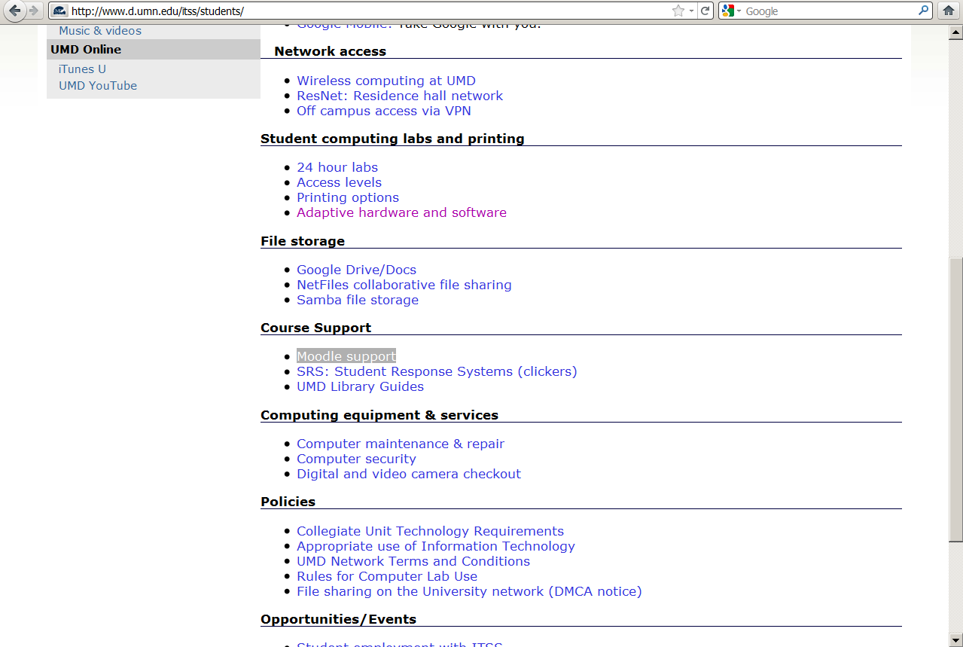
click on “Moodle Support” . . .
http://www.d.umn.edu/itss/students/

Slide 27
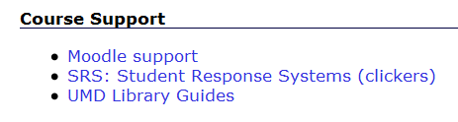
click on “Moodle Support” . . .
http://www.d.umn.edu/itss/students/

Slide 28
Your log-in page will then look something like the following . . .
Log in using your “x.500” information . . .
(that’s the log-in information you use for your e-mail)
https://moodle.umn.edu/

Slide 29
Log in using your “x.500” information . . .

Slide 30
Your Moodle “home” will look something like the following . . .
https://moodle.umn.edu/

Slide 31
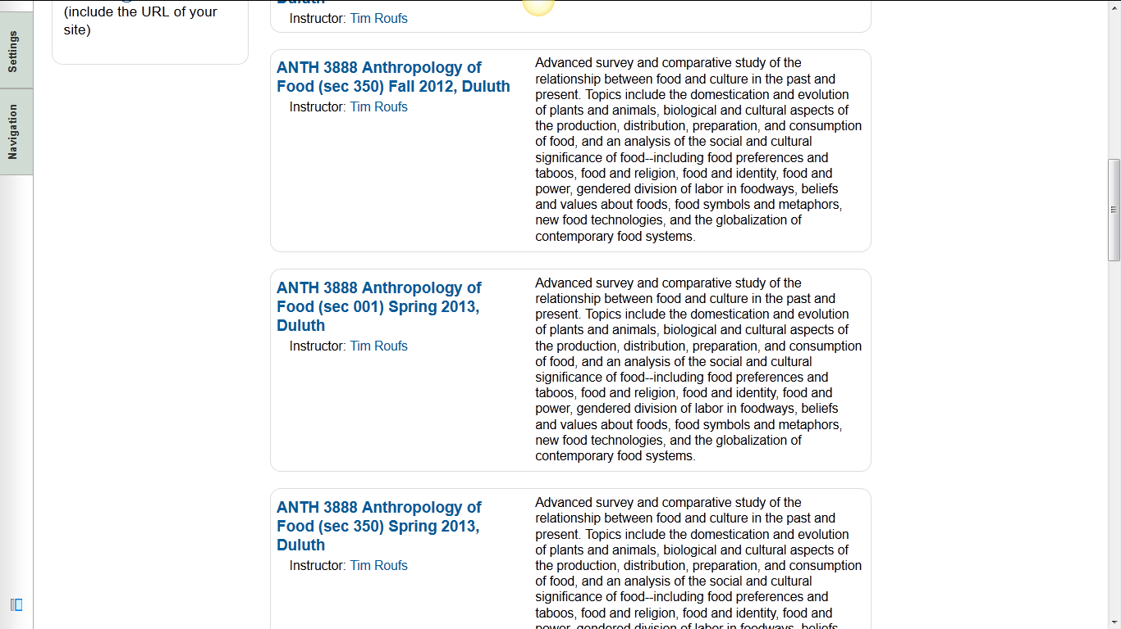
Your Moodle “home” will look something like this . . .

Slide 32
Select Anthropology of Food . . .
https://moodle.umn.edu/

Slide 33
Your Moodle “home” will look something like this . . .

Slide 34
Your Moodle screen
will look
something like the following . . .

Slide 35
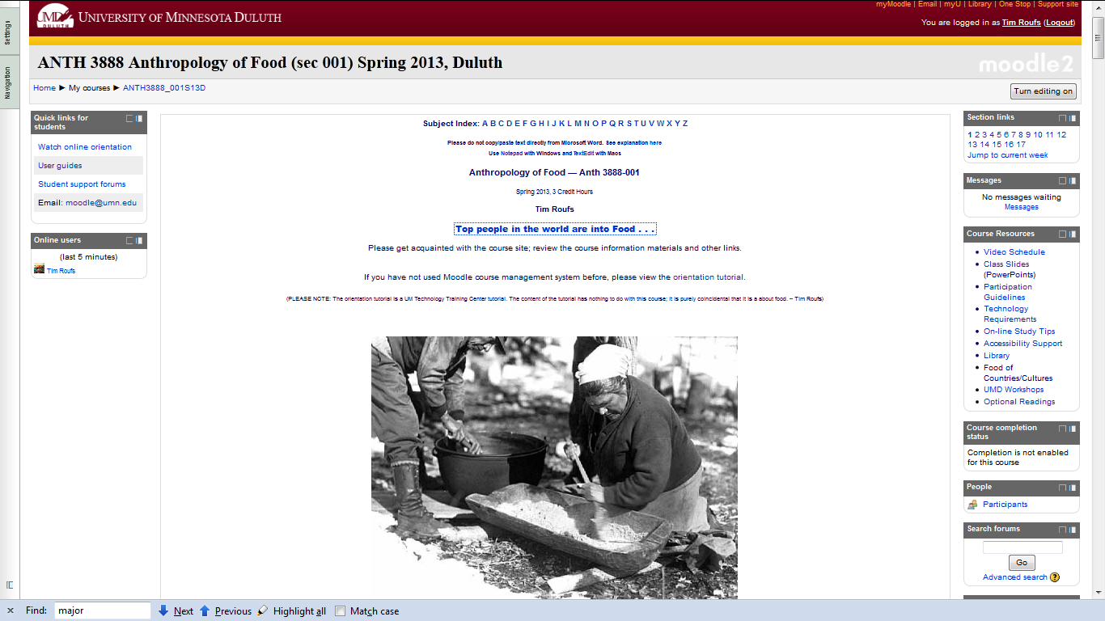
Your Moodle screen will look something like this . . .

Slide 36
Your Moodle screen will look something like this . . .
scroll down

Slide 37
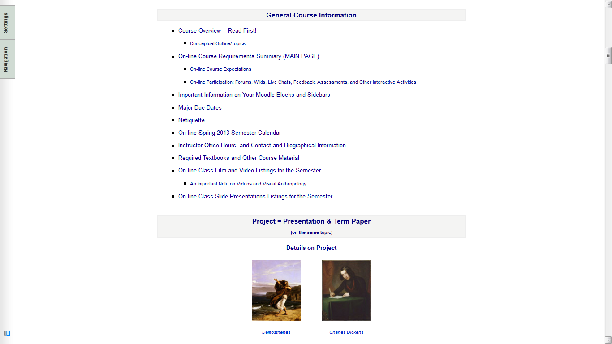
“Block 1”

Slide 38
“Block 1”
contains the basic information for the course

Slide 39
scroll down

Slide 40
And the listing for Week 1
will look something like this . . .

Slide 41
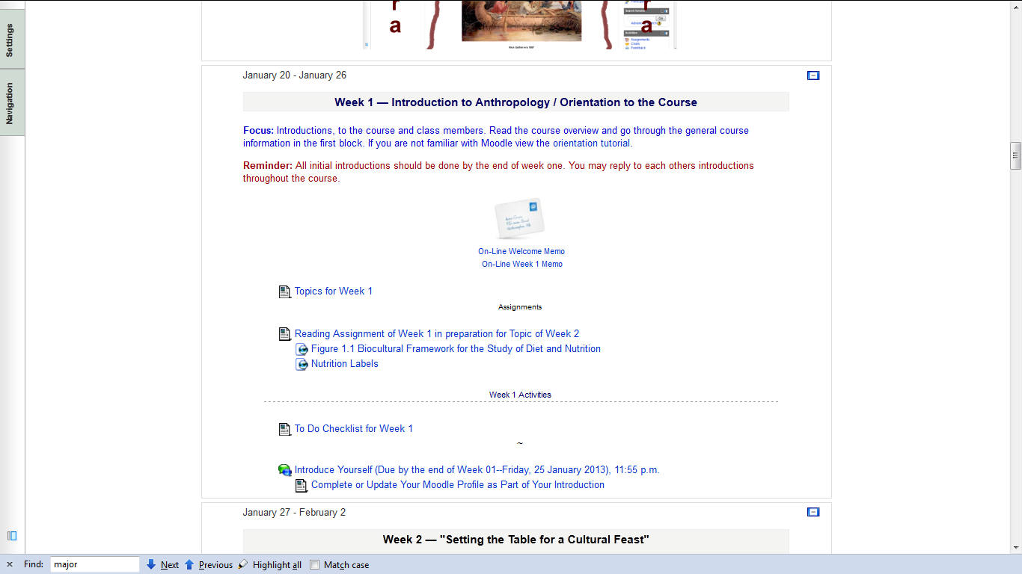

Slide 42
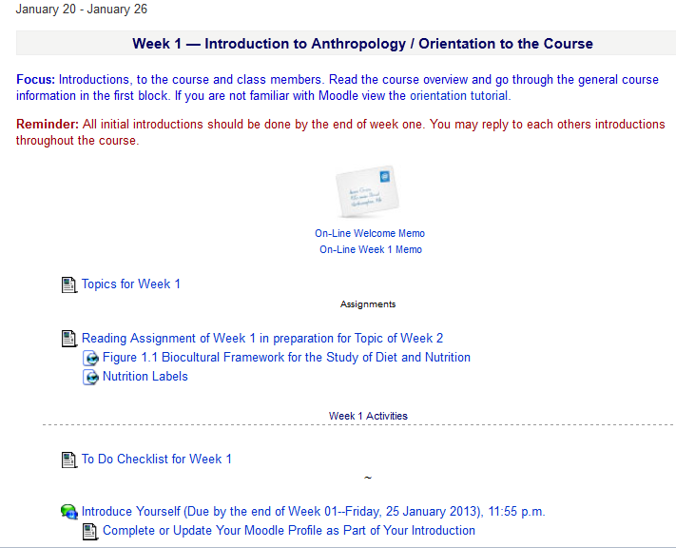

Slide 43
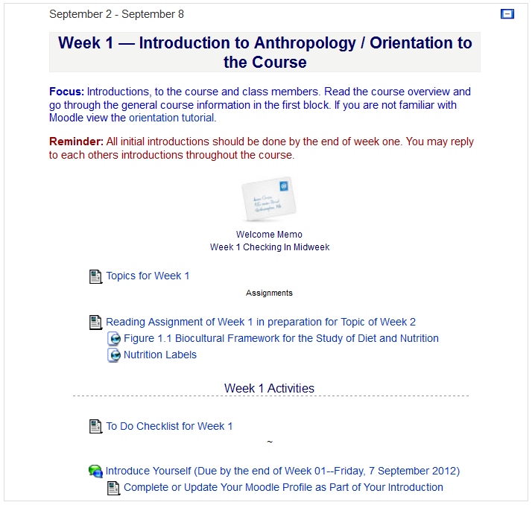
There are usually three main parts to the listing of a week . . .

Slide 44
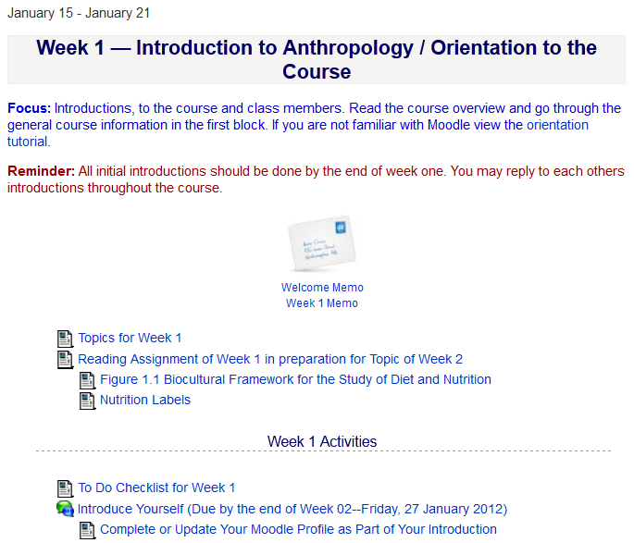
1. Topics for the Week . . .

Slide 45
2. Readings for the Week . . .

Slide 46
and 3. Activities for the week . . .

Slide 47
The first week . . .
    introduce yourself
    and, just for the fun of it, have a look around at the rest of the materials

Slide 48
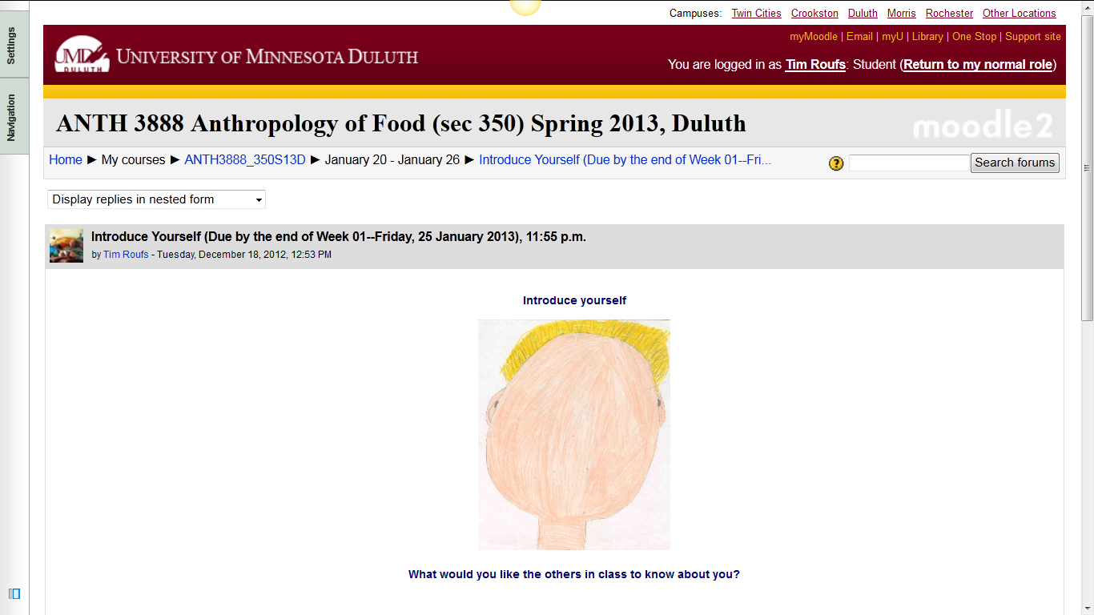
And the Introduction Page will look something like this . . .

Slide 49
The first week . . .
    introduce yourself
    and, just for the fun of it, have a look around at the rest of the materials
    be sure to Update Your Moodle Profile
    as part of your introduction

Slide 50
The first week . . .
    introduce yourself
    and, just for the fun of it, have a look around at the rest of the materials

Slide 51
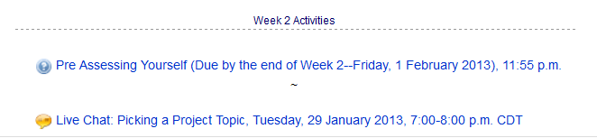
Week 2 . . .
    do the Pre-Assessment
    join in on the Forum Discussion
    and, just for the fun of it, have a look around at the rest of the materials

Slide 52
And the “Pre Assessment” Materials
will look something like the following . . .

Slide 53
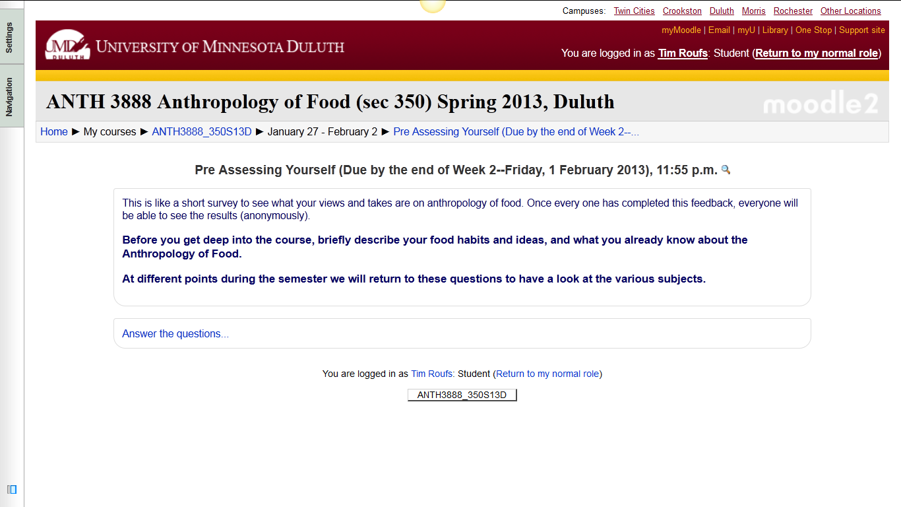
And the “Pre Assessment” Materials will look something like this . . .

Slide 54
Week 2 . . .
    do the Pre-Assessment
    join in on the Live Chat
    and, just for the fun of it, have a look around at the rest of the materials

Slide 55
Week 2 . . .
    do the Pre-Assessment
    join in on the Live Chat
    and, just for the fun of it, have a look around at the rest of the materials

Slide 56
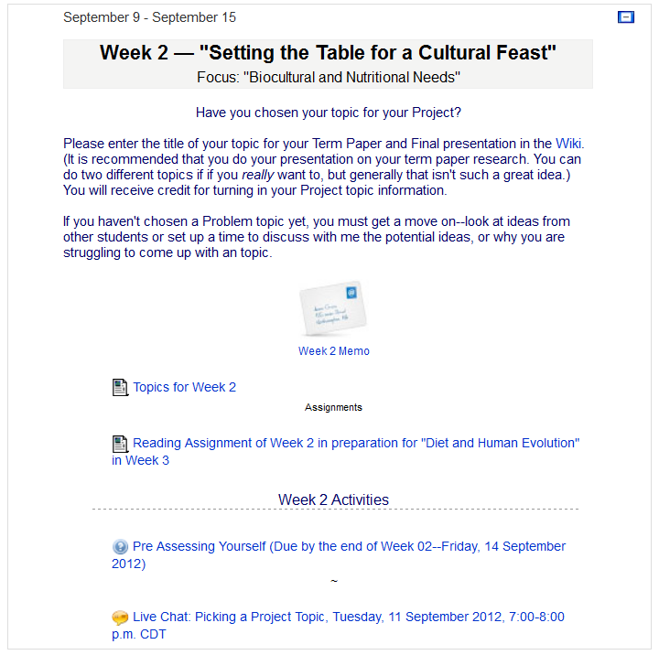
Week 2 . . .
    do the Pre-Assessment
    join in on the Forum Discussion
    then look around still more,
    just for the fun of it

Slide 57
The “First-Day” Handout information contains the basic information . . .
It look something like the following . . .
https://moodle.umn.edu/

Slide 58
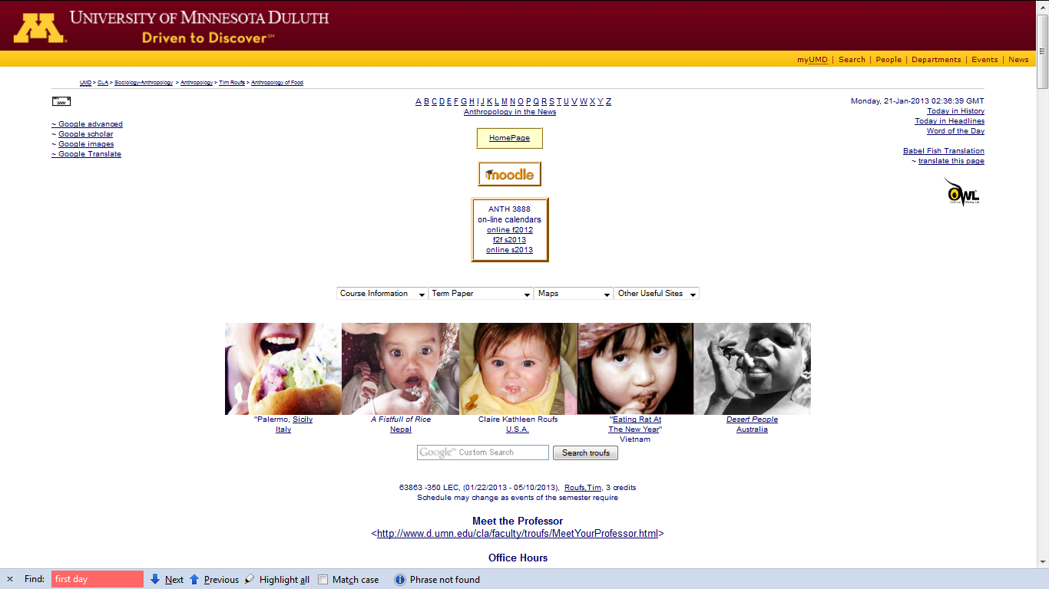
“First-Day” Handout information . . .
http://www.d.umn.edu/cla/faculty/troufs/anthfood/afhandout_first-day_online.html

Slide 59
“First-Day” Handout information . . .
scroll down
http://www.d.umn.edu/cla/faculty/troufs/anthfood/afhandout_first-day_online.html

Slide 60
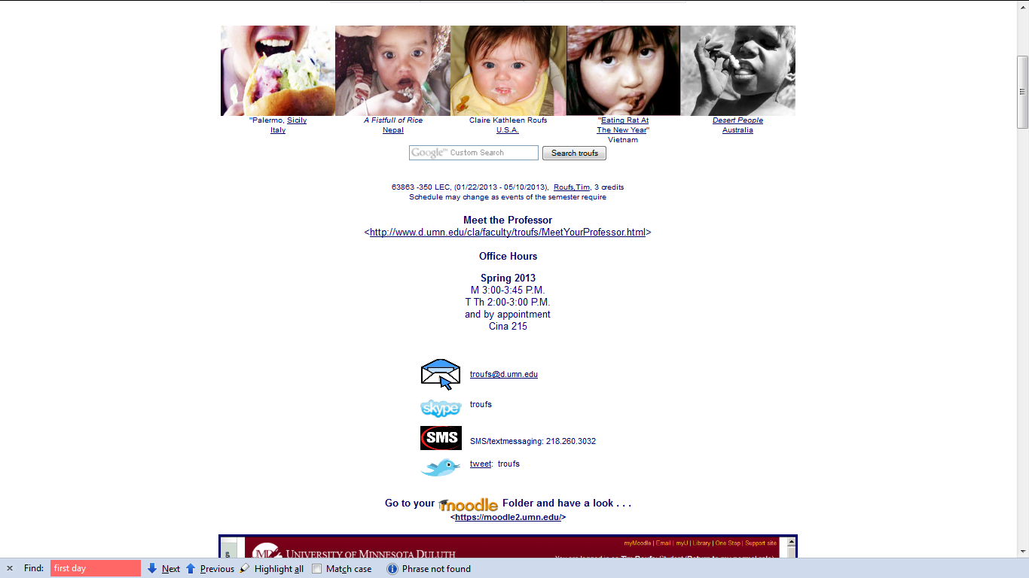
“First-Day” Handout information . . .
Basic Contact information . . .
http://www.d.umn.edu/cla/faculty/troufs/anthfood/afhandout_first-day_online.html

Slide 61
“First-Day” Handout information . . .
Basic Contact information . . .
scroll down
http://www.d.umn.edu/cla/faculty/troufs/anthfood/afhandout_first-day_online.html

Slide 62
“First-Day” Handout information . . .
Moodle Home and
“Block 1”

Slide 63
“First-Day” Handout information . . .
Moodle “Block 1”
scroll down

Slide 64
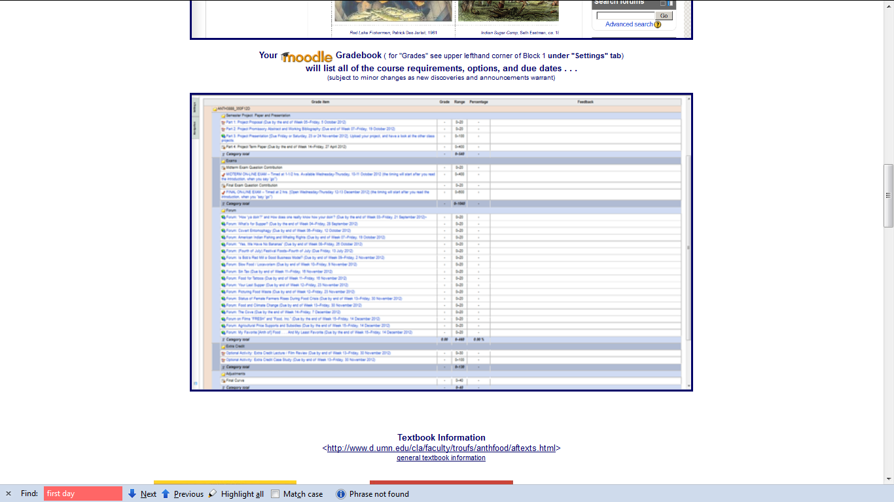
“First-Day” Handout information . . .
Moodle Grader
http://www.d.umn.edu/cla/faculty/troufs/anthfood/afhandout_first-day_online.html

Slide 65
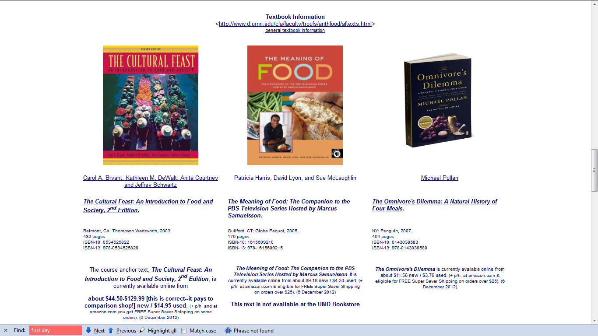
Basic Text Information

Slide 66
Basic Text Information
including information on purchasing texts . . .

Slide 67
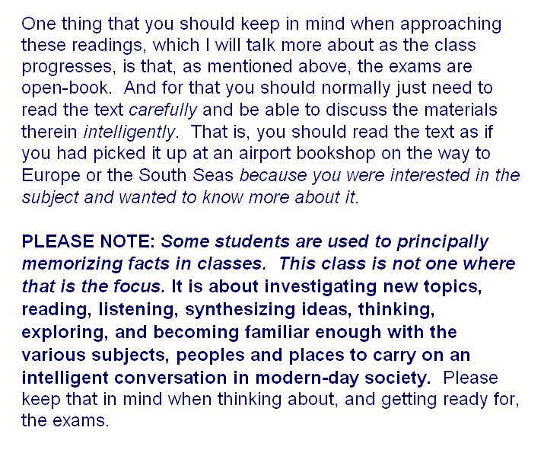

Slide 68
Governing Procedures
pay attention . . .

Slide 69
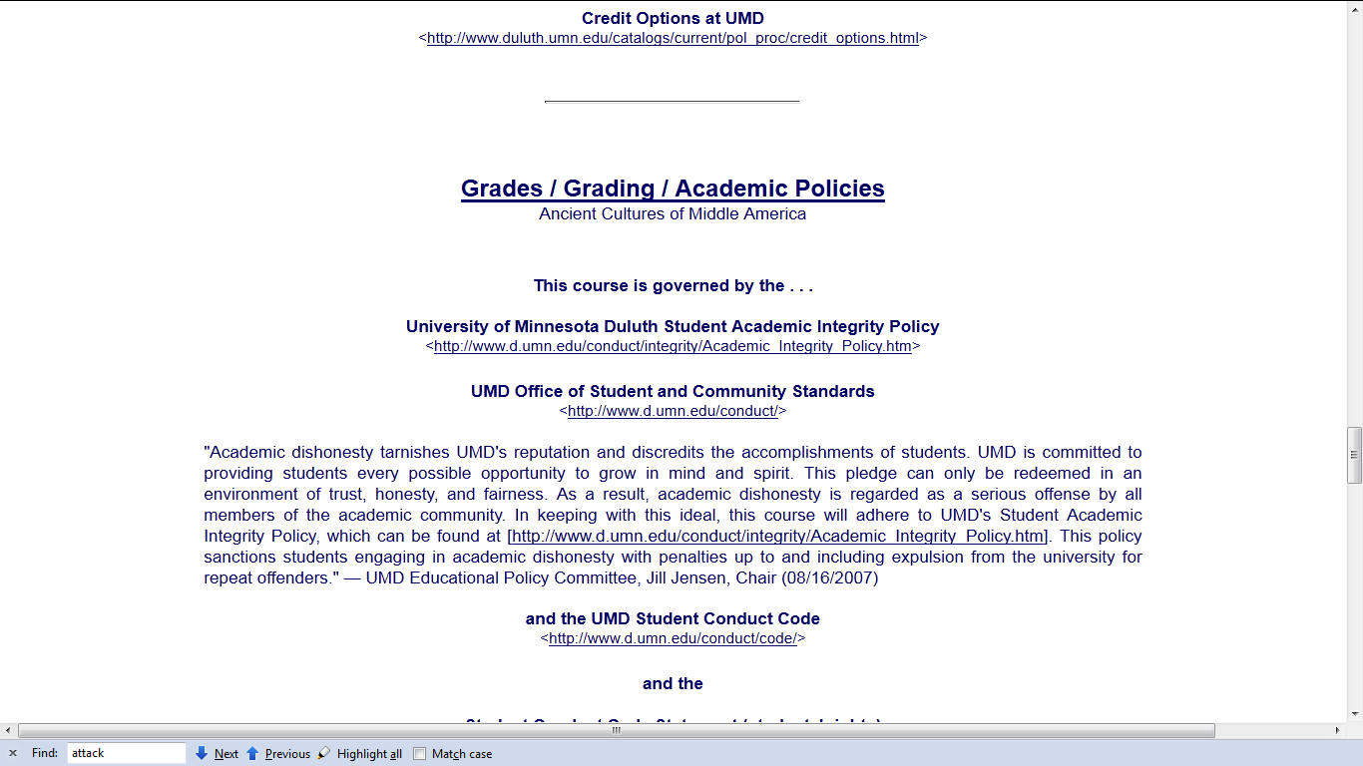
Governing Procedures

Slide 70
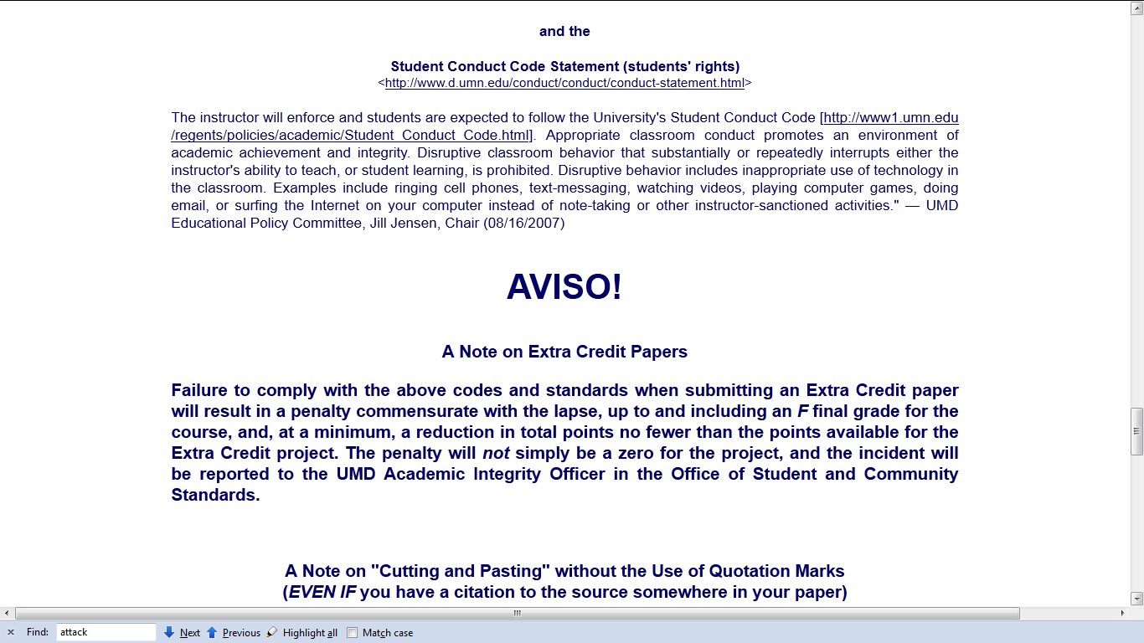
Governing Procedures

Slide 71
Governing Procedures
Governing Procedures
note on Extra Credit Papers

Slide 72
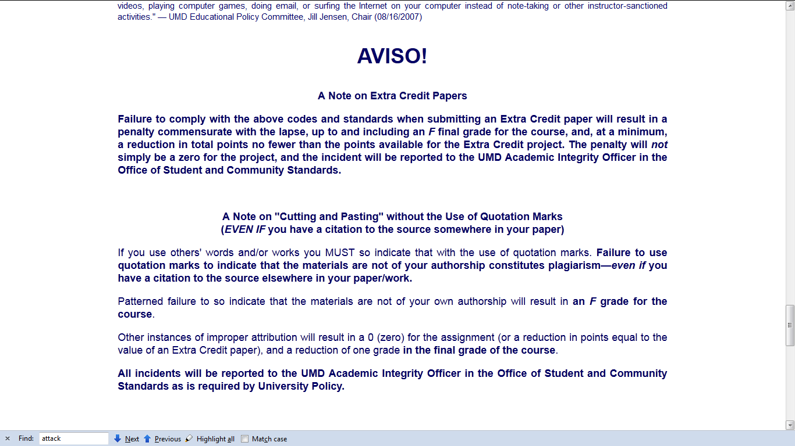
Governing Procedures

Slide 73
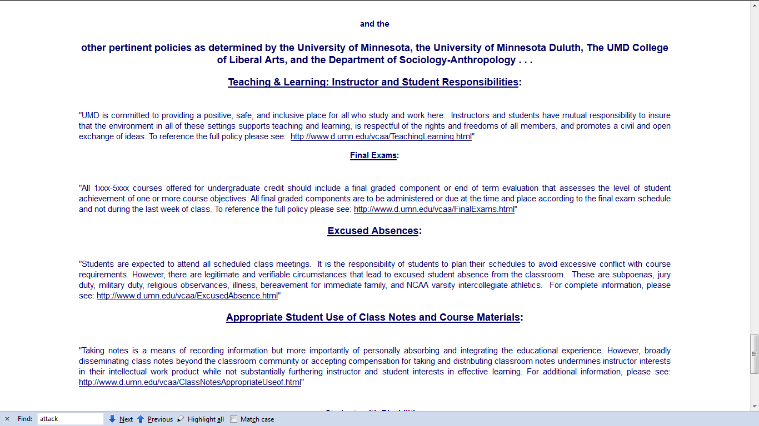
Governing Procedures

Slide 74
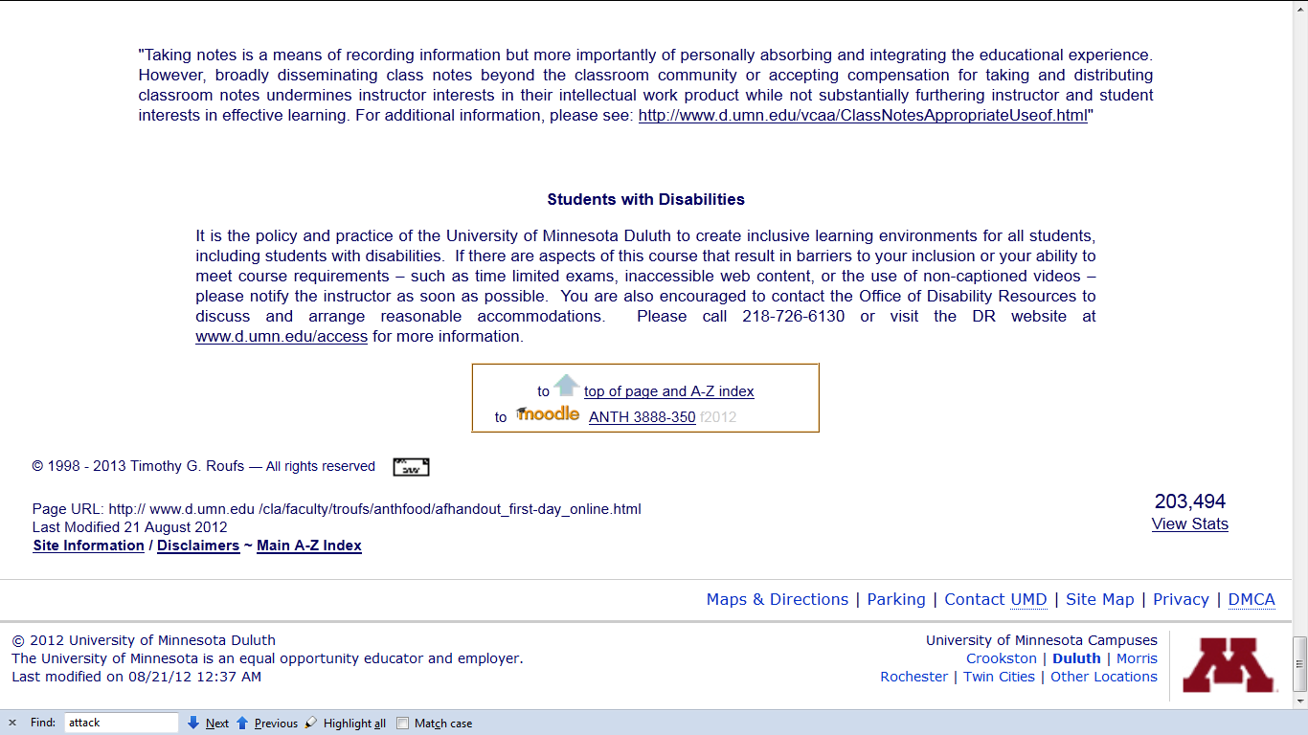
Special Facilities Information

Slide 75
Back to the main
Moodle page
“Block 1”

Slide 77
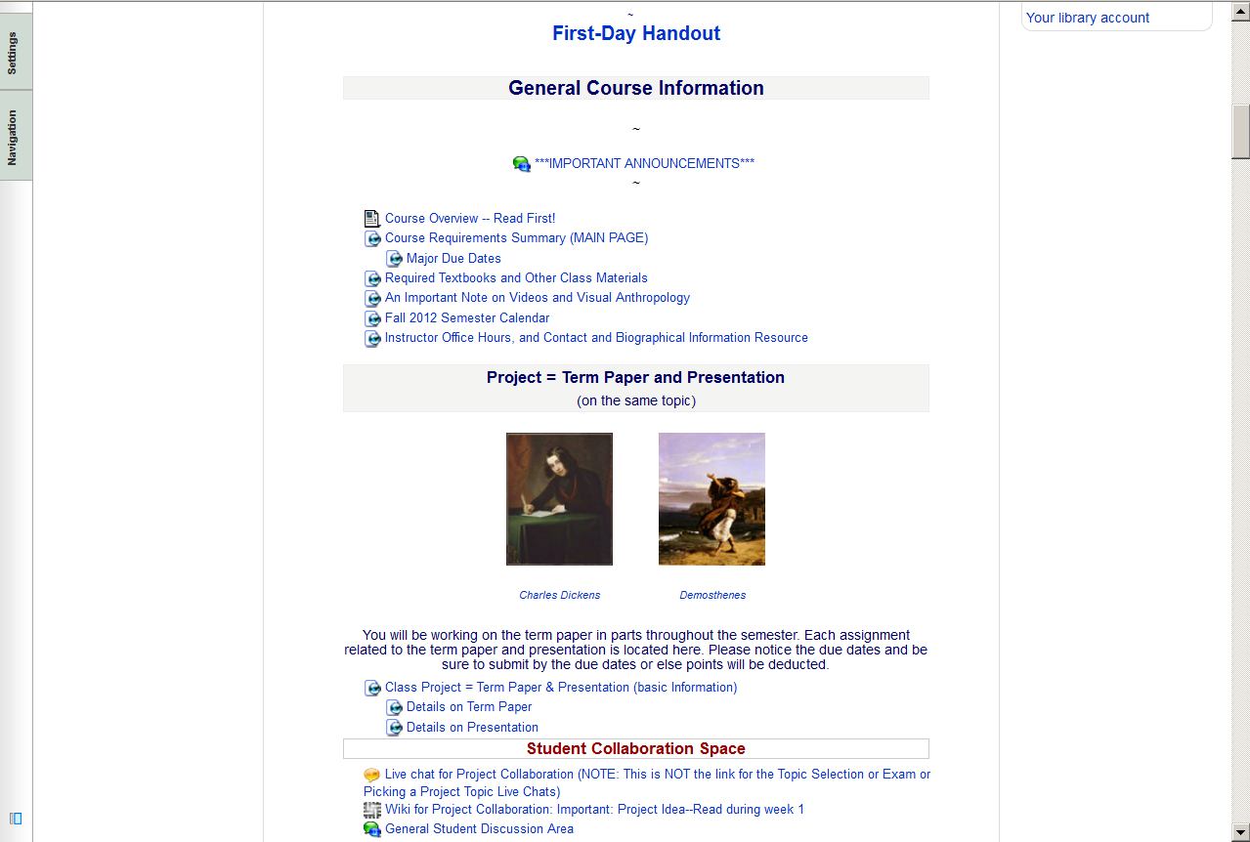

Slide 78
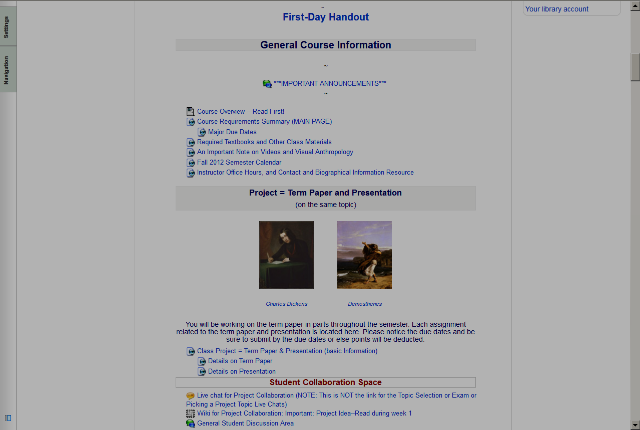
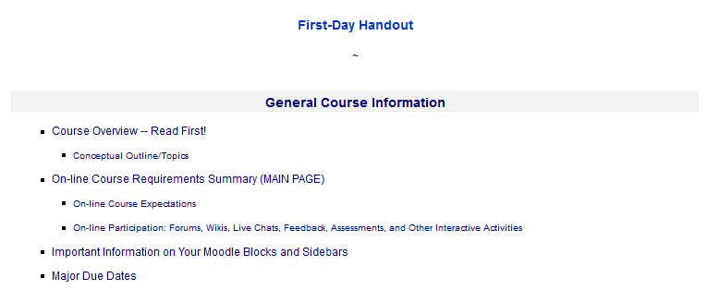

Slide 80
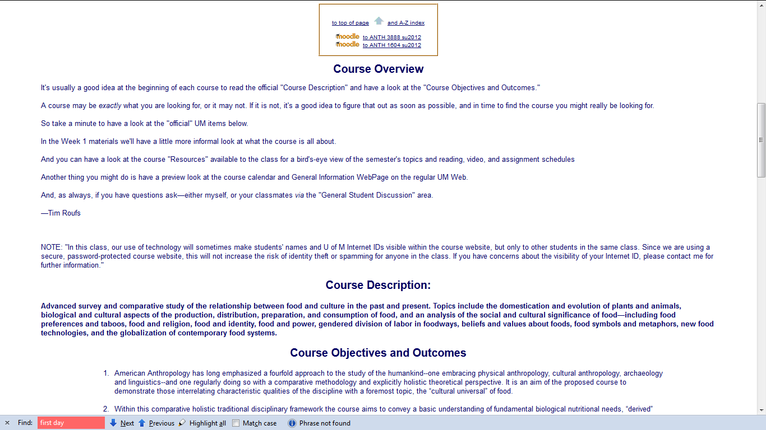

Slide 81
Back to the main
Moodle page
“Block 1”

Slide 82
requirements, due dates, options, and grades

Slide 83
click here for grades link
requirements, due dates, options, and grades

Slide 84
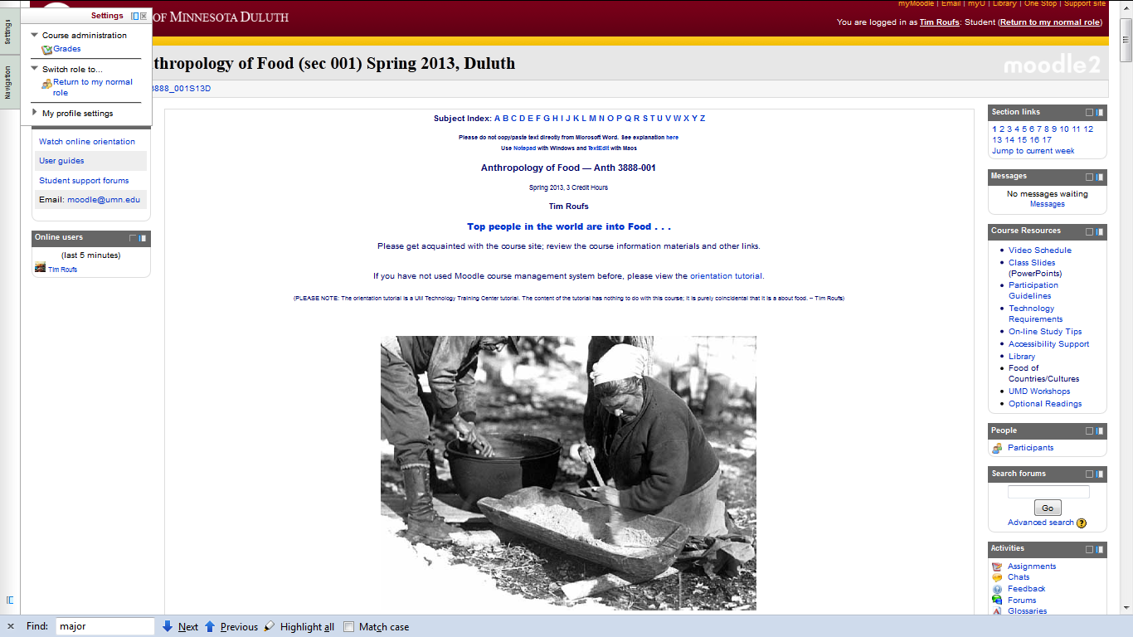

Slide 85
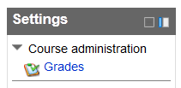

Slide 86
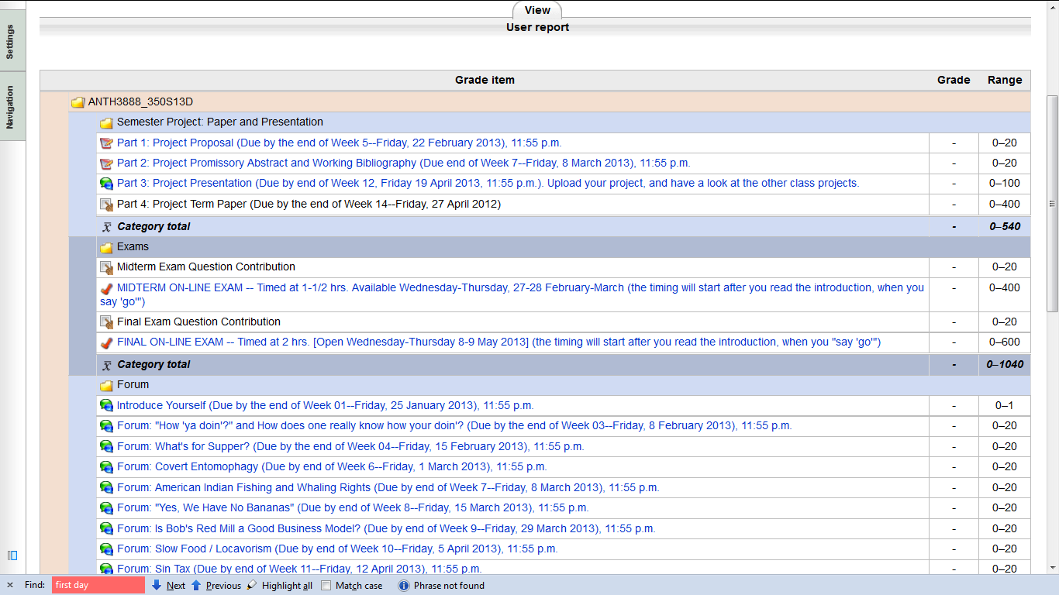
Your Gradebook
will look something like this

Slide 87
Your Gradebook
will look something like this
this is the best place to check requirements, due dates, options, and grades . . .

Slide 88
Back to the main
Moodle page
“Block 1”

Slide 90
The “Major Due Dates” web page is a handy site

Slide 91
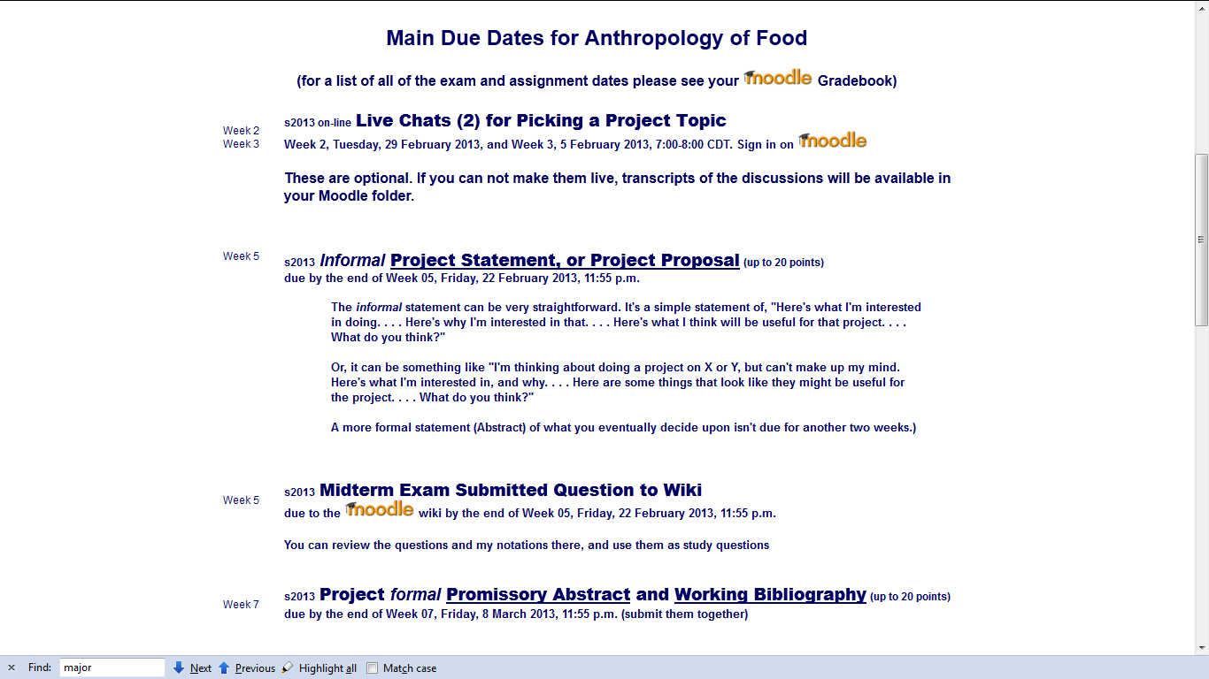

Slide 92
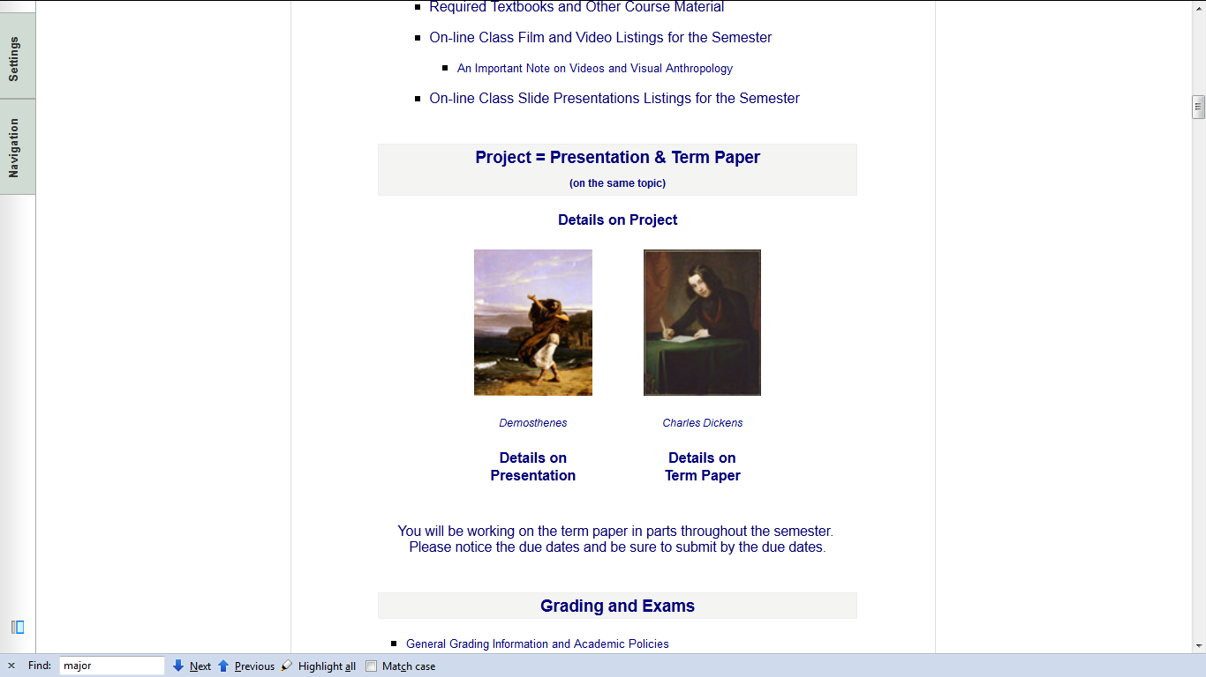
The information on the semester project is also handy

Slide 93
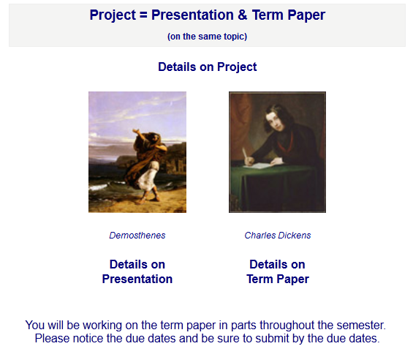

Slide 94
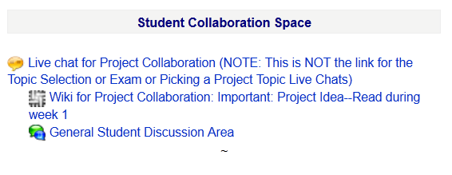
The Student Collaboration Space could also be very handy

Slide 95
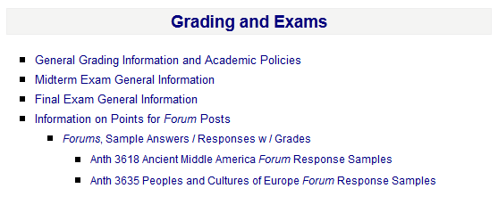
Details on exams and grading are found here . . .

Slide 96
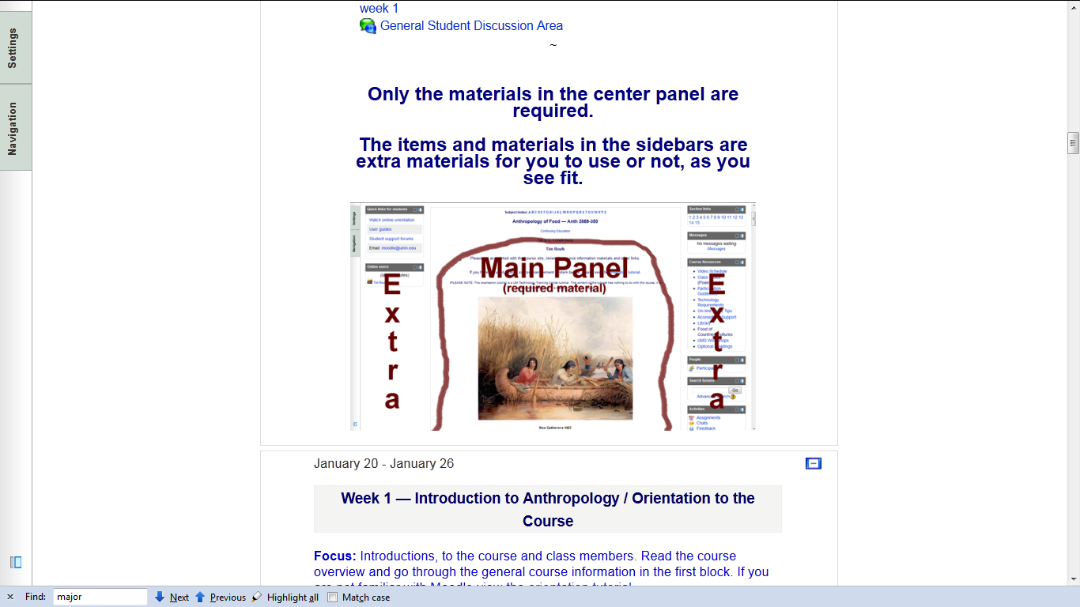
NOTE: Only the Materials in the center panel are required

Slide 97
Back to the main
Moodle page
“Block 1”

Slide 98
Back to the main
Moodle page
“Block 1”
REM

Slide 99
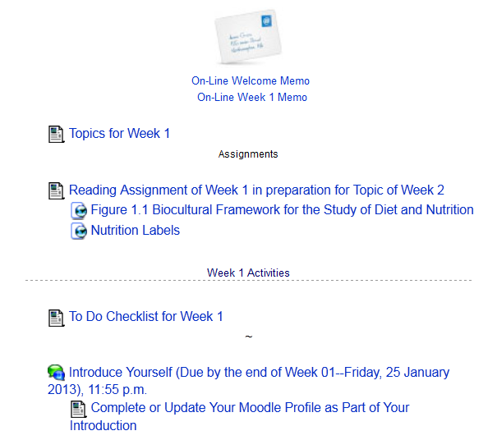
Reading Assignments . . .

Slide 100
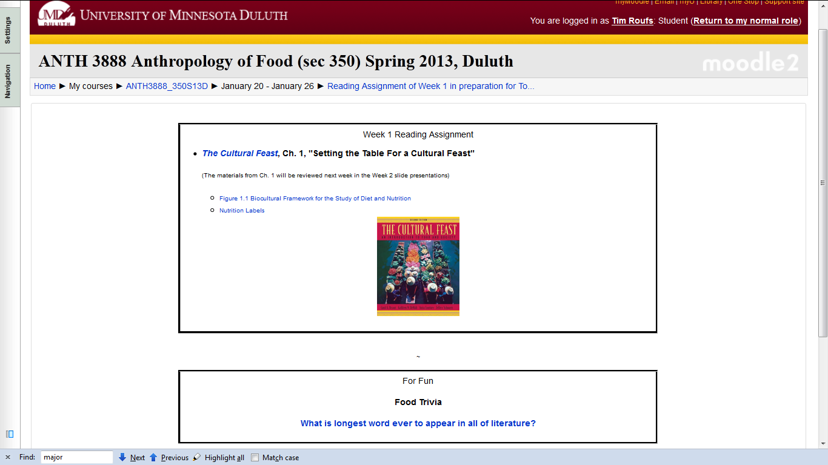
Reading Assignments for Week 1

Slide 101
With a little Trivia thrown in at no extra charge . . .

Slide 102
And occasionally a few charts and diagrams
to help out with the readings . . .

Slide 103
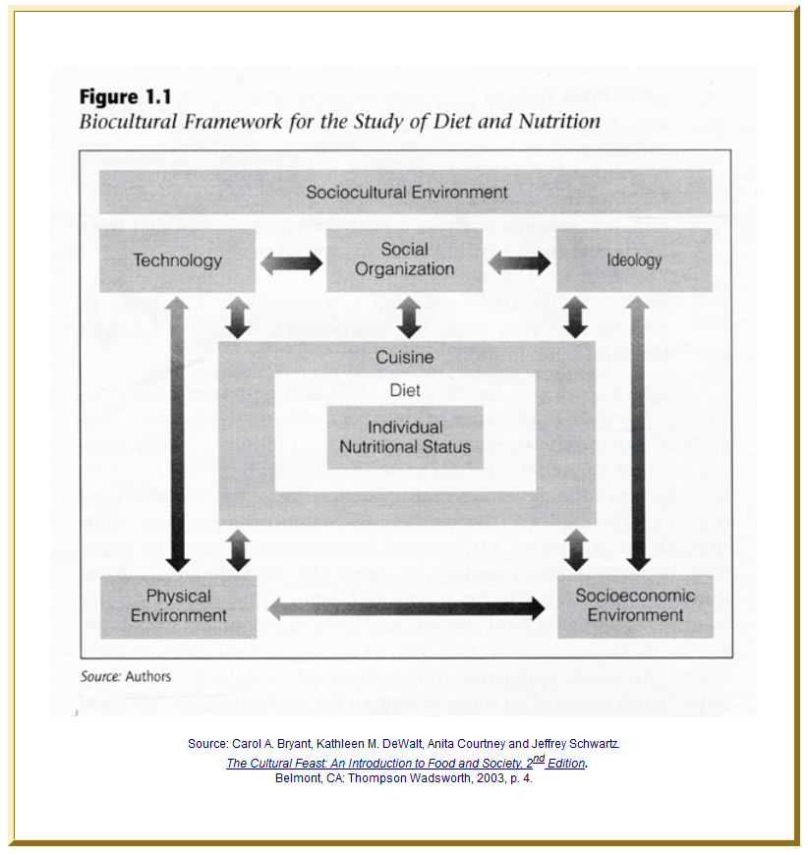

Slide 104
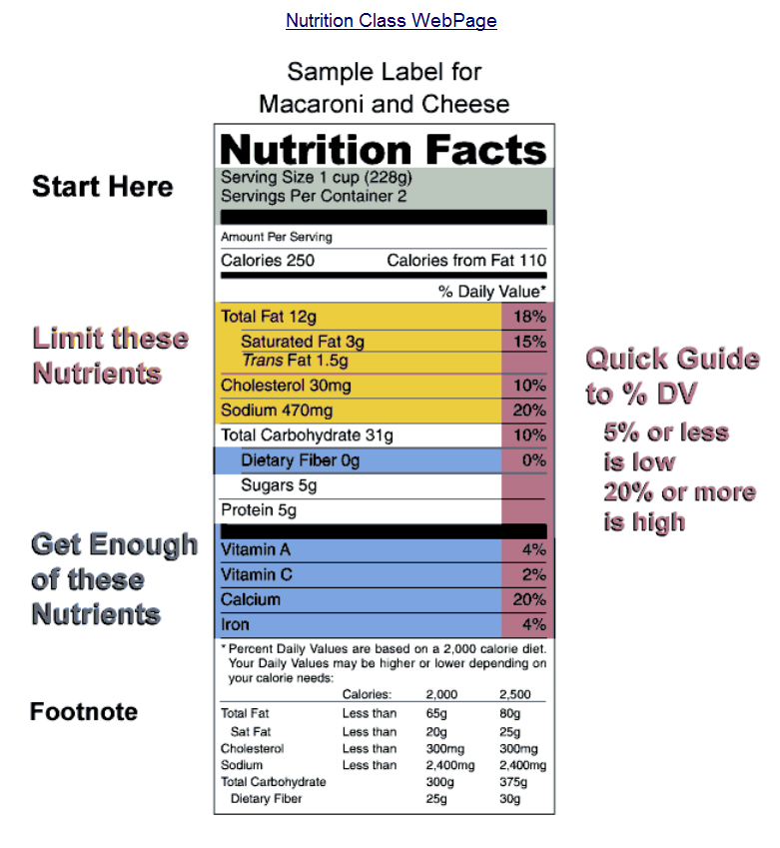

Slide 105
REM: Don’t‘ forget the Activities . . .

Slide 106
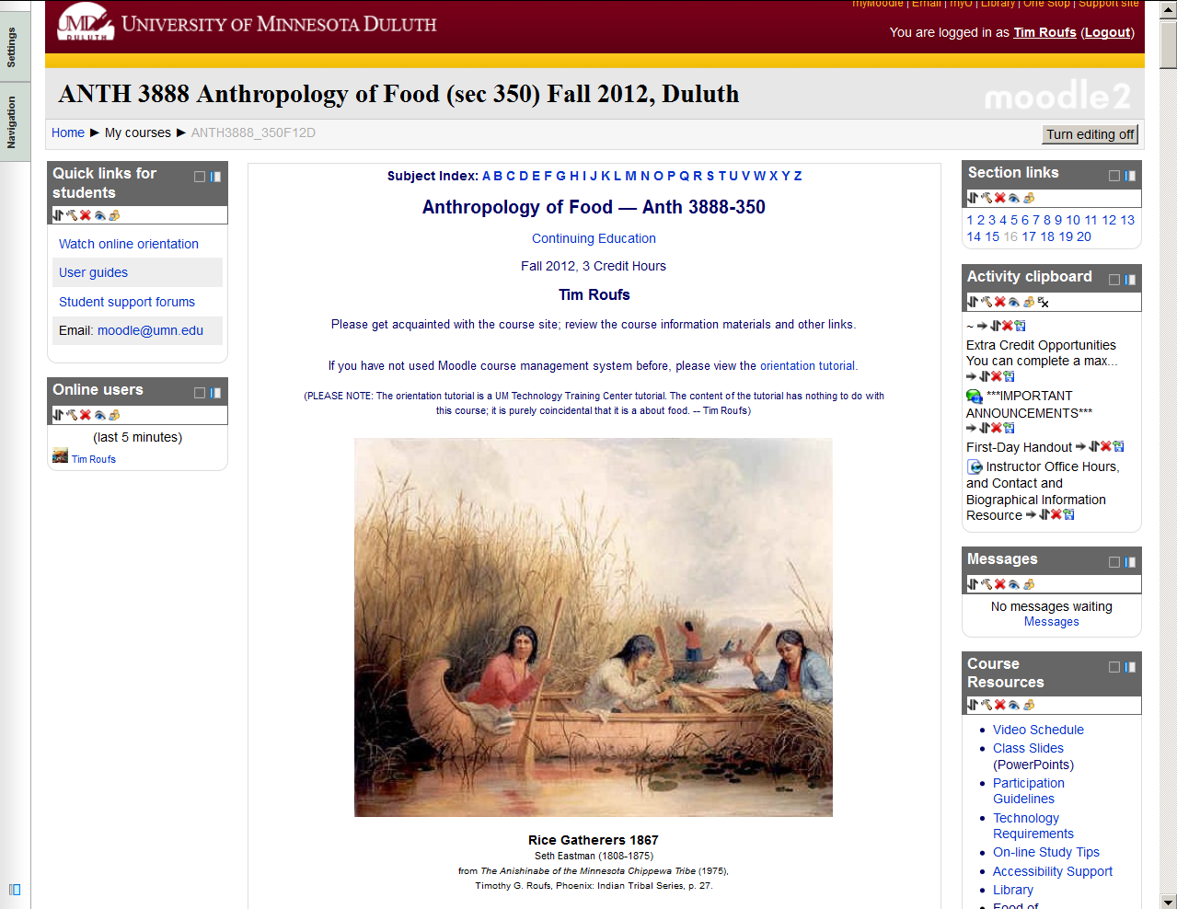
And, if you haven’t already done so,
have a look at the
Orientation Materials

Slide 108
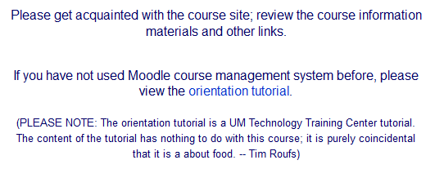

Slide 109

And, for the fun of it,
have a look at the
“Meet Your Professor” Materials

Slide 110
Why?

Slide 111
Research shows that people who know a little about their teachers . . .

Slide 112
Research shows that people who know a little about their teachers . . .
Learn more . . .

Slide 113
Research shows that people who know a little about their teachers . . .
Learn more . . .
Remember it better . . .

Slide 114
Research shows that people who know a little about their teachers . . .
Learn more . . .
Remember it better . . .
Have more fun learning . . .

Slide 115
one more piece
of useful information . . .

Slide 117
At the very top of “Block 1” you will see an alphabet.
Clicking on a letter will bring you to a page that indexes course WebPages for virtually all of the scheduled topics and items in the course.

Slide 119
At the very top of “Block 1” you will see an alphabet.
Clicking on a letter will bring you to a page that indexes course WebPages for virtually all of the scheduled topics and items in the course.

Slide 120
This information is very useful

Slide 121
How useful?

Slide 122
in the last four years there have been 223,000+ page visits to the
Anthropology of Food course page . . .

Slide 123

in the last four years there have been 223,000+ page visits to the
Anthropology of Food course page . . .

Slide 124
to access a topic simply click on a letter to go to an index page . . .

Slide 125

and from the index page click on the item you want . . .

Slide 126
scroll down for more items

Slide 127


Slide 128
scroll down

Slide 129

click on item . . . and . . .

Slide 130

voilá

Slide 131
Next . . .

Slide 132


Slide 133

Laptops
Welcome
(in fact, they’re encouraged)

Slide 134
If your browser allows,
clicking on this URL
should take you to your Moodle home . . .
https://moodle2.umn.edu/
(your browser may require that you double-click)
If your browser does not allow you to click on the above URL just enter it in your browser window . . .

Slide 135
Once again . . .
Welcome to
Anthropology of Food
Enjoy your stay!
University of Minnesota Duluth
Tim Roufs

