Slide 1
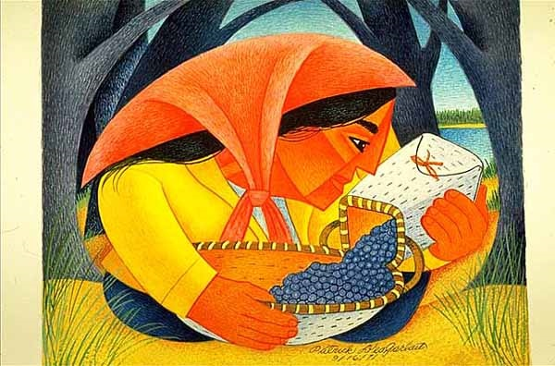
Start deck in “Slide Show” mode,
and use your up/down arrow keys and/or
your space bar to advance the slides
University of Minnesota Duluth
Tim Roufs
© 2010-2024

Slide 2
REM
indicates that the materials
are a REMinder
and are thus being repeated . . .
REMinder

Slide 3
ANTH 1080
Global Cultures
Main
Characteristics of
Anthropology
University of Minnesota Duluth
Tim Roufs
© 2010-2024

Slide 4
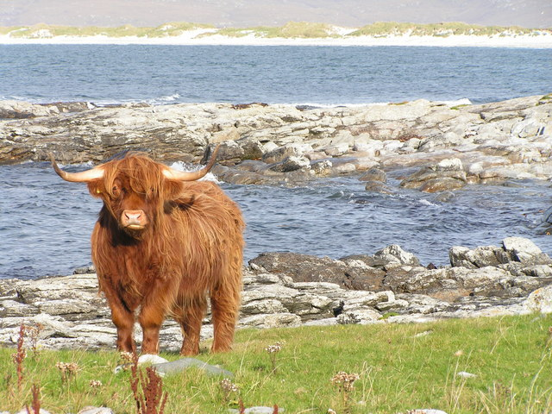
ANTH 3888
Anthropology of Food
Culture
as a
Primary Concept
University of Minnesota Duluth
Tim Roufs
© 2010-2024
http://en.wikipedia.org/wiki/Highland_cattle

Slide 5
American
Main Characteristics of˄Anthropology
1. the four fields of general anthropology
culture as a primary concept
comparative method as major approach
holism as a primary theoretical goal
fieldwork as a primary research technique

Slide 6
American
Main Characteristics of˄Anthropology
1. the four fields of general anthropology
culture as a primary concept
comparative method as major approach
holism as a primary theoretical goal
fieldwork as a primary research technique

Slide 7
Main Characteristics
“culture” is
  learned
  shared
  transmitted from generation to generation
  based on symbols
  integrated

Slide 8
Main Characteristics
“culture”
  learned
  shared
  transmitted from generation to generation
  based on symbols
  integrated
some focus on the idea that it involves
“shared understanding”

Slide 9
Main Characteristics
“culture”
    is not inherited
  (i.e., is not biological)
    is not “instinct”

Slide 10
Main Characteristics
“cultures”
    are groups of people sharing a common heritage
    (and usually a common language)

Slide 11
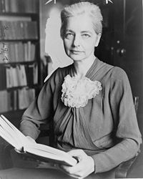
Main Characteristics
“cultures”
    are “integrated”
    -- an idea that was pioneered and emphasized by the “pioneer” anthropologist Ruth Benedict
Ruth Fulton Benedict
1887-1948
Patterns of Culture
1934

Slide 12
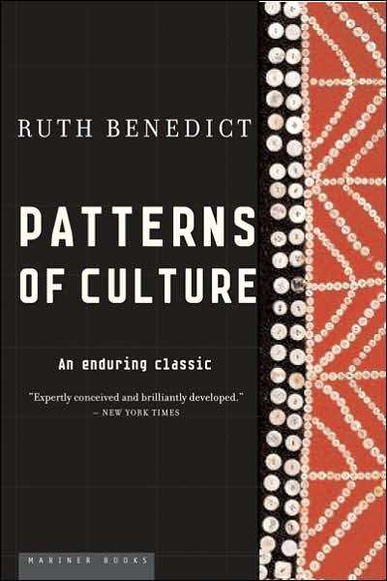
Ruth Fulton Benedict
1887-1948
Patterns of Culture
1934

Slide 13
Main Characteristics
“cultures”
    are integrated
    Interact and change
      the idea that some cultures
      (like “hunting and gathering” cultures, or the Amish)
      do not change is not correct

Slide 14
The Concept of Culture
microculture
  are smaller groups with distinct pattern of learned and shared behavior and thinking found within larger cultures such as ethnic groups in localized regions
  some people like to think of these as
  “local cultures”

Slide 15
The Concept of Culture
microculture
  are smaller groups with distinct pattern of learned and shared behavior and thinking found within larger cultures such as ethnic groups in localized regions
  some people like to think of these as
  “local cultures”

Slide 16
The Concept of Culture
microcultures can include ethnic groups within nations
  e.g., Greek-Americans
  e.g., Anishinabe (Chippewa; Ojibwa)
  e.g., Irish “Travellers”
    sometimes incorrectly called “Gypsies”
  e.g., Australian Aboriginals
  e.g., Cajun
  e.g., Rom (Gypsies)
  e.g., Basques
  e.g., Kurds

Slide 17
The Concept of Culture
microcultures can include ethnic groups within nations
  e.g., Greek-Americans
  e.g., Anishinabe (Chippewa; Ojibwa)
  e.g., Irish “Travellers”
    sometimes incorrectly called “Gypsies”
  e.g., Australian Aboriginals
  e.g., Cajun
  e.g., Rom (Gypsies)
  e.g., Basques
  e.g., Kurds
local groups generally strive to preserve their cultural identity

Slide 18
The Concept of Culture
local groups (microcultures)
generally strive to preserve their cultural identity with . . .
food
clothing
religion
ritual
music, dance, and other arts
language
cultural symbols . . .

Slide 19
The Concept of Culture
microcultures can include ethnic groups within nations
  e.g., Greek-Americans
  e.g., Anishinabe (Chippewa; Ojibwa)
  e.g., Irish “Travellers”
    sometimes incorrectly called “Gypsies”
  e.g., Australian Aboriginals
  e.g., Cajun
  e.g., Rom (Gypsies)
  e.g., Basques
  e.g., Kurds

Slide 20
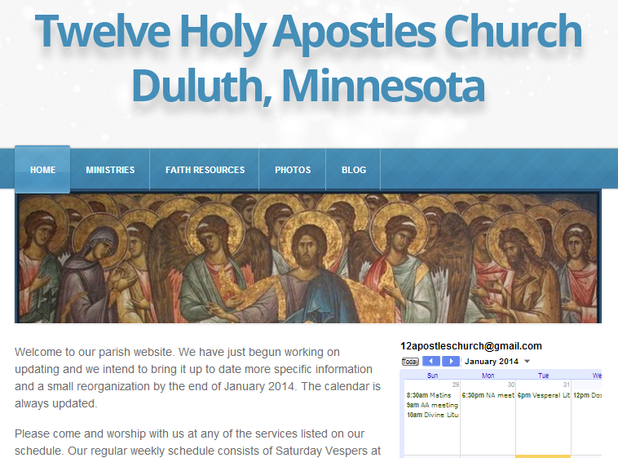
The Concept of Culture
microculture
  are smaller groups with distinct pattern of learned and shared behavior and thinking found within larger cultures such as ethnic groups in localized regions
  some people like to think of these as
  “local cultures”

Slide 21
The Concept of Culture
microculture
  are smaller groups with distinct pattern of learned and shared behavior and thinking found within larger cultures such as ethnic groups in localized regions
  some people like to think of these as
  “local cultures”
local groups generally strive to preserve their cultural identity . . .

Slide 22
The Concept of Culture
local groups (microcultures)
generally strive to preserve their cultural identity with . . .
food
clothing
religion
ritual
music, dance, and other arts
language
cultural symbols . . .

Slide 23
The Concept of Culture
local groups (microcultures)
generally strive to preserve their cultural identity with . . .
food
clothing
religion
ritual
music, dance, and other arts
language
cultural symbols . . .

Slide 24
The Concept of Culture
microcultures can include ethnic groups within nations
  e.g., Anishinabe (Chippewa; Ojibwa)
  e.g., Irish “Travellers”
    sometimes incorrectly called “Gypsies”
  e.g., Australian Aboriginals
  e.g., Cajan
  e.g., Rom (Gypsies)
  e.g., Basques
  e.g., Kurds
. . . most often
cultures and microcultures are associated with their cuisine . . .
and can sometimes even be defined by their cuisine …

Slide 25
The Concept of Culture
microcultures can include ethnic groups within nations
  e.g., Anishinabe (Chippewa; Ojibwa)
  e.g., Irish “Travellers”
    sometimes incorrectly called “Gypsies”
  e.g., Australian Aboriginals
  e.g., Cajan
  e.g., Rom (Gypsies)
  e.g., Basques
  e.g., Kurds
. . . most often
these cultures are associated with their cuisine . . .
and can sometimes even be defined by their cuisine …
and they sometimes can even be defined by their cuisine . . .

Slide 26
The Concept of Culture
microcultures can include ethnic groups within nations
  e.g., Anishinabe (Chippewa; Ojibwa)
  e.g., Irish “Travellers”
    sometimes incorrectly called “Gypsies”
  e.g., Australian Aboriginals
  e.g., Cajan
  e.g., Rom (Gypsies)
  e.g., Basques
  e.g., Kurds
. . . and one’s cuisine is often a key factor in one’s own individual and collective identity . . .

Slide 27
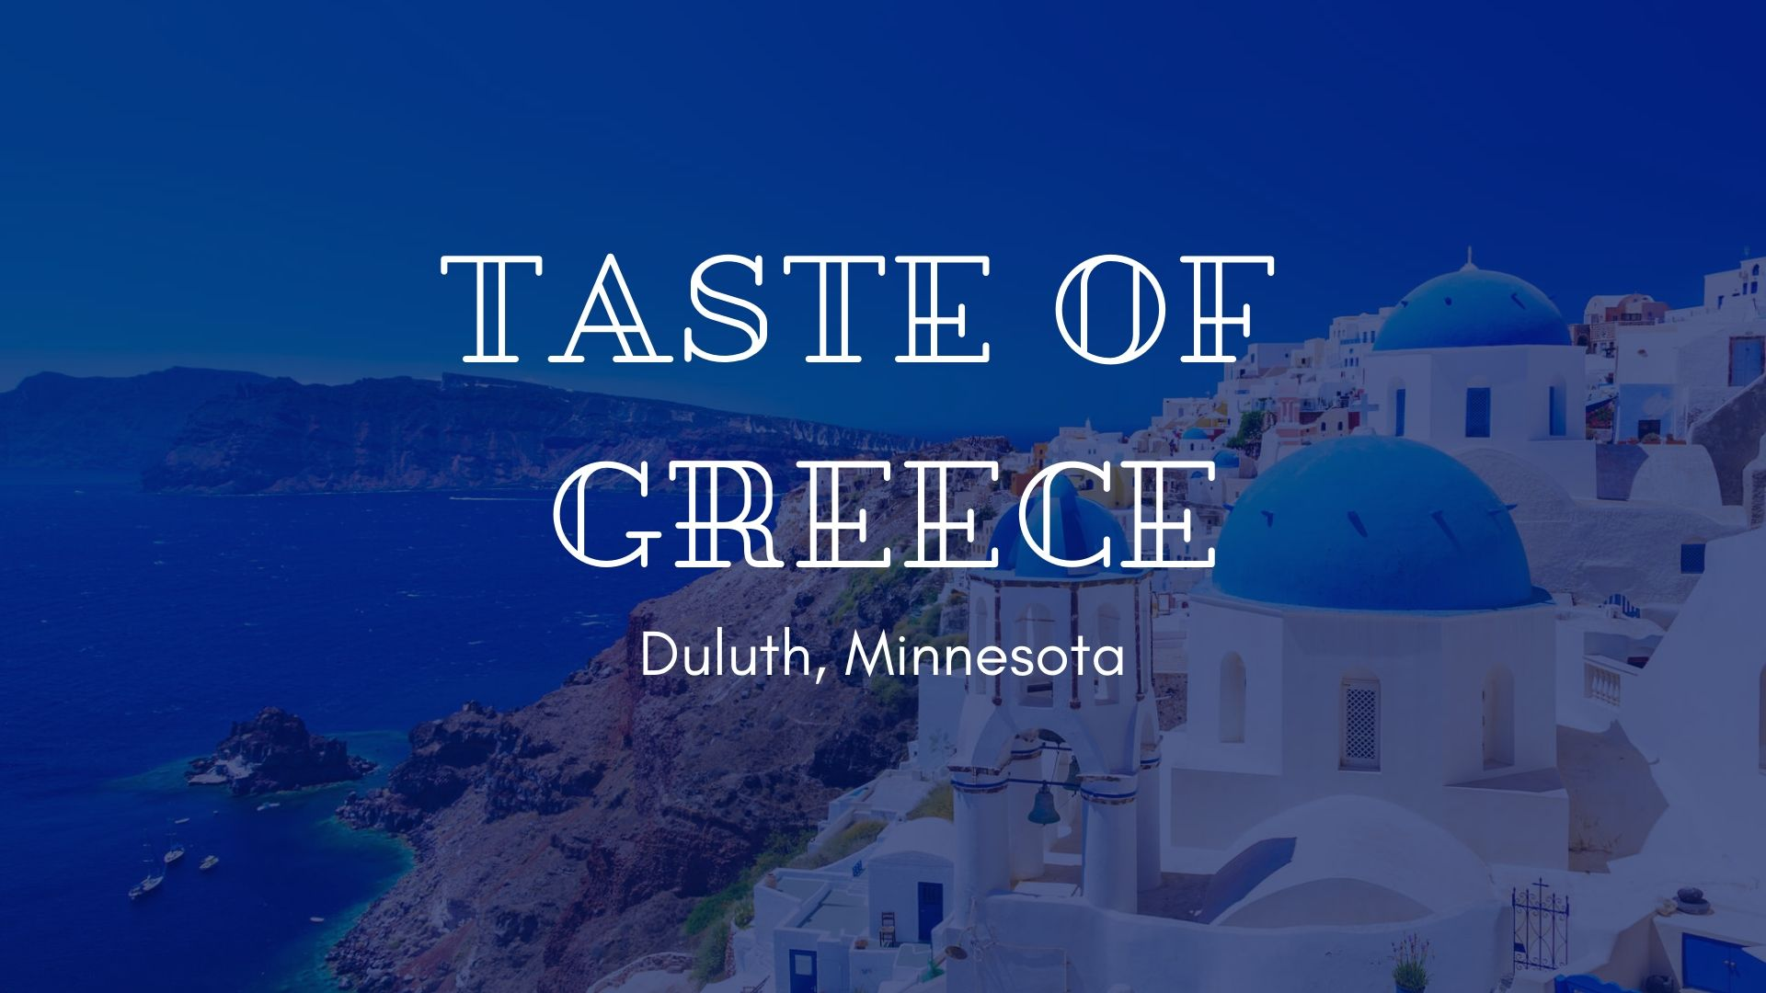

Slide 28
A Taste of Greece
31th Annual Food Festival 2023

Slide 29
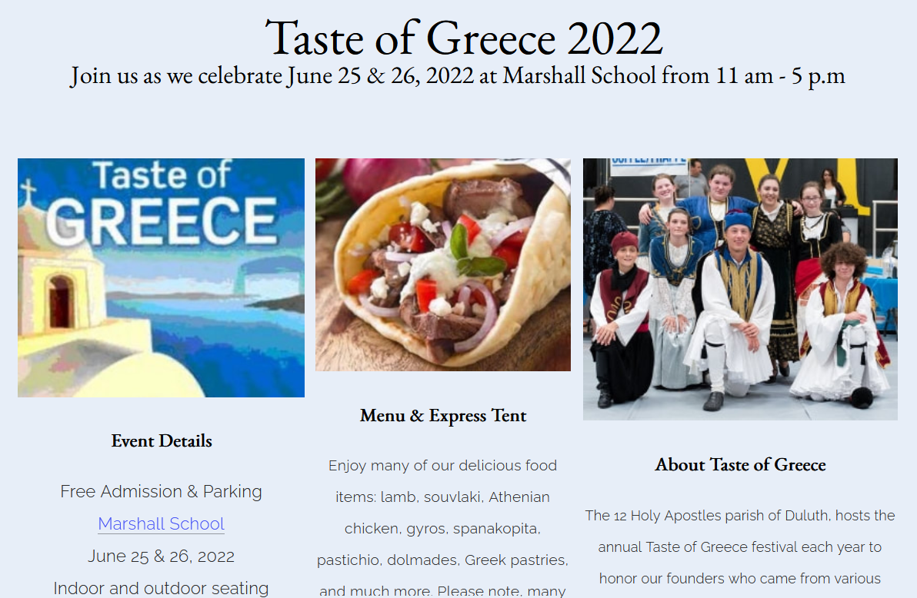
A Taste of Greece 2023
31th Annual Food Festival 2023

Slide 30
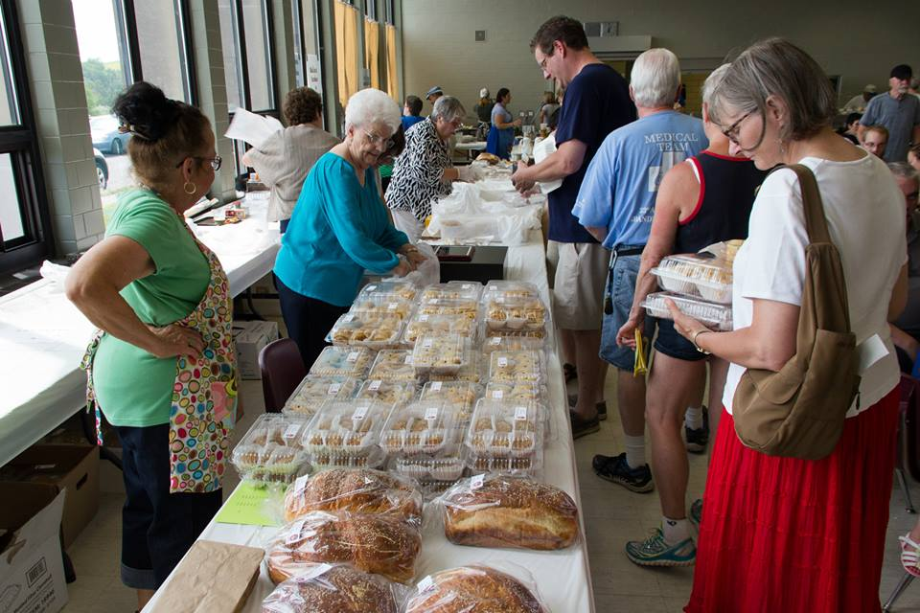
www.facebook.com/alexganeevphotography/photos/

Slide 31
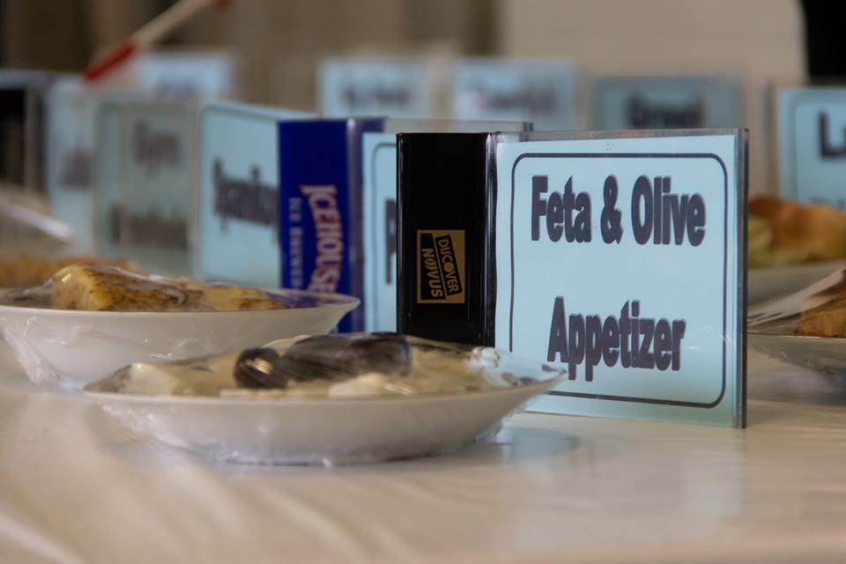
www.facebook.com/alexganeevphotography/photos/

Slide 32
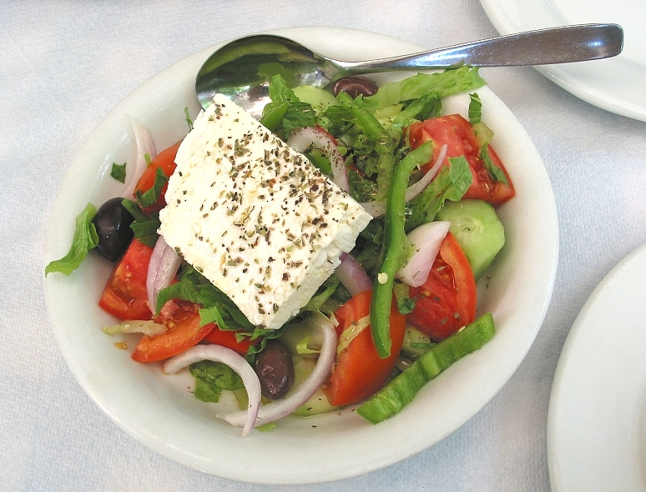
“Greek Salad”
“Farmer’s Salad”

Slide 33
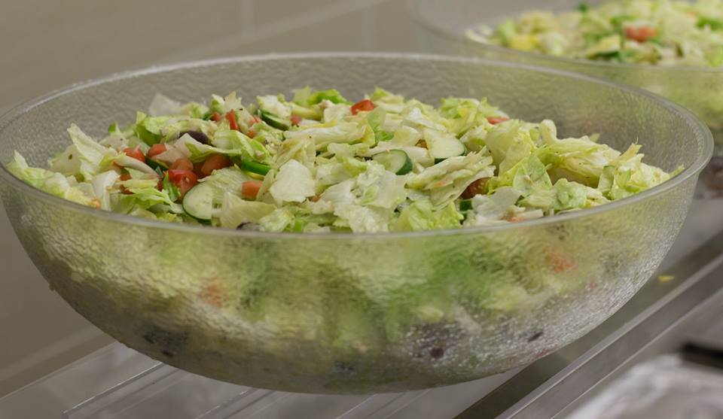
“Greek Salad”
“Farmer’s Salad”
www.facebook.com/alexganeevphotography/photos/

Slide 34
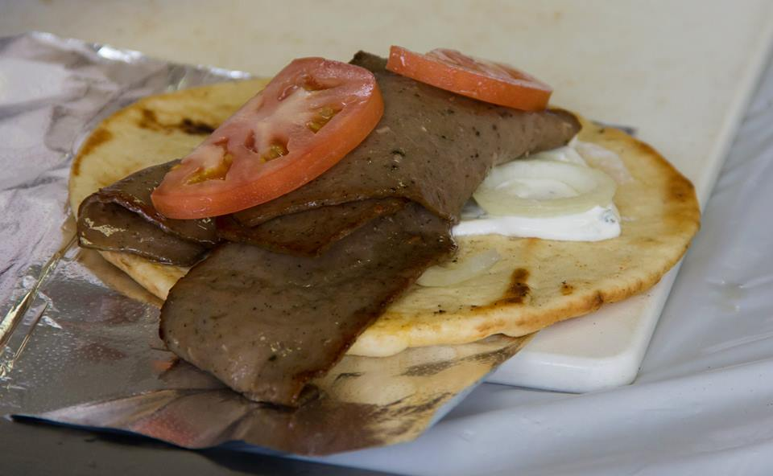
Gyro
gyro
www.facebook.com/alexganeevphotography/photos/

Slide 35
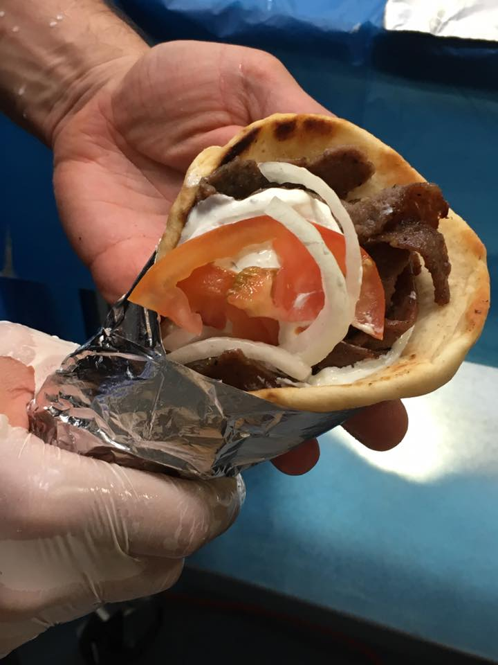
gyro
A Tate of Greece
25th Annual Food Festival 2017

Slide 36
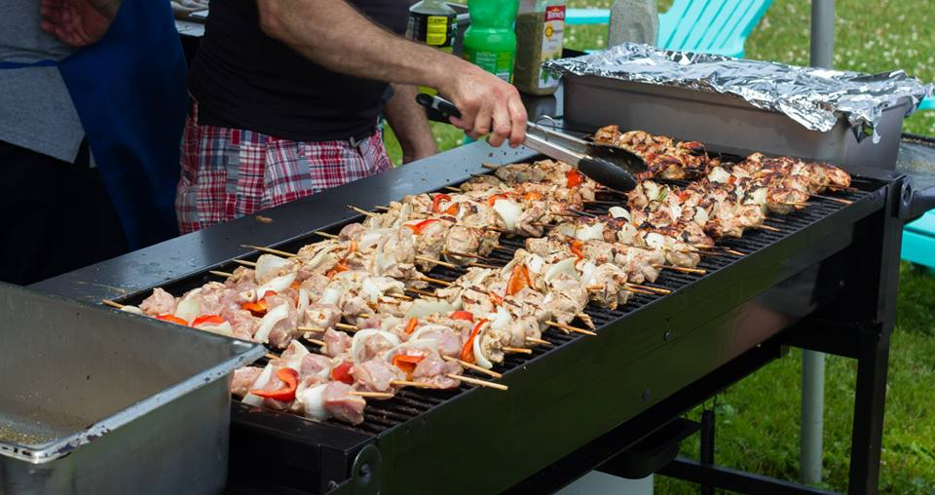
souvlaki
www.facebook.com/alexganeevphotography/photos/

Slide 37
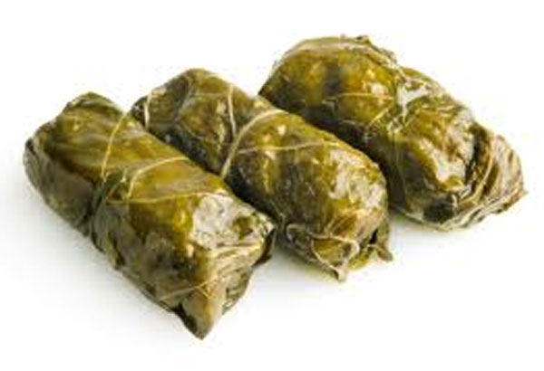
dolmathes

Slide 38
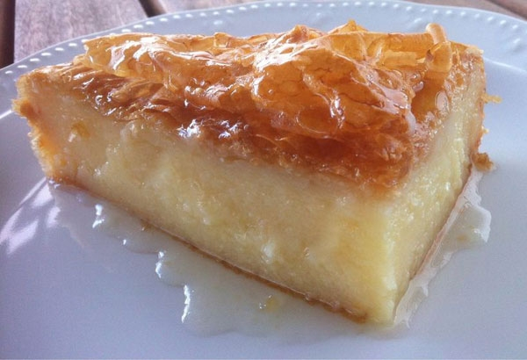
galaktoboureko

Slide 39
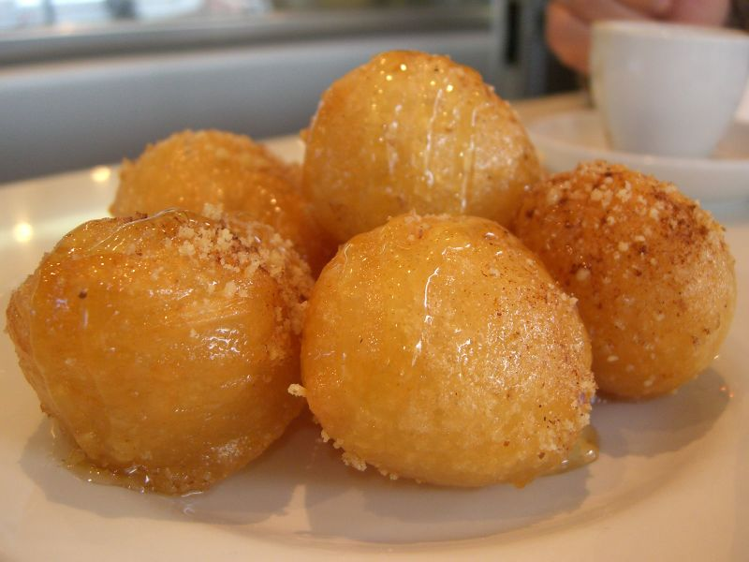
loukoumades

Slide 40
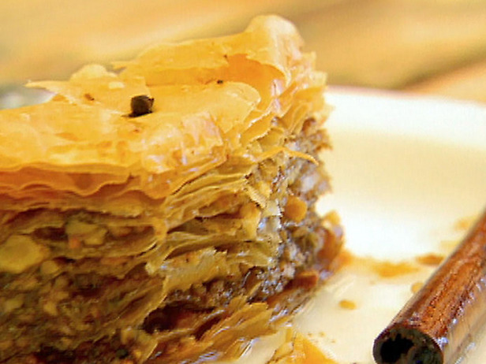
baklava

Slide 41
Greek baklava

Slide 42
dimond-shaped
with a whole clove
and no pistachios
Greek baklava

Slide 43
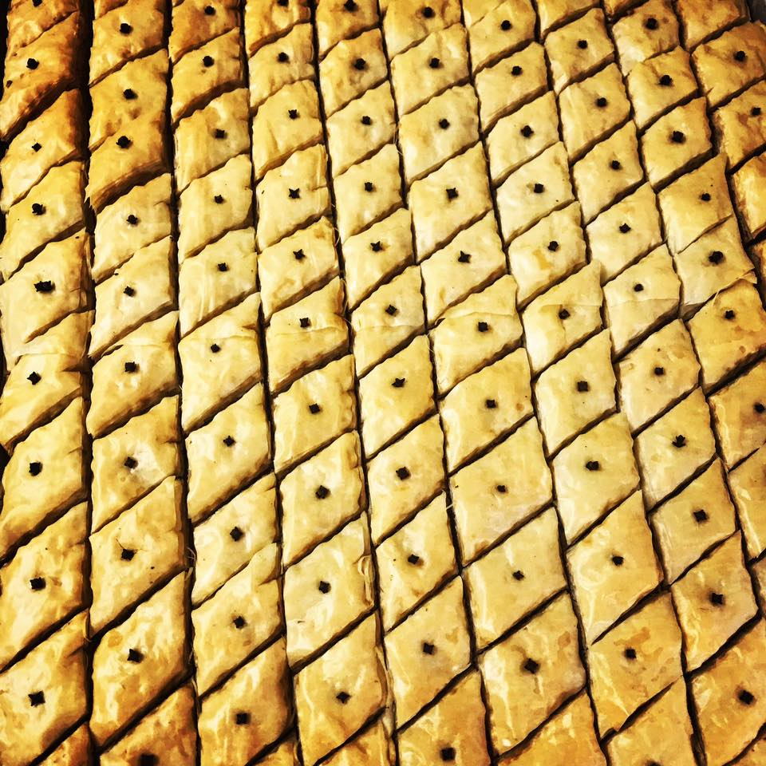
cut diamond-shaped
then served with a whole clove
A Tate of Greece
25th Annual Food Festival 2017

Slide 44
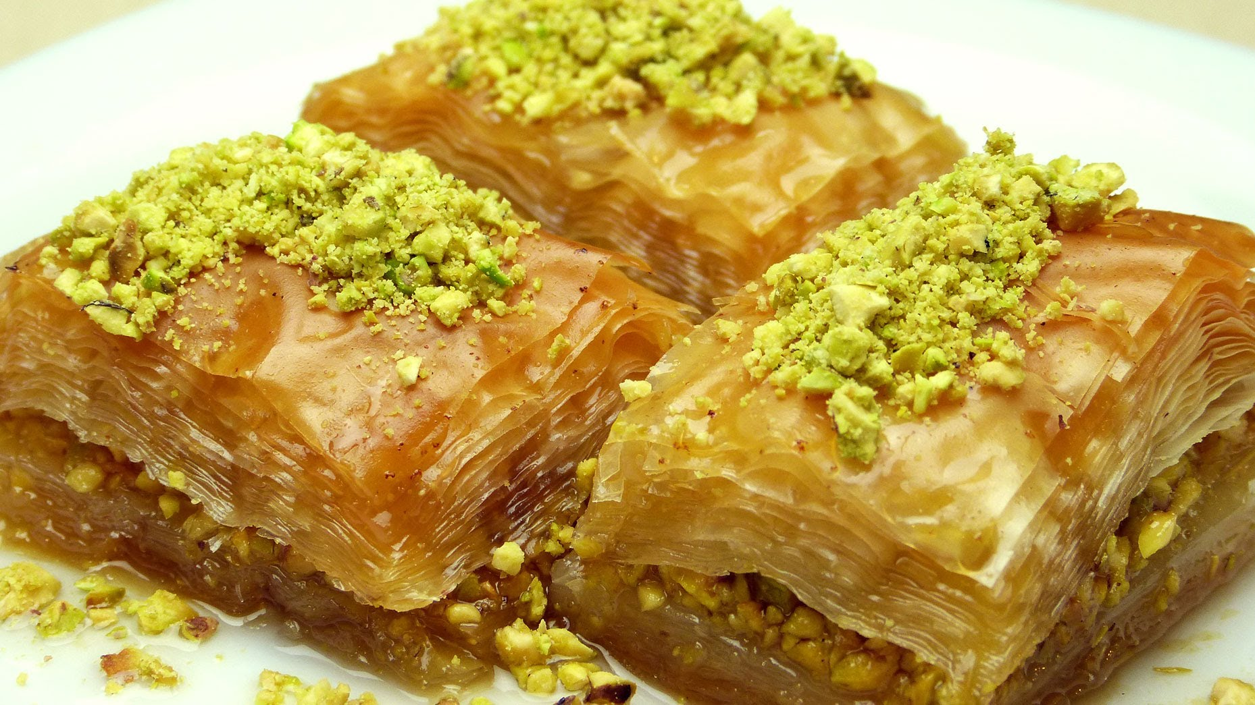
with pistachios
Turkish baklava

Slide 45
Turkish baklava

Slide 46
rectangular
and often with pistachios
Turkish baklava

Slide 47
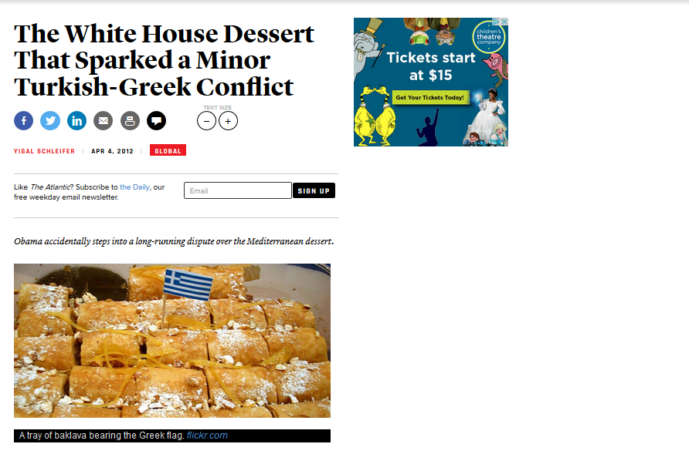
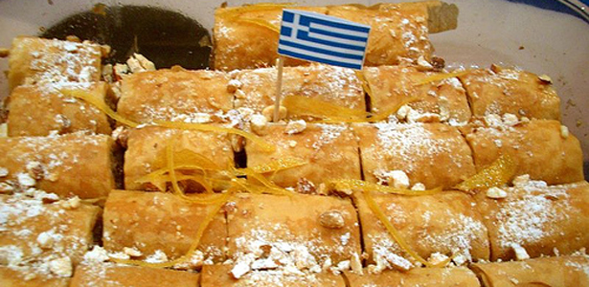
http://www.theatlantic.com/international/archive/2012/04/the-white-house-dessert-that-sparked-a-minor-turkish-greek-conflict/255439/

Slide 48
Greek flag
Turkish baklava
http://www.theatlantic.com/international/archive/2012/04/the-white-house-dessert-that-sparked-a-minor-turkish-greek-conflict/255439/

Slide 49
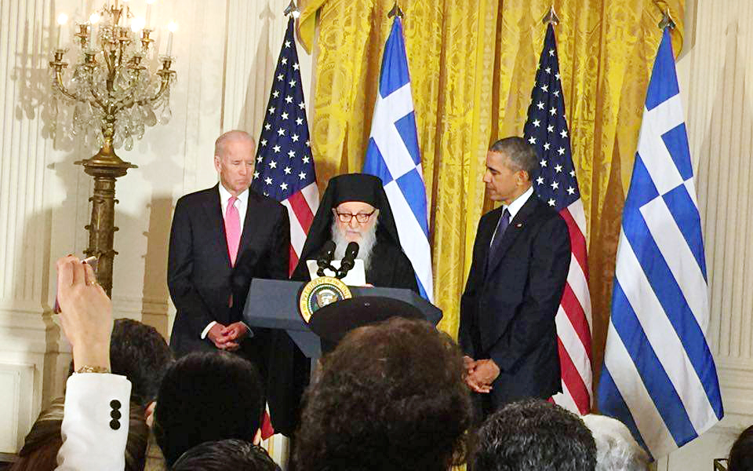
http://www.theatlantic.com/international/archive/2012/04/the-white-house-dessert-that-sparked-a-minor-turkish-greek-conflict/255439/

Slide 50

“baklava wars”
http://www.d.umn.edu/cla/faculty/troufs/anthfood/SweetTreats.html#title

Slide 51
http://www.d.umn.edu/cla/faculty/troufs/anthfood/SweetTreats.html#title

Slide 52
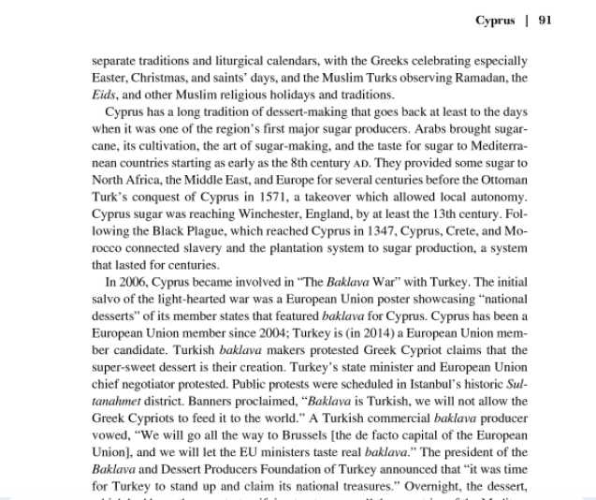
“baklava wars”
http://www.d.umn.edu/cla/faculty/troufs/anthfood/SweetTreats.html#title

Slide 53
dimond-shaped
with a whole clove
and no pistachios
Greek baklava

Slide 54
rectangular
and often with pistachios
Turkish baklava

Slide 55
http://www.theatlantic.com/international/archive/2012/04/the-white-house-dessert-that-sparked-a-minor-turkish-greek-conflict/255439/

Slide 56
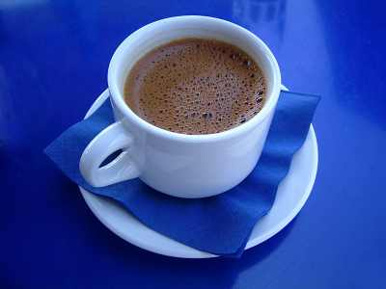
Ellinikos Kafes
http://www.ultimate-guide-to-greek-food.com/greek-coffee.html

Slide 57
Greek coffee?
http://www.ultimate-guide-to-greek-food.com/greek-coffee.html

Slide 58
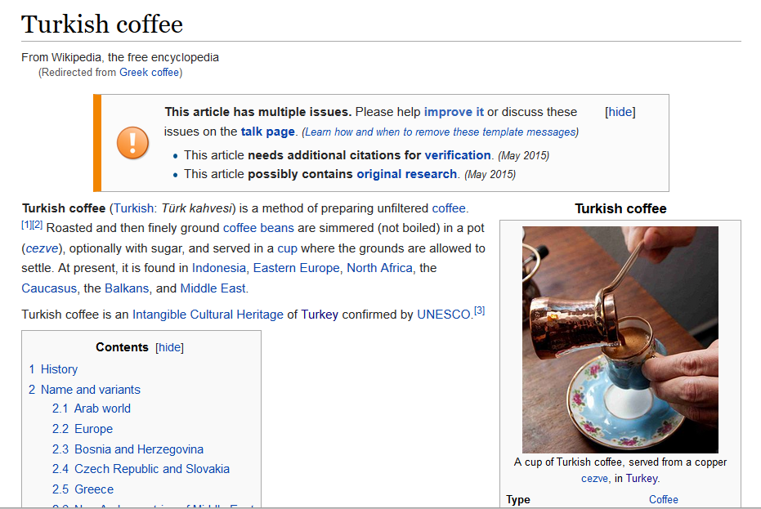

https://en.wikipedia.org/wiki/Turkish_coffee

Slide 59
https://en.wikipedia.org/wiki/Turkish_coffee

Slide 60
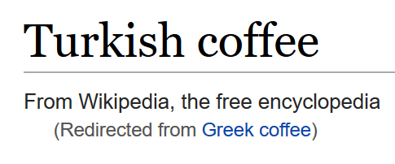
https://en.wikipedia.org/wiki/Turkish_coffee

Slide 61
https://en.wikipedia.org/wiki/Turkish_coffee

Slide 62

https://en.wikipedia.org/wiki/Turkish_coffee

Slide 63
The Concept of Culture
local groups (microcultures)
generally strive to preserve their cultural identity with . . .
food
clothing
religion
ritual
music, dance, and other arts
language
cultural symbols . . .

Slide 64
The Concept of Culture
local groups (microcultures)
generally strive to preserve their cultural identity with . . .
food
clothing
religion
ritual
music, dance, and other arts
language
cultural symbols . . .

Slide 65
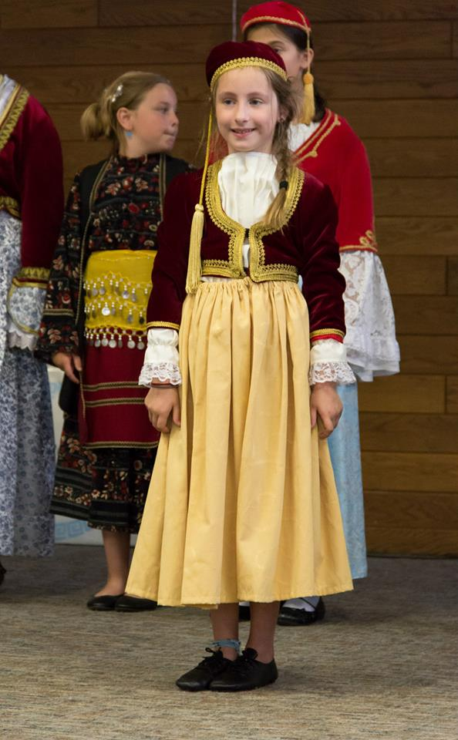
www.facebook.com/alexganeevphotography/photos/

Slide 66
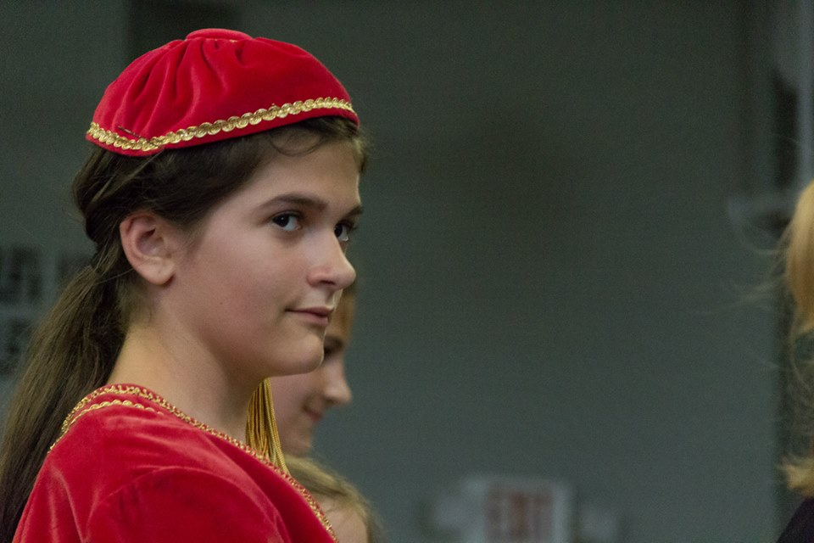
www.facebook.com/alexganeevphotography/photos/

Slide 67
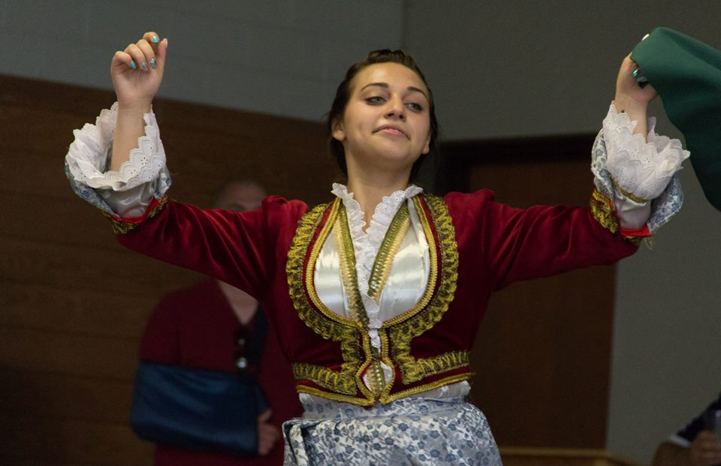
www.facebook.com/alexganeevphotography/photos/

Slide 68
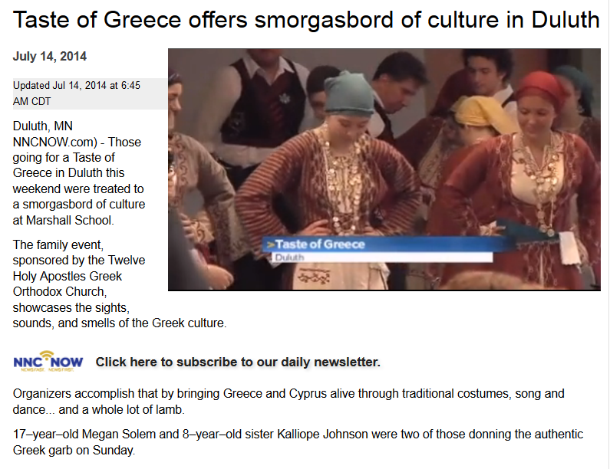
A Taste of Greece
22nd Annual Food Festival 2014

Slide 69
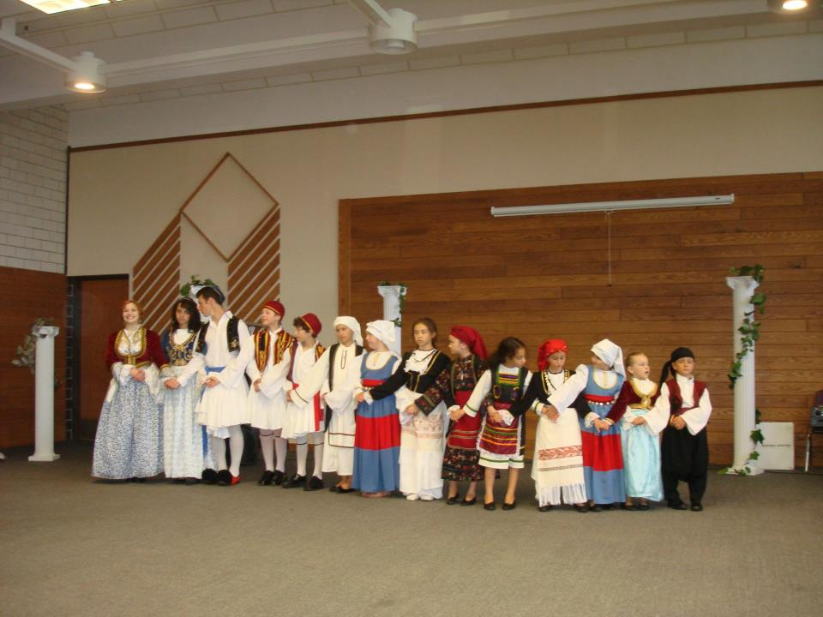
A Taste of Greece
22nd Annual Food Festival 2014
https://www.facebook.com/pages/Taste-of-Greece-Festival-Duluth-Minnesota/199921043362252

Slide 70
The Concept of Culture
local groups (microcultures)
generally strive to preserve their cultural identity with . . .
food
clothing
religion
ritual
music, dance, and other arts
language
cultural symbols . . .

Slide 71
The Concept of Culture
local groups (microcultures)
generally strive to preserve their cultural identity with . . .
food
clothing
religion
ritual
music, dance, and other arts
language
cultural symbols . . .

Slide 73
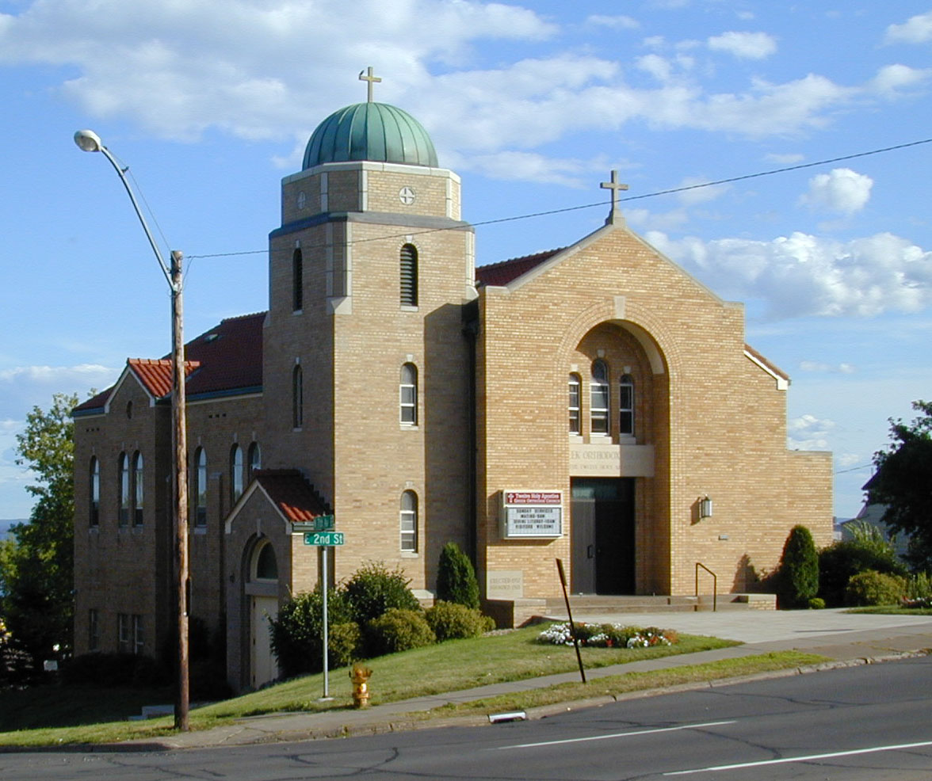
https://www.facebook.com/pages/Taste-of-Greece-Festival-Duluth-Minnesota/199921043362252

Slide 74
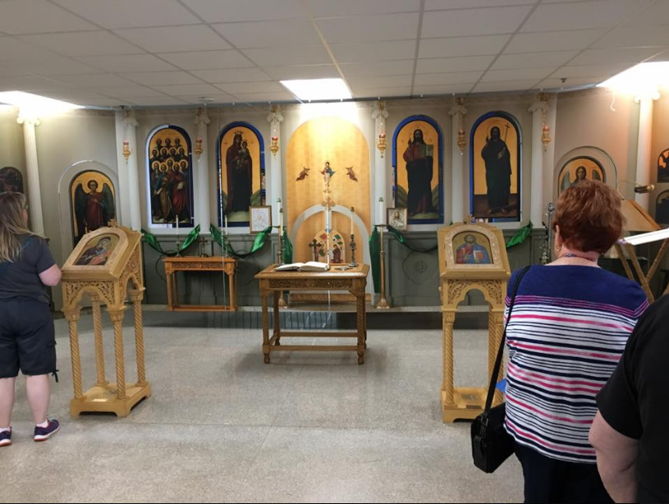
The Taste of Greece Festival, Duluth, MN, 2017

Slide 75
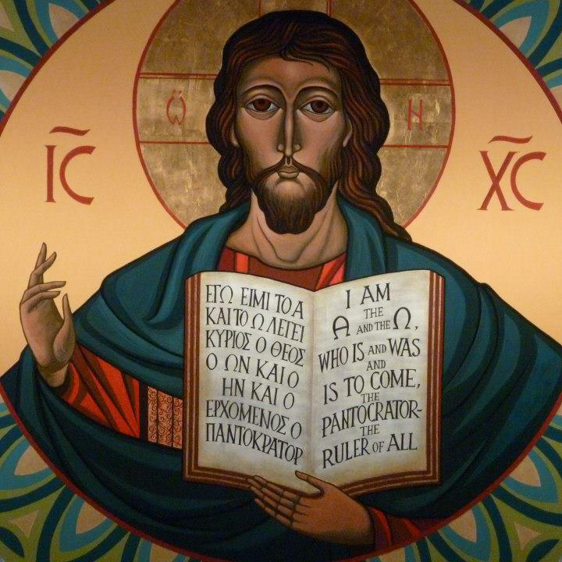
https://www.facebook.com/12HolyApostlesChurch/photos/

Slide 76
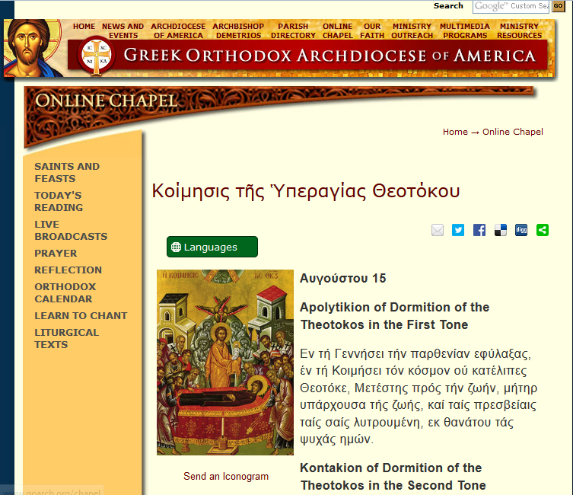
http://www.goarch.org/chapel/saints_view?contentid=165&date=8/15/2015&D=SA&language=el

Slide 77
The Concept of Culture
local groups (microcultures)
generally strive to preserve their cultural identity with . . .
food
clothing
religion
ritual
music, dance, and other arts
language
cultural symbols . . .

Slide 78
The Concept of Culture
local groups (microcultures)
generally strive to preserve their cultural identity with . . .
food
clothing
religion
ritual
music, dance, and other arts
language
cultural symbols . . .

Slide 79
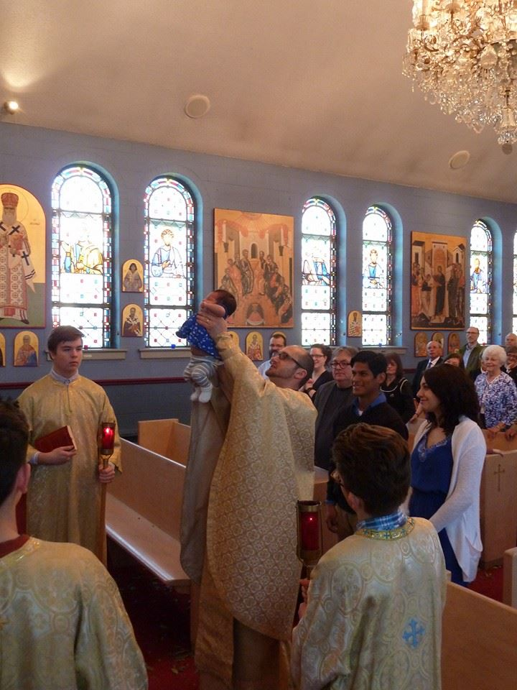
www.facebook.com/alexganeevphotography/photos/

Slide 80
The Concept of Culture
local groups (microcultures)
generally strive to preserve their cultural identity with . . .
food
clothing
religion
ritual
music, dance, and other arts
language
cultural symbols . . .

Slide 81
The Concept of Culture
local groups (microcultures)
generally strive to preserve their cultural identity with . . .
food
clothing
religion
ritual
music, dance, and other arts
language
cultural symbols . . .

Slide 82
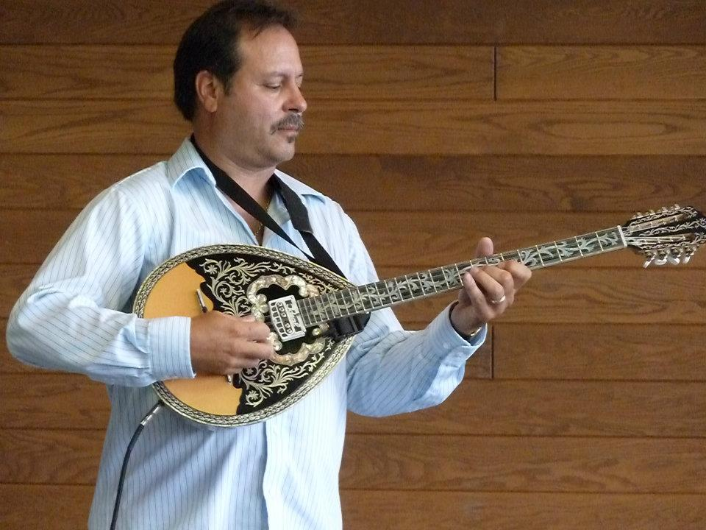
A Taste of Greece
22nd Annual Food Festival 2014
https://www.facebook.com/pages/Taste-of-Greece-Festival-Duluth-Minnesota/199921043362252

Slide 83
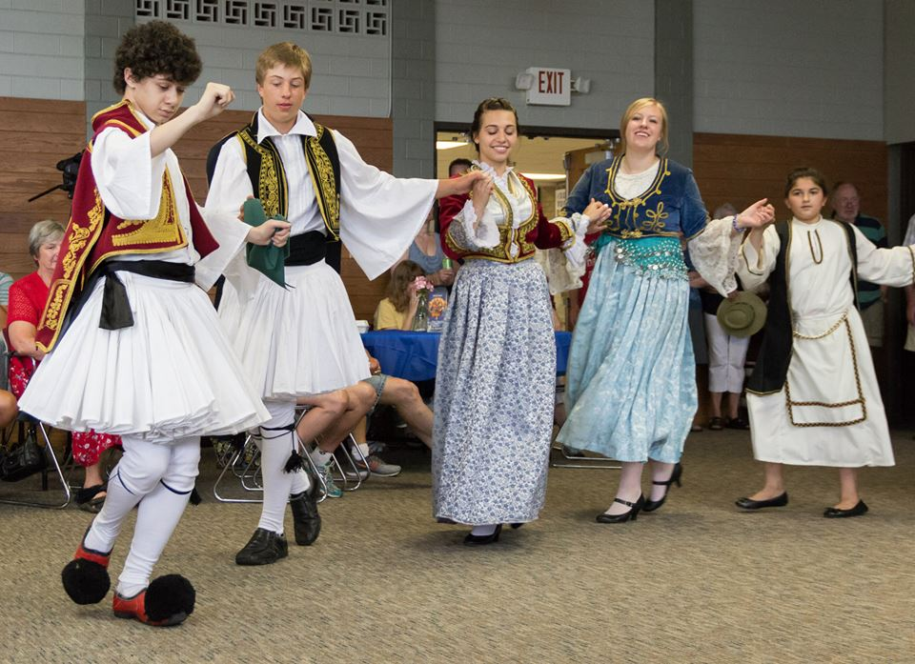
www.facebook.com/alexganeevphotography/photos/

Slide 84
The Concept of Culture
local groups (microcultures)
generally strive to preserve their cultural identity with . . .
food
clothing
religion
ritual
music, dance, and other arts
language
cultural symbols . . .
and in Greek communities
there’s ALWAYS

Slide 85
www.facebook.com/alexganeevphotography/photos/

Slide 86
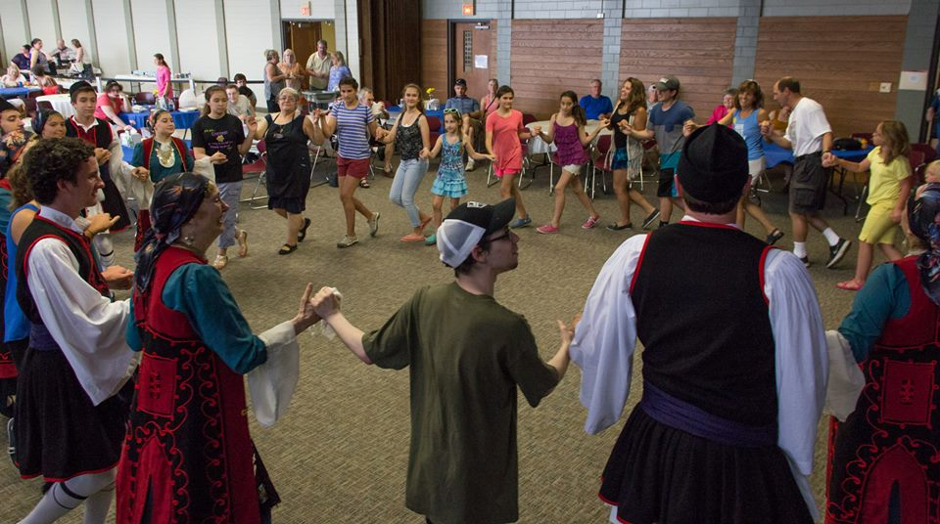

Slide 87
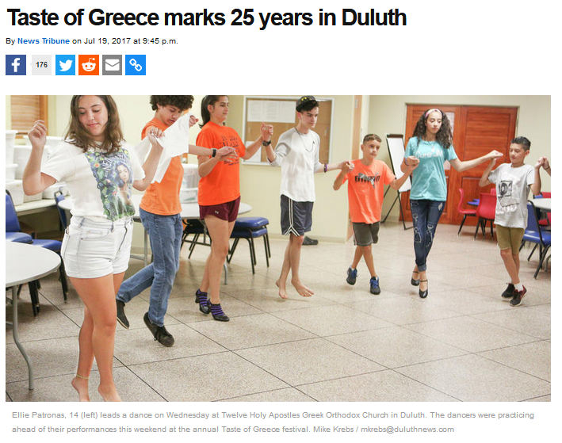
. . . now 27 years . . .
A Tate of Greece
23nd Annual Food Festival 2015
http://www.duluthnewstribune.com/news/4300249-taste-greece-marks-25-years-duluth

Slide 88
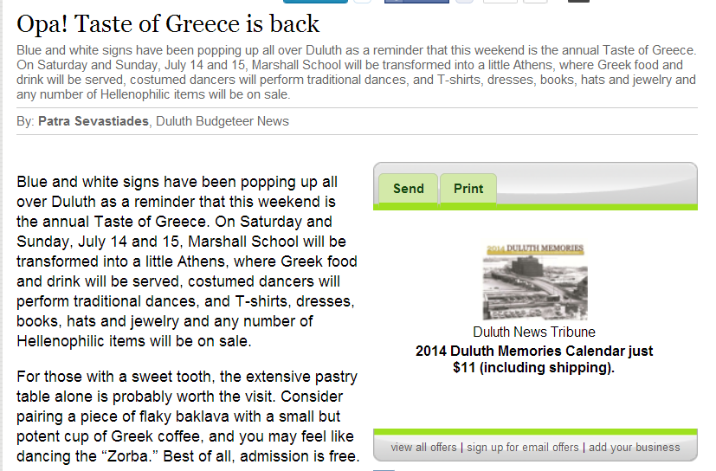
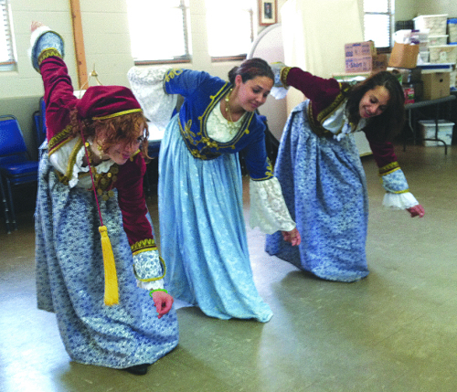
A Taste of Greece
22nd Annual Food Festival 2014
The “Zorba” begins with a low sweeping motion. Eva Sevastiades, 19, Megan Solem, 15, and Tess Sevastiades, 15, start to dance.
(Photo by Patra Sevastiades)

Slide 89
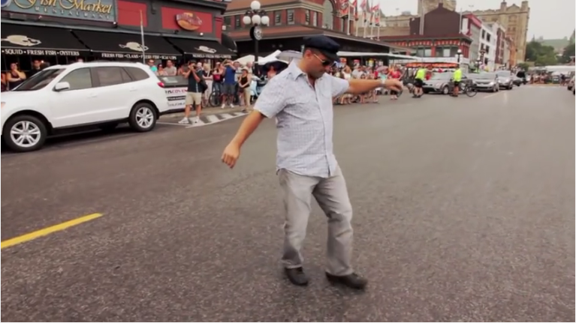

. . . 5:00
Ottawa Greek Festival (GreekFest)
https://www.youtube.com/watch?v=UhDgpXWkFHE

Slide 90
watch this short video
. . . 5:00
Ottawa Greek Festival (GreekFest)
https://www.youtube.com/watch?v=UhDgpXWkFHE

Slide 91
Watch this short video
(8:07 min.)
It says a lot about Greek culture
and about festivals
https://www.youtube.com/wa8:07tch?v=UhDgpXWkFHE
. . . 5:00
Ottawa Greek Festival (GreekFest)
https://www.youtube.com/watch?v=UhDgpXWkFHE

Slide 92
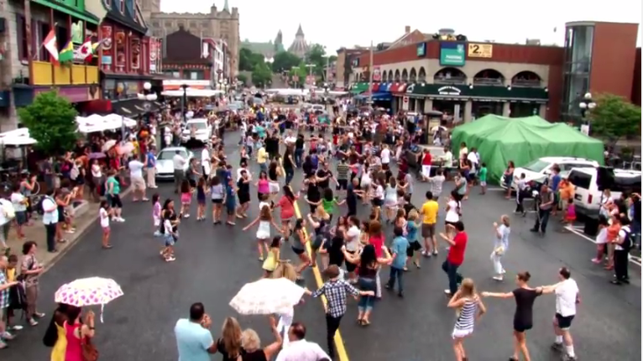
. . . 5:00
Ottawa Greek Festival (GreekFest)
https://www.youtube.com/watch?v=UhDgpXWkFHE

Slide 93
The Concept of Culture
local groups (microcultures)
generally strive to preserve their cultural identity with . . .
food
clothing
religion
ritual
fine arts
language
cultural symbols . . .

Slide 94
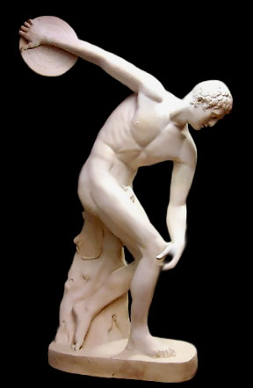
Discus Thrower
ca. 460 B.C.
http://www.crystalinks.com/greekart.html

Slide 95
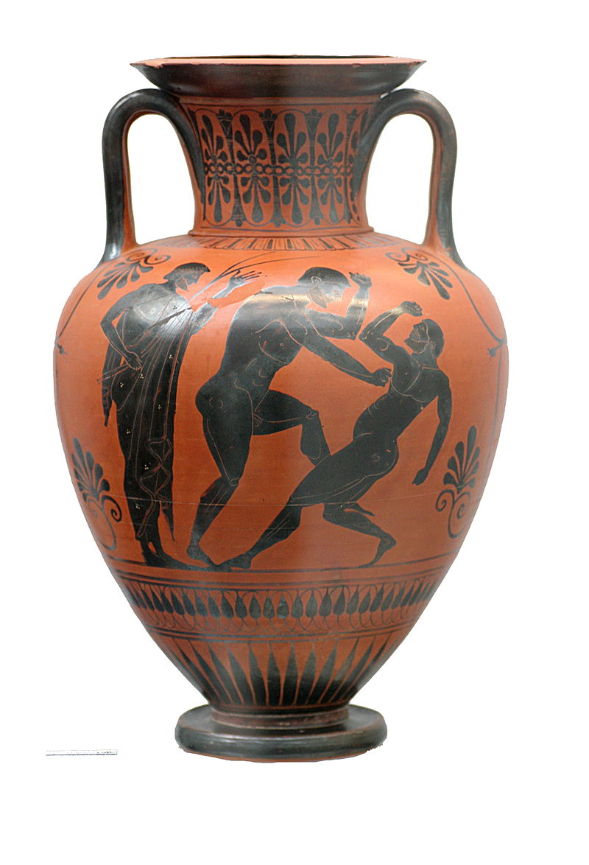
Black figure Amphora
Atalante painter
500-490 B.C.
https://en.wikipedia.org/wiki/Ancient_Greek_architecture#/media/File:Boxers_Staatliche_Antikensammlungen_1541.jpg

Slide 96
The Concept of Culture
local groups (microcultures)
generally strive to preserve their cultural identity with . . .
food
clothing
religion
ritual
architecture
(sometimes)
language
cultural symbols . . .

Slide 97
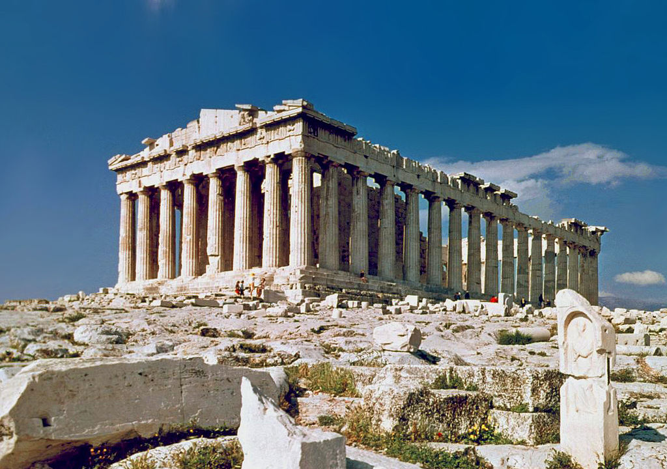
https://en.wikipedia.org/wiki/Ancient_Greek_architecture#/media/File:O_Partenon_de_Atenas.jpg

Slide 98
The Concept of Culture
local groups (microcultures)
generally strive to preserve their cultural identity with . . .
food
clothing
religion
ritual
music, dance, and other arts
language
cultural symbols . . .

Slide 99
The Concept of Culture
local groups (microcultures)
generally strive to preserve their cultural identity with . . .
food
clothing
religion
ritual
music, dance, and other arts
language
cultural symbols . . .

Slide 100
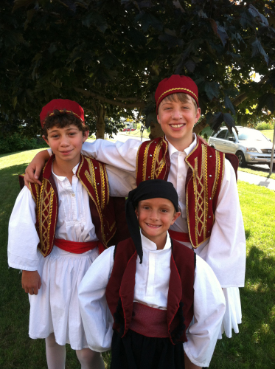
names
A Taste of Greece
22nd Annual Food Festival 2014
Dima Sevastiades, Styli Regas and Demetri Bush wear their dance costumes for the Taste of Greece.
(Photo by Patra Sevastiades)

Slide 101
even the names often reinforce one’s cultural identity
A Taste of Greece
22nd Annual Food Festival 2014
Dima Sevastiades, Styli Regas and Demetri Bush wear their dance costumes for the Taste of Greece.
(Photo by Patra Sevastiades)

Slide 102
A Taste of Greece
22nd Annual Food Festival 2014
Dima Sevastiades, Styli Regas and Demetri Bush wear their dance costumes for the Taste of Greece.
(Photo by Patra Sevastiades)

Slide 103
http://www.goarch.org/chapel/saints_view?contentid=165&date=8/15/2015&D=SA&language=el

Slide 104
https://www.facebook.com/12HolyApostlesChurch/photos/

Slide 105
The Concept of Culture
local groups (microcultures)
generally strive to preserve their cultural identity with . . .
food
clothing
religion
ritual
music, dance, and other arts
language
cultural symbols . . .

Slide 106
The Concept of Culture
local groups (microcultures)
generally strive to preserve their cultural identity with . . .
food
clothing
religion
ritual
music, dance, and other arts
language
cultural symbols . . .

Slide 107


Slide 108
including colors

Slide 109
“Greek Coffee”

Slide 110
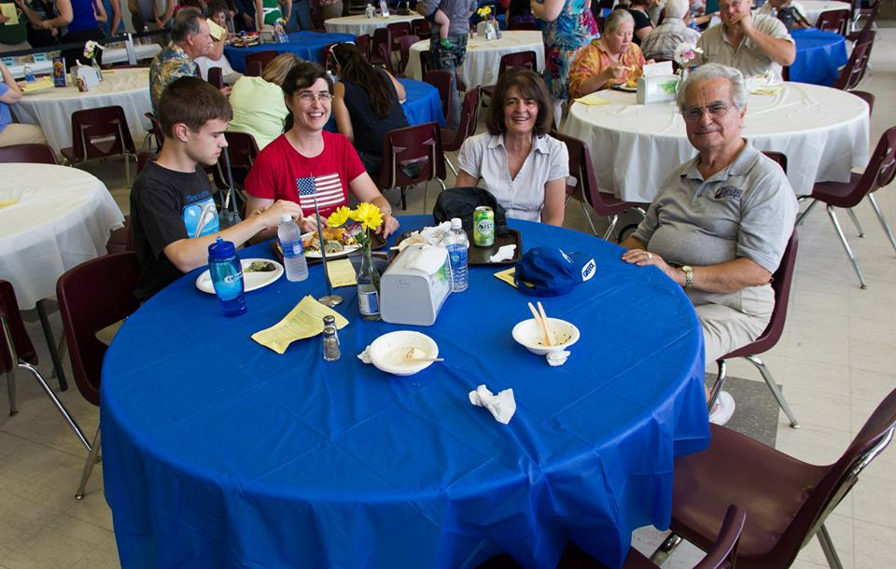
https://www.facebook.com/alexganeevphotography/photos/

Slide 111
The Concept of Culture
local groups (microcultures)
generally strive to preserve their cultural identity with . . .
food
clothing
religion
ritual
music, dance, and other arts
language
cultural symbols . . .
and these can be combined . . .

Slide 112

and these features are common
In Greek communities . . .
Greek Festivals are common wherever Greeks reside . . .

Slide 113
religion
language
art
symbols
https://www.facebook.com/12HolyApostlesChurch/photos/

Slide 114
food
religion
symbols
Greek baklava

Slide 115
clothing
music
dance
symbols,
(including “Zorba”)
A Taste of Greece
22nd Annual Food Festival 2014
The “Zorba” begins with a low sweeping motion. Eva Sevastiades, 19, Megan Solem, 15, and Tess Sevastiades, 15, start to dance.
(Photo by Patra Sevastiades)

Slide 116
The Concept of Culture
local groups (microcultures)
there are many microcultures . . .
and . . .

Slide 117
The Concept of Culture
local groups (microcultures)
generally strive to preserve their cultural identity with . . .
food
clothing
religion
ritual
music, dance, and other arts
language
cultural symbols . . .

Slide 118
Montgomery, Minnesota

Slide 119

Montgomery Minnesota
Celebrates its
Czech Heritage
Montgomery, Minnesota
Kolacky Days Festival, est. 1929

Slide 120

Czech
Montgomery, Minnesota
Kolacky Days Festival, est. 1929

Slide 121

Montgomery, Minnesota
http://www.montgomerymn.org/

Slide 122

Montgomery, Minnesota
http://www.montgomerymn.org/

Slide 123

Montgomery, Minnesota
http://www.montgomerymn.org/

Slide 124

Montgomery, Minnesota
http://www.montgomerymn.org/

Slide 125

Montgomery, Minnesota
http://www.montgomerymn.org/

Slide 126

Montgomery, Minnesota
http://www.montgomerymn.org/

Slide 127

Montgomery, Minnesota
http://www.montgomerymn.org/

Slide 128

Montgomery, Minnesota
http://www.montgomerymn.org/

Slide 129

Montgomery, Minnesota
http://www.montgomerymn.org/

Slide 130

Montgomery, Minnesota
http://www.montgomerymn.org/

Slide 131

Montgomery, Minnesota
http://www.montgomerymn.org/

Slide 132

Budejovice Church
(St. John's Chapel)
Montgomery, Minnesota
https://fleetingfarms.wordpress.com/2014/06/25/budejovice-church-montgomery-minnesota/

Slide 133

https://www.czechheritageclub.com/

Slide 134

https://www.c8zechheritageclub.com/PDF-Files/StNick-23-full.pdf

Slide 135

https://www.montgomerymn.org/masopust/

Slide 136

“Dvořák or Dvorak is a common Czech surname, originally referring to a rich landowner with a manor house
(Czech dvůr. . . .)
It is the fourth most common surname in the Czech lands.” -- Wikipedia
Montgomery, Minnesota
Kolacky Days Festival, est. 1929

Slide 137
Motto:
Vitáme Vás
"We welcome you"
Montgomery, Minnesota
Kolacky Days Festival, est. 1929

Slide 138
The Concept of Culture
local groups (microcultures)
there are many microcultures . . .
for example . . .

Slide 139
Ely, Minnesota

Slide 140

A "Taste of Slovenia" Event Branch 23 Ely, Minnesota
Notes:
140

Slide 141

potica
featured in
Greenwood Press
31 May 2018
Notes:
141

Slide 142


Slovenia
potica, a Slovenian treat
http://www.duluthbudgeteer.com/community/4121672-simple-cooking-leads-success
Notes:
142

Slide 143
Slovenia
http://www.duluthbudgeteer.com/community/4121672-simple-cooking-leads-success
Notes:
143

Slide 144


Sevnica, Slovenia
https://www.washingtonpost.com/news/in-sight/wp/2017/06/19/inside-melania-trumps-home-town/?utm_term=.f78c5c044104
Notes:
144

Slide 145

hometown of
Melania Knauss Trump
https://www.washingtonpost.com/news/in-sight/wp/2017/06/19/inside-melania-trumps-home-town/?utm_term=.f78c5c044104
Notes:
145

Slide 146

Melania Knauss Trump
https://commons.wikimedia.org/wiki/File:Melania_Trump_Official_Portrait.jpg
Notes:
146

Slide 147
Duluth, Minnesota

Slide 148


Slide 149


Slide 150

Salolampi, the Concordia Finnish Language, Near Bemidji, MN
https://www.concordialanguagevillages.org/languages/finnish
Notes:
150

Slide 151


Slide 152

Sign in Scandia, MN.
Swedish Cultural Society of Duluth
Notes:
152

Slide 153


Finland
Duluthian Beatrice Ojakangas inducted into the Scandinavian-American Hall of Fame
http://www.duluthbudgeteer.com/community/4121672-simple-cooking-leads-success
Notes:
153

Slide 154

https://www.swedishculturalsociety.org/lucia
Notes:
154

Slide 155

Swedish Cultural Society of Duluth
Notes:
155

Slide 156



Sweden
http://www.duluthnewstribune.com/pursuits/scrapbook/3895745-linnea-hinkel-chosen-santa-lucia
Notes:
156

Slide 157

Sweden
https://www.facebook.com/Swedishculturalsociety/
Notes:
157

Slide 158

Sweden
https://www.facebook.com/Swedishculturalsociety/
Notes:
158

Slide 159

Sweden
2023 Lucia Greta Jablonski
Swedish Cultural Society of Duluth
https://www.facebook.com/Swedishculturalsociety/
Notes:
159

Slide 160

Sweden
https://www.facebook.com/p/Sami-Cultural-Center-of-North-America-100064257266401/
Notes:
160

Slide 161

Sweden
Alison Aune, 2020
“Swedish Immigration Paintings” Gammelgården Museum .
Swedish Cultural Society of Duluth
https://www.facebook.com/Swedishculturalsociety/photos
Notes:
161

Slide 162

Sweden
Sjölunden, the Concordia Swedish Language, Near Bemidji, MN
https://www.concordialanguagevillages.org/languages/swedish
Notes:
162

Slide 163

http://www.samiculturalcenter.org/
Notes:
163

Slide 164
Sami Cultural Center of North America
Lakeside Professional Building
4915 E Superior St, Duluth, MN 55804, USA
http://www.samiculturalcenter.org/
Notes:
164

Slide 165

https://www.facebook.com/p/Sami-Cultural-Center-of-North-America-100064257266401/
Notes:
165

Slide 166

https://www.facebook.com/p/Sami-Cultural-Center-of-North-America-100064257266401/
Notes:
166

Slide 167
Norwegian-Americans
in Duluth

Slide 168


https://www.facebook.com/NortunLodge16/

Slide 169


http://www.duluthnewstribune.com/news/4034988-duluthians-celebrate-syttende-mai
Notes:
169

Slide 170


http://www.duluthnewstribune.com/news/4034988-duluthians-celebrate-syttende-mai
Notes:
170

Slide 171

https://www.facebook.com/NortunLodge16/
Notes:
171

Slide 172

Duluth, MN.
https://www.facebook.com/NortunLodge16/
Notes:
172

Slide 173
Duluthian
Norwegian-Americans in Norway

Slide 174

Notes:
174

Slide 175


Norway
C.N. FaceBook
Notes:
175

Slide 176

C.N. FaceBook
Notes:
176

Slide 177

C.N. FaceBook
Notes:
177

Slide 178
Friends of
Duluthian
Norwegian-Americans in Duluth

Slide 179

Ecuadorian Friends at Duluth’s Vikre Distillery
C.N. FaceBook
Notes:
179

Slide 180
Others
in Duluth

Slide 181

309 East Central Entrance
Duluth, MN 55811

Slide 182


http://www.mprnews.org/story/2016/09/13/npr-pho-central-to-vietnamese-identity
Notes:
182

Slide 183
Elsewhere in Minnesota

Slide 184
Green Bay, Wisconsin

Slide 185


Wallonia
(Belgium)
The Green Bay and UPER
Wallonians celebrate
with Booyah
(French-speaking Belgian)
Cadott, Wisconsin
https://www.travelwisconsin.com/events/fairs-festivals/booya-days-40367
Notes:
185

Slide 186
Wallonia
(Belgium)
Cadott, Wisconsin
https://www.travelwisconsin.com/events/fairs-festivals/booya-days-40367
Notes:
186

Slide 187

Wallonia
(Belgium)
Green Bay, Wisconsin
https://www.facebook.com/TheBooyahShed/
Notes:
187

Slide 188
booyah
featured in
Greenwood Press
31 May 2018
Notes:
188

Slide 189
The Concept of Culture
microcultures can include ethnic groups within nations
  e.g., Greek-Americans
  e.g., Anishinabe (Chippewa; Ojibwa)
  e.g., Irish “Travellers”
    sometimes incorrectly called “Gypsies”
  e.g., Australian Aboriginals
  e.g., Cajun
  e.g., Rom (Gypsies)
  e.g., Basques
  e.g., Kurds

Slide 190
REM
The Concept of Culture
microcultures can include ethnic groups within nations
  e.g., Anishinabe (Chippewa; Ojibwa)
  e.g., Irish “Travellers”
    sometimes incorrectly called “Gypsies”
  e.g., Australian Aboriginals
  e.g., Cajan
  e.g., Rom (Gypsies)
  e.g., Basques
  e.g., Kurds
. . . most often
these cultures are associated with their cuisine . . .
and can sometimes even be defined by their cuisine …

Slide 191
REM
The Concept of Culture
microcultures can include ethnic groups within nations
  e.g., Anishinabe (Chippewa; Ojibwa)
  e.g., Irish “Travellers”
    sometimes incorrectly called “Gypsies”
  e.g., Australian Aboriginals
  e.g., Cajan
  e.g., Rom (Gypsies)
  e.g., Basques
  e.g., Kurds
. . . most often
these cultures are associated with their cuisine . . .
and can sometimes even be defined by their cuisine …
and cultures sometimes can even be defined by their cuisine . . .

Slide 192
REM
The Concept of Culture
microcultures can include ethnic groups within nations
  e.g., Anishinabe (Chippewa; Ojibwa)
  e.g., Irish “Travellers”
    sometimes incorrectly called “Gypsies”
  e.g., Australian Aboriginals
  e.g., Cajan
  e.g., Rom (Gypsies)
  e.g., Basques
  e.g., Kurds
. . . most often
these cultures are associated with their cuisine . . .
and can sometimes even be defined by their cuisine …
and can sometimes even be defined by their cuisine . . .

Slide 193
The Concept of Culture
microcultures can include ethnic groups within nations
  e.g., Anishinabe (Chippewa; Ojibwa)
  e.g., Irish “Travellers”
    sometimes incorrectly called “Gypsies”
  e.g., Australian Aboriginals
  e.g., Cajan
  e.g., Rom (Gypsies)
  e.g., Basques
  e.g., Kurds
“cuisine”
“. . . from French cuisine, ‘cooking; culinary art; kitchen’;
ultimately from Latin coquere, ‘to cook’“
“. . . a specific set of cooking traditions and practices, often associated with a specific culture” . . .

Slide 194
The Concept of Culture
microcultures can include ethnic groups within nations
  e.g., Anishinabe (Chippewa; Ojibwa)
  e.g., Irish “Travellers”
    sometimes incorrectly called “Gypsies”
  e.g., Australian Aboriginals
  e.g., Cajan
  e.g., Rom (Gypsies)
  e.g., Basques
  e.g., Kurds
. . . and one’s cuisine is often a key factor in one’s own individual and collective identity . . .

Slide 195
The Concept of Culture
microcultures can include ethnic groups within nations
  e.g., Anishinabe (Chippewa; Ojibwa)
  e.g., Irish “Travellers”
    sometimes incorrectly called “Gypsies”
  e.g., Australian Aboriginals
  e.g., Cajan
  e.g., Rom (Gypsies)
  e.g., Basques
  e.g., Kurds
. . . the most famous food and culture quote of all time is . . .

Slide 196
The Concept of Culture
microcultures can include ethnic groups within nations
  e.g., Anishinabe (Chippewa; Ojibwa)
  e.g., Irish “Travellers”
    sometimes incorrectly called “Gypsies”
  e.g., Australian Aboriginals
  e.g., Cajan
  e.g., Rom (Gypsies)
  e.g., Basques
  e.g., Kurds
“Tell me what you eat, and I will tell you what you are“
-- Jean Anthelme Brillat-Savarin Brillat-Savarin, Physiologie du goût (The Physiology of Taste), 1875

Slide 197

1875
http://en.wikipedia.org/wiki/Brillat-Savarin
Notes:
197

Slide 198
. . . This is one of the few books next to the Bible said to have never been out of print since its first edition
1875
http://en.wikipedia.org/wiki/Brillat-Savarin
Notes:
198

Slide 199
The Concept of Culture
microcultures can include ethnic groups within nations
  e.g., Greek-Americans
  e.g., Anishinabe (Chippewa; Ojibwa)
  e.g., Irish “Travellers”
    sometimes incorrectly called “Gypsies”
  e.g., Australian Aboriginals
  e.g., Cajun
  e.g., Rom (Gypsies)
  e.g., Basques
  e.g., Kurds

Slide 200
The Concept of Culture
every region has its own
local cultures,
or microcultures . . .
Notes:
200

Slide 201
The Concept of Culture
even in places like Minnesota
there are many microcultures . . .
Notes:
201

Slide 202
The Concept of Culture
microcultures can include ethnic groups within nations
  e.g., Greek-Americans
  e.g., Anishinabe (Chippewa; Ojibwa)
  e.g., Irish “Travellers”
    sometimes incorrectly called “Gypsies”
  e.g., Australian Aboriginals
  e.g., Cajun
  e.g., Rom (Gypsies)
  e.g., Basques
  e.g., Kurds

Slide 203
The Concept of Culture
microcultures can include ethnic groups within nations
  e.g., Greek-Americans
  e.g., Anishinabe (Chippewa; Ojibwa)
  e.g., Irish “Travellers”
    sometimes incorrectly called “Gypsies”
  e.g., Australian Aboriginals
  e.g., Cajun
  e.g., Rom (Gypsies)
  e.g., Basques
  e.g., Kurds
for e.g., Anishinabe
(known less appropriately as
“The Ojibwa,” and “The Chippewa”)
. . .

Slide 204
The Concept of Culture
microcultures can include ethnic groups within nations
  e.g., Anishinabe (Chippewa; Ojibwa)
  e.g., Irish “Travellers”
    sometimes incorrectly called “Gypsies”
  e.g., Rom (Gypsies)
  e.g., Basques
  e.g., Kurds
  e.g., Australian Aboriginals
as we have seen,
local groups generally strive to preserve their cultural identity, for e.g. . . .

Slide 205


you can probably see signs of this in your area . . .
www.worldlicenceplates.com/usa/US_MNXX.html

Slide 206



Wikipedia
you can see signs of this in tourism . . .
://www.blackbearcasinoresort.com/

Slide 207


you can see signs of this in tourism . . .
http://news.minnesota.publicradio.org/features/2005/02/24_hemphills_fonduluth/?refid=0
Notes:
207

Slide 208

you can see signs of this in the news. . .
http://minnesota.publicradio.org/display/web/2010/05/04/ojibwe-treaty-rights/
Notes:
208

Slide 209

you can see signs of this in the news. . .
http://www.startribune.com/wild-rice-showdown-looms-in-northern-minnesota/322642951/
Notes:
209

Slide 210

you can see signs of this in the news. . .
http://www.startribune.com/indian-ricers-back-protesting-on-hole-in-the-day-lake/323222791/#5
Notes:
210

Slide 211
The Concept of Culture
and, as usual, local groups (microcultures)
generally strive to preserve their cultural identity with . . .
food
clothing
religion
ritual
music, dance, and other arts
language
cultural symbols . . .

Slide 212
The Concept of Culture
and, as usual, local groups (microcultures)
generally strive to preserve their cultural identity with . . .
food
clothing
religion
ritual
music, dance, and other arts
language
cultural symbols . . .

Slide 213
The Concept of Culture
microcultures can include ethnic groups within nations
  e.g., Anishinabe (Chippewa; Ojibwa)
  e.g., Irish “Travellers”
    sometimes incorrectly called “Gypsies”
  e.g., Rom (Gypsies)
  e.g., Basques
  e.g., Kurds
  e.g., Australian Aboriginals
and people especially love their own “soul food”. . .

Slide 214
The Concept of Culture
microcultures can include ethnic groups within nations
  e.g., Anishinabe (Chippewa; Ojibwa)
  e.g., Irish “Travellers”
    sometimes incorrectly called “Gypsies”
  e.g., Rom (Gypsies)
  e.g., Basques
  e.g., Kurds
  e.g., Australian Aboriginals
food is a key part of their cultural identity,
often dating back to their prehistoric past,
and defining their history . . .

Slide 215

for example . . .
Minnesota Historical Society Press
Notes:
215

Slide 216

The Minnesota Ethnic Food Book
Notes:
216

Slide 217
for e.g., Anishinabe
(known less appropriately as
“The Ojibwa,” and “The Chippewa”)
. . .
The Minnesota Ethnic Food Book
Notes:
217

Slide 218

Indian hunter with deer, 1908.
Minnesota Historical Society

Slide 219

Pictograph from Hegman Lake, Minnesota

Slide 220

www.duluthnewstribune.com/articles/index.cfm?id=60658&section=homepage
Notes:
220

Slide 221

www.indiancountry.com/content.cfm?id=1096416829
Notes:
221

Slide 222
The Concept of Culture
microcultures can include ethnic groups within nations
  e.g., Anishinabe (Chippewa; Ojibwa)
  e.g., Irish “Travellers”
    sometimes incorrectly called “Gypsies”
  e.g., Rom (Gypsies)
  e.g., Basques
  e.g., Kurds
  e.g., Australian Aboriginals
food is a key part of their cultural identity,
often dating back to their prehistoric past,
and defining their history . . .

Slide 223
The Concept of Culture
microcultures can include ethnic groups within nations
  e.g., Anishinabe (Chippewa; Ojibwa)
  e.g., Irish “Travellers”
    sometimes incorrectly called “Gypsies”
  e.g., Rom (Gypsies)
  e.g., Basques
  e.g., Kurds
  e.g., Australian Aboriginals
and people still love their own “soul food”. . .

Slide 224

we’ll see how important cookbooks have been in defining race, gender, class, and ethnic groups . . .
Sherrie A. Inness, Secret Ingredients, Palgrave Macmillan, 2006, p. 169

Slide 225

Bannock / Frybread
Wikimedia

Slide 226
The Concept of Culture
and, as usual, local groups (microcultures)
generally strive to preserve their cultural identity with . . .
food
clothing
religion
ritual
music, dance, and other arts
language
cultural symbols . . .

Slide 227

http://www.d.umn.edu/cla/faculty/troufs/Buffalo/PB24.html

Slide 228

Chuck Branch (left) gives a beaded pen and lanyard to Dr. Deborah Powell, dean of the University of Minnesota Medical School, during a traditional American Indian feast and giveaway Tuesday at the University of Minnesota Medical School Duluth campus. The event was to recognize those who helped him during his two years at the school. He will finish at the University of Minnesota-Twin Cities campus. The pen has turtles in its design, representing his clan.
CLINT AUSTIN / NEWS TRIBUNE Wednesday, 16 April 2008
www.duluthnewstribune.com/articles/index.cfm?id=64520&section=None

Slide 229
The Concept of Culture
and, as usual, local groups (microcultures)
generally strive to preserve their cultural identity with . . .
food
clothing
religion
ritual
music, dance, and other arts
language
cultural symbols . . .

Slide 230


Slide 231

Larry Aitken is a Native healer on the White Earth Reservation. He says there are hundreds of plants found in the forest that can be used for medicine.
(MPR Photo/Tom Robertson)
http://news.minnesota.publicradio.org/features/2003/08/18_gundersond_spiritualityeigh/
Notes:
²³¹

Slide 232

Wanda Baxter, an elder on the Red Lake Reservation, says a Native healer saved her life. She had cancer, but after three years of treatment by a tribal healer, she says she's healthy.
(MPR Photo/Tom Robertson)
http://news.minnesota.publicradio.org/features/2003/08/18_gundersond_spiritualityeigh/
Notes:
²³²

Slide 233

Chippewa medicine man singer with ceremonial turtle clan drum.
Photograph Collection ca. 1900
Minnesota Historical Society, Negative No. 21120

Slide 234
The Concept of Culture
and, as usual, local groups (microcultures)
generally strive to preserve their cultural identity with . . .
food
clothing
religion
ritual
music, dance, and other arts
language
cultural symbols . . .

Slide 235

Paul Buffalo Meditating Medicine

Slide 236
The Concept of Culture
and, as usual, local groups (microcultures)
generally strive to preserve their cultural identity with . . .
food
clothing
religion
ritual
music, dance, and other arts
language
cultural symbols . . .

Slide 237

Chuck Branch holds his son, Marcus, while singing with the Onigamising Singers from Grant Language & Arts Magnet School during a traditional American Indian feast and giveaway Tuesday at the University of Minnesota Medical School Duluth campus. It was to recognize those who helped him during his two years there, before he moves to the Twin Cities campus of the medical school.
CLINT AUSTIN / NEWS TRIBUNE Wednesday,
16 April 2008
www.duluthnewstribune.com/articles/index.cfm?id=64520&section=None

Slide 238

http://ourmothertongues.org/language/Ojibwe/9

Slide 239
Woman and Blueberries.
Patrick DesJarlait (1912-1972)
Minnesota Historical Society

Slide 240

Indian Sugar Camp, 1853
Seth Eastman (1808-1878 American)
Newberry Library, Chicago

Slide 241

http://www.d.umn.edu/cla/faculty/troufs/Buffalo/PB07.html#title

Slide 242
The Concept of Culture
and, as usual, local groups (microcultures)
generally strive to preserve their cultural identity with . . .
food
clothing
religion
ritual
music, dance, and other arts
language
cultural symbols . . .

Slide 243

http://ourmothertongues.org/language/Ojibwe/9

Slide 244

http://ourmothertongues.org/language/Ojibwe/9

Slide 245

http://cla.umn.edu/ais/undhttp://www.tpt.org/?a=productions&id=3rgraduate/dakota-ojibwe-language-programs

Slide 246

http://anishinabe.mpls.k12.mn.us/

Slide 247
The Concept of Culture
and, as usual, local groups (microcultures)
generally strive to preserve their cultural identity . . .
food
clothing
religion
ritual
music, dance, and other arts
language
cultural symbols . . .
language also differentiates neighboring tribal identities, as with the Lakota and Bde Maka Ska
(fka Lake Calhoon) . . .

Slide 248


Slide 249


Slide 250
The Concept of Culture
local groups (microcultures)
generally strive to preserve their cultural identity with . . .
food
clothing
religion
ritual
music, dance, and other arts
language
cultural symbols . . .
and these can be combined . . .

Slide 251
The Concept of Culture
microcultures can include ethnic groups within nations
  e.g., Anishinabe (Chippewa; Ojibwa)
  e.g., Irish “Travellers”
    sometimes incorrectly called “Gypsies”
  e.g., Rom (Gypsies)
  e.g., Basques
  e.g., Kurds
  e.g., Australian Aboriginals
sometimes their language defines their annual (seasonal) cycles
and ritual calendars . . .

Slide 252

www.ojibwe.org/home/pdf/Ojibwe_Beginner_Dictionary.pdf

Slide 253

http://www.d.umn.edu/cla/faculty/troufs/anthfood/afwildrice.html#title

Slide 254

Paul Buffalo Meditating Wild Rice Beds

Slide 255

Indians harvesting wild rice near Brainerd, 1905.
.Minnesota Historical Society

Slide 256
www.ojibwe.org/home/pdf/Ojibwe_Beginner_Dictionary.pdf

Slide 257
http://www.d.umn.edu/cla/faculty/troufs/Buffalo/PB07.html#title

Slide 258

Day's Place, Frozen Sap, Lake Mille Lacs
Minnesota Historical Society

Slide 259

Mrs. Day Granulating Maple Sugar, Lake Mille Lacs
.Minnesota Historical Society

Slide 260

http://www.angelfire.com/wa/chippewalanguagebook/index.calender.html

Slide 261

Blueberry Bannock, also known as Indian biscuits, is made with a batter of blueberry juice, maple sugar, flour, baking powder and eggs -- DEREK MONTGOMERY/NEWS TRIBUNE
www.duluthnewstribune.com/articles/index.cfm?id=60658&section=homepage
Notes:
261

Slide 262
The Concept of Culture
microcultures can include ethnic groups within nations
  e.g., Anishinabe (Chippewa; Ojibwa)
  e.g., Irish “Travellers”
    sometimes incorrectly called “Gypsies”
  e.g., Rom (Gypsies)
  e.g., Basques
  e.g., Kurds
  e.g., Australian Aboriginals
and we can see food reflected in historical linguistics . . .

Slide 263

The Concept of Culture

Slide 264
The Concept of Culture
microcultures can include ethnic groups within nations
  e.g., Anishinabe (Chippewa; Ojibwa)
  e.g., Irish “Travellers”
    sometimes incorrectly called “Gypsies”
  e.g., Rom (Gypsies)
  e.g., Basques
  e.g., Kurds
  e.g., Australian Aboriginals
modern-day place names . . .

Slide 265

Minnesota
Place Names
include
Mahnomen (“wild rice”)
Mahnomen County
Nibish (“tea”)
Menahga (“blueberry”) . . .

Slide 266

Wisconsin
Place Names
include
Menominee (“wild rice”)
Kenosha (ginoozhe “pike”)
Kewaunee (“prairie hen / wild duck”) . . .

Slide 267

http://en.wikipedia.org/wiki/Menominee

Slide 268
The Concept of Culture
and, as usual, local groups (microcultures)
generally strive to preserve their cultural identity with . . .
food
clothing
religion
ritual
music, dance, and other arts
language
cultural symbols . . .

Slide 269
Chuck Branch (left) gives a beaded pen and lanyard to Dr. Deborah Powell, dean of the University of Minnesota Medical School, during a traditional American Indian feast and giveaway Tuesday at the University of Minnesota Medical School Duluth campus. The event was to recognize those who helped him during his two years at the school. He will finish at the University of Minnesota-Twin Cities campus. The pen has turtles in its design, representing his clan.
CLINT AUSTIN / NEWS TRIBUNE Wednesday, 16 April 2008
www.duluthnewstribune.com/articles/index.cfm?id=64520&section=None

Slide 270
Chippewa medicine man singer with ceremonial turtle clan drum.
Photograph Collection ca. 1900
Minnesota Historical Society, Negative No. 21120

Slide 271
2008
ca. 1900
www.duluthnewstribune.com/articles/index.cfm?id=64520&section=None

Slide 272
2008
ca. 1900
www.duluthnewstribune.com/articles/index.cfm?id=64520&section=None

Slide 273
2008
ca. 1900
www.duluthnewstribune.com/articles/index.cfm?id=64520&section=None

Slide 274
Wikipedia
you can see signs of this in tourism . . .
://www.blackbearcasinoresort.com/

Slide 275
you can see signs of this in tourism . . .
http://news.minnesota.publicradio.org/features/2005/02/24_hemphills_fonduluth/?refid=0
Notes:
275

Slide 276
The Concept of Culture
and, as usual, local groups (microcultures)
generally strive to preserve their cultural identity with . . .
food
clothing
religion
ritual
music, dance, and other arts
language
cultural symbols . . .

Slide 277
The Concept of Culture
local groups (microcultures)
generally strive to preserve their cultural identity with . . .
food
clothing
religion
ritual
music, dance, and other arts
language
cultural symbols . . .
and these can be combined . . .

Slide 278
The Concept of Culture
. . . these elements are often
key factors in one’s individual
and in collective,
even national, identities . . .

Slide 279

and this is the case for almost every group . . .
University of Arizona pres (1998)
Notes:
279

Slide 280
The Concept of Culture
microcultures can include ethnic groups within nations
  e.g., Anishinabe (Chippewa; Ojibwa)
  e.g., Irish “Travellers”
    sometimes incorrectly called “Gypsies”
  e.g., Rom (Gypsies)
  e.g., Basques
  e.g., Kurds
  e.g., Australian Aboriginals
and people especially love their own “soul food”. . .

Slide 281
Bannock / Frybread
Wikimedia

Slide 282
The Concept of Culture
REM
even in places like Minnesota
there are many microcultures . . .
Notes:
282

Slide 283
for example . . .
Minnesota Historical Society Press
Notes:
283

Slide 284

http://www.mprnews.org/story/2015/12/02/appetites-iron-range-recipes
Notes:
284

Slide 285
Main Characteristics in a Nutshell

Slide 286
Main Characteristics of Anthropology
1. the four fields of general anthropology
culture as a primary concept
comparative method as major approach
holism as a primary theoretical goal
fieldwork as a primary research technique

Slide 287
The End
Culture
as a
Primary Concept
Anthropology of Food
University of Minnesota Duluth
Tim Roufs
© 2010-2024
http://en.wikipedia.org/wiki/Highland_cattle

