Slide 1
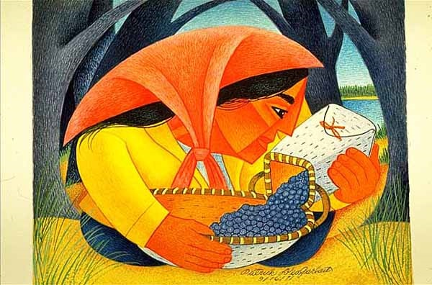
ANTH 1080
Global Cultures
Start deck in “Slide Show” mode,
and use your up/down arrow keys and/or
your space bar to advance the slides
University of Minnesota Duluth
Tim Roufs
© 2010-2024

Slide 2
REM
indicates that the materials
are a REMinder
and are thus being repeated . . .
REMinder

Slide 3
ANTH 1080
Global Cultures
Main
Characteristics of
Anthropology
University of Minnesota Duluth
Tim Roufs
© 2010-2024

Slide 4
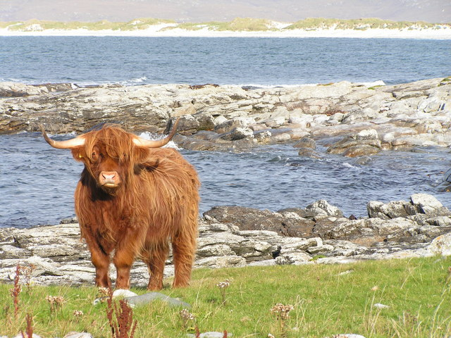
ANTH 3888
Anthropology of Food
The Four Fields
of
American Anthropology
University of Minnesota Duluth
Tim Roufs
© 2010-2024
http://en.wikipedia.org/wiki/Highland_cattle

Slide 5
American
Main Characteristics of˄Anthropology
1. the four fields of general anthropology
culture as a primary concept
comparative method as major approach
holism as a primary theoretical goal
fieldwork as a primary research technique

Slide 6
American
Main Characteristics of˄Anthropology
1. the four fields of general anthropology
culture as a primary concept
comparative method as major approach
holism as a primary theoretical goal
fieldwork as a primary research technique

Slide 7
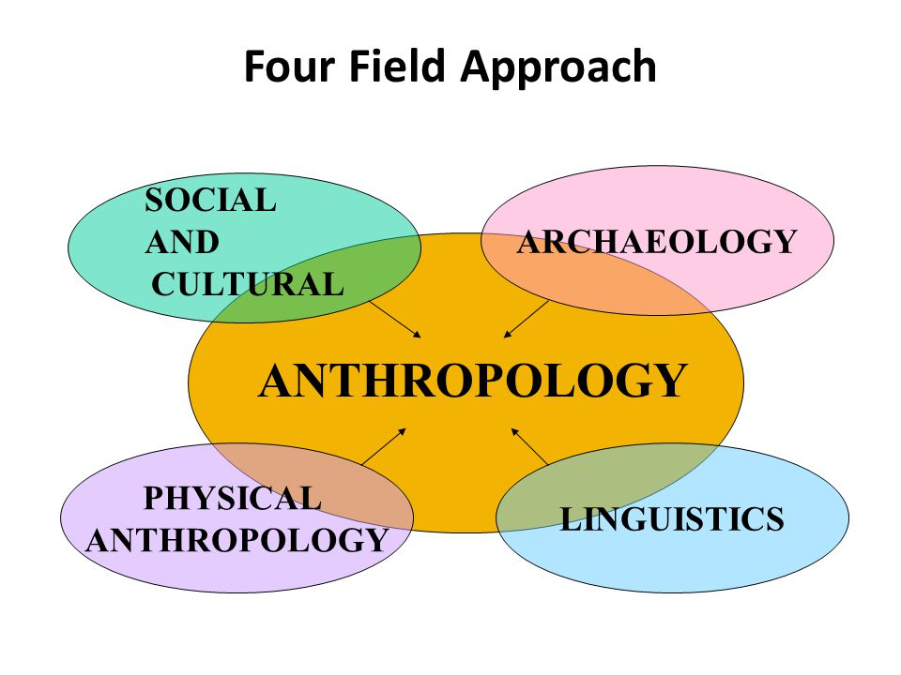
https://slideplayer.com/slide/2407456/9/images/66/Four+Field+Approach+SOCIAL+ARCHAEOLOGY+AND+CULTURAL+PHYSICAL.jpg

Slide 8
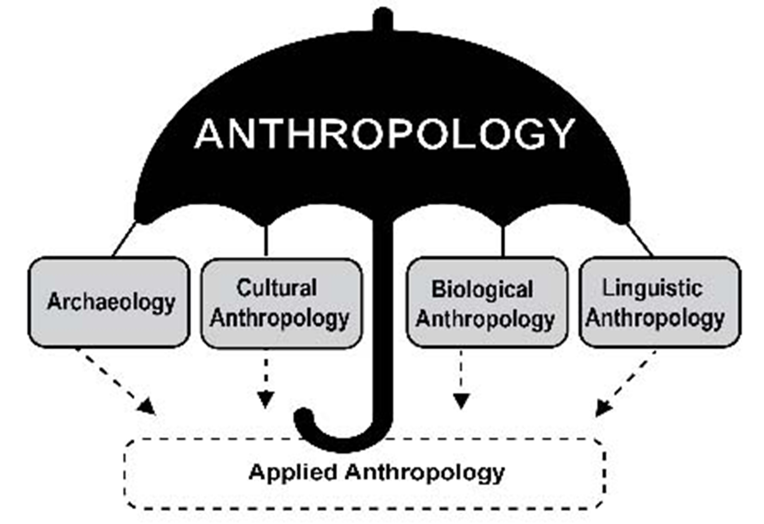

Slide 9
You’ll see the four field approach
in American Anthropology . . .
American Anthropology
cultural / social
physical
archaeology
linguistics

Slide 10
These are also commonly known as . . .

Slide 11
So . . . we’re going to have a look at . . .
sociocultural
biophysical
archaeological
linguistical

Slide 12
So . . . we’re going to have a look at . . .
sociocultural
biophysical
archaeological
linguistical
cultural / social
physical / biological
archaeological
linguistical

Slide 13
So . . . we’re going to have a look at . . .
sociocultural
biophysical
archaeological
linguistical
cultural / social
physical / biological
archaeological
linguistical

Slide 14
Main Characteristics
“culture” is
  learned
  shared
  transmitted from generation to generation
  based on symbols
  integrated

Slide 15
Main Characteristics
“culture”
  learned
  shared
  transmitted from generation to generation
  based on symbols
  integrated
some focus on the idea that it involves
“shared understanding”

Slide 16
Main Characteristics
“culture”
    is not inherited
  (i.e., is not biological)
    is not “instinct”

Slide 17
Main Characteristics
“cultures”
    are groups of people sharing a common heritage
    (and usually a common language)

Slide 18
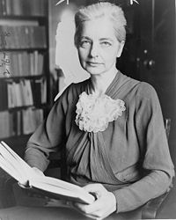
Main Characteristics
“cultures”
    are “integrated”
    -- an idea that was pioneered and emphasized by the “pioneer” anthropologist Ruth Benedict
Ruth Fulton Benedict
1887-1948
Patterns of Culture
1934

Slide 19
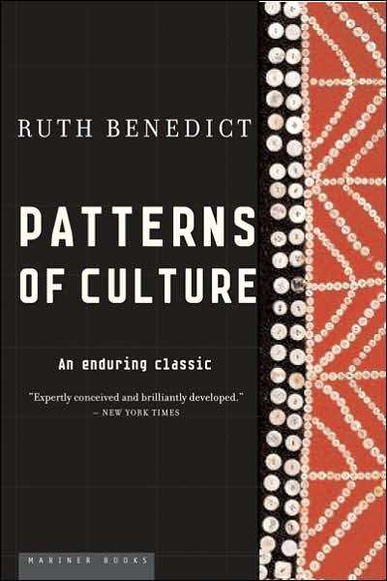
Ruth Fulton Benedict
1887-1948
Patterns of Culture
1934

Slide 20
Main Characteristics
“cultures”
    are integrated
    Interact and change
      the idea that some cultures
      (like “hunting and gathering” cultures, or the Amish)
      do not change is not correct

Slide 21
The Concept of Culture
microculture
  are smaller groups with distinct pattern of learned and shared behavior and thinking found within larger cultures such as ethnic groups in localized regions
  some people like to think of these as
  “local cultures”

Slide 22
The Concept of Culture
microculture
  are smaller groups with distinct pattern of learned and shared behavior and thinking found within larger cultures such as ethnic groups in localized regions
  some people like to think of these as
  “local cultures”

Slide 23
The Concept of Culture
microcultures can include ethnic groups within nations
  e.g., Greek-Americans
  e.g., Anishinabe (Chippewa; Ojibwa)
  e.g., Irish “Travellers”
    sometimes incorrectly called “Gypsies”
  e.g., Australian Aboriginals
  e.g., Cajun
  e.g., Rom (Gypsies)
  e.g., Basques
  e.g., Kurds

Slide 24
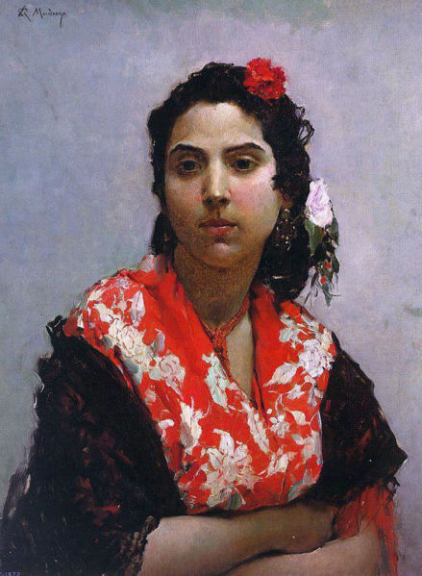
Gitana
Raimundo Madrazo
1841-1920
http://en.wikipedia.org/wiki/Main_Page

Slide 25
The Concept of Culture
microcultures can include ethnic groups within nations
  e.g., Greek-Americans
  e.g., Anishinabe (Chippewa; Ojibwa)
  e.g., Irish “Travellers”
    sometimes incorrectly called “Gypsies”
  e.g., Australian Aboriginals
  e.g., Cajun
  e.g., Rom (Gypsies)
  e.g., Basques
  e.g., Kurds
local groups generally strive to preserve their cultural identity

Slide 26
The Concept of Culture
local groups (microcultures)
generally strive to preserve their cultural identity with . . .
food
clothing
religion
ritual
music, dance, and other arts
language
cultural symbols . . .

Slide 27
The Concept of Culture
microcultures can include ethnic groups within nations
  e.g., Greek-Americans
  e.g., Anishinabe (Chippewa; Ojibwa)
  e.g., Irish “Travellers”
    sometimes incorrectly called “Gypsies”
  e.g., Australian Aboriginals
  e.g., Cajun
  e.g., Rom (Gypsies)
  e.g., Basques
  e.g., Kurds

Slide 28

The Concept of Culture
microculture
  are smaller groups with distinct pattern of learned and shared behavior and thinking found within larger cultures such as ethnic groups in localized regions
  some people like to think of these as
  “local cultures”

Slide 29
The Concept of Culture
microculture
  are smaller groups with distinct pattern of learned and shared behavior and thinking found within larger cultures such as ethnic groups in localized regions
  some people like to think of these as
  “local cultures”
local groups generally strive to preserve their cultural identity . . .

Slide 30
The Concept of Culture
local groups (microcultures)
generally strive to preserve their cultural identity with . . .
food
clothing
religion
ritual
music, dance, and other arts
language
cultural symbols . . .

Slide 31
The Concept of Culture
local groups (microcultures)
generally strive to preserve their cultural identity with . . .
food
clothing
religion
ritual
music, dance, and other arts
language
cultural symbols . . .

Slide 32
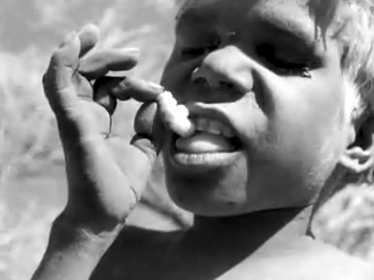
The Desert People

Slide 33
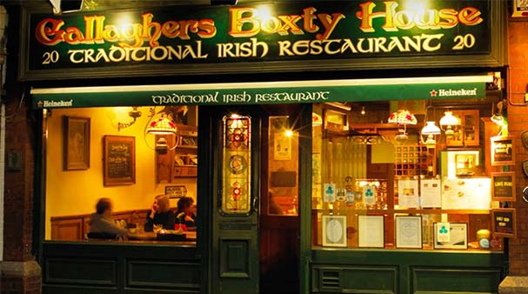
https://www.dublinpass.com/dublin-attractions/the-boxty-house.htmlhttps://www.dublinpass.com/dublin-attractions/the-boxty-house.html

Slide 34
So . . . we’re going to have a look at . . .
sociocultural
biophysical
archaeological
linguistical
cultural / social
physical / biological
archaeological
linguistical

Slide 35
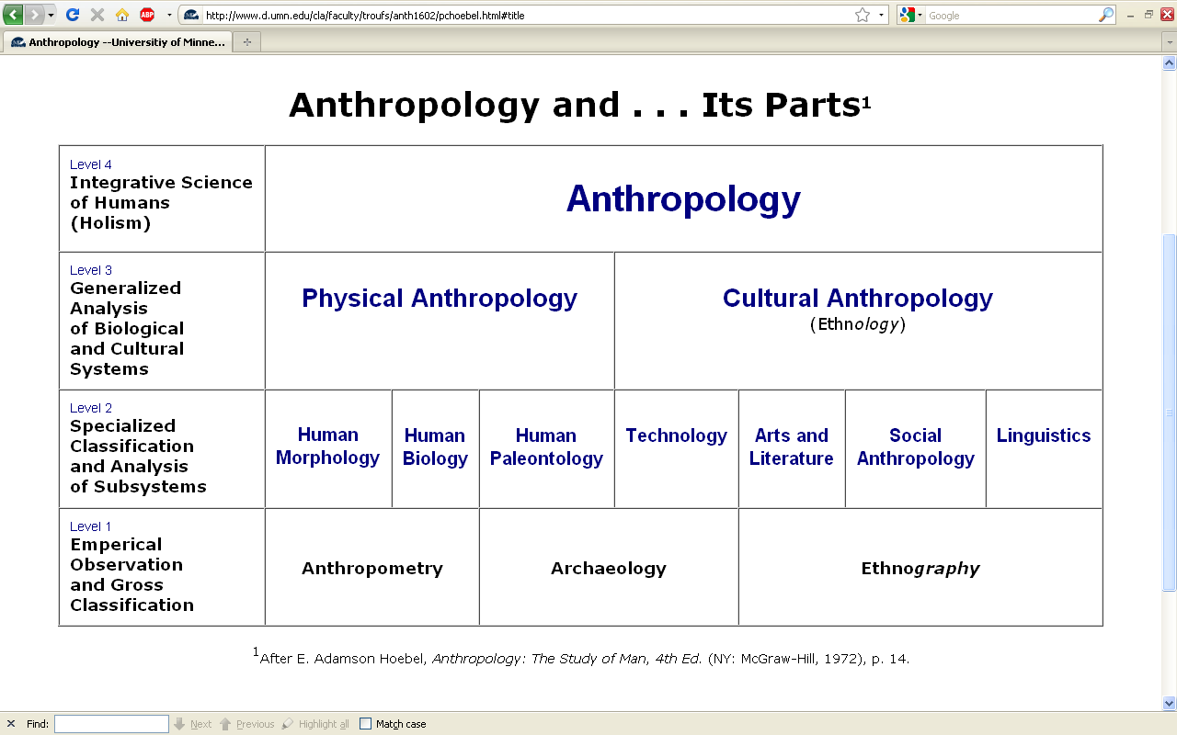
Understanding Global Cultures
Anthropology
Bio-physical
URL link to print: https://www.d.umn.edu/cla/faculty/troufs/anth1602/pchoebel.html#title

Slide 36
. . . biophysical looks at all things biological and physical, and involves
subjects like . . .

Slide 37

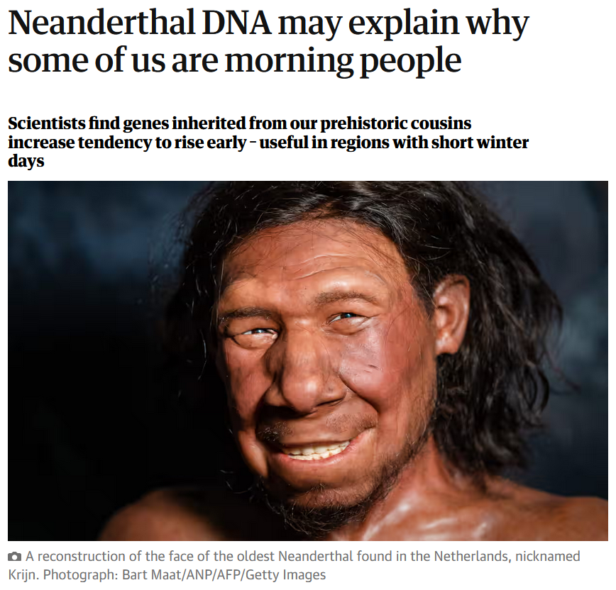
14 December 2023
https://www.theguardian.com/science/2023/dec/14/neanderthal-dna-may-explain-why-some-of-us-are-morning-people?CMP=share_btn_link

Slide 38
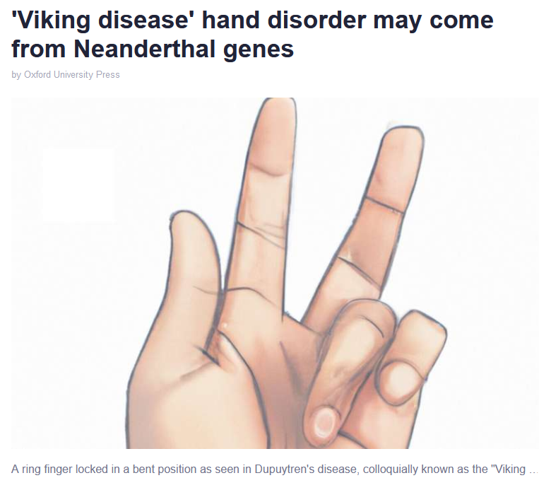

14 June 2023
https://phys.org/news/2023-06-viking-disease-disorder-neanderthal-genes.html

Slide 39
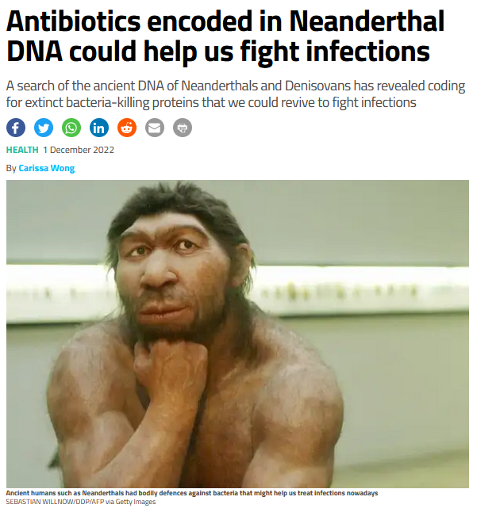

1 December 2022
https://www.newscientist.com/article/2349196-antibiotics-encoded-in-neanderthal-dna-could-help-us-fight-infections/

Slide 40
. . . biophysical involves
things like . . .

Slide 41
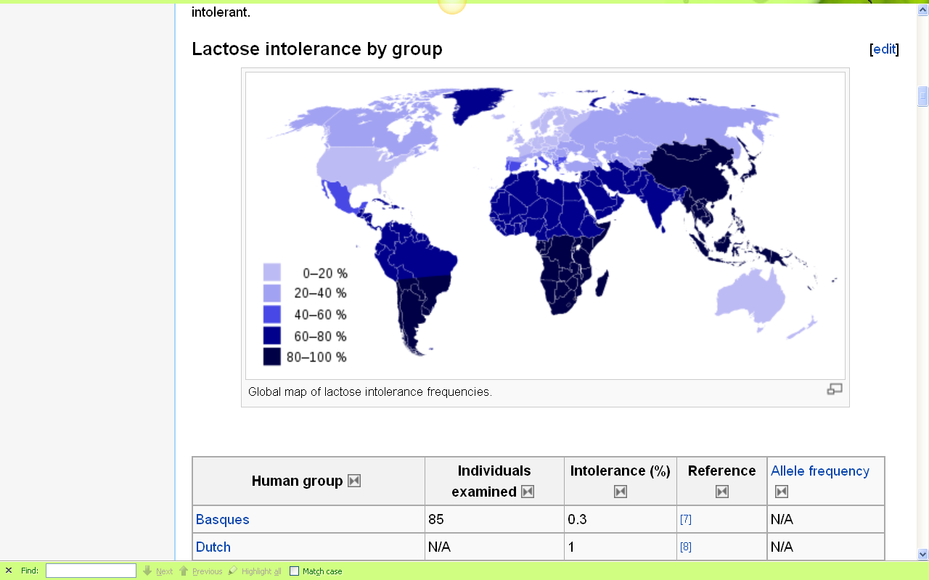
Europeans are some of the few peoples of the world that can drink milk without getting sick
http://en.wikipedia.org/wiki/Lactose_intolerance

Slide 42
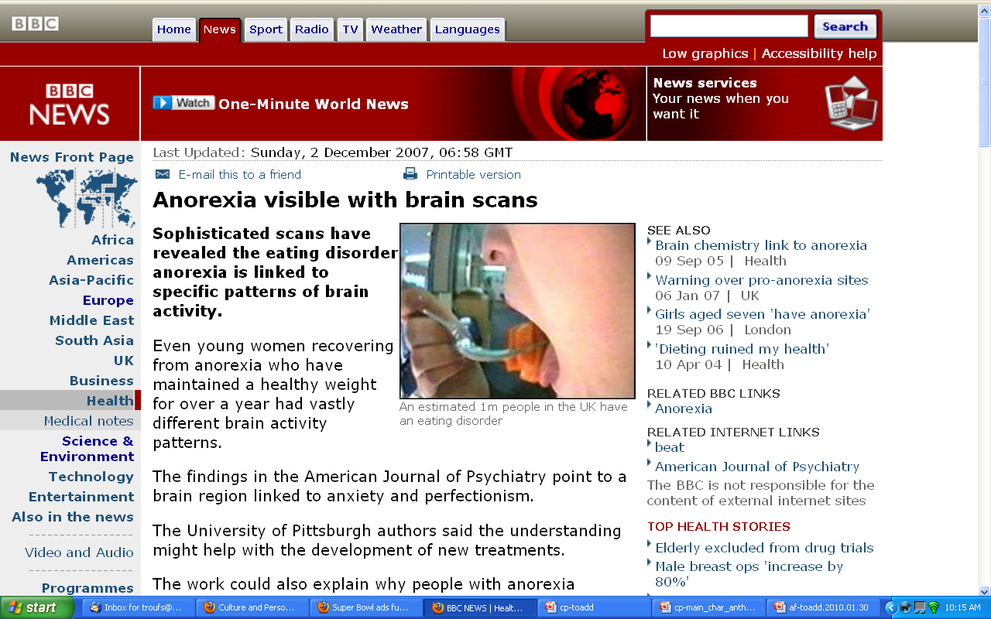
http://news.bbc.co.uk/2/hi/health/7120564.stm

Slide 43
. . . and biophysical involves
things like . . .

Slide 44

Penguin Avery, 2009

Slide 45
. . . but ultimately anthropologists seek to study phenomena in terms of both physical and cultural aspects
. . .

Slide 46
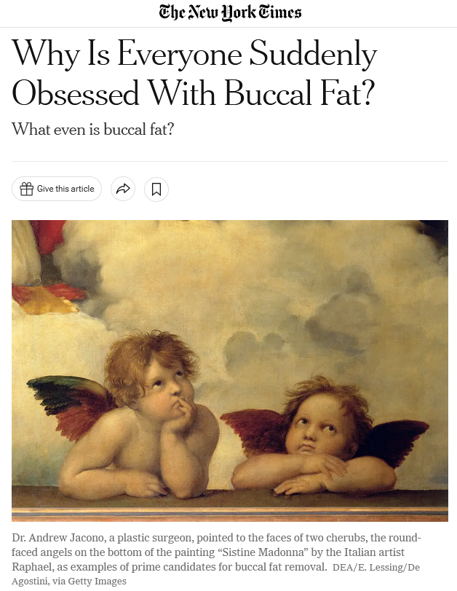
16 December 2022
https://www.nytimes.com/2022/12/16/style/buccal-fat-removal-tiktok-plastic-surgery.html?smid=em-share

Slide 47
Understanding Global Cultures
Anthropology
Bio-physical
Cultural
URL link to print: https://www.d.umn.edu/cla/faculty/troufs/anth1602/pchoebel.html#title

Slide 48
  for example, numerous studies have shown that exposure to images [cultural] of ultrathin models can lead to body dissatisfaction and eventually to unhealthy eating behaviors and physical illness [physical] . . .
The Cultural Feast, 2nd ed., p. 115

Slide 49

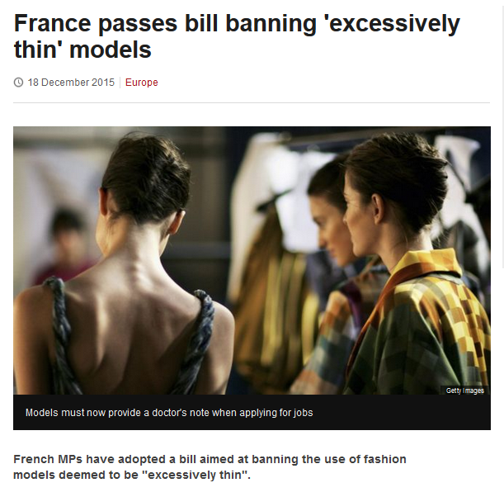
http://www.bbc.com/news/world-europe-35130792

Slide 50
So . . . we’re going to have a look at . . .
sociocultural
biophysical
archaeological
linguistical
cultural / social
physical / biological
archaeological
linguistical

Slide 51
. . . archaeology investigates cultures of the past, and questions of how things that we see today came to be that way, including forensics . . .

Slide 52
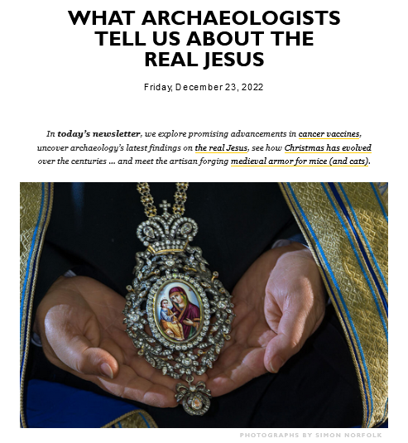
23 December 2022
https://outlook.live.com/mail/0/inbox/id/AQQkADAwATY0MDABLThjYwAxLTJjN2YtMDACLTAwCgAQAO9LDmUJCQBBSasELYWIBD7v

Slide 53
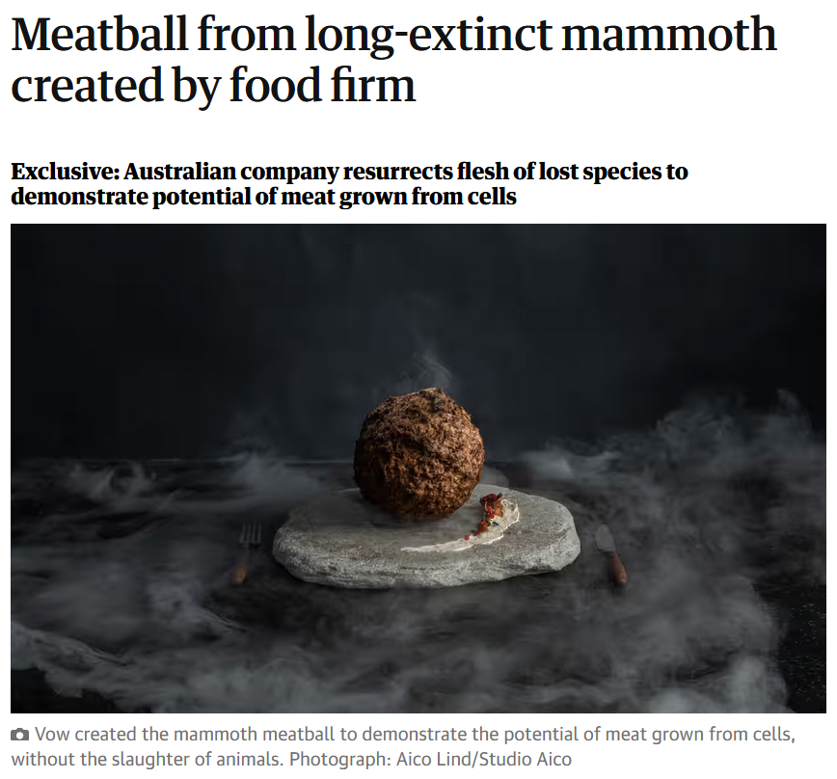
1 March 2023
https://www.theguardian.com/environment/2023/mar/28/meatball-mammoth-created-cultivated-meat-firm?CMP=Share_iOSApp_Other

Slide 54
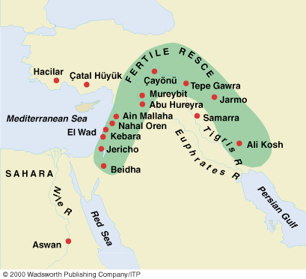
Early Neolithic sites
Understanding Physical Anthropology and Archaeology, 9th Ed., p. 349.

Slide 55
the comparative method compares things, for e.g., process of domestication / civilization
    maize – Mexico
    wheat – Turkey
    rice – China
    manioc – Brazil
    millet – Africa

Slide 56
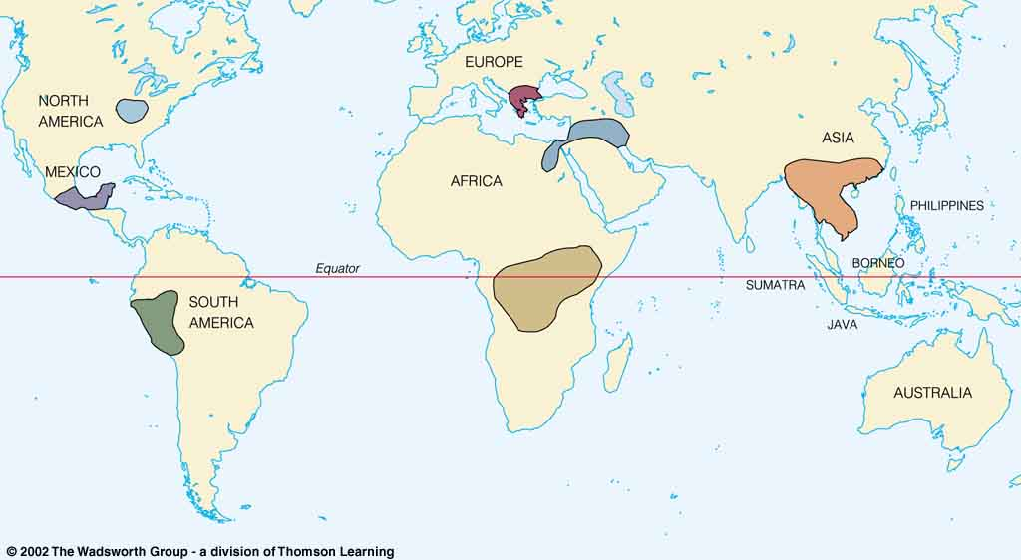
Origin of Domestication for Selected Plants
Compare . . .
wheat
10,500 ybp
maize
4,200 ybp
rice
7,000 ybp
manioc
4,200 ybp
millet
4,000 ybp
Understanding Physical Anthropology and Archaeology, 9th Ed., p. 342.

Slide 57

F. J. Simoons
1994
Eat not this Flesh, Food Avoidances from Pre-history to Present.
Madison: University of Wisconsin Press.

Slide 58
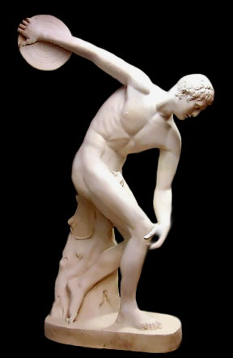
Discus Thrower
ca. 460 B.C.
http://www.crystalinks.com/greekart.html

Slide 59
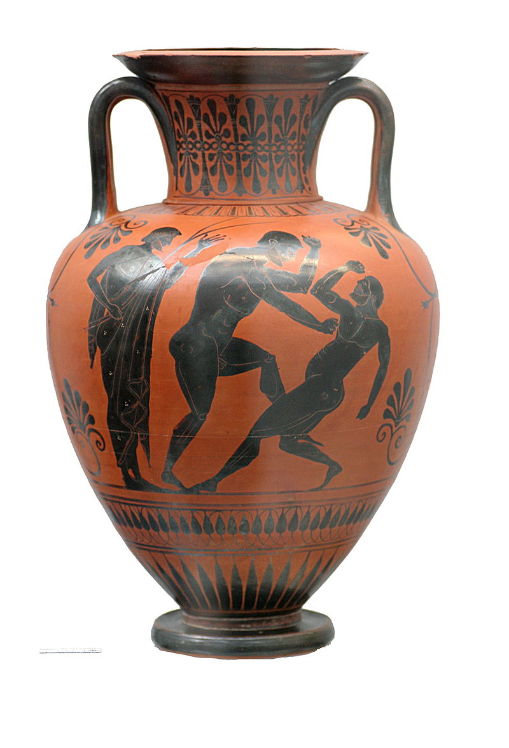
Black figure Amphora
Atalante painter
500-490 B.C.
https://en.wikipedia.org/wiki/Ancient_Greek_architecture#/media/File:Boxers_Staatliche_Antikensammlungen_1541.jpg

Slide 60
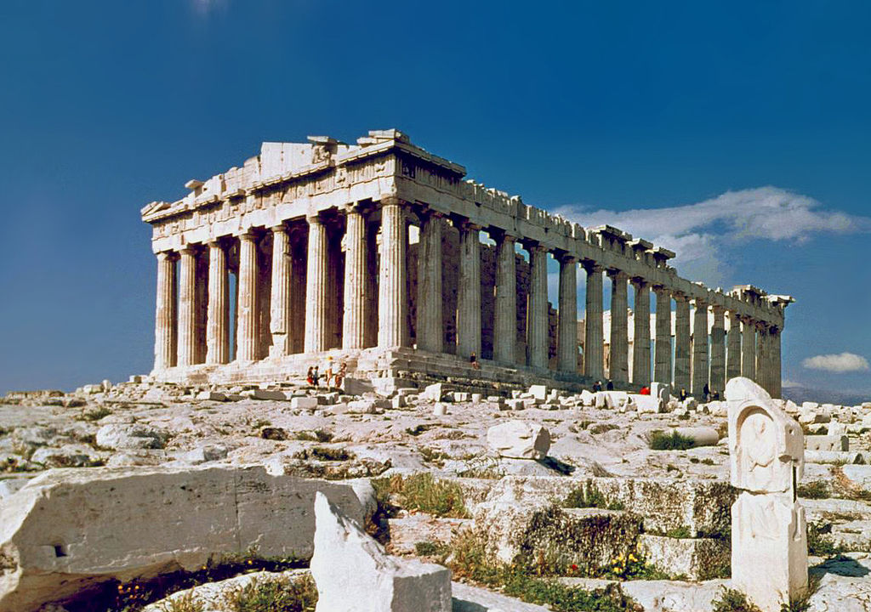
https://en.wikipedia.org/wiki/Ancient_Greek_architecture#/media/File:O_Partenon_de_Atenas.jpg

Slide 61
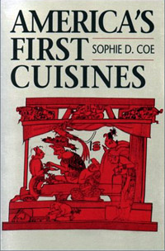
Aztec
Maya
Inca
Sophie D. Coe
America's First Cuisines
Austin: University of Texax Press, 1994.
www.d.umn.edu/cla/faculty/troufs/anthfood/aftexts.html#title

Slide 62
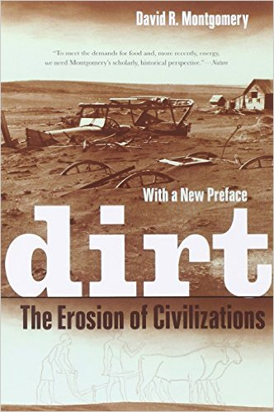
Mesopotamia
China
North America
South America
Europe
Asia
Africa
Pacific Islands
Berkeley: University of California, 2012
http://www.amazon.com/Empires-Food-Feast-Famine-Civilizations/dp/1582437939/ref=sr_1_1?ie=UTF8&qid=1452654498&sr=8-1&keywords=empires+of+food

Slide 63

Mesopotamia
China
North America
South America
Europe
Asia
Africa
Pacific Islands
Berkeley: Counterpoint, 2012:
http://www.amazon.com/Empires-Food-Feast-Famine-Civilizations/dp/1582437939/ref=sr_1_1?ie=UTF8&qid=1452654498&sr=8-1&keywords=empires+of+food

Slide 64
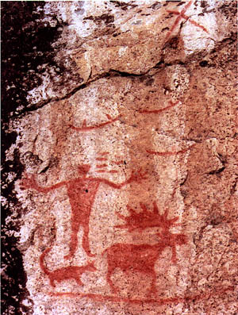
Pictograph from Hegman Lake, Minnesota

Slide 65
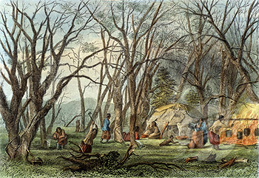
Indian Sugar Camp, 1853
Seth Eastman (1808-1878 American)
Newberry Library, Chicago

Slide 66
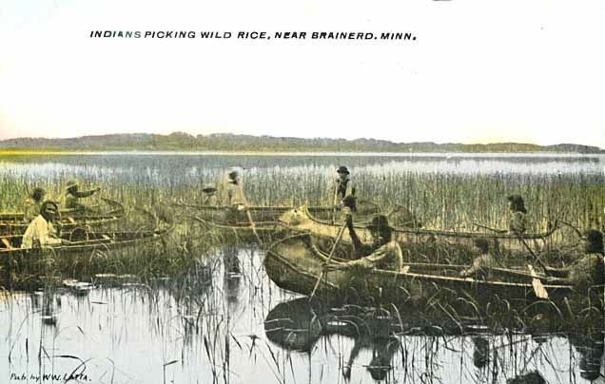
Indians harvesting wild rice near Brainerd, 1905.
.Minnesota Historical Society

Slide 67
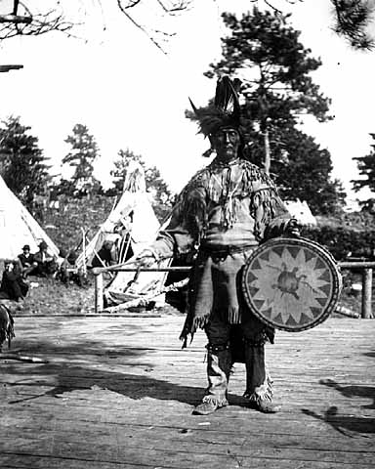
Chippewa medicine man singer with ceremonial turtle clan drum.
Photograph Collection ca. 1900
Minnesota Historical Society, Negative No. 21120

Slide 68
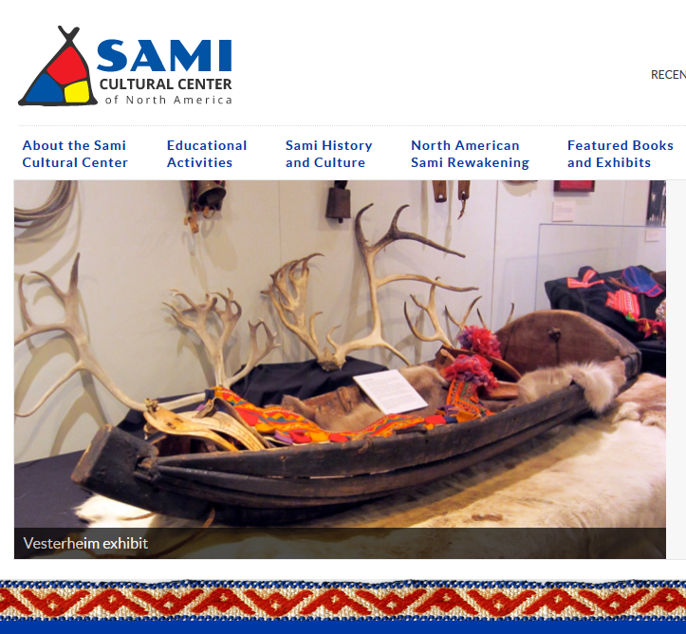

http://www.samiculturalcenter.org/
Notes:
68

Slide 69
. . . and finally . . .

Slide 70
So . . . we’re going to have a look at . . .
sociocultural
biophysical
archaeological
linguistical
cultural / social
physical / biological
archaeological
linguistical

Slide 71
. . . linguistics looks at languages and dialects historically, psychologically, and culturally . . .

Slide 72

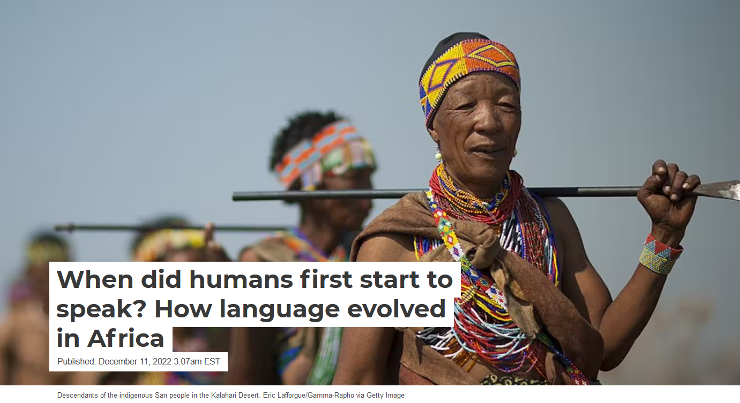
December 11, 2022
https://theconversation.com/when-did-humans-first-start-to-speak-how-language-evolved-in-africa-194372

Slide 73
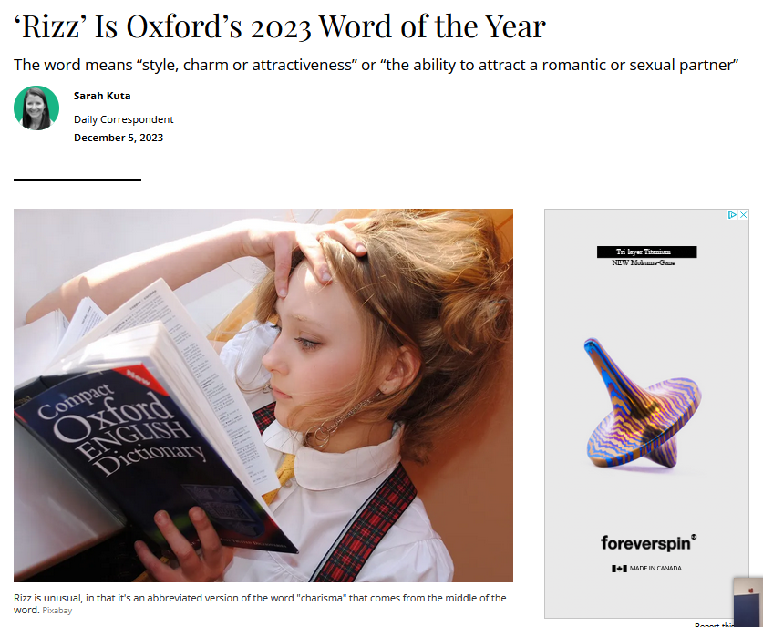

https://www.smithsonianmag.com/smart-news/rizz-is-oxfords-2023-word-of-the-year-180983367/

Slide 74
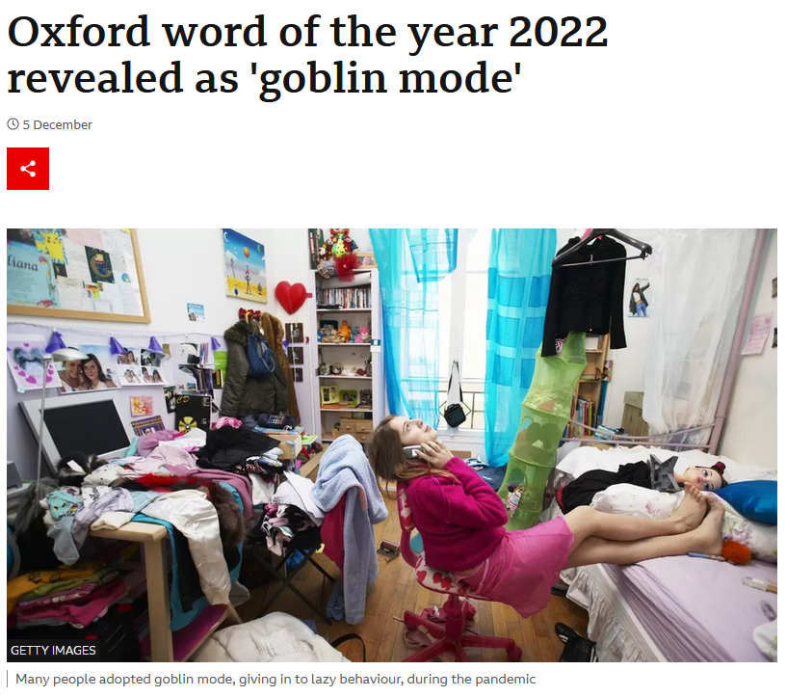
December 11, 2022
https://www.bbc.co.uk/news/uk-63857329

Slide 75
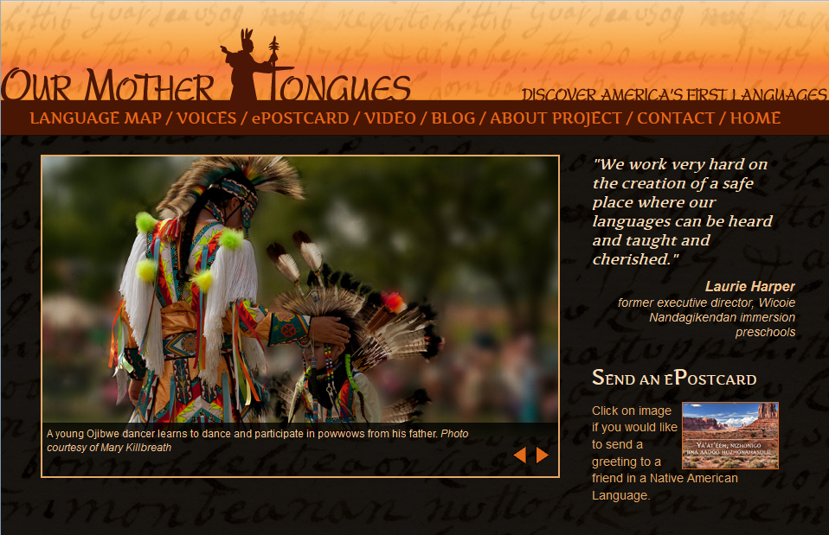
http://ourmothertongues.org/language/Ojibwe/9

Slide 76
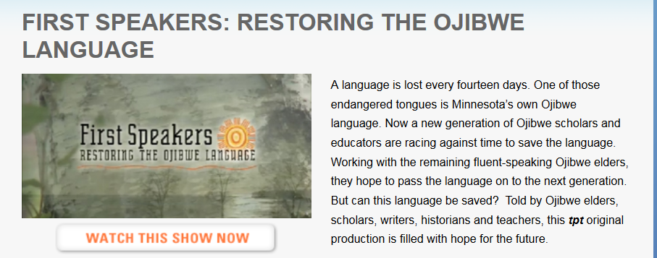
http://cla.umn.edu/ais/undhttp://www.tpt.org/?a=productions&id=3rgraduate/dakota-ojibwe-language-programs

Slide 77
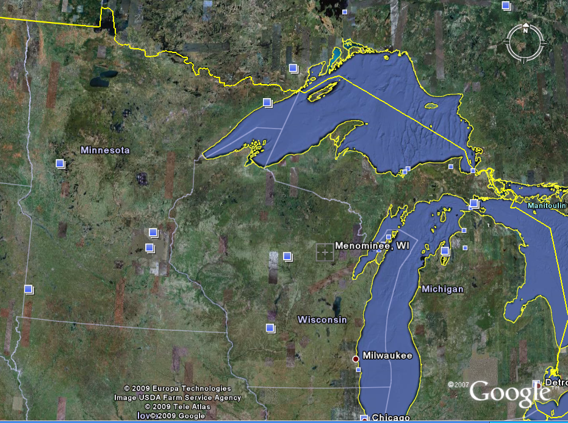
Wisconsin
Place Names
include
Menominee (“wild rice”)
Kenosha (ginoozhe “pike”)
Kewaunee (“prairie hen / wild duck”) . . .

Slide 78
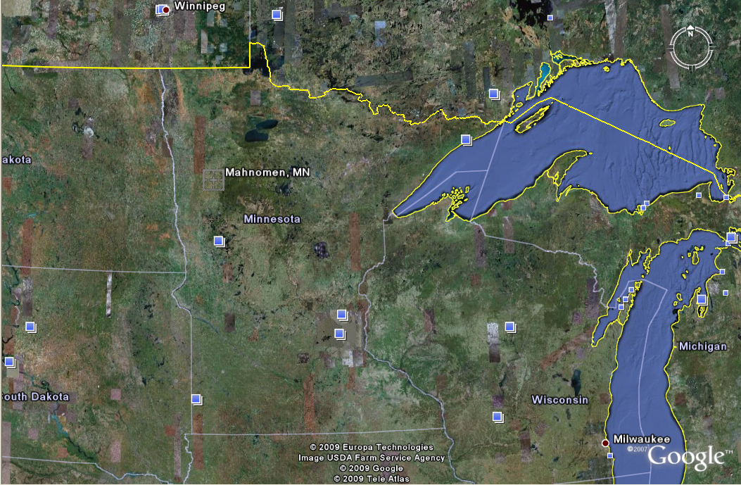
Minnesota
Place Names
include
Mahnomen (“wild rice”)
Mahnomen County
Nibish (“tea”)
Menahga (“blueberry”) . . .

Slide 79
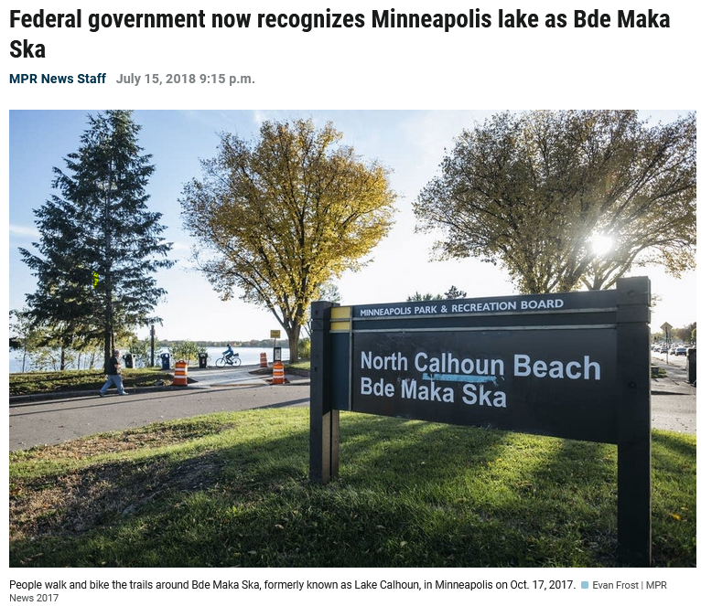

Slide 80
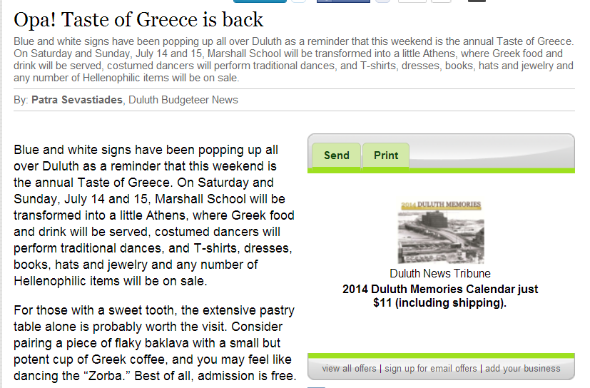
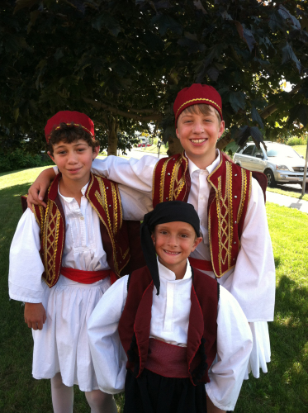
for e.g., names often reinforce one’s cultural identity
A Taste of Greece
22nd Annual Food Festival 2014
Dima Sevastiades, Styli Regas and Demetri Bush wear their dance costumes for the Taste of Greece.
(Photo by Patra Sevastiades)

Slide 81
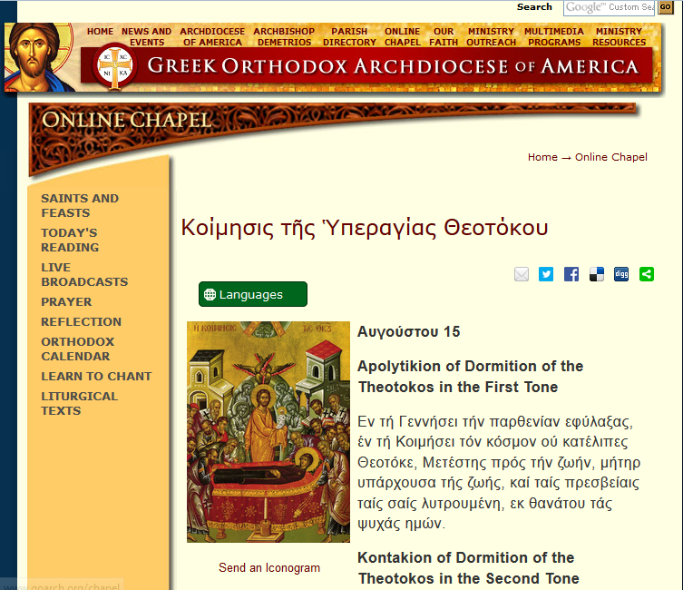
http://www.goarch.org/chapel/saints_view?contentid=165&date=8/15/2015&D=SA&language=el

Slide 82
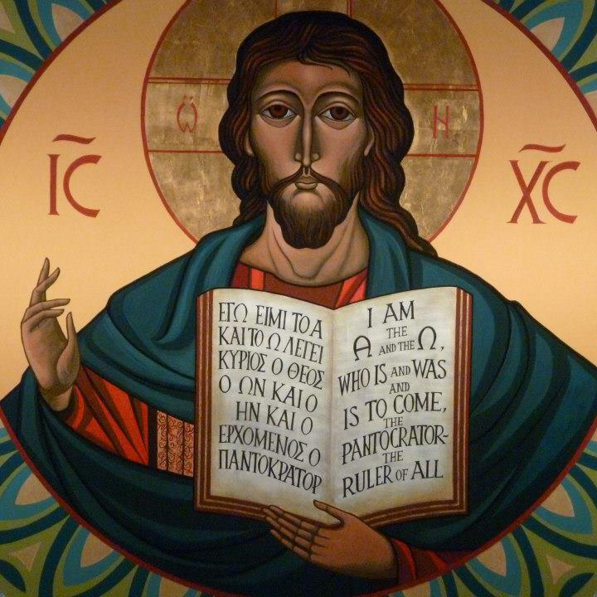
https://www.facebook.com/12HolyApostlesChurch/photos/

Slide 83
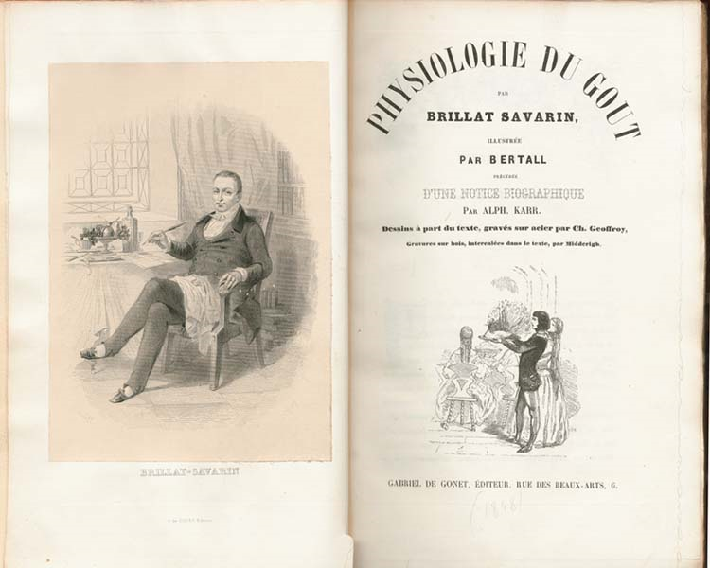
. . . This is one of the few books next to the Bible said to have never been out of print since its first edition
1875
http://en.wikipedia.org/wiki/Brillat-Savarin
Notes:
83

Slide 84
Main Characteristics in a Nutshell

Slide 85
American
Main Characteristics of˄Anthropology
1. the four fields of general anthropology
culture as a primary concept
comparative method as major approach
holism as a primary theoretical goal
fieldwork as a primary research technique

Slide 86
The End
The Four Fields
of
American Anthropology
University of Minnesota Duluth
Tim Roufs
© 2010-2024
http://en.wikipedia.org/wiki/Highland_cattle

