Slide 1
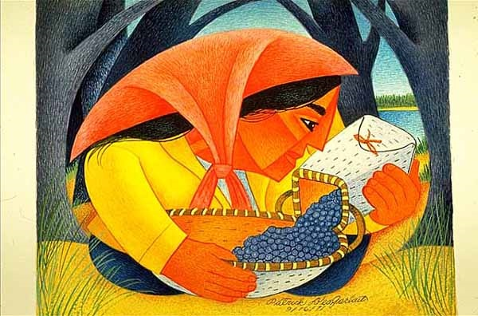
Start deck in “Slide Show” mode,
and use your up/down arrow keys and/or
your space bar to advance the slides
University of Minnesota Duluth
Tim Roufs
© 2010-2024

Slide 2
REM
indicates that the materials
are a REMinder
and are thus being repeated . . .
REMinder

Slide 3
ANTH 3888
Anthropology of Food
University of Minnesota Duluth
Tim Roufs
© 2010-2024

Slide 4
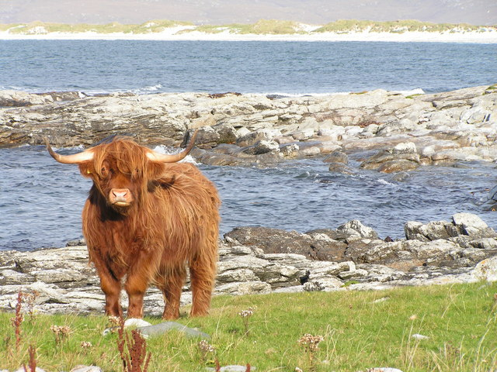
Main
Characteristics of
Anthropology
Anthropology of Food
University of Minnesota Duluth
Tim Roufs
© 2010-2024
http://en.wikipedia.org/wiki/Highland_cattle

Slide 5
American
Main Characteristics of˄Anthropology
1. the four fields of general anthropology
culture as a primary concept
comparative method as major approach
holism as a primary theoretical goal
fieldwork as a primary research technique

Slide 6
American
Main Characteristics of˄Anthropology
1. the four fields of general anthropology
culture as a primary concept
comparative method as major approach
holism as a primary theoretical goal
fieldwork as a primary research technique

Slide 7
Main Characteristics of Anthropology
1. the four fields of general anthropology
culture as a primary concept
comparative method as major approach
holism
or the study of "humankind" as a whole, as a primary theoretical goal
fieldwork as a primary research technique

Slide 8
with humans,
in anthropology,
holism looks at an item including the many subdisciplines in the areas of . . .

Slide 9
Holism tries to put all of the pieces together . . .
Anthropology of Food
and its . . .
cultural / social
physical
archaeology
linguistics
(Bio-physical)

Slide 10
let’s have a look at that on the
“Anthropology and . . . Its Parts” chart . . .

Slide 11
Main Characteristics of Anthropology
1. the four fields of general anthropology
culture as a primary concept
comparative method as major approach
holism as a primary theoretical goal
  Anthropology and its Parts chart
fieldwork as a primary research technique

Slide 12
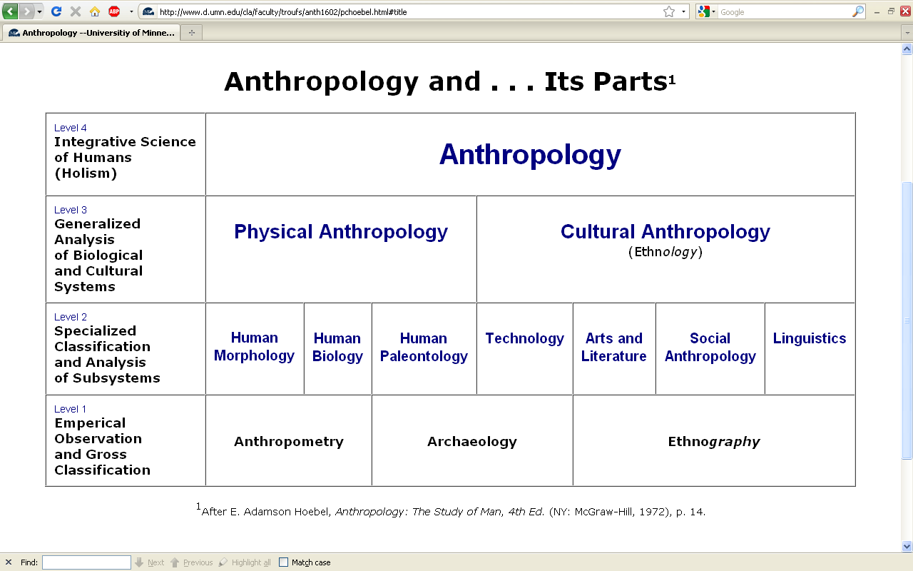
URL link to print: https://www.d.umn.edu/cla/faculty/troufs/anth1602/pchoebel.html#title

Slide 13
NOTE:
usually anthropologists read charts from the bottom up
that has to do with the fact that in archaeology the oldest layers are at the bottom of a site and the newer ones are on top

Slide 14
REM: We’re having a look at . . .
Food
and its . . .
cultural / social
physical
archaeology
linguistics
would appear on the chart as . . .

Slide 15
. . . but first note that the two main divisions
of Anthropology are
Bio-physical and Cultural . . .

Slide 16
Understanding Global Cultures
Anthropology
URL link to print: https://www.d.umn.edu/cla/faculty/troufs/anth1602/pchoebel.html#title

Slide 17
URL link to print: https://www.d.umn.edu/cla/faculty/troufs/anth1602/pchoebel.html#title

Slide 18
Understanding Global Cultures
Anthropology
Bio-physical
URL link to print: https://www.d.umn.edu/cla/faculty/troufs/anth1602/pchoebel.html#title

Slide 19
. . . Bio-physical involves
things like . . .

Slide 20

http://news.bbc.co.uk/2/hi/health/7120564.stm

Slide 21
. . . but ultimately anthropologists seek to study phenomena in terms of both physical and cultural aspects
. . .

Slide 22
Understanding Global Cultures
Anthropology
Bio-physical
Cultural
URL link to print: https://www.d.umn.edu/cla/faculty/troufs/anth1602/pchoebel.html#title

Slide 23
  for example, numerous studies have shown that exposure to images [cultural] of ultrathin models can lead to body dissatisfaction and eventually to unhealthy eating behaviors and physical illness [physical] . . .
The Cultural Feast, 2nd ed., p. 115

Slide 24

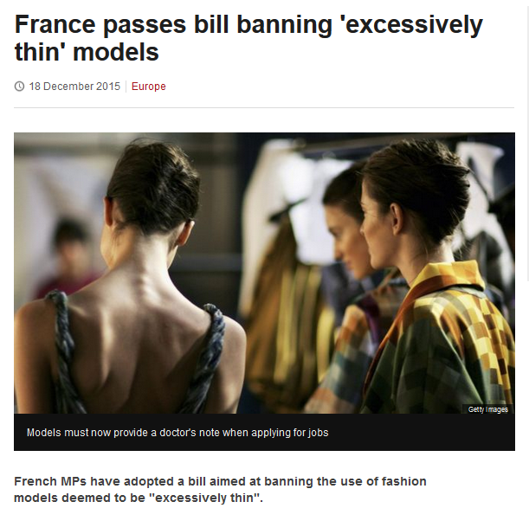
http://www.bbc.com/news/world-europe-35130792

Slide 25
Understanding Global Cultures
. . . but ultimately anthropologists seek to study phenomena in terms of both physical and cultural aspects
. . .
. . . as well as other aspects, for e.g., the psychological
. . .

Slide 26
ANTH 3888
FOOD

Slide 27
NOTE:
There are four levels . . .
(REM: read from the bottom up)

Slide 28
URL link to print: https://www.d.umn.edu/cla/faculty/troufs/anth1602/pchoebel.html#title

Slide 29
URL link to print: https://www.d.umn.edu/cla/faculty/troufs/anth1602/pchoebel.html#title

Slide 30
URL link to print: https://www.d.umn.edu/cla/faculty/troufs/anth1602/pchoebel.html#title

Slide 31
URL link to print: https://www.d.umn.edu/cla/faculty/troufs/anth1602/pchoebel.html#title

Slide 32
HOLISM
Involves all four levels
and all
of the physical and cultural
components combined

Slide 33
holism
URL link to print: https://www.d.umn.edu/cla/faculty/troufs/anth1602/pchoebel.html#title

Slide 34
holism
holism
URL link to print: https://www.d.umn.edu/cla/faculty/troufs/anth1602/pchoebel.html#title

Slide 35
Anthropology
URL link to print: https://www.d.umn.edu/cla/faculty/troufs/anth1602/pchoebel.html#title

Slide 36
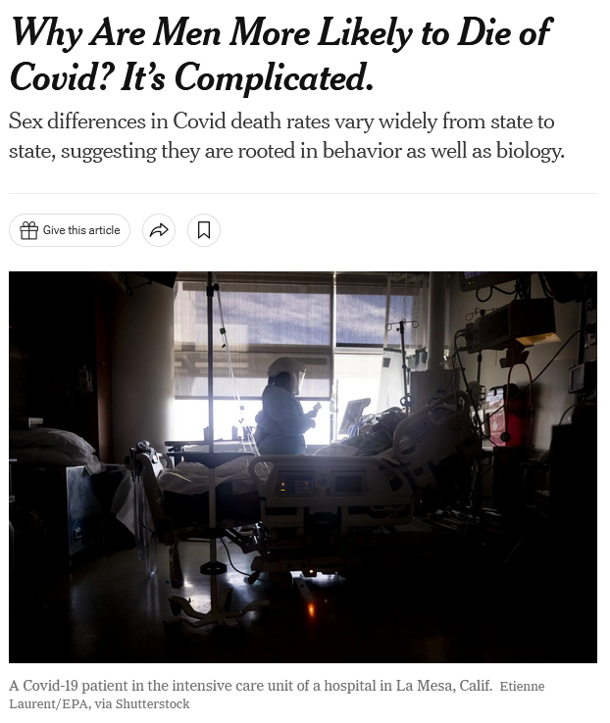
January 19, 2022
https://www.nytimes.com/2022/01/19/health/covid-gender-deaths-men-women.html?referringSource=articleShare

Slide 37
REM
. . . the two main divisions
of Anthropology are
Bio-physical and Cultural . . .

Slide 38
Understanding Global Cultures
Anthropology
URL link to print: https://www.d.umn.edu/cla/faculty/troufs/anth1602/pchoebel.html#title

Slide 39
Anthropology
Bio-physical
URL link to print: https://www.d.umn.edu/cla/faculty/troufs/anth1602/pchoebel.html#title

Slide 40
Anthropology
Bio-physical
Food and Culture
URL link to print: https://www.d.umn.edu/cla/faculty/troufs/anth1602/pchoebel.html#title

Slide 41
Bio-physical |
Food and Culture
URL link to print: https://www.d.umn.edu/cla/faculty/troufs/anth1602/pchoebel.html#title

Slide 42
here is what that would look like
on the Biocultural Framework diagram from p. 4 of The Cultural Feast . . .

Slide 43
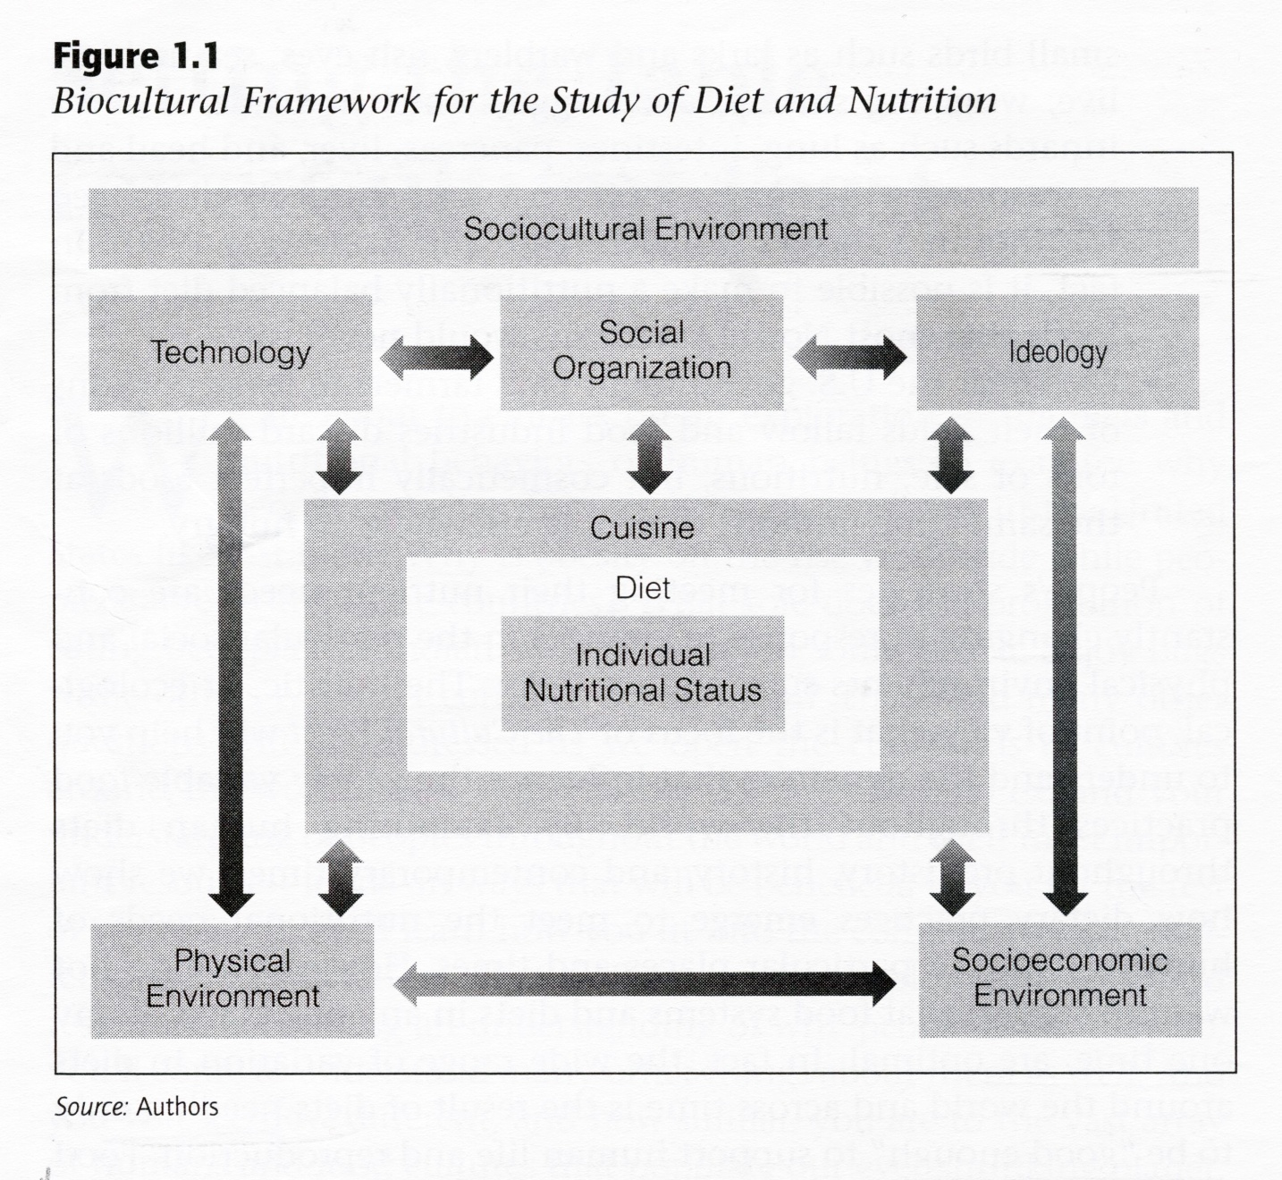
The Cultural Feast, 2nd ed., p. 4

Slide 44
Food and Culture
The Cultural Feast, 2nd ed., p. 4

Slide 45
Food and Culture
Physical Anthropology
The Cultural Feast, 2nd ed., p. 4

Slide 46
. . . Bio-physical involves
things like . . .

Slide 47
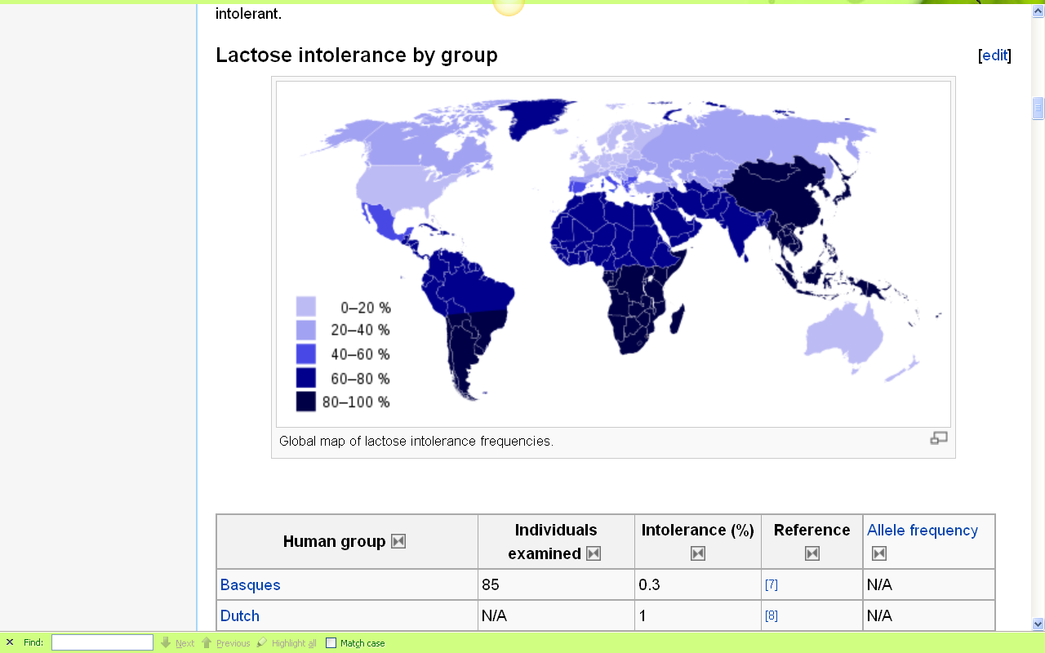
Europeans are some of the few peoples of the world that can drink milk without getting sick
http://en.wikipedia.org/wiki/Lactose_intolerance

Slide 48
http://news.bbc.co.uk/2/hi/health/7120564.stm

Slide 49
. . . but, as mentioned above, ultimately anthropologists seek to study phenomena in terms of both physical and cultural aspects
. . .

Slide 50
Anthropology
Bio-physical
Food and Culture
URL link to print: https://www.d.umn.edu/cla/faculty/troufs/anth1602/pchoebel.html#title

Slide 51
. . . and that ultimately involves lots of subdisciplines . . .

Slide 52
Anthropology
Bio-physical |
Food and Culture
URL link to print: https://www.d.umn.edu/cla/faculty/troufs/anth1602/pchoebel.html#title

Slide 53
Anthropology
Bio-physical |
Food and Culture
measuring
URL link to print: https://www.d.umn.edu/cla/faculty/troufs/anth1602/pchoebel.html#title

Slide 54
Anthropology
Bio-physical |
Food and Culture
measuring
excavating
URL link to print: https://www.d.umn.edu/cla/faculty/troufs/anth1602/pchoebel.html#title

Slide 55
Anthropology
Bio-physical |
Food and Culture
measuring
excavating
participant /
observation
URL link to print: https://www.d.umn.edu/cla/faculty/troufs/anth1602/pchoebel.html#title

Slide 56
Anthropology
Bio-physical |
Food and Culture
body
size/shape,
etc.
measuring
excavating
participant /
observation
URL link to print: https://www.d.umn.edu/cla/faculty/troufs/anth1602/pchoebel.html#title

Slide 57
Anthropology
Bio-physical |
Food and Culture
body
size/shape,
etc.
nutrition,
etc.
measuring
excavating
participant /
observation
URL link to print: https://www.d.umn.edu/cla/faculty/troufs/anth1602/pchoebel.html#title

Slide 58
Anthropology
Bio-physical |
Food and Culture
body
size/shape,
etc.
nutrition,
etc.
hunting /
meat eating
measuring
excavating
participant /
observation
URL link to print: https://www.d.umn.edu/cla/faculty/troufs/anth1602/pchoebel.html#title

Slide 59
Anthropology
Bio-physical |
Food and Culture
body
size/shape,
etc.
nutrition,
etc.
hunting /
meat eating
the
“Agricultural
Revolution”
measuring
excavating
participant /
observation
URL link to print: https://www.d.umn.edu/cla/faculty/troufs/anth1602/pchoebel.html#title

Slide 60
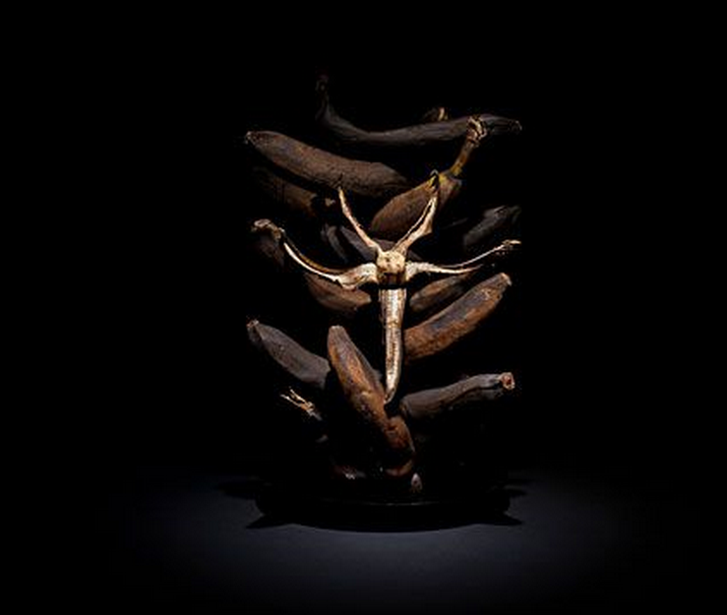
Forum discussion topic

Slide 61
Anthropology
Bio-physical |
Food and Culture
body
size/shape,
etc.
nutrition,
etc.
hunting /
meat eating
the
“Agricultural
Revolution”
food in
art
literature
measuring
excavating
participant /
observation
URL link to print: https://www.d.umn.edu/cla/faculty/troufs/anth1602/pchoebel.html#title

Slide 62
Anthropology
Bio-physical |
Food and Culture
body
size/shape,
etc.
nutrition,
etc.
hunting /
meat eating
the
“Agricultural
Revolution”
food in
art
literature
food and
society and
belief, etc.
measuring
excavating
participant /
observation
URL link to print: https://www.d.umn.edu/cla/faculty/troufs/anth1602/pchoebel.html#title

Slide 63
Anthropology
Bio-physical |
Food and Culture
body
size/shape,
etc.
nutrition,
etc.
hunting /
meat eating
the
“Agricultural
Revolution”
food in
art
literature
food and
society and
belief, etc.
food
and
language
measuring
excavating
participant /
observation
URL link to print: https://www.d.umn.edu/cla/faculty/troufs/anth1602/pchoebel.html#title

Slide 64
some examples of holistic comparative work include . . .

Slide 65

Penguin Avery, 2009

Slide 66
“I’m one of the few experts—if not the only expert—to have conducted large-scale, longitudinal surveys following obesity on a global scale.” (p. 2)
Penguin Avery, 2009

Slide 67
Barry Popkin’s work looks at . . .
(Trivia: Barry is from Superior, WI, and includes Superior in his comparisons in this book)

Slide 68
Anthropology
Bio-physical |
Food and Culture
body
size/shape,
etc.
nutrition,
etc.
hunting /
meat eating
the
“Agricultural
Revolution”
food in
art
literature
food and
society and
belief, etc.
food
and
language
measuring
excavating
participant /
observation

Slide 69
holism
holism

Slide 70
In some ways this chart business is all about
Theory
but key theory that is important to the understanding of the Anthropology of Food

Slide 71
theory
holism

Slide 72
theory
holism
and the theory ultimately also includes the
results of interdisciplinary study,
esp. with food history, nutrition studies, and the business of producing, distributing and marketing food . . .

Slide 73
theory
One excellent example of holism in action is
Nassim Nicholas Taleb’s
INCERTO. . .

Slide 74
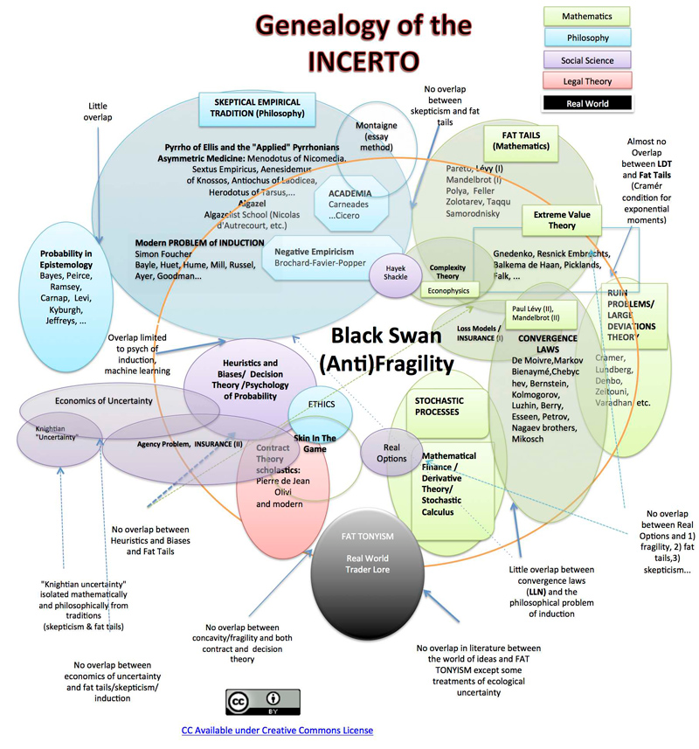

Slide 75
Main Characteristics
in a Nutshell

Slide 76
Main Characteristics of Anthropology
1. the four fields of general anthropology
culture as a primary concept
comparative method as major approach
holism as a primary theoretical goal
  Anthropology and its Parts chart
fieldwork as a primary research technique

Slide 77
The End
Main
Characteristics of
Anthropology
Anthropology of Food
University of Minnesota Duluth
Tim Roufs
© 2010-2024
http://en.wikipedia.org/wiki/Highland_cattle

