Slide 1
Chapter 1
“Next Steps”
Tim Roufs
© 2010
www.d.umn.edu/cla/faculty/troufs/anthfood/aftexts.html#title

Slide 2
“Setting the Table for a Cultural Feast”
Biocultural Framework
for the Study of Diet and Nutrition
Food Systems
Next Steps

Slide 3
The Cultural Feast
The Cultural Feast is organized into three parts:
Part I: “Evolutionary and Historical Roots of Human Dietary Practices”
looks at the evolutionary and historical roots of human dietary practices
The Cultural Feast, 2nd ed., p. 15

Slide 4
The Cultural Feast
Part I: Ch. 2
examines
primate and hominid diets and their implications
for diet and health today
The Cultural Feast, 2nd ed., p. 15

Slide 5
The Cultural Feast
Part I: Ch. 3
looks at
contemporary food systems within a historical context,
focusing on the impact of a series of dramatic changes in
the ways people interact with the environment to obtain food
The Cultural Feast, 2nd ed., p. 15

Slide 6
The Cultural Feast
Part II: “Food and Culture”
covers modern human populations
and how the technology, social organization, and ideology related to
food production, distribution, and consumption form a set of interacting phenomena that both influence and are influenced by the foods and diets that people consume
The Cultural Feast, 2nd ed., p. 15

Slide 7
The Cultural Feast
Part II: Ch. 4
introduces the
concept of culture and describes the influence it has on food practices,
including what is considered edible and how groups select certain items
to make up their diet
The Cultural Feast, 2nd ed., p. 15

Slide 8
The Cultural Feast
Part II: Ch. 4
is followed by a more detailed examination of
the major components of culture:
technology (Part II: Chs. 5 and 6)
social organization (Part II: Ch. 7)
ideology (Part II: Ch. 8)
The Cultural Feast, 2nd ed., p. 16

Slide 9
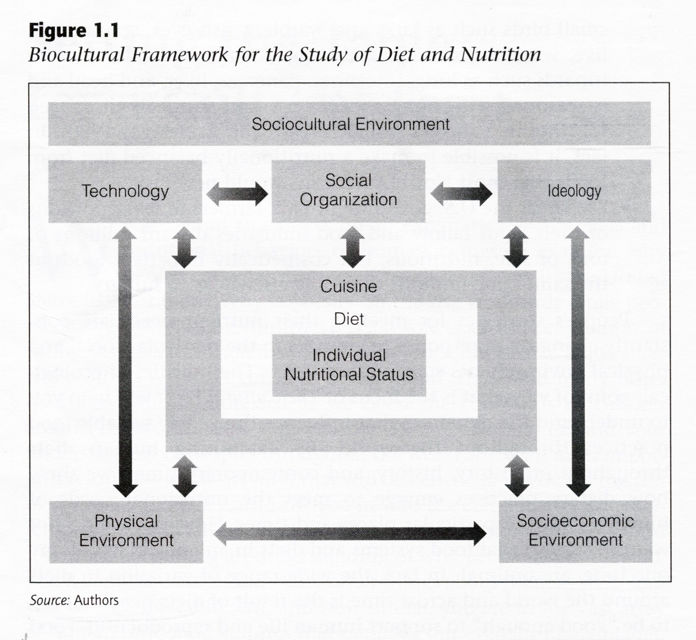
The Cultural Feast, 2nd ed., p. 4

Slide 10
The Cultural Feast
Part III: “Strategies for Addressing Nutrition Challenges”
moves beyond the concept of culture to explore the need for and processes of change in contemporary nutrition
it examines some of the important issues in hunger and dietary change and examines issues and various ways to improve human dietary patterns
The Cultural Feast, 2nd ed., p. 15

Slide 11
The Cultural Feast
Part III: Ch. 9
describes the world food situation and the numerous factors that contribute to
. . .
undernourishment
undernutrition
micronutrient malnutrition
hunger
The Cultural Feast, 2nd ed., p. 16

Slide 12
The Cultural Feast
Part III: Ch. 10
examines the types of solutions that can be implemented at the
international
national
household levels
to improve the food supply and make appropriate food available to families and individuals
The Cultural Feast, 2nd ed., p. 16

Slide 13
and the units of analysis
with these latter topics,
topics which will be covered towards the end of the semester,
are . . .

Slide 14
“units of analysis”:
one person
the family
the community
a region
a “culture area”
a culture / “subculture”
a nation / several nations
an item or action itself
a “cultural metaphor”

Slide 15
next:
Chapter 2
“Diet and Human Evolution”
Tim Roufs
© 2010
www.d.umn.edu/cla/faculty/troufs/anthfood/aftexts.html#title

