Slide 1
Anthropology of Food
Nutritional Anthroplogy

Slide 3
Basic Nutritional Needs

Slide 4
Ralph Linton
Basic Needs

Slide 5
diet

Slide 6
Nutrition

Slide 7
Anorexia / Bulimia
Bio-Physical

Slide 8
obesity
Bio-Physical

Slide 9
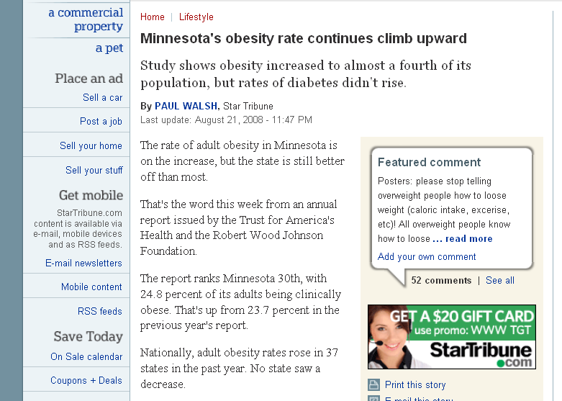
www.startribune.com/lifestyle/27224664.html

Slide 10
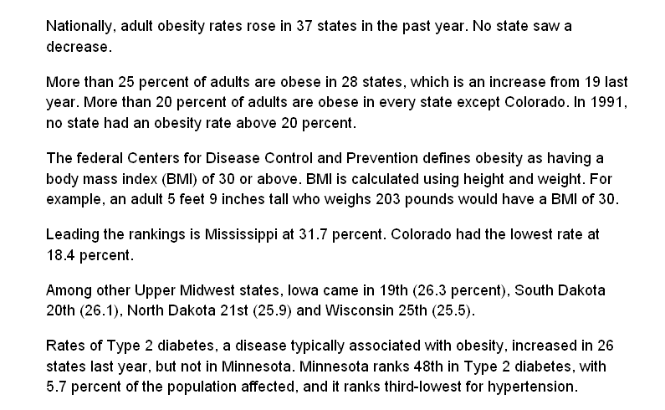
www.startribune.com/lifestyle/27224664.html

Slide 11

www.startribune.com/lifestyle/27224664.html
www.wsoctv.com/news/17262427/detail.html

Slide 12
www.wsoctv.com/news/17262427/detail.html

Slide 13
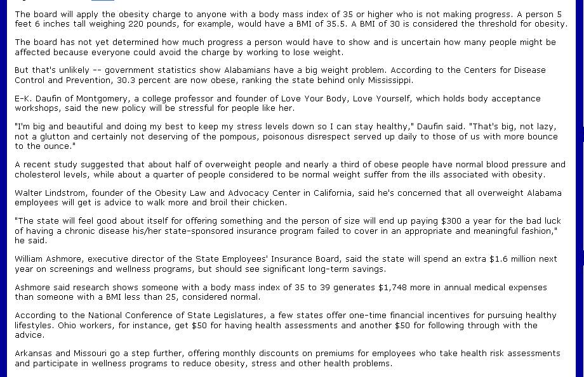
www.wsoctv.com/news/17262427/detail.html

Slide 14
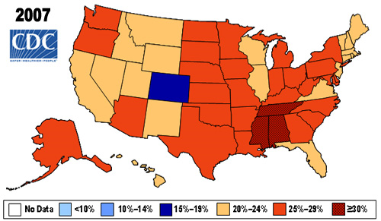
www.cdc.gov/nccdphp/dnpa/obesity/trend/maps/

Slide 15
www.startribune.com/lifestyle/27224664.html

Slide 16
www.startribune.com/lifestyle/27224664.html

Slide 17
www.startribune.com/lifestyle/27224664.html

Slide 18
Nutritional eco-genetics

Slide 19
/
Gary Paul Nabhan
  Why Some like it hot
    Favism/Sickle cell Anemia
    Sardinia
    Crete
    Supertasters
    Alcohol Tolerance
    Lactose Intolerance

Slide 20
Alcohol tolerance
Bio-Physical

Slide 21
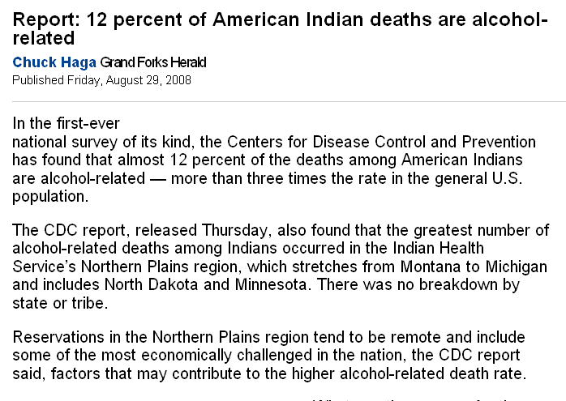
www.grandforksherald.com/articles/index.cfm?id=85362&section=homepage&CFID=78496208&CFTOKEN=18366292&jsessionid=8830e599e5944c3e5047

Slide 22
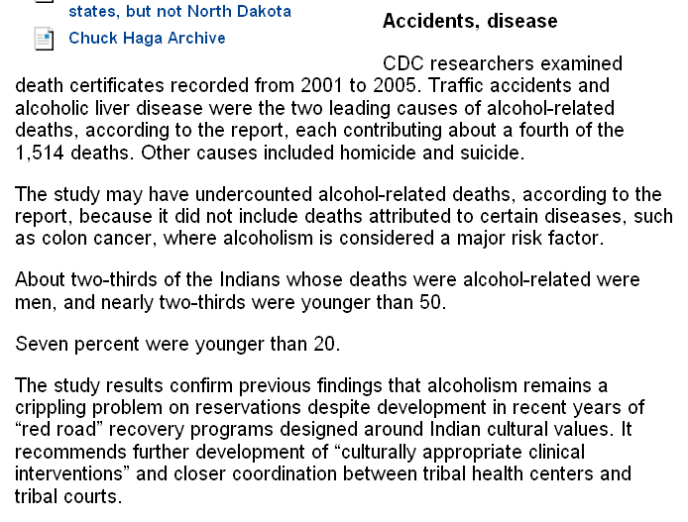
www.grandforksherald.com/articles/index.cfm?id=85362&section=homepage&CFID=78496208&CFTOKEN=18366292&jsessionid=8830e599e5944c3e5047

Slide 23
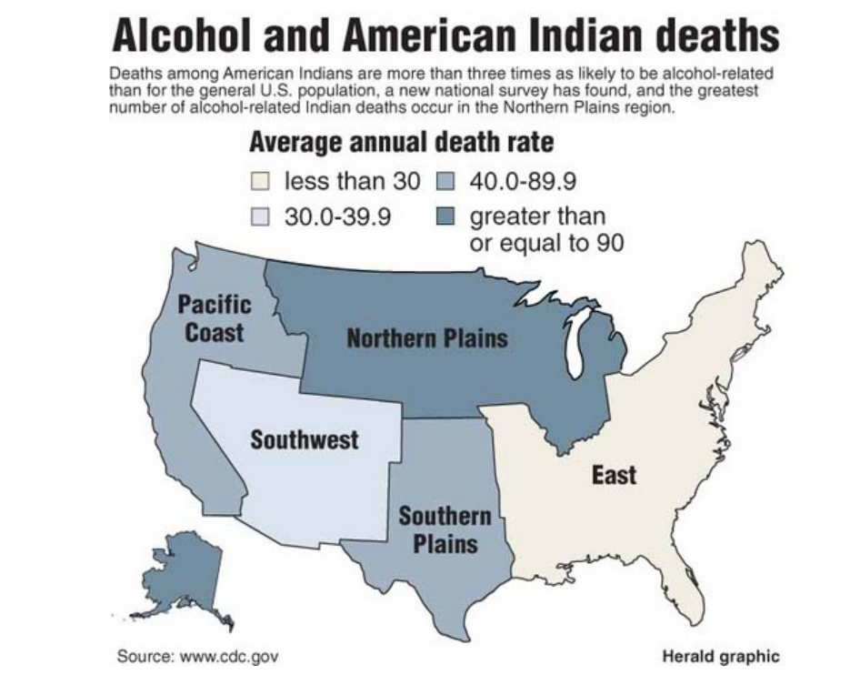
www.grandforksherald.com/articles/index.cfm?id=85362&section=homepage&CFID=78496208&CFTOKEN=18366292&jsessionid=8830e599e5944c3e5047

