Slide 1
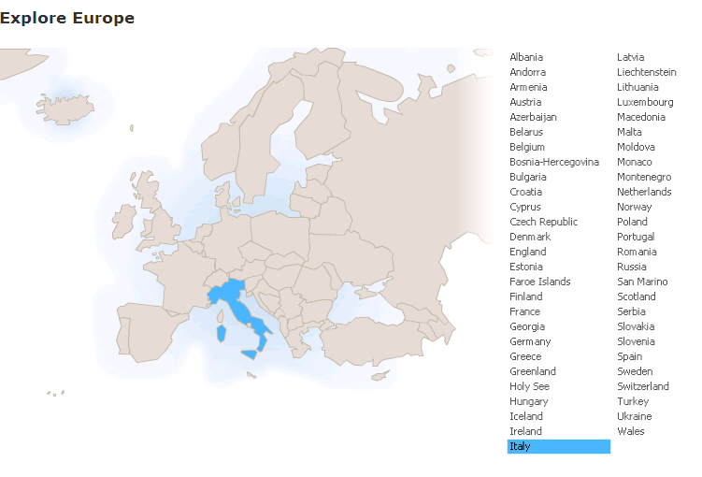
Run in “Slide Show” mode.
Use your up / down arrow keys and / or
your space bar to advance the slides
An Introduction
and Some Background to the Country
Demography
and
An Introduction to
the Makings of a Metaphor
Italy
© 2009-2024 Timothy G. Roufs, University of Minnesota Duluth

Slide 2
Italy
© 2009-2024 Timothy G. Roufs, University of Minnesota Duluth

Slide 3
Demography
Italy
© 2009-2024 Timothy G. Roufs, University of Minnesota Duluth

Slide 4
Italy’s contemporary demographic situation reflects a complex history, geography, ecology, demographic make up, world view, and so forth
. . .

Slide 5
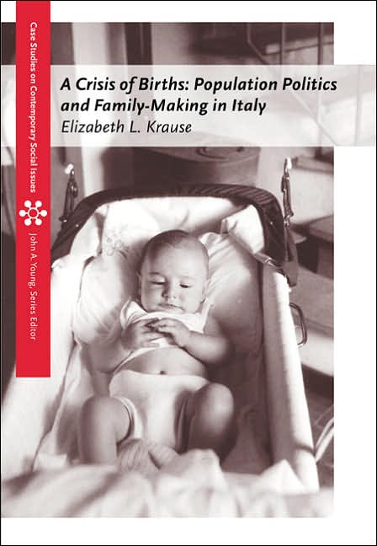
Much of this is detailed in Betsy Krause’s excellent book
Elizabeth L. Krause
A Crisis of Births:
Population Politics and Family-Making in Italy
Belmont, CA: Thompson Wadsworth, 2005.
http://www.d.umn.edu/cla/faculty/troufs/anth3635/cetexts.html#CrisisofBirths

Slide 6
So first, a bit of history and background . . .

Slide 7
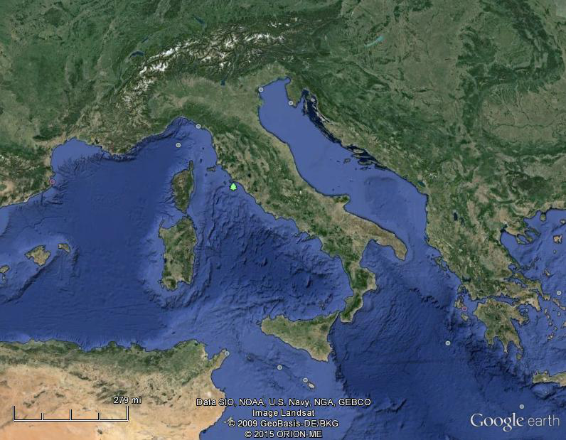
Of all European countries Italy, “the boot,” is probably the most recognizable . . .
Notes:
7

Slide 8
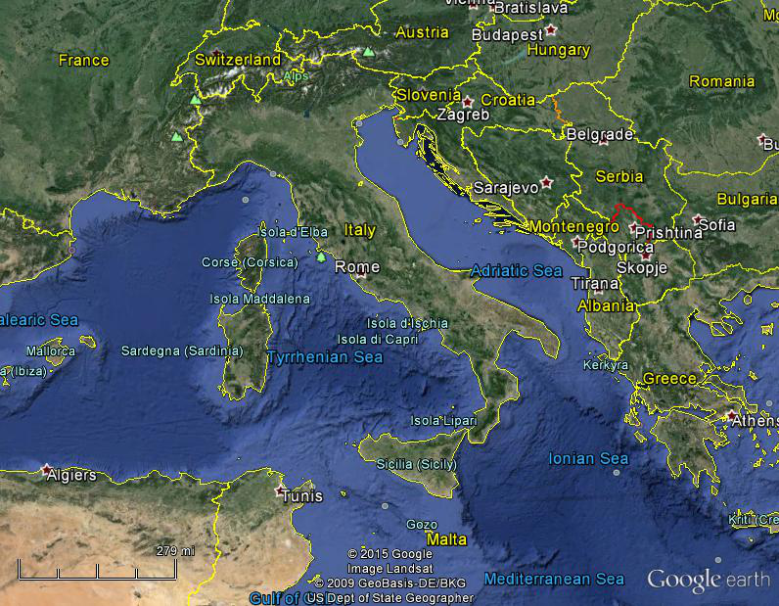
Italy, and her current neighbors . . .
Notes:
8

Slide 9
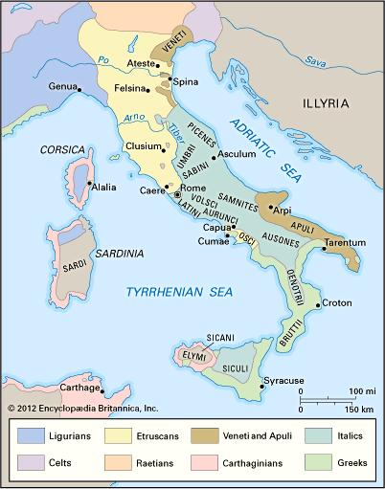
ancient Italic peoples:
Distribution of peoples of ancient Italy ca. 500 B.C.
©Encyclopædia Britannica, Inc.
https://www.britannica.com/topic/history-of-Italy
Notes:
9

Slide 10
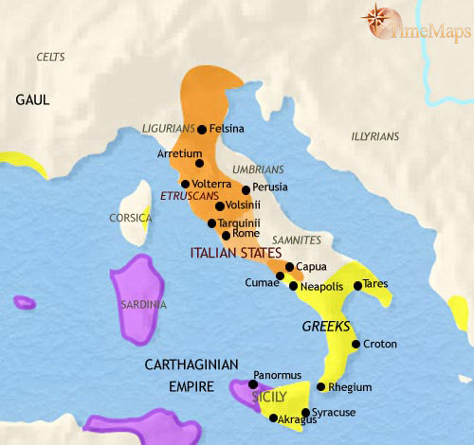
500 B.C.
http://www.timemaps.com/history/italy-500bc
Notes:
10

Slide 11
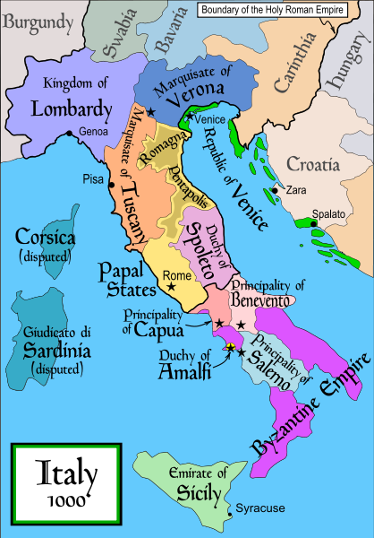
1000
Italy was divided for centuries into small kingdoms and city-states
http://en.wikipedia.org/wiki/Italy
Notes:
11

Slide 12
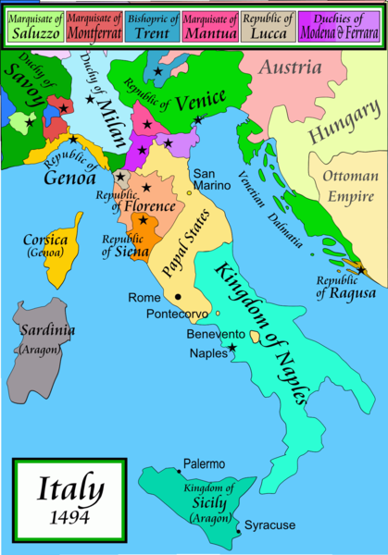
1494
Italy was divided for centuries into small kingdoms and city-states
http://en.wikipedia.org/wiki/Italy
Notes:
12

Slide 13
1494
Italy was divided for centuries into small kingdoms and city-states
http://en.wikipedia.org/wiki/Italy
Notes:
13

Slide 14
In 1494 Christopher Columbus from Genoa went on his second voyage to the New World
Italy was divided for centuries into small kingdoms and city-states
http://en.wikipedia.org/wiki/Italy
Notes:
14

Slide 15
In 1494 Christopher Columbus from Genoa is on his second voyage to the New World
Christopher Columbus was a sugar merchant from Genoa, married to the daughter of a sugar merchant from Madeira, Felipa Perestrello.
Columbus was looking for a way around Venice’s monopoly on things like sugar. . . .
Italy was divided for centuries into small kingdoms and city-states
http://en.wikipedia.org/wiki/Italy
Notes:
15

Slide 16
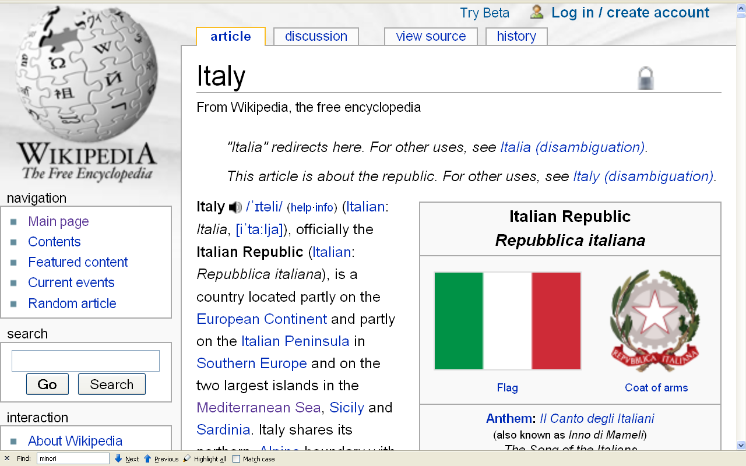
Formation of Italy
Unification —17 March 1861
Republic —2 June 1946
http://en.wikipedia.org/wiki/Italy
Notes:
16

Slide 17
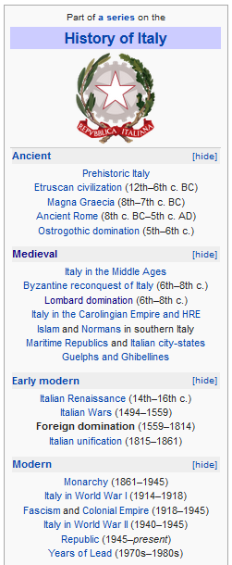
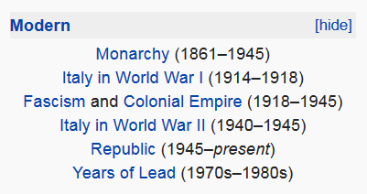
http://en.wikipedia.org/wiki/History_of_Italy_during_foreign_domination_and_the_unification
Notes:
17

Slide 18
http://en.wikipedia.org/wiki/History_of_Italy_during_foreign_domination_and_the_unification
Notes:
18

Slide 19
Formation of Italy
Unification —17 March 1861
Republic —2 June 1946
http://en.wikipedia.org/wiki/Italy
Notes:
19

Slide 20
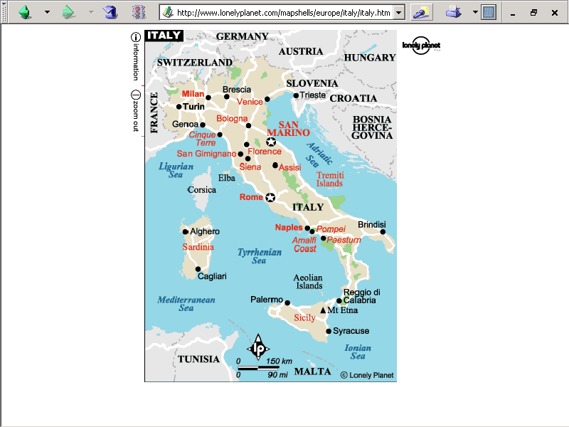
population size
61,021,855 (2023 est.)
https://www.worldometers.info/world-population/italy-population/

Slide 21
Note
Sicily

Slide 22
Note
Sardinia

Slide 23
Note
Kingdom of Tavolara
(unrecognized micronation)
https://en.wikipedia.org/wiki/Kingdom_of_Tavolara

Slide 24
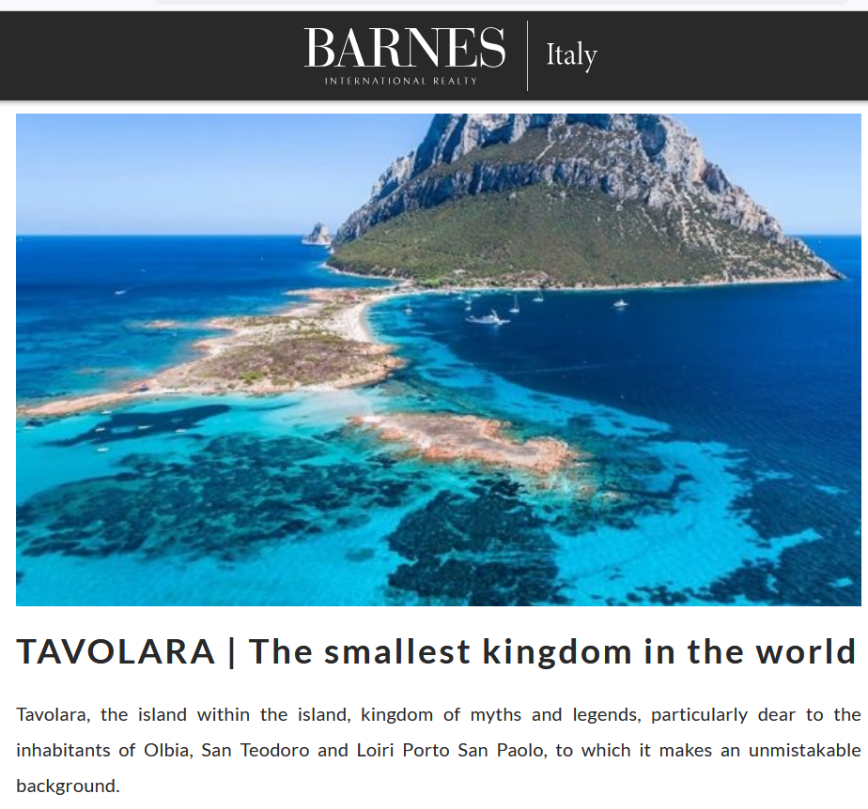
https://barnes-italy.com/tavolara-the-smallest-kingdom-in-the-world/
Notes:
24

Slide 25
Note
Corsica
(French)
Notes:
25

Slide 26
Principality of Seborga
(unrecognized micronation)
Note
https://en.wikipedia.org/wiki/Seborga
Notes:
26

Slide 27

Notes:
27

Slide 28
Note
Rome

Slide 29
The Holy See
(The Vatican)
an independent country
Note
Notes:
29

Slide 30
Note
Notes:
30

Slide 31
Note
The Most Serene Republic
of San Marino
an independent country
Notes:
31

Slide 32
Basic Demographics
CAN BE BORING . . .
BUT . . .

Slide 33
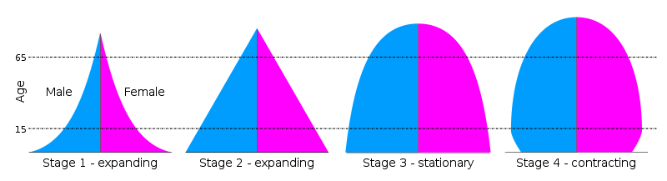
demographics are necessary
to get some long-term idea
of where a country has been and
where it is headed . . .
Notes:
33

Slide 34
demographics are necessary
to get some long-term idea
of where a country has been and
where it is headed . . .
for e.g., . . .
Notes:
34

Slide 35
Demographics
total fertility rate in Italy:
1.24 children born / 1,000 woman
(2023 est.)
country comparison to the world: 221
10.7 deaths / 1,000 population
(2021 est.)
country comparison to the world: 24
net migration rate:
3.2 migrant(s) / 1,000 population
(2021 est.)
country comparison to the world: 34
CIA World Factbook
https://www.cia.gov/the-world-factbook/countries/italy/

Slide 36
So what?

Slide 37
Demographics
total fertility rate in Italy:
1.24 children born / 1,000 woman
(2023 est.)
country comparison to the world: 221
10.7 deaths / 1,000 population
(2021 est.)
country comparison to the world: 24
net migration rate:
3.2 migrant(s) / 1,000 population
(2021 est.)
country comparison to the world: 34
this is one of
the lowest rates in the world
CIA World Factbook
https://www.cia.gov/the-world-factbook/countries/italy/

Slide 38



Demographics
Just two years earlier . . .
total fertility rate in Italy:
1.47 children born / 1,000 woman
(2021 est.)
country comparison to the world: 209
1.24
net migration rate:
3.2 migrant(s) / 1,000 population
(2021 est.)
country comparison to the world: 34
it was one of the lowest rates
in the world even before COVID
and it is declining rapidly
CIA World Factbook
https://www.cia.gov/the-world-factbook/countries/italy/

Slide 39

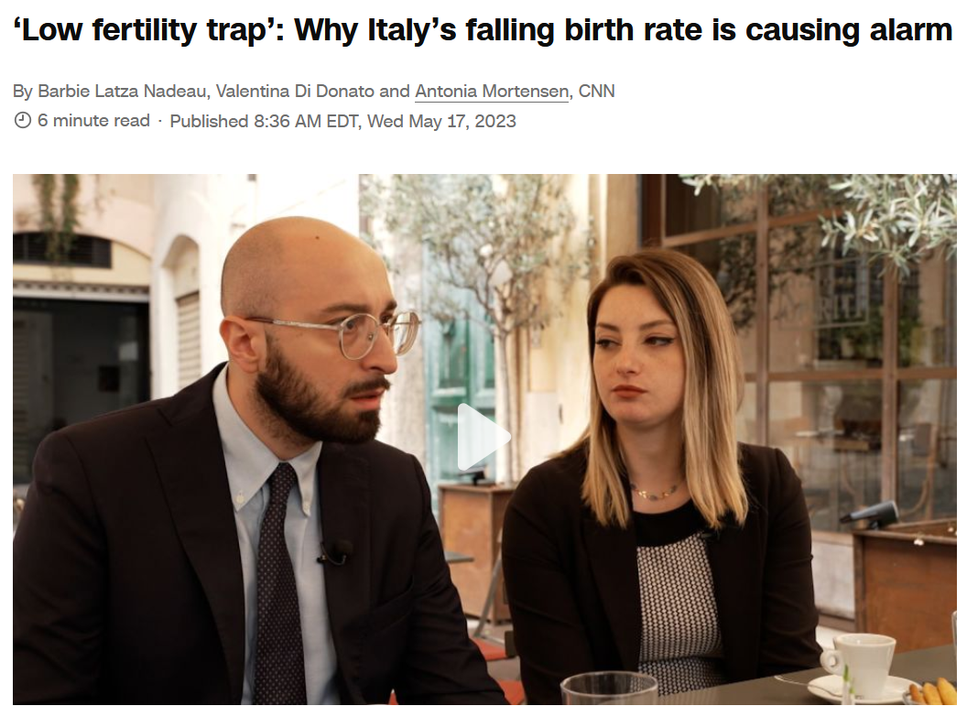
17 May 2023
10.7 deaths / 1,000 population
(2021 est.)
country comparison to the world: 24
net migration rate:
3.2 migrant(s) / 1,000 population
(2021 est.)
country comparison to the world: 34
https://www.cnn.com/2023/05/17/europe/italy-record-low-birth-rate-intl-cmd

Slide 40


TheStreet
10.7 deaths / 1,000 population
(2021 est.)
country comparison to the world: 24
net migration rate:
3.2 migrant(s) / 1,000 population
(2021 est.)
country comparison to the world: 34
https://www.thestreet.com/technology/elon-musk-is-very-worried-about-italy

Slide 41
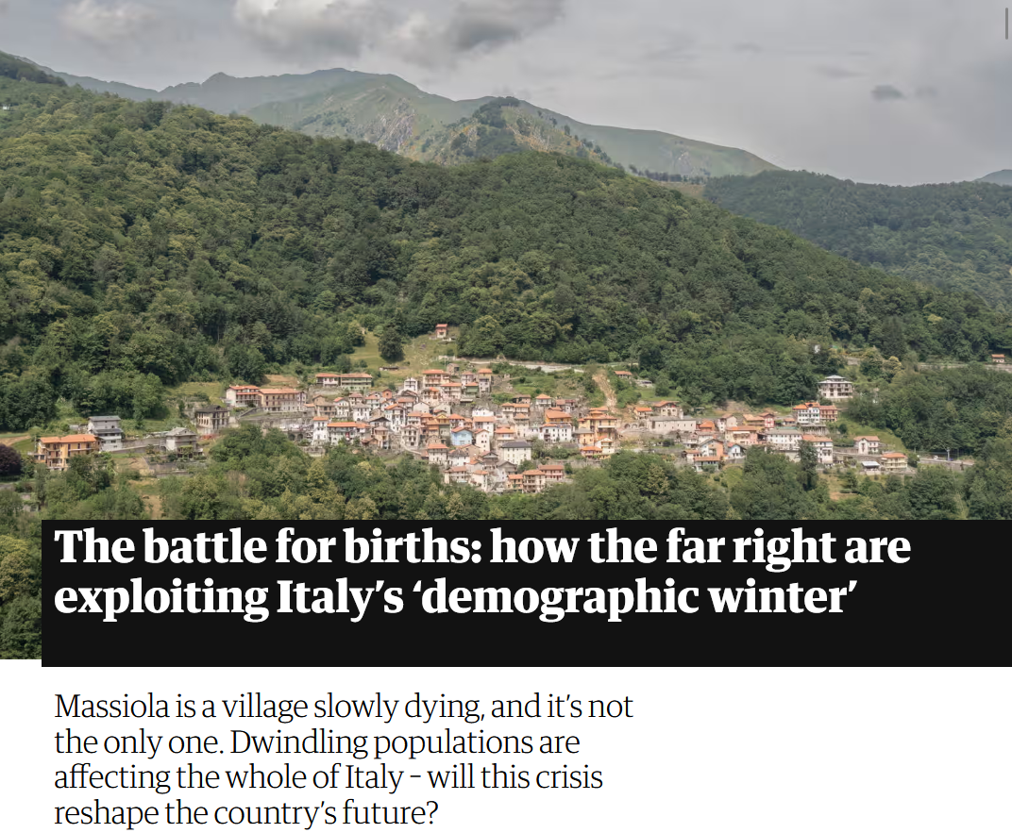

7 October 2023
net migration rate:
3.2 migrant(s) / 1,000 population
(2021 est.)
country comparison to the world: 34
https://www.theguardian.com/world/2023/oct/07/italy-births-far-right-demographic-winter?CMP=Share_iOSApp_Other

Slide 42
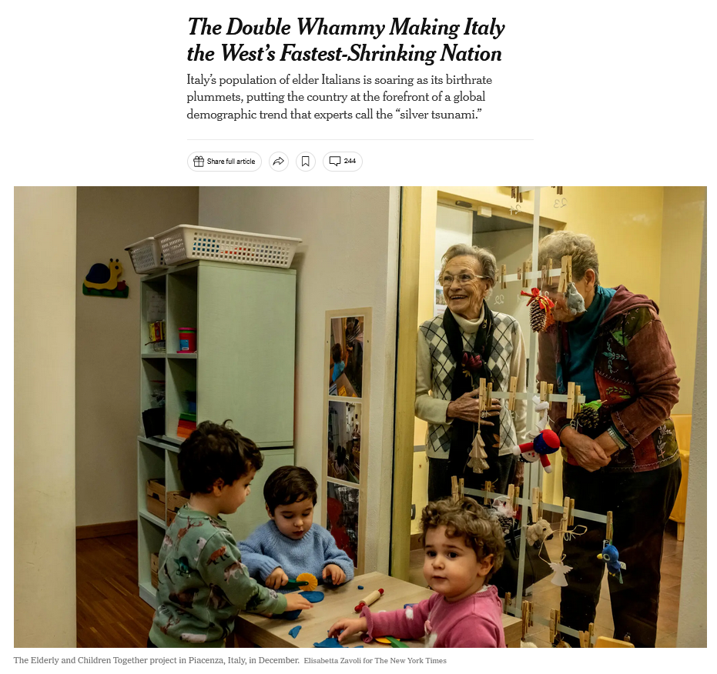
30 January 2023
net migration rate:
3.2 migrant(s) / 1,000 population
(2021 est.)
country comparison to the world: 34
https://www.nytimes.com/2023/01/30/world/europe/italy-birthrate.html?smid=em-share

Slide 43
Demographics
total fertility rate in Italy:
1.24 children born / 1,000 woman
(2023 est.)
country comparison to the world: 221
10.7 deaths / 1,000 population
(2021 est.)
country comparison to the world: 24
That means not enough children are being born to sustain the population . . .
CIA World Factbook
https://www.cia.gov/the-world-factbook/countries/italy/

Slide 44

Demographics
Population: 61,021,855
(2023 est.)
country comparison to the world: 24
Population growth rate: -0.11%
(2023 est.)
country comparison to the world: 202
65 years and over: 23.31%
(2023 est.)
CIA World Factbook
https://www.cia.gov/the-world-factbook/countris/italy/

Slide 45
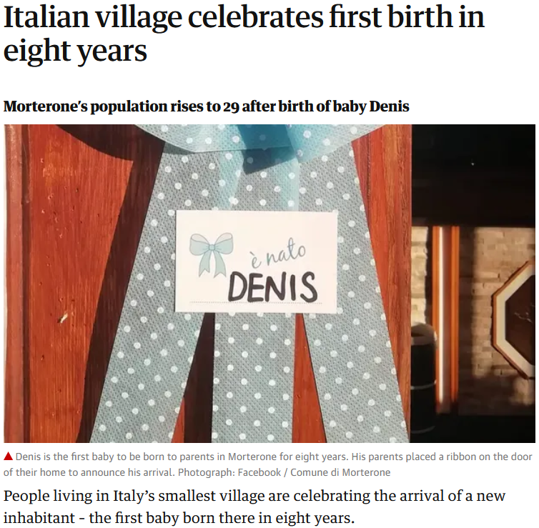
21 Jul 2020
https://www.theguardian.com/world/2020/jul/21/italian-village-morterone-celebrates-first-birth-in-eight-years?CMP=Share_iOSApp_Other

Slide 46
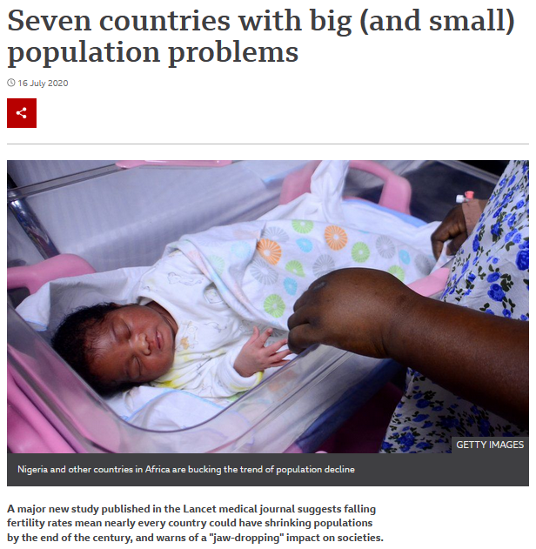

16 Jul 2020
Including Italy
https://www.bbc.com/news/world-53424726

Slide 47
Demographics
total fertility rate in Italy:
1.24 children born / 1,000 woman
(2023 est.)
country comparison to the world: 221
an overall total fertility rate of 2.1 is needed for the population in an area
to remain stable,
assuming no immigration or emigration occurs . . .
10.7 deaths / 1,000 population
(2021 est.)
country comparison to the world: 24
CIA World Factbook
https://www.cia.gov/the-world-factbook/countries/italy/

Slide 48
Demographics
total fertility rate in Italy:
1.24 children born / 1,000 woman
(2023 est.)
country comparison to the world: 209
The low birth rate is a huge
slow-moving crisis . . .
and unless something
is eventually done,
Italy as we know it will disappear . . .
10.7 deaths / 1,000 population
(2021 est.)
country comparison to the world: 24
net migration rate:
3.2 migrant(s) / 1,000 population
(2021 est.)
country comparison to the world: 34
CIA World Factbook
https://www.cia.gov/the-world-factbook/countries/italy/

Slide 49



Martin J. Gannon and Rajnandini Pillai
Understanding Global Cultures
“Although Italian culture is justifiably renowned, it is in danger of extinction, as are the cultures of some other developed nations. It has one of the lowest fertility rate among nations: 1.19 children per woman. After Sweden, Italy has the oldest population among nations, with 16.1% of its population over 65.”
1.24
22.1
[23.31%]
[2023 est.]
www.d.umn.edu/cla/faculty/troufs/anth1095/index.html#Gannon

Slide 50
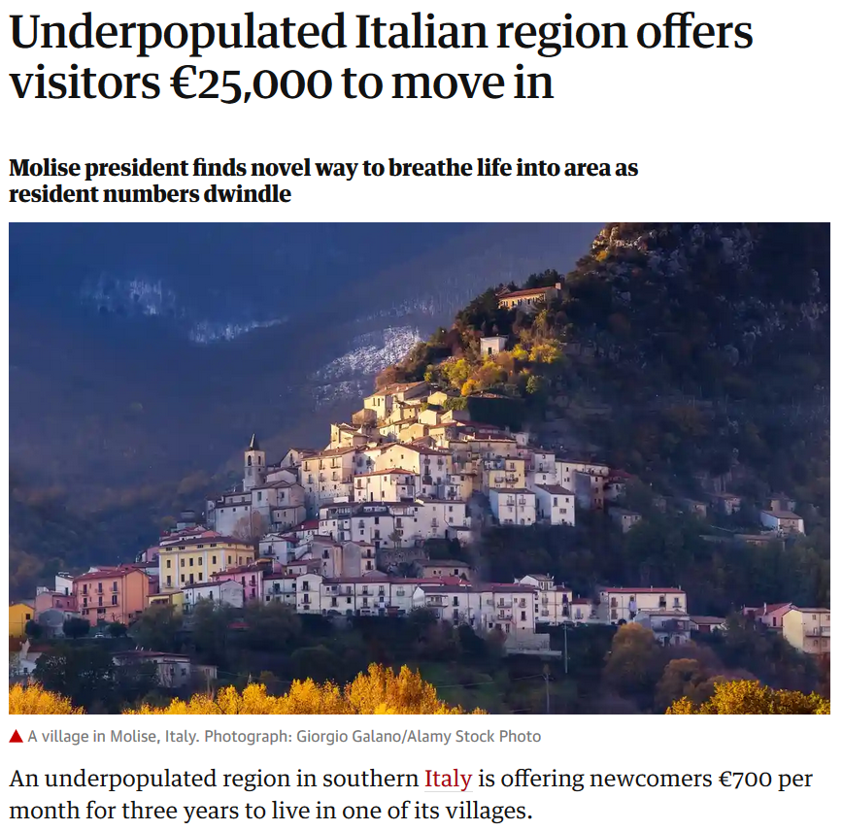
Wed 11 Sep 2019
https://www.theguardian.com/world/2019/sep/11/underpopulated-italian-region-molise?CMP=Share_iOSApp_Other

Slide 51
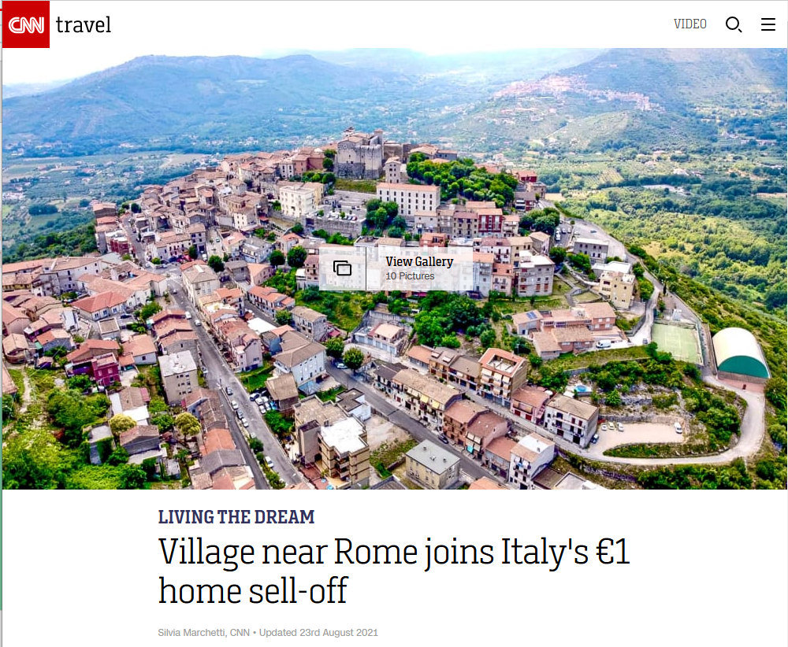





$1.18 USD
23 August 2021
http://edition.cnn.com/travel/article/italy-one-euro-homes-maenza-rome/index.html

Slide 52
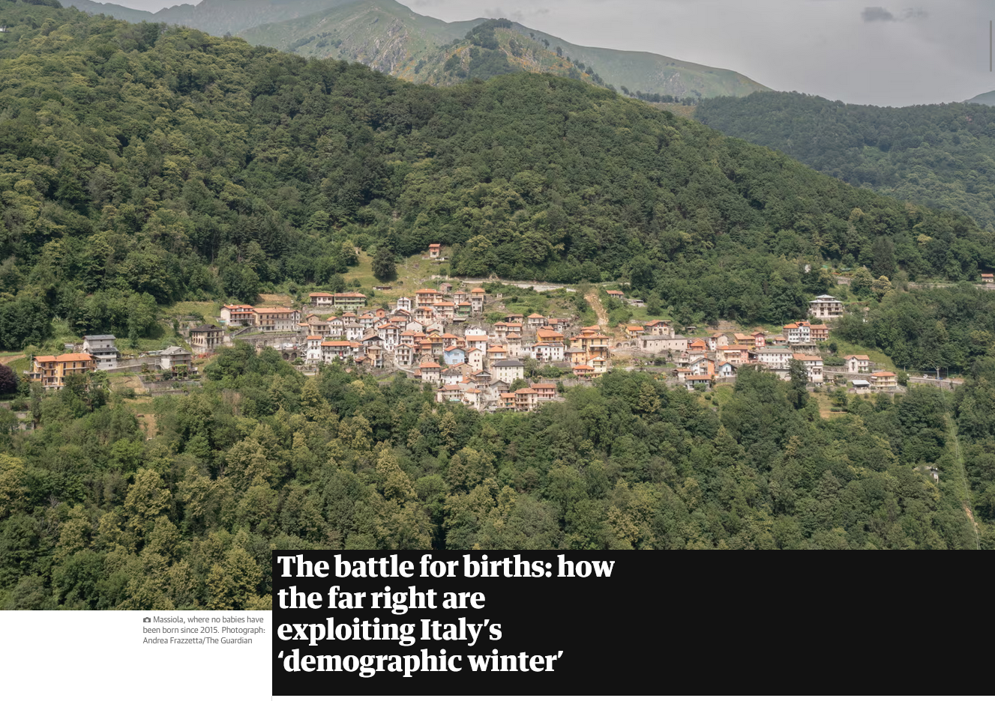
23 August 2021
https://www.theguardian.com/world/2023/oct/07/italy-births-far-right-demographic-winter?CMP=Share_iOSApp_Other

Slide 53
Demographics
total fertility rate in Italy:
1.24 children born / 1,000 woman
(2023 est.)
country comparison to the world: 209
and in the meantime, there will be big problems trying to support
an aging population . . .
10.7 deaths / 1,000 population
(2021 est.)
country comparison to the world: 24
net migration rate:
3.2 migrant(s) / 1,000 population
(2021 est.)
country comparison to the world: 34
CIA World Factbook
https://www.cia.gov/the-world-factbook/countries/italy/

Slide 54
Demographics
Population: 61,021,855
(2023 est.)
country comparison to the world: 24
Population growth rate: -0.11%
(2023 est.)
country comparison to the world: 202
65 years and over: 23.31%
(2023 est.)
CIA World Factbook
https://www.cia.gov/the-world-factbook/countries/italy/

Slide 55
This is detailed in Betsy Krause’s excellent book
Elizabeth L. Krause
A Crisis of Births:
Population Politics and Family-Making in Italy
Belmont, CA: Thompson Wadsworth, 2005.
http://www.d.umn.edu/cla/faculty/troufs/anth3635/cetexts.html#CrisisofBirths

Slide 56
Here’s how that works . . .

Slide 57
Population change =
births minus deaths
plus net migration
(immigration minus emigration)

Slide 58
If you like formulas, here’s the formula:
∆p = (b-d) + (i-e)
∆p = population change
b = births
d = deaths
I = immigration
e = emigration

Slide 59
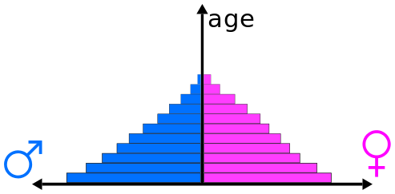
Population Pyramids
reflect population composition and change
https://en.wikipedia.org/wiki/Population_pyramid
Notes:
59

Slide 60
Population Pyramids for 4 Stages of the Demographic Transition Model
“. . . the transition from high birth and death rates to low birth and death rates as a country develops from a pre-industrial to an industrialized economic system”
population is expanding
https://en.wikipedia.org/wiki/Population_pyramid
https://en.wikipedia.org/wiki/Demographic_transition
Notes:
60

Slide 61
Population Pyramids for 4 Stages of the Demographic Transition Model
“. . . the transition from high birth and death rates to low birth and death rates as a country develops from a pre-industrial to an industrialized economic system”
population is expanding
https://en.wikipedia.org/wiki/Population_pyramid
https://en.wikipedia.org/wiki/Demographic_transition
Notes:
61

Slide 62
Population Pyramids for 4 Stages of the Demographic Transition Model
“. . . the transition from high birth and death rates to low birth and death rates as a country develops from a pre-industrial to an industrialized economic system”
population is stationary
https://en.wikipedia.org/wiki/Population_pyramid
https://en.wikipedia.org/wiki/Demographic_transition
Notes:
62

Slide 63
Population Pyramids for 4 Stages of the Demographic Transition Model
“. . . the transition from high birth and death rates to low birth and death rates as a country develops from a pre-industrial to an industrialized economic system”
population is contracting
https://en.wikipedia.org/wiki/Population_pyramid
https://en.wikipedia.org/wiki/Demographic_transition
Notes:
63

Slide 64
a major problem occurs with the large and growing
“dependent population”
(those not in the work force who must be supported by those in the work force)

Slide 65
“dependent population” =
the number of people that have to be supported by those of working age
Usually, it’s
(the population aged 0-14 + those 65 and over)
divided by
(the total population 15-64)

Slide 66
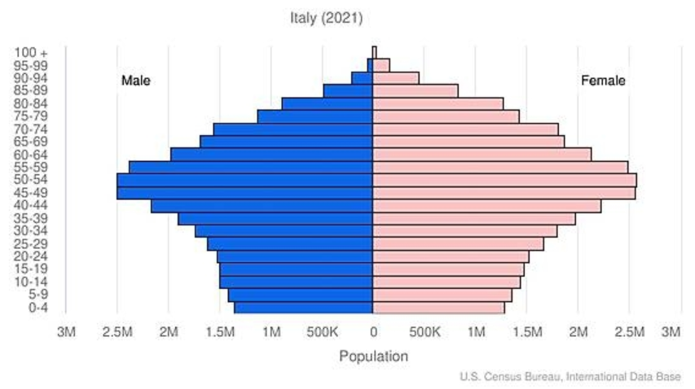
Population Pyramid
“dependent population”
“dependent population”
CIA World Factbook
https://www.cia.gov/the-world-factbook/countries/italy/
Notes:
66

Slide 67
Population Pyramid
People who have to support the “dependent population”
male
female
CIA World Factbook
https://www.cia.gov/the-world-factbook/countries/italy/
Notes:
67

Slide 68
Population Pyramid
Every 5 years
the lines move up one level
CIA World Factbook
https://www.cia.gov/the-world-factbook/countries/italy/
Notes:
68

Slide 69

Population Pyramid
And the “bulge”,
combined with the shrinking base groups, could be a big problem in the future as it moves up
CIA World Factbook
https://www.cia.gov/the-world-factbook/countries/italy/
Notes:
69

Slide 70
Population Pyramid
And the “bulge”,
combined with the shrinking base groups, could be a big problem in the future as it moves up
CIA World Factbook
https://www.cia.gov/the-world-factbook/countries/italy/
Notes:
70

Slide 71
Population Pyramid
And the “bulge”,
combined with the shrinking base groups, could be a big problem in the future as it moves up
CIA World Factbook
https://www.cia.gov/the-world-factbook/countries/italy/
Notes:
71

Slide 72
Population Pyramid
And the “bulge”,
combined with the shrinking base groups, could be a big problem in the future as it moves up
CIA World Factbook
https://www.cia.gov/the-world-factbook/countries/italy/
Notes:
72

Slide 73
Population Pyramid
And the “bulge”,
combined with the shrinking base groups, could be a big problem in the future as it moves up
CIA World Factbook
https://www.cia.gov/the-world-factbook/countries/italy/
Notes:
73

Slide 74
Population Pyramid
And the “bulge”,
combined with the shrinking base groups, could be a big problem in the future as it moves up
CIA World Factbook
https://www.cia.gov/the-world-factbook/countries/italy/
Notes:
74

Slide 75
Population Pyramid
And the “bulge”,
combined with the shrinking base groups, could be a big problem in the future as it moves up
CIA World Factbook
https://www.cia.gov/the-world-factbook/countries/italy/
Notes:
75

Slide 76
Population Pyramid
And the “bulge”,
combined with the shrinking base groups, could be a big problem in the future as it moves up
CIA World Factbook
https://www.cia.gov/the-world-factbook/countries/italy/
Notes:
76

Slide 77
Population Pyramid
This bulge is a big problem
because it means that there
will eventually be lots of old people
(not working)
and fewer people who
are in the workforce to support them
combined with children
not in the workforce
for the workers to also support
CIA World Factbook
https://www.cia.gov/library/publications/the-world-factbook/geos/it.html
Notes:
77

Slide 78

so Italy has lots of seniors
(not in the work force) . . .

Slide 79
so Italy has lots of seniors
(not in the work force) . . .
and their younger population is contracting (therefore eventually fewer in the work will be forced to support those who are not) . . .

Slide 80
that is to say Italy has a large and growing
“dependent population”
(those not in the work force who must be supported by those in the work force)

Slide 81
to further complicate things, looking at the problem regionally . . .
and that causes further problems for the southern region,
the poorer part . . .

Slide 82
young people entering into the workforce want to go north (to the richer areas, or to another country) to find work . . .
and that causes further problems for the southern region,
the poorer part . . .

Slide 83
young people entering into the workforce want to go north (to the richer areas, or to another country) to find work . . .
and that causes further problems for the southern region,
the poorer part . . .

Slide 84
young people entering into the workforce want to go north (to the richer areas, or to another country) to find work . . .
and it causes problems for families because Italian families generally do not like their young to leave the area of their family home . . .

Slide 85
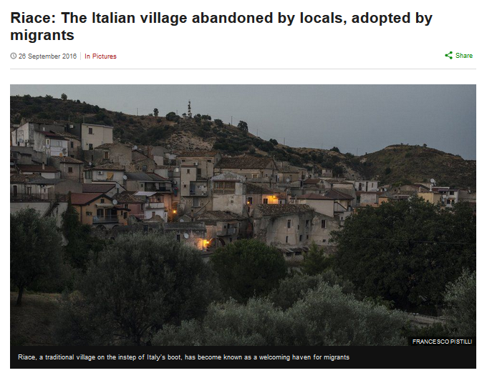
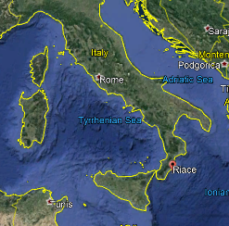
http://www.bbc.com/news/in-pictures-37289713

Slide 86
and Italians often live long lives . . .
which makes the economics of the demographic situation worse . . .

Slide 87
Demographics
Population: 61,021,855
(2023 est.)
country comparison to the world: 24
Population growth rate: -0.11%
(2023 est.)
country comparison to the world: 202
65 years and over: 23.31%
(2023 est.)
CIA World Factbook
https://www.cia.gov/the-world-factbook/countries/italy/

Slide 88
Demographics
urban population:
72% of total population
(2023)
rate of urbanization: 0.27% annual rate of change
(2020-2025 est.)
Infant mortality rate:
total: 3.1 deaths/1,000 live births
(2023 est.)
country comparison to the world: 210
Life expectancy at birth:
total population: 82.8 years
(2023 est.)
country comparison to the world: 19
CIA World Factbook
https://www.cia.gov/the-world-factbook/countries/italy/

Slide 89
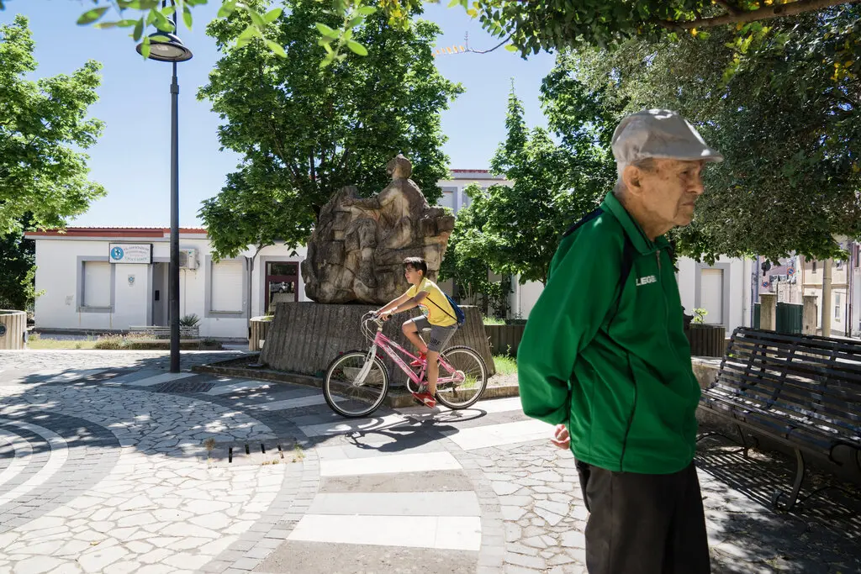
13 July 2022
Who’s the Oldest of Them All?
Two towns in Sardinia battle for the distinction of having the longest-living residents. One has the imprimatur of Guinness World Records.
https://www.nytimes.com/2022/07/13/world/europe/italy-sardinia-perdasdefogu-seulo-longevity.html?smid=em-share

Slide 90
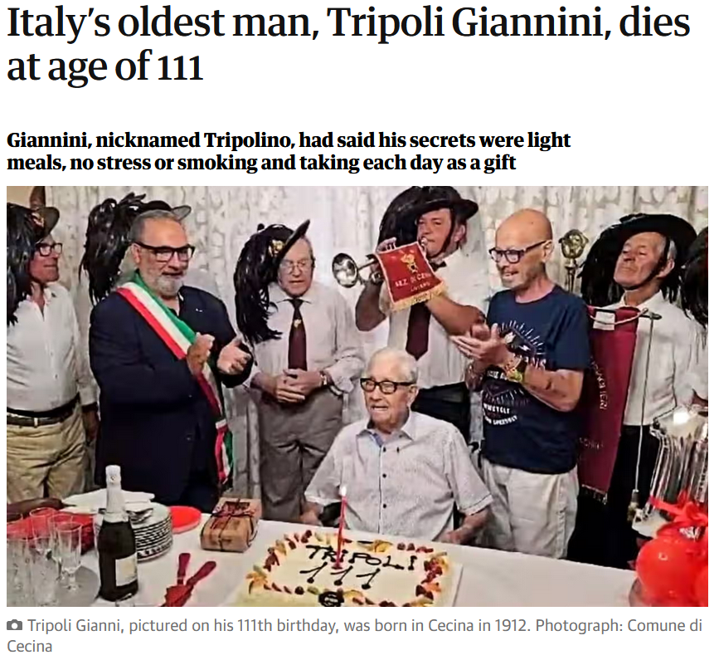
1 January 2024
https://www.theguardian.com/world/2024/jan/01/italys-oldest-man-tripoli-giannini-dies-at-age-of-111?CMP=share_btn_link

Slide 91
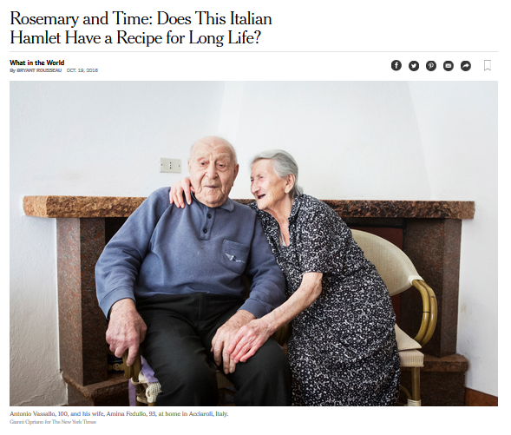
http://www.nytimes.com/2016/10/20/world/what-in-the-world/rosemary-and-time-does-this-italian-hamlet-have-a-recipe-for-long-life.html?emc=edit_ne_20161019&nl=evening-briefing&nlid=60046204&te=1
Notes:
91

Slide 92

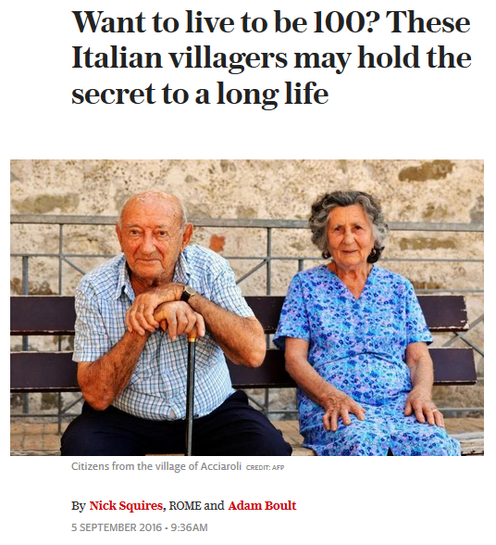
http://www.telegraph.co.uk/news/2016/09/05/want-to-live-to-be-100-these-italian-villagers-may-hold-the-secr/
Notes:
92

Slide 93
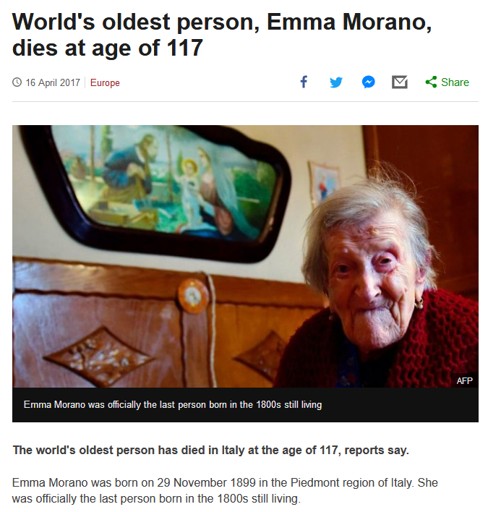
http://www.bbc.com/news/world-europe-39610937
Notes:
93

Slide 94
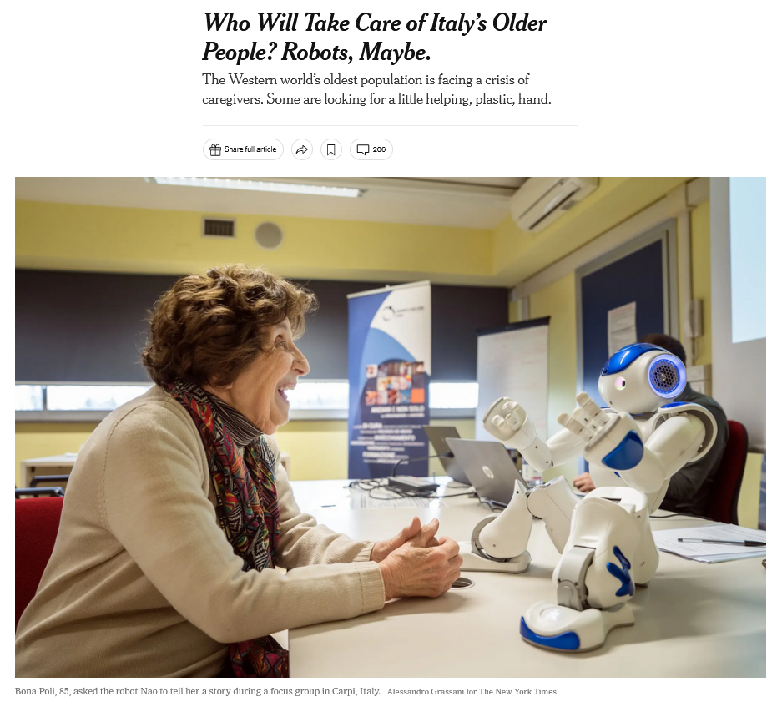
27 March 2023
https://www.nytimes.com/2023/03/25/world/europe/who-will-take-care-of-italys-older-people-robots-maybe.html?smid=nytcore-ios-share&referringSource=articleShare
Notes:
94

Slide 95
Demographics
total fertility rate:
1.24 children born / 1,000 woman
(2023 est.)
country comparison to the world: 221
11.3 deaths / 1,000 population
(2023 est.)
country comparison to the world: 24
net migration rate:
3.2 migrant(s) / 1,000 population
(2023 est.)
country comparison to the world: 39
CIA World Factbook
https://www.cia.gov/the-world-factbook/countries/italy/

Slide 96
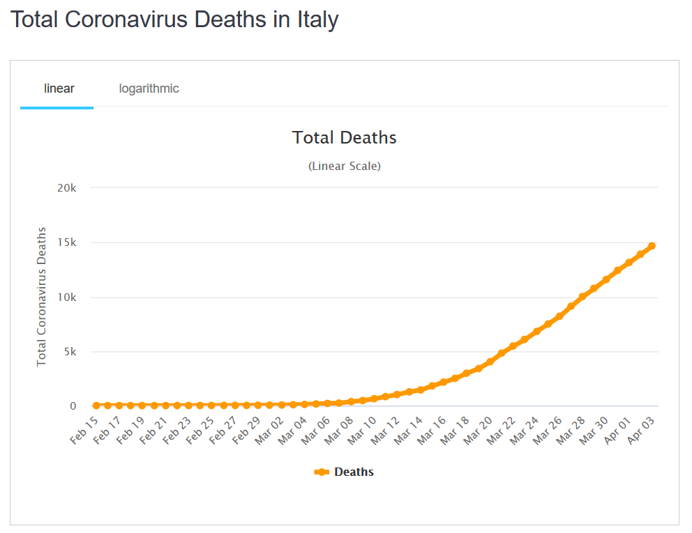
Demographics
total fertility rate:
1.47 children born / 1,000 woman
(2020 est.)
country comparison to the world: 204
death rates changed with Covid-19
(2020 est.)
10.7 deaths / 1,000 population
(2020 est.)
country comparison to the world: 48
net migration rate:
4.1 migrant(s) / 1,000 population
(2015 est.)
country comparison to the world: 29
03 April 2020
CIA World Factbook
https://www.worldometers.info/coronavirus/country/italy/

Slide 97
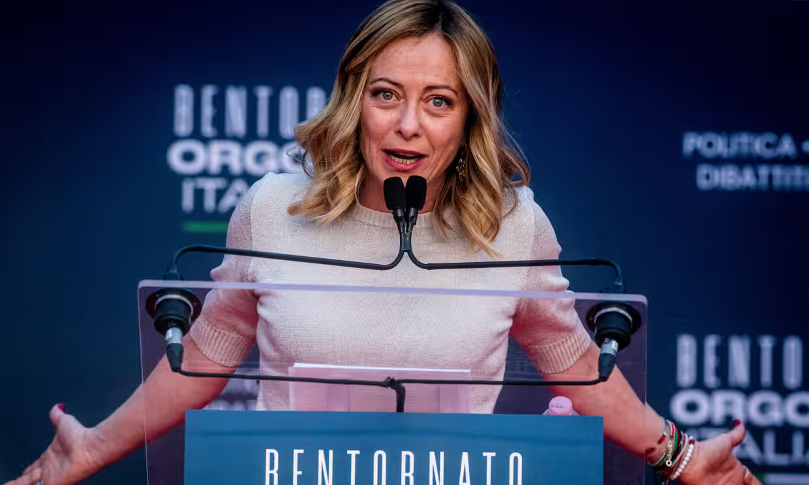
“The issue of the country’s demographic crisis is shooting up the political agenda because Giorgia Meloni’s nationalistic government sees in the birthrate – as did Benito Mussolini – a symbol of patriotic vigour.”
Meloni in Rome, 17 December 2023.
Photograph: Alessandro Serran/Shutterstock

Slide 98
What else?

Slide 99
Population Pyramid
And all of that also means both their labor force and markets are shrinking over time . . . unless the pattern changes
(which is might with Covid-19)
CIA World Factbook
https://www.cia.gov/the-world-factbook/countries/italy/
Notes:
99

Slide 100
Population Pyramid
And all of that also means both their labor force and markets are shrinking over time . . . unless the pattern changes
(which is might with Covid-19)
CIA World Factbook
https://www.cia.gov/the-world-factbook/countries/italy/
Notes:
100

Slide 101
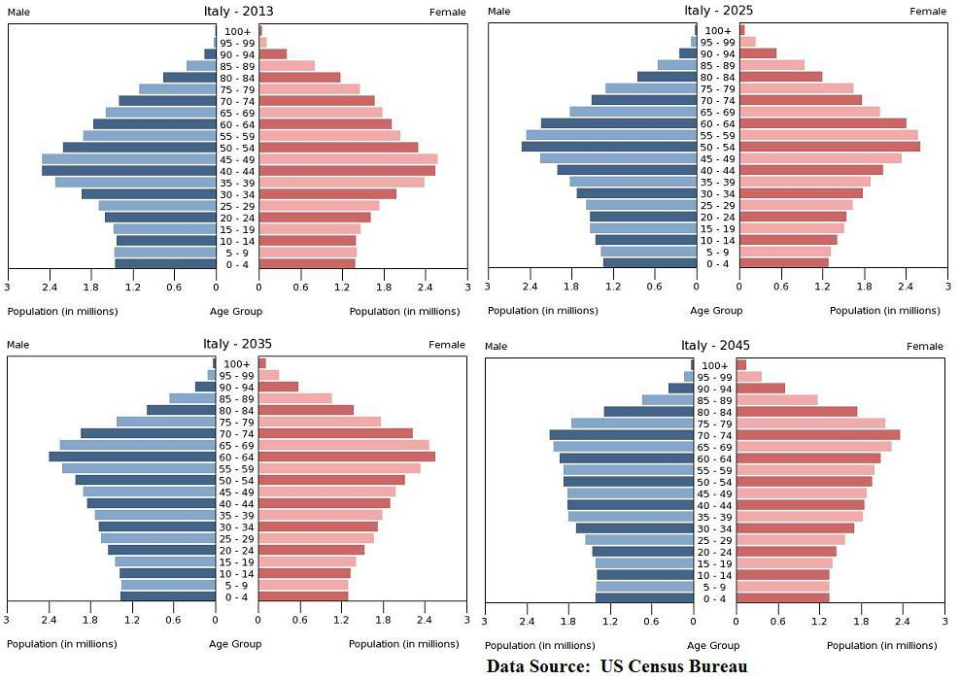






Italy Faces Ugly Future Without Reforms, Eurozone Exit -- Jake Huneycutt, Huneycutt Capital + Research
http://seekingalpha.com/article/1246651-italy-faces-ugly-future-without-reforms-eurozone-exit
Notes:
101

Slide 102
One solution to the demographic problem is to bring in outsiders (immigration) . . .
BUT . . .

Slide 103
One solution to the demographic problem is to bring in outsiders (immigration) . . .
BUT . . .

Slide 104
Population Pyramid
they can import people for the work force, but they only want certain kinds of people
(basically skilled, who are not immigrants of the boats from Africa or the Near East, or from Afghanistan)
CIA World Factbook
https://www.cia.gov/the-world-factbook/countries/italy/
Notes:
104

Slide 105
Population Pyramid
they can import people for the work force, but they only want certain kinds of people
(basically skilled, who are not immigrants of the boats from Africa or the Near East, or from Afghanistan)
CIA World Factbook
https://www.cia.gov/the-world-factbook/countries/italy/
Notes:
105

Slide 106
And the migration picture has been rapidly changing since 2015, with Italy, Greece, and Hungary under
“unprecedented pressure”
http://en.wikipedia.org/wiki/Italy
Notes:
106

Slide 107
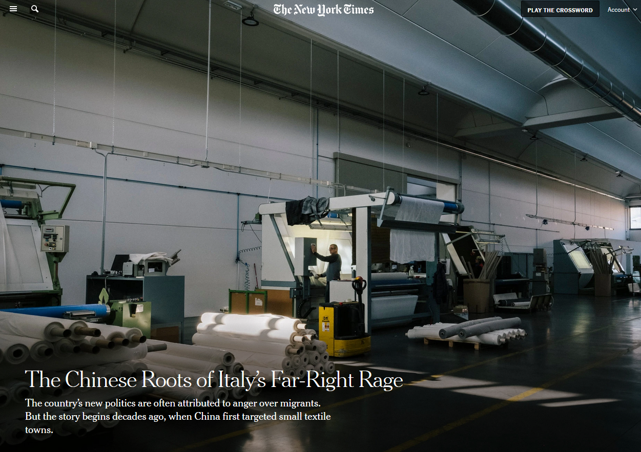
5 Dec 2019
And issues related to immigration have already severely affected Italian politics . . .
This is discussed in Betsey Krause’s book . . .
Source

Slide 108
as immigration to Italy
is high . . .
and immigration
is a hot political issue . . .

Slide 109
so although Italy really needs immigrants for its labor force,
it wants to have only certain kinds of immigrants . . .
and also limit the numbers of immigrants . . .

Slide 110
Demographics
total fertility rate:
1.24 children born / 1,000 woman
(2023 est.)
country comparison to the world: 221
11.3 deaths / 1,000 population
(2023 est.)
country comparison to the world: 24
net migration rate:
3.2 migrant(s) / 1,000 population
(2023 est.)
country comparison to the world: 39
CIA World Factbook
https://www.cia.gov/the-world-factbook/countries/italy/

Slide 111
as immigration to Italy
is high . . .
and immigration
is a hot political issue . . .

Slide 112

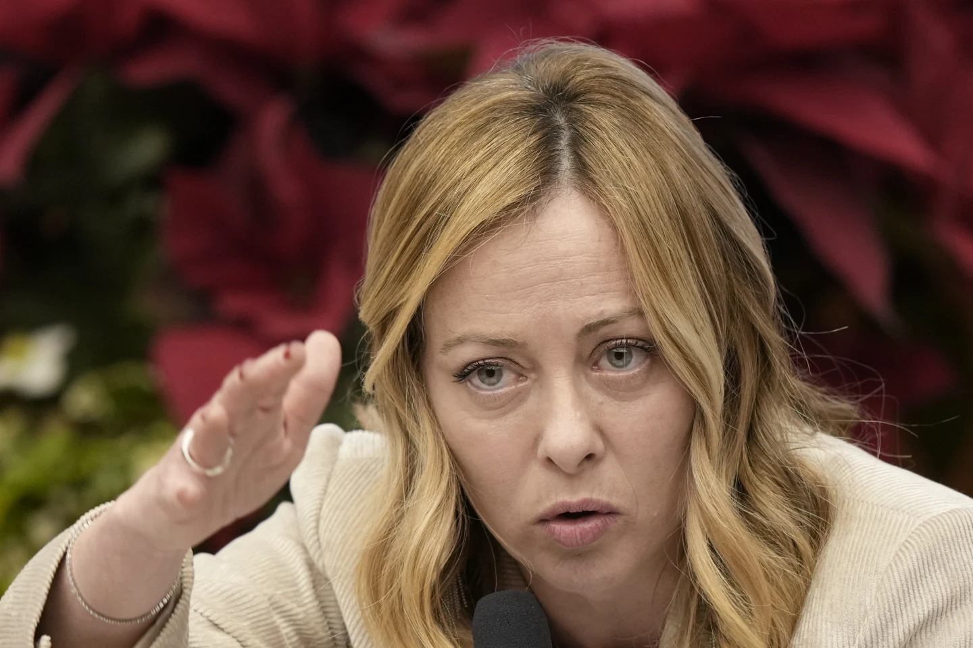
4 January 2024
Italian Premier Meloni says curbing migrant arrivals from Africa is about investment, not charity
https://apnews.com/article/italy-eu-africa-migration-strategy-energy-bfffac3ff93ad2a97aead324caa11130

Slide 113
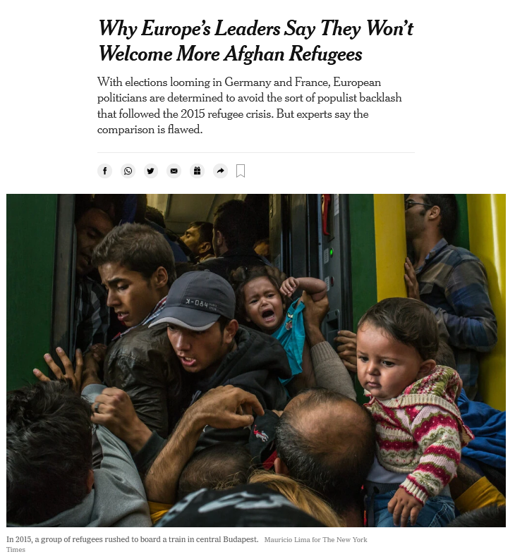
18 August 2021
https://www.nytimes.com/2021/08/18/world/europe/afghanistan-refugees-europe-migration-asylum.html

Slide 114

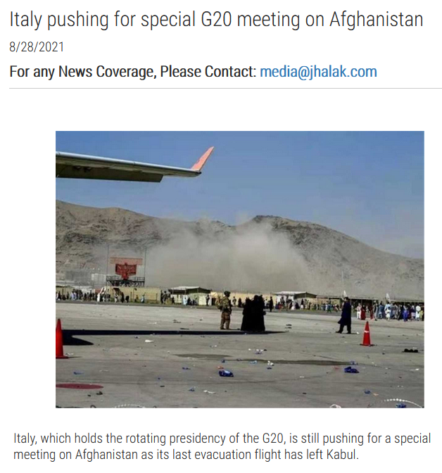
28 August 2021
https://www.jhalak.com/global-news-Italy-pushing-for-special-G20-meeting-on-Afghanistan-83161

Slide 115
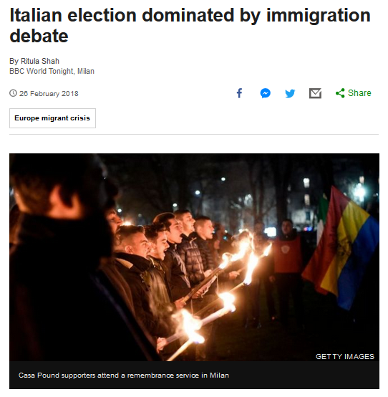
Notes:
115

Slide 116
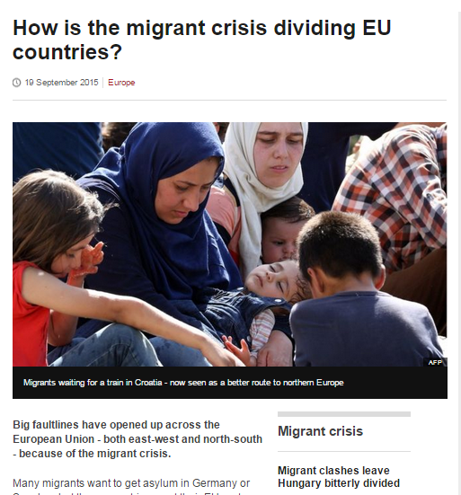

http://www.bbc.com/news/world-europe-34278886
Notes:
116

Slide 117
Martin J. Gannon and Rajnandini Pillai
Understanding Global Cultures
“Still, the population is large, and these trends are likely to reverse. Also, there are many people who want to immigrate to Italy, and in fact, there are countless numbers of illegal aliens crossing its borders daily. Thus, although Italy will probably change, its cultural base should be relatively secure, at least for the foreseeable future.”
www.d.umn.edu/cla/faculty/troufs/anth1095/index.html#Gannon

Slide 118
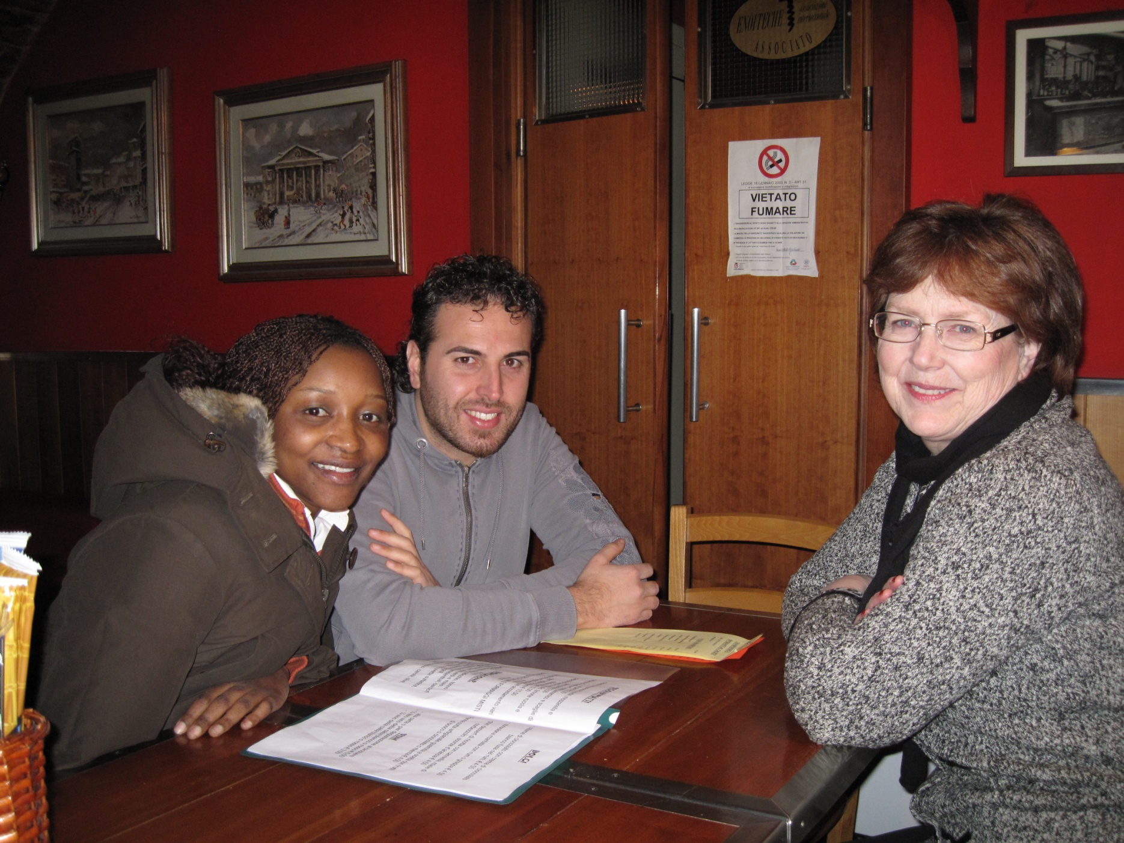

Slide 119

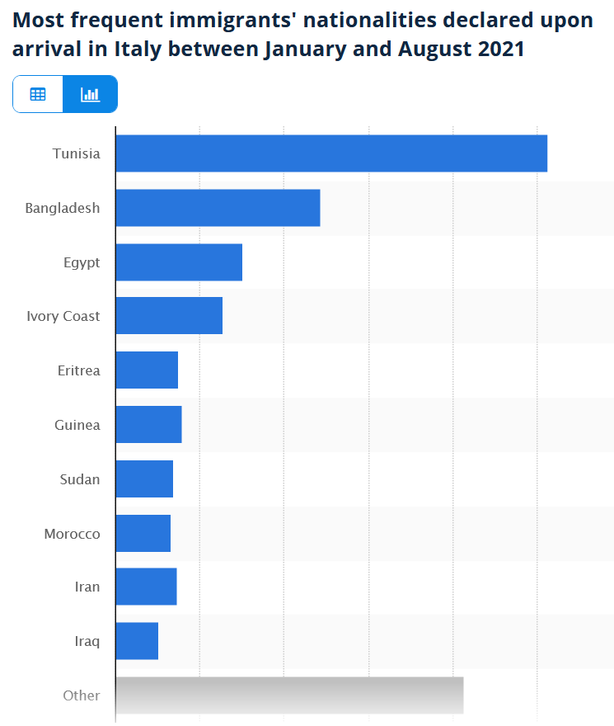
https://www.statista.com/statistics/624866/top-immigrant-nationalities-declared-upon-landing-italy/

Slide 120

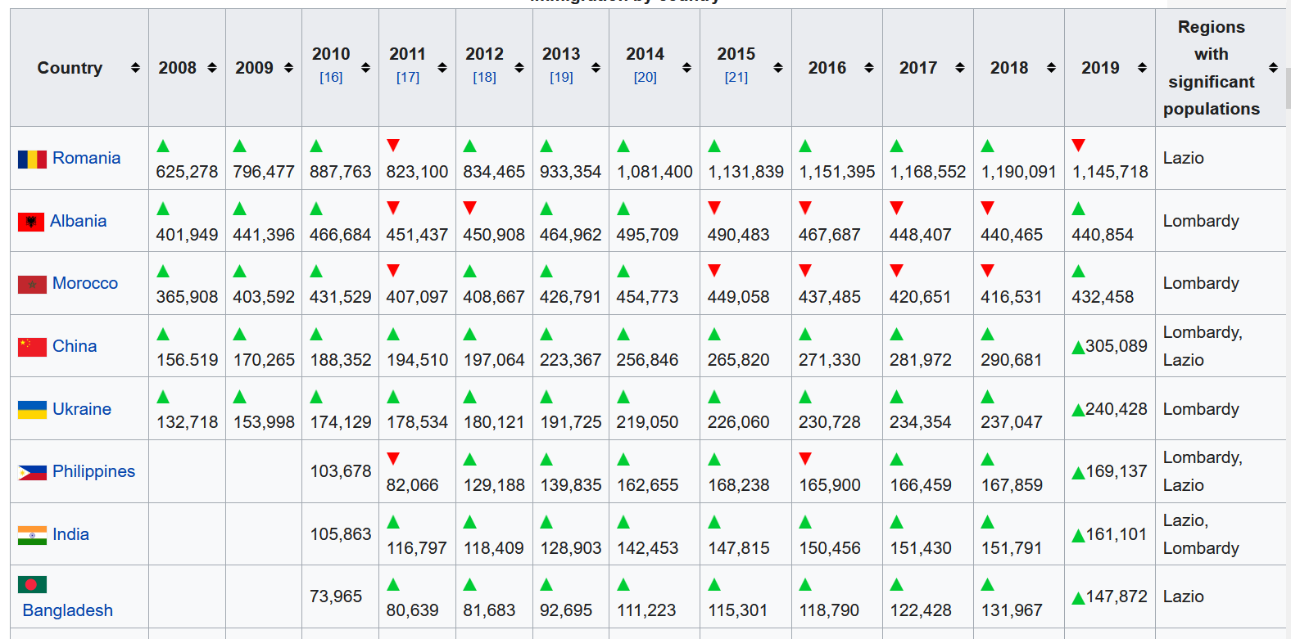
Immigration to Italy
If you are interested
in this situation,
check link below for details . . .
https://en.wikipedia.org/wiki/Immigration_to_Italy

Slide 121
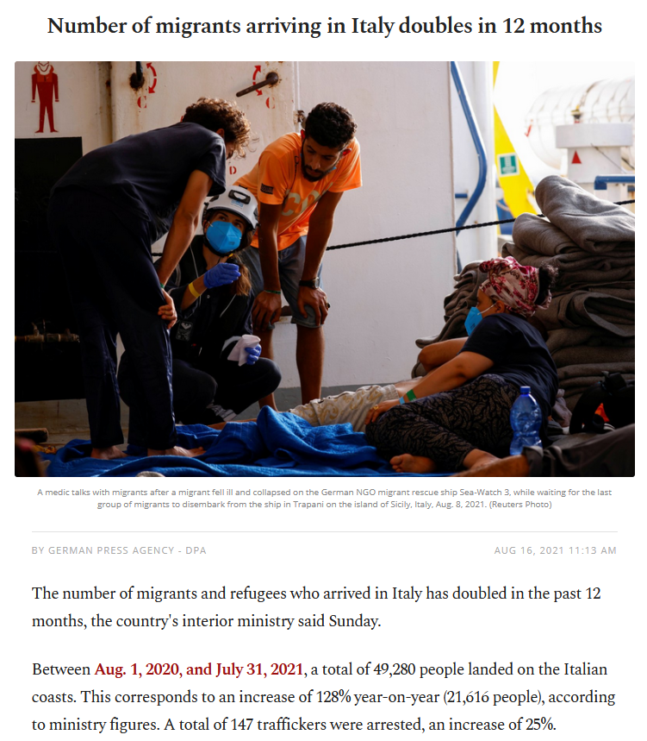
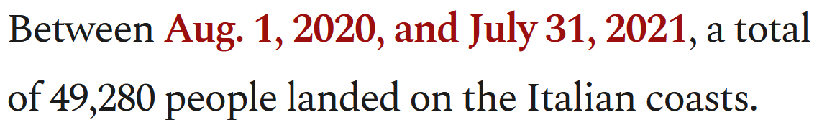


16 August 2021
https://www.dailysabah.com/world/europe/number-of-migrants-arriving-in-italy-doubles-in-12-months

Slide 122

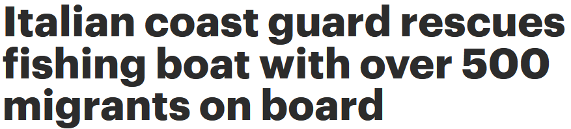
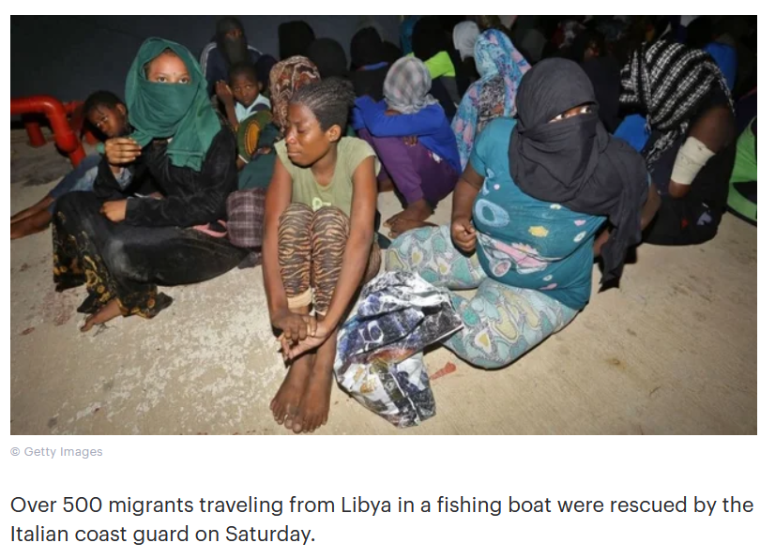
28 August 2021
https://thehill.com/policy/international/569879-italian-coast-guard-rescues-fishing-boat-with-over-500-migrants-on-board

Slide 123
Martin J. Gannon and Rajnandini Pillai
Understanding Global Cultures
“Still, the population is large, and these trends are likely to reverse. Also, there are many people who want to immigrate to Italy, and in fact, there are countless numbers of illegal aliens crossing its borders daily. Thus, although Italy will probably change, its cultural base should be relatively secure, at least for the foreseeable future.”
And they’re willing to risk dying to get there . . .
www.d.umn.edu/cla/faculty/troufs/anth1095/index.html#Gannon

Slide 124
Thousands of migrants
drown each year
trying to reach Greece or Italy . . .
http://www.bbc.com/news/world-europe-24583286

Slide 125
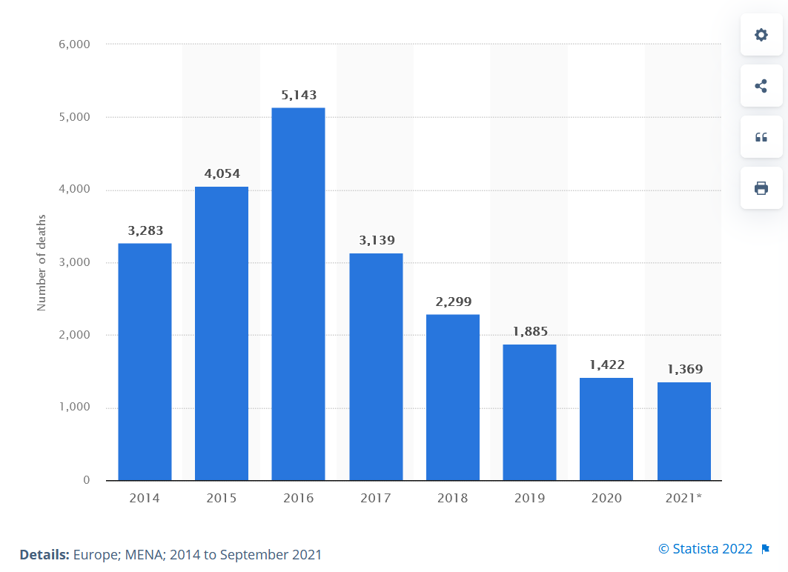
Number of recorded deaths of migrants in the Mediterranean Sea from 2014 to 2021
https://www.statista.com/statistics/1082077/deaths-of-migrants-in-the-mediterranean-sea/

Slide 126
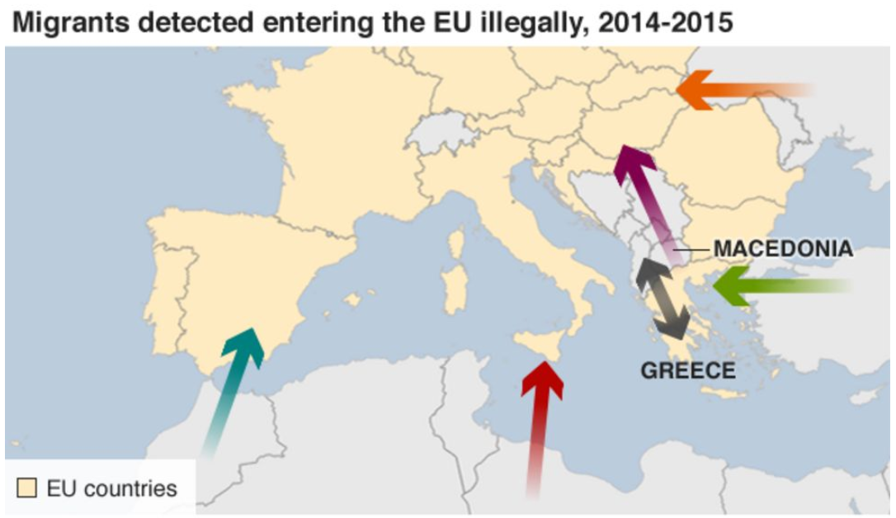
http://www.bbc.com/news/world-europe-24583286

Slide 127
and to complicate the situation still further . . .

Slide 128
Martin J. Gannon and Rajnandini Pillai
Understanding Global Cultures
“Still, the population is large, and these trends are likely to reverse. Also, there are many people who want to immigrate to Italy, and in fact, there are countless numbers of illegal aliens crossing its borders daily. Thus, although Italy will probably change, its cultural base should be relatively secure, at least for the foreseeable future.”
www.d.umn.edu/cla/faculty/troufs/anth1095/index.html#Gannon

Slide 129
Martin J. Gannon and Rajnandini Pillai
Understanding Global Cultures
“Still, the population is large, and these trends are likely to reverse. Also, there are many people who want to immigrate to Italy, and in fact, there are countless numbers of
illegal aliens crossing its borders daily. Thus, although Italy will probably change, its cultural base should be relatively secure, at least for the foreseeable future.”
www.d.umn.edu/cla/faculty/troufs/anth1095/index.html#Gannon

Slide 130

http://www.bbc.com/news/world-africa-32311358
Notes:
130

Slide 131



04 August 2021
https://www.michigansthumb.com/news/article/Italy-presses-EU-nations-to-open-ports-to-rescued-16362678.php

Slide 132


16 April 2018
http://www.bbc.com/news/world-africa-32332767

Slide 133

http://www.bbc.com/news/world-europe-24583286

Slide 134
Martin J. Gannon and Rajnandini Pillai
Understanding Global Cultures
“One final example of externalization is somewhat disturbing, in that
Italy is experiencing difficulty integrating the large number of legal and illegal immigrants
flooding into their country,
particularly those from the African nations of Morocco, Nigeria, Senegal, and Tunisia.”
www.d.umn.edu/cla/faculty/troufs/anth1095/index.html#Gannon

Slide 135
and to complicate the situation still further . . .

Slide 136
Martin J. Gannon and Rajnandini Pillai
Understanding Global Cultures
“Still, the population is large, and these trends are likely to reverse. Also, there are many people who want to immigrate to Italy, and in fact, there are countless numbers of illegal aliens crossing its borders daily. Thus, although Italy will probably change, its cultural base should be relatively secure, at least for the foreseeable future.”
www.d.umn.edu/cla/faculty/troufs/anth1095/index.html#Gannon

Slide 137


Europe’s Open Back Door: Italian Migration Up 50% in 2023
Giorgia Meloni
4 January 2024
https://europeanconservative.com/articles/news/europes-open-back-door-italian-migration-up-50-in-2023/
Notes:
\\\

Slide 138
Martin J. Gannon and Rajnandini Pillai
Understanding Global Cultures
“Still, the population is large, and these trends are likely to reverse. Also, there are many people who want to immigrate to Italy, and in fact, there are countless numbers of
illegal aliens crossing its borders daily. Thus, although Italy will probably change, its cultural base should be relatively secure, at least for the foreseeable future.”
www.d.umn.edu/cla/faculty/troufs/anth1095/index.html#Gannon

Slide 139


6 October 2023
Sunak, Meloni demand more urgency to combat migration
‘We are two of the closest friends in Europe today,’ British and Italian leaders write.
https://www.politico.eu/cdn-cgi/image/width=1920,quality=80,onerror=redirect,format=auto/wp-content/uploads/2023/10/06/GettyImages-1674680061-scaled.jpg
Notes:
139

Slide 140

http://www.bbc.com/news/world-europe-32371348
Notes:
140

Slide 141
Martin J. Gannon and Rajnandini Pillai
Understanding Global Cultures
“One final example of externalization is somewhat disturbing, in that
Italy is experiencing difficulty integrating the large number of legal and illegal immigrants
flooding into their country,
particularly those from the African nations of Morocco, Nigeria, Senegal, and Tunisia.”
www.d.umn.edu/cla/faculty/troufs/anth1095/index.html#Gannon

Slide 142
http://www.bbc.com/news/world-europe-24583286

Slide 143
04 August 2021
https://www.michigansthumb.com/news/article/Italy-presses-EU-nations-to-open-ports-to-rescued-16362678.php

Slide 144
16 April 2018
http://www.bbc.com/news/world-africa-32332767

Slide 145
Martin J. Gannon and Rajnandini Pillai
Understanding Global Cultures
The poorest Italians are most affected in that they feel that these immigrants are taking jobs away from them.
Many Italians are upset by a trend of increasing “disturbing incidents” of violence against the immigrants
  They have “externalized” the problem dramatically in newspapers, on television, and in the traditional piazza
www.d.umn.edu/cla/faculty/troufs/anth1095/index.html#Gannon

Slide 146
Martin J. Gannon and Rajnandini Pillai
Understanding Global Cultures
The poorest Italians are most affected in that they feel that these immigrants are taking jobs away from them.
Many Italians are upset by a trend of increasing “disturbing incidents” of violence against the immigrants
  They have “externalized” the problem dramatically in newspapers, on television, and in the traditional piazza
www.d.umn.edu/cla/faculty/troufs/anth1095/index.html#Gannon

Slide 147

22 May 2019
https://www.nytimes.com/2019/05/22/world/europe/italy-palermo-immigrants-salvino.html

Slide 148

9 Aug 2019
https://www.nytimes.com/2019/08/09/business/italy-economy-debt.html

Slide 149

http://news.bbc.co.uk/2/hi/europe/8450083.stm

Slide 150

http://news.bbc.co.uk/2/hi/europe/8504591.stm

Slide 151

Martin J. Gannon and Rajnandini Pillai
Understanding Global Cultures
“Although such outbreaks of violence are common in many societies, these
Italians are confronting the problem in an open manner involving everyone in the society,
and solutions are gradually being implemented.”
www.d.umn.edu/cla/faculty/troufs/anth1095/index.html#Gannon

Slide 152



10 January 2010
http://news.bbc.co.uk/2/hi/europe/8450657.stm

Slide 153



19 April 2015
http://www.bbc.com/news/world-africa-32366035

Slide 154



6 September 2015
http://www.bbc.com/news/world-europe-34162844

Slide 155




29 September 2019
Spirce

Slide 156





21 August 2021
https://www.indiatoday.in/world/story/vatican-urges-world-welcome-afghan-refugees-taliban-takeover-1843600-2021-08-21

Slide 158
“The Schengen Agreement”

Slide 159
It is important to note that people can move freely within the EU and certain other countries because of
“The Schengen Agreement” . . .

Slide 160







https://en.wikipedia.org/wiki/Schengen_Agreement

Slide 161

Schengen Agreement
1995
“There are 26 countries in Schengen - 22 EU members and four non-EU.
Those four are:
Iceland and Norway (since 2001),
Switzerland (since 2008) and Liechtenstein (since 2011).”
http://www.bbc.com/news/world-europe-13194723

Slide 162
Schengen Agreement
1995
http://www.bbc.com/news/world-europe-13194723

Slide 163
“A surge of desperate migrants from the Middle East and Africa has put unprecedented pressure on EU countries, especially Italy, Greece, and Hungary.”
Schengen Agreement
1995
http://www.bbc.com/news/world-europe-13194723

Slide 164
It is expected that those
asylum seekers who are admitted will compete with current residents at the bottom of the social scale for existing low-paying jobs.
This quite likely will be a continuing source social unrest.
Schengen Agreement
1995
http://www.bbc.com/news/world-europe-13194723

Slide 165
Martin J. Gannon and Rajnandini Pillai
Understanding Global Cultures
The poorest Italians are most affected in that they feel that these immigrants are taking jobs away from them.
www.d.umn.edu/cla/faculty/troufs/anth1095/index.html#Gannon

Slide 166
and, in the end, as in other countries, many “take it out” on and blame the immigrants and migrants for their problems . . .

Slide 167
and, in the end, as in other countries, many “take it out” on and blame the immigrants and migrants for their problems . . .
and that becomes a huge political problem in Italy and throughout Europe . . .

Slide 168
“The Dublin Regulation”
gives EU member states the right to transfer migrants to the first country of entry to the EU
https://en.wikipedia.org/wiki/Dublin_Regulation

Slide 169
“The Dublin Regulation”
essentially gives EU member states the right to transfer migrants to the first country of entry to the EU
https://en.wikipedia.org/wiki/Dublin_Regulation

Slide 170




https://en.wikipedia.org/wiki/Dublin_Regulation

Slide 171
And what are the mostly likely “ . . . responsible
Member State[s] . . . through which the asylum seeker[s] first entered the EU”?

Slide 172
The so-called
PIIGS
of Europe . . .
Portugal, Italy, Ireland, Greece, and Spain
https://en.wikipedia.org/wiki/PIGS_(economics)

Slide 173

ITALY
SPAIN
PORTUGAL
Portugal, Italy, Ireland, Greece, and Spain
http://www.bbc.com/news/world-europe-24583286

Slide 174
demographic features combined with economic indices and policies led to the
derogatory classification
of Italy as one of the
PIIGS of Europe . . .

Slide 175
Portugal, Italy, Ireland, Greece, and Spain
Notes:
175

Slide 176

Portugal, Italy, Ireland, Greece, and Spain
https://en.wikipedia.org/wiki/PIGS_%28economics%29
Notes:
176

Slide 177
https://en.wikipedia.org/wiki/PIGS_%28economics%29
Notes:
177

Slide 178
other important demographics . . .

Slide 179
Demographics
Population: 61,021,855
(2023 est.)
country comparison to the world: 24
Population growth rate: -0.11%
(2023 est.)
country comparison to the world: 202
65 years and over: 23.31%
(2023 est.)
CIA World Factbook
https://www.cia.gov/the-world-factbook/countries/italy/

Slide 180
Demographics
Italy has the third-largest population in the European Union and about the 23rd-largest population worldwide
The population density, at over
201.7 persons per km²
(over 522.4 / mi²)
is the 6th highest in the European Union
Wikipedia
http://en.wikipedia.org/wiki/Italy#Demographics

Slide 181

Population:
Italy: 61,021,855 (2023 est.)
Minnesota: 5,705,494 (2020 Census)
Population Density:
Italy: 522.4+ / mi² (201.7+ / km²)
Minnesota: 71.0 / mi² (27.4 / km²)

Slide 182

Coparisons with Minnesota
Population:
Italy: 61,021,855 (2023 est.)
Minnesota: 5,705,494 (2020 Census)
Population Density:
Italy: 532 / mi² (206 / km²)
Minnesota: 71.0 / mi² (27.4 / km²)

Slide 183


61,021,855
https://en.wikipedia.org/wiki/Demographics_of_the_European_Union#Population_by_nation
Notes:
183

Slide 184
throughout the country most people are
urban and Catholic . . .

Slide 185
Demographics
urban population:
72% of total population
(2023)
rate of urbanization: 0.27% annual rate of change
(2020-2025 est.)
Infant mortality rate:
total: 3.1 deaths/1,000 live births
(2023 est.)
country comparison to the world: 210
Life expectancy at birth:
total population: 82.8 years
(2023 est.)
country comparison to the world: 19
CIA World Factbook
https://www.cia.gov/the-world-factbook/countries/italy/

Slide 186
Demographics
Religions
Roman Catholic 80%-90%
  approximately
  about one-third regularly attend services
Other 10-20%%
  includes “mature Protestant” and Jewish communities
  and a growing Muslim immigrant community
CIA World Factbook
https://www.cia.gov/the-world-factbook/countries/italy/

Slide 187
Demographics
Religions
Roman Catholic 80%-90%
  approximately
  about one-third regularly attend services
Other 10-20%%
  includes “mature Protestant” and Jewish communities
  and a growing Muslim immigrant community
CIA World Factbook
https://www.cia.gov/the-world-factbook/countries/italy/

Slide 188
And virtually everyone, male and female,
is literate . . .

Slide 189
Demographics
Literacy
definition: age 15 and over can read and write
    total population: 99.2%
    male: 99.4%
    female: 99%
(2018 est.)
CIA World Factbook
https://www.cia.gov/the-world-factbook/countries/italy/

Slide 190
However, with many other things,
there is a large
North-South divide . . .

Slide 191
Demographics
Italy has the fourth-largest population in the European Union and the 23rd-largest population worldwide
The population density, at over 201.7 persons per square kilometer (over 522.4/sq mi), is the fifth highest in the European Union
The highest density is in Northern Italy, as that one-third of the country contains almost half of the total population
Wikipedia
http://en.wikipedia.org/wiki/Italy#Demographics

Slide 192
Demographics
Italy has the fourth-largest population in the European Union and the 23rd-largest population worldwide
The population density, at over 201.7 persons per square kilometer (over 522.4/sq mi), is the fifth highest in the European Union
The highest density is in Northern Italy, as that one-third of the country contains almost half of the total population
Wikipedia
http://en.wikipedia.org/wiki/Italy#Demographics

Slide 193

for Europe, at least, earthlight photos give you a sense of population density
https://commons.wikimedia.org/wiki/File:Earthlights_2002.jpg
Notes:
193

Slide 194
https://commons.wikimedia.org/wiki/File:Earthlights_2002.jpg
Notes:
194

Slide 195
“The North”
https://commons.wikimedia.org/wiki/File:Earthlights_2002.jpg
Notes:
195

Slide 196
Oslo
Stockholm
St. Petersburg
Edinburgh
Glasgow
Copenhagen
London
Brussels
Paris
Milan
Venice
Rome
Madrid
Naples
Athens
https://commons.wikimedia.org/wiki/File:Earthlights_2002.jpg
Notes:
196

Slide 197


Milan
Venice
Rome
Milan
Venice
Naples
Rome
Naples
Population Density (2000)
Wikipedia
http://en.wikipedia.org/wiki/Italy#Demographics

Slide 198

European
Union
Populations
https://en.wikipedia.org/wiki/Demographics_of_the_European_Union#Population_by_nation
Notes:
198

Slide 199
That is one of the reasons Italy is classified by Gannon and Pillai as a
“Cleft National Culture”
    one in which the regions, and subcultures of the diverse ethnic groups,
    are difficult to integrate

Slide 200



http://www.d.umn.edu/cla/faculty/troufs/anth1095/index.html#text

Slide 201
Martin J. Gannon and Rajnandini Pillai
Understanding Global Cultures
The Appenine mountains run directly down the peninsula’s center, and its northern range almost completely cuts off the north from the south
  Many Italians view Italy as two separate nations
    The wealthier, industrial north
    The poorer, more agrarian south
www.d.umn.edu/cla/faculty/troufs/anth1095/index.html#Gannon

Slide 202
Martin J. Gannon and Rajnandini Pillai
Understanding Global Cultures
The country is divided into two main regions
“Continental Italy” (aka “The North”)
  The Alps
  The northern Italian plain
“Mediterranean Italy” (aka “The South”)
  The Italian peninsula and the islands
www.d.umn.edu/cla/faculty/troufs/anth1095/index.html#Gannon

Slide 203
Demographics
Ethnic groups
In the North
  German-Italians
  French-Italians
  Slovene-Italians
In the South
  Albanian-Italians
  Greek-Italians
CIA World Factbook
https://www.cia.gov/the-world-factbook/countries/italy/

Slide 204

http://www.reliefweb.int/rw/RWB.NSF/db900LargeMaps/SKAR-64GDTU?OpenDocument

Slide 205

https://en.wikipedia.org/wiki/Padania
Notes:
205

Slide 206

http://en.wikipedia.org/wiki/Northern_League_%28Italy%29
Notes:
206

Slide 207
A bit of background . . .

Slide 208
Martin J. Gannon and Rajnandini Pillai
Understanding Global Cultures
  In the 11th century King Frederico established an autocratic form of government in the south that was both politically and economically successful
    But his successors corrupted it
    The Mafia arose as the middlemen between the kings and the people, which tended to reinforce corruption
www.d.umn.edu/cla/faculty/troufs/anth1095/index.html#Gannon

Slide 209
Martin J. Gannon and Rajnandini Pillai
Understanding Global Cultures
The civic traditions of the north and south
of Italy originated from
different sources
and these traditions have persisted for centuries
(Robert Putnam 1991)
www.d.umn.edu/cla/faculty/troufs/anth1095/index.html#Gannon

Slide 210
Martin J. Gannon and Rajnandini Pillai
Understanding Global Cultures
In the
north
there has been a centuries-long legacy of
civic involvement through guilds
and democratic elections
that has held corruption in check
www.d.umn.edu/cla/faculty/troufs/anth1095/index.html#Gannon

Slide 211
Martin J. Gannon and Rajnandini Pillai
Understanding Global Cultures
Today,
the north of Italy is as successful as or more successful than Germany,
whereas the south
languishes in poverty
even though millions of dollars have been devoted to eradicating it
www.d.umn.edu/cla/faculty/troufs/anth1095/index.html#Gannon

Slide 212



Martin J. Gannon and Rajnandini Pillai
Understanding Global Cultures
Because of industrialization, northern Italians have had the benefit of a thriving economy and a relatively prosperous existence
In contrast, southern Italians, who have relied on farming for their livelihood, have tended to be poorer and less educated
www.d.umn.edu/cla/faculty/troufs/anth1095/index.html#Gannon

Slide 213




Martin J. Gannon and Rajnandini Pillai
Understanding Global Cultures
Because of industrialization, northern Italians have had the benefit of a thriving economy and a relatively prosperous existence
In contrast, southern Italians, who have relied on farming for their livelihood, have tended to be poorer and less educated
www.d.umn.edu/cla/faculty/troufs/anth1095/index.html#Gannon

Slide 214


Martin J. Gannon and Rajnandini Pillai
Understanding Global Cultures
Today poverty still exists in some areas, particularly in the south
Italian industry has become increasingly successful, but success is not shared equally by everyone
  Because northern companies believe there is a difference in the northern and southern work ethic, they are reluctant to locate branches in the south
www.d.umn.edu/cla/faculty/troufs/anth1095/index.html#Gannon

Slide 215




Martin J. Gannon and Rajnandini Pillai
Understanding Global Cultures
Today poverty still exists in some areas, particularly in the south
Italian industry has become increasingly successful, but success is not shared equally by everyone
  Because northern companies believe there is a difference in the northern and southern work ethic, they are reluctant to locate branches in the south
www.d.umn.edu/cla/faculty/troufs/anth1095/index.html#Gannon

Slide 216
Martin J. Gannon and Rajnandini Pillai
Understanding Global Cultures
The large migration of workers from the south to the north has left behind people who are not willing to give up customs and traditions that have been followed since early European civilization
www.d.umn.edu/cla/faculty/troufs/anth1095/index.html#Gannon

Slide 217


Martin J. Gannon and Rajnandini Pillai
Understanding Global Cultures
“The people from the [northern and southern] regions are similar in that
they love life and enjoy
creating the illusion of a show.”
“However, the difference between the people from these two regions is that
southerners tend
to cling to past ways of living
whereas many northerners
look toward the future.”
www.d.umn.edu/cla/faculty/troufs/anth1095/index.html#Gannon

Slide 218


Martin J. Gannon and Rajnandini Pillai
Understanding Global Cultures
To most
northerners,
wealth
is the way to ensure the lasting defense and prosperity of the family and close friends
  “The northerner is perpetually trying to acquire wealth in its various forms”
    S/he wants a job, a good job, and then a better job
    S/he also wants the scientific and technical knowledge that will ensure better paid employment and advancement
www.d.umn.edu/cla/faculty/troufs/anth1095/index.html#Gannon

Slide 219


Martin J. Gannon and Rajnandini Pillai
Understanding Global Cultures
many
southerners,
on the other hand,
want above all
to be obeyed, admired,
respected, and envied
They want wealth too, but frequently
as an instrument to influence people
Southerners are preoccupied with
commanding the respect of the audience throughout the many operas of life
www.d.umn.edu/cla/faculty/troufs/anth1095/index.html#Gannon

Slide 220

Martin J. Gannon and Rajnandini Pillai
Understanding Global Cultures
many southerners,
be they wealthy or poor,
want the gratitude of powerful friends and relatives,
the fear of their enemies,
and the respect of everybody
Southerners seek wealth as a means of commanding obedience and respect from others
www.d.umn.edu/cla/faculty/troufs/anth1095/index.html#Gannon

Slide 221
business
http://www.reliefweb.int/rw/RWB.NSF/db900LargeMaps/SKAR-64GDTU?OpenDocument

Slide 222
Martin J. Gannon and Rajnandini Pillai
Understanding Global Cultures
Although many of the differences
between “the Two Italies”
have been defused and minimized through time
business dealings differ in the two regions . . .
www.d.umn.edu/cla/faculty/troufs/anth1095/index.html#Gannon

Slide 223

Martin J. Gannon and Rajnandini Pillai
Understanding Global Cultures
Working with people from
northern Italy
a low-context subculture that
emphasizes written rules and agreements, is
much like dealing with the Americans or Germans
  Negotiating effectively with northern Italians essentially means communicating with them in A
  straightforward, sophisticated manner
  social talk should be kept to a minimum
  in order to get down to business
www.d.umn.edu/cla/faculty/troufs/anth1095/index.html#Gannon

Slide 224

Martin J. Gannon and Rajnandini Pillai
Understanding Global Cultures
When negotiating with people from
southern Italy
a high-context subculture in which
oral communication and subtle nuances are stressed,
a visitor must spend time
establishing rapport
with his or her counterparts
  long-term relationship are important to southern Italians, and trust must be built up before business dealings can become truly effective
www.d.umn.edu/cla/faculty/troufs/anth1095/index.html#Gannon

Slide 225
Martin J. Gannon and Rajnandini Pillai
Understanding Global Cultures
In spite of these subtle differences,
most Italians use
a collaborative style of negotiating
in that they will continue a dialogue until everyone’s needs are met
  Part of this style is due to the
  emotional nature of many Italians
  The emotional nature of such Italians enables them to see past the words spoken to the emotions felt
www.d.umn.edu/cla/faculty/troufs/anth1095/index.html#Gannon

Slide 226
Martin J. Gannon and Rajnandini Pillai
Understanding Global Cultures
In spite of these subtle differences,
most Italians use
a collaborative style of negotiating
in that they will continue a dialogue until everyone’s needs are met
  communication involves much more than words
www.d.umn.edu/cla/faculty/troufs/anth1095/index.html#Gannon

Slide 227
Martin J. Gannon and Rajnandini Pillai
Understanding Global Cultures
This insight helps them empathize and understand the needs of those with whom they negotiate
Such aggressive yet emotional Italians want to please everyone, including themselves
Therefore, the collaborative style of negotiating is common throughout Italy
www.d.umn.edu/cla/faculty/troufs/anth1095/index.html#Gannon

Slide 228
Martin J. Gannon and Rajnandini Pillai
Understanding Global Cultures
Similar to the operative importance of both the chorus and soloists,
the regional Italian differences, combined with the overall Italian culture,
helped Italy gain economic strength
during the 1970s and 1980s
  As noted, this strength of Italy lies in the proliferation of small-scale commercial and industrial enterprises, which are usually family run
www.d.umn.edu/cla/faculty/troufs/anth1095/index.html#Gannon

Slide 229
Martin J. Gannon and Rajnandini Pillai
Understanding Global Cultures
People whose families used to be
southern farmers brought their deep-rooted traditions to the north
  Some of these traditions and skills enabled many southerners to move their families from farming into the commercial market
  The tradition of keeping ownership within the family combined with the skill of managing a diverse product mix and willingness to work long hours, makes the new entrepreneurs able to compete effectively with their European neighbors
www.d.umn.edu/cla/faculty/troufs/anth1095/index.html#Gannon

Slide 230

Martin J. Gannon and Rajnandini Pillai
Understanding Global Cultures
. . . the Northern League . . . periodically seeks to create
two separate nations in Italy
But the economically prosperous north depends heavily on emigration from the south for its workforce
www.d.umn.edu/cla/faculty/troufs/anth1095/index.html#Gannon

Slide 231
Martin J. Gannon and Rajnandini Pillai
Understanding Global Cultures
In the end,
the north and south
are closely linked to one another culturally, even though there are regional differences . . .
www.d.umn.edu/cla/faculty/troufs/anth1095/index.html#Gannon

Slide 232
Italy
public debt
www.d.umn.edu/cla/faculty/troufs/anth1095/index.html#Gannon

Slide 233
Martin J. Gannon and Rajnandini Pillai
Understanding Global Cultures
However, Italy is facing major economic problems, and
its public debt is large
www.d.umn.edu/cla/faculty/troufs/anth1095/index.html#Gannon

Slide 234
Martin J. Gannon and Rajnandini Pillai
Understanding Global Cultures
However, Italy is facing major economic problems, and
its public debt is large
131.8% of GDP
(2017 est.)
https://www.cia.gov/the-world-factbook/countries/italy/#introduction
www.d.umn.edu/cla/faculty/troufs/anth1095/index.html#Gannon

Slide 235
Martin J. Gannon and Rajnandini Pillai
Understanding Global Cultures
However, Italy is facing major economic problems, and
its public debt is still large
$49,060 per capita
(2017 est.)
https://en.wikipedia.org/wiki/List_of_countries_by_government_debt
www.d.umn.edu/cla/faculty/troufs/anth1095/index.html#Gannon

Slide 236

http://en.wikipedia.org/wiki/List_of_countries_by_public_debt

Slide 237








Zimbabwe
Italy
Hungary
United States
https://en.wikipedia.org/wiki/List_of_countries_by_government_debt

Slide 238
Martin J. Gannon and Rajnandini Pillai
Understanding Global Cultures
Some governments
in villages and even large towns
do not have the money to manage critical services . . .
www.d.umn.edu/cla/faculty/troufs/anth1095/index.html#Gannon

Slide 240


www.cbsnews.com/stories/2008/06/27/ap/entertainment/main4215219.shtml

Slide 241


19 October 2023
European court says Italy violated rights of residents near Naples over garbage crisis
https://static.independent.co.uk/2023/10/19/13/Italy_Naples_Trash_82494.jpg?quality=75&width=990&height=614&fit=bounds&format=pjpg&crop=16%3A9%2Coffset-y0.5&auto=webp

Slide 242
Martin J. Gannon and Rajnandini Pillai
Understanding Global Cultures
To maintain a leading role in the European Union,
Italy must change this situation . . .
and they’re still working on
the problem . . .
www.d.umn.edu/cla/faculty/troufs/anth1095/index.html#Gannon

Slide 243
demographic features combined with economic indices and policies led to the
derogatory classification
of Italy as one of the
PIIGS of Europe . . .

Slide 244
Portugal, Italy, Ireland, Greece, and Spain
Notes:
244

Slide 245
Portugal, Italy, Ireland, Greece, and Spain
https://en.wikipedia.org/wiki/PIGS_%28economics%29
Notes:
245

Slide 246
https://en.wikipedia.org/wiki/PIGS_%28economics%29
Notes:
246

Slide 247






Author: Rannpháirtí anaithnid
https://en.wikipedia.org/wiki/PIGS_%28economics%29
Notes:
247

Slide 248
These are a problem because they have huge public sector debt with no growth . . . and a rapidly expanding “dependent population”
(old people and children not in the work force)
https://en.wikipedia.org/wiki/PIGS_%28economics%29
Notes:
248

Slide 249





Author: Rannpháirtí anaithnid
https://en.wikipedia.org/wiki/PIGS_%28economics%29
Notes:
249

Slide 250
On a brighter note,
The piazzas are wonderful
. . .

Slide 251
  The Overture
  Pageantry and Spectacle
  Voice
  Externalization
  5. Chorus and Soloists
The piazza
Italy
www.d.umn.edu/cla/faculty/troufs/anth1095/index.html#Gannon

Slide 252
Martin J. Gannon and Rajnandini Pillai
Understanding Global Cultures
  Because of the importance of drama in everyday life, Italians value the piazza as the center of every town and village
  It is the stage on which people gather to share conversation and relate experiences
  The actions that take place in the piazza are
  minor dramas of Italian life
  “everyone knows that gatherings will occur at
  regular times at the piazza, usually around noon and at 5 or 6 p.m. after work”
www.d.umn.edu/cla/faculty/troufs/anth1095/index.html#Gannon

Slide 253
Martin J. Gannon and Rajnandini Pillai
Understanding Global Cultures
  Because of the importance of drama in everyday life, Italians value the piazza as the center of every town and village
  It is the stage on which people gather to share conversation and relate experiences
  The actions that take place in the piazza are
  minor dramas of Italian life
  “everyone knows that gatherings will occur at
  regular times at the piazza, usually around noon and at 5 or 6 p.m. after work”
www.d.umn.edu/cla/faculty/troufs/anth1095/index.html#Gannon

Slide 254

Piazza dei Mercanti, Milan
http://tintore.org/cgi-bin/article.cgi?article_id=110

Slide 255

Fontana del Nettuno in Piazza Navone, Rome
http://www.traveladventures.org/continents/europe/romefountains01.shtml

Slide 256

Trevi Fountain, Rome
https://en.wikipedia.org/wiki/Trevi_Fountain

Slide 257

Piazza of St. Peters, The Holy See
http://dl.lib.brown.edu:8080/exist/mjp/plookup.xq?id=BerniniGiovanni

Slide 258

1496
Piazza San Marco, Venice
http://dl.lib.brown.edu:8080/exist/mjp/plookup.xq?id=BerniniGiovanni

Slide 259

Piazza San Marco, Venice
(the same one that floods about four times a year)
“. . . acqua alta . . . water reaching 110 cm, at which point flooding covers 14 percent of Venice, happens about four times a year.”
https://www.walksofitaly.com/blog/venice/flooding-acqua-alta-tips
Notes:
259

Slide 260
Martin J. Gannon and Rajnandini Pillai
Understanding Global Cultures
Even in Italian cities where there is no central piazza, it is well-known that
certain avenues serve as substitutes for them, and the village-like behavior is replaced along them
  On these avenues there are many outdoor cafés
    Italy has far more bars and restaurants per capita than comparable European nations
www.d.umn.edu/cla/faculty/troufs/anth1095/index.html#Gannon

Slide 261
Martin J. Gannon and Rajnandini Pillai
Understanding Global Cultures
  On these avenues there are many outdoor cafés
    Italy has far more bars and restaurants per capita than comparable European nations
      Italy: 257 (inhabitants per café and restaurant)
      Britain: 451
      France: 795
      Germany: 558
      Spain: 778
        (Richard 1995)
www.d.umn.edu/cla/faculty/troufs/anth1095/index.html#Gannon

Slide 262

Piazza Sant'Egidio, Rome
http://www.liveromelikearoman.com/piazzatoday.htm

Slide 263
Martin J. Gannon and Rajnandini Pillai
Understanding Global Cultures
Even in Italian cities where there is no central piazza, it is well-known that
certain avenues serve as substitutes for them, and the village-like behavior is replaced along them
  And if there’s not a proper outdoor café
  there will still be tables and chairs and other places to sit and visit in the public space
www.d.umn.edu/cla/faculty/troufs/anth1095/index.html#Gannon

Slide 264

Castagneto Carducci, Province of Livorno, region of Tuscany, Italy
Willie Henderson

Slide 265

Piazza dei Signori, Vicenza, Northern Italy
www.bed-breakfast-italy.com/bars.htm

Slide 266
Martin J. Gannon and Rajnandini Pillai
Understanding Global Cultures
Venezia (1997) suggests that the large
piazza is more descriptive of southern Italy,
whereas bars
(and the adjoining small parks)
are more descriptive of northern Italy
www.d.umn.edu/cla/faculty/troufs/anth1095/index.html#Gannon

Slide 267

Bar in Piazza dei Signori, Vicenza, Northern Italy
www.bed-breakfast-italy.com/bars.htm

Slide 268
What about “outsiders”?

Slide 269
  The Overture
  Pageantry and Spectacle
  Voice
  Externalization
  5. Chorus and Soloists
Outsiders
Italy
www.d.umn.edu/cla/faculty/troufs/anth1095/index.html#Gannon

Slide 270
Italians have generally been
leery of outsiders . . .
And, generally speaking, everyone is considered to be an outsider except members of the family . . .

Slide 271
Italians have generally been
leery of outsiders . . .
And, generally speaking, everyone is considered to be an outsider except members of the family . . .
www.d.umn.edu/cla/faculty/troufs/anth1095/index.html#Gannon

Slide 272
Martin J. Gannon and Rajnandini Pillai
Understanding Global Cultures
Many Italians do not put much faith in what others who are not family members say . . .
www.d.umn.edu/cla/faculty/troufs/anth1095/index.html#Gannon

Slide 273
Martin J. Gannon and Rajnandini Pillai
Understanding Global Cultures
The characteristics of the chorus and soloist can also be applied to other aspects of Italian culture . . .
  Italians tend to be individualistic people, yet they place importance on the group . . .
    The family is the primary group that influences individuals
www.d.umn.edu/cla/faculty/troufs/anth1095/index.html#Gannon

Slide 274
Martin J. Gannon and Rajnandini Pillai
Understanding Global Cultures
The characteristics of the chorus and soloist can also be applied to other aspects of Italian culture . . .
  Italians tend to be individualistic people, yet they place importance on the group . . .
    The family is the primary group that influences individuals
www.d.umn.edu/cla/faculty/troufs/anth1095/index.html#Gannon

Slide 275
Martin J. Gannon and Rajnandini Pillai
Understanding Global Cultures
  Closeness within the family is strong,
  and family members tend to be
  much less trustful of those outside it
    This helps to explain why Italians,
    like operatic singers,
    are emotionally passionate toward friends and extended family
www.d.umn.edu/cla/faculty/troufs/anth1095/index.html#Gannon

Slide 276
Martin J. Gannon and Rajnandini Pillai
Understanding Global Cultures
  Closeness within the family is strong,
  and family members tend to be
  much less trustful of those outside it
    This helps to explain why Italians,
    like operatic singers,
    are emotionally passionate toward friends and extended family
www.d.umn.edu/cla/faculty/troufs/anth1095/index.html#Gannon

Slide 277
Martin J. Gannon and Rajnandini Pillai
Understanding Global Cultures
Italians also try to avoid risk and uncertainty in everyday life,
preferring friends over strangers
and familiar over new or strange situations,
as their behavior in the piazza and externalization would confirm
www.d.umn.edu/cla/faculty/troufs/anth1095/index.html#Gannon

Slide 278
Martin J. Gannon and Rajnandini Pillai
Understanding Global Cultures
As indicated earlier, the north of Italy has been very successful economically
  Most of this success is due to the existence of small firms specializing in particular products
  These firms both compete and cooperate with one another
    If one firm cannot honor an order, a neighboring firm will help it produce the product so that the commitment can be kept
    At the same time, firms will cut prices to move ahead of neighboring competitors
www.d.umn.edu/cla/faculty/troufs/anth1095/index.html#Gannon

Slide 279
Martin J. Gannon and Rajnandini Pillai
Understanding Global Cultures
These types of close business relationships echo
family and village patterns
that are also expressed in the opera
www.d.umn.edu/cla/faculty/troufs/anth1095/index.html#Gannon

Slide 280
Martin J. Gannon and Rajnandini Pillai
Understanding Global Cultures
The characteristics of the chorus and soloist can also be
applied to other aspects of Italian culture . . .
    The family is the primary group that influences individuals
    Whenever important decisions are made, the individual usually consults with family members to get their opinion and evaluation of the situation
    Although the family’s opinion is important, the final evaluation is made by the individual
www.d.umn.edu/cla/faculty/troufs/anth1095/index.html#Gannon

Slide 281
Martin J. Gannon and Rajnandini Pillai
Understanding Global Cultures
“Externalization
[in the Opera metaphor]
is directly related to the
mixing and balancing of diverse elements
in both the opera and Italian society.”
www.d.umn.edu/cla/faculty/troufs/anth1095/index.html#Gannon

Slide 282
Martin J. Gannon and Rajnandini Pillai
Understanding Global Cultures
Because the entire community or audience is involved in the unfolding of the drama, several issues and factors come into play that involve numerous individuals
  It is not an accident that the Italians have not specialized in one-person stage shows or dramas
www.d.umn.edu/cla/faculty/troufs/anth1095/index.html#Gannon

Slide 283
Martin J. Gannon and Rajnandini Pillai
Understanding Global Cultures
Thus, Italy, while
primarily stressing individualism, is
oriented toward
specific aspects
of groupism or collectivism
www.d.umn.edu/cla/faculty/troufs/anth1095/index.html#Gannon

Slide 284
Martin J. Gannon and Rajnandini Pillai
Understanding Global Cultures
Even though individuals might not give the country as a whole much consideration,
they place great importance
on local and regional affiliation
www.d.umn.edu/cla/faculty/troufs/anth1095/index.html#Gannon

Slide 285
  The Overture
  Pageantry and Spectacle
  Voice
  Externalization
  5. Chorus and Soloists
The importance of both the chorus and the soloists
[in the Opera metaphor],
. . . reflects the unity of Italian culture (chorus)
but also regional variations, particularly between the north and south
Italy
www.d.umn.edu/cla/faculty/troufs/anth1095/index.html#Gannon

Slide 286
Martin J. Gannon and Rajnandini Pillai
Understanding Global Cultures
When Italians created the opera around 1600, there were no soloists
  The first great Italian composer, Claudio Monteverdi, basically used different parts of the chorus to express the ideas and emotions
  However, singers vied with one another for the spotlight and gradually soloists became prominent
www.d.umn.edu/cla/faculty/troufs/anth1095/index.html#Gannon

Slide 287
Martin J. Gannon and Rajnandini Pillai
Understanding Global Cultures
“The tension and balance between
the chorus and soloists
epitomize the struggles between
the northern and southern regions,
in that each region retains certain
easily perceptible characteristics
among its inhabitants.”
www.d.umn.edu/cla/faculty/troufs/anth1095/index.html#Gannon

Slide 288
And in the end,
Italians North and South pretty much value and celebrate all aspects of life, come what may . . .
daily enjoying beauty,
and appreciating the simple things in life . . .

Slide 289
Demography is Great!
Italy
© 2009-2024 Timothy G. Roufs, University of Minnesota Duluth

