Slide 1
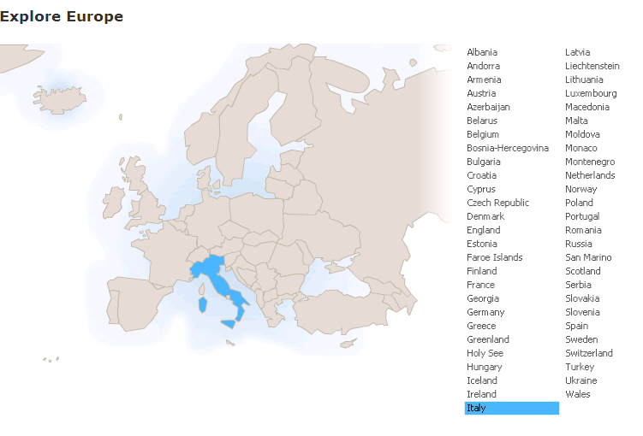
Run in “Slide Show” mode.
Use your up / down arrow keys and / or
your space bar to advance the slides
Languages
and communication
Italy
© 2009-2024 Timothy G. Roufs, University of Minnesota Duluth

Slide 2
Italy
© 2009-2024 Timothy G. Roufs, University of Minnesota Duluth

Slide 3
Languages
and communication
Italy
© 2009-2024 Timothy G. Roufs, University of Minnesota Duluth

Slide 4
Italy’s contemporary language situation reflects a complex history, geography, ecology, demographic make up, world view, and so forth
. . .

Slide 5
So first, a bit of history and background . . .

Slide 6
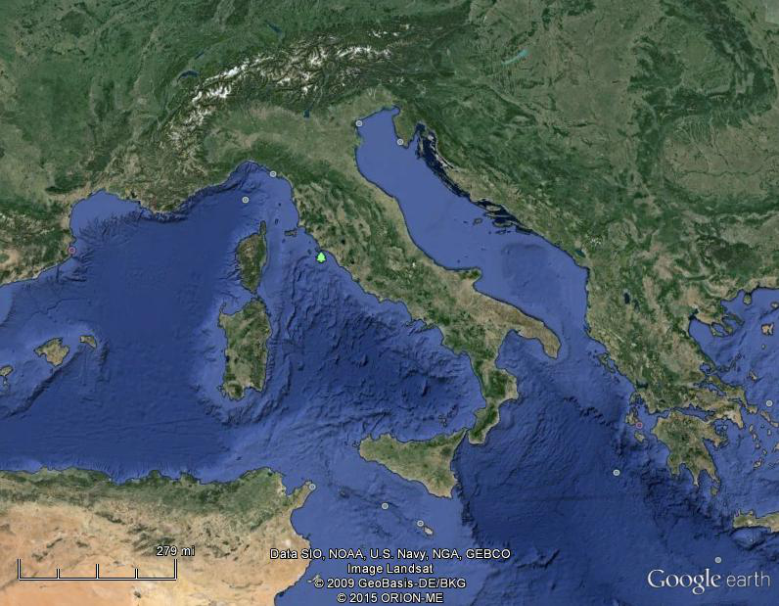
Of all European countries Italy, “the boot,” is probably the most recognizable . . .
Notes:
6

Slide 7
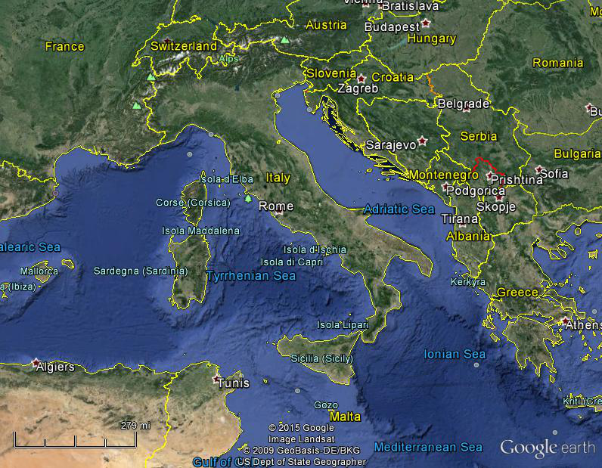
Italy, and her current neighbors . . .
Notes:
7

Slide 8
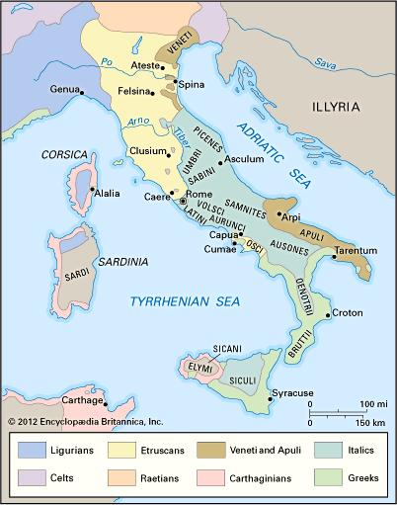
ancient Italic peoples:
Distribution of peoples of ancient Italy ca. 500 B.C.
©Encyclopædia Britannica, Inc.
https://www.britannica.com/topic/history-of-Italy
Notes:
8

Slide 9
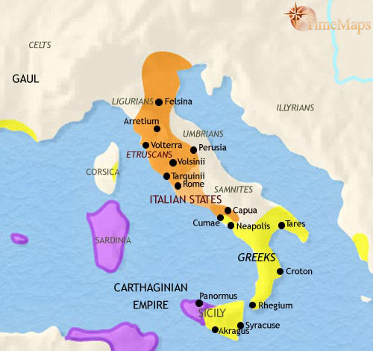
500 B.C.
http://www.timemaps.com/history/italy-500bc
Notes:
9

Slide 10
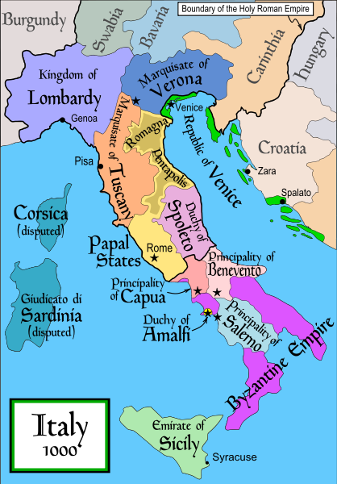
1000
Italy was divided for centuries into small kingdoms and city-states
http://en.wikipedia.org/wiki/Italy
Notes:
10

Slide 11
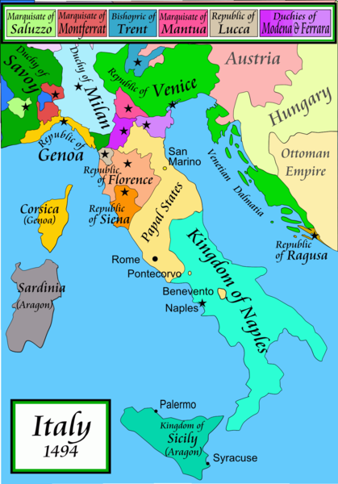
1494
Italy was divided for centuries into small kingdoms and city-states
http://en.wikipedia.org/wiki/Italy
Notes:
11

Slide 12
1494
Italy was divided for centuries into small kingdoms and city-states
http://en.wikipedia.org/wiki/Italy
Notes:
12

Slide 13
In 1494 Christopher Columbus from Genoa went on his second voyage to the New World
Italy was divided for centuries into small kingdoms and city-states
http://en.wikipedia.org/wiki/Italy
Notes:
13

Slide 14
In 1494 Christopher Columbus from Genoa is on his second voyage to the New World
Christopher Columbus was a sugar merchant from Genoa, married to the daughter of a sugar merchant from Madeira, Felipa Perestrello.
Columbus was looking for a way around Venice’s monopoly on things like sugar. . . .
Italy was divided for centuries into small kingdoms and city-states
http://en.wikipedia.org/wiki/Italy
Notes:
14

Slide 15
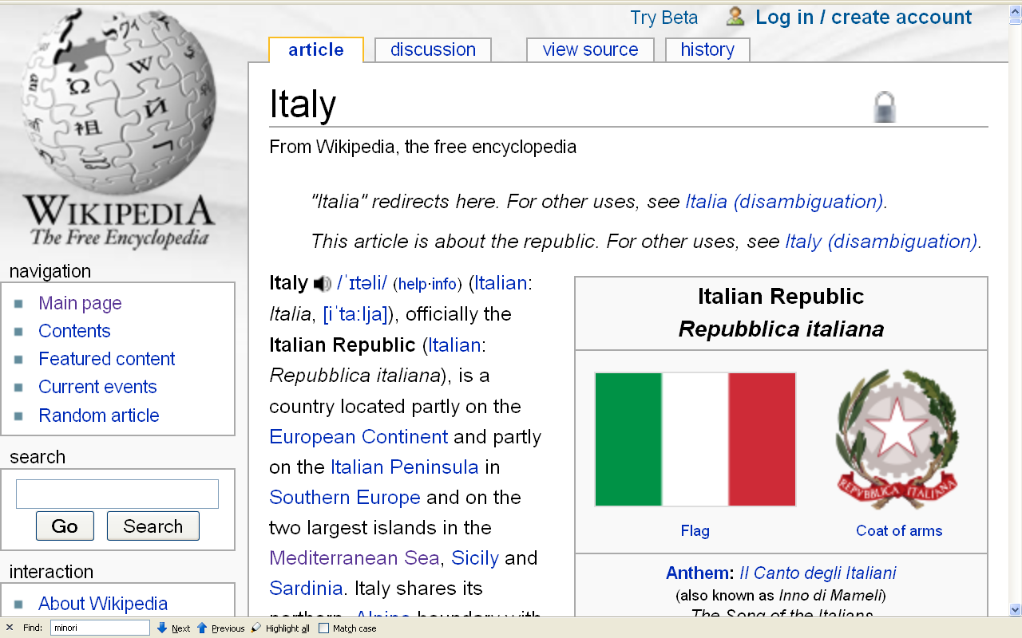
Formation of Italy
Unification —17 March 1861
Republic —2 June 1946
http://en.wikipedia.org/wiki/Italy
Notes:
15

Slide 16
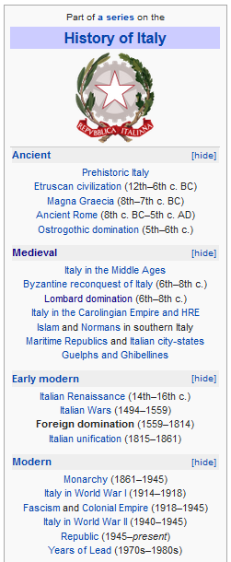
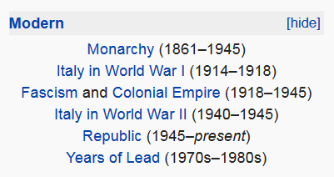
http://en.wikipedia.org/wiki/History_of_Italy_during_foreign_domination_and_the_unification
Notes:
16

Slide 17
http://en.wikipedia.org/wiki/History_of_Italy_during_foreign_domination_and_the_unification
Notes:
17

Slide 18
Formation of Italy
Unification —17 March 1861
Republic —2 June 1946
http://en.wikipedia.org/wiki/Italy
Notes:
18

Slide 19
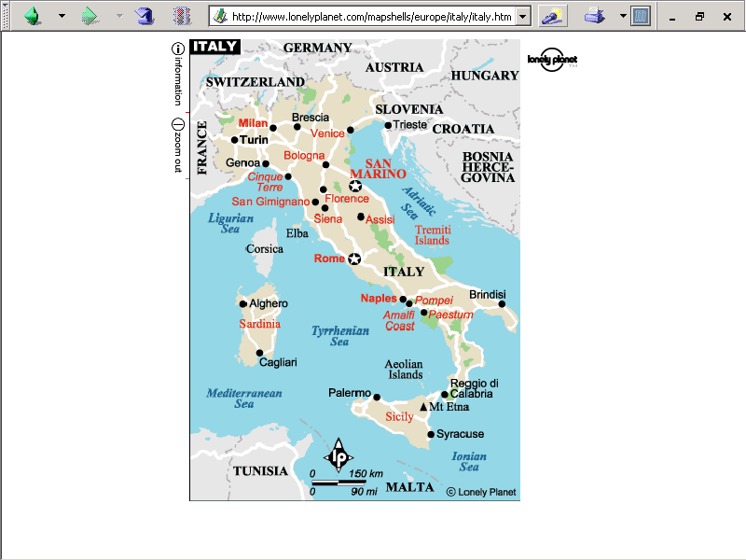
population size
61,021,855 (2023 est.)
https://www.worldometers.info/world-population/italy-population/

Slide 20
Note
Sicily

Slide 21
Note
Sardinia

Slide 22
Note
Kingdom of Tavolara
(unrecognized micronation)
https://en.wikipedia.org/wiki/Kingdom_of_Tavolara

Slide 23
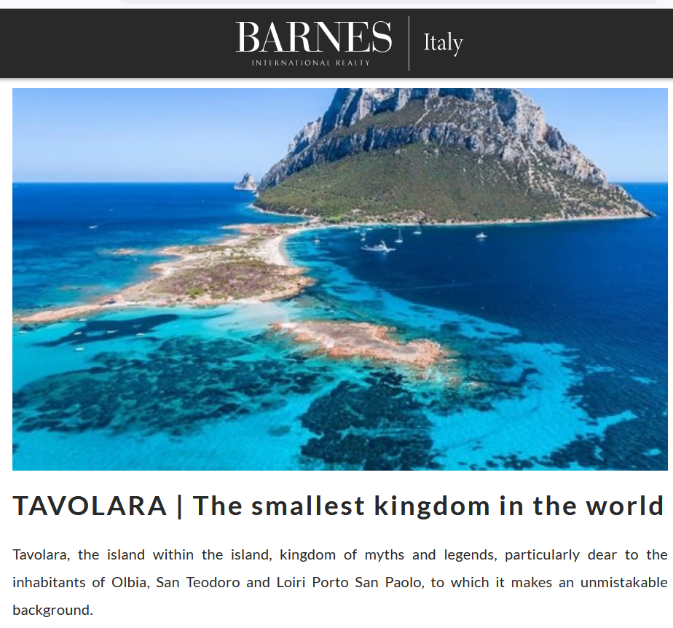
https://barnes-italy.com/tavolara-the-smallest-kingdom-in-the-world/
Notes:
23

Slide 24
Note
Corsica
(French)
Notes:
24

Slide 25
Principality of Seborga
(unrecognized micronation)
Note
https://en.wikipedia.org/wiki/Seborga
Notes:
25

Slide 26
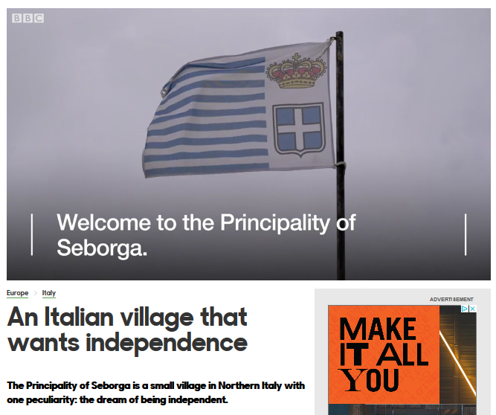
Notes:
26

Slide 27
Note
Rome

Slide 28
The Holy See
(The Vatican)
an independent country
Note
Notes:
28

Slide 29
Note
Notes:
29

Slide 30
Note
The Most Serene Republic
of San Marino
an independent country
Notes:
30

Slide 31
Languages
and communication
Italy
© 2009-2024 Timothy G. Roufs, University of Minnesota Duluth

Slide 32
Languages
and communication
are really interesting . . .

Slide 33
Languages
and communication
are really interesting . . .
Especially in Italy . . .

Slide 34
Italy’s
Languages
Italian (official)
German
  parts of Trentino-Alto Adige region are predominantly German speaking
French
  small French-speaking minority in Valle d'Aosta region (near France)
Slovene
  Slovene-speaking minority in the Trieste-Gorizia area (near Slovenia)
include . . .
CIA World Factbook
https://www.cia.gov/the-world-factbook/countries/italy/

Slide 35
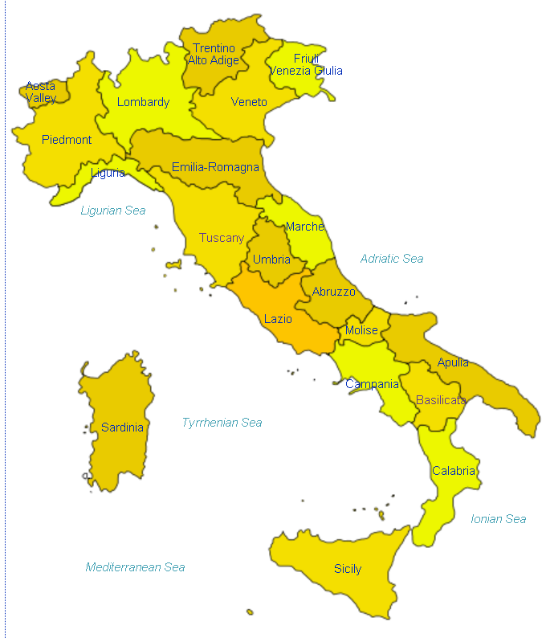
Italian
is spoken throughout Italy
http://en.wikipedia.org/wiki/Regions_of_Italy
Notes:
35

Slide 36
Languages
Italian (official)
German
  parts of Trentino-Alto Adige region are predominantly German speaking
French
  small French-speaking minority in Valle d'Aosta region (near France)
Slovene
  Slovene-speaking minority in the Trieste-Gorizia area (near Slovenia)
CIA World Factbook
https://www.cia.gov/the-world-factbook/countries/italy/

Slide 37
German
is spoken in the very north
http://en.wikipedia.org/wiki/Regions_of_Italy
Notes:
37

Slide 38
Languages
Italian (official)
German
  parts of Trentino-Alto Adige region are predominantly German speaking
French
  small French-speaking minority in Valle d'Aosta region (near France)
Slovene
  Slovene-speaking minority in the Trieste-Gorizia area (near Slovenia)
CIA World Factbook
https://www.cia.gov/the-world-factbook/countries/italy/

Slide 39
French
is spoken in the northwest
http://en.wikipedia.org/wiki/Regions_of_Italy
Notes:
39

Slide 40
Languages
Italian (official)
German
  parts of Trentino-Alto Adige region are predominantly German speaking
French
  small French-speaking minority in Valle d'Aosta region (near France)
Slovene
  Slovene-speaking minority in the Trieste-Gorizia area (near Slovenia)
CIA World Factbook
https://www.cia.gov/the-world-factbook/countries/italy/

Slide 41
Slovene
is spoken in the northeast
http://en.wikipedia.org/wiki/Regions_of_Italy
Notes:
41

Slide 42
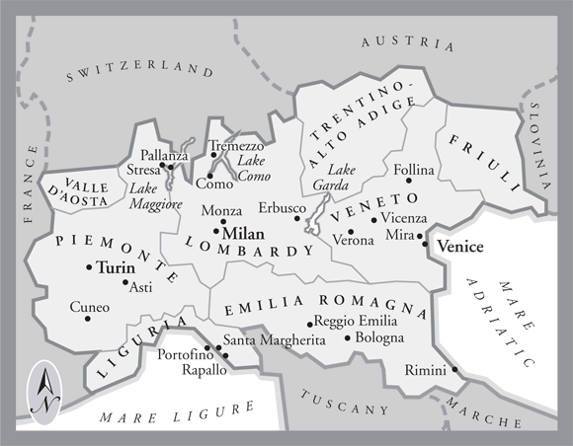

In northern Italy people in three regions speak a different primary language,
in addition to Italian . . .
German
Slovene
French
Italian
is spoken throughout Italy
Tuscany
www.jdbassc.com/maps/map_southern_italy.asp
Notes:
42

Slide 43
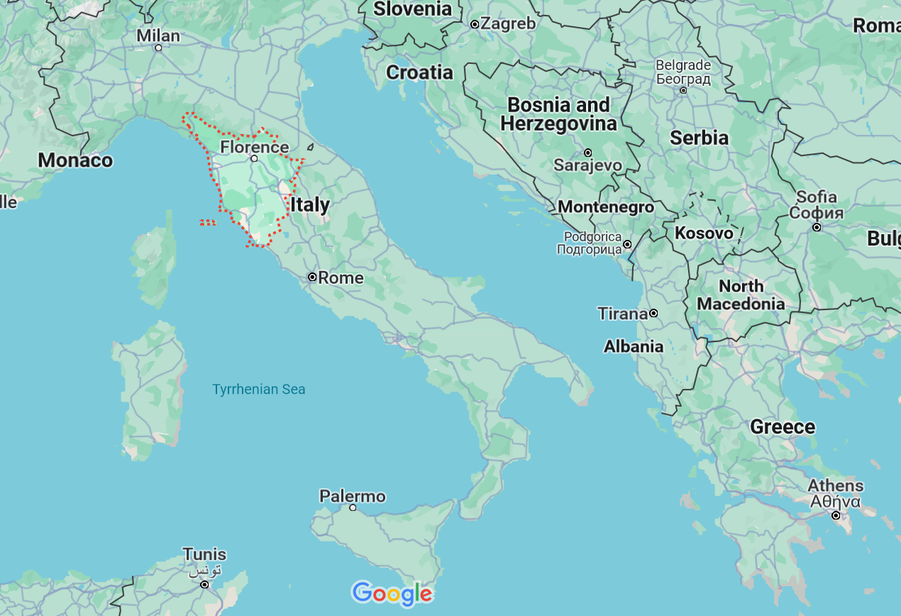

German
French
Slovene
Tuscany
Italian
In the neighboring Tuscany region
they speak Italian, which historically was based on the Florentine dialect . . .

Slide 44
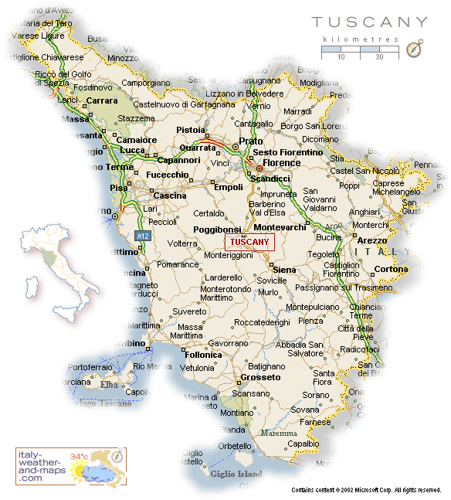
Florence
Pisa
http://healthmap.files.wordpress.com/2009/12/tuscany-map.gif

Slide 45
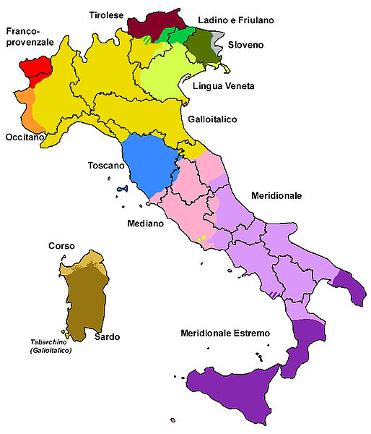
all the languages include . . .
Official language(s) | Italian
Regional language(s) | German, Neapolitan, Slovene, Piedmontese, Sardinian, Sardinian, Tabarchino, Sassarese, Gallurese, Ladin, Cimbrian, Mocheno, Venetian
Minority language(s) | Albanian, Catalan, German, Greek, Slovene, Croatian, French, Franco-Provençal, Friulian, Ladin, Occitan, Sardinia
Main immigrant language(s) | Romanian, Berber, Maghrebi Arabic, Albanian
Main foreign language(s) | English (25%) Spanish (17%) French (14%)
Dialects of Italy by Group
http://en.wikipedia.org/wiki/List_of_languages_of_Italy
Notes:
45

Slide 46
But throughout Italy as a whole, Italian is spoken as a main language . . .

Slide 47
Italian
http://en.wikipedia.org/wiki/Regions_of_Italy
Notes:
47

Slide 48
although dialect differences
are significant . . .

Slide 49
Martin J. Gannon and Rajnandini Pillai
Understanding Global Cultures
The Italian history of invasions has produced many dialects, each the product of the particular regional invader
  The language of Italy consists of
  both local dialects and Italian,
  a derivative of the Tuscan language
  Although linguistic variations are disappearing to some extent due to the homogenizing effects of television and telecommunications, Italians still cling to the notion of having their own regional dialect
www.d.umn.edu/cla/faculty/troufs/anth1095/index.html#Gannon

Slide 50
Martin J. Gannon and Rajnandini Pillai
Understanding Global Cultures
The vocal selections of the chorus in the Italian opera are directly comparable to the many regional variations of the Italian language
Although each section is important to the harmony of the chorus, each has its own melody
www.d.umn.edu/cla/faculty/troufs/anth1095/index.html#Gannon

Slide 51
Dialects of Italy by Group
http://en.wikipedia.org/wiki/List_of_languages_of_Italy
Notes:
51

Slide 52
1494
compare these
with the old kingdoms
Dialects of Italy by Group
http://en.wikipedia.org/wiki/List_of_languages_of_Italy
Notes:
52

Slide 53
1000
1494
compare these
with the old kingdoms
Dialects of Italy by Group
http://en.wikipedia.org/wiki/List_of_languages_of_Italy
Notes:
53

Slide 54
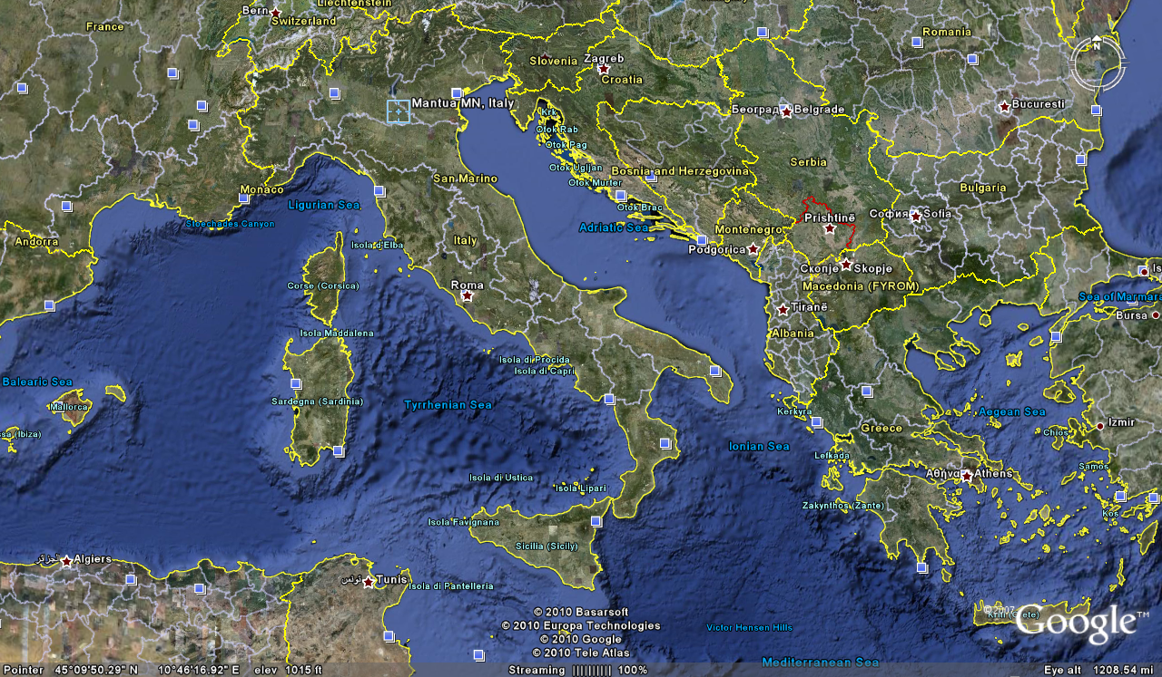
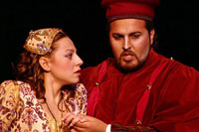
Cosimo Vassallo
is from
Palermo, Sicily
Letizia Colajanni
and
Cosimo Vassallo
/

Slide 55
Cossimo lives in
Mantova
503 miles away
(by air)
/
Letizia Colajanni
and
Cosimo Vassallo

Slide 56
If Cosimo speaks Italian with
his Palermo accent in
Montova, some
will have difficult understanding him
/
Cosimo Vassallo
is from
Palermo, Sicily
Letizia Colajanni
and
Cosimo Vassallo
/

Slide 57
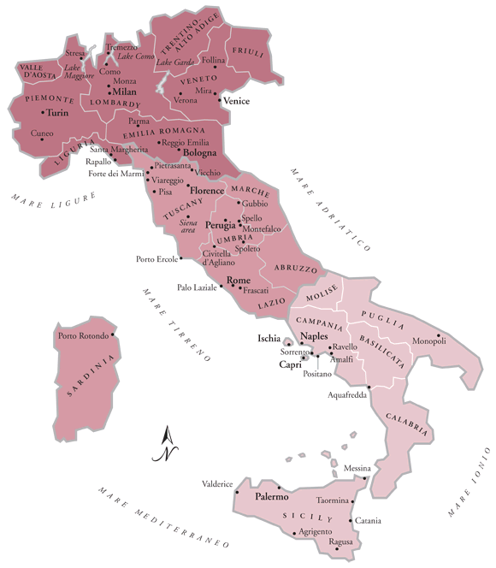
/
My friend Martin Aricochi
who lives in
Brixen (Bressanone), Italy, spoke German until he went to school,
www.jdbassc.com/maps/map_southern_italy.asp
Notes:
57

Slide 58
/
My friend Martin Aricochi
who lives in
Brixen (Bressanone), Italy, spoke German until he went to school,
and they still speak German at home
www.jdbassc.com/maps/map_southern_italy.asp
Notes:
58

Slide 59
And virtually everyone, male and female,
is literate . . .

Slide 60
Italy
is a very literate country . . .

Slide 61
Literacy
definition: age 15 and over can read and write
    total population: 99.2%
    male: 99.4%
    female: 99%
(2018 est.)
CIA World Factbook
https://www.cia.gov/the-world-factbook/countries/italy/

Slide 62
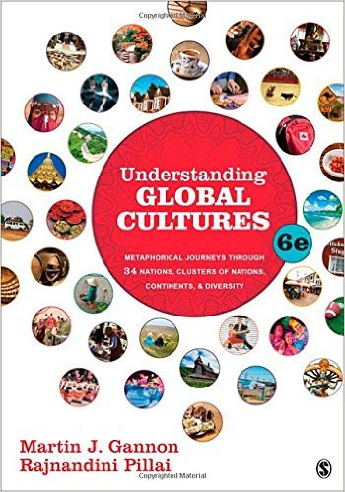
The text
(Thousand Oaks, CA: SAGE Publications, 2015)
Notes:
ousa

Slide 63
Martin J. Gannon and Rajnandini Pillai
Understanding Global Cultures
Gannon and Pillai
suggest that . . .
“to understand Italy
it is a good idea to
look at the opera . . .”
www.d.umn.edu/cla/faculty/troufs/anth1095/index.html#Gannon

Slide 64
Gannon and Pillai's
European Cultural Metaphors include
Ch. 15. French Wine . . .
Ch. 17. The Traditional British House
Ch. 21. The Italian Opera
Ch. 22. Belgian Lace
Ch. 24. The Russian Ballet
Ch. 30. The Spanish Bullfight
Ch. 31. The Portuguese Bullfight
www.d.umn.edu/cla/faculty/troufs/anth1095/index.html#Gannon

Slide 65
Martin J. Gannon and Rajnandini Pillai
Understanding Global Cultures
And that means look at the language of the opera . . .
(among other things)
www.d.umn.edu/cla/faculty/troufs/anth1095/index.html#Gannon

Slide 66
Martin J. Gannon and Rajnandini Pillai
Understanding Global Cultures
  the soloists and chorus in the opera express themselves through
    language
    gesture
    music
    and always through highly skilled acting
www.d.umn.edu/cla/faculty/troufs/anth1095/index.html#Gannon

Slide 67
Martin J. Gannon and Rajnandini Pillai
Understanding Global Cultures
Gannon and Pillai suggest that there are five main features of Italy’s
Opera Cultural Metaphor . . .
www.d.umn.edu/cla/faculty/troufs/anth1095/index.html#Gannon

Slide 68
Martin J. Gannon and Rajnandini Pillai
Understanding Global Cultures
and all of the features of the Opera as Cultural Metaphor relate in one way or another to Italy’s languages . . .
www.d.umn.edu/cla/faculty/troufs/anth1095/index.html#Gannon

Slide 69
  The Overture
  Pageantry and Spectacle
  Voice
  Externalization
  5. Chorus and Soloists
Italy
www.d.umn.edu/cla/faculty/troufs/anth1095/index.html#Gannon

Slide 70
  The Overture
  Pageantry and Spectacle
  Voice
  Externalization
  5. Chorus and Soloists
sets the mood
and gives some idea as to what one can expect, as introductions do in conversations
Italy
www.d.umn.edu/cla/faculty/troufs/anth1095/index.html#Gannon

Slide 71
Martin J. Gannon and Rajnandini Pillai
Understanding Global Cultures
“Italian culture emphasizes overtures. Italy stands somewhere in the middle of the continuum between American low-context culture and Asian high-context culture. Americans tend to ignore the overture and get down to business rather quickly. On the other hand, many Asians devote a significant amount of time getting to know their negotiating counterparts before doing business with them. . . .”
www.d.umn.edu/cla/faculty/troufs/anth1095/index.html#Gannon

Slide 72
Martin J. Gannon and Rajnandini Pillai
Understanding Global Cultures
“Italian culture emphasizes overtures. Italy stands somewhere in the middle of the continuum between American low-context culture and Asian high-context culture. American tend to ignore the overture and get down to business rather quickly. On the other hand, many Asians devote a significant amount of time getting to know their negotiating counterparts before doing business with them. . . .”
American
(low context)
Italian
“Asians”
(high context)
www.d.umn.edu/cla/faculty/troufs/anth1095/index.html#Gannon

Slide 73
Martin J. Gannon and Rajnandini Pillai
Understanding Global Cultures
There are regional differences in the manner in which the overture is performed
  In the south, the overture can be much more involved
    A person may visit a store, and chat with the owner, two or three times before purchasing something
    Both parties have a good idea about the outcome, but there will be expressions of emotion, various uses of argument and persuasion, and different tones of vice that will help to facilitate the final outcome or sale
    Still, the unexpected can, and does, occur, because fate is a critical element in the mix
www.d.umn.edu/cla/faculty/troufs/anth1095/index.html#Gannon

Slide 74
Martin J. Gannon and Rajnandini Pillai
Understanding Global Cultures
There are regional differences in the manner in which the overture is performed
  In the south, the overture can be much more involved
    A person may visit a store, and chat with the owner, two or three times before purchasing something
    Both parties have a good idea about the outcome, but there will be expressions of emotion, various uses of argument and persuasion, and different tones of vice that will help to facilitate the final outcome or sale
    Still, the unexpected can, and does, occur, because fate is a critical element in the mix
www.d.umn.edu/cla/faculty/troufs/anth1095/index.html#Gannon

Slide 75
  The Overture
  Pageantry and Spectacle
  Voice
  Externalization
  5. Chorus and Soloists
Italy
www.d.umn.edu/cla/faculty/troufs/anth1095/index.html#Gannon

Slide 76
  The Overture
  Pageantry and Spectacle
  Voice
  Externalization
  5. Chorus and Soloists
The pageantry and spectacle in the opera-like activities are like those performed in the daily lives of the Italians
Italy
www.d.umn.edu/cla/faculty/troufs/anth1095/index.html#Gannon

Slide 77
Martin J. Gannon and Rajnandini Pillai
Understanding Global Cultures
“Once the overture is over and the curtain goes up, the audience is greeted by a set so visually stunning that it elicits applause. This is the beginning of the pageantry and spectacle. They play such an important role in Italian life that people and things frequently tend to be judged first and foremost on their appearances.”
www.d.umn.edu/cla/faculty/troufs/anth1095/index.html#Gannon

Slide 78
Martin J. Gannon and Rajnandini Pillai
Understanding Global Cultures
“This eternal search for surface pleasures and distractions is accompanied by garbo. Although this term cannot be translated exactly, it is the finesse that Italians use to deal with situations delicately and without offense.
Garbo turns Italian life into a work of art. Italians tend to have a very public orientation, are willing to share a lot, and are used to being on stage at all times.”
www.d.umn.edu/cla/faculty/troufs/anth1095/index.html#Gannon

Slide 79
Martin J. Gannon and Rajnandini Pillai
Understanding Global Cultures
“This eternal search for surface pleasures and distractions is accompanied by garbo. Although this term cannot be translated exactly, it is the finesse that Italians use to deal with situations delicately and without offense, including those involving language and communication skills.
www.d.umn.edu/cla/faculty/troufs/anth1095/index.html#Gannon

Slide 80
Martin J. Gannon and Rajnandini Pillai
Understanding Global Cultures
the Italian reliance on spectacle and garbo
helps people solve most of their problems
www.d.umn.edu/cla/faculty/troufs/anth1095/index.html#Gannon

Slide 81
Martin J. Gannon and Rajnandini Pillai
Understanding Global Cultures
The spectacle of Italian life is quite apparent in the area of
language and communications
www.d.umn.edu/cla/faculty/troufs/anth1095/index.html#Gannon

Slide 82
Martin J. Gannon and Rajnandini Pillai
Understanding Global Cultures
The spectacle of Italian life is quite apparent in the area of
language and communications
  Italians tend to be skilled conversationalists
  Onlookers can frequently follow the conversation from a distance because of the gestures and facial expressions that area employed to convey different emotions
    Similarly, one can understand many of the actions that take place in an opera without fully understanding what the actors are singing
www.d.umn.edu/cla/faculty/troufs/anth1095/index.html#Gannon

Slide 83
Martin J. Gannon and Rajnandini Pillai
Understanding Global Cultures
Pageantry and spectacle also apply to business presentations and negotiations
  A manager should ensure that the aesthetics of a presentation should be clear and exact
  S/he should demonstrate a mastery of detail and language
  S/he should be well organized
  Polish and elegance count for a great deal
www.d.umn.edu/cla/faculty/troufs/anth1095/index.html#Gannon

Slide 84
Martin J. Gannon and Rajnandini Pillai
Understanding Global Cultures
Pageantry and spectacle also apply to business presentations and negotiations
  A manager should ensure that the aesthetics of a presentation should be clear and exact
  S/he should demonstrate a mastery of detail and language
  S/he should be well organized
  Polish and elegance count for a great deal
www.d.umn.edu/cla/faculty/troufs/anth1095/index.html#Gannon

Slide 85
Martin J. Gannon and Rajnandini Pillai
Understanding Global Cultures
Pageantry and spectacle also apply to business presentations and negotiations
  However, although pageantry is important in business presentations and negotiations, Italians also tend to expect good-faith bargaining
www.d.umn.edu/cla/faculty/troufs/anth1095/index.html#Gannon

Slide 86
Martin J. Gannon and Rajnandini Pillai
Understanding Global Cultures
Although Italians tend to be emotional and dramatic, few decisions are influenced by sentiments, tastes, hazards or hopes, but usually by a careful evaluation of the relative strength of the contending parties
  This is one of the reasons that, when negotiating even the smallest deal, Italians prefer to look each other in the face
www.d.umn.edu/cla/faculty/troufs/anth1095/index.html#Gannon

Slide 87
Martin J. Gannon and Rajnandini Pillai
Understanding Global Cultures
Although Italians tend to be emotional and dramatic, few decisions are influenced by sentiments, tastes, hazards or hopes, but usually by a careful evaluation of the relative strength of the contending parties
  This is one of the reasons that, when negotiating even the smallest deal, Italians prefer to look each other in the face
www.d.umn.edu/cla/faculty/troufs/anth1095/index.html#Gannon

Slide 88
Martin J. Gannon and Rajnandini Pillai
Understanding Global Cultures
However, transparent deceptions are employed to give each person the feeling that s/he is a unique specimen of humanity, worthy of special consideration
www.d.umn.edu/cla/faculty/troufs/anth1095/index.html#Gannon

Slide 89
Martin J. Gannon and Rajnandini Pillai
Understanding Global Cultures
In Italy,
few confess to being
“an average man”
www.d.umn.edu/cla/faculty/troufs/anth1095/index.html#Gannon

Slide 90
Martin J. Gannon and Rajnandini Pillai
Understanding Global Cultures
“Italians tend to believe that their language is the most beautiful one in the world.”
  Italians put great emotion into their language, speaking with passion, rhythm, and changing tonality
www.d.umn.edu/cla/faculty/troufs/anth1095/index.html#Gannon

Slide 91
Martin J. Gannon and Rajnandini Pillai
Understanding Global Cultures
“Italians tend to believe that their language is the most beautiful one in the world.”
  Italians put great emotion into their language, speaking with passion, rhythm, and changing tonality
www.d.umn.edu/cla/faculty/troufs/anth1095/index.html#Gannon

Slide 92
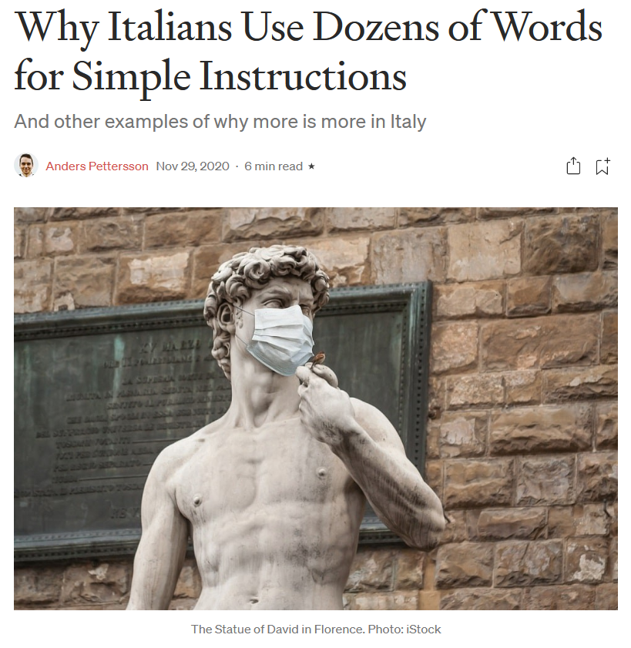

29 Nov 2020
https://humanparts.medium.com/why-italians-use-dozens-of-words-for-simple-instructions-b3e499f2f0df

Slide 93
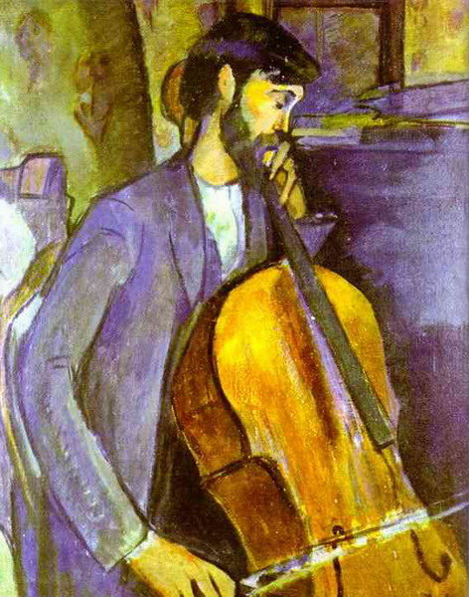
  take the word
  cello
  for instance
http://commons.wikimedia.org/wiki/File:Modigliani_%E2%80%93_Cello_Player.jpg

Slide 94
If you ever have the chance, ask a native Italian speaker to pronounce the name of this instrument.
  cello
http://commons.wikimedia.org/wiki/File:Modigliani_%E2%80%93_Cello_Player.jpg

Slide 95
Pronunciation of “cello” in English:
chel’ oh
Listen: https://www.youtube.com/watch?v=2ap8VVxF0vM
Pronunciation of “cello” in Italian:
ˈtʃɛl’əʊ
Listen: https://www.youtube.com/watch?v=44JGT1hJA0s

Slide 96
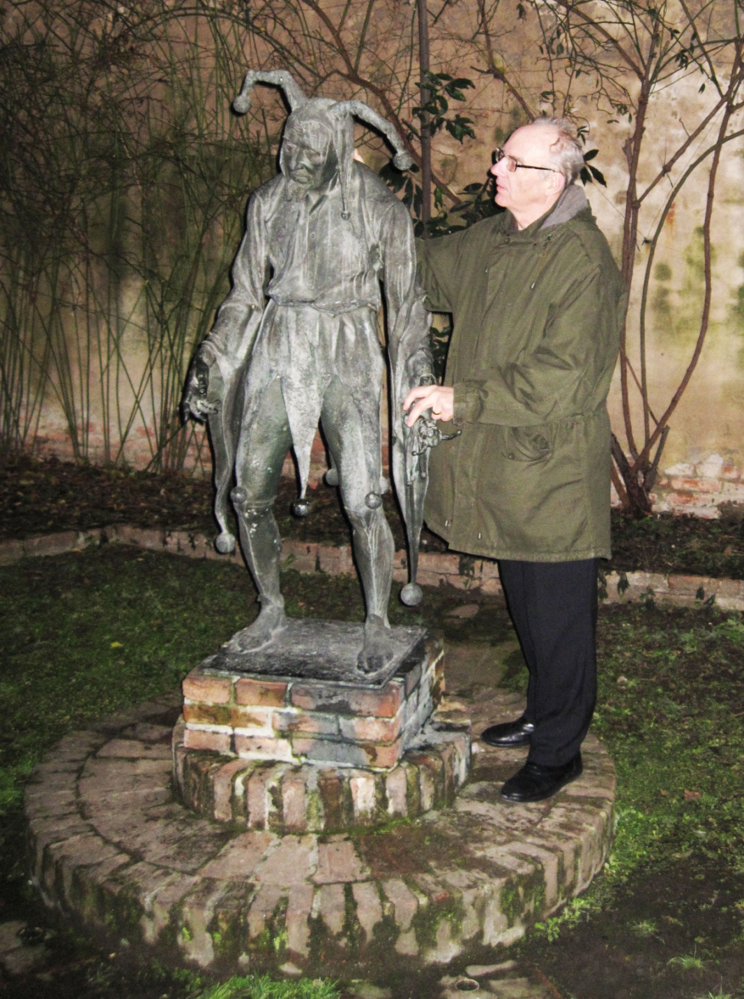
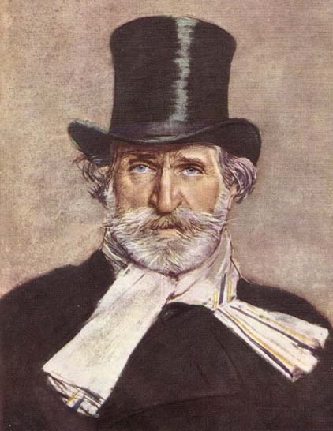
Giuseppe Verdi
Rigoletto
(on the left)
Mantova, Italy

Slide 97
Giuseppe Verdi
Joe Green
Rigoletto
(on the left)
Mantova, Italy

Slide 98
this wouldn’t at all be the same translated into American English and mentioned by a Texan . . .
Giuseppe Verdi
Rigoletto
(on the left)
Mantova, Italy

Slide 99
And
“Joe Green”
Is just not the same as
“Giuseppe Verdi”
Listen: https://www.youtube.com/watch?v=aKbg9xDT93s
Giuseppe Verdi

Slide 100
Martin J. Gannon and Rajnandini Pillai
Understanding Global Cultures
“Italians tend to believe that their language is the most beautiful one in the world.”
  Much of the beauty of the Italian language derives form the fact that it has a higher proportion of vowels to consonants than all or more languages, which gives it something of a musical effect
www.d.umn.edu/cla/faculty/troufs/anth1095/index.html#Gannon

Slide 101
Martin J. Gannon and Rajnandini Pillai
Understanding Global Cultures
“Italians tend to believe that their language is the most beautiful one in the world.”
  sibilant
  is a type of fricative or affricate consonant, made by directing a jet of air through a narrow channel in the vocal tract towards the sharp edge of the teeth
  Wikipedia
www.d.umn.edu/cla/faculty/troufs/anth1095/index.html#Gannon

Slide 102
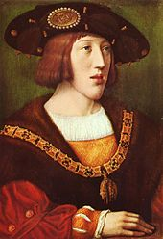
Martin J. Gannon and Rajnandini Pillai
Understanding Global Cultures
“Italians tend to believe that their language is the most beautiful one in the world.”
“I speak Spanish to God,
Italian to women,
French to men
and
German to my horse”
Attributed to King Charles V
King of Spain and Holy Roman Emperor
1500–1558
www.d.umn.edu/cla/faculty/troufs/anth1095/index.html#Gannon
https://en.wikipedia.org/wiki/Charles_V,_Holy_Roman_Emperor

Slide 103
Martin J. Gannon and Rajnandini Pillai
Understanding Global Cultures
“Italians tend to believe that their language is the most beautiful one in the world.”
“She opened up a book of poems and handed it to me written by an Italian poet from the 13th century and every one of them words rang true and glowed like burning coal pouring off of every page like it was written in my soul from me to you.”
Bob Dylan
1941 –
who said the following quote?
www.d.umn.edu/cla/faculty/troufs/anth1095/index.html#Gannon

Slide 104
Martin J. Gannon and Rajnandini Pillai
Understanding Global Cultures
“Italians tend to believe that their language is the most beautiful one in the world.”
A fairly recent quote . . .
“She opened up a book of poems and handed it to me written by an Italian poet from the 13th century and every one of them words rang true and glowed like burning coal pouring off of every page like it was written in my soul from me to you.”
Bob Dylan
1941 –
www.d.umn.edu/cla/faculty/troufs/anth1095/index.html#Gannon

Slide 105
Martin J. Gannon and Rajnandini Pillai
Understanding Global Cultures
“Italians tend to believe that their language is the most beautiful one in the world.”
“She opened up a book of poems and handed it to me written by an Italian poet from the 13th century and every one of them words rang true and glowed like burning coal pouring off of every page like it was written in my soul from me to you.”
Bob Dylan
1941 –
the correct answer is . . .
www.d.umn.edu/cla/faculty/troufs/anth1095/index.html#Gannon

Slide 106
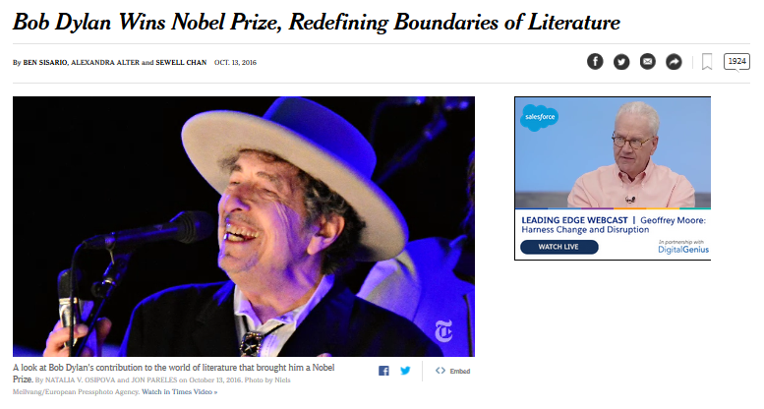
By . . .
http://www.nytimes.com/2016/10/14/arts/music/bob-dylan-nobel-prize-literature.html?smid=fb-nytimes&smtyp=cur&_r=0

Slide 107
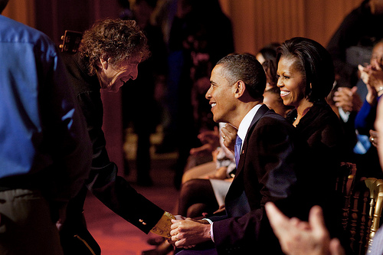
Martin J. Gannon and Rajnandini Pillai
Understanding Global Cultures
“Italians tend to believe that their language is the most beautiful one in the world.”
Bob Dylan
1941 –
Presidential Medal of Freedom 2012

Slide 108
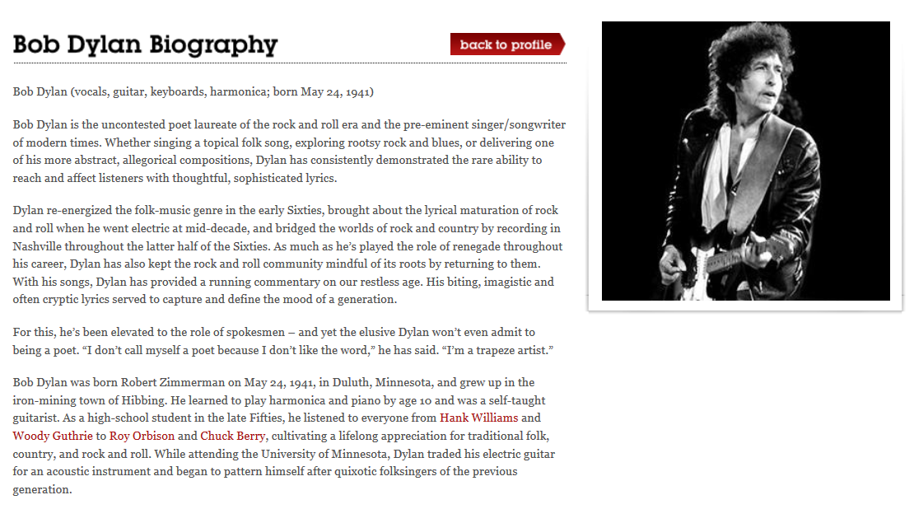

Martin J. Gannon and Rajnandini Pillai
Understanding Global Cultures
https://rockhall.com/inductees/bob-dylan/bio/

Slide 109

Martin J. Gannon and Rajnandini Pillai
Understanding Global Cultures
http://amoralto.tumblr.com/post/60467020158/melody-maker-beatles-saydylan-shows-the-way

Slide 110
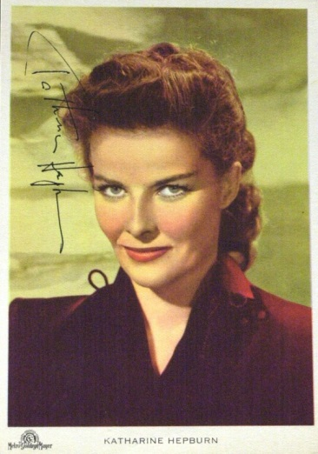
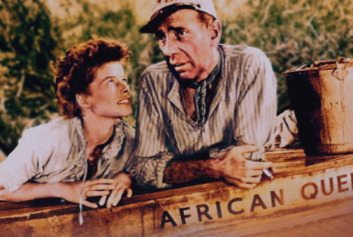
Martin J. Gannon and Rajnandini Pillai
Understanding Global Cultures
“Italians tend to believe that their language is the most beautiful one in the world.”
The average Hollywood film star's ambition is to be
admired by an American,
courted by an Italian,
married to an Englishman
and have a French boyfriend.”
Katharine Hepburn
1907 –2003
www.d.umn.edu/cla/faculty/troufs/anth1095/index.html#Gannon

Slide 111
Martin J. Gannon and Rajnandini Pillai
Understanding Global Cultures
“Italians tend to believe that their language is the most beautiful one in the world.”
  It is the quality of the way people speak that is of utmost importance
    this bias is replicated in the opera in that there are several strikingly different types of voice registers, such as the soprano and the bass
www.d.umn.edu/cla/faculty/troufs/anth1095/index.html#Gannon

Slide 112
Martin J. Gannon and Rajnandini Pillai
Understanding Global Cultures
“Italians tend to believe that their language is the most beautiful one in the world.”
  And, like the opera, the sound and cadence of the communication play a role at least equal to the content of what is said in getting the message across
  Italians are often much more interested in engaging and entertaining their listeners than in conveying their thoughts accurately
www.d.umn.edu/cla/faculty/troufs/anth1095/index.html#Gannon

Slide 113
Martin J. Gannon and Rajnandini Pillai
Understanding Global Cultures
“Perhaps the most difficult operatic singing is associated with bel canto, or beautiful music, introduced by the romantic Italian composer Bellini. This form of music requires extraordinary exertion and ability on the part of the singers, especially when they are singing together to express their thoughts and emotions. Bel canto is so difficult a form of opera that there is only a limited number of singers who can perform it effectively, and only Italian composers have been very successful in this area.”
www.d.umn.edu/cla/faculty/troufs/anth1095/index.html#Gannon

Slide 114
Martin J. Gannon and Rajnandini Pillai
Understanding Global Cultures
“Perhaps the most difficult operatic singing is associated with bel canto, or beautiful music, introduced by the romantic Italian composer Bellini. This form of music requires extraordinary exertion and ability on the part of the singers, especially when they are singing together to express their thoughts and emotions. Bel canto is so difficult a form of opera that there is only a limited number of singers who can perform it effectively, and only Italian composers have been very successful in this area.”
www.d.umn.edu/cla/faculty/troufs/anth1095/index.html#Gannon

Slide 115
Martin J. Gannon and Rajnandini Pillai
Understanding Global Cultures
Italians tend to talk louder than many other nationalities
  But more so in the south than in the north
Stories are told with passion, anger and joy
The air in Italy is filled with so many voices that one must frequently talk in a very loud voice to be understood,
“thereby increasing the total uproar”
www.d.umn.edu/cla/faculty/troufs/anth1095/index.html#Gannon

Slide 116
Martin J. Gannon and Rajnandini Pillai
Understanding Global Cultures
Oral communication in Italy is something of a show itself
Speaking is punctuated by elaborate gestures, befitting the Italian operatic tradition
Whatever the section of the country, Italians talk with their hands
  Quick, agile, expressive movement of the hands, arms, and shoulders contribute emphasis and sincerity to the spoken words and facial expressions
www.d.umn.edu/cla/faculty/troufs/anth1095/index.html#Gannon

Slide 117
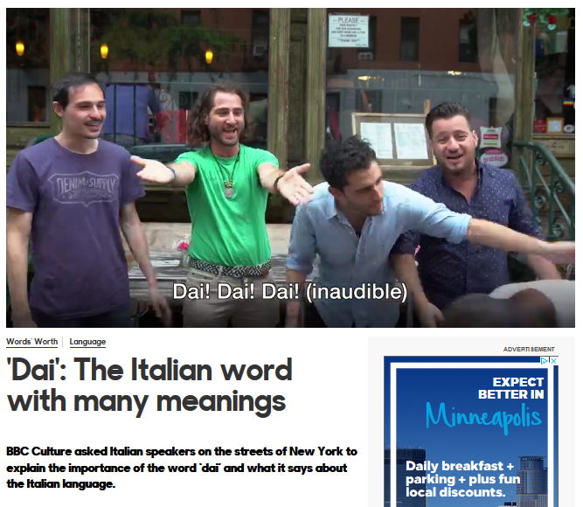

http://www.bbc.com/culture/story/20171207-dai-the-italian-word-with-many-meanings

Slide 118
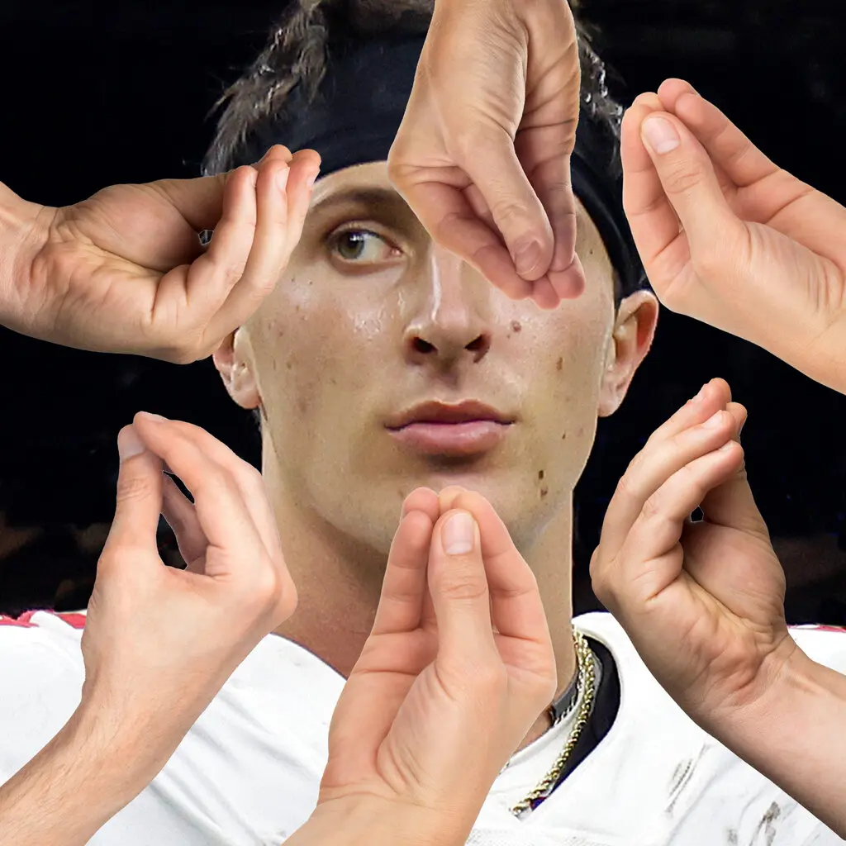
The Hand Gesture Heard Round the World
Emperor Augustus
ruled Rome
27 BC to AD 14
6 January 2024
https://www.nytimes.com/2024/01/06/opinion/tommy-devito-football-italian.html?smid=nytcore-ios-share&referringSource=articleShare

Slide 119

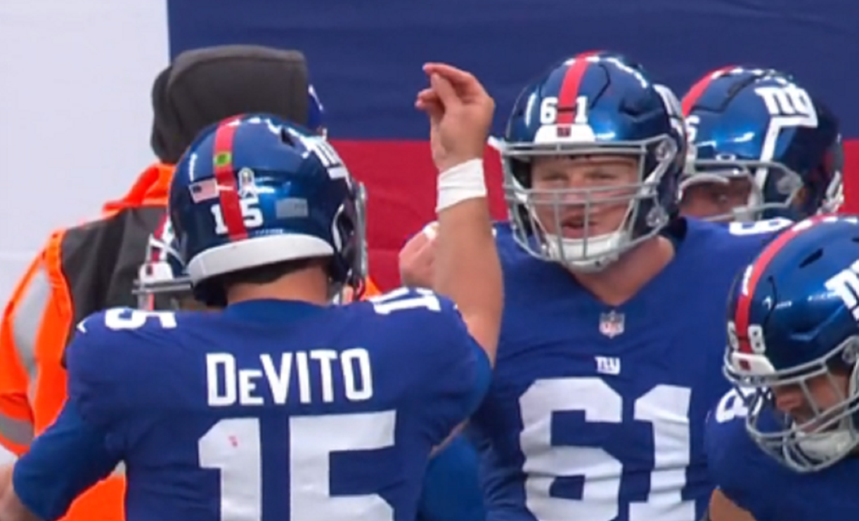

Giants' Tommy DeVito shares the origin behind his pinched fingers touchdown celebration
26 November 2023
https://www.cbssports.com/nfl/news/giants-tommy-devito-shares-the-origin-behind-his-pinched-fingers-touchdown-celebration/
https://brobible.com/sports/article/giants-played-sopranos-theme-song-tommy-devito-entrance/

Slide 120
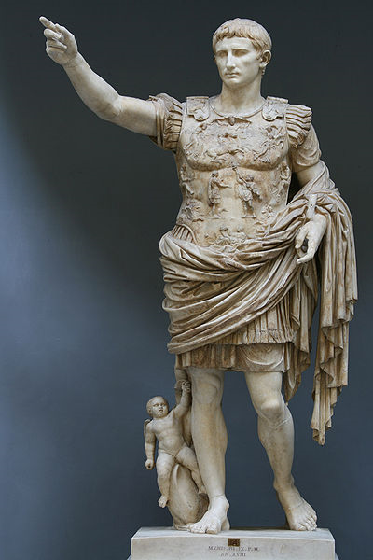
Martin J. Gannon and Rajnandini Pillai
Understanding Global Cultures
“Italians tend to believe that their language is the most beautiful one in the world.”
  Italians put great emotion into their language, speaking with passion, rhythm, and changing tonality
Emperor Augustus
ruled Rome
27 BC to AD 14
www.d.umn.edu/cla/faculty/troufs/anth1095/index.html#Gannon

Slide 121
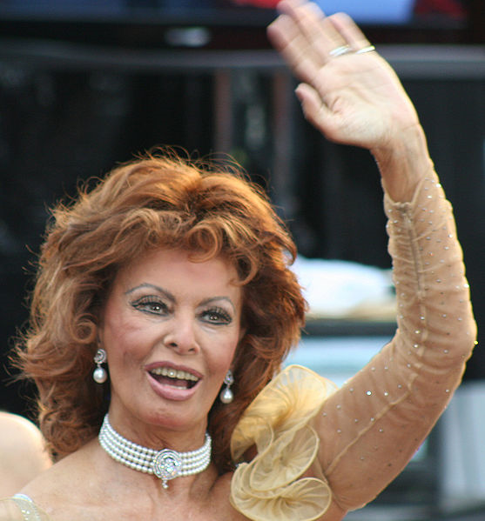
Martin J. Gannon and Rajnandini Pillai
Understanding Global Cultures
“Italians tend to believe that their language is the most beautiful one in the world.”
  Italians put great emotion into their language, speaking with passion, rhythm, and changing tonality
Sophia Loren
ruled Hollywood,
at the 2009 Academy Awards
Emperor Augustus
ruled Rome
27 BC to AD 14
www.d.umn.edu/cla/faculty/troufs/anth1095/index.html#Gannon

Slide 122
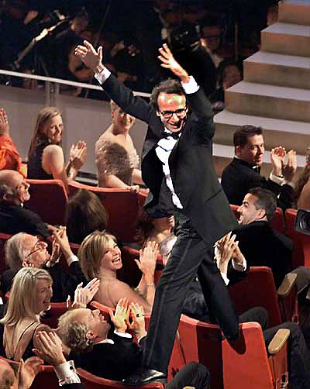
Martin J. Gannon and Rajnandini Pillai
Understanding Global Cultures
“Italians tend to believe that their language is the most beautiful one in the world.”
  Italians put great emotion into their language, speaking with passion, rhythm, and changing tonality
Roberto Benigni
71st Academy Awards
Best Foreign Film
Best Actor
1999
www.d.umn.edu/cla/faculty/troufs/anth1095/index.html#Gannon

Slide 123
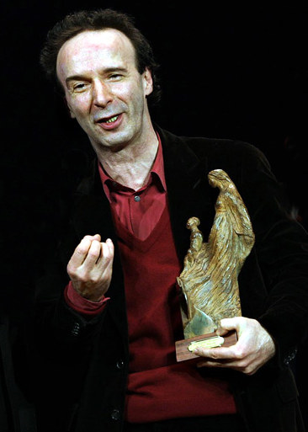
Martin J. Gannon and Rajnandini Pillai
Understanding Global Cultures
“Italians tend to believe that their language is the most beautiful one in the world.”
  Italians put great emotion into their language, speaking with passion, rhythm, and changing tonality
Roberto Benigni
2006
www.d.umn.edu/cla/faculty/troufs/anth1095/index.html#Gannon

Slide 124
Martin J. Gannon and Rajnandini Pillai
Understanding Global Cultures
However, the gestures are not, as many believe, unrealistically exaggerated
In fact, the gestures are so realistic that they may be unapparent
www.d.umn.edu/cla/faculty/troufs/anth1095/index.html#Gannon

Slide 125
Martin J. Gannon and Rajnandini Pillai
Understanding Global Cultures
The acting of the opera singers, derived directly from the Italian’s natural mimicry,
contributes to the
erroneous impression of excessive exaggeration
www.d.umn.edu/cla/faculty/troufs/anth1095/index.html#Gannon

Slide 126
Martin J. Gannon and Rajnandini Pillai
Understanding Global Cultures
In reality,
Italian gestures are based on natural and “instinctive” movements
and therefore
can be understood by the inexperienced
at first sight
www.d.umn.edu/cla/faculty/troufs/anth1095/index.html#Gannon

Slide 127
Martin J. Gannon and Rajnandini Pillai
Understanding Global Cultures
In addition to gestures, Italians
sometimes employ flattery and polite lies to make life decorous and agreeable
  The purpose is to reduce the turbulence of the day-to-day living and to make life more acceptable
  Flattery somehow makes the wariest of men feel bigger and more confident, similar to the larger-than-life opera singer
www.d.umn.edu/cla/faculty/troufs/anth1095/index.html#Gannon

Slide 128
Martin J. Gannon and Rajnandini Pillai
Understanding Global Cultures
In addition to gestures, Italians
sometimes employ flattery and polite lies to make life decorous and agreeable
  The purpose is to reduce the turbulence of the day-to-day living and to make life more acceptable
  Flattery somehow makes the wariest of men feel bigger and more confident, similar to the larger-than-life opera singer
www.d.umn.edu/cla/faculty/troufs/anth1095/index.html#Gannon

Slide 129
Martin J. Gannon and Rajnandini Pillai
Understanding Global Cultures
In addition to gestures, Italians
sometimes employ flattery and polite lies to make life decorous and agreeable
  The purpose is to reduce the turbulence of the day-to-day living and to make life more acceptable
  Flattery somehow makes the wariest of men feel bigger and more confident, similar to the larger-than-life opera singer
www.d.umn.edu/cla/faculty/troufs/anth1095/index.html#Gannon

Slide 130
Martin J. Gannon and Rajnandini Pillai
Understanding Global Cultures
In addition to gestures, Italians
sometimes employ flattery and polite lies to make life decorous and agreeable
  This perspective accounts for the fact that Italians sometimes make promises they know they cannot fulfill
  Small lies can be justified in order to give pleasure, provoke emotion, or prove a point
  Casualness toward promises is part of accepted Italian behavior
www.d.umn.edu/cla/faculty/troufs/anth1095/index.html#Gannon

Slide 131
Martin J. Gannon and Rajnandini Pillai
Understanding Global Cultures
“Contentiousness is generally not far below the surface of the Italian personality”
  This argumentativeness surprises many because it is discordant with the usual Italian demeanor
  For most Italians, controversy is a hobby or a sport, something in which Italians take immense pleasure (Levine 1963)
www.d.umn.edu/cla/faculty/troufs/anth1095/index.html#Gannon

Slide 132
Martin J. Gannon and Rajnandini Pillai
Understanding Global Cultures
Italians are frequently portrayed as joyful people with an operatic song on their lips
This is not completely true
  They can be somber, just as many of their operas can end up in death and tragedy
  This dark side is emphasized through humor, which tends to be more insulting than witty
www.d.umn.edu/cla/faculty/troufs/anth1095/index.html#Gannon

Slide 133
Martin J. Gannon and Rajnandini Pillai
Understanding Global Cultures
Italians are frequently portrayed as joyful people with an operatic song on their lips
This is not completely true
  They can be somber, just as many of their operas can end up in death and tragedy
  This dark side is emphasized through humor, which tends to be more insulting than witty
www.d.umn.edu/cla/faculty/troufs/anth1095/index.html#Gannon

Slide 134
Martin J. Gannon and Rajnandini Pillai
Understanding Global Cultures
Humor generally implies the ability to detach oneself form the object of wit
  however, the Italians tend to be passionate people who identify easily with what they are talking about
www.d.umn.edu/cla/faculty/troufs/anth1095/index.html#Gannon

Slide 135
Martin J. Gannon and Rajnandini Pillai
Understanding Global Cultures
“Italians make up for this type of humor by analyzing everything around them through conversation.”
  Talking is a great pastime for most Italians, who frequently meet in cafés to discuss the latest news
  Privacy is frequently lacking in any Italian community, even though Italians say they mind their own business
    Ron R. . . .
www.d.umn.edu/cla/faculty/troufs/anth1095/index.html#Gannon

Slide 136
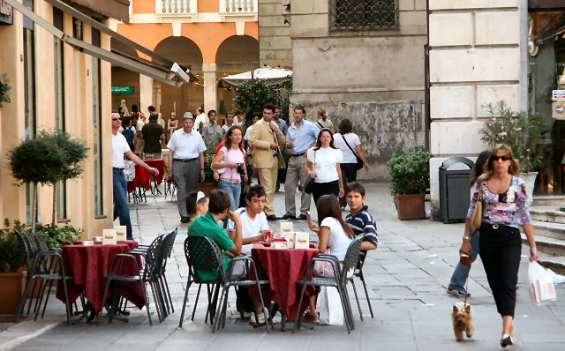
Bar in Piazza dei Signori, Vicenza, Northern Italy
www.bed-breakfast-italy.com/bars.htm

Slide 137
Martin J. Gannon and Rajnandini Pillai
Understanding Global Cultures
“Italians make up for this type of humor by analyzing everything around them through conversation.”
  Talking is a great pastime for most Italians, who frequently meet in cafés to discuss the latest news
  Privacy is frequently lacking in any Italian community, even though Italians say they mind their own business
    Ron R. . . .
www.d.umn.edu/cla/faculty/troufs/anth1095/index.html#Gannon

Slide 138
Martin J. Gannon and Rajnandini Pillai
Understanding Global Cultures
There is little, if any, private life for most Italians
  Everything of importance occurs in public or is at least discussed in public
  “There is no word for privacy in the Italian language, and information is shared widely”
www.d.umn.edu/cla/faculty/troufs/anth1095/index.html#Gannon

Slide 139
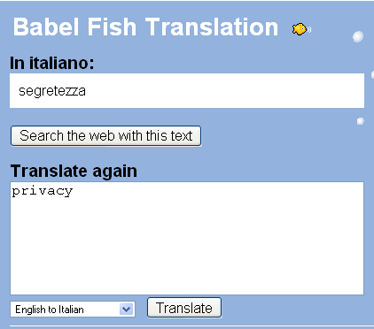
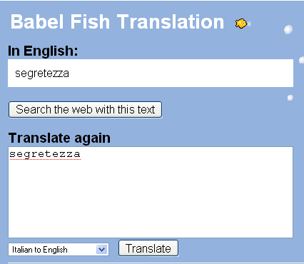
Martin J. Gannon and Rajnandini Pillai
Understanding Global Cultures
There is little, if any, private life for most Italians
  Everything of importance occurs in public or is at least discussed in public
  “There is no word for privacy in the Italian language, and information is shared widely”
www.d.umn.edu/cla/faculty/troufs/anth1095/index.html#Gannon

Slide 140
Martin J. Gannon and Rajnandini Pillai
Understanding Global Cultures
“Unlike the reserved Englishman,
the Italian is apt to tell an acquaintance of a half hour’s standing
all about his financial status,
his family’s health problems,
and details of his current emotional attachments.”
    Robin Blagburn and surgeon
www.d.umn.edu/cla/faculty/troufs/anth1095/index.html#Gannon

Slide 141
Martin J. Gannon and Rajnandini Pillai
Understanding Global Cultures
“The Italian love of conversation as a pastime usually limits the chances of something secret staying so for very long, and it is this love of conversation (and voice) that is intimately related to externalization . . .”
www.d.umn.edu/cla/faculty/troufs/anth1095/index.html#Gannon

Slide 142
and sometimes Italy speaks from beyond the grave . . .

Slide 143
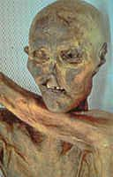
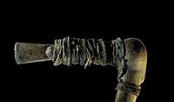
The Iceman’s Ax
Ötzi the Iceman
Bolzano, Italy

Slide 144
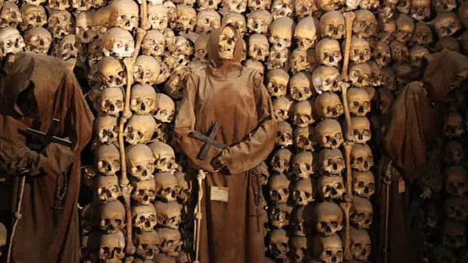
Catacombs of Rome
https://javitour.com/catacumbas-de-roma/

Slide 145
  The Overture
  Pageantry and Spectacle
  Voice
  Externalization
  5. Chorus and Soloists
Italy
www.d.umn.edu/cla/faculty/troufs/anth1095/index.html#Gannon

Slide 146
Externalization refers specifically to the belief that
feelings and emotions
are so powerful
that an individual cannot keep them within himself or herself and must express them to others
  The Overture
  Pageantry and Spectacle
  Voice
  Externalization
  5. Chorus and Soloists
Italy
www.d.umn.edu/cla/faculty/troufs/anth1095/index.html#Gannon

Slide 147
Externalization refers specifically to the belief that
feelings and emotions
are so powerful
that an individual cannot keep them within himself or herself and must express them to others
  The Overture
  Pageantry and Spectacle
  Voice
  Externalization
  5. Chorus and Soloists
Italy
www.d.umn.edu/cla/faculty/troufs/anth1095/index.html#Gannon

Slide 148
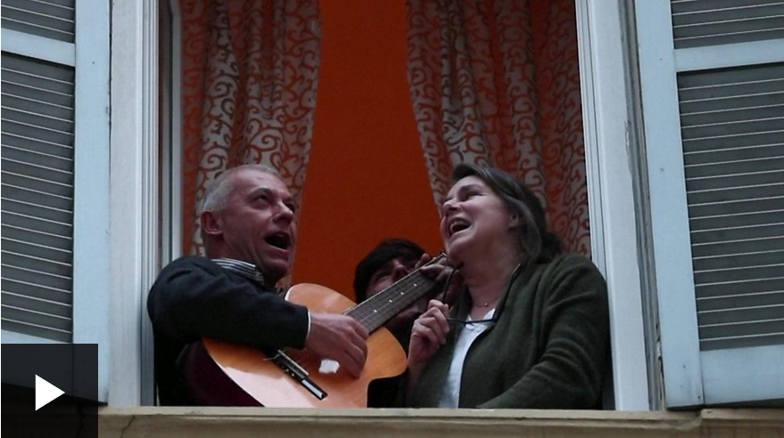
14 Mar 2020
Coronavirus: Italians sang from their windows to boost morale
A countrywide lockdown due to coronavirus didn't stop Italians from bursting into morale-boosting song in a nationwide flashmob event.

Slide 149
Martin J. Gannon and Rajnandini Pillai
Understanding Global Cultures
Externalization refers specifically to the fact that feelings and emotions are so overwhelming that the individual cannot keep them to himself or herself, but must express them to others
  It also refers to the assumption that
  the event is more important than the actions of one individual, which is consistent with the Italian reaction to catastrophes and uncertainty.
www.d.umn.edu/cla/faculty/troufs/anth1095/index.html#Gannon

Slide 150
Martin J. Gannon and Rajnandini Pillai
Understanding Global Cultures
That is, the drama is of more significance to the viewers or community than to the individuals because of its symbolism and generality
  This pattern of behavior is the opposite of that of the Anglo-Saxon, which emphasizes that a person should control emotions and not express them or, as the British say, keep a stiff upper lip.
www.d.umn.edu/cla/faculty/troufs/anth1095/index.html#Gannon

Slide 151
  The Overture
  Pageantry and Spectacle
  Voice
  Externalization
  5. Chorus and Soloists
The piazza
Italy
www.d.umn.edu/cla/faculty/troufs/anth1095/index.html#Gannon

Slide 152
Martin J. Gannon and Rajnandini Pillai
Understanding Global Cultures
  Because of the importance of drama in everyday life, Italians value the piazza as the center of every town and village
  It is the stage on which people gather to share conversation and relate experiences
  The actions that take place in the piazza are
  minor dramas of Italian life
  “everyone knows that gatherings will occur at
  regular times at the piazza, usually around noon and at 5 or 6 p.m. after work”
www.d.umn.edu/cla/faculty/troufs/anth1095/index.html#Gannon

Slide 153
Martin J. Gannon and Rajnandini Pillai
Understanding Global Cultures
Business confidentiality can be a problem in Italy
  People discuss secret business negotiations with both friends and family as well as the press
  Therefore, leaks are common for most large business deals
www.d.umn.edu/cla/faculty/troufs/anth1095/index.html#Gannon

Slide 154
Martin J. Gannon and Rajnandini Pillai
Understanding Global Cultures
This overall fearful, suspicious attitude may be partially due to a quality upon which Italians place a high value . . .
cleverness
www.d.umn.edu/cla/faculty/troufs/anth1095/index.html#Gannon

Slide 155
Martin J. Gannon and Rajnandini Pillai
Understanding Global Cultures
Because of the constant change and struggle in the country, those who can survive through
enterprise, cunning, imagination, and intelligence
are held in high esteem by others around them
  In other words, those who can create
  the most imaginative show are admired by many Italians
www.d.umn.edu/cla/faculty/troufs/anth1095/index.html#Gannon

Slide 156
Martin J. Gannon and Rajnandini Pillai
Understanding Global Cultures
Minor deceptions, cleverly and subtly executed, are acceptable even if not necessary
Because everyone is trying to outsmart everyone else, the population as a whole is placed on the defensive
Visitors to Italy often comment on this feature of Italian life
www.d.umn.edu/cla/faculty/troufs/anth1095/index.html#Gannon

Slide 157
  The Overture
  Pageantry and Spectacle
  Voice
  Externalization
  5. Chorus and Soloists
business
Italy
www.d.umn.edu/cla/faculty/troufs/anth1095/index.html#Gannon

Slide 158
Martin J. Gannon and Rajnandini Pillai
Understanding Global Cultures
Although many of the differences
between “the Two Italies”, North and South,
have been defused and minimized through time
business dealings differ in the two regions, North and South . . .
www.d.umn.edu/cla/faculty/troufs/anth1095/index.html#Gannon

Slide 159
Martin J. Gannon and Rajnandini Pillai
Understanding Global Cultures
Working with people from
northern Italy
a low-context subculture that
emphasizes written rules and agreements,
Is much like dealing
with the Americans or Germans
  Negotiating effectively with northern Italians essentially means communicating with them in a straightforward, sophisticated manner
  social talk should be kept to a minimum
  in order to get down to business
www.d.umn.edu/cla/faculty/troufs/anth1095/index.html#Gannon

Slide 160
Martin J. Gannon and Rajnandini Pillai
Understanding Global Cultures
When negotiating with people from
southern Italy
a high-context subculture in which
oral communication and subtle nuances are stressed,
a visitor must spend time
establishing rapport
with his or her counterparts
  long-term relationship are important to southern Italians, and trust must be built up before business dealings can become truly effective
www.d.umn.edu/cla/faculty/troufs/anth1095/index.html#Gannon

Slide 161
Martin J. Gannon and Rajnandini Pillai
Understanding Global Cultures
In spite of these subtle differences,
most Italians use
a collaborative style of negotiating
in that they will continue a dialogue until everyone’s needs are met
  Part of this style is due to the
  emotional nature of many Italians
  The emotional nature of such Italians enables them to see past the words spoken to the emotions felt
www.d.umn.edu/cla/faculty/troufs/anth1095/index.html#Gannon

Slide 162
Martin J. Gannon and Rajnandini Pillai
Understanding Global Cultures
This insight helps them empathize and understand the needs of those with whom they negotiate
Such aggressive yet emotional Italians want to please everyone, including themselves
Therefore, the collaborative style of negotiating is common throughout Italy
www.d.umn.edu/cla/faculty/troufs/anth1095/index.html#Gannon

Slide 163
Martin J. Gannon and Rajnandini Pillai
Understanding Global Cultures
In spite of these subtle differences,
most Italians use
a collaborative style of negotiating
in that they will continue a dialogue until everyone’s needs are met
In short . . .
  communication involves much more than words
www.d.umn.edu/cla/faculty/troufs/anth1095/index.html#Gannon

Slide 164
truer words
were never spoken

Slide 165
As Gannon and Pillai
sum it up . . .

Slide 166
Martin J. Gannon and Rajnandini Pillai
Understanding Global Cultures
“This, then, is Italy.
It is still a grand and larger-than-life society whose citizens
love pageantry and spectacle,
emphasize a range of voices
in everyday life,
externalize emotions and feelings,
and feel a commitment to the town and region of the country
in which they were born. . . .”
www.d.umn.edu/cla/faculty/troufs/anth1095/index.html#Gannon

Slide 167
Languages
and communication
Italy
© 2009-2024 Timothy G. Roufs, University of Minnesota Duluth

