Slide 1
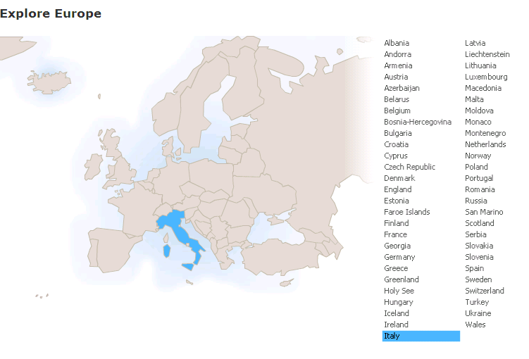
Run in “Slide Show” mode.
Use your up / down arrow keys and / or
your space bar to advance the slides
Regions
Italy
© 2009-2024 Timothy G. Roufs, University of Minnesota Duluth

Slide 2
Italy

Slide 3
Regions
Italy

Slide 4
Italy’s contemporary situation reflects a complex history, geography, ecology, demographic make up, world view, and so forth
. . .

Slide 5
So first, a bit of history and background . . .

Slide 6
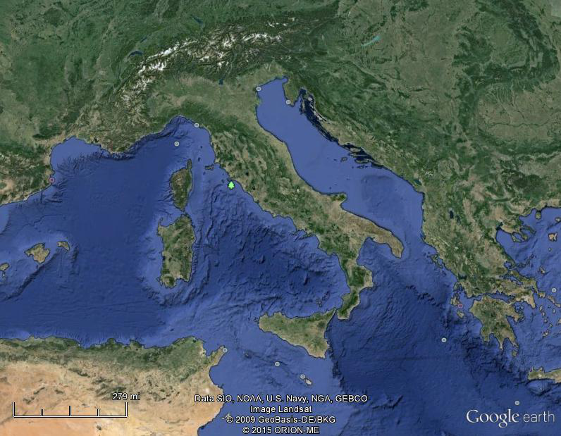
Of all European countries Italy, “the boot,” is probably the most recognizable . . .
Notes:
6

Slide 7
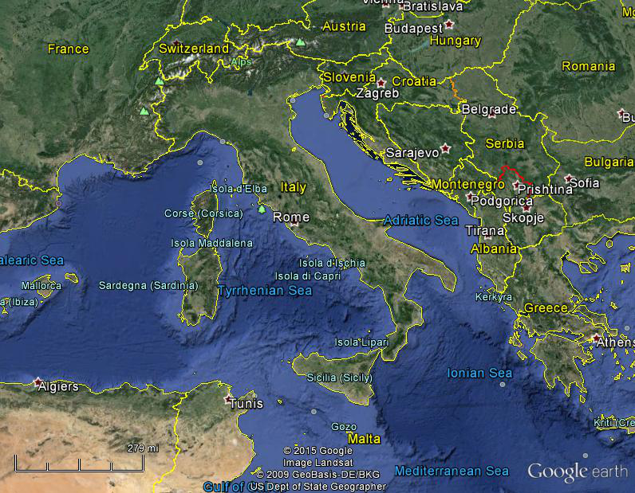
Italy, and her current neighbors . . .
Notes:
7

Slide 8
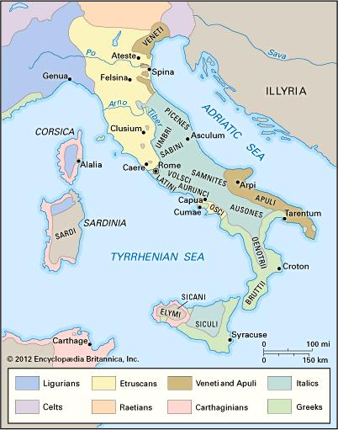
ancient Italic peoples:
Distribution of peoples of ancient Italy ca. 500 B.C.
©Encyclopædia Britannica, Inc.
https://www.britannica.com/topic/history-of-Italy
Notes:
8

Slide 9
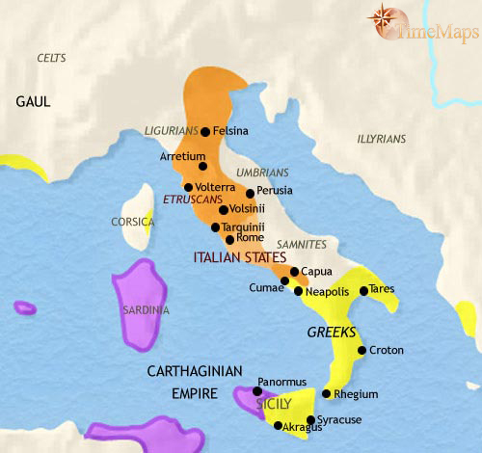
500 B.C.
http://www.timemaps.com/history/italy-500bc
Notes:
9

Slide 10
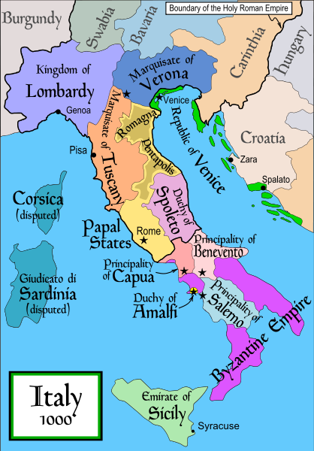
1000
Italy was divided for centuries into small kingdoms and city-states
http://en.wikipedia.org/wiki/Italy
Notes:
10

Slide 11
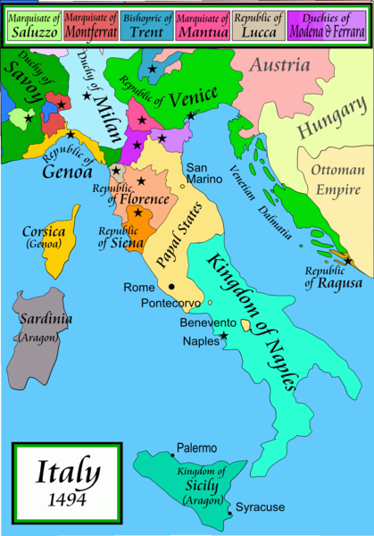
1494
Italy was divided for centuries into small kingdoms and city-states
http://en.wikipedia.org/wiki/Italy
Notes:
11

Slide 12
1494
Italy was divided for centuries into small kingdoms and city-states
http://en.wikipedia.org/wiki/Italy
Notes:
12

Slide 13
In 1494 Christopher Columbus from Genoa went on his second voyage to the New World
Italy was divided for centuries into small kingdoms and city-states
http://en.wikipedia.org/wiki/Italy
Notes:
13

Slide 14
In 1494 Christopher Columbus from Genoa is on his second voyage to the New World
Christopher Columbus was a sugar merchant from Genoa, married to the daughter of a sugar merchant from Madeira, Felipa Perestrello.
Columbus was looking for a way around Venice’s monopoly on things like sugar. . . .
Italy was divided for centuries into small kingdoms and city-states
http://en.wikipedia.org/wiki/Italy
Notes:
14

Slide 15
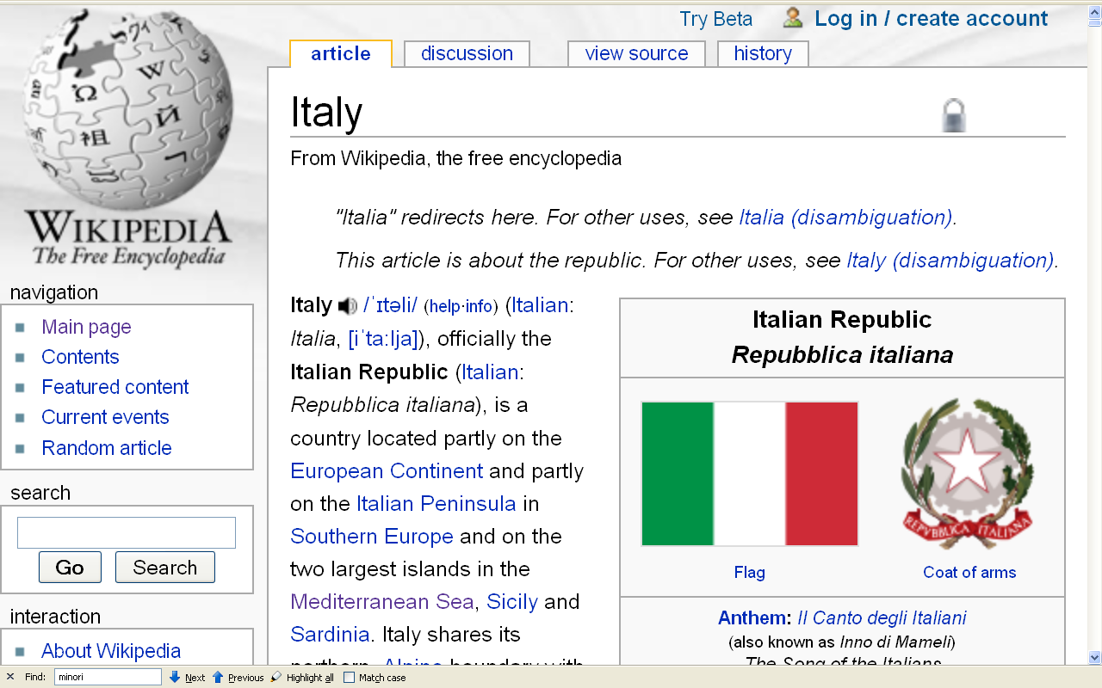
Formation of Italy
Unification —17 March 1861
Republic —2 June 1946
http://en.wikipedia.org/wiki/Italy
Notes:
15

Slide 16
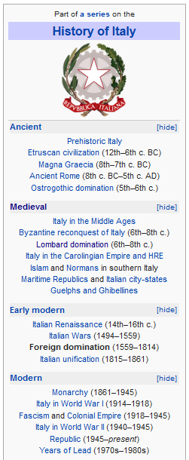
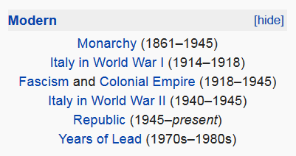
http://en.wikipedia.org/wiki/History_of_Italy_during_foreign_domination_and_the_unification
Notes:
16

Slide 17
http://en.wikipedia.org/wiki/History_of_Italy_during_foreign_domination_and_the_unification
Notes:
17

Slide 18
Formation of Italy
Unification —17 March 1861
Republic —2 June 1946
http://en.wikipedia.org/wiki/Italy
Notes:
18

Slide 19
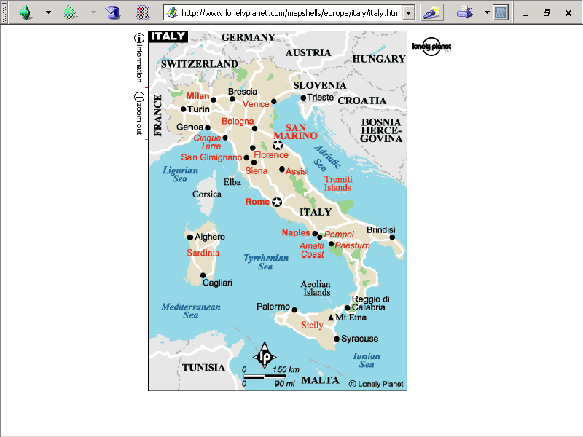
population size
61,021,855 (2023 est.)
https://www.worldometers.info/world-population/italy-population/

Slide 20
Note
Sicily

Slide 21
Note
Sardinia

Slide 22
Note
Kingdom of Tavolara
(unrecognized micronation)
https://en.wikipedia.org/wiki/Kingdom_of_Tavolara

Slide 23
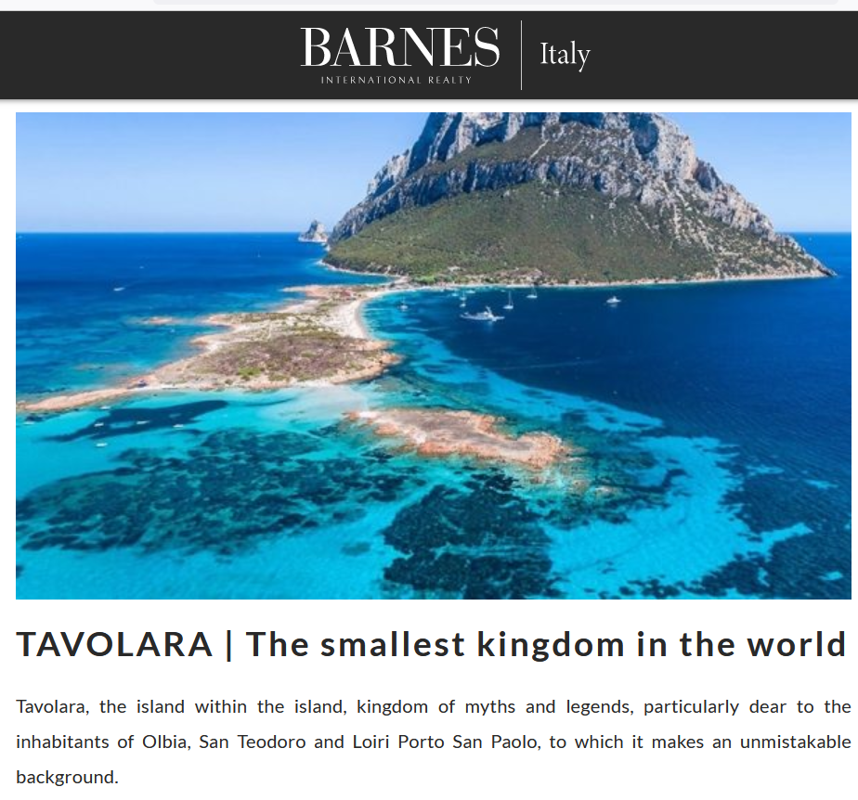
https://barnes-italy.com/tavolara-the-smallest-kingdom-in-the-world/
Notes:
23

Slide 24
Note
Corsica
(French)
Notes:
24

Slide 25
Principality of Seborga
(unrecognized micronation)
Note
https://en.wikipedia.org/wiki/Seborga
Notes:
25

Slide 26
Notes:
26

Slide 27
Note
Rome

Slide 28
The Holy See
(The Vatican)
an independent country
Note
Notes:
28

Slide 29
Note
Notes:
29

Slide 30
Note
The Most Serene Republic of San Marino
an independent country
Notes:
30

Slide 31
Regions
Italy

Slide 32
regions
and
cultural metaphors
as
Units of Analysis

Slide 33
units of analysis may include:
one person
the family
the community
a region
a “culture area”
a culture / “subculture”
a nation
the world
an item or action itself
a “cultural metaphor”
(not as a “culture area”)

Slide 34
The Making of a Metaphor
Italy

Slide 35
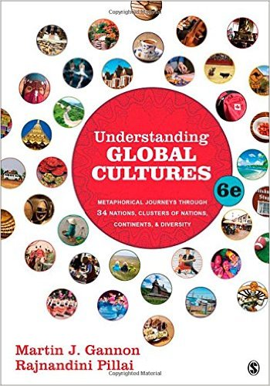
The text
(Thousand Oaks, CA: SAGE Publications, 2015)
Notes:
ousa

Slide 36
Martin J. Gannon and Rajnandini Pillai Understanding Global Cultures
Gannon and Pillai
suggest that . . .
“to understand Italy
it is a good idea to
look at the opera . . .” as a cultural metaphor . . .
www.d.umn.edu/cla/faculty/troufs/anth1095/index.html#Gannon

Slide 37
Martin J. Gannon and Rajnandini Pillai Understanding Global Cultures
Gannon and Pillai focus on
five distinctive characteristics of the opera
and demonstrates how they illustrate Italian life across its various regions . . .
www.d.umn.edu/cla/faculty/troufs/anth1095/index.html#Gannon

Slide 38
The Overture
Pageantry and Spectacle
Voice
Externalization
5. Chorus and Soloists
Italy
www.d.umn.edu/cla/faculty/troufs/anth1095/index.html#Gannon

Slide 39
Gannon and Pillai classify Italy as one of the
“Cleft National Cultures”
that they discuss

Slide 40
http://www.d.umn.edu/cla/faculty/troufs/anth1095/index.html#text

Slide 41
http://www.d.umn.edu/cla/faculty/troufs/anth1095/index.html#text

Slide 42
Gannon and Pillai classify Italy as a
“Cleft National Culture”
one in which the regions, and subcultures of the diverse ethnic groups,
are difficult to integrate

Slide 43
Gannon and Pillai's European Cultural Metaphors include
Ch. 19 The Italian Opera
Ch. 20 Belgian Lace
Ch. 22 The Turkish Coffehouse
Ch. 31 The Russian Ballet
Ch. 32 Estonian Singing
Ch. 33 The Polish Village Church
Ch. 34 The Spanish Bullfight
Ch. 35 The Portuguese Bullfight
Italy is culturally divided
“North - South”

Slide 44
in a nutshell . . .

Slide 45
Martin J. Gannon and Rajnandini Pillai Understanding Global Cultures
The country is divided into two main regions
“Continental Italy” (aka “The North”)
The Alps
The northern Italian plain
“Mediterranean Italy” (aka “The South”)
The Italian peninsula and the islands
www.d.umn.edu/cla/faculty/troufs/anth1095/index.html#Gannon

Slide 46
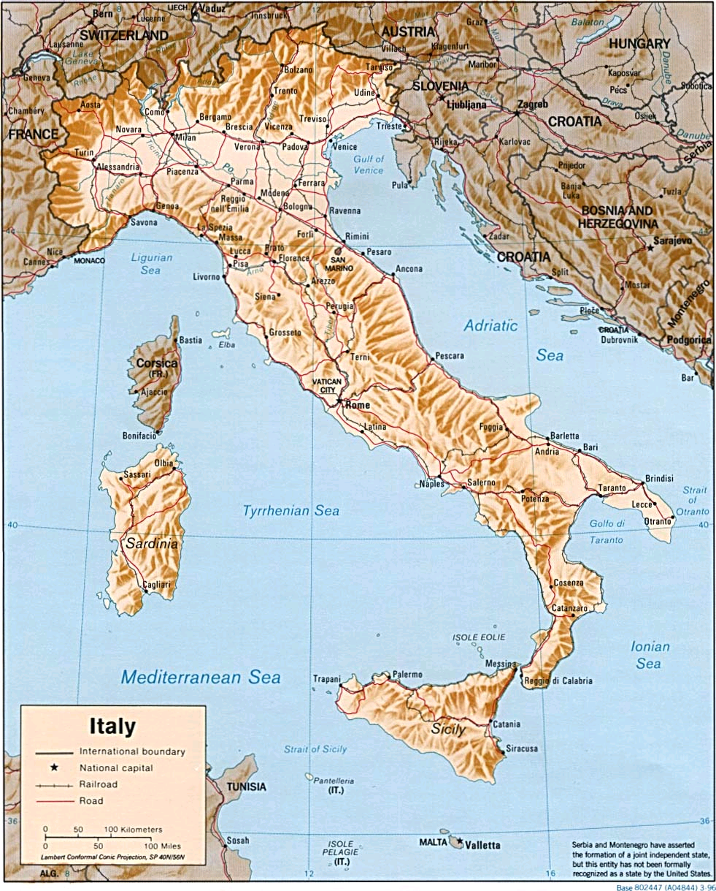
http://www.reliefweb.int/rw/RWB.NSF/db900LargeMaps/SKAR-64GDTU?OpenDocument

Slide 47
Martin J. Gannon and Rajnandini Pillai Understanding Global Cultures
The Apennine mountains run directly down the peninsula’s center, and its northern range almost completely cuts off the north from the south
This geographical division has led to extreme regionalism
www.d.umn.edu/cla/faculty/troufs/anth1095/index.html#Gannon

Slide 48
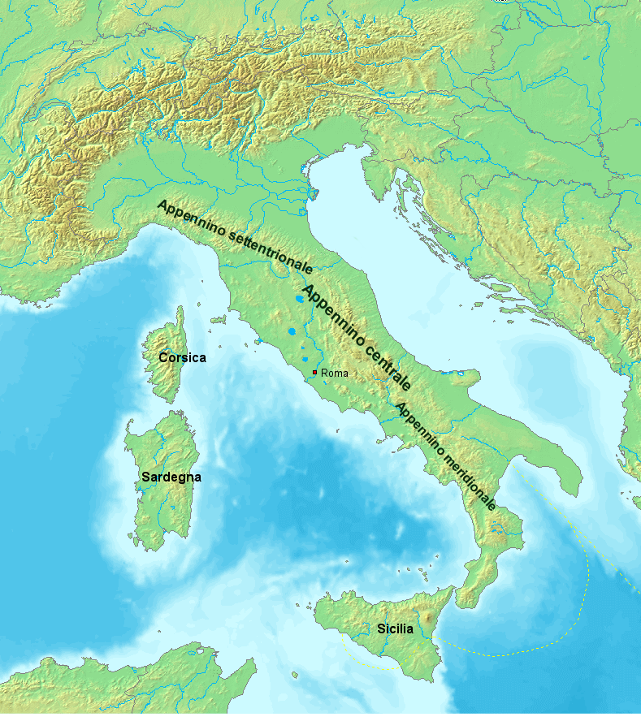
https://en.wikipedia.org/wiki/Apennine_Mountains

Slide 49
Martin J. Gannon and Rajnandini Pillai Understanding Global Cultures
The Apennine mountains run directly down the peninsula’s center, and its northern range almost completely cuts off the north from the south
Many Italians view Italy as two separate nations
The wealthier, industrial north
The poorer, more agrarian south
www.d.umn.edu/cla/faculty/troufs/anth1095/index.html#Gannon

Slide 50
Sometimes the northern region is called
Padania . . .
Some even arguing that it should be an independent country . . .
https://en.wikipedia.org/wiki/Padanian_nationalism

Slide 51
Sometimes the northern region is called
Padania . . .
Some even arguing that it should be an independent country . . .
https://en.wikipedia.org/wiki/Padanian_nationalism

Slide 52
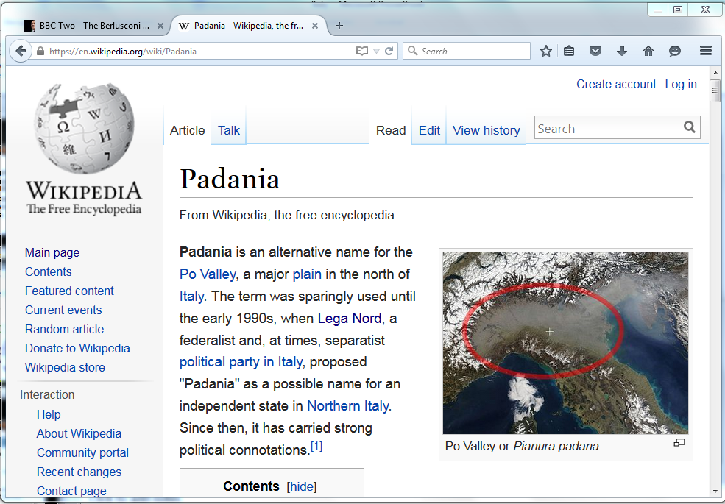
https://en.wikipedia.org/wiki/Padania
Notes:
52

Slide 53
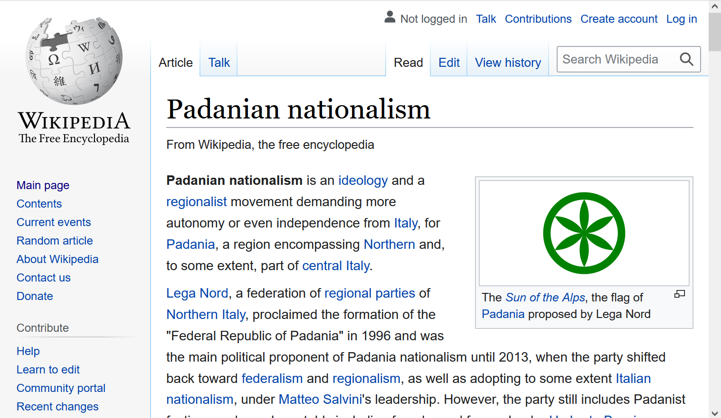
https://en.wikipedia.org/wiki/Padanian_nationalism
Notes:
53

Slide 54
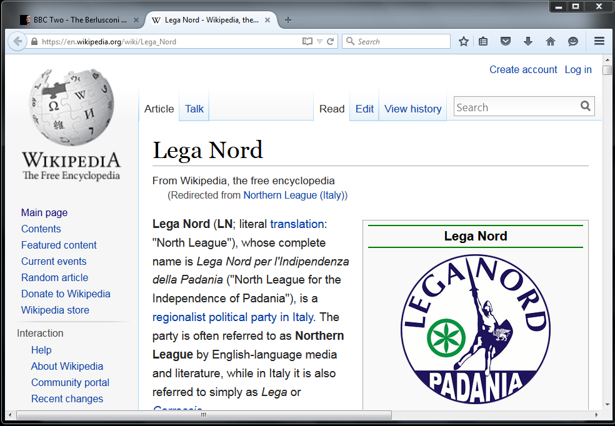
http://en.wikipedia.org/wiki/Northern_League_%28Italy%29
Notes:
54

Slide 55
Demographics
The highest population density is in Northern Italy,
as that one-third of the country contains almost half of the total population
Wikipedia
http://en.wikipedia.org/wiki/Italy#Demographics

Slide 56
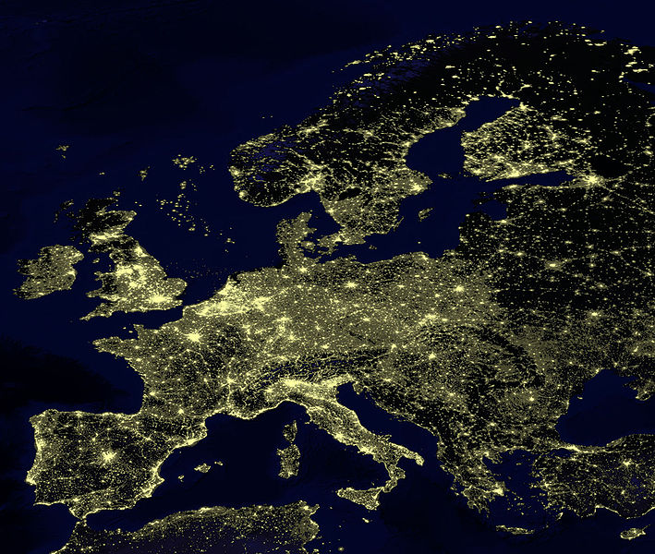
for Europe, at least, earthlight photos give you a sense of population density
https://commons.wikimedia.org/wiki/File:Earthlights_2002.jpg
Notes:
56

Slide 57
https://commons.wikimedia.org/wiki/File:Earthlights_2002.jpg
Notes:
57

Slide 58
https://commons.wikimedia.org/wiki/File:Earthlights_2002.jpg
Notes:
58

Slide 59
Oslo
Stockholm
St. Petersburg
Edinburgh
Glasgow
Copenhagen
London
Brussels
Paris
Milan
Venice
Rome
Madrid
Naples
Athens
https://commons.wikimedia.org/wiki/File:Earthlights_2002.jpg
Notes:
59

Slide 60
Demographics
urban population:
72% of total population
(2023)
rate of urbanization: 0.27% annual rate of change
(2020-2025 est.)
Infant mortality rate:
total: 3.1 deaths/1,000 live births
(2023 est.)
country comparison to the world: 210
Life expectancy at birth:
total population: 82.8 years
(2023 est.)
country comparison to the world: 19
CIA World Factbook
https://www.cia.gov/the-world-factbook/countries/italy/

Slide 61
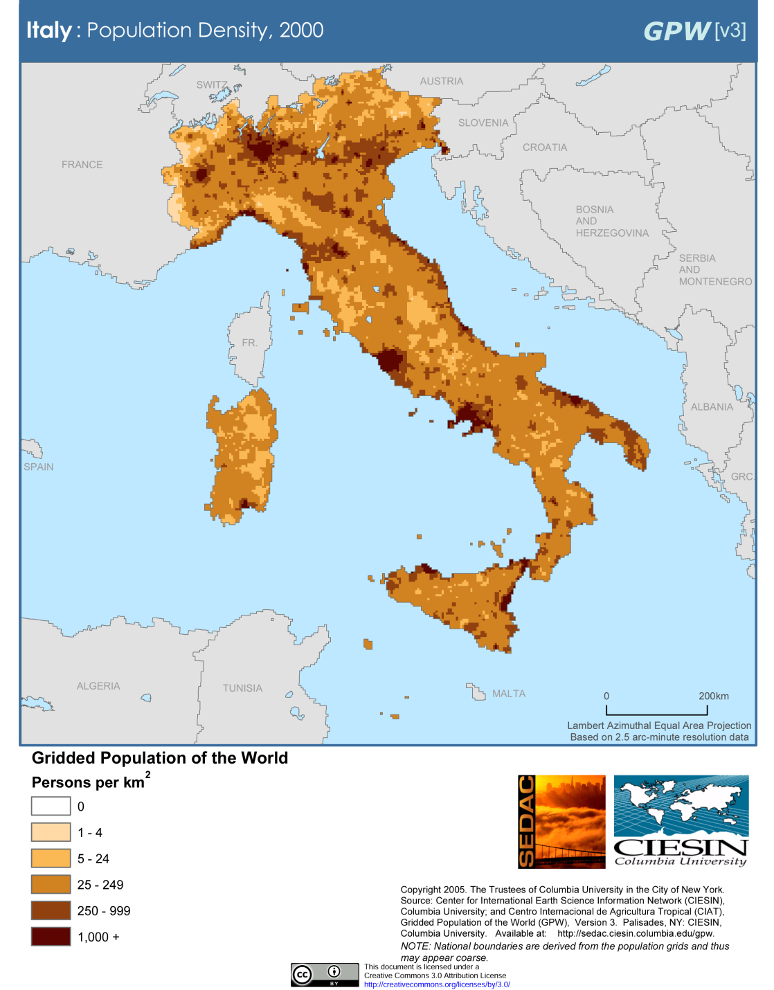
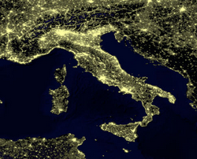
Milan
Venice
Rome
Milan
Venice
Naples
Rome
Naples
Population Density (2000)
Wikipedia
http://en.wikipedia.org/wiki/Italy#Demographics

Slide 62
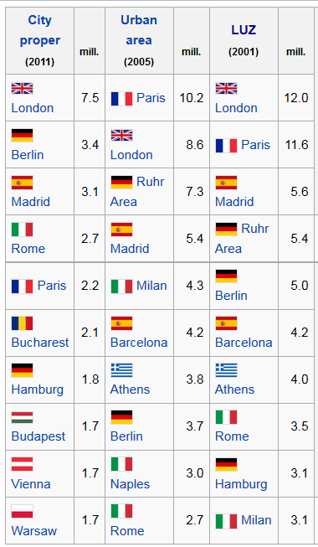
European
Union
Populations
https://en.wikipedia.org/wiki/Demographics_of_the_European_Union#Population_by_nation
Notes:
62

Slide 63
Demographics
Main Ethnic groups
In the North
German-Italians
French-Italians
Slovene-Italians
In the South
Albanian-Italians
Greek-Italians
CIA World Factbook
https://www.cia.gov/the-world-factbook/countries/italy/

Slide 64
Main Languages
Italian (official)
German
parts of Trentino-Alto Adige region are predominantly German speaking
French
small French-speaking minority in Valle d'Aosta region (near France)
Slovene
Slovene-speaking minority in the Trieste-Gorizia area (near Slovenia)
CIA World Factbook
https://www.cia.gov/the-world-factbook/countries/italy/

Slide 65
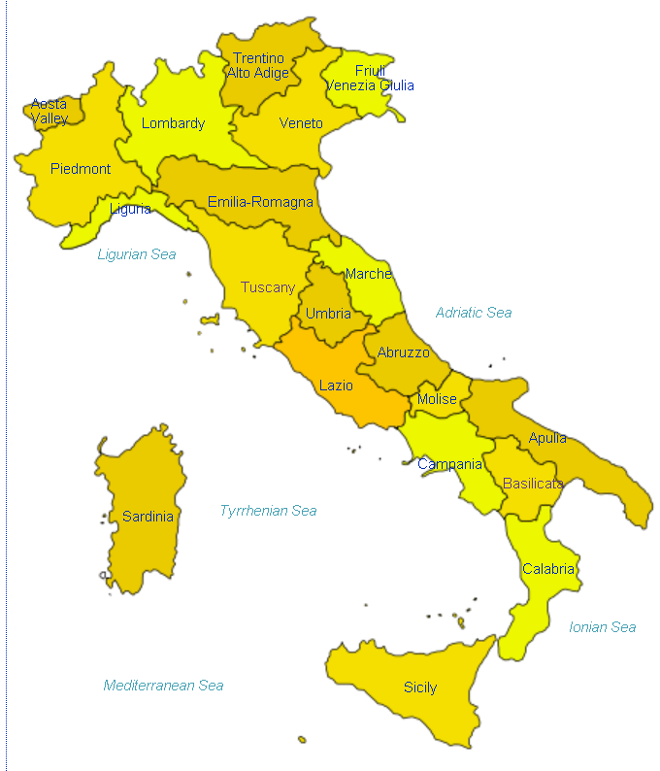
Italian
http://en.wikipedia.org/wiki/Regions_of_Italy
Notes:
65

Slide 66
Main Languages
Italian (official)
German
parts of Trentino-Alto Adige region are predominantly German speaking
French
small French-speaking minority in Valle d'Aosta region (near France)
Slovene
Slovene-speaking minority in the Trieste-Gorizia area (near Slovenia)
CIA World Factbook
https://www.cia.gov/the-world-factbook/countries/italy/

Slide 67
German
http://en.wikipedia.org/wiki/Regions_of_Italy
Notes:
67

Slide 68
Main Languages
Italian (official)
German
parts of Trentino-Alto Adige region are predominantly German speaking
French
small French-speaking minority in Valle d'Aosta region (near France)
Slovene
Slovene-speaking minority in the Trieste-Gorizia area (near Slovenia)
CIA World Factbook
https://www.cia.gov/the-world-factbook/countries/italy/

Slide 69
French
http://en.wikipedia.org/wiki/Regions_of_Italy
Notes:
69

Slide 70
Main Languages
Italian (official)
German
parts of Trentino-Alto Adige region are predominantly German speaking
French
small French-speaking minority in Valle d'Aosta region (near France)
Slovene
Slovene-speaking minority in the Trieste-Gorizia area (near Slovenia)
CIA World Factbook
https://www.cia.gov/the-world-factbook/countries/italy/

Slide 71
Slovene
http://en.wikipedia.org/wiki/Regions_of_Italy
Notes:
71

Slide 72
http://en.wikipedia.org/wiki/Regions_of_Italy
Notes:
72

Slide 73
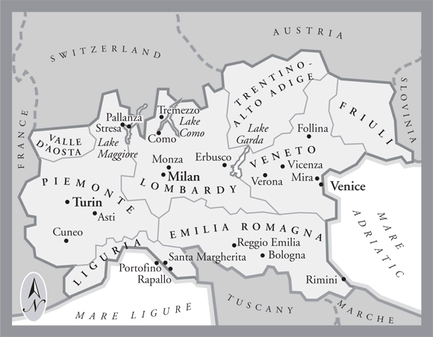
In northern Italy people in three regions speak a different primary language,
in addition to Italian . . .
German
Slovene
French
Italian
is spoken throughout Italy
Tuscany
www.jdbassc.com/maps/map_southern_italy.asp
Notes:
73

Slide 74
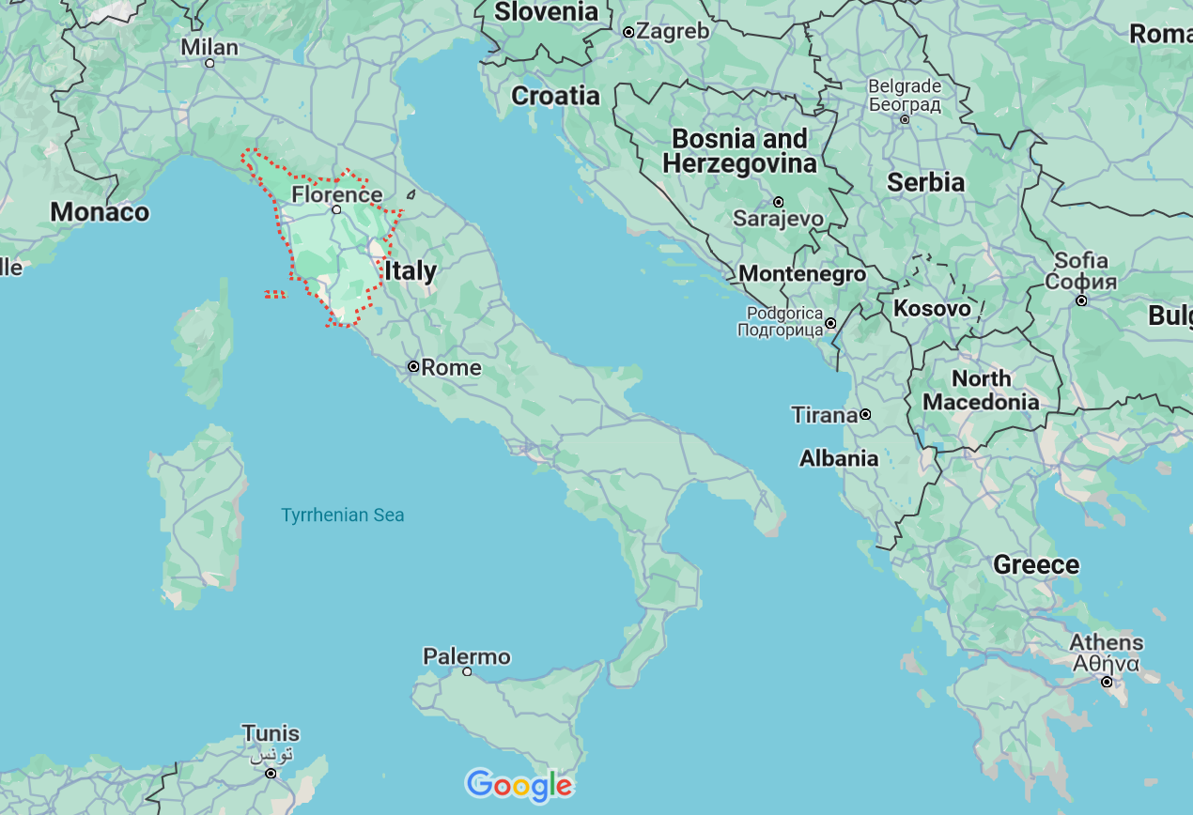
German
French
Slovene
Tuscany
Italian
In the neighboring Tuscany region
they speak Italian, which historically was based on the Florentine dialect . . .

Slide 75
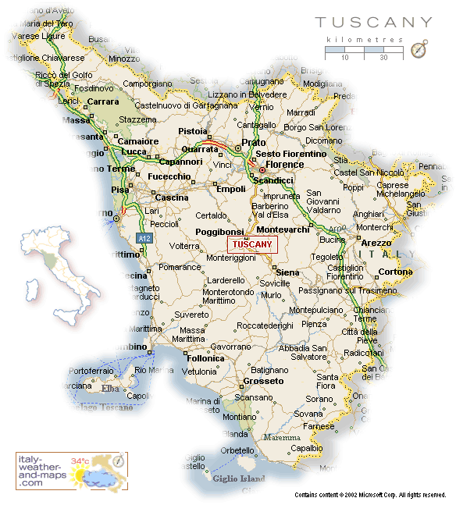
Florence
Pisa
http://healthmap.files.wordpress.com/2009/12/tuscany-map.gif

Slide 76
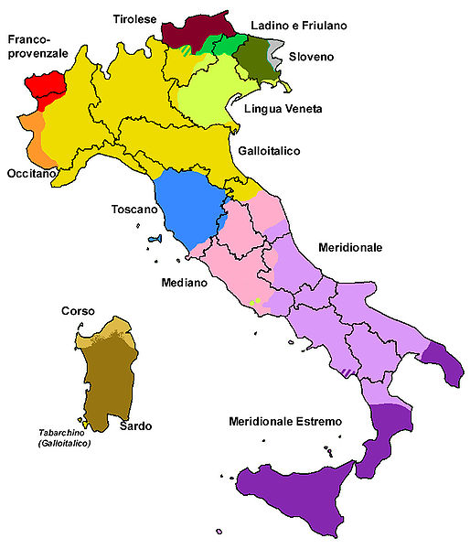
Official language(s) | Italian
Regional language(s) | German, Neapolitan, Slovene, Piedmontese, Sardinian, Sardinian, Tabarchino, Sassarese, Gallurese, Ladin, Cimbrian, Mocheno, Venetian
Minority language(s) | Albanian, Catalan, German, Greek, Slovene, Croatian, French, Franco-Provençal, Friulian, Ladin, Occitan, Sardinia
Main immigrant language(s) | Romanian, Berber, Maghrebi Arabic, Albanian
Main foreign language(s) | English (25%) Spanish (17%) French (14%)
Dialects of Italy by Group
http://en.wikipedia.org/wiki/List_of_languages_of_Italy
Notes:
76

Slide 77
Dialects of Italy by Group
http://en.wikipedia.org/wiki/List_of_languages_of_Italy
Notes:
77

Slide 78
Dialects of Italy by Group
http://en.wikipedia.org/wiki/List_of_languages_of_Italy
Notes:
78

Slide 79
compare these
with the old kingdoms
Dialects of Italy by Group
http://en.wikipedia.org/wiki/List_of_languages_of_Italy
Notes:
79

Slide 80
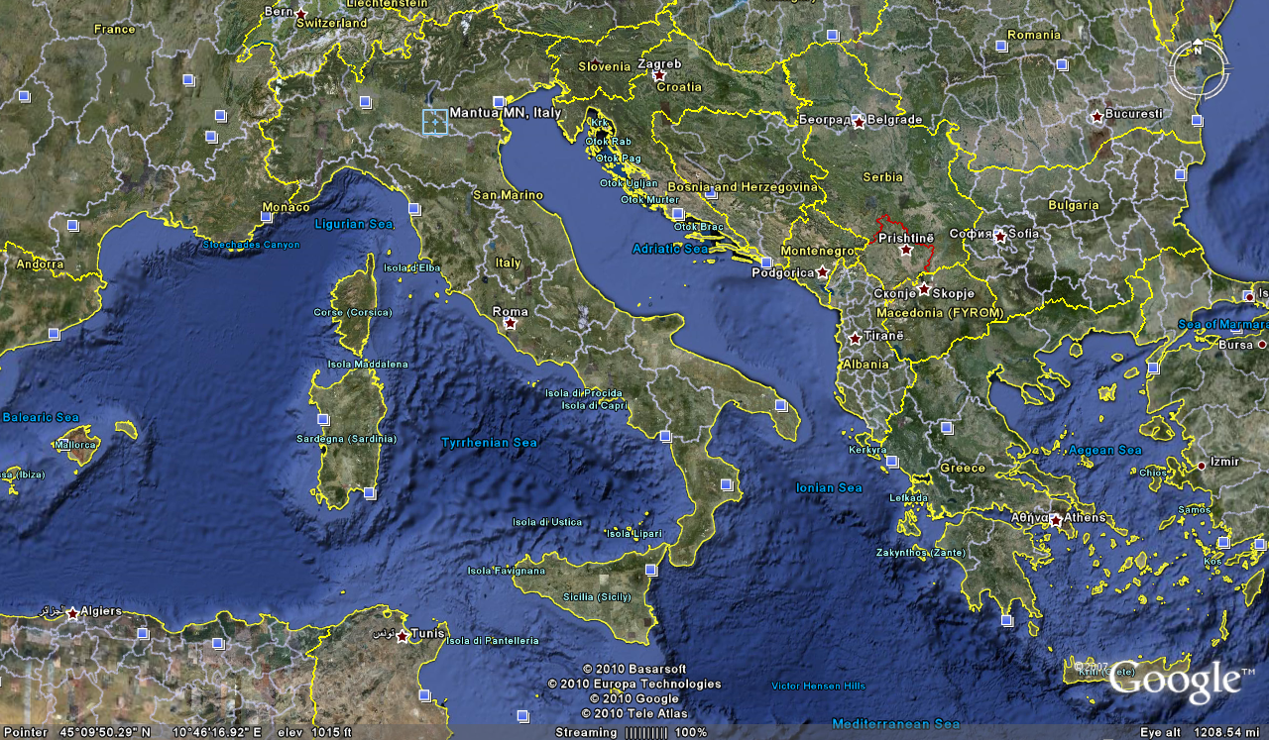
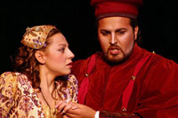
Cosimo Vassallo
is from
Palermo, Sicily
Letizia Colajanni
and
Cosimo Vassallo
/

Slide 81
Cossimo lives in
Mantova
503 miles away
(by air)
/
Letizia Colajanni
and
Cosimo Vassallo

Slide 82
If Cosimo speaks Italian with
his Palermo accent in
Montova, some
will have difficult understanding him
/
Cosimo Vassallo
is from
Palermo, Sicily
Letizia Colajanni
and
Cosimo Vassallo
/

Slide 83
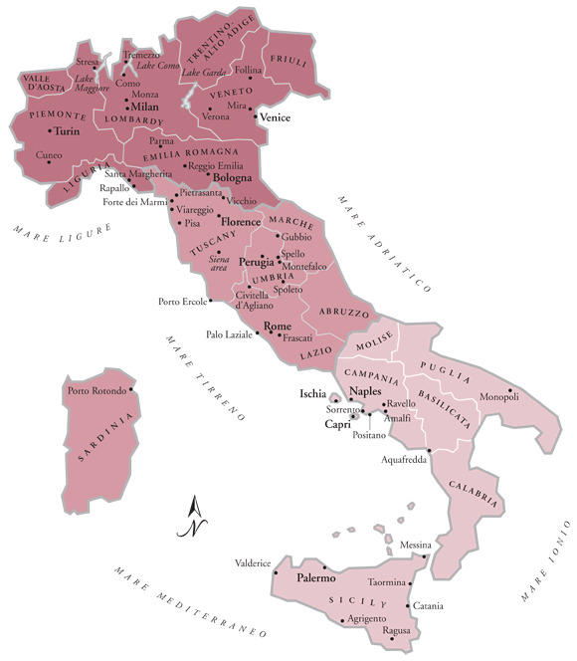
/
My friend Martin Aricochi
who lives in
Brixen (Bressanone), Italy, spoke German until he went to school,
www.jdbassc.com/maps/map_southern_italy.asp
Notes:
83

Slide 84
/
My friend Martin Aricochi
who lives in
Brixen (Bressanone), Italy, spoke German until he went to school,
and they still speak German at home
www.jdbassc.com/maps/map_southern_italy.asp
Notes:
84

Slide 85
A bit of background . . .

Slide 86
Martin J. Gannon and Rajnandini Pillai Understanding Global Cultures
The civic traditions of the north and south
of Italy originated from
different sources
and these traditions have persisted for centuries
(Robert Putnam 1991)
www.d.umn.edu/cla/faculty/troufs/anth1095/index.html#Gannon

Slide 87
Martin J. Gannon and Rajnandini Pillai Understanding Global Cultures
In the
north
there has been a centuries-long legacy of
civic involvement through guilds
and democratic elections
that has held corruption in check
www.d.umn.edu/cla/faculty/troufs/anth1095/index.html#Gannon

Slide 88
Martin J. Gannon and Rajnandini Pillai Understanding Global Cultures
In the 11th century King Frederico established an autocratic form of government in the south that was both politically and economically successful
But his successors corrupted it
The Mafia arose as the middlemen between the kings and the people, which tended to reinforce corruption
www.d.umn.edu/cla/faculty/troufs/anth1095/index.html#Gannon

Slide 89
Martin J. Gannon and Rajnandini Pillai Understanding Global Cultures
Today,
the north of Italy is as successful as or more successful than Germany,
whereas the south
languishes in poverty
even though millions of dollars have been devoted to eradicating it
www.d.umn.edu/cla/faculty/troufs/anth1095/index.html#Gannon

Slide 90
Martin J. Gannon and Rajnandini Pillai Understanding Global Cultures
Because of industrialization, northern Italians have had the benefit of a thriving economy and a relatively prosperous existence
In contrast, southern Italians, who have relied on farming for their livelihood, have tended to be poorer and less educated
www.d.umn.edu/cla/faculty/troufs/anth1095/index.html#Gannon

Slide 91
Martin J. Gannon and Rajnandini Pillai Understanding Global Cultures
Because of industrialization, northern Italians have had the benefit of a thriving economy and a relatively prosperous existence
Southern Italians, who have relied on farming for their livelihood, have tended to be poorer and less educated
www.d.umn.edu/cla/faculty/troufs/anth1095/index.html#Gannon

Slide 92
Martin J. Gannon and Rajnandini Pillai Understanding Global Cultures
Today poverty still exists in some areas, particularly in the south
Italian industry has become increasingly successful, but success is not shared equally by everyone
Because northern companies believe there is a difference in the northern and southern work ethic, they are reluctant to locate branches in the south
www.d.umn.edu/cla/faculty/troufs/anth1095/index.html#Gannon

Slide 93
Martin J. Gannon and Rajnandini Pillai Understanding Global Cultures
Today poverty still exists in some areas, particularly in the south
Italian industry has become increasingly successful, but success is not shared equally by everyone
Because northern companies believe there is a difference in the northern and southern work ethic, they are reluctant to locate branches in the south
www.d.umn.edu/cla/faculty/troufs/anth1095/index.html#Gannon

Slide 94
Martin J. Gannon and Rajnandini Pillai Understanding Global Cultures
The large migration of workers from the south to the north has left behind people who are not willing to give up customs and traditions that have been followed since early European civilization
www.d.umn.edu/cla/faculty/troufs/anth1095/index.html#Gannon

Slide 95
Martin J. Gannon and Rajnandini Pillai Understanding Global Cultures
“The people from the [northern and southern] regions are similar in that
they love life and enjoy
creating the illusion of a show.”
“However, the difference between the people from these two regions is that
southerners tend
to cling to past ways of living
whereas many northerners
look toward the future.”
www.d.umn.edu/cla/faculty/troufs/anth1095/index.html#Gannon

Slide 96
Martin J. Gannon and Rajnandini Pillai Understanding Global Cultures
To most
northerners,
wealth
is the way to ensure the lasting defense and prosperity of the family and close friends
“The northerner is perpetually trying to acquire wealth in its various forms”
S/he wants a job, a good job, and then a better job
S/he also wants the scientific and technical knowledge that will ensure better paid employment and advancement
www.d.umn.edu/cla/faculty/troufs/anth1095/index.html#Gannon

Slide 97
Martin J. Gannon and Rajnandini Pillai Understanding Global Cultures
many
southerners,
on the other hand,
want above all
to be obeyed, admired,
respected, and envied
They want wealth too, but frequently as an instrument to influence people
Southerners are preoccupied with commanding the respect of the audience throughout the many operas of life
www.d.umn.edu/cla/faculty/troufs/anth1095/index.html#Gannon

Slide 98
Martin J. Gannon and Rajnandini Pillai Understanding Global Cultures
many southerners,
be they wealthy or poor,
want the gratitude of powerful friends and relatives,
the fear of their enemies,
and the respect of everybody
Southerners seek wealth as a means of commanding obedience and respect from others
www.d.umn.edu/cla/faculty/troufs/anth1095/index.html#Gannon

Slide 99
business
http://www.reliefweb.int/rw/RWB.NSF/db900LargeMaps/SKAR-64GDTU?OpenDocument

Slide 100
Martin J. Gannon and Rajnandini Pillai Understanding Global Cultures
Although many of the differences
between “the Two Italies”
have been defused and minimized through time
business dealings differ in the two regions . . .
www.d.umn.edu/cla/faculty/troufs/anth1095/index.html#Gannon

Slide 101
Martin J. Gannon and Rajnandini Pillai Understanding Global Cultures
Working with people from
northern Italy
a low-context subculture that
emphasizes written rules and agreements, is much like dealing with the Americans or Germans
Negotiating effectively with northern Italians essentially means communicating with them in A straightforward, sophisticated manner
social talk should be kept to a minimum in order to get down to business
www.d.umn.edu/cla/faculty/troufs/anth1095/index.html#Gannon

Slide 102
Martin J. Gannon and Rajnandini Pillai Understanding Global Cultures
When negotiating with people from
southern Italy
a high-context subculture in which oral communication and subtle nuances are stressed,
a visitor must spend time
establishing rapport
with his or her counterparts
long-term relationship are important to southern Italians, and trust must be built up before business dealings can become truly effective
www.d.umn.edu/cla/faculty/troufs/anth1095/index.html#Gannon

Slide 103
Martin J. Gannon and Rajnandini Pillai Understanding Global Cultures
In spite of these subtle differences,
most Italians use
a collaborative style of negotiating
in that they will continue a dialogue until everyone’s needs are met
Part of this style is due to the emotional nature of many Italians
The emotional nature of such Italians enables them to see past the words spoken to the emotions felt
www.d.umn.edu/cla/faculty/troufs/anth1095/index.html#Gannon

Slide 104
Martin J. Gannon and Rajnandini Pillai Understanding Global Cultures
In spite of these subtle differences,
most Italians use
a collaborative style of negotiating
in that they will continue a dialogue until everyone’s needs are met
communication involves much more than words
www.d.umn.edu/cla/faculty/troufs/anth1095/index.html#Gannon

Slide 105
Martin J. Gannon and Rajnandini Pillai Understanding Global Cultures
This insight helps them empathize and understand the needs of those with whom they negotiate
Such aggressive yet emotional Italians want to please everyone, including themselves
Therefore, the collaborative style of negotiating is common throughout Italy
www.d.umn.edu/cla/faculty/troufs/anth1095/index.html#Gannon

Slide 106
Martin J. Gannon and Rajnandini Pillai Understanding Global Cultures
Similar to the operative importance of both the chorus and soloists,
the regional Italian differences, combined with the overall Italian culture,
helped Italy gain economic strength
during the 1970s and 1980s
As noted, this strength of Italy lies in the proliferation of small-scale commercial and industrial enterprises, which are usually family run
www.d.umn.edu/cla/faculty/troufs/anth1095/index.html#Gannon

Slide 107
Martin J. Gannon and Rajnandini Pillai Understanding Global Cultures
People whose families used to be
southern farmers brought their deep-rooted traditions to the north
Some of these traditions and skills enabled many southerners to move their families from farming into the commercial market
The tradition of keeping ownership within the family combined with the skill of managing a diverse product mix and willingness to work long hours, makes the new entrepreneurs able to compete effectively with their European neighbors
www.d.umn.edu/cla/faculty/troufs/anth1095/index.html#Gannon

Slide 108
Martin J. Gannon and Rajnandini Pillai Understanding Global Cultures
. . . the Northern League . . . periodically seeks to create two separate nations in Italy
But the economically prosperous north depends heavily on emigration from the south for its workforce
www.d.umn.edu/cla/faculty/troufs/anth1095/index.html#Gannon

Slide 109
Martin J. Gannon and Rajnandini Pillai Understanding Global Cultures
In the end,
the north and south
are closely linked to one another culturally, even though there are regional differences . . .
www.d.umn.edu/cla/faculty/troufs/anth1095/index.html#Gannon

Slide 110
The Overture
Pageantry and Spectacle
Voice
Externalization
5. Chorus and Soloists
education
Italy
www.d.umn.edu/cla/faculty/troufs/anth1095/index.html#Gannon

Slide 111
Martin J. Gannon and Rajnandini Pillai Understanding Global Cultures
Education
has been a major mechanism for bringing about
the modernization of Italy
and
minimizing the regional differences
By diffusing the national culture through the teaching of one Italian language and by raising literacy levels, Italians have stressed cultural unity and deemphasized regionalism to a greater degree than in the past
www.d.umn.edu/cla/faculty/troufs/anth1095/index.html#Gannon

Slide 112
Martin J. Gannon and Rajnandini Pillai Understanding Global Cultures
Although the Italian culture consists of many regional subcultures, the modernization of Italy has begun to unify these subcultures
The Italian culture is continuously changing to one where the melody of the regional soloists blends together into a harmonic chorus, “as political reforms confirm”
www.d.umn.edu/cla/faculty/troufs/anth1095/index.html#Gannon

Slide 113
The Overture
Pageantry and Spectacle
Voice
Externalization
5. Chorus and Soloists
political divisions
Italy
www.d.umn.edu/cla/faculty/troufs/anth1095/index.html#Gannon

Slide 114
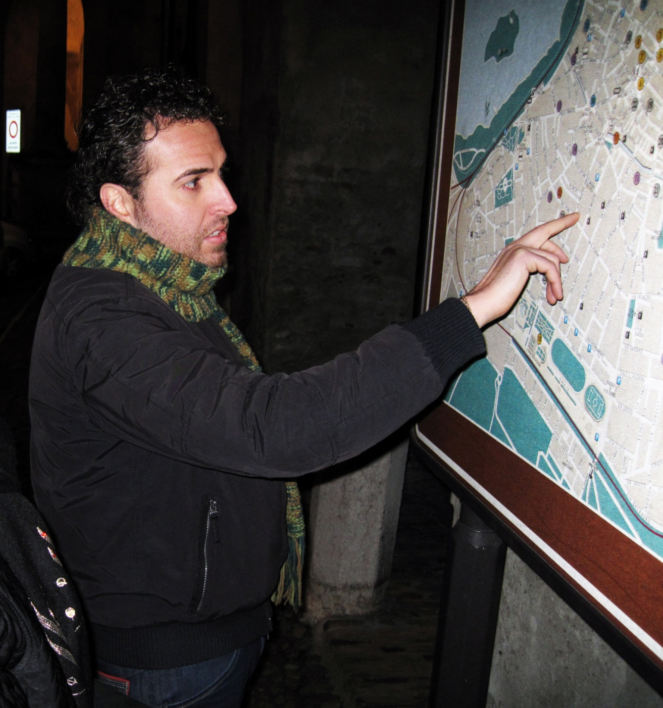
In Italy
the comune
(plural comuni)
is the basic administrative division of both provinces and regions, and may be properly approximated in casual speech by the English word township or municipality
Tim Roufs
Notes:
114

Slide 115
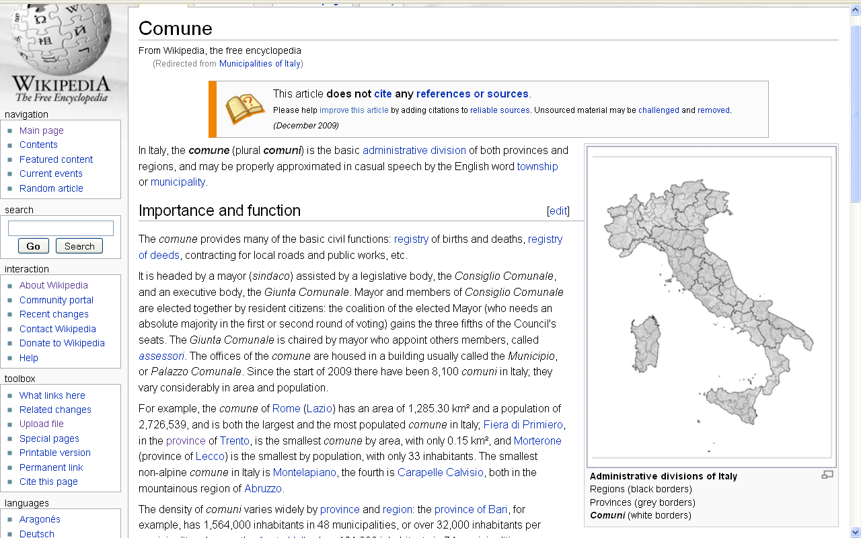
township or municipality
http://en.wikipedia.org/wiki/Municipalities_of_Italy
Notes:
115

Slide 116
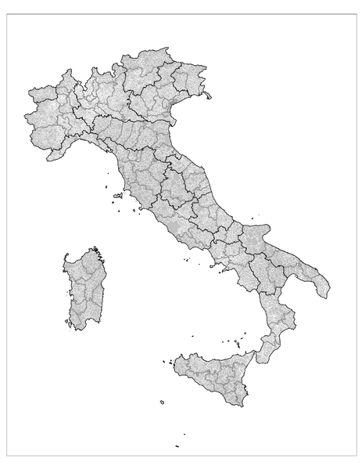
Administrative divisions of Italy: Regions (black borders) Provinces (grey borders) Comuni (white borders)
http://en.wikipedia.org/wiki/Municipalities_of_Italy
Notes:
116

Slide 117
Cosimo Vassallo
A new district in Northern Italy
was just established in 2009
Tim Roufs
Notes:
117

Slide 118
and in southern Italy they even have a region that doesn’t exist . . .
(or at least that’s what they like to say . . .)

Slide 119
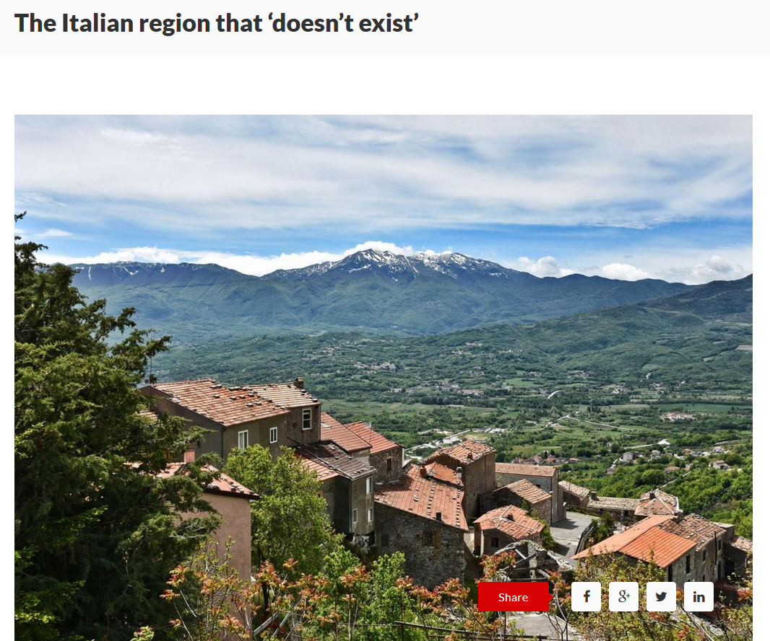
Nov 6 2019
Molise
https://www.wetheitalians.com/default/italian-region-doesnt-exist
Notes:
119

Slide 120
and other factors sometimes need to be considered relative to political divisions . . .

Slide 121
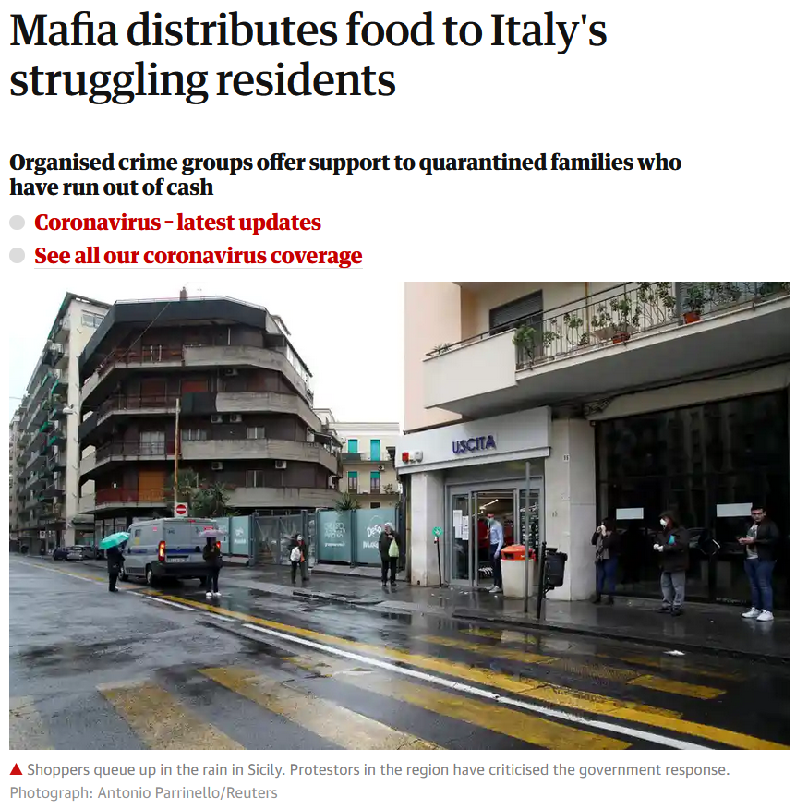
10 April 2020
https://www.theguardian.com/world/2020/apr/10/mafia-distributes-food-to-italys-struggling-residents?CMP=Share_iOSApp_Other

Slide 122
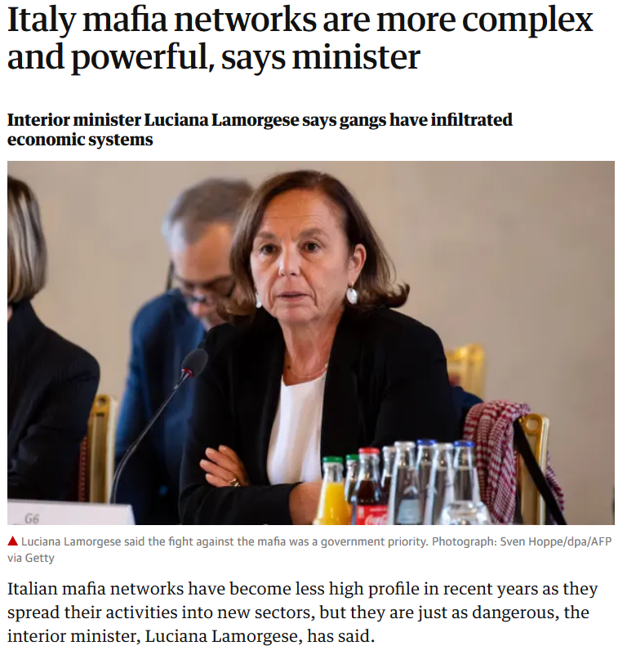
Wed 30 Oct 2019
https://www.theguardian.com/world/2019/oct/30/italy-mafia-networks-are-more-complex-and-powerful-says-minister?CMP=Share_iOSApp_Other

Slide 123
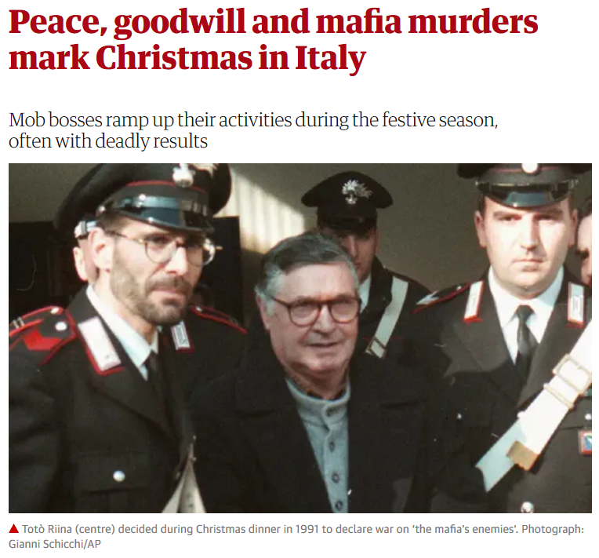
Thu 26 Dec 2019
https://www.theguardian.com/world/2019/dec/26/peace-goodwill-and-mafia-murders-mark-christmas-in-italy?CMP=Share_iOSApp_Other

Slide 124
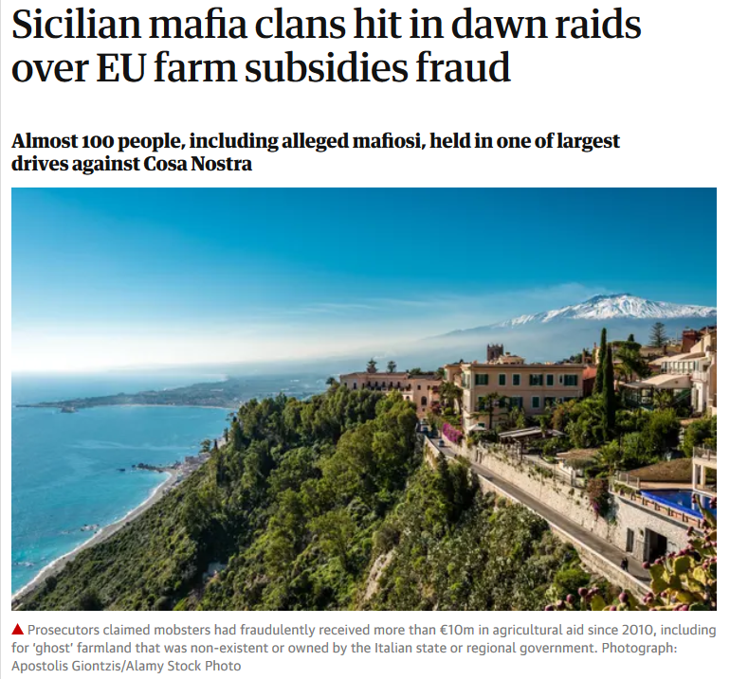
Wed 15 Jan 2020
https://www.theguardian.com/world/2020/jan/15/sicilian-police-launch-dawn-raids-in-eu-subsidies-sting?CMP=Share_iOSApp_Other

Slide 125
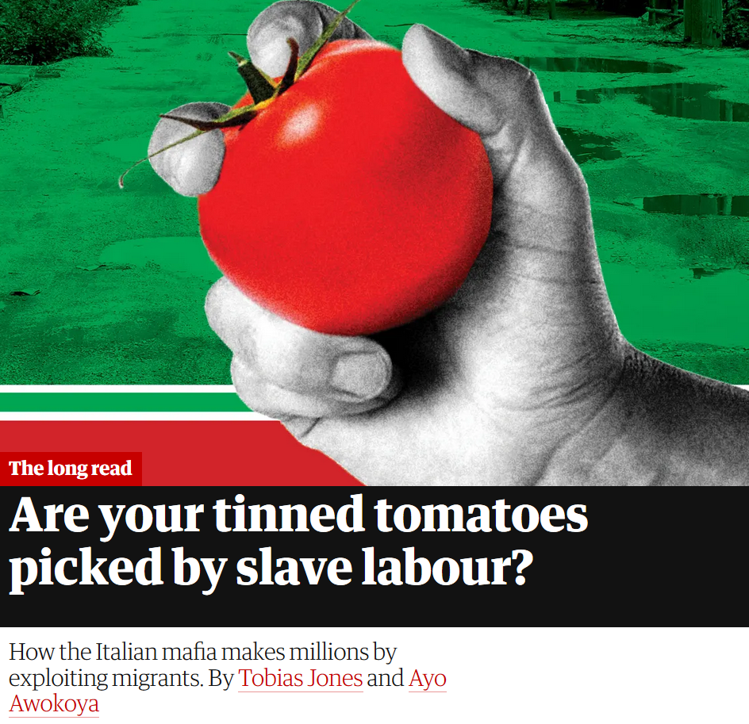
Thurs 20 June 2019
https://www.theguardian.com/world/2019/jun/20/tomatoes-italy-mafia-migrant-labour-modern-slavery?CMP=Share_iOSApp_Other

Slide 126
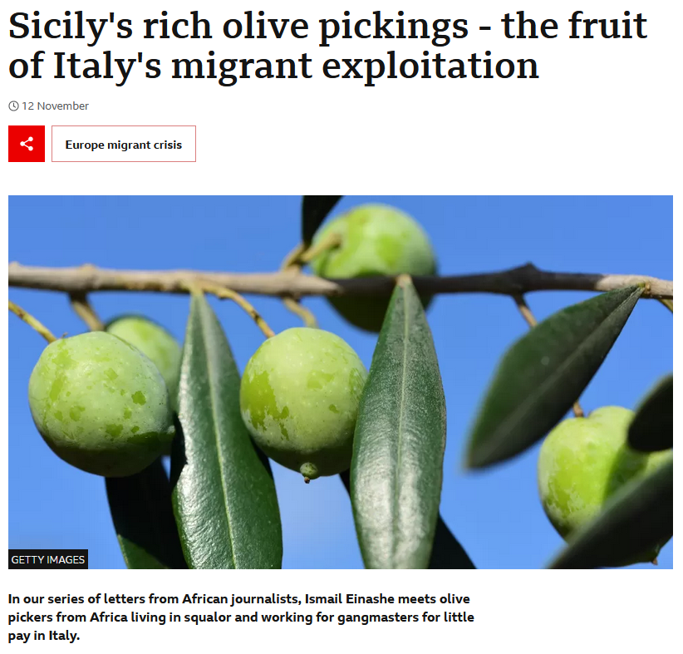
12 November 2022
https://www.bbc.com/news/world-africa-63595025

Slide 127
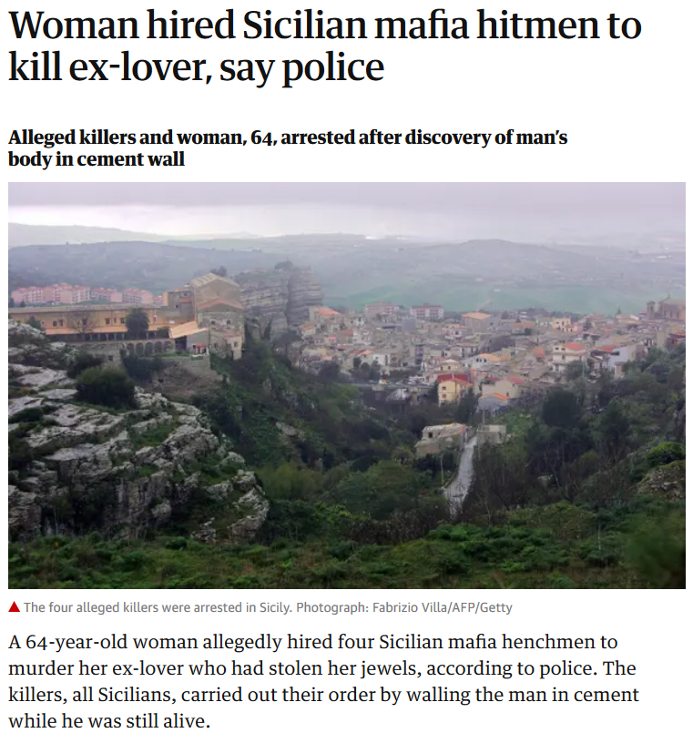
Sat 9 Mar 2019
https://www.theguardian.com/world/2019/mar/09/woman-hired-sicilian-mafia-hitmen-to-kill-ex-lover-say-police?CMP=Share_iOSApp_Other

Slide 128
“There were sixteen good harvests and 111 famine years in northern Italy from
1451 to 1767.”
Alan Macfarlane (1997). p.64. ISBN 0-631-18117-2
https://en.wikipedia.org/wiki/Famine

Slide 129
Martin J. Gannon and Rajnandini Pillai Understanding Global Cultures
Italians tend to talk louder than many other nationalities
But more so in the south than in the north
Stories are told with passion, anger and joy
The air in Italy is filled with so many voices that one must frequently talk in a very loud voice to be understood, “thereby increasing the total uproar”
www.d.umn.edu/cla/faculty/troufs/anth1095/index.html#Gannon

Slide 130
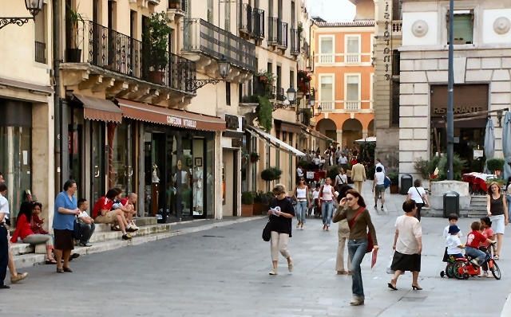
Piazza dei Signori, Vicenza, Northern Italy
www.bed-breakfast-italy.com/bars.htm

Slide 131
Martin J. Gannon and Rajnandini Pillai Understanding Global Cultures
Venezia (1997) suggests that the large
piazza is more descriptive of southern Italy, whereas bars (and the adjoining small parks) are more descriptive of northern Italy
www.d.umn.edu/cla/faculty/troufs/anth1095/index.html#Gannon

Slide 132
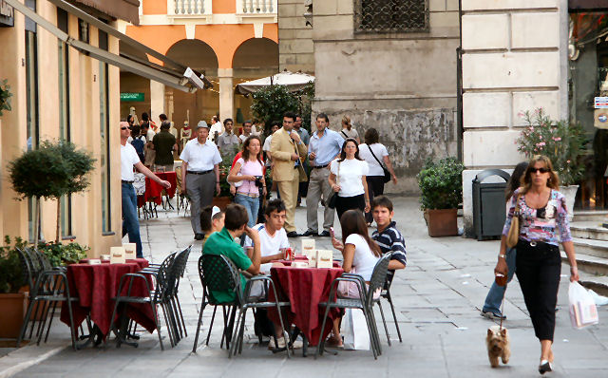
Bar in Piazza dei Signori, Vicenza, Northern Italy
www.bed-breakfast-italy.com/bars.htm

Slide 133
Martin J. Gannon and Rajnandini Pillai Understanding Global Cultures
However,
Italy tends to be a man’s world
The principle of male superiority is enforced less strictly in the north than in the south
For e.g., in some Sicilian villages, unmarried women are supposed to sit indoors during the day when unchaperoned
www.d.umn.edu/cla/faculty/troufs/anth1095/index.html#Gannon

Slide 134
Demographics
Religions
Roman Catholic 80%-90%
approximately
about one-third regularly attend services
Other 10-20%%
includes “mature Protestant” and Jewish communities
and a growing Muslim immigrant community
CIA World Factbook
https://www.cia.gov/the-world-factbook/countries/italy/

Slide 135
Martin J. Gannon and Rajnandini Pillai Understanding Global Cultures
There are regional differences in the manner in which the overture is performed
In Milan, which has been influenced by its proximity to Switzerland and Germany, there is a tendency to shorten the overture
Still, it occurs, even in the smallest café that has only a few tables and a modest menu featuring sandwiches, in the form of a few minutes of conversation with the owner
www.d.umn.edu/cla/faculty/troufs/anth1095/index.html#Gannon

Slide 136
Martin J. Gannon and Rajnandini Pillai Understanding Global Cultures
There are regional differences in the manner in which the overture is performed
In Milan, which has been influenced by its proximity to Switzerland and Germany, there is a tendency to shorten the overture
Still, it occurs, even in the smallest café that has only a few tables and a modest menu featuring sandwiches, in the form of a few minutes of conversation with the owner
. . . but it is still there
www.d.umn.edu/cla/faculty/troufs/anth1095/index.html#Gannon

Slide 137
Martin J. Gannon and Rajnandini Pillai Understanding Global Cultures
There are regional differences in the manner in which the overture is performed
In the south, the overture can be much more involved
A person may visit a store, and chat with the owner, two or three times before purchasing something
Both parties have a good idea about the outcome, but there will be expressions of emotion, various uses of argument an persuasion, and different tones of vice that will help to facilitate the final outcome or sale
Still, the unexpected can, and does, occur, because fate is a critical element in the mix
www.d.umn.edu/cla/faculty/troufs/anth1095/index.html#Gannon

Slide 138
Martin J. Gannon and Rajnandini Pillai Understanding Global Cultures
There are regional differences in the manner in which the overture is performed
In the south, the overture can be much more involved
A person may visit a store, and chat with the owner, two or three times before purchasing something
Both parties have a good idea about the outcome, but there will be expressions of emotion, various uses of argument an persuasion, and different tones of vice that will help to facilitate the final outcome or sale
Still, the unexpected can, and does, occur, because fate is a critical element in the mix
www.d.umn.edu/cla/faculty/troufs/anth1095/index.html#Gannon

Slide 139
The Overture
Pageantry and Spectacle
Voice
Externalization
5. Chorus and Soloists
Language
and Communication
Italy
www.d.umn.edu/cla/faculty/troufs/anth1095/index.html#Gannon

Slide 140
Externalization, which refers specifically to the belief that feelings and emotions are so powerful that an individual cannot keep them within himself or herself and must express them to others
The Overture
Pageantry and Spectacle
Voice
Externalization
5. Chorus and Soloists
Italy
www.d.umn.edu/cla/faculty/troufs/anth1095/index.html#Gannon

Slide 141
The Overture
Pageantry and Spectacle
Voice
Externalization
5. Chorus and Soloists
The piazza
Italy
www.d.umn.edu/cla/faculty/troufs/anth1095/index.html#Gannon

Slide 142
Martin J. Gannon and Rajnandini Pillai Understanding Global Cultures
Venezia (1997) suggests that the large
piazza is more descriptive of southern Italy, whereas bars (and the adjoining small parks) are more descriptive of northern Italy
www.d.umn.edu/cla/faculty/troufs/anth1095/index.html#Gannon

Slide 143
Bar in Piazza dei Signori, Vicenza, Northern Italy
www.bed-breakfast-italy.com/bars.htm

Slide 144
The Overture
Pageantry and Spectacle
Voice
Externalization
5. Chorus and Soloists
la Famiglia
Italy
www.d.umn.edu/cla/faculty/troufs/anth1095/index.html#Gannon

Slide 145
Martin J. Gannon and Rajnandini Pillai Understanding Global Cultures
The family and the extended kinship groups are the basic building blocks for externalization
Familial relationships tend to be close and emotional
The behaviors found in the piazza are replicated within the family
The family is generally seen as one’s greatest resource and protection against all troubles
www.d.umn.edu/cla/faculty/troufs/anth1095/index.html#Gannon

Slide 146
Martin J. Gannon and Rajnandini Pillai Understanding Global Cultures
However,
Italy tends to be a man’s world
About 62% of the workforce is still male
Today, Italy ranks 19th in terms of number of men per 100 women
94.3
www.d.umn.edu/cla/faculty/troufs/anth1095/index.html#Gannon

Slide 147
Martin J. Gannon and Rajnandini Pillai Understanding Global Cultures
However,
Italy tends to be a man’s world
The principle of male superiority is enforced less strictly in the north than in the south
For e.g., in some Sicilian villages, unmarried women are supposed to sit indoors during the day when unchaperoned
www.d.umn.edu/cla/faculty/troufs/anth1095/index.html#Gannon

Slide 148
Martin J. Gannon and Rajnandini Pillai Understanding Global Cultures
As indicated earlier, the north of Italy has been very successful economically
Most of this success is due to the existence of small firms specializing in particular products
These firms both compete and cooperate with one another
If one firm cannot honor an order, a neighboring firm will help it produce the product so that the commitment can be kept
At the same time, firms will cut prices to move ahead of neighboring competitors
www.d.umn.edu/cla/faculty/troufs/anth1095/index.html#Gannon

Slide 149
Martin J. Gannon and Rajnandini Pillai Understanding Global Cultures
Even though individuals might not give the country as a whole much consideration,
they place great importance
on local and regional affiliation
www.d.umn.edu/cla/faculty/troufs/anth1095/index.html#Gannon

Slide 150
The Overture
Pageantry and Spectacle
Voice
Externalization
5. Chorus and Soloists
The importance of both the chorus and the soloists,
which reflects the unity of Italian culture (chorus)
but also regional variations, particularly between the north and south
Italy
www.d.umn.edu/cla/faculty/troufs/anth1095/index.html#Gannon

Slide 151
Martin J. Gannon and Rajnandini Pillai Understanding Global Cultures
“The tension and balance between
the chorus and soloists
epitomize the struggles between
the northern and southern regions,
in that each region retains certain
easily perceptible characteristics
among its inhabitants.”
www.d.umn.edu/cla/faculty/troufs/anth1095/index.html#Gannon

Slide 152
The Overture
Pageantry and Spectacle
Voice
Externalization
5. Chorus and Soloists
Home Townism
Italy
www.d.umn.edu/cla/faculty/troufs/anth1095/index.html#Gannon

Slide 153
Martin J. Gannon and Rajnandini Pillai Understanding Global Cultures
Most Italians define themselves by
the town where they were born,
and there is a sharp contrast between northern and southern Italy
www.d.umn.edu/cla/faculty/troufs/anth1095/index.html#Gannon

Slide 154
Martin J. Gannon and Rajnandini Pillai Understanding Global Cultures
“These regional differences are similar to the chorus and soloists in operas”
Soloists represent the regional differences in the culture
The chorus is the embodiment of the overall Italian culture
www.d.umn.edu/cla/faculty/troufs/anth1095/index.html#Gannon

Slide 155
Martin J. Gannon and Rajnandini Pillai Understanding Global Cultures
“These regional differences are similar to the chorus and soloists in operas”
Soloists represent the regional differences in the culture
The chorus is the embodiment of the overall Italian culture
www.d.umn.edu/cla/faculty/troufs/anth1095/index.html#Gannon

Slide 156
Martin J. Gannon and Rajnandini Pillai Understanding Global Cultures
The Italian word that expresses the idea of belonging first to a town, then to a region, and finally to a nation is campanilismo,
which means “bell tower”
It refers to the fact that people do not want to travel so far as to be out of sight of the piazza church steeple
www.d.umn.edu/cla/faculty/troufs/anth1095/index.html#Gannon

Slide 157
Martin J. Gannon and Rajnandini Pillai Understanding Global Cultures
The Italian word that expresses the idea of belonging first to a town, then to a region, and finally to a nation is campanilismo,
which means “bell tower” -ismo
It refers to the fact that people do not want to travel so far as to be out of sight of the piazza church steeple
www.d.umn.edu/cla/faculty/troufs/anth1095/index.html#Gannon

Slide 158
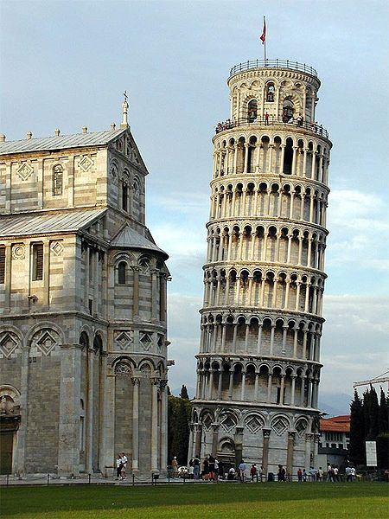
“Leaning Tower”
campanile, or freestanding bell tower, of the cathedral of the Italian city of Pisa
http://en.wikipedia.org/wiki/Leaning_Tower_of_Pisa

Slide 159
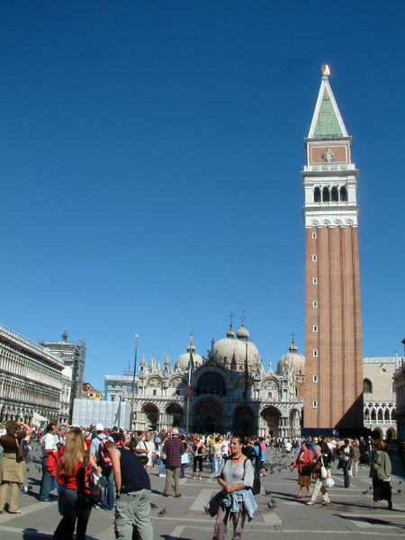
Campanile
of
St. Mark's Basilica
Venice
http://en.wikipedia.org/wiki/St_Mark%27s_Campanile

Slide 160
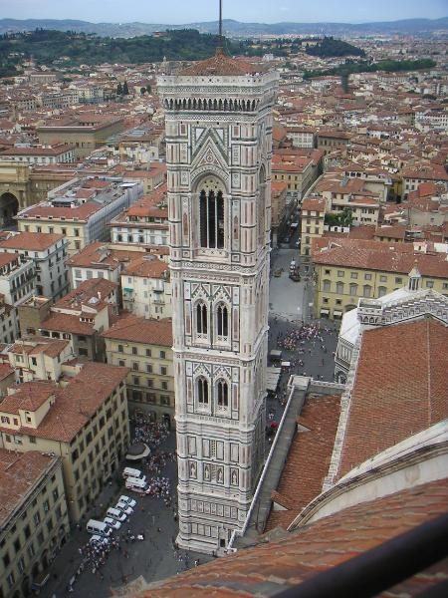
Bell tower of the Florence Cathedra from Brunelleschi's Dome
l
http://www.pictureninja.com/pages/italy/tuscany/image-bell-tower-florentine-cathedral.htm

Slide 161
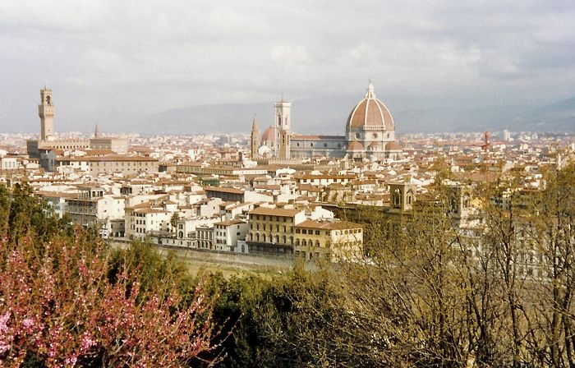
Florence, with cathedral Santa Maria del Fiore and Palazzo Vecchio
http://www.sights-and-culture.com/Italy/Florence-city-view.html

Slide 162
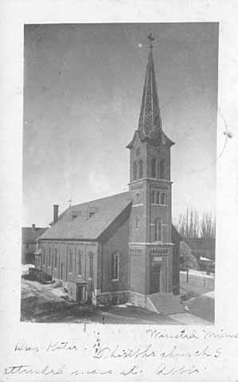
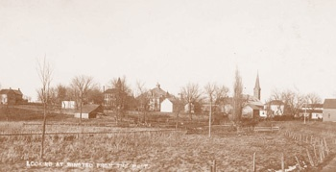
Catholic Church at Winsted
Photograph Collection, Postcard 1907 Location no. MM1.9 WN r2
Minnesota Historical Society

Slide 163
Martin J. Gannon and Rajnandini Pillai Understanding Global Cultures
In the opera there is inherent inequity in the amount of fame given to each of the soloists
The same is true in the Italian economy
www.d.umn.edu/cla/faculty/troufs/anth1095/index.html#Gannon

Slide 164
Martin J. Gannon and Rajnandini Pillai Understanding Global Cultures
Because of industrialization, northern Italians have had the benefit of a thriving economy and a relatively prosperous existence
In contrast, southern Italians, who have relied on farming for their livelihood, have tended to be poorer and less educated
www.d.umn.edu/cla/faculty/troufs/anth1095/index.html#Gannon

Slide 165
Martin J. Gannon and Rajnandini Pillai Understanding Global Cultures
Today poverty still exists in some areas, particularly in the south
Italian industry has become increasingly successful, but success is not shared equally by everyone
Because northern companies believe there is a difference in the northern and southern work ethic, they are reluctant to locate branches in the south
www.d.umn.edu/cla/faculty/troufs/anth1095/index.html#Gannon

Slide 166
Martin J. Gannon and Rajnandini Pillai Understanding Global Cultures
The large migration of workers from the south to the north has left behind people who are not willing to give up customs and traditions that have been followed since early European civilization
www.d.umn.edu/cla/faculty/troufs/anth1095/index.html#Gannon

Slide 167
Martin J. Gannon and Rajnandini Pillai Understanding Global Cultures
“The people from the [northern and southern] regions are similar in that
they love life and enjoy
creating the illusion of a show.”
“However, the difference between the people from these two regions is that
southerners tend
to cling to past ways of living
whereas many northerners look toward the future.”
www.d.umn.edu/cla/faculty/troufs/anth1095/index.html#Gannon

Slide 168
Martin J. Gannon and Rajnandini Pillai Understanding Global Cultures
To most
northerners,
wealth
is the way to ensure the lasting defense and prosperity of the family and close friends
“The northerner is perpetually trying to acquire wealth in its various forms”
S/he wants a job, a good job, and then a better job
S/he also wants the scientific and technical knowledge that will ensure better paid employment and advancement
www.d.umn.edu/cla/faculty/troufs/anth1095/index.html#Gannon

Slide 169
Martin J. Gannon and Rajnandini Pillai Understanding Global Cultures
many
southerners,
on the other hand,
want above all
to be obeyed, admired,
respected, and envied
They want wealth too, but frequently as an instrument to influence people
Southerners are preoccupied with commanding the respect of the audience throughout the many operas of life
www.d.umn.edu/cla/faculty/troufs/anth1095/index.html#Gannon

Slide 170
Martin J. Gannon and Rajnandini Pillai Understanding Global Cultures
many southerners,
be they wealthy or poor,
want the gratitude of powerful friends and relatives,
the fear of their enemies,
and the respect of everybody
Southerners seek wealth as a means of commanding obedience and respect from others
www.d.umn.edu/cla/faculty/troufs/anth1095/index.html#Gannon

Slide 171
Martin J. Gannon and Rajnandini Pillai Understanding Global Cultures
in the south the culture centers around death
The Italians worry that the operatic drama of life will fall apart when a family member dies
The experience of dying and the fear of not being able to react properly to such an event has forced southerners to create a complex strategy to enable them to face and conquer death
The purpose of these rituals is to re-establish contact between the living and the dead, because according to southern beliefs, the family includes both the living and the dead
www.d.umn.edu/cla/faculty/troufs/anth1095/index.html#Gannon

Slide 172
Martin J. Gannon and Rajnandini Pillai Understanding Global Cultures
Each family member has reciprocal rights and duties, and people tend to attach great value to these obligations
The dead have to protect the living
The living have to keep alive the memory of the dead
www.d.umn.edu/cla/faculty/troufs/anth1095/index.html#Gannon

Slide 173
Martin J. Gannon and Rajnandini Pillai Understanding Global Cultures
This distinction between north and south can be found easily in Italian operas that tend to depict the characteristics
of one region or the other . . .
www.d.umn.edu/cla/faculty/troufs/anth1095/index.html#Gannon

Slide 174
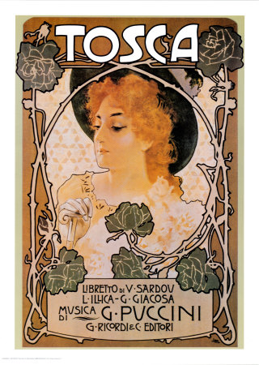
Cavalleria
Rusticana
North
South
http://en.wikipedia.org/wiki/Tosca

Slide 175
Martin J. Gannon and Rajnandini Pillai Understanding Global Cultures
for e.g. . . .
Cavalleria Rusticana, by Pietro Mascagni, represents a classic southern opera with its emphasis on humble, folk, suspicion, and revenge
www.d.umn.edu/cla/faculty/troufs/anth1095/index.html#Gannon

Slide 176
Martin J. Gannon and Rajnandini Pillai Understanding Global Cultures
In contrast, Giuseppe Verdi’s
Tosca emphasizes the north,
as it takes place in elegant urban settings in which important personages display more subtle and complex feelings,
although no less passionate
(and perhaps even more so)
than those found among the southerners
www.d.umn.edu/cla/faculty/troufs/anth1095/index.html#Gannon

Slide 177
The Overture
Pageantry and Spectacle
Voice
Externalization
5. Chorus and Soloists
Quiz . . .
Italy
www.d.umn.edu/cla/faculty/troufs/anth1095/index.html#Gannon

Slide 178
North or South?

Slide 179
North or South?
http://en.wikipedia.org/wiki/Tosca

Slide 180
North or South?
http://en.wikipedia.org/wiki/Tosca

Slide 181
“On Day 1 of Broad Lockdown, a Debate Arises: Can Italians Follow the Rules?”
March 19, 2020
Even today, many question whether folks will follow the Covid-19 rules . . .
https://www.nytimes.com/2020/03/08/world/europe/italy-coronavirus-quarantine.html?referringSource=articleShare

Slide 182
Martin J. Gannon and Rajnandini Pillai Understanding Global Cultures
Before unification, Italians never quite identified with the many foreign bodies that conquered and ruled them.
This is a possible explanation for Italians’ historic contempt for the law and paying taxes;
and even though Italians have been influenced overwhelmingly by foreign rule, they have managed to create a culture that is distinctly their own
and this varies somewhat by region
www.d.umn.edu/cla/faculty/troufs/anth1095/index.html#Gannon

Slide 183
The Overture
Pageantry and Spectacle
Voice
Externalization
5. Chorus and Soloists
sets the mood
and gives some idea as to what one can expect
Italy
www.d.umn.edu/cla/faculty/troufs/anth1095/index.html#Gannon

Slide 184
Martin J. Gannon and Rajnandini Pillai Understanding Global Cultures
“. . . Italians take a midway position on the issue of personal trust and knowledge, but they do tend to convey their feelings and thoughts at least partially at the beginning of a relationship. The other party has some understanding of what will unfold, but it is only a preview that is imperfect, because
the unexpected frequently occurs.”
www.d.umn.edu/cla/faculty/troufs/anth1095/index.html#Gannon

Slide 185
Martin J. Gannon and Rajnandini Pillai Understanding Global Cultures
There are regional differences in the manner in which the overture is performed
In Milan, which has been influenced by its proximity to Switzerland and Germany, there is a tendency to shorten the overture
Still, it occurs, even in the smallest café that has only a few tables and a modest menu featuring sandwiches, in the form of a few minutes of conversation with the owner
www.d.umn.edu/cla/faculty/troufs/anth1095/index.html#Gannon

Slide 186
Martin J. Gannon and Rajnandini Pillai Understanding Global Cultures
There are regional differences in the manner in which the overture is performed
In Milan, which has been influenced by its proximity to Switzerland and Germany, there is a tendency to shorten the overture
Still, it occurs, even in the smallest café that has only a few tables and a modest menu featuring sandwiches, in the form of a few minutes of conversation with the owner
. . . but it is still there
www.d.umn.edu/cla/faculty/troufs/anth1095/index.html#Gannon

Slide 187
This is Manuela Fina from Milan, Italy, who implanted my Cochlear implant . . .
http://www.d.umn.edu/cla/faculty/troufs/anth1095/Germany.html#title

Slide 188
What did Manuela Fina first discuss in the initial meeting
about a cochlear implant . . . ?
(which eventually took a 7-hour operation,
with a surgical team of 10
and cost almost the price
of an average American house)
Dr. Manuela Fina and Kim Smyth Roufs discussed . . .

Slide 189
What did Manuela Fina first discuss in the initial meeting
about a cochlear implant . . . ?
(which eventually took a 7-hour operation,
with a surgical team of 10
and cost almost the price
of an average American house)
Dr. Manuela Fina and Kim Smyth Roufs discussed . . .

Slide 190
ladies’ Italian fine stockings

Slide 191
Martin J. Gannon and Rajnandini Pillai Understanding Global Cultures
There are regional differences in the manner in which the overture is performed
In the south, the overture can be much more involved
A person may visit a store, and chat with the owner, two or three times before purchasing something
Both parties have a good idea about the outcome, but there will be expressions of emotion, various uses of argument an persuasion, and different tones of vice that will help to facilitate the final outcome or sale
Still, the unexpected can, and does, occur, because fate is a critical element in the mix
www.d.umn.edu/cla/faculty/troufs/anth1095/index.html#Gannon

Slide 192
Martin J. Gannon and Rajnandini Pillai Understanding Global Cultures
There are regional differences in the manner in which the overture is performed
In the south, the overture can be much more involved
A person may visit a store, and chat with the owner, two or three times before purchasing something
Both parties have a good idea about the outcome, but there will be expressions of emotion, various uses of argument an persuasion, and different tones of vice that will help to facilitate the final outcome or sale
Still, the unexpected can, and does, occur, because fate is a critical element in the mix
www.d.umn.edu/cla/faculty/troufs/anth1095/index.html#Gannon

Slide 193
Martin J. Gannon and Rajnandini Pillai Understanding Global Cultures
Italy has rapidly changing governments
66 since World War II
67th government with
Giuseppe Conte
as of 1 June 2018
www.d.umn.edu/cla/faculty/troufs/anth1095/index.html#Gannon

Slide 194
“There is, in fact, no law or government at all [in Italy]; and it is wonderful how well things go on without them.”
Lord Byron
English Romantic poet and satirist
1788-1824
www.d.umn.edu/cla/faculty/troufs/anth1095/index.html#Gannon

Slide 195
The Overture
Pageantry and Spectacle
Voice
Externalization
5. Chorus and Soloists
Italy
www.d.umn.edu/cla/faculty/troufs/anth1095/index.html#Gannon

Slide 196
The Overture
Pageantry and Spectacle
Voice
Externalization
5. Chorus and Soloists
The pageantry and spectacle itself and the manner in which the opera-like activities are performed in the daily life of the Italians
Italy
www.d.umn.edu/cla/faculty/troufs/anth1095/index.html#Gannon

Slide 197
Martin J. Gannon and Rajnandini Pillai Understanding Global Cultures
“By and large, Italy is a land of spectacle and pageantry. Italians tend to be more animated and expressive than most other nationalities.”
“Italians, particularly those in the south, revel when communicating in an expressive manner.”
www.d.umn.edu/cla/faculty/troufs/anth1095/index.html#Gannon

Slide 198
Martin J. Gannon and Rajnandini Pillai Understanding Global Cultures
“By and large, Italy is a land of spectacle and pageantry. Italians tend to be more animated and expressive than most other nationalities.”
The level of noise in Italy tends to be high in public places
And people tend to congregate rather than be isolated from one another
www.d.umn.edu/cla/faculty/troufs/anth1095/index.html#Gannon

Slide 199
Martin J. Gannon and Rajnandini Pillai Understanding Global Cultures
“By and large, Italy is a land of spectacle and pageantry. Italians tend to be more animated and expressive than most other nationalities.”
Some bystanders do not mind becoming part of the action
www.d.umn.edu/cla/faculty/troufs/anth1095/index.html#Gannon

Slide 200
Martin J. Gannon and Rajnandini Pillai Understanding Global Cultures
“Once the overture is over and the curtain goes up, the audience is greeted by a set so visually stunning that it elicits applause. This is the beginning of the pageantry and spectacle. They play such an important role in Italian life that people and things frequently tend to be judged first and foremost on their appearances.”
www.d.umn.edu/cla/faculty/troufs/anth1095/index.html#Gannon

Slide 201
http://en.wikipedia.org/wiki/Aida

Slide 202
Martin J. Gannon and Rajnandini Pillai Understanding Global Cultures
“Italians tend to make life’s dull and insignificant moments exciting and significant by decorating and ritualizing them.”
“This practice of embellishing everyday events was developed by a realistic group of people that tends to react cautiously because it believes that
catastrophes cannot be averted, only mitigated.”
www.d.umn.edu/cla/faculty/troufs/anth1095/index.html#Gannon

Slide 203
Martin J. Gannon and Rajnandini Pillai Understanding Global Cultures
“Italians tend to make life’s dull and insignificant moments exciting and significant by
decorating and ritualizing them.”
“This practice of
embellishing everyday events was developed by a realistic group of people that tends to react cautiously because it believes that catastrophes cannot be averted, only mitigated.”
www.d.umn.edu/cla/faculty/troufs/anth1095/index.html#Gannon

Slide 204
Martin J. Gannon and Rajnandini Pillai Understanding Global Cultures
On these avenues there are many outdoor cafés
Italy has far more bars and restaurants per capita than comparable European nations
Italy: 257 (inhabitants per café and restaurant)
Britain: 451
France: 795
Germany: 558
Spain: 778
(Richard 1995)
www.d.umn.edu/cla/faculty/troufs/anth1095/index.html#Gannon

Slide 205
Piazza Sant'Egidio, Rome
http://www.liveromelikearoman.com/piazzatoday.htm

Slide 206
Martin J. Gannon and Rajnandini Pillai Understanding Global Cultures
Even in Italian cities where there is no central piazza, it is well-known that
certain avenues serve as substitutes for them, and the village-like behavior is replaced along them
And if there’s not a proper outdoor café there will still be tables and chairs and other places to sit and visit in the public space
www.d.umn.edu/cla/faculty/troufs/anth1095/index.html#Gannon

Slide 207
Castagneto Carducci, Province of Livorno, region of Tuscany, Italy
Willie Henderson

Slide 208
Piazza dei Signori, Vicenza, Northern Italy
www.bed-breakfast-italy.com/bars.htm

Slide 209
Martin J. Gannon and Rajnandini Pillai Understanding Global Cultures
Venezia (1997) suggests that the large
piazza is more descriptive of southern Italy, whereas bars (and the adjoining small parks) are more descriptive of northern Italy
www.d.umn.edu/cla/faculty/troufs/anth1095/index.html#Gannon

Slide 210
Bar in Piazza dei Signori, Vicenza, Northern Italy
www.bed-breakfast-italy.com/bars.htm

Slide 211
Martin J. Gannon and Rajnandini Pillai Understanding Global Cultures
There is little, if any, private life for most Italians
Everything of importance occurs in public or is at least discussed in public
“There is no word for privacy in the Italian language, and information is shared widely”
www.d.umn.edu/cla/faculty/troufs/anth1095/index.html#Gannon

Slide 212
Martin J. Gannon and Rajnandini Pillai Understanding Global Cultures
There is little, if any, private life for most Italians
Everything of importance occurs in public or is at least discussed in public
“There is no word for privacy in the Italian language, and information is shared widely”
www.d.umn.edu/cla/faculty/troufs/anth1095/index.html#Gannon

Slide 213
The Overture
Pageantry and Spectacle
Voice
Externalization
5. Chorus and Soloists
The importance of both the chorus and the soloists,
which reflects the unity of Italian culture (chorus)
but also regional variations, particularly between the north and south
Italy
www.d.umn.edu/cla/faculty/troufs/anth1095/index.html#Gannon

Slide 214
The Overture
Pageantry and Spectacle
Voice
Externalization
5. Chorus and Soloists
Home Townism
Italy
www.d.umn.edu/cla/faculty/troufs/anth1095/index.html#Gannon

Slide 215
Martin J. Gannon and Rajnandini Pillai Understanding Global Cultures
Most Italians define themselves by
the town where they were born,
and there is a sharp contrast between northern and southern Italy
www.d.umn.edu/cla/faculty/troufs/anth1095/index.html#Gannon

Slide 216
Martin J. Gannon and Rajnandini Pillai Understanding Global Cultures
“These regional differences are similar to the chorus and soloists in operas”
Soloists represent the regional differences in the culture
The chorus is the embodiment of the overall Italian culture
www.d.umn.edu/cla/faculty/troufs/anth1095/index.html#Gannon

Slide 217
Martin J. Gannon and Rajnandini Pillai Understanding Global Cultures
“These regional differences are similar to the chorus and soloists in operas”
Soloists represent the regional differences in the culture
The chorus is the embodiment of the overall Italian culture
www.d.umn.edu/cla/faculty/troufs/anth1095/index.html#Gannon

Slide 218
Martin J. Gannon and Rajnandini Pillai Understanding Global Cultures
The Italian word that expresses the idea of belonging first to a town, then to a region, and finally to a nation is campanilismo,
which means “bell tower”
It refers to the fact that people do not want to travel so far as to be out of sight of the piazza church steeple
www.d.umn.edu/cla/faculty/troufs/anth1095/index.html#Gannon

Slide 219
Martin J. Gannon and Rajnandini Pillai Understanding Global Cultures
The Italian word that expresses the idea of belonging first to a town, then to a region, and finally to a nation is campanilismo,
which means “bell tower” -ismo
It refers to the fact that people do not want to travel so far as to be out of sight of the piazza church steeple
www.d.umn.edu/cla/faculty/troufs/anth1095/index.html#Gannon

Slide 220
“Leaning Tower”
campanile, or freestanding bell tower, of the cathedral of the Italian city of Pisa
http://en.wikipedia.org/wiki/Leaning_Tower_of_Pisa

Slide 221
Campanile
of
St. Mark's Basilica
Venice
http://en.wikipedia.org/wiki/St_Mark%27s_Campanile

Slide 222
Bell tower of the Florence Cathedra from Brunelleschi's Dome
l
http://www.pictureninja.com/pages/italy/tuscany/image-bell-tower-florentine-cathedral.htm

Slide 223
Florence, with cathedral Santa Maria del Fiore and Palazzo Vecchio
http://www.sights-and-culture.com/Italy/Florence-city-view.html

Slide 224
Martin J. Gannon and Rajnandini Pillai Understanding Global Cultures
Because of industrialization, northern Italians have had the benefit of a thriving economy and a relatively prosperous existence
In contrast, southern Italians, who have relied on farming for their livelihood, have tended to be poorer and less educated
www.d.umn.edu/cla/faculty/troufs/anth1095/index.html#Gannon

Slide 225
Martin J. Gannon and Rajnandini Pillai Understanding Global Cultures
Today poverty still exists in some areas, particularly in the south
Italian industry has become increasingly successful, but success is not shared equally by everyone
Because northern companies believe there is a difference in the northern and southern work ethic, they are reluctant to locate branches in the south
www.d.umn.edu/cla/faculty/troufs/anth1095/index.html#Gannon

Slide 226
Martin J. Gannon and Rajnandini Pillai Understanding Global Cultures
The large migration of workers from the south to the north has left behind people who are not willing to give up customs and traditions that have been followed since early European civilization
www.d.umn.edu/cla/faculty/troufs/anth1095/index.html#Gannon

Slide 227
9 Aug 2019
https://www.nytimes.com/2019/08/09/business/italy-economy-debt.html

Slide 228
Martin J. Gannon and Rajnandini Pillai Understanding Global Cultures
“The people from the [northern and southern] regions are similar in that
they love life and enjoy
creating the illusion of a show.”
“However, the difference between the people from these two regions is that
southerners tend
to cling to past ways of living
whereas many northerners look toward the future.”
www.d.umn.edu/cla/faculty/troufs/anth1095/index.html#Gannon

Slide 229
Martin J. Gannon and Rajnandini Pillai Understanding Global Cultures
To most
northerners,
wealth
is the way to ensure the lasting defense and prosperity of the family and close friends
“The northerner is perpetually trying to acquire wealth in its various forms”
S/he wants a job, a good job, and then a better job
S/he also wants the scientific and technical knowledge that will ensure better paid employment and advancement
www.d.umn.edu/cla/faculty/troufs/anth1095/index.html#Gannon

Slide 230
Martin J. Gannon and Rajnandini Pillai Understanding Global Cultures
many
southerners,
on the other hand,
want above all
to be obeyed, admired,
respected, and envied
They want wealth too, but frequently as an instrument to influence people
Southerners are preoccupied with commanding the respect of the audience throughout the many operas of life
www.d.umn.edu/cla/faculty/troufs/anth1095/index.html#Gannon

Slide 231
Martin J. Gannon and Rajnandini Pillai Understanding Global Cultures
many southerners,
be they wealthy or poor,
want the gratitude of powerful friends and relatives,
the fear of their enemies,
and the respect of everybody
Southerners seek wealth as a means of commanding obedience and respect from others
www.d.umn.edu/cla/faculty/troufs/anth1095/index.html#Gannon

Slide 232
Martin J. Gannon and Rajnandini Pillai Understanding Global Cultures
in the south the culture centers around death
The Italians worry that the operatic drama of life will fall apart when a family member dies
The experience of dying and the fear of not being able to react properly to such an event has forced southerners to create a complex strategy to enable them to face and conquer death
The purpose of these rituals is to re-establish contact between the living and the dead, because according to southern beliefs, the family includes both the living and the dead
www.d.umn.edu/cla/faculty/troufs/anth1095/index.html#Gannon

Slide 233
Martin J. Gannon and Rajnandini Pillai Understanding Global Cultures
Each family member has reciprocal rights and duties, and people tend to attach great value to these obligations
The dead have to protect the living
The living have to keep alive the memory of the dead
www.d.umn.edu/cla/faculty/troufs/anth1095/index.html#Gannon

Slide 234
Martin J. Gannon and Rajnandini Pillai Understanding Global Cultures
This distinction between north and south can be found easily in Italian operas that tend to depict the characteristics
of one region or the other . . .
www.d.umn.edu/cla/faculty/troufs/anth1095/index.html#Gannon

Slide 235
Cavalleria
Rusticana
North
South
http://en.wikipedia.org/wiki/Tosca

Slide 236
Martin J. Gannon and Rajnandini Pillai Understanding Global Cultures
for e.g. . . .
Cavalleria Rusticana, by Pietro Mascagni, represents a classic southern opera with its emphasis on humble, folk, suspicion, and revenge
www.d.umn.edu/cla/faculty/troufs/anth1095/index.html#Gannon

Slide 237
http://en.wikipedia.org/wiki/Cavalleria_rusticana

Slide 238
http://en.wikipedia.org/wiki/Cavalleria_rusticana

Slide 239
the Piazza
http://en.wikipedia.org/wiki/Cavalleria_rusticana

Slide 240
An, of course, even in a small village they manage to get lots of people on stage.
Maria Markina and Brandon Jovanovich in Cavalleria Rusticana.
http://www.culturevulture.net/Opera/cavalleriahgo_10-08.htm

Slide 241
An, of course, even in a small village they manage to get lots of people on stage.
Maria Markina and Brandon Jovanovich in Cavalleria Rusticana.
http://www.culturevulture.net/Opera/cavalleriahgo_10-08.htm

Slide 242
Martin J. Gannon and Rajnandini Pillai Understanding Global Cultures
In contrast, Giuseppe Verdi’s
Tosca emphasizes the north,
as it takes place in elegant urban settings in which important personages display more subtle and complex feelings,
although no less passionate
(and perhaps even more so)
than those found among the southerners
www.d.umn.edu/cla/faculty/troufs/anth1095/index.html#Gannon

Slide 243
http://en.wikipedia.org/wiki/Tosca

Slide 244
major anthropological studies of Italy . . .

Slide 245
certain regions have become affiliated with certain research problems
Susan Parman, Europe in the Anthropological Imagination, pp. 11 - 14

Slide 246
. . . David I. Kertzer notes in his review of American anthropologists working in Italy, most work [in Italy] continues to be done on islands and in the rural south
Susan Parman, Europe in the Anthropological Imagination, pp. 11 - 14

Slide 247
in addition, anthropologists often are drawn to border regions
Susan Parman, Europe in the Anthropological Imagination, pp. 11 - 14

Slide 248
In addition, anthropologists often are drawn to border regions…
Saunders near the French border
Holmes near the Yugoslav border
Ward on the Austrian border
Cole and Wolf spanning the Austrian-Italian border
Susan Parman, Europe in the Anthropological Imagination, pp. 11 - 14

Slide 249
Nancy F. Breuner
1992 Cult of the Virgin Mary in Southern Italy and Spain. Ethos 20:66-95.
Parman's classic picks -- Tony Galt

Slide 250
the chapters in Parman suggest that there has been a tendency in the history of the anthropology of Europe to ...
exoticize the familiar
create syndromes of difference
such as “honor and shame”
and to stress the study of the rural, the semiliterate folk, the small scale, preferably on islands
Susan Parman, Europe in the Anthropological Imagination, pp. 11 - 14

Slide 251
David I. Kertzer Europe in the Anthropological Imagination
David D. Gilmore, ed. Honor and Shame and the Unity of the Mediterranean. American Ethnologist. 15:813-814
http://www.d.umn.edu/cla/faculty/troufs/anth3635/cetexts.html#Parman

Slide 252
David I. Kertzer Europe in the Anthropological Imagination
Michael Herzfeld (1987, p. 11) “the extension of ethnography to the circum-Mediterranean has created a need for exoticizing devices to justify research in what is otherwise a familiar cultural backyard”
Kertzlier: “He notes that anthropologists’ concentrations on such topics as honor and shame, presented as hallmarks of these cultures, along with the unremitting village-level focus of so much of the anthropology done there, furthers this distancing, rendering the otherwise dangerously familiar into the satisfying exotic” (71)
http://www.d.umn.edu/cla/faculty/troufs/anth3635/cetexts.html#Parman

Slide 253
David I. Kertzer Europe in the Anthropological Imagination
“. . . In the field the air should smell of
cow dung, not car exhaust”
(71)
http://www.d.umn.edu/cla/faculty/troufs/anth3635/cetexts.html#Parman

Slide 254
David I. Kertzer Europe in the Anthropological Imagination
“Judging from the anthropological literature, one might well conclude that Italy is a nation of peasants living in remote and desolate villages”
(Kertzer 1983, 52)
http://www.d.umn.edu/cla/faculty/troufs/anth3635/cetexts.html#Parman

Slide 255
David I. Kertzer Europe in the Anthropological Imagination
“Indeed, over the centuries there has been a constant flux of population between cities and their rural hinterland in Italy, belying scholars’ apparent categorical imperative to contrast ‘city-dwellers’ with ‘peasants’” (72)
http://www.d.umn.edu/cla/faculty/troufs/anth3635/cetexts.html#Parman

Slide 256
David I. Kertzer Europe in the Anthropological Imagination
“The professional anglophone anthropology of Italy dates back to the work of Charlotte Gower Chapman who was a graduate student at the University of Chicago in the 1920s. . . .”
Robert Redfield, her mentor, had just completed his study Tepotzlan, Mexico
http://www.d.umn.edu/cla/faculty/troufs/anth3635/cetexts.html#Parman

Slide 257
David I. Kertzer Europe in the Anthropological Imagination
the classic ethnography of Italy is Charlotte Gower Chapman’s study of a small Sicilian community of Milocca . . .
Susan Parman, Europe in the Anthropological Imagination, pp. 11 - 14

Slide 258
Milocca: A Sicilian Village
Charlotte Gower Chapman

Slide 259
David I. Kertzer Europe in the Anthropological Imagination
Charlotte Gower Chapman’s Ph.D. dissertation research focused on the Sicilian-American community of Chicago
http://www.d.umn.edu/cla/faculty/troufs/anth3635/cetexts.html#Parman

Slide 260
David I. Kertzer Europe in the Anthropological Imagination
Charlotte Gower Chapman herself describes Milocca as “by no means typical” of Sicilian communities, being “much smaller” and “more isolated” than the average (73)
http://www.d.umn.edu/cla/faculty/troufs/anth3635/cetexts.html#Parman

Slide 261
David I. Kertzer Europe in the Anthropological Imagination
“...[Milocca] was ‘an hour’s walk from the end of the nearest highway, and more than two hours form the nearest railroad station’” (73)
Chapman sought out a small village despite the fact that even Sicily’s agricultural population lived primarily in large communities (sometimes referred to as agro-towns) (73)
http://www.d.umn.edu/cla/faculty/troufs/anth3635/cetexts.html#Parman

Slide 262
David I. Kertzer Europe in the Anthropological Imagination
“Thus, the preferred anthropological peasant community was not even typical of peasant settlements, since the most typical were presumably too large for satisfactory anthropological treatment.” (73)
http://www.d.umn.edu/cla/faculty/troufs/anth3635/cetexts.html#Parman

Slide 263
David I. Kertzer Europe in the Anthropological Imagination
Chapman’s work reflects two features that would mark the development of anglophone anthropology of Italy
The equation of anthropology with the study of the rural (indeed, the less-literate-the-better) folk
The preference for anthropological work on Italy’s to big islands – Sicily and Sardinia (73)
http://www.d.umn.edu/cla/faculty/troufs/anth3635/cetexts.html#Parman

Slide 264
David I. Kertzer Europe in the Anthropological Imagination
The pattern of the ahistorical community studies set in Italy’s most remote areas—almost entirely in the mainland south and the two islands—continued as a number of foreign anthropologists began to venture into Italy in the 1950s and early 1960s
Topics such as honor and sham on the cultural level, and local-level patterns of family, kinship, and patron-client relations on the social level, dominated the work done in these years (73-74)
http://www.d.umn.edu/cla/faculty/troufs/anth3635/cetexts.html#Parman

Slide 265
David I. Kertzer Europe in the Anthropological Imagination
Major changes began to take place in the late 1960s, changes traceable to developments in anthropology that can only be understood against the broader context of what was going on in the American society at the time. (74)
http://www.d.umn.edu/cla/faculty/troufs/anth3635/cetexts.html#Parman

Slide 266
David I. Kertzer Europe in the Anthropological Imagination
“The influence of various forms of leftist political currents in the United States and Europe led to both a heightened interest in political economy and a new view of the poor that saw them not folkloristically but, in adaptive terms, as victims of exploitation.” (74)
http://www.d.umn.edu/cla/faculty/troufs/anth3635/cetexts.html#Parman

Slide 267
David I. Kertzer Europe in the Anthropological Imagination
American Anthropology in Italy, 1975-1994
The choice of research sites made by American anthropologists working in Italy continued their “attachment to working on Italy’s to main islands”
Including at least 7 anthropologists on Sicily alone
at least 3 anthropologists for Sardinia (75)
http://www.d.umn.edu/cla/faculty/troufs/anth3635/cetexts.html#Parman

Slide 268
David I. Kertzer Europe in the Anthropological Imagination
American Anthropology in Italy, 1975-1994
By contrast, 5 anthropologists have published work in Central Italy
Of the 13 American scholars who have published monographs 1975-1994 based on Italian fieldwork, only 3 did their work in the northern half of the country (that is north of Umbria) (76)
http://www.d.umn.edu/cla/faculty/troufs/anth3635/cetexts.html#Parman

Slide 269
David I. Kertzer Europe in the Anthropological Imagination
American Anthropology in Italy, 1975-1994
By contrast, 5 anthropologists have published work in Central Italy
Of the 13 American scholars who have published monographs 1975-1994 based on Italian fieldwork, only 3 did their work in the northern half of the country (that is north of Umbria) (76)
http://www.d.umn.edu/cla/faculty/troufs/anth3635/cetexts.html#Parman

Slide 270
David I. Kertzer Europe in the Anthropological Imagination
American Anthropology in Italy, 1975-1994
By contrast, 5 anthropologists have published work in Central Italy
Of the 13 American scholars who have published monographs 1975-1994 based on Italian fieldwork, only 3 did their work in the northern half of the country (that is north of Umbria) (76)
http://www.d.umn.edu/cla/faculty/troufs/anth3635/cetexts.html#Parman

Slide 271
David I. Kertzer Europe in the Anthropological Imagination
There is “...Not only a heavy concentration in the southern third of the country, but a strong tendency for the relatively few anthropologists working in the northern two-thirds of the country to work in small, generally peripheral communities.”
Although the northern third of the country is primarily urban, and filled with important cities like Milan, Turin, Genoa, and Venice, not to mention such important provincial centers as Brescia, Verona, Parma, and Modena, American anthropologists have studiously avoided such centers.” (76)
http://www.d.umn.edu/cla/faculty/troufs/anth3635/cetexts.html#Parman

Slide 272
David I. Kertzer Europe in the Anthropological Imagination
Adding British anthropologists to Kertzer’s analysis would not alter the picture of where the anthropologists have chosen to work
The best British anthropology conducted in Italy have been done in the rural south
John Davis’s (1973) study of Pisticci
Caroline White’s (1980) study of the Fucino area (78)
http://www.d.umn.edu/cla/faculty/troufs/anth3635/cetexts.html#Parman

Slide 273
David I. Kertzer Europe in the Anthropological Imagination
Those doing historical research, rather than fieldwork, partially escape this pattern
Horn (1991, 1994), Milan
Yanagisako (1991), Como (78)
http://www.d.umn.edu/cla/faculty/troufs/anth3635/cetexts.html#Parman

Slide 274
David I. Kertzer Europe in the Anthropological Imagination
And there have “important recent developments in the American anthropology of Italy” which are beginning to highlight…
small industry in central Italy
combined use of ethnography, oral history, and archival research in Sicily to provide valuable insights into the historical decline of fertility in Italy (76)
http://www.d.umn.edu/cla/faculty/troufs/anth3635/cetexts.html#Parman

Slide 275
David I. Kertzer Europe in the Anthropological Imagination
Looking at the problem areas rather than the research site . . .
Diverse works focus more on history than on contemporary ethnography
Italy has been one of the most productive sites in the move of American anthropology towards history (76-77)
http://www.d.umn.edu/cla/faculty/troufs/anth3635/cetexts.html#Parman

Slide 276
David I. Kertzer Europe in the Anthropological Imagination
Looking at the problem areas rather than the research site . . .
Diverse works focus more on history than on contemporary ethnography
Italy has been one of the most productive sites in the move of American anthropology towards history (76-77)
http://www.d.umn.edu/cla/faculty/troufs/anth3635/cetexts.html#Parman

Slide 277
David I. Kertzer Europe in the Anthropological Imagination
Diverse works focus more on history than on contemporary ethnography
Medical topics
Demographic topics
Studies of the impact of out-migration and household organization
Role of the state and science in regulating reproduction in the Fascist era
Transformation of sharecropping
Institutionalization of infant abandonment (76-77)
http://www.d.umn.edu/cla/faculty/troufs/anth3635/cetexts.html#Parman

Slide 278
David I. Kertzer Europe in the Anthropological Imagination
These studies often combine a focus on culture and social life with the recognition of the role of the state in producing historical change (77)
http://www.d.umn.edu/cla/faculty/troufs/anth3635/cetexts.html#Parman

Slide 279
David I. Kertzer Europe in the Anthropological Imagination
Other studies include ...
Galt’s work on the impact of economic change on family organization in an Apulian community
John Davis’s “pioneering work on economy and kinship” in Pisticci, which illustrates why and how the historical dimension is so crucial to current anthropological work (77)
http://www.d.umn.edu/cla/faculty/troufs/anth3635/cetexts.html#Parman

Slide 280
David I. Kertzer Europe in the Anthropological Imagination
These studies examine culture and social organization as ever-changing processes, and recognize the importance of using archival sources alongside the more traditional ethnographic methods (77)
http://www.d.umn.edu/cla/faculty/troufs/anth3635/cetexts.html#Parman

Slide 281
David I. Kertzer Europe in the Anthropological Imagination
One other related reason for this [other than those discussed earlier in Kertzer’s article]: “Our still deeply rooted commitment to a model of field research that—vilify it all we like—continues to rest on the community study model. In sort, in the sixty-five years since Charlotte Chapman got the Prefect of Sicily to order the mayor to order the midwife to put her up and be sure she got to know what she wanted to know about Milocca (and one can only imagine what the Prefect thought this American woman was doing in such a village), we still pine for the simplicity of a manageable field setting, one we can get a handle on, one where people will know who we are, where the social boundary is clear, the scale is human, and the cow dung wafts thought the air.”
http://www.d.umn.edu/cla/faculty/troufs/anth3635/cetexts.html#Parman

Slide 282
David I. Kertzer Europe in the Anthropological Imagination
Since Kertzer’s article (1998) some important works have been done not following the “traditional” pattern . . .
http://www.d.umn.edu/cla/faculty/troufs/anth3635/cetexts.html#Parman

Slide 283
Betsy Krause’s excellent book
Elizabeth L. Krause
A Crisis of Births:
Population Politics and Family-Making in Italy
Belmont, CA: Thompson Wadsworth, 2005.
http://www.d.umn.edu/cla/faculty/troufs/anth3635/cetexts.html#CrisisofBirths

Slide 284
Martin J. Gannon and Rajnandini Pillai Understanding Global Cultures
“This, then, is Italy.
It is still a grand and larger-than-life society whose citizens
love pageantry and spectacle,
emphasize a range of voices
in everyday life,
externalize emotions and feelings,
and feel a commitment to the town and region of the country
in which they were born. . . .”
www.d.umn.edu/cla/faculty/troufs/anth1095/index.html#Gannon

Slide 285
Regions
Italy

