Slide 1
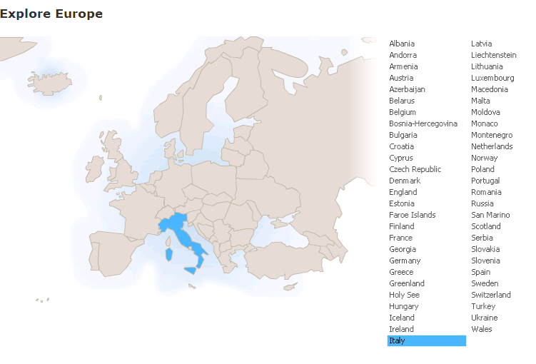
Run in “Slide Show” mode.
Use your up / down arrow keys and / or
your space bar to advance the slides
Forces of Nature
and World View
Italy
© 2009-2024 Timothy G. Roufs, University of Minnesota Duluth

Slide 2
Italy
© 2009-2024 Timothy G. Roufs, University of Minnesota Duluth

Slide 3
Forces of Nature
and World View
Italy
© 2009-2024 Timothy G. Roufs, University of Minnesota Duluth

Slide 4
Italy’s contemporary situation reflects a complex history, geography, ecology, demographic make up, world view, and so forth
. . .

Slide 5
So first, a bit of history and background . . .

Slide 6
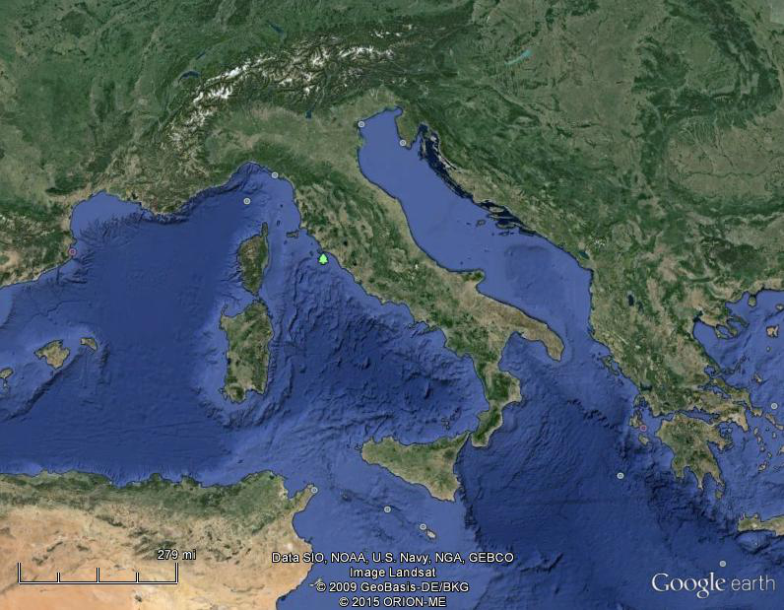
Of all European countries Italy, “the boot,” is probably the most recognizable . . .
Notes:
6

Slide 7
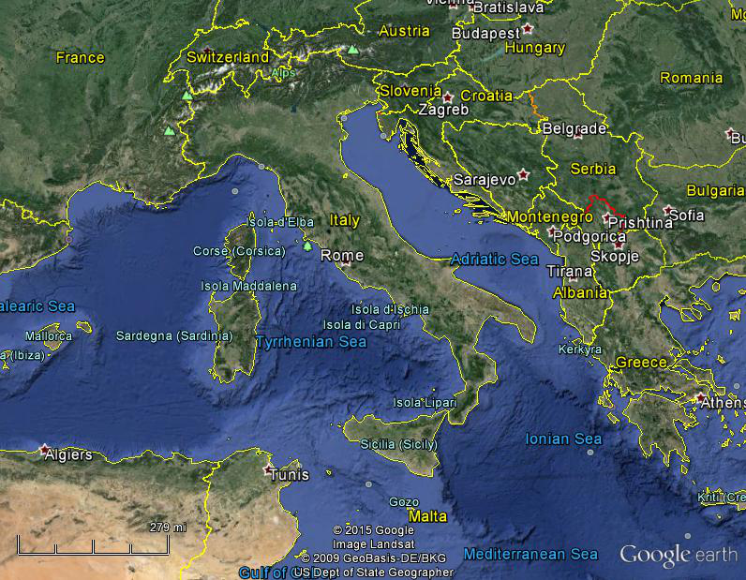
Italy, and her current neighbors . . .
Notes:
7

Slide 8
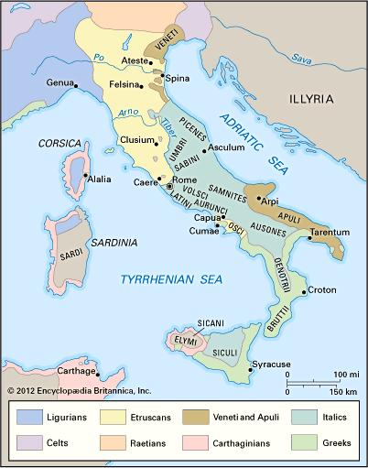
ancient Italic peoples:
Distribution of peoples of ancient Italy ca. 500 B.C.
©Encyclopædia Britannica, Inc.
https://www.britannica.com/topic/history-of-Italy
Notes:
8

Slide 9
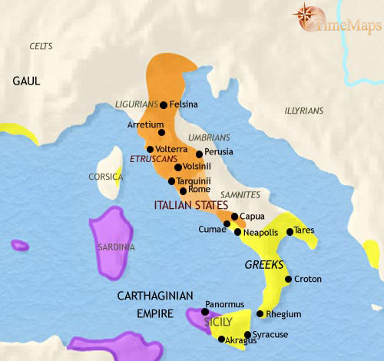
500 B.C.
http://www.timemaps.com/history/italy-500bc
Notes:
9

Slide 10
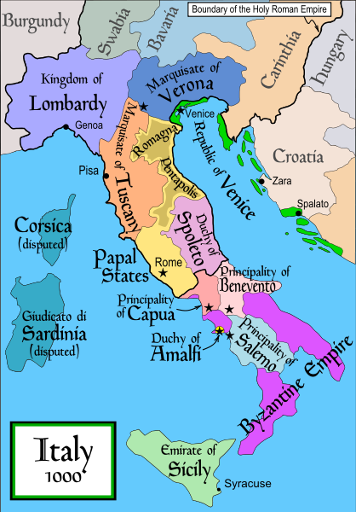
1000
Italy was divided for centuries into small kingdoms and city-states
http://en.wikipedia.org/wiki/Italy
Notes:
10

Slide 11
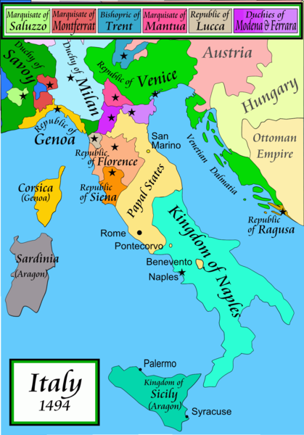
1494
Italy was divided for centuries into small kingdoms and city-states
http://en.wikipedia.org/wiki/Italy
Notes:
11

Slide 12
1494
Italy was divided for centuries into small kingdoms and city-states
http://en.wikipedia.org/wiki/Italy
Notes:
12

Slide 13
In 1494 Christopher Columbus from Genoa went on his second voyage to the New World
Italy was divided for centuries into small kingdoms and city-states
http://en.wikipedia.org/wiki/Italy
Notes:
13

Slide 14
In 1494 Christopher Columbus from Genoa is on his second voyage to the New World
Christopher Columbus was a sugar merchant from Genoa, married to the daughter of a sugar merchant from Madeira, Felipa Perestrello.
Columbus was looking for a way around Venice’s monopoly on things like sugar. . . .
Italy was divided for centuries into small kingdoms and city-states
http://en.wikipedia.org/wiki/Italy
Notes:
14

Slide 15
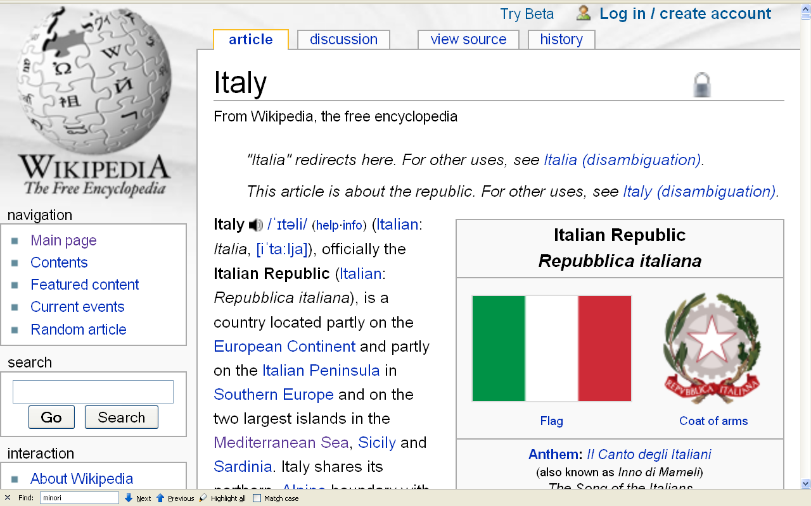
Formation of Italy
Unification —17 March 1861
Republic —2 June 1946
http://en.wikipedia.org/wiki/Italy
Notes:
15

Slide 16
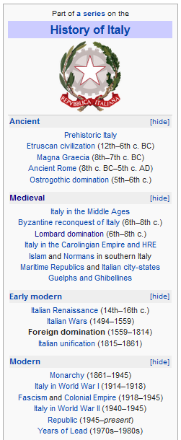
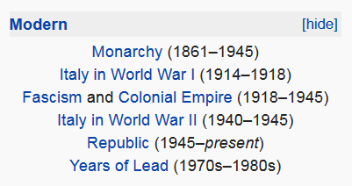
http://en.wikipedia.org/wiki/History_of_Italy_during_foreign_domination_and_the_unification
Notes:
16

Slide 17
http://en.wikipedia.org/wiki/History_of_Italy_during_foreign_domination_and_the_unification
Notes:
17

Slide 18
Formation of Italy
Unification —17 March 1861
Republic —2 June 1946
http://en.wikipedia.org/wiki/Italy
Notes:
18

Slide 19
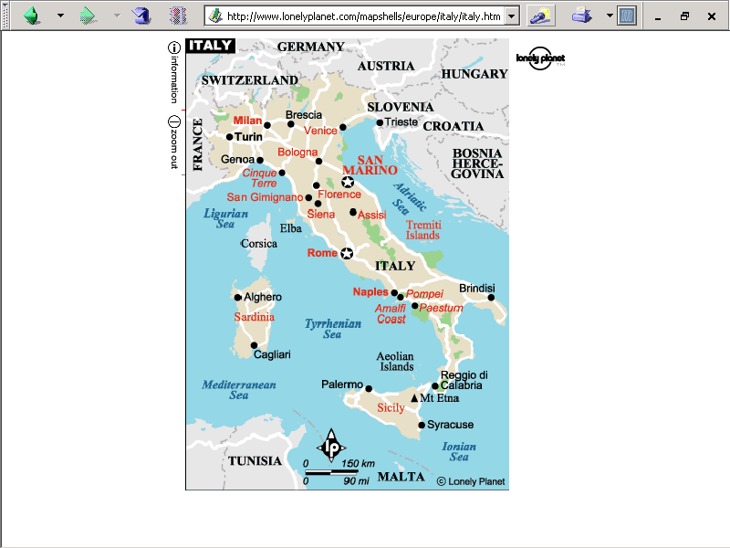
population size
62,390,364 (July 2021 est.)
https://www.worldometers.info/world-population/italy-population/

Slide 20
Note
Sicily

Slide 21
Note
Sardinia

Slide 22
Note
Kingdom of Tavolara
(unrecognized micronation)
https://en.wikipedia.org/wiki/Kingdom_of_Tavolara

Slide 23
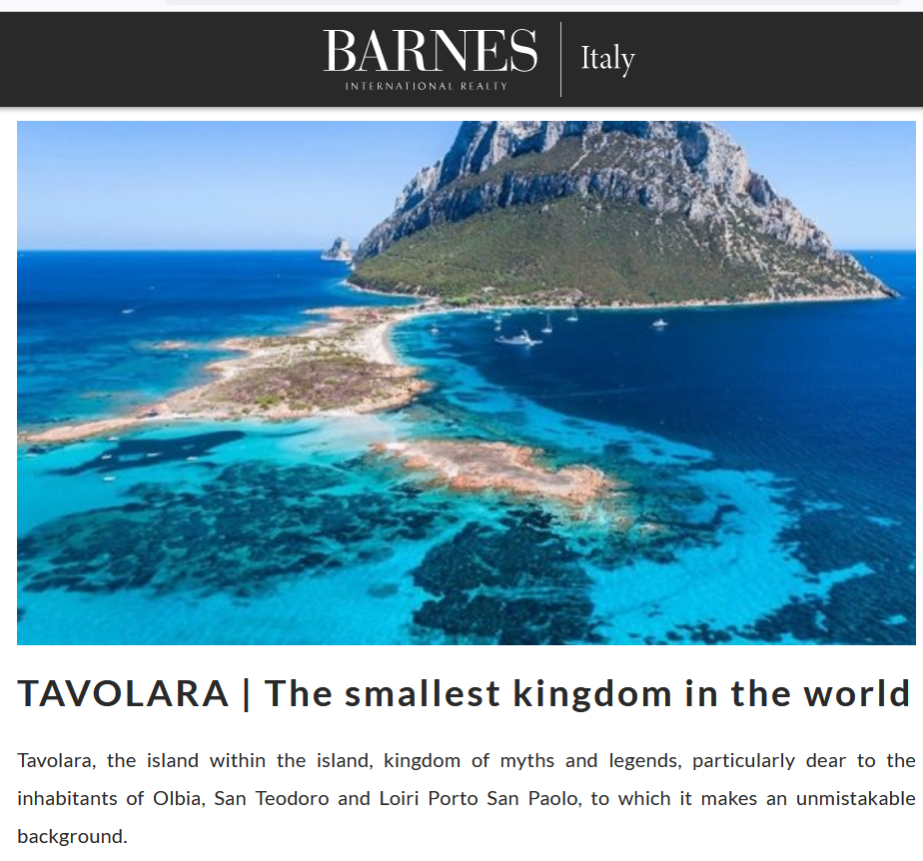
https://barnes-italy.com/tavolara-the-smallest-kingdom-in-the-world/
Notes:
23

Slide 24
Note
Corsica
(French)
Notes:
24

Slide 25
Principality of Seborga
(unrecognized micronation)
Note
https://en.wikipedia.org/wiki/Seborga
Notes:
25

Slide 26
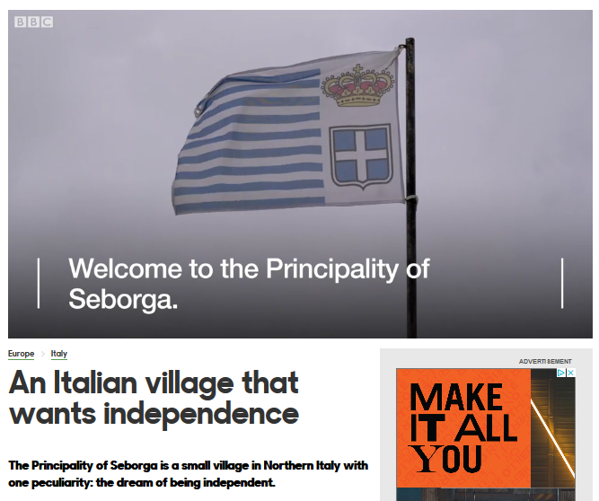
Notes:
26

Slide 27
Note
Rome

Slide 28
The Holy See
(The Vatican)
an independent country
Note
Notes:
28

Slide 29
Note
Notes:
29

Slide 30
Note
The Most Serene Republic
of San Marino
an independent country
Notes:
30

Slide 31
the
Units of Analysis
can be combined
(and quite often are)

Slide 32
“units of analysis” may include:
  one person
  the family
  the community
  a region
  a “culture area”
  a culture / “subculture”
  a country / nation
  the world
  an item or action itself
  a “cultural metaphor”
“units of analysis” may include:

Slide 33
Forces of Nature
and World View
Italy
© 2009-2024 Timothy G. Roufs, University of Minnesota Duluth

Slide 34
The Forces of Nature
strongly influence Italians’ World View
Italy

Slide 35
Martin J. Gannon and Rajnandini Pillai
Understanding Global Cultures
Historically, Italy has been victimized by overwhelming natural disasters
          Earthquakes
          Volcanoes
          Floods
          Famines
www.d.umn.edu/cla/faculty/troufs/anth1095/index.html#Gannon

Slide 36
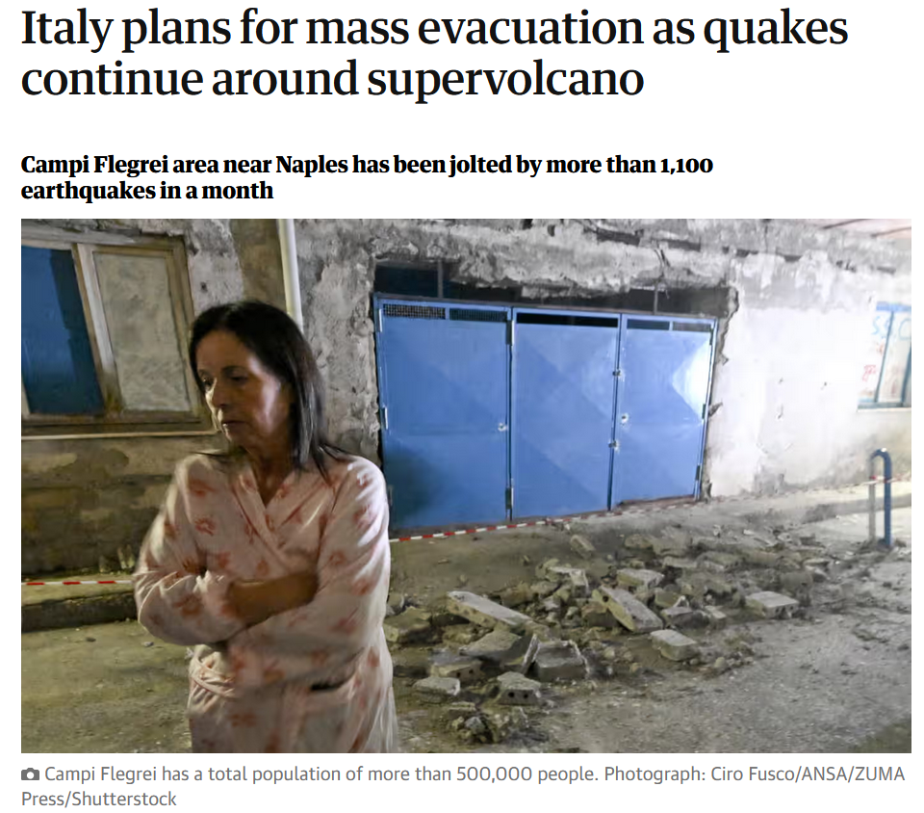

5 October 2023
https://www.theguardian.com/world/2023/oct/05/italy-supervolcano-campi-flegrei-naples-earthquakes-evacuation-plans?CMP=Share_iOSApp_Other
Notes:
36

Slide 37
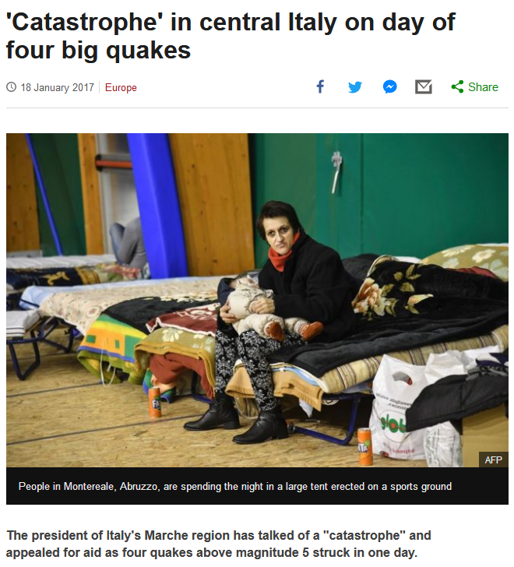

http://www.bbc.com/news/world-europe-38663608?ocid=global_bbccom_email_18012017_top+news+stories
Notes:
37

Slide 38
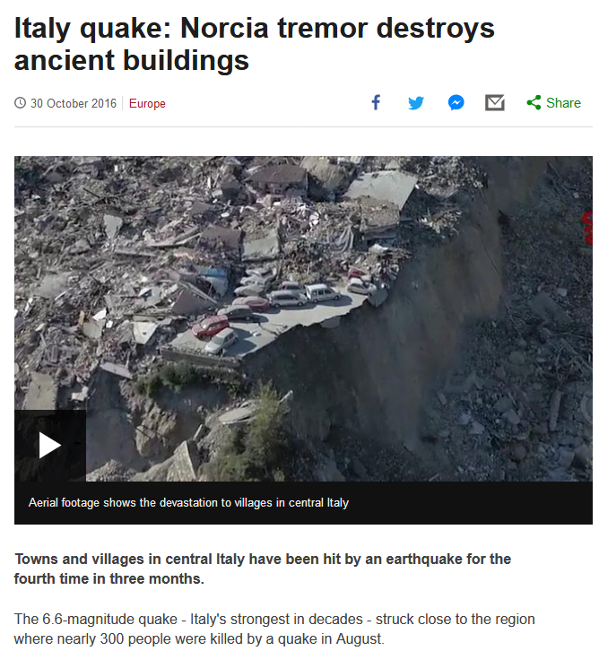
http://www.bbc.com/news/world-europe-37814975
Notes:
38

Slide 39
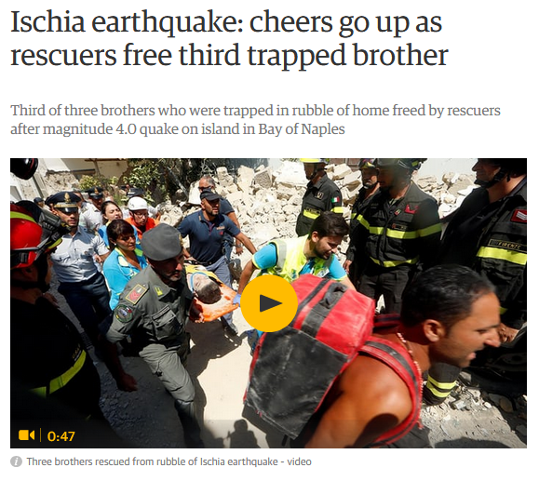
22 August 2017
https://www.theguardian.com/world/2017/aug/21/earthquake-strikes-italian-island-of-ischia-with-one-reported-dead?CMP=Share_iOSApp_Other
Notes:
39

Slide 40
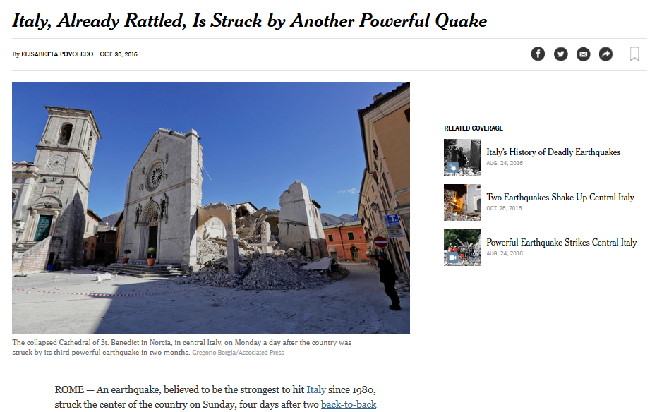
http://www.nytimes.com/2016/10/31/world/europe/italy-earthquake-norcia.html?em_pos=large&emc=edit_nn_20161031&nl=morning-briefing&nlid=60046204
Notes:
40

Slide 41
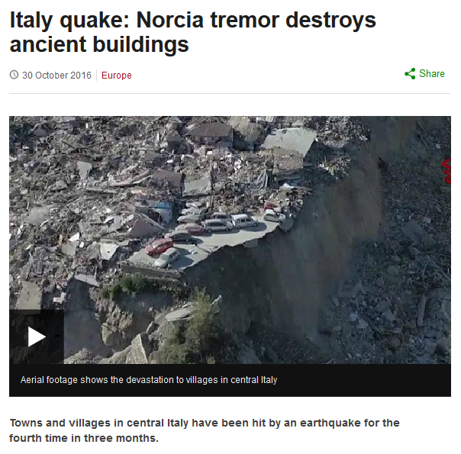
http://www.bbc.com/news/world-europe-37814975#%22
Notes:
41

Slide 42
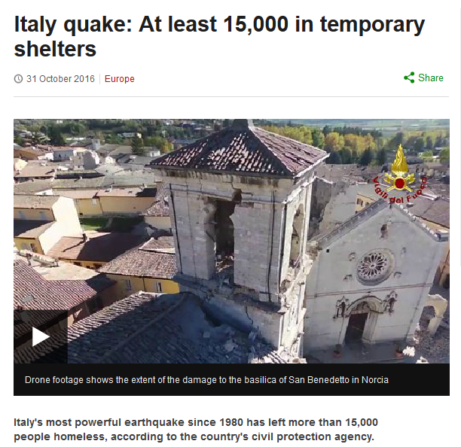
http://www.bbc.com/news/world-europe-37823614?ocid=global_bbccom_email_31102016_top+news+stories
Notes:
42

Slide 43
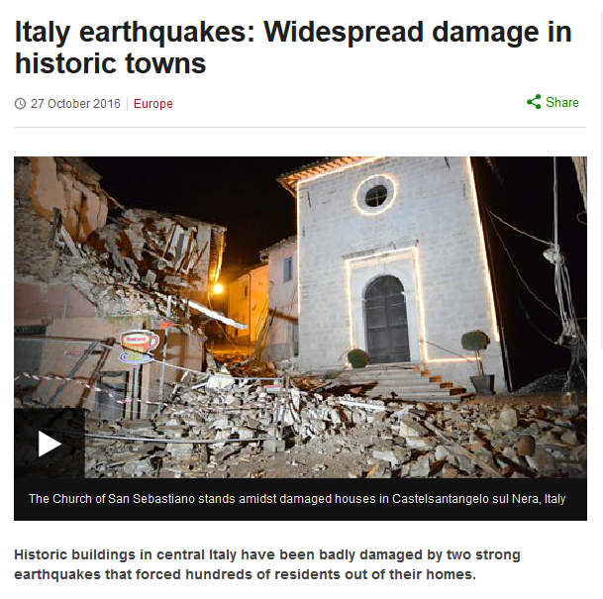
http://www.bbc.com/news/world-europe-37785853
Notes:
43

Slide 44
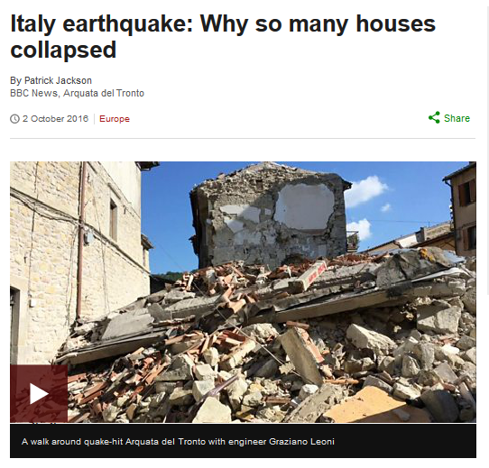
20 May 2012
http://www.bbc.com/news/world-europe-37522660
Notes:
44

Slide 45
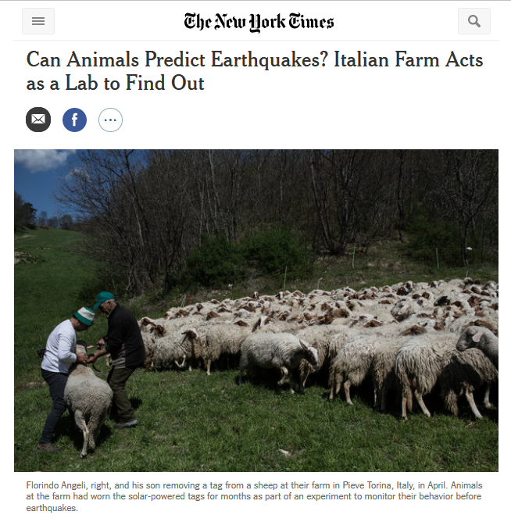
17 June 2017
20 May 2012
Source
Notes:
45

Slide 46
Martin J. Gannon and Rajnandini Pillai
Understanding Global Cultures
Historically, Italy has been victimized by overwhelming natural disasters
          Earthquakes
          Volcanoes
          Floods
          Famines
and sinkholes
www.d.umn.edu/cla/faculty/troufs/anth1095/index.html#Gannon

Slide 47
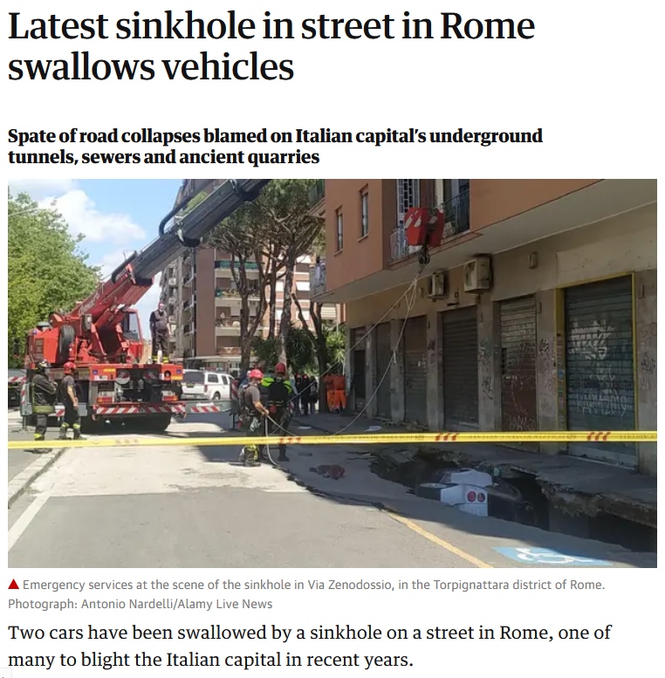
25 May 2021
20 May 2012
https://www.theguardian.com/world/2021/may/25/latest-sinkhole-in-street-in-rome-swallows-vehicles?CMP=Share_iOSApp_Other
Notes:
47

Slide 48
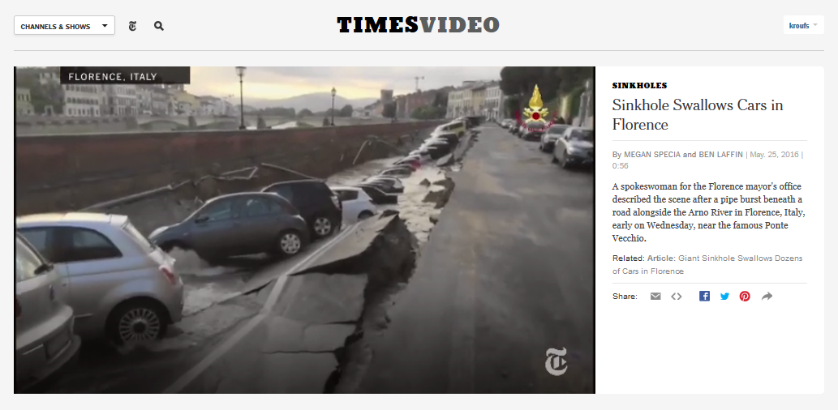
20 May 2012
http://www.nytimes.com/video/world/europe/100000004435414/sinkhole-swallows-cars-in-italy.html
Notes:
48

Slide 49
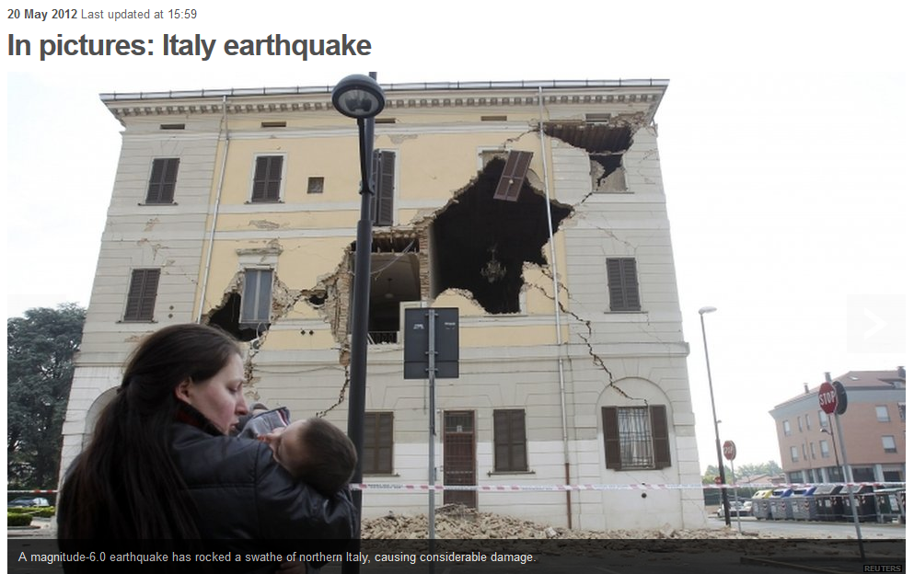
20 May 2012
http://www.bbc.com/news/world-europe-18135901
Notes:
49

Slide 50
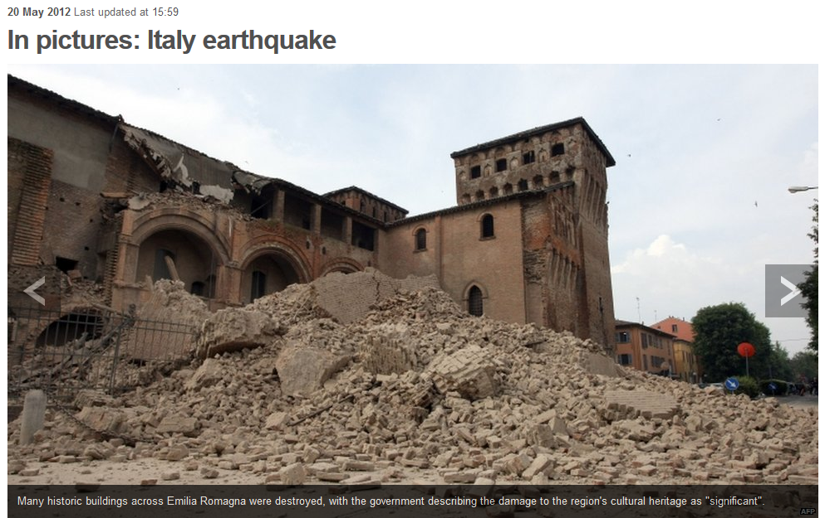
20 May 2012
20 May 2012
http://www.bbc.com/news/world-europe-18135901
Notes:
50

Slide 51
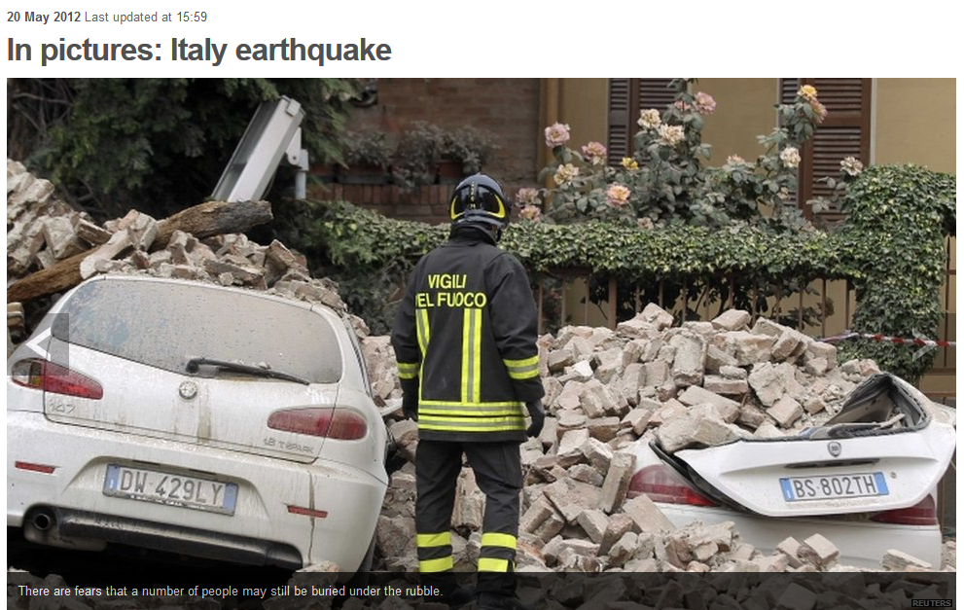
20 May 2012
20 May 2012
http://www.bbc.com/news/world-europe-18135901
Notes:
51

Slide 52
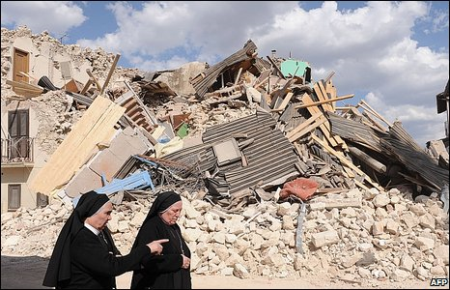
6 April 2009
http://news.bbc.co.uk/2/hi/in_pictures/7984969.stm
Notes:
52

Slide 53
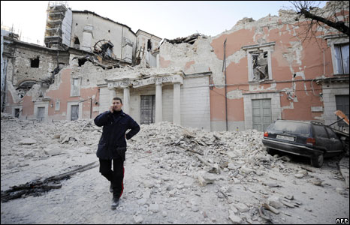
6 April 2009
http://news.bbc.co.uk/2/hi/in_pictures/7984969.stm
Notes:
53

Slide 54
Martin J. Gannon and Rajnandini Pillai
Understanding Global Cultures
Historically, Italy has been victimized by overwhelming natural disasters
          Earthquakes
          Volcanoes
          Floods
          Famines
and sinkholes
and avalanches
www.d.umn.edu/cla/faculty/troufs/anth1095/index.html#Gannon

Slide 55
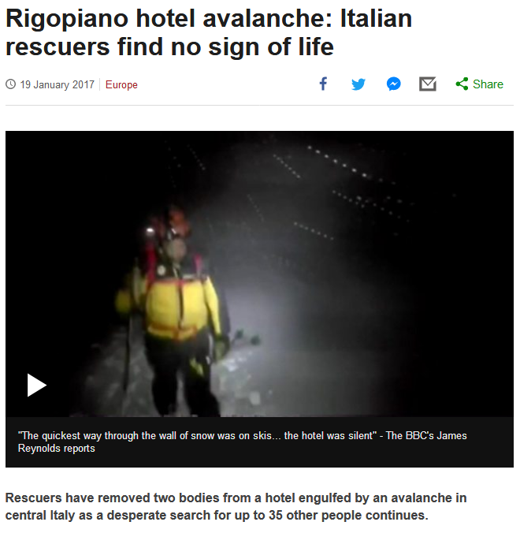
http://www.bbc.com/news/world-europe-38674788?ocid=global_bbccom_email_19012017_top+news+stories
Notes:
55

Slide 56
Martin J. Gannon and Rajnandini Pillai
Understanding Global Cultures
Historically, Italy has been victimized by overwhelming natural disasters
          Earthquakes
          Volcanoes
          Floods
          Famines
www.d.umn.edu/cla/faculty/troufs/anth1095/index.html#Gannon

Slide 57
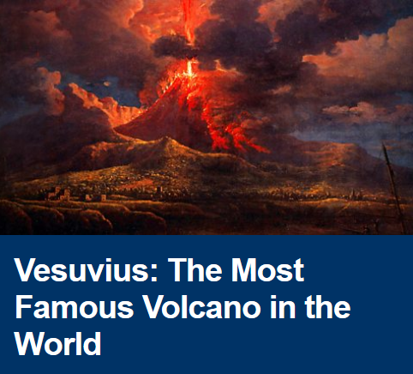
http://www.bbc.co.uk/programmes/b011792s
Notes:
57

Slide 58
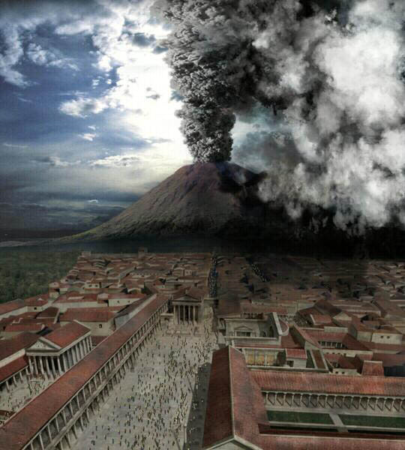
Pompei
http://en.wikipedia.org/wiki/Pompeii
Notes:
58

Slide 59
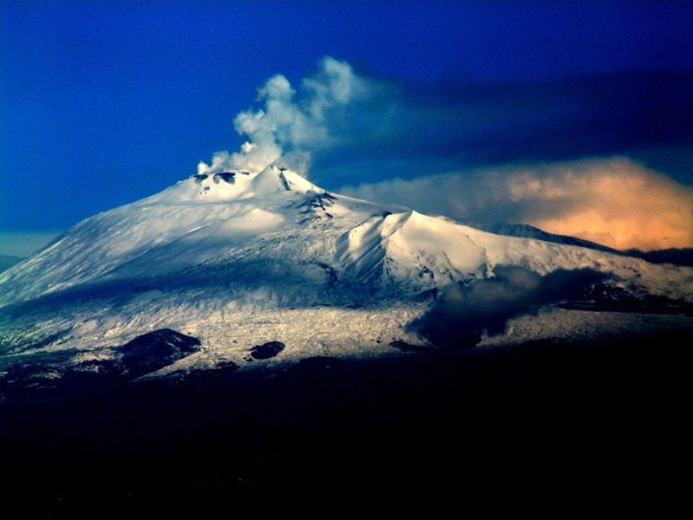
Mt. Etna
Sicily
http://en.wikipedia.org/wiki/Mt._Etna
Notes:
59

Slide 60

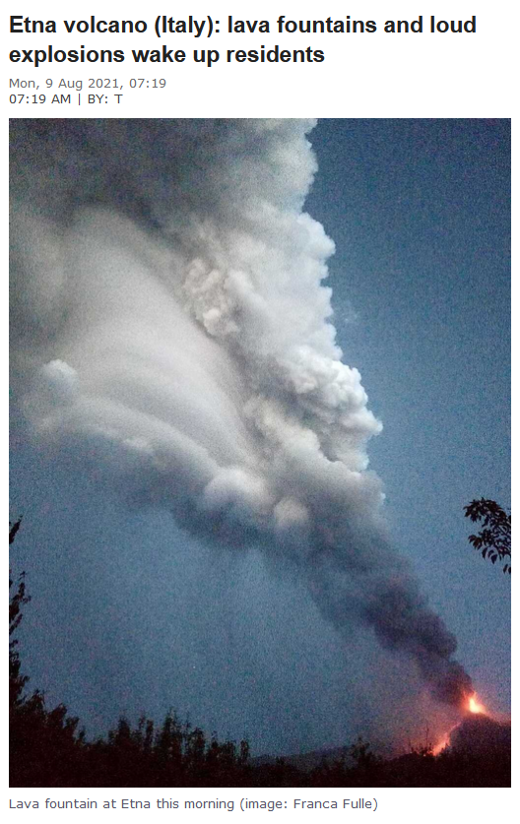
09 August 2021
https://www.volcanodiscovery.com/etna/news/137785/Etna-volcano-Italy-lava-fountains-and-loud-explosions-wake-up-residents.html
Notes:
60

Slide 61

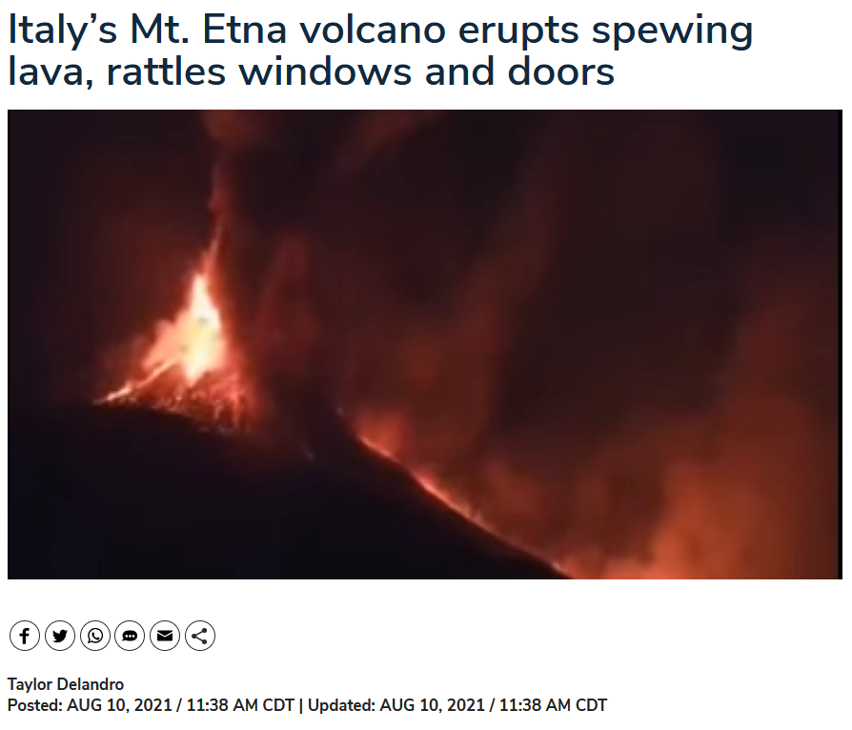
10 August 2021
https://www.newsnationnow.com/world/video-italys-mt-etna-volcano-erupts-spewing-lava-rattles-windows-and-doors/
Notes:
61

Slide 62
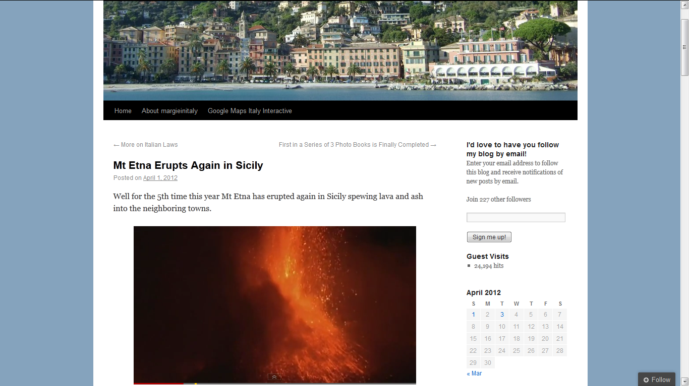
http://margieinitaly.wordpress.com/2012/04/01/mt-etna-erupts-again-in-sicily/
Notes:
62

Slide 63
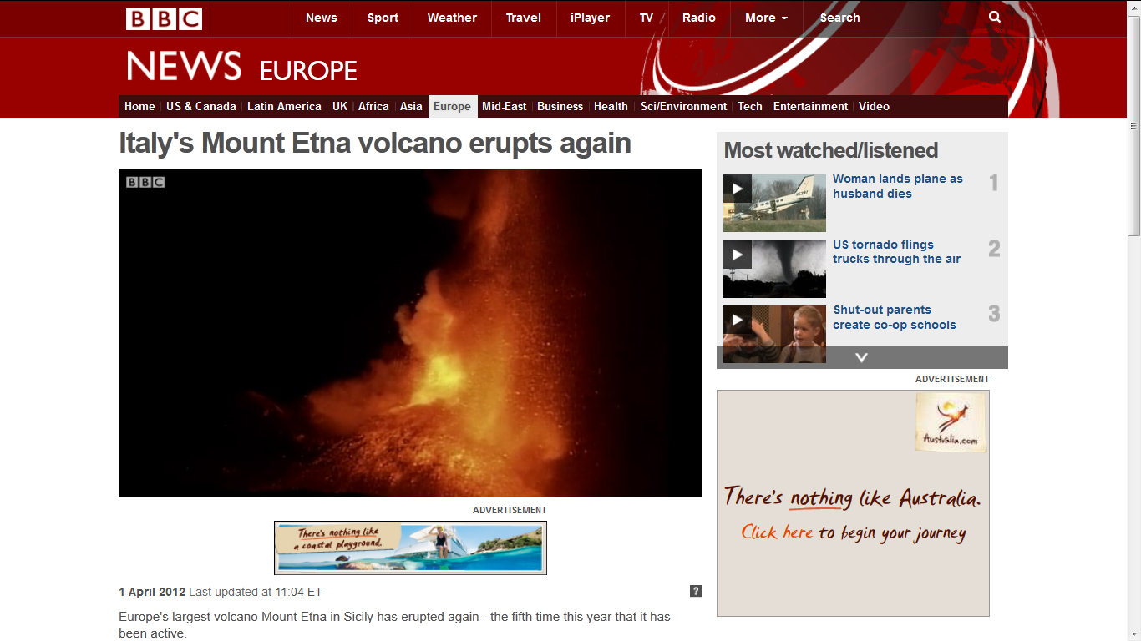
http://www.bbc.co.uk/news/world-europe-17577784
Notes:
63

Slide 64
Martin J. Gannon and Rajnandini Pillai
Understanding Global Cultures
Historically, Italy has been victimized by overwhelming natural disasters
          Earthquakes
          Volcanoes
          Floods
          Famines
www.d.umn.edu/cla/faculty/troufs/anth1095/index.html#Gannon

Slide 65
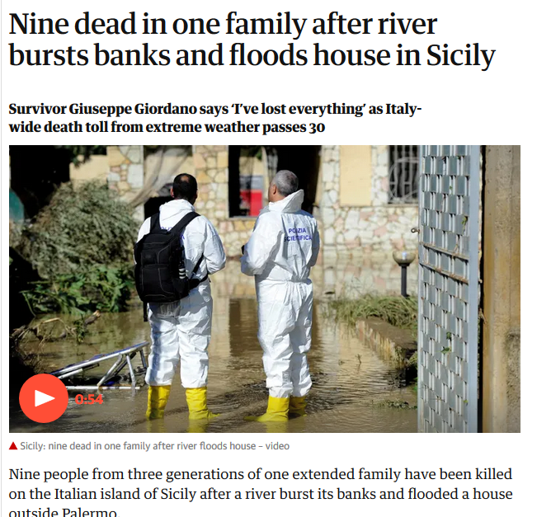
Notes:
65

Slide 66
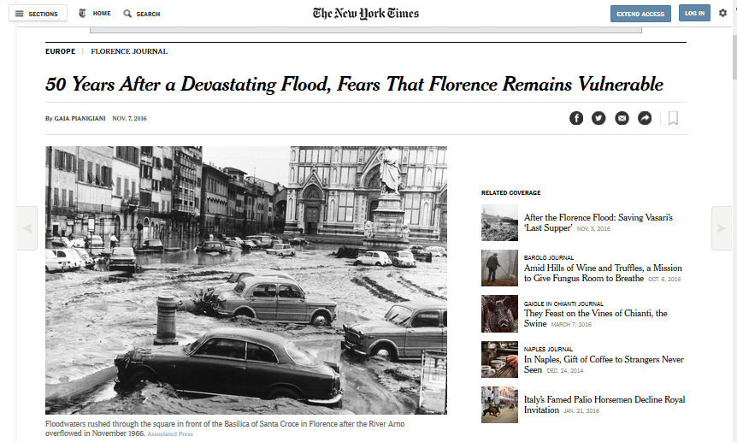
7 November 2016
http://www.nytimes.com/2016/11/08/world/europe/50-years-after-a-devastating-flood-fears-that-florence-remains-vulnerable.html?mwrsm=Email&_r=0
Notes:
66

Slide 67
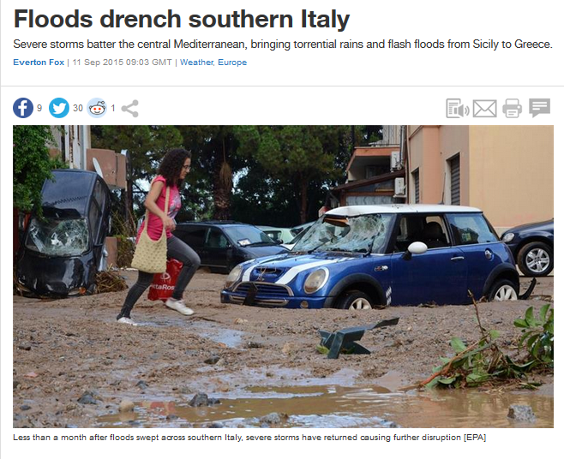

11 September 2015
http://www.aljazeera.com/news/2015/09/floods-drench-southern-italy-150911085234449.html
Notes:
67

Slide 68
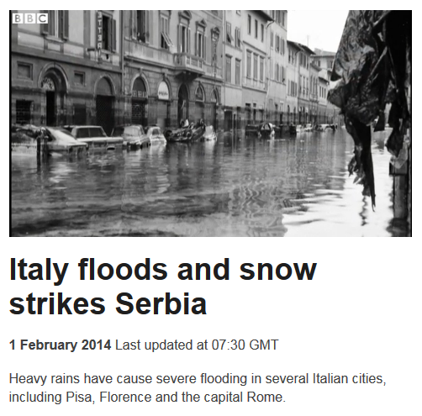
1 February 2014
http://www.bbc.com/news/world-us-canada-25648773
Notes:
68

Slide 69
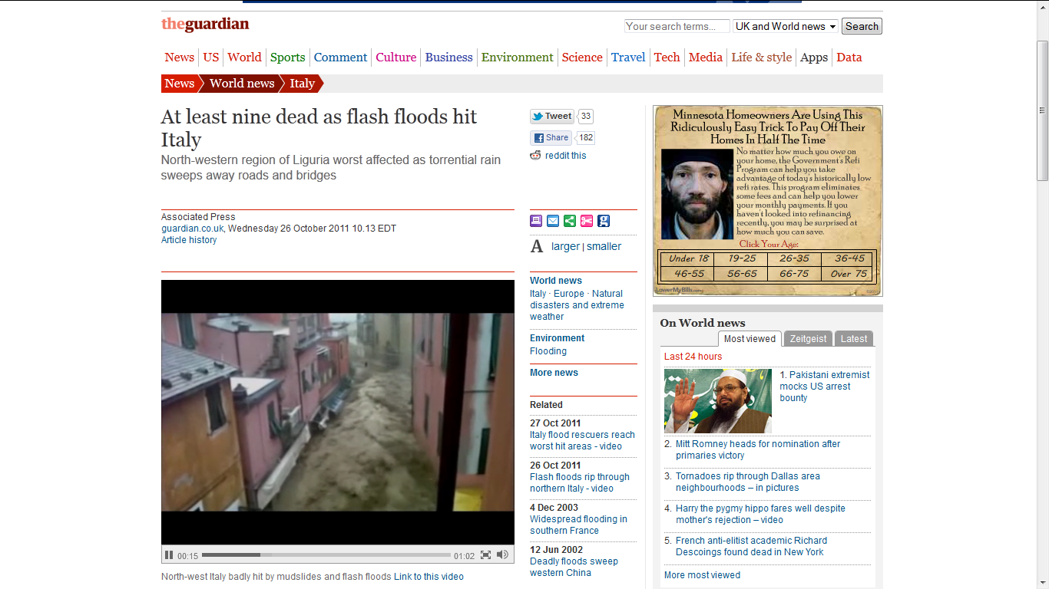
Liguria Region
2011
http://www.guardian.co.uk/world/2011/oct/26/flash-floods-hit-italy
Notes:
69

Slide 70

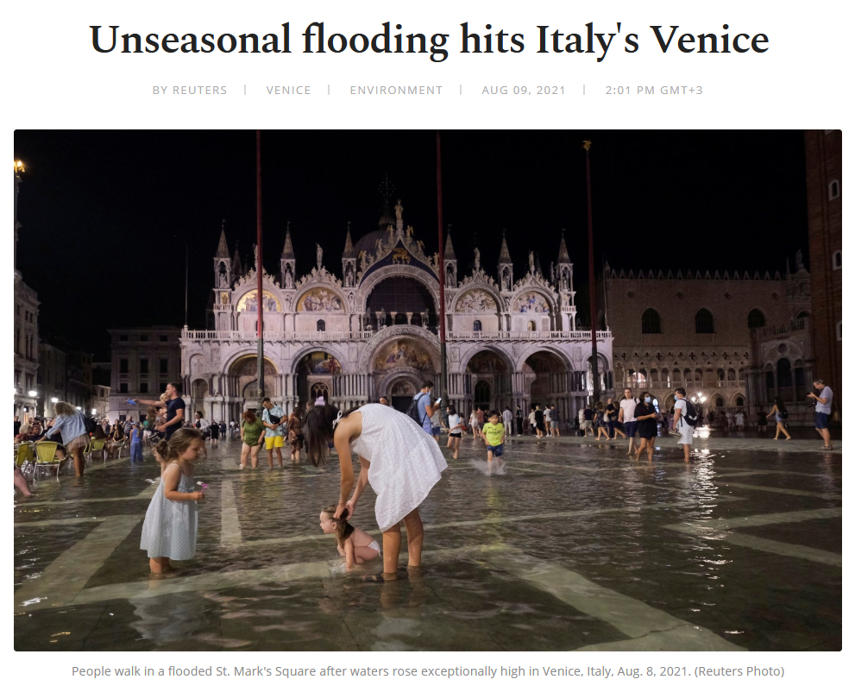
09 August 2021
Venice
2019
https://www.dailysabah.com/life/environment/unseasonal-flooding-hits-italys-venice
Notes:
70

Slide 71
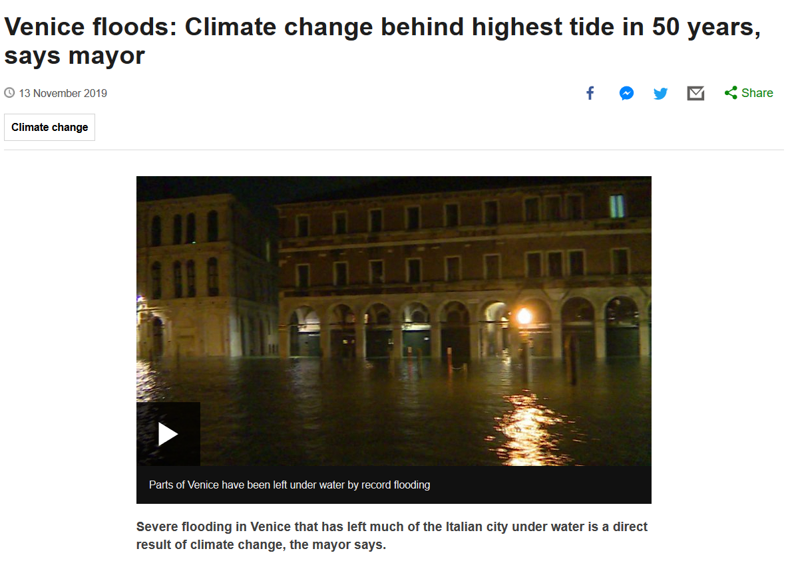
Venice
2019
Notes:
71

Slide 72
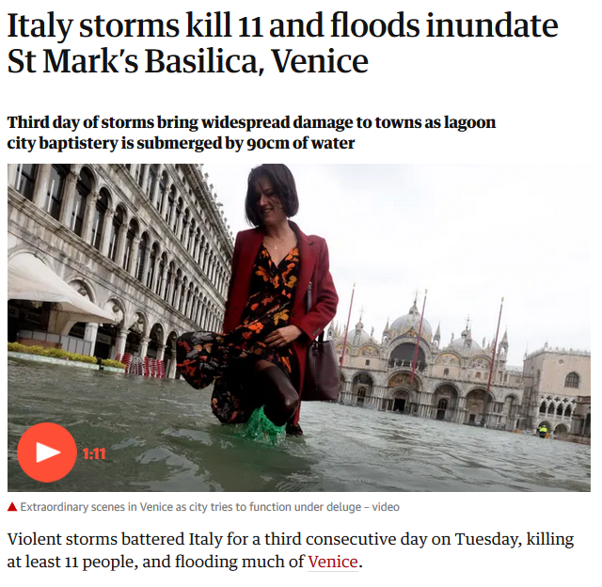
Venice
2018
Notes:
72

Slide 73
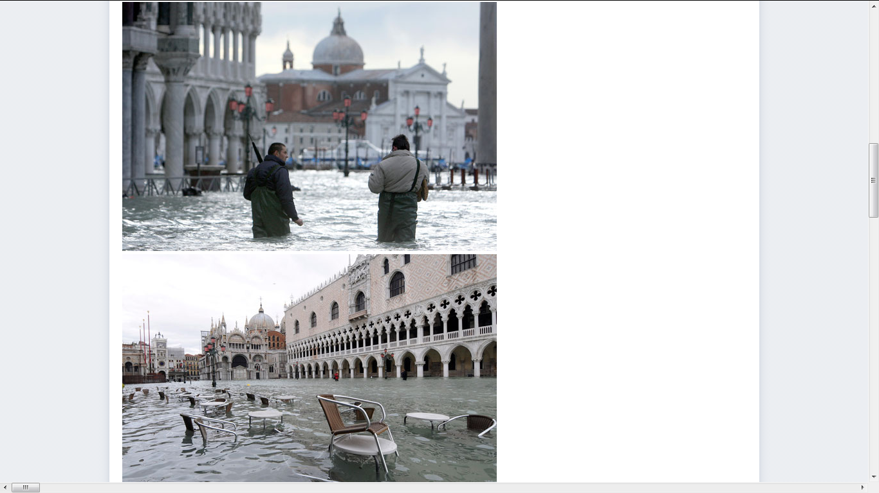
Venice
2008
http://news.ninemsn.com.au/slideshow_ajax.aspx?sectionid=9016&sectionname=slideshowajax&subsectionid=148615&subsectionname=venicefloods
Notes:
73

Slide 74
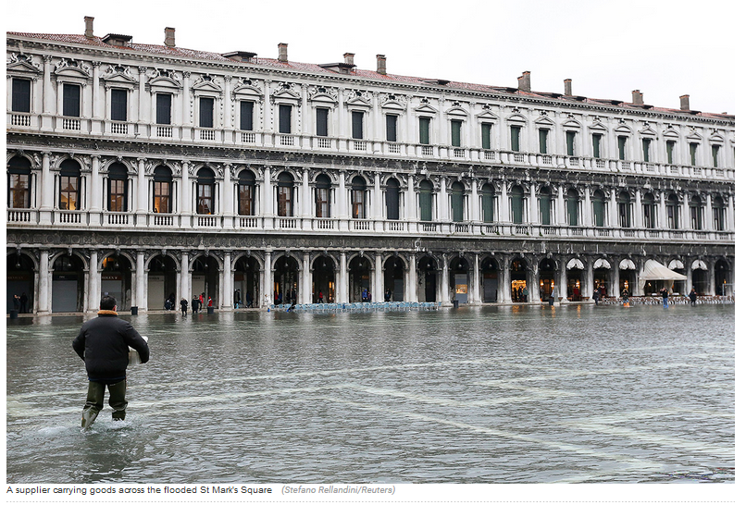
St. Mark’s Square
2 February 2015
http://www.ibtimes.co.uk/venice-carnival-2015-revellers-try-keep-their-costumes-dry-flooded-st-marks-square-1486241
Notes:
74

Slide 75
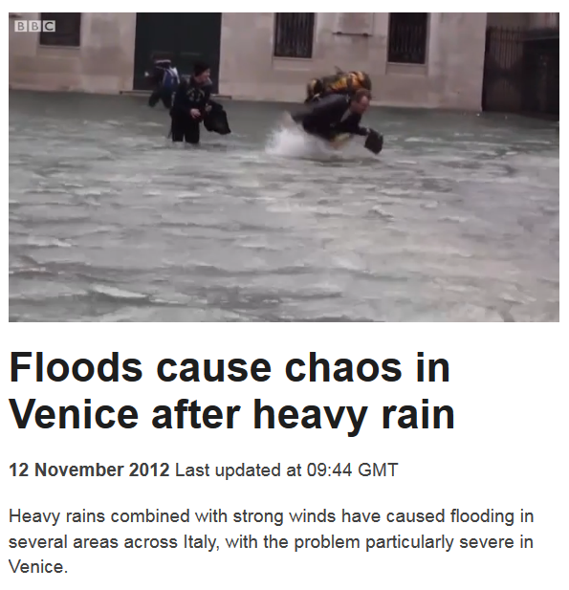
http://www.bbc.com/news/world-europe-20294488
Notes:
75

Slide 76
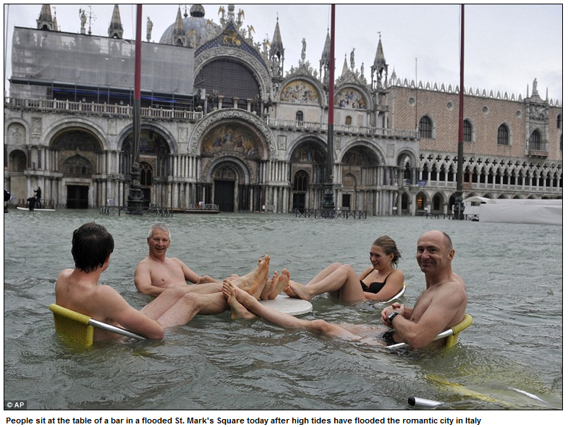
St. Mark’s Square
11 November 2012
http://www.dailymail.co.uk/news/article-2231342/Tourists-swim-Venices-iconic-St-Marks-Square-Floating-City-flooded-high-tides.html
Notes:
76

Slide 77

https://www.walksofitaly.com/blog/venice/flooding-acqua-alta-tips
Notes:
77

Slide 78

“. . . acqua alta . . . water reaching 110 cm, at which point flooding covers 14 percent of Venice, happens about four times a year.”
https://www.walksofitaly.com/blog/venice/flooding-acqua-alta-tips
Notes:
78

Slide 79

http://www.bbc.com/news/world-europe-24510314
Notes:
79

Slide 80
you can go on-line and experiment with computer models that show you when Venice, and how much of the rest of Italy, will disappear with global warming . . .
http://geology.com/sea-level-rise/venice.shtml

Slide 81

http://geology.com/sea-level-rise/venice.shtml
Notes:
81

Slide 82
Martin J. Gannon and Rajnandini Pillai
Understanding Global Cultures
Historically, Italy has been victimized by overwhelming natural disasters
          Earthquakes
          Volcanoes
          Floods
          Famines
www.d.umn.edu/cla/faculty/troufs/anth1095/index.html#Gannon

Slide 83
“There were sixteen good harvests and 111 famine years in northern Italy from
1451 to 1767.”
Alan Macfarlane (1997). p.64. ISBN 0-631-18117-2
https://en.wikipedia.org/wiki/Famine

Slide 84

http://histoiremesure.revues.org/4119?lang=en

Slide 85

Famines in Italy: a chronology and a short account
(ca. 1250-1810)
http://www.eshd.eu/sites/default/files/webform/famineinitaly_alfani_mocarelli_strangio.pdf

Slide 86
Martin J. Gannon and Rajnandini Pillai
Understanding Global Cultures
Historically, Italy has been victimized by overwhelming natural disasters
          Earthquakes
          Volcanoes
          Floods
          Famines
. . . and . . .
www.d.umn.edu/cla/faculty/troufs/anth1095/index.html#Gannon

Slide 87
Martin J. Gannon and Rajnandini Pillai
Understanding Global Cultures
Historically, Italy has been victimized by overwhelming natural disasters
    and widespread fires
      forest-fire type
www.d.umn.edu/cla/faculty/troufs/anth1095/index.html#Gannon

Slide 88

http://news.bbc.co.uk/2/hi/europe/830513.stm
Notes:
88

Slide 89

http://www.guardian.co.uk/world/2011/oct/26/flash-floods-hit-italy
Notes:
89

Slide 90
Martin J. Gannon and Rajnandini Pillai
Understanding Global Cultures
It is a geologically young country, most of which cannot be categorized as terra firma, and there have been so many mudslides resulting in great loss of property and life both in the past and in recent years that the Italians nickname the nation
“landslide country”
www.d.umn.edu/cla/faculty/troufs/anth1095/index.html#Gannon

Slide 91


04 October 2020
https://www.bbc.com/news/world-europe-54402096
Notes:
91

Slide 92

Mon 25 Nov 2019
https://www.theguardian.com/world/2019/nov/25/storms-france-greece-italy-destruction-floods?CMP=Share_iOSApp_Other
Notes:
92

Slide 93

http://www.bbc.com/news/world-europe-30076940
Notes:
93

Slide 94

http://news.bbc.co.uk/2/hi/8517378.stm
Notes:
94

Slide 95

http://www.eea.europa.eu/data-and-maps/figures/landslides-in-italy
Notes:
95

Slide 96
http://www.eea.europa.eu/data-and-maps/figures/landslides-in-italy
Notes:
96

Slide 97

The map shows: LEFT: Distribution of landslides with human consequences from AD 1300 to 2002. The size of the triangle indicates the intensity of the event. RIGHT: Landslide susceptibility map of Italy.
http://www.eea.europa.eu/data-and-maps/figures/landslides-in-italy
Notes:
97

Slide 98
Martin J. Gannon and Rajnandini Pillai
Understanding Global Cultures
Historically, Italy has been victimized by overwhelming natural disasters
    and even COVID
www.d.umn.edu/cla/faculty/troufs/anth1095/index.html#Gannon

Slide 99


https://nypost.com/2016/08/30/relic-depicting-italian-towns-patron-saint-found-in-earthquake-rubble/

Slide 100
  The Overture
  Pageantry and Spectacle
  Voice
  Externalization
  5. Chorus and Soloists
Villages are protected primarily bytheir Patron Saints.
In this case . . .
Santo Patrono
Italy
www.d.umn.edu/cla/faculty/troufs/anth1095/index.html#Gannon

Slide 101
Martin J. Gannon and Rajnandini Pillai
Understanding Global Cultures
Once a year, in every village and city, there is a celebration in honor of its patron saint (santo patrono) in which a parade is featured. The statue of the saint is place in the lead position in the parade, followed by the clergy, members of the upper classes, and then all other citizens. A celebration follows in the piazza, or town center. This tradition al festival and parade help to strengthen the feeling of solidarity and permit people to escape from the regular routine in a dramatic, spectacular, and fun-filled manner.”
www.d.umn.edu/cla/faculty/troufs/anth1095/index.html#Gannon

Slide 102


“There is a St. Corona, and her remains are in Anzu, a town in northern Italy . . .”
https://www.ncronline.org/news/spirituality/st-corona-patron-saint-pandemics

Slide 103

Palermo pins hopes on patron saint to rid Italy of coronavirus
Fri 13 Mar 2020 12.15 EDT
14 Mar 2020
Residents of Sicilian capital pray for another miracle from Saint Rosalia, who they say rescued the city from a deadly plague in 1625

Slide 104
Some Background to the Country
The Forces of Nature and World View
Italy

Slide 105
Martin J. Gannon and Rajnandini Pillai
Understanding Global Cultures
As a result, Italy exudes an aura of
“precariousness”
www.d.umn.edu/cla/faculty/troufs/anth1095/index.html#Gannon

Slide 106
Martin J. Gannon and Rajnandini Pillai
Understanding Global Cultures
Italians tend to accept
insecurity as a fact of life.
This acceptance may explain why they seem to be able to
enjoy life more for the moment
and why the are willing
to accept events as they happen
www.d.umn.edu/cla/faculty/troufs/anth1095/index.html#Gannon

Slide 107
Martin J. Gannon and Rajnandini Pillai
Understanding Global Cultures
Italians tend to feel that
if something is going to happen,
it will,
and that not much can be done about it
www.d.umn.edu/cla/faculty/troufs/anth1095/index.html#Gannon

Slide 108


7 August 2023
https://www.bbc.com/news/world-europe-66429342

Slide 109
Martin J. Gannon and Rajnandini Pillai
Understanding Global Cultures
George Foster:
“Peasant Fatalism”
www.d.umn.edu/cla/faculty/troufs/anth1095/index.html#Gannon

Slide 110

“Classics" in the Anthropology of Europe
George Foster
“Peasant Society and the Image of Limited Good.”
American
Anthropologist
67:293-315.
Parman's classic picks -- Tony Galt

Slide 111
Martin J. Gannon and Rajnandini Pillai
Understanding Global Cultures
“This, then, is Italy.
It is still a grand and larger-than-life society whose citizens
love pageantry and spectacle,
emphasize a range of voices
in everyday life,
externalize emotions and feelings,
and feel a commitment to the town and region of the country
in which they were born. . . .”
www.d.umn.edu/cla/faculty/troufs/anth1095/index.html#Gannon

Slide 112
Forces of Nature
and World View
Italy
© 2009-2024 Timothy G. Roufs, University of Minnesota Duluth

