Slide 1
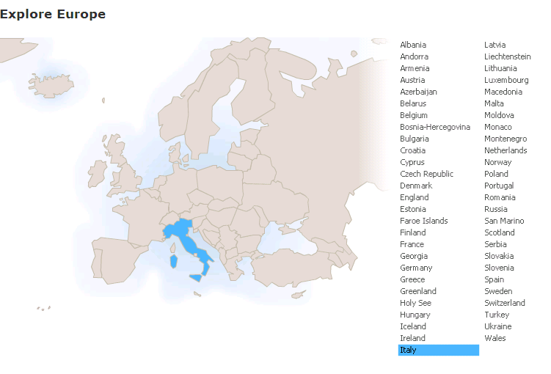
Run in “Slide Show” mode.
Use your up / down arrow keys and / or
your space bar to advance the slides
History
and World View
Italy
© 2009-2024 Timothy G. Roufs, University of Minnesota Duluth

Slide 2
Italy
© 2009-2024 Timothy G. Roufs, University of Minnesota Duluth

Slide 3
History
and World View
Italy
© 2009-2024 Timothy G. Roufs, University of Minnesota Duluth

Slide 4
Italy’s contemporary situation reflects a complex history, geography, ecology, demographic make up, world view, and so forth
. . .

Slide 5
So first, a bit of history and background . . .

Slide 6
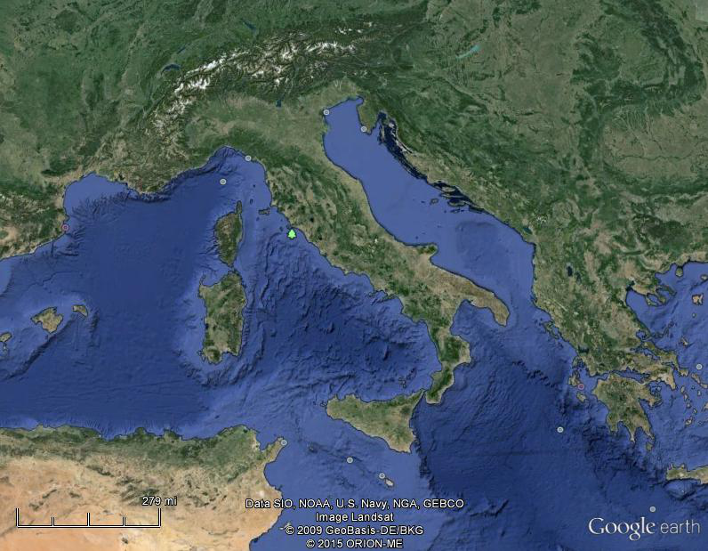
Of all European countries Italy, “the boot,” is probably the most recognizable . . .
Notes:
6

Slide 7
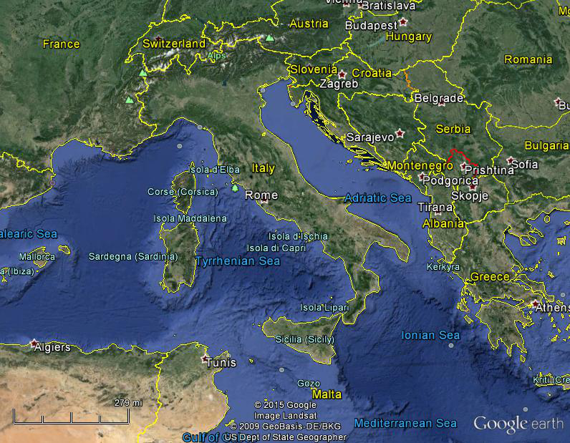
Italy, and her current neighbors . . .
Notes:
7

Slide 8
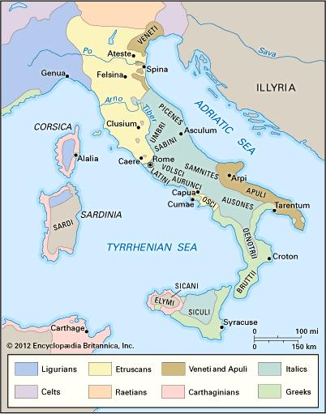
ancient Italic peoples:
Distribution of peoples of ancient Italy ca. 500 B.C.
©Encyclopædia Britannica, Inc.
https://www.britannica.com/topic/history-of-Italy
Notes:
8

Slide 9
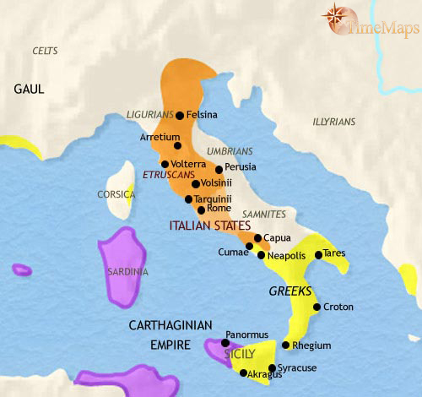
500 B.C.
http://www.timemaps.com/history/italy-500bc
Notes:
9

Slide 10
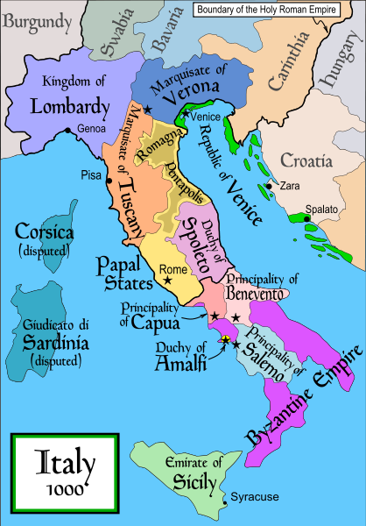
1000
Italy was divided for centuries into small kingdoms and city-states
http://en.wikipedia.org/wiki/Italy
Notes:
10

Slide 11
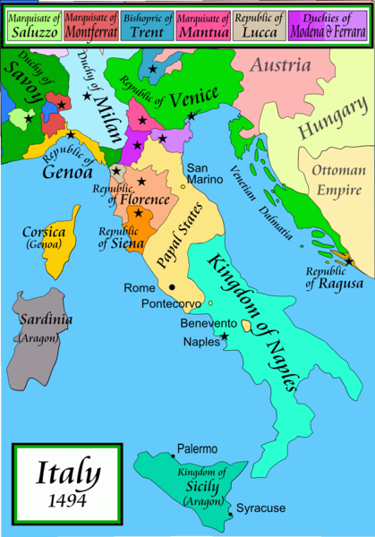
1494
Italy was divided for centuries into small kingdoms and city-states
http://en.wikipedia.org/wiki/Italy
Notes:
11

Slide 12
1494
Italy was divided for centuries into small kingdoms and city-states
http://en.wikipedia.org/wiki/Italy
Notes:
12

Slide 13
In 1494 Christopher Columbus from Genoa went on his second voyage to the New World
Italy was divided for centuries into small kingdoms and city-states
http://en.wikipedia.org/wiki/Italy
Notes:
13

Slide 14
In 1494 Christopher Columbus from Genoa is on his second voyage to the New World
Christopher Columbus was a sugar merchant from Genoa, married to the daughter of a sugar merchant from Madeira, Felipa Perestrello.
Columbus was looking for a way around Venice’s monopoly on things like sugar. . . .
Italy was divided for centuries into small kingdoms and city-states
http://en.wikipedia.org/wiki/Italy
Notes:
14

Slide 15
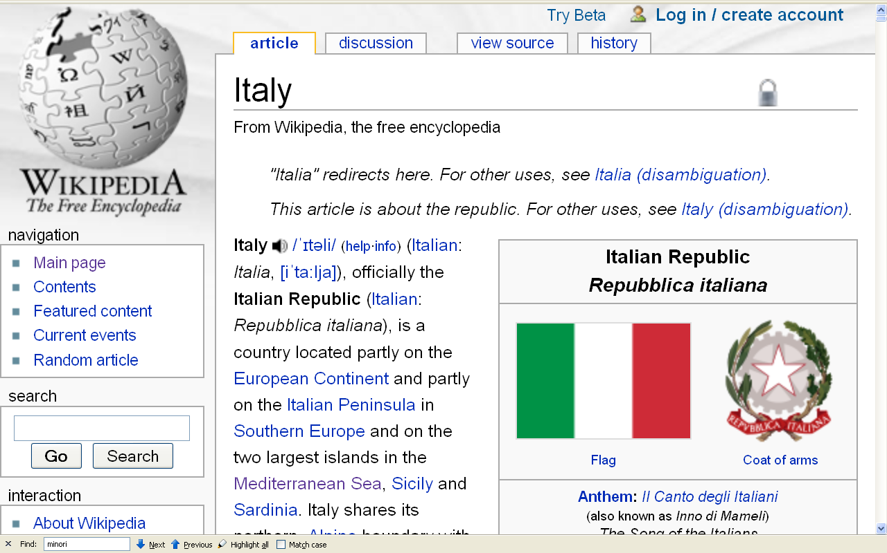
Formation of Italy
Unification —17 March 1861
Republic —2 June 1946
http://en.wikipedia.org/wiki/Italy
Notes:
15

Slide 16
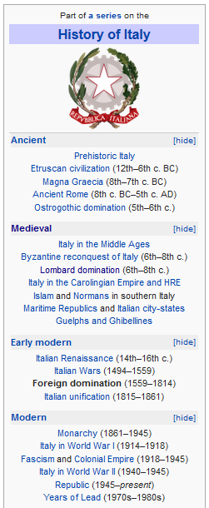
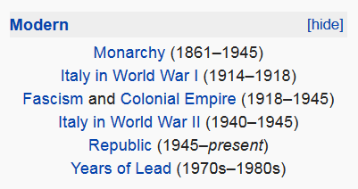
http://en.wikipedia.org/wiki/History_of_Italy_during_foreign_domination_and_the_unification
Notes:
16

Slide 17
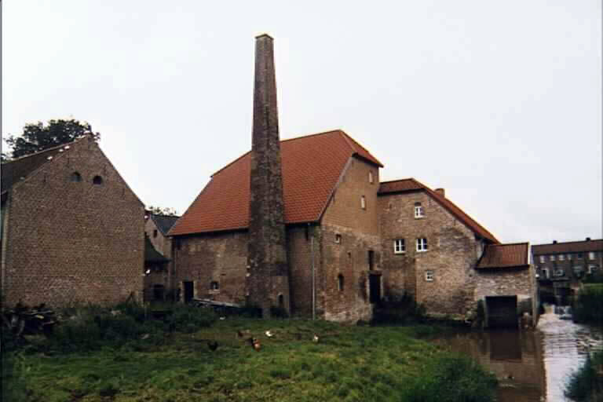
by comparison,
the Roufs family left
Sittard / Nieuwstadt, Netherlands, in 1842
Italy was “unified” almost 20 years later
1861
Notes:
17

Slide 18
Roufs Mill
Sittard, Netherlands
Notes:
18

Slide 19
Formation of Italy
Unification —17 March 1861
Republic —2 June 1946
http://en.wikipedia.org/wiki/Italy
Notes:
19

Slide 20
http://en.wikipedia.org/wiki/History_of_Italy_during_foreign_domination_and_the_unification
Notes:
20

Slide 21
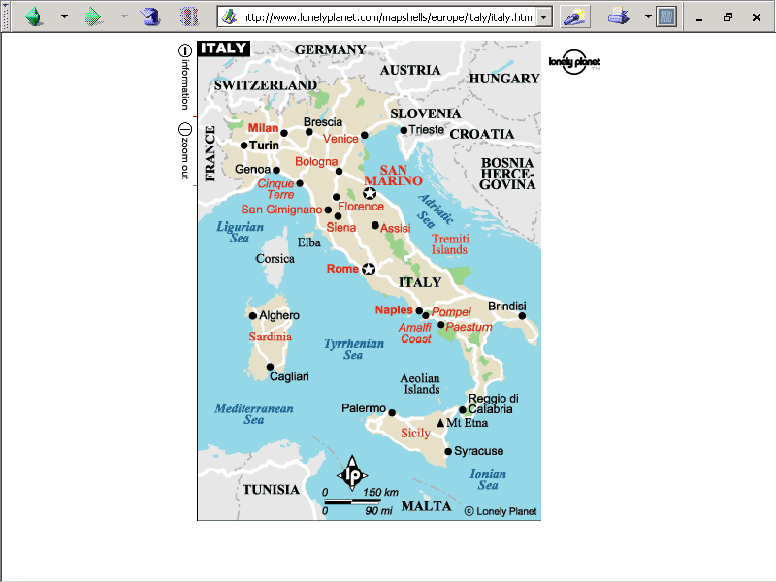
population size
62,390,364 (July 2021 est.)
https://www.worldometers.info/world-population/italy-population/

Slide 22
Note
Sicily

Slide 23
Note
Sardinia

Slide 24
Note
Kingdom of Tavolara
(unrecognized micronation)
https://en.wikipedia.org/wiki/Kingdom_of_Tavolara

Slide 25
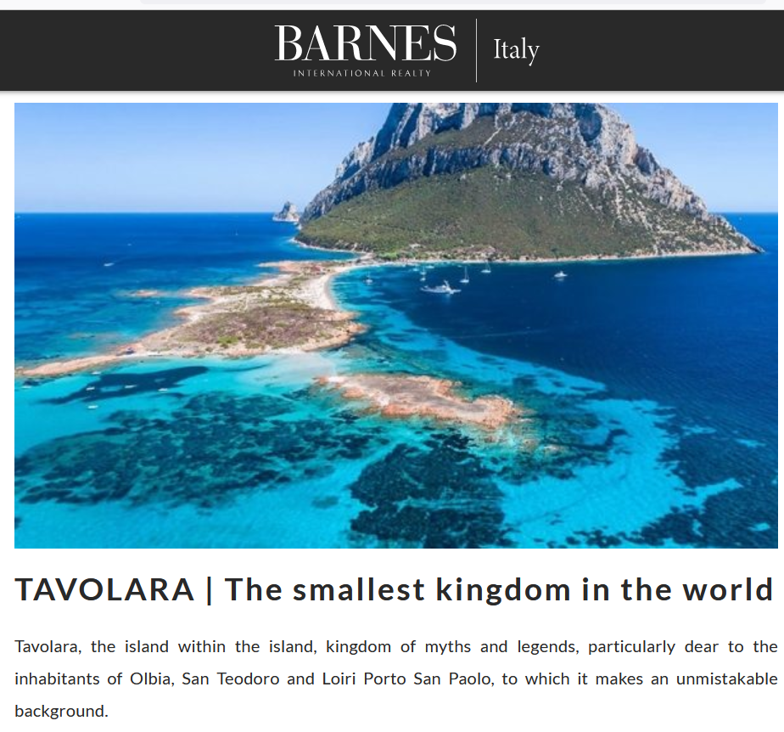
https://barnes-italy.com/tavolara-the-smallest-kingdom-in-the-world/
Notes:
25

Slide 26
Note
Corsica
(French)
Notes:
26

Slide 27
Principality of Seborga
(unrecognized micronation)
Note
https://en.wikipedia.org/wiki/Seborga
Notes:
27

Slide 28
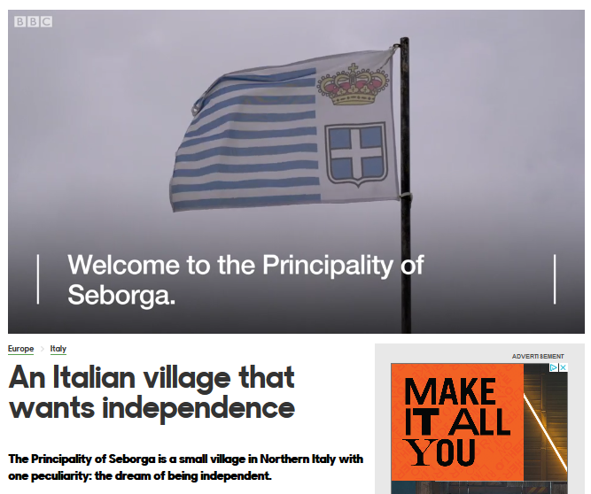
Notes:
28

Slide 29
Note
Rome

Slide 30
The Holy See
(The Vatican)
an independent country
Note
Notes:
30

Slide 31
Note
Notes:
31

Slide 32
Note
The Most Serene Republic of San Marino
an independent country
Notes:
32

Slide 33
Cultural Metaphor
Italian Opera
Italy
© 2009-2024 Timothy G. Roufs, University of Minnesota Duluth

Slide 34
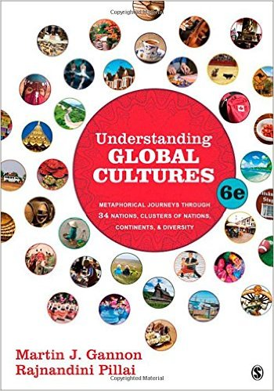
The text
(Thousand Oaks, CA: SAGE Publications, 2015)
Notes:
ousa

Slide 35
Gannon and Pillai's European Cultural Metaphors include
Ch. 19 The Italian Opera
Ch. 20 Belgian Lace
Ch. 22 The Turkish Coffehouse
Ch. 31 The Russian Ballet
Ch. 32 Estonian Singing
Ch. 33 The Polish Village Church
Ch. 34 The Spanish Bullfight
Ch. 35 The Portuguese Bullfight

Slide 36
Gannon and Pillai classify Italy as one of the
“Cleft National Cultures”
that they discuss

Slide 37
http://www.d.umn.edu/cla/faculty/troufs/anth1095/index.html#text

Slide 38
http://www.d.umn.edu/cla/faculty/troufs/anth1095/index.html#text

Slide 39
Cultural Metaphors
“Cleft National Culture”
one in which the regions, and subcultures of the diverse ethnic groups,
are difficult to integrate

Slide 40
Gannon and Pillai's European Cultural Metaphors include
Ch. 19 The Italian Opera
Ch. 20 Belgian Lace
Ch. 22 The Turkish Coffehouse
Ch. 31 The Russian Ballet
Ch. 32 Estonian Singing
Ch. 33 The Polish Village Church
Ch. 34 The Spanish Bullfight
Ch. 35 The Portuguese Bullfight
Italy is culturally divided
“North - South”

Slide 41
in a nutshell . . .

Slide 42
Martin J. Gannon and Rajnandini Pillai Understanding Global Cultures
The country is divided into two main regions
“Continental Italy” (aka “The North”)
The Alps
The northern Italian plain
“Mediterranean Italy” (aka “The South”)
The Italian peninsula and the islands
www.d.umn.edu/cla/faculty/troufs/anth1095/index.html#Gannon

Slide 43
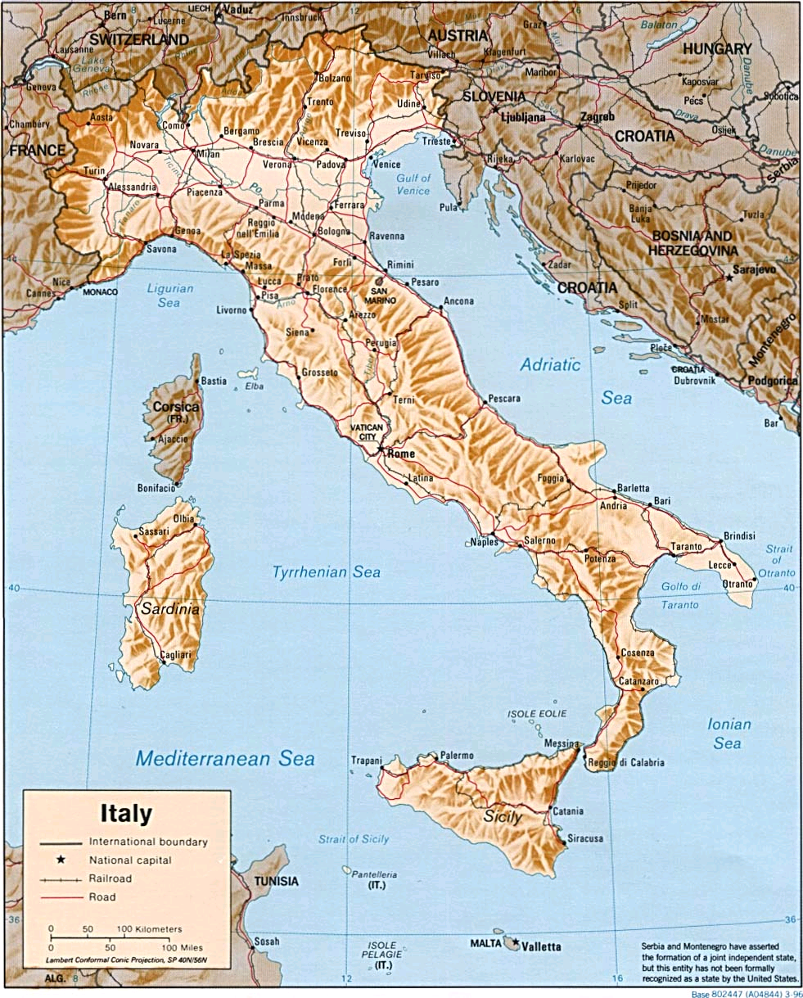
http://www.reliefweb.int/rw/RWB.NSF/db900LargeMaps/SKAR-64GDTU?OpenDocument

Slide 44
Martin J. Gannon and Rajnandini Pillai Understanding Global Cultures
The Apennine mountains run directly down the peninsula’s center, and its northern range almost completely cuts off the north from the south
This geographical division has led to extreme regionalism
www.d.umn.edu/cla/faculty/troufs/anth1095/index.html#Gannon

Slide 45
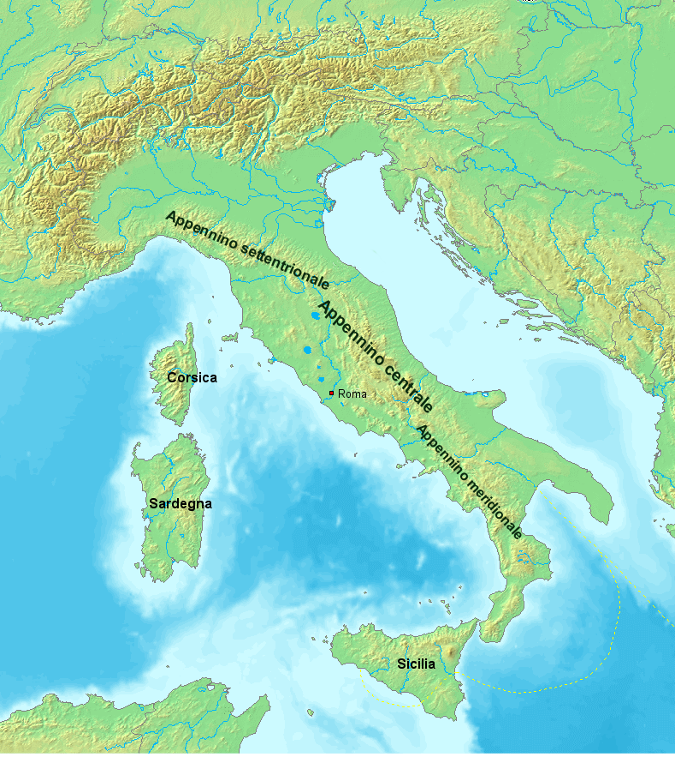
https://en.wikipedia.org/wiki/Apennine_Mountains

Slide 46
Martin J. Gannon and Rajnandini Pillai Understanding Global Cultures
The Apennine mountains run directly down the peninsula’s center, and its northern range almost completely cuts off the north from the south
Many Italians view Italy as two separate nations
The wealthier, industrial north
The poorer, more agrarian south
www.d.umn.edu/cla/faculty/troufs/anth1095/index.html#Gannon

Slide 47
Sometimes the northern region is called
Padania . . .
Some even arguing that it should be an independent country . . .
https://en.wikipedia.org/wiki/Padanian_nationalism

Slide 48
Sometimes the northern region is called
Padania . . .
Some even arguing that it should be an independent country . . .
https://en.wikipedia.org/wiki/Padanian_nationalism

Slide 49
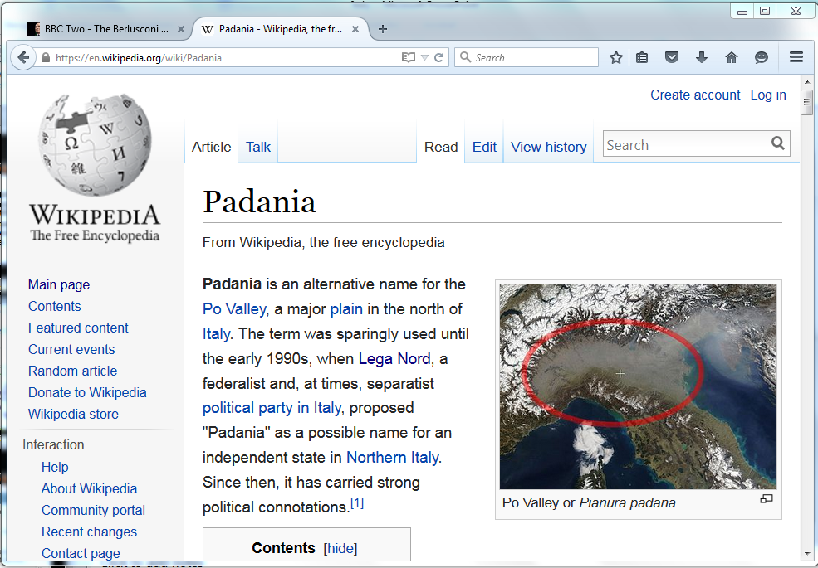
https://en.wikipedia.org/wiki/Padania
Notes:
49

Slide 50
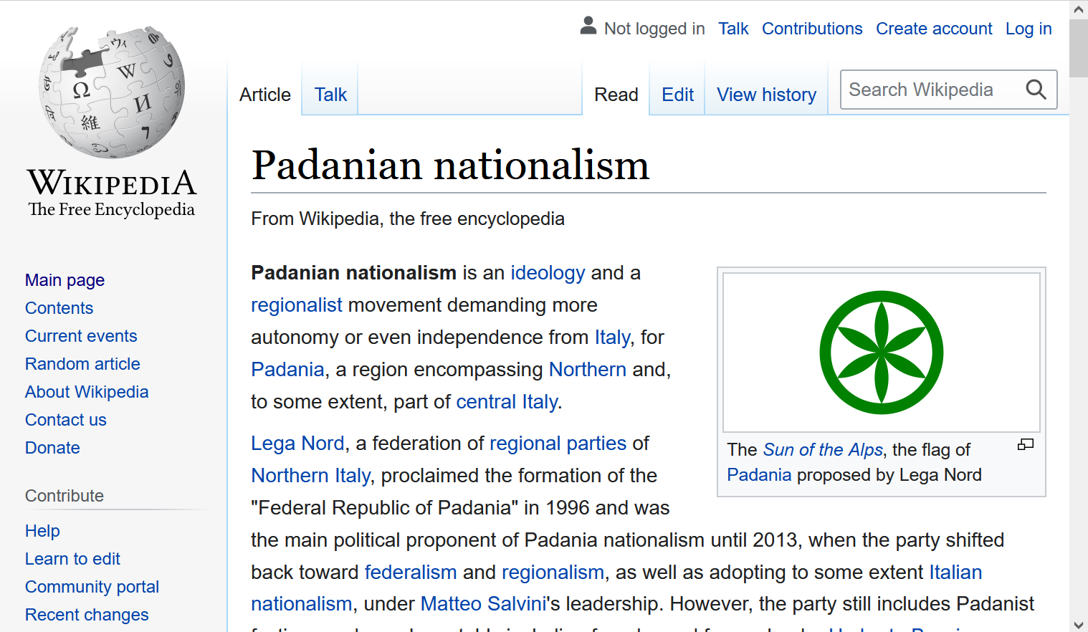
https://en.wikipedia.org/wiki/Padanian_nationalism
Notes:
50

Slide 51
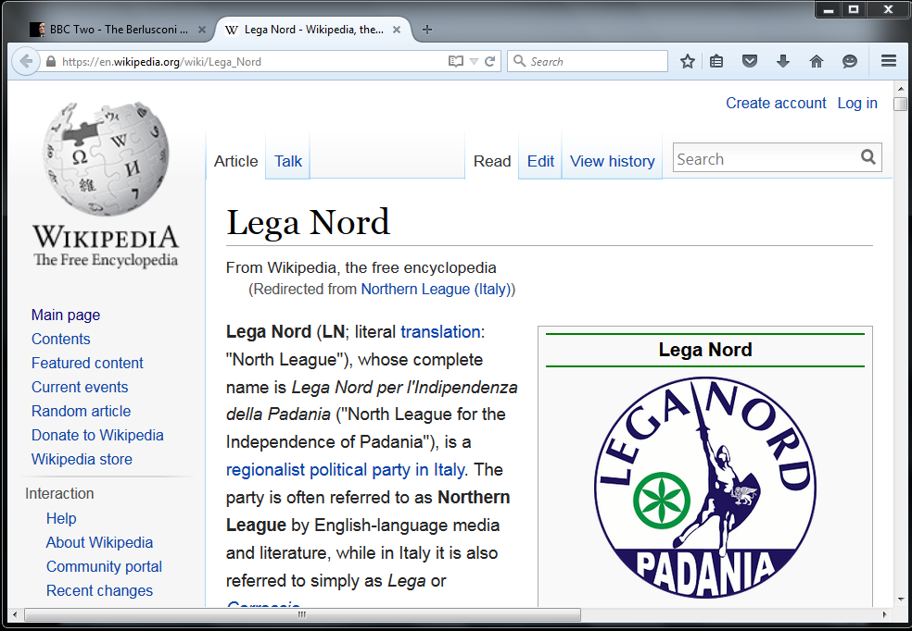
http://en.wikipedia.org/wiki/Northern_League_%28Italy%29
Notes:
51

Slide 52
Demographics
The highest population density is in Northern Italy,
as that one-third of the country contains almost half of the total population
Wikipedia
http://en.wikipedia.org/wiki/Italy#Demographics

Slide 53
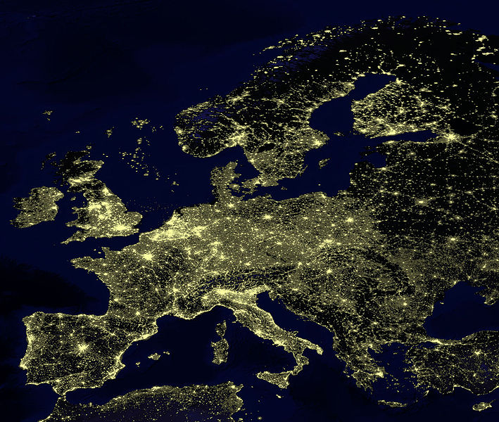
for Europe, at least, earthlight photos give you a sense of population density
https://commons.wikimedia.org/wiki/File:Earthlights_2002.jpg
Notes:
53

Slide 54
https://commons.wikimedia.org/wiki/File:Earthlights_2002.jpg
Notes:
54

Slide 55
https://commons.wikimedia.org/wiki/File:Earthlights_2002.jpg
Notes:
55

Slide 56
Oslo
Stockholm
St. Petersburg
Edinburgh
Glasgow
Copenhagen
London
Brussels
Paris
Milan
Venice
Rome
Madrid
Naples
Athens
https://commons.wikimedia.org/wiki/File:Earthlights_2002.jpg
Notes:
56

Slide 57
Demographics
urban population:
71.3% of total population
(2021)
rate of urbanization: 0.27% annual rate of change
(2020-2025 est.)
Infant mortality rate:
total: 3.14 deaths/1,000 live births
(2021 est.)
country comparison to the world: 210
Life expectancy at birth:
total population: 82.67 years
(2021 est.)
country comparison to the world: 17
CIA World Factbook
https://www.cia.gov/the-world-factbook/countries/italy/

Slide 58
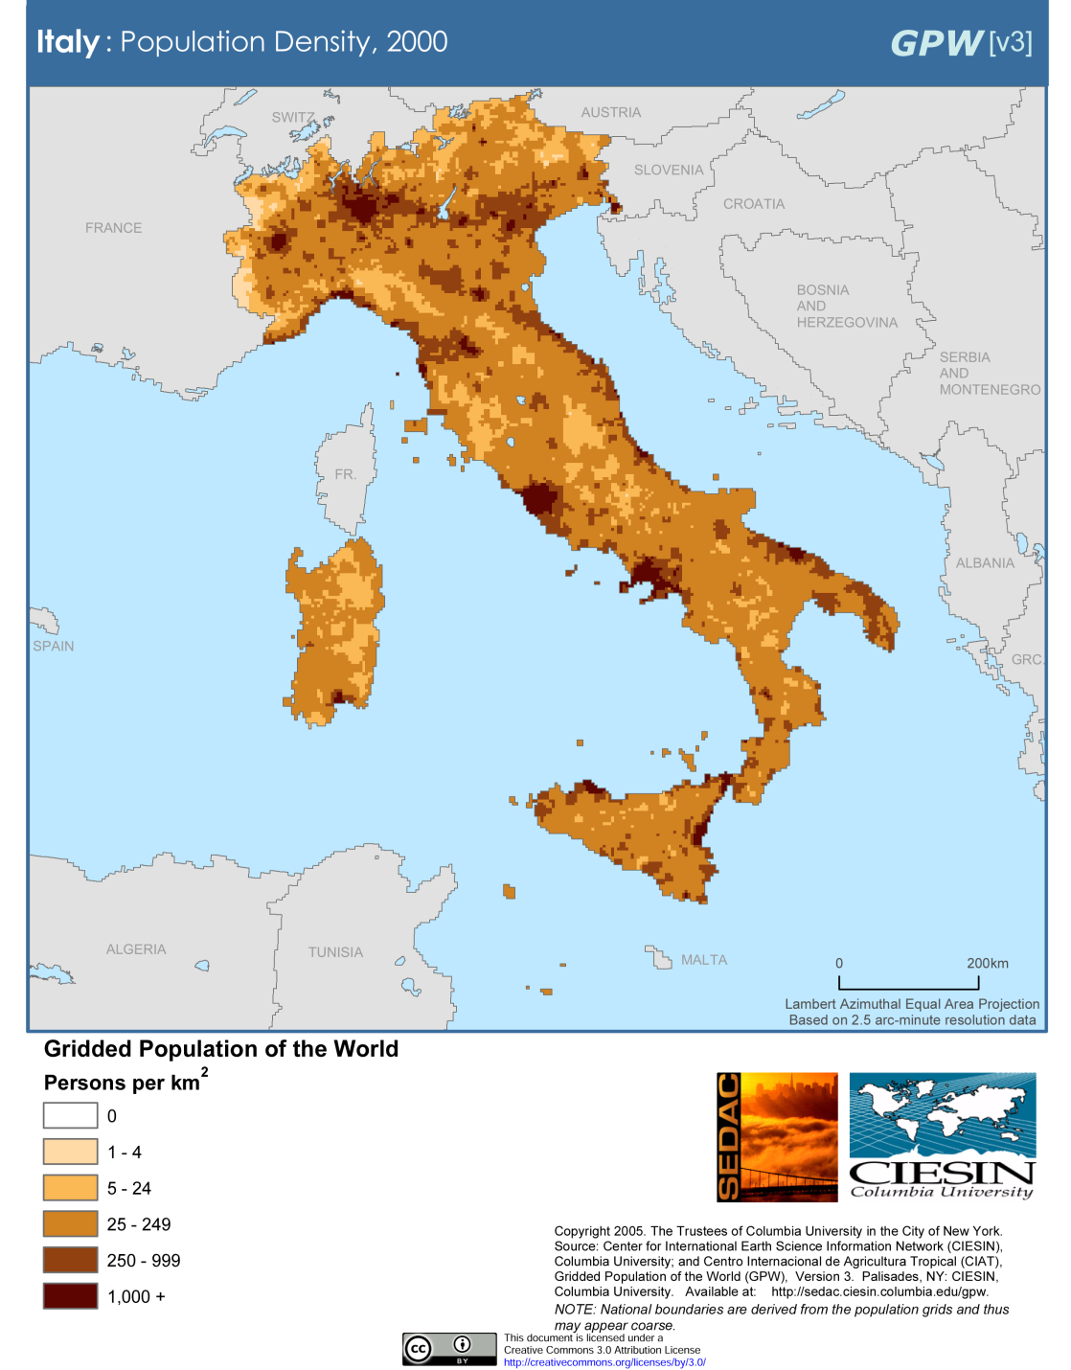
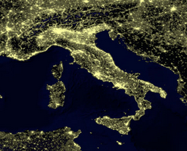
Milan
Venice
Rome
Milan
Venice
Naples
Rome
Naples
Population Density (2000)
Wikipedia
http://en.wikipedia.org/wiki/Italy#Demographics

Slide 59
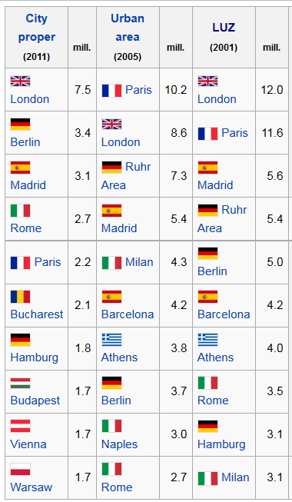
European
Union
Populations
https://en.wikipedia.org/wiki/Demographics_of_the_European_Union#Population_by_nation
Notes:
59

Slide 60
Demographics
Main Ethnic groups
In the North
German-Italians
French-Italians
Slovene-Italians
In the South
Albanian-Italians
Greek-Italians
CIA World Factbook
https://www.cia.gov/the-world-factbook/countries/italy/

Slide 61
Main Languages
Italian (official)
German
parts of Trentino-Alto Adige region are predominantly German speaking
French
small French-speaking minority in Valle d'Aosta region (near France)
Slovene
Slovene-speaking minority in the Trieste-Gorizia area (near Slovenia)
CIA World Factbook
https://www.cia.gov/the-world-factbook/countries/italy/

Slide 62
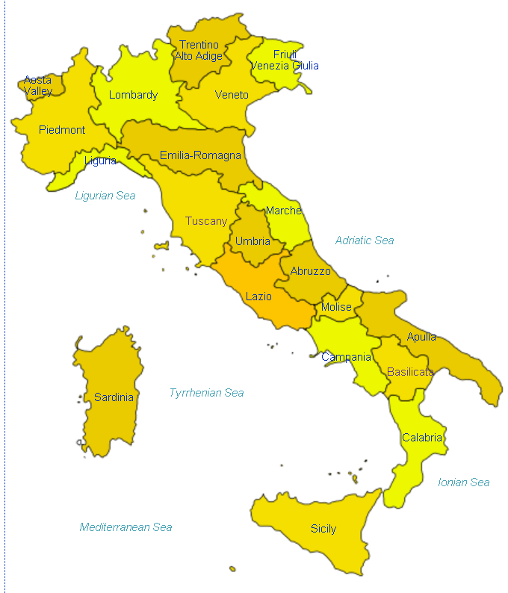
Italian
http://en.wikipedia.org/wiki/Regions_of_Italy
Notes:
62

Slide 63
Main Languages
Italian (official)
German
parts of Trentino-Alto Adige region are predominantly German speaking
French
small French-speaking minority in Valle d'Aosta region (near France)
Slovene
Slovene-speaking minority in the Trieste-Gorizia area (near Slovenia)
CIA World Factbook
https://www.cia.gov/the-world-factbook/countries/italy/

Slide 64
German
http://en.wikipedia.org/wiki/Regions_of_Italy
Notes:
64

Slide 65
Main Languages
Italian (official)
German
parts of Trentino-Alto Adige region are predominantly German speaking
French
small French-speaking minority in Valle d'Aosta region (near France)
Slovene
Slovene-speaking minority in the Trieste-Gorizia area (near Slovenia)
CIA World Factbook
https://www.cia.gov/the-world-factbook/countries/italy/

Slide 66
French
http://en.wikipedia.org/wiki/Regions_of_Italy
Notes:
66

Slide 67
Main Languages
Italian (official)
German
parts of Trentino-Alto Adige region are predominantly German speaking
French
small French-speaking minority in Valle d'Aosta region (near France)
Slovene
Slovene-speaking minority in the Trieste-Gorizia area (near Slovenia)
CIA World Factbook
https://www.cia.gov/the-world-factbook/countries/italy/

Slide 68
Slovene
http://en.wikipedia.org/wiki/Regions_of_Italy
Notes:
68

Slide 69
http://en.wikipedia.org/wiki/Regions_of_Italy
Notes:
69

Slide 70
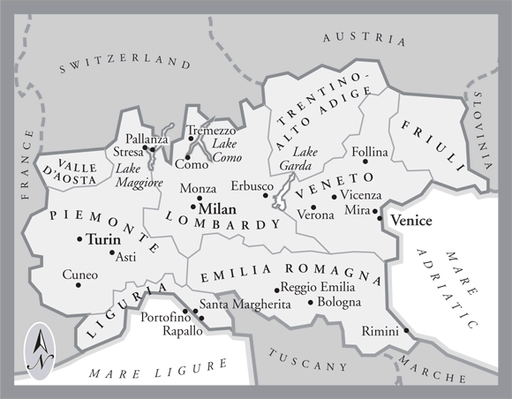
In northern Italy people in three regions speak a different primary language,
in addition to Italian . . .
German
Slovene
French
Italian
is spoken throughout Italy
Tuscany
www.jdbassc.com/maps/map_southern_italy.asp
Notes:
70

Slide 71
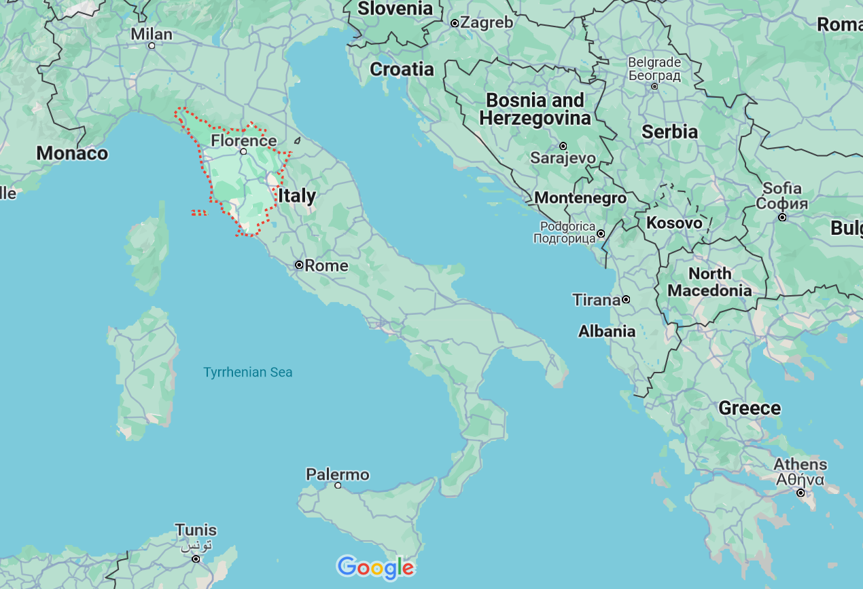
German
French
Slovene
Tuscany
Italian
In the neighboring Tuscany region
they speak Italian, which historically was based on the Florentine dialect . . .

Slide 72
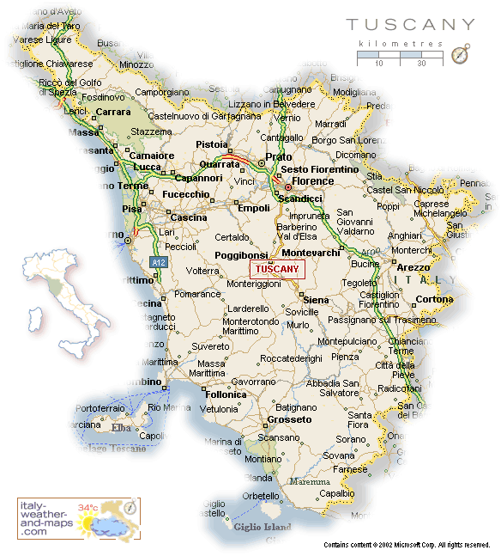
Florence
Pisa
http://healthmap.files.wordpress.com/2009/12/tuscany-map.gif

Slide 73
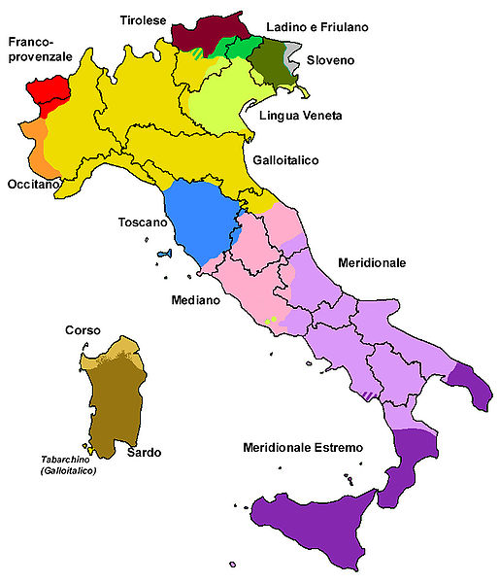
Official language(s) | Italian
Regional language(s) | German, Neapolitan, Slovene, Piedmontese, Sardinian, Sardinian, Tabarchino, Sassarese, Gallurese, Ladin, Cimbrian, Mocheno, Venetian
Minority language(s) | Albanian, Catalan, German, Greek, Slovene, Croatian, French, Franco-Provençal, Friulian, Ladin, Occitan, Sardinia
Main immigrant language(s) | Romanian, Berber, Maghrebi Arabic, Albanian
Main foreign language(s) | English (25%) Spanish (17%) French (14%)
Dialects of Italy by Group
http://en.wikipedia.org/wiki/List_of_languages_of_Italy
Notes:
73

Slide 74
Martin J. Gannon and Rajnandini Pillai Understanding Global Cultures
The Italian history of invasions has produced many dialects, each the product of the particular regional invader
The language of Italy consists of both local dialects and Italian, a derivative of the Tuscan language
Although linguistic variations are disappearing to some extent due to the homogenizing effects of television and telecommunications, Italians still cling to the notion of having their own regional dialect
www.d.umn.edu/cla/faculty/troufs/anth1095/index.html#Gannon

Slide 75
Martin J. Gannon and Rajnandini Pillai Understanding Global Cultures
The vocal selections of the chorus in the Italian opera are directly comparable to the many regional variations of the Italian language
Although each section is important to the harmony of the chorus, each has its own melody
www.d.umn.edu/cla/faculty/troufs/anth1095/index.html#Gannon

Slide 76
Dialects of Italy by Group
http://en.wikipedia.org/wiki/List_of_languages_of_Italy
Notes:
76

Slide 77
1494
compare these
with the old kingdoms
Dialects of Italy by Group
http://en.wikipedia.org/wiki/List_of_languages_of_Italy
Notes:
77

Slide 78
1000
1494
compare these
with the old kingdoms
Dialects of Italy by Group
http://en.wikipedia.org/wiki/List_of_languages_of_Italy
Notes:
78

Slide 79
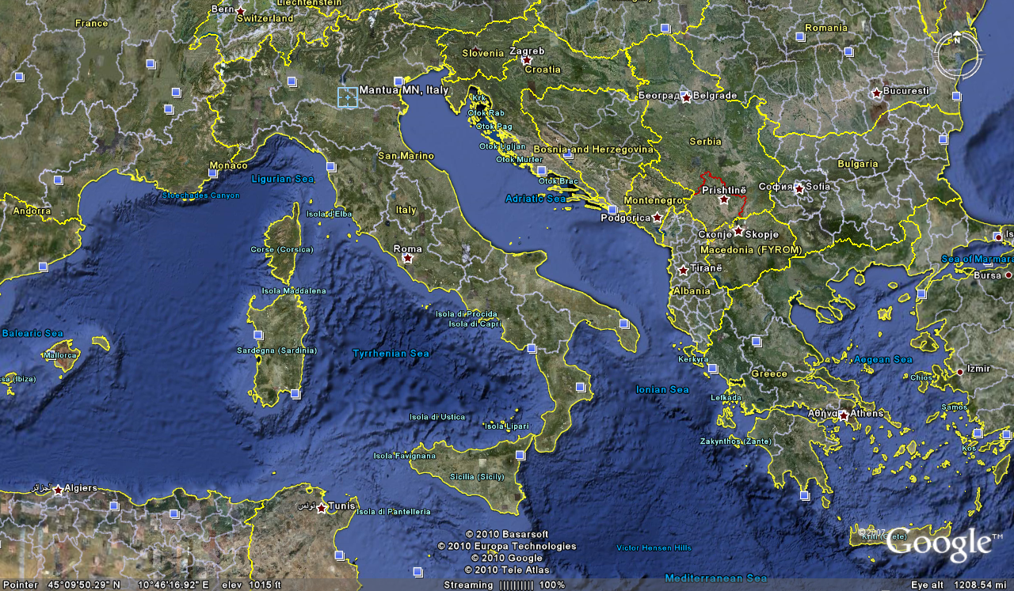
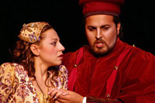
Cosimo Vassallo
is from
Palermo, Sicily
Letizia Colajanni
and
Cosimo Vassallo
/

Slide 80
Cossimo lives in
Mantova
503 miles away
(by air)
/
Letizia Colajanni
and
Cosimo Vassallo

Slide 81
If Cosimo speaks Italian with
his Palermo accent in
Montova, some
will have difficult understanding him
/
Cosimo Vassallo
is from
Palermo, Sicily
Letizia Colajanni
and
Cosimo Vassallo
/

Slide 82
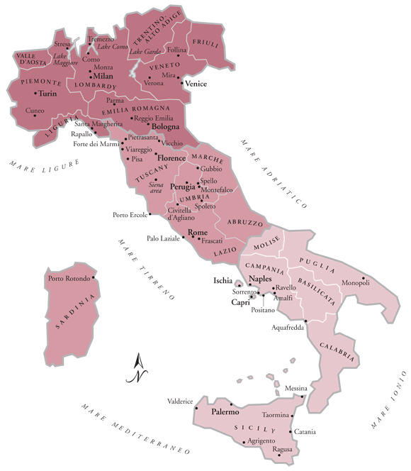
/
My friend Martin Aricochi
who lives in
Brixen (Bressanone), Italy, spoke German until he went to school,
www.jdbassc.com/maps/map_southern_italy.asp
Notes:
82

Slide 83
/
My friend Martin Aricochi
who lives in
Brixen (Bressanone), Italy, spoke German until he went to school,
and they still speak German at home
www.jdbassc.com/maps/map_southern_italy.asp
Notes:
83

Slide 84
A bit of background . . .

Slide 85
Martin J. Gannon and Rajnandini Pillai Understanding Global Cultures
The civic traditions of the north and south
of Italy originated from
different sources
and these traditions have persisted for centuries
(Robert Putnam 1991)
www.d.umn.edu/cla/faculty/troufs/anth1095/index.html#Gannon

Slide 86
Martin J. Gannon and Rajnandini Pillai Understanding Global Cultures
In the
north
there has been a centuries-long legacy of
civic involvement through guilds
and democratic elections
that has held corruption in check
www.d.umn.edu/cla/faculty/troufs/anth1095/index.html#Gannon

Slide 87
Martin J. Gannon and Rajnandini Pillai Understanding Global Cultures
In the 11th century King Frederico established an autocratic form of government in the south that was both politically and economically successful
But his successors corrupted it
The Mafia arose as the middlemen between the kings and the people, which tended to reinforce corruption
www.d.umn.edu/cla/faculty/troufs/anth1095/index.html#Gannon

Slide 88
Martin J. Gannon and Rajnandini Pillai Understanding Global Cultures
Today,
the north of Italy is as successful as or more successful than Germany,
whereas the south
languishes in poverty
even though millions of dollars have been devoted to eradicating it
www.d.umn.edu/cla/faculty/troufs/anth1095/index.html#Gannon

Slide 89
Martin J. Gannon and Rajnandini Pillai Understanding Global Cultures
Because of industrialization, northern Italians have had the benefit of a thriving economy and a relatively prosperous existence
In contrast, southern Italians, who have relied on farming for their livelihood, have tended to be poorer and less educated
www.d.umn.edu/cla/faculty/troufs/anth1095/index.html#Gannon

Slide 90
Martin J. Gannon and Rajnandini Pillai Understanding Global Cultures
Because of industrialization, northern Italians have had the benefit of a thriving economy and a relatively prosperous existence
Southern Italians, who have relied on farming for their livelihood, have tended to be poorer and less educated
www.d.umn.edu/cla/faculty/troufs/anth1095/index.html#Gannon

Slide 91
Martin J. Gannon and Rajnandini Pillai Understanding Global Cultures
Today poverty still exists in some areas, particularly in the south
Italian industry has become increasingly successful, but success is not shared equally by everyone
Because northern companies believe there is a difference in the northern and southern work ethic, they are reluctant to locate branches in the south
www.d.umn.edu/cla/faculty/troufs/anth1095/index.html#Gannon

Slide 92
Martin J. Gannon and Rajnandini Pillai Understanding Global Cultures
Today poverty still exists in some areas, particularly in the south
Italian industry has become increasingly successful, but success is not shared equally by everyone
Because northern companies believe there is a difference in the northern and southern work ethic, they are reluctant to locate branches in the south
www.d.umn.edu/cla/faculty/troufs/anth1095/index.html#Gannon

Slide 93
Martin J. Gannon and Rajnandini Pillai Understanding Global Cultures
The large migration of workers from the south to the north has left behind people who are not willing to give up customs and traditions that have been followed since early European civilization
www.d.umn.edu/cla/faculty/troufs/anth1095/index.html#Gannon

Slide 94
Martin J. Gannon and Rajnandini Pillai Understanding Global Cultures
“The people from the [northern and southern] regions are similar in that
they love life and enjoy
creating the illusion of a show.”
“However, the difference between the people from these two regions is that
southerners tend
to cling to past ways of living
whereas many northerners
look toward the future.”
www.d.umn.edu/cla/faculty/troufs/anth1095/index.html#Gannon

Slide 95
Martin J. Gannon and Rajnandini Pillai Understanding Global Cultures
To most
northerners,
wealth
is the way to ensure the lasting defense and prosperity of the family and close friends
“The northerner is perpetually trying to acquire wealth in its various forms”
S/he wants a job, a good job, and then a better job
S/he also wants the scientific and technical knowledge that will ensure better paid employment and advancement
www.d.umn.edu/cla/faculty/troufs/anth1095/index.html#Gannon

Slide 96
Martin J. Gannon and Rajnandini Pillai Understanding Global Cultures
many
southerners,
on the other hand,
want above all
to be obeyed, admired,
respected, and envied
They want wealth too, but frequently as an instrument to influence people
Southerners are preoccupied with commanding the respect of the audience throughout the many operas of life
www.d.umn.edu/cla/faculty/troufs/anth1095/index.html#Gannon

Slide 97
Martin J. Gannon and Rajnandini Pillai Understanding Global Cultures
many southerners,
be they wealthy or poor,
want the gratitude of powerful friends and relatives,
the fear of their enemies,
and the respect of everybody
Southerners seek wealth as a means of commanding obedience and respect from others
www.d.umn.edu/cla/faculty/troufs/anth1095/index.html#Gannon

Slide 98
business
http://www.reliefweb.int/rw/RWB.NSF/db900LargeMaps/SKAR-64GDTU?OpenDocument

Slide 99
Martin J. Gannon and Rajnandini Pillai Understanding Global Cultures
Although many of the differences
between “the Two Italies”
have been defused and minimized through time
business dealings differ in the two regions . . .
www.d.umn.edu/cla/faculty/troufs/anth1095/index.html#Gannon

Slide 100
Martin J. Gannon and Rajnandini Pillai Understanding Global Cultures
Working with people from
northern Italy
a low-context subculture that
emphasizes written rules and agreements, is much like dealing with the Americans or Germans
Negotiating effectively with northern Italians essentially means communicating with them in A straightforward, sophisticated manner
social talk should be kept to a minimum in order to get down to business
www.d.umn.edu/cla/faculty/troufs/anth1095/index.html#Gannon

Slide 101
Martin J. Gannon and Rajnandini Pillai Understanding Global Cultures
When negotiating with people from
southern Italy
a high-context subculture in which oral communication and subtle nuances are stressed,
a visitor must spend time
establishing rapport
with his or her counterparts
long-term relationship are important to southern Italians, and trust must be built up before business dealings can become truly effective
www.d.umn.edu/cla/faculty/troufs/anth1095/index.html#Gannon

Slide 102
The Overture
Pageantry and Spectacle
Voice
Externalization
5. Chorus and Soloists
political divisions
Italy
www.d.umn.edu/cla/faculty/troufs/anth1095/index.html#Gannon

Slide 103
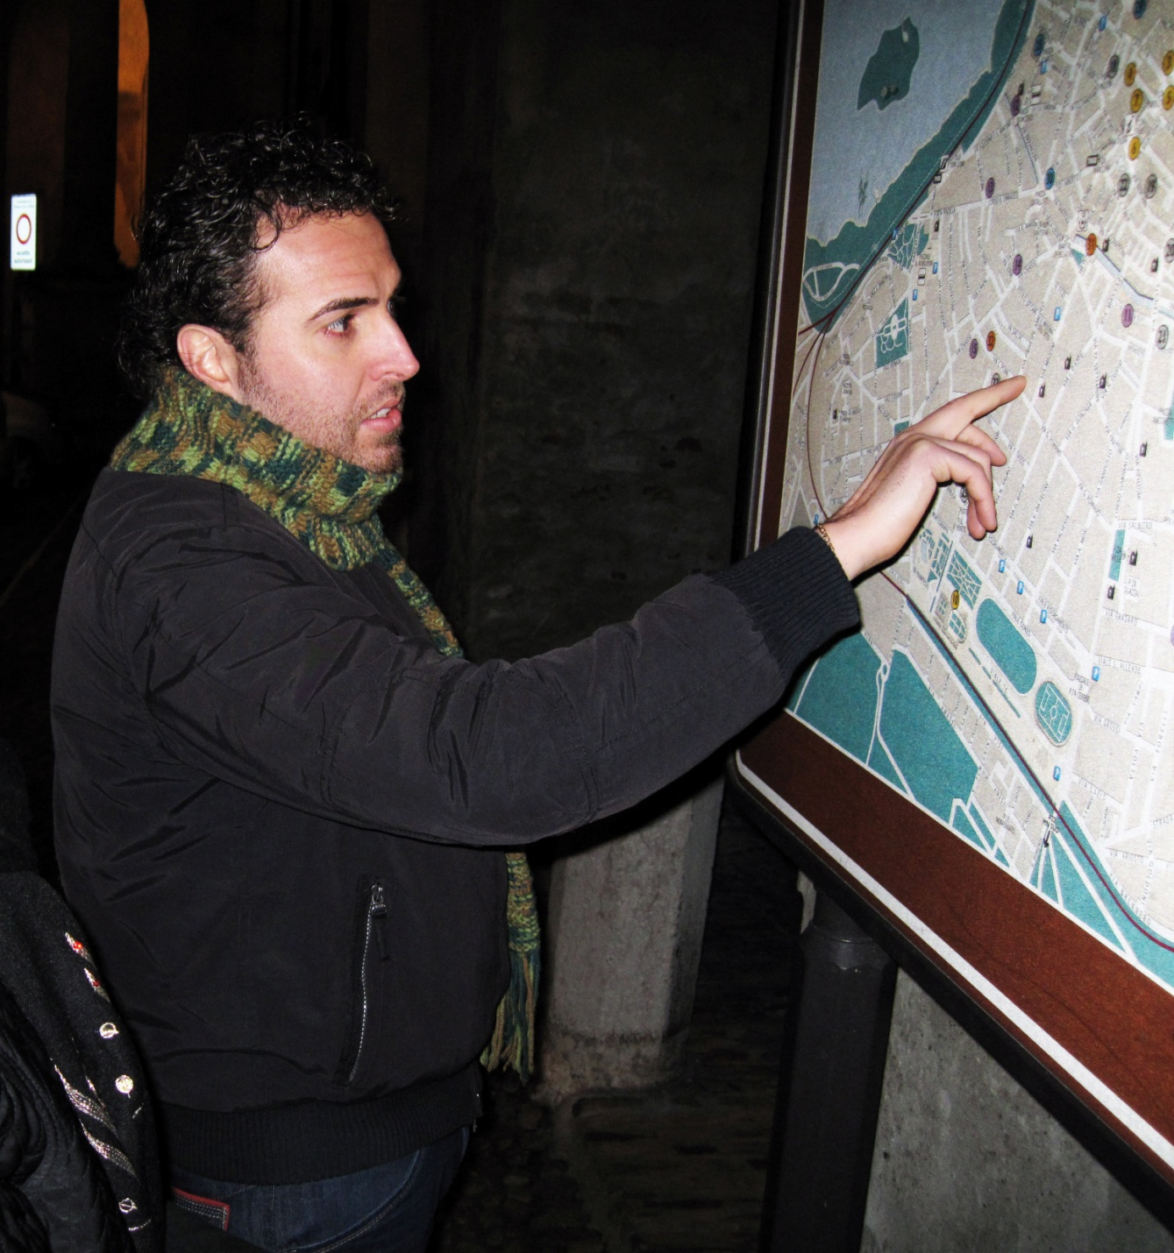
In Italy
the comune
(plural comuni)
is the basic administrative division of both provinces and regions, and may be properly approximated in casual speech by the English word township or municipality
Tim Roufs
Notes:
103

Slide 104
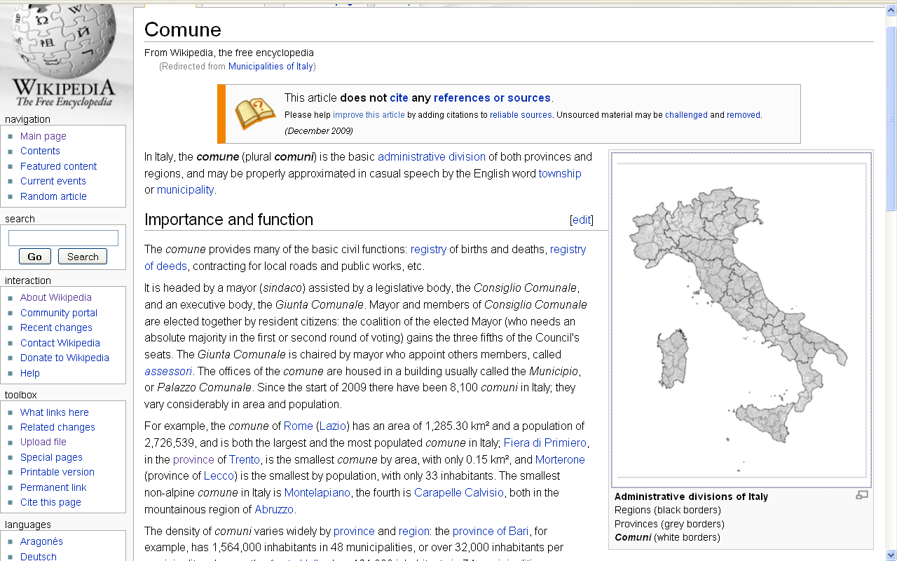
township or municipality
http://en.wikipedia.org/wiki/Municipalities_of_Italy
Notes:
104

Slide 105
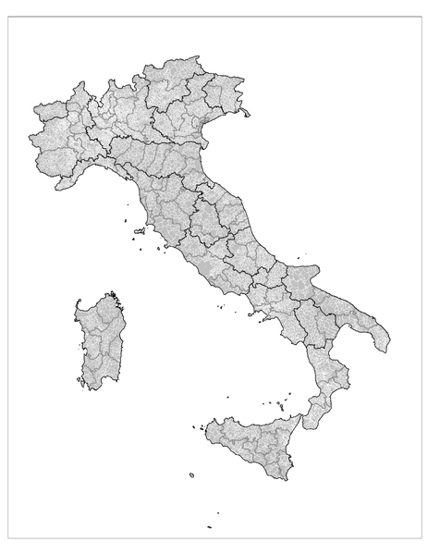
Administrative divisions of Italy: Regions (black borders) Provinces (grey borders) Comuni (white borders)
http://en.wikipedia.org/wiki/Municipalities_of_Italy
Notes:
105

Slide 106
Cosimo Vassallo
A new district in Northern Italy
was just established in 2009
Tim Roufs
Notes:
106

Slide 107
and in southern Italy they even have a region that doesn’t exist . . .
(or at least that’s what they like to say . . .)

Slide 108
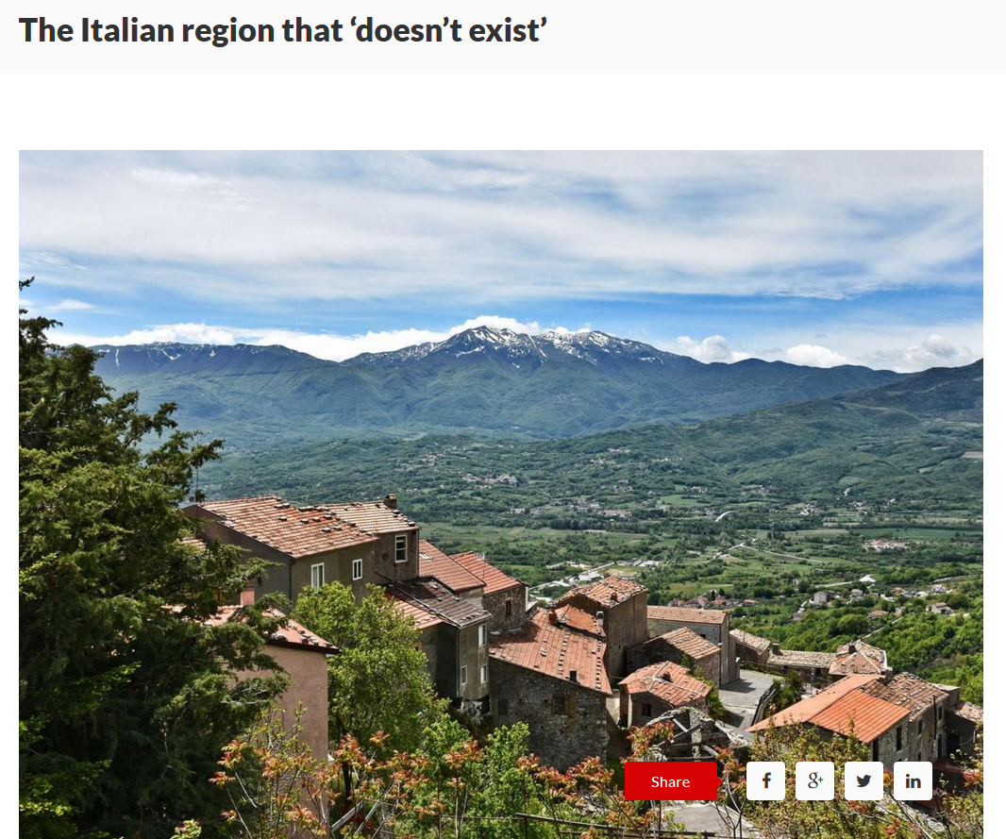
Nov 6 2019
Molise
https://www.wetheitalians.com/default/italian-region-doesnt-exist
Notes:
108

Slide 109
and other factors sometimes need to be considered relative to political divisions . . .

Slide 110
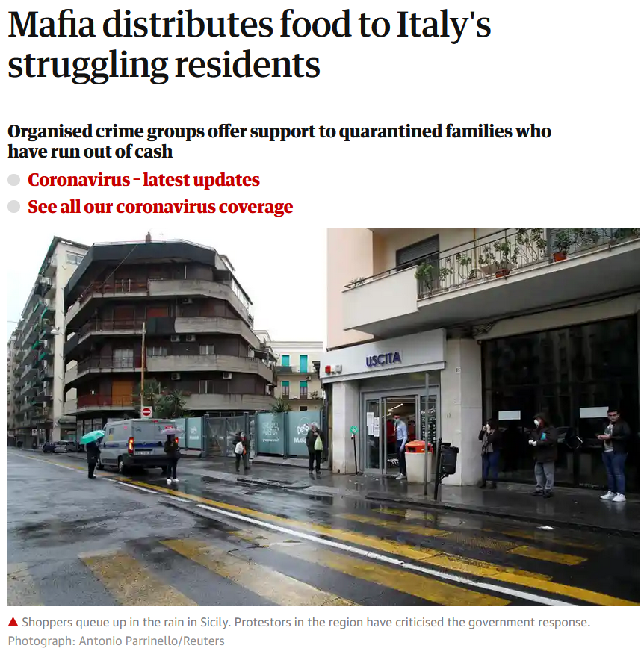
10 April 2020
https://www.theguardian.com/world/2020/apr/10/mafia-distributes-food-to-italys-struggling-residents?CMP=Share_iOSApp_Other

Slide 111
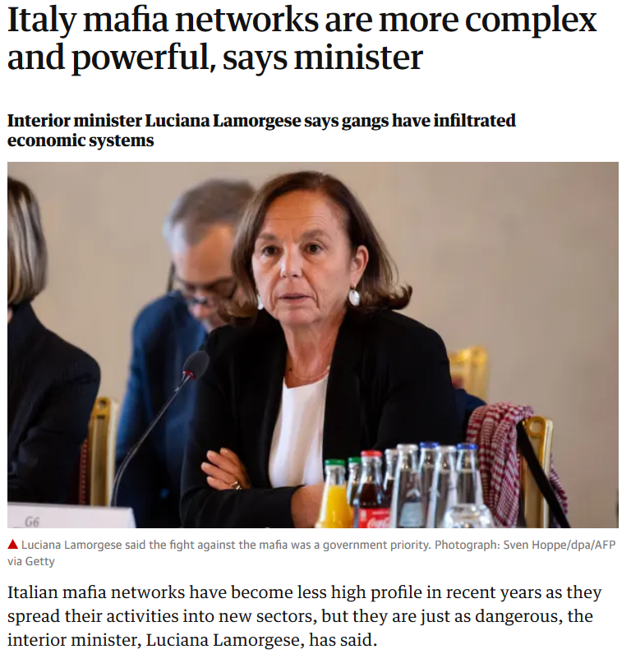
Wed 30 Oct 2019
https://www.theguardian.com/world/2019/oct/30/italy-mafia-networks-are-more-complex-and-powerful-says-minister?CMP=Share_iOSApp_Other

Slide 112
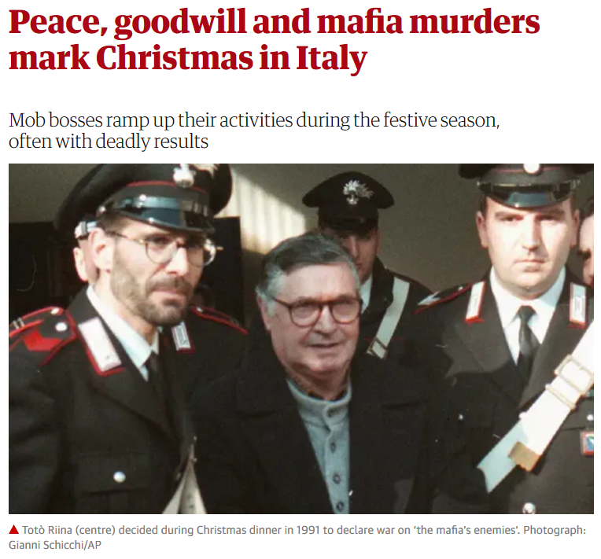
Thu 26 Dec 2019
https://www.theguardian.com/world/2019/dec/26/peace-goodwill-and-mafia-murders-mark-christmas-in-italy?CMP=Share_iOSApp_Other

Slide 113
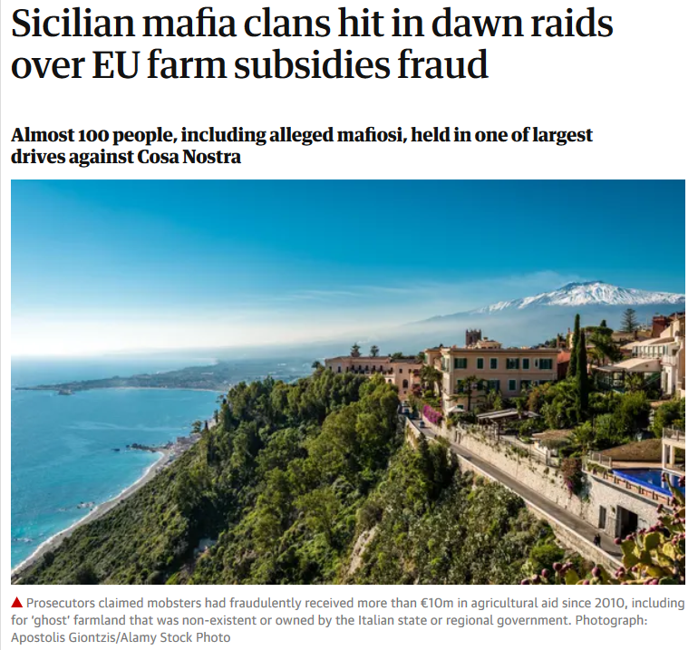
Wed 15 Jan 2020
https://www.theguardian.com/world/2020/jan/15/sicilian-police-launch-dawn-raids-in-eu-subsidies-sting?CMP=Share_iOSApp_Other

Slide 114
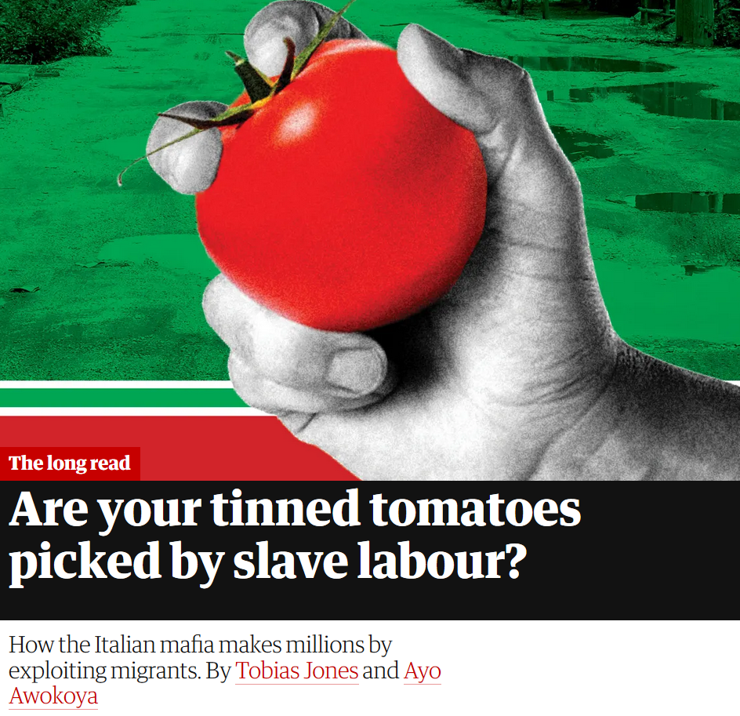
Thurs 20 June 2019
https://www.theguardian.com/world/2019/jun/20/tomatoes-italy-mafia-migrant-labour-modern-slavery?CMP=Share_iOSApp_Other

Slide 115
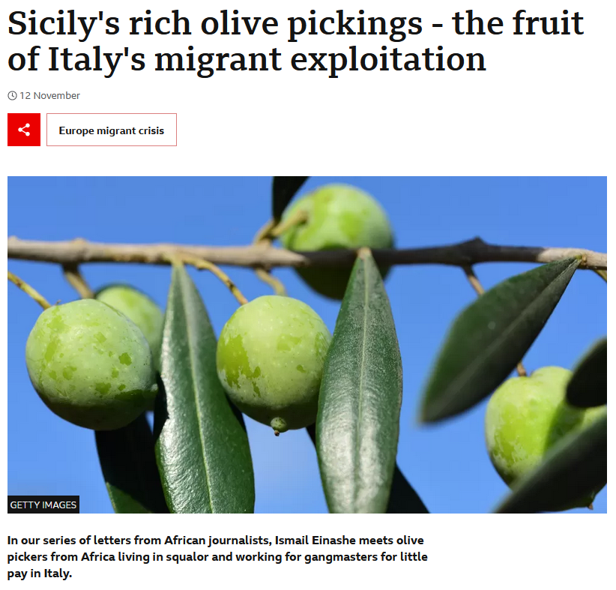
12 November 2022
https://www.bbc.com/news/world-africa-63595025

Slide 116
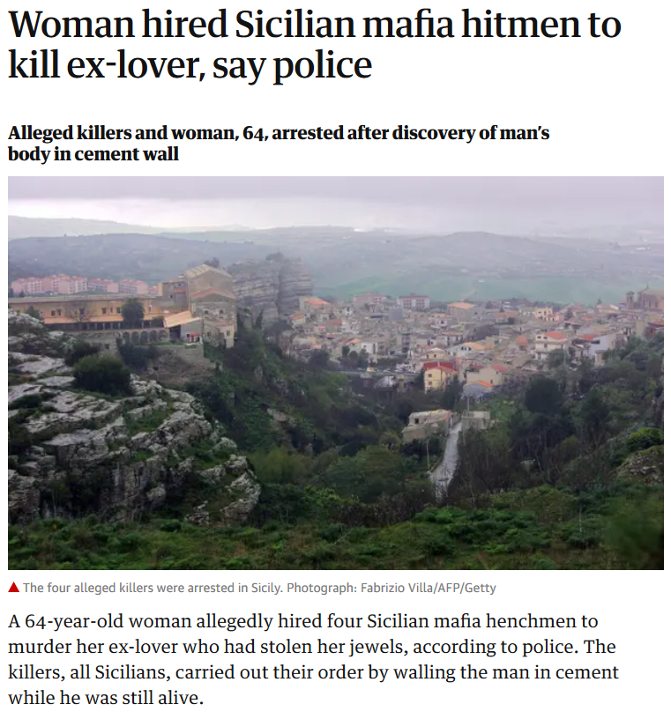
Sat 9 Mar 2019
https://www.theguardian.com/world/2019/mar/09/woman-hired-sicilian-mafia-hitmen-to-kill-ex-lover-say-police?CMP=Share_iOSApp_Other

Slide 117
Martin J. Gannon and Rajnandini Pillai Understanding Global Cultures
The civic traditions of the north and south
of Italy originated from
different sources
and these traditions have persisted for centuries
(Robert Putnam 1991)
www.d.umn.edu/cla/faculty/troufs/anth1095/index.html#Gannon

Slide 118
Martin J. Gannon and Rajnandini Pillai Understanding Global Cultures
In the
north
there has been a centuries-long legacy of
civic involvement through guilds
and democratic elections
that has held corruption in check
www.d.umn.edu/cla/faculty/troufs/anth1095/index.html#Gannon

Slide 119
Martin J. Gannon and Rajnandini Pillai Understanding Global Cultures
Today,
the north of Italy is as successful as or more successful than Germany,
whereas the south
languishes in poverty
even though millions of dollars have been devoted to eradicating it
www.d.umn.edu/cla/faculty/troufs/anth1095/index.html#Gannon

Slide 120
Martin J. Gannon and Rajnandini Pillai Understanding Global Cultures
. . . the Northern League . . . periodically seeks to create two separate nations in Italy
But the economically prosperous north depends heavily on emigration from the south for its workforce
www.d.umn.edu/cla/faculty/troufs/anth1095/index.html#Gannon

Slide 121
Martin J. Gannon and Rajnandini Pillai Understanding Global Cultures
the north and south
are closely linked to one another culturally, even though there are regional differences
www.d.umn.edu/cla/faculty/troufs/anth1095/index.html#Gannon

Slide 122
Martin J. Gannon and Rajnandini Pillai Understanding Global Cultures
Historically, Italy has been victimized by overwhelming natural disasters
Earthquakes
Volcanoes
Floods
Famines
. . . and . . .
www.d.umn.edu/cla/faculty/troufs/anth1095/index.html#Gannon

Slide 123
Martin J. Gannon and Rajnandini Pillai Understanding Global Cultures
Historically, Italy has been victimized by overwhelming natural disasters
Earthquakes
Volcanoes
Floods
Famines
www.d.umn.edu/cla/faculty/troufs/anth1095/index.html#Gannon

Slide 124
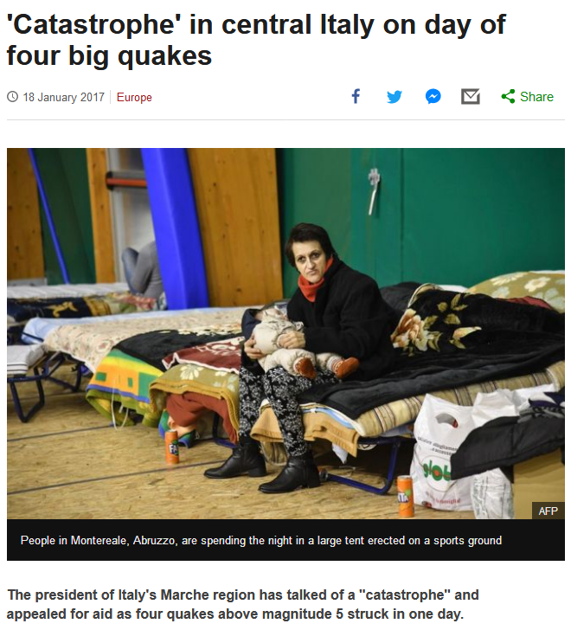
http://www.bbc.com/news/world-europe-38663608?ocid=global_bbccom_email_18012017_top+news+stories
Notes:
124

Slide 125
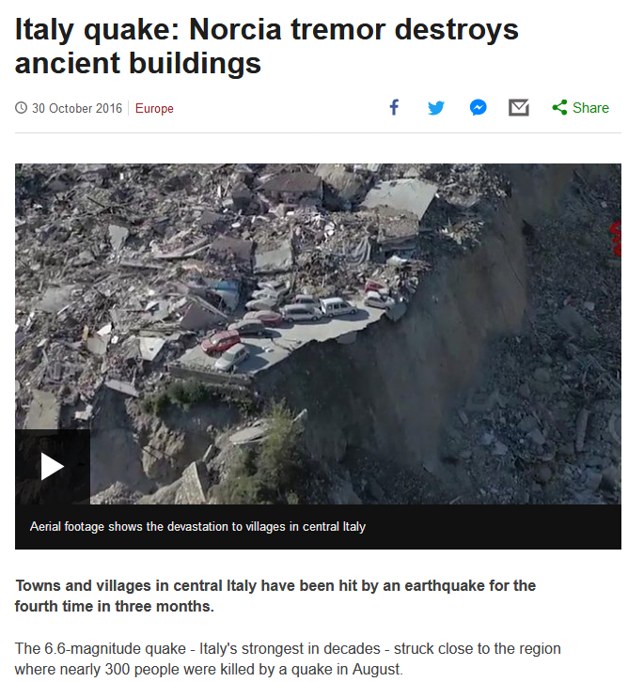
http://www.bbc.com/news/world-europe-37814975
Notes:
125

Slide 126
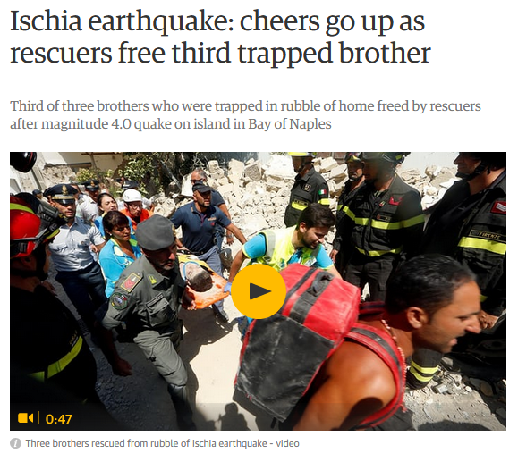
22 August 2017
https://www.theguardian.com/world/2017/aug/21/earthquake-strikes-italian-island-of-ischia-with-one-reported-dead?CMP=Share_iOSApp_Other
Notes:
126

Slide 127
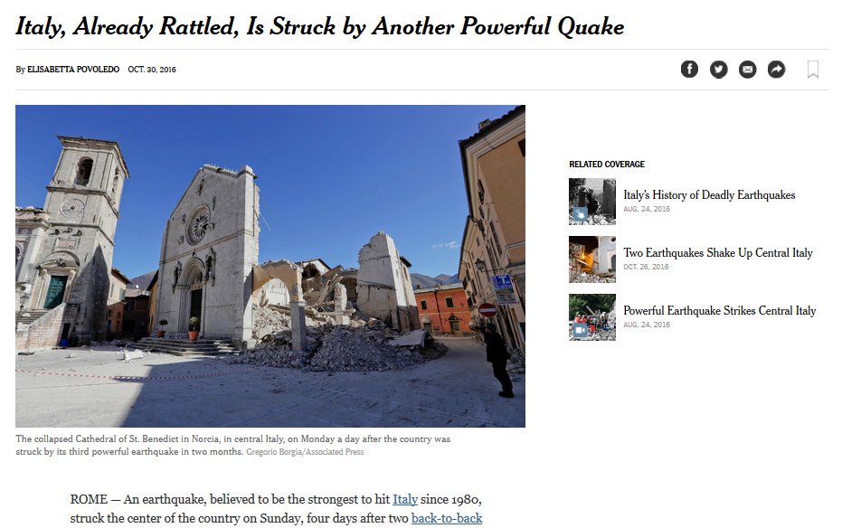
http://www.nytimes.com/2016/10/31/world/europe/italy-earthquake-norcia.html?em_pos=large&emc=edit_nn_20161031&nl=morning-briefing&nlid=60046204
Notes:
127

Slide 128
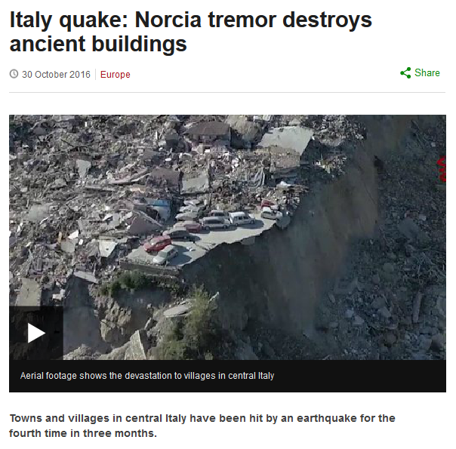
http://www.bbc.com/news/world-europe-37814975#%22
Notes:
128

Slide 129
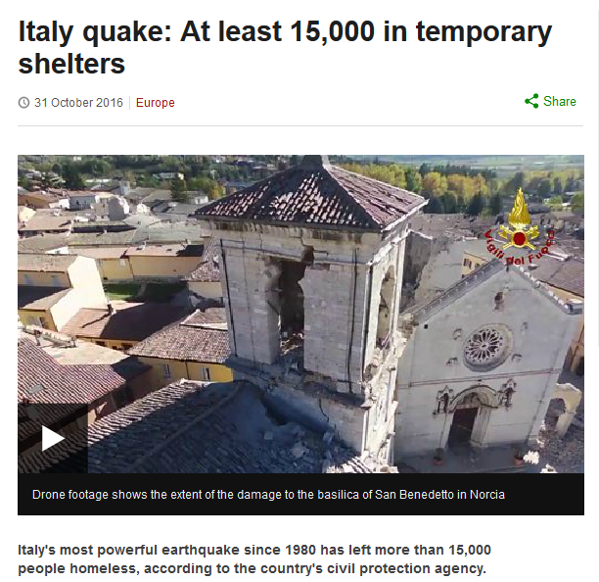
http://www.bbc.com/news/world-europe-37823614?ocid=global_bbccom_email_31102016_top+news+stories
Notes:
129

Slide 130
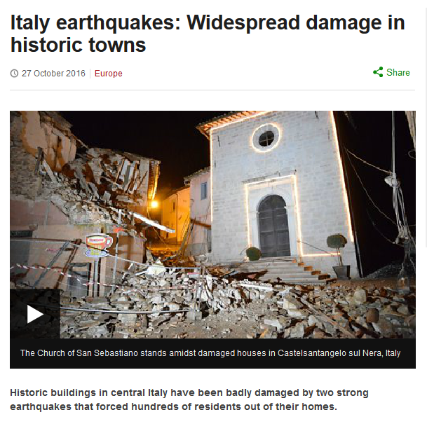
http://www.bbc.com/news/world-europe-37785853
Notes:
130

Slide 131
20 May 2012
http://www.bbc.com/news/world-europe-37522660
Notes:
131

Slide 132
17 June 2017
20 May 2012
Source
Notes:
132

Slide 133
Martin J. Gannon and Rajnandini Pillai Understanding Global Cultures
Historically, Italy has been victimized by overwhelming natural disasters
Earthquakes
Volcanoes
Floods
Famines
and sinkholes
www.d.umn.edu/cla/faculty/troufs/anth1095/index.html#Gannon

Slide 134
25 May 2021
20 May 2012
https://www.theguardian.com/world/2021/may/25/latest-sinkhole-in-street-in-rome-swallows-vehicles?CMP=Share_iOSApp_Other
Notes:
134

Slide 135
20 May 2012
http://www.nytimes.com/video/world/europe/100000004435414/sinkhole-swallows-cars-in-italy.html
Notes:
135

Slide 136
20 May 2012
http://www.bbc.com/news/world-europe-18135901
Notes:
136

Slide 137
20 May 2012
20 May 2012
http://www.bbc.com/news/world-europe-18135901
Notes:
137

Slide 138
20 May 2012
20 May 2012
http://www.bbc.com/news/world-europe-18135901
Notes:
138

Slide 139
6 April 2009
http://news.bbc.co.uk/2/hi/in_pictures/7984969.stm
Notes:
139

Slide 140
6 April 2009
http://news.bbc.co.uk/2/hi/in_pictures/7984969.stm
Notes:
140

Slide 141
Martin J. Gannon and Rajnandini Pillai Understanding Global Cultures
Historically, Italy has been victimized by overwhelming natural disasters
Earthquakes
Volcanoes
Floods
Famines
and sinkholes
and avalanches
www.d.umn.edu/cla/faculty/troufs/anth1095/index.html#Gannon

Slide 142
http://www.bbc.com/news/world-europe-38674788?ocid=global_bbccom_email_19012017_top+news+stories
Notes:
142

Slide 143
Martin J. Gannon and Rajnandini Pillai Understanding Global Cultures
Historically, Italy has been victimized by overwhelming natural disasters
Earthquakes
Volcanoes
Floods
Famines
www.d.umn.edu/cla/faculty/troufs/anth1095/index.html#Gannon

Slide 144
http://www.bbc.co.uk/programmes/b011792s
Notes:
144

Slide 145
Pompei
http://en.wikipedia.org/wiki/Pompeii
Notes:
145

Slide 146
Mt. Etna
Sicily
http://en.wikipedia.org/wiki/Mt._Etna
Notes:
146

Slide 147
09 August 2021
https://www.volcanodiscovery.com/etna/news/137785/Etna-volcano-Italy-lava-fountains-and-loud-explosions-wake-up-residents.html
Notes:
147

Slide 148
10 August 2021
https://www.newsnationnow.com/world/video-italys-mt-etna-volcano-erupts-spewing-lava-rattles-windows-and-doors/
Notes:
148

Slide 149
http://margieinitaly.wordpress.com/2012/04/01/mt-etna-erupts-again-in-sicily/
Notes:
149

Slide 150
Martin J. Gannon and Rajnandini Pillai Understanding Global Cultures
Historically, Italy has been victimized by overwhelming natural disasters
Earthquakes
Volcanoes
Floods
Famines
www.d.umn.edu/cla/faculty/troufs/anth1095/index.html#Gannon

Slide 151
Notes:
151

Slide 152
7 November 2016
http://www.nytimes.com/2016/11/08/world/europe/50-years-after-a-devastating-flood-fears-that-florence-remains-vulnerable.html?mwrsm=Email&_r=0
Notes:
152

Slide 153
11 September 2015
http://www.aljazeera.com/news/2015/09/floods-drench-southern-italy-150911085234449.html
Notes:
153

Slide 154
1 February 2014
http://www.bbc.com/news/world-us-canada-25648773
Notes:
154

Slide 155
Liguria Region
2011
http://www.guardian.co.uk/world/2011/oct/26/flash-floods-hit-italy
Notes:
155

Slide 156
09 August 2021
Venice
2019
https://www.dailysabah.com/life/environment/unseasonal-flooding-hits-italys-venice
Notes:
156

Slide 157
Venice
2019
Notes:
157

Slide 158
Venice
2018
Notes:
158

Slide 159
Venice
2008
http://news.ninemsn.com.au/slideshow_ajax.aspx?sectionid=9016&sectionname=slideshowajax&subsectionid=148615&subsectionname=venicefloods
Notes:
159

Slide 160
St. Mark’s Square
2 February 2015
http://www.ibtimes.co.uk/venice-carnival-2015-revellers-try-keep-their-costumes-dry-flooded-st-marks-square-1486241
Notes:
160

Slide 161
http://www.bbc.com/news/world-europe-20294488
Notes:
161

Slide 162
St. Mark’s Square
11 November 2012
http://www.dailymail.co.uk/news/article-2231342/Tourists-swim-Venices-iconic-St-Marks-Square-Floating-City-flooded-high-tides.html
Notes:
162

Slide 163
https://www.walksofitaly.com/blog/venice/flooding-acqua-alta-tips
Notes:
163

Slide 164
“. . . acqua alta . . . water reaching 110 cm, at which point flooding covers 14 percent of Venice, happens about four times a year.”
https://www.walksofitaly.com/blog/venice/flooding-acqua-alta-tips
Notes:
164

Slide 165
http://www.bbc.com/news/world-europe-24510314
Notes:
165

Slide 166
you can go on-line and experiment with computer models that show you when Venice, and how much of the rest of Italy, will disappear with global warming . . .
http://geology.com/sea-level-rise/venice.shtml

Slide 167
http://geology.com/sea-level-rise/venice.shtml
Notes:
167

Slide 168
Martin J. Gannon and Rajnandini Pillai Understanding Global Cultures
Historically, Italy has been victimized by overwhelming natural disasters
Earthquakes
Volcanoes
Floods
Famines
www.d.umn.edu/cla/faculty/troufs/anth1095/index.html#Gannon

Slide 169
“There were sixteen good harvests and 111 famine years in northern Italy from
1451 to 1767.”
Alan Macfarlane (1997). p.64. ISBN 0-631-18117-2
https://en.wikipedia.org/wiki/Famine

Slide 170
http://histoiremesure.revues.org/4119?lang=en

Slide 171
Famines in Italy: a chronology and a short account
(ca. 1250-1810)
http://www.eshd.eu/sites/default/files/webform/famineinitaly_alfani_mocarelli_strangio.pdf

Slide 172
Martin J. Gannon and Rajnandini Pillai Understanding Global Cultures
Historically, Italy has been victimized by overwhelming natural disasters
Earthquakes
Volcanoes
Floods
Famines
. . . and . . .
www.d.umn.edu/cla/faculty/troufs/anth1095/index.html#Gannon

Slide 173
Martin J. Gannon and Rajnandini Pillai Understanding Global Cultures
Historically, Italy has been victimized by overwhelming natural disasters
and widespread fires
forest-fire type
www.d.umn.edu/cla/faculty/troufs/anth1095/index.html#Gannon

Slide 174
http://news.bbc.co.uk/2/hi/europe/830513.stm
Notes:
174

Slide 175
http://www.guardian.co.uk/world/2011/oct/26/flash-floods-hit-italy
Notes:
175

Slide 176
Martin J. Gannon and Rajnandini Pillai Understanding Global Cultures
It is a geologically young country, most of which cannot be categorized as terra firma, and there have been so many mudslides resulting in great loss of property and life both in the past and in recent years that the Italians nickname the nation
“landslide country”
www.d.umn.edu/cla/faculty/troufs/anth1095/index.html#Gannon

Slide 177
04 October 2020
https://www.bbc.com/news/world-europe-54402096
Notes:
177

Slide 178
Mon 25 Nov 2019
https://www.theguardian.com/world/2019/nov/25/storms-france-greece-italy-destruction-floods?CMP=Share_iOSApp_Other
Notes:
178

Slide 179
http://www.bbc.com/news/world-europe-30076940
Notes:
179

Slide 180
http://news.bbc.co.uk/2/hi/8517378.stm
Notes:
180

Slide 181
http://www.eea.europa.eu/data-and-maps/figures/landslides-in-italy
Notes:
181

Slide 182
http://www.eea.europa.eu/data-and-maps/figures/landslides-in-italy
Notes:
182

Slide 183
The map shows: LEFT: Distribution of landslides with human consequences from AD 1300 to 2002. The size of the triangle indicates the intensity of the event. RIGHT: Landslide susceptibility map of Italy.
http://www.eea.europa.eu/data-and-maps/figures/landslides-in-italy
Notes:
183

Slide 184
in Italy the forces of nature strongly affect their world view . . .

Slide 185
Martin J. Gannon and Rajnandini Pillai Understanding Global Cultures
As a result, Italy exudes an aura of
“precariousness”
www.d.umn.edu/cla/faculty/troufs/anth1095/index.html#Gannon

Slide 186
Martin J. Gannon and Rajnandini Pillai Understanding Global Cultures
Italians tend to accept
insecurity as a fact of life.
This acceptance may explain why they seem to be able to
enjoy life more for the moment
and why the are willing
to accept events as they happen
www.d.umn.edu/cla/faculty/troufs/anth1095/index.html#Gannon

Slide 187
Martin J. Gannon and Rajnandini Pillai Understanding Global Cultures
Italians tend to feel that
if something is going to happen,
it will,
and that not much can be done about it
www.d.umn.edu/cla/faculty/troufs/anth1095/index.html#Gannon

Slide 188
7 August 2023
https://www.bbc.com/news/world-europe-66429342

Slide 189
Martin J. Gannon and Rajnandini Pillai Understanding Global Cultures
George Foster:
“Peasant Fatalism”
www.d.umn.edu/cla/faculty/troufs/anth1095/index.html#Gannon

Slide 190
“Classics" in the Anthropology of Europe
George Foster
“Peasant Society and the Image of Limited Good.”
American
Anthropologist
67:293-315.
Parman's classic picks -- Tony Galt

Slide 191
Some Background to the Country
History
and World View
Italy

Slide 192
Martin J. Gannon and Rajnandini Pillai Understanding Global Cultures
Italy’s history is filled
with many culturally rich
and influential periods . . .
www.d.umn.edu/cla/faculty/troufs/anth1095/index.html#Gannon

Slide 193
http://en.wikipedia.org/wiki/History_of_Italy_during_foreign_domination_and_the_unification
Notes:
193

Slide 194
some examples . . .

Slide 195
http://en.wikipedia.org/wiki/History_of_Italy_during_foreign_domination_and_the_unification
Notes:
195

Slide 196
Notes:
196

Slide 197
http://en.wikipedia.org/wiki/History_of_Italy_during_foreign_domination_and_the_unification
Notes:
197

Slide 198
Martin J. Gannon and Rajnandini Pillai Understanding Global Cultures
Italy’s history is filled with many culturally rich and influential periods, including . . .
The Roman Empire
The Renaissance
www.d.umn.edu/cla/faculty/troufs/anth1095/index.html#Gannon

Slide 199
http://www.mapsofwar.com/images/EMPIRE17.swf
http://www.mapsofwar.com/images/EMPIRE17.swf
Notes:
199

Slide 200
http://www.mapsofwar.com/images/EMPIRE17.swf
http://www.mapsofwar.com/images/EMPIRE17.swf
Notes:
200

Slide 201
8th Century B.C. – Decline and Fall of Rome A.D. 476
Notes:
201

Slide 202
http://en.wikipedia.org/wiki/History_of_Italy_during_foreign_domination_and_the_unification
Notes:
202

Slide 203
https://en.wikipedia.org/wiki/Italy_in_the_Middle_Ages
Notes:
203

Slide 204
1000 AD
Italy was divided for centuries into small kingdoms and city-states
http://en.wikipedia.org/wiki/Italy
Notes:
204

Slide 205
http://en.wikipedia.org/wiki/History_of_Italy_during_foreign_domination_and_the_unification
Notes:
205

Slide 206
http://www.mapsofwar.com/images/EMPIRE17.swf
http://www.mapsofwar.com/images/EMPIRE17.swf
Notes:
206

Slide 207
http://en.wikipedia.org/wiki/History_of_Italy_during_foreign_domination_and_the_unification
Notes:
207

Slide 208
https://en.wikipedia.org/wiki/Germanic_peoples
Notes:
208

Slide 209
https://en.wikipedia.org/wiki/Lombards
Notes:
209

Slide 210
http://en.wikipedia.org/wiki/History_of_Italy_during_foreign_domination_and_the_unification
Notes:
210

Slide 211
https://en.wikipedia.org/wiki/Kingdom_of_Italy_%28Holy_Roman_Empire%29
Notes:
211

Slide 212
Notes:
212

Slide 213
http://en.wikipedia.org/wiki/History_of_Italy_during_foreign_domination_and_the_unification
Notes:
213

Slide 214
Martin J. Gannon and Rajnandini Pillai Understanding Global Cultures
Italy’s history is filled with many culturally rich and influential periods, including . . .
The Roman Empire
The Renaissance
www.d.umn.edu/cla/faculty/troufs/anth1095/index.html#Gannon

Slide 215
Notes:
215

Slide 216
Filippo Brunelleschi
Santa Maria del Fiore cupola
https://commons.wikimedia.org/wiki/File:Santa_Maria_del_Fiore_cupola_%281622842169%29.jpg
Notes:
216

Slide 217
The Creation of Adam
Sistine Chapel
Notes:
217

Slide 218
http://lolsnaps.com/funny/38709
Notes:
218

Slide 219
http://en.wikipedia.org/wiki/History_of_Italy_during_foreign_domination_and_the_unification
Notes:
219

Slide 220
Formation of Italy
Unification —17 March 1861
Republic —2 June 1946
http://en.wikipedia.org/wiki/Italy
Notes:
220

Slide 221
Martin J. Gannon and Rajnandini Pillai Understanding Global Cultures
Italy emerged as a nation-state
in 1861
as a result of national unification, known as the
risorgimento,
or revival
www.d.umn.edu/cla/faculty/troufs/anth1095/index.html#Gannon

Slide 222
Martin J. Gannon and Rajnandini Pillai Understanding Global Cultures
Before unification,
Italians never quite identified with the many foreign bodies that conquered and ruled them
. . .
www.d.umn.edu/cla/faculty/troufs/anth1095/index.html#Gannon

Slide 223
http://en.wikipedia.org/wiki/History_of_Italy_during_foreign_domination_and_the_unification
Notes:
223

Slide 224
Martin J. Gannon and Rajnandini Pillai Understanding Global Cultures
Before unification, Italians never quite identified with the many foreign bodies that conquered and ruled them.
This is a possible explanation for Italians’ historic contempt for the law and paying taxes
and even though Italians have been influenced overwhelmingly by foreign rule, they have managed to create a culture that is distinctly their own
www.d.umn.edu/cla/faculty/troufs/anth1095/index.html#Gannon

Slide 225
“On Day 1 of Broad Lockdown, a Debate Arises: Can Italians Follow the Rules?”
March 19, 2020
https://www.nytimes.com/2020/03/08/world/europe/italy-coronavirus-quarantine.html?referringSource=articleShare

Slide 226
Martin J. Gannon and Rajnandini Pillai Understanding Global Cultures
Before unification, Italians never quite identified with the many foreign bodies that conquered and ruled them.
This is a possible explanation for Italians’ historic contempt for the law and paying taxes;
and even though Italians have been influenced overwhelmingly by foreign rule, they have managed to create a culture that is distinctly their own
www.d.umn.edu/cla/faculty/troufs/anth1095/index.html#Gannon

Slide 227
Some Background to the Country
The Opera
and World View
Italy

Slide 228
Martin J. Gannon and Rajnandini Pillai nd Rajnandini Pillai Understanding Global Cultures
“To understand Italy
it is a good idea to
look at the opera . . .”
www.d.umn.edu/cla/faculty/troufs/anth1095/index.html#Gannon

Slide 229
Martin J. Gannon and Rajnandini Pillai nd Rajnandini Pillai Understanding Global Cultures
. . . that art form
that Italians invented
and raised to its
highest level of achievement
and that represents most, if not all, of
the major features of Italian culture
www.d.umn.edu/cla/faculty/troufs/anth1095/index.html#Gannon

Slide 230
Martin J. Gannon and Rajnandini Pillai nd Rajnandini Pillai Understanding Global Cultures
. . . that art form
that Italians invented
and raised to its
highest level of achievement
and that represents most, if not all, of
the major features of Italian culture
Florence, Venice, and Rome were largely
the cradles of opera
starting towards the end of the 16th century
(in Florence 1597)
www.d.umn.edu/cla/faculty/troufs/anth1095/index.html#Gannon

Slide 231
Venice
Florence
Genoa
Rome
Classic 16th Century Atlas Map of Italy
http://alteagallery.com/stock_detail.php?ref=9355
Notes:
231

Slide 232
La Fenice opera house in Venice in 1837
https://en.wikipedia.org/wiki/Italian_opera

Slide 233
Martin J. Gannon and Rajnandini Pillai Understanding Global Cultures
“The reliance on spectacle must be clearly grasped if one wants to understand the Italians.
Spectacle helps people solve most of their problems, and it governs public and private life.
It is one of the reasons that Italians have always excelled in activities in which impressions are important . . .
opera
architecture
industrial / technological design
decoration
landscape gardening
cinema
fashions
www.d.umn.edu/cla/faculty/troufs/anth1095/index.html#Gannon

Slide 234
The Overture
Pageantry and Spectacle
Voice
Externalization
5. Chorus and Soloists
Activities . . .
with Impressions
Italy
www.d.umn.edu/cla/faculty/troufs/anth1095/index.html#Gannon

Slide 235
Martin J. Gannon and Rajnandini Pillai Understanding Global Cultures
“The reliance on spectacle must be clearly grasped if one wants to understand the Italians.
Spectacle helps people solve most of their problems, and it governs public and private life.
It is one of the reasons that Italians have always excelled in activities in which impressions are important . . .
opera
architecture
industrial / technological design
decoration
landscape gardening
cinema
fashions
www.d.umn.edu/cla/faculty/troufs/anth1095/index.html#Gannon

Slide 236
El Duomo
Milan
http://en.wikipedia.org/wiki/Architecture_of_Italy

Slide 237
Brunelleschi's dome for the Duomo of Florence, Santa Maria del Fiore
http://en.wikipedia.org/wiki/Architecture_of_Italy

Slide 238
St. Peter’s Dome
Roma
http://en.wikipedia.org/wiki/Architecture_of_Italy

Slide 239
Saint Mark's Basilica
Venice
http://en.wikipedia.org/wiki/Architecture_of_Italy

Slide 240
Venice and its Lagoon
http://en.wikipedia.org/wiki/Architecture_of_Italy

Slide 241
Bologna
http://en.wikipedia.org/wiki/Bologna

Slide 242
Two Towers
Bologna
http://en.wikipedia.org/wiki/Bologna

Slide 243
http://nyti.ms/1FFtb3D

Slide 244
The Teatro alla Scala in Milan
Said to be the greatest opera house in the world
http://en.wikipedia.org/wiki/Architecture_of_Italy

Slide 245
The Italian Renaissance Cotton Mansion
2309 East First Street
Duluth, Minnesota
1908

Slide 246
The Teatro alla Scala in Milan
http://en.wikipedia.org/wiki/Architecture_of_Italy

Slide 247
Martin J. Gannon and Rajnandini Pillai Understanding Global Cultures
“The reliance on spectacle must be clearly grasped if one wants to understand the Italians.
Spectacle helps people solve most of their problems, and it governs public and private life.
It is one of the reasons that Italians have always excelled in activities in which impressions are important . . .
opera
architecture
industrial / technological design
decoration
landscape gardening
cinema
fashions
www.d.umn.edu/cla/faculty/troufs/anth1095/index.html#Gannon

Slide 248
20 July 2020
https://arstechnica.com/information-technology/2020/07/us-navys-next-warship-will-have-an-italian-accent/

Slide 250
Europa and the Bull Enlèvement d'Europe Nöel-Nicolas Coypel, c. 1726

Slide 251
2024 Lamborghini Revuelto
All yours for around $608,358.
https://www.caranddriver.com/lamborghini/revuelto

Slide 252
2023 Lamborghini Huracan Sterrato
All yours for around $270,000.
https://blog.dupontregistry.com/lamborghini/new-2023-lamborghini-huracan-sterrato-is-revealed-602-hp-off-road-supercar/

Slide 253
2022 Lamborghini Sian
All yours for $3.6 million.
https://www.roadandtrack.com/news/a37294264/2022-lamborghini-countach/

Slide 254
2022 Lamborghini Countach
All yours for $2.64 million.
https://www.roadandtrack.com/news/a37294264/2022-lamborghini-countach/

Slide 257
2024 Alfa Romeo Stelvio Quadrifoglio
https://www.alfaromeousa.com/cars/giulia/quadrifoglio

Slide 258
2022/2023 Alfa Romeo Stelvio Quadrifoglio
Source

Slide 260
2024 Maserati GranTurismo

Slide 261
2022 Maserati MC20

Slide 263
2024 Ferrari Purosangue
starting at $402,050
https://www.caranddriver.com/ferrari/purosangue

Slide 264
2023 Ferrari 296 GTS
https://www.motor1.com/reviews/621685/2023-ferrari-296-gts-first-drive/

Slide 265
Ferrari Icona: Monza SP1
https://www.ferrarilakeforest.com/manufacturer-information/upcoming-ferrari-models/

Slide 266
2016 Ferrari F80 Concept

Slide 267
2015 Ferrari F80 Supercar Concept

Slide 271
2024 Ducati Panigale V4
$24,995.00
https://www.wheelsinmotionmc.com/inventory/v1/Current/Ducati/Panigale/Panigale-V4/Red--Chatsworth-California---21336901?format=print

Slide 274
2024 Bugatti Mistral Roadster
Price: $5 Million
https://www.caranddriver.com/news/a40874138/2024-bugatti-mistral-5-cool-design-elements/

Slide 275
Sorry
Sold Out
2023 Bugatti W16 Mistral
Price: $5 Million

Slide 276
2022 Bugatti Chiron
Price: $3.6-$3.9 Million

Slide 277
Bugatti Niniette 66 yacht is a 1,000-hp Chiron for the Water

Slide 279
Martin J. Gannon and Rajnandini Pillai Understanding Global Cultures
“The reliance on spectacle must be clearly grasped if one wants to understand the Italians.
Spectacle helps people solve most of their problems, and it governs public and private life.
It is one of the reasons that Italians have always excelled in activities in which impressions are important . . .
opera
architecture
industrial / technological design
decoration
and yes, even toilets
www.d.umn.edu/cla/faculty/troufs/anth1095/index.html#Gannon

Slide 280
Laufen Alessi One wall-hung toilet and bidet
ILBAGNOALESSI
Stefano Giovannoni
Designer

Slide 281
https://gestione.aetitalia.it/download/sito/d27bded_sanitarisquarefoto23.jpg

Slide 282
https://gestione.aetitalia.it/download/sito/d27bded_sanitarisquarefoto23.jpg

Slide 283
Cielo
Italy
https://www.ceramicacielo.it/en/products/smile/floor+mounted+wc+%26+bidet/back+to+wall+one+hole+bidet/111

Slide 284
And even the Italian trains
are beautiful . . .

Slide 285
The Carolinian stopping
in Raleigh, North Carolina
in "Phase V" livery. Wikipedia
Trenitalia series ETR 500 at Venezia S.Lucia
http://commons.wikimedia.org/wiki/File:Trenitalia-series-ETR500.jpg

Slide 286
compare the Italian train to the U.S.A. train
The Carolinian stopping
in Raleigh, North Carolina
in "Phase V" livery. Wikipedia
Trenitalia series ETR 500 at Venezia S.Lucia
http://commons.wikimedia.org/wiki/File:Trenitalia-series-ETR500.jpg

Slide 287
Martin J. Gannon and Rajnandini Pillai Understanding Global Cultures
“The reliance on spectacle must be clearly grasped if one wants to understand the Italians.
Spectacle helps people solve most of their problems, and it governs public and private life.
It is one of the reasons that Italians have always excelled in activities in which impressions are important . . .
opera
architecture
industrial / technological design
decoration
landscape gardening
cinema
fashions
www.d.umn.edu/cla/faculty/troufs/anth1095/index.html#Gannon

Slide 288
Garden façade of Villa Cetinale 17th-century Tuscany
http://www.architecturaldigest.com/decor/2014-05/ned-lambton-villa-cetinale-siena-italy-slideshow

Slide 289
The cloister of the Abbey of Monreale, Sicily, Italy
http://www.suggestkeyword.com/aXRhbGlhbiBnYXJkZW5z/

Slide 290
Sting and Trudie Styler'sTuscan Paradise
http://www.architecturaldigest.com/celebrity-homes/2011/sting-trudie-styler-tuscan-garden-article

Slide 291
Martin J. Gannon and Rajnandini Pillai Understanding Global Cultures
“The reliance on spectacle must be clearly grasped if one wants to understand the Italians.
Spectacle helps people solve most of their problems, and it governs public and private life.
It is one of the reasons that Italians have always excelled in activities in which impressions are important . . .
opera
architecture
industrial / technological design
decoration
landscape gardening
cinema
fashions
www.d.umn.edu/cla/faculty/troufs/anth1095/index.html#Gannon

Slide 292
Federico

Slide 293
Federico
Fellini

Slide 294
Federico Fellini
Original movie poster by Giorgio Olivetti
http://giornale.regione.marche.it/archivio/num0400/art09.htm

Slide 295
Federico Fellini
http://news.bbc.co.uk/2/hi/europe/7925032.stm

Slide 296
http://en.wikipedia.org/wiki/Academy_Award_for_Best_Foreign_Language_Film

Slide 298
La vita è bella
Roberto Benigni
http://en.wikipedia.org/wiki/La_vita_%C3%A8_bella

Slide 299
Grand Budapest Hotel 2014 Best Costume Design
Milena Canonero
https://en.wikipedia.org/wiki/The_Grand_Budapest_Hotel

Slide 300
Martin J. Gannon and Rajnandini Pillai Understanding Global Cultures
“The reliance on spectacle must be clearly grasped if one wants to understand the Italians.
Spectacle helps people solve most of their problems, and it governs public and private life.
It is one of the reasons that Italians have always excelled in activities in which impressions are important . . .
opera
architecture
industrial / technological design
decoration
landscape gardening
cinema
fashions
www.d.umn.edu/cla/faculty/troufs/anth1095/index.html#Gannon

Slide 301
https://fashionista.com/2023/09/milan-fashion-week-spring-2024-trendhttps://fashionista.com/2023/09/milan-fashion-week-spring-2024-trends

Slide 302
21 June 2023
Milan men’s fashion week spring/summer 2024: the highlights – in pictures
https://www.theguardian.com/fashion/gallery/2023/jun/21/milan-mens-fashion-week-springsummer-2024-the-highlights-in-pictures

Slide 303
http://en.wikipedia.org/wiki/Italian_fashion

Slide 304
http://en.wikipedia.org/wiki/Italian_fashion

Slide 305
the list of
Italian fashion houses and luxury brands
is seemingly endless . . .
https://en.wikipedia.org/wiki/Italian_fashion#Italian_fashion_houses_and_luxury_brands

Slide 311
GIORGIO ARMANI
“the blue eyed designer
of the
spring-summer 2015 season!”
http://www.fashionavecpassion.com/an-emporio-armani-brand-new-fashion-ss15-the-futuristic-classic/

Slide 314
The Overture
Pageantry and Spectacle
Voice
Externalization
5. Chorus and Soloists
Language
and Communication
Italy
www.d.umn.edu/cla/faculty/troufs/anth1095/index.html#Gannon

Slide 315
The Overture
Pageantry and Spectacle
Voice
Externalization
5. Chorus and Soloists
The use and importance of voice to express words
in a musical fashion
Italy
www.d.umn.edu/cla/faculty/troufs/anth1095/index.html#Gannon

Slide 316
Martin J. Gannon and Rajnandini Pillai Understanding Global Cultures
“Italians tend to believe that their language is the most beautiful one in the world.”
Italians put great emotion into their language, speaking with passion, rhythm, and changing tonality
www.d.umn.edu/cla/faculty/troufs/anth1095/index.html#Gannon

Slide 317
Martin J. Gannon and Rajnandini Pillai Understanding Global Cultures
“Italians tend to believe that their language is the most beautiful one in the world.”
Italians put great emotion into their language, speaking with passion, rhythm, and changing tonality
www.d.umn.edu/cla/faculty/troufs/anth1095/index.html#Gannon

Slide 318
29 Nov 2020
https://humanparts.medium.com/why-italians-use-dozens-of-words-for-simple-instructions-b3e499f2f0df

Slide 319
take the word
cello
for instance
http://commons.wikimedia.org/wiki/File:Modigliani_%E2%80%93_Cello_Player.jpg

Slide 320
If you ever have the chance, ask a native Italian speaker to pronounce the name of this instrument.
cello
http://commons.wikimedia.org/wiki/File:Modigliani_%E2%80%93_Cello_Player.jpg

Slide 321
Pronunciation of “cello” in English:
chel’ oh
Listen: https://www.youtube.com/watch?v=2ap8VVxF0vM
Pronunciation of “cello” in Italian:
ˈtʃɛl’əʊ
Listen: https://www.youtube.com/watch?v=44JGT1hJA0s

Slide 322
Giuseppe Verdi
Rigoletto (on the left) Mantova, Italy

Slide 323
Giuseppe Verdi
Joe Green
Rigoletto (on the left) Mantova, Italy

Slide 324
this wouldn’t at all be the same translated into American English and mentioned by a Texan . . .
Giuseppe Verdi
Rigoletto (on the left) Mantova, Italy

Slide 325
And
“Joe Green”
Is just not the same as
“Giuseppe Verdi”
Listen: https://www.youtube.com/watch?v=aKbg9xDT93s
Giuseppe Verdi

Slide 326
Martin J. Gannon and Rajnandini Pillai Understanding Global Cultures
“Italians tend to believe that their language is the most beautiful one in the world.”
Much of the beauty of the Italian language derives form the fact that it has a higher proportion of vowels to consonants than all or more languages, which gives it something of a musical effect
www.d.umn.edu/cla/faculty/troufs/anth1095/index.html#Gannon

Slide 327
Martin J. Gannon and Rajnandini Pillai Understanding Global Cultures
“Italians tend to believe that their language is the most beautiful one in the world.”
sibilant
is a type of fricative or affricate consonant, made by directing a jet of air through a narrow channel in the vocal tract towards the sharp edge of the teeth
Wikipedia
www.d.umn.edu/cla/faculty/troufs/anth1095/index.html#Gannon

Slide 328
Martin J. Gannon and Rajnandini Pillai Understanding Global Cultures
“Italians tend to believe that their language is the most beautiful one in the world.”
“I speak Spanish to God,
Italian to women,
French to men
and
German to my horse”
Attributed to King Charles V
King of Spain and Holy Roman Emperor
1500–1558
www.d.umn.edu/cla/faculty/troufs/anth1095/index.html#Gannon
https://en.wikipedia.org/wiki/Charles_V,_Holy_Roman_Emperor

Slide 329
Martin J. Gannon and Rajnandini Pillai Understanding Global Cultures
“Italians tend to believe that their language is the most beautiful one in the world.”
“She opened up a book of poems and handed it to me written by an Italian poet from the 13th century and every one of them words rang true and glowed like burning coal pouring off of every page like it was written in my soul from me to you.”
Bob Dylan
1941 –
who said the following quote?
www.d.umn.edu/cla/faculty/troufs/anth1095/index.html#Gannon

Slide 330
Martin J. Gannon and Rajnandini Pillai Understanding Global Cultures
“Italians tend to believe that their language is the most beautiful one in the world.”
“She opened up a book of poems and handed it to me written by an Italian poet from the 13th century and every one of them words rang true and glowed like burning coal pouring off of every page like it was written in my soul from me to you.”
Bob Dylan
1941 –
www.d.umn.edu/cla/faculty/troufs/anth1095/index.html#Gannon

Slide 331
Martin J. Gannon and Rajnandini Pillai Understanding Global Cultures
“Italians tend to believe that their language is the most beautiful one in the world.”
“She opened up a book of poems and handed it to me written by an Italian poet from the 13th century and every one of them words rang true and glowed like burning coal pouring off of every page like it was written in my soul from me to you.”
Bob Dylan
1941 –
the correct answer is . . .
www.d.umn.edu/cla/faculty/troufs/anth1095/index.html#Gannon

Slide 332
By . . .
http://www.nytimes.com/2016/10/14/arts/music/bob-dylan-nobel-prize-literature.html?smid=fb-nytimes&smtyp=cur&_r=0

Slide 333
Martin J. Gannon and Rajnandini Pillai Understanding Global Cultures
“Italians tend to believe that their language is the most beautiful one in the world.”
Bob Dylan
1941 –
Presidential Medal of Freedom 2012

Slide 334
Martin J. Gannon and Rajnandini Pillai Understanding Global Cultures
https://rockhall.com/inductees/bob-dylan/bio/

Slide 335
Martin J. Gannon and Rajnandini Pillai Understanding Global Cultures
http://amoralto.tumblr.com/post/60467020158/melody-maker-beatles-saydylan-shows-the-way

Slide 336
Martin J. Gannon and Rajnandini Pillai Understanding Global Cultures
“Italians tend to believe that their language is the most beautiful one in the world.”
The average Hollywood film star's ambition is to be
admired by an American,
courted by an Italian,
married to an Englishman
and have a French boyfriend.”
Katharine Hepburn
1907 –2003
www.d.umn.edu/cla/faculty/troufs/anth1095/index.html#Gannon

Slide 337
Martin J. Gannon and Rajnandini Pillai Understanding Global Cultures
“Italians tend to believe that their language is the most beautiful one in the world.”
It is the quality of the way people speak that is of utmost importance
this bias is replicated in the opera in that there are several strikingly different types of voice registers, such as the soprano and the bass
www.d.umn.edu/cla/faculty/troufs/anth1095/index.html#Gannon

Slide 338
Martin J. Gannon and Rajnandini Pillai Understanding Global Cultures
“Italians tend to believe that their language is the most beautiful one in the world.”
And, like the opera, the sound and cadence of the communication play a role at least equal to the content of what is said in getting the message across
Italians are often much more interested in engaging and entertaining their listeners than in conveying their thoughts accurately
www.d.umn.edu/cla/faculty/troufs/anth1095/index.html#Gannon

Slide 339
Martin J. Gannon and Rajnandini Pillai Understanding Global Cultures
“Perhaps the most difficult operatic singing is associated with bel canto, or beautiful music, introduced by the romantic Italian composer Bellini. This form of music requires extraordinary exertion and ability on the part of the singers, especially when they are singing together to express their thoughts and emotions. Bel canto is so difficult a form of opera that there is only a limited number of singers who can perform it effectively, and only Italian composers have been very successful in this area.”
www.d.umn.edu/cla/faculty/troufs/anth1095/index.html#Gannon

Slide 340
Martin J. Gannon and Rajnandini Pillai Understanding Global Cultures
“Perhaps the most difficult operatic singing is associated with bel canto, or beautiful music, introduced by the romantic Italian composer Bellini. This form of music requires extraordinary exertion and ability on the part of the singers, especially when they are singing together to express their thoughts and emotions. Bel canto is so difficult a form of opera that there is only a limited number of singers who can perform it effectively, and only Italian composers have been very successful in this area.”
www.d.umn.edu/cla/faculty/troufs/anth1095/index.html#Gannon

Slide 341
Martin J. Gannon and Rajnandini Pillai Understanding Global Cultures
Italians tend to talk louder than many other nationalities
But more so in the south than in the north
Stories are told with passion, anger and joy
The air in Italy is filled with so many voices that one must frequently talk in a very loud voice to be understood, “thereby increasing the total uproar”
www.d.umn.edu/cla/faculty/troufs/anth1095/index.html#Gannon

Slide 342
Martin J. Gannon and Rajnandini Pillai Understanding Global Cultures
Oral communication in Italy is something of a show itself
Speaking is punctuated by elaborate gestures, befitting the Italian operatic tradition
Whatever the section of the country, Italians talk with their hands
Quick, agile, expressive movement of the hands, arms, and shoulders contribute emphasis and sincerity to the spoken words and facial expressions
www.d.umn.edu/cla/faculty/troufs/anth1095/index.html#Gannon

Slide 343
http://www.bbc.com/culture/story/20171207-dai-the-italian-word-with-many-meanings

Slide 344
The Hand Gesture Heard Round the World
Emperor Augustus
ruled Rome
27 BC to AD 14
6 January 2024
https://www.nytimes.com/2024/01/06/opinion/tommy-devito-football-italian.html?smid=nytcore-ios-share&referringSource=articleShare

Slide 345
Giants' Tommy DeVito shares the origin behind his pinched fingers touchdown celebration
26 November 2023
https://www.cbssports.com/nfl/news/giants-tommy-devito-shares-the-origin-behind-his-pinched-fingers-touchdown-celebration/
https://brobible.com/sports/article/giants-played-sopranos-theme-song-tommy-devito-entrance/

Slide 346
Martin J. Gannon and Rajnandini Pillai Understanding Global Cultures
“Italians tend to believe that their language is the most beautiful one in the world.”
Italians put great emotion into their language, speaking with passion, rhythm, and changing tonality
Emperor Augustus
ruled Rome
27 BC to AD 14
www.d.umn.edu/cla/faculty/troufs/anth1095/index.html#Gannon

Slide 347
Martin J. Gannon and Rajnandini Pillai Understanding Global Cultures
“Italians tend to believe that their language is the most beautiful one in the world.”
Italians put great emotion into their language, speaking with passion, rhythm, and changing tonality
Sophia Loren
ruled Hollywood,
at the 2009 Academy Awards
Emperor Augustus
ruled Rome
27 BC to AD 14
www.d.umn.edu/cla/faculty/troufs/anth1095/index.html#Gannon

Slide 348
Martin J. Gannon and Rajnandini Pillai Understanding Global Cultures
“Italians tend to believe that their language is the most beautiful one in the world.”
Italians put great emotion into their language, speaking with passion, rhythm, and changing tonality
Roberto Benigni
71st Academy Awards
Best Foreign Film
Best Actor
1999
www.d.umn.edu/cla/faculty/troufs/anth1095/index.html#Gannon

Slide 349
Martin J. Gannon and Rajnandini Pillai Understanding Global Cultures
“Italians tend to believe that their language is the most beautiful one in the world.”
Italians put great emotion into their language, speaking with passion, rhythm, and changing tonality
Roberto Benigni
2006
www.d.umn.edu/cla/faculty/troufs/anth1095/index.html#Gannon

Slide 350
Martin J. Gannon and Rajnandini Pillai Understanding Global Cultures
However, the gestures are not, as many believe, unrealistically exaggerated
In fact, the gestures are so realistic that they may be unapparent
www.d.umn.edu/cla/faculty/troufs/anth1095/index.html#Gannon

Slide 351
Martin J. Gannon and Rajnandini Pillai Understanding Global Cultures
The acting of the opera singers, derived directly from the Italian’s natural mimicry, contributes to the erroneous impression of excessive exaggeration
www.d.umn.edu/cla/faculty/troufs/anth1095/index.html#Gannon

Slide 352
Martin J. Gannon and Rajnandini Pillai Understanding Global Cultures
In reality,
Italian gestures are based on natural and “instinctive” movements
and therefore can be understood by the inexperienced at first sight
www.d.umn.edu/cla/faculty/troufs/anth1095/index.html#Gannon

Slide 353
Martin J. Gannon and Rajnandini Pillai Understanding Global Cultures
The Italian history of invasions has produced many dialects, each the product of the particular regional invader
The language of Italy consists of both local dialects and Italian, a derivative of the Tuscan language
Although linguistic variations are disappearing to some extent due to the homogenizing effects of television and telecommunications, Italians still cling to the notion of having their own regional dialect
www.d.umn.edu/cla/faculty/troufs/anth1095/index.html#Gannon

Slide 354
Languages
Italian (official)
German
parts of Trentino-Alto Adige region are predominantly German speaking
French
small French-speaking minority in Valle d'Aosta region (near France)
Slovene
Slovene-speaking minority in the Trieste-Gorizia area (near Slovenia)
CIA World Factbook
https://www.cia.gov/library/publications/the-world-factbook/geos/it.html

Slide 355
German
Slovene
French
Italian
www.jdbassc.com/maps/map_southern_italy.asp
Notes:
355

Slide 356
German
French
Slovene
Tuscany
Italian
In the neighboring Tuscany region
they speak Italian, which historically was based on the Florentine dialect . . .

Slide 357
Dialects of Italy by Group
http://en.wikipedia.org/wiki/List_of_languages_of_Italy
Notes:
357

Slide 358
compare these
with the old kingdoms
Dialects of Italy by Group
http://en.wikipedia.org/wiki/List_of_languages_of_Italy
Notes:
358

Slide 359
Official language(s) | Italian
Regional language(s) | German, Neapolitan, Slovene, Piedmontese, Sardinian, Sardinian, Tabarchino, Sassarese, Gallurese, Ladin, Cimbrian, Mocheno, Venetian
Minority language(s) | Albanian, Catalan, German, Greek, Slovene, Croatian, French, Franco-Provençal, Friulian, Ladin, Occitan, Sardinia
Main immigrant language(s) | Romanian, Berber, Maghrebi Arabic, Albanian
Main foreign language(s) | English (25%) Spanish (17%) French (14%)
Dialects of Italy by Group
http://en.wikipedia.org/wiki/List_of_languages_of_Italy
Notes:
359

Slide 360
The Overture
Pageantry and Spectacle
Voice
Externalization
5. Chorus and Soloists
Italy
www.d.umn.edu/cla/faculty/troufs/anth1095/index.html#Gannon

Slide 361
Externalization, which refers specifically to the belief that feelings and emotions are so powerful that an individual cannot keep them within himself or herself and must express them to others
The Overture
Pageantry and Spectacle
Voice
Externalization
5. Chorus and Soloists
Italy
www.d.umn.edu/cla/faculty/troufs/anth1095/index.html#Gannon

Slide 362
The Overture
Pageantry and Spectacle
Voice
Externalization
5. Chorus and Soloists
la Famiglia
Italy
www.d.umn.edu/cla/faculty/troufs/anth1095/index.html#Gannon

Slide 363
Martin J. Gannon and Rajnandini Pillai Understanding Global Cultures
The family and the extended kinship groups are the basic building blocks for externalization
www.d.umn.edu/cla/faculty/troufs/anth1095/index.html#Gannon

Slide 364
Martin J. Gannon and Rajnandini Pillai Understanding Global Cultures
“Italians have had a difficult history. The institutions have change, rulers have come and gone, and people have to survive. And people do survive, thanks to their personal, unofficial relationships. . . .”
www.d.umn.edu/cla/faculty/troufs/anth1095/index.html#Gannon

Slide 365
Martin J. Gannon and Rajnandini Pillai Understanding Global Cultures
The family and the extended kinship groups are the basic building blocks for externalization
Familial relationships tend to be close and emotional
The behaviors found in the piazza are replicated within the family
The family is generally seen as one’s greatest resource and protection against all troubles

Slide 366
Martin J. Gannon and Rajnandini Pillai Understanding Global Cultures
The family and the extended kinship groups are the basic building blocks for externalization
Familial relationships tend to be close and emotional
The behaviors found in the piazza are replicated within the family
The family is generally seen as one’s greatest resource and protection against all troubles
www.d.umn.edu/cla/faculty/troufs/anth1095/index.html#Gannon

Slide 367
Martin J. Gannon and Rajnandini Pillai Understanding Global Cultures
The family and the extended kinship groups are the basic building blocks for externalization
Familial relationships tend to be close and emotional
The behaviors found in the piazza are replicated within the family
The family is generally seen as one’s greatest resource and protection against all troubles
www.d.umn.edu/cla/faculty/troufs/anth1095/index.html#Gannon

Slide 368
Martin J. Gannon and Rajnandini Pillai Understanding Global Cultures
The family and the extended kinship groups are the basic building blocks for externalization
Children are critically important, and normally, everything is done for them, even to the extent of satisfying their smallest wishes
www.d.umn.edu/cla/faculty/troufs/anth1095/index.html#Gannon

Slide 369
Martin J. Gannon and Rajnandini Pillai Understanding Global Cultures
The family and the extended kinship groups are the basic building blocks for externalization
Parents often go without comforts to pamper the and to see that they go to school and reach a higher rung on the social ladder
www.d.umn.edu/cla/faculty/troufs/anth1095/index.html#Gannon

Slide 370
Martin J. Gannon and Rajnandini Pillai Understanding Global Cultures
The family and the extended kinship groups are the basic building blocks for externalization
This attitude can be linked directly to…
The constant influx of foreigners who compete with the Italians for jobs
Rapidly changing governments
The overwhelming natural disasters that have characterized Italian history
www.d.umn.edu/cla/faculty/troufs/anth1095/index.html#Gannon

Slide 371
Martin J. Gannon and Rajnandini Pillai Understanding Global Cultures
The family and the extended kinship groups are the basic building blocks for externalization
Externalization plays a part in this support, because the family views its children as public expressions
of its values and lifestyles
www.d.umn.edu/cla/faculty/troufs/anth1095/index.html#Gannon

Slide 372
Martin J. Gannon and Rajnandini Pillai Understanding Global Cultures
The family and the extended kinship groups are the basic building blocks for externalization
Family connections
are often
extremely important for handling problems and getting ahead
Outside the family, official and legal authority is frequently considered hostile until proven otherwise
www.d.umn.edu/cla/faculty/troufs/anth1095/index.html#Gannon

Slide 373
Martin J. Gannon and Rajnandini Pillai Understanding Global Cultures
The family and the extended kinship groups are the basic building blocks for externalization
Family connections
are often
extremely important for handling problems and getting ahead
Closeness within the family is transferred to outside relationships and brings a personal edge to most social interactions
www.d.umn.edu/cla/faculty/troufs/anth1095/index.html#Gannon

Slide 374
Martin J. Gannon and Rajnandini Pillai Understanding Global Cultures
In the Italian business environment,
family contacts tend to be necessary
to run a successful company
An example of the importance of contacts is the general lack of hiring policies
Hiring is usually accomplished through personal connections and recommendations
Many corporations select people on the basis of their relationship with that person or his or her family
www.d.umn.edu/cla/faculty/troufs/anth1095/index.html#Gannon

Slide 375
Martin J. Gannon and Rajnandini Pillai Understanding Global Cultures
“The family remains the center and stronghold of Italian life, despite all modern trends, where the
role of each member
is understood and performed as elaborately as any Italian opera.”
Although men are the official leaders of the families, and women are subordinate to them, the reality of family life is much more complex
www.d.umn.edu/cla/faculty/troufs/anth1095/index.html#Gannon

Slide 376
Martin J. Gannon and Rajnandini Pillai Understanding Global Cultures
“The main character in the family,
who might be compared to
the lead tenor, is the father.”
He is in charge of the family’s general affairs
Although he holds center stage, his wife is an equally important figure, like the lead soprano
www.d.umn.edu/cla/faculty/troufs/anth1095/index.html#Gannon

Slide 377
Martin J. Gannon and Rajnandini Pillai Understanding Global Cultures
“The Italian father may be the head of the family,
but the mother is its heart.”
Yielding authority to the father, she traditionally assumes total control of the emotional realm of the family
The mother usually manages the family in a subtle, almost imperceptible way
She soothes the father’s feelings while avoiding open conflicts
www.d.umn.edu/cla/faculty/troufs/anth1095/index.html#Gannon

Slide 378
Martin J. Gannon and Rajnandini Pillai Understanding Global Cultures
“The Italian father may be the head of the family,
but the mother is its heart.”
The woman of the house frequently has the last, unspoken word . . .
www.d.umn.edu/cla/faculty/troufs/anth1095/index.html#Gannon

Slide 379
Martin J. Gannon and Rajnandini Pillai Understanding Global Cultures
The factors that determine the strength of the family are placed in the hands of women
Wives engineer appropriate and convenient marriages
Keep track of distant relations
See to it that everyone does the suitable thing, not for individual happiness, but for the family as a whole
www.d.umn.edu/cla/faculty/troufs/anth1095/index.html#Gannon

Slide 380
Martin J. Gannon and Rajnandini Pillai Understanding Global Cultures
The fact that women form the predominant character of Italian life can be seen through many small signs
popular songs frequently highlight the role of mothers
www.d.umn.edu/cla/faculty/troufs/anth1095/index.html#Gannon

Slide 381
Martin J. Gannon and Rajnandini Pillai Understanding Global Cultures
https://pageshot.net/I7kl1o0RkGZTegU5/www.bbc.com

Slide 382
Martin J. Gannon and Rajnandini Pillai Understanding Global Cultures
However,
Italy tends to be a man’s world
About 62% of the workforce is still male
Today, Italy ranks 19th in terms of number of men per 100 women
94.3
www.d.umn.edu/cla/faculty/troufs/anth1095/index.html#Gannon

Slide 383
Martin J. Gannon and Rajnandini Pillai Understanding Global Cultures
However,
Italy tends to be a man’s world
About 62% of the workforce is still male
When a child is born, the proud parents tie a blue ribbon to the door for a son, but only sometimes do not-quite-so-proud parents of a girl put out a pink ribbon
similar to the way Baptisms are handled in Kypseli, on the island of Santorini, Greece
www.d.umn.edu/cla/faculty/troufs/anth1095/index.html#Gannon

Slide 384
Martin J. Gannon and Rajnandini Pillai Understanding Global Cultures
However,
Italy tends to be a man’s world
The principle of male superiority is enforced less strictly in the north than in the south
For e.g., in some Sicilian villages, unmarried women are supposed to sit indoors during the day when unchaperoned
www.d.umn.edu/cla/faculty/troufs/anth1095/index.html#Gannon

Slide 386
“Divorce Italian Style is
a comedy milestone. . . .
The movie also marked a breakthrough for foreign film in America, winning popular as well art-house success, Academy Award nominations for director Pietro Germi and star Marcello Mastroianni, and--the first of only a few foreign-language films to do so--the Oscar itself for Original Screenplay.” -- Richard T. Jameson

Slide 387
Martin J. Gannon and Rajnandini Pillai Understanding Global Cultures
Divorce and abortion have been legalized in Italy
Legal abortion symbolizes the loosening of individual morals and the breaking of the hold of the Catholic Church over the family
In 1974 civil divorce became legal, but it seems to be more a symbol of social independence than anything else
Not many marriages have actually ended in divorce
There are only 0.6 divorces per 1,000 population
In the U.S.A. there are 4.5 /1000
The number of separated couples, however, has increased significantly
www.d.umn.edu/cla/faculty/troufs/anth1095/index.html#Gannon

Slide 388
Martin J. Gannon and Rajnandini Pillai Understanding Global Cultures
Many Italians view divorce as unacceptable
because it chips away at the foundation of the family and entire clans
Others argue that it has not increased in popularity due to the fact that, without a husband, most women would be in dire financial straits
This argument is losing merit as industrialization ushers women into the workforce
www.d.umn.edu/cla/faculty/troufs/anth1095/index.html#Gannon

Slide 389
Martin J. Gannon and Rajnandini Pillai Understanding Global Cultures
Divorce is still viewed seriously
If a man leaves his wife, it is not uncommon for the ex-wife to move in with the husband’s family, while he is ostracized
www.d.umn.edu/cla/faculty/troufs/anth1095/index.html#Gannon

Slide 390
Family Meal Chef and author Gabrielle Hamilton follows her stomach (and heart) back to her Italian
[ex-]mother-in-law.
May 2011
http://en.wikipedia.org/wiki/Papparazzi

Slide 391
Martin J. Gannon and Rajnandini Pillai Understanding Global Cultures
The family frequently extracts everyone’s first loyalty
Italians raise their children to mutually supportive and contribute to the family
Separation from the family is generally not desired, expected, or accepted easily
www.d.umn.edu/cla/faculty/troufs/anth1095/index.html#Gannon

Slide 392
Martin J. Gannon and Rajnandini Pillai Understanding Global Cultures
The family frequently extracts everyone’s first loyalty
Italians raise their children to mutually supportive and contribute to the family
Separation from the family is generally not desired, expected, or accepted easily
www.d.umn.edu/cla/faculty/troufs/anth1095/index.html#Gannon

Slide 393
Martin J. Gannon and Rajnandini Pillai Understanding Global Cultures
Things that create conflict
in Italian families may be sources of celebration in other cultures . . .
www.d.umn.edu/cla/faculty/troufs/anth1095/index.html#Gannon

Slide 394
Martin J. Gannon and Rajnandini Pillai Understanding Global Cultures
Some normally joyful events that may cause “operatic sadness” are . . .
A job promotion that necessitates moving away from the family
Acceptance into a prestigious university in a foreign land
Getting married
www.d.umn.edu/cla/faculty/troufs/anth1095/index.html#Gannon

Slide 395
Martin J. Gannon and Rajnandini Pillai Understanding Global Cultures
Some normally joyful events that may cause “operatic sadness” are . . .
Although these experiences may be sources of personal growth for the individual, they are likely to be experienced negatively if they weaken the collective sense of family
www.d.umn.edu/cla/faculty/troufs/anth1095/index.html#Gannon

Slide 396
Martin J. Gannon and Rajnandini Pillai Understanding Global Cultures
Many Italians
view education and vocational training as
secondary to the security, affection, and sense of relatedness that the family has to offer
www.d.umn.edu/cla/faculty/troufs/anth1095/index.html#Gannon

Slide 397
Martin J. Gannon and Rajnandini Pillai Understanding Global Cultures
Personal identity
tends to be derived
primarily
from affiliation with the family,
not from one’s occupation
or personal success
www.d.umn.edu/cla/faculty/troufs/anth1095/index.html#Gannon

Slide 398
Martin J. Gannon and Rajnandini Pillai Understanding Global Cultures
Learning
is a threat to the family system
if it means that a young person will be unduly influenced by outside authorities and perhaps accept work abroad
www.d.umn.edu/cla/faculty/troufs/anth1095/index.html#Gannon

Slide 399
Martin J. Gannon and Rajnandini Pillai Understanding Global Cultures
Family connections
are extremely important for handling problems and getting ahead
Italians, not wanting to work for outsiders,
often start their own family business
The business naturally adds to the solidarity of the family
www.d.umn.edu/cla/faculty/troufs/anth1095/index.html#Gannon

Slide 400
Martin J. Gannon and Rajnandini Pillai Understanding Global Cultures
Family connections
are extremely important for handling problems and getting ahead
Italians, not wanting to work for outsiders,
often start their own family business
The business naturally adds to the solidarity of the family
www.d.umn.edu/cla/faculty/troufs/anth1095/index.html#Gannon

Slide 401
http://www.yarussos.com/

Slide 402
http://www.yarussos.com/

Slide 403
http://www.yarussos.com/

Slide 404
The Overture
Pageantry and Spectacle
Voice
Externalization
5. Chorus and Soloists
Outsiders
Italy
www.d.umn.edu/cla/faculty/troufs/anth1095/index.html#Gannon

Slide 405
Martin J. Gannon and Rajnandini Pillai Understanding Global Cultures
Most Italians do not put much faith in what others say
Everyone is considered to be an outsider except members of the family
www.d.umn.edu/cla/faculty/troufs/anth1095/index.html#Gannon

Slide 406
The Overture
Pageantry and Spectacle
Voice
Externalization
5. Chorus and Soloists
Immigrants
Italy
www.d.umn.edu/cla/faculty/troufs/anth1095/index.html#Gannon

Slide 407
Martin J. Gannon and Rajnandini Pillai Understanding Global Cultures
“One final example of externalization is somewhat disturbing, in that
Italy is experiencing difficulty integrating the large number of legal and illegal immigrants
flooding into their country,
particularly those from the African nations of Morocco, Nigeria, Senegal, and Tunisia.”
www.d.umn.edu/cla/faculty/troufs/anth1095/index.html#Gannon

Slide 408
Martin J. Gannon and Rajnandini Pillai Understanding Global Cultures
The poorest Italians are most affected in that they feel that these immigrants are taking jobs away from them.
Many Italians are upset by a trend of increasing “disturbing incidents” of violence against the immigrants
They have “externalized” the problem dramatically in newspapers, on television, and in the traditional piazza
www.d.umn.edu/cla/faculty/troufs/anth1095/index.html#Gannon

Slide 409
22 May 2019
https://www.nytimes.com/2019/05/22/world/europe/italy-palermo-immigrants-salvino.html

Slide 410
9 Aug 2019
https://www.nytimes.com/2019/08/09/business/italy-economy-debt.html

Slide 411
http://news.bbc.co.uk/2/hi/europe/8450083.stm

Slide 412
http://news.bbc.co.uk/2/hi/europe/8504591.stm

Slide 413
Martin J. Gannon and Rajnandini Pillai Understanding Global Cultures
“Although such outbreaks of violence are common in many societies, these
Italians are confronting the problem in an open manner involving everyone in the society,
and solutions are gradually being implemented.”
www.d.umn.edu/cla/faculty/troufs/anth1095/index.html#Gannon

Slide 414
10 January 2010
http://news.bbc.co.uk/2/hi/europe/8450657.stm

Slide 415
19 April 2015
http://www.bbc.com/news/world-africa-32366035

Slide 416
6 September 2015
http://www.bbc.com/news/world-europe-34162844

Slide 417
29 September 2019
Spirce

Slide 418
21 August 2021
https://www.indiatoday.in/world/story/vatican-urges-world-welcome-afghan-refugees-taliban-takeover-1843600-2021-08-21

Slide 419
The Overture
Pageantry and Spectacle
Voice
Externalization
5. Chorus and Soloists
Home Townism
Italy
www.d.umn.edu/cla/faculty/troufs/anth1095/index.html#Gannon

Slide 420
Martin J. Gannon and Rajnandini Pillai Understanding Global Cultures
Most Italians define themselves by
the town where they were born,
and there is a sharp contrast between northern and southern Italy
www.d.umn.edu/cla/faculty/troufs/anth1095/index.html#Gannon

Slide 421
Martin J. Gannon and Rajnandini Pillai Understanding Global Cultures
“These regional differences are similar to the chorus and soloists in operas”
Soloists represent the regional differences in the culture
The chorus is the embodiment of the overall Italian culture
www.d.umn.edu/cla/faculty/troufs/anth1095/index.html#Gannon

Slide 422
Martin J. Gannon and Rajnandini Pillai Understanding Global Cultures
“These regional differences are similar to the chorus and soloists in operas”
Soloists represent the regional differences in the culture
The chorus is the embodiment of the overall Italian culture
www.d.umn.edu/cla/faculty/troufs/anth1095/index.html#Gannon

Slide 423
Martin J. Gannon and Rajnandini Pillai Understanding Global Cultures
The Italian word that expresses the idea of belonging first to a town, then to a region, and finally to a nation is campanilismo,
which means “bell tower”
It refers to the fact that people do not want to travel so far as to be out of sight of the piazza church steeple
www.d.umn.edu/cla/faculty/troufs/anth1095/index.html#Gannon

Slide 424
“Leaning Tower”
campanile, or freestanding bell tower, of the cathedral of the Italian city of Pisa
http://en.wikipedia.org/wiki/Leaning_Tower_of_Pisa

Slide 425
Campanile
of
St. Mark's Basilica
Venice
http://en.wikipedia.org/wiki/St_Mark%27s_Campanile

Slide 426
Two Towers
Bologna
http://en.wikipedia.org/wiki/Bologna

Slide 427
Bell tower of the Florence Cathedra from Brunelleschi's Dome
l
http://www.pictureninja.com/pages/italy/tuscany/image-bell-tower-florentine-cathedral.htm

Slide 428
Florence, with cathedral Santa Maria del Fiore and Palazzo Vecchio
http://www.sights-and-culture.com/Italy/Florence-city-view.html

Slide 429
Catholic Church at Winsted
Photograph Collection, Postcard 1907 Location no. MM1.9 WN r2
Minnesota Historical Society

Slide 430
Literacy
definition: age 15 and over can read and write
total population: 99.2%
male: 99.4%
female: 99%
(2018 est.)
CIA World Factbook
https://www.cia.gov/library/publications/the-world-factbook/geos/it.html

Slide 431
History
and World View
Italy
© 2009-2024 Timothy G. Roufs, University of Minnesota Duluth

