Slide 1
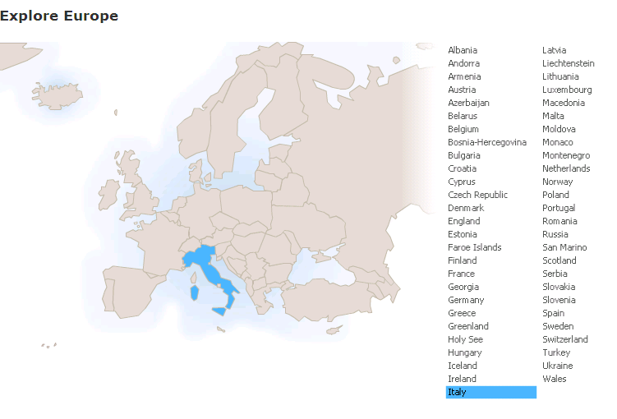
Run in “Slide Show” mode.
Use your up / down arrow keys and / or
your space bar to advance the slides
Immigration /
Emigration
Italy
© 2009-2024 Timothy G. Roufs, University of Minnesota Duluth

Slide 2
Italy
© 2009-2024 Timothy G. Roufs, University of Minnesota Duluth

Slide 3
Immigration /
Emigration
Italy
© 2009-2024 Timothy G. Roufs, University of Minnesota Duluth

Slide 4
Italy’s contemporary immigrant/emigrant situation reflects a complex history, geography, ecology, demographic make up, world view, and so forth
. . .

Slide 5
So first, a bit of history and background . . .

Slide 6
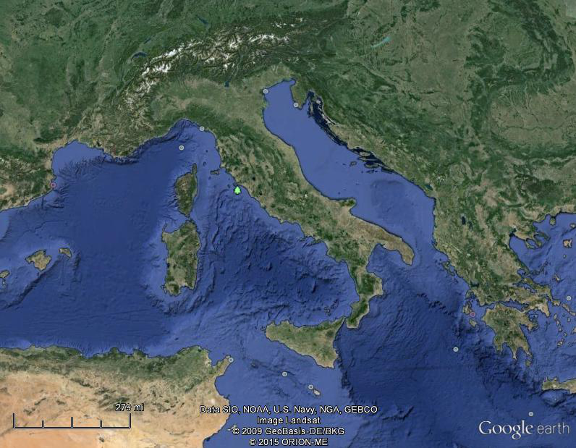
Of all European countries Italy, “the boot,” is probably the most recognizable . . .
Notes:
6

Slide 7
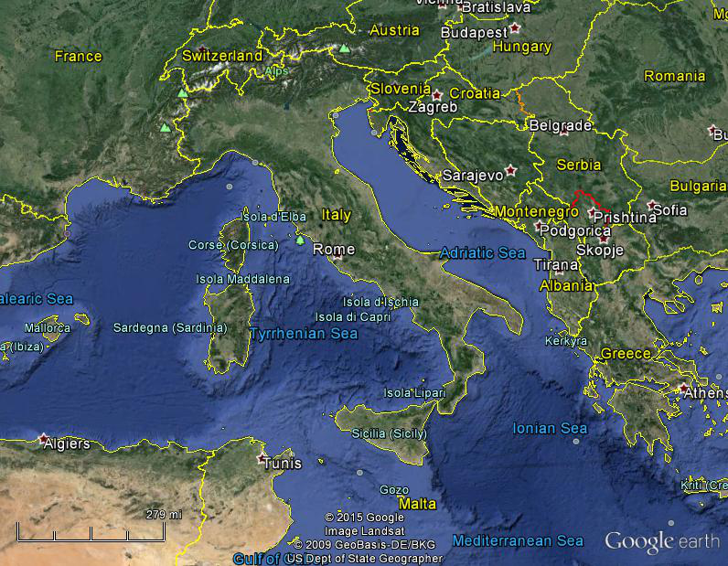
Italy, and her current neighbors . . .
Notes:
7

Slide 8
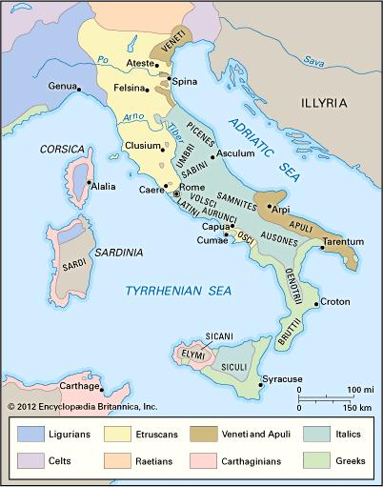
ancient Italic peoples:
Distribution of peoples of ancient Italy ca. 500 B.C.
©Encyclopædia Britannica, Inc.
https://www.britannica.com/topic/history-of-Italy
Notes:
8

Slide 9
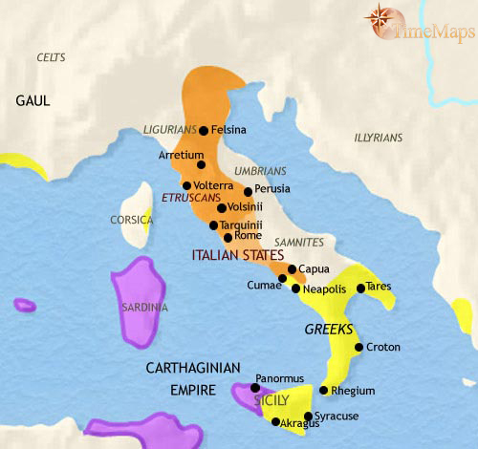
500 B.C.
http://www.timemaps.com/history/italy-500bc
Notes:
9

Slide 10
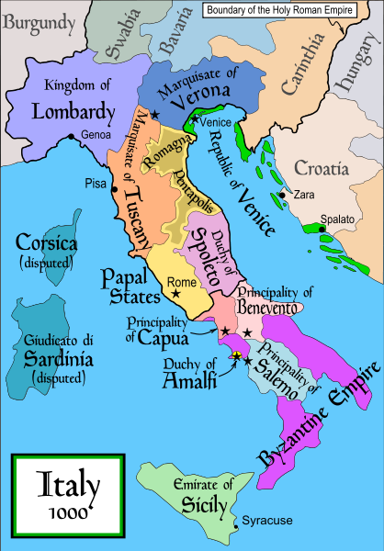
1000
Italy was divided for centuries into small kingdoms and city-states
http://en.wikipedia.org/wiki/Italy
Notes:
10

Slide 11
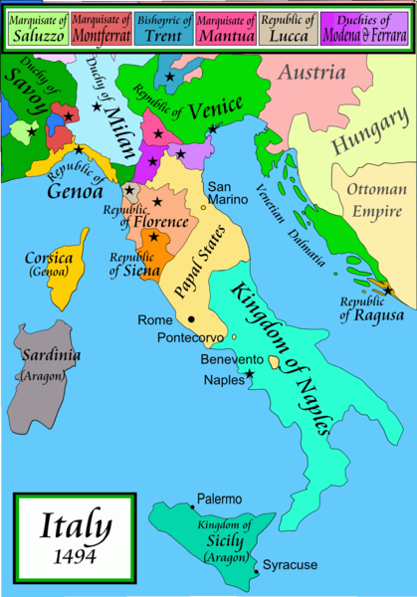
1494
Italy was divided for centuries into small kingdoms and city-states
http://en.wikipedia.org/wiki/Italy
Notes:
11

Slide 12
In 1494 Christopher Columbus from Genoa went on his second voyage to the New World
Italy was divided for centuries into small kingdoms and city-states
http://en.wikipedia.org/wiki/Italy
Notes:
12

Slide 13
In 1494 Christopher Columbus from Genoa is on his second voyage to the New World
Christopher Columbus was a sugar merchant from Genoa, married to the daughter of a sugar merchant from Madeira, Felipa Perestrello.
Columbus was looking for a way around Venice’s monopoly on things like sugar. . . .
Italy was divided for centuries into small kingdoms and city-states
http://en.wikipedia.org/wiki/Italy
Notes:
13

Slide 14
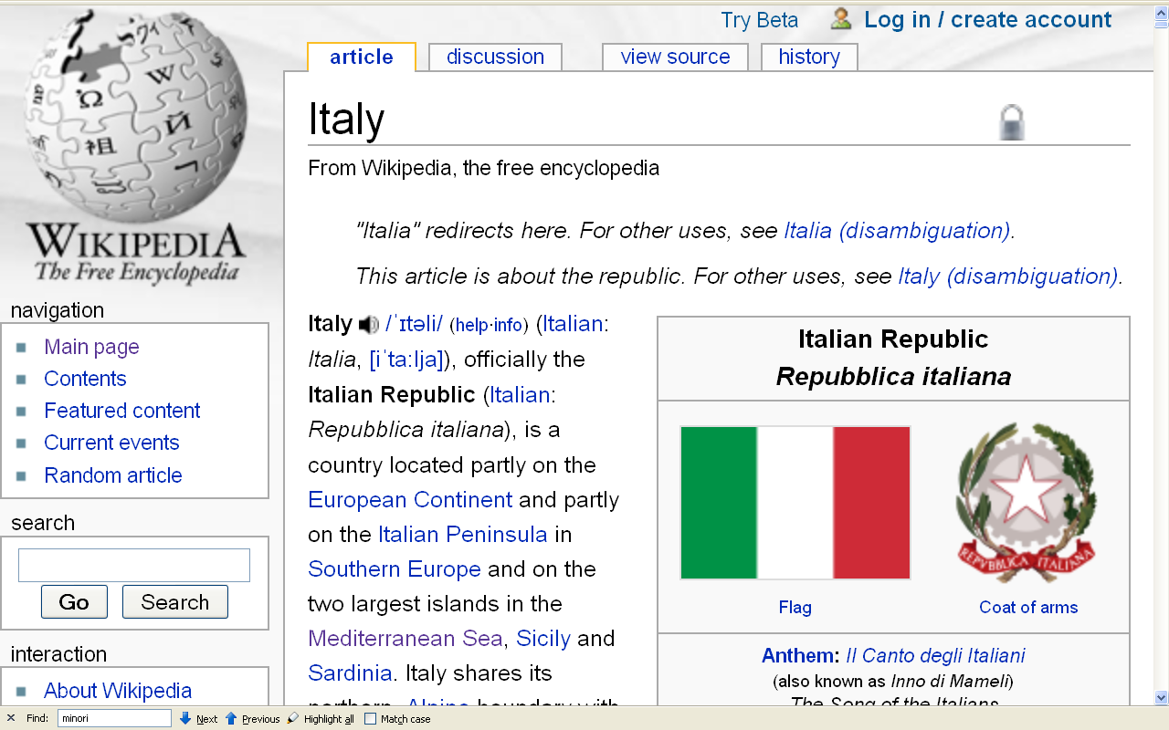
Formation of Italy
Unification —17 March 1861
Republic —2 June 1946
http://en.wikipedia.org/wiki/Italy
Notes:
14

Slide 15
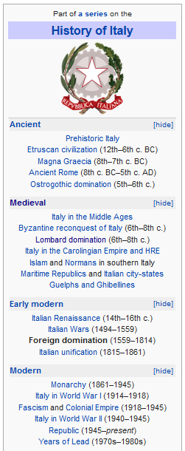
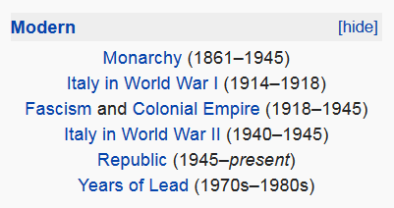
http://en.wikipedia.org/wiki/History_of_Italy_during_foreign_domination_and_the_unification
Notes:
15

Slide 16
http://en.wikipedia.org/wiki/History_of_Italy_during_foreign_domination_and_the_unification
Notes:
16

Slide 17
Formation of Italy
Unification —17 March 1861
Republic —2 June 1946
http://en.wikipedia.org/wiki/Italy
Notes:
17

Slide 18
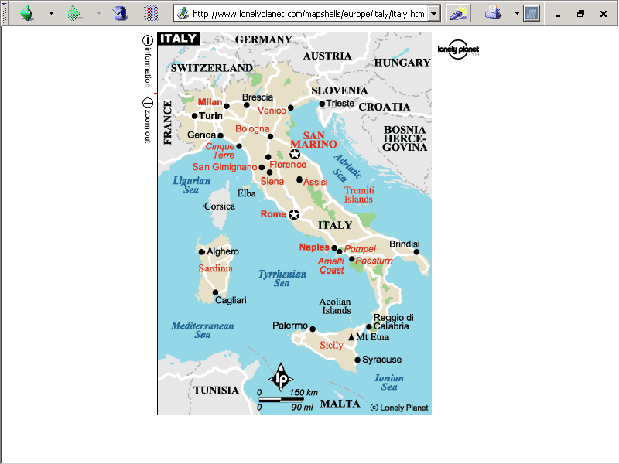
population size
61,021,855 (2023 est.)
https://www.worldometers.info/world-population/italy-population/

Slide 19
Note
Sicily

Slide 20
Note
Sardinia

Slide 21
Note
Kingdom of Tavolara
(unrecognized micronation)
https://en.wikipedia.org/wiki/Kingdom_of_Tavolara

Slide 22
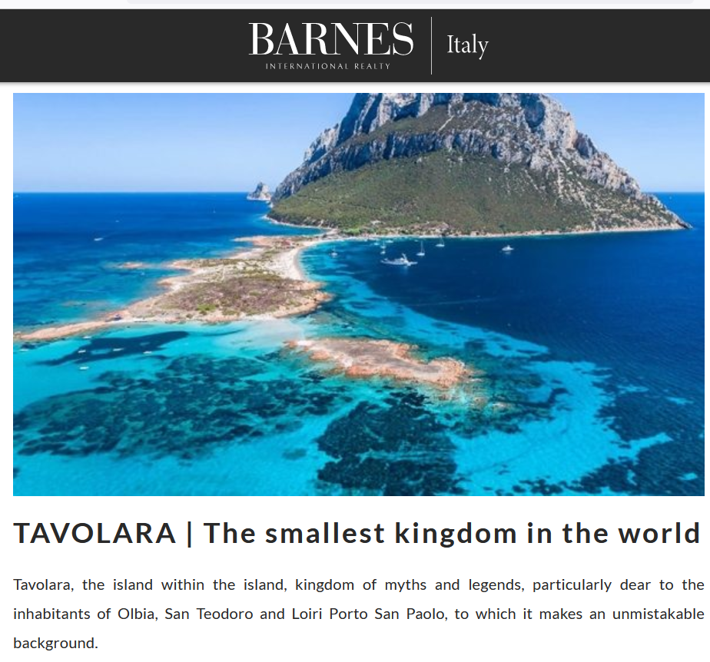
https://barnes-italy.com/tavolara-the-smallest-kingdom-in-the-world/
Notes:
22

Slide 23
Note
Corsica
(French)
Notes:
23

Slide 24
Principality of Seborga
(unrecognized micronation)
Note
https://en.wikipedia.org/wiki/Seborga
Notes:
24

Slide 25
Notes:
25

Slide 26
Note
Rome

Slide 27
The Holy See
(The Vatican)
an independent country
Note
Notes:
27

Slide 28
Note
Notes:
28

Slide 29
Note
The Most Serene Republic of San Marino
an independent country
Notes:
29

Slide 30
Gannon and Pillai classify Italy as one of the
“Cleft National Cultures”
that they discuss

Slide 31
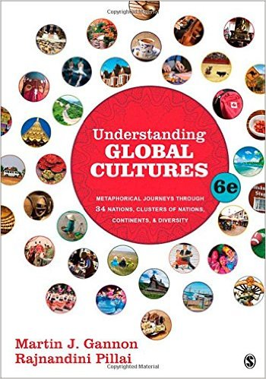
http://www.d.umn.edu/cla/faculty/troufs/anth1095/index.html#text

Slide 33
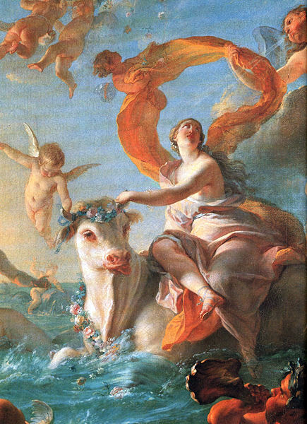
Europa and the Bull Enlèvement d'Europe Nöel-Nicolas Coypel, c. 1726

Slide 34
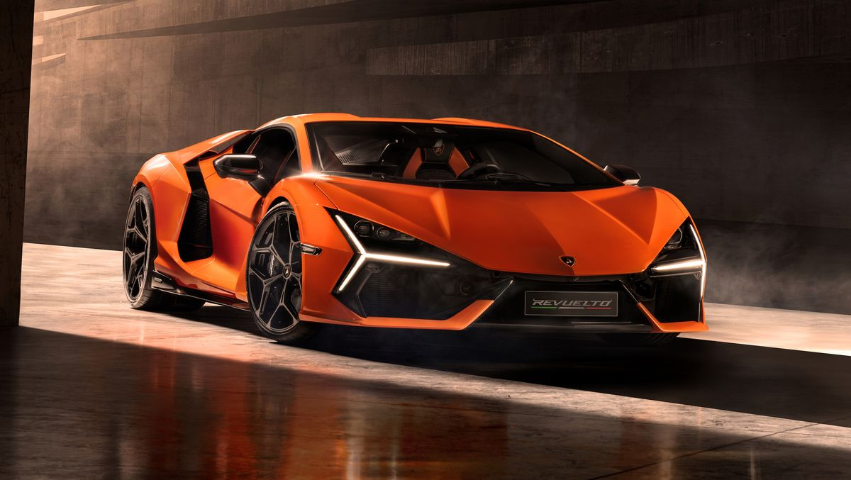
2024 Lamborghini Revuelto
All yours for around $608,358.
https://www.caranddriver.com/lamborghini/revuelto

Slide 35
2023 Lamborghini Huracan Sterrato
All yours for around $270,000.
https://blog.dupontregistry.com/lamborghini/new-2023-lamborghini-huracan-sterrato-is-revealed-602-hp-off-road-supercar/

Slide 36
2022 Lamborghini Sian
All yours for $3.6 million.
https://www.roadandtrack.com/news/a37294264/2022-lamborghini-countach/

Slide 37
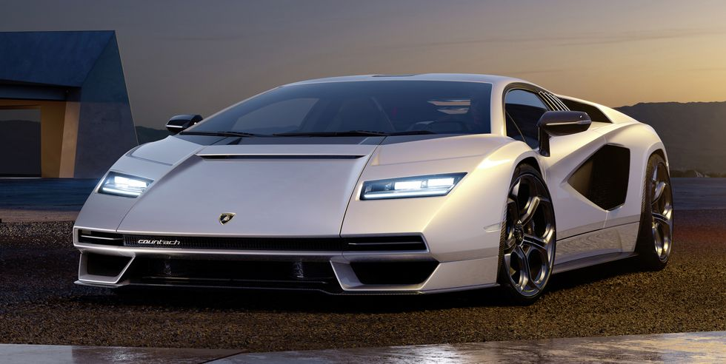
2022 Lamborghini Countach
All yours for $2.64 million.
https://www.roadandtrack.com/news/a37294264/2022-lamborghini-countach/

Slide 40
2024 Alfa Romeo Stelvio Quadrifoglio
https://www.alfaromeousa.com/cars/giulia/quadrifoglio

Slide 41
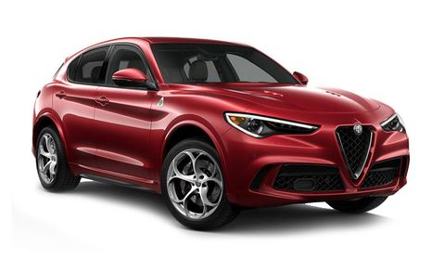
2022/2023 Alfa Romeo Stelvio Quadrifoglio
Source

Slide 43
2024 Maserati GranTurismo

Slide 44
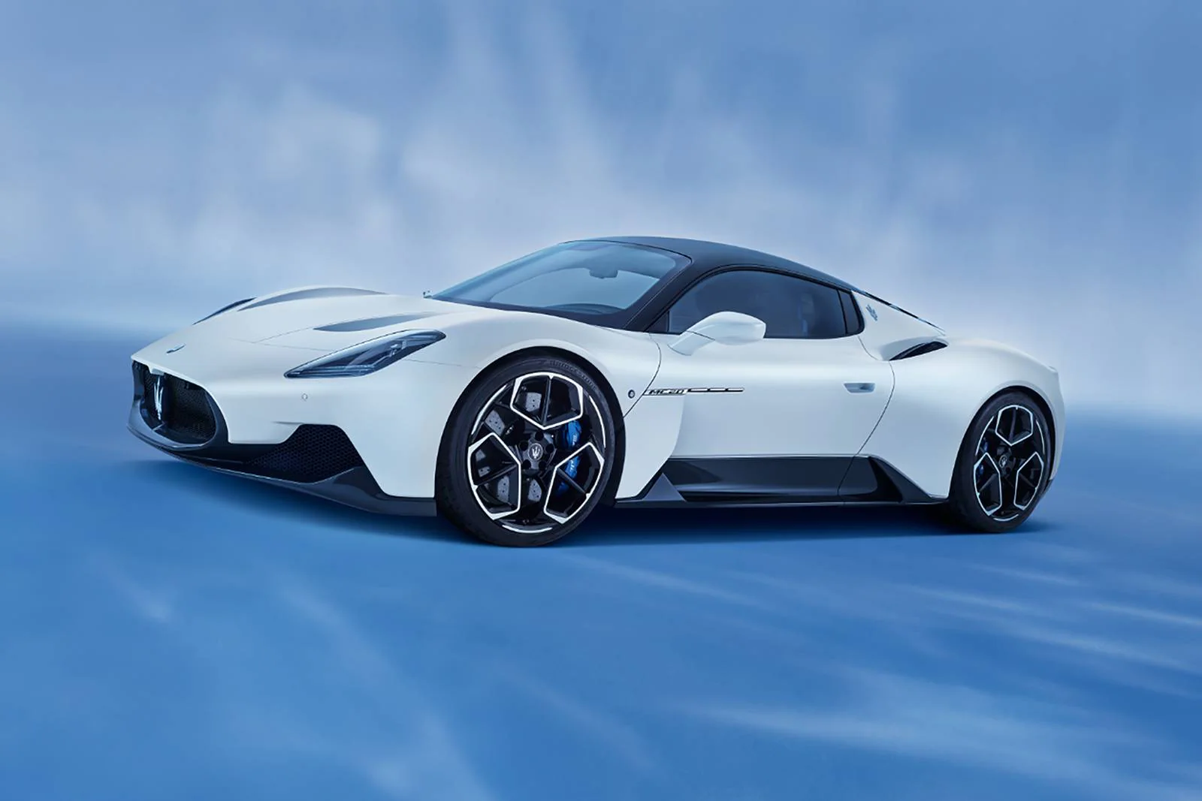
2022 Maserati MC20

Slide 46
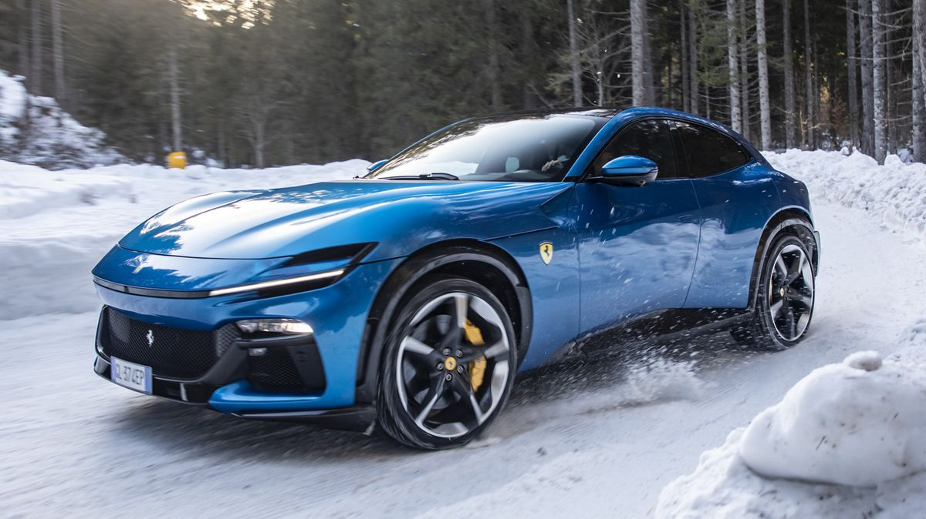
2024 Ferrari Purosangue
starting at $402,050
https://www.caranddriver.com/ferrari/purosangue

Slide 47
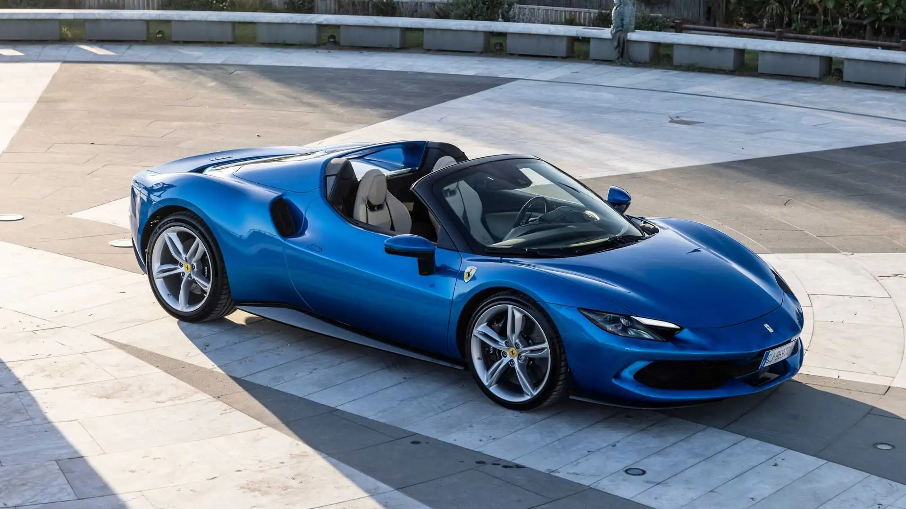
2023 Ferrari 296 GTS
https://www.motor1.com/reviews/621685/2023-ferrari-296-gts-first-drive/

Slide 48
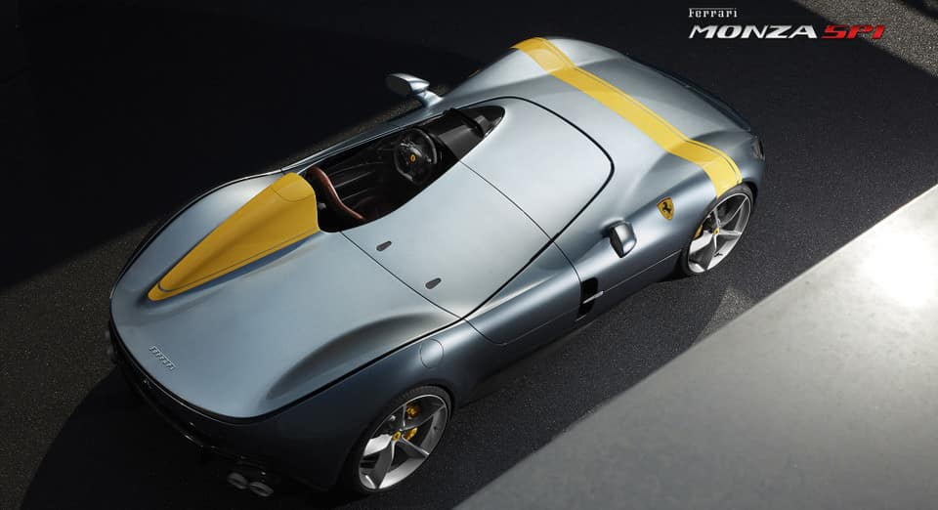
Ferrari Icona: Monza SP1
https://www.ferrarilakeforest.com/manufacturer-information/upcoming-ferrari-models/

Slide 49
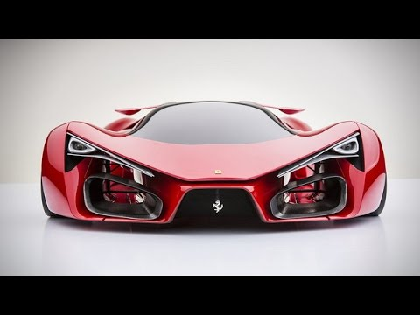
2016 Ferrari F80 Concept

Slide 50
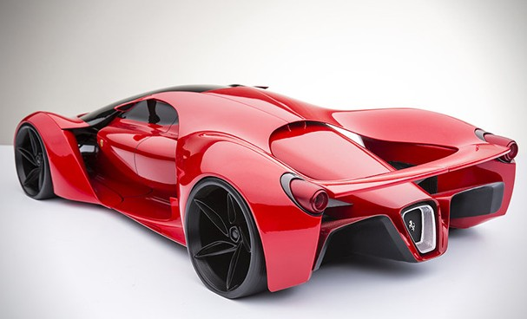
2015 Ferrari F80 Supercar Concept

Slide 52
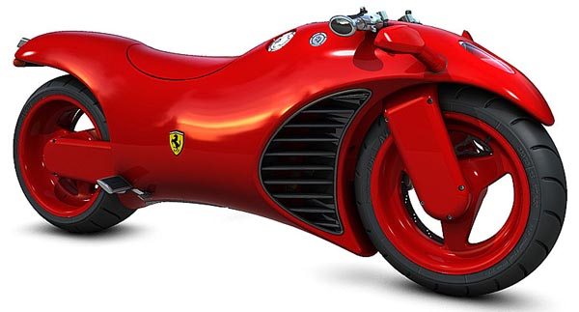

Slide 54
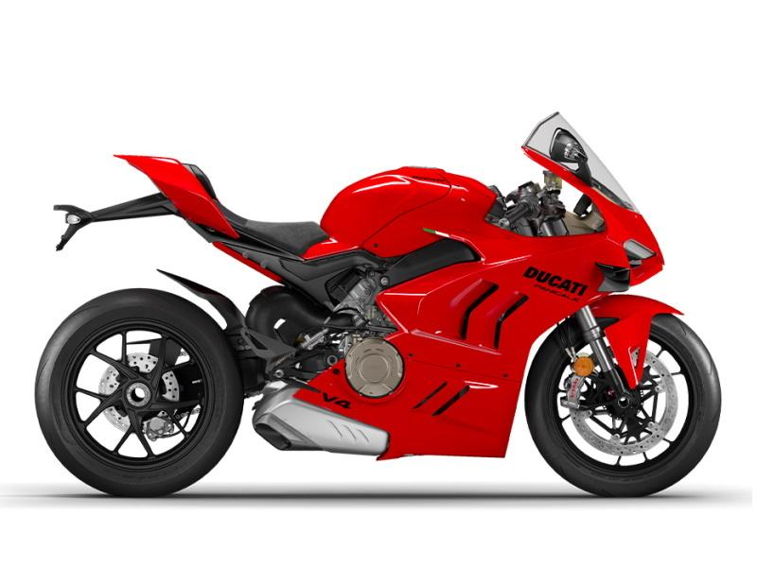
2024 Ducati Panigale V4
$24,995.00
https://www.wheelsinmotionmc.com/inventory/v1/Current/Ducati/Panigale/Panigale-V4/Red--Chatsworth-California---21336901?format=print

Slide 55
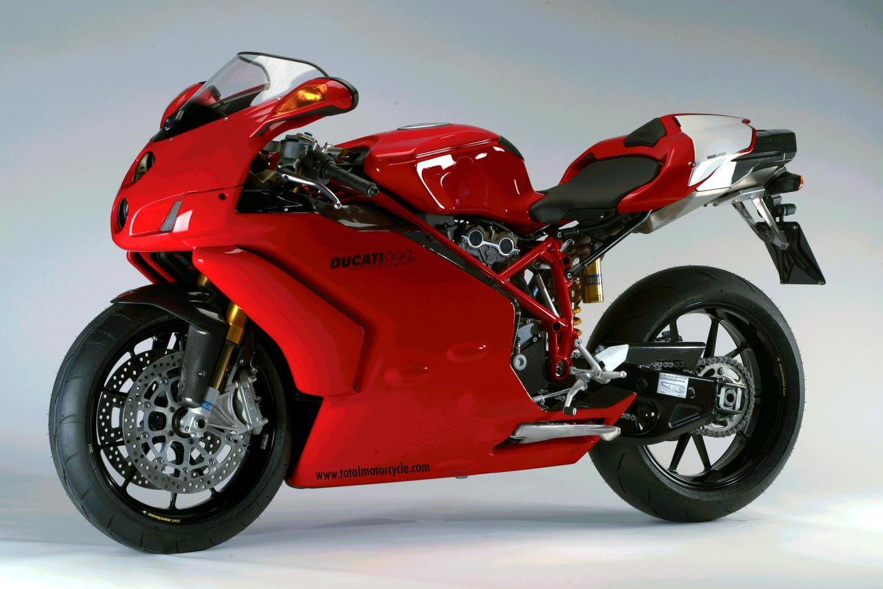

Slide 57
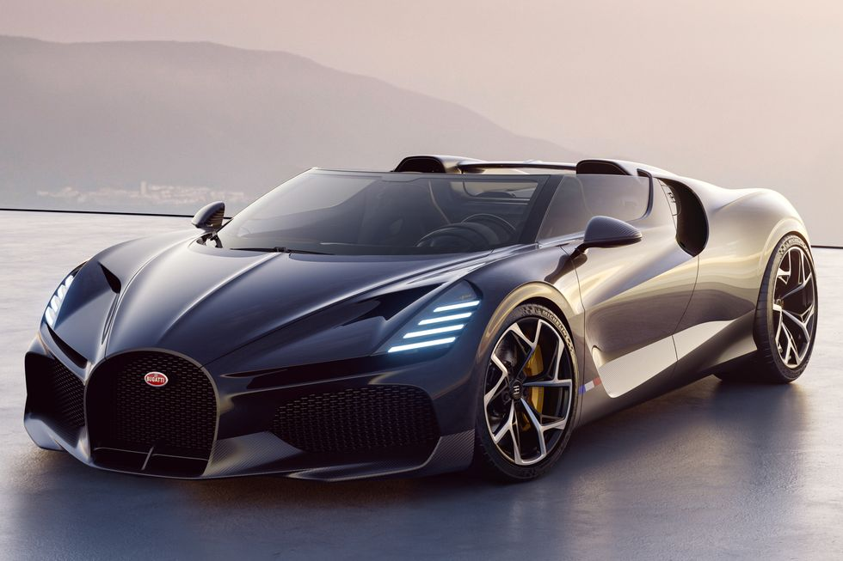
2024 Bugatti Mistral Roadster
Price: $5 Million
https://www.caranddriver.com/news/a40874138/2024-bugatti-mistral-5-cool-design-elements/

Slide 58
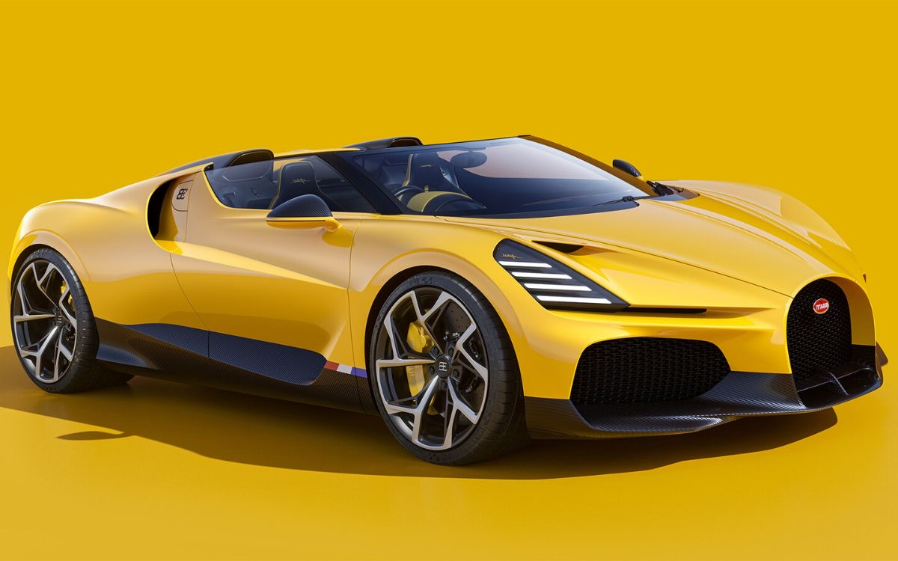
Sorry
Sold Out
2023 Bugatti W16 Mistral
Price: $5 Million

Slide 59
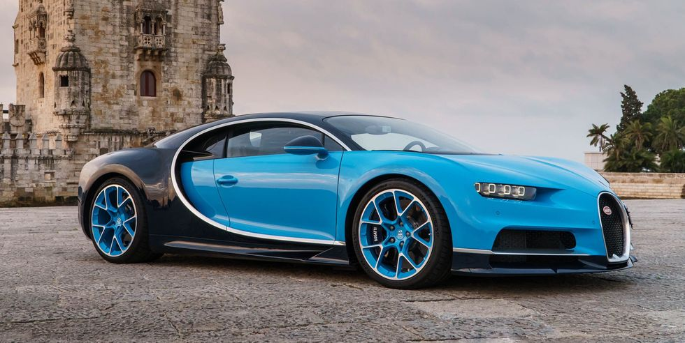
2022 Bugatti Chiron
Price: $3.6-$3.9 Million

Slide 60
Bugatti Niniette 66 yacht is a 1,000-hp Chiron for the Water

Slide 61
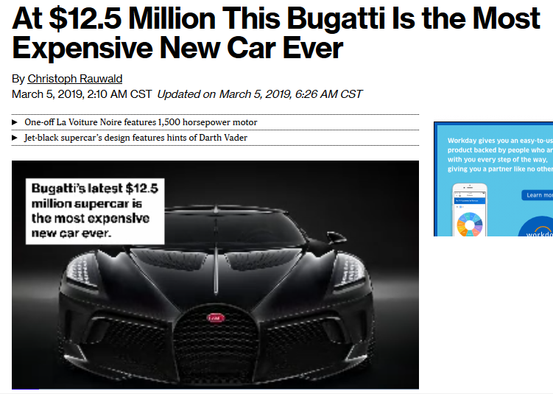

Slide 62
Martin J. Gannon and Rajnandini Pillai Understanding Global Cultures
“The reliance on spectacle must be clearly grasped if one wants to understand the Italians.
Spectacle helps people solve most of their problems, and it governs public and private life.
It is one of the reasons that Italians have always excelled in activities in which impressions are important . . .
opera
architecture
industrial / technological design
decoration
and yes, even toilets
www.d.umn.edu/cla/faculty/troufs/anth1095/index.html#Gannon

Slide 63
Laufen Alessi One wall-hung toilet and bidet
ILBAGNOALESSI
Stefano Giovannoni
Designer

Slide 64
https://gestione.aetitalia.it/download/sito/d27bded_sanitarisquarefoto23.jpg

Slide 65
https://gestione.aetitalia.it/download/sito/d27bded_sanitarisquarefoto23.jpg

Slide 66
Cielo
Italy
https://www.ceramicacielo.it/en/products/smile/floor+mounted+wc+%26+bidet/back+to+wall+one+hole+bidet/111

Slide 67
And even the Italian trains
are beautiful . . .

Slide 68
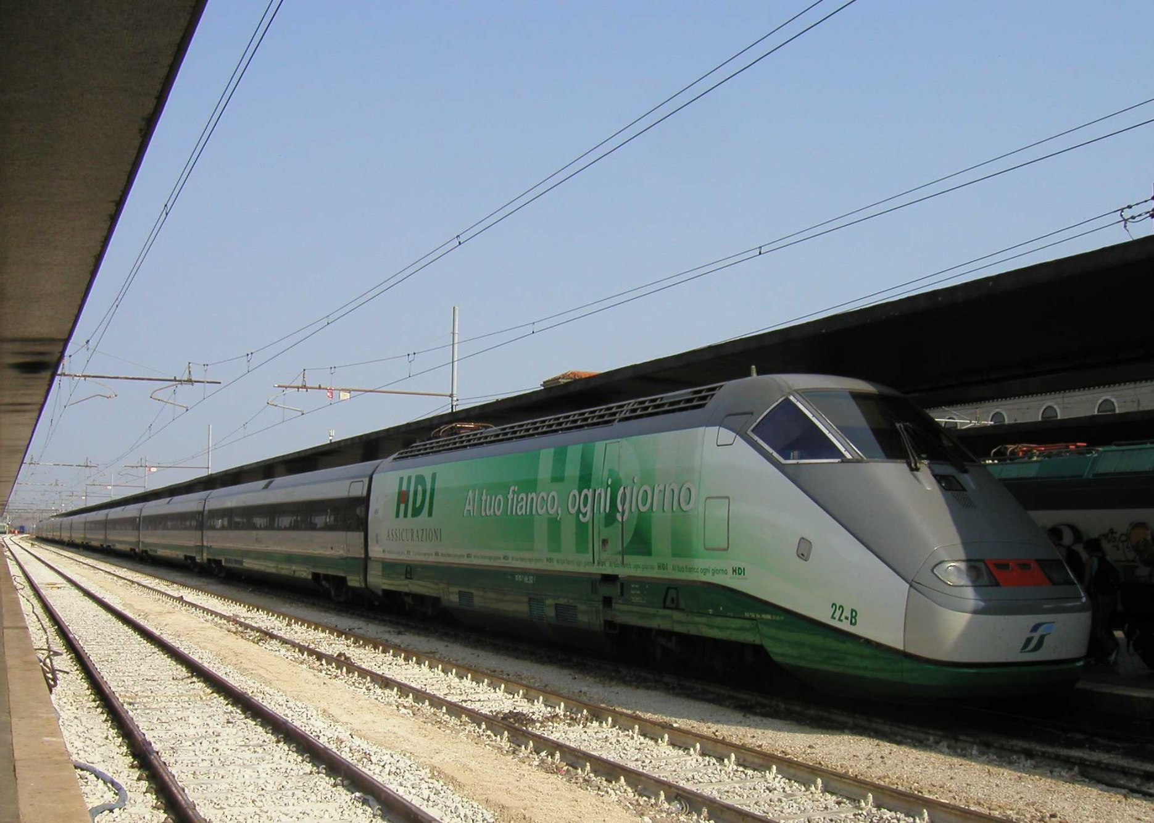
The Carolinian stopping
in Raleigh, North Carolina
in "Phase V" livery. Wikipedia
Trenitalia series ETR 500 at Venezia S.Lucia
http://commons.wikimedia.org/wiki/File:Trenitalia-series-ETR500.jpg

Slide 69
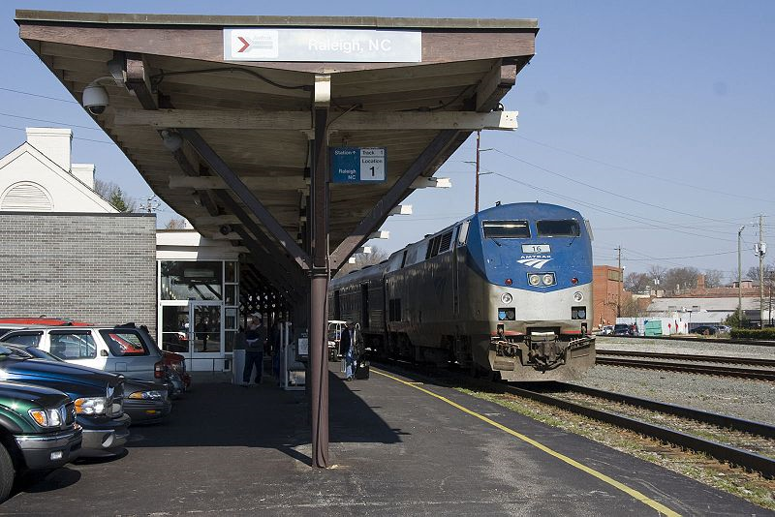
compare the Italian train to the U.S.A. train
The Carolinian stopping
in Raleigh, North Carolina
in "Phase V" livery. Wikipedia
Trenitalia series ETR 500 at Venezia S.Lucia
http://commons.wikimedia.org/wiki/File:Trenitalia-series-ETR500.jpg

Slide 70
Martin J. Gannon and Rajnandini Pillai Understanding Global Cultures
“The reliance on spectacle must be clearly grasped if one wants to understand the Italians.
Spectacle helps people solve most of their problems, and it governs public and private life.
It is one of the reasons that Italians have always excelled in activities in which impressions are important . . .
opera
architecture
industrial / technological design
decoration
landscape gardening
cinema
fashions
www.d.umn.edu/cla/faculty/troufs/anth1095/index.html#Gannon

Slide 71
http://www.d.umn.edu/cla/faculty/troufs/anth1095/index.html#text

Slide 72
“Cleft National Culture”
one in which the regions, and subcultures of the diverse ethnic groups,
are difficult to integrate

Slide 73
in a nutshell . . .

Slide 74
Gannon and Pillai's European Cultural Metaphors include
Ch. 19 The Italian Opera
Ch. 20 Belgian Lace
Ch. 22 The Turkish Coffehouse
Ch. 31 The Russian Ballet
Ch. 32 Estonian Singing
Ch. 33 The Polish Village Church
Ch. 34 The Spanish Bullfight
Ch. 35 The Portuguese Bullfight
Italy is culturally divided
“North - South”

Slide 75
Martin J. Gannon and Rajnandini Pillai Understanding Global Cultures
The country is divided into two main regions
“Continental Italy” (aka “The North”)
The Alps
The northern Italian plain
“Mediterranean Italy” (aka “The South”)
The Italian peninsula and the islands
www.d.umn.edu/cla/faculty/troufs/anth1095/index.html#Gannon

Slide 76
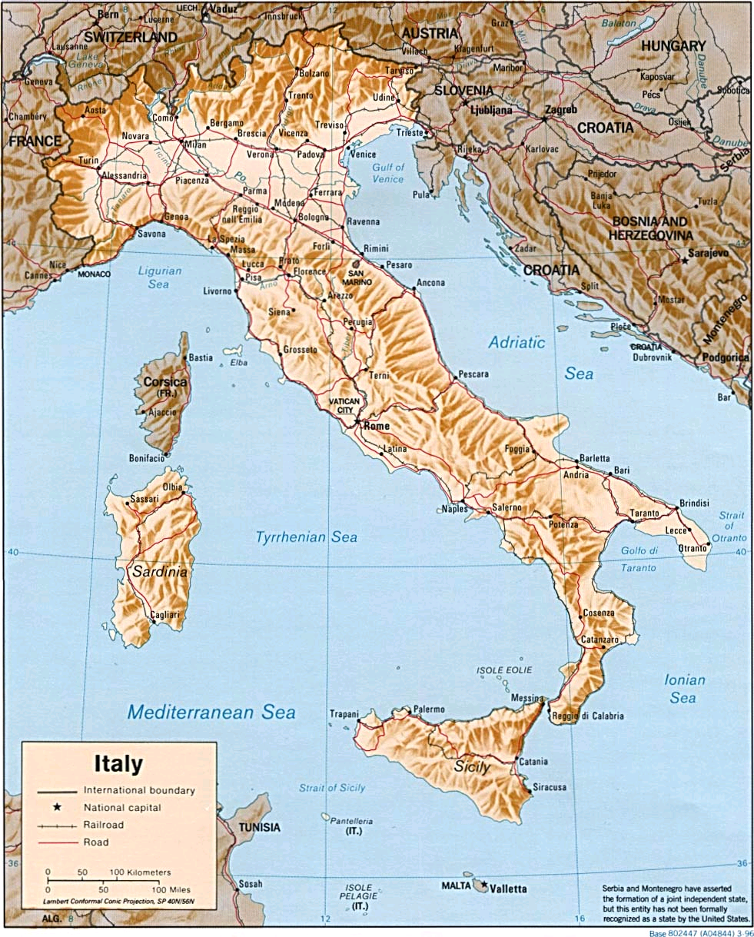
http://www.reliefweb.int/rw/RWB.NSF/db900LargeMaps/SKAR-64GDTU?OpenDocument

Slide 77
Martin J. Gannon and Rajnandini Pillai Understanding Global Cultures
The Apennine mountains run directly down the peninsula’s center, and its northern range almost completely cuts off the north from the south
This geographical division has led to extreme regionalism
www.d.umn.edu/cla/faculty/troufs/anth1095/index.html#Gannon

Slide 78
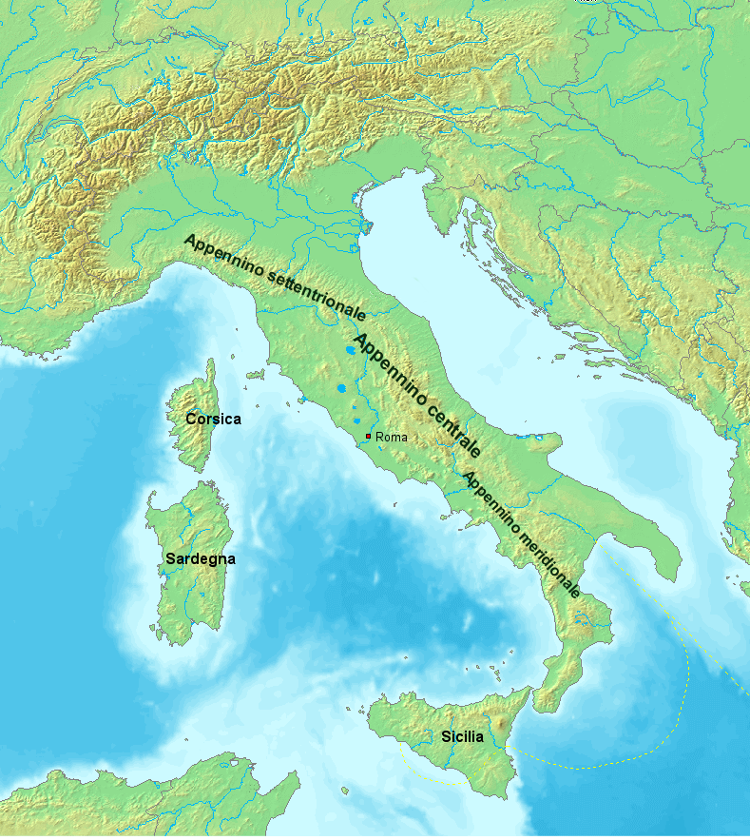
https://en.wikipedia.org/wiki/Apennine_Mountains

Slide 79
Martin J. Gannon and Rajnandini Pillai Understanding Global Cultures
The Apennine mountains run directly down the peninsula’s center, and its northern range almost completely cuts off the north from the south
Many Italians view Italy as two separate nations
The wealthier, industrial north
The poorer, more agrarian south
www.d.umn.edu/cla/faculty/troufs/anth1095/index.html#Gannon

Slide 80
Sometimes the northern region is called
Padania . . .
Some even arguing that it should be an independent country . . .
https://en.wikipedia.org/wiki/Padanian_nationalism

Slide 81
Sometimes the northern region is called
Padania . . .
Some even arguing that it should be an independent country . . .
https://en.wikipedia.org/wiki/Padanian_nationalism

Slide 82
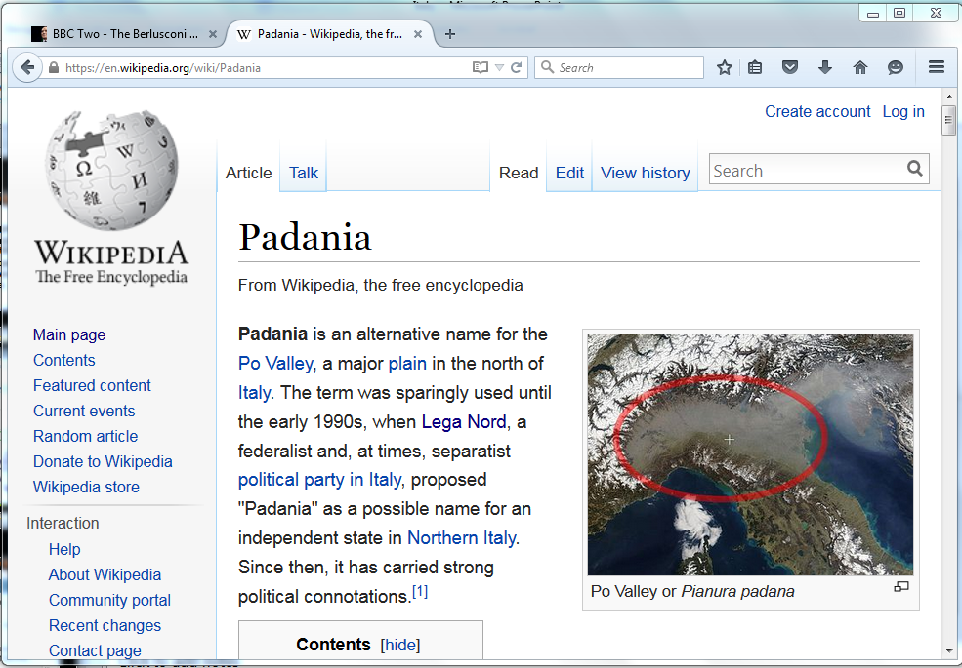
https://en.wikipedia.org/wiki/Padania
Notes:
82

Slide 83
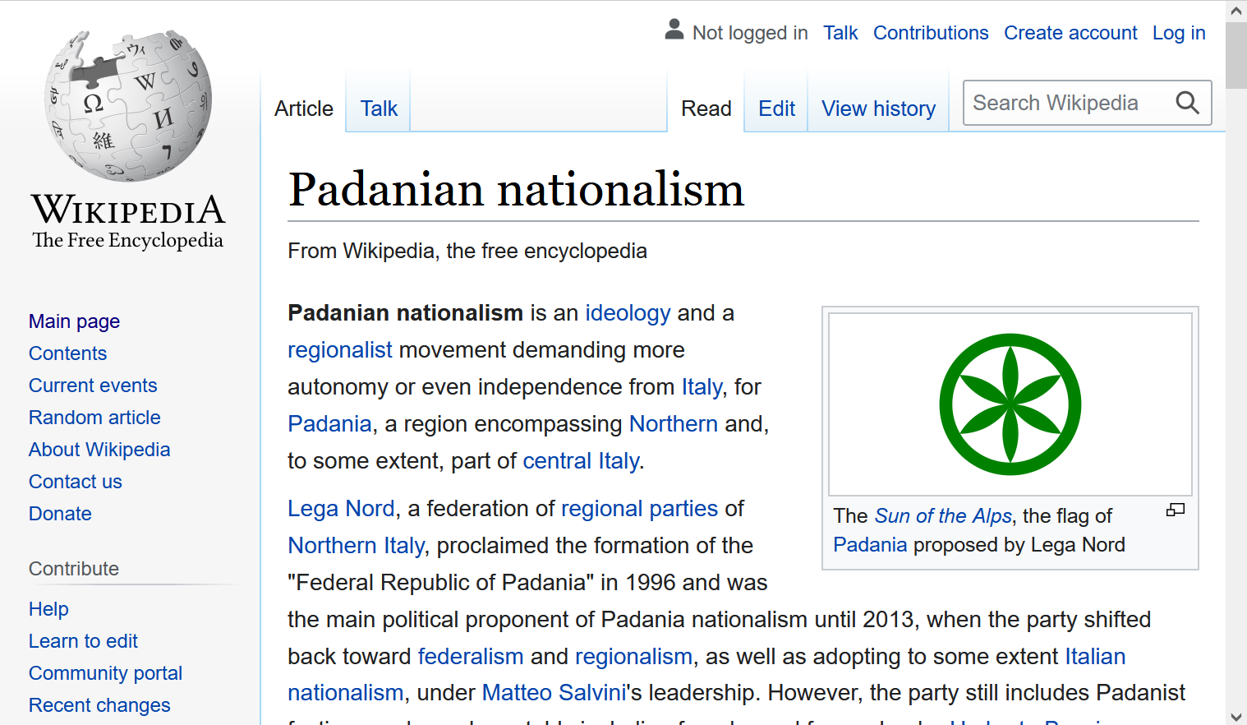
https://en.wikipedia.org/wiki/Padanian_nationalism
Notes:
83

Slide 84
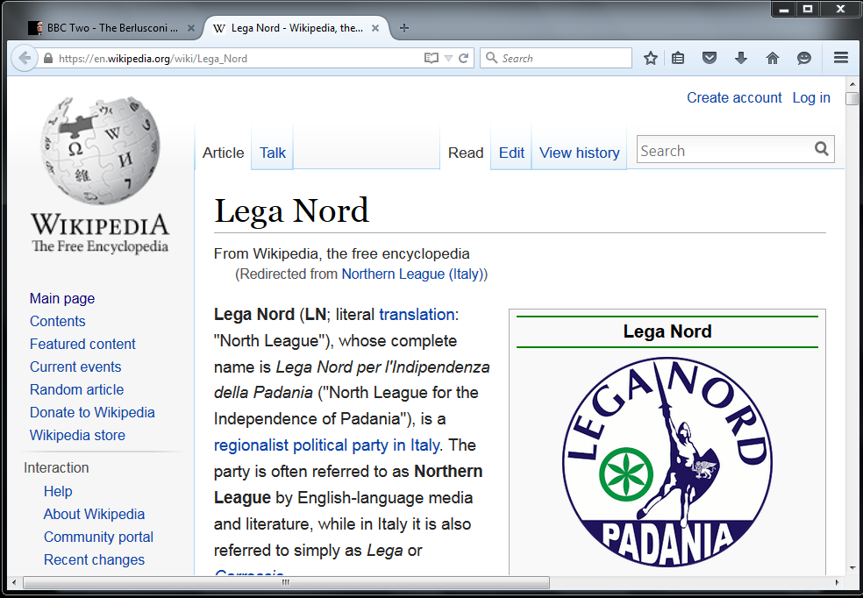
http://en.wikipedia.org/wiki/Northern_League_%28Italy%29
Notes:
84

Slide 85
Basic Demographics
Italy

Slide 86
note. . .
population size
61,021,855 (2023 est.)
https://www.worldometers.info/world-population/italy-population/

Slide 87
Demographics
Population: 60,482,849
(03 April 2020 est.)
country comparison to the world: 17
Population growth rate: 0.11%
(2020 est.)
country comparison to the world: 186
65 years and over: 22.1%
(2020 est.)
CIA World Factbook
https://www.cia.gov/library/publications/the-world-factbook/geos/it.html

Slide 88
Demographics
Italy has the fourth-largest population in the European Union and the 24th-largest population worldwide
The population density, at over
201.7 persons per km²
(over 522.4 / mi²)
is the fifth highest in the European Union
The highest density is in Northern Italy, as that one-third of the country contains almost half of the total population
Wikipedia
http://en.wikipedia.org/wiki/Italy#Demographics

Slide 89
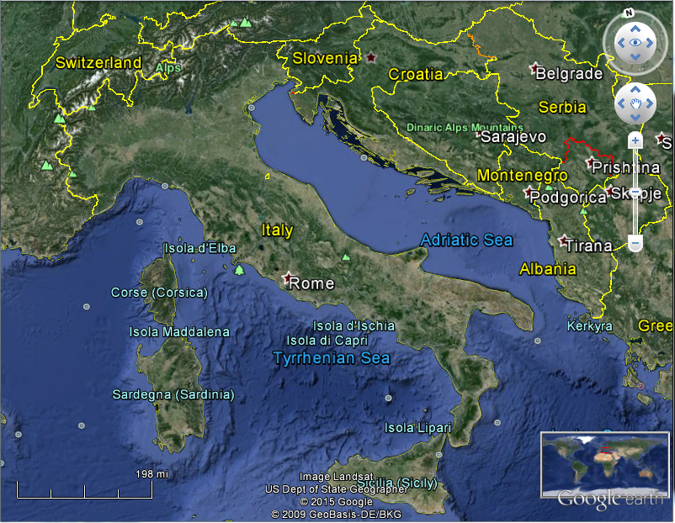
Population:
Italy: 61,021,855 (2023 est.)
Minnesota: 5,705,494 (2020 Census)
Population Density:
Italy: 522.4+ / mi² (201.7+ / km²)
Minnesota: 71.0 / mi² (27.4 / km²)

Slide 90
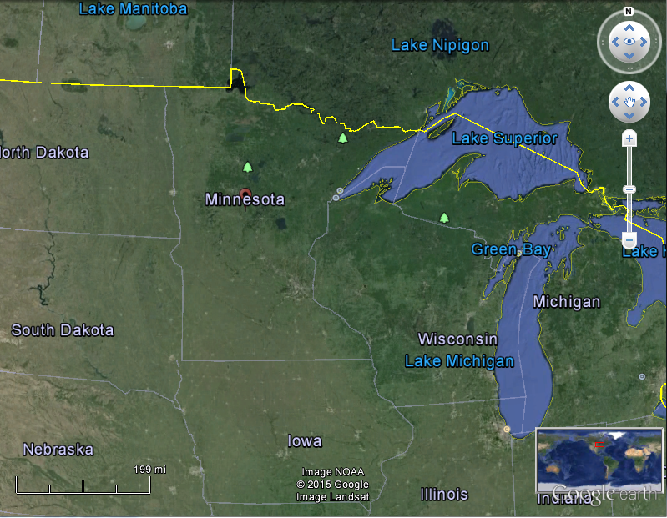
Coparisons with Minnesota
Population:
Italy: 61,021,855 (2023 est.)
Minnesota: 5,705,494 (2020 Census)
Population Density:
Italy: 532 / mi² (206 / km²)
Minnesota: 71.0 / mi² (27.4 / km²)

Slide 91
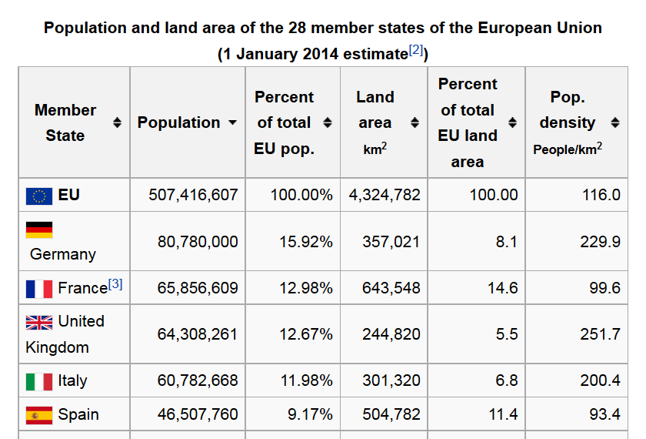
https://en.wikipedia.org/wiki/Demographics_of_the_European_Union#Population_by_nation
Notes:
91

Slide 92
Demographics
The highest population density is in Northern Italy,
as that one-third of the country contains almost half of the total population
Wikipedia
http://en.wikipedia.org/wiki/Italy#Demographics

Slide 93
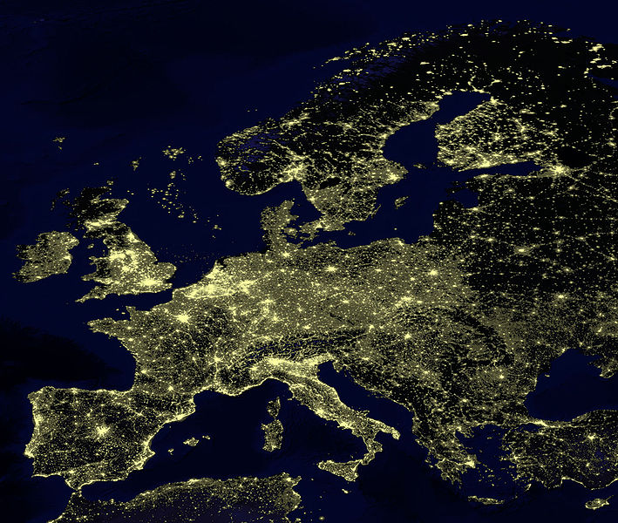
for Europe, at least, earthlight photos give you a sense of population density
https://commons.wikimedia.org/wiki/File:Earthlights_2002.jpg
Notes:
93

Slide 94
https://commons.wikimedia.org/wiki/File:Earthlights_2002.jpg
Notes:
94

Slide 95
https://commons.wikimedia.org/wiki/File:Earthlights_2002.jpg
Notes:
95

Slide 96
Oslo
Stockholm
St. Petersburg
Edinburgh
Glasgow
Copenhagen
London
Brussels
Paris
Milan
Venice
Rome
Madrid
Naples
Athens
https://commons.wikimedia.org/wiki/File:Earthlights_2002.jpg
Notes:
96

Slide 97
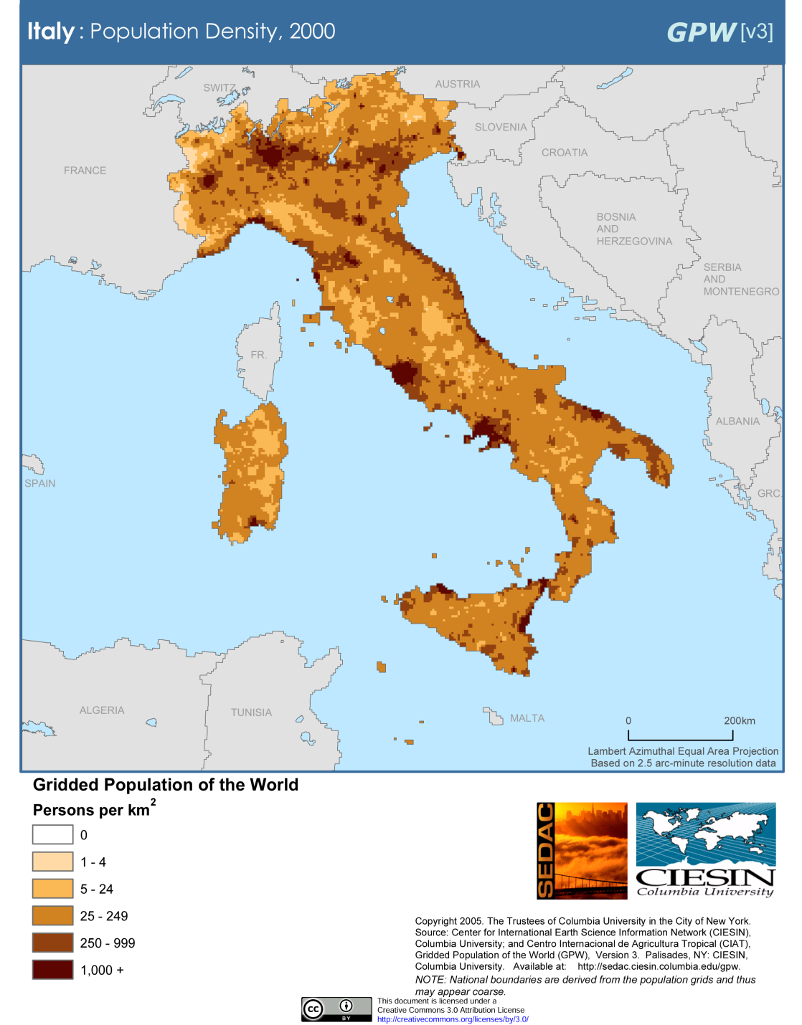
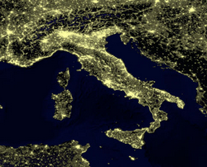
Milan
Venice
Rome
Milan
Venice
Naples
Rome
Naples
Population Density (2000)
Wikipedia
http://en.wikipedia.org/wiki/Italy#Demographics

Slide 98
Demographics
urban population:
72% of total population
(2023)
rate of urbanization: 0.27% annual rate of change
(2020-2025 est.)
Infant mortality rate:
total: 3.1 deaths/1,000 live births
(2023 est.)
country comparison to the world: 210
Life expectancy at birth:
total population: 82.8 years
(2023 est.)
country comparison to the world: 19
CIA World Factbook
https://www.cia.gov/the-world-factbook/countries/italy/

Slide 99
Demographics
Ethnic Groups
In the North
German-Italians
French-Italians
Slovene-Italians
In the South
Albanian-Italians
Greek-Italians
CIA World Factbook
https://www.cia.gov/library/publications/the-world-factbook/geos/it.html

Slide 100
the main languages of Italy reflect the main ethnic groups,
at least in the north,
and include . . .

Slide 101
Italy’s
Languages
Italian (official)
German
parts of Trentino-Alto Adige region are predominantly German speaking
French
small French-speaking minority in Valle d'Aosta region (near France)
Slovene
Slovene-speaking minority in the Trieste-Gorizia area (near Slovenia)
include . . .
CIA World Factbook
https://www.cia.gov/the-world-factbook/countries/italy/

Slide 102
Main Languages
Italian (official)
German
parts of Trentino-Alto Adige region are predominantly German speaking
French
small French-speaking minority in Valle d'Aosta region (near France)
Slovene
Slovene-speaking minority in the Trieste-Gorizia area (near Slovenia)
CIA World Factbook
https://www.cia.gov/the-world-factbook/countries/italy/

Slide 103
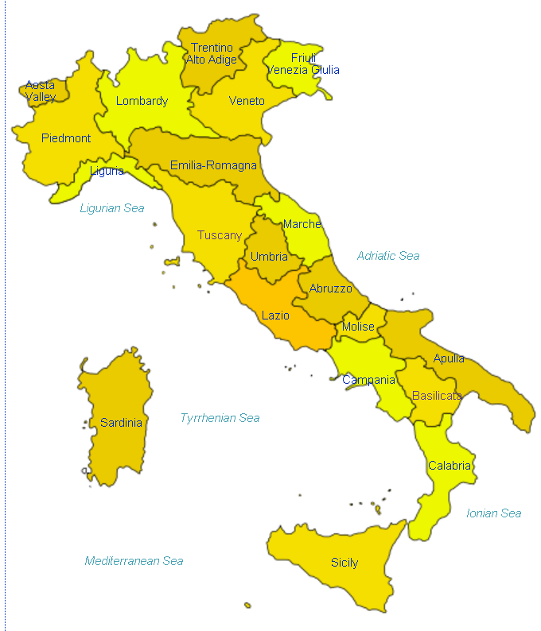
German
http://en.wikipedia.org/wiki/Regions_of_Italy
Notes:
103

Slide 104
Main Languages
Italian (official)
German
parts of Trentino-Alto Adige region are predominantly German speaking
French
small French-speaking minority in Valle d'Aosta region (near France)
Slovene
Slovene-speaking minority in the Trieste-Gorizia area (near Slovenia)
CIA World Factbook
https://www.cia.gov/the-world-factbook/countries/italy/

Slide 105
French
http://en.wikipedia.org/wiki/Regions_of_Italy
Notes:
105

Slide 106
Main Languages
Italian (official)
German
parts of Trentino-Alto Adige region are predominantly German speaking
French
small French-speaking minority in Valle d'Aosta region (near France)
Slovene
Slovene-speaking minority in the Trieste-Gorizia area (near Slovenia)
CIA World Factbook
https://www.cia.gov/the-world-factbook/countries/italy/

Slide 107
Slovene
http://en.wikipedia.org/wiki/Regions_of_Italy
Notes:
107

Slide 108
http://en.wikipedia.org/wiki/Regions_of_Italy
Notes:
108

Slide 109
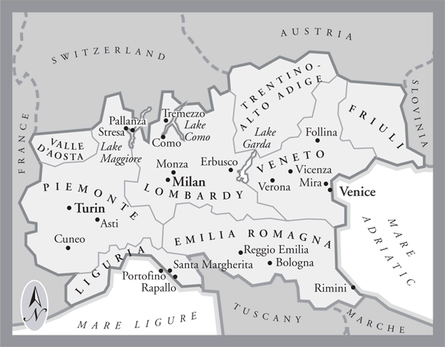
In northern Italy people in three regions speak a different primary language,
in addition to Italian . . .
German
Slovene
French
Italian
is spoken throughout Italy
Tuscany
www.jdbassc.com/maps/map_southern_italy.asp
Notes:
109

Slide 110
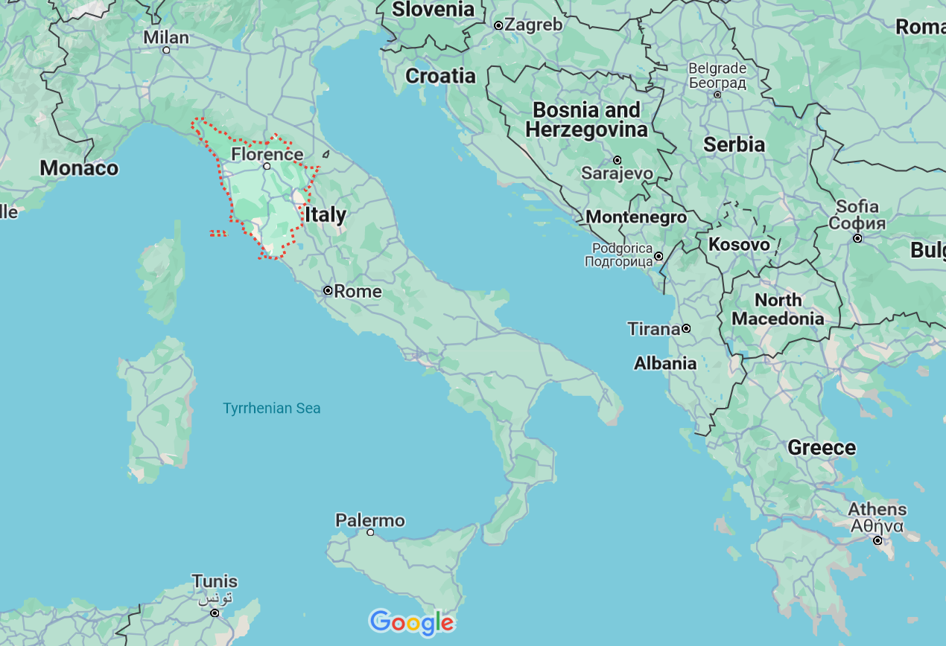
German
French
Slovene
Tuscany
Italian
In the neighboring Tuscany region
they speak Italian, which historically was based on the Florentine dialect . . .

Slide 111
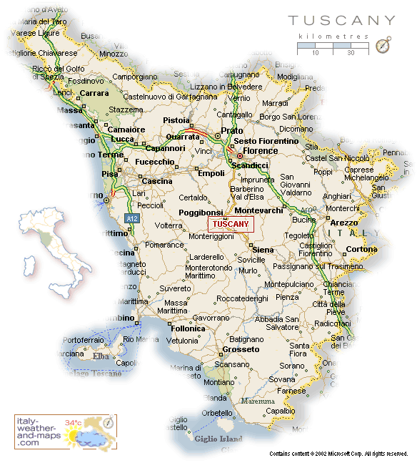
Florence
Pisa
http://healthmap.files.wordpress.com/2009/12/tuscany-map.gif

Slide 112
Italian
throughout
http://en.wikipedia.org/wiki/Regions_of_Italy
Notes:
112

Slide 113
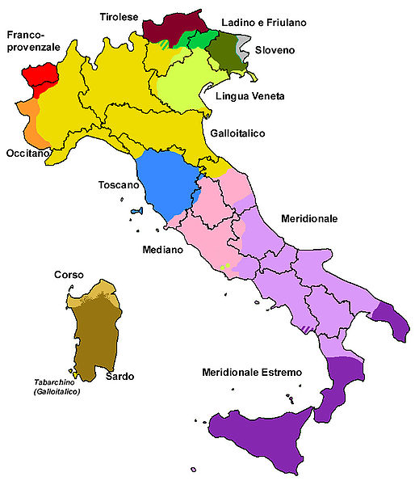
all the languages include . . .
Official language(s) | Italian
Regional language(s) | German, Neapolitan, Slovene, Piedmontese, Sardinian, Sardinian, Tabarchino, Sassarese, Gallurese, Ladin, Cimbrian, Mocheno, Venetian
Minority language(s) | Albanian, Catalan, German, Greek, Slovene, Croatian, French, Franco-Provençal, Friulian, Ladin, Occitan, Sardinia
Main immigrant language(s) | Romanian, Berber, Maghrebi Arabic, Albanian
Main foreign language(s) | English (25%) Spanish (17%) French (14%)
Dialects of Italy by Group
http://en.wikipedia.org/wiki/List_of_languages_of_Italy
Notes:
113

Slide 114
Martin J. Gannon and Rajnandini Pillai Understanding Global Cultures
The Italian history of invasions has produced many dialects, each the product of the particular regional invader
The language of Italy consists of both local dialects and Italian, a derivative of the Tuscan language
Although linguistic variations are disappearing to some extent due to the homogenizing effects of television and telecommunications, Italians still cling to the notion of having their own regional dialect
www.d.umn.edu/cla/faculty/troufs/anth1095/index.html#Gannon

Slide 115
Martin J. Gannon and Rajnandini Pillai Understanding Global Cultures
The vocal selections of the chorus in the Italian opera are directly comparable to the many regional variations of the Italian language
Although each section is important to the harmony of the chorus, each has its own melody
www.d.umn.edu/cla/faculty/troufs/anth1095/index.html#Gannon

Slide 116
Dialects of Italy by Group
http://en.wikipedia.org/wiki/List_of_languages_of_Italy
Notes:
116

Slide 117
1494
compare these
with the old kingdoms
Dialects of Italy by Group
http://en.wikipedia.org/wiki/List_of_languages_of_Italy
Notes:
117

Slide 118
1000
1494
compare these
with the old kingdoms
Dialects of Italy by Group
http://en.wikipedia.org/wiki/List_of_languages_of_Italy
Notes:
118

Slide 119
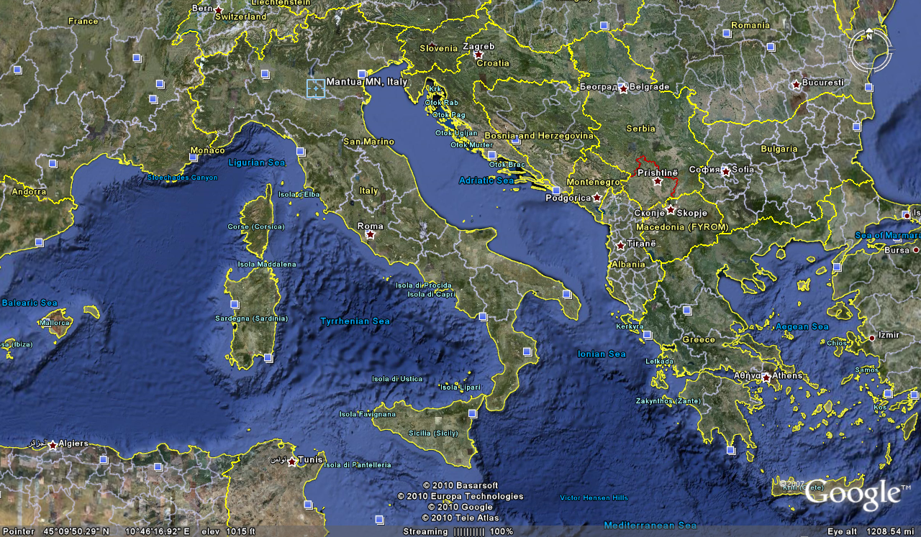
Cosimo Vassallo
is from
Palermo, Sicily
Letizia Colajanni
and
Cosimo Vassallo
/

Slide 120
Cossimo lives in
Mantova
503 miles away
(by air)
/
Letizia Colajanni
and
Cosimo Vassallo

Slide 121
If Cosimo speaks Italian with
his Palermo accent in
Montova, some
will have difficult understanding him
/
Cosimo Vassallo
is from
Palermo, Sicily
Letizia Colajanni
and
Cosimo Vassallo
/

Slide 122
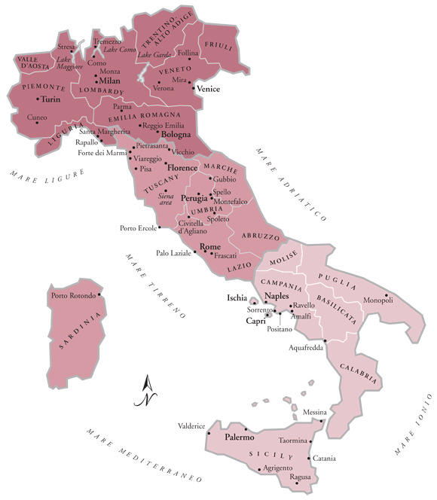
/
My friend Martin Aricochi
who lives in
Brixen (Bressanone), Italy, spoke German until he went to school,
www.jdbassc.com/maps/map_southern_italy.asp
Notes:
122

Slide 123
/
My friend Martin Aricochi
who lives in
Brixen (Bressanone), Italy, spoke German until he went to school,
and they still speak German at home
www.jdbassc.com/maps/map_southern_italy.asp
Notes:
123

Slide 124
the main religions include . . .

Slide 125
Demographics
Religions
Roman Catholic 80%-90%
approximately
about one-third regularly attend services
Other 10-20%%
includes “mature Protestant” and Jewish communities
and a growing Muslim immigrant community
CIA World Factbook
https://www.cia.gov/library/publications/the-world-factbook/geos/it.html

Slide 126
Demographics
Religions
Roman Catholic 80%-90%
approximately
about one-third regularly attend services
Other 10-20%%
includes “mature Protestant” and Jewish communities
and a growing Muslim immigrant community
CIA World Factbook
https://www.cia.gov/library/publications/the-world-factbook/geos/it.html

Slide 127
Literacy
definition: age 15 and over can read and write
total population: 99.2%
male: 99.4%
female: 99%
(2018 est.)
CIA World Factbook
https://www.cia.gov/library/publications/the-world-factbook/geos/it.html

Slide 128
One really important feature about Italy is their very low population growth rate,
a rate so low it will eventually cause big problems
(if not changed) . . .

Slide 129
Demographics
total fertility rate in Italy:
1.24 children born / 1,000 woman
(2023 est.)
country comparison to the world: 221
10.7 deaths / 1,000 population
(2021 est.)
country comparison to the world: 24
That means not enough children are being born to sustain the population . . .
CIA World Factbook
https://www.cia.gov/the-world-factbook/countries/italy/

Slide 130
Demographics
Population: 61,021,855
(2023 est.)
country comparison to the world: 24
Population growth rate: -0.11%
(2023 est.)
country comparison to the world: 202
65 years and over: 23.31%
(2023 est.)
CIA World Factbook
https://www.cia.gov/the-world-factbook/countris/italy/

Slide 131
21 Jul 2020
https://www.theguardian.com/world/2020/jul/21/italian-village-morterone-celebrates-first-birth-in-eight-years?CMP=Share_iOSApp_Other

Slide 132
16 Jul 2020
Including Italy
https://www.bbc.com/news/world-53424726

Slide 133
Demographics
total fertility rate in Italy:
1.24 children born / 1,000 woman
(2023 est.)
country comparison to the world: 221
an overall total fertility rate of 2.1 is needed for the population in an area
to remain stable,
assuming no immigration or emigration occurs . . .
10.7 deaths / 1,000 population
(2021 est.)
country comparison to the world: 24
CIA World Factbook
https://www.cia.gov/the-world-factbook/countries/italy/

Slide 134
Demographics
total fertility rate in Italy:
1.24 children born / 1,000 woman
(2023 est.)
country comparison to the world: 209
The low birth rate is a huge
slow-moving crisis . . .
and unless something
is eventually done,
Italy as we know it will disappear . . .
10.7 deaths / 1,000 population
(2021 est.)
country comparison to the world: 24
net migration rate:
3.2 migrant(s) / 1,000 population
(2021 est.)
country comparison to the world: 34
CIA World Factbook
https://www.cia.gov/the-world-factbook/countries/italy/

Slide 135
Martin J. Gannon and Rajnandini Pillai Understanding Global Cultures
“Although Italian culture is justifiably renowned, it is in danger of extinction, as are the cultures of some other developed nations. It has one of the lowest fertility rate among nations: 1.19 children per woman. After Sweden, Italy has the oldest population among nations, with 16.1% of its population over 65.”
1.24
22.1
[23.31%]
[2023 est.]
www.d.umn.edu/cla/faculty/troufs/anth1095/index.html#Gannon

Slide 136
Wed 11 Sep 2019
https://www.theguardian.com/world/2019/sep/11/underpopulated-italian-region-molise?CMP=Share_iOSApp_Other

Slide 137
$1.18 USD
23 August 2021
http://edition.cnn.com/travel/article/italy-one-euro-homes-maenza-rome/index.html

Slide 138
23 August 2021
https://www.theguardian.com/world/2023/oct/07/italy-births-far-right-demographic-winter?CMP=Share_iOSApp_Other

Slide 139
Demographics
total fertility rate in Italy:
1.24 children born / 1,000 woman
(2023 est.)
country comparison to the world: 209
and in the meantime, there will be big problems trying to support
an aging population . . .
10.7 deaths / 1,000 population
(2021 est.)
country comparison to the world: 24
net migration rate:
3.2 migrant(s) / 1,000 population
(2021 est.)
country comparison to the world: 34
CIA World Factbook
https://www.cia.gov/the-world-factbook/countries/italy/

Slide 140
Demographics
Population: 61,021,855
(2023 est.)
country comparison to the world: 24
Population growth rate: -0.11%
(2023 est.)
country comparison to the world: 202
65 years and over: 23.31%
(2023 est.)
CIA World Factbook
https://www.cia.gov/the-world-factbook/countries/italy/

Slide 141
This is detailed in Betsy Krause’s excellent book
Elizabeth L. Krause
A Crisis of Births:
Population Politics and Family-Making in Italy
Belmont, CA: Thompson Wadsworth, 2005.
http://www.d.umn.edu/cla/faculty/troufs/anth3635/cetexts.html#CrisisofBirths

Slide 142
Here’s how that works . . .

Slide 143
If you like formulas, here’s the formula:
∆p = (b-d) + (i-e)
∆p = population change
b = births
d = deaths
I = immigration
e = emigration

Slide 144
Population Pyramids
reflect population composition and change
https://en.wikipedia.org/wiki/Population_pyramid
Notes:
144

Slide 145
Population Pyramids for 4 Stages of the Demographic Transition Model
“. . . the transition from high birth and death rates to low birth and death rates as a country develops from a pre-industrial to an industrialized economic system”
population is expanding
https://en.wikipedia.org/wiki/Population_pyramid
https://en.wikipedia.org/wiki/Demographic_transition
Notes:
145

Slide 146
Population Pyramids for 4 Stages of the Demographic Transition Model
“. . . the transition from high birth and death rates to low birth and death rates as a country develops from a pre-industrial to an industrialized economic system”
population is expanding
https://en.wikipedia.org/wiki/Population_pyramid
https://en.wikipedia.org/wiki/Demographic_transition
Notes:
146

Slide 147
Population Pyramids for 4 Stages of the Demographic Transition Model
“. . . the transition from high birth and death rates to low birth and death rates as a country develops from a pre-industrial to an industrialized economic system”
population is stationary
https://en.wikipedia.org/wiki/Population_pyramid
https://en.wikipedia.org/wiki/Demographic_transition
Notes:
147

Slide 148
Population Pyramids for 4 Stages of the Demographic Transition Model
“. . . the transition from high birth and death rates to low birth and death rates as a country develops from a pre-industrial to an industrialized economic system”
population is contracting
https://en.wikipedia.org/wiki/Population_pyramid
https://en.wikipedia.org/wiki/Demographic_transition
Notes:
148

Slide 149
a major problem occurs with the large and growing
“dependent population”
(those not in the work force who must be supported by those in the work force)

Slide 150
“dependent population” =
the number of people that have to be supported by those of working age
Usually, it’s
(the population aged 0-14 + those 65 and over)
divided by
(the total population 15-64)

Slide 151
Population Pyramid
“dependent population”
“dependent population”
CIA World Factbook
https://www.cia.gov/the-world-factbook/countries/italy/
Notes:
151

Slide 152
Population Pyramid
People who have to support the “dependent population”
male
female
CIA World Factbook
https://www.cia.gov/the-world-factbook/countries/italy/
Notes:
152

Slide 153
Population Pyramid
Every 5 years
the lines move up one level
CIA World Factbook
https://www.cia.gov/the-world-factbook/countries/italy/
Notes:
153

Slide 154
Population Pyramid
And the “bulge”,
combined with the shrinking base groups, could be a big problem in the future as it moves up
CIA World Factbook
https://www.cia.gov/the-world-factbook/countries/italy/
Notes:
154

Slide 155
Population Pyramid
And the “bulge”,
combined with the shrinking base groups, could be a big problem in the future as it moves up
CIA World Factbook
https://www.cia.gov/the-world-factbook/countries/italy/
Notes:
155

Slide 156
Population Pyramid
And the “bulge”,
combined with the shrinking base groups, could be a big problem in the future as it moves up
CIA World Factbook
https://www.cia.gov/the-world-factbook/countries/italy/
Notes:
156

Slide 157
Population Pyramid
And the “bulge”,
combined with the shrinking base groups, could be a big problem in the future as it moves up
CIA World Factbook
https://www.cia.gov/the-world-factbook/countries/italy/
Notes:
157

Slide 158
Population Pyramid
And the “bulge”,
combined with the shrinking base groups, could be a big problem in the future as it moves up
CIA World Factbook
https://www.cia.gov/the-world-factbook/countries/italy/
Notes:
158

Slide 159
Population Pyramid
And the “bulge”,
combined with the shrinking base groups, could be a big problem in the future as it moves up
CIA World Factbook
https://www.cia.gov/the-world-factbook/countries/italy/
Notes:
159

Slide 160
Population Pyramid
And the “bulge”,
combined with the shrinking base groups, could be a big problem in the future as it moves up
CIA World Factbook
https://www.cia.gov/the-world-factbook/countries/italy/
Notes:
160

Slide 161
Population Pyramid
And the “bulge”,
combined with the shrinking base groups, could be a big problem in the future as it moves up
CIA World Factbook
https://www.cia.gov/the-world-factbook/countries/italy/
Notes:
161

Slide 162
Population Pyramid
And the “bulge”,
combined with the shrinking base groups, could be a big problem in the future as it moves up
CIA World Factbook
https://www.cia.gov/the-world-factbook/countries/italy/
Notes:
162

Slide 163
Population Pyramid
This bulge is a big problem
because it means that there
will eventually be lots of old people
(not working)
and fewer people who
are in the workforce to support them
combined with children
not in the workforce
for the workers to also support
CIA World Factbook
https://www.cia.gov/library/publications/the-world-factbook/geos/it.html
Notes:
163

Slide 164
so Italy has lots of seniors
(not in the work force) . . .

Slide 165
so Italy has lots of seniors
(not in the work force) . . .
and their younger population is contracting (therefore eventually fewer in the work will be forced to support those who are not) . . .

Slide 166
that is to say Italy has a large and growing
“dependent population”
(those not in the work force who must be supported by those in the work force)

Slide 167
to further complicate things, looking at the problem regionally . . .
and that causes further problems for the southern region,
the poorer part . . .

Slide 168
young people entering into the workforce want to go north (to the richer areas, or to another country) to find work . . .
and that causes further problems for the southern region,
the poorer part . . .

Slide 169
young people entering into the workforce want to go north (to the richer areas, or to another country) to find work . . .
and that causes further problems for the southern region,
the poorer part . . .

Slide 170
young people entering into the workforce want to go north (to the richer areas, or to another country) to find work . . .
and it causes problems for families because Italian families generally do not like their young to leave the area of their family home . . .

Slide 171
Wed 11 Sep 2019
https://www.theguardian.com/world/2019/sep/11/underpopulated-italian-region-molise?CMP=Share_iOSApp_Other

Slide 172
http://www.bbc.com/news/in-pictures-37289713

Slide 173
and these problems, in both the North and South,
go back a long ways . . .
and that causes further problems for the southern region,
the poorer part . . .

Slide 174
5 Dec 2019
Source

Slide 175
5 Dec 2019
And issues related to immigration have already severely affected Italian politics . . .
This is discussed in Betsey Krause’s book . . .
Source

Slide 176
and Italians often live long lives . . .
which makes the economics of the demographic situation worse . . .

Slide 177
Demographics
total fertility rate in Italy:
1.24 children born / 1,000 woman
(2023 est.)
country comparison to the world: 221
10.7 deaths / 1,000 population
(2021 est.)
country comparison to the world: 24
That means not enough children are being born to sustain the population . . .
CIA World Factbook
https://www.cia.gov/the-world-factbook/countries/italy/

Slide 178
Demographics
Population: 61,021,855
(2023 est.)
country comparison to the world: 24
Population growth rate: -0.11%
(2023 est.)
country comparison to the world: 202
65 years and over: 23.31%
(2023 est.)
CIA World Factbook
https://www.cia.gov/the-world-factbook/countris/italy/

Slide 179
21 Jul 2020
https://www.theguardian.com/world/2020/jul/21/italian-village-morterone-celebrates-first-birth-in-eight-years?CMP=Share_iOSApp_Other

Slide 180
16 Jul 2020
Including Italy
https://www.bbc.com/news/world-53424726

Slide 181
Demographics
total fertility rate in Italy:
1.24 children born / 1,000 woman
(2023 est.)
country comparison to the world: 221
an overall total fertility rate of 2.1 is needed for the population in an area
to remain stable,
assuming no immigration or emigration occurs . . .
10.7 deaths / 1,000 population
(2021 est.)
country comparison to the world: 24
CIA World Factbook
https://www.cia.gov/the-world-factbook/countries/italy/

Slide 182
Demographics
total fertility rate in Italy:
1.24 children born / 1,000 woman
(2023 est.)
country comparison to the world: 209
The low birth rate is a huge
slow-moving crisis . . .
and unless something
is eventually done,
Italy as we know it will disappear . . .
10.7 deaths / 1,000 population
(2021 est.)
country comparison to the world: 24
net migration rate:
3.2 migrant(s) / 1,000 population
(2021 est.)
country comparison to the world: 34
CIA World Factbook
https://www.cia.gov/the-world-factbook/countries/italy/

Slide 183
Martin J. Gannon and Rajnandini Pillai Understanding Global Cultures
“Although Italian culture is justifiably renowned, it is in danger of extinction, as are the cultures of some other developed nations. It has one of the lowest fertility rate among nations: 1.19 children per woman. After Sweden, Italy has the oldest population among nations, with 16.1% of its population over 65.”
1.24
22.1
[23.31%]
[2023 est.]
www.d.umn.edu/cla/faculty/troufs/anth1095/index.html#Gannon

Slide 184
Wed 11 Sep 2019
https://www.theguardian.com/world/2019/sep/11/underpopulated-italian-region-molise?CMP=Share_iOSApp_Other

Slide 185
$1.18 USD
23 August 2021
http://edition.cnn.com/travel/article/italy-one-euro-homes-maenza-rome/index.html

Slide 186
23 August 2021
https://www.theguardian.com/world/2023/oct/07/italy-births-far-right-demographic-winter?CMP=Share_iOSApp_Other

Slide 187
Demographics
total fertility rate in Italy:
1.24 children born / 1,000 woman
(2023 est.)
country comparison to the world: 209
and in the meantime, there will be big problems trying to support
an aging population . . .
10.7 deaths / 1,000 population
(2021 est.)
country comparison to the world: 24
net migration rate:
3.2 migrant(s) / 1,000 population
(2021 est.)
country comparison to the world: 34
CIA World Factbook
https://www.cia.gov/the-world-factbook/countries/italy/

Slide 188
Demographics
Population: 61,021,855
(2023 est.)
country comparison to the world: 24
Population growth rate: -0.11%
(2023 est.)
country comparison to the world: 202
65 years and over: 23.31%
(2023 est.)
CIA World Factbook
https://www.cia.gov/the-world-factbook/countries/italy/

Slide 189
This is detailed in Betsy Krause’s excellent book
Elizabeth L. Krause
A Crisis of Births:
Population Politics and Family-Making in Italy
Belmont, CA: Thompson Wadsworth, 2005.
http://www.d.umn.edu/cla/faculty/troufs/anth3635/cetexts.html#CrisisofBirths

Slide 190
Here’s how that works . . .

Slide 191
Population change =
births minus deaths
plus net migration
(immigration minus emigration)

Slide 192
If you like formulas, here’s the formula:
∆p = (b-d) + (i-e)
∆p = population change
b = births
d = deaths
I = immigration
e = emigration

Slide 193
Population Pyramids
reflect population composition and change
https://en.wikipedia.org/wiki/Population_pyramid
Notes:
193

Slide 194
Population Pyramids for 4 Stages of the Demographic Transition Model
“. . . the transition from high birth and death rates to low birth and death rates as a country develops from a pre-industrial to an industrialized economic system”
population is expanding
https://en.wikipedia.org/wiki/Population_pyramid
https://en.wikipedia.org/wiki/Demographic_transition
Notes:
194

Slide 195
Population Pyramids for 4 Stages of the Demographic Transition Model
“. . . the transition from high birth and death rates to low birth and death rates as a country develops from a pre-industrial to an industrialized economic system”
population is expanding
https://en.wikipedia.org/wiki/Population_pyramid
https://en.wikipedia.org/wiki/Demographic_transition
Notes:
195

Slide 196
Population Pyramids for 4 Stages of the Demographic Transition Model
“. . . the transition from high birth and death rates to low birth and death rates as a country develops from a pre-industrial to an industrialized economic system”
population is stationary
https://en.wikipedia.org/wiki/Population_pyramid
https://en.wikipedia.org/wiki/Demographic_transition
Notes:
196

Slide 197
Population Pyramids for 4 Stages of the Demographic Transition Model
“. . . the transition from high birth and death rates to low birth and death rates as a country develops from a pre-industrial to an industrialized economic system”
population is contracting
https://en.wikipedia.org/wiki/Population_pyramid
https://en.wikipedia.org/wiki/Demographic_transition
Notes:
197

Slide 198
a major problem occurs with the large and growing
“dependent population”
(those not in the work force who must be supported by those in the work force)

Slide 199
“dependent population” =
the number of people that have to be supported by those of working age
Usually, it’s
(the population aged 0-14 + those 65 and over)
divided by
(the total population 15-64)

Slide 200
Population Pyramid
“dependent population”
“dependent population”
CIA World Factbook
https://www.cia.gov/the-world-factbook/countries/italy/
Notes:
200

Slide 201
Population Pyramid
People who have to support the “dependent population”
male
female
CIA World Factbook
https://www.cia.gov/the-world-factbook/countries/italy/
Notes:
201

Slide 202
Population Pyramid
Every 5 years
the lines move up one level
CIA World Factbook
https://www.cia.gov/the-world-factbook/countries/italy/
Notes:
202

Slide 203
Population Pyramid
And the “bulge”,
combined with the shrinking base groups, could be a big problem in the future as it moves up
CIA World Factbook
https://www.cia.gov/the-world-factbook/countries/italy/
Notes:
203

Slide 204
Population Pyramid
And the “bulge”,
combined with the shrinking base groups, could be a big problem in the future as it moves up
CIA World Factbook
https://www.cia.gov/the-world-factbook/countries/italy/
Notes:
204

Slide 205
Population Pyramid
And the “bulge”,
combined with the shrinking base groups, could be a big problem in the future as it moves up
CIA World Factbook
https://www.cia.gov/the-world-factbook/countries/italy/
Notes:
205

Slide 206
Population Pyramid
And the “bulge”,
combined with the shrinking base groups, could be a big problem in the future as it moves up
CIA World Factbook
https://www.cia.gov/the-world-factbook/countries/italy/
Notes:
206

Slide 207
Population Pyramid
And the “bulge”,
combined with the shrinking base groups, could be a big problem in the future as it moves up
CIA World Factbook
https://www.cia.gov/the-world-factbook/countries/italy/
Notes:
207

Slide 208
Population Pyramid
And the “bulge”,
combined with the shrinking base groups, could be a big problem in the future as it moves up
CIA World Factbook
https://www.cia.gov/the-world-factbook/countries/italy/
Notes:
208

Slide 209
Population Pyramid
And the “bulge”,
combined with the shrinking base groups, could be a big problem in the future as it moves up
CIA World Factbook
https://www.cia.gov/the-world-factbook/countries/italy/
Notes:
209

Slide 210
Population Pyramid
And the “bulge”,
combined with the shrinking base groups, could be a big problem in the future as it moves up
CIA World Factbook
https://www.cia.gov/the-world-factbook/countries/italy/
Notes:
210

Slide 211
Population Pyramid
This bulge is a big problem
because it means that there
will eventually be lots of old people
(not working)
and fewer people who
are in the workforce to support them
combined with children
not in the workforce
for the workers to also support
CIA World Factbook
https://www.cia.gov/library/publications/the-world-factbook/geos/it.html
Notes:
211

Slide 212
so Italy has lots of seniors
(not in the work force) . . .

Slide 213
so Italy has lots of seniors
(not in the work force) . . .
and their younger population is contracting (therefore eventually fewer in the work will be forced to support those who are not) . . .

Slide 214
that is to say Italy has a large and growing
“dependent population”
(those not in the work force who must be supported by those in the work force)

Slide 215
to further complicate things, looking at the problem regionally . . .
and that causes further problems for the southern region,
the poorer part . . .

Slide 216
young people entering into the workforce want to go north (to the richer areas, or to another country) to find work . . .
and that causes further problems for the southern region,
the poorer part . . .

Slide 217
young people entering into the workforce want to go north (to the richer areas, or to another country) to find work . . .
and that causes further problems for the southern region,
the poorer part . . .

Slide 218
young people entering into the workforce want to go north (to the richer areas, or to another country) to find work . . .
and it causes problems for families because Italian families generally do not like their young to leave the area of their family home . . .

Slide 219
http://www.bbc.com/news/in-pictures-37289713

Slide 220
and Italians often live long lives . . .
which makes the economics of the demographic situation worse . . .

Slide 221
Demographics
Population: 61,021,855
(2023 est.)
country comparison to the world: 24
Population growth rate: -0.11%
(2023 est.)
country comparison to the world: 202
65 years and over: 23.31%
(2023 est.)
CIA World Factbook
https://www.cia.gov/the-world-factbook/countries/italy/

Slide 222
Demographics
urban population:
72% of total population
(2023)
rate of urbanization: 0.27% annual rate of change
(2020-2025 est.)
Infant mortality rate:
total: 3.1 deaths/1,000 live births
(2023 est.)
country comparison to the world: 210
Life expectancy at birth:
total population: 82.8 years
(2023 est.)
country comparison to the world: 19
CIA World Factbook
https://www.cia.gov/the-world-factbook/countries/italy/

Slide 223
13 July 2022
Who’s the Oldest of Them All?
Two towns in Sardinia battle for the distinction of having the longest-living residents. One has the imprimatur of Guinness World Records.
https://www.nytimes.com/2022/07/13/world/europe/italy-sardinia-perdasdefogu-seulo-longevity.html?smid=em-share

Slide 224
1 January 2024
https://www.theguardian.com/world/2024/jan/01/italys-oldest-man-tripoli-giannini-dies-at-age-of-111?CMP=share_btn_link

Slide 225
http://www.nytimes.com/2016/10/20/world/what-in-the-world/rosemary-and-time-does-this-italian-hamlet-have-a-recipe-for-long-life.html?emc=edit_ne_20161019&nl=evening-briefing&nlid=60046204&te=1
Notes:
225

Slide 226
http://www.telegraph.co.uk/news/2016/09/05/want-to-live-to-be-100-these-italian-villagers-may-hold-the-secr/
Notes:
226

Slide 227
http://www.bbc.com/news/world-europe-39610937
Notes:
227

Slide 228
27 March 2023
https://www.nytimes.com/2023/03/25/world/europe/who-will-take-care-of-italys-older-people-robots-maybe.html?smid=nytcore-ios-share&referringSource=articleShare
Notes:
228

Slide 229
Demographics
total fertility rate:
1.24 children born / 1,000 woman
(2023 est.)
country comparison to the world: 221
11.3 deaths / 1,000 population
(2023 est.)
country comparison to the world: 24
net migration rate:
3.2 migrant(s) / 1,000 population
(2023 est.)
country comparison to the world: 39
CIA World Factbook
https://www.cia.gov/the-world-factbook/countries/italy/

Slide 230
Demographics
total fertility rate:
1.47 children born / 1,000 woman
(2020 est.)
country comparison to the world: 204
death rates changed with Covid-19
(2020 est.)
10.7 deaths / 1,000 population
(2020 est.)
country comparison to the world: 48
net migration rate:
4.1 migrant(s) / 1,000 population
(2015 est.)
country comparison to the world: 29
03 April 2020
CIA World Factbook
https://www.worldometers.info/coronavirus/country/italy/

Slide 231
“The issue of the country’s demographic crisis is shooting up the political agenda because Giorgia Meloni’s nationalistic government sees in the birthrate – as did Benito Mussolini – a symbol of patriotic vigour.”
Meloni in Rome, 17 December 2023.
Photograph: Alessandro Serran/Shutterstock

Slide 232
What else?

Slide 233
Population Pyramid
And all of that also means both their labor force and markets are shrinking over time . . . unless the pattern changes
(which is might with Covid-19)
CIA World Factbook
https://www.cia.gov/the-world-factbook/countries/italy/
Notes:
233

Slide 234
Population Pyramid
And all of that also means both their labor force and markets are shrinking over time . . . unless the pattern changes
(which is might with Covid-19)
CIA World Factbook
https://www.cia.gov/the-world-factbook/countries/italy/
Notes:
234

Slide 235
Italy Faces Ugly Future Without Reforms, Eurozone Exit -- Jake Huneycutt, Huneycutt Capital + Research
http://seekingalpha.com/article/1246651-italy-faces-ugly-future-without-reforms-eurozone-exit
Notes:
235

Slide 236
One solution to the demographic problem is to bring in outsiders (immigration) . . .
BUT . . .

Slide 237
One solution to the demographic problem is to bring in outsiders (immigration) . . .
BUT . . .

Slide 238
Population Pyramid
they can import people for the work force, but they only want certain kinds of people
(basically skilled, who are not immigrants of the boats from Africa or the Near East, or from Afghanistan)
CIA World Factbook
https://www.cia.gov/the-world-factbook/countries/italy/
Notes:
238

Slide 239
Population Pyramid
they can import people for the work force, but they only want certain kinds of people
(basically skilled, who are not immigrants of the boats from Africa or the Near East, or from Afghanistan)
CIA World Factbook
https://www.cia.gov/the-world-factbook/countries/italy/
Notes:
239

Slide 240
And the migration picture has been rapidly changing since 2015, with Italy, Greece, and Hungary under
“unprecedented pressure”
http://en.wikipedia.org/wiki/Italy
Notes:
240

Slide 241
5 Dec 2019
And issues related to immigration have already severely affected Italian politics . . .
This is discussed in Betsey Krause’s book . . .
Source

Slide 242
as immigration to Italy
is high . . .
and immigration
is a hot political issue . . .

Slide 243
so although Italy really needs immigrants for its labor force,
it wants to have only certain kinds of immigrants . . .
and also limit the numbers of immigrants . . .

Slide 244
Demographics
total fertility rate:
1.24 children born / 1,000 woman
(2023 est.)
country comparison to the world: 221
11.3 deaths / 1,000 population
(2023 est.)
country comparison to the world: 24
net migration rate:
3.2 migrant(s) / 1,000 population
(2023 est.)
country comparison to the world: 39
CIA World Factbook
https://www.cia.gov/the-world-factbook/countries/italy/

Slide 245
as immigration to Italy
is high . . .
and immigration
is a hot political issue . . .

Slide 246
4 January 2024
Italian Premier Meloni says curbing migrant arrivals from Africa is about investment, not charity
https://apnews.com/article/italy-eu-africa-migration-strategy-energy-bfffac3ff93ad2a97aead324caa11130

Slide 247
18 August 2021
https://www.nytimes.com/2021/08/18/world/europe/afghanistan-refugees-europe-migration-asylum.html

Slide 248
28 August 2021
https://www.jhalak.com/global-news-Italy-pushing-for-special-G20-meeting-on-Afghanistan-83161

Slide 249
Notes:
249

Slide 250
http://www.bbc.com/news/world-europe-34278886
Notes:
250

Slide 251
Martin J. Gannon and Rajnandini Pillai Understanding Global Cultures
“Still, the population is large, and these trends are likely to reverse. Also, there are many people who want to immigrate to Italy, and in fact, there are countless numbers of illegal aliens crossing its borders daily. Thus, although Italy will probably change, its cultural base should be relatively secure, at least for the foreseeable future.”
www.d.umn.edu/cla/faculty/troufs/anth1095/index.html#Gannon

Slide 253
so although Italy really needs immigrants for its labor force,
it wants to have only certain kinds of immigrants . . .
and also limit the numbers of immigrants . . .

Slide 254
and to complicate the situation still further . . .

Slide 255
Martin J. Gannon and Rajnandini Pillai Understanding Global Cultures
“Still, the population is large, and these trends are likely to reverse. Also, there are many people who want to immigrate to Italy, and in fact, there are countless numbers of illegal aliens crossing its borders daily. Thus, although Italy will probably change, its cultural base should be relatively secure, at least for the foreseeable future.”
www.d.umn.edu/cla/faculty/troufs/anth1095/index.html#Gannon

Slide 256
Martin J. Gannon and Rajnandini Pillai Understanding Global Cultures
“Still, the population is large, and these trends are likely to reverse. Also, there are many people who want to immigrate to Italy, and in fact, there are countless numbers of
illegal aliens crossing its borders daily. Thus, although Italy will probably change, its cultural base should be relatively secure, at least for the foreseeable future.”
www.d.umn.edu/cla/faculty/troufs/anth1095/index.html#Gannon

Slide 257
Demographics
total fertility rate:
1.47 children born / 1,000 woman
(2021 est.)
country comparison to the world: 209
10.7 deaths / 1,000 population
(2021 est.)
country comparison to the world: 24
net migration rate:
3.2 migrant(s) / 1,000 population
(2021 est.)
country comparison to the world: 34
CIA World Factbook
https://www.cia.gov/the-world-factbook/countries/italy/

Slide 258
https://www.statista.com/statistics/624866/top-immigrant-nationalities-declared-upon-landing-italy/

Slide 259
Immigration to Italy
If you are interested
in this situation,
check link below for details . . .
https://en.wikipedia.org/wiki/Immigration_to_Italy

Slide 260
16 August 2021
https://www.dailysabah.com/world/europe/number-of-migrants-arriving-in-italy-doubles-in-12-months

Slide 261
28 August 2021
https://thehill.com/policy/international/569879-italian-coast-guard-rescues-fishing-boat-with-over-500-migrants-on-board

Slide 262
Martin J. Gannon and Rajnandini Pillai Understanding Global Cultures
“Still, the population is large, and these trends are likely to reverse. Also, there are many people who want to immigrate to Italy, and in fact, there are countless numbers of illegal aliens crossing its borders daily. Thus, although Italy will probably change, its cultural base should be relatively secure, at least for the foreseeable future.”
And they’re willing to risk dying to get there . . .
www.d.umn.edu/cla/faculty/troufs/anth1095/index.html#Gannon

Slide 263
Thousands of migrants
drown each year
trying to reach Greece or Italy . . .
http://www.bbc.com/news/world-europe-24583286

Slide 264
http://www.bbc.com/news/world-europe-24583286

Slide 265
and to complicate the situation still further . . .

Slide 266
Martin J. Gannon and Rajnandini Pillai Understanding Global Cultures
“Still, the population is large, and these trends are likely to reverse. Also, there are many people who want to immigrate to Italy, and in fact, there are countless numbers of illegal aliens crossing its borders daily. Thus, although Italy will probably change, its cultural base should be relatively secure, at least for the foreseeable future.”
www.d.umn.edu/cla/faculty/troufs/anth1095/index.html#Gannon

Slide 267
Europe’s Open Back Door: Italian Migration Up 50% in 2023
Giorgia Meloni
4 January 2024
https://europeanconservative.com/articles/news/europes-open-back-door-italian-migration-up-50-in-2023/
Notes:
\\\

Slide 268
Martin J. Gannon and Rajnandini Pillai Understanding Global Cultures
“Still, the population is large, and these trends are likely to reverse. Also, there are many people who want to immigrate to Italy, and in fact, there are countless numbers of
illegal aliens crossing its borders daily. Thus, although Italy will probably change, its cultural base should be relatively secure, at least for the foreseeable future.”
www.d.umn.edu/cla/faculty/troufs/anth1095/index.html#Gannon

Slide 269
6 October 2023
Sunak, Meloni demand more urgency to combat migration
‘We are two of the closest friends in Europe today,’ British and Italian leaders write.
https://www.politico.eu/cdn-cgi/image/width=1920,quality=80,onerror=redirect,format=auto/wp-content/uploads/2023/10/06/GettyImages-1674680061-scaled.jpg
Notes:
269

Slide 270
http://www.bbc.com/news/world-europe-32371348
Notes:
270

Slide 271
http://www.bbc.com/news/world-africa-32311358
Notes:
271

Slide 272
04 August 2021
https://www.michigansthumb.com/news/article/Italy-presses-EU-nations-to-open-ports-to-rescued-16362678.php

Slide 273
16 April 2018
http://www.bbc.com/news/world-africa-32332767

Slide 274
http://www.bbc.com/news/world-europe-24583286

Slide 275
Martin J. Gannon and Rajnandini Pillai Understanding Global Cultures
“One final example of externalization is somewhat disturbing, in that
Italy is experiencing difficulty integrating the large number of legal and illegal immigrants
flooding into their country,
particularly those from the African nations of Morocco, Nigeria, Senegal, and Tunisia.”
www.d.umn.edu/cla/faculty/troufs/anth1095/index.html#Gannon

Slide 276
Martin J. Gannon and Rajnandini Pillai Understanding Global Cultures
The poorest Italians are most affected in that they feel that these immigrants are taking jobs away from them.
Many Italians are upset by a trend of increasing “disturbing incidents” of violence against the immigrants
They have “externalized” the problem dramatically in newspapers, on television, and in the traditional piazza
www.d.umn.edu/cla/faculty/troufs/anth1095/index.html#Gannon

Slide 277
22 May 2019
https://www.nytimes.com/2019/05/22/world/europe/italy-palermo-immigrants-salvino.html

Slide 278
9 Aug 2019
https://www.nytimes.com/2019/08/09/business/italy-economy-debt.html

Slide 279
http://news.bbc.co.uk/2/hi/europe/8450083.stm

Slide 280
http://news.bbc.co.uk/2/hi/europe/8504591.stm

Slide 281
Martin J. Gannon and Rajnandini Pillai Understanding Global Cultures
“Although such outbreaks of violence are common in many societies, these
Italians are confronting the problem in an open manner involving everyone in the society,
and solutions are gradually being implemented.”
www.d.umn.edu/cla/faculty/troufs/anth1095/index.html#Gannon

Slide 282
10 January 2010
http://news.bbc.co.uk/2/hi/europe/8450657.stm

Slide 283
19 April 2015
http://www.bbc.com/news/world-africa-32366035

Slide 284
6 September 2015
http://www.bbc.com/news/world-europe-34162844

Slide 285
29 September 2019
Spirce

Slide 286
21 August 2021
https://www.indiatoday.in/world/story/vatican-urges-world-welcome-afghan-refugees-taliban-takeover-1843600-2021-08-21

Slide 287
“The Schengen Agreement”

Slide 288
It is important to note that people can move freely within the EU and certain other countries because of
“The Schengen Agreement” . . .

Slide 289
https://en.wikipedia.org/wiki/Schengen_Agreement

Slide 290
Schengen Agreement
1995
“There are 26 countries in Schengen - 22 EU members and four non-EU.
Those four are:
Iceland and Norway (since 2001),
Switzerland (since 2008) and Liechtenstein (since 2011).”
http://www.bbc.com/news/world-europe-13194723

Slide 291
Schengen Agreement
1995
http://www.bbc.com/news/world-europe-13194723

Slide 292
“A surge of desperate migrants from the Middle East and Africa has put unprecedented pressure on EU countries, especially Italy, Greece, and Hungary.”
Schengen Agreement
1995
http://www.bbc.com/news/world-europe-13194723

Slide 293
It is expected that those
asylum seekers who are admitted will compete with current residents at the bottom of the social scale for existing low-paying jobs.
This quite likely will be a continuing source social unrest.
Schengen Agreement
1995
http://www.bbc.com/news/world-europe-13194723

Slide 294
Martin J. Gannon and Rajnandini Pillai Understanding Global Cultures
The poorest Italians are most affected in that they feel that these immigrants are taking jobs away from them.
www.d.umn.edu/cla/faculty/troufs/anth1095/index.html#Gannon

Slide 295
and, in the end, as in other countries, many “take it out” on and blame the immigrants and migrants for their problems . . .

Slide 296
and, in the end, as in other countries, many “take it out” on and blame the immigrants and migrants for their problems . . .
and that becomes a huge political problem in Italy and throughout Europe . . .

Slide 297
“The Dublin Regulation”
gives EU member states the right to transfer migrants to the first country of entry to the EU
https://en.wikipedia.org/wiki/Dublin_Regulation

Slide 298
“The Dublin Regulation”
essentially gives EU member states the right to transfer migrants to the first country of entry to the EU
https://en.wikipedia.org/wiki/Dublin_Regulation

Slide 299
https://en.wikipedia.org/wiki/Dublin_Regulation

Slide 300
And what are the mostly likely “ . . . responsible
Member State[s] . . . through which the asylum seeker[s] first entered the EU”?

Slide 301
The so-called
PIIGS
of Europe . . .
Portugal, Italy, Ireland, Greece, and Spain
https://en.wikipedia.org/wiki/PIGS_(economics)

Slide 302
ITALY
SPAIN
PORTUGAL
Portugal, Italy, Ireland, Greece, and Spain
http://www.bbc.com/news/world-europe-24583286

Slide 303
demographic features combined with economic indices and policies led to the
derogatory classification
of Italy as one of the
PIIGS of Europe . . .

Slide 304
Portugal, Italy, Ireland, Greece, and Spain
Notes:
304

Slide 305
Portugal, Italy, Ireland, Greece, and Spain
https://en.wikipedia.org/wiki/PIGS_%28economics%29
Notes:
305

Slide 306
https://en.wikipedia.org/wiki/PIGS_%28economics%29
Notes:
306

Slide 307
These are a problem because they have huge public sector debt with no growth . . . and a rapidly expanding “dependent population”
(old people and children not in the work force)
Author: Rannpháirtí anaithnid
https://en.wikipedia.org/wiki/PIGS_%28economics%29
Notes:
307

Slide 308
Author: Rannpháirtí anaithnid
https://en.wikipedia.org/wiki/PIGS_%28economics%29
Notes:
308

Slide 309
http://www.bbc.com/news/world-europe-24583286

Slide 310
http://www.bbc.com/news/world-middle-east-34224619

Slide 311
http://www.bbc.com/news/world-europe-24636868
Notes:
311

Slide 312
http://www.bbc.com/news/world-europe-24636868
Notes:
312

Slide 313
What about “outsiders”?

Slide 314
The Overture
Pageantry and Spectacle
Voice
Externalization
5. Chorus and Soloists
Outsiders
Italy
www.d.umn.edu/cla/faculty/troufs/anth1095/index.html#Gannon

Slide 315
Italians have generally been
leery of outsiders . . .
And, generally speaking, everyone is considered to be an outsider except members of the family . . .

Slide 316
Italians have generally been
leery of outsiders . . .
And, generally speaking, everyone is considered to be an outsider except members of the family . . .
www.d.umn.edu/cla/faculty/troufs/anth1095/index.html#Gannon

Slide 317
Martin J. Gannon and Rajnandini Pillai Understanding Global Cultures
Many Italians do not put much faith in what others say . . .
www.d.umn.edu/cla/faculty/troufs/anth1095/index.html#Gannon

Slide 318
Martin J. Gannon and Rajnandini Pillai Understanding Global Cultures
The characteristics of the chorus and soloist can also be applied to other aspects of Italian culture . . .
Italians tend to be individualistic people, yet they place importance on the group . . .
The family is the primary group that influences individuals
www.d.umn.edu/cla/faculty/troufs/anth1095/index.html#Gannon

Slide 319
Martin J. Gannon and Rajnandini Pillai Understanding Global Cultures
The characteristics of the chorus and soloist can also be applied to other aspects of Italian culture . . .
Italians tend to be individualistic people, yet they place importance on the group . . .
The family is the primary group that influences individuals
www.d.umn.edu/cla/faculty/troufs/anth1095/index.html#Gannon

Slide 320
Martin J. Gannon and Rajnandini Pillai Understanding Global Cultures
Closeness within the family is strong,
and family members tend to be
much less trustful of those outside it
This helps to explain why Italians,
like operatic singers,
are emotionally passionate toward friends and extended family
www.d.umn.edu/cla/faculty/troufs/anth1095/index.html#Gannon

Slide 321
Martin J. Gannon and Rajnandini Pillai Understanding Global Cultures
Closeness within the family is strong,
and family members tend to be
much less trustful of those outside it
This helps to explain why Italians,
like operatic singers,
are emotionally passionate toward friends and extended family
www.d.umn.edu/cla/faculty/troufs/anth1095/index.html#Gannon

Slide 322
Martin J. Gannon and Rajnandini Pillai Understanding Global Cultures
Italians also try to avoid risk and uncertainty in everyday life,
preferring friends over strangers
and familiar over new or strange situations,
as their behavior in the piazza and externalization would confirm
www.d.umn.edu/cla/faculty/troufs/anth1095/index.html#Gannon

Slide 323
Martin J. Gannon and Rajnandini Pillai Understanding Global Cultures
As indicated earlier, the north of Italy has been very successful economically
Most of this success is due to the existence of small firms specializing in particular products
These firms both compete and cooperate with one another
If one firm cannot honor an order, a neighboring firm will help it produce the product so that the commitment can be kept
At the same time, firms will cut prices to move ahead of neighboring competitors
www.d.umn.edu/cla/faculty/troufs/anth1095/index.html#Gannon

Slide 324
Martin J. Gannon and Rajnandini Pillai Understanding Global Cultures
These types of close business relationships echo
family and village patterns
that are also expressed in the opera
www.d.umn.edu/cla/faculty/troufs/anth1095/index.html#Gannon

Slide 325
Martin J. Gannon and Rajnandini Pillai Understanding Global Cultures
The characteristics of the chorus and soloist can also be
applied to other aspects of Italian culture . . .
The family is the primary group that influences individuals
Whenever important decisions are made, the individual usually consults with family members to get their opinion and evaluation of the situation
Although the family’s opinion is important, the final evaluation is made by the individual
www.d.umn.edu/cla/faculty/troufs/anth1095/index.html#Gannon

Slide 326
Martin J. Gannon and Rajnandini Pillai Understanding Global Cultures
The influence of the group is also felt in
the business environment
In business meetings people will externalize their feelings and opinions about a subject
They will listen to everyone’s ideas and freely give their own opinions
Business meetings tend to be productive in Italy due to the openness displayed by everyone
www.d.umn.edu/cla/faculty/troufs/anth1095/index.html#Gannon

Slide 327
Martin J. Gannon and Rajnandini Pillai Understanding Global Cultures
This overall fearful, suspicious attitude may be partially due to a quality upon which Italians place a high value . . .
cleverness
www.d.umn.edu/cla/faculty/troufs/anth1095/index.html#Gannon

Slide 328
Martin J. Gannon and Rajnandini Pillai Understanding Global Cultures
Whereas the family is the group that, above all else, dramatically influences the individual,
another important group,
the political party,
can be the difference between employment and unemployment
www.d.umn.edu/cla/faculty/troufs/anth1095/index.html#Gannon

Slide 329
Martin J. Gannon and Rajnandini Pillai Understanding Global Cultures
Italians move from group to group, feeling little remorse when doing so because
they tend to be skeptical of all groups besides the family
www.d.umn.edu/cla/faculty/troufs/anth1095/index.html#Gannon

Slide 330
Martin J. Gannon and Rajnandini Pillai Understanding Global Cultures
Members of groups often create
powerful coalitions
that are
used for gaining power and influence
These subcultures, groups, and parties allow for intergroup bargaining and dealing to gain coordination and cooperation between all involved
www.d.umn.edu/cla/faculty/troufs/anth1095/index.html#Gannon

Slide 331
Martin J. Gannon and Rajnandini Pillai Understanding Global Cultures
In Geert Hofstede’s study
of the cultural values of 53 countries,
Italians cluster with those countries emphasizing a large power distance between groups in society,
that is, they tend to accept the fact that some groups are and perhaps should be more powerful than others,
and they act accordingly
(1991)
www.d.umn.edu/cla/faculty/troufs/anth1095/index.html#Gannon

Slide 332
Martin J. Gannon and Rajnandini Pillai Understanding Global Cultures
Italy has a political system that since World War II has been based on
proportional representation from many minor political parties
There are more than 40 parties in the Chamber of Deputies
This system was put in place to guard against the rise of one-party rule, as happened under Fascism
www.d.umn.edu/cla/faculty/troufs/anth1095/index.html#Gannon

Slide 333
Martin J. Gannon and Rajnandini Pillai Understanding Global Cultures
the political system tends
to be extremely inefficient
because of the changes of government
and the system “tends to be corrupt”
“kickbacks” are “a regular business practice”
that is estimated to add 15% to 20% to the final price
www.d.umn.edu/cla/faculty/troufs/anth1095/index.html#Gannon

Slide 334
The Overture
Pageantry and Spectacle
Voice
Externalization
5. Chorus and Soloists
Immigrants
Italy
www.d.umn.edu/cla/faculty/troufs/anth1095/index.html#Gannon

Slide 335
there’s the issue of politics . . .
relatively dynamic politics
. . .

Slide 336
there’s the issue of politics . . .
relatively dynamic politics
. . .

Slide 337
Recent Politics
Italy
© 2009-2020 Timothy G. Roufs, University of Minnesota Duluth

Slide 338
The latest government in Italy . . .

Slide 339
26 September 2022
https://www.bbc.com/news/world-europe-63029909

Slide 340
25 September 2022
https://www.npr.org/2022/09/24/1124685476/giorgia-meloni-italy-election

Slide 341
25 September 2022
Most far-right leader since WWII
69th Government in Italy since 1946
leader of Fratelli d'Italia, the Brothers of Italy party with Neo-Fascist roots
Italy's first female prime minister
Meloni's opposition to immigration animated her and her base
“An astute political operative”
https://www.npr.org/2022/09/24/1124685476/giorgia-meloni-italy-election

Slide 342
25 September 2022
Most far-right leader since WWII
leader of Fratelli d'Italia, the Brothers of Italy party with Neo-Fascist roots
https://www.npr.org/2022/09/24/1124685476/giorgia-meloni-italy-election

Slide 343
https://en.wikipedia.org/wiki/Brothers_of_Italy

Slide 344
25 September 2022
Meloni's opposition to immigration animated her and her base
https://www.npr.org/2022/09/24/1124685476/giorgia-meloni-italy-election

Slide 345
25 September 2022
https://www.npr.org/2022/09/24/1124685476/giorgia-meloni-italy-election

Slide 346
Martin J. Gannon and Rajnandini Pillai Understanding Global Cultures
Sergio Mattarella
is the President of the Italian Republic (since 3 February 2015)
Giorgia Meloni
is the nation's Prime Minister
(President of the Council of Ministers)
(Since 22 October 2022)
www.d.umn.edu/cla/faculty/troufs/anth1095/index.html#Gannon

Slide 347
Martin J. Gannon and Rajnandini Pillai Understanding Global Cultures
Sergio Mattarella
is the President of the Italian Republic (since 3 February 2015)
Giorgia Meloni
is the nation's Prime Minister
(President of the Council of Ministers)
(Since 22 October 2022)
The President is the “head of state”
www.d.umn.edu/cla/faculty/troufs/anth1095/index.html#Gannon

Slide 348
Martin J. Gannon and Rajnandini Pillai Understanding Global Cultures
Sergio Mattarella
is the President of the Italian Republic (since 3 February 2015)
Giorgia Meloni
is the nation's Prime Minister
(President of the Council of Ministers)
(Since 22 October 2022)
The Prime Minister is the “head of government”
www.d.umn.edu/cla/faculty/troufs/anth1095/index.html#Gannon

Slide 349
Martin J. Gannon and Rajnandini Pillai Understanding Global Cultures
Italy has rapidly changing governments
69 since World War II
(an average of one every 1.14 years.)
69th government with
Giorgia Meloni
as of 22 October 2022
www.d.umn.edu/cla/faculty/troufs/anth1095/index.html#Gannon

Slide 350
Mario Draghi
was (2021)
68th government
(“technocratic”)
https://www.theguardian.com/world/2021/feb/06/mario-draghi-secures-support-from-key-parties-to-form-new-italian-government

Slide 351
Mario Draghi
was (2021)
68th government
(“technocratic”)
https://www.theguardian.com/world/2021/feb/06/mario-draghi-secures-support-from-key-parties-to-form-new-italian-government

Slide 352
In 2018 . . .
Notes:
352

Slide 353
In 2018 . . .
Notes:
353

Slide 354
In 2018 . . .
Notes:
354

Slide 355
Notes:
355

Slide 356
http://en.wikipedia.org/wiki/History_of_Italy_during_foreign_domination_and_the_unification
Notes:
356

Slide 357
Formation of Italy
Unification —17 March 1861
Republic —2 June 1946
http://en.wikipedia.org/wiki/Italy
Notes:
357

Slide 358
3 February 2021
Italy forms a governo tecnico—“technocratic government” (technical government)—consisting of people with expert skills, with no necessary connection to other political forces, in emergency situations caused by parliamentary stalemate(s).
https://atalayar.com/en/content/draghi-tasked-forming-technocratic-government-italy

Slide 359
31 January 2021
https://www.economist.com/the-economist-explains/2021/01/31/why-does-italy-go-through-so-many-governments

Slide 360
31 January 2021
https://italicsmag.com/2021/01/25/italy-is-ungovernable-thats-the-point-government-crisis/

Slide 361
talks of other
“devolutions” / secessions . . .
are many . . .

Slide 363
Notes:
363

Slide 364
Cosimo Vassallo
A new district in Northern Italy
was just established in 2009
Tim Roufs
Notes:
364

Slide 365
In Italy
the comune
(plural comuni)
is the basic administrative division of both provinces and regions, and may be properly approximated in casual speech by the English word township or municipality
Tim Roufs
Notes:
365

Slide 366
township or municipality
http://en.wikipedia.org/wiki/Municipalities_of_Italy
Notes:
366

Slide 367
Administrative divisions of Italy: Regions (black borders) Provinces (grey borders) Comuni (white borders)
http://en.wikipedia.org/wiki/Municipalities_of_Italy
Notes:
367

Slide 368
Some Background to the Country
The Regions Revisited
Italy

Slide 369
Nov 6 2019
Molise
https://www.wetheitalians.com/default/italian-region-doesnt-exist
Notes:
369

Slide 370
Martin J. Gannon and Rajnandini Pillai Understanding Global Cultures
Italy is classified by Gannon as a
“Cleft National Culture”
one in which the subcultures of the diverse ethnic groups are difficult
to integrate
www.d.umn.edu/cla/faculty/troufs/anth1095/index.html#Gannon

Slide 371
Martin J. Gannon and Rajnandini Pillai Understanding Global Cultures
The country is divided into two main regions
“Continental Italy” (aka “The North”)
The Alps
The northern Italian plain
“Mediterranean Italy” (aka “The South”)
The Italian peninsula and the islands
www.d.umn.edu/cla/faculty/troufs/anth1095/index.html#Gannon

Slide 372
Martin J. Gannon and Rajnandini Pillai Understanding Global Cultures
The Appenine mountains run directly down the peninsula’s center, and its northern range almost completely cuts off the north from the south
This geographical division has led to extreme regionalism
www.d.umn.edu/cla/faculty/troufs/anth1095/index.html#Gannon

Slide 373
Martin J. Gannon and Rajnandini Pillai Understanding Global Cultures
The Appenine mountains run directly down the peninsula’s center, and its northern range almost completely cuts off the north from the south
Many Italians view Italy as two separate nations
The wealthier, industrial north
The poorer, more agrarian south
www.d.umn.edu/cla/faculty/troufs/anth1095/index.html#Gannon

Slide 374
http://www.reliefweb.int/rw/RWB.NSF/db900LargeMaps/SKAR-64GDTU?OpenDocument

Slide 375
Martin J. Gannon and Rajnandini Pillai Understanding Global Cultures
In the 11th century King Frederico established an autocratic form of government in the south that was both politically and economically successful
But his successors corrupted it
The Mafia arose as the middlemen between the kings and the people, which tended to reinforce corruption
www.d.umn.edu/cla/faculty/troufs/anth1095/index.html#Gannon

Slide 376
Wed 30 Oct 2019
https://www.theguardian.com/world/2019/oct/30/italy-mafia-networks-are-more-complex-and-powerful-says-minister?CMP=Share_iOSApp_Other

Slide 377
Thu 26 Dec 2019
https://www.theguardian.com/world/2019/dec/26/peace-goodwill-and-mafia-murders-mark-christmas-in-italy?CMP=Share_iOSApp_Other

Slide 378
Wed 15 Jan 2020
https://www.theguardian.com/world/2020/jan/15/sicilian-police-launch-dawn-raids-in-eu-subsidies-sting?CMP=Share_iOSApp_Other

Slide 379
Thurs 20 June 2019
https://www.theguardian.com/world/2019/jun/20/tomatoes-italy-mafia-migrant-labour-modern-slavery?CMP=Share_iOSApp_Other

Slide 380
Martin J. Gannon and Rajnandini Pillai Understanding Global Cultures
The civic traditions of the north and south
of Italy originated from
different sources
and these traditions have persisted for centuries
(Robert Putnam 1991)
www.d.umn.edu/cla/faculty/troufs/anth1095/index.html#Gannon

Slide 381
Martin J. Gannon and Rajnandini Pillai Understanding Global Cultures
In the
north
there has been a centuries-long legacy of
civic involvement through guilds
and democratic elections
that has held corruption in check
www.d.umn.edu/cla/faculty/troufs/anth1095/index.html#Gannon

Slide 382
Martin J. Gannon and Rajnandini Pillai Understanding Global Cultures
Today,
the north of Italy is as successful as or more successful than Germany,
whereas the south
languishes in poverty
even though millions of dollars have been devoted to eradicating it
www.d.umn.edu/cla/faculty/troufs/anth1095/index.html#Gannon

Slide 383
Martin J. Gannon and Rajnandini Pillai Understanding Global Cultures
. . . the Northern League . . . periodically seeks to create two separate nations in Italy
But the economically prosperous north depends heavily on emigration from the south for its workforce
www.d.umn.edu/cla/faculty/troufs/anth1095/index.html#Gannon

Slide 384
Martin J. Gannon and Rajnandini Pillai Understanding Global Cultures
the north and south
are closely linked to one another culturally, even though there are regional differences
www.d.umn.edu/cla/faculty/troufs/anth1095/index.html#Gannon

Slide 385
Martin J. Gannon and Rajnandini Pillai Understanding Global Cultures
“Although Italian culture is justifiably renowned, it is in danger of extinction, as are the cultures of some other developed nations. It has one of the lowest fertility rate among nations: 1.19 children per woman. After Sweden, Italy has the oldest population among nations, with 16.1% of its population over 65.”
1.24
22.1
[23.31%]
[2023 est.]
www.d.umn.edu/cla/faculty/troufs/anth1095/index.html#Gannon

Slide 386
http://news.bbc.co.uk/2/hi/europe/7500605.stm

Slide 387
Martin J. Gannon and Rajnandini Pillai Understanding Global Cultures
Because the entire community or audience is involved in the unfolding of the drama, several issues and factors come into play that involve numerous individuals
It is not an accident that the Italians have not specialized in one-person stage shows or dramas
www.d.umn.edu/cla/faculty/troufs/anth1095/index.html#Gannon

Slide 388
Martin J. Gannon and Rajnandini Pillai Understanding Global Cultures
Thus, Italy, while
primarily stressing individualism, is
oriented toward
specific aspects
of groupism or collectivism
www.d.umn.edu/cla/faculty/troufs/anth1095/index.html#Gannon

Slide 389
Martin J. Gannon and Rajnandini Pillai Understanding Global Cultures
Even though individuals might not give the country as a whole much consideration,
they place great importance
on local and regional affiliation
www.d.umn.edu/cla/faculty/troufs/anth1095/index.html#Gannon

Slide 390
The Overture
Pageantry and Spectacle
Voice
Externalization
5. Chorus and Soloists
The importance of both the chorus and the soloists,
which reflects the unity of Italian culture (chorus)
but also regional variations, particularly between the north and south
Italy
www.d.umn.edu/cla/faculty/troufs/anth1095/index.html#Gannon

Slide 391
Martin J. Gannon and Rajnandini Pillai Understanding Global Cultures
When Italians created the opera around 1600, there were no soloists
The first great Italian composer, Claudio Monteverdi, basically used different parts of the chorus to express the ideas and emotions
However, singers vied with one another for the spotlight and gradually soloists became prominent
www.d.umn.edu/cla/faculty/troufs/anth1095/index.html#Gannon

Slide 392
Martin J. Gannon and Rajnandini Pillai Understanding Global Cultures
“The tension and balance between
the chorus and soloists
epitomize the struggles between
the northern and southern regions,
in that each region retains certain
easily perceptible characteristics
among its inhabitants.”
www.d.umn.edu/cla/faculty/troufs/anth1095/index.html#Gannon

Slide 393
The Overture
Pageantry and Spectacle
Voice
Externalization
5. Chorus and Soloists
Home Townism
Italy
www.d.umn.edu/cla/faculty/troufs/anth1095/index.html#Gannon

Slide 394
Martin J. Gannon and Rajnandini Pillai Understanding Global Cultures
Most Italians define themselves by
the town where they were born,
and there is a sharp contrast between northern and southern Italy
www.d.umn.edu/cla/faculty/troufs/anth1095/index.html#Gannon

Slide 395
Martin J. Gannon and Rajnandini Pillai Understanding Global Cultures
“The people from the [northern and southern] regions are similar in that
they love life and enjoy
creating the illusion of a show.”
“However, the difference between the people from these two regions is that
southerners tend
to cling to past ways of living
whereas many northerners look toward the future.”
www.d.umn.edu/cla/faculty/troufs/anth1095/index.html#Gannon

Slide 396
Martin J. Gannon and Rajnandini Pillai Understanding Global Cultures
To most
northerners,
wealth
is the way to ensure the lasting defense and prosperity of the family and close friends
“The northerner is perpetually trying to acquire wealth in its various forms”
S/he wants a job, a good job, and then a better job
S/he also wants the scientific and technical knowledge that will ensure better paid employment and advancement
www.d.umn.edu/cla/faculty/troufs/anth1095/index.html#Gannon

Slide 397
Martin J. Gannon and Rajnandini Pillai Understanding Global Cultures
many
southerners,
on the other hand,
want above all
to be obeyed, admired,
respected, and envied
They want wealth too, but frequently as an instrument to influence people
Southerners are preoccupied with commanding the respect of the audience throughout the many operas of life
www.d.umn.edu/cla/faculty/troufs/anth1095/index.html#Gannon

Slide 398
Martin J. Gannon and Rajnandini Pillai Understanding Global Cultures
many southerners,
be they wealthy or poor,
want the gratitude of powerful friends and relatives,
the fear of their enemies,
and the respect of everybody
Southerners seek wealth as a means of commanding obedience and respect from others
www.d.umn.edu/cla/faculty/troufs/anth1095/index.html#Gannon

Slide 399
Martin J. Gannon and Rajnandini Pillai Understanding Global Cultures
in the south the culture centers around death
The Italians worry that the operatic drama of life will fall apart when a family member dies
The experience of dying and the fear of not being able to react properly to such an event has forced southerners to create a complex strategy to enable them to face and conquer death
The purpose of these rituals is to re-establish contact between the living and the dead, because according to southern beliefs, the family includes both the living and the dead
www.d.umn.edu/cla/faculty/troufs/anth1095/index.html#Gannon

Slide 400
Martin J. Gannon and Rajnandini Pillai Understanding Global Cultures
Each family member has reciprocal rights and duties, and people tend to attach great value to these obligations
The dead have to protect the living
The living have to keep alive the memory of the dead
www.d.umn.edu/cla/faculty/troufs/anth1095/index.html#Gannon

Slide 401
Martin J. Gannon and Rajnandini Pillai Understanding Global Cultures
People whose families used to be
southern farmers brought their deep-rooted traditions to the north
Some of these traditions and skills enabled many southerners to move their families from farming into the commercial market
The tradition of keeping ownership within the family combined with the skill of managing a diverse product mix and willingness to work long hours, makes the new entrepreneurs able to compete effectively with their European neighbors
www.d.umn.edu/cla/faculty/troufs/anth1095/index.html#Gannon

Slide 402
and, of course, huge public sector debt and deficit budgets complicates almost everything
. . .

Slide 403
The Overture
Pageantry and Spectacle
Voice
Externalization
5. Chorus and Soloists
public debt
Italy
www.d.umn.edu/cla/faculty/troufs/anth1095/index.html#Gannon

Slide 404
Martin J. Gannon and Rajnandini Pillai Understanding Global Cultures
However, Italy is facing major economic problems, and
its public debt is still large
www.d.umn.edu/cla/faculty/troufs/anth1095/index.html#Gannon

Slide 405
Martin J. Gannon and Rajnandini Pillai Understanding Global Cultures
However, Italy is facing major economic problems, and
its public debt is large
131.8% of GDP
(2017 est.)
https://www.cia.gov/the-world-factbook/countries/italy/#introduction
www.d.umn.edu/cla/faculty/troufs/anth1095/index.html#Gannon

Slide 406
Martin J. Gannon and Rajnandini Pillai Understanding Global Cultures
However, Italy is facing major economic problems, and
its public debt is still large
$49,060 per capita
(2017 est.)
https://en.wikipedia.org/wiki/List_of_countries_by_government_debt
www.d.umn.edu/cla/faculty/troufs/anth1095/index.html#Gannon

Slide 407
Author: Rannpháirtí anaithnid
https://en.wikipedia.org/wiki/PIGS_%28economics%29
Notes:
407

Slide 408
http://en.wikipedia.org/wiki/List_of_countries_by_public_debt

Slide 409
Zimbabwe
Italy
Hungary
United States
https://en.wikipedia.org/wiki/List_of_countries_by_government_debt

Slide 410
Martin J. Gannon and Rajnandini Pillai Understanding Global Cultures
Some governments
in villages and even large towns
do not have the money to manage critical services . . .
www.d.umn.edu/cla/faculty/troufs/anth1095/index.html#Gannon

Slide 412
www.cbsnews.com/stories/2008/06/27/ap/entertainment/main4215219.shtml

Slide 413
19 October 2023
European court says Italy violated rights of residents near Naples over garbage crisis
https://static.independent.co.uk/2023/10/19/13/Italy_Naples_Trash_82494.jpg?quality=75&width=990&height=614&fit=bounds&format=pjpg&crop=16%3A9%2Coffset-y0.5&auto=webp

Slide 414
Martin J. Gannon and Rajnandini Pillai Understanding Global Cultures
To maintain a leading role in the European Union,
Italy must change this situation . . .
and they’re still working on
the problem . . .
www.d.umn.edu/cla/faculty/troufs/anth1095/index.html#Gannon

Slide 415
http://news.bbc.co.uk/2/hi/europe/8548994.stm

Slide 416
Martin J. Gannon and Rajnandini Pillai Understanding Global Cultures
“This, then, is Italy.
It is still a grand and larger-than-life society whose citizens
love pageantry and spectacle,
emphasize a range of voices
in everyday life,
externalize emotions and feelings,
and feel a commitment to the town and region of the country
in which they were born. . . .”
www.d.umn.edu/cla/faculty/troufs/anth1095/index.html#Gannon

Slide 417
Immigration /
Emigration
Italy
© 2009-2024 Timothy G. Roufs, University of Minnesota Duluth

