Slide 1
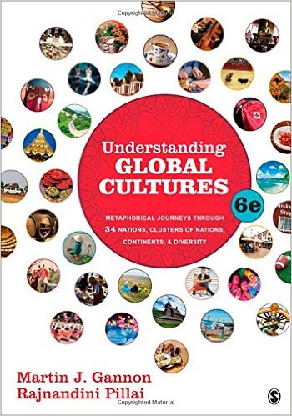
Start deck in “Slide Show” mode,
and use your up/down arrow keys and/or
your space bar to advance the slides
© 2010-2024 Timothy G. Roufs, University of Minnesota Duluth

Slide 2
REM
indicates that the materials
are a REMinder
and are thus being repeated . . .
REMinder

Slide 3
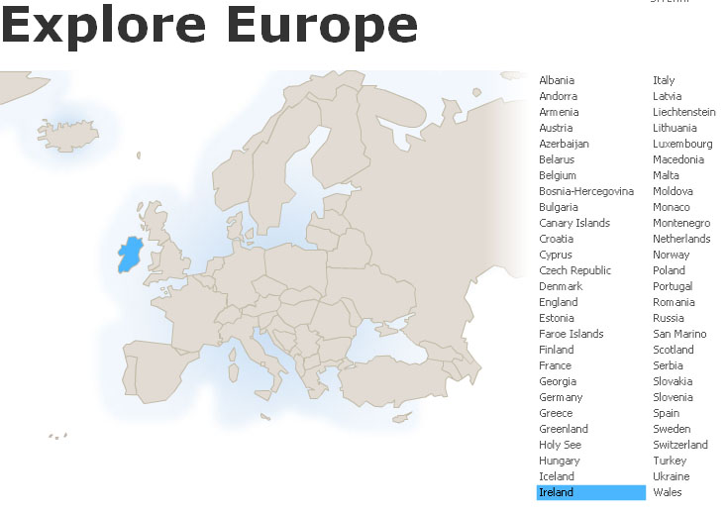
How to find links to
Information
on
Countries
around the World . . .
Global Cultures
University of Minnesota Duluth
Tim Roufs © 2010-2024

Slide 4
on the course WebPages there are many links to
information on “countries, cultures, regions, areas and territories . . .”
around the world

Slide 5
and one or more of these
might prove interesting, and useful with your class project

Slide 6
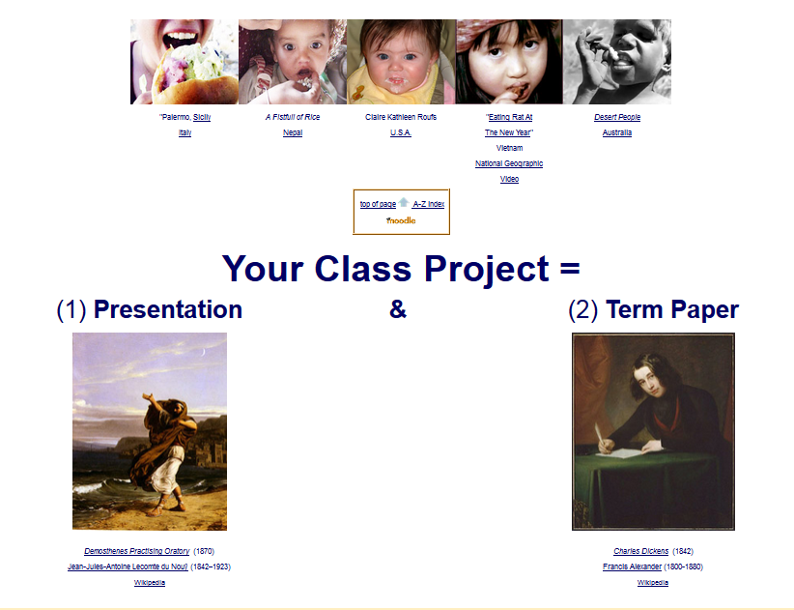
In addition, the A - Z information should also be very useful when it comes time to start thinking about your class project

Slide 7
you can just click on
the A-Z index in your Canvas home to find the country or culture you’re interested in . . .
click “A” for “Afghanistan” . . . “W” for “Wallonia (Belgium)”

Slide 8
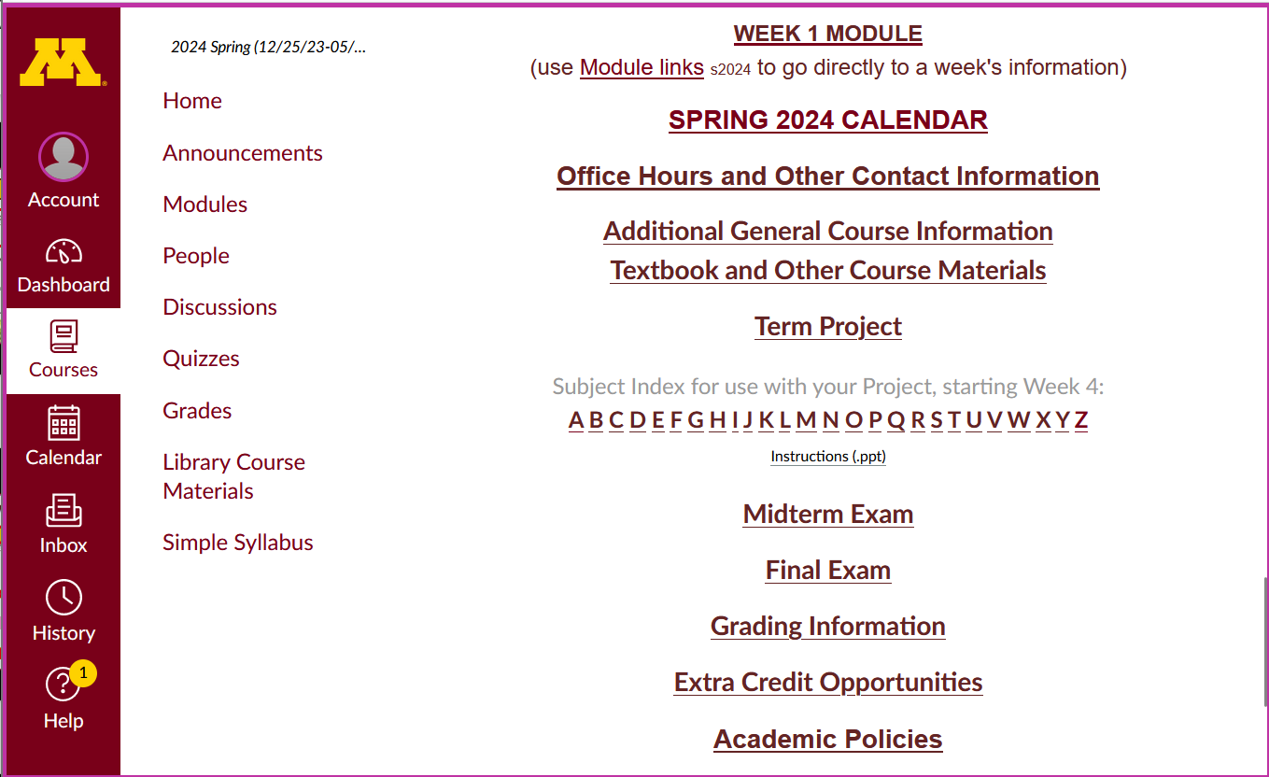
They will be useful later on with your project . .
A-Z Subject Index links

Slide 9
click “A” for “Afghanistan” . . .

Slide 10
click “W” for “Wallonia” (in Belgium) . . .

Slide 11
and so forth . . .

Slide 12
or you can click on “C” and then go to lists of countries . . .

Slide 13
and there is a course WebPage listing all of the countries, cultures and areas available for this course . . .

Slide 14
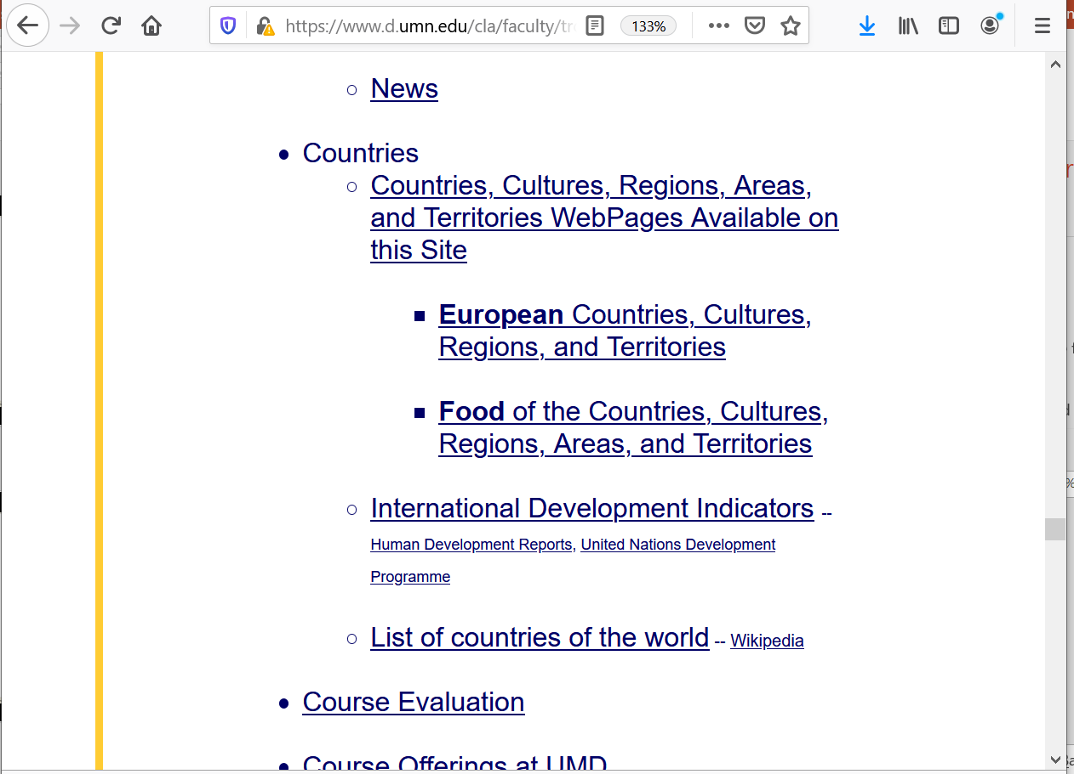
If you click on “C” and go to “Countries” you have three options:
ALL COUNTRIES that are available
EUROPEAN countries
FOOD LINKS on countries

Slide 15
for this course use the
first list,
the All COUNTRIES list . . .

Slide 17
to get to that course WebPage just click on the
“Countries / Cultures . . .” link in the middle section
of your Canvas Home Page . . .

Slide 18
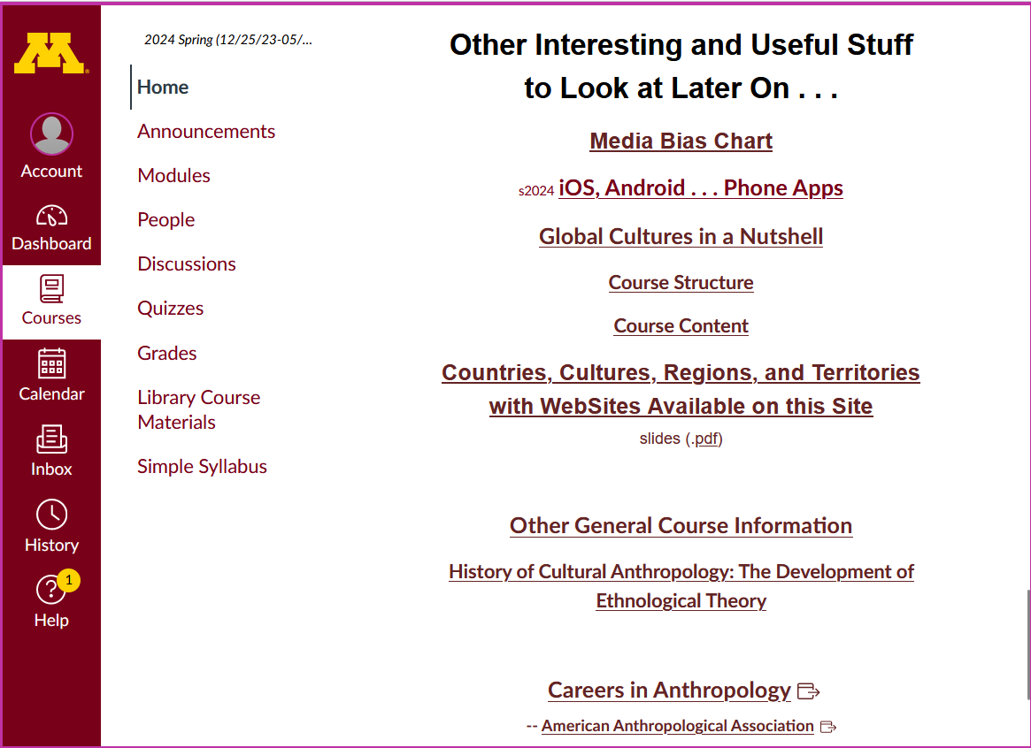

Slide 19
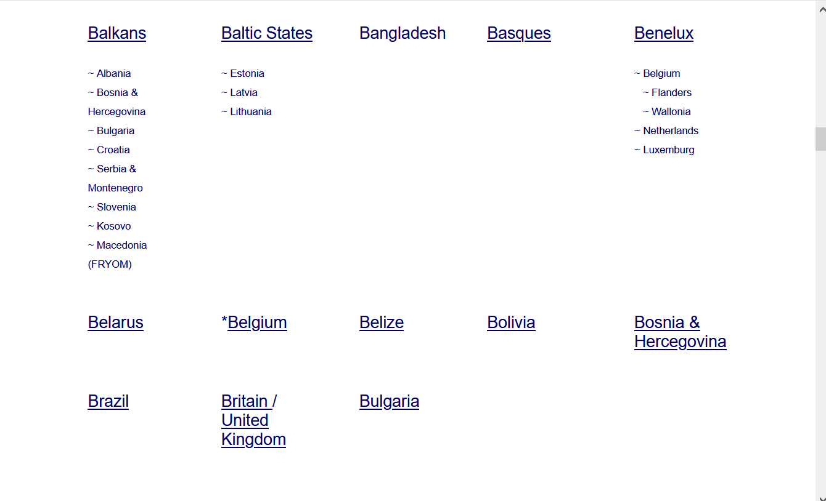
the countries page looks like this

Slide 20
scroll down for the individual countries . . .
or use the page A-Z . . . at the top of the page

Slide 21
scroll down for the individual countries . . .
or use the page A-Z . . . at the top of the page

Slide 22
where to go?

Slide 23
how about Belgium?

Slide 24
the first horse meat that I (knowingly) ate was in Belgium
the best restaurant meal that I have ever eaten was in
Bruges, Belgium
(“the most romantic city in the world”)
[these two events are unrelated]

Slide 25
the first horse meat that I (knowingly) ate was in Belgium
the best restaurant meal that I have ever eaten was in
Bruges, Belgium
(“the most romantic city in the world”)
[these two events are unrelated]

Slide 26
so let’s go to Belgium . . .

Slide 28
Belgium is divided (some say “split”) into three major cultural groups . . .

Slide 29
Waloons
Flemish
People in Brussels
Belgium is divided (some say “split”) into three major cultural groups . . .

Slide 30
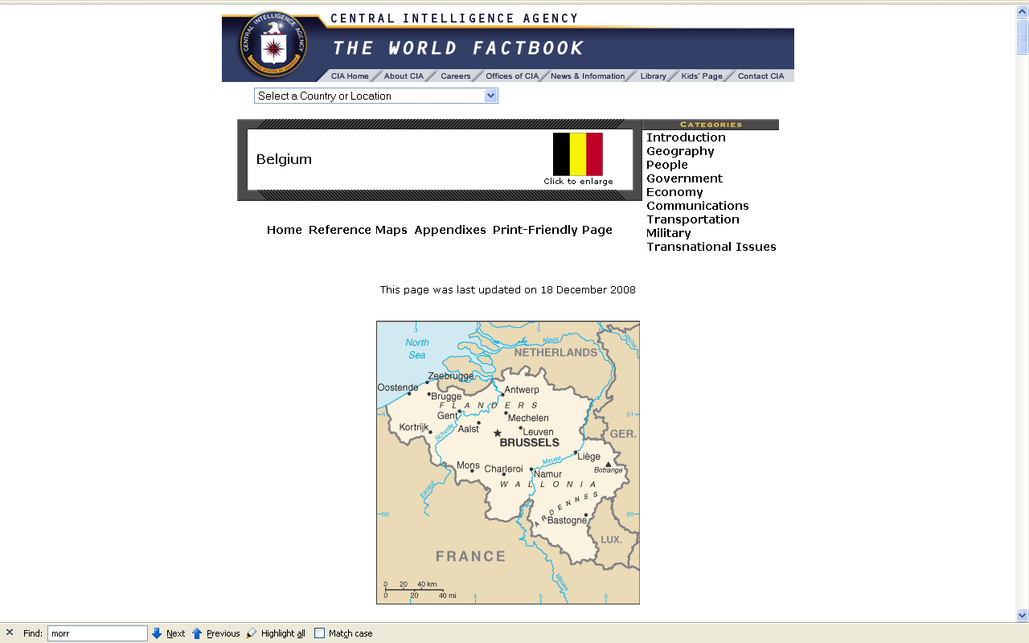
Waloonia
(French Speaking)
(Catholic)

Slide 31
Flanders
(Flemish Speaking)
(Catholic)

Slide 32
Brussels tends to operate as a separate “region”
(Multilingual)
(Catholic)

Slide 33
click on “Belgium” to start your trip

Slide 34
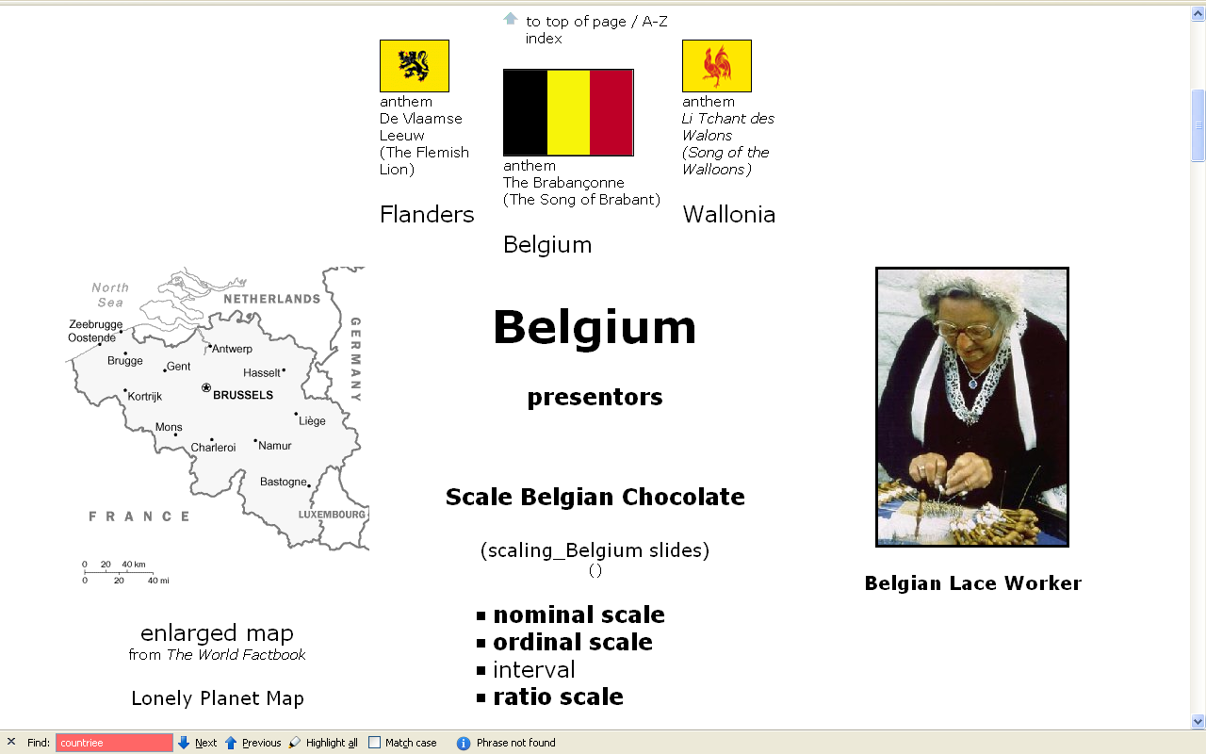

Slide 35
note the three divisions:
Belgium (the country)
Flanders
Wallonia

Slide 36
Belgium, as well as the rest of the sites listed in the textbook have a list of primary resources (useful for your class project) listed prominently towards the top of their pages . . .

Slide 37
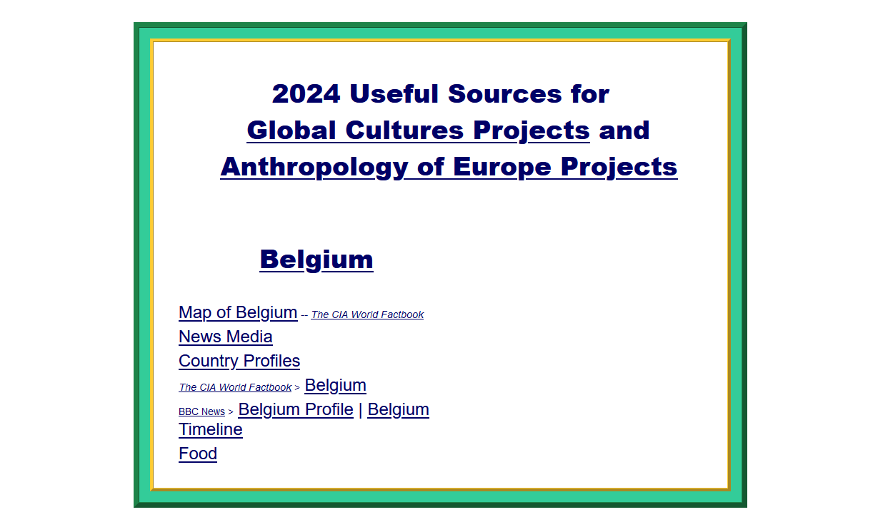
Towards the top of a country’s listings there is a handy set of links to food, news, maps, and profiles . . .

Slide 38
And there are a lots of interesting and fun things to learn about the countries.
In Belgium, for e.g. . . .

Slide 39
Food Trivia 1:
in Belgium there is no such thing as a “Belgian waffle”

Slide 40
Food Trivia 2:
but there is a “Brussels sprout”

Slide 41
“Brussels sprouts as we now know them were grown possibly as early as the 1200s in what is now Belgium”.
Wikipedia

Slide 42
Format Factoid: This is the way most Europeans punctuate a “full stop” at the end of a sentence with a quotation mark
in the U.S.A. it is conventionally just the reverse
“Brussels sprouts as we now know them were grown possibly as early as the 1200s in what is now Belgium”.
Wikipedia

Slide 43
Food Trivia 3:
“french fries”
are
French-speaking
Belgium fare,
not French . . .

Slide 44
Food Trivia 3:
“french fries”
are
French-speaking
Belgium fare,
not French . . .
Format Factoid:
“french fries” is not capitalized

Slide 45
Food Trivia 3:
“french fries”
are
French-speaking
Belgium fare,
not French . . .

Slide 46
(. . . a fact most American national politicians apparently were ignorant of when they once voted to serve only “freedom fries” in Washington when France wouldn’t support the second war in Iraq . . .)

Slide 47
. . . but more to the point, speaking of “french” fries, what’s in a name anyway?
Some folks love “escargot”, aka “snails”,
but wouldn’t think of eating “slugs”, even if they were “freedom slugs” . . .

Slide 48
. . . but more to the point, speaking of “french” fries, what’s in a name anyway?
some folks love “escargot”, aka in English as “snails”,
but wouldn’t think of eating “slugs”, even if they were “freedom slugs” . . .

Slide 49
. . . but more to the point, speaking of “french” fries, what’s in a name anyway?
some folks love “escargot”, aka in English as “snails”,
but wouldn’t think of eating “slugs”, even if they were “freedom slugs” . . .

Slide 50
. . . back to the other items on the Belgium page . . .

Slide 51
have a look at some of the many items on the page . . .
they tell you a lot about the country
for e.g., note that Belgium has
three national anthems as well as three flags

Slide 52
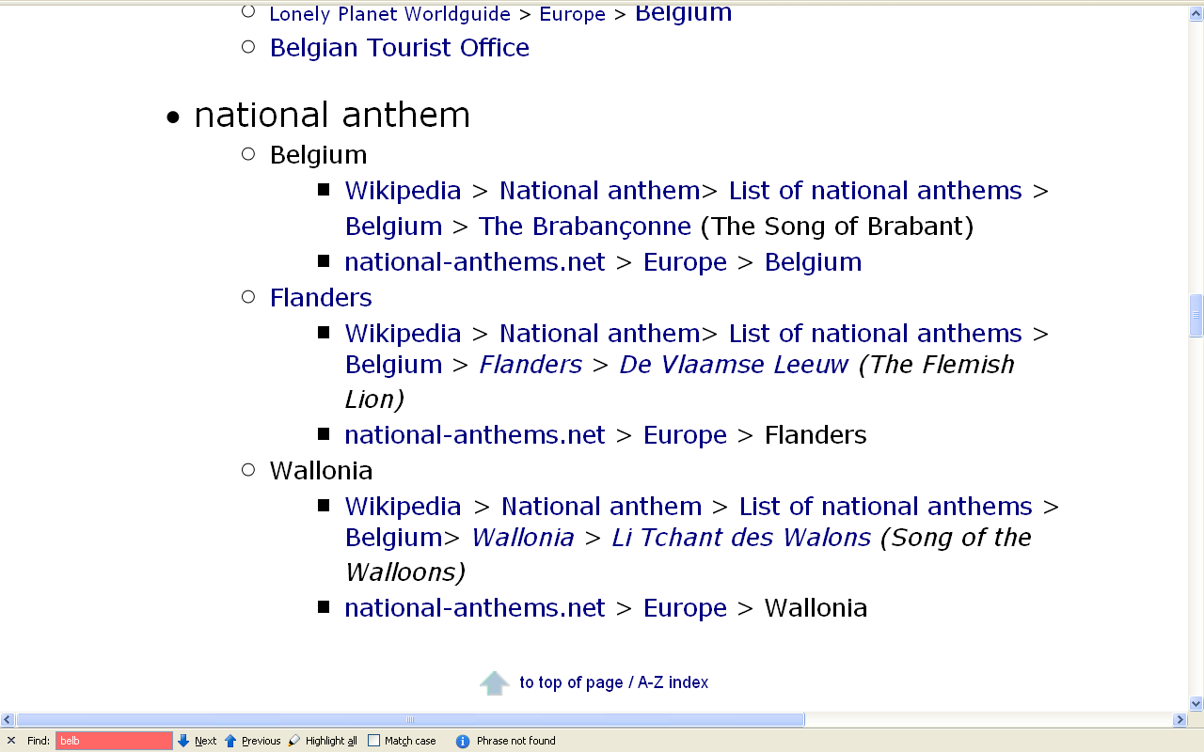
. . . the major regions . . .

Slide 53
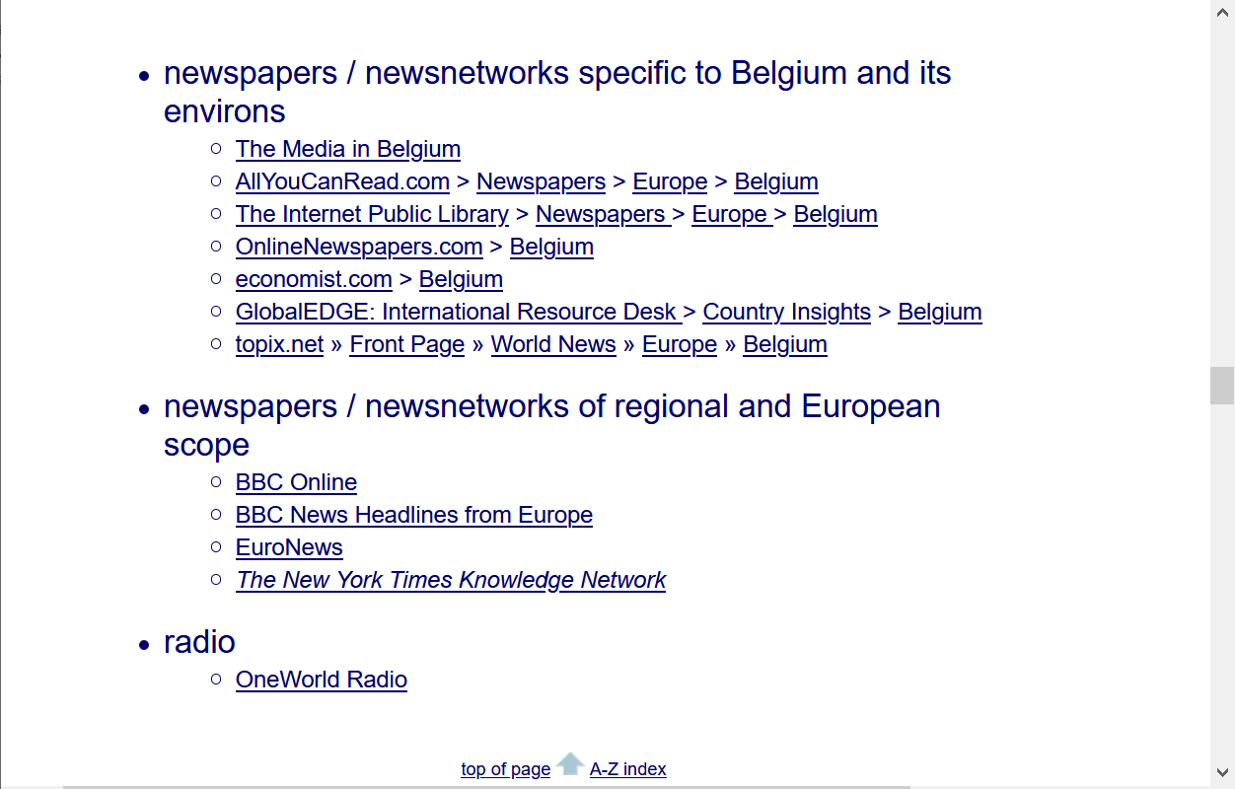
. . . about news and the media . . .

Slide 54
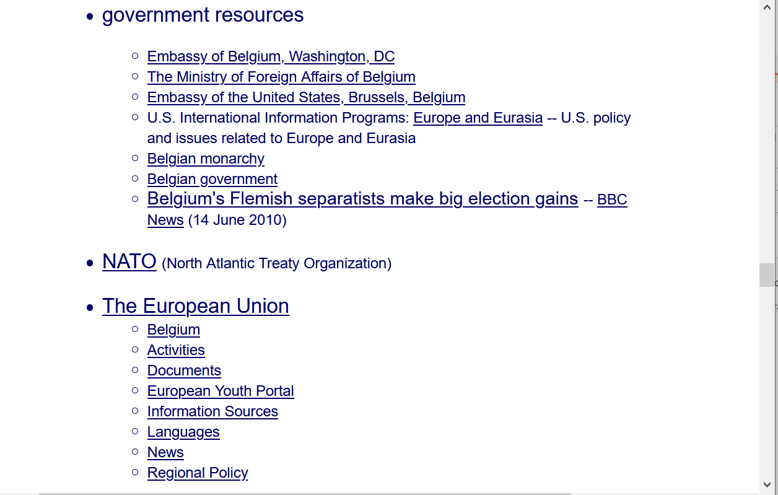
. . . about government and politics . . .

Slide 55
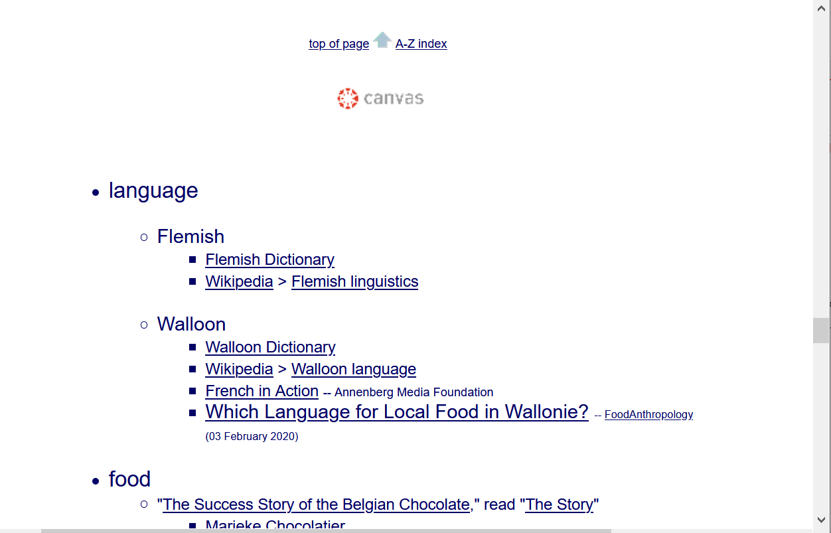
. . . about language . . .

Slide 56
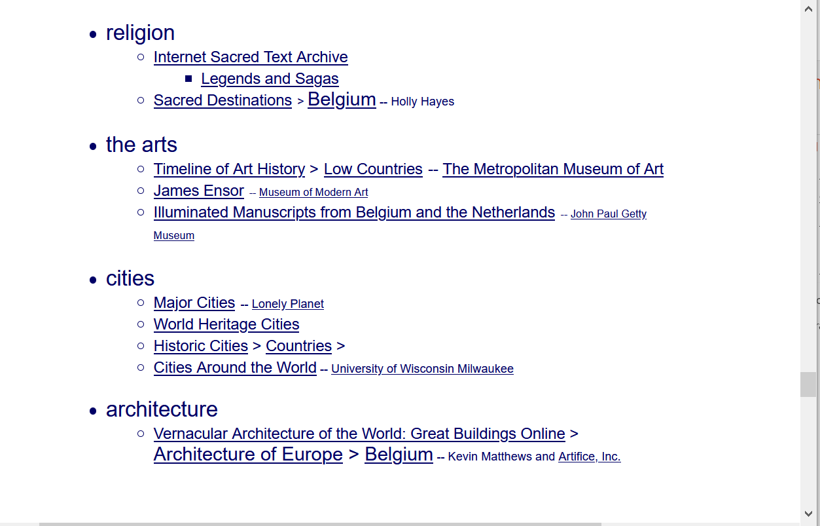
. . . about religion, the arts, and more . . .

Slide 57
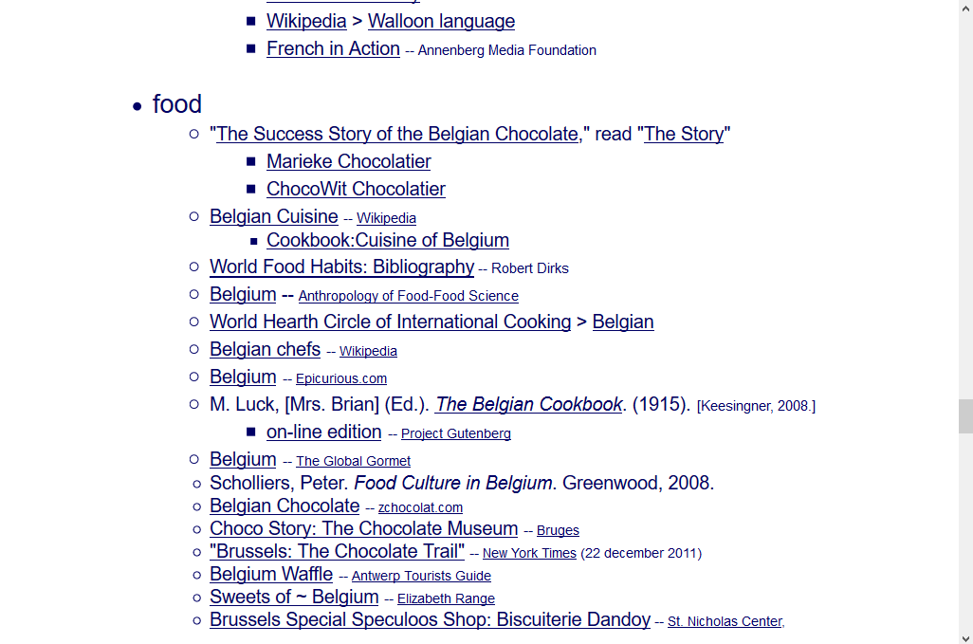
this is the food section of the Belgian class WebPage . . .
. . . about food . . .

Slide 58
this is the food section of the Belgian class WebPage . . .
in the food section, for e.g., you can find a lot of information on Belgium cuisine
. . .
and you might even note that they have some of the best chocolate in the world . . .
and that they DO love waffles
(but each region has their own style and name – what we call the “Belgium Waffle” is a “Brussels Waffle”)

Slide 59
this is the food section of the Belgian class WebPage . . .
in the food section, for e.g., you can find a lot of information on Belgium cuisine
. . .
and you might even note that they have some of the best chocolate in the world . . .
and that they DO love waffles
(but each region has their own style and name – what we call the “Belgium Waffle” is a “Brussels Waffle”)

Slide 60
this is the food section of the Belgian class WebPage . . .
in the food section, for e.g., you can find a lot of information on Belgium cuisine
. . .
and you might even note that they have some of the best chocolate in the world . . .
and that they DO love waffles
(but each region has their own style and name – what we call the “Belgium Waffle” is a “Brussels Waffle”)

Slide 61
this is the food section of the Belgian class WebPage . . .
what we call the “Belgian Waffle” is what they call the “Brussels Waffle” and it’s the style eaten in the Brussels area
other areas of Belgium have their own styles

Slide 62
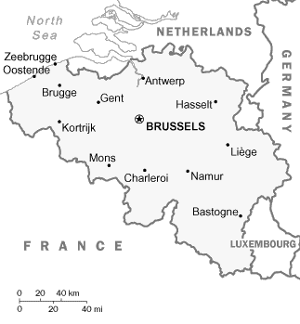
this is the food section of the Belgian class WebPage . . .
what we call the “Belgian Waffle” is what they call the “Brussels Waffle” and it’s the style eaten in the Brussels area
other areas of Belgium have their own styles

Slide 63
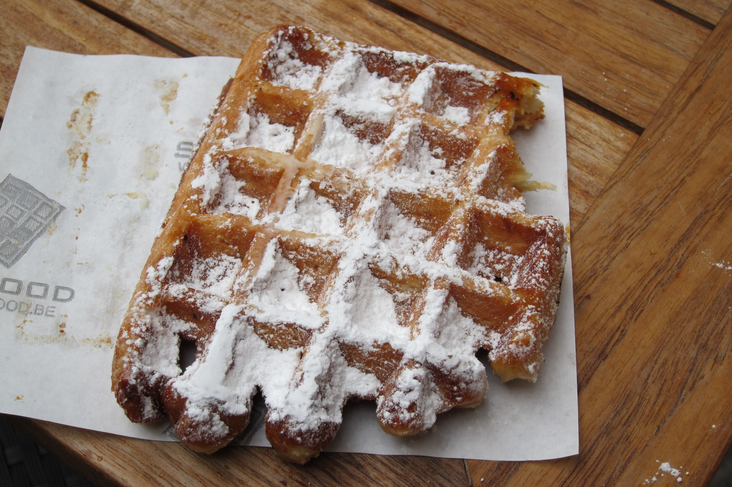
source

Slide 64
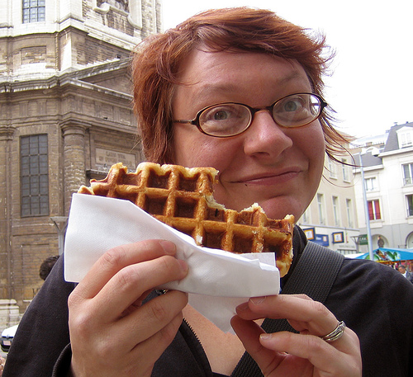
Eaten as you might eat a donut
source

Slide 65
this is the food section of the Belgian class WebPage . . .
what we call the “Belgian Waffle” is what they call the “Brussels Waffle” and it’s the style eaten in the Brussels area
other areas of Belgium have their own styles . . .

Slide 66
Liège waffle
(From the Walloon Region,
Belgium’s most popular)

Slide 67
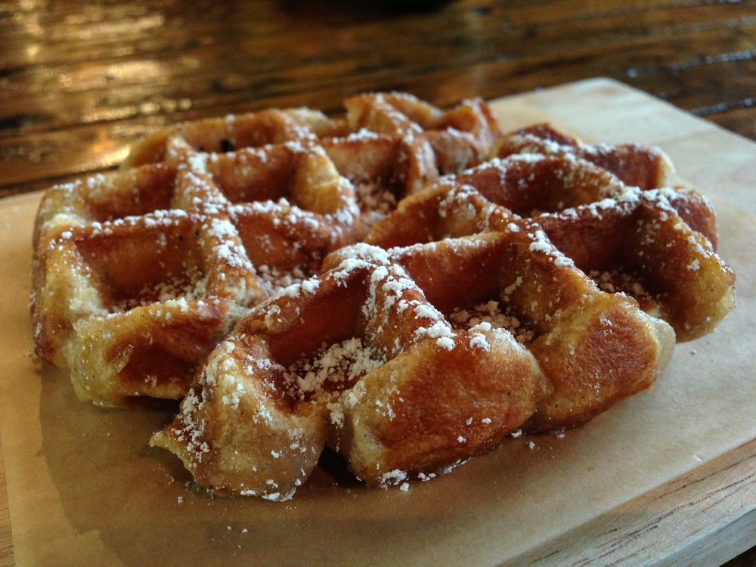
Liège waffle
(From the Walloon Region,
Belgium’s most popular)
source

Slide 68
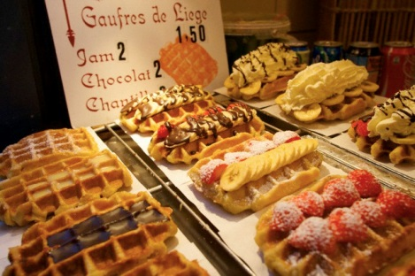
Source: Roufs and Roufs, Sweet Treats

Slide 69
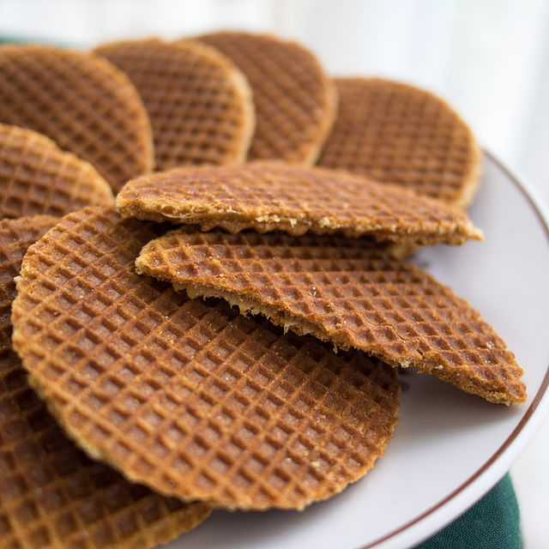
the popular Stroopwafels (syrup waffles)
were first made in Gouda, The Netherlands,
which is also famous for its cheese . . .
Source Wikipedia

Slide 70
Gouda
the popular Stroopwafels (syrup waffles)
were first made in Gouda, The Netherlands,
which is also famous for its cheese . . .

Slide 71
the term “Belgium Waffle” was invented as a marketing ploy to sell waffles to Americans at a World’s Fair in America

Slide 72
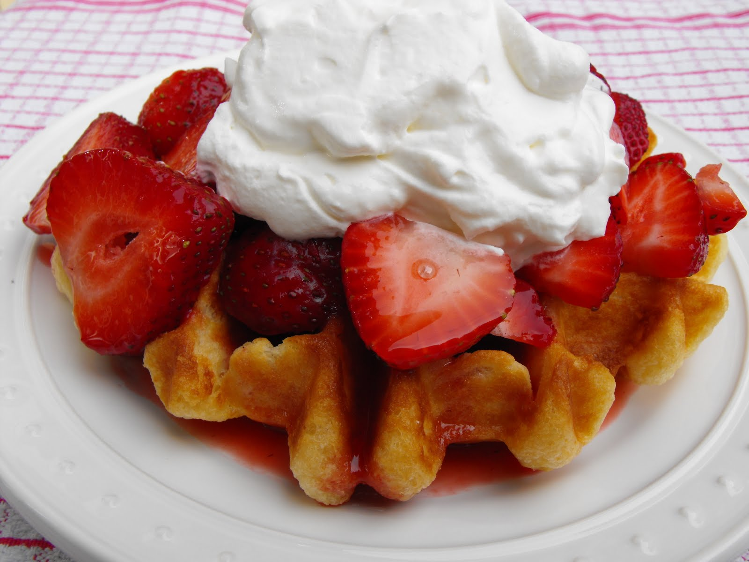
the term “Belgium Waffle” was invented in American
as a (very successful) marketing ploy . . .
source

Slide 73
this is the food section of the Belgian class WebPage . . .
you probably will not find too much on-line about it, but the horsemeat sausages are really wonderful . . .
Really . . .
wonderful.

Slide 74
this is the food section of the Belgian class WebPage . . .
you probably will not find too much on-line about it, but the horsemeat sausages are really wonderful . . .
really . . .
wonderful.

Slide 75
this is the food section of the Belgian class WebPage . . .
you probably will not find too much on-line about it, but the horsemeat sausages are really wonderful . . .
really . . .
wonderful.

Slide 76
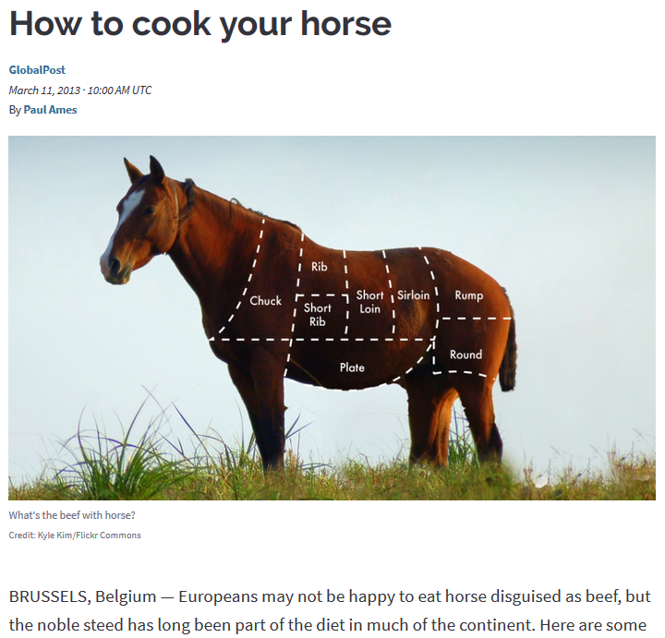
https://www.pri.org/stories/2013-03-11/how-cook-your-horse

Slide 77
. . . and at the bottom of each country page there is a collection of WebSites that could be useful for things like your class project . . .

Slide 78
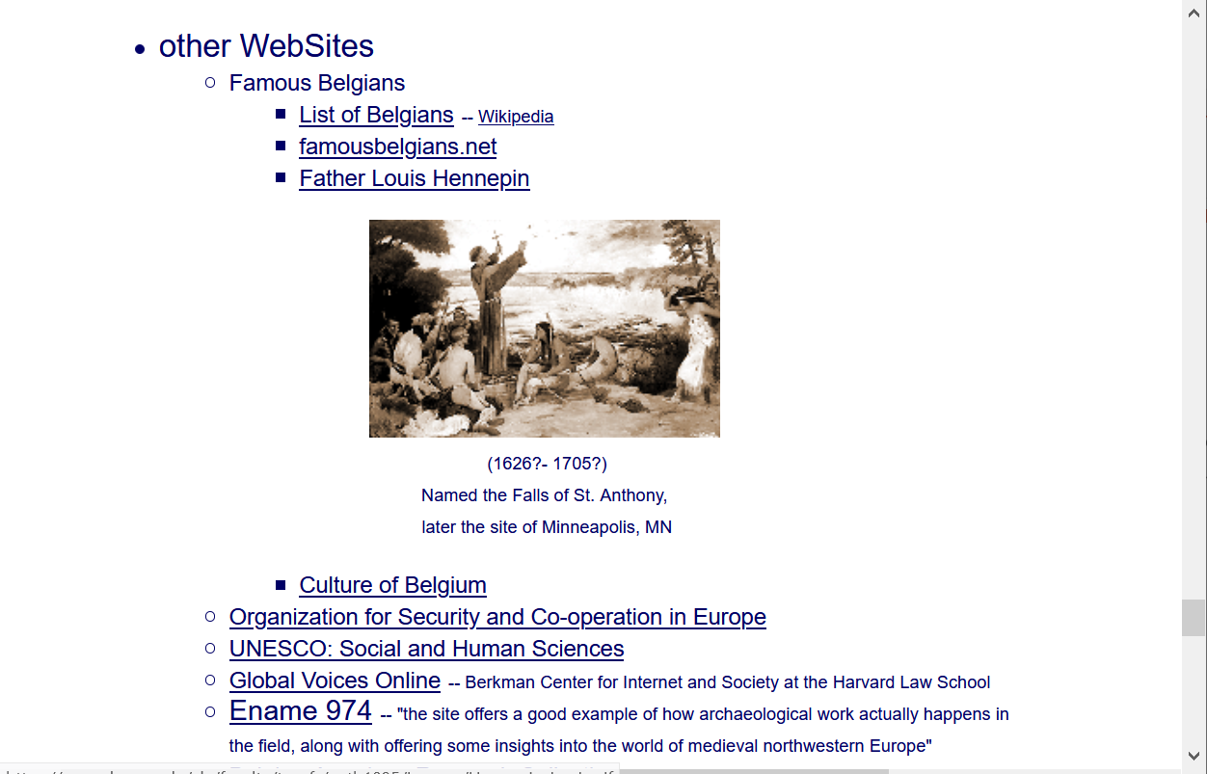
. . . links to other useful WebSites . . .

Slide 79
They will be useful later on with your project . .
or go to the country from your
A-Z index on your Canvas pages . . .

Slide 80
REM
A-Z Subject Index Links

Slide 81
REM:
To go to any country (or region, or subject matter) simply go to the A-Z index at the top of any WebPage click on the first letter of the items you want . . . and
“Bob’s your Uncle. . . .”
REM

Slide 82
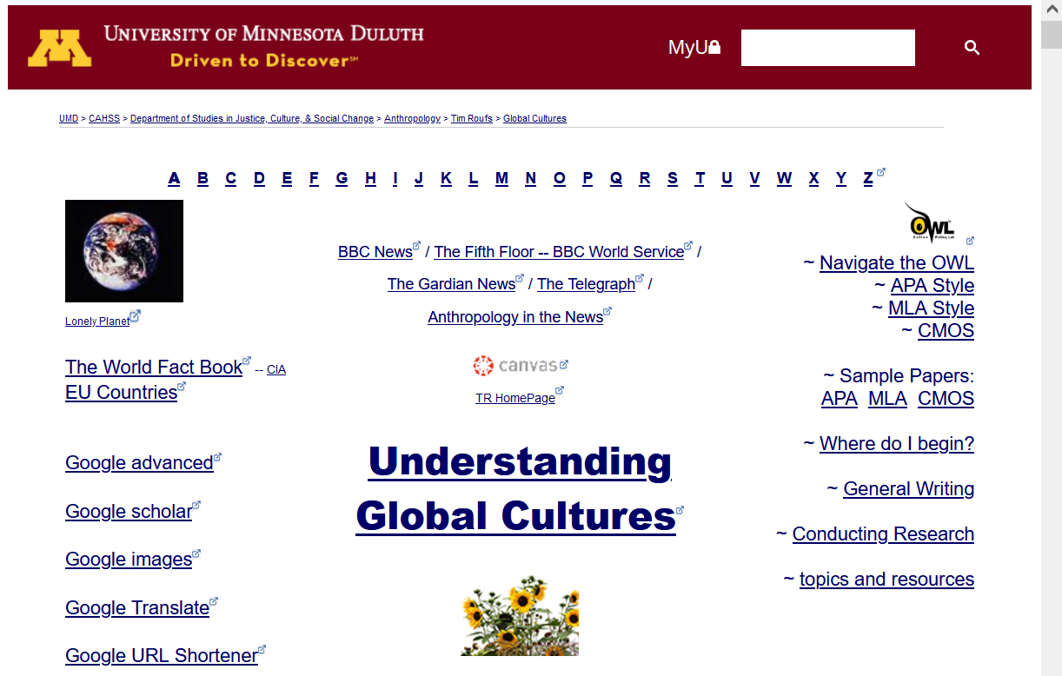
REM
A-Z Subject Index Links

Slide 83
Bon Appétit!

Slide 84
Bon Appétit!
The French-speaking Wallonians like to hear you talk like that

Slide 85
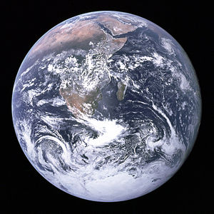
Use your imagination and
Explore
Countries and Cultures
around the World . . .

