Slide 1
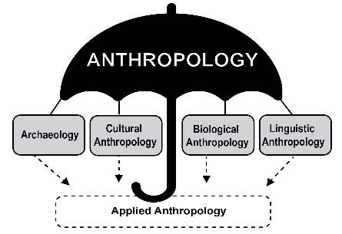
Use your up/down arrow keys and/or your space bar to see the slides
Tim Roufs
© 2021-2024
https://perspectives.pressbooks.com/chapter/introduction-to-anthropology/

Slide 2
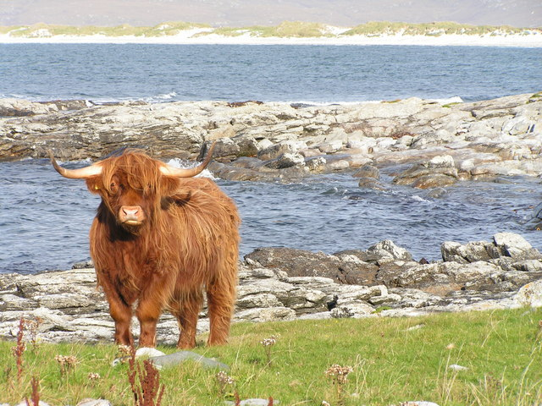
Holism
in
Anthropology
Global Cultures
University of Minnesota Duluth
Tim Roufs
© 2021-2024
http://en.wikipedia.org/wiki/Highland_cattle

Slide 3
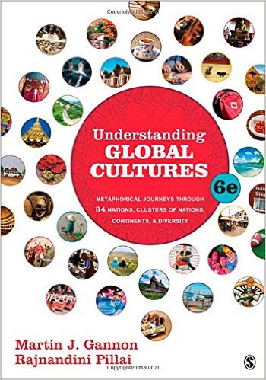
Holism
in
Anthropology
Global Cultures
University of Minnesota Duluth
Tim Roufs
© 2021-2024

Slide 4
American
Main Characteristics of Anthropology
˄
1. the four fields of general anthropology
culture as a primary concept
comparative method as major approach
holism as a primary theoretical goal
fieldwork as a primary research technique

Slide 5
American
Main Characteristics of˄Anthropology
1. the four fields of general anthropology
culture as a primary concept
comparative method as major approach
holism as a primary theoretical goal
fieldwork as a primary research technique

Slide 6
First let’s have a brief look at the other
Main Characteristics of Anthropology
1. the four fields of general anthropology
culture as a primary concept
comparative method as major approach
holism as a primary theoretical goal
fieldwork as a primary research technique

Slide 7
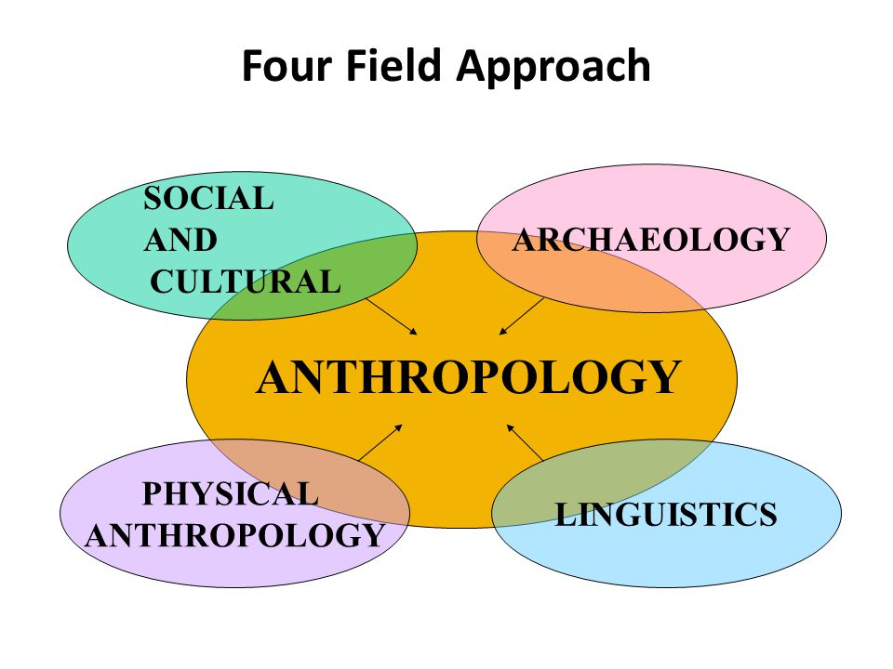
https://slideplayer.com/slide/2407456/9/images/66/Four+Field+Approach+SOCIAL+ARCHAEOLOGY+AND+CULTURAL+PHYSICAL.jpg

Slide 8
You’ll see the four field approach
in American Anthropology . . .
American Anthropology
cultural / social
physical
archaeology
linguistics

Slide 9
These are also
commonly known as . . .
sociocultural
biophysical
archaeological
linguistical

Slide 10
These are also
commonly known as . . .
sociocultural
biophysical
archaeological
linguistical

Slide 11
Main Characteristics of Anthropology
1. the four fields of general anthropology
culture as a primary concept
comparative method as major approach
holism as a primary theoretical goal
fieldwork as a primary research technique

Slide 12
Main Characteristics
“culture” is
  learned
  shared
  transmitted from generation to generation
  based on symbols
  integrated

Slide 13
The Concept of Culture
microculture
  are smaller groups with distinct pattern of learned and shared behavior and thinking found within larger cultures such as ethnic groups in localized regions
  some people like to think of these as
  “local cultures”

Slide 14
The Concept of Culture
microcultures can include ethnic groups within nations
  e.g., Greek-Americans
  e.g., Anishinabe (Chippewa; Ojibwa)
  e.g., Irish “Travellers”
    sometimes incorrectly called “Gypsies”
  e.g., Australian Aboriginals
  e.g., Cajun
  e.g., Rom (Gypsies)
  e.g., Basques
  e.g., Kurds

Slide 15
The Concept of Culture
local groups (microcultures)
generally strive to preserve their cultural identity with . . .
food
clothing
religion
ritual
music, dance, and other arts
language
cultural symbols . . .

Slide 16
The Concept of Culture
local groups (microcultures)
generally strive to preserve their cultural identity . . . for e.g., . . .
  Greek-Americans in Duluth
. . .

Slide 17
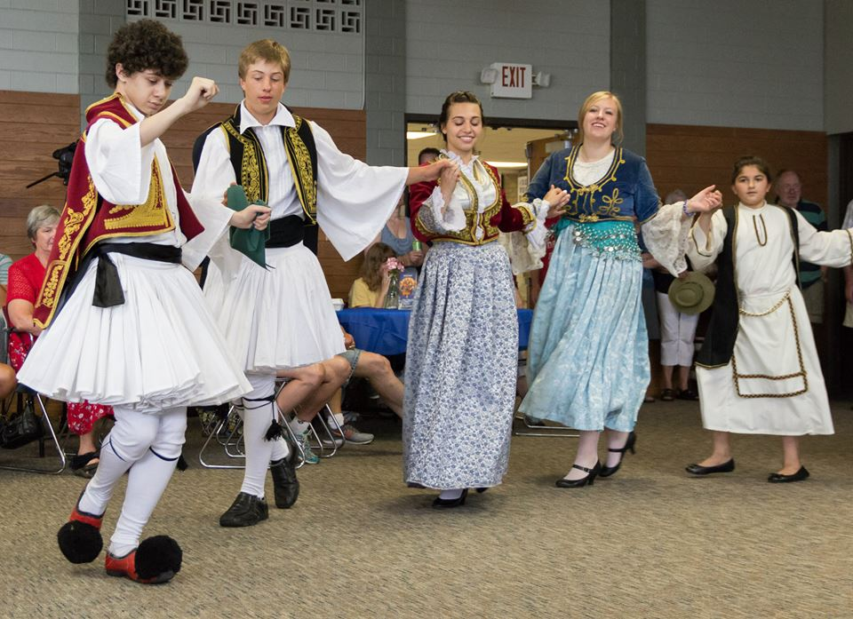
  Greek-Americans in Duluth
www.facebook.com/alexganeevphotography/photos/

Slide 18
Main Characteristics of Anthropology
1. the four fields of general anthropology
culture as a primary concept
comparative method as major approach
holism as a primary theoretical goal
fieldwork as a primary research technique

Slide 19
Compare . . .
Main Characteristics
comparative method
  as a major approach to the study of human behavior
  the comparative method compares things (what else would a “comparative” method do?)

Slide 20
Compare . . .
Main Characteristics
comparative method
  One form of comparative method was pioneered by Fred Eggan
  (University of Chicago)
“Social anthropology and
the method of controlled comparison”
  American Anthropologist, 56:743-61 (1954)

Slide 21
Compare . . .
Main Characteristics
comparative method
  One form of comparative method was pioneered by Fred Eggan
  (University of Chicago)
“Social anthropology and
the method of controlled comparison”
  American Anthropologist, 56:743-61 (1954)

Slide 22
Main Characteristics
comparative method
often, for e.g.,
folks compare things regionally in an attempt
to understand process

Slide 23
Compare . . .
Main Characteristics
comparative method
  Other methods . . .
process
essentially refers to
how things change
or
how things came to be
the way they are now
compare things regionally
in an attempt to understand process

Slide 24
Compare . . .
Main Characteristics
the comparative method compares things
for e.g. . . .
David Montgomery compares what happens when great civilizations around the world ignore problems they are having with top soil . . .
Spoiler: All failed

Slide 25
Compare . . .
Main Characteristics
the comparative method compares things
for e.g. . .
David Montgomery compares what happens when great civilizations around the world ignore problems they are having with top soil . . .
Spoiler: All failed

Slide 26

Mesopotamia
China
North America
South America
Europe
Asia
Africa
Pacific Islands
Berkeley: University of California, 2012
http://www.amazon.com/Empires-Food-Feast-Famine-Civilizations/dp/1582437939/ref=sr_1_1?ie=UTF8&qid=1452654498&sr=8-1&keywords=empires+of+food

Slide 27
Compare . . .
Main Characteristics
the comparative method compares things
for e.g. . . .
David Montgomery compares what happens when great civilizations around the world ignore problems they are having with top soil . . .
Spoiler: All failed

Slide 28
Compare . . .
Main Characteristics
the comparative method compares things
for e.g. . . .
In a similar manner Evan D. Fraser and Andrew Rimas compare
Feast, Famine, and the Rise and Fall of Civilizations
around the world. . .

Slide 29

Mesopotamia
China
North America
South America
Europe
Asia
Africa
Pacific Islands
Berkeley: Counterpoint, 2012:
http://www.amazon.com/Empires-Food-Feast-Famine-Civilizations/dp/1582437939/ref=sr_1_1?ie=UTF8&qid=1452654498&sr=8-1&keywords=empires+of+food

Slide 30
Compare . . .
Main Characteristics
the comparative method compares things
for e.g. . . .
In a similar manner Barry Popkin compares lifestyle changes
around the world and how those changes have affected body composition (i.e., increased obesity rates). . .

Slide 31
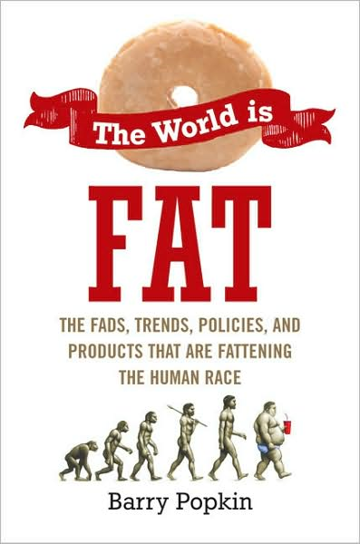
The Popkin, 1950s
“typical multigenerational American family”
and 3 children
Superior, WI, U.S.A.
The “Jones, ” 2006
and 2 children
Suburban Cleveland, U.S.A.
Cesar and Ana Garcia
and 4 children
Immigrant Mexicans from Chiapas Mexico
Suburban Los Angeles
Rahul Desai and His Wife
and 4 children
Uttar Pradesh, Northern India
Gopal and Noopur Patel
and 3 children
Uttar Pradesh, Northern India
studied how lifestyle changes over the long term have affected the body composition of
Americans
80,000+ and 20,000
Chinese
22,000+
200+ communities
Russians
11,000+
300+ communities
Brazilians
Filipinos
Penguin Avery, 2009

Slide 32
The Popkin, 1950s
“typical multigenerational American family”
and 3 children
Superior, WI, U.S.A.
The “Jones, ” 2006
and 2 children
Suburban Cleveland, U.S.A.
Cesar and Ana Garcia
and 4 children
Immigrant Mexicans from Chiapas Mexico
Suburban Los Angeles
Rahul Desai and His Wife
and 4 children
Uttar Pradesh, Northern India
Gopal and Noopur Patel
and 3 children
Uttar Pradesh, Northern India
studied how lifestyle changes over the long term have affected the body composition of
Americans
80,000+ and 20,000
Chinese
22,000+
200+ communities
Russians
11,000+
300+ communities
Brazilians
Filipinos
including Superior, WI
(his home town)
Penguin Avery, 2009

Slide 33
American
Main Characteristics of˄Anthropology
1. the four fields of general anthropology
culture as a primary concept
comparative method as major approach
holism as a primary theoretical goal
fieldwork as a primary research technique

Slide 34
Main Characteristics of Anthropology
1. the four fields of general anthropology
culture as a primary concept
comparative method as major approach
holism
or the study of "humankind" as a whole, as a primary theoretical goal
fieldwork as a primary research technique

Slide 35
holism tries to put all of the pieces together . . .
American Anthropology
cultural / social
physical (bio-physical)
archaeology
linguistics

Slide 36
An excellent example of trying to understand things holistically comes from Finland . . .

Slide 37

Finland is switching their
entire school curriculum to
holistic studies . . .
https://brightside.me/wonder-curiosities/finland-will-become-the-first-country-in-the-world-to-get-rid-of-all-school-subjects-259910/

Slide 38
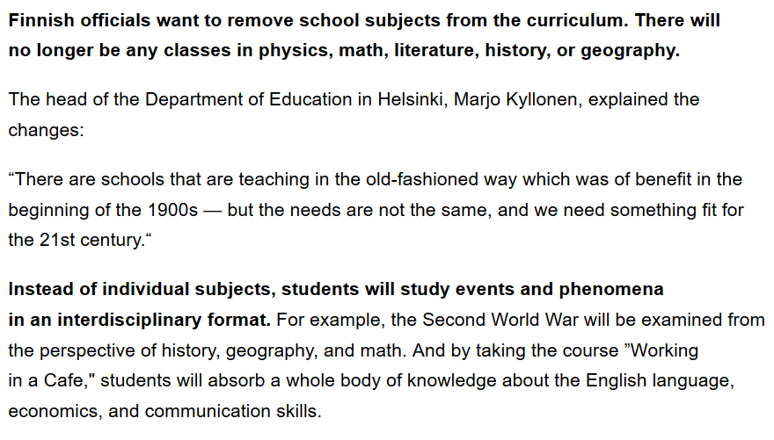
https://brightside.me/wonder-curiosities/finland-will-become-the-first-country-in-the-world-to-get-rid-of-all-school-subjects-259910/

Slide 39
In Anthropology
HOLISM
involves all four levels
and all
of the physical and
cultural (or behavioral)
components combined . . .

Slide 40
A simple example . . .

Slide 41
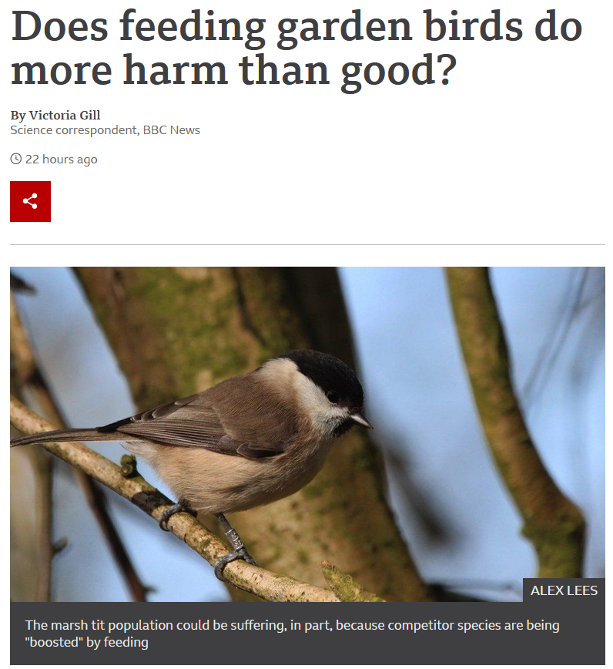

27 August 2021
https://www.bbc.com/news/science-environment-58346043

Slide 42
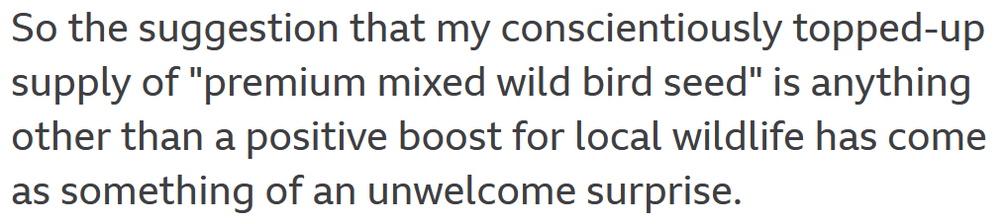
27 August 2021
https://www.bbc.com/news/science-environment-58346043

Slide 43
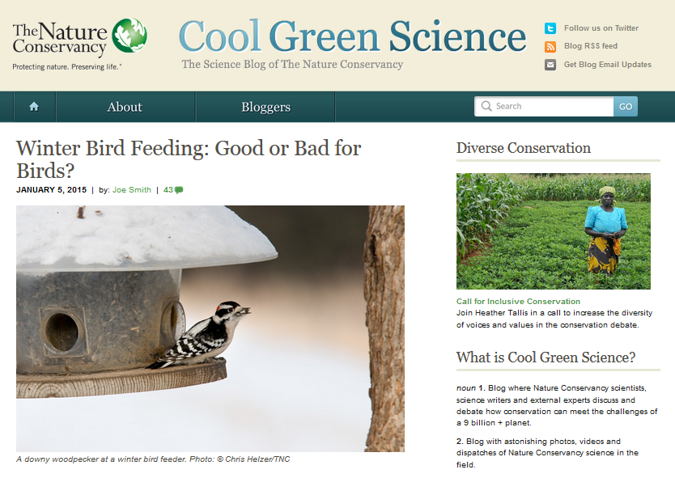
http://blog.nature.org/science/2015/01/05/winter-bird-feeding-good-or-bad-for-birds/

Slide 44
Is it good to feed the winter birds?
Yes . . .
for the reasons one might suspect . . .
http://blog.nature.org/science/2015/01/05/winter-bird-feeding-good-or-bad-for-birds/

Slide 45
Is it good to feed the winter birds?
Yes . . .
for the reasons one might suspect . . .
A simple answer . . .
http://blog.nature.org/science/2015/01/05/winter-bird-feeding-good-or-bad-for-birds/

Slide 46
Is it good to feed the winter birds?
Yes . . .
for the reasons one might suspect . . .
http://blog.nature.org/science/2015/01/05/winter-bird-feeding-good-or-bad-for-birds/

Slide 47
Is it good to feed the winter birds?
More than 40 percent of U.S. households feed their backyard birds, and in the United Kingdom, the rate is as high as 75 percent.
A study conducted during winter in Wisconsin showed that black-capped chickadees with access to bird seed had a much higher overwinter survival rate (69 percent) as compared to those without access to human-provided seed (37 percent survival
Furthermore, some studies have shown that birds making it through the winter in better physical condition see those benefits carry over into the nesting season
Bird feeding produces significantly earlier egg laying dates, larger clutches of eggs, higher chick weights and higher overall breeding success across a wide range of bird species
http://blog.nature.org/science/2015/01/05/winter-bird-feeding-good-or-bad-for-birds/

Slide 48
Is it good to feed the winter birds?
Yes . . .
for the reasons one might suspect . . .
BUT . . .
let’s look at the question from the anthropological
holistic
point of view . . .
http://blog.nature.org/science/2015/01/05/winter-bird-feeding-good-or-bad-for-birds/

Slide 49
Is it good to feed the winter birds?
Yes . . .
for the reasons one might suspect . . .
BUT . . .
let’s look at the question from the anthropological
holistic
point of view . . .
http://blog.nature.org/science/2015/01/05/winter-bird-feeding-good-or-bad-for-birds/

Slide 50
Is it good to feed the winter birds?
Yes . . .
for the one might suspect . . .
A holistic view would also consider . . .
http://blog.nature.org/science/2015/01/05/winter-bird-feeding-good-or-bad-for-birds/

Slide 51
Is it good to feed the winter birds?
feeding can promote the survival and reproduction of the not-quite-fittest
one research group found that birds fed during winter subsequently laid a smaller number of eggs that had lower hatching success and ultimately fledged fewer young than birds that weren’t fed at all
the offspring that did fledge weighed less and had a lower survival rate than the young of unfed birds
http://blog.nature.org/science/2015/01/05/winter-bird-feeding-good-or-bad-for-birds/

Slide 52
Is it good to feed the winter birds?
both species [in two U.K. studies], when they had access to bird food, laid fewer eggs, had lower hatching success, and ultimately had fewer chicks fledged
feeding an irresistible diet that was unbalanced – too high in fat to produce high-quality eggs
http://blog.nature.org/science/2015/01/05/winter-bird-feeding-good-or-bad-for-birds/

Slide 53
Is it good to feed the winter birds?
bird feeding allowed individuals with a lower reproductive capacity which ordinarily would not survive the winter the chance to nest
the feeders may be in poor quality nesting habitat – leading the birds to choose these suboptimal sites as nesting areas in the spring
http://blog.nature.org/science/2015/01/05/winter-bird-feeding-good-or-bad-for-birds/

Slide 54
Is it good to feed the winter birds?
So from the holistic view, one must look at things like the impacts of bird feeding not only on the survival
of the birds fed,
but also on things like . . .
http://blog.nature.org/science/2015/01/05/winter-bird-feeding-good-or-bad-for-birds/

Slide 55
Is it good to feed the winter birds?
  overall reproductive success
  other factors such as disease transmission
  species range expansion
  population trajectories
  and the long-range evolutionary effects on the species
http://blog.nature.org/science/2015/01/05/winter-bird-feeding-good-or-bad-for-birds/

Slide 56
So what to do . . . ?

Slide 57
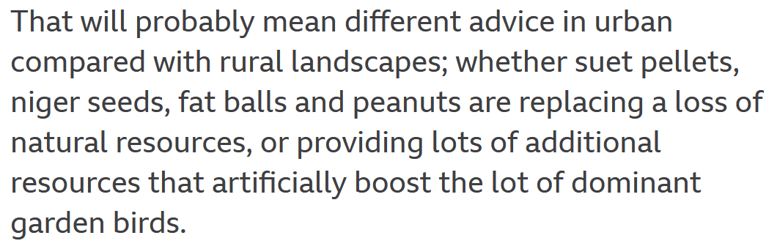
27 August 2021
https://www.bbc.com/news/science-environment-58346043

Slide 58
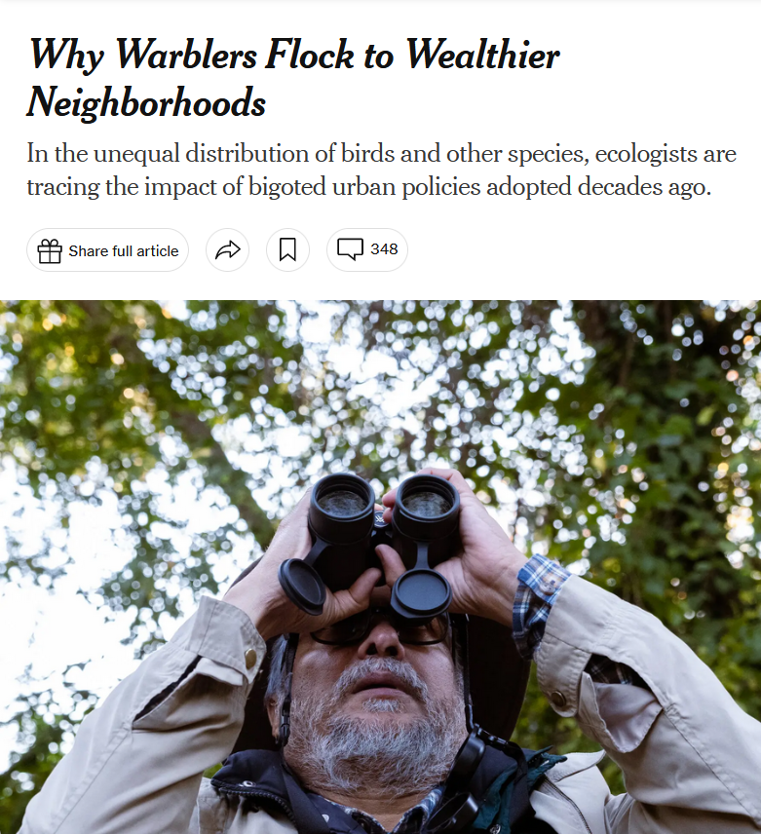
*Why Warblers Flock to Wealthier Neighborhoods (21 November 2023)

Slide 59
Looking at the bird situation even more holistically, other studies show that urban birds are also better off (genetically and otherwise) living in wealthier neighborhoods than living in poorer neighborhoods . . . .
*Why Warblers Flock to Wealthier Neighborhoods (21 November 2023)

Slide 60
Urban birds, like people, are better off in more prosperous neighborhoods than in poor and marginal areas as “patterns of income inequality . . . carry over to influence urban biodiversity” as human inequality creates barriers to wildlife movement.
*Why Warblers Flock to Wealthier Neighborhoods (21 November 2023)

Slide 61
“. . . Like a wall or a highway, systemic racism creates a barrier to wildlife movement.”*
In many communities, “The birds were ‘an indicator of these broader conditions that are effectively bad for people.’”*
*Why Warblers Flock to Wealthier Neighborhoods (21 November 2023)

Slide 62
another simple,
but important,
example . . .

Slide 63
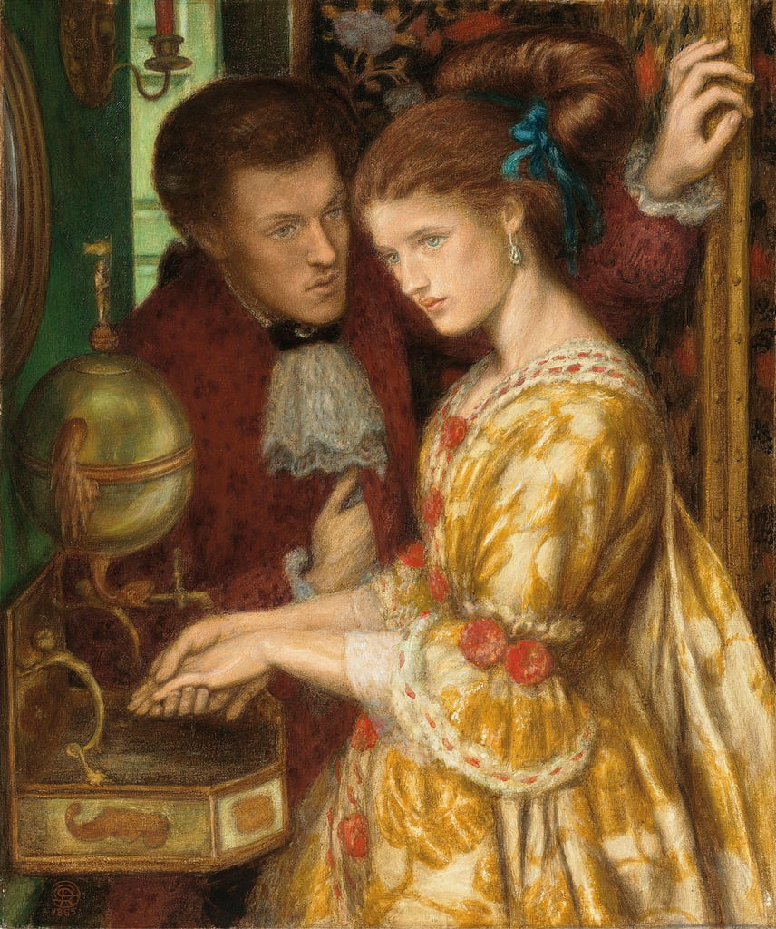
Washing Hands, 1865
Dante Gabriel Rossetti (1828–1882)
https://commons.wikimedia.org/wiki/File:Dante_Gabriel_Rossetti_-_Washing_Hands.jpg

Slide 64
With COVID-19 handwashing became a focused feature of life and most now recognize that handwashing in general is of tremendous importance for both the individual and for society in general . . .
http://www.bbc.com/news/health-40118539

Slide 65
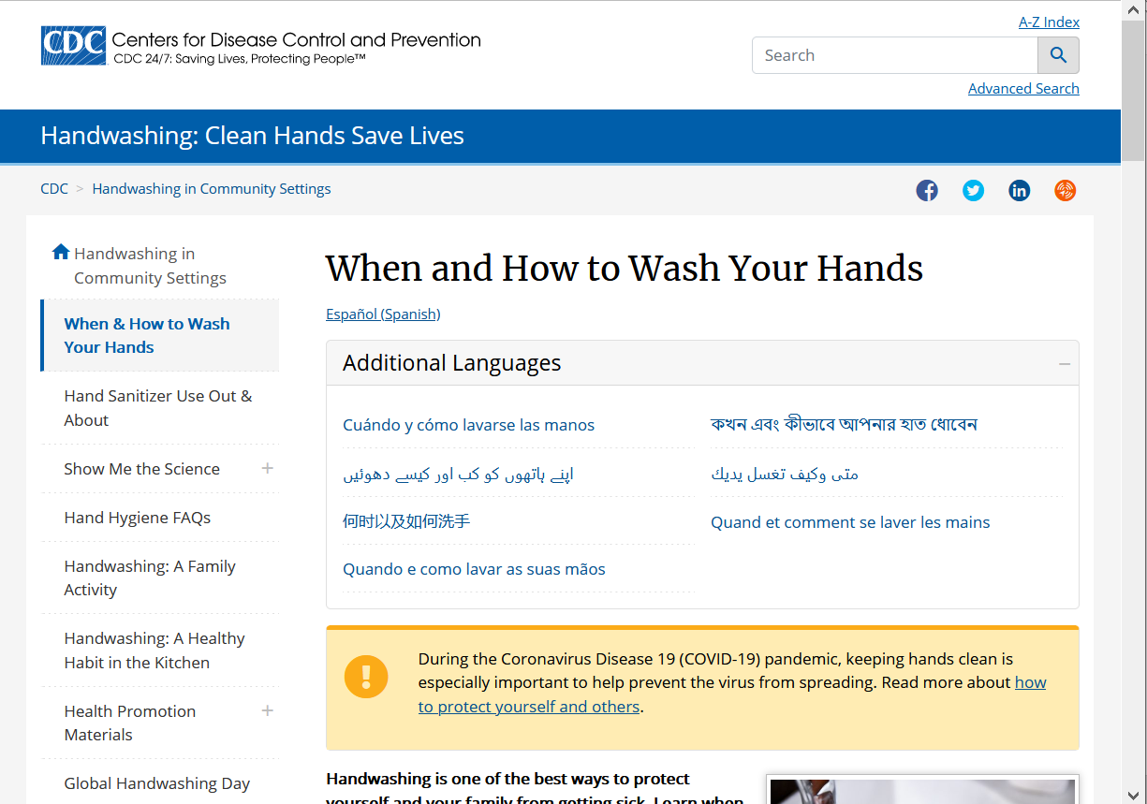
The U.S. CDC issues lots of instructions . . .
https://www.cdc.gov/handwashing/when-how-handwashing.html

Slide 66
Question:
Does it make any difference if you wash your hands with cold water or warm water?
http://www.bbc.com/news/health-40118539

Slide 67
Answer from Scientists:
?
Answer from Anthropologists:
?
(REM: Anthropologists look at things holistically)
http://www.bbc.com/news/health-40118539

Slide 68
Answer from Scientists:
No
Answer from Anthropologists:
Yes
(REM: Anthropologists look at things holistically)
http://www.bbc.com/news/health-40118539

Slide 69
Answer from Scientists:
No
Answer from Anthropologists:
Yes
(REM: Anthropologists look at things holistically)
http://www.bbc.com/news/health-40118539

Slide 70
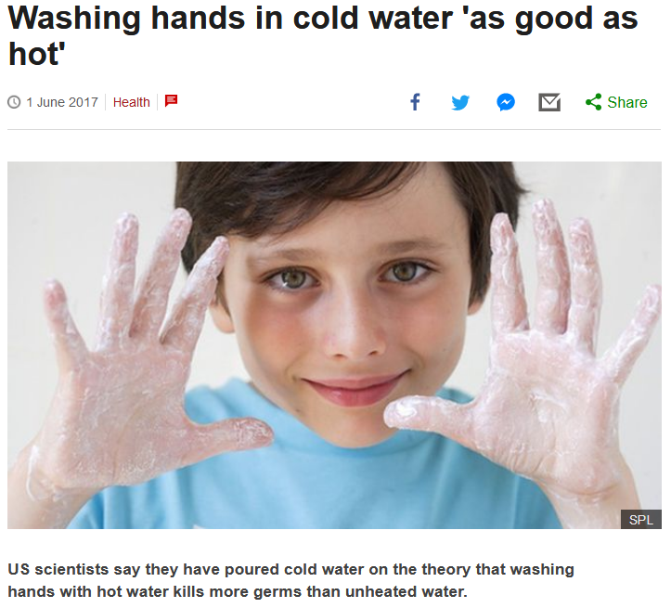


http://www.bbc.com/news/health-40118539

Slide 71
US scientists say they have poured cold water on the theory that washing hands with hot water kills more germs than unheated water.
http://www.bbc.com/news/health-40118539

Slide 72
Article:
“Quantifying the Effects of Water Temperature, Soap Volume, Lather Time, and Antimicrobial Soap as Variables in the Removal of Escherichia coli ATCC 11229 from Hands”
Dane A. Jensen, David R. Macinga, David J. Shumaker, Roberto Bellino, James W. Arbogast and Donald W. Schaffner
Journal of Food Protection, Volume 80, Issue 6 (June 2017), pp. 1022-1031.
http://jfoodprotection.org/doi/pdf/10.4315/0362-028X.JFP-16-370http://jfoodprotection.org/doi/pdf/10.4315/0362-028X.JFP-16-370

Slide 73
an anthropologist would look at the problem of water temperature holistically, and conclude that the water temperature DOES make a difference . . .
http://www.bbc.com/news/health-40118539

Slide 74
because length of time of washing hands
(like length of time
brushing one’s teeth)
is a key variable to overall effectiveness
. . .
http://www.bbc.com/news/health-40118539

Slide 75
because length of time of washing hands
(like length of time
brushing one’s teeth)
is a key variable to overall effectiveness
. . .
http://www.bbc.com/news/health-40118539

Slide 76

Dentists knew that all along . . .
Brusheez® Kid's Electric Toothbrush Set

Slide 77
. . . in other words, HUMAN BEHAVIOR
is a most-important
key variable
http://www.bbc.com/news/health-40118539

Slide 78
. . . and people tend to wash their hands longer if the water temperature is comfortably warm
http://www.bbc.com/news/health-40118539

Slide 79
even the scientists focusing on water temperature in the experiments note more or less in passing that human behavior is an important issue . . .
http://www.bbc.com/news/health-40118539

Slide 80
“A large part of the variability in the data was associated with the behaviors of the volunteers. Understanding what behaviors and human factors most influence hand washing may help researchers find techniques to optimize the effectiveness of hand washing.”
Dane A. Jensen, David R. Macinga, David J. Shumaker, Roberto Bellino, James W. Arbogast and Donald W. Schaffner
Journal of Food Protection, Volume 80, Issue 6 (June 2017), pp. 1022-1031.
http://jfoodprotection.org/doi/abs/10.4315/0362-028X.JFP-16-370http://jfoodprotection.org/doi/abs/10.4315/0362-028X.JFP-16-370

Slide 81
One more example . . .

Slide 82
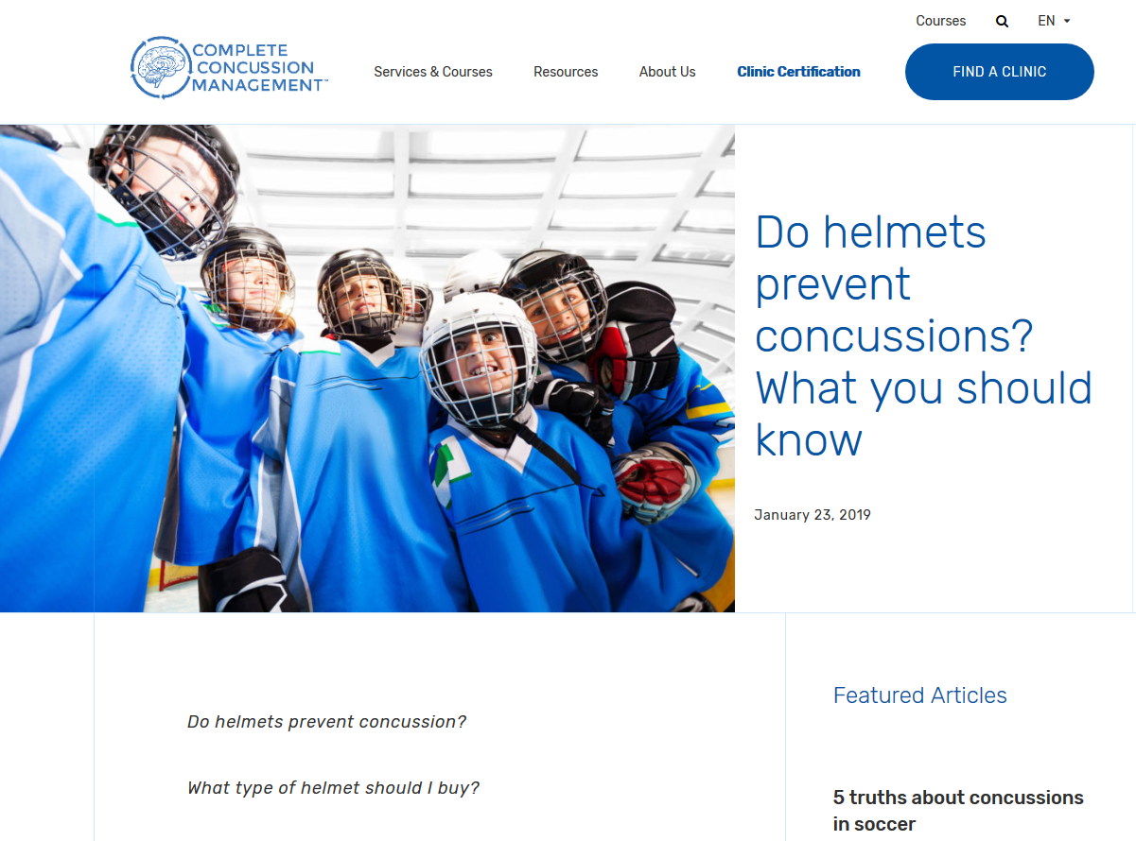

Slide 83
No . . .
Wearing helmets may actually result in more concussions because players assume that helmets help prevent concussions and thus take less care to prevent them . . .

Slide 84
Concussions are caused by acceleration or deceleration of the brain inside the skull . . .
Helmets on the outside of the skull do not mitigate that . . . and athletes think they can hit harder with the helmet on, and that can only increase the chances of a concussion . . .

Slide 85
It is more likely that if athletes were to
wear no helmets that the actual number of concussions would be reduced . . .

Slide 86
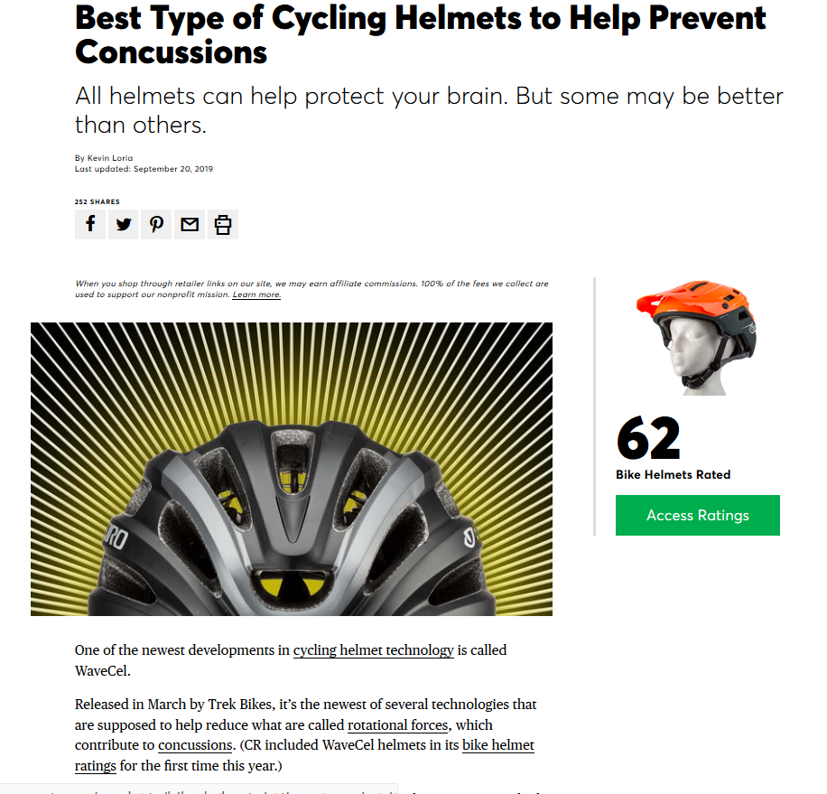
But wear a bike helmet to protect your head.
Wearing a bike helmet reduces the risk of serious head injury (to your skull) by about 70 percent.

Slide 87
with humans,
in anthropology,
holism looks at an item including the many subdisciplines in the areas of . . .

Slide 88
Holism tries to put all of the pieces together . . .
Global Cultures
and its . . .
cultural / social
physical
archaeology
linguistics
(bio-physical)

Slide 89
let’s have a look at that on the
“Anthropology and . . . Its Parts” chart . . .

Slide 90
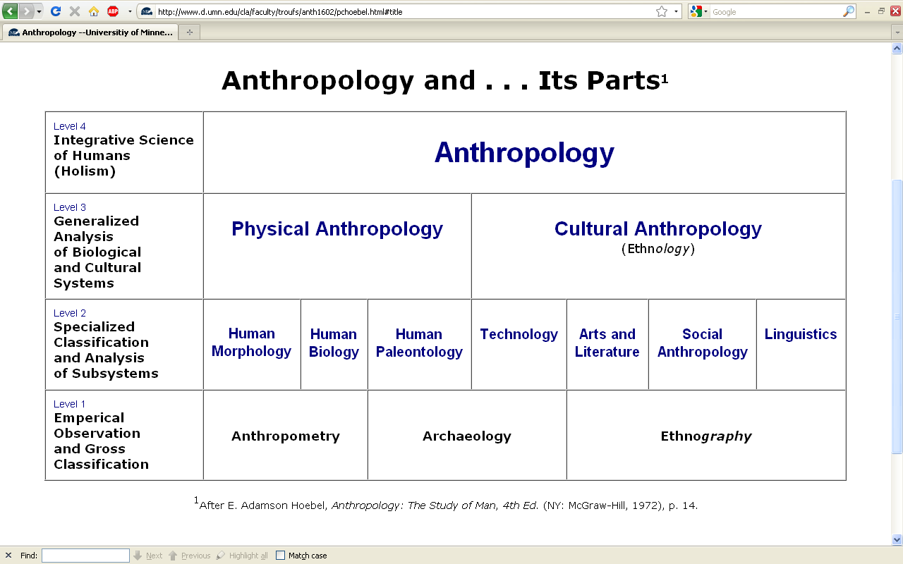
URL link to print: https://www.d.umn.edu/cla/faculty/troufs/anth1602/pchoebel.html#title

Slide 91
REM: We’re having a look at . . .
Global Cultures
and their . . .
cultural / social
physical
archaeology
linguistics
and that would appear on the chart as . . .

Slide 92
NOTE:
usually anthropologists read charts from the bottom up
that has to do with the fact that in archaeology the oldest layers are at the bottom of a site and the newer ones are on top

Slide 93
. . . but first note that the two main divisions
of Anthropology are
bio-physical and cultural . . .

Slide 94
Understanding Global Cultures
Anthropology
URL link to print: https://www.d.umn.edu/cla/faculty/troufs/anth1602/pchoebel.html#title

Slide 95
URL link to print: https://www.d.umn.edu/cla/faculty/troufs/anth1602/pchoebel.html#title

Slide 96
Understanding Global Cultures
Anthropology
Bio-physical
URL link to print: https://www.d.umn.edu/cla/faculty/troufs/anth1602/pchoebel.html#title

Slide 97
. . . biophysical involves
things like . . .

Slide 98
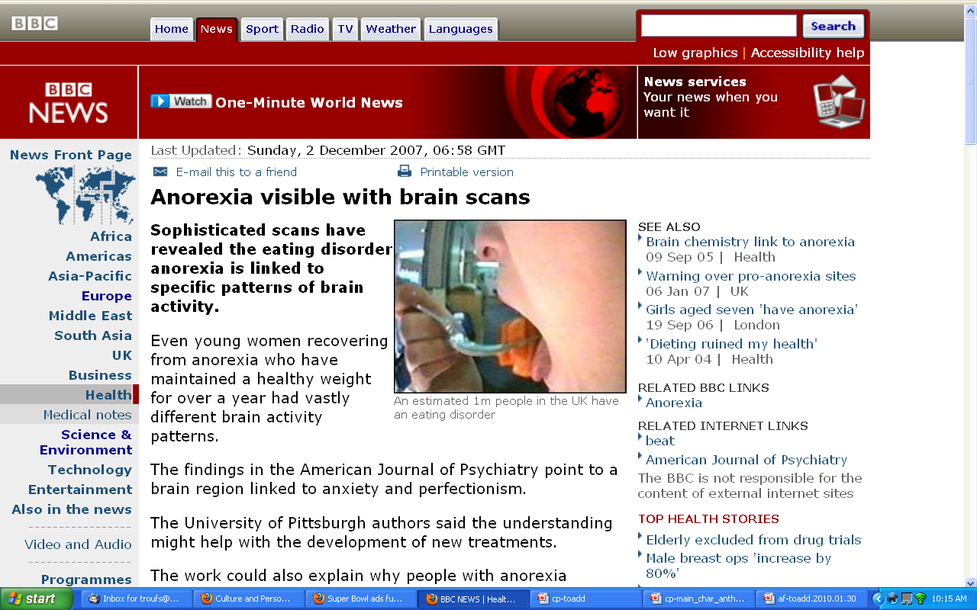
http://news.bbc.co.uk/2/hi/health/7120564.stm

Slide 99
. . . but ultimately anthropologists seek to study phenomena in terms of both physical and cultural aspects
. . .

Slide 100
Understanding Global Cultures
Anthropology
Bio-physical
Cultural
URL link to print: https://www.d.umn.edu/cla/faculty/troufs/anth1602/pchoebel.html#title

Slide 101
  for example, numerous studies have shown that exposure to images [cultural] of ultrathin models can lead to body dissatisfaction and eventually to unhealthy eating behaviors and physical illness [physical] . . .
The Cultural Feast, 2nd ed., p. 115

Slide 102
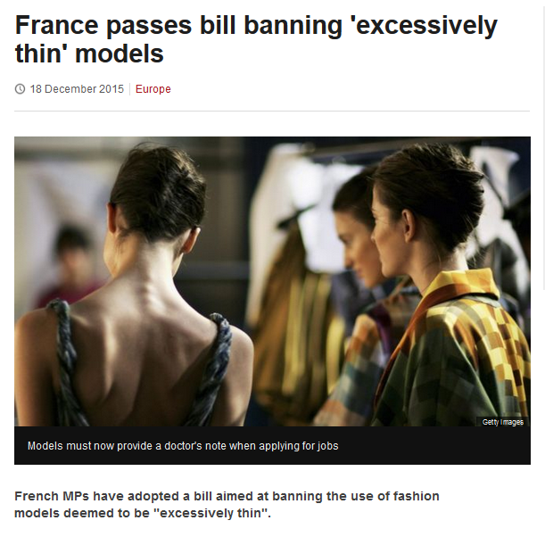
http://www.bbc.com/news/world-europe-35130792

Slide 103
Understanding Global Cultures
. . . and to understand a phenomena in terms of both physical and cultural aspects
. . .
. . . ultimately involves lots of subdisciplines . . .

Slide 104
. . . and that ultimately involves lots of subdisciplines . . .

Slide 105
NOTE:
There are four levels . . .
(REM: read from the bottom up)

Slide 106
URL link to print: https://www.d.umn.edu/cla/faculty/troufs/anth1602/pchoebel.html#title

Slide 107
URL link to print: https://www.d.umn.edu/cla/faculty/troufs/anth1602/pchoebel.html#title

Slide 108
URL link to print: https://www.d.umn.edu/cla/faculty/troufs/anth1602/pchoebel.html#title

Slide 109
URL link to print: https://www.d.umn.edu/cla/faculty/troufs/anth1602/pchoebel.html#title

Slide 110
HOLISM
Involves all four levels
and all
of the physical and cultural
components combined

Slide 111
holism
URL link to print: https://www.d.umn.edu/cla/faculty/troufs/anth1602/pchoebel.html#title

Slide 112
holism
holism
URL link to print: https://www.d.umn.edu/cla/faculty/troufs/anth1602/pchoebel.html#title

Slide 113
Anthropology
URL link to print: https://www.d.umn.edu/cla/faculty/troufs/anth1602/pchoebel.html#title

Slide 114

source

Slide 115
REM
. . . the two main divisions
of Anthropology are
bio-physical and cultural . . .

Slide 116
Understanding Global Cultures
Anthropology
URL link to print: https://www.d.umn.edu/cla/faculty/troufs/anth1602/pchoebel.html#title

Slide 117
Anthropology
Bio-physical
URL link to print: https://www.d.umn.edu/cla/faculty/troufs/anth1602/pchoebel.html#title

Slide 118
Understanding Global Cultures
Anthropology
Bio-physical
Cultural
URL link to print: https://www.d.umn.edu/cla/faculty/troufs/anth1602/pchoebel.html#title

Slide 119
. . . but, as mentioned above, ultimately anthropologists seek to study phenomena in terms of both physical and cultural aspects
. . .

Slide 120
Anthropology
Bio-physical
Food and Culture
URL link to print: https://www.d.umn.edu/cla/faculty/troufs/anth1602/pchoebel.html#title

Slide 121
  as in the example mentioned above, numerous studies have shown that exposure to images [cultural] of ultrathin models can lead to body dissatisfaction and eventually to unhealthy eating behaviors and physical illness [physical] . . .
The Cultural Feast, 2nd ed., p. 115

Slide 122
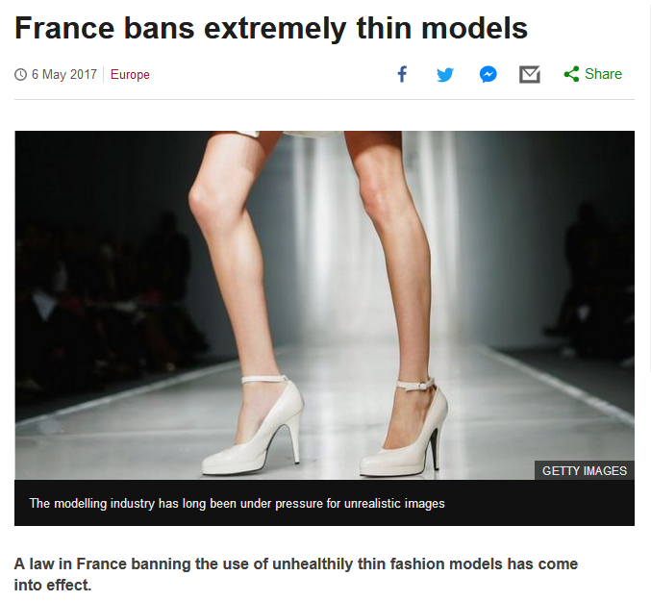
http://www.bbc.com/news/world-europe-39821036http://www.bbc.com/news/world-europe-39821036

Slide 123
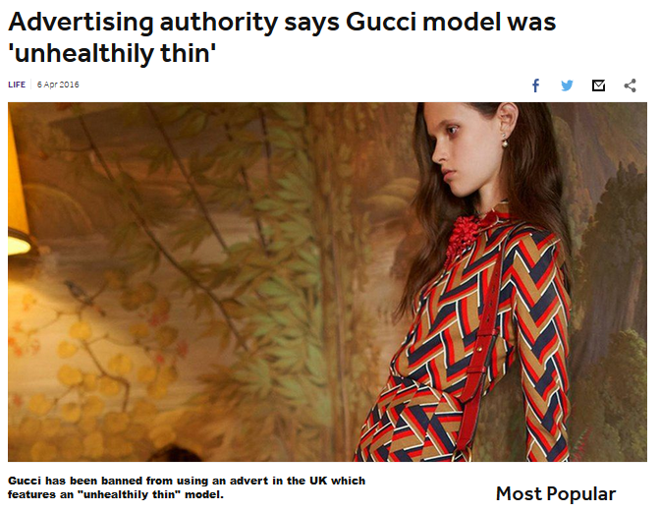
http://www.bbc.co.uk/newsround/35979565

Slide 124
Understanding Global Cultures
. . . and to understand a phenomena in terms of both physical and cultural aspects
. . .
. . . ultimately involves lots of disciplines and subdisciplines . . .

Slide 125
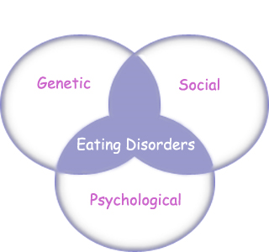
“Eating Disorders are about feelings, not food.”
The Eating Disorder Foundation
www.eatingdisorderfoundation.org/EatingDisorders.htm

Slide 126
. . . and that ultimately involves lots of subdisciplines . . .

Slide 127
Understanding Global Cultures
Anthropology
Bio-physical
Cultural
measuring
excavating
participant /
observation
URL link to print: https://www.d.umn.edu/cla/faculty/troufs/anth1602/pchoebel.html#title

Slide 128
Understanding Global Cultures
Anthropology
Bio-physical
Cultural
body
size/shape,
etc.
measuring
excavating
participant /
observation
URL link to print: https://www.d.umn.edu/cla/faculty/troufs/anth1602/pchoebel.html#title

Slide 129
Understanding Global Cultures
Anthropology
Bio-physical
Cultural
body
size/shape,
etc.
nutrition,
etc.
measuring
excavating
participant /
observation
URL link to print: https://www.d.umn.edu/cla/faculty/troufs/anth1602/pchoebel.html#title

Slide 130
Understanding Global Cultures
Anthropology
Bio-physical
Cultural
body
size/shape,
etc.
nutrition,
etc.
hunting /
meat eating
measuring
excavating
participant /
observation
URL link to print: https://www.d.umn.edu/cla/faculty/troufs/anth1602/pchoebel.html#title

Slide 131
Understanding Global Cultures
Anthropology
Bio-physical
Cultural
body
size/shape,
etc.
nutrition,
etc.
hunting /
meat eating
the
“Agricultural
Revolution”
measuring
excavating
participant /
observation
URL link to print: https://www.d.umn.edu/cla/faculty/troufs/anth1602/pchoebel.html#title

Slide 132
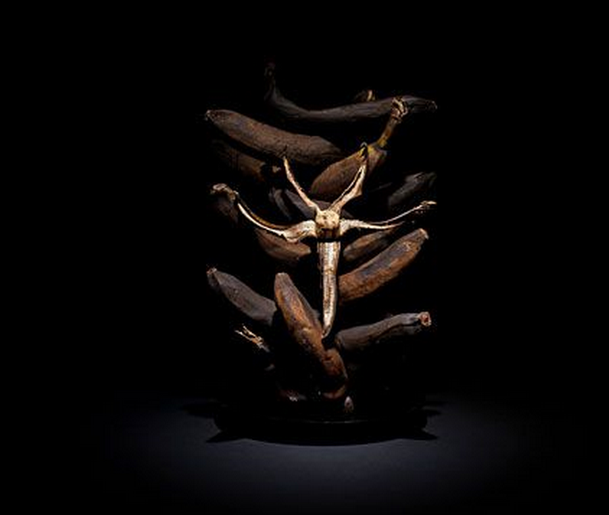

Slide 133
Understanding Global Cultures
Anthropology
Bio-physical
Cultural
body
size/shape,
etc.
nutrition,
etc.
hunting /
meat eating
the
“Agricultural
Revolution”
art
literature,
etc.
measuring
excavating
participant /
observation
URL link to print: https://www.d.umn.edu/cla/faculty/troufs/anth1602/pchoebel.html#title

Slide 134
Understanding Global Cultures
Anthropology
Bio-physical
Cultural
body
size/shape,
etc.
nutrition,
etc.
hunting /
meat eating
the
“Agricultural
Revolution”
art
literature,
etc.
kinship,
beliefs, etc.
measuring
excavating
participant /
observation
URL link to print: https://www.d.umn.edu/cla/faculty/troufs/anth1602/pchoebel.html#title

Slide 135
Understanding Global Cultures
Anthropology
Bio-physical
Cultural
body
size/shape,
etc.
nutrition,
etc.
hunting /
meat eating
the
“Agricultural
Revolution”
art
literature,
etc.
kinship,
beliefs, etc.
language,
history,
structure,
world view,
etc.
measuring
excavating
participant /
observation
URL link to print: https://www.d.umn.edu/cla/faculty/troufs/anth1602/pchoebel.html#title

Slide 136
some examples of holistic comparative work include . . .

Slide 137
Penguin Avery, 2009

Slide 138
“I’m one of the few experts—if not the only expert—to have conducted large-scale, longitudinal surveys following obesity on a global scale.” (p. 2)
Penguin Avery, 2009

Slide 139
Barry Popkin’s work looks at . . .
(Trivia: Barry is from Superior, WI, and includes Superior in his comparisons in this book)

Slide 140
Understanding Global Cultures
Anthropology
Bio-physical
Cultural
body
size/shape,
etc.
nutrition,
etc.
hunting /
meat eating
the
“Agricultural
Revolution”
art
literature,
etc.
kinship,
beliefs, etc.
language,
history,
structure,
world view,
etc.
measuring
excavating
participant /
observation
URL link to print: https://www.d.umn.edu/cla/faculty/troufs/anth1602/pchoebel.html#title

Slide 141
In some ways this chart business is all about
Theory
but key theory that is important to understanding Global Cultures

Slide 142
Understanding Global Cultures
theory
holism
URL link to print: https://www.d.umn.edu/cla/faculty/troufs/anth1602/pchoebel.html#title

Slide 143
Understanding Global Cultures
theory
holism
and the theory ultimately also includes the
results of interdisciplinary study,
esp. with history, biological studies, economics, marketing . . .
URL link to print: https://www.d.umn.edu/cla/faculty/troufs/anth1602/pchoebel.html#title

Slide 144
theory
One excellent example of holism in action is
Nassim Nicholas Taleb’s
INCERTO. . .

Slide 145
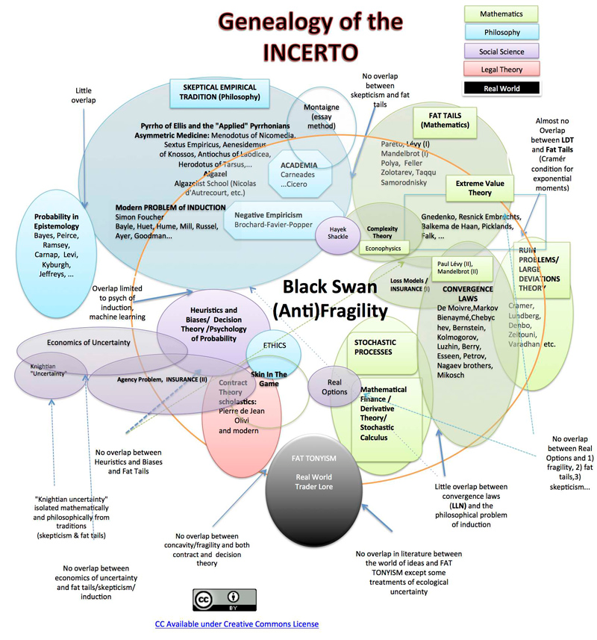

Slide 146
And finally,
we have the last
main characteristic of anthropology . . .

Slide 147
Main Characteristics of Anthropology
1. the four fields of general anthropology
culture as a primary concept
comparative method as major approach
holism as a primary theoretical goal
fieldwork as a primary research technique

Slide 148
Most of all (generally)
Anthropologists
LOVE . . .

Slide 149
Main Characteristics of Anthropology
1. the four fields of general anthropology
culture as a primary concept
comparative method as major approach
holism as a primary theoretical goal
fieldwork
as a primary research technique --
involving “participant observation”

Slide 150
And as I mentioned in the
“An Important Note on Videos and Visual Anthropology” message
we would LOVE to take you along with us around the world and visit with real people, but the next best thing we can do is bring the world to you in the form of films and videos. And we’ll do a lot of that.

Slide 151
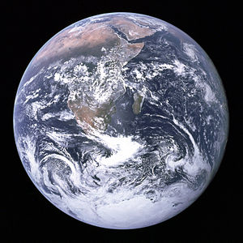
we’ll go
around the world

Slide 152
The End
Holism
in
Anthropology
Global Cultures
University of Minnesota Duluth
Tim Roufs
© 2021-2024

