Slide 1
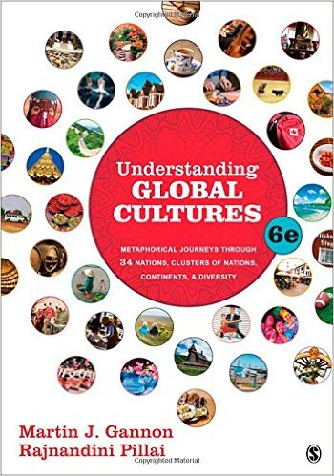
Start deck in “Slide Show” mode,
and use your up/down arrow keys and/or
your space bar to advance the slides
© 2010-2024 Timothy G. Roufs, University of Minnesota Duluth

Slide 2
REM
indicates that the materials
are a REMinder
and are thus being repeated . . .
REMinder

Slide 3
ANTH 1080
Global Cultures
© 2010-2024 Timothy G. Roufs, University of Minnesota Duluth

Slide 4
ANTH 1080
Global Cultures
Main
Characteristics of
Anthropology
© 2010-2024 Timothy G. Roufs, University of Minnesota Duluth

Slide 5
ANTH 1080
Global Cultures
Comparative Method
as a
Major Approach
© 2010-2024 Timothy G. Roufs, University of Minnesota Duluth

Slide 6
American
Main Characteristics of˄Anthropology
1. the four fields of general anthropology
culture as a primary concept
comparative method as major approach
holism as a primary theoretical goal
fieldwork as a primary research technique

Slide 7
American
Main Characteristics of˄Anthropology
1. the four fields of general anthropology
culture as a primary concept
comparative method as major approach
holism as a primary theoretical goal
fieldwork as a primary research technique

Slide 8
Compare . . .
Main Characteristics
comparative method
  as a major approach to the study of human behavior
  the comparative method compares things (what else would a “comparative” method do?)

Slide 9
Compare . . .
Main Characteristics
comparative method
  One form of comparative method was pioneered by Fred Eggan
  (University of Chicago)
“Social anthropology and
the method of controlled comparison”
  American Anthropologist, 56:743-61 (1954)

Slide 10
Compare . . .
Main Characteristics
comparative method
  One form of comparative method was pioneered by Fred Eggan
  (University of Chicago)
“Social anthropology and
the method of controlled comparison”
  American Anthropologist, 56:743-61 (1954)

Slide 11
Compare . . .
Main Characteristics
the comparative method compares things
for e.g. . . .
David Montgomery compares what happens when great civilizations around the world ignore problems they are having with top soil . . .
Spoiler: All failed

Slide 12
Main Characteristics
comparative method
For e.g., we compare the basic ways people look at the world itself . . .

Slide 13
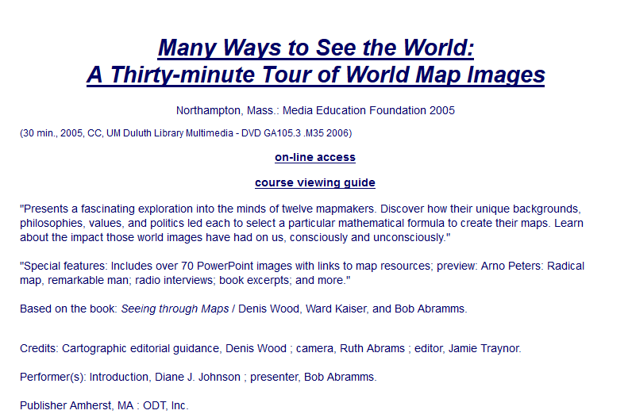
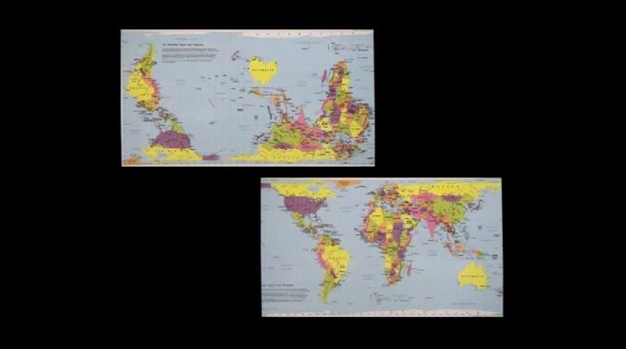

Slide 14
Main Characteristics
comparative method
For e.g., the textbook compares “bullfighting” in Spain and Portugal in terms of their cultural metaphors . . .

Slide 15
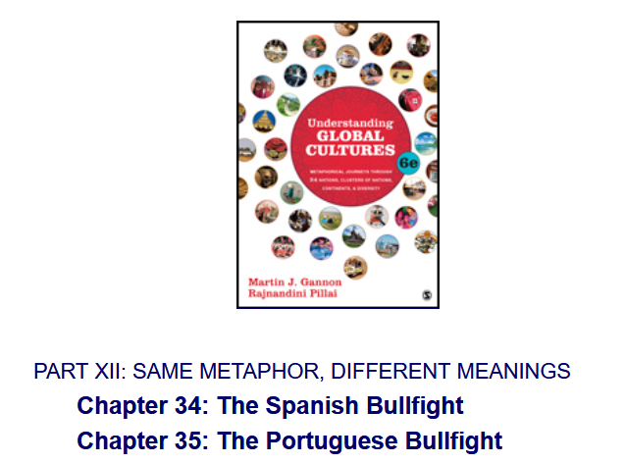

Slide 16
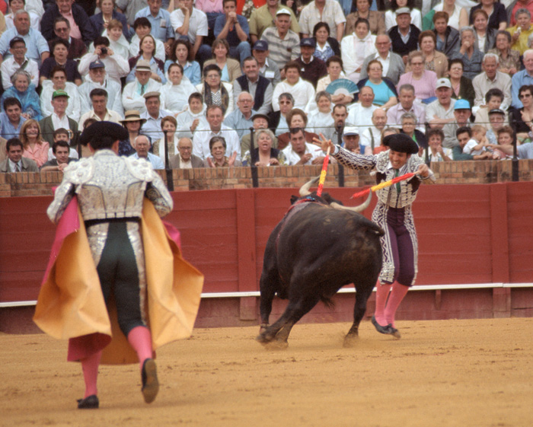
. . . Spain and Portugal . . .

Slide 17
Main Characteristics
comparative method
In class and in the textbook,
we compare regions of the Caribbean . . .

Slide 18
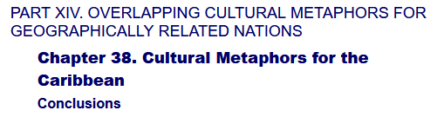

Slide 19

. . . we visit
BBC Caribbean with Simon Reeve

Slide 20
Main Characteristics
comparative method
In class and in the textbook,
we compare “egalitarian” Commonwealth countries
Canada and Australia . . .

Slide 21



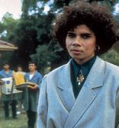

Slide 22

At the Great Barrier Reef of Australia

Slide 23
Main Characteristics
comparative method
We compare
GREAT GATHERINGS
Around the world . . .

Slide 24
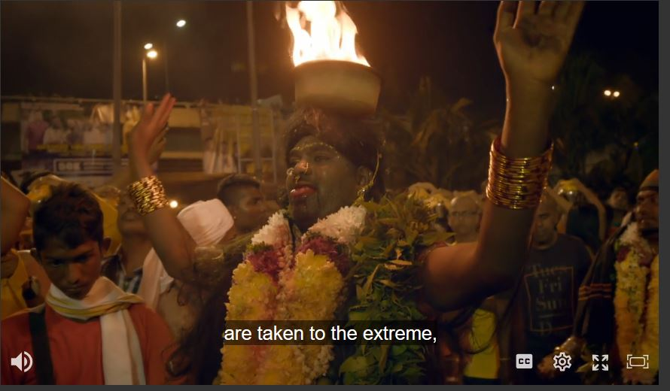
Great Gatherings: Malaysia

Slide 25
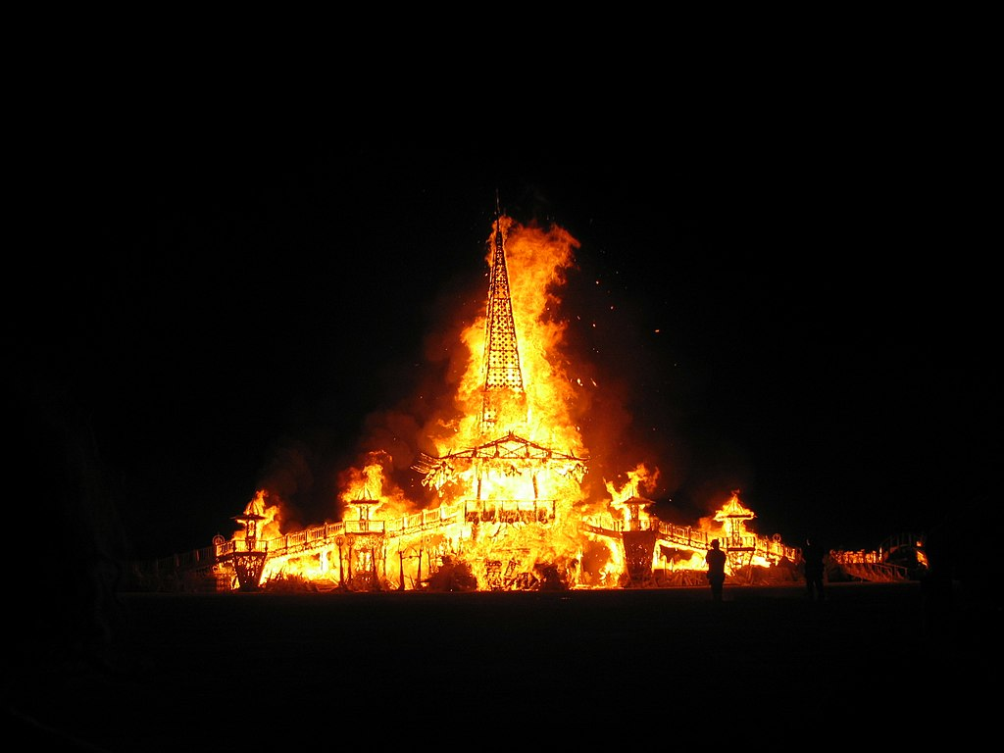
Wikipedia
Great Gatherings: Burning Man, U.S.A.

Slide 26
Cultural
Metaphors
Chapter 11: Irish Conversations
Chapter 22: The Turkish Coffeehouse

Slide 27
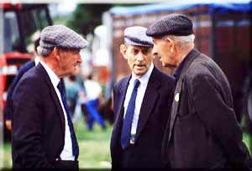
Irish Conversations
Wikipedia

Slide 28
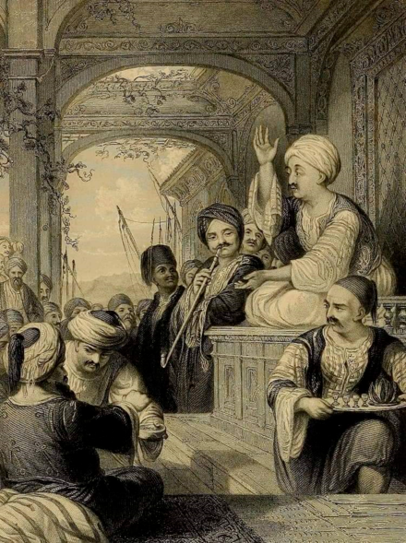
The Turkish Coffeehouse
Wikipedia

Slide 29
Main Characteristics
comparative method
We compare
Religious and Secular Dance
Around the world . . .

Slide 30
Main Characteristics
comparative method
We compare
Religious Dances . . .

Slide 31
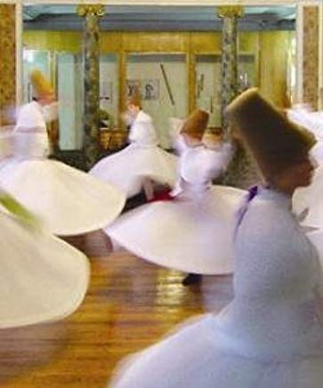
Turkey: Sema Ceremony
I Named Her Angel

Slide 32
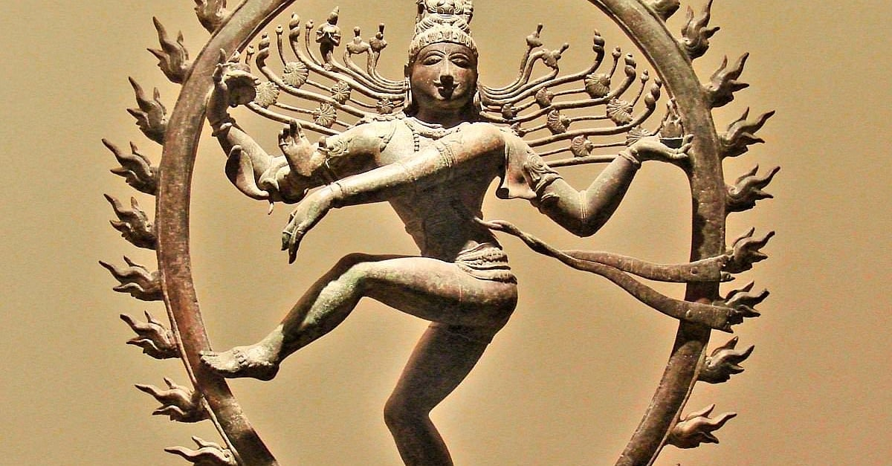
India: The Dance of Shiva
https://www.worldhistory.org/article/831/shiva-nataraja---lord-of-the-dance/

Slide 33
Main Characteristics
comparative method
We compare
Secular Dances . . .

Slide 34
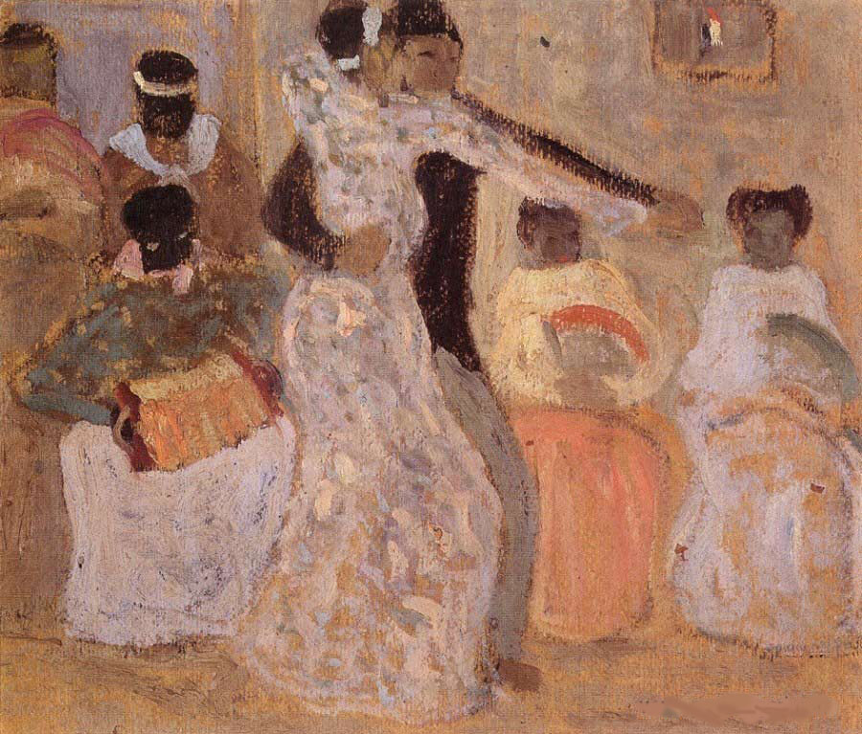
Turkey
El Tango
Dance around the World

Slide 35
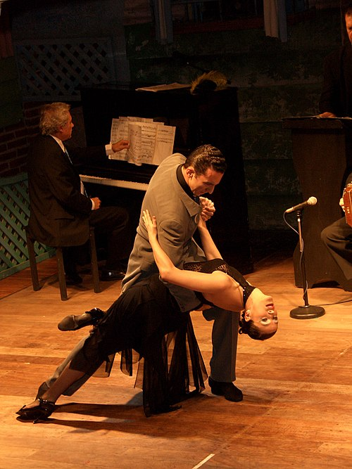
Turkey
Argentina
Dance around the World

Slide 36
Main Characteristics
comparative method
We compare
“Romantic Love”
and marriage practices
in several cultures . . .

Slide 37

. . . to
Niger
(West Africa)
Nepal
France / England
Canada . . .

Slide 38
Main Characteristics
comparative method
We compare the significance of burial practices around the world . . .

Slide 39
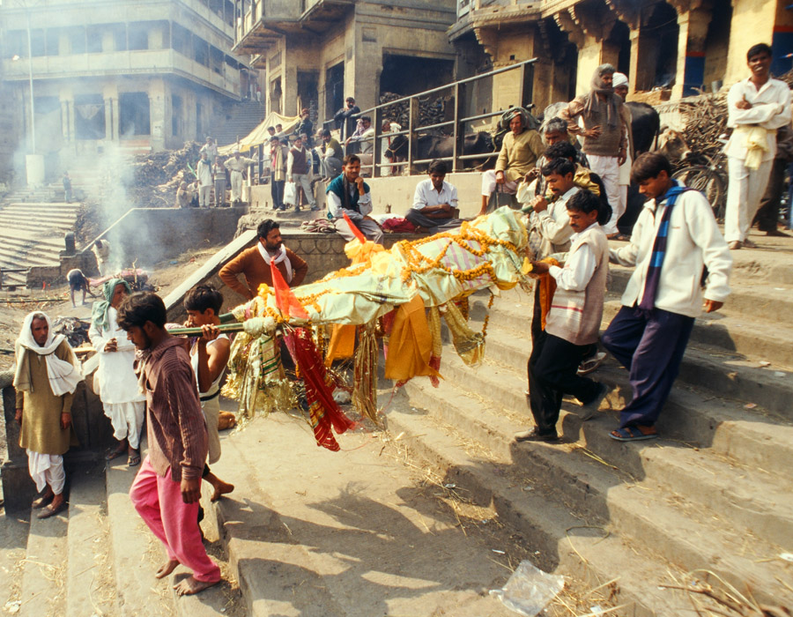
. . . India . . .

Slide 40
Main Characteristics
comparative method
We compare the significance of religious beliefs and behaviors of Chinese in China and Malaysia . . .

Slide 41
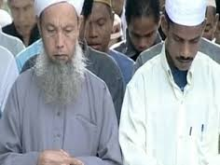
. . . we visit China and Malaysia . . .

Slide 42
Cultural
Metaphors
PART VIII: THE BASE CULTURE AND ITS DIFFUSION ACROSS BORDERS (CLUSTERS OF NATIONS): THE EXAMPLE OF CHINA
Chapter 24: The Chinese Family Altar: The Expatriate Chinese Outside of China
Chapter 25: The Singapore Hawker Centers

Slide 43
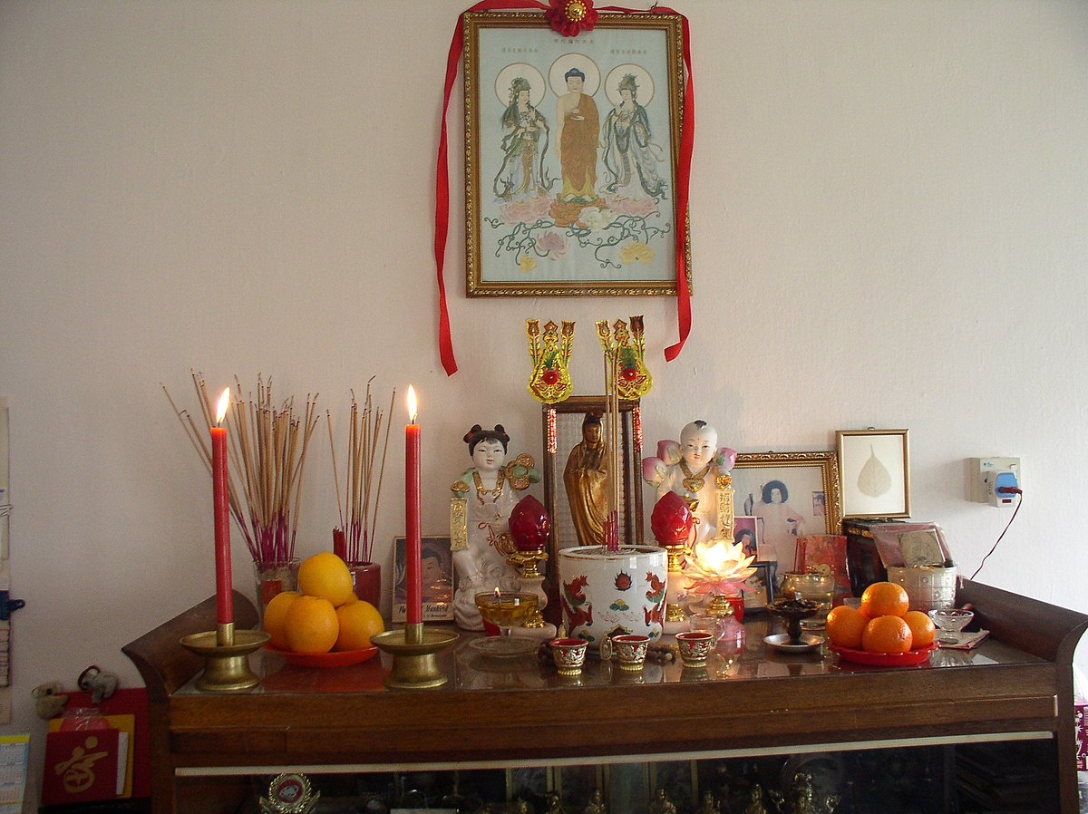
The Chinese Family Altar
Wikimedia Commond

Slide 44
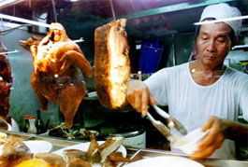
The Singapore Hawker Centers
Wikipedia

Slide 45
Compare . . .
Main Characteristics
the comparative method compares things
for e.g. . . .
In a similar manner Evan D. Fraser and Andrew Rimas compare
Feast, Famine, and the Rise and Fall of Civilizations
around the world. . .

Slide 46
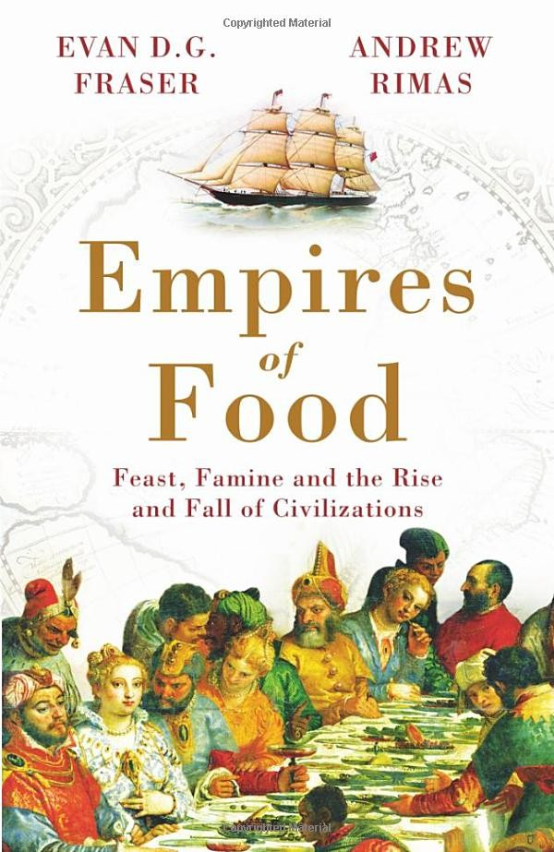
Mesopotamia
China
North America
South America
Europe
Asia
Africa
Pacific Islands
Berkeley: Counterpoint, 2012:
http://www.amazon.com/Empires-Food-Feast-Famine-Civilizations/dp/1582437939/ref=sr_1_1?ie=UTF8&qid=1452654498&sr=8-1&keywords=empires+of+food

Slide 47
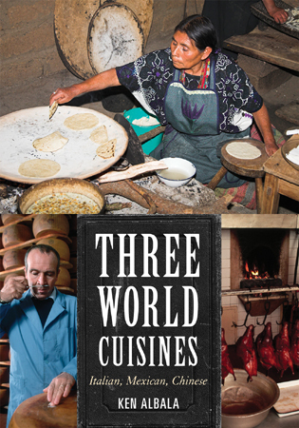
Italian
Mexican
Chinese
comparing cultures and cuisines

Slide 48
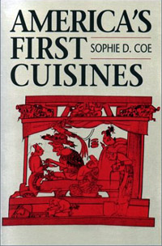
Aztec
Maya
Inca
Sophie D. Coe
America's First Cuisines
Austin: University of Texax Press, 1994.
comparing cultures and cuisines
www.d.umn.edu/cla/faculty/troufs/anthfood/aftexts.html#title

Slide 49
Aztec
Maya
Inca
Sophie D. Coe
America's First Cuisines
Austin: University of Texax Press, 1994.
comparing cultures and cuisines
www.d.umn.edu/cla/faculty/troufs/anthfood/aftexts.html#title

Slide 50

Penguin Avery, 2009

Slide 51
The Popkin, 1950s
“typical multigenerational American family”
and 3 children
Superior, WI, U.S.A.
The “Jones, ” 2006
and 2 children
Suburban Cleveland, U.S.A.
Cesar and Ana Garcia
and 4 children
Immigrant Mexicans from Chiapas Mexico
Suburban Los Angeles
Rahul Desai and His Wife
and 4 children
Uttar Pradesh, Northern India
Gopal and Noopur Patel
and 3 children
Uttar Pradesh, Northern India
studied how lifestyle changes over the long term have affected the body composition of
Americans
80,000+ and 20,000
Chinese
22,000+
200+ communities
Russians
11,000+
300+ communities
Brazilians
Filipinos
Penguin Avery, 2009

Slide 52
The Popkin, 1950s
“typical multigenerational American family”
and 3 children
Superior, WI, U.S.A.
The “Jones, ” 2006
and 2 children
Suburban Cleveland, U.S.A.
Cesar and Ana Garcia
and 4 children
Immigrant Mexicans from Chiapas Mexico
Suburban Los Angeles
Rahul Desai and His Wife
and 4 children
Uttar Pradesh, Northern India
Gopal and Noopur Patel
and 3 children
Uttar Pradesh, Northern India
studied how lifestyle changes over the long term have affected the body composition of
Americans
80,000+ and 20,000
Chinese
22,000+
200+ communities
Russians
11,000+
300+ communities
Brazilians
Filipinos
including Superior, WI
(his home town)
Penguin Avery, 2009

Slide 53
Compare . . .
Main Characteristics
and items like “culture bound syndromes” are compared with similar phenomena that are thought to be “universal” . . . .

Slide 54
Main Characteristics
comparative method
often, for e.g.,
folks compare things regionally in an attempt
to understand process

Slide 55
Compare . . .
Main Characteristics
comparative method
  Other methods . . .
process
essentially refers to
how things change
or
how things came to be
the way they are now
compare things regionally
in an attempt to understand process

Slide 56
Compare . . .
Main Characteristics
the comparative method compares things
for e.g. . . .
David Montgomery compares what happens when great civilizations around the world ignore problems they are having with top soil . . .
Spoiler: All failed

Slide 57
Compare . . .
Main Characteristics
the comparative method compares things
for e.g. . .
David Montgomery compares what happens when great civilizations around the world ignore problems they are having with top soil . . .
Spoiler: All failed

Slide 58

Mesopotamia
China
North America
South America
Europe
Asia
Africa
Pacific Islands
Berkeley: University of California, 2012
http://www.amazon.com/Empires-Food-Feast-Famine-Civilizations/dp/1582437939/ref=sr_1_1?ie=UTF8&qid=1452654498&sr=8-1&keywords=empires+of+food

Slide 59
Compare . . .
Main Characteristics
the comparative method compares things
for e.g. . . .
David Montgomery compares what happens when great civilizations around the world ignore problems they are having with top soil . . .
Spoiler: All failed

Slide 60
Compare . . .
Main Characteristics
the comparative method compares things, for e.g., process of domestication / civilization
    maize – Mexico
    wheat – Turkey
    rice – China
    manioc – Brazil
    millet – Africa

Slide 61
Compare . . .
Main Characteristics
the comparative method compares things, for e.g., process of domestication / civilization
    maize – Mexico
    wheat – Turkey
    rice – China
    manioc – Brazil
    millet – Africa

Slide 62
Compare . . .
Main Characteristics
the comparative method compares things, for e.g., process of domestication / civilization
    maize – Mexico
    wheat – Turkey
    rice – China
    manioc – Brazil
    millet – Africa

Slide 63
Compare . . .
Main Characteristics
the comparative method compares things, for e.g., process of domestication / civilization
    maize – Mexico
    wheat – Turkey
    rice – China
    manioc – Brazil
    millet – Africa

Slide 64
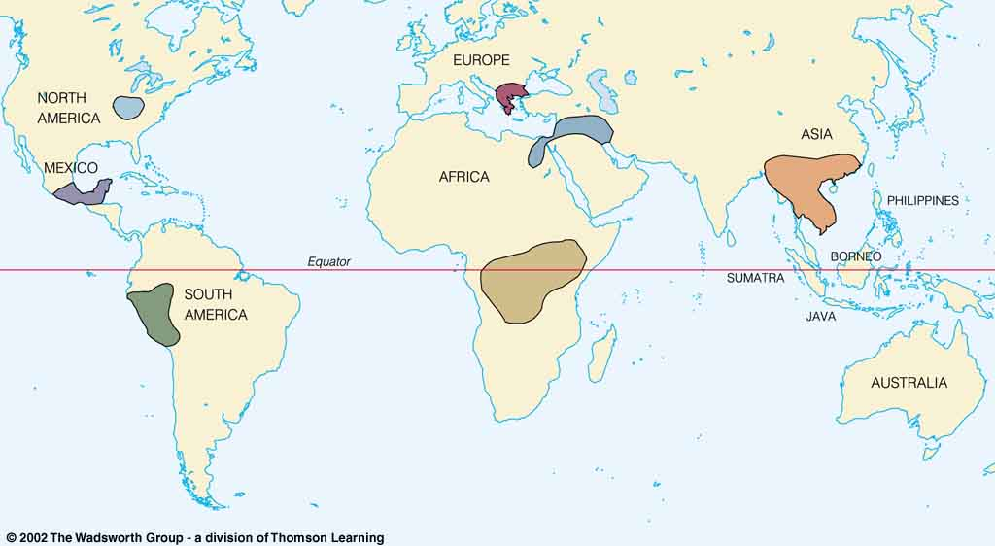
Origin of Domestication for Selected Plants
Compare . . .
wheat
10,500 ybp
maize
4,200 ybp
rice
7,000 ybp
manioc
4,200 ybp
millet
4,000 ybp
Understanding Physical Anthropology and Archaeology, 9th Ed., p. 342.

Slide 65
The Neolithic Revolution
=
The Agriculture Revolution

Slide 66
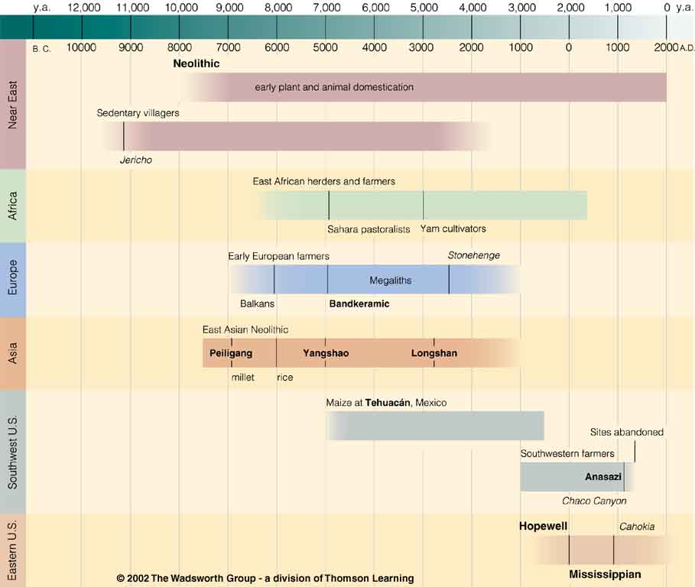
Neolithic
Time line for Ch. 14 Food Production
Understanding Physical Anthropology and Archaeology, 9th Ed., p. 333.

Slide 67
Main Characteristics in a Nutshell

Slide 68
American
Main Characteristics of˄Anthropology
1. the four fields of general anthropology
culture as a primary concept
comparative method as major approach
holism as a primary theoretical goal
fieldwork as a primary research technique

Slide 69
Note two terms in the “major characteristics of anthropology” listing . . .

Slide 70
Main Characteristics
1. culture as a primary concept
2. comparative method as major approach to the study of human behavior
3. holism or the study of "humankind" as a whole, as a primary theoretical goal
4. fieldwork as a primary research
technique, involving “participant observation”

Slide 71
Main Characteristics
1. culture as a primary concept
2. comparative method as major approach to the study of human behavior
3. holism or the study of "humankind" as a whole, as a primary theoretical goal
4. fieldwork as a primary research
technique, involving “participant observation”
what’s the difference?

Slide 72
Main Characteristics
1. culture as a primary concept
2. comparative method as major approach to the study of human behavior
3. holism or the study of "humankind" as a whole, as a primary theoretical goal
4. fieldwork as a primary research
technique, involving “participant observation” = how you get information
= tool

Slide 73
Main Characteristics
1. culture as a primary concept
2. comparative method as major approach to the study of human behavior
3. holism or the study of "humankind" as a whole, as a primary theoretical goal
4. fieldwork as a primary research
technique, involving “participant observation” = how you get information
data gathering technique —
participant observation
(fieldwork)
= tool

Slide 74
Main Characteristics
Anthropologists use other tools . . . like questionnaires, interview schedules, psychological tests, documentary filming . . . but “participant observation” is a characteristic technique use by anthropologists, especially cultural anthropologists (ethnologists)
1. culture as a primary concept
2. comparative method as major approach to the study of human behavior
3. holism or the study of "humankind" as a whole, as a primary theoretical goal
4. fieldwork as a primary research
technique, involving “participant observation” = how you get information
= tool

Slide 75
Main Characteristics
Anthropologists use other tools . . . like questionnaires, interview schedules, psychological tests, documentary filming . . . but “participant observation” is a characteristic technique use by anthropologists, especially cultural anthropologists (ethnologists)
1. culture as a primary concept
2. comparative method as major approach to the study of human behavior
3. holism or the study of "humankind" as a whole, as a primary theoretical goal
4. fieldwork as a primary research
technique, involving “participant observation” = how you get information
NOTE:
= tool

Slide 76
Main Characteristics
1. culture as a primary concept
2. comparative method as major approach to the study of human behavior
3. holism or the study of "humankind" as a whole, as a primary theoretical goal
4. fieldwork as a primary research
technique, involving “participant observation” = how you get information
= tool

Slide 77
Main Characteristics
1. culture as a primary concept
2. comparative method as major approach to the study of human behavior
3. holism or the study of "humankind" as a whole, as a primary theoretical goal
4. fieldwork as a primary research
technique, involving “participant observation” = how you get information
= approach
how you use information
= tool

Slide 78
Main Characteristics
1. culture as a primary concept
2. comparative method as major approach to the study of human behavior
3. holism or the study of "humankind" as a whole, as a primary theoretical goal
4. fieldwork as a primary research
technique, involving “participant observation” = how you get information
= tool

Slide 79
Main Characteristics
1. culture as a primary concept
2. comparative method as major approach to the study of human behavior
3. holism or the study of "humankind" as a whole, as a primary theoretical goal
4. fieldwork as a primary research
technique, involving “participant observation” = how you get information
other tools include
things like . . .
= tool

Slide 80
Main Characteristics
“24-hour activity survey”
  (self-reported, diary)
“interview schedules”
(interviewer asks questions and records answers)
“questionnaire”
(person records own information retrospectively)
1. culture as a primary concept
2. comparative method as major approach to the study of human behavior
3. holism or the study of "humankind" as a whole, as a primary theoretical goal
4. fieldwork as a primary research
technique, involving “participant observation” = how you get information
= tool
  after Marion Nestle, Food Politics, Rev. Ed., 2007, pp. 401-405

Slide 81
Main Characteristics
1. culture as a primary concept
2. comparative method as major approach to the study of human behavior
3. holism or the study of "humankind" as a whole, as a primary theoretical goal
4. fieldwork as a primary research
technique, involving “participant observation” = how you get information
and in Global Cultures studies there are lots of other tools and approaches . . .
= tool

Slide 82
  studies of humans and non-humans in the laboratory
biochemical research
(“test tube”)
epidemiological research
(deals with populations data and trends)
clinical studies of humans
(generally medical)
  after Marion Nestle, Food Politics, Rev. Ed., 2007, pp. 401-405

Slide 83
Anthropologists often like to use a research “technique” based on
“unobtrusive measures” . . .
(either in the field or elsewhere)

Slide 84
  “unobtrusive measures”
  analysis of data on availability in government, commerce, industry, markets
  things like food supply data analysis
    (U.S.A. production + imported)
    (foods available for consumption)
    (unknown: home garden production, hunting/fishing/foraging, amount of food wasted . . .)
  chemical composition analysis . . .
  after Marion Nestle, Food Politics, Rev. Ed., 2007, pp. 401-405

Slide 85
ANTH 1080
Global Cultures
The End
Comparative Method
as a
Major Approach
© 2010-2024 Timothy G. Roufs, University of Minnesota Duluth

