Slide 1
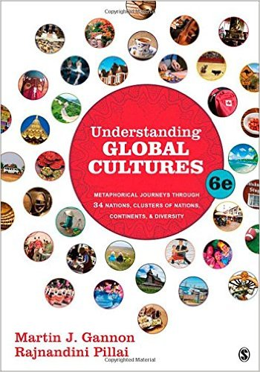
Start deck in “Slide Show” mode,
and use your up/down arrow keys and/or
your space bar to advance the slides
© 2010-2024 Timothy G. Roufs, University of Minnesota Duluth

Slide 2
REM
indicates that the materials
are a REMinder
and are thus being repeated . . .
REMinder

Slide 3
ANTH 1080
Global Cultures
Main
Characteristics of
Anthropology
© 2010-2024 Timothy G. Roufs, University of Minnesota Duluth

Slide 4
ANTH 1080
Global Cultures
Fieldwork
as a
Primary Research
Technique
© 2010-2024 Timothy G. Roufs, University of Minnesota Duluth

Slide 5
American
Main Characteristics of˄Anthropology
1. the four fields of general anthropology
culture as a primary concept
comparative method as major approach
holism as a primary theoretical goal
fieldwork as a primary research technique

Slide 6
And finally,
we have the last
main characteristic of American Anthropology . . .

Slide 7
American
Main Characteristics of˄Anthropology
1. the four fields of general anthropology
culture as a primary concept
comparative method as major approach
holism as a primary theoretical goal
fieldwork as a primary research technique

Slide 8
Most of all (generally)
Anthropologists
LOVE . . .

Slide 9
Main Characteristics of Anthropology
1. the four fields of general anthropology
culture as a primary concept
comparative method as major approach
holism as a primary theoretical goal
fieldwork as a primary research technique -- involving “participant observation”

Slide 10
Note two terms in the
“Main Characteristics
of Anthropology”
listing . . .

Slide 11
Main Characteristics
1. culture as a primary concept
2. comparative method as major approach to the study of human behavior
3. holism or the study of "humankind" as a whole, as a primary theoretical goal
4. fieldwork as a primary research technique, involving “participant observation”

Slide 12
Main Characteristics
1. culture as a primary concept
2. comparative method as major approach to the study of human behavior
3. holism or the study of "humankind" as a whole, as a primary theoretical goal
4. fieldwork as a primary research technique, involving “participant observation”
what’s the difference?

Slide 13
Main Characteristics
1. culture as a primary concept
2. comparative method as major approach to the study of human behavior
3. holism or the study of "humankind" as a whole, as a primary theoretical goal
4. fieldwork as a primary research technique, involving “participant observation” = how you get information
= tool

Slide 14
Main Characteristics
1. culture as a primary concept
2. comparative method as major approach to the study of human behavior
3. holism or the study of "humankind" as a whole, as a primary theoretical goal
4. fieldwork as a primary research technique, involving “participant observation” = how you get information
data gathering technique —
participant observation
(fieldwork)
= tool

Slide 15
Main Characteristics
Anthropologists use other tools . . . like questionnaires, interview schedules, psychological tests, documentary filming . . . but “participant observation” is a characteristic technique use by anthropologists, especially cultural anthropologists (ethnologists)
1. culture as a primary concept
2. comparative method as major approach to the study of human behavior
3. holism or the study of "humankind" as a whole, as a primary theoretical goal
4. fieldwork as a primary research technique, involving “participant observation” = how you get information
= tool

Slide 16
Main Characteristics
Anthropologists use other tools . . . like questionnaires, interview schedules, psychological tests, documentary filming . . . but “participant observation” is a characteristic technique use by anthropologists, especially cultural anthropologists (ethnologists)
1. culture as a primary concept
2. comparative method as major approach to the study of human behavior
3. holism or the study of "humankind" as a whole, as a primary theoretical goal
4. fieldwork as a primary research technique, involving “participant observation” = how you get information
NOTE:
= tool

Slide 17
Main Characteristics
1. culture as a primary concept
2. comparative method as major approach to the study of human behavior
3. holism or the study of "humankind" as a whole, as a primary theoretical goal
4. fieldwork as a primary research technique, involving “participant observation” = how you get information
= tool

Slide 18
Main Characteristics
1. culture as a primary concept
2. comparative method as major approach to the study of human behavior
3. holism or the study of "humankind" as a whole, as a primary theoretical goal
4. fieldwork as a primary research technique, involving “participant observation” = how you get information
= approach
how you use information
= tool

Slide 19
Main Characteristics of Anthropology
1. the four fields of general anthropology
culture as a primary concept
comparative method as major approach
holism as a primary theoretical goal
fieldwork as a primary research technique -- involving “participant observation”

Slide 20
Main Characteristics
1. culture as a primary concept
2. comparative method as major approach to the study of human behavior
3. holism or the study of "humankind" as a whole, as a primary theoretical goal
4. fieldwork as a primary research technique, involving “participant observation” = how you get information
= tool

Slide 21
Main Characteristics
1. culture as a primary concept
2. comparative method as major approach to the study of human behavior
3. holism or the study of "humankind" as a whole, as a primary theoretical goal
4. fieldwork as a primary research technique, involving “participant observation” = how you get information
other tools include
things like . . .
= tool

Slide 22
Main Characteristics
“24-hour activity survey”
(self-reported, diary)
“interview schedules”
(interviewer asks questions and records answers)
“questionnaire” (person records own information retrospectively)
1. culture as a primary concept
2. comparative method as major approach to the study of human behavior
3. holism or the study of "humankind" as a whole, as a primary theoretical goal
4. fieldwork as a primary research technique, involving “participant observation” = how you get information
= tool
after Marion Nestle, Food Politics, Rev. Ed., 2007, pp. 401-405

Slide 23
Main Characteristics
1. culture as a primary concept
2. comparative method as major approach to the study of human behavior
3. holism or the study of "humankind" as a whole, as a primary theoretical goal
4. fieldwork as a primary research technique, involving “participant observation” = how you get information
and in Global Cultures studies there are lots of other tools and approaches . . .
= tool

Slide 24
studies of humans and non-humans in the laboratory
biochemical research
(“test tube”)
epidemiological research (deals with populations data and trends)
clinical studies of humans
(generally medical)
after Marion Nestle, Food Politics, Rev. Ed., 2007, pp. 401-405

Slide 25
Anthropologists often like to use a research “technique” based on
“unobtrusive measures” . . .
(either in the field or elsewhere)

Slide 26
“unobtrusive measures”
analysis of data on availability in government, commerce, industry, markets
things like food supply data analysis
(U.S.A. production + imported)
(foods available for consumption)
(unknown: home garden production, hunting/fishing/foraging, amount of food wasted . . .)
chemical composition analysis . . .
after Marion Nestle, Food Politics, Rev. Ed., 2007, pp. 401-405

Slide 27
But most of all (generally)
Anthropologists
LOVE . . .

Slide 28
Main Characteristics of Anthropology
1. the four fields of general anthropology
culture as a primary concept
comparative method as major approach
holism as a primary theoretical goal
fieldwork as a primary research technique -- involving “participant observation”

Slide 29
And fieldwork in the area of Global Cultures is some of the very best . . .

Slide 30
Unfortunately, in this class we cannot travel to places far and wide in person, so we’ll do the next best thing and go there
via videos and slides.
In class we’ll see . . .

Slide 31
France . . .

Slide 32
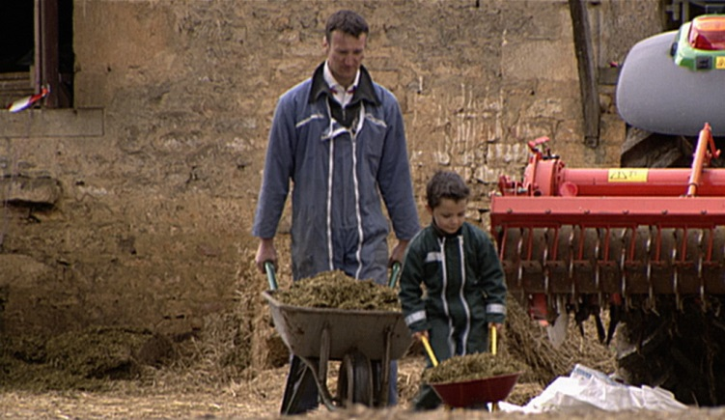
. . . this including,
Après l'hiver, le printemps
(After Winter, Spring)

Slide 33
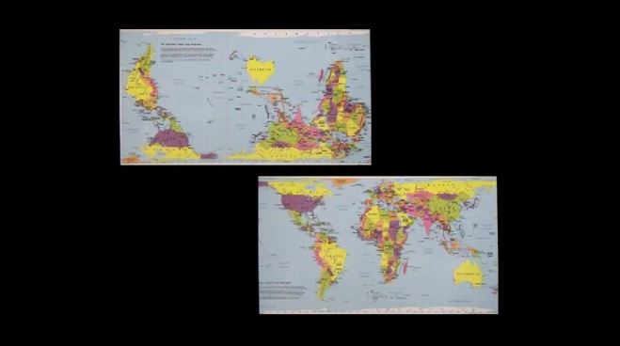
Films and Videos

Slide 34
Films and Videos

Slide 35
We’ll visit immigrants to Spain

Slide 36
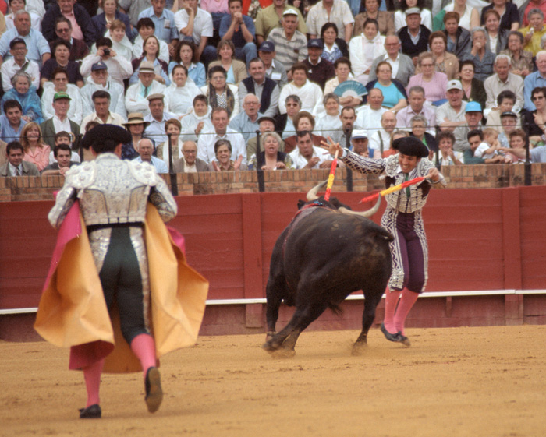
. . . and visit Spain and Portugal . . .

Slide 37
. . . and Spanish emigrants to Scotland
And we’re going to visit Spanish emigrants to Scotland on-line

Slide 38
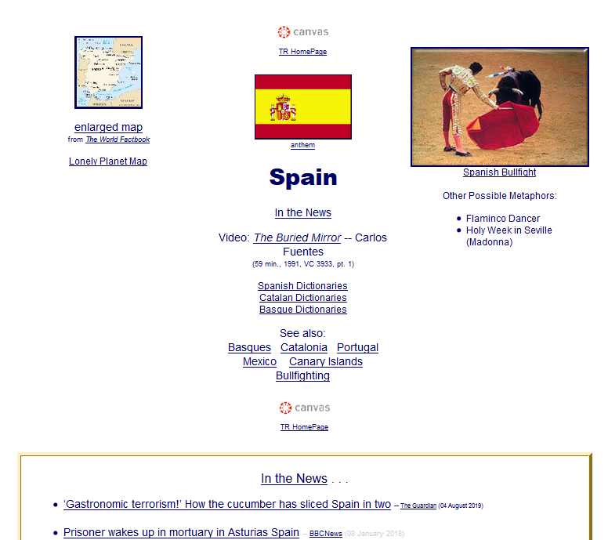
. . . and we’ll try to develop a holistic view . . .
+
foreign immigrants to Spain
Spanish emigrants to Scotland
+
current news from
Spain and Scotland
immigration
discussion

Slide 39
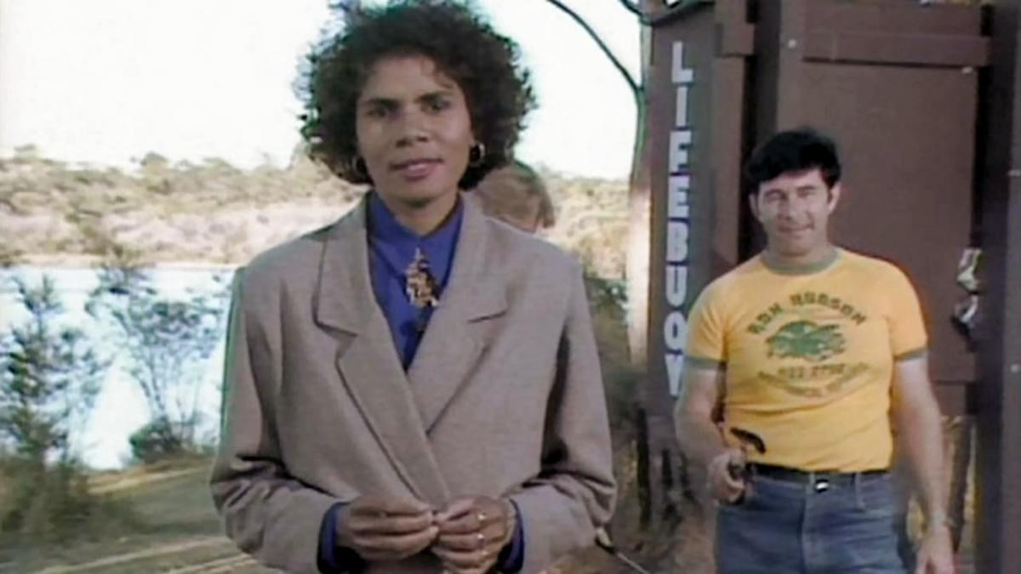
. . . and visit
native cultural reformers
in Australia

Slide 40
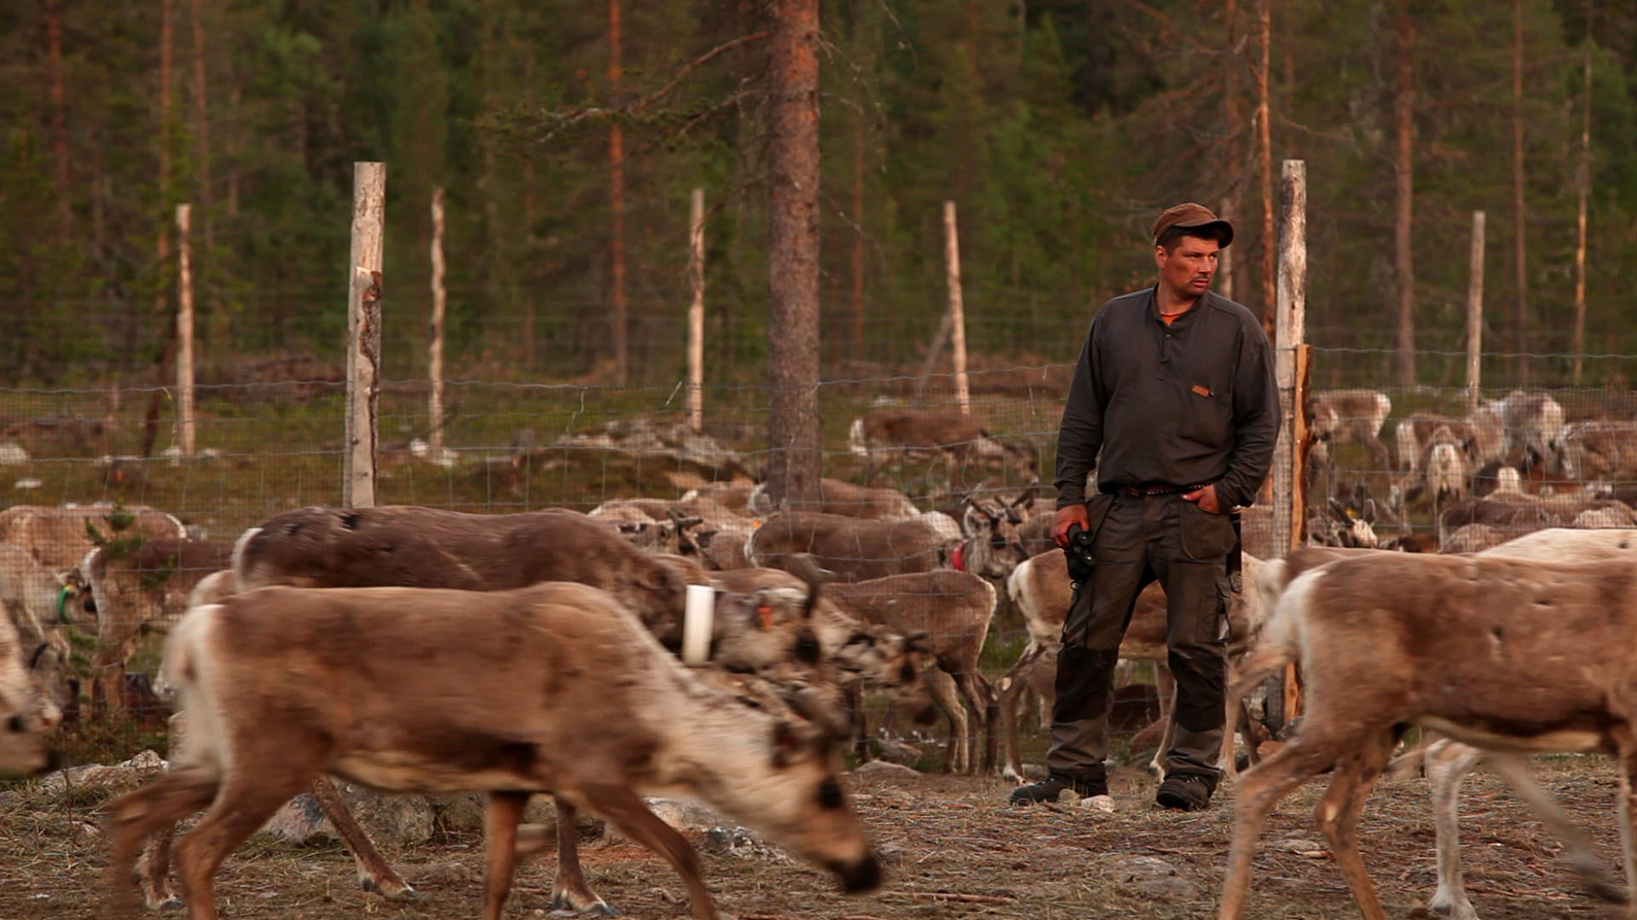
We’ll visit
Aatsinki . . . Arctic Cowboys
of the frozen forests of Finnish Lapland

Slide 41
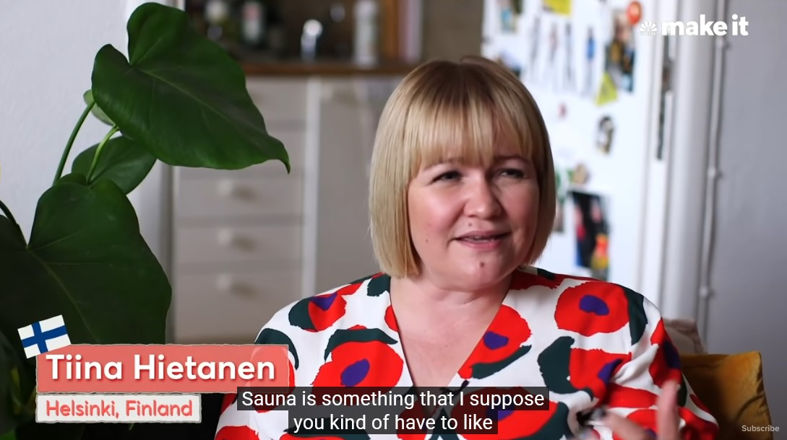
Finland, the “Happiest Country in the World”

Slide 42
And we’ll have a look at
Hmong
immigrants
(in Appleton, Wisconsin)

Slide 43
. . . a visit to Malaysia . . .

Slide 44
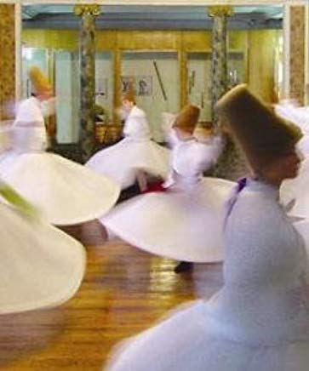
. . . and visit with
with the
“whirling Dervishes”
in Türkiye
fka Turkey

Slide 45
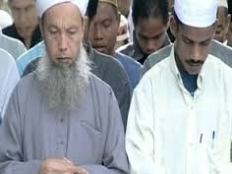
We’ll also visit China and Malaysia . . .

Slide 46
. . . and Mexico . . .

Slide 47
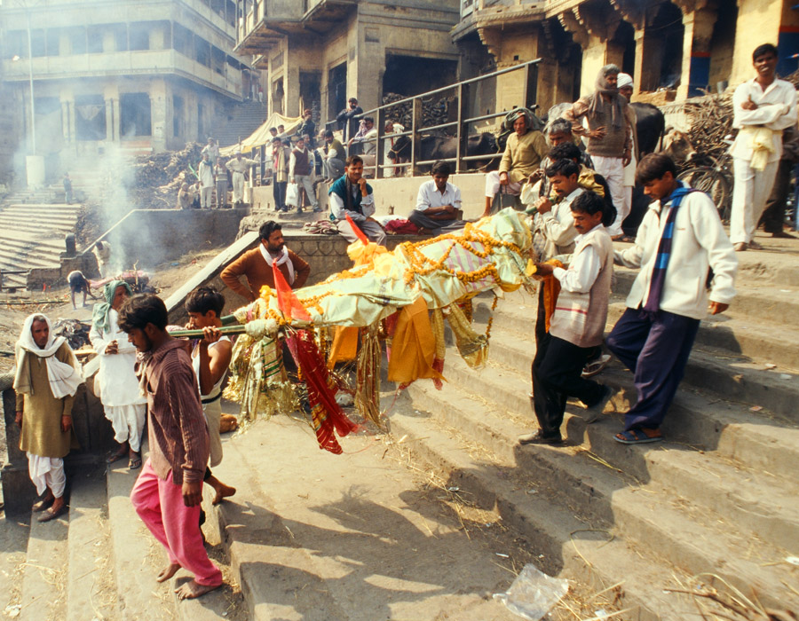
. . . and India . . .

Slide 48
We’ll compare
Niger
(West Africa)
Nepal
France / England
Canada . . .

Slide 49
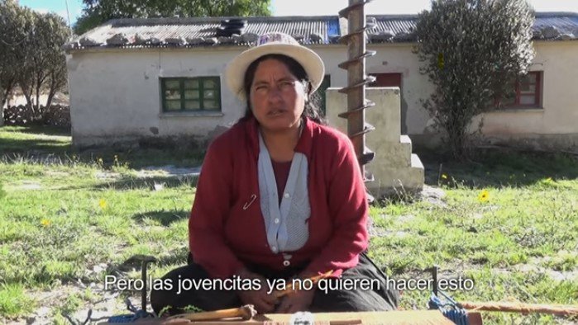
. . . and visit
Aymara of Bolivia
VIDEO: Tejiendo Relatos—”Weaving Stories"

Slide 50
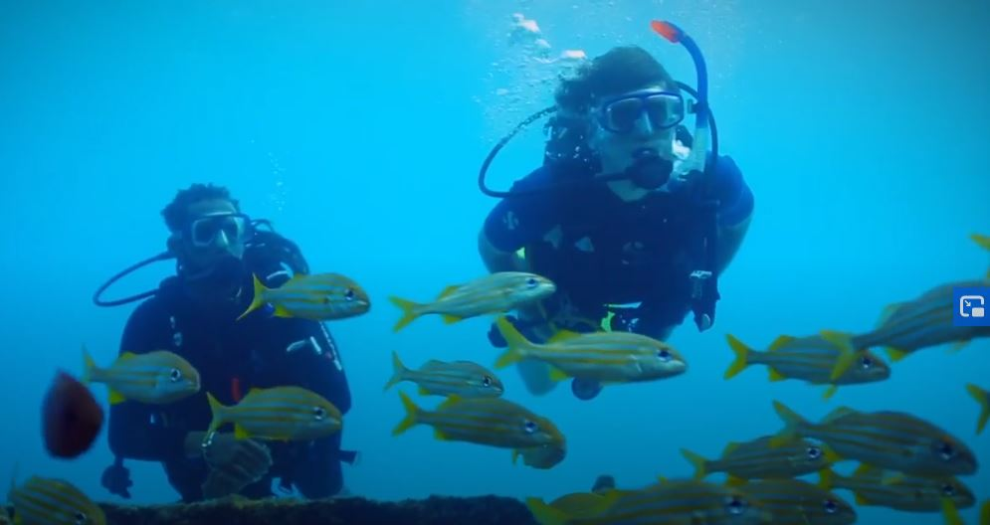
. . . and we’ll visit
The Caribbean with Simon Reeve

Slide 51
And as I mentioned earlier and in the “An Important Note on Videos and Visual Anthropology,” we would LOVE to take you along with us around the world, but the next best thing we can do is bring the world to you in the form of films and videos.
And we’ll do a lot of that.

Slide 52
So films and videos make up a very large part of this class . . .
In the best of all possible worlds, we would head off to the countries and cultures and meet and talk with the people.
That is simply not practical for this class
(but one can always sign up for one or more study abroad experiences).

Slide 53
So films and videos make up a very large part of this class . . .
In the best of all possible worlds, we would head off to the countries and cultures and meet and talk with the people.
That is simply not practical for this class
(but one can always sign up for one or more study abroad experiences).

Slide 54
So films and videos make up a very large part of this class . . .
In the best of all possible worlds, we would head off to the countries and cultures and meet and talk with the people.
That is simply not practical for this class
(but one can always sign up for one or more study abroad experiences).

Slide 55
So we’ll go
around the world
via videos
and slides

Slide 56
And what does
Leonardo DiCaprio think of this collection?

Slide 58
REM
Main Characteristics in a Nutshell

Slide 59
Main Characteristics of Anthropology
1. the four fields of general anthropology
culture as a primary concept
comparative method as major approach
holism as a primary theoretical goal
fieldwork as a primary research technique -- involving “participant observation”

Slide 60
ANTH 1080
Global Cultures
The End
Fieldwork
as a
Primary Research
Technique
© 2010-2024 Timothy G. Roufs, University of Minnesota Duluth

