Slide 1
Start deck in “Slide Show” mode,
and use your up/down arrow keys and/or
your space bar to advance the slides
© 2010-2024 Timothy G. Roufs, University of Minnesota Duluth

Slide 2
REM
indicates that the materials
are a REMinder
and are thus being repeated . . .
REMinder

Slide 3
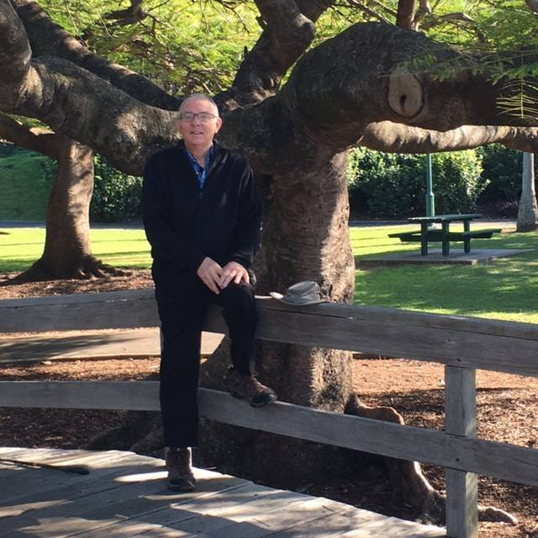
Welcome to
Global Cultures
Tim Roufs
Brisbane, Australia, 2017

Slide 4
This will be a great course . . .
you will see

Slide 5
First thing . . .
go to your Week 1
“Sunday Memo”
and check it out . . .

Slide 6
How do you find
the “Sunday Memos”
in the first place?

Slide 7
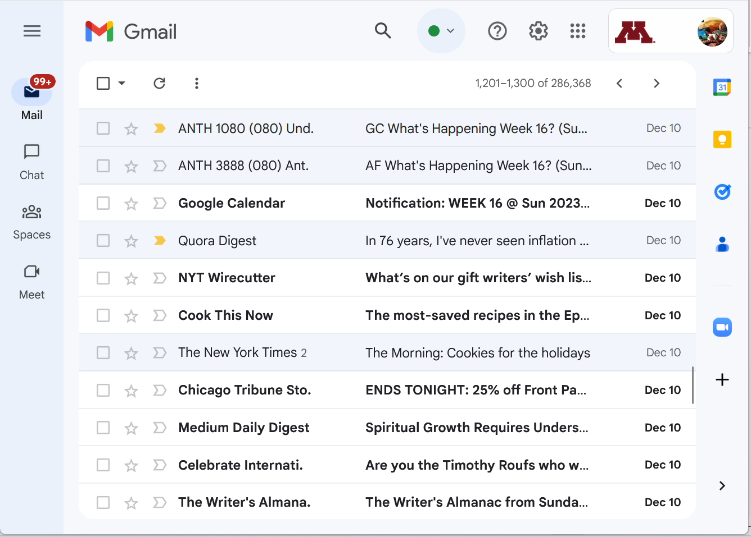
Your “Sunday Memos”
will appear in your
UM Gmail account . . .

Slide 8
“Sunday Memos”
Your “Sunday Memos”
will also appear on your
Canvas “Home” page . . .

Slide 9
“Sunday Memo” Week 1
1
Your “Sunday Memos”
will also appear on your
Canvas “Home” page . . .

Slide 10
“Sunday Memo” Week 1
scroll up
1
Your “Sunday Memos”
will also appear on your
Canvas “Home” page . . .

Slide 11
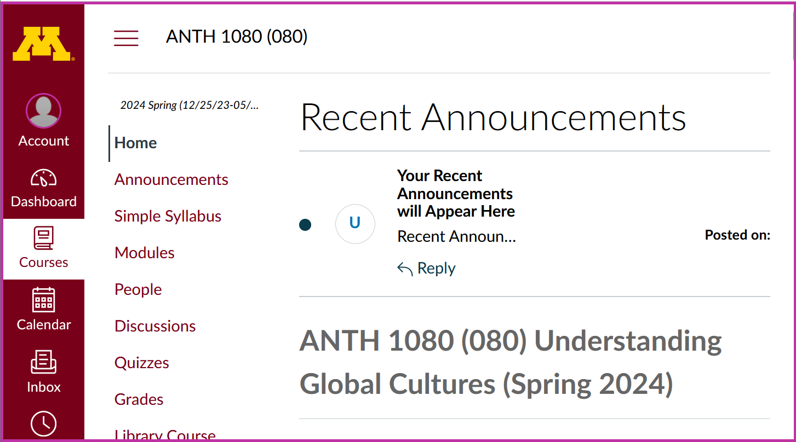
And in your “Announcements” Folder
“Sunday Memos” Recent Announcements Window.
And your “Sunday Memos”
will also appear on your
Canvas “Home” page at the top . . .

Slide 12
. . . and on a WebPage index

Slide 13
scroll down

Slide 14
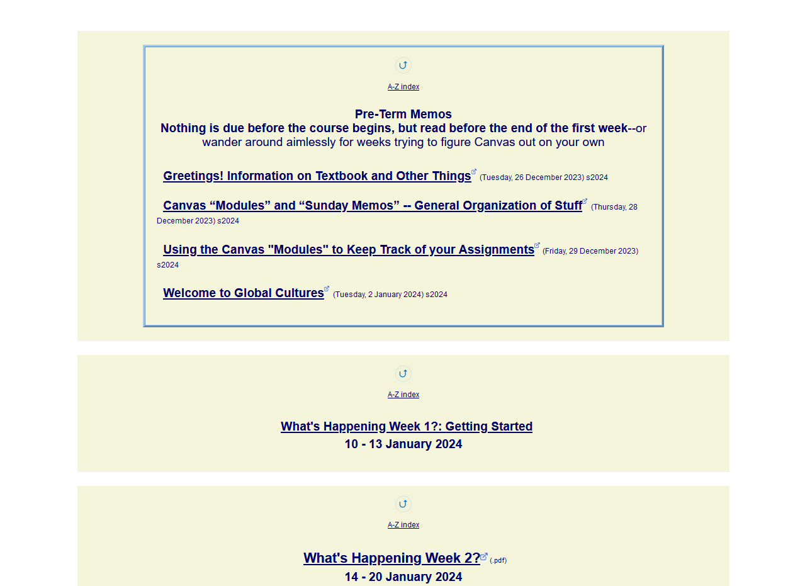
open the
Week 1 “Sunday Memo”

Slide 15
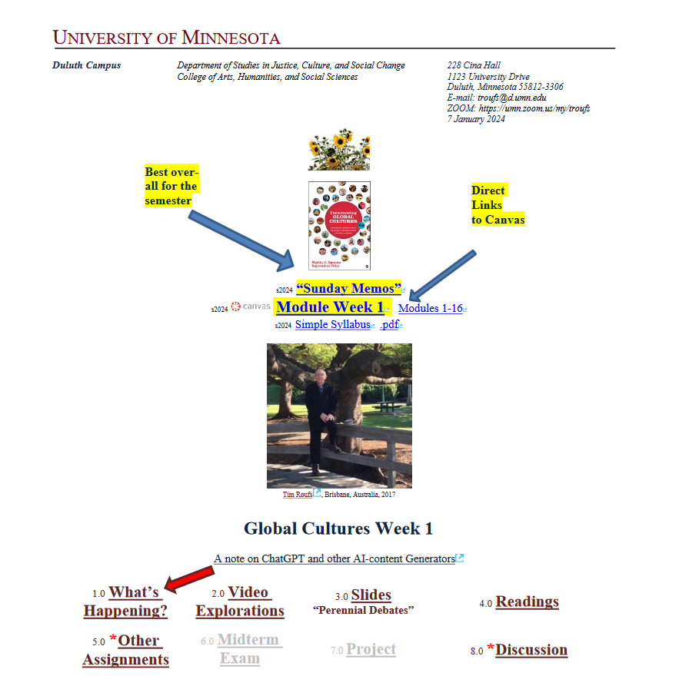
it looks like this . . .

Slide 16
check out the memo
Generally speaking,
the “Sunday Memos”
are the best place to find out
“What’s Happening”
for the week

Slide 18
(if you are not already in Canvas)
Go to your
course management site
and check it out . . .

Slide 19
How do you find your
folder?

Slide 20
Further instructions follow,
but if you want,
and your browser permits,
clicking on the URL that follows
in the next slide
will take you to your Canvas home . . .
(your browser may require that you double-click)

Slide 21
https://canvas.umn.edu
(your browser may require that you double-click)
If your browser does not allow you to click on the above URL just enter it in your browser window . . .
Continue here for further instructions . . .
There is another link at the end of this program

Slide 22
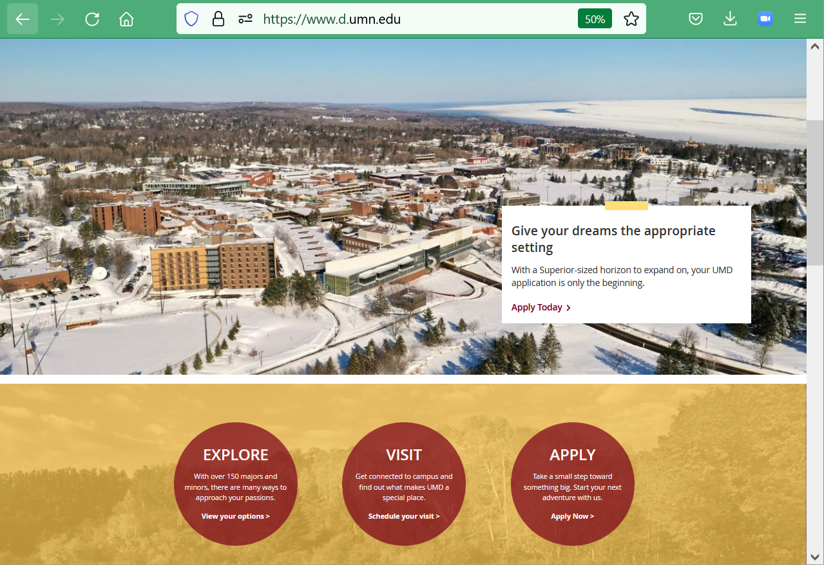
or enter:
canvas.umn.edu
here

Slide 23
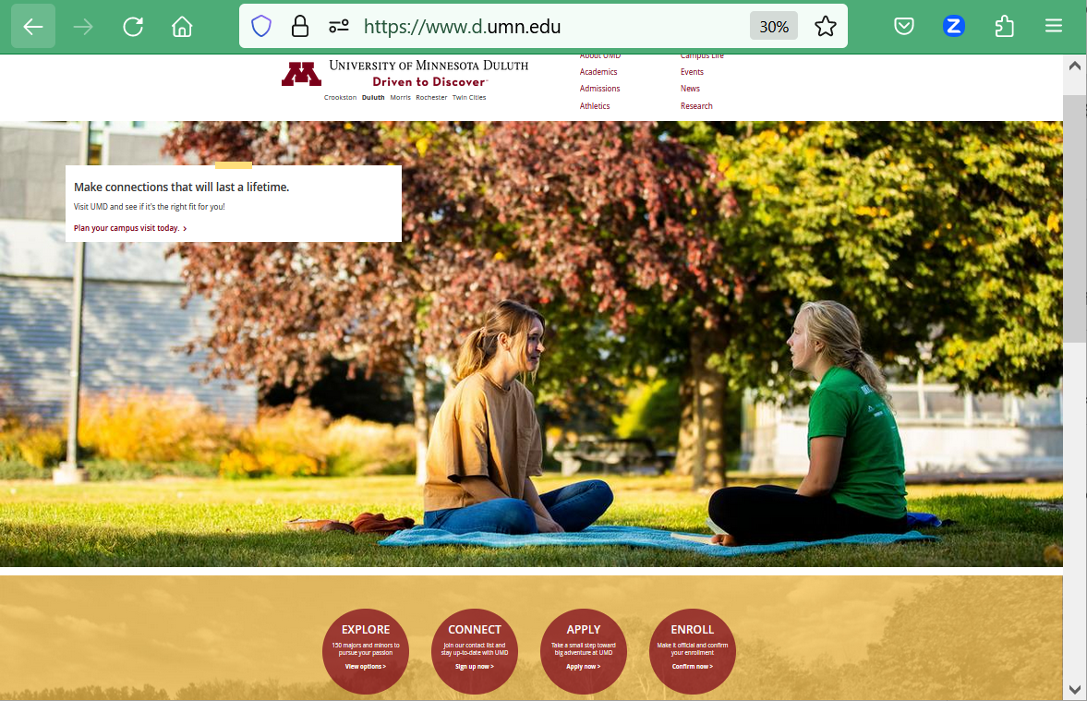
or enter:
canvas.umn.edu
here

Slide 24
or enter:
canvas.umn.edu
here

Slide 25
or Click links like this

Slide 26
You may also access your Canvas folder from any of the many
course index and content
web pages . . .

Slide 27
Click Here

Slide 28
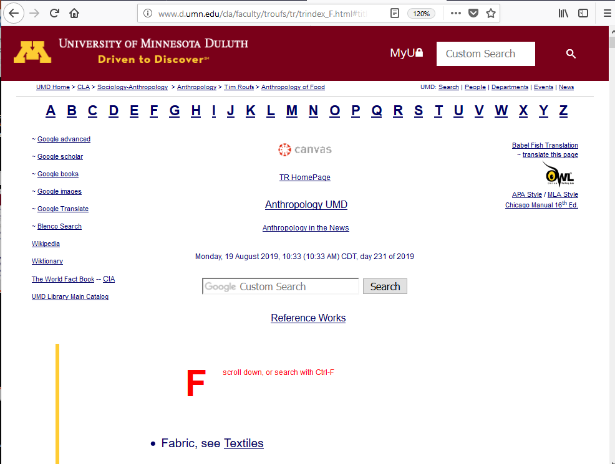
Click Here

Slide 29
Your log-in page
will then present
the UM Canvas Sign In prompt . . .

Slide 30
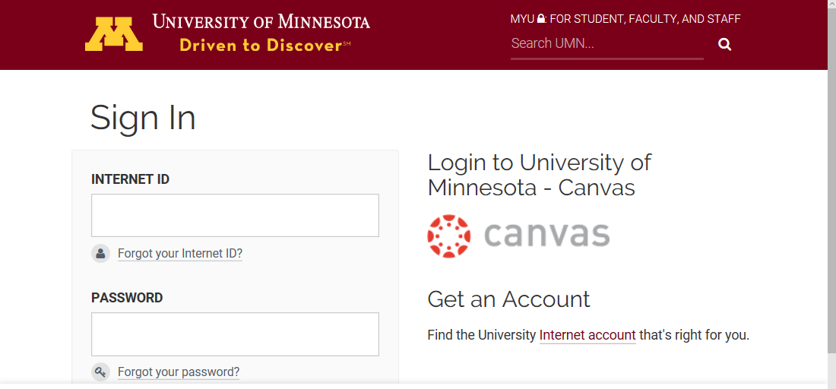
Log in using your “x.500” information . . .
(that’s the log-in information you use for your e-mail)

Slide 31
Log in using your “x.500” information . . .
(that’s the log-in information you use for your e-mail)
Log in using your “x.500” information . . .

Slide 32
Your Sign In will then bring
you to the “Duo Push” screen . . .

Slide 33
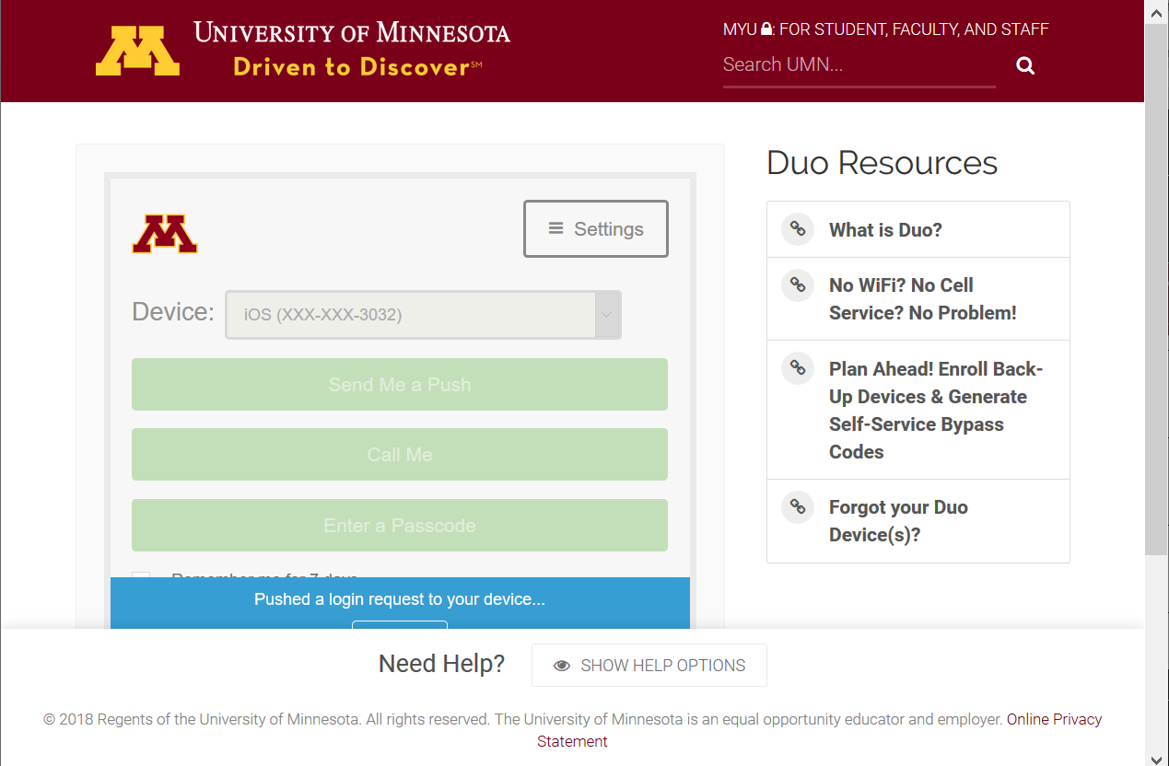

Slide 34
And the “Duo Push” will send
a Login Request
(generally) to your phone . . .

Slide 35
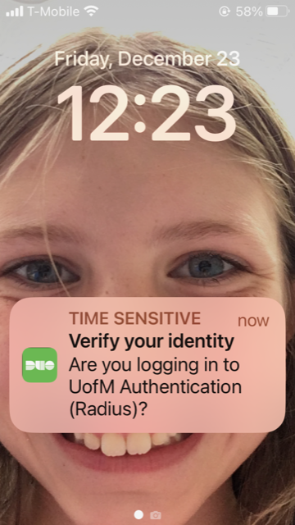
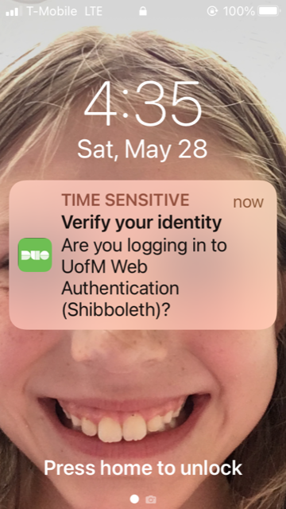
Duo Login Request Alert

Slide 36
Approve the
Login Request
and “Bob’s your uncle” . . .
1887 Lord Salisbury?

Slide 37
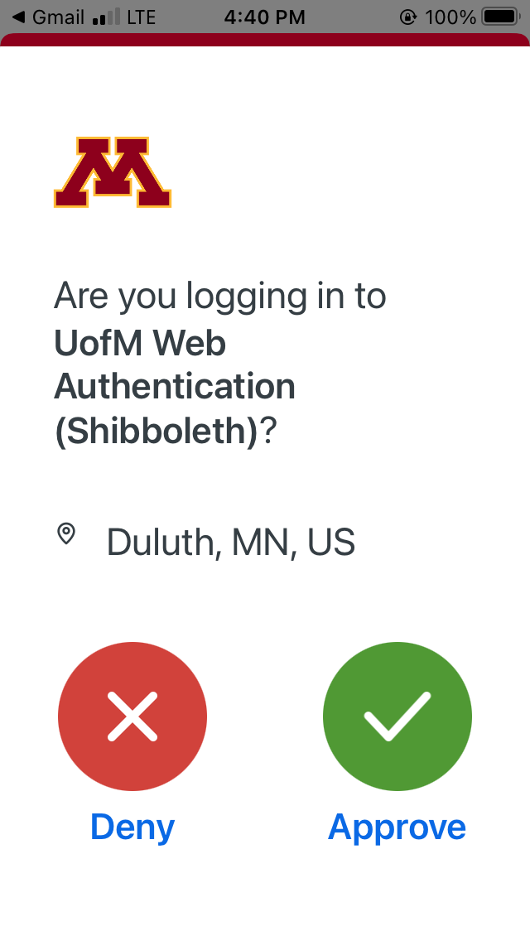
verify here in your UM e-mail

Slide 38
Your Canvas “Dashboard” on your laptop
will look something like the following . . .
https://canvas.umn.edu/

Slide 39
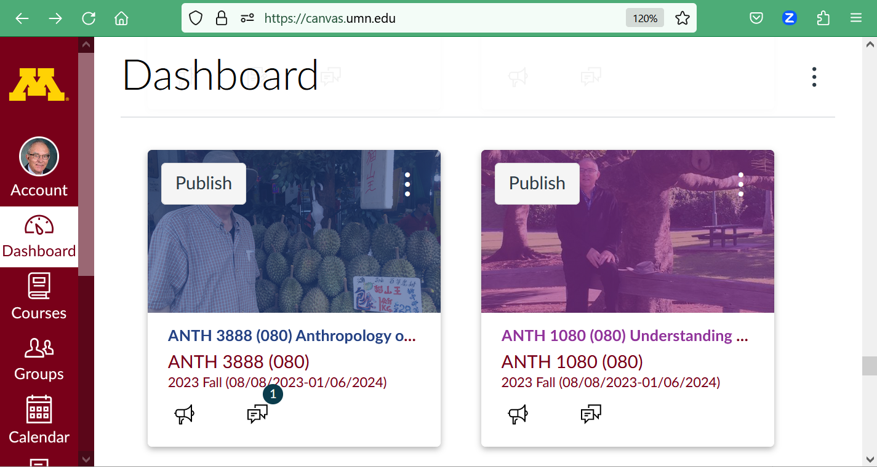
Select ANTH 1080
Dashboard
Your laptop Canvas “Dashboard” will look something like this . . .

Slide 40
Your Canvas “Dashboard” on your phone
will look something like the following . . .
https://canvas.umn.edu/

Slide 41
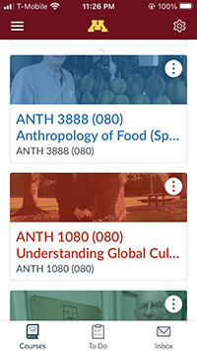
Your Canvas phone app
Dashboard screen
will look
something like this . . .

Slide 42
click on ANTH 1080

Slide 43
Your Canvas “Home” screen
on your phone
will look something like the following . . .

Slide 44
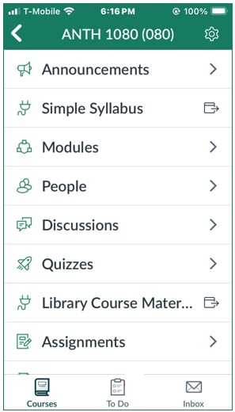
Your Canvas phone app
“Home” screen, for e.g.,
will look
something like this . . .

Slide 45
Your Canvas phone app
“Home” screen, for e.g.,
will look
something like this . . .
the weekly “What’s Happening?” memo is available here on your phone

Slide 46
NOTE: Not all Canvas features work on phone apps . . .
And different phone models work differently . . .

Slide 47
Your Canvas “Home” screen
on your laptop
will look something like the following . . .

Slide 48
Home page
Your laptop Canvas “Home” screen will look something like this

Slide 49
your laptop
Canvas folder has
two important
navigation panels . . .

Slide 50
GLOBAL navigation . . .
COURSE navigation . . .

Slide 51
global navigation

Slide 52
GLOBAL navigation . . .
and
COURSE navigation . . .

Slide 53
course navigation

Slide 54
How to hide the
“course Navigation”
panel . . .

Slide 55
use the “hamburger” button
to turn panel on/off
(the border is turned off when panel is on)

Slide 56
course navigation

Slide 57
hide course navigation panel here
use the “hamburger” button

Slide 58
course navigation panel disappears

Slide 59
global navigation remains

Slide 60
to un-hide course navigation panel
use the “hamburger” button

Slide 61
course navigation returns

Slide 62
course navigation returns
Scroll down for basic information on Home Page . . .

Slide 64
Have a look at the
“First Day Handout” . . .

Slide 65
The “First-Day” Handout information contains the basic course information . . .
It’s the syllabus
It look something like the following . . .
https://canvas.umn.edu/

Slide 66
The “First-Day” Handout information contains the basic course information . . .
It’s the syllabus
It look something like the following . . .
https://canvas.umn.edu/

Slide 67
Where to Begin?

Slide 68
Where to Begin?
Read the Week 1 “Sunday Memo”
Open your Canvas folder, select ANTH 3635, and have a look around . . .
Check out your Week 1 Canvas “Module”
Read the “First-Day” handout
Have fun

Slide 69
Where to Begin?
Read the Week 1 “Sunday Memo”
Open your Canvas folder, select ANTH 1080, and have a look around . . .
Check out your Week 1 Canvas “Module”
Read the “First-Day” handout
Have fun

Slide 70
Where to Begin?
Read the Week 1 “Sunday Memo”
Open your Canvas folder, select ANTH 1080, and have a look around . . .
Check out your Week 1 Canvas “Module”
Read the “First-Day” handout
Have fun

Slide 71
Where to Begin?
Read the Week 1 “Sunday Memo”
Open your Canvas folder, select ANTH 1080, and have a look around . . .
Check out your Week 1 Canvas “Module”
Read the “First-Day” handout
Have fun

Slide 72
Where to Begin?
Read the Week 1 “Sunday Memo”
Open your Canvas folder, select ANTH 1080, and have a look around . . .
Check out your Week 1 Canvas “Module”
Read the “First-Day” handout
Have fun

Slide 73
Where to Begin?
Read the Week 1 “Sunday Memo”
Open your Canvas folder, select ANTH 1080, and have a look around . . .
Check out your Week 1 Canvas “Module”
Read the “First-Day” handout
Have fun

Slide 74
REM
Select ANTH 1080
Dashboard
Your laptop Canvas “Dashboard” will look something like this . . .

Slide 75
AVISO!
One of the main complaints regarding Canvas is that it is difficult to find assignments.
Right now, before you do anything else,
do this to fix that problem . . .
Go to the "Modules" Section
(using the Course Navigation Panel)

Slide 76
AVISO!
One of the main complaints regarding Canvas is that it is difficult to find assignments.
Right now, before you do anything else,
do this to fix that problem . . .
Go to the "Modules" Section
(using the Course Navigation Panel)

Slide 77
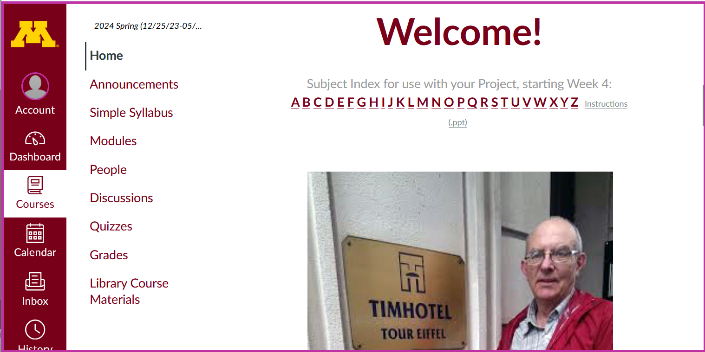
GENERAL LINK TO ALL MODULES

Slide 78
. . . and that will take you
to the Modules folder,
which looks
something like this . . .

Slide 80
COLLAPSE / EXPAND ALL SECTIONS AT ONCE HERE

Slide 81
Then open each Module
one-by-one
as you need it / them . . .

Slide 82
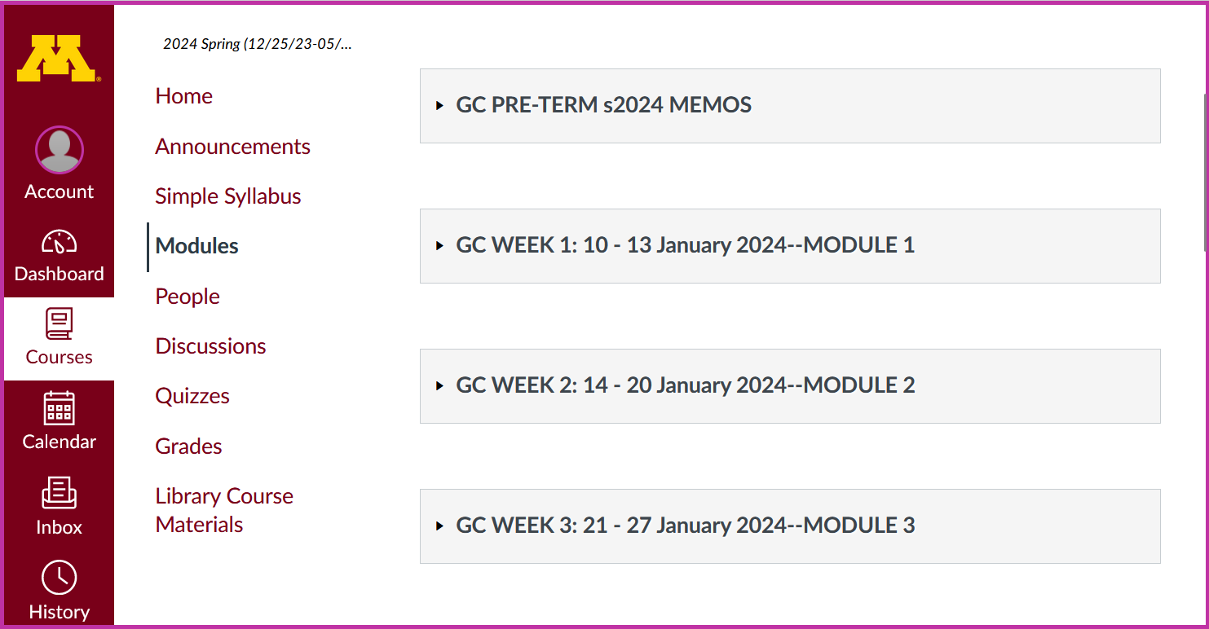
open / close Modules as you need them

Slide 83
And the expanded
Week 1 Module
will look like this . . .

Slide 84
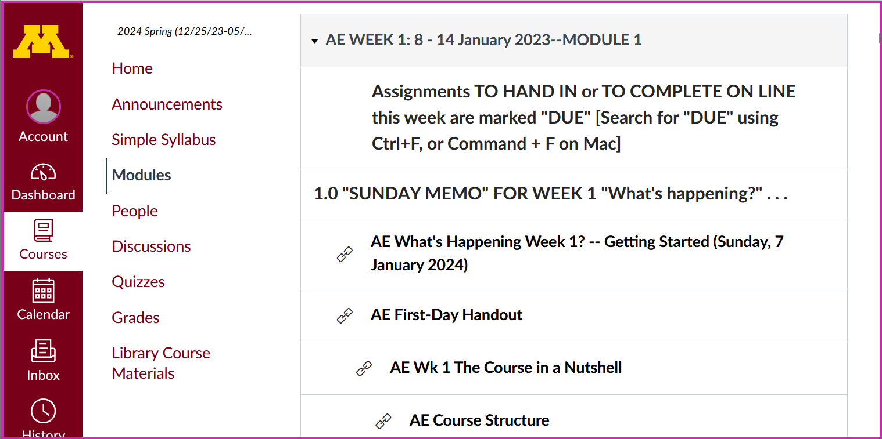

Slide 85
To get started
with the basics of the course,
check out the Week 1 “Sunday Memo”
"What's Happening Week 1?
-- Getting Started" . . .

Slide 86
Getting Started

Slide 87
After you are done with that check out
the "First Day Handout” . . .
(the class syllabus) . . .

Slide 88
First-Day handout

Slide 90
to return to the beginning from anywhere, simply click “Home”

Slide 91
Other useful information . . .

Slide 92
Simple Syllabus
Try the Simple Syllabus . . .

Slide 93
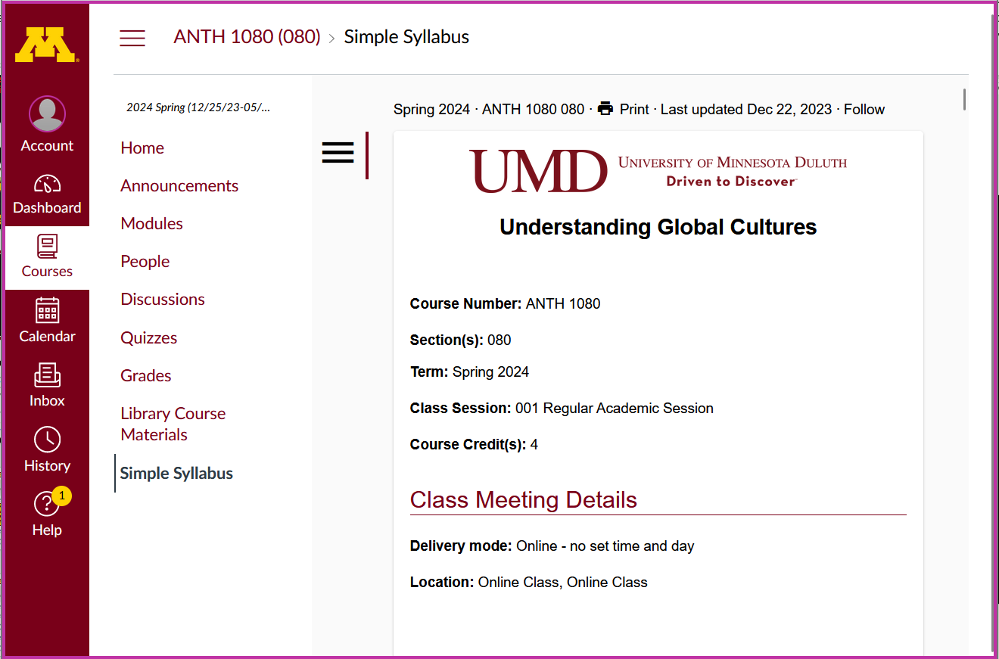

Slide 94
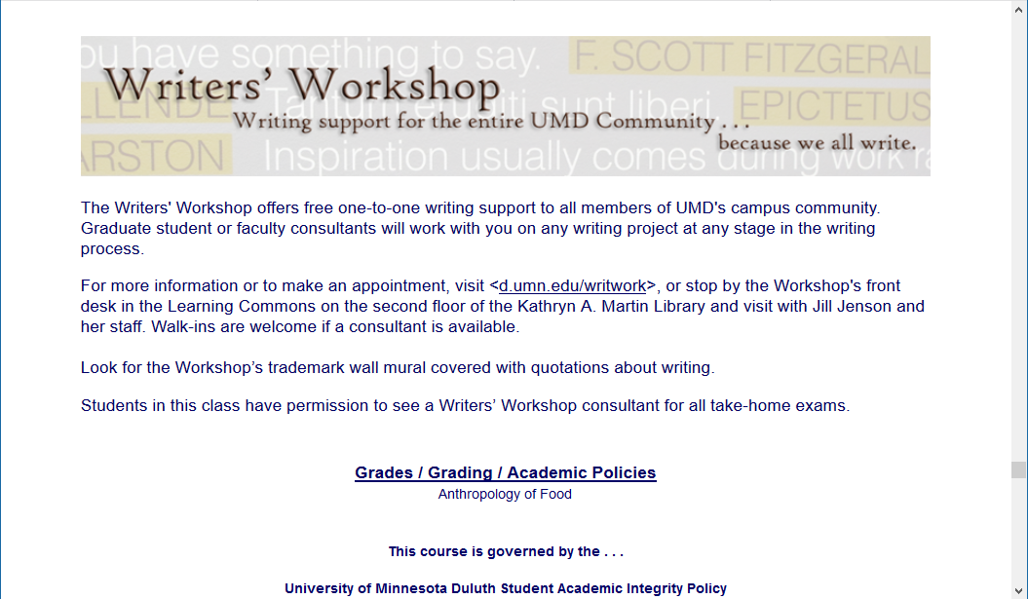
Other Useful Information . . .
Writers’ Workshop
is an excellent resource for
Everyone!
Second Floor UMD Library

Slide 95
Other Useful Information . . .

Slide 96
Governing Procedures
pay attention . . .

Slide 97
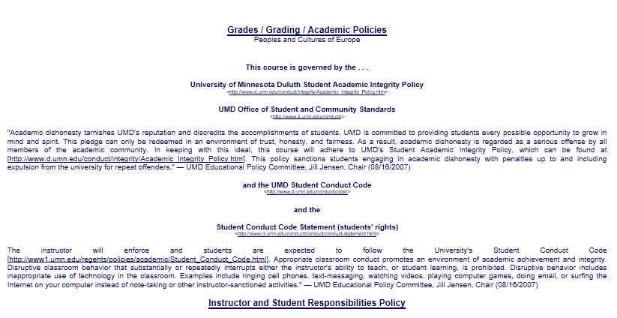

Slide 98
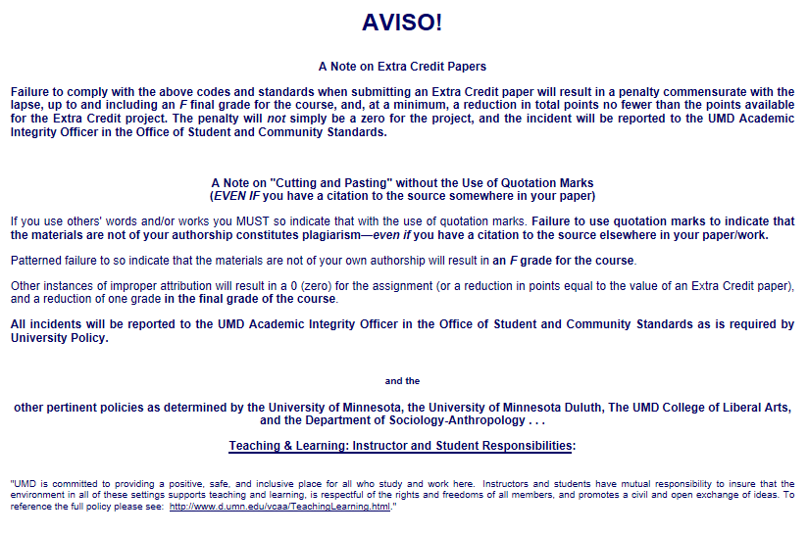

Slide 99
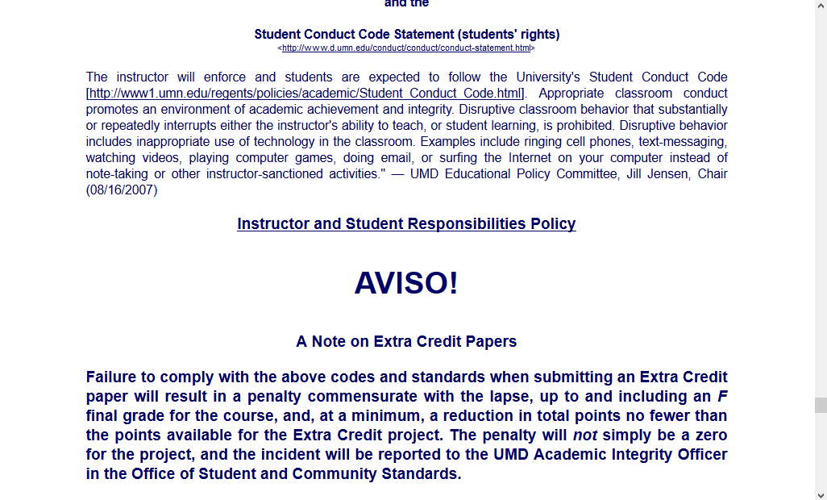
NB: Governing Procedures
note on Extra Credit Papers

Slide 101
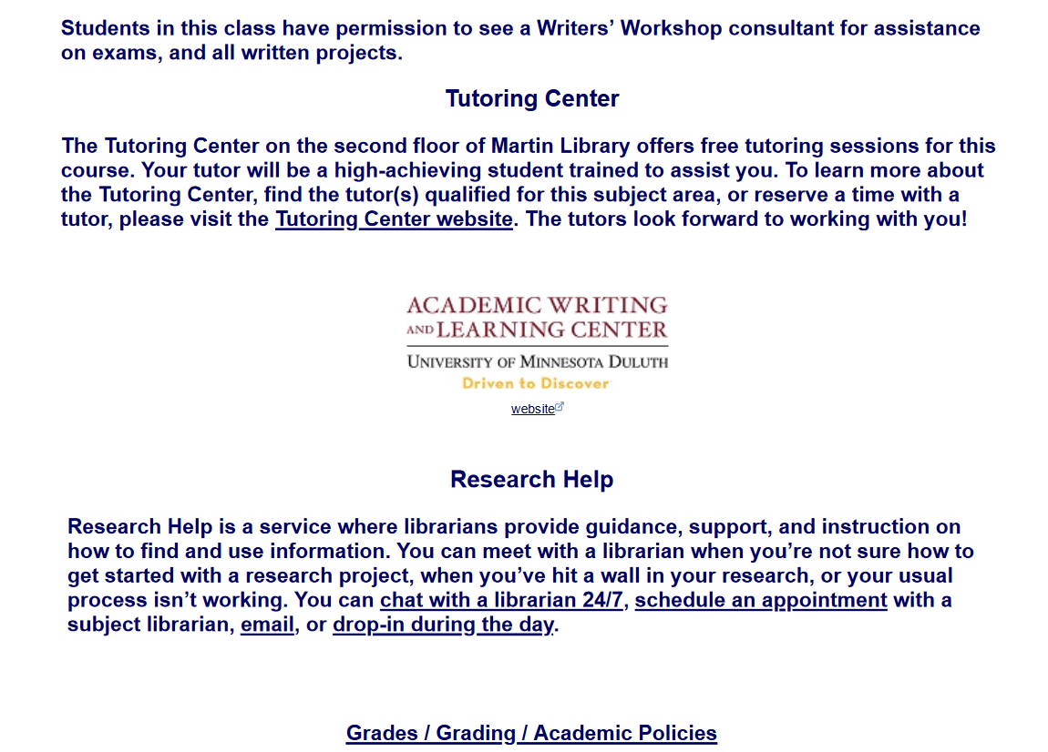

Slide 103
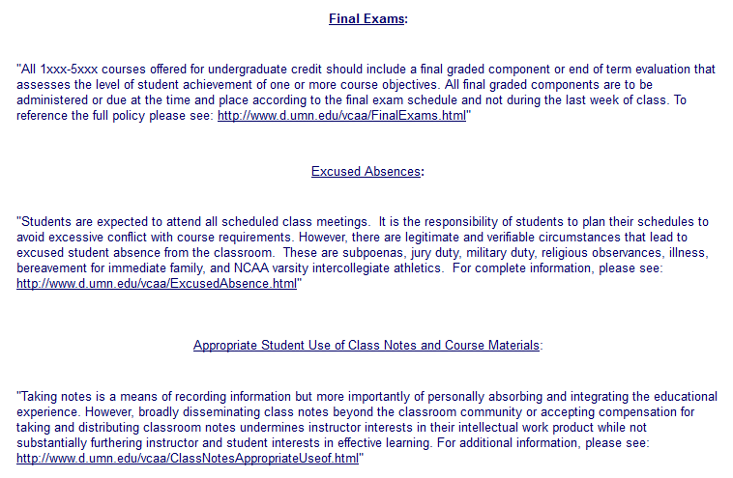

Slide 104
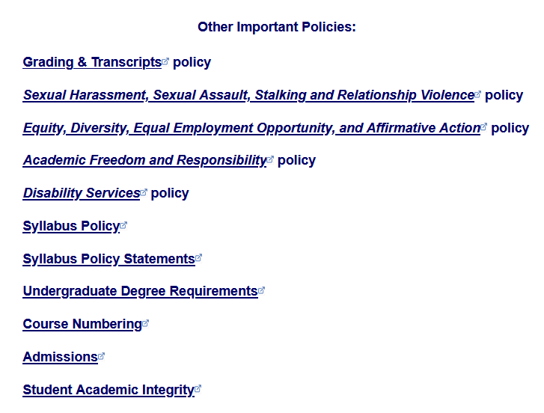

Slide 105
Special Facilities Information

Slide 108
Once again . . .
Welcome to
Global Cultures
© 2010-2024 Timothy G. Roufs, University of Minnesota Duluth

Slide 109
Once again . . .
Welcome to
Global Cultures
Enjoy your stay!
© 2010-2024 Timothy G. Roufs, University of Minnesota Duluth

Slide 110
as we go
around the world . . .

Slide 111
© 2010-2024 Timothy G. Roufs, University of Minnesota Duluth

Slide 112
http://www.d.umn.edu/cla/faculty/troufs/index.html
0

