Slide 1
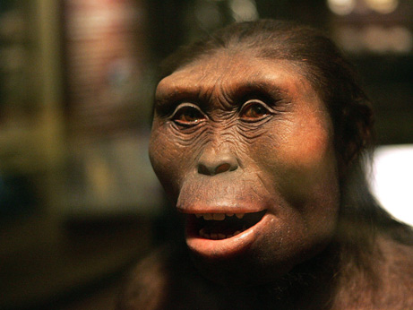
use your up/down arrow keys and/or
your space bar to advance the slides
Other
Important
Terms
Prehistoric Cultures
University of Minnesota Duluth
"Selam"
aka "Lucy's Baby”
Tim Roufs © 2010-2013
http://www.d.umn.edu/cla/faculty/troufs/anth1602/

Slide 2
Other
Important
Terms
Prehistoric Cultures
University of Minnesota Duluth
"Selam"
aka "Lucy's Baby”
Tim Roufs © 2010-2013
http://www.d.umn.edu/cla/faculty/troufs/anth1602/

Slide 3
. . . and one or more of these term clarifications
might prove interesting, and even helpful with your exams and class projects

Slide 4
this is the same chart as in the
“Main Characteristics of Anthropology”
material

Slide 5
difficult terms

Slide 6
ethnography
scientific description of cultures
(“a portrait of a people”)

Slide 7
ethno – graphy
graph from the Greek, meaning something “written” or “drawn”

Slide 8
ethno – graphy
ethnography looks at “who,” “what,” “where” and “when”

Slide 9
ethnology
comparative study of cultures

Slide 10
ethn – ology
comparative study of cultures

Slide 11
ethn – ology
ethnology looks at “why” and “how”

Slide 12
ethnology
comparative study of cultures

Slide 13
ethnology
comparative study of cultures
take out the n and that yields an entirely different word . . .

Slide 14
ethology
comparative study of cultures
scientific study of the social behavior of animals, especially in their natural environments

Slide 15
primatology
scientific study of the social behavior of primates, especially (non-human primates) apes and monkeys

Slide 16
primatology
scientific study of the social behavior of primates, especially (non-human primates) apes and monkeys
we’ll see this in Ch. 6, “An Overview of the Primates”
Ch. 7, “Primate Behavior”

Slide 17
“primatologist”
usually refers to one who studies the behavior and social lives of chimpanzees, gorillas, orangutans, monkeys, etc.
e.g., Jane Goodall, Diane Fossy
Birute Galdikas-Brindamour

Slide 18
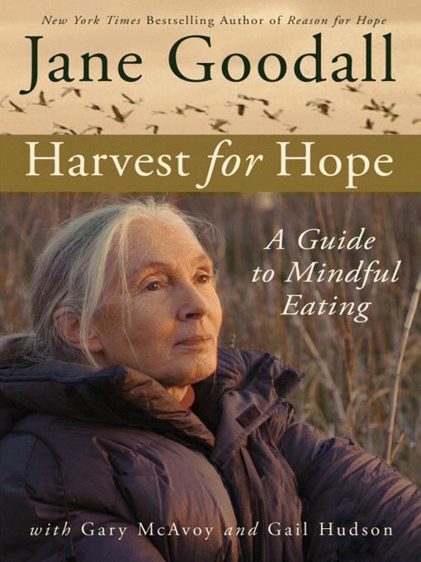
Jane Goodall is the most famous primatologist of all time . . .
Grand Central Publishing, 2006

Slide 19
“primates” include
prosimians (“pre-monkeys”)
monkeys
apes
and also humans

Slide 20
include
“primates”
prosimians (“pre-monkeys”)
monkeys
apes
and also humans

Slide 21
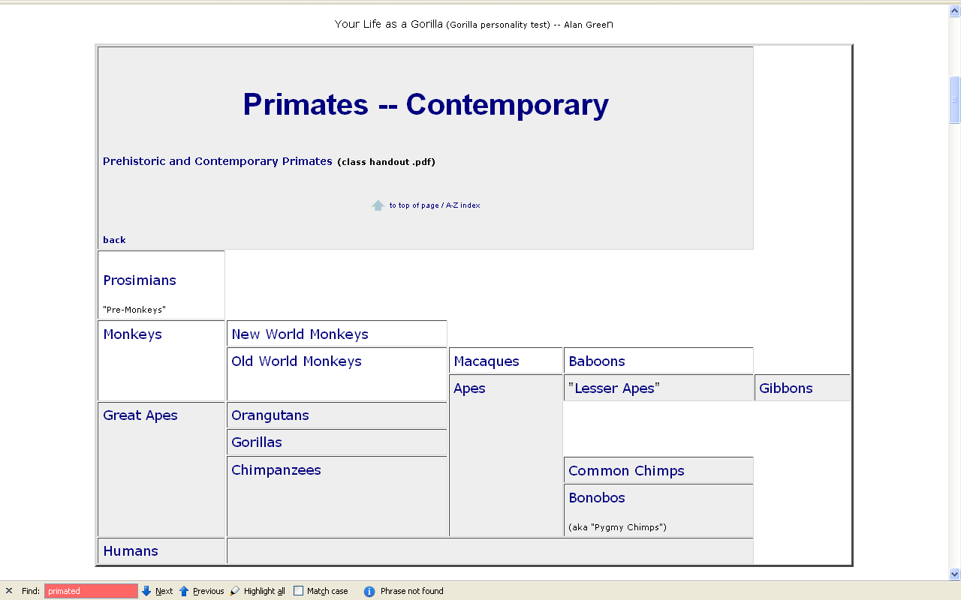
www.d.umn.edu/cla/faculty/troufs/anth1602/pcprim.html

Slide 22
“non-human primates” are
prosimians (“pre-monkeys”)
monkeys
apes

Slide 23
“non-human primates”
www.d.umn.edu/cla/faculty/troufs/anth1602/pcprim.html

Slide 24
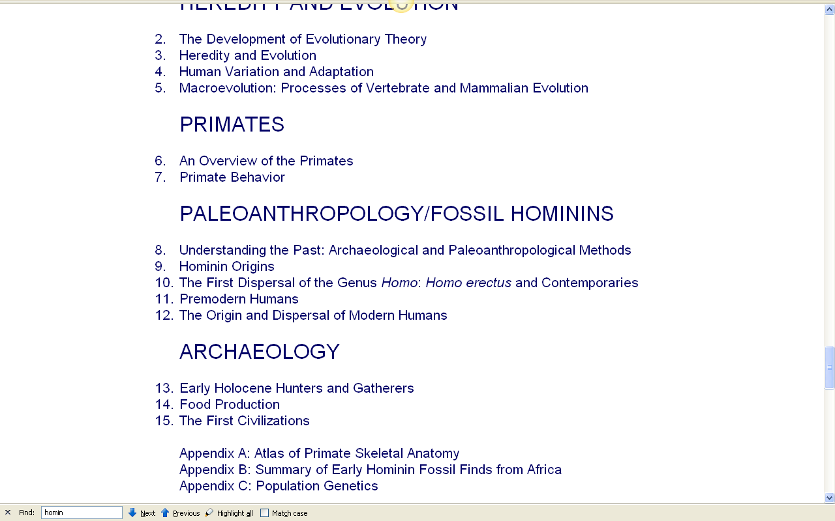
with regard to primates, note one major recent change . . .

Slide 25
with regard to primates, note one major recent change . . .
“hominins” is now generally used rather than “hominids”

Slide 26
this reflects a relatively recent change in the classification of the Great Apes and prehistoric forms like “Lucy”
“hominins” is now generally used rather than “hominids”

Slide 27
other important terms include . . .

Slide 28
ethnocentrism
judging other cultures by the standards of one’s own culture rather than by the standards of that particular culture

Slide 29
two fundamental concepts in anthropology are . . .
ethnocentrism
judging other cultures by the standards of one’s own culture rather than by the standards of that particular culture
cultural relativism

Slide 30
ethnocentrism
is the mindset of judging other cultures by the standards of one’s own culture rather than by the standards of that particular culture

Slide 31
cultural relativism
refers to the perspective that each culture must be understood in terms of the values and ideas of that culture and should not be judged by the standards of another

Slide 32
in recent times two types of cultural relativism have emerged . . .
cultural relativism
absolute cultural relativism
critical cultural relativism

Slide 33
the term as originally proposed came to be referred to as . . .
in recent times two types of cultural relativism have emerged . . .
cultural relativism
absolute cultural relativism
critical cultural relativism

Slide 34
absolute cultural relativism
the perspective that says a person from one culture should not question the rightness or wrongness of behavior or ideas in other cultures because that would be ethnocentric

Slide 35
absolute cultural relativism
was quickly criticized as unacceptable as, taken literally, [absolute] cultural relativism suggested we should accept anything and everything that was thought to be OK by the people under consideration

Slide 36
absolute cultural relativism
critics quickly pointed to Hitler and the World War II Holocaust and (rightfully) said that no one should accept behaviors that resulted in The [WW II] Holocaust; that such behavior was unacceptable under any circumstances

Slide 37
absolute cultural relativism
and the critics added enough other examples so that the original concept of cultural relativism was modified and resulted in today’s concept of
critical cultural relativism

Slide 38
critical cultural relativism
offers an alternative view that poses questions about cultural practices and ideas in terms of who accepts them and why, and who they might be harming or helping

Slide 39
critical cultural relativism . . .
answered many of the early critics
but—even accepting the modified concept—it is oftentimes not easy to figure out what “. . . in terms of who accepts them and why, and who they might be harming or helping” means

Slide 40
critical cultural relativism . . .
let’s look at a few examples of where
“it is oftentimes not easy to figure out what ‘. . . in terms of who accepts them and why, and who they might be harming or helping’ means” . . .

Slide 41
absolute cultural relativism
how about?
doctor assisted suicide
arranged “underage” marriage
female genital mutilations
withholding of medical treatment of children for religious reasons
polygyny . . .

Slide 42
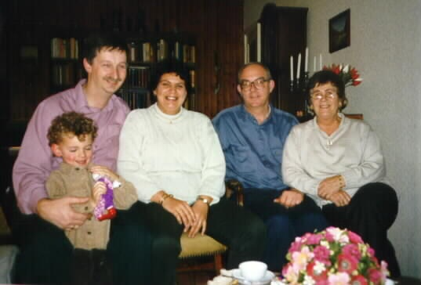
in many places doctor assisted suicide is legal, perfectly acceptable to many if not most, of the members of a culture

Slide 43
is that OK?

Slide 44
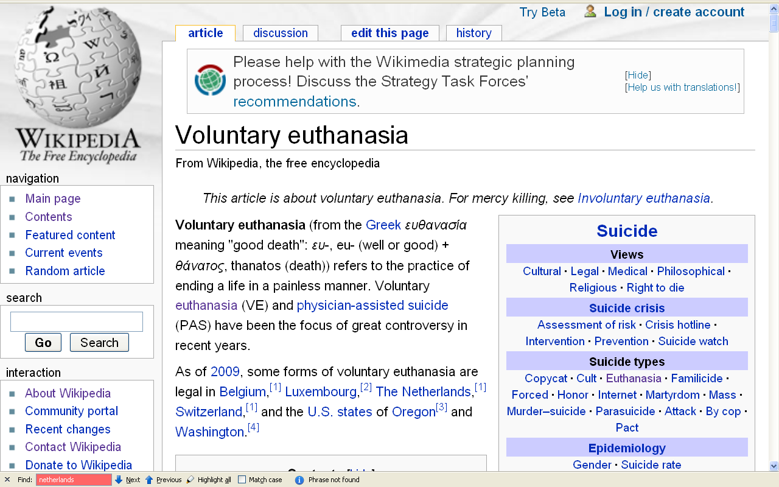
people living in the states of Oregon and Washington, and the countries of Belgium, Luxembourg, The Netherlands and Switzerland think so (for e.g.)
\ http://en.wikipedia.org/wiki/Voluntary_euthanasia

Slide 45
absolute cultural relativism
how about?
Doctor Assisted Suicide
arranged “underage” marriage
female genital mutilations
withholding of medical treatment of children for religious reasons
polygyny . . .

Slide 46
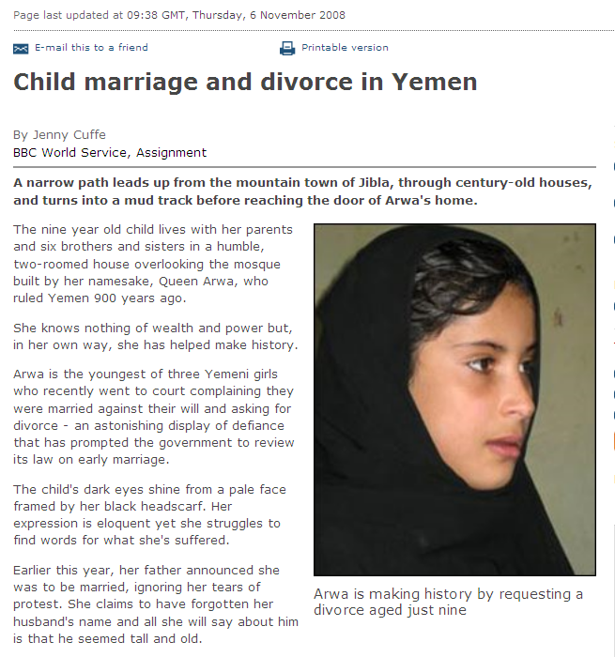
a 9-year-old requests a divorce in Yemen
http://news.bbc.co.uk/2/hi/middle_east/7711554.stm
Notes:
46

Slide 47
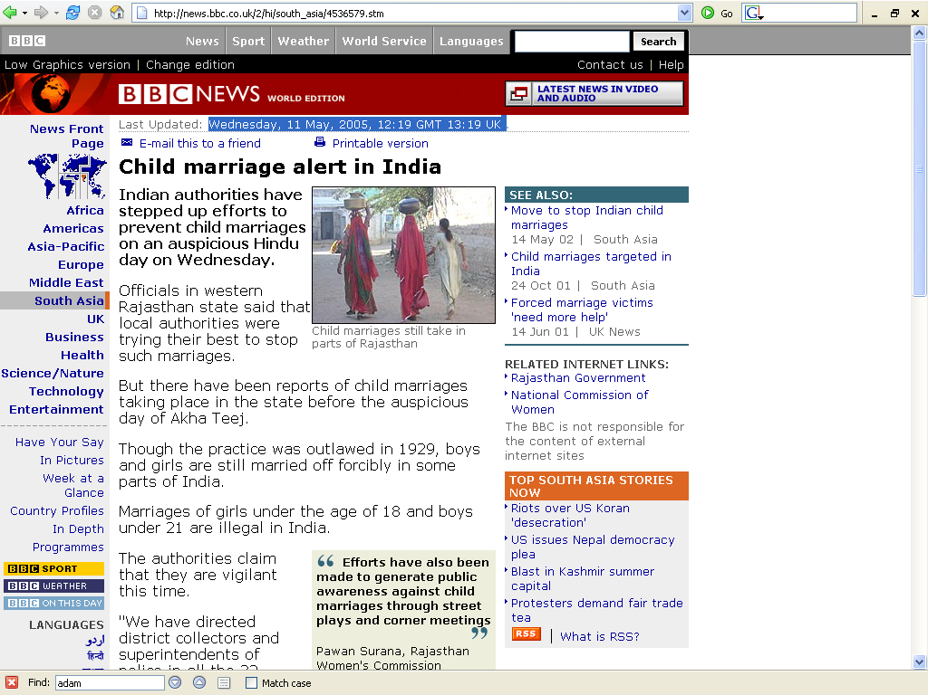
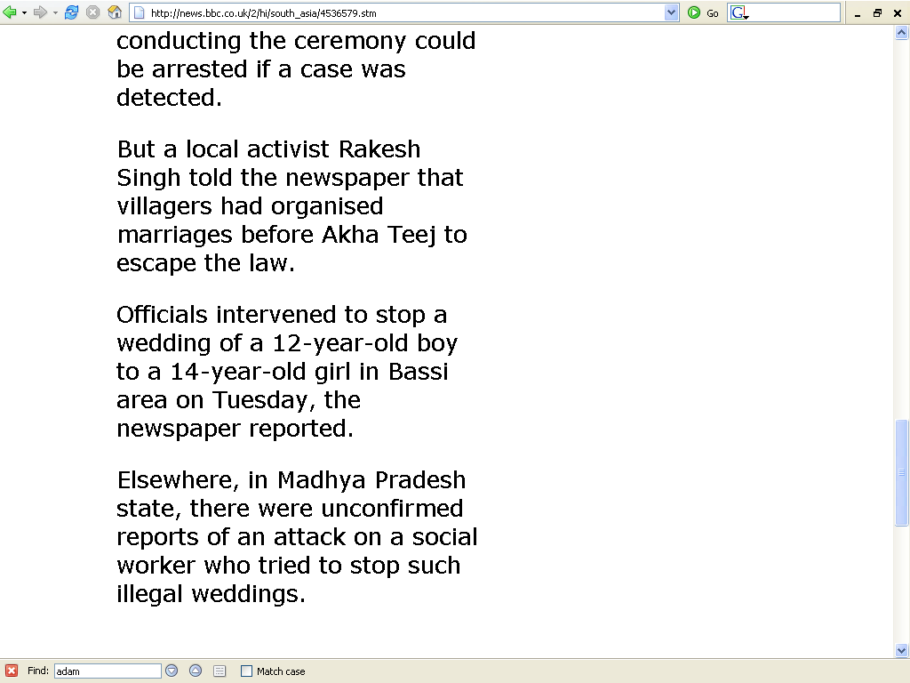
http://news.bbc.co.uk/2/hi/south_asia/4536579.stm

Slide 48
N!ai, one of the little girls in the film The Hunters,
was married to Gunda at the age of 8

Slide 49
we’ll see The Hunters and N!ai! (as a little girl) Week 13
N!ai, one of the little girls in the film The Hunters,
was married to Gunda at the age of 8

Slide 50
absolute cultural relativism
how about?
Doctor Assisted Suicide
arranged “underage” marriage
female genital mutilations
withholding of medical treatment of children for religious reasons
polygyny . . .

Slide 51
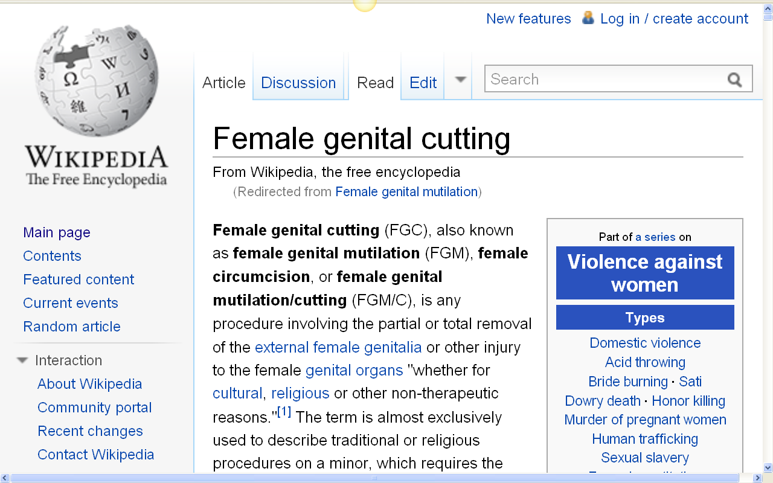
http://en.wikipedia.org/wiki/Female_genital_mutilation

Slide 52
absolute cultural relativism
how about?
Doctor Assisted Suicide
arranged “underage” marriage
female genital mutilations
withholding of medical treatment of children for religious reasons
polygyny . . .

Slide 53
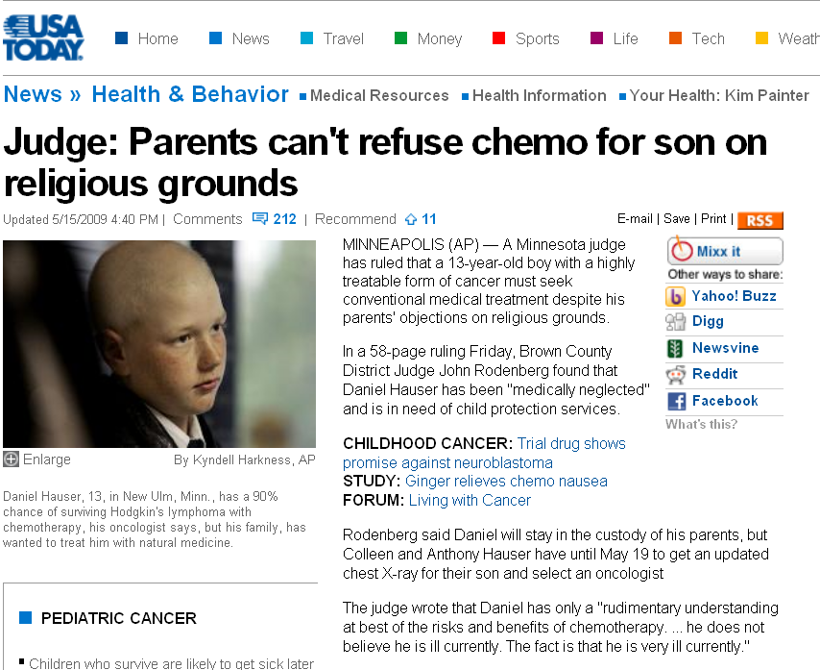
this is in Minnesota, not Africa
www.usatoday.com/news/health/2009-05-15-forced-chemotherapy_N.htm

Slide 54
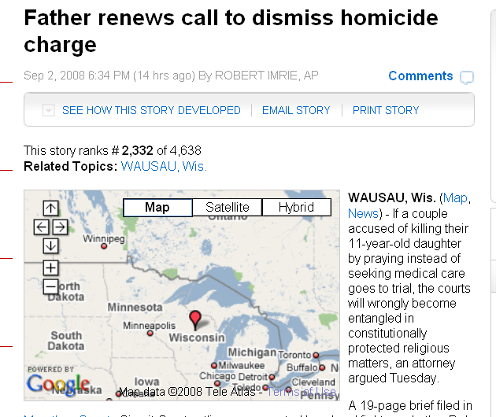
this is in Wisconsin, not Minnesota
www.examiner.com/a-1567034~Father_renews_call_to_dismiss_homicide_charge.html

Slide 55
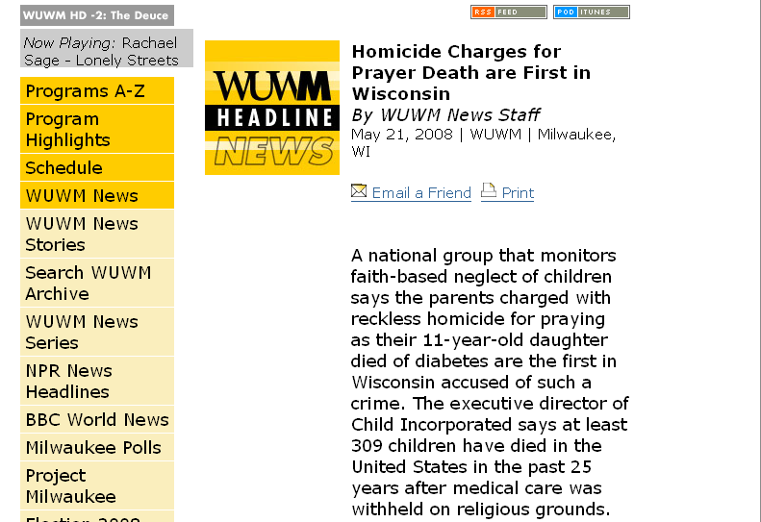
www.wuwm.com/programs/news/view_news.php?articleid=2242

Slide 56
absolute cultural relativism
how about?
Doctor Assisted Suicide
arranged “underage” marriage
female genital mutilations
withholding of medical treatment of children for religious reasons
polygyny . . .

Slide 57
http://www.d.umn.edu/cla/faculty/troufs/anth1602/video/Yanomamo.html

Slide 58
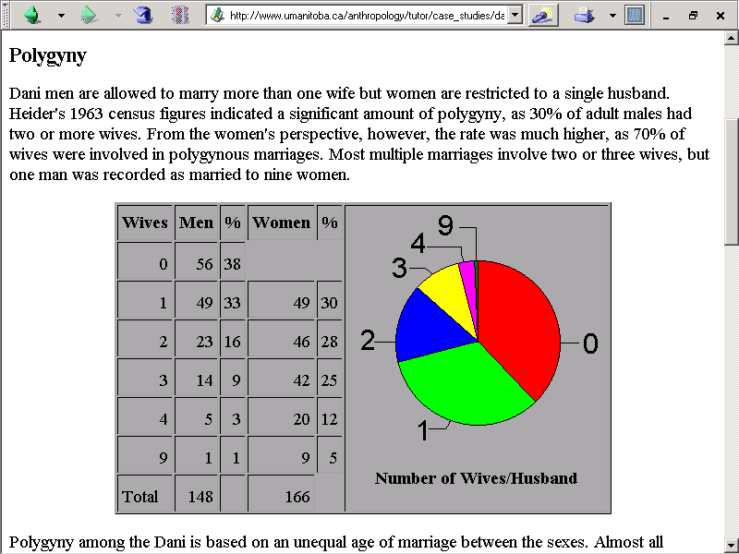
http://www.umanitoba.ca/anthropology/tutor/case_studies/dani/marriage.html

Slide 59
Compare . . .
www.d.umn.edu/cla/faculty/troufs/anth1602/video/Yanomamo.html#title

Slide 60
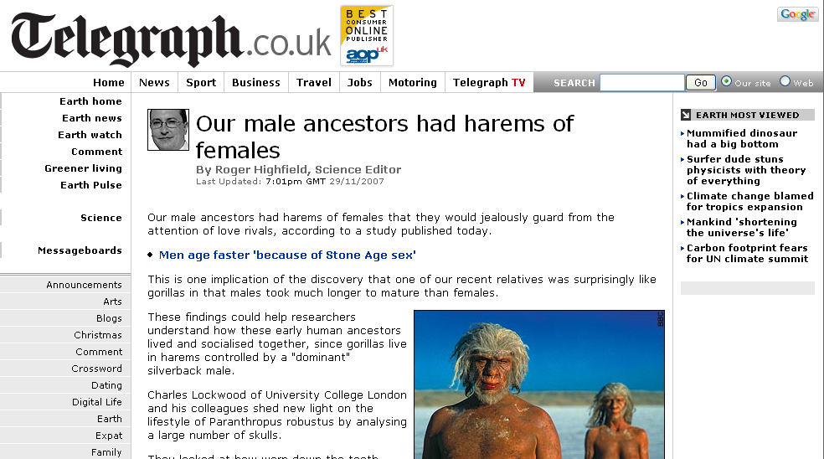
www.telegraph.co.uk/earth/main.jhtml?xml=/earth/2007/11/29/sciharem129.xml
Notes:
60

Slide 61
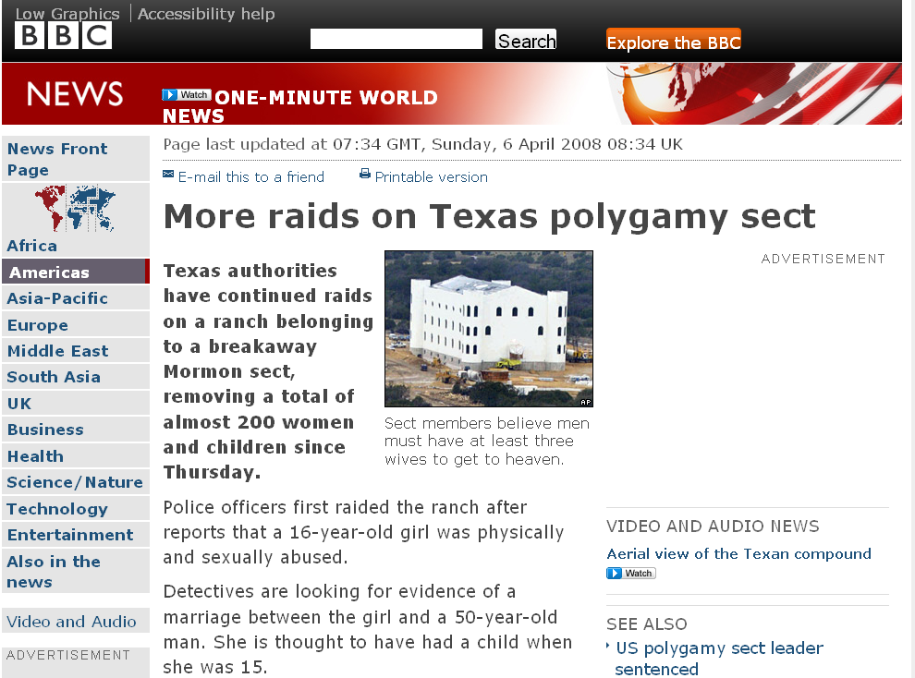
http://news.bbc.co.uk/2/hi/americas/7333004.stm

Slide 62
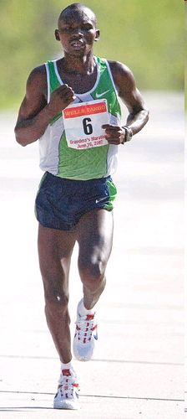
Grandma's Marathon: Remembering a fallen champion
Kevin Pates Duluth News Tribune Published Sunday, June 15, 2008
There will be a moment of silence before the start of Saturday’s 32nd Grandma’s Marathon.
Standing on North Shore Drive, just south of Two Harbors, Stephen Muturi will gather his thoughts and emotions before the day’s task of running 26.2 miles.
He’ll remember close friend and countryman Wesly Ngetich, last year’s champion, who was killed Jan. 21 at Emarti village in Kenya’s Trans Mara district. Ngetich was caught in the middle of an incident that turned violent. He was 31 and had two wives and three children, ages 8, 6 and 1. “Wesly was a peacemaker. . . .”
www.duluthnewstribune.com/articles/index.cfm?id=68557
Notes:
62

Slide 63
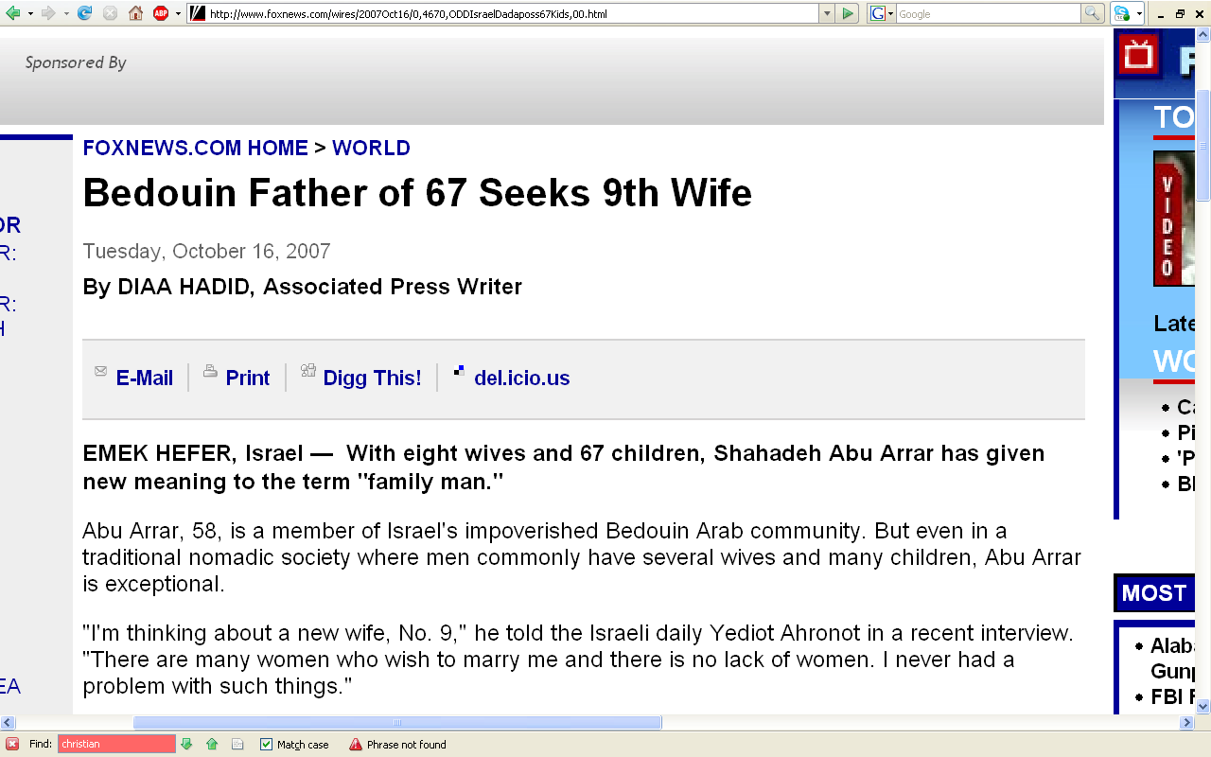
http://www.foxnews.com/wires/2007Oct16/0,4670,ODDIsraelDadaposs67Kids,00.html

Slide 64
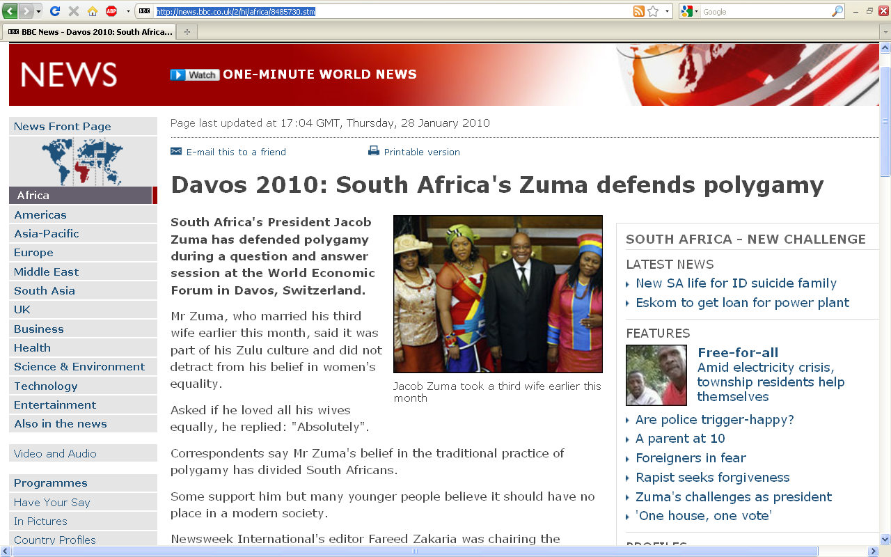
http://news.bbc.co.uk/2/hi/africa/8485730.stm
Notes:
64

Slide 65
absolute cultural relativism
how about ? . . .
cannibalism

Slide 66
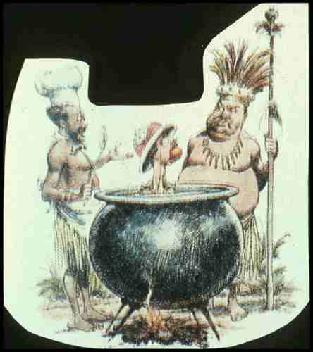

Slide 67
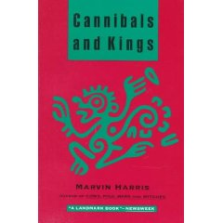
Marvin Harris (of “cultural materialism” fame) writes about cannibalism
from an anthropological view
Knopf 1991

Slide 68
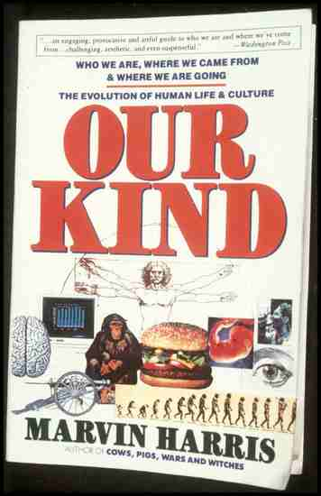

Slide 69
cannibalism
Moula-Gercy, France
“Bones Offer Evidence of a Neanderthal - Eat - Neanderthal World”
78 fragments from 6 skeletons
ca. 100,000 ybp
30 September 1999

Slide 70
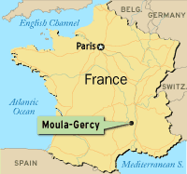
ABACNEWS.com/MagellanGeographix

Slide 71
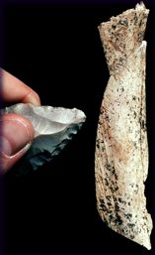
Fragment of a Neandertal thigh bone
UCAL Berkeley / AP Photo

Slide 72
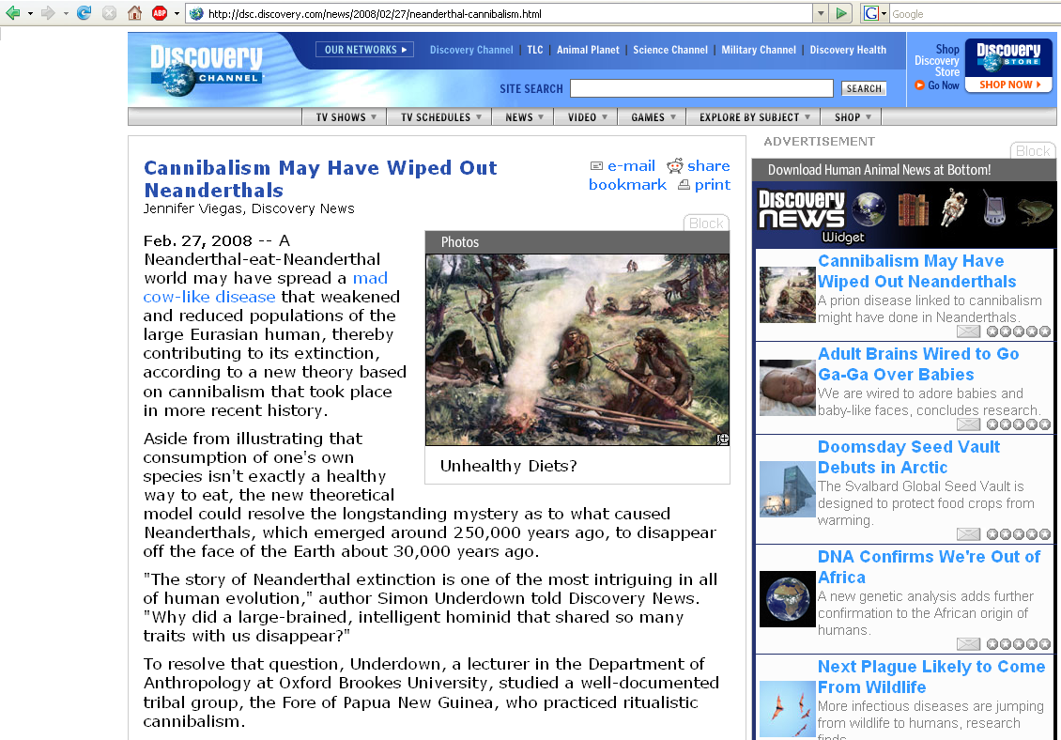
http://dsc.discovery.com/news/2008/02/27/neanderthal-cannibalism.html
Notes:
72

Slide 75
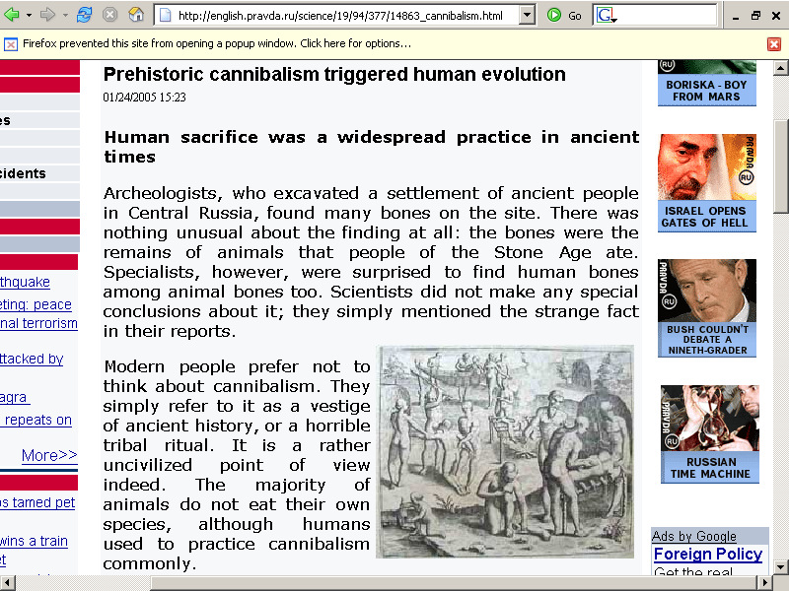
http://english.pravda.ru/science/19/94/377/14863_cannibalism.html

Slide 76
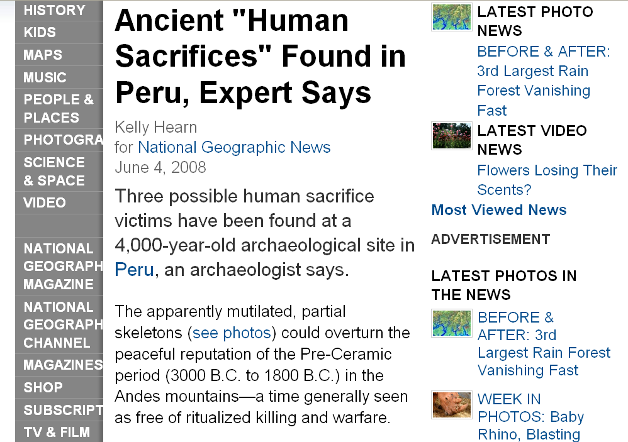
http://news.nationalgeographic.com/news/2008/06/080604-human-sacrifice.html
Notes:
76

Slide 77
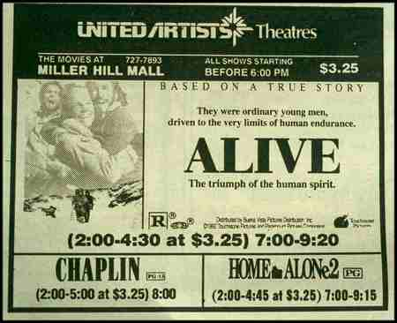
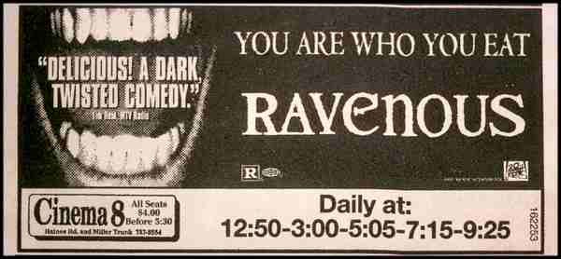
“survival
cannibalism”

Slide 78
Stephen King
“Survivor Type”
1985
“survival
cannibalism”

Slide 79
“gustatory
cannibalism”

Slide 80
“ritual cannibalism”

Slide 81
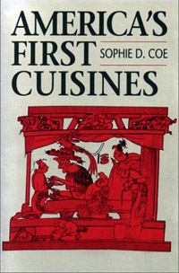
cultural relativism?
stealing peoples’ land and property
infant cranial deformation
Aztec human heart sacrifice
cannibalism
selling and eating children
eating insects
eating dogs
. . .
“ritual cannibalism”
e.g., Aztecs must sacrifice and eat humans
in order to please the gods
in order that the gods allow
the sun to rise each day,
so that the world doesn’t end

Slide 82
we’ll have a very short look at
cannibalism
with the discussion of
Homo erectus
Week 9

Slide 83
absolute cultural relativism
how about ? . . .

Slide 84
cultural relativism
stealing peoples’ land and property
infant cranial deformation
Aztec human heart sacrifice
cannibalism
selling and eating children
eating insects
eating dogs
. . .

Slide 85
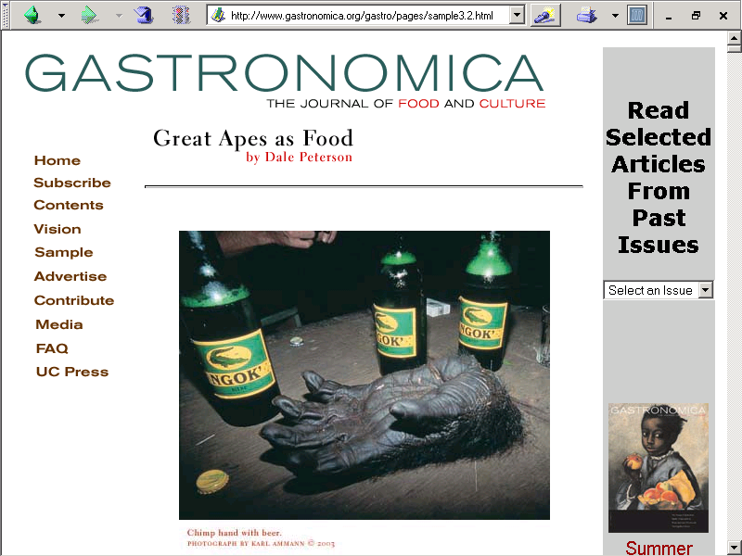
or eating gorilla?
Spring
2003
http://www.gastronomica.org/gastro/pages/sample3.2.html

Slide 86
switching to
a much more pleasant subject . . .

Slide 87
always remember
that
people live in
multiple cultural worlds

Slide 88
multiple cultural worlds include
class
race
ethnicity
gender
age
institutions

Slide 89
more
Other
Important
Terms
to come later . . .
University of Minnesota Duluth
"Selam"
aka "Lucy's Baby”
Tim Roufs © 2010-2013
http://www.d.umn.edu/cla/faculty/troufs/anth1602/

