Slide 1
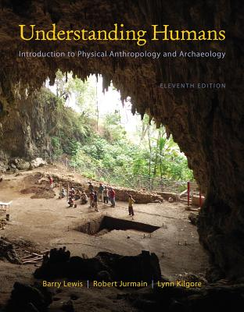
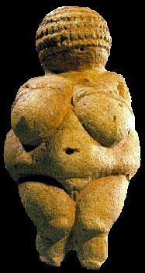
History of Though:
Darwin and Wallace
University of Minnesota Duluth
Tim Roufs
© 2010-2013
http://www.d.umn.edu/cla/faculty/troufs/anth1602/

Slide 2
. . . or how to make sense
out of Ch. 2 of the text . . .
University of Minnesota Duluth
Tim Roufs
© 2010-2013
http://www.d.umn.edu/cla/faculty/troufs/anth1602/

Slide 3
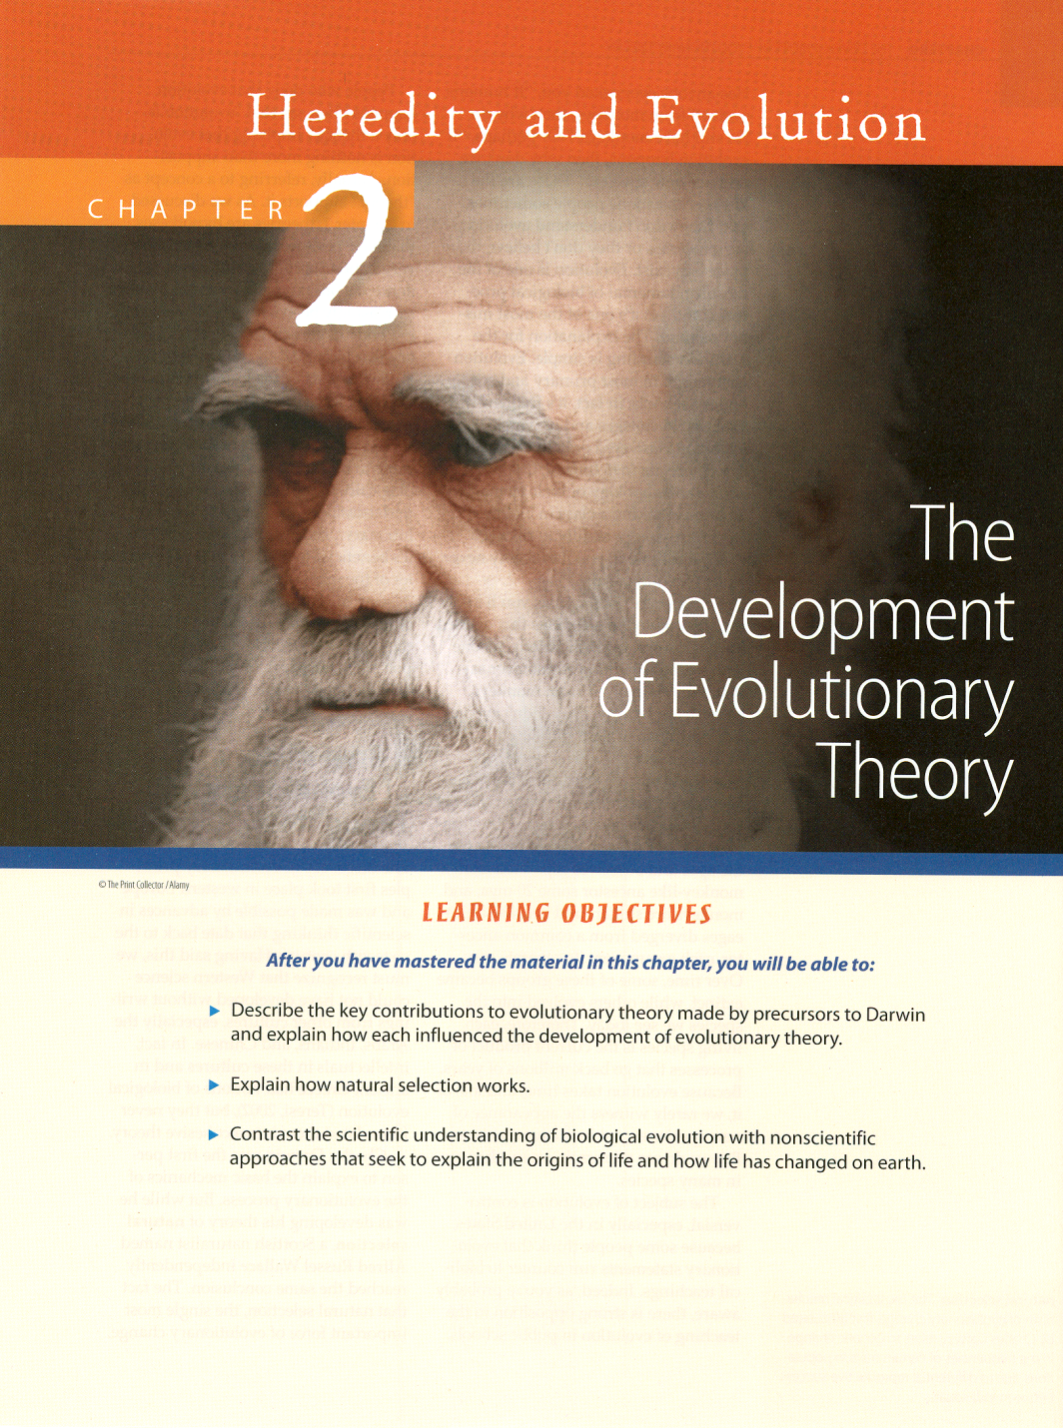

Slide 4
Important People / Works
Charles Darwin
(1809 - 1882)
Origin of Species
1859
Descent of Man
1871

Slide 5
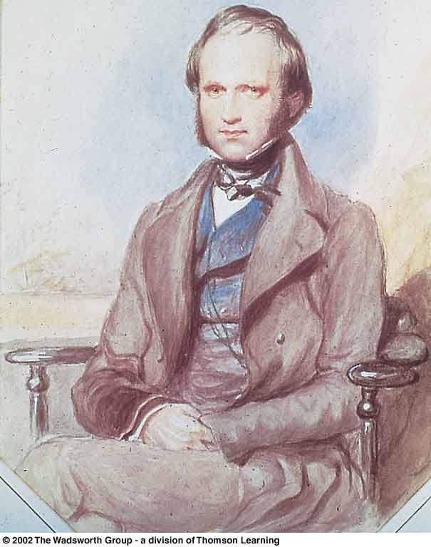
Charles Darwin as a young man
Understanding Physical Anthropology and Archaeology, 8th ed., p. 30

Slide 6
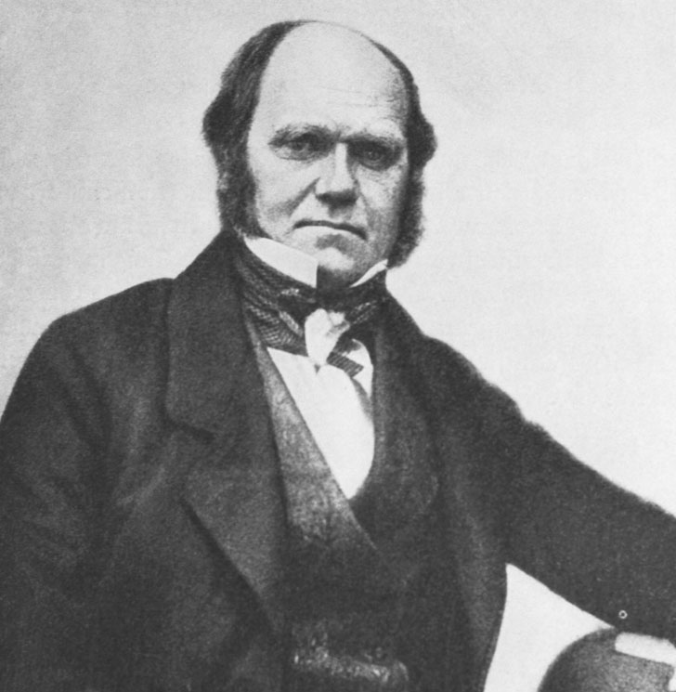
Charles Darwin five years before
publication of Origin of Species
Understanding Humans, 11th ed., p. 26

Slide 7
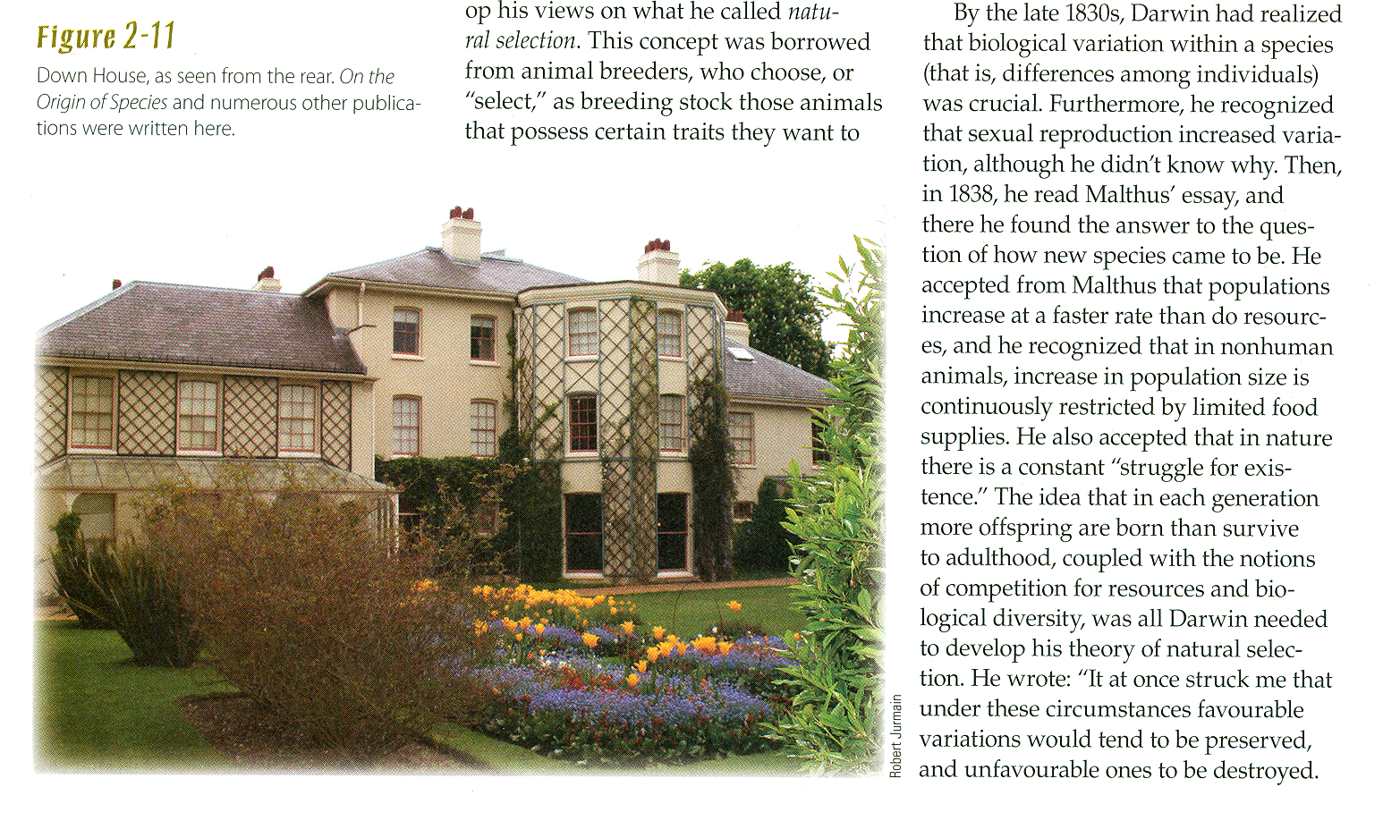
The Darwin home, Down House, in the village of Down
Understanding Physical Anthropology and Archaeology, 8th ed., p. 28

Slide 8
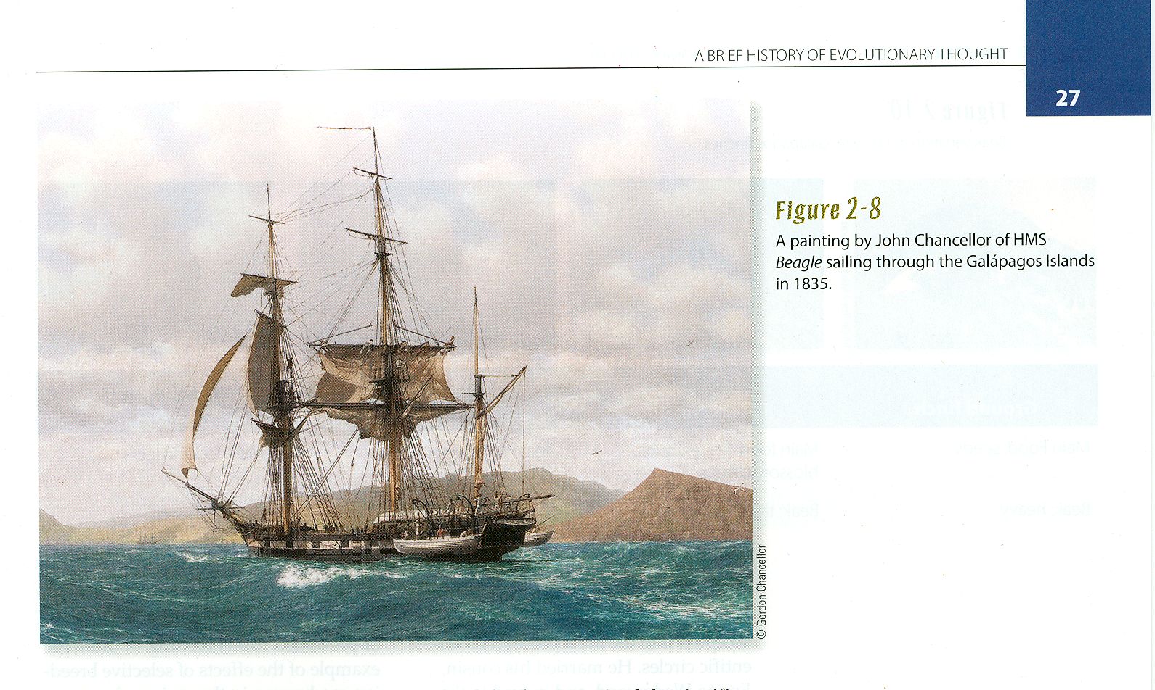
Charles Darwin
Journey on
The Beagle
1831 - 1836
Journey on
The Beagle
1831 - 1836

Slide 9
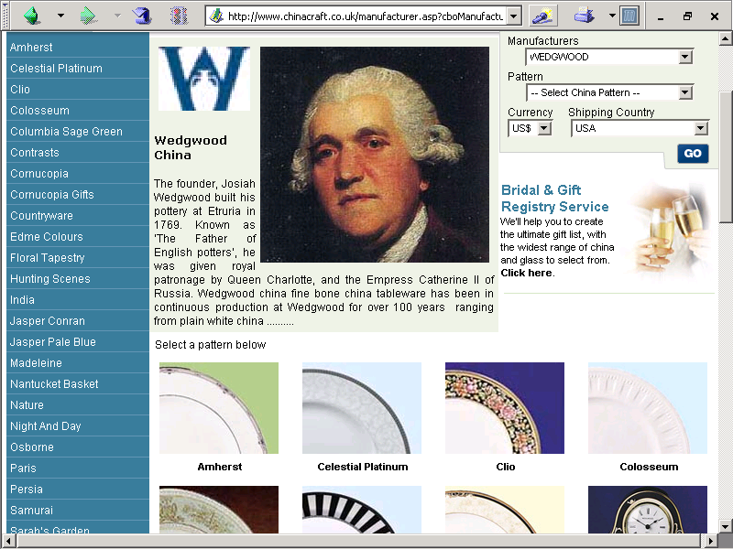

Slide 10
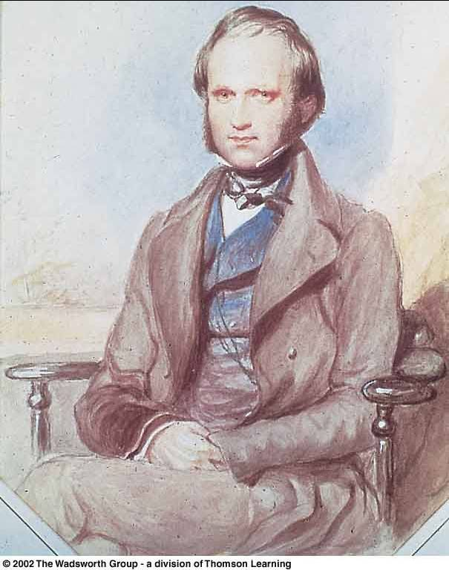
In 1839 Charles Darwin married his first cousin, Emma Wedgwood
Daughter of the younger Josiah Wedgwood, son of the Josiah Wedgwood who founded the pottery works
Darwin's mother Susannah was the sister of his wife’s father

Slide 11
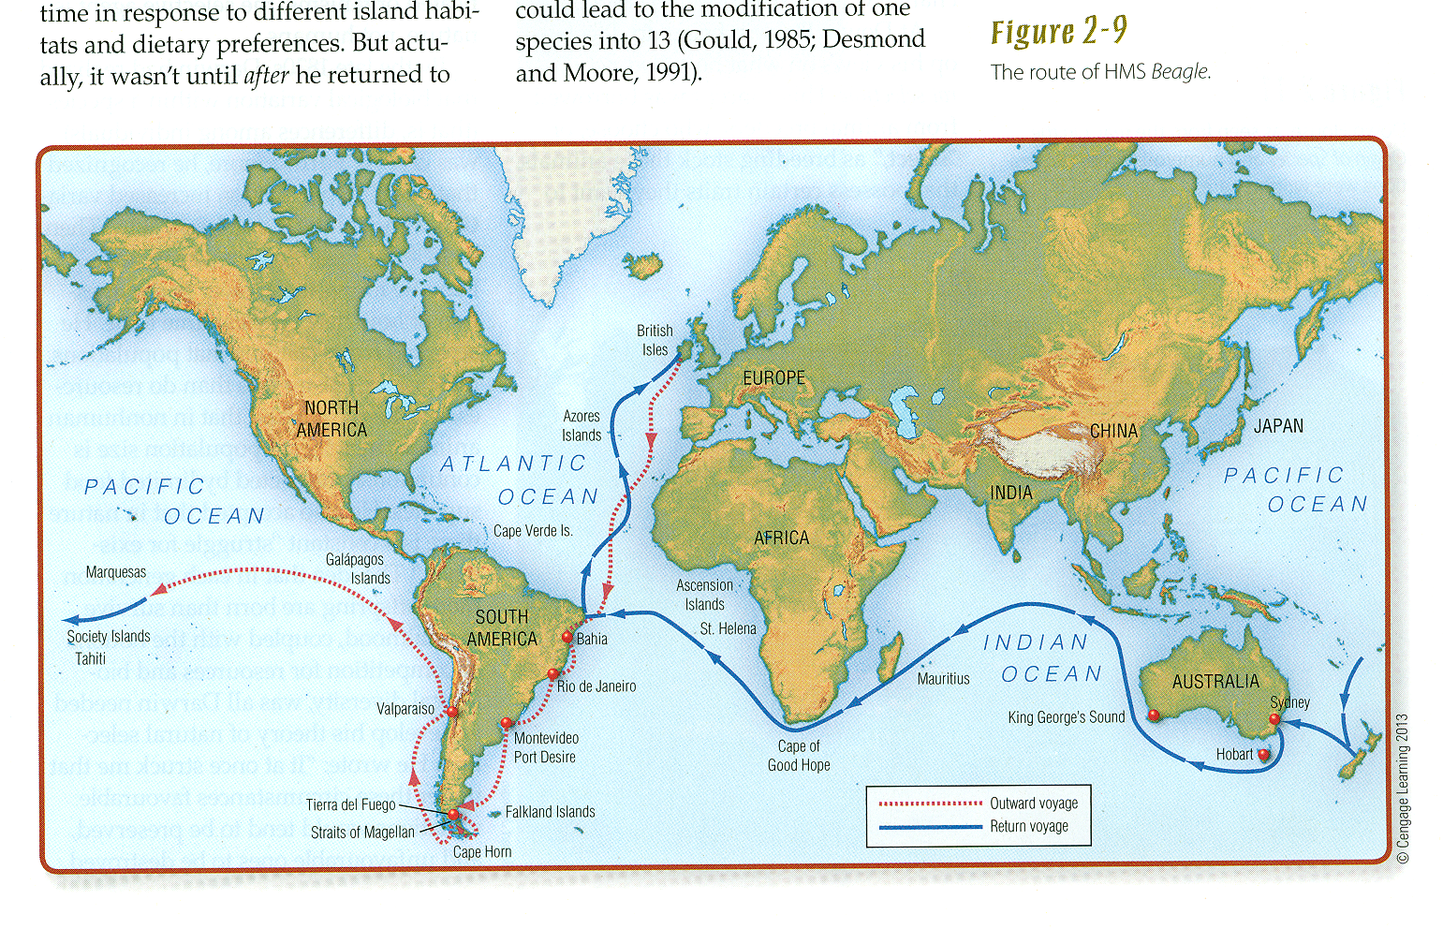
1831
1835
The route of the HMS Beagle
Understanding Humans, 11th ed., p. 27

Slide 12
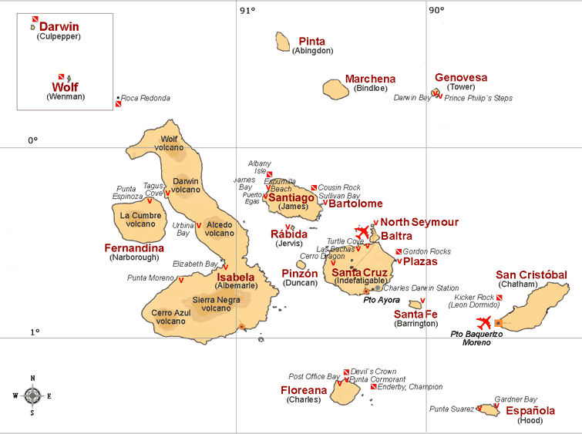

Slide 13
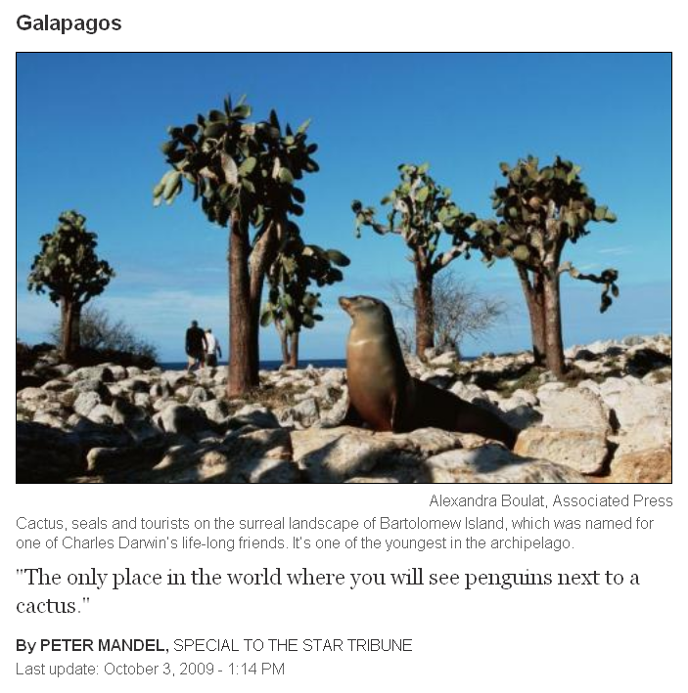
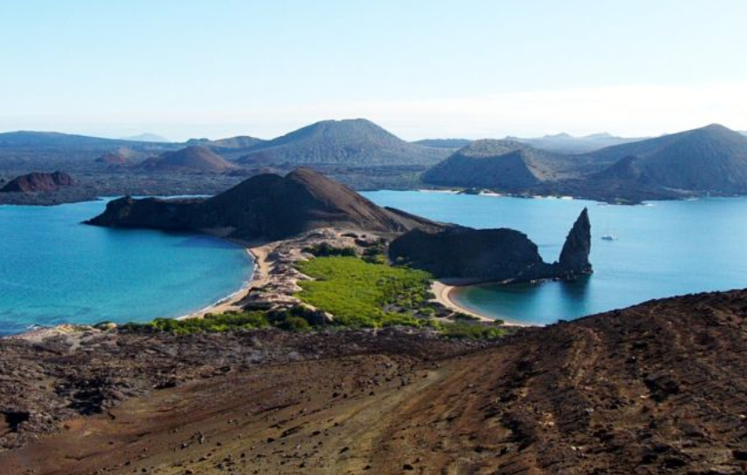

Slide 15
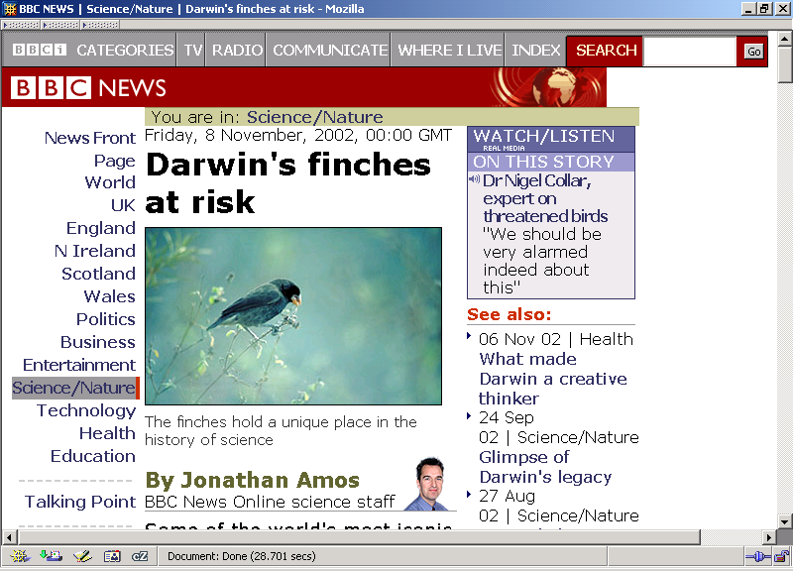
http://news.bbc.co.uk/1/hi/sci/tech/2415261.stm

Slide 16
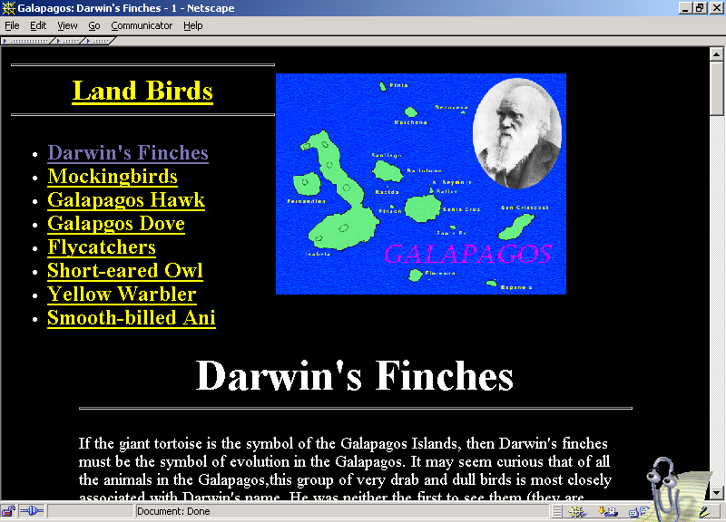
www.rit.edu/~rhrsbi/GalapagosPages/DarwinFinch.html

Slide 17
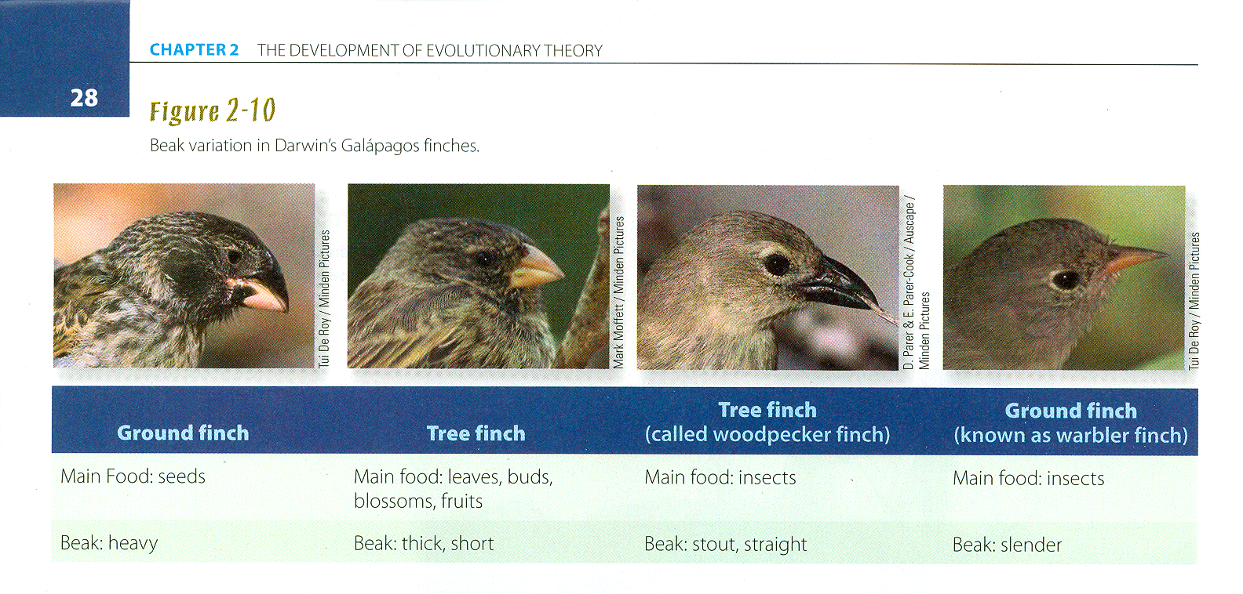
Beak variation in Darwin’s Galápagos finches
Understanding Humans, 11th ed., p. 28

Slide 18
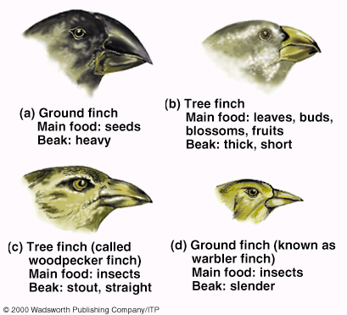
Beak variation in Darwin’s Galápagos finches
Understanding Humans, 10th ed., p. 27

Slide 19
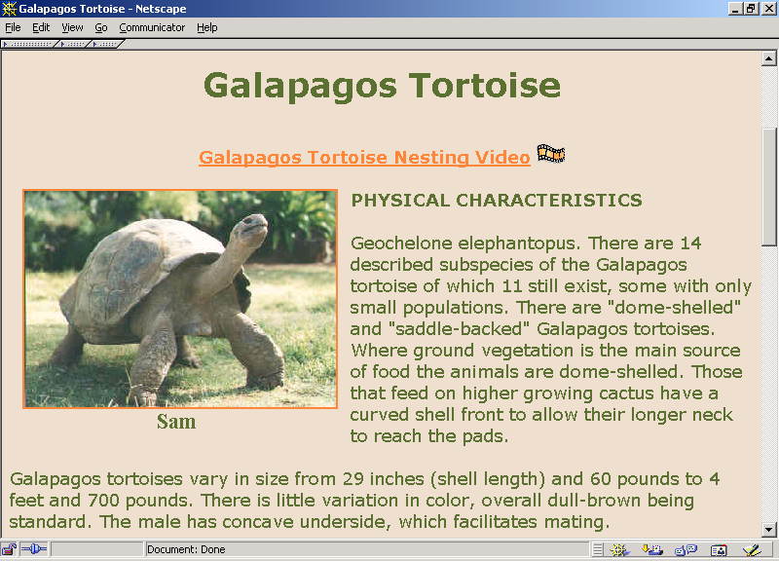
www.honoluluzoo.org/galapagos_tortoise.htm

Slide 20
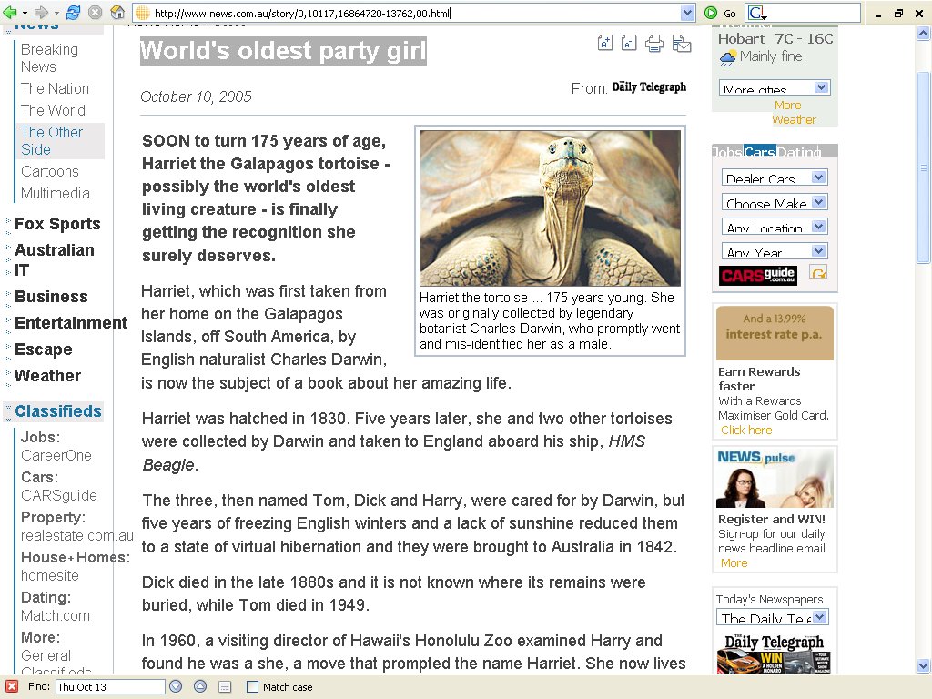
www.news.com.au/story/0,10117,16864720-13762,00.html

Slide 21
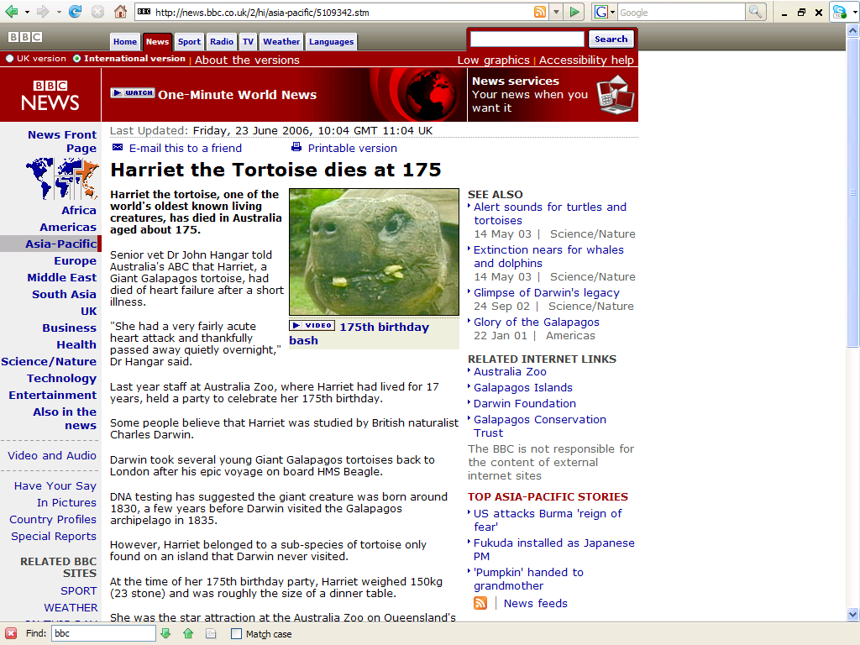
news.bbc.co.uk/2/hi/asia-pacific/5109342.stm

Slide 22
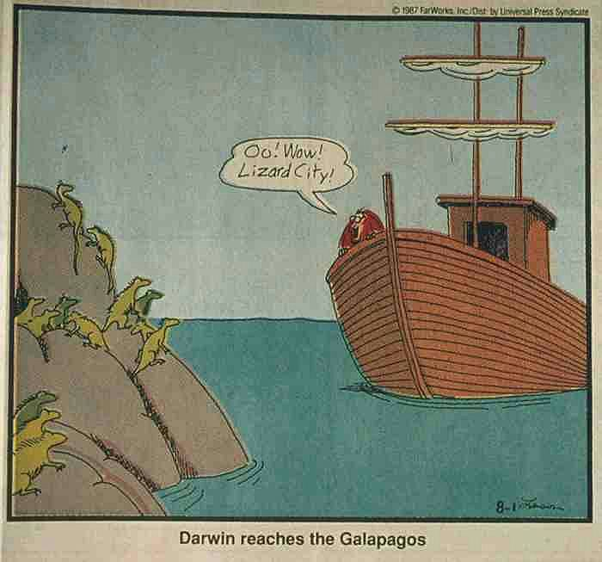

Slide 23
Eventually
Darwin asked the question:
Why would God make a separate species for each island?

Slide 24
Theory of Natural Selection
Observation 1
Without environmental pressures, every species tends to multiply in geometric progression
(Thomas Malthus, Essay on the Principle of Population, 1798, and others)

Slide 25
Theory of Natural Selection
population, when unchecked, grows in a geometric ratio
population, if unchecked, the human population will double every 25 years because of geometric progression
    1, 2, 4, 8, 16, 32, 64. . . .

Slide 26
Theory of Natural Selection
Arithmatic
(+2) 2 -- 4 -- 6 -- 8 -- 10 -- 12 -- n
Geometric
(X 2) 2 -- 4 -- 8 -- 16 -- 32 -- 64 -- n

Slide 27
Theory of Natural Selection
Potential exponential increase of populations =
“superfecundity”
(Thomas Malthus, 1798 and others)

Slide 28
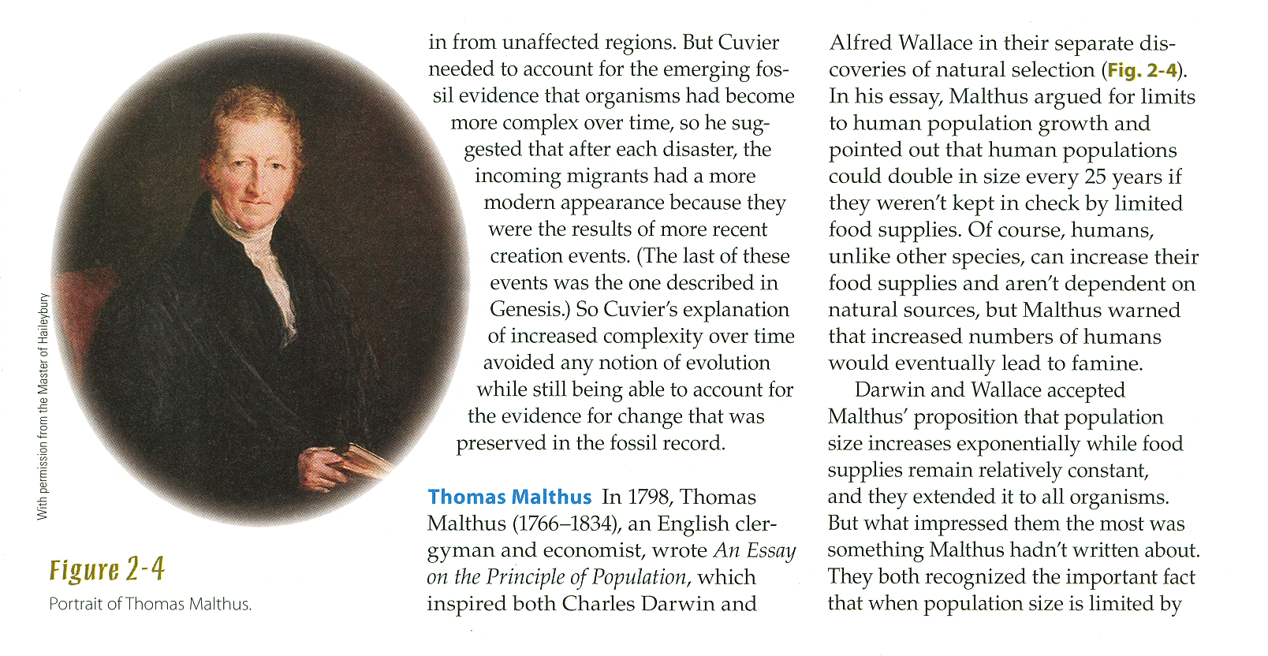
Thomas Malthus
Understanding Humans, 11th ed., p. 24

Slide 29
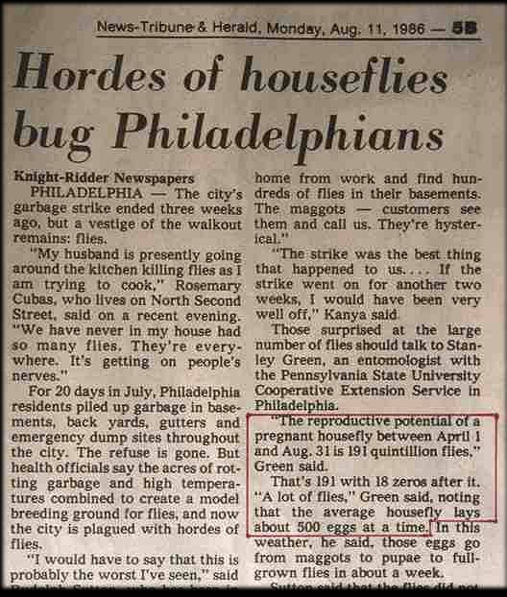

Slide 30
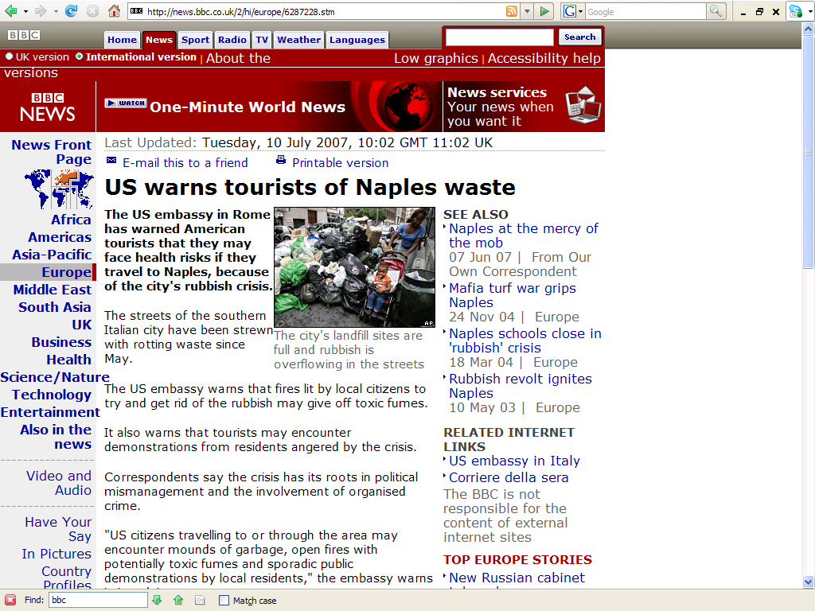
http://news.bbc.co.uk/2/hi/europe/6287228.stm

Slide 31
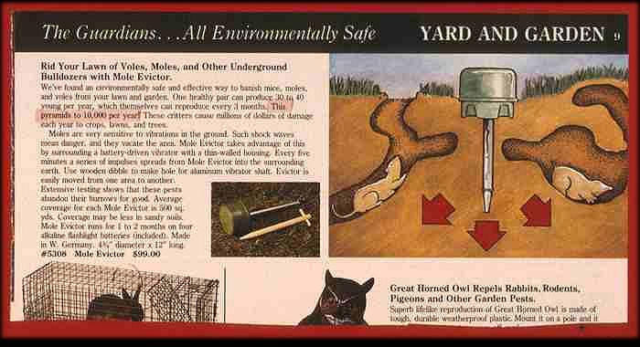

Slide 32
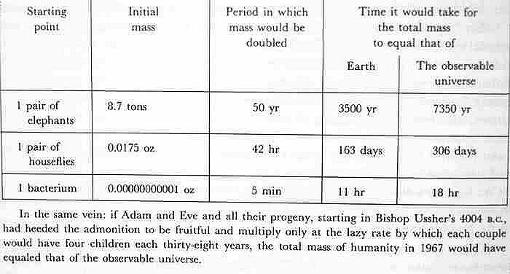

Slide 33
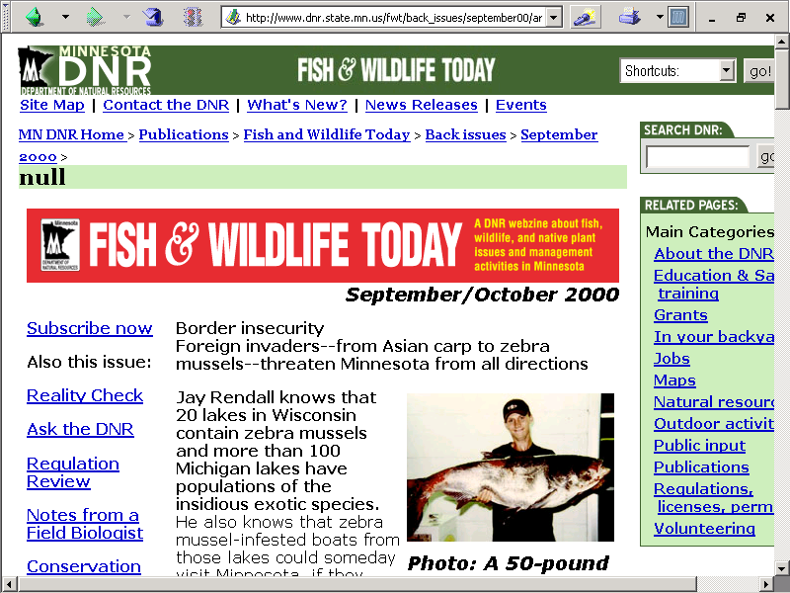
www.dnr.state.mn.us/fwt/back_issues/september00/article3.html

Slide 34
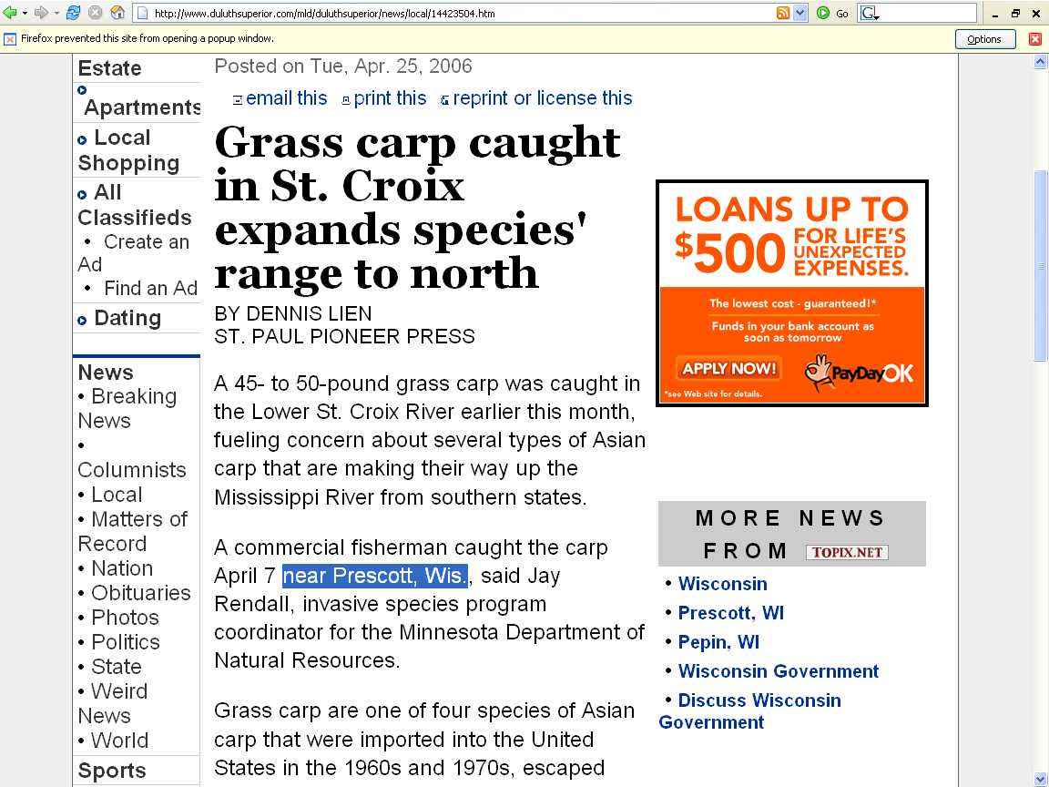
www.duluthsuperior.com/mld/duluthsuperior/news/local/14423504.htm

Slide 35
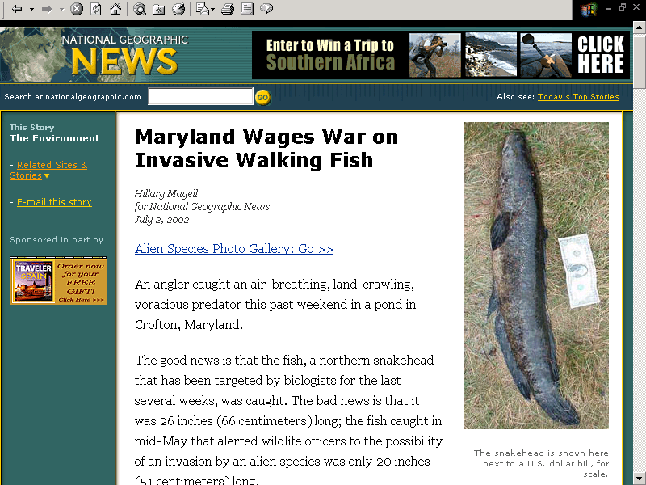
^{02 July 2002}
news.nationalgeographic.com/news/2002/07/0702_020702_snakehead.html

Slide 36
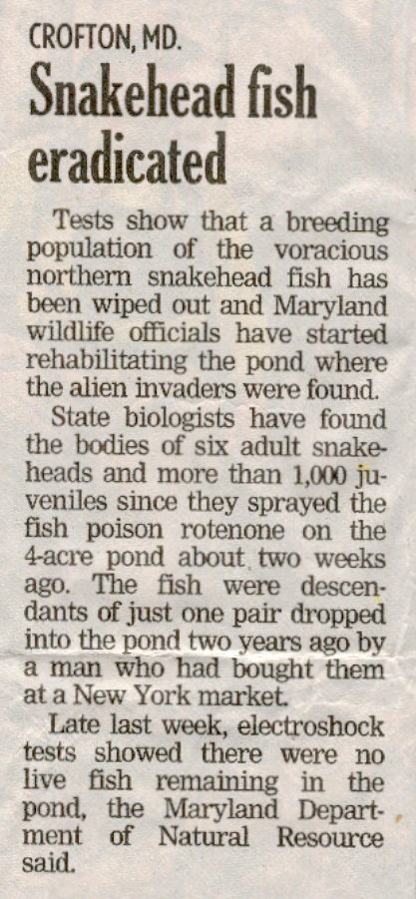
In 2 years 2 snakeheads
bred to 1000+
in a 4-acre pond
^{Duluth News Tribune,} Thursday 19 September, 2002, 2A

Slide 37
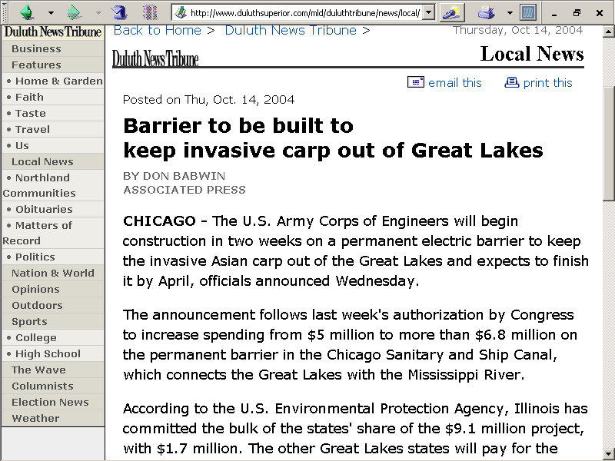
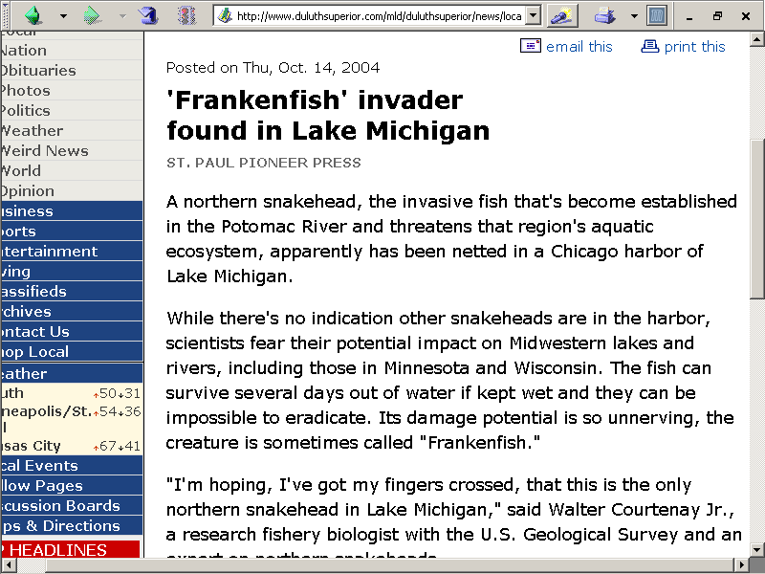
p. 2D
In 2 years 2 snakeheads
bred to 1000+
in a 4-acre pond
p. 5D
^{Duluth News Tribune,} ^{Thursday 14 October, 2004}

Slide 38
Theory of Natural Selection
Observation 2
But under field conditions, although fluctuations occur frequently, the size of a population remains remarkable constant over long periods of time
(Source: Universal observations)

Slide 39
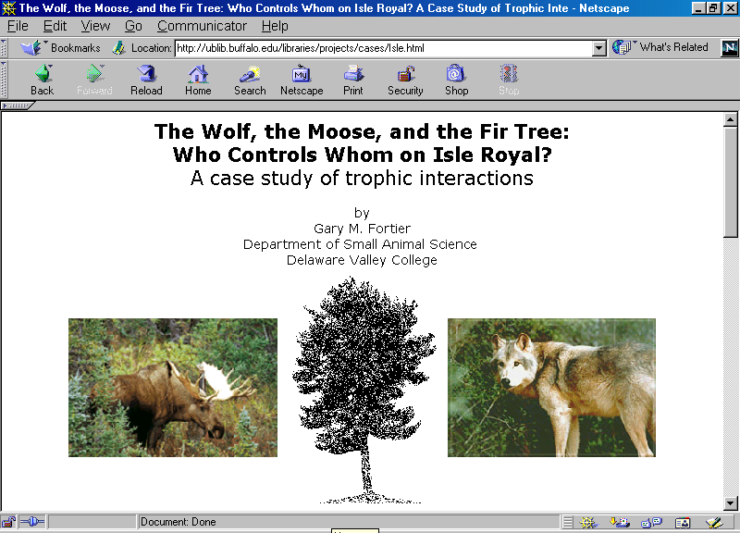
ublib.buffalo.edu/libraries/projects/cases/Isle.html

Slide 40
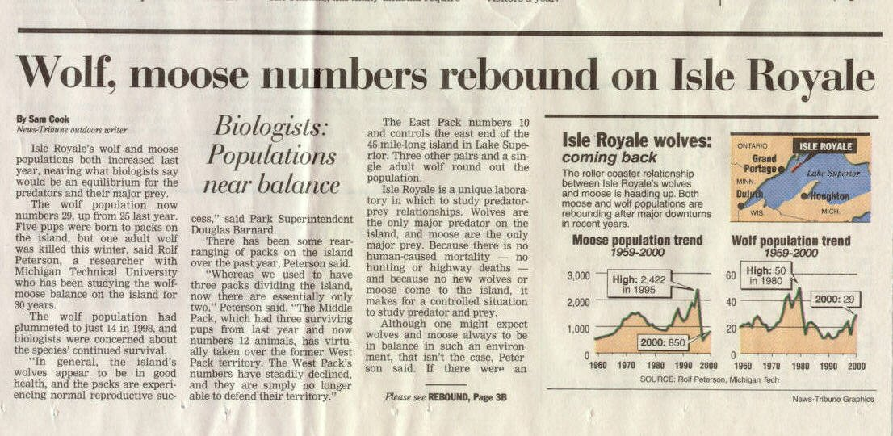

Slide 41

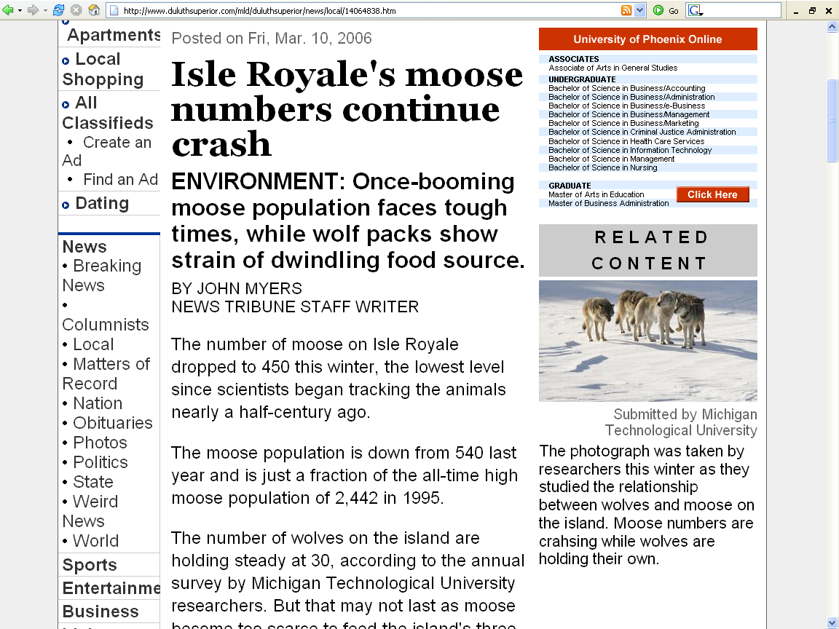
http://www.duluthsuperior.com/mld/duluthsuperior/news/local/14064838.htm

Slide 42

Isle Royale moose, wolf continue decline
TREND CONTINUES: The battle between predator and prey on Lake Superior’s largest island is turning out to be a lose-lose situation this winter as wolf and moose numbers continue a downward spiral.
xxx

Slide 43
Isle Royale moose, wolf continue decline
John Myers
Duluth News Tribune - 03/08/2007
The battle between predator and prey on Lake Superior’s largest island is turning out to be a lose-lose situation this winter as wolf and moose numbers continue a downward spiral.
Isle Royale moose numbers crashed another 15 percent from the 2006 record low level of 450, at just 385 animals. Wolf numbers declined nearly one-third, from 30 to 21.
Moose on the island are dying for a variety of reasons, including hot summers, infestations of ticks and relentless hunting pressure from remaining wolves, said John Vucetich, an assistant professor at Michigan Technological University in Houghton who helped conduct this winter’s survey.
With fewer moose to eat, wolves are battling and killing each other over the right to the remaining moose.
xxx

Slide 44
Theory of Natural Selection
Observation 3
Limits are placed on
population expansion
by limited environmental resources
(Source: observations reinforced by Malthus)

Slide 45
Theory of Natural Selection
Conclusion 1
Therefore not all organisms will survive to adulthood and reproduce
  therefore there must be a “struggle for existence”
(Author of inference: Thomas Malthus)

Slide 46
Theory of Natural Selection
Observation 4
Not all members of a species are alike
  that is, there exists considerable individual uniqueness and variation
(Source: Animal breeders, taxonomists)

Slide 47
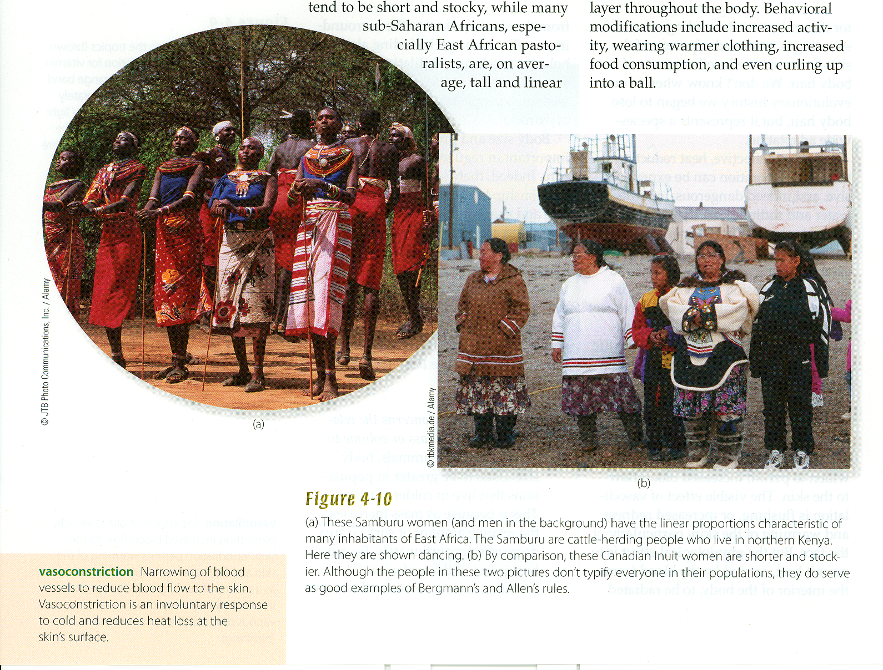
Understanding Humans, 11th ed., p. 86

Slide 48
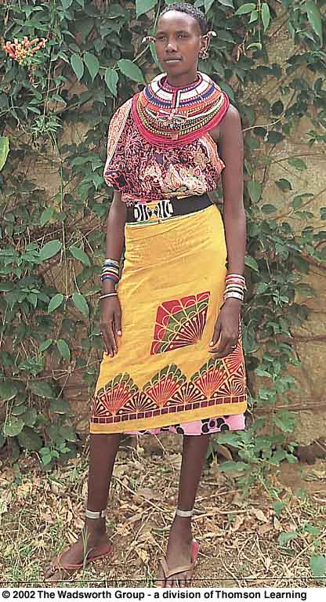
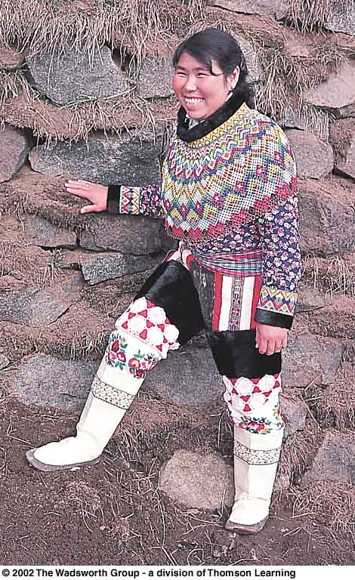
Understanding Humans, 10th ed., p. 89

Slide 49
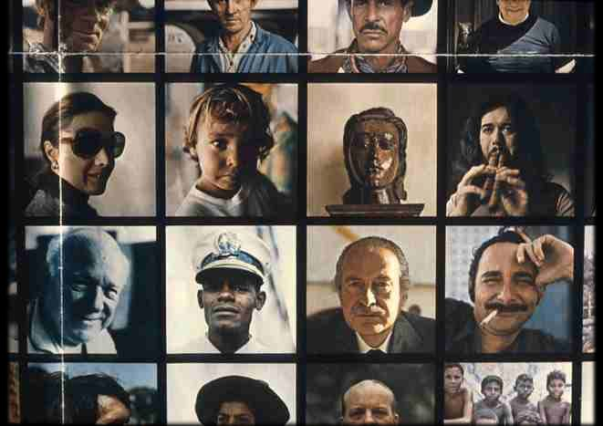

Slide 50
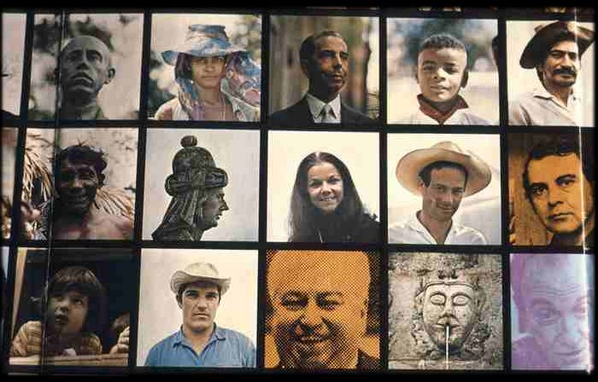

Slide 51
Theory of Natural Selection
Observation 5
Parents often pass their individual variations on to their offspring
(Source: Animal breeders, taxonomists)

Slide 52
Theory of Natural Selection
Conclusion 2
Hence in “the struggle for existence” individuals featuring favorable variations will enjoy a competitive advantage over others . . .

Slide 53
Theory of Natural Selection
. . . and they will survive in proportionately greater numbers
. . . and will produce offspring in increasingly greater numbers

Slide 54

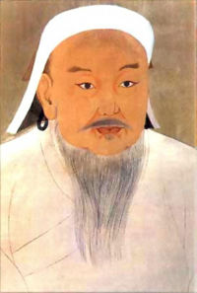
Genghis Khan
Khagan of Mongol Empire
("Khan of the Mongols")
http://en.wikipedia.org/wiki/Genghis_khan

Slide 55
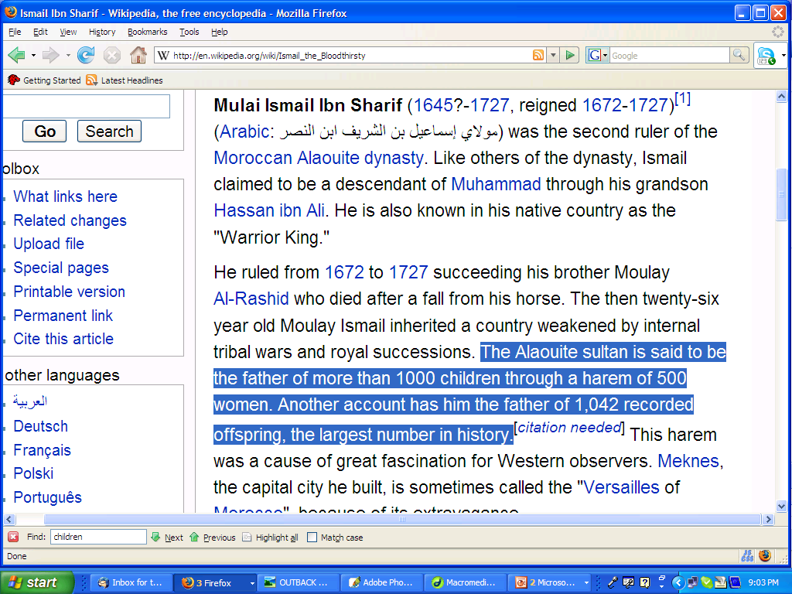
“Ismail the Bloodthirsty”
http://en.wikipedia.org/wiki/Ismail_the_Bloodthirsty

Slide 56
Theory of Natural Selection
There is
“differential reproduction”
and
“differential survival
  i.e., “natural selection”
(Author of inference: Darwin)

Slide 57
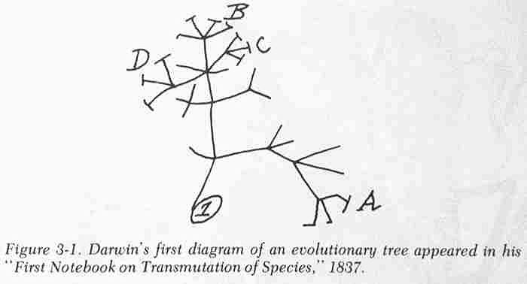

Slide 58
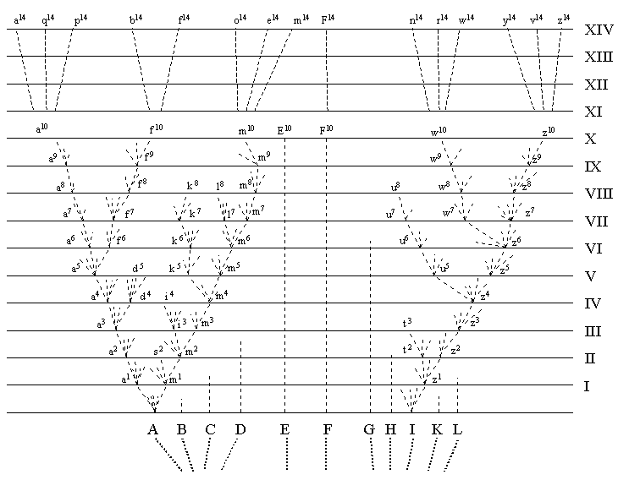

Slide 59
Theory of Natural Selection
Conclusion 3
Through the action of natural selection over many generations a species could evolve
(Author of inference: Darwin)

Slide 60
Natural Selection:
The principle mechanism of Darwinian evolutionary change, by which the individuals best adapted to the environment contributed more offspring to succeeding generations than others do. . .

Slide 61
Natural Selection:
As more of such individuals’ characteristics are incorporated into the gene pool, the characteristics of the population evolve.

Slide 62
Glossary
evolution
A change in the genetic structure of a population
The term is also frequently used to refer to the appearance of a new species

Slide 63
Glossary
evolution
Modern genetic definition:
a change in the frequency of alleles
(one of a group of genes)
from one generation
to the next

Slide 64
Evolution:
cumulative changes in the average characteristics of a population that occur over many generations

Slide 65
Important People / Works
Charles Darwin
(1809 - 1882)
Origin of Species
1859

Slide 66
Important People / Works
Charles Darwin
(1809 - 1882)
On the Origin of Species by Means of Natural Selection or the Preservation of Favoured Races in the Struggle for Life
1859

Slide 67
Glossary
biospecies
paleospecies
chronospecies

Slide 68
biospecies

Slide 69
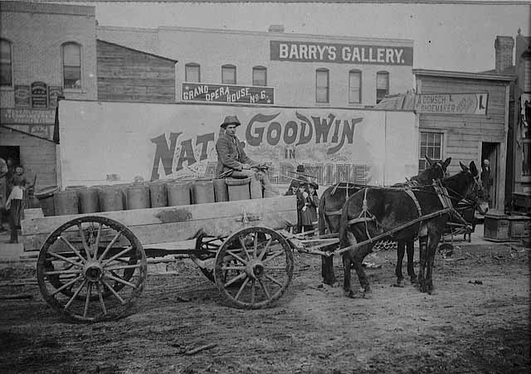
Paul H. Ristau driving a mule-drawn cart
in Superior, Wisconsin, ca. 1890
Photo courtesy of the Minnesota Historical Society

Slide 70
male ass
(jack)
female
horse
(mare)
mule
all male mules are sterile
almost all female mules are sterile
if not ¾ horse or ¾ ass

Slide 71
female ass
(jennet)
male
horse
(stallion)
hinny
all hinnies are sterile,
except in rare cases

Slide 72
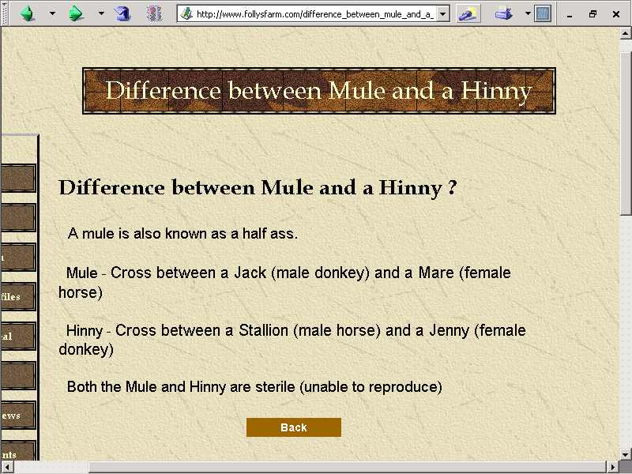
www.follysfarm.com/difference_between_mule_and_a_hinny.htm

Slide 73
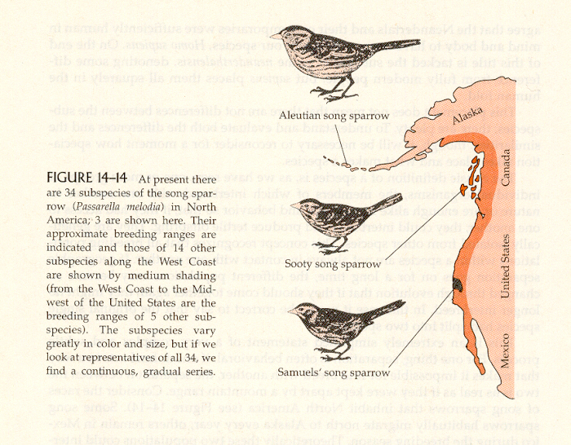
But species are
sometimes not
easy to define
A
B
C
N
X
Z
Humankind Emerging, 7th edition, p. 418

Slide 74
A
B
C
N
Z

Slide 75
A
B
C
N
Z
A
Z

Slide 76
Parallel from Linguistics
A
B
C
N
Z
Smithwick
“Smíth-wick”
(Duluth)
“Smidt-whick”
(Galway, Ireland)
“Sméddik”
(Birmingham, England)
“Smǽrik”
(Smithwick , England)

Slide 77
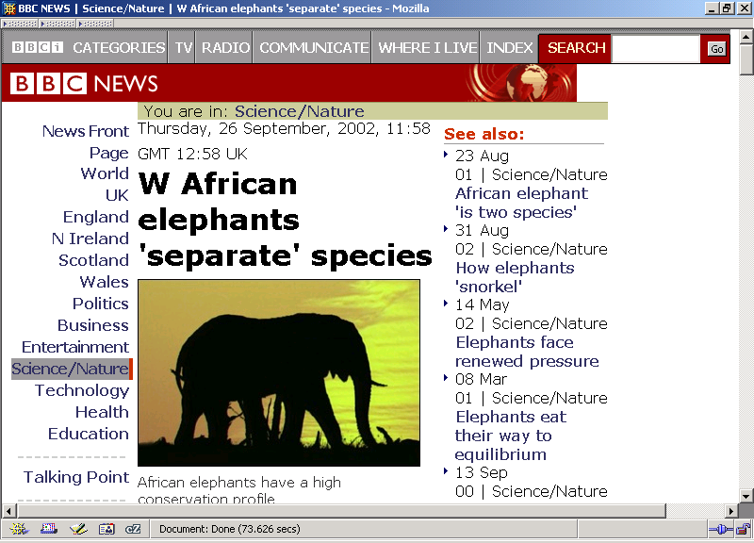
http://news.bbc.co.uk/1/hi/sci/tech/2282801.stm

Slide 78
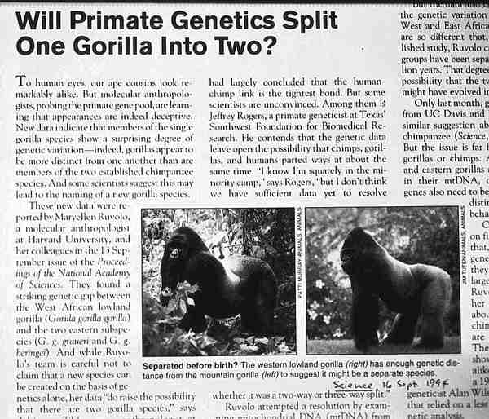

Slide 79
Glossary
biospecies
paleospecies

Slide 80
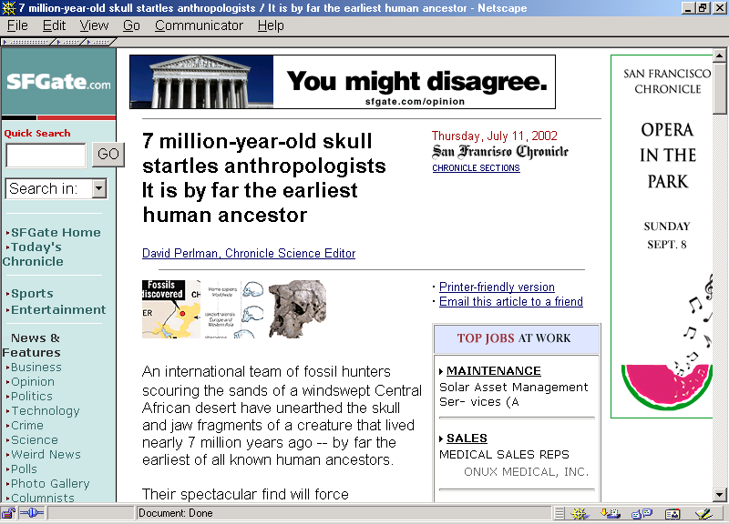
Sahelanthropus
tchadensis
KNM-WT 17000
www.sfgate.com/cgi-bin/article.cgi?file=/chronicle/archive/2002/07/11/MN205986.DTL

Slide 81

July 23, 2001
Ardipithecus
ramidus
kadabba

Slide 82
Glossary
biospecies
paleospecies
chronospecies

Slide 84
Basic Concepts
genotype
phenotype

Slide 85
Basic Concepts
genotype
includes genetic items
you can not see

Slide 86
Basic Concepts
phenotype
the observable physical characteristics of an organism
  the things you can see
  the detectable expressions of genotypes

Slide 87

news.bbc.co.uk/1/hi/health/2284783.stm

Slide 88
Basic Concepts
Phenotype / Genotype
my wife’s family’s feet

Slide 89
Basic Concepts
Phenotype / Genotype
my cousins’ feet

Slide 90

Polydactyly in a human infant (a) and in a cat (b).
Understanding Humans, 10th ed., p. 38
Notes:
90

Slide 91

Basic Concepts
Phenotype / Genotype
my wife’s heart

Slide 92
Important People / Works
Alfred Wallace
(1823 - 1913)
working separately from Darwin arrived at the same generalizations at the same time as Darwin

Slide 93
Alfred Russel Wallace
Understanding Humans, 10th ed., p. 29

Slide 94

Alfred Russel Wallace
Understanding Humans, 11h ed., p. 30
Notes:
94

Slide 95
Theory of Natural Selection
Observation 1
Without environmental pressures, every species tends to multiply in geometric progression
(Thomas Malthus, Essay on the Principle of Population, 1798, and others)

Slide 96
Theory of Natural Selection
Observation 2
But under field conditions, although fluctuations occur frequently, the size of a population remains remarkable constant over long periods of time
(Source: Universal observations)

Slide 97
Theory of Natural Selection
Observation 3
Limits are placed on population expansion by limited environmental resources
(Source: observations reinforced by Malthus)

Slide 98
Theory of Natural Selection
Conclusion 1
Therefore not all organisms will survive to adulthood and reproduce
  therefore there must be a “struggle for existence”
(Author of inference: Thomas Malthus)

Slide 99
Theory of Natural Selection
Observation 4
Not all members of a species are alike; that is, there exists considerable individual uniqueness and variation
(Source: Animal breeders, taxonomists)

Slide 100
Theory of Natural Selection
Observation 5
Parents often pass their individual variations on to their offspring
(Source: Animal breeders, taxonomists)

Slide 101
Theory of Natural Selection
Conclusion 2
Hence in the struggle for existence individuals featuring favorable variations will enjoy a competitive advantage over others . . .

Slide 102
. . . And they will survive in proportionately greater numbers and will produce offspring in increasingly greater numbers

Slide 103
Theory of Natural Selection
There is “differential reproduction” and “differential survival,” i.e., “natural selection”
(Author of inference: Darwin)

Slide 104
Theory of Natural Selection
Conclusion 3
Through the action of natural selection over many generations a species could evolve
(Author of inference: Darwin)

Slide 105
Theory of Natural Selection
Both Darwin and Wallace knew:
the principle cause of
natural selection
is the environment

Slide 106

Understanding Humans, 11th ed., p. 31

Slide 107

Understanding Humans, 10th ed., p. 31
www.blackwellpublishing.com/ridley/a-z/Peppered_moth.asp

Slide 108

But look at them without color vision.

Slide 109


Slide 110

Understanding Humans, 11th ed., p. 29

Slide 111

Contrasting ideas about the mechanism of evolution.
According to Lamarck’s theory
According to the Darwin-Wallace
Understanding Humans, 11th ed., p. 24

Slide 112


Slide 113


Slide 114
Theory of Natural Selection
Problem
What is the source of individual variation?
Didn’t know then because of lack of knowledge of modern genetics

Slide 115
Theory of Natural Selection
Neither Darwin nor Wallace knew:
the source of
individual variation

Slide 116
Theory of Natural Selection
Neither Darwin nor Wallace knew:
the source of
individual variation
= genetics
(inherited characteristics)

Slide 117
Theory of Natural Selection
Problem:
If natural selection only weeds out what already exists, how can it produce anything new?
Didn’t know then because of lack of knowledge of mutation and sexual recombination from modern genetics

Slide 118
Mutation

Slide 119

A – T - C - G
Understanding Physical Anthropology and Archaeology, 11th ed., p. 41

Slide 120

www.cnn.com/2008/WORLD/europe/09/15/uk.church.darwin.apology.ap/index.html
Notes:
120

Slide 121

http://en.wikipedia.org/wiki/Evolution_and_the_Roman_Catholic_Church
Notes:
121

Slide 122

Important People / Works
Continue on to Set #06A
Gregor Johann Mendel
(1822 - 1884)
Understanding Physical Anthropology and Archaeology, 11th ed., p. 48
Notes:
122

Slide 123
Understanding Humans, 10th ed., p. 26

