Slide 1
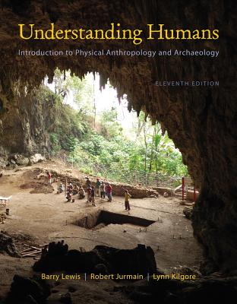
Conceptual Changes
Between the 18th and 20th Centuries
Tim Roufs
© 2010-2013

Slide 2
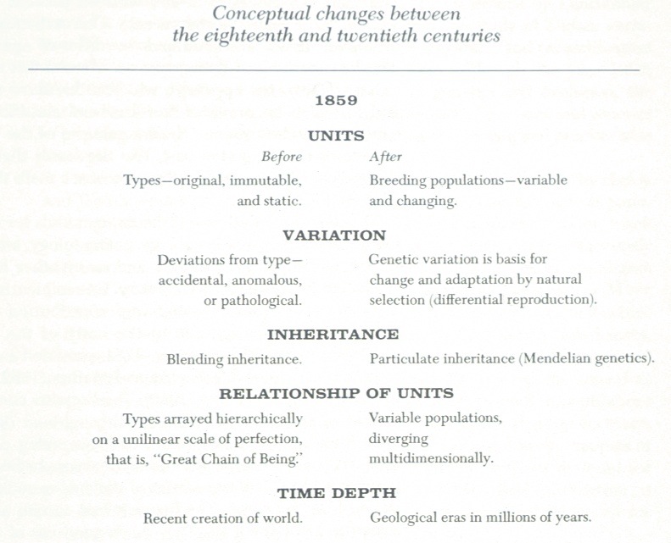

Slide 3
Units
Before 1859
types are original, static,
and immutable

Slide 4
Units
After 1859
breeding populations are considered variable and changing

Slide 5
Variation
Before 1859
deviations from a type are considered accidental, anomalous, or pathological

Slide 6
Inheritance
After 1859
particulate inheritance
(Mendelian genetics)

Slide 7
Variation
After 1859
genetic variation is basis for change and adaptation by natural selection
(differential reproduction)

Slide 8
Inheritance
Before 1859
blending inheritance

Slide 9
Relationship of Units
Before 1859
types are arrayed hierarchically on a unilinear scale of perfection called a “Great Chain of Being”

Slide 10
Relationship of Units
After 1859
variable populations are seen to diverge multidimensionally

Slide 11
Time Depth
Before 1859
people believed in a recent creation of the world
(on 23 October 4004 B.C.)

Slide 12
Time Depth
After 1859
people begin to think in geological eras of millions of years

Slide 13
Past Imges
“Past images of our ancient ancestors were a mix of fact and fancy that often reflected the prejudices of the age as much as they did the fossil record.” – UNWP 02-27-89

Slide 14
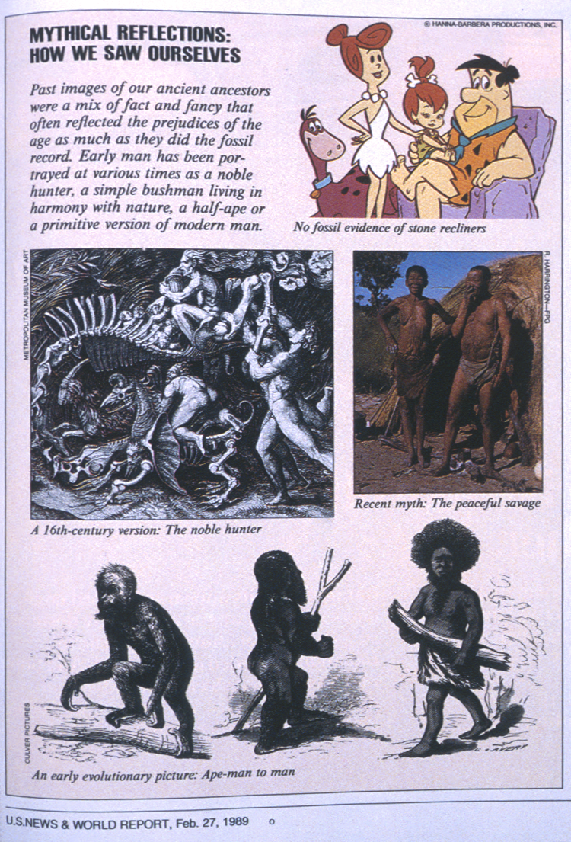

Slide 15
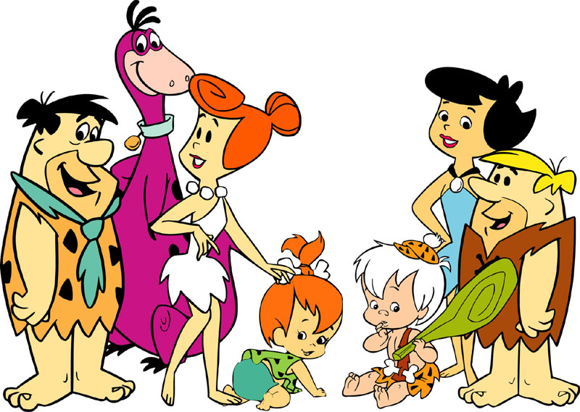

Slide 16
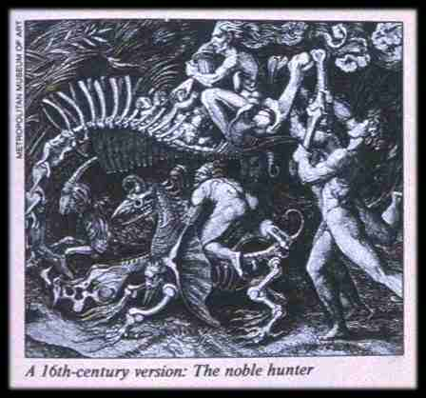

Slide 17
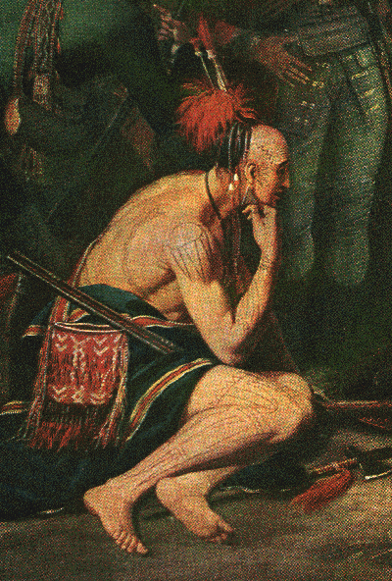

Slide 18
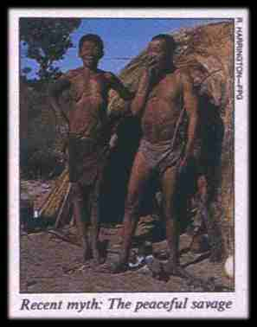

Slide 19
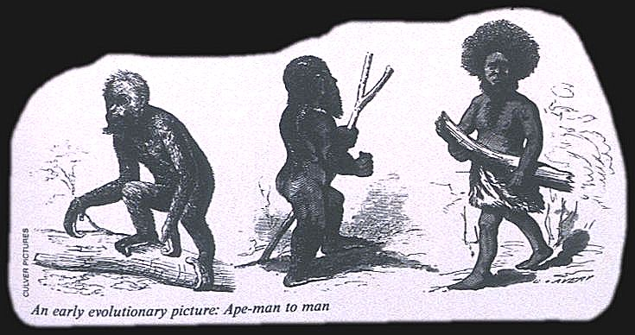

Slide 20
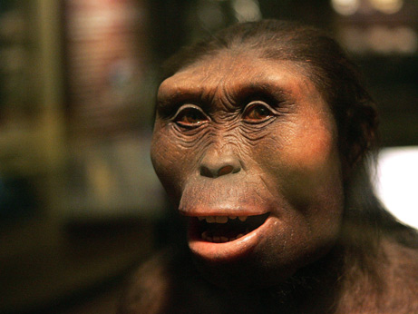
Continue on to . . .
Main
Characteristics of
Anthropology
Prehistoric Cultures
University of Minnesota Duluth
"Selam"
aka "Lucy's Baby”
Tim Roufs © 2010-2013
http://www.d.umn.edu/cla/faculty/troufs/anth1602/

