Slide 1
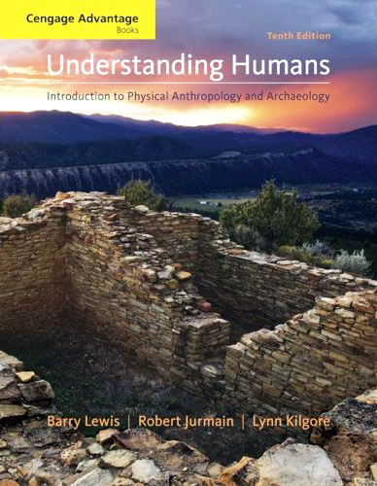
Major Characteristics of Modern Physical Anthropology
#1 - #6

Slide 2
. . . or how to make sense out of Ch. 2 and Ch. 3 of the text . . .

Slide 3
Major Periods in the History of Physical Anthropology
“Pre-Scientific Period” (to 1859)
Period of Evolutionism and Concern over Races (1860 - ca. 1940)
The Period Since WW II

Slide 4
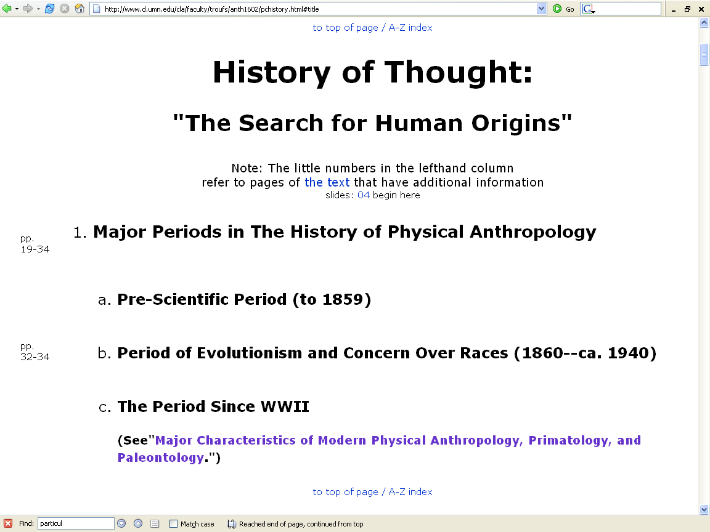
http://www.d.umn.edu/cla/faculty/troufs/anth1602/pchistory.html

Slide 5
Modern Physical Anthropology
1. Increased interest in the behavior of apes and monkeys, particularly field studies

Slide 8
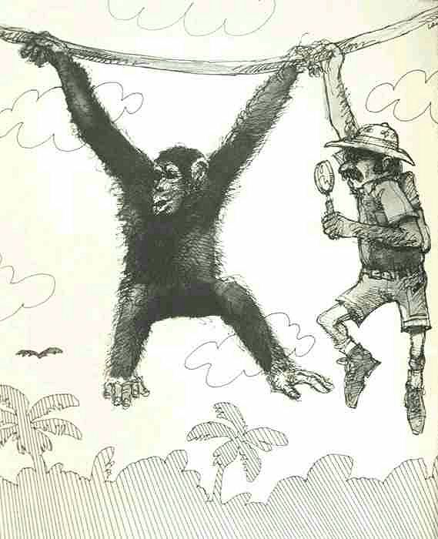

Slide 9
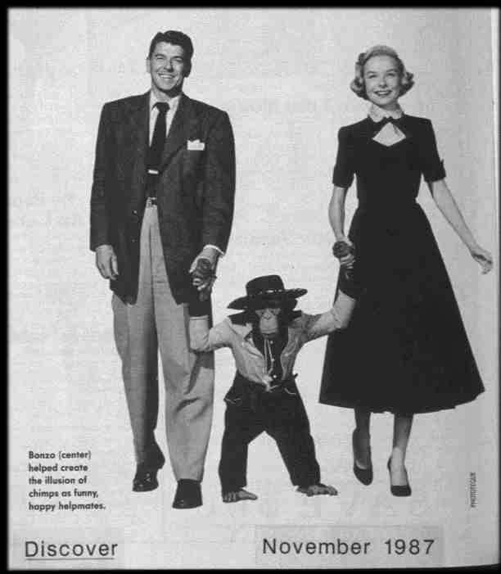

Slide 10
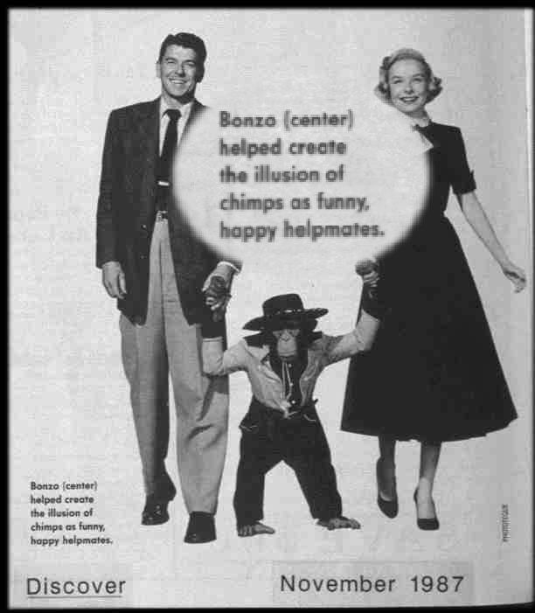

Slide 11
difficult terms

Slide 12
Glossary
ethology
scientific study of the social behavior of animals, especially in their natural environments

Slide 13
Glossary
ethnology
comparative study of cultures

Slide 14
Glossary
primatology
scientific study of the social behavior of primates, especially apes and monkeys

Slide 15
Glossary
primatologist
one who studies the behavior and social lives of chimpanzees, gorillas, monkeys, etc.
e.g., Jane Goodall
Diane Fossy
Birute Galdikas-Brindamour

Slide 16
Glossary
primatologist
e.g., Jane Goodall

Slide 17
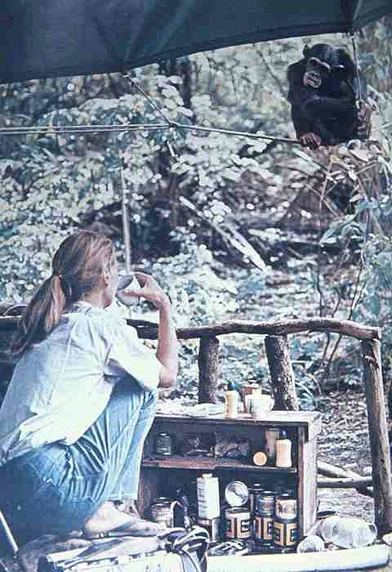
Jane Goodall

Slide 18
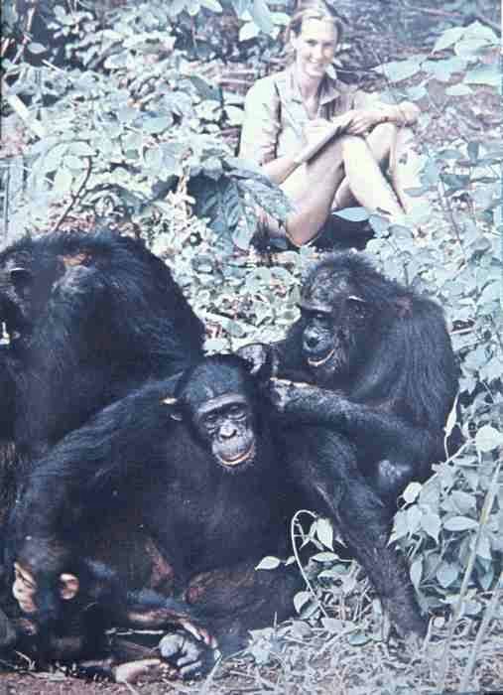
Jane Goodall

Slide 19
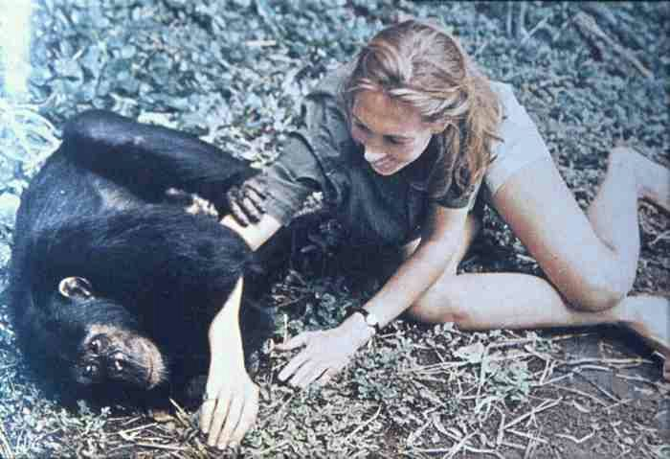
Jane Goodall

Slide 20
Glossary
primatologist
e.g., Diane Fossy

Slide 21
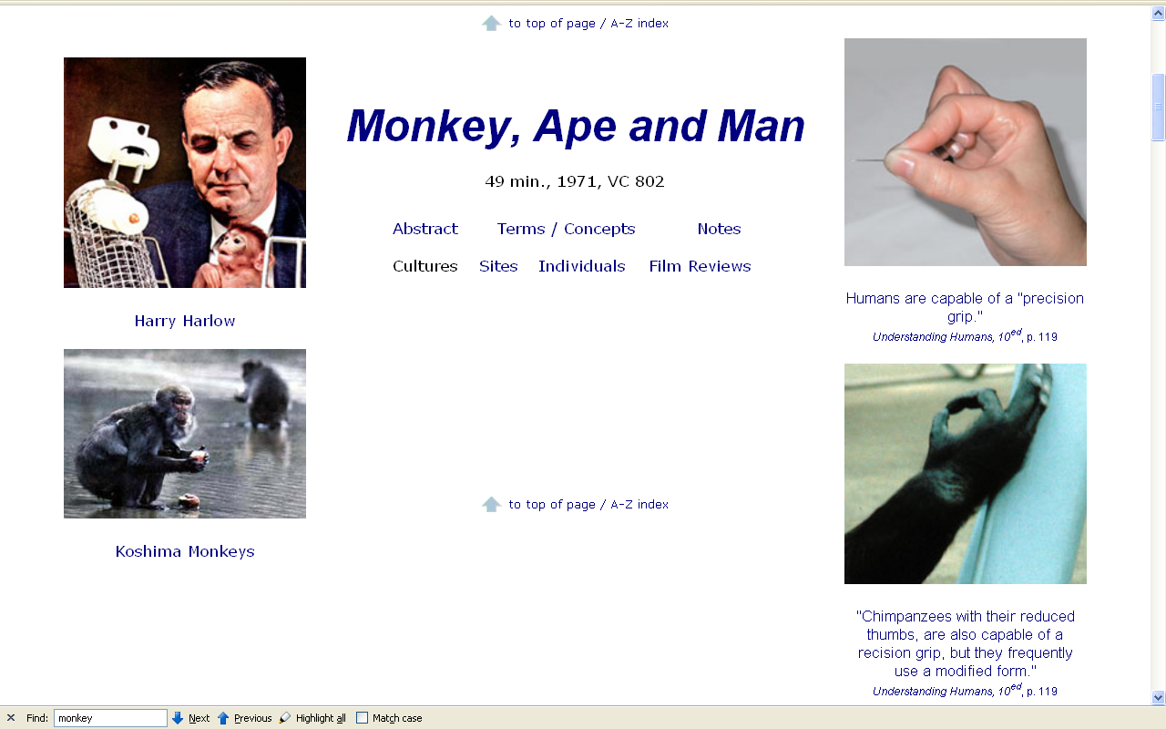
Dian Fossy

Slide 22
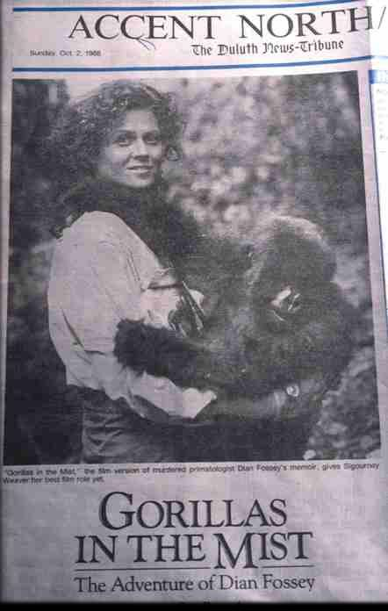
Dian Fossy

Slide 23
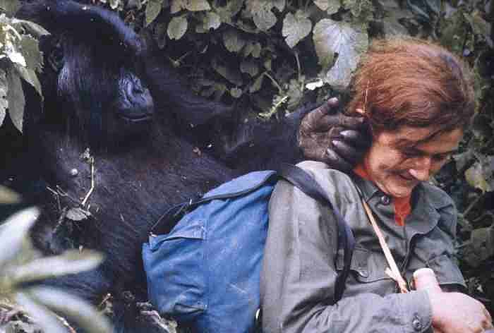
Dian Fossy

Slide 24
Glossary
primatologist
e.g., Birute Galdikas - Brindamour

Slide 25
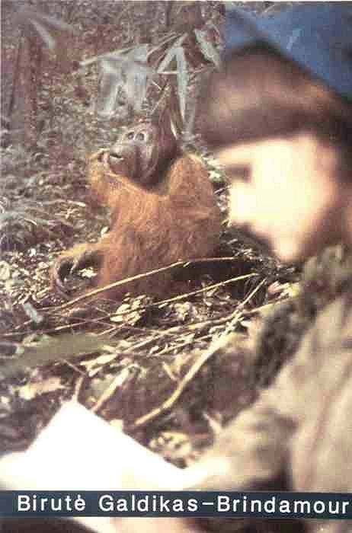

Slide 26
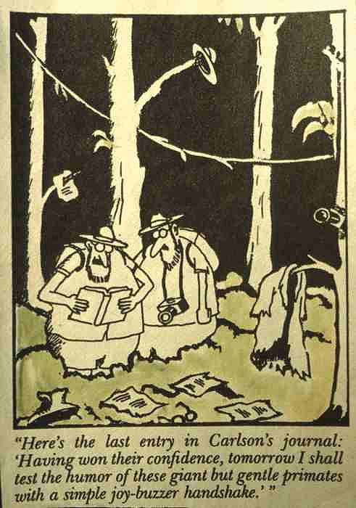

Slide 27
Modern Physical Anthropology
2. Shift of Emphasis from measurement and classification toward a concern with the influence of genetics on stability and variation in human populations

Slide 28
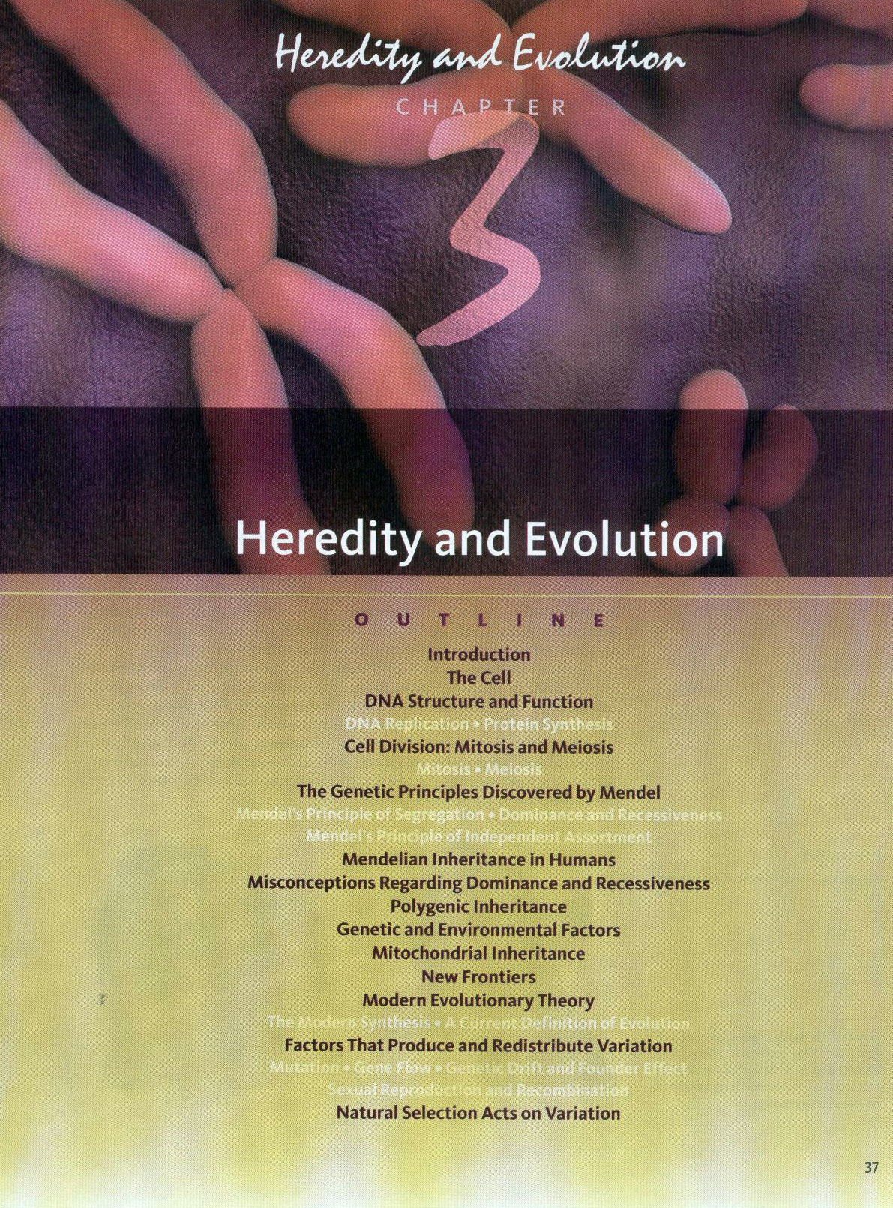

Slide 29
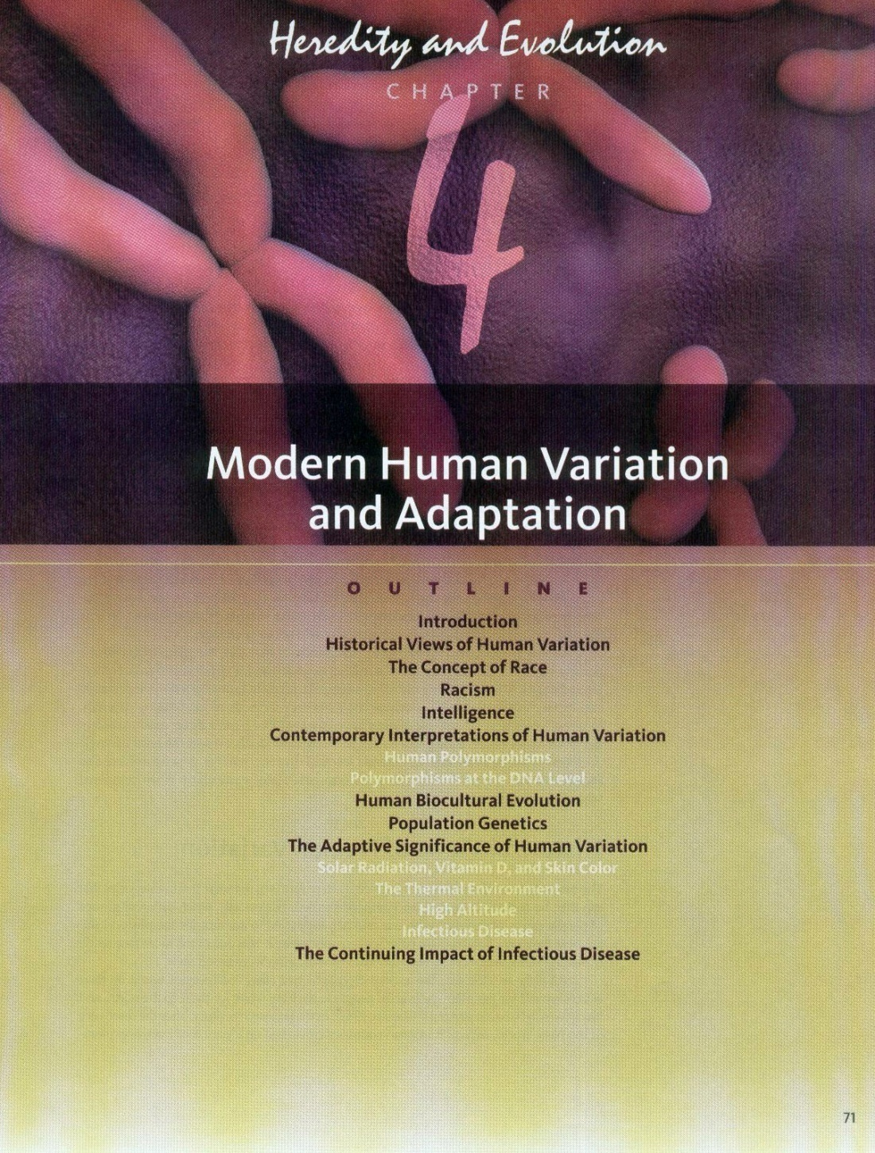

Slide 31
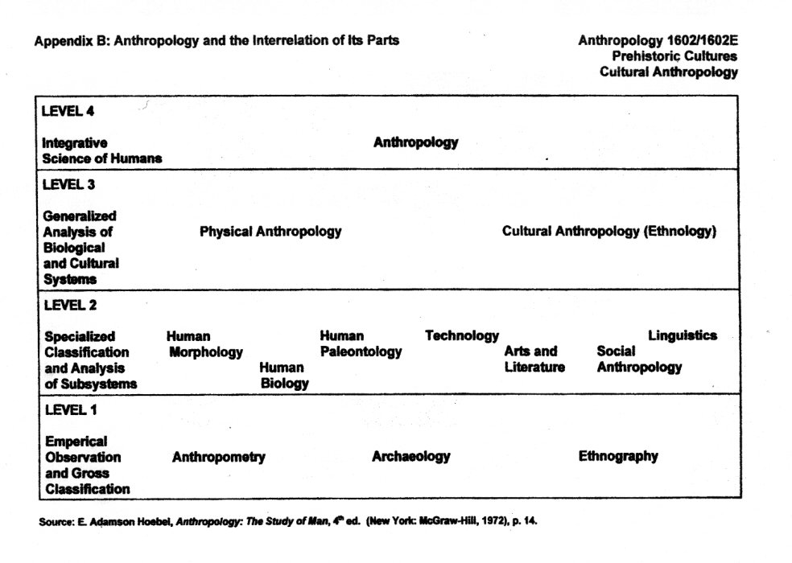

Slide 32
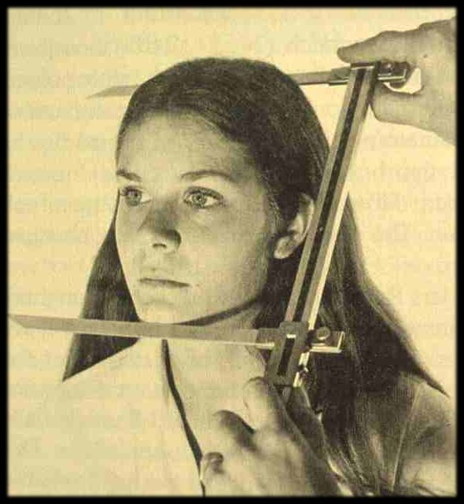

Slide 33
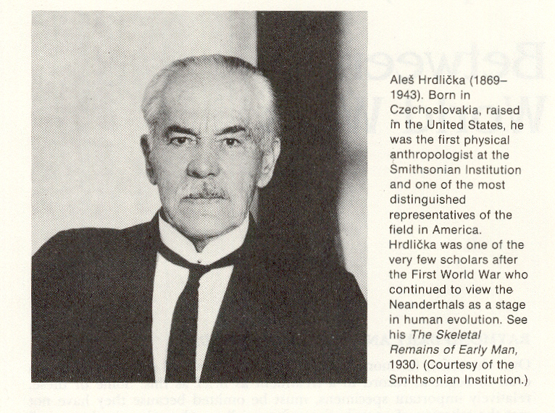
Brace, The Stages of Human Evolution, 3rd Ed., Prentice-Hall, 1988, p. 25.

Slide 34
Hrdlička, Aleš. “Anthropology of the Chippewa.” (1916). In Holmes
Anniversary Volume, F. W. Hodge
(ed.). Washington: G. W. Bryan,
pp. 198 – 227.

Slide 35
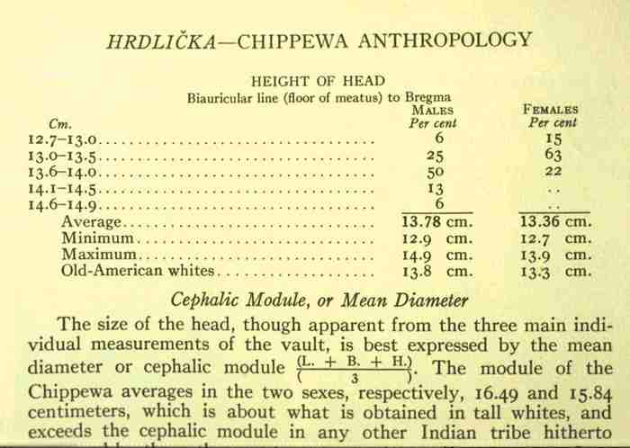

Slide 36
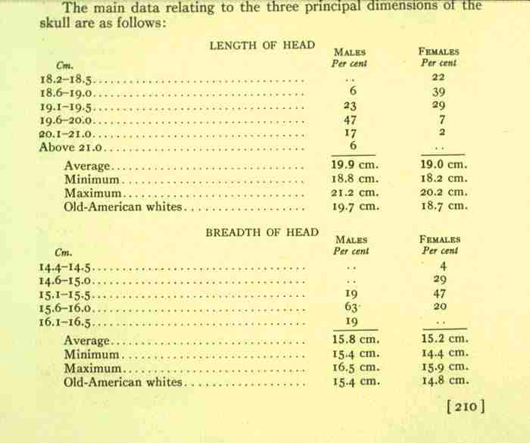

Slide 37
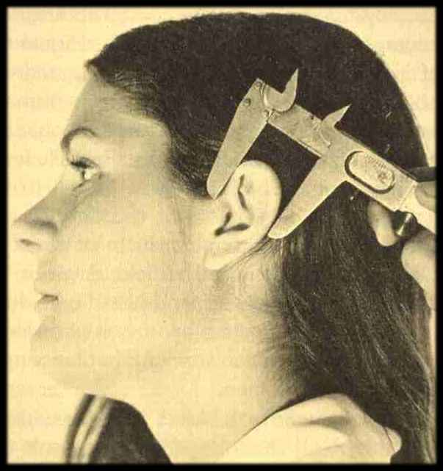

Slide 38
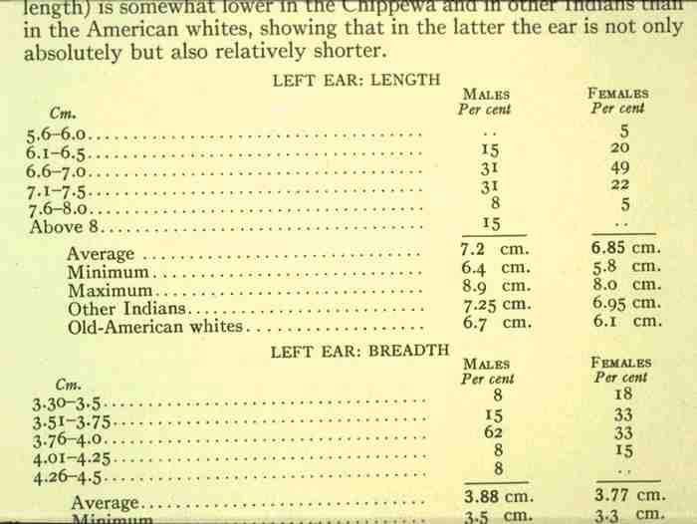

Slide 39
Modern Physical Anthropology
2. Shift of Emphasis from measurement and classification toward a concern with the influence of genetics on stability and variation in human populations

Slide 40
Glossary
particulate inheritance
things are inherited as “particles”
chromosomes
DNA

Slide 41
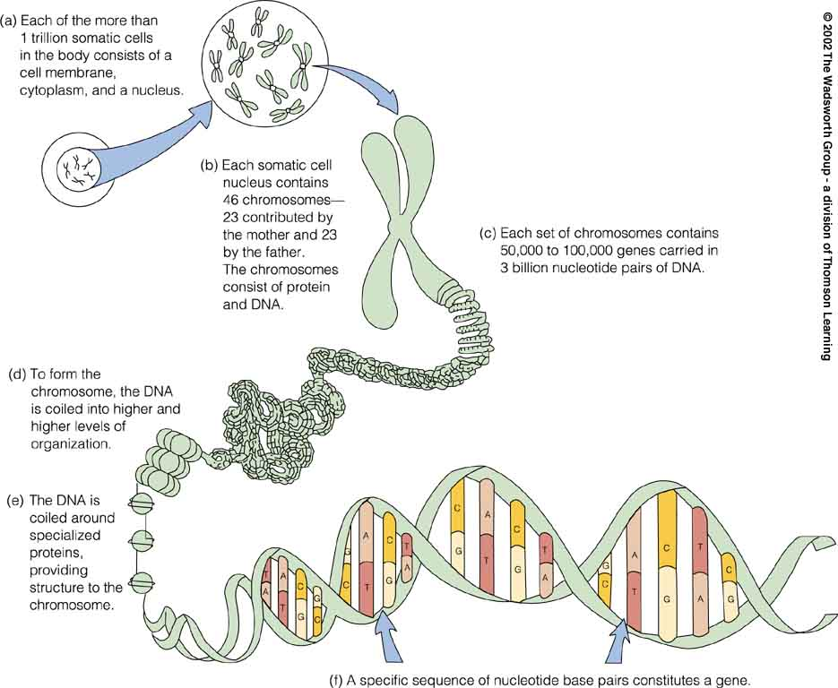
A model of a human chromosome
Understanding Humans, 10th ed., p. 76

Slide 42
Basic Concepts
genotype
phenotype

Slide 43
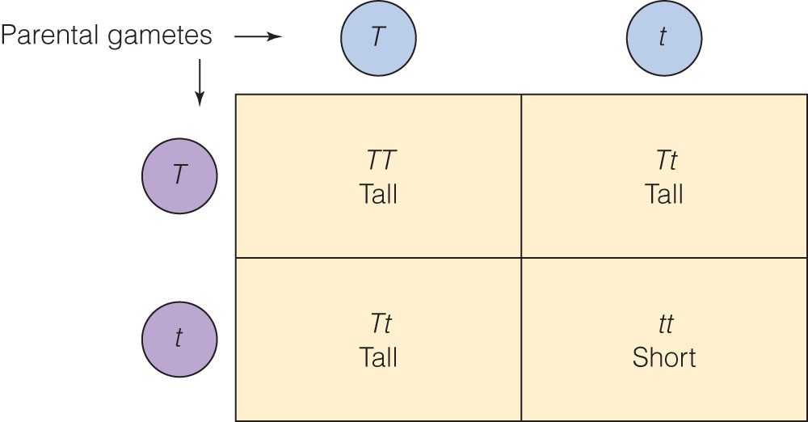
gametes are “reproductive cells
(eggs and sperm in animals)
developed from precursor cells
in ovaries and testes”
Punnett square representing
possible genotypes and phenotypes
Understanding Humans, 10th ed., p. 53

Slide 44
Punnett square representing
possible genotypes and phenotypes
Understanding Humans, 10th ed., p. 53

Slide 45
Punnett square representing
possible genotypes and phenotypes
Understanding Humans, 10th ed., p. 53

Slide 46
Punnett square representing
possible genotypes and phenotypes
Understanding Humans, 10th ed., p. 53

Slide 47
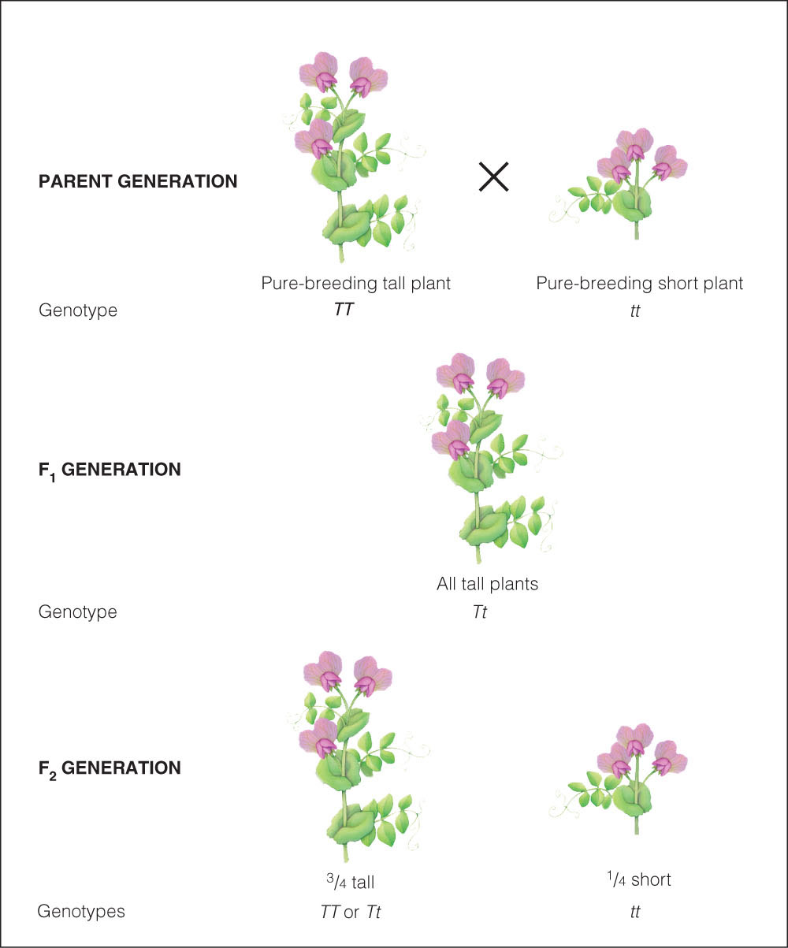
Understanding Humans, 10th ed., p. 52

Slide 48
Basic Concepts
genotype
phenotype

Slide 49
Basic Concepts
genotype
phenotype

Slide 50
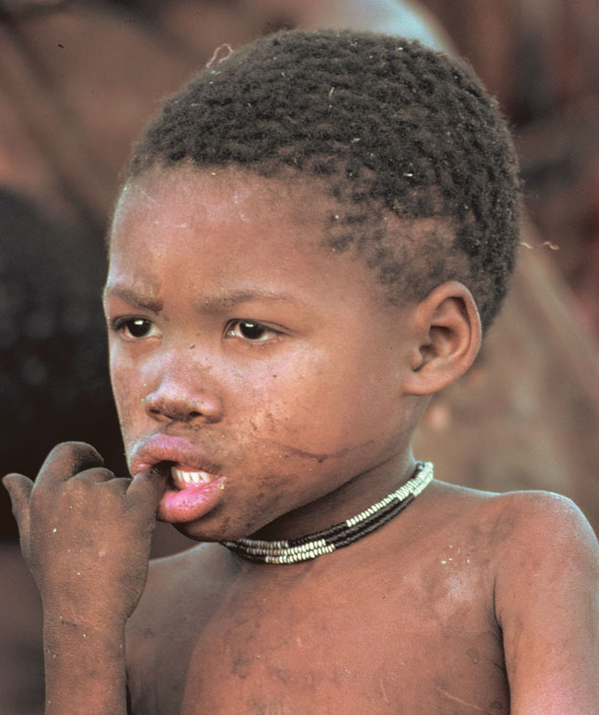
“Some examples of phenotypic variation among Africans.”
San (South African)
Understanding Humans, 10th ed., p. 76

Slide 51
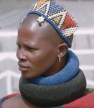
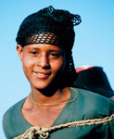
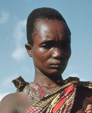
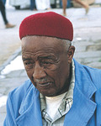
“Some examples of phenotypic variation among Africans.”
San (South African)
Understanding Humans, 10th ed., p. 76

Slide 52
Basic Concepts
genotype
phenotype

Slide 53
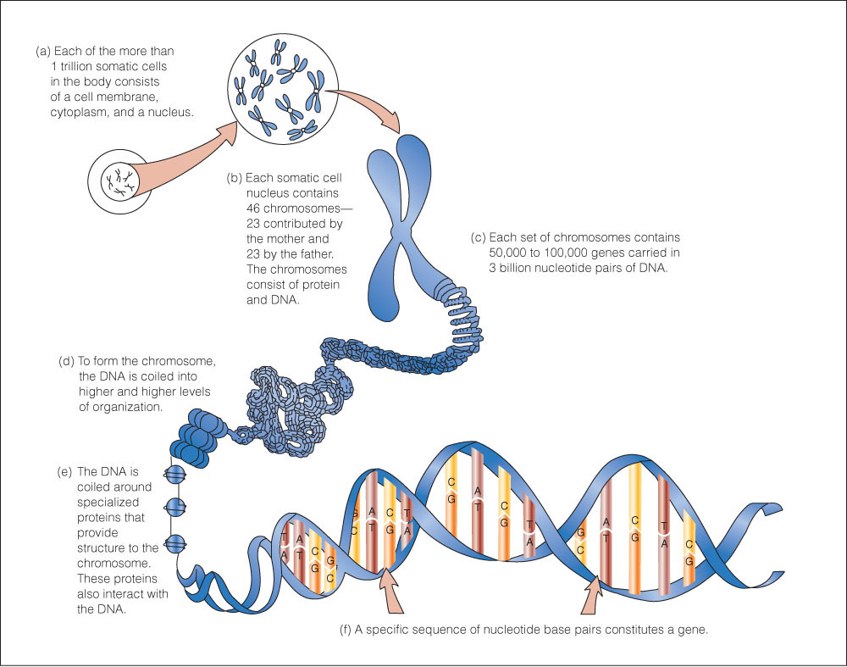
Understanding Humans, 10th ed., p. 45

Slide 54
Modern Physical Anthropology
Work on blood studies, blood typing
. . .

Slide 56
www.d.umn.edu/cla/faculty/troufs/anth1602/video/Yanomamo.html

Slide 57
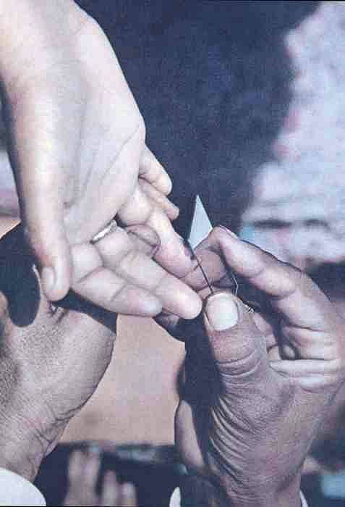

Slide 58
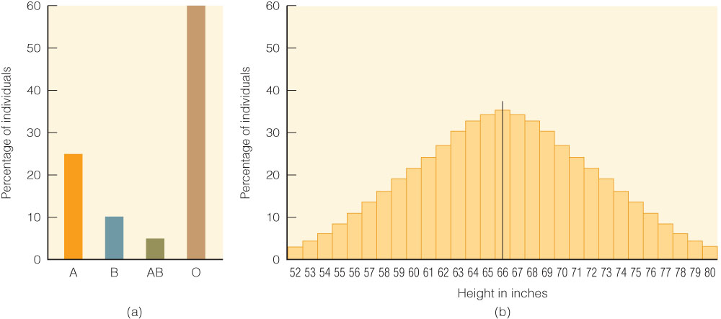
(a) Shows “the discontinuous Distribution of a Mendelian trait (ABO blood type)
in a theoretical population. . . .”
Understanding Humans, 10th ed., p. 57

Slide 59
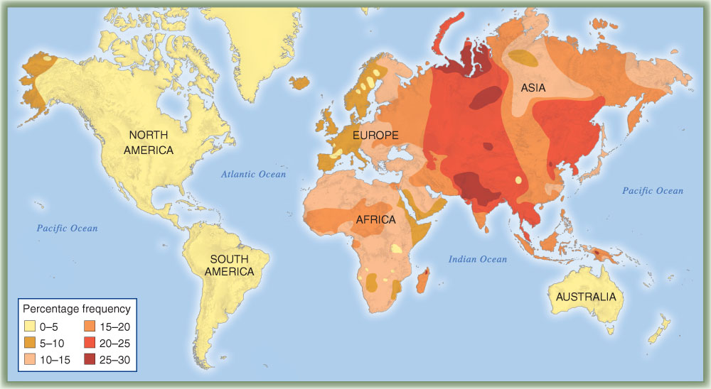
“ABO blood group system.
Distribution of the B allele in the indigenous populations of the world.”
(After Mourant et al., 1976.)
Understanding Humans, 10th ed., p. 57

Slide 60
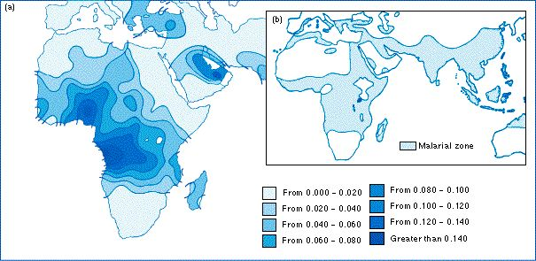
sickle cell anemia frequencies
www.blackwellpublishing.com/ridley/tutorials/The_theory_of_natural_selection__part_2_8.asp

Slide 61
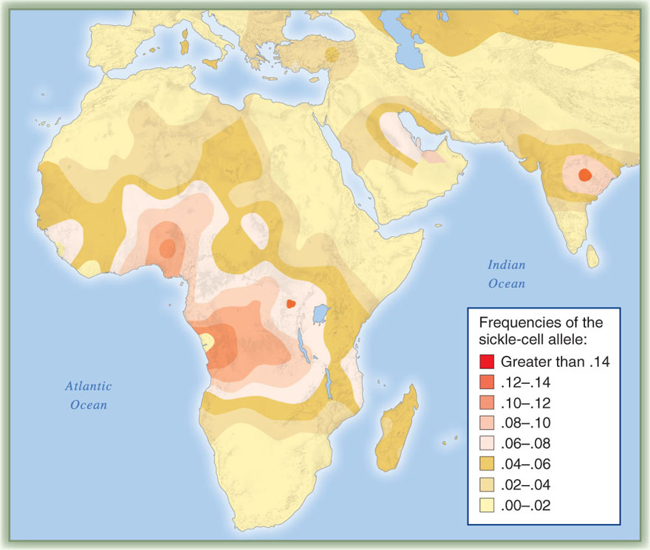
“Distribution of the sickle-cell allele in the Old World.”
Understanding Humans, 10th ed., p. 68

Slide 62
Modern Physical Anthropology
Work on dietary influences on body composition, nutrition and health

Slide 63
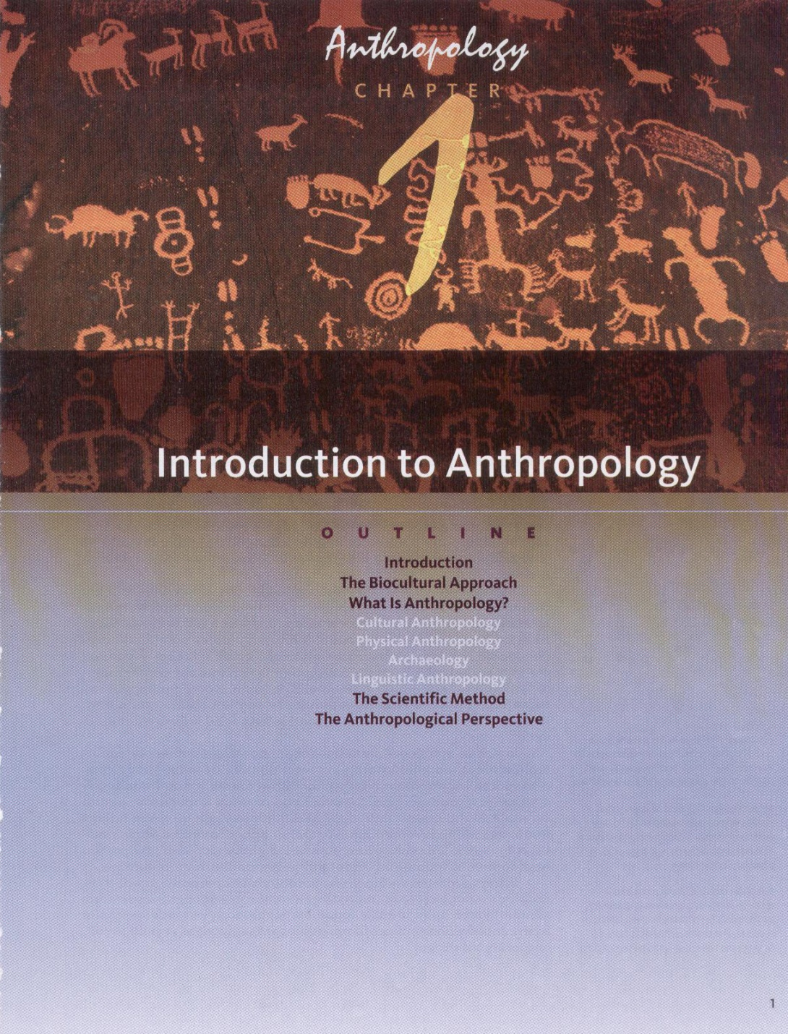

Slide 64
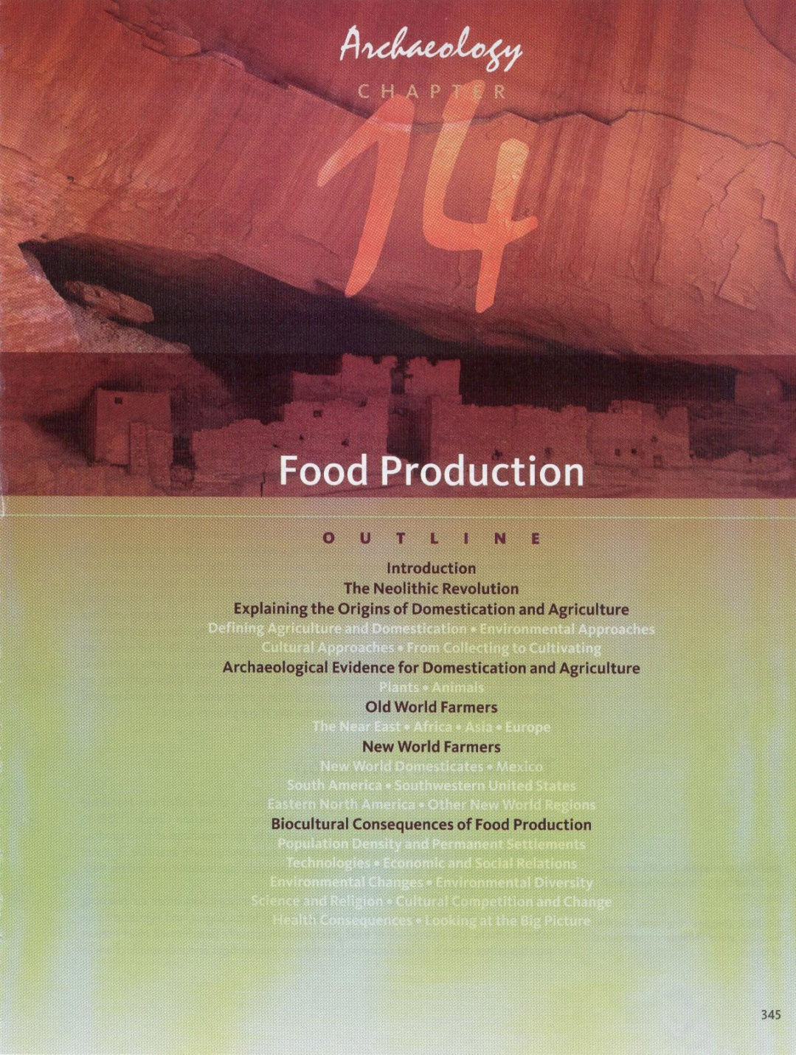

Slide 65
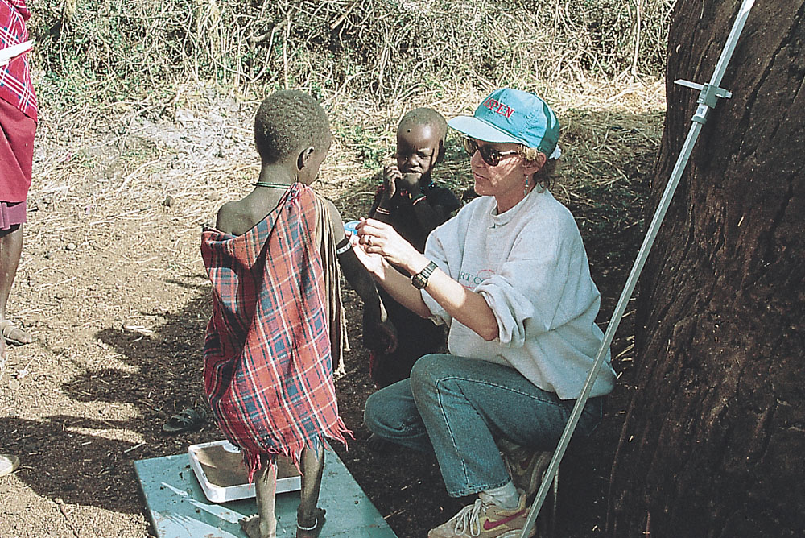
Kathleen Galvin measures upper arm circumference
of a young Maasai boy in Tanania.
Understanding Humans, 10th ed., p. 8

Slide 66
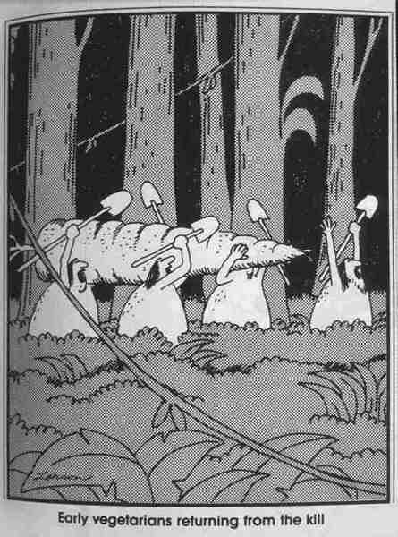

Slide 67
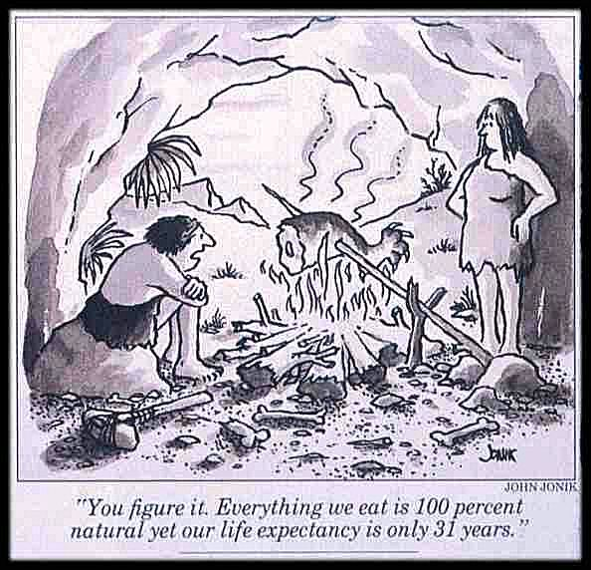

Slide 68
Modern Physical Anthropology
Work on the effects of things like differing muscle stress on body shape
human morphology

Slide 69
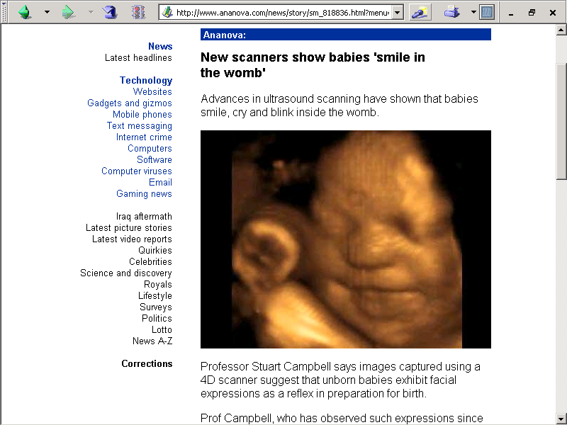

Slide 70
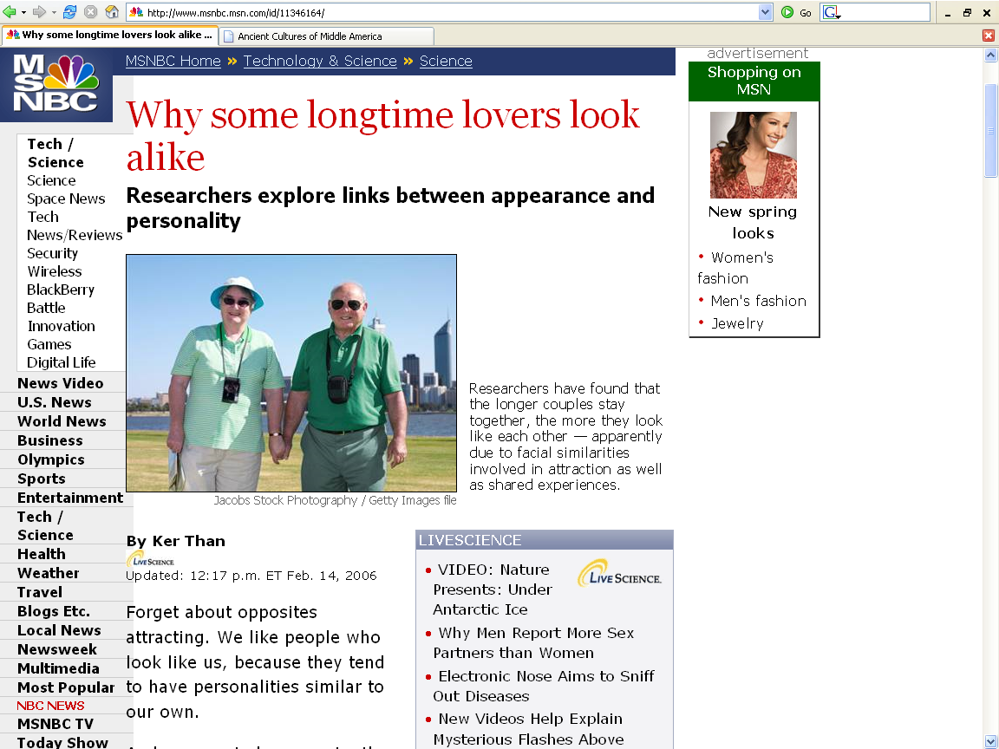
http://www.msnbc.msn.com/id/11346164/

Slide 71
Modern Physical Anthropology
Why do children
adopted at a very young age
often end up
looking like their adoptive parent(s)?

Slide 72
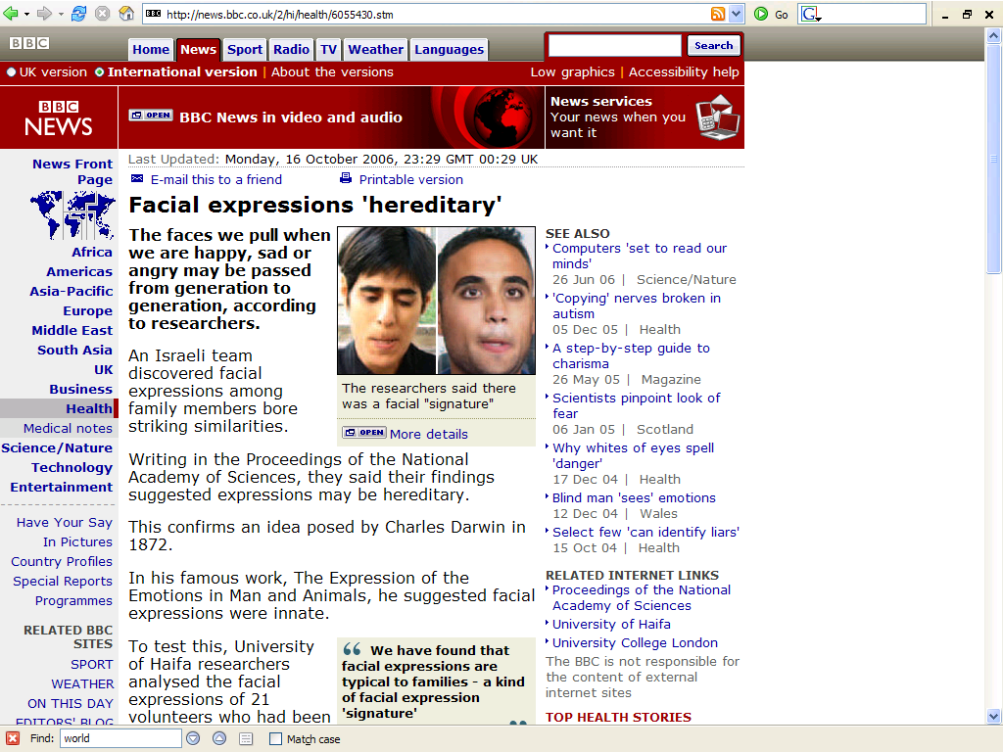
news.bbc.co.uk/2/hi/health/6055430.stm

Slide 73
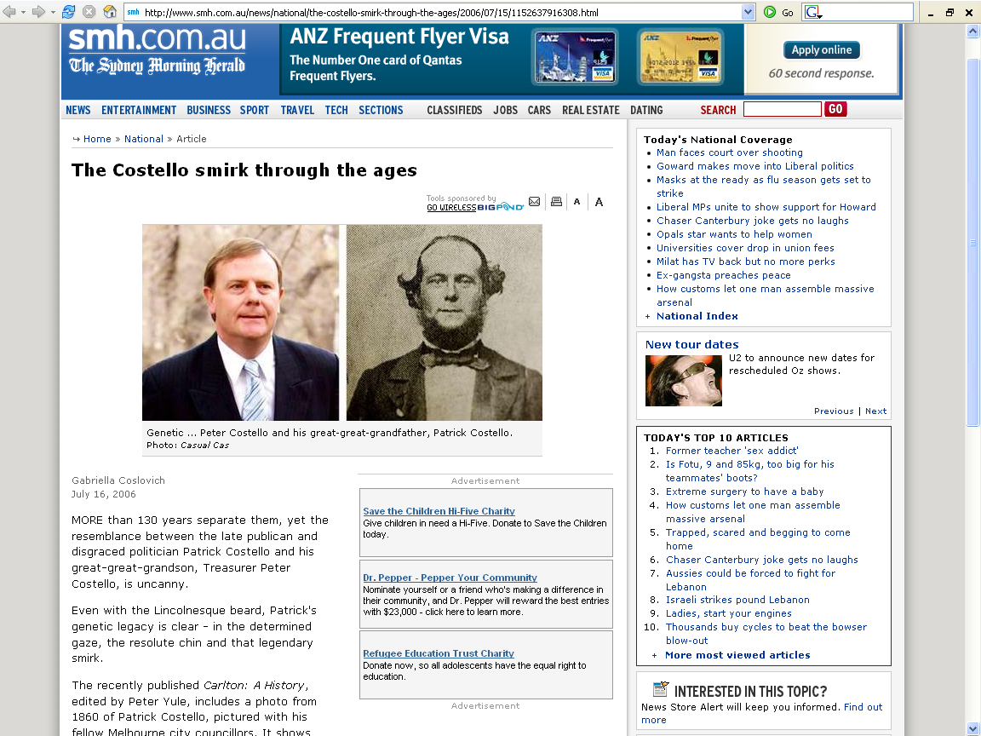
www.smh.com.au/news/national/the-costello-smirk-through-the-ages/2006/07/15/1152637916308.html

Slide 74
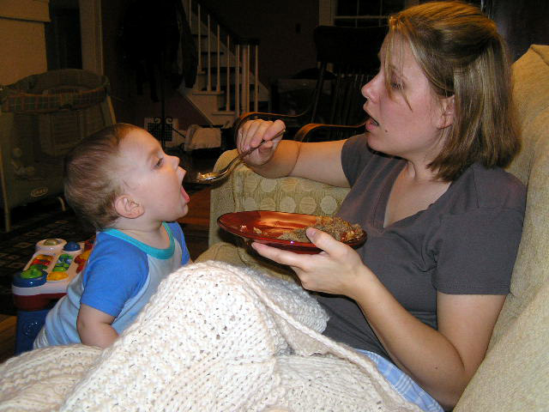
Casey and Penny Roufs 27 September 2007

Slide 75
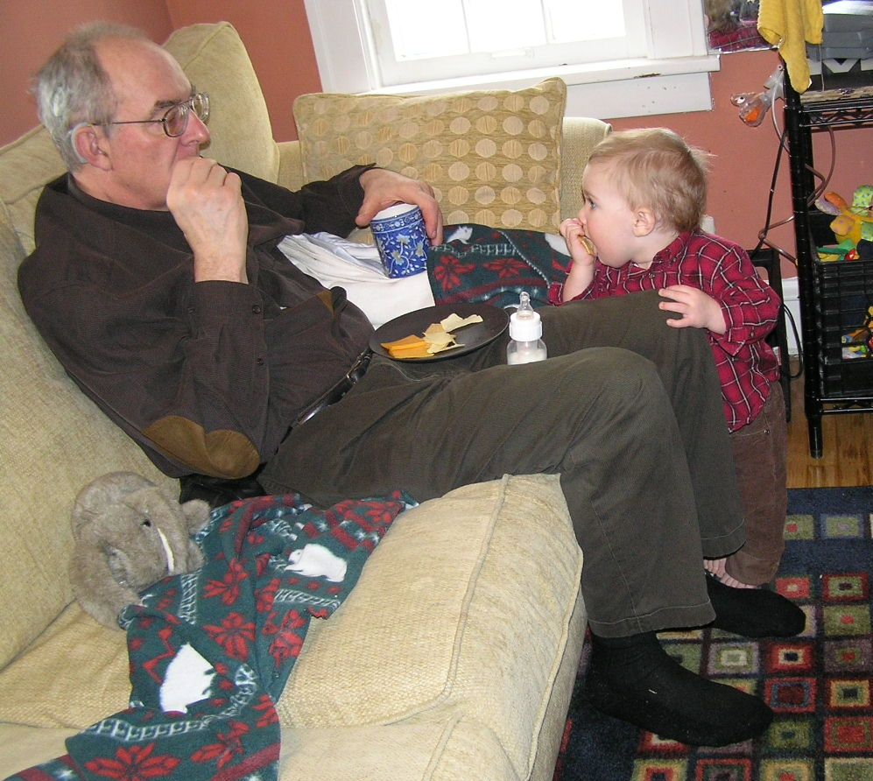
Casey and Tim Roufs 27

Slide 76
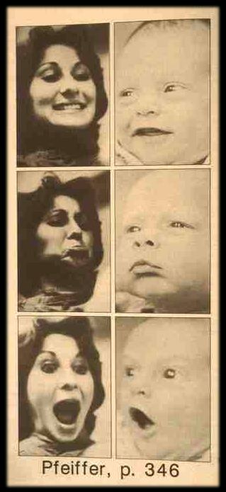

Slide 77
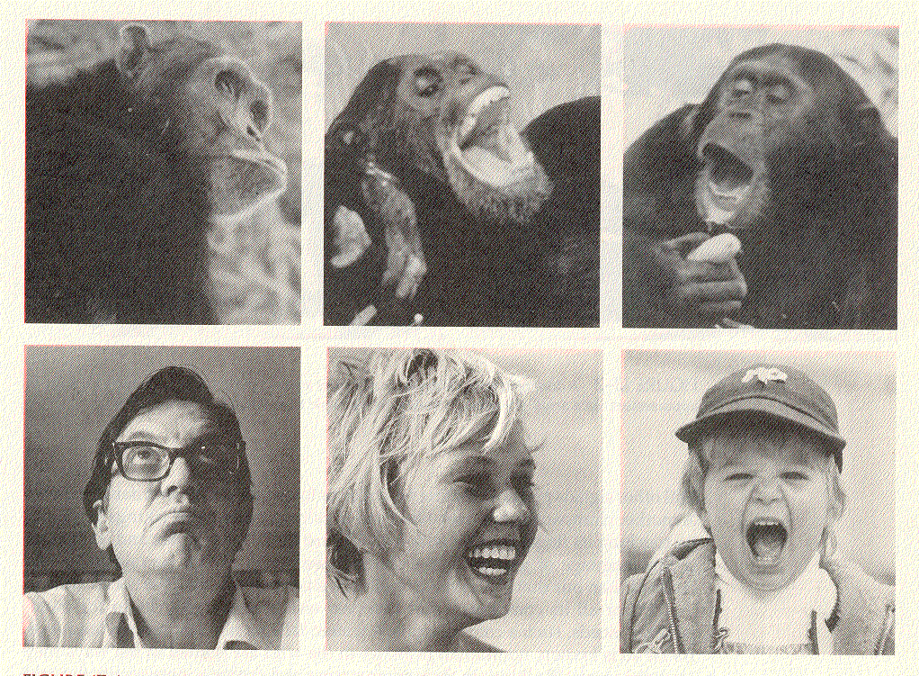
Campbell, Humankind Emerging, 8th ed., p. 369

Slide 78
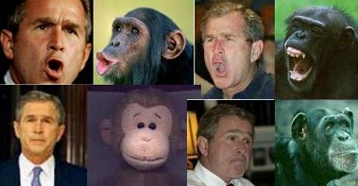

Slide 80
Modern Physical Anthropology
This process is unintentional, and occurs by imitation
But in other situations body modification is intentional . . .

Slide 81
Koskimo (Kwakiutl) woman
Mayan head deformation
halfmoon.org

Slide 83
Nurture
or
Nature?

Slide 84
Modern Physical Anthropology
6. Work on genetic processes as they determine morphology and other things . . .

Slide 91
Modern Physical Anthropology
NEXT:
Work on effects of culture as it influences human breeding patterns

