Slide 1
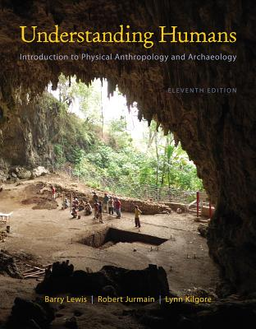
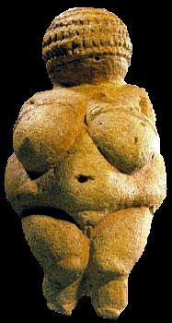
Class Slides Set 10A
Special Skills Used to Study Early Humans
. . . or how to make sense
out of
Ch. 8 of the text . . .
University of Minnesota Duluth
Tim Roufs
© 2010-2013
http://www.d.umn.edu/cla/faculty/troufs/anth1602/

Slide 2
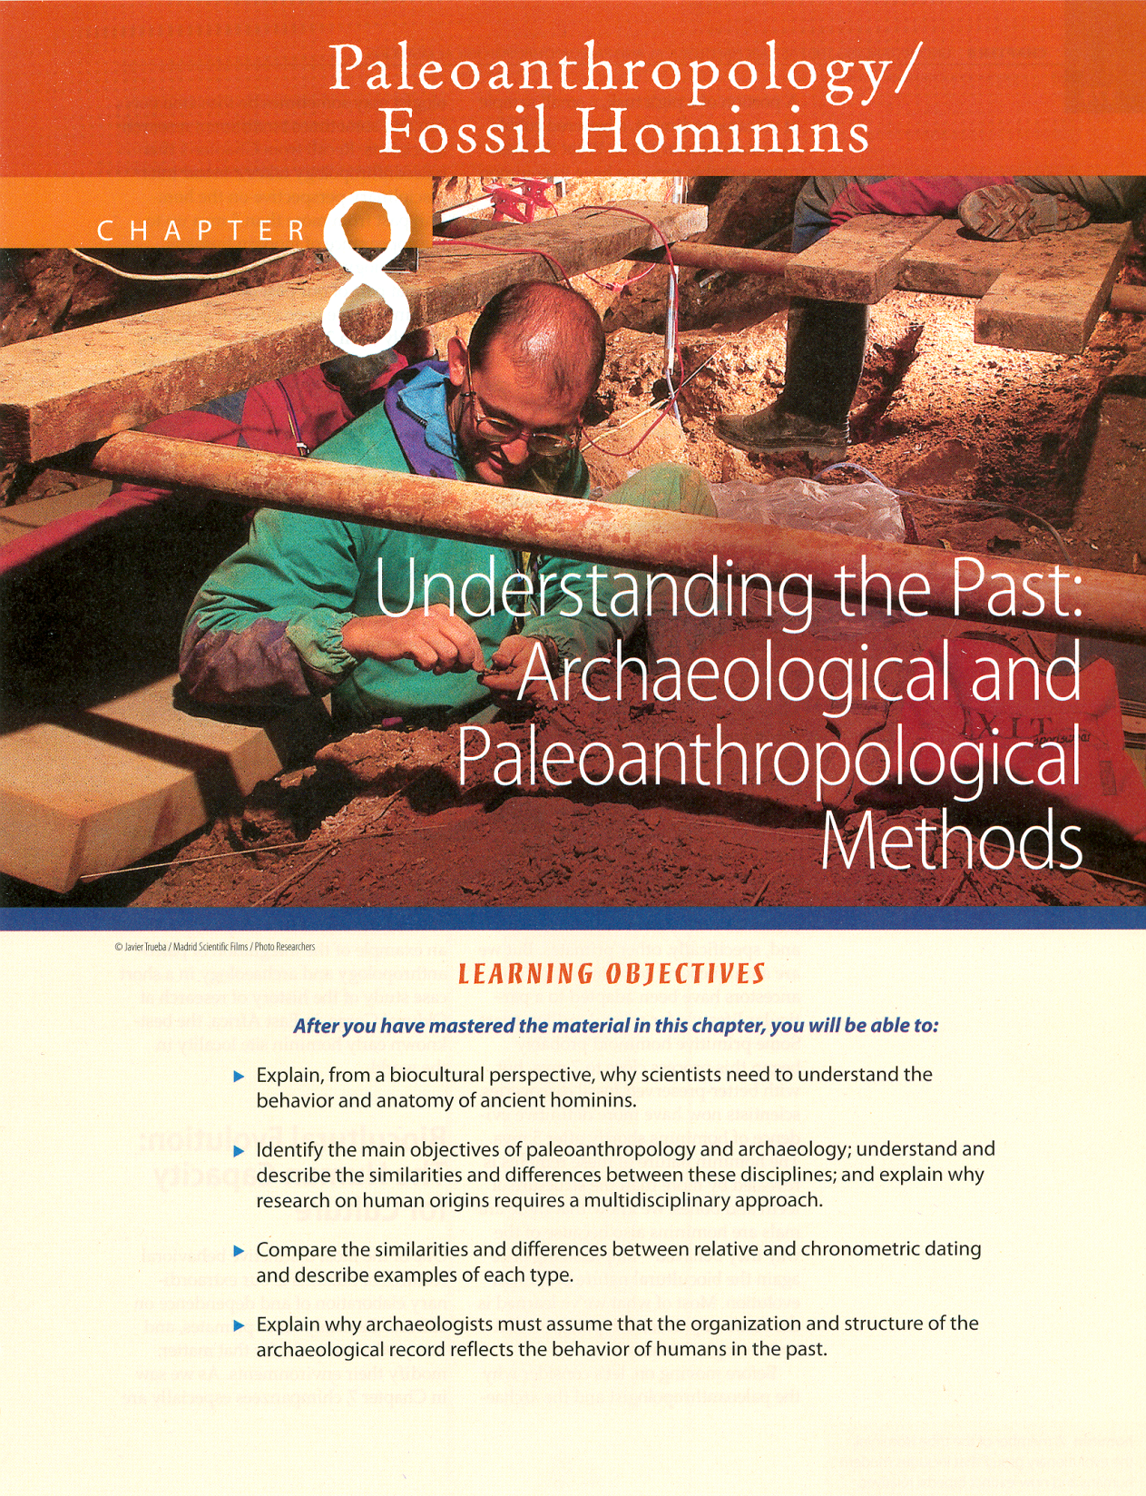
In the Field

Slide 3
Special Skills Used to Study Early Humans
In the Field
In the Laboratory
In the Field and Laboratory

Slide 4
Special Skills Used to Study Early Humans
In the Field
In the Laboratory
In the Field and Laboratory

Slide 5
In the Field
Paleoanthropologists
Geologists
Surveyors
Draftspeople
Photographers

Slide 6
In the Field
Paleoanthropologists
Geologists
Surveyors
Draftspeople
Photographers

Slide 7
In the Field
Paleoanthropologists
Geologists
Surveyors
Draftspeople
Photographers
do paleoanthropology,
which is the interdisciplinary approach to the study of earlier hominins
– their chronology, physical structure, archaeological remains, habitats, etc.

Slide 8
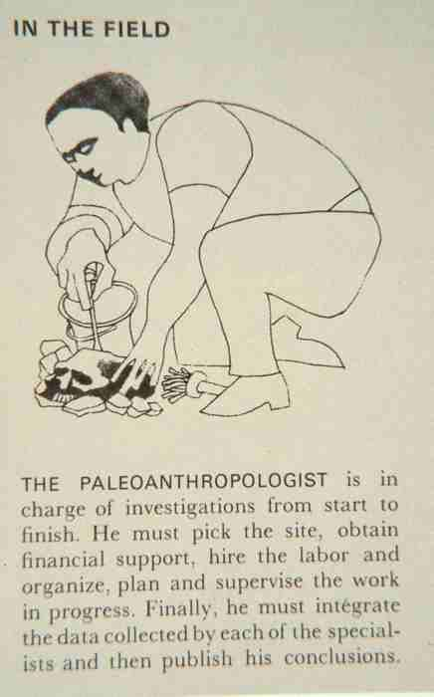

Slide 9
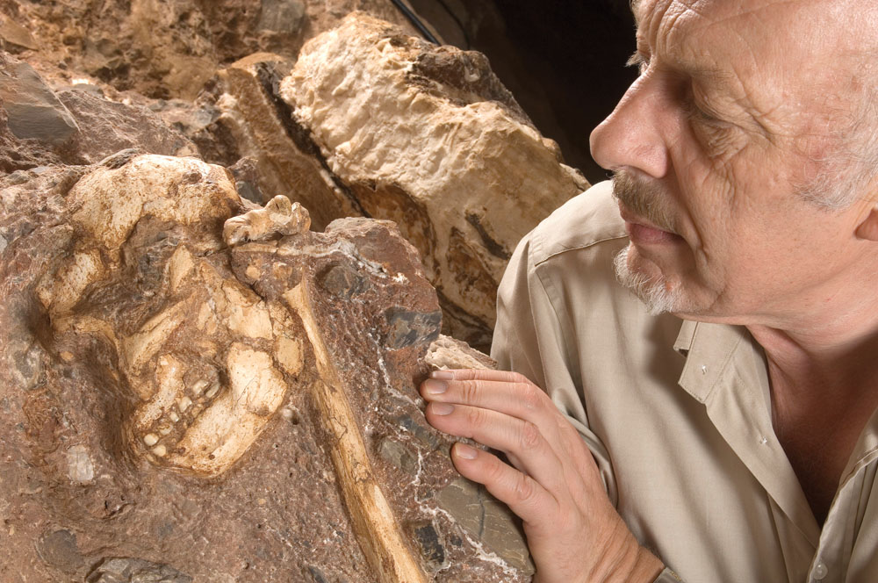
Paleoanthropologist Ronald Clark exams 2-my-old skeleton
Sterkfontein Cave, South Africa
Understanding Humans, 10th Ed., p. 223.

Slide 10
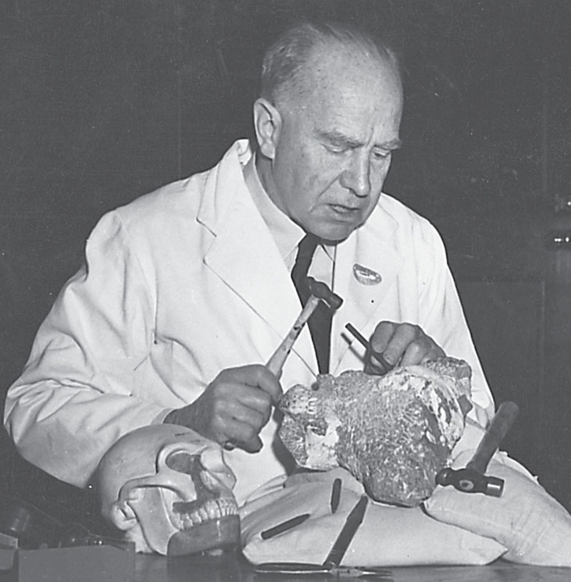
Raymond Dart, working in his laoratory
Understanding Humans, 10th Ed., p. 223.

Slide 11
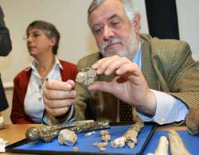
Paleoanthropologists Brigitte Senut and Martin Pickford
Video: Search for the First Human – A Secrets of the Dead Special

Slide 12
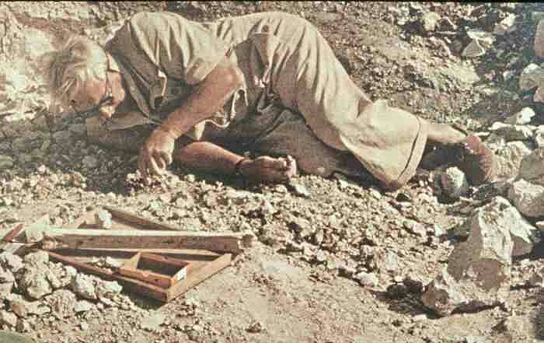
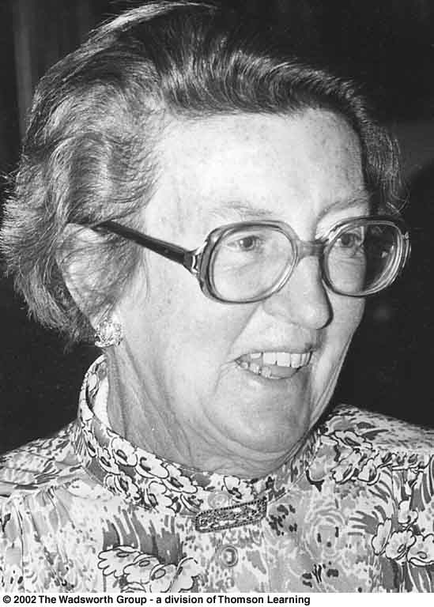
Louis Leakey
Mary Leakey
11th ed., p. 192

Slide 13
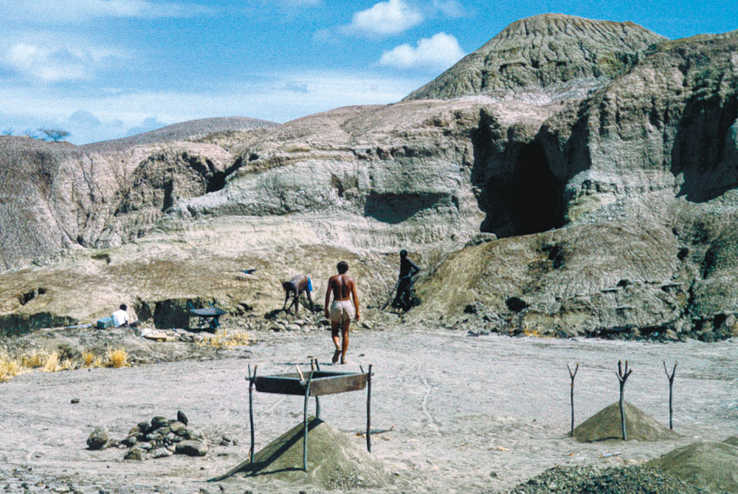
Paleoanthropological research at Omo, Ethiopia
Understanding Humans, 10th Ed., p. 7.

Slide 14
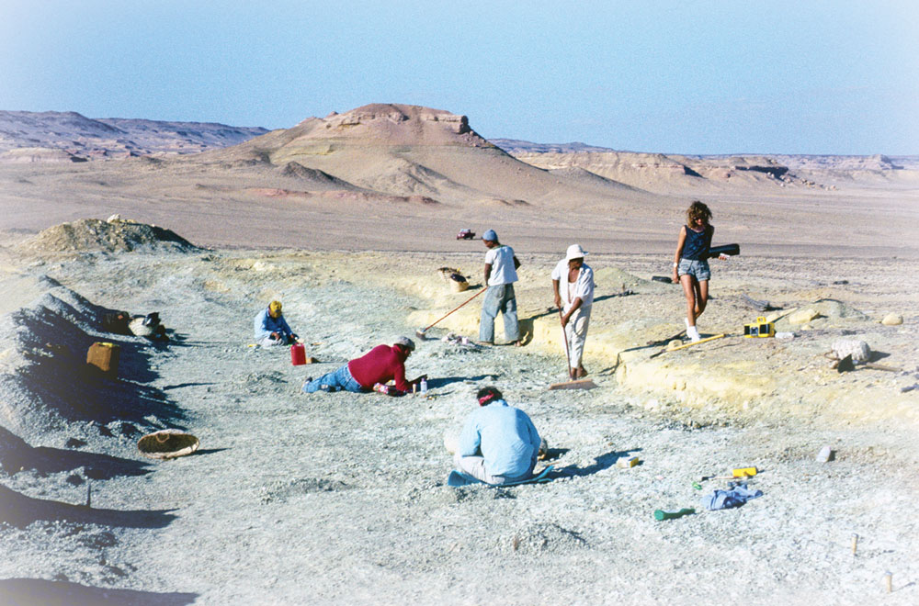
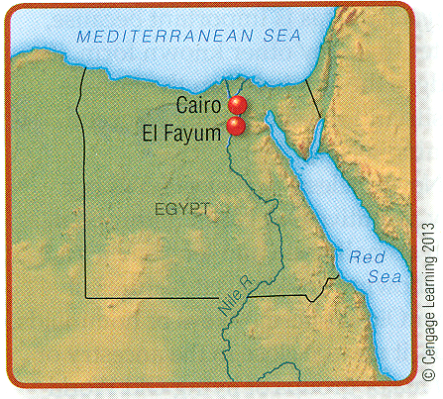
Field Excavations at Fayum, Egypt.
Understanding Humans, 11th Ed., p. 199

Slide 15
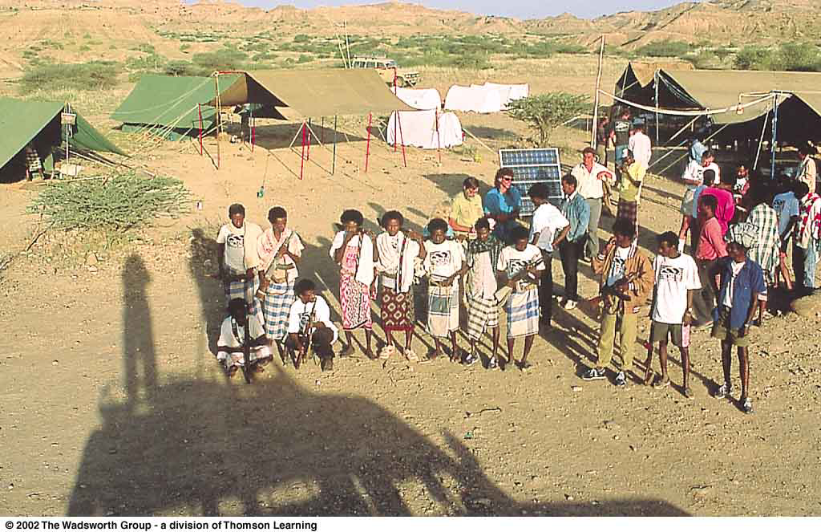
Field camp at Hadar, Ethiopia.
Understanding Physical Anthropology and Archaeology, 8th ed., p. 282

Slide 16
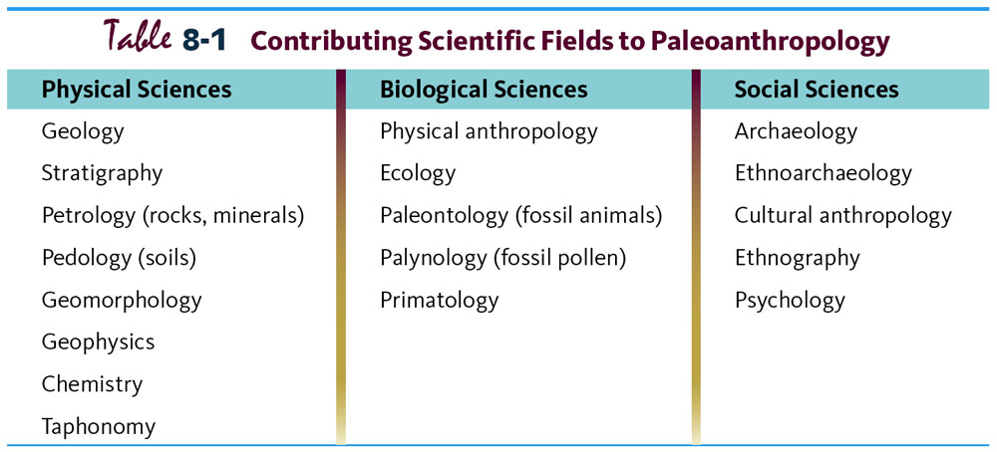
Paleoanthropology is Heavily Interdisciplinary.
Understanding Humans, 10th Ed., p. 178.

Slide 17
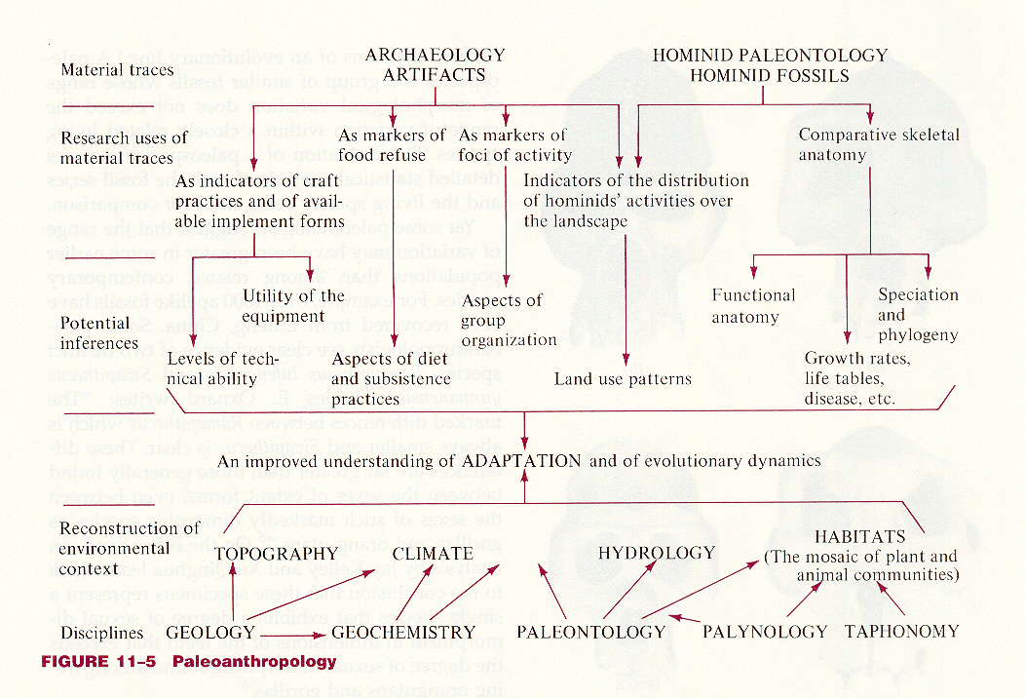
Stein and Rowe, Physical Anthropology, 7th ed., p. 253

Slide 18
More about these specialties with the
Lab specialists
Paleoanthropology is Heavily Interdisciplinary.
Understanding Humans, 10th Ed., p. 178.

Slide 19
In the Field
Paleoanthropologists
Geologists
Surveyors
Draftspeople
Photographers

Slide 20
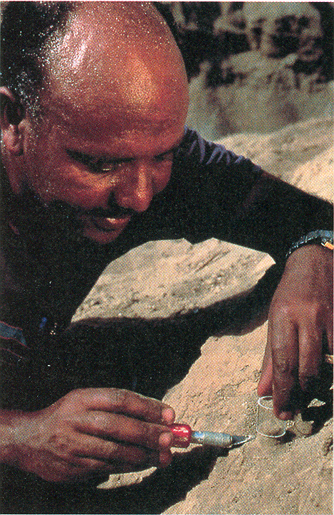
Geologist sampling sediment
containing magnetically charged particles
for paleomagnetic dating
Understanding Humans, 11th Ed., p. 188

Slide 21
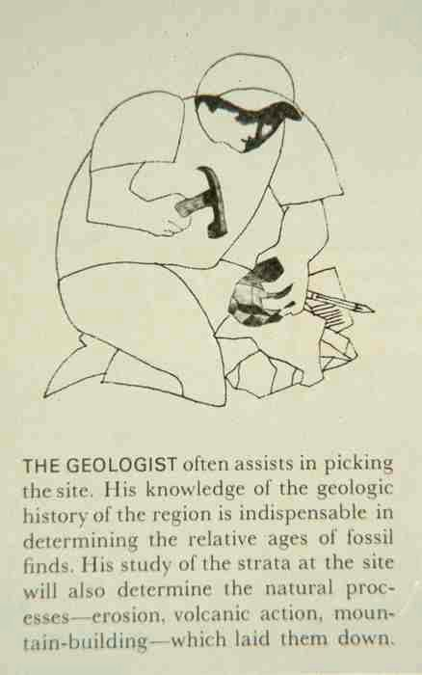

Slide 22
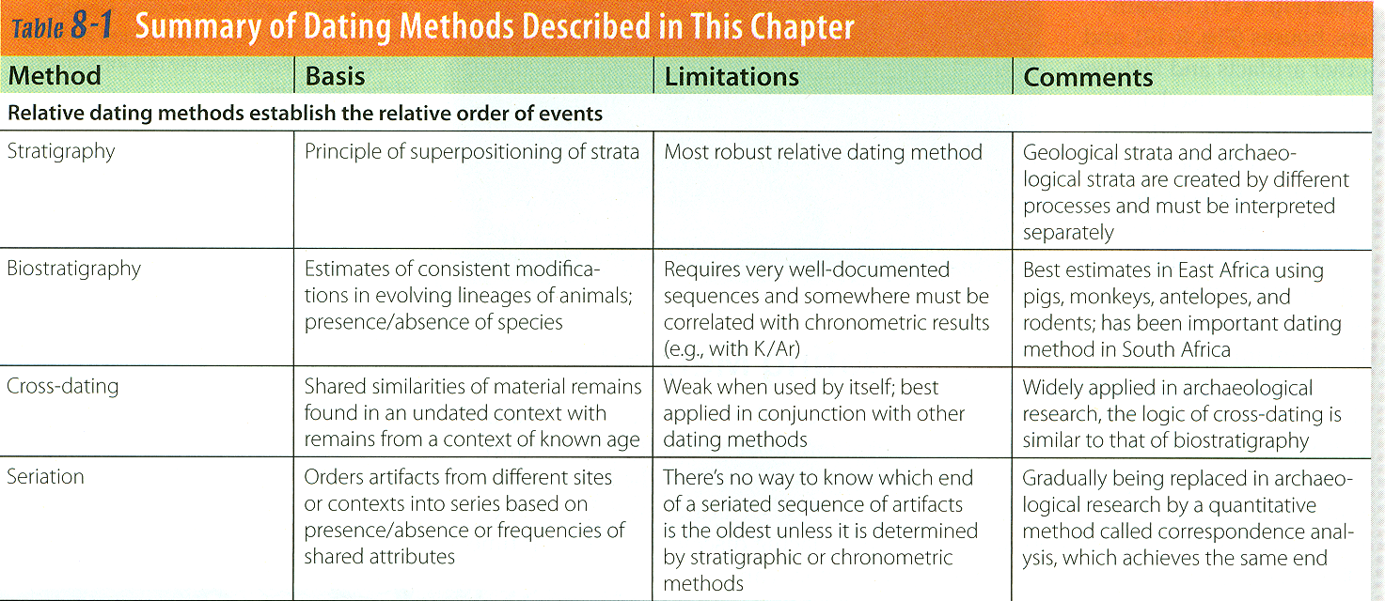
Paleoanthropology is Heavily Interdisciplinary.
Understanding Humans, 11th Ed., p. 184

Slide 23
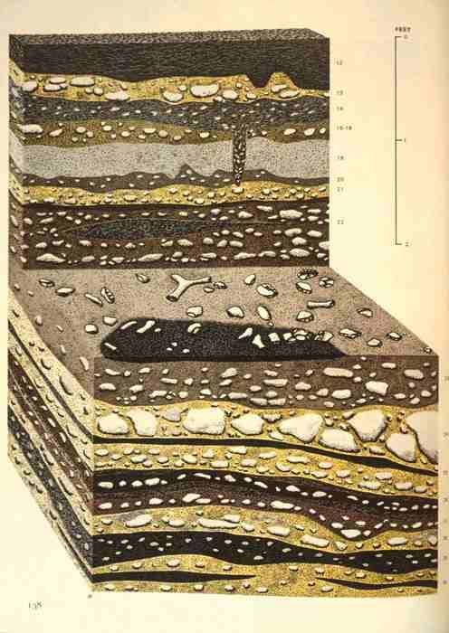
Notes:
23

Slide 24
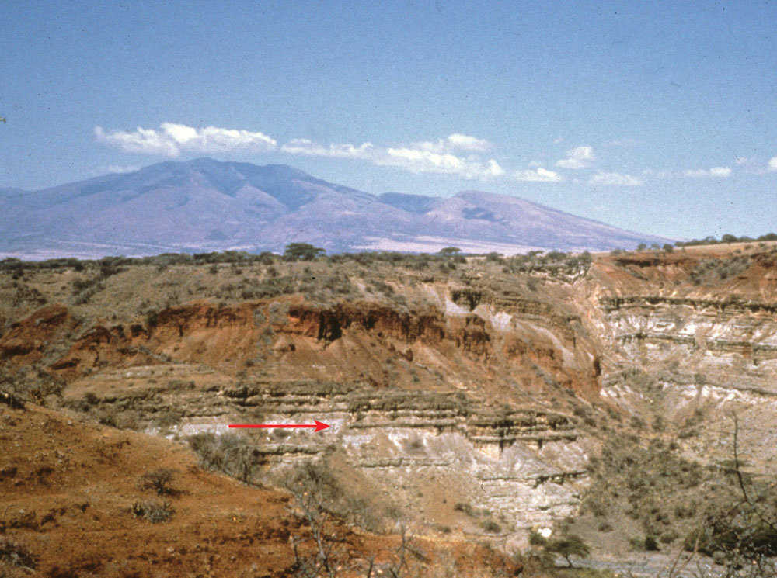
Geological sequence at Olduvai Gorge.
Understanding Humans, 11th Ed., p. 193.

Slide 25
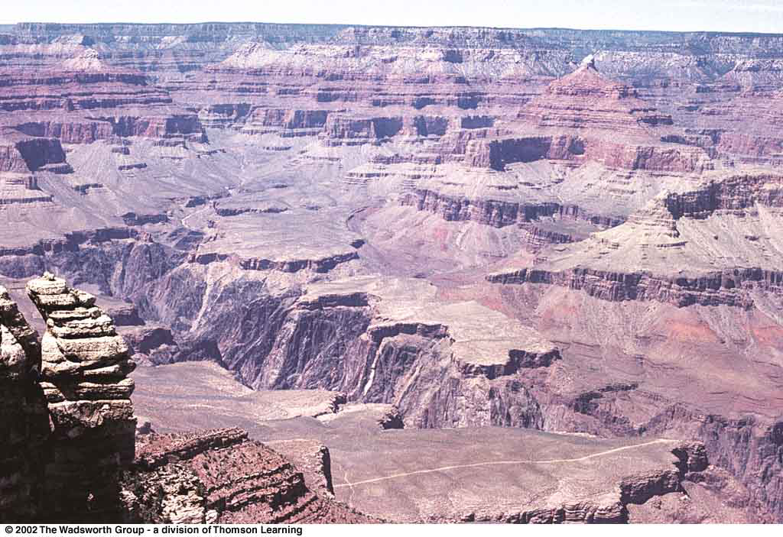
Colorado River, Grand Canyon in Arizona.
Understanding Physical Anthropology and Archaeology, 8th ed., p. 353

Slide 26
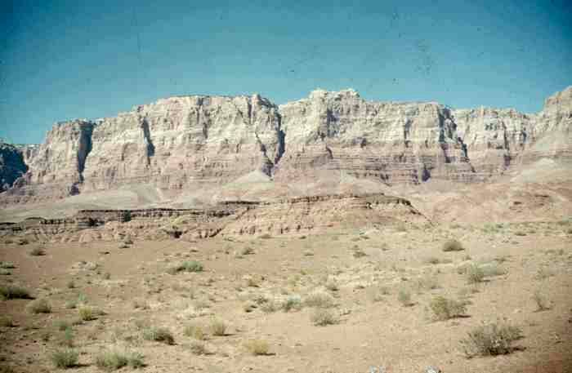
Photo courtesy of James Grant, UMD Geology Department.

Slide 27
Paleoanthropology is Heavily Interdisciplinary.
Understanding Humans, 11th Ed., p. 184

Slide 28
relative dating methods
relative dating methods
Paleoanthropology is Heavily Interdisciplinary.
Understanding Humans, 11th Ed., p. 184

Slide 29
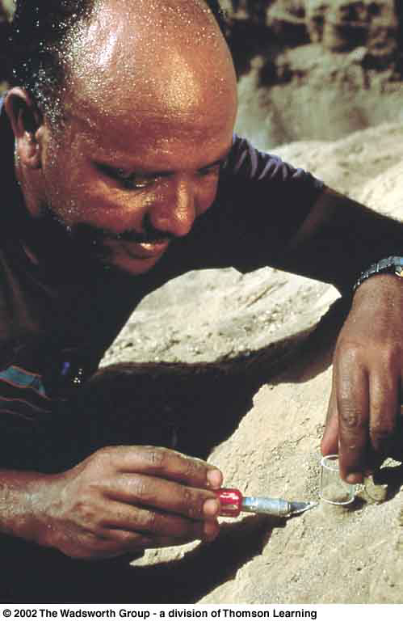
Geological samples are recovered along with the fossils.
Michael Tesfaye precisely excavates a sample of sediment to be used later for paleomagnetic analysis.
Understanding Physical Anthropology and Archaeology, 11t^{h} ed., p. 188

Slide 30
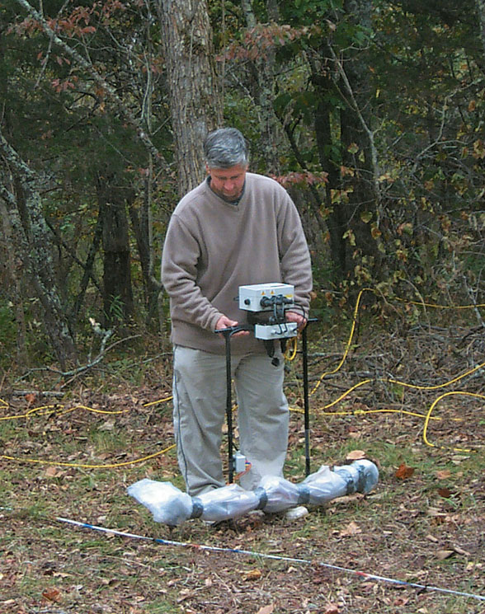
An electrical resistance survey locates archaeological features . . .
Understanding Humans, 11th Ed., p. 179

Slide 31
More about these specialties with the
Lab specialists
relative dating methods
Paleoanthropology is Heavily Interdisciplinary.
Understanding Humans, 11th Ed., p. 184

Slide 32
In the Field
Paleoanthropologists
Geologists
Surveyors
Draftspeople
Photographers

Slide 33
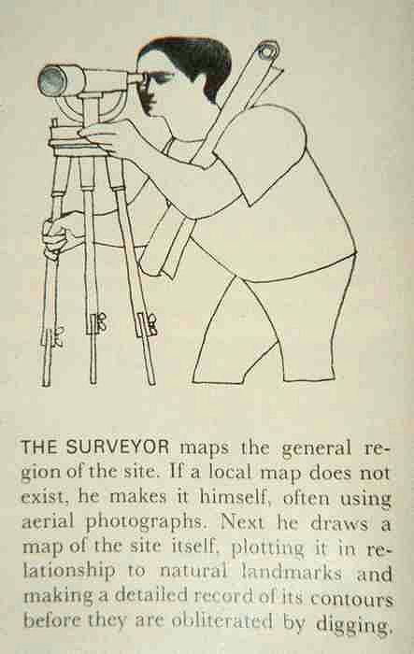

Slide 34
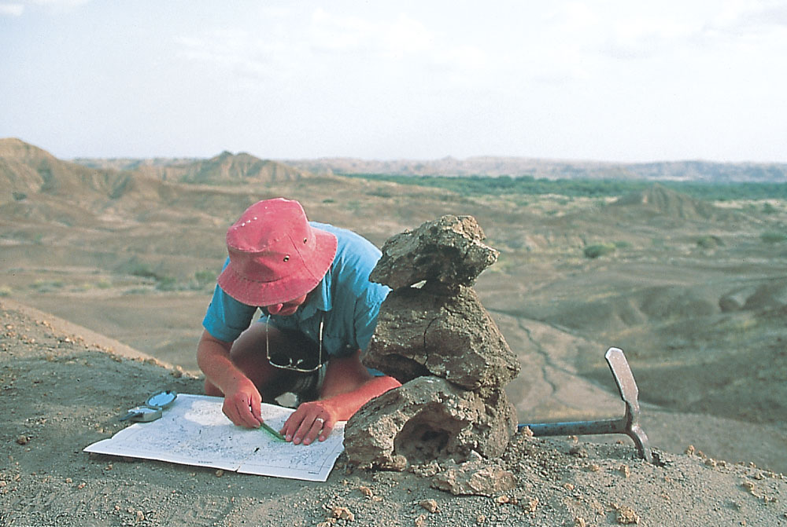
Paleoanthropologist maps an area in Ethiopia . . .
Understanding Humans, 11th Ed., p. 176

Slide 35
In the Field
Paleoanthropologists
Geologists
Surveyors
Draftspeople
Photographers

Slide 36
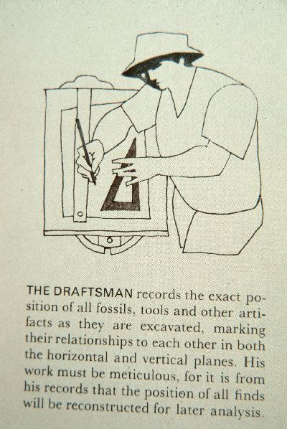

Slide 37
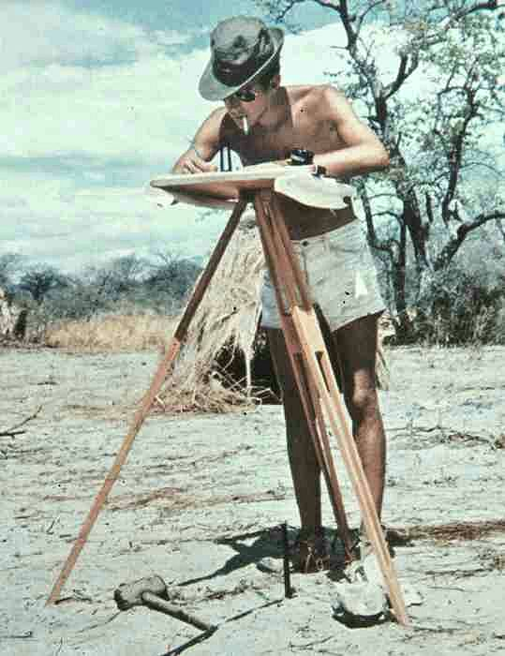

Slide 38
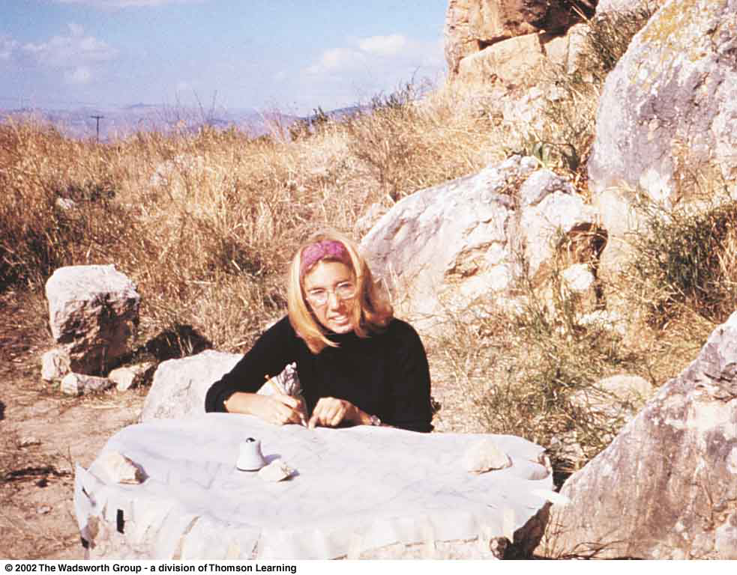
Archaeological Illustrator, Whitney Powell-Cummer
Understanding Physical Anthropology and Archaeology, 8th ed., p. 21

Slide 39
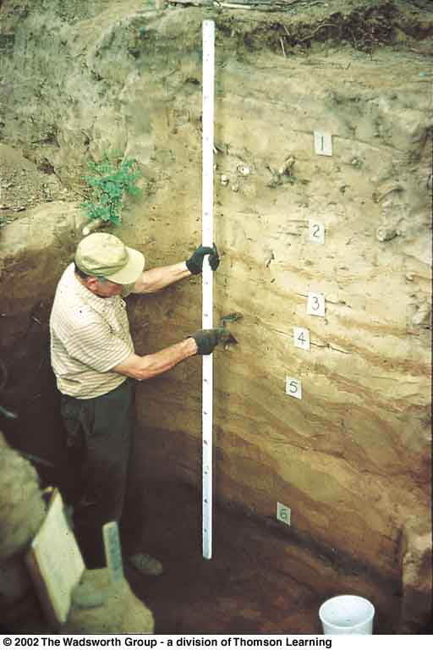
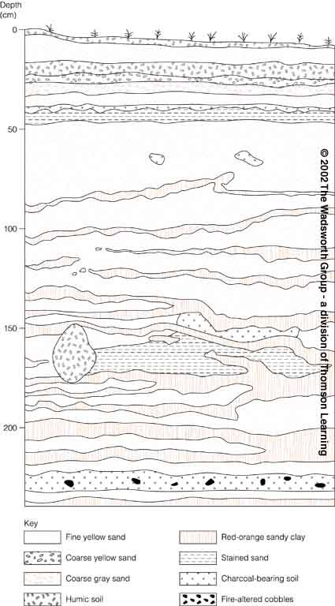
Susquehanna River site, PA Typical stratification of a deep site
Understanding Physical Anthropology and Archaeology, 10th ed., p. 190, 8t^{h} ed., p. 403

Slide 40
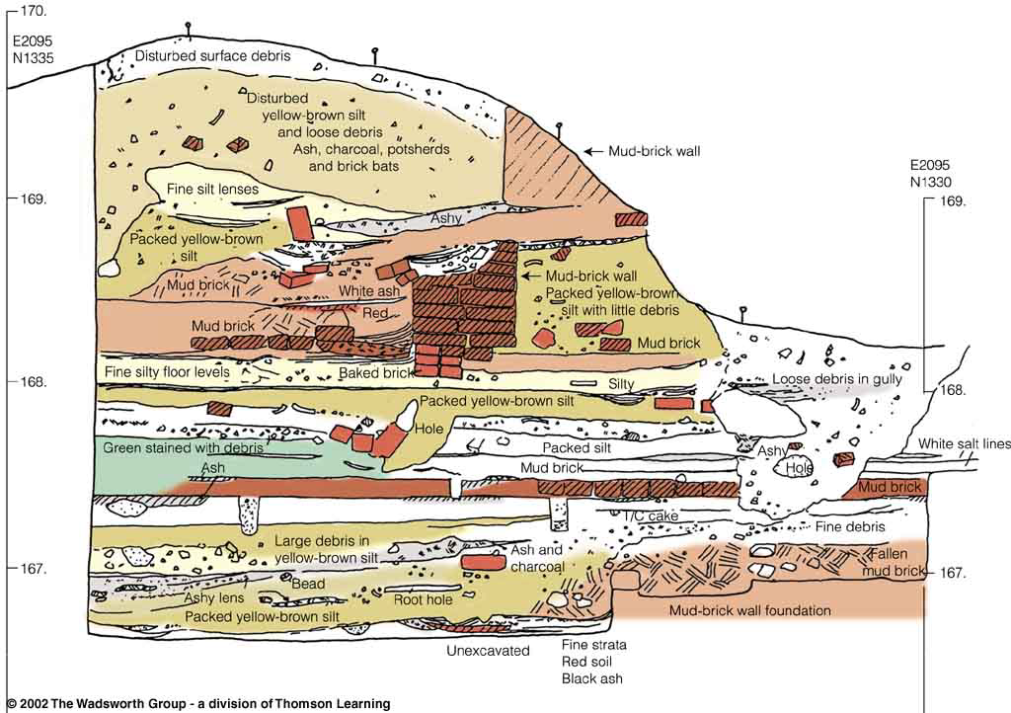
A cross section through a tell at Harappa, India.
Understanding Physical Anthropology and Archaeology, 8th ed., p. 456

Slide 41
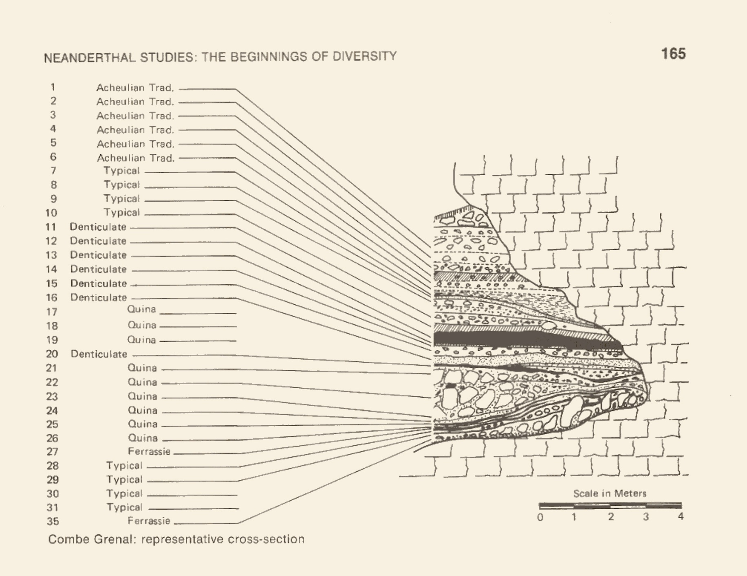
Combe Grenal, Dordogne Valley, SW France.
The Emergence of Humankind (4th ed). (Harper & Row, 1985), p. 165

Slide 42
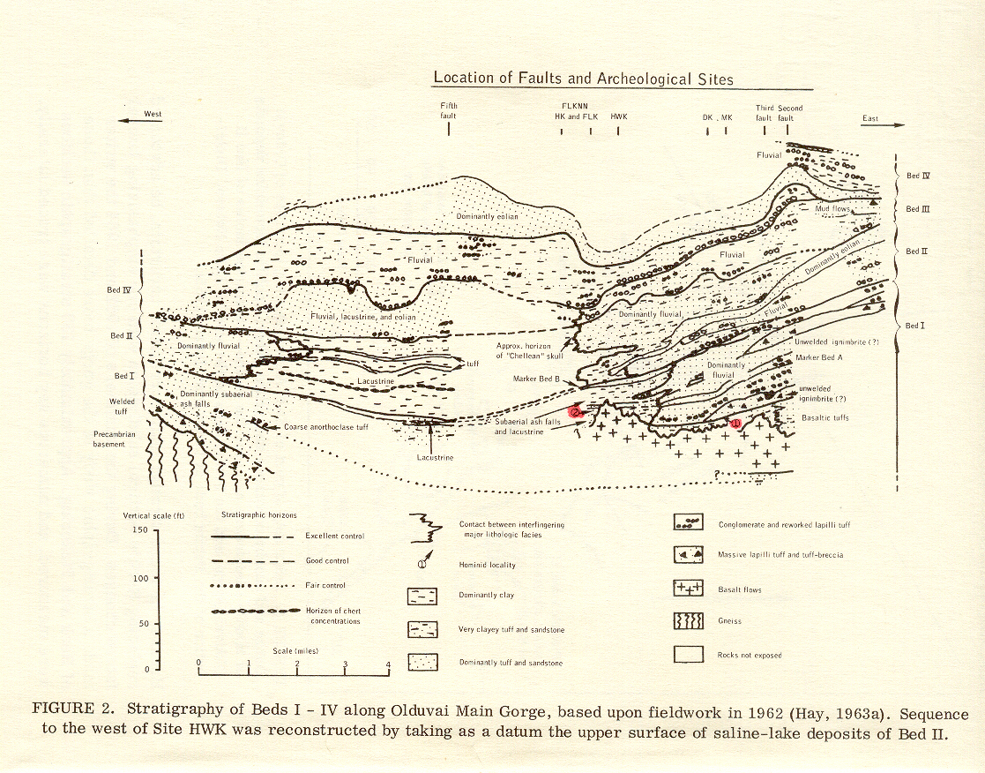
Stratigraphy of Beds I – IV, Olduvai Main Gorge.
Time and Stratigraphy in the Evoluton of Man. (National Research Council, 1967), p. 32

Slide 43
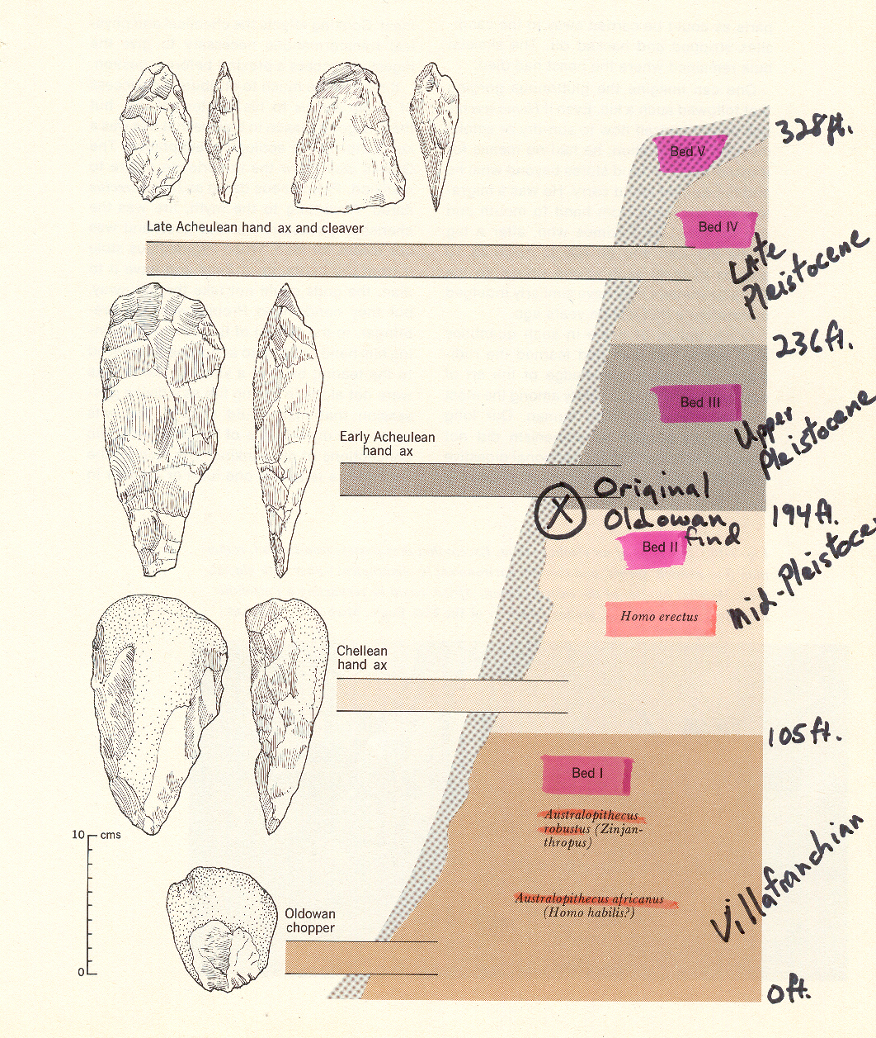
Olduvai Gorge, Kenya.
Hoebel, Anthropology: The Study of Man and Archaeology, 4th ed., p. 153

Slide 44
In the Field
Paleoanthropologists
Geologists
Surveyors
Draftspeople
Photographers

Slide 45
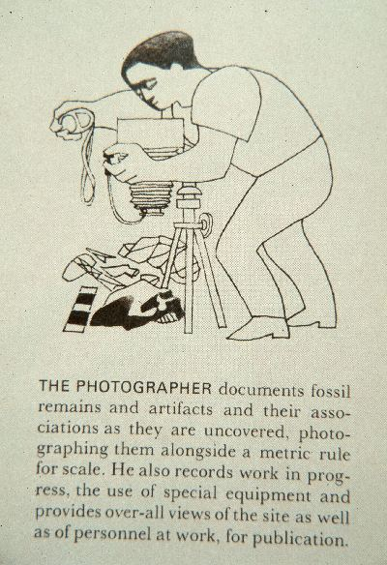

Slide 46
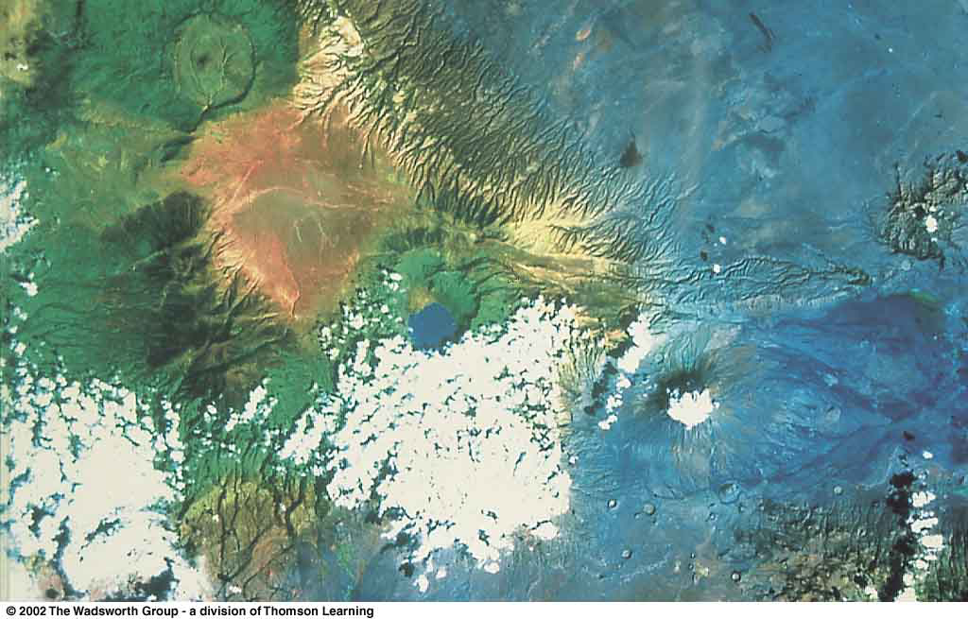
Satellite photo, northern Tanzania, near Olduvai Gorge. The mountainous regions are part of the escarpment of the Rift Valley. A lake has formed inside a volcanic crater.
Understanding Humans, 10th Ed., p. 179

Slide 47
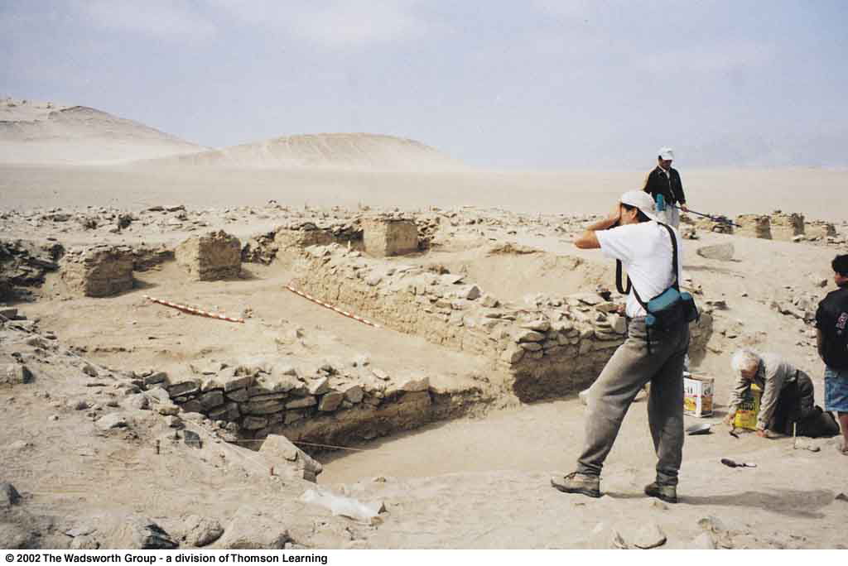
Photographing a newly excavated unit of a large structure.
Understanding Physical Anthropology and Archaeology, 8th ed., p. 365

Slide 48
In the Field
site feature
a feature in an archaeological site that you can not bring back
to the lab
For example, a cave, a river, a house wall, a well . . .

Slide 49
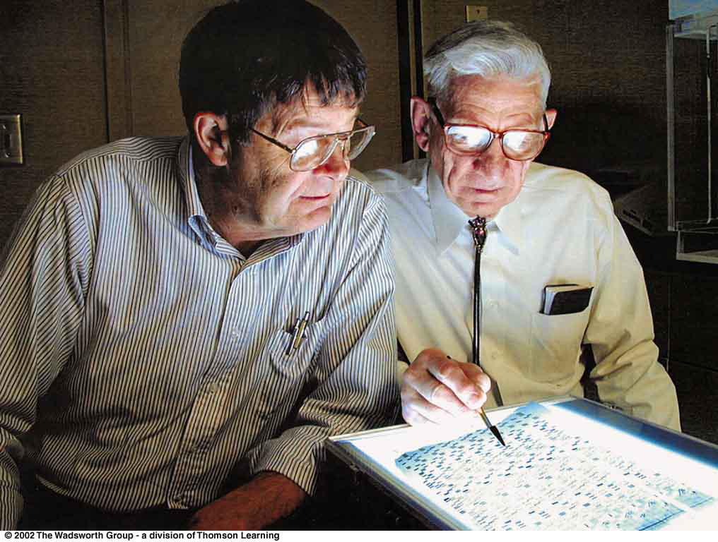
Continue on to Set # 10B
Special Skills Used to Study Early Humans
In the Lab

