Slide 1
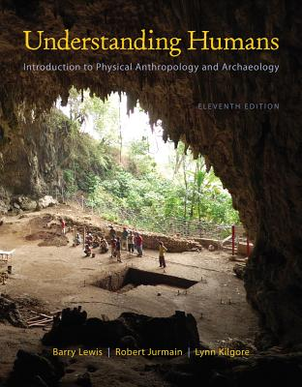
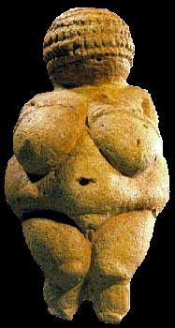
Class Slides Set 10A
Special Skills Used to Study Early Humans
. . . or how to make sense
out of
Ch. 8 of the text . . .
University of Minnesota Duluth
Tim Roufs
© 2010-2013
http://www.d.umn.edu/cla/faculty/troufs/anth1602/

Slide 2
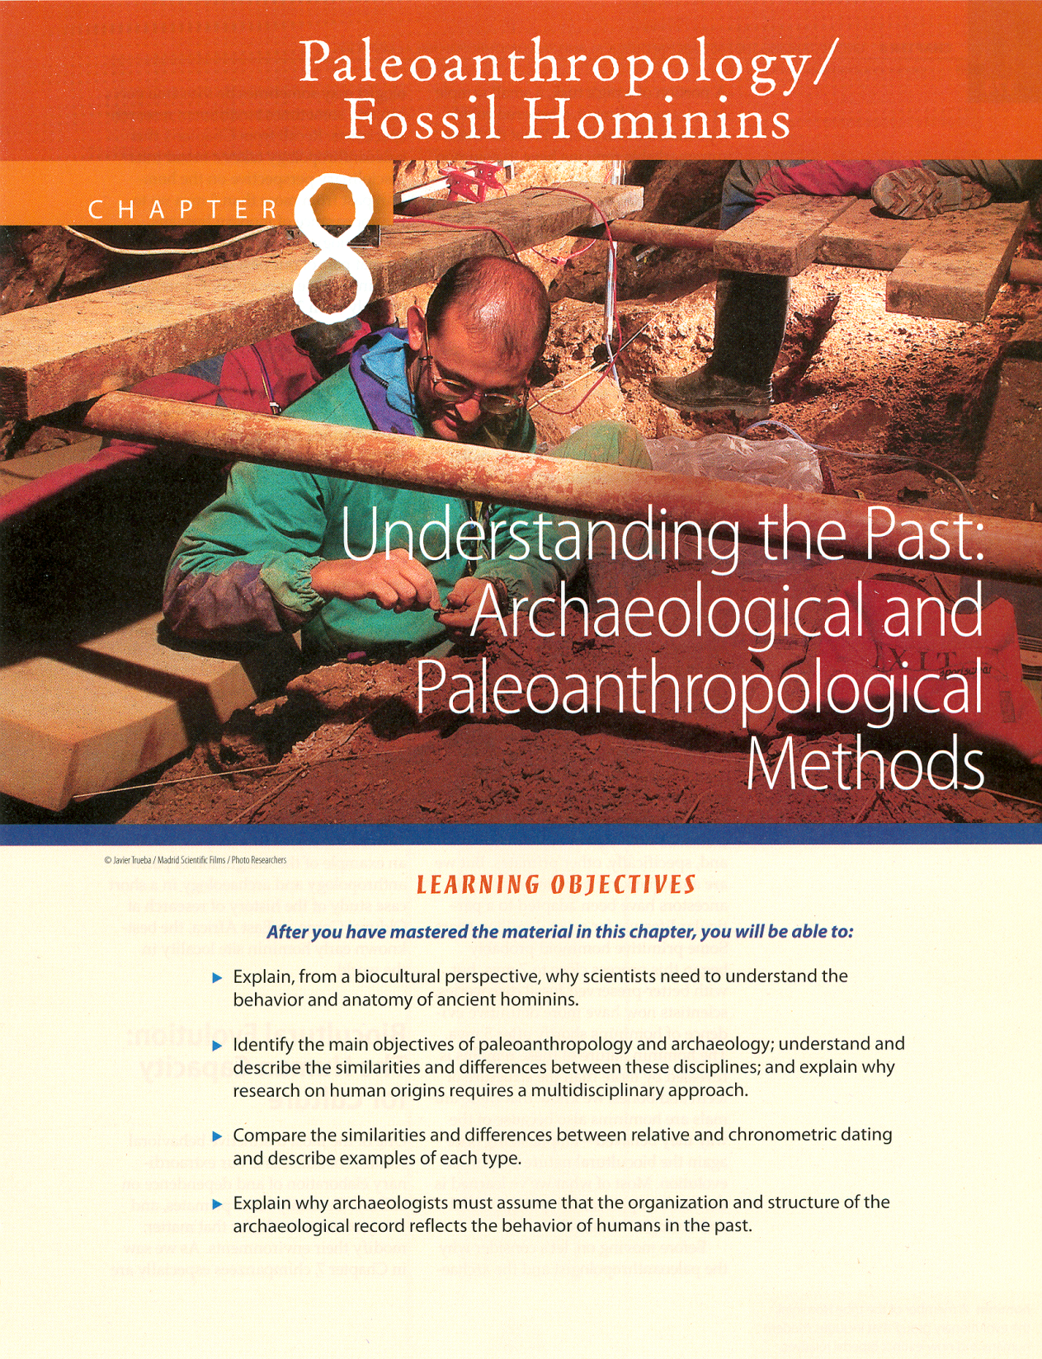
In the Lab

Slide 3
Special Skills Used to Study Early Humans
In the Field
In the Laboratory
In the Field and Laboratory

Slide 4
In the Lab
Petrologists (rocks, minerals)
Pedologists (soils)
Geophysicists / Geochemists
Palynologists (pollen analysis)
Muscle Reconstruction Specialists
Casting Experts

Slide 5
In the Lab
Petrologists (rocks, minerals)
Pedologists (soils)
Geophysicists / Geochemists
Palynologists (pollen analysis)
Muscle Reconstruction Specialists
Casting Experts

Slide 6
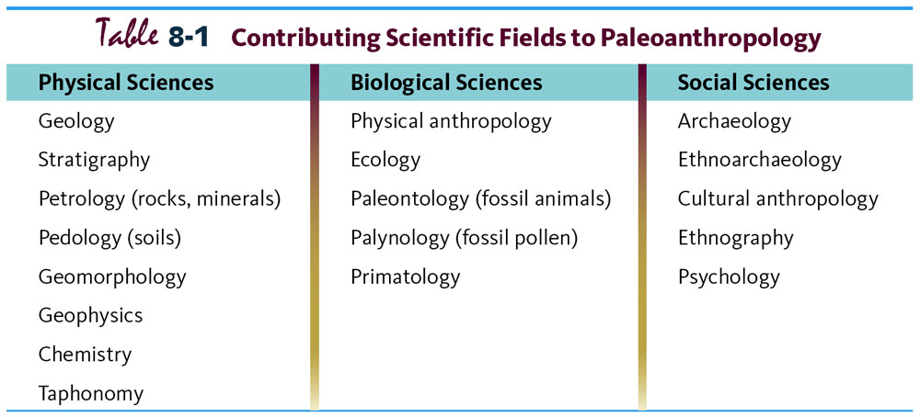
Paleoanthropology is Heavily Interdisciplinary.
Understanding Humans, 10th Ed., p. 178.

Slide 7
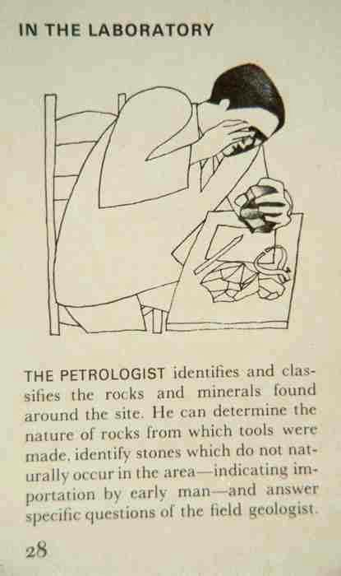

Slide 8
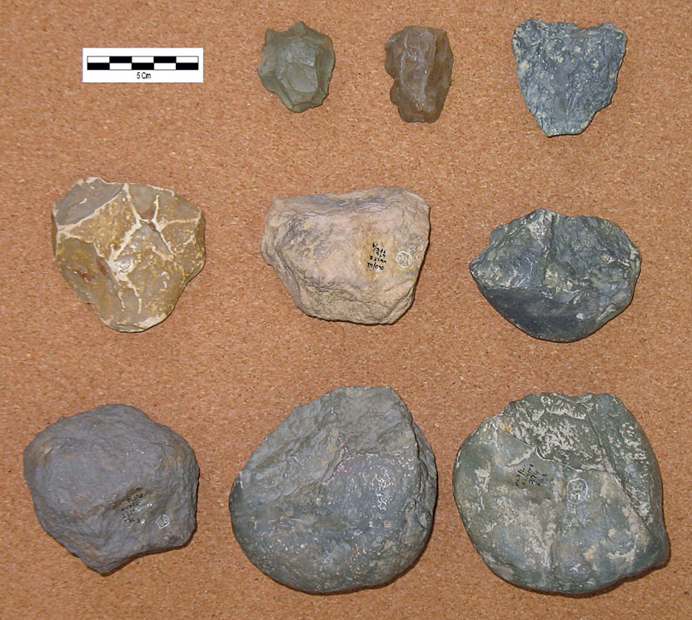
Olduwan assemblage, consisting of a few simple stone tools,
mostly flakes choppers, corers, and hammerstones
Understanding Humans, 10th Ed., p. 228.

Slide 9
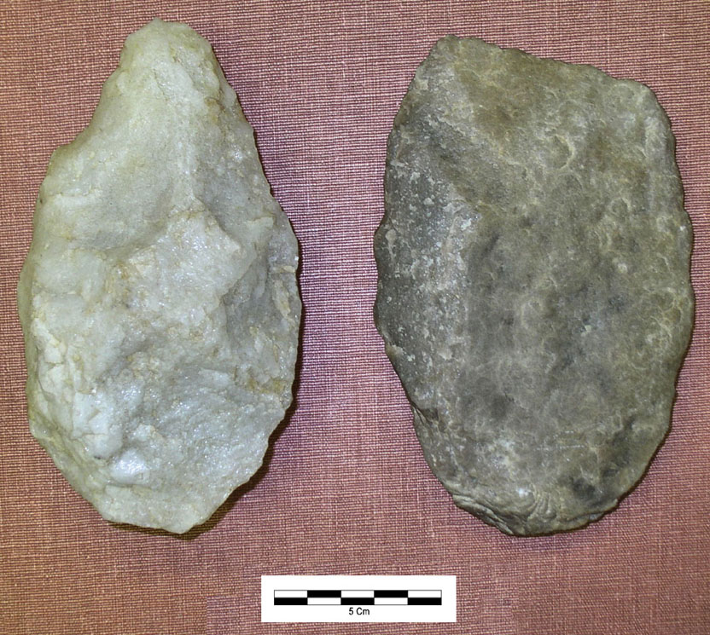
Hand axe (left) and cleaver (right),
both of which were basic tools of the Acheulian tradition
Understanding Humans, 10th Ed., p. 251.

Slide 10
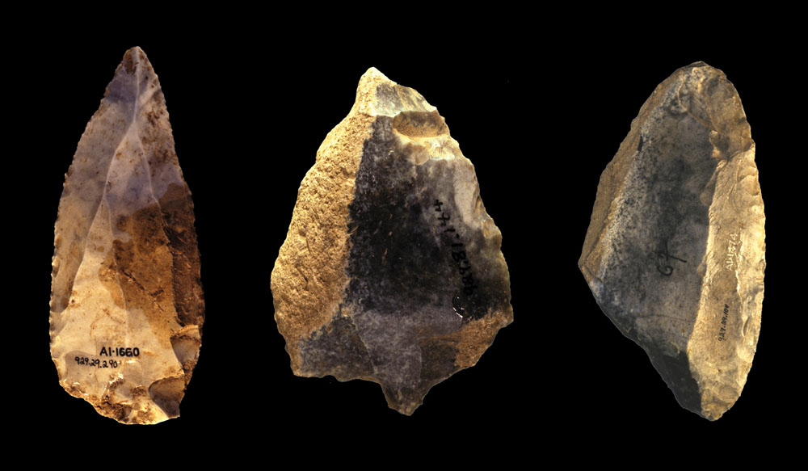
Mousterian Levallois point (left), a perforator, a side scraper.
Understanding Humans, 10th Ed., p. 275.

Slide 11
In the Lab
Petrologists (rocks, minerals)
Pedologists (soils)
Geophysicists / Geochemists
Palynologists (pollen analysis)
Muscle Reconstruction Specialists
Casting Experts

Slide 12
Paleoanthropology is Heavily Interdisciplinary.
Understanding Humans, 10th Ed., p. 178.

Slide 13
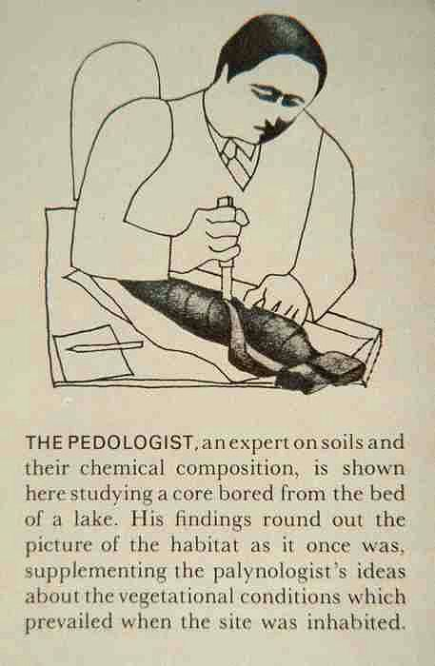

Slide 14
In the Lab
Petrologists (rocks, minerals)
Pedologists (soils)
Geophysicists / Geochemists
Palynologists (pollen analysis)
Muscle Reconstruction Specialists
Casting Experts

Slide 15
Paleoanthropology is Heavily Interdisciplinary.
Understanding Humans, 10th Ed., p. 178.

Slide 16
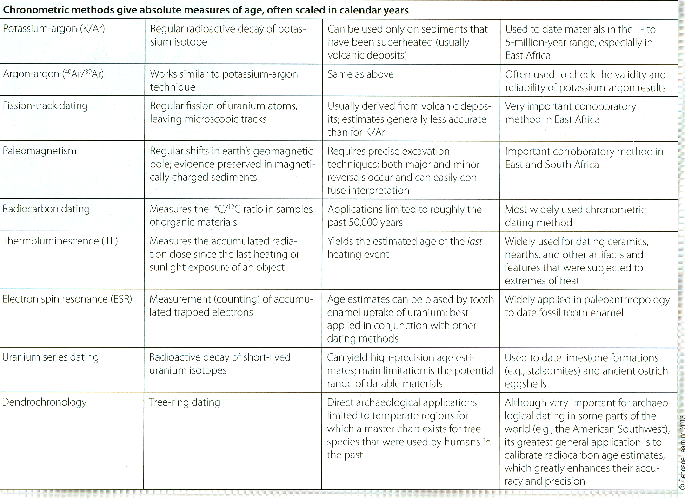
chronometric dating methods
A Summary of Dating Methods.
Understanding Humans, 11th Ed., p. 184

Slide 17
A Summary of Dating Methods.
Understanding Humans, 11th Ed., p. 184

Slide 18
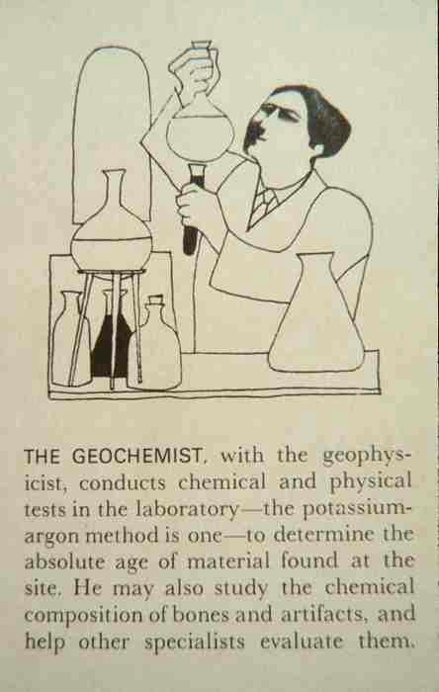

Slide 19
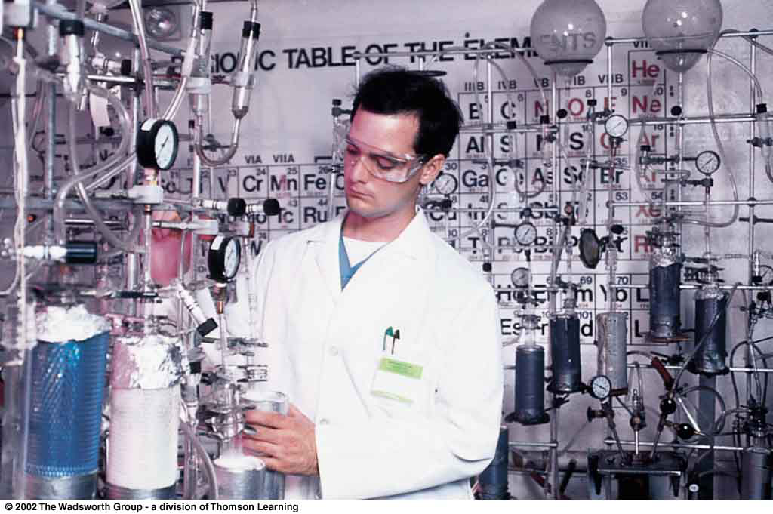
Technician in a modern radiocarbon dating laboratory.
Understanding Humans, 10th Ed., p. 194.

Slide 20
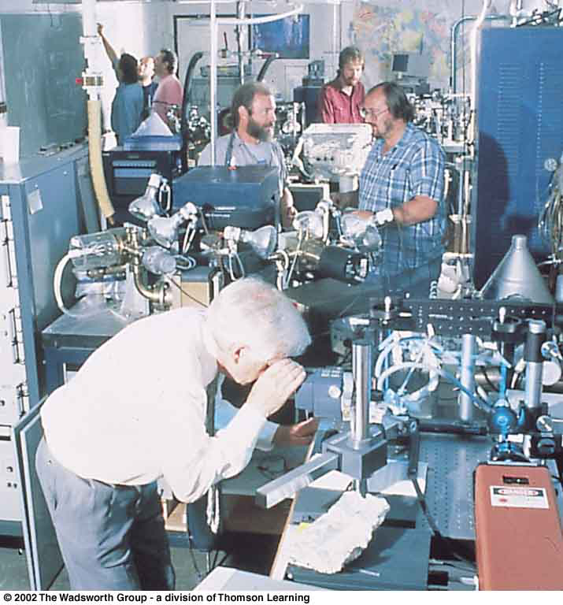
Geochemists at The Berkeley Geochronology Laboratory.
Understanding Physical Anthropology and Archaeology, 8th ed., p. 286

Slide 21
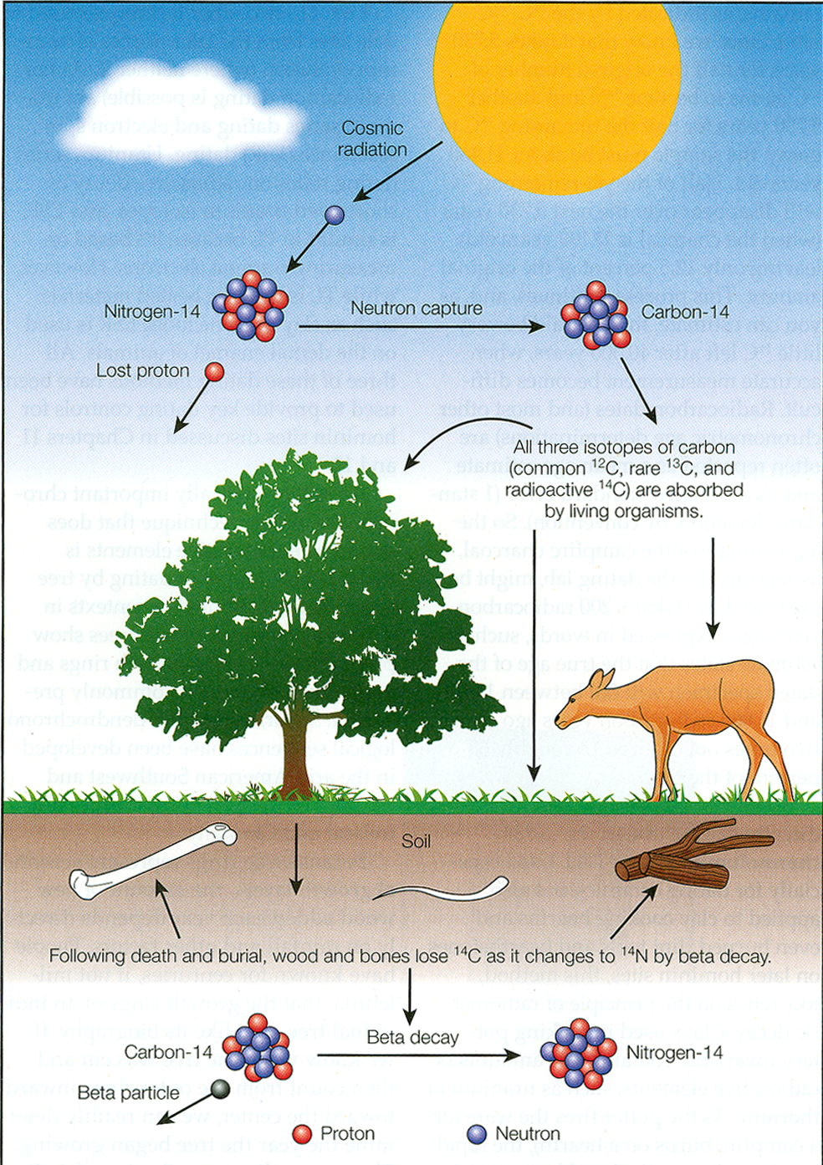
Understanding Humans, 11th Ed., p. 199

Slide 22
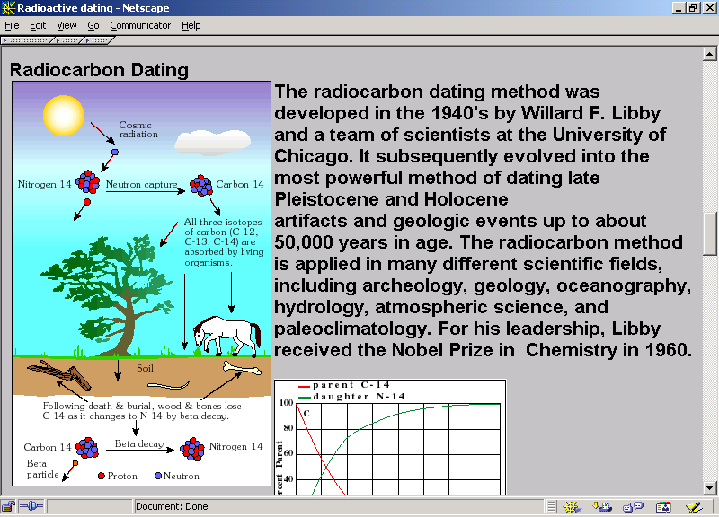

Slide 23
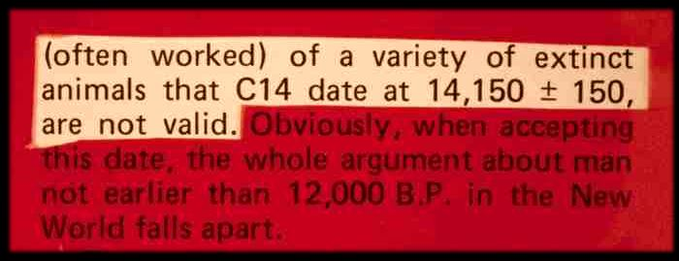

Slide 24
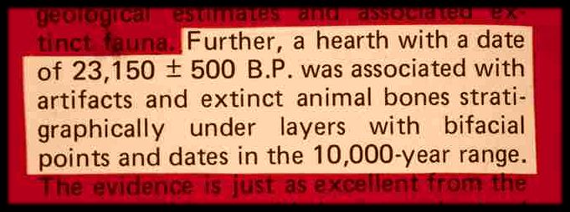

Slide 25
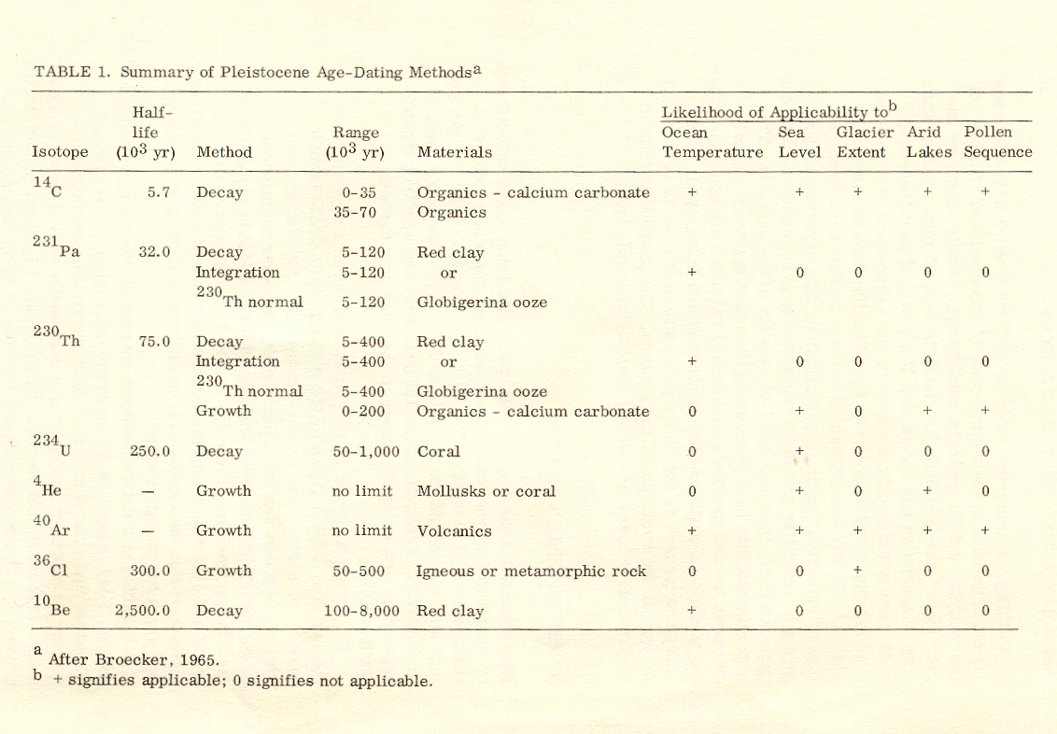
Summary of Pleistocene Age-Dating Methods.
Time and Stratigraphy in the Evoluton of Man. (National Research Council, 1967), p. 46

Slide 26
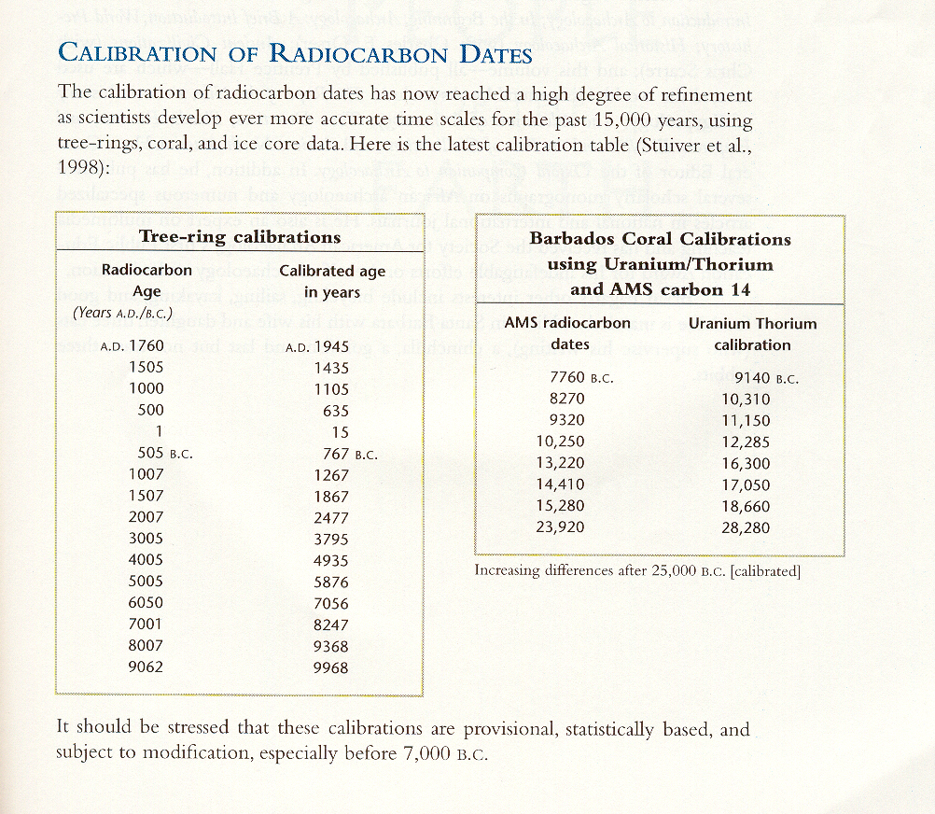
Calibration of Radiocarbon Dates.
People of the Earth (10th ed). (Prentice-Hall, 2001), p. XXI

Slide 27
In the Lab
Petrologists (rocks, minerals)
Pedologists (soils)
Geophysicists / Geochemists
Palynologists (pollen analysis)
Muscle Reconstruction Specialists
Casting Experts

Slide 28
Paleoanthropology is Heavily Interdisciplinary.
Understanding Humans, 10th Ed., p. 178.

Slide 29
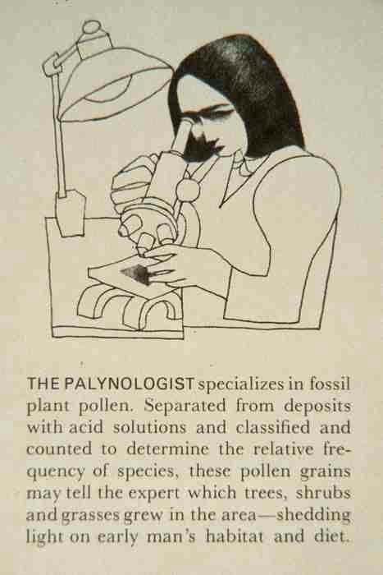

Slide 30
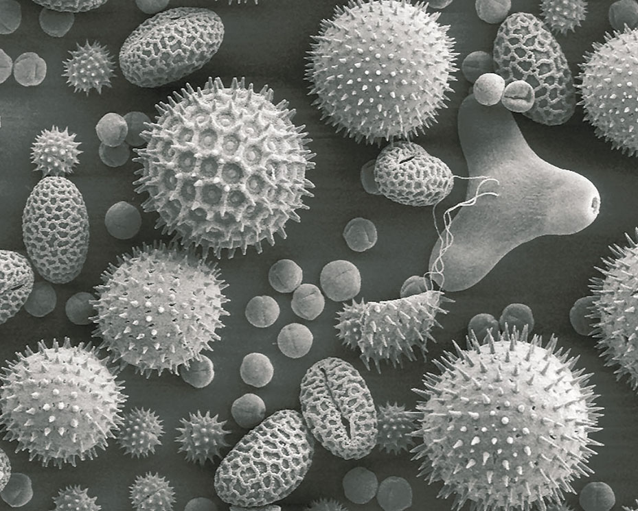
75 micrometers (µm)
3/1000 in.
Pollen grains from common flowering plants.
Understanding Humans, 11th Ed., p. 351

Slide 31
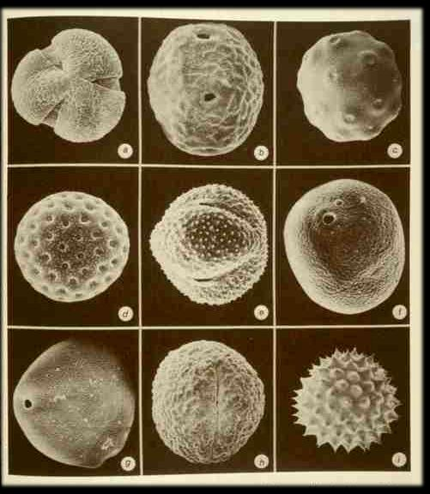
ragweed pollen

Slide 32
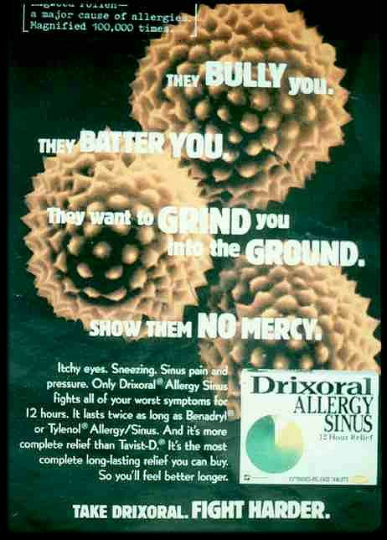
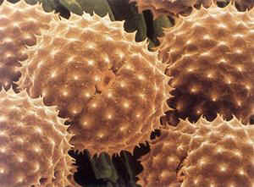

Slide 33
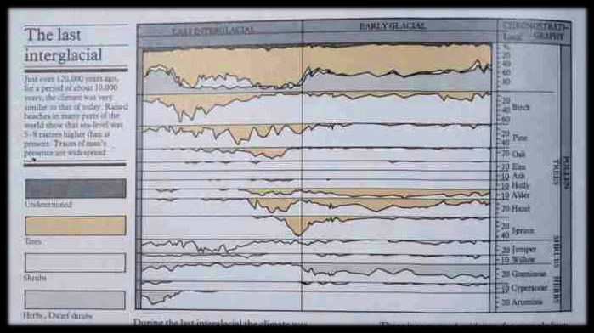

Slide 34
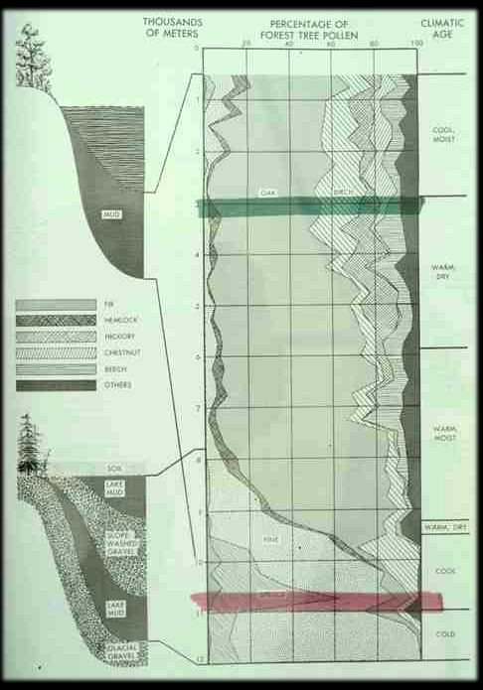

Slide 35
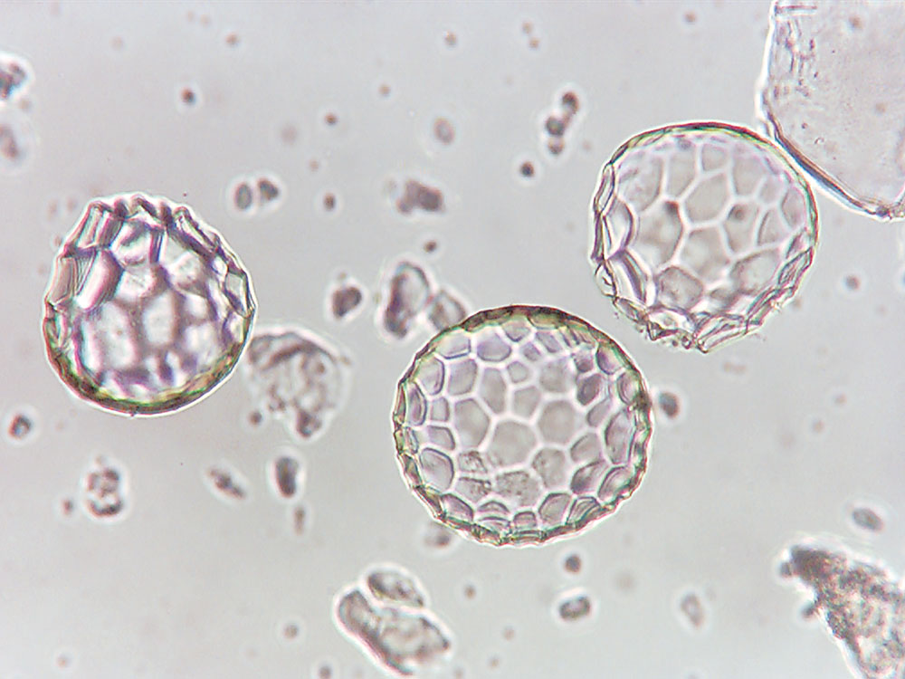
phytoliths
120 micrometers (µm)
ca. 5/1000 in.
Squash (Cucurbita ficifolia) phytoliths
Understanding Humans, 11th Ed., p. 351

Slide 36
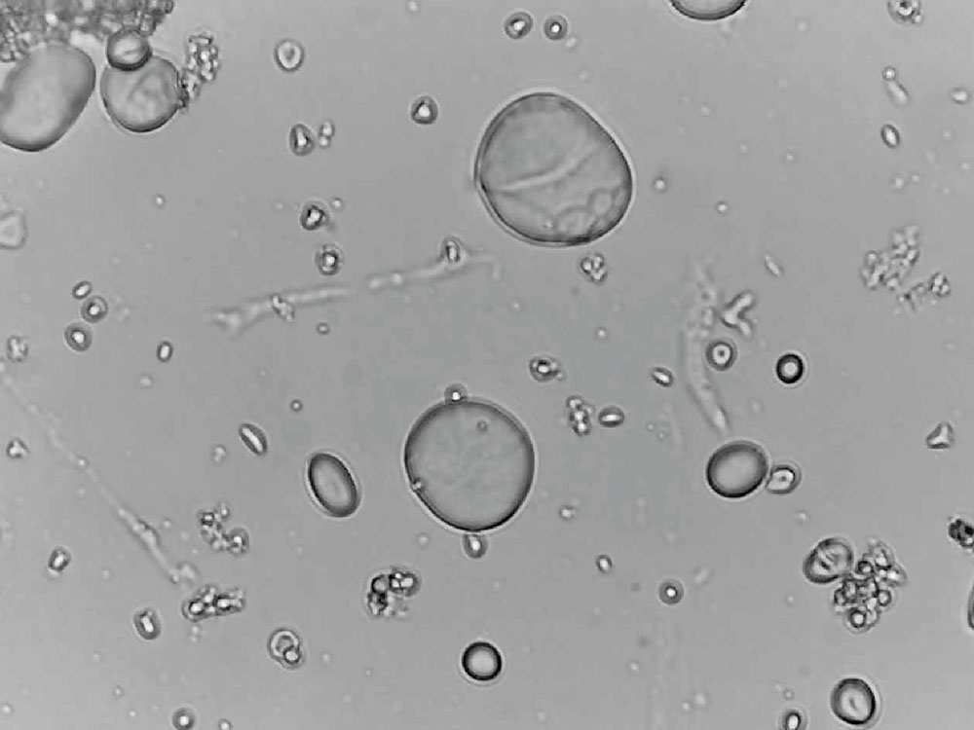
starch grains
Wild emmer wheat (Triticum dicoccoides) starch grains
which show distinctive craterlike surface impressions.
Useful complement to phytoliths as a data source and are a
major tool in archaeological investigations of root crops.
Understanding Humans, 11th Ed., p. 352

Slide 37
In the Lab
Petrologists (rocks, minerals)
Pedologists (soils)
Geophysicists / Geochemists
Palynologists (pollen analysis)
Muscle Reconstruction Specialists
Casting Experts

Slide 38
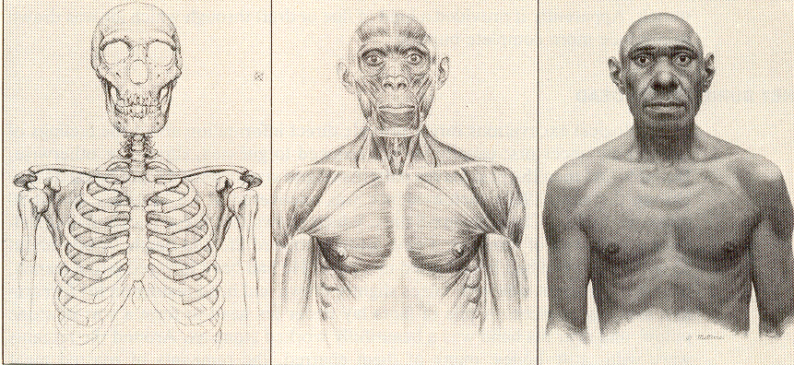
Three stages in a reconstruction of a Neandertal male.
The Emergence of Humankind (4th Ed). (Harper & Row, 1985), p. 149

Slide 39
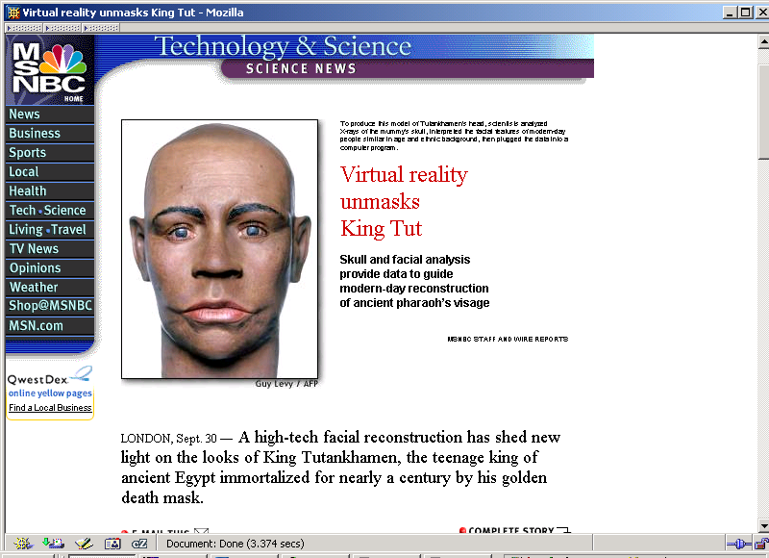
Sept. 30, 2002

Slide 40
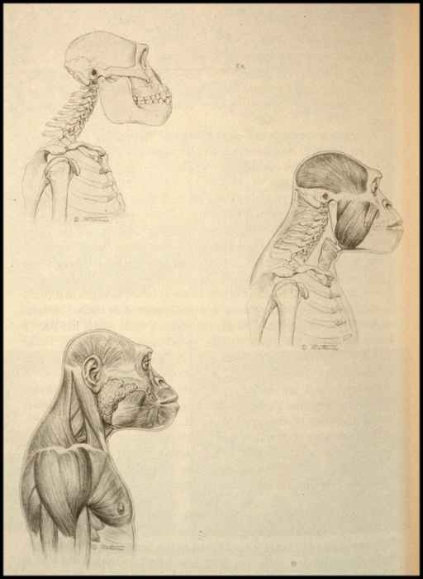

Slide 41
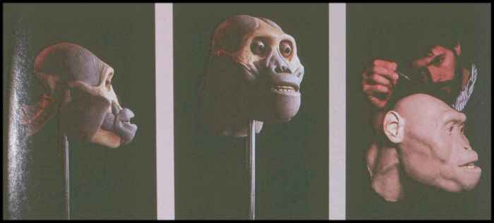

Slide 42
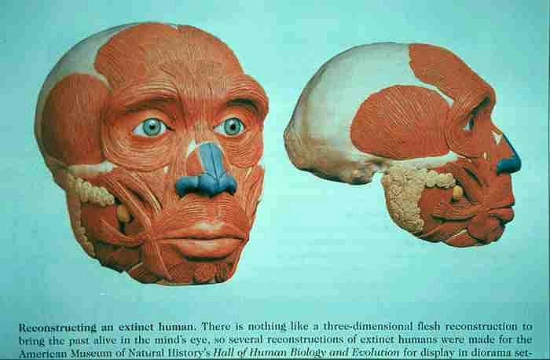

Slide 43
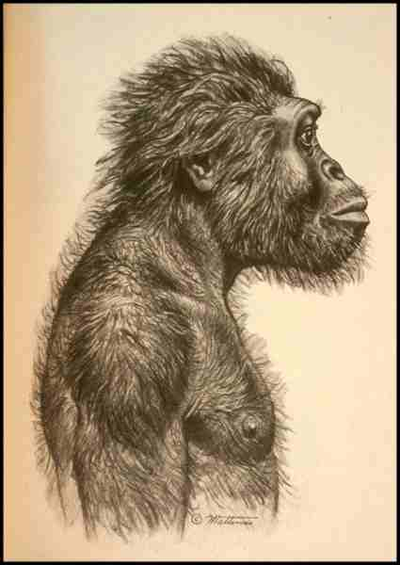

Slide 44
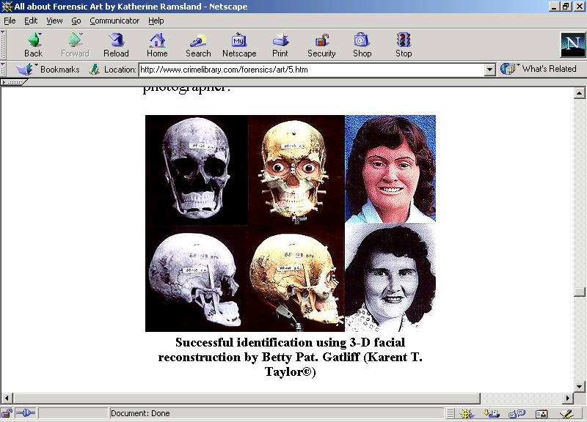

Slide 45
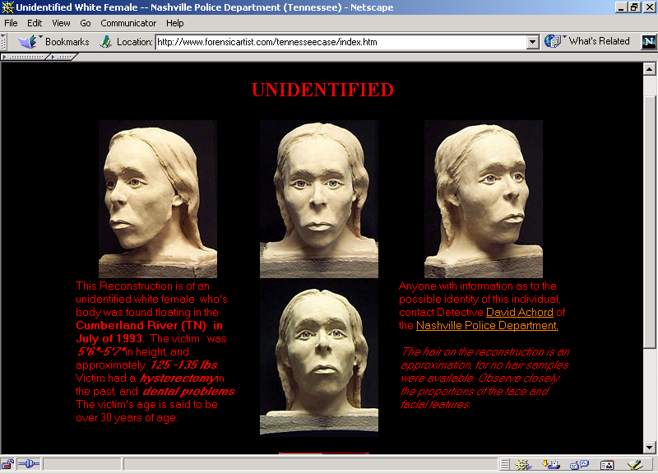

Slide 46
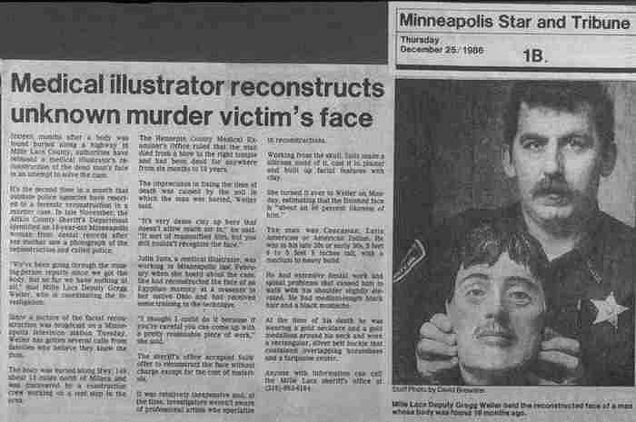

Slide 47
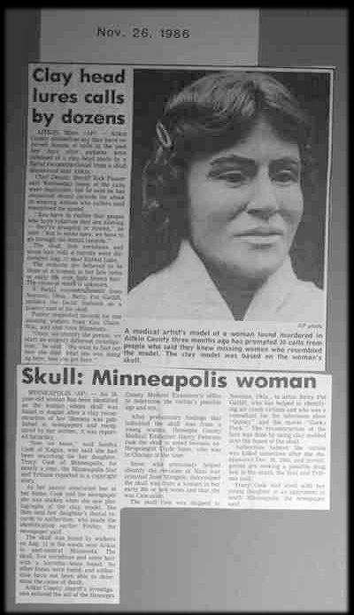

Slide 48
In the Lab
Petrologists (rocks, minerals)
Pedologists (soils)
Geophysicists / Geochemists
Palynologists (pollen analysis)
Muscle Reconstruction Specialists
Casting Experts

Slide 49
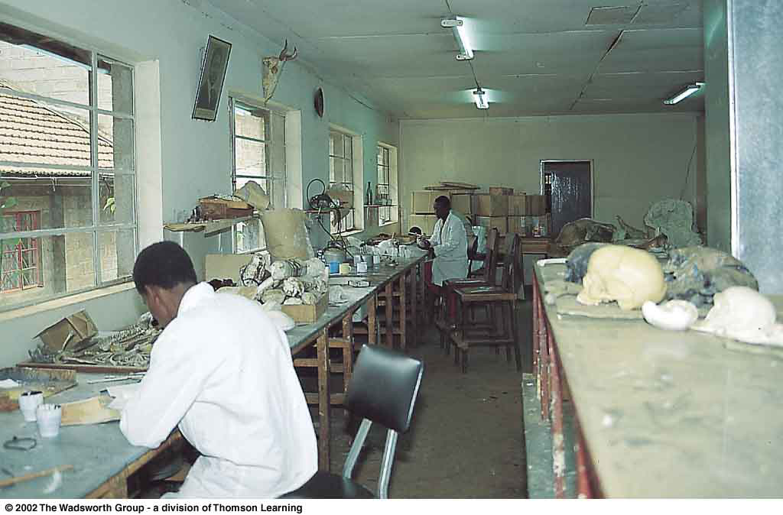
The casting laboratory at the Kenya Museums of Natural History.
Understanding Physical Anthropology and Archaeology, 8th ed., p. 286

Slide 50
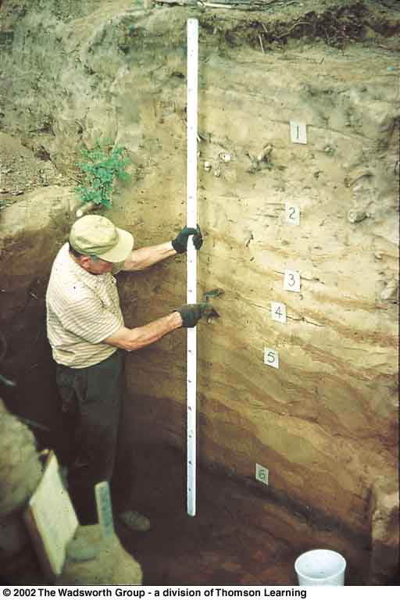
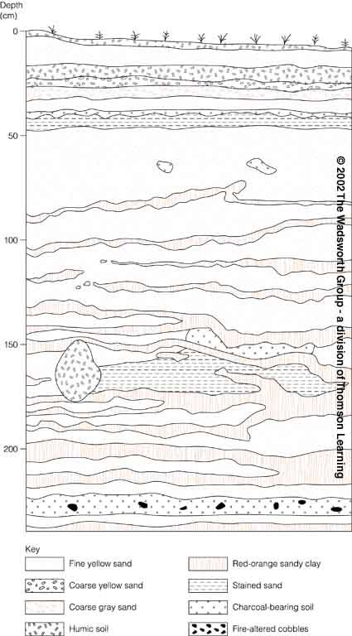
Continue on to Set # 10C
Special Skills Used to Study Early Humans
In the Field and Lab
Understanding Physical Anthropology and Archaeology, 8th ed., pp. 363, 403

