Slide 1
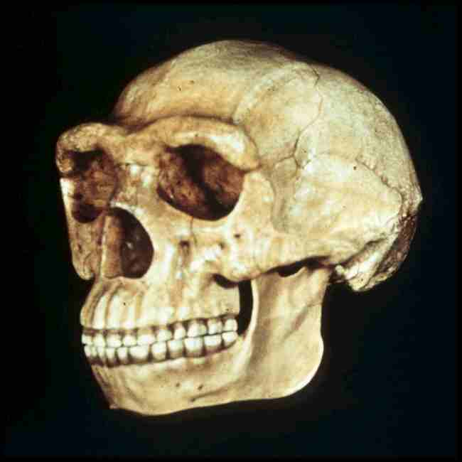
Class Slides Set # 26A
Tim Roufs’ section
“Peking Man”
  aka Homo erectus pekinensis
  aka Sinanthropus

Slide 2
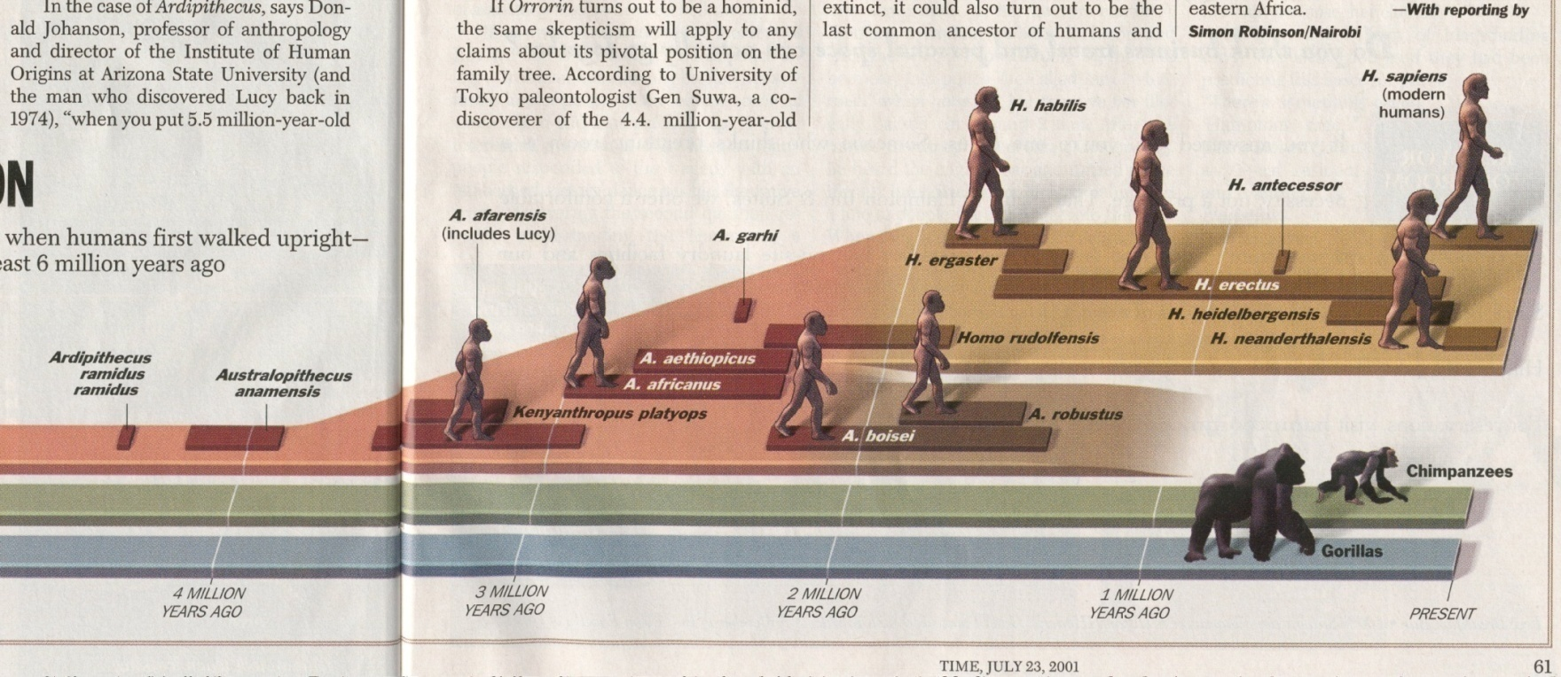
^{Time 23 July 2001}

Slide 3
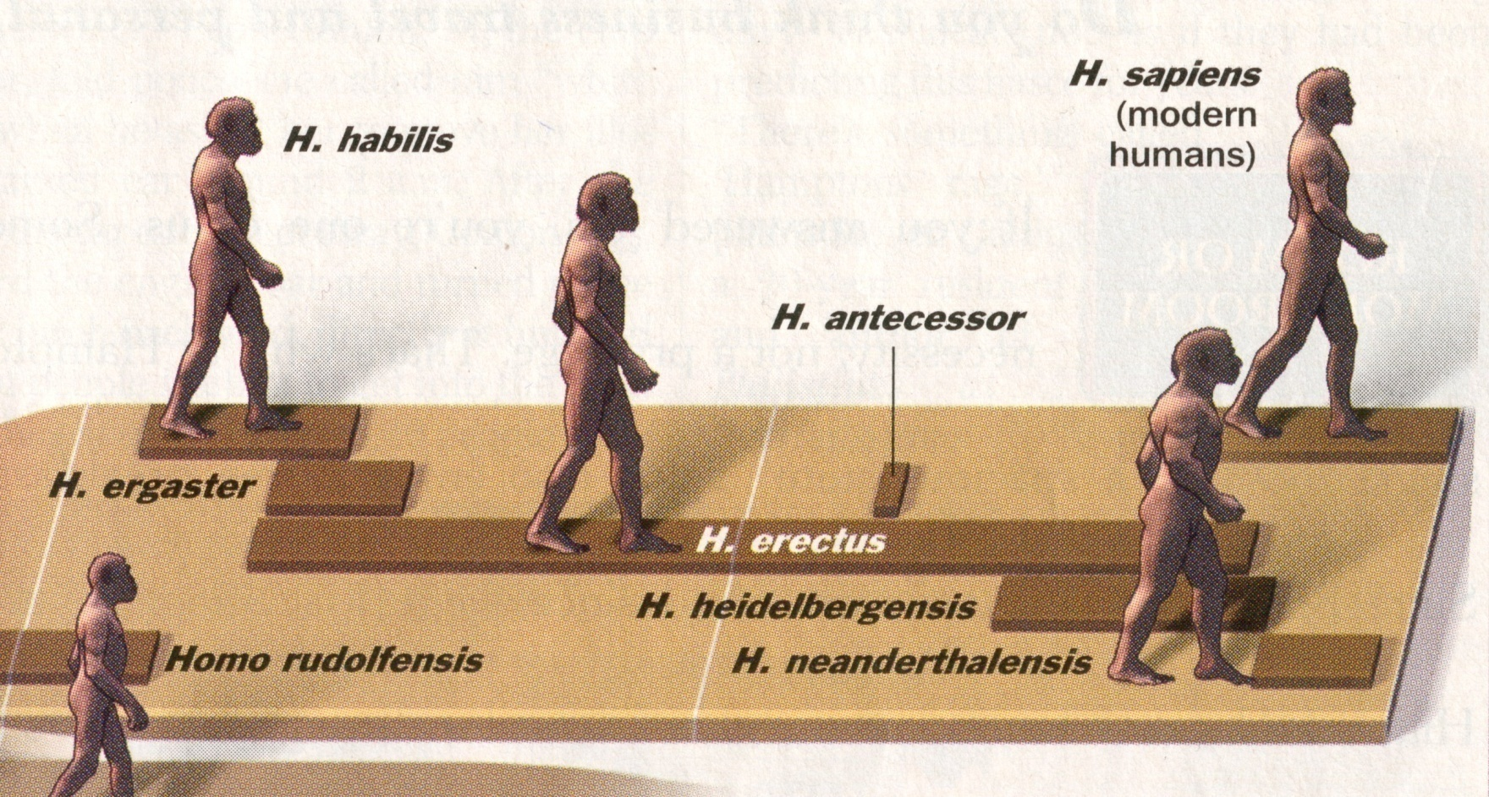
^{Time 23 July 2001}

Slide 4
Homo
Genus
Homo
Species
rudolfensis ( “early” )
habilis ( “early” )
erectus
  Java (Trinil)
    Pithecanthropus erectus
  China (Beijing)
    Homo erectus pekinensis
  Africa . . .
  Europe . . .
sapiens

Slide 5
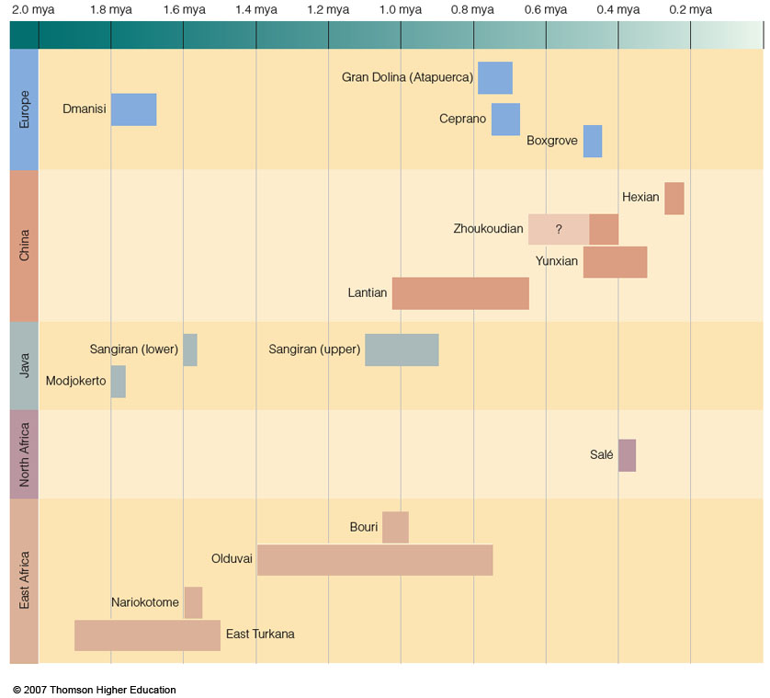
Understanding Physical Anthropology and Archaeology, 9th ed., p. 238

Slide 6
Selected Major Discoveries / Events, ca. 1850 - Present
1920s
"Peking Man"
Choukoutien, China
(now Zhoukoudian)
Sinanthropus
Homo erectus pekinensis
0.5 - 0.2 mya

Slide 7
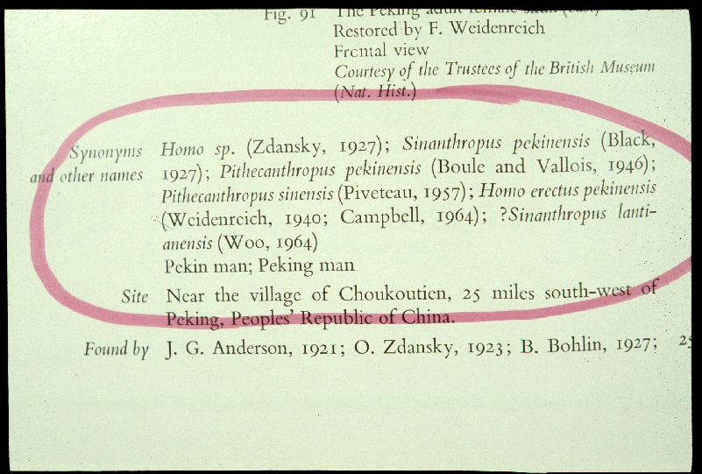

Slide 8
Major Sites: China
Choukoutien = Zhoukoudian
( Chou-kou-tien )

Slide 9
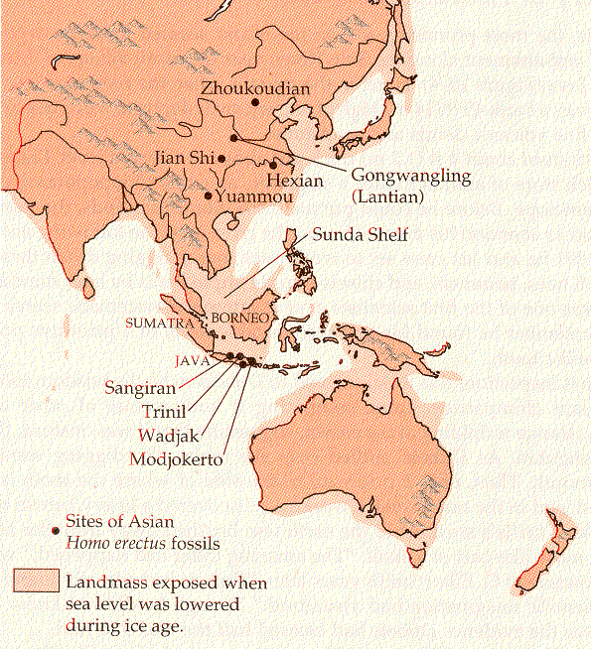
Campbell – Loy, Humankind Emerging, 7th ed., p. 295

Slide 10
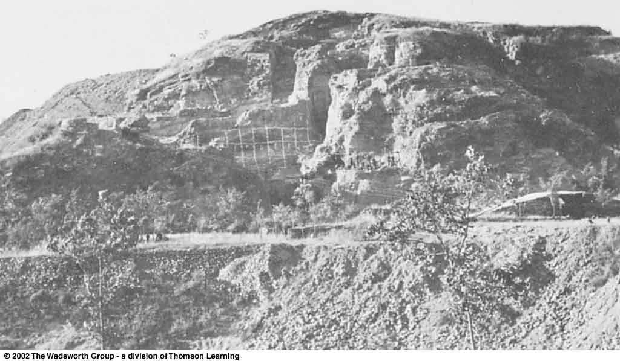
^{Zhoukoudian Cave.}
Understanding Physical Anthropology and Archaeology, 8th ed., p. 267

Slide 11
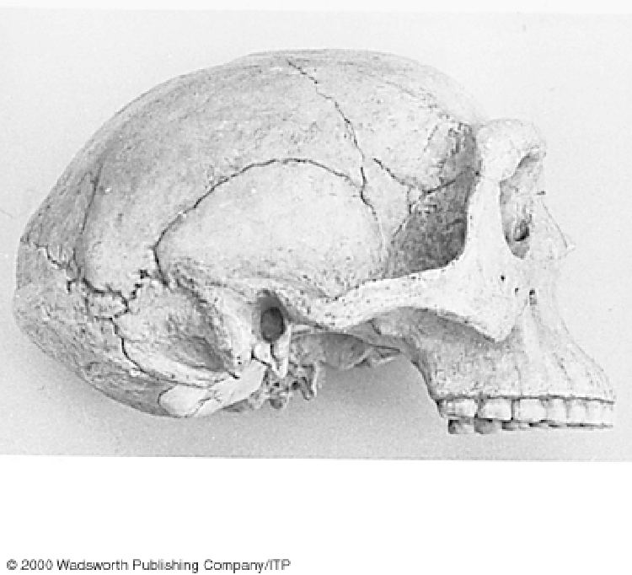
^{Homo erectus from Zhoukoudian}
Understanding Physical Anthropology and Archaeology, 9th ed., p. 225

Slide 12
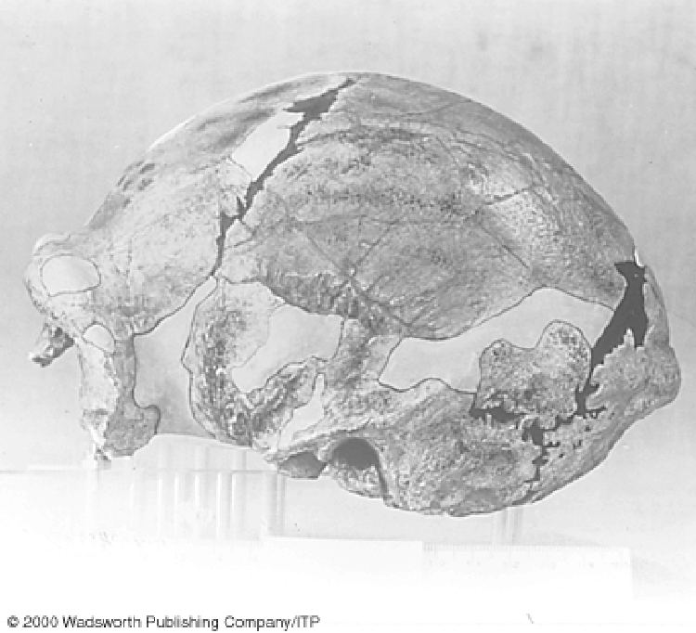
Trinil Homo erectus from Zhoukoudian
Understanding Physical Anthropology and Archaeology, 9th ed., p. 227

Slide 13
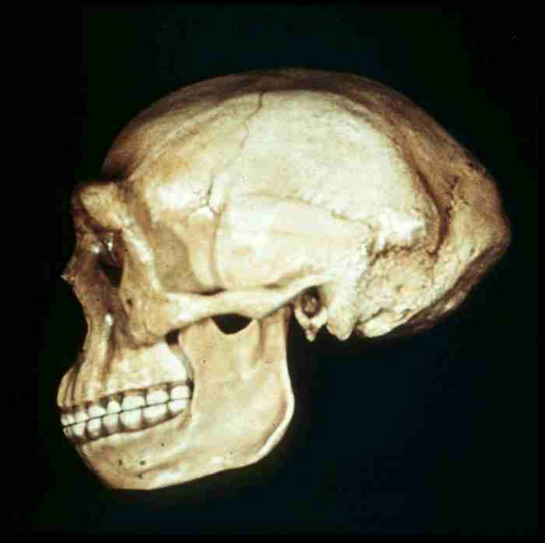

Slide 14
^{foraminia mentalia}

Slide 15
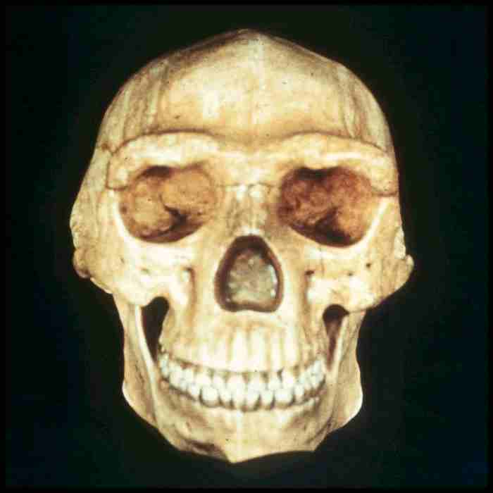

Slide 16
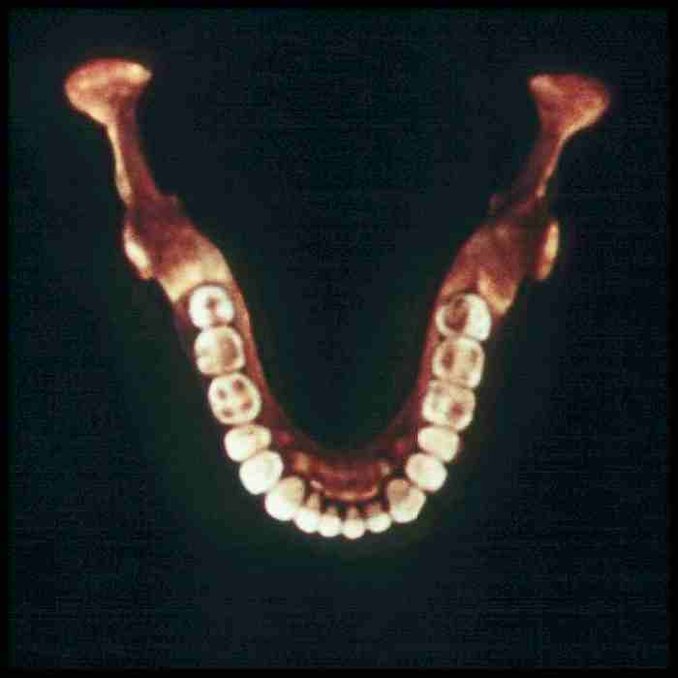

Slide 17
Homo erectus pekinensis
Beijing people
Had larger cranial capacity
    830 - 1300 cc
    avg. = 1075

Slide 18
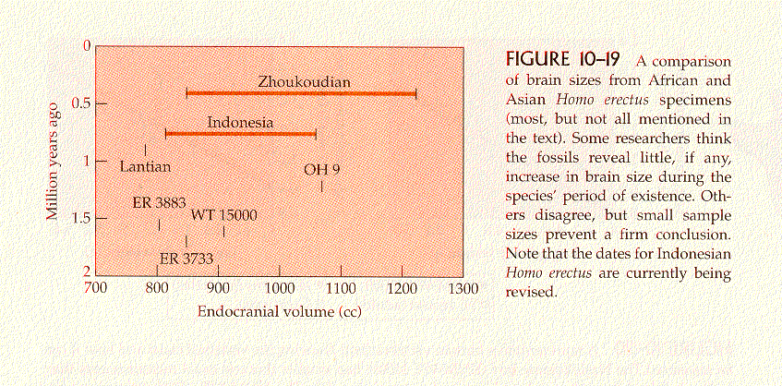
Campbell – Loy, Humankind Emerging, 7th ed., p. 317

Slide 19
Homo erectus pekinensis
Beijing people
Had larger cranial capacity
    830 - 1300 cc
    avg. = 1075
had fire

Slide 20
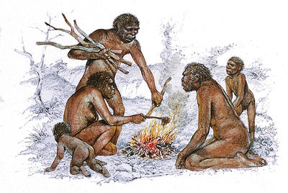
www.gridclub.com/fact_gadget/1001/human_world/prehistoric_people/639.html

Slide 21
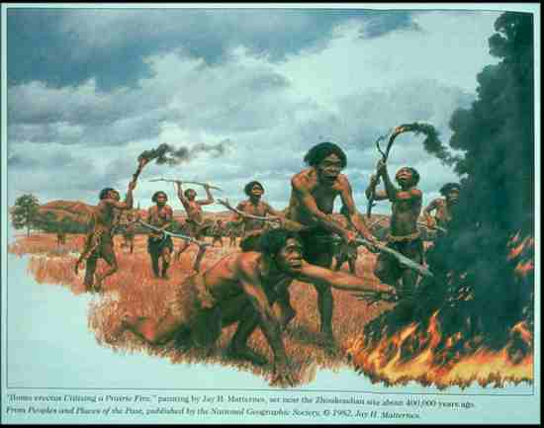

Slide 22
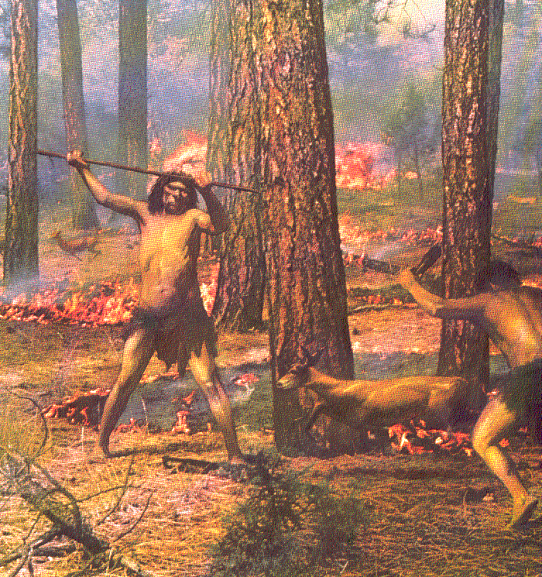
The First Men (Little Brown, 1973), p. 26

Slide 23
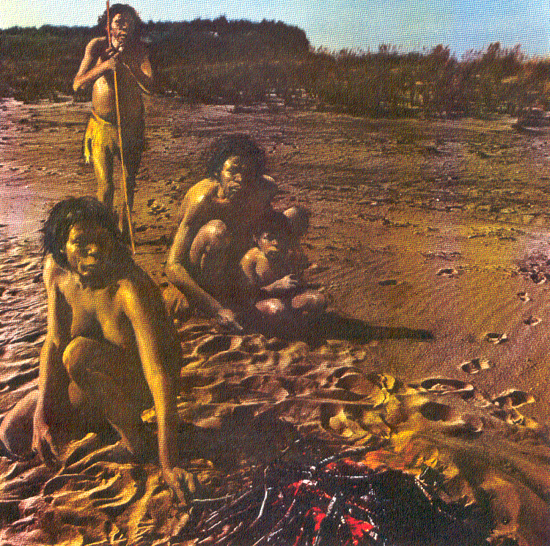
The First Men (Little Brown, 1973), p. 8

Slide 24
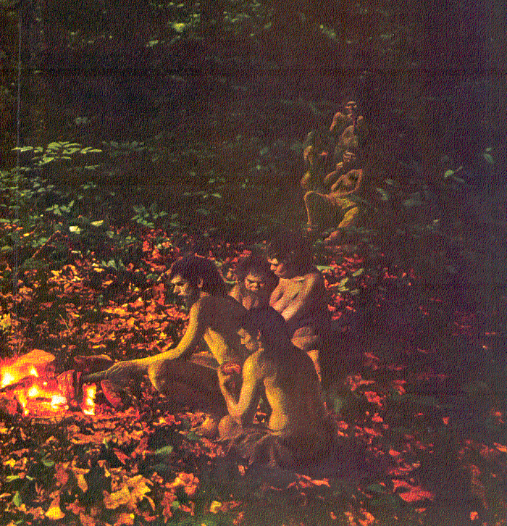
The First Men (Little Brown, 1973), p. 29

Slide 25
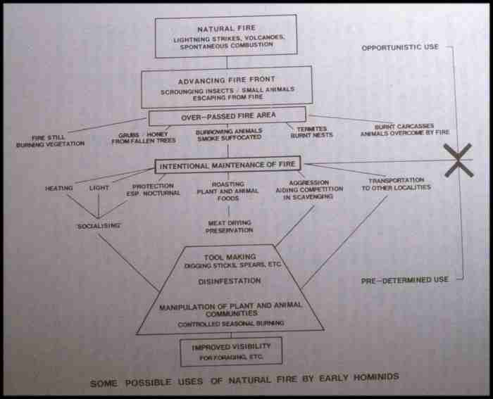

Slide 26
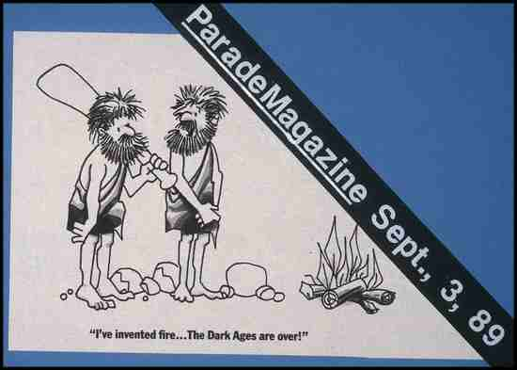

Slide 27
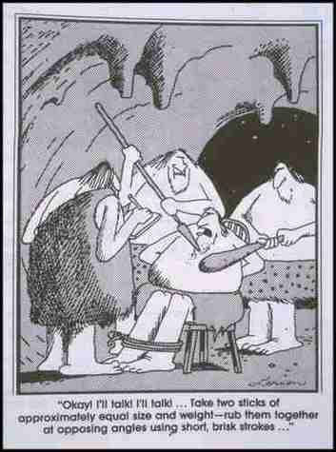

Slide 28
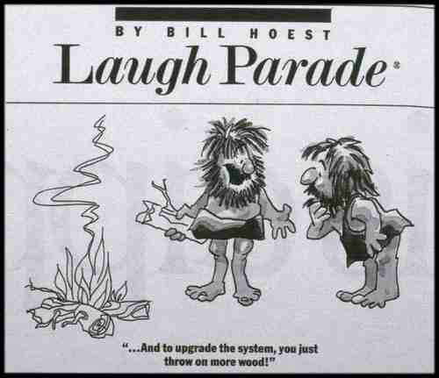

Slide 29
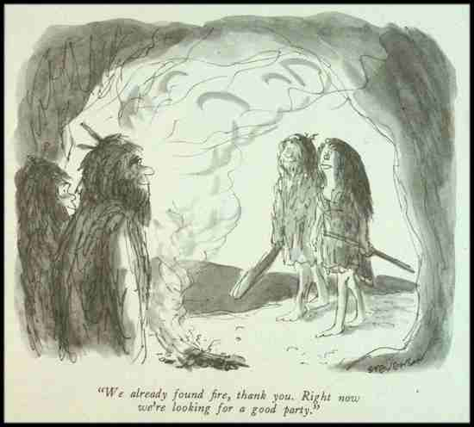

Slide 30
Homo erectus pekinensis
Beijing people
Had larger cranial capacity
    830 - 1300 cc
    avg. = 1075
had fire
lived in caves

Slide 31
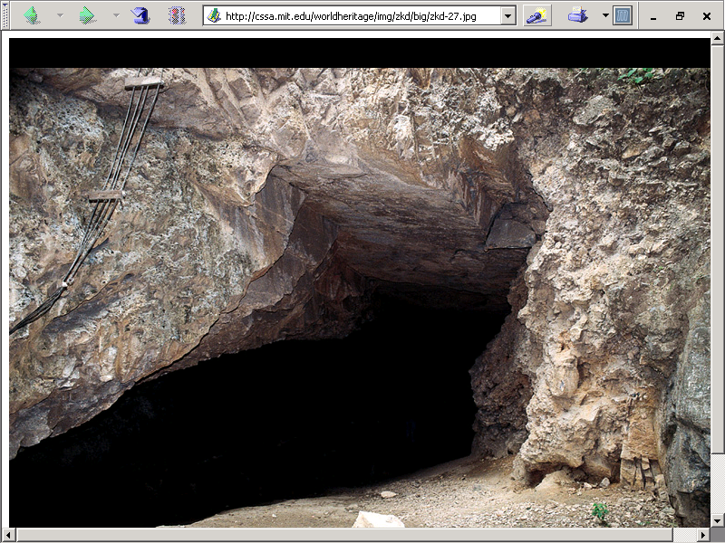
http://cssa.mit.edu/worldheritage/img/zkd/big/zkd-08b.jpg

Slide 32
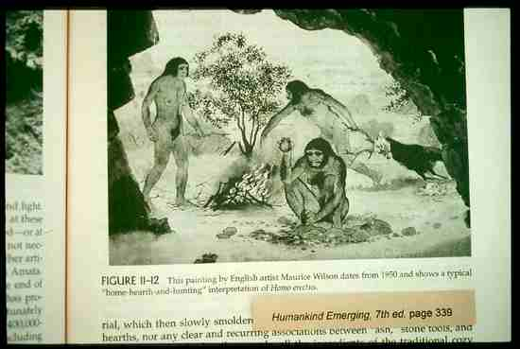

Slide 33
Homo erectus pekinensis
Beijing people
Had larger cranial capacity
    830 - 1300 cc
    avg. = 1075
had fire
lived in caves
had better tools

Slide 34
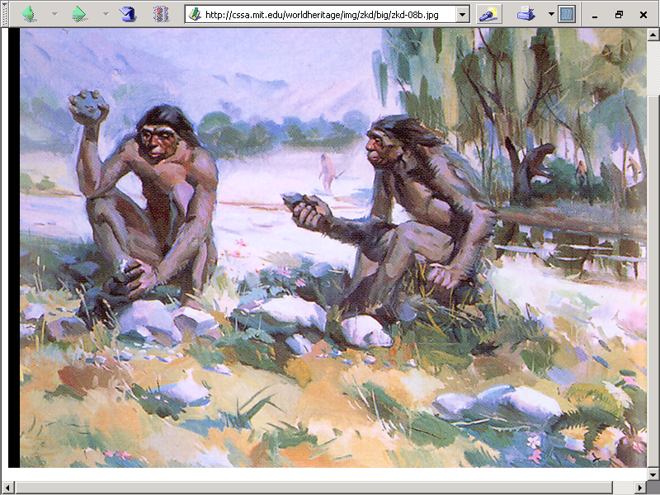
http://cssa.mit.edu/worldheritage/img/zkd/big/zkd-08b.jpg

Slide 35
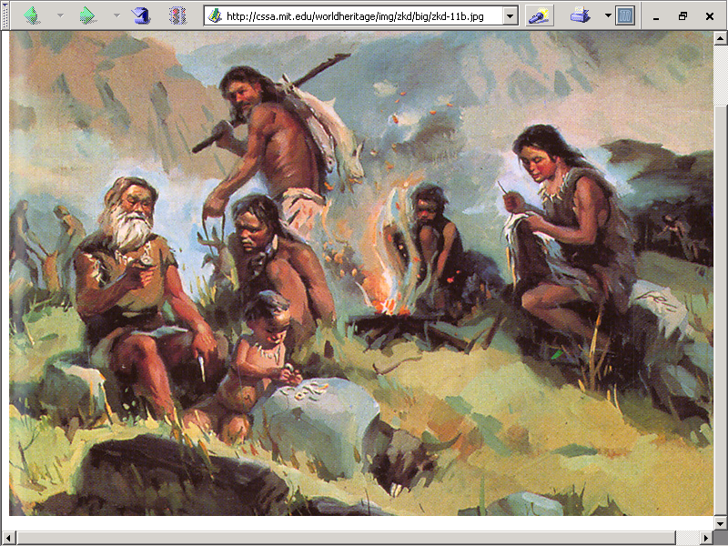
http://cssa.mit.edu/worldheritage/img/zkd/big/zkd-08b.jpg

Slide 36
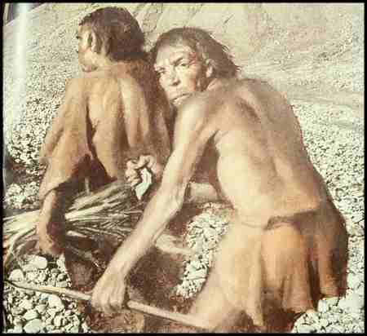

Slide 37
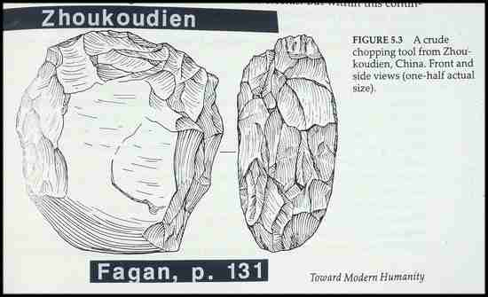

Slide 38
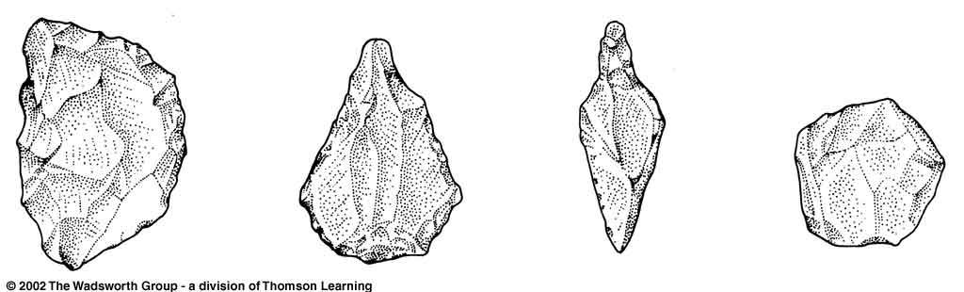
Quartzite chopper Flint point Flint Awl Graver or Burin
Chinese Tools from Middle Pleistocene sites.
Understanding Physical Anthropology and Archaeology, 8th ed., p. 268

Slide 39
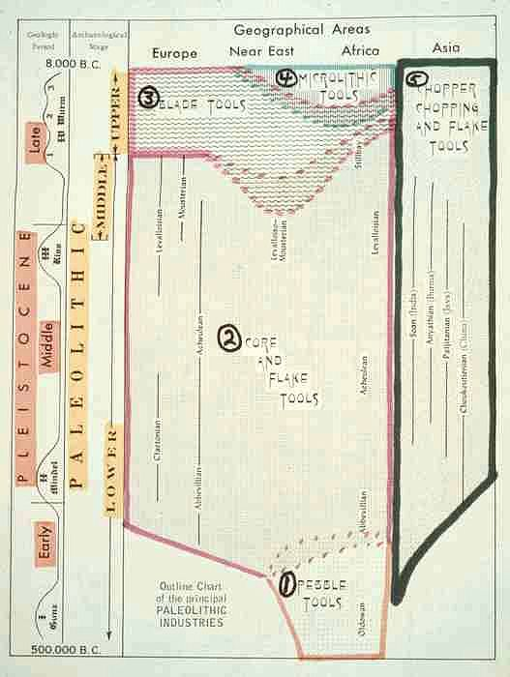

Slide 40
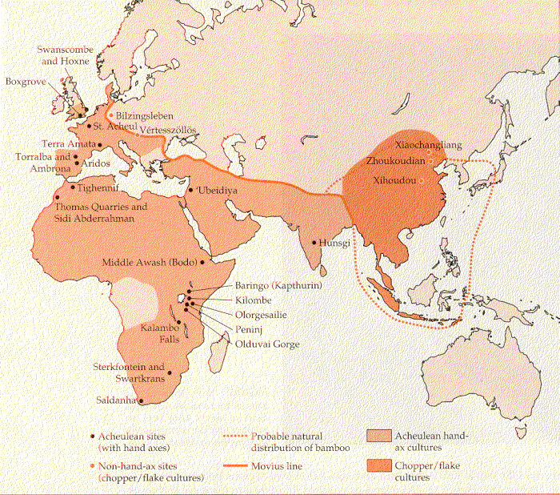
Movius Line
Source: Campbell and Loy, Humankind Emerging, 7th ed, p. 334

Slide 41
Homo erectus pekinensis
Beijing people
Had larger cranial capacity
    830 - 1300 cc
    avg. = 1075
had fire
lived in caves
had better tools
seemed inclined to eat their neighbor

Slide 42
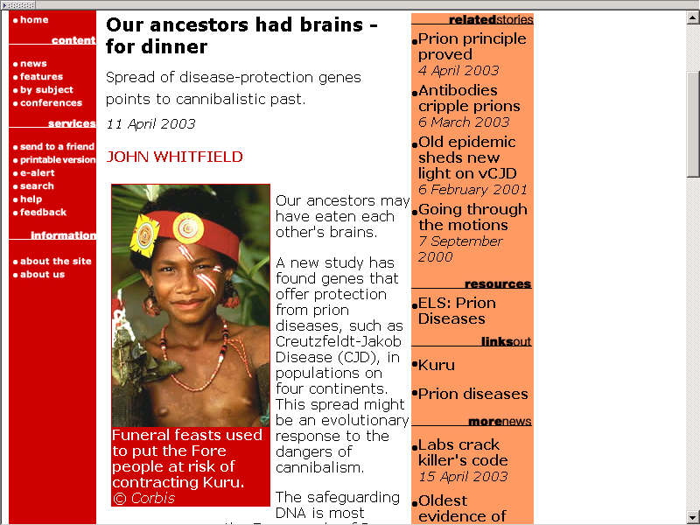

Slide 43
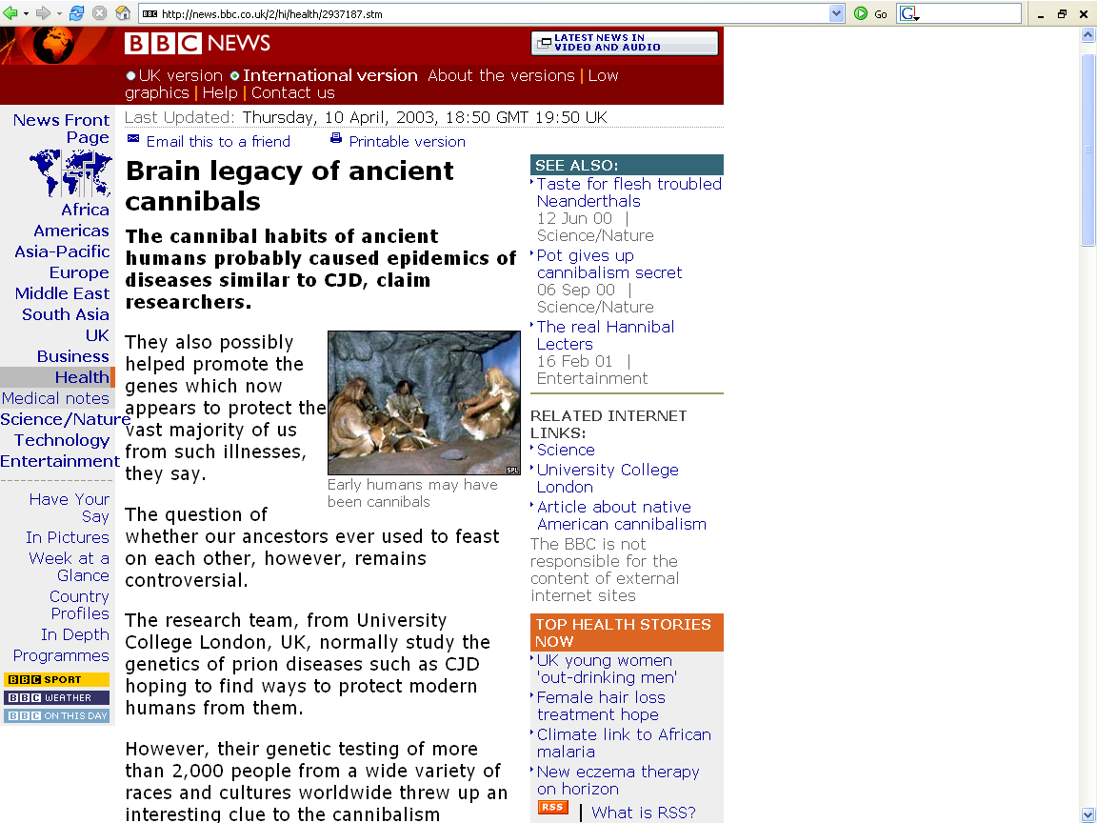
http://news.bbc.co.uk/2/hi/health/2937187.stm

Slide 44
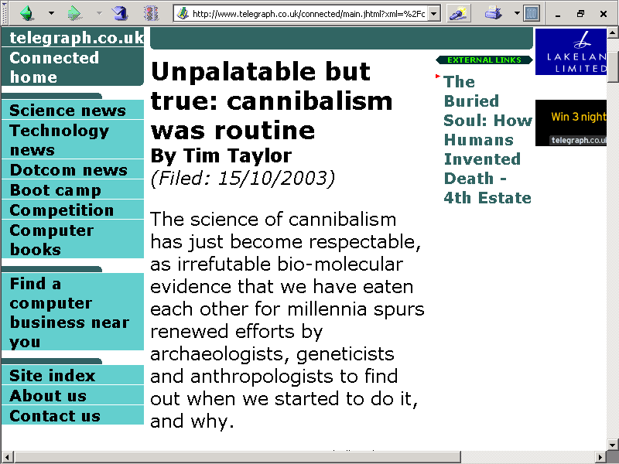

Slide 45
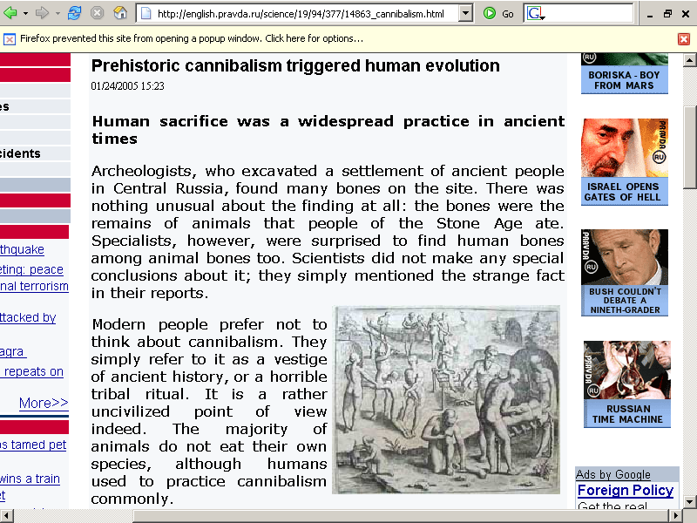
http://english.pravda.ru/science/19/94/377/14863_cannibalism.html

Slide 46
Homo erectus pekinensis
Types of Cannibalism
f2003 edit these out in favor of a separate file on cannibalism.
Use ca-cannibalism.ppt

Slide 47
Homo erectus pekinensis
Types of Cannibalism
Survival

Slide 48
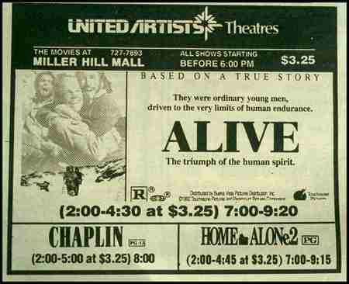


Slide 49
Homo erectus pekinensis
Types of Cannibalism
Survival
Gustatory

Slide 50
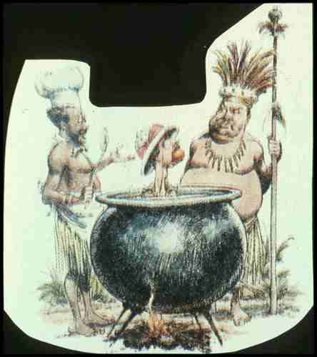

Slide 51


Slide 52
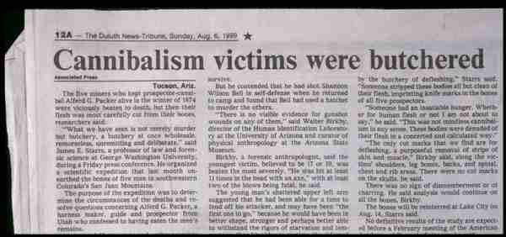

Slide 53
Cannibalism
Moula-Gercy, France
“Bones Offer Evidence of a Neanderthal - Eat - Neanderthal World”
78 fragments from 6 skeletons
ca. 100,000 ybp
30 September 1999

Slide 54
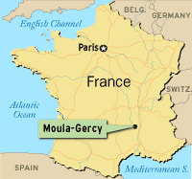
(ABACNEWS.com/MagellanGeographix)

Slide 55
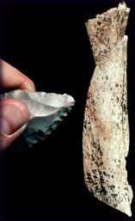
Fragment of a Neandertal Thigh bone
^{(UCAL Berkeley / AP Photo)}

Slide 56
Homo erectus pekinensis
Types of Cannibalism
Survival
Gustatory
Ritualistic or Incorporative

Slide 57


Slide 58
Homo erectus
Java stratigraphy
Modern deposits and bones
Sampoeng stratum (Neolithic)
Ngandong stratum (Upper Pleistocene)
Trinil stratum (Middle Pleistocene)
Djetis stratum (Lower Pleistocene)
Three or more strata (Pliocene)

Slide 59
Homo erectus pekinensis
Beijing people were geographically isolated
This shows up in . . .

Slide 60
Homo erectus pekinensis
Mongoloid shovel-shaped incisors
taurodontism
    molars and premolars with enlarged pulp cavities extending downward into fused roots
mandibular torus
    heavy bony ridge on inside of lower jaw from canine to first molar on each side
extra foraminia mentalia
    2 - 5 openings in lower jawbone through which pass the nerves and blood vessels

Slide 61
Homo erectus pekinensis
Mongoloid shovel-shaped incisors

Slide 62
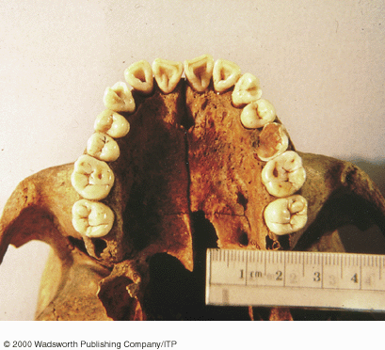
Shovel-shaped incisors, shown here in a modern Homo sapiens sapiens
Understanding Physical Anthropology and Archaeology, 8th ed., p. 263

Slide 63
Homo erectus pekinensis
Mongoloid shovel-shaped incisors
taurodontism
    molars and premolars with enlarged pulp cavities extending downward into fused roots

Slide 64
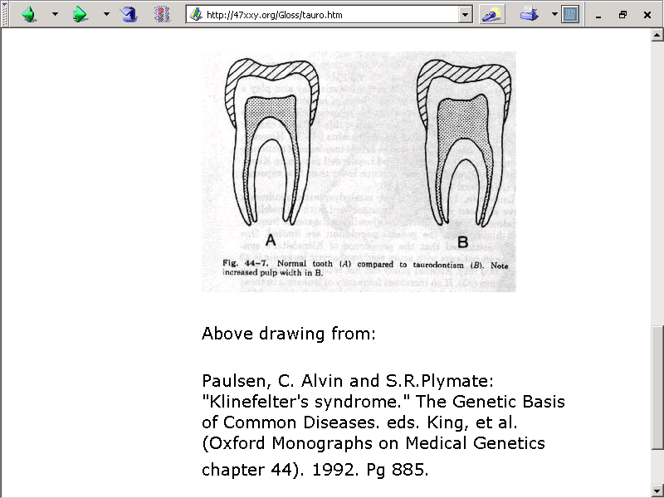

Slide 65
Homo erectus pekinensis
Mongoloid shovel-shaped incisors
taurodontism
    molars and premolars with enlarged pulp cavities extending downward into fused roots
mandibular torus
    heavy bony ridge on inside of lower jaw from canine to first molar on each side

Slide 66
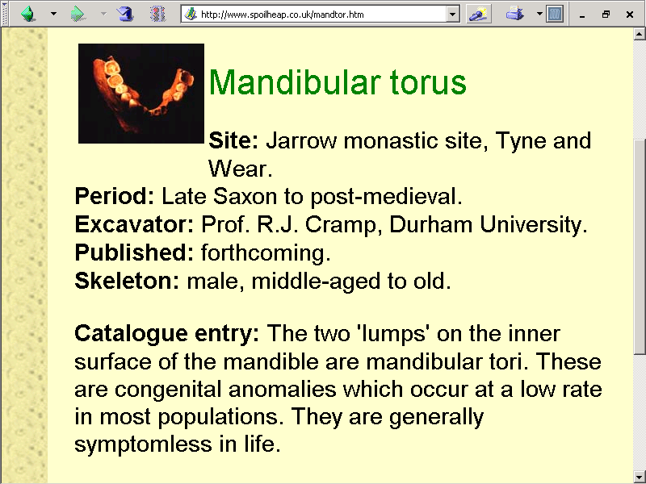

Slide 67
Homo erectus pekinensis
Mongoloid shovel-shaped incisors
taurodontism
    molars and premolars with enlarged pulp cavities extending downward into fused roots
mandibular torus
    heavy bony ridge on inside of lower jaw from canine to first molar on each side
extra foraminia mentalia
    2 - 5 openings in lower jawbone through which pass the nerves and blood vessels

Slide 68
Homo erectus pekinensis

Slide 69
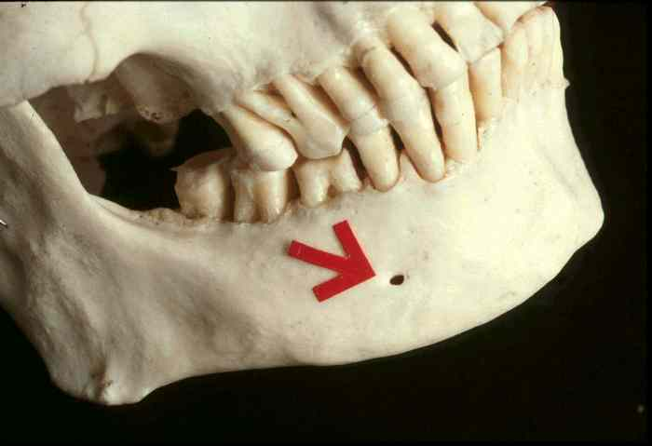
Homo sapiens sapiens

Slide 70
Major Sites: China
Lantian
(Chenjiawo)

Slide 71
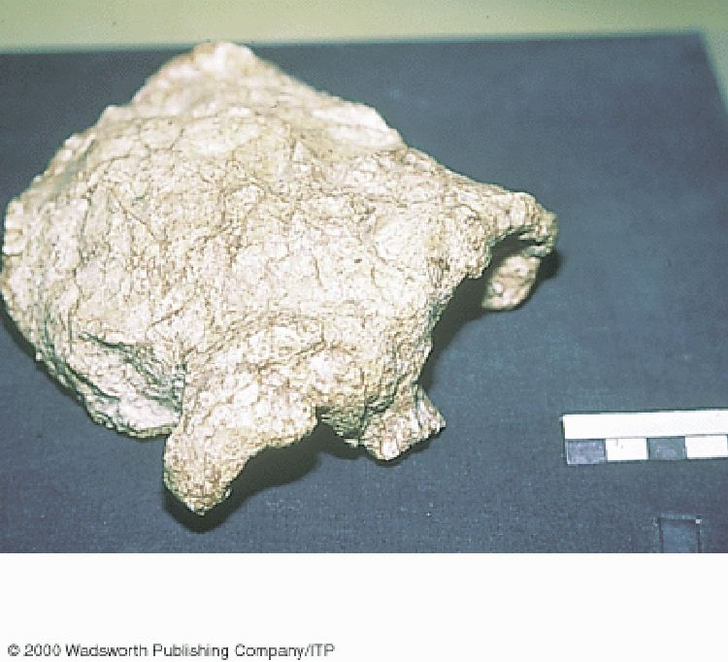
Homo erectus from Lantian (Chenjawo)
Understanding Physical Anthropology and Archaeology, 9th ed., p. 225

Slide 72
Major Sites: China
Hexian
(Lontandong Cave)

Slide 73
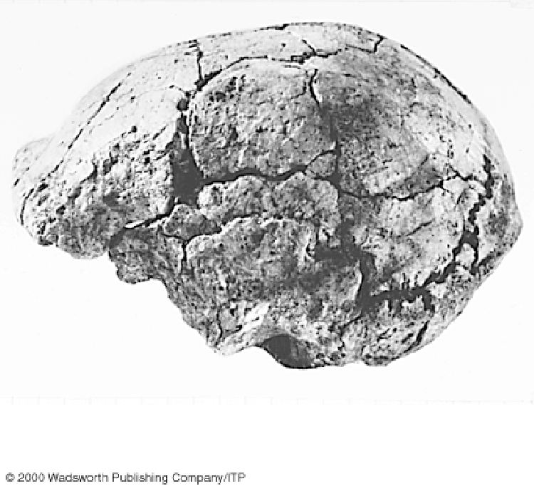
Homo erectus from Hexian (Lontandong Cave)
Understanding Physical Anthropology and Archaeology, 9th ed., p. 225

Slide 74
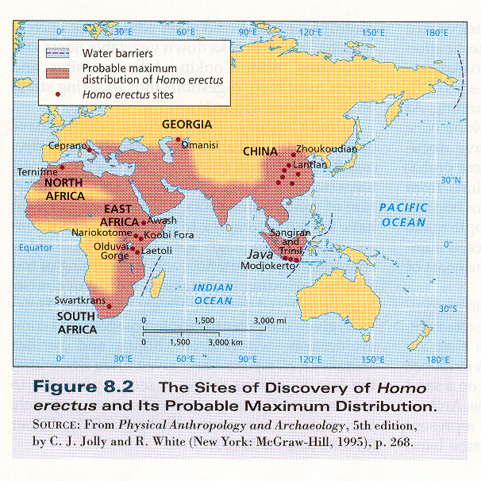
Kottak, Physical Anthropology & Archaeology (NY: McGraw-Hill, 2004), p. 202.

Slide 75
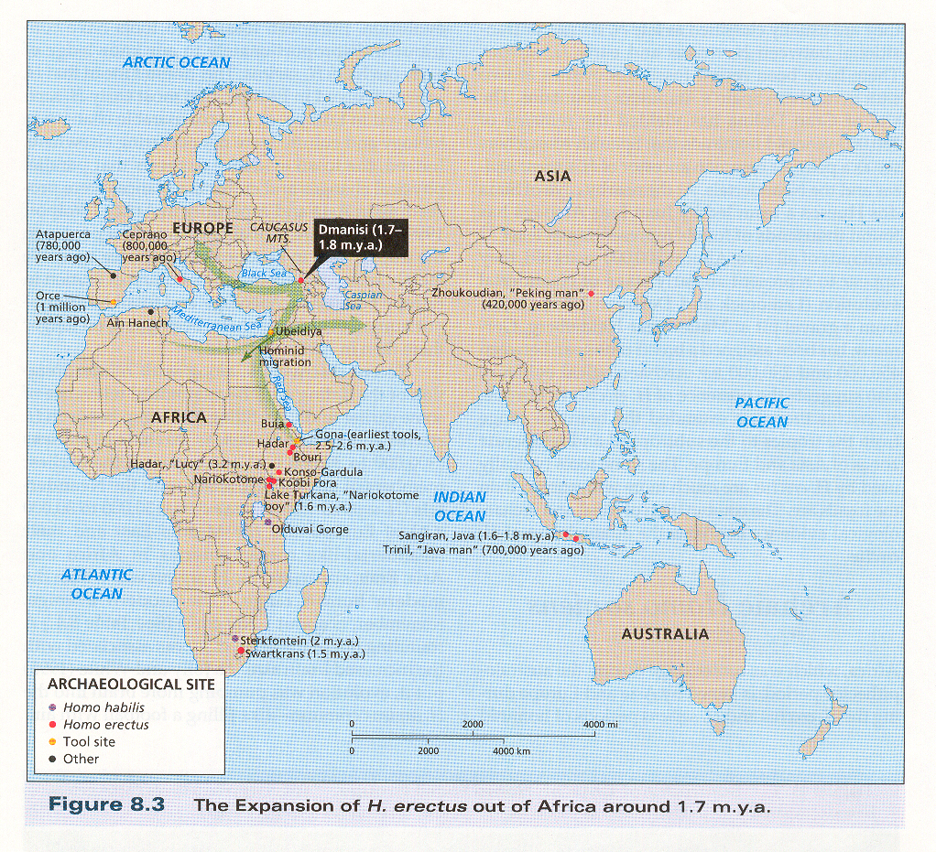
Kottak, Physical Anthropology & Archaeology (NY: McGraw-Hill, 2004), p. 203.

Slide 76
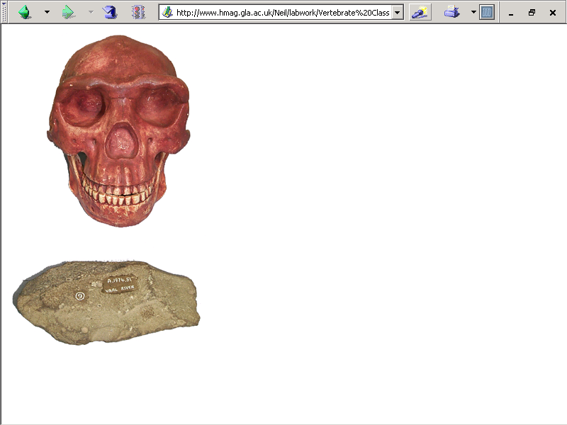
REM
Homo erecti
are hand axe people

Slide 77

Next:
Homo erectus in Africa

