Slide 1
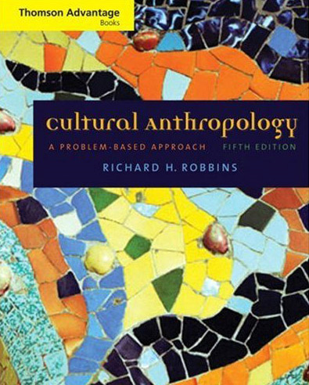
Political Organization
and
Leadership
Tim Roufs
© 2010

Slide 2
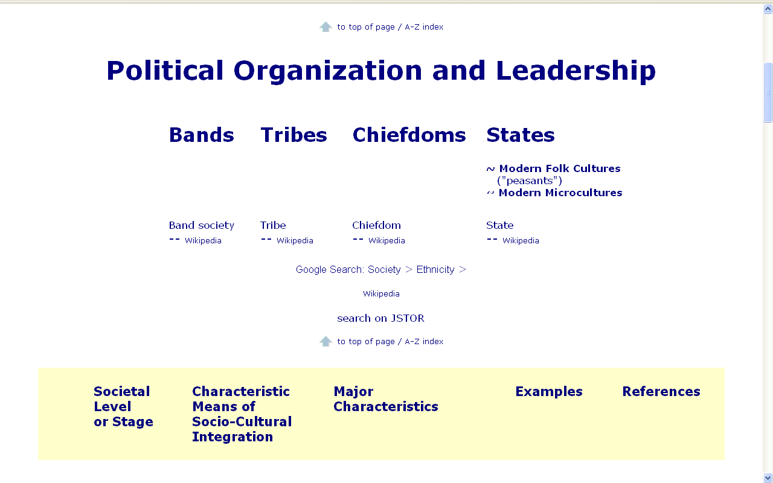

Slide 3
Political Organization and Leadership
  V.B. Modern Microcultures
  V.A. Modern Folk Societies
  IIII. States
  III. Chiefdoms
  II. Tribes
  I. Bands

Slide 4
Political Organization and Leadership
  V.B. Modern Microcultures
  V.A. Modern Folk Societies
  IIII. States
  III. Chiefdoms
  II. Tribes
  I. Bands
  “Civilization”
  “Barbarism”
  “Savagery”

Slide 5
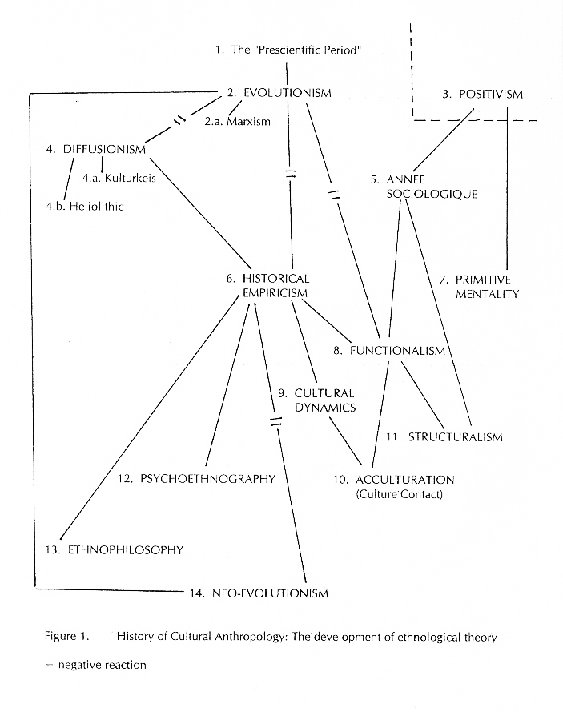
  “Civilization”
  “Barbarism”
  “Savagery”
  Unilinear Evolution
  (19th Century Evolution)
  Multilinear Evolution

Slide 6
  “Civilization”
  “Barbarism”
  “Savagery”
  Unilinear Evolution
  (19th Century Evolution)
  Marshall Sahlins
  Elman Service
  Julian Steward
  Multilinear Evolution

Slide 7
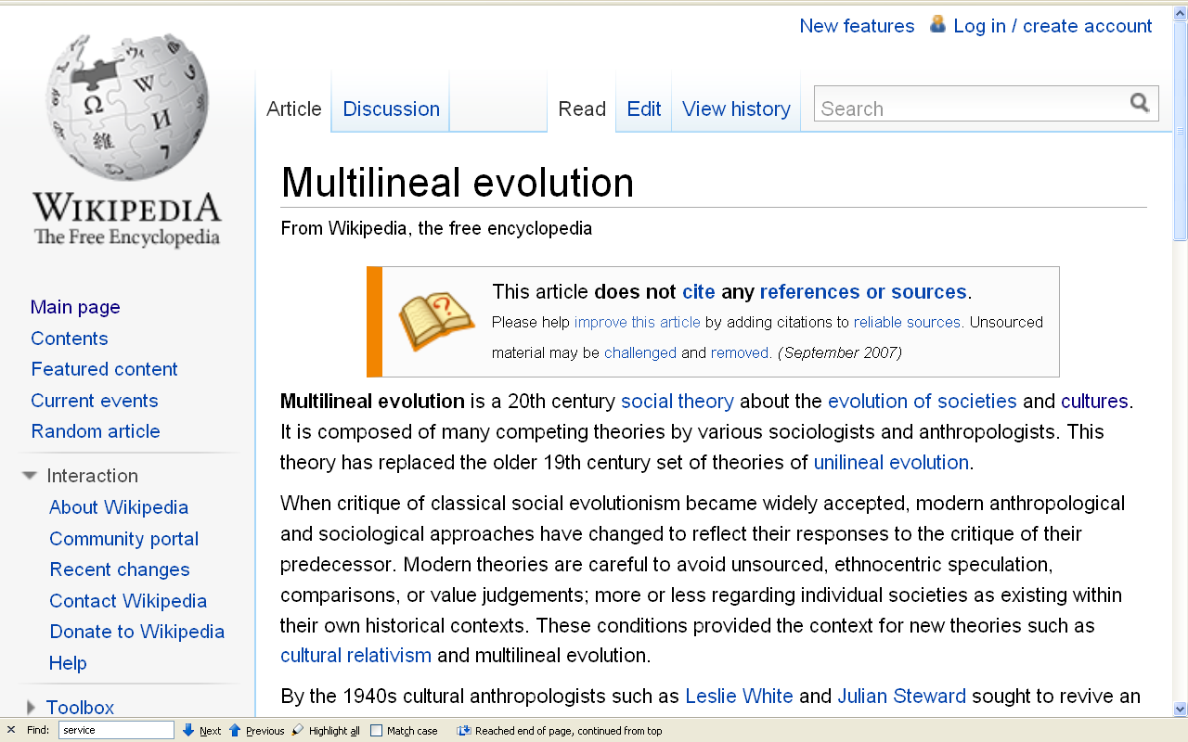
http://en.wikipedia.org/wiki/Multilineal_evolution

Slide 13
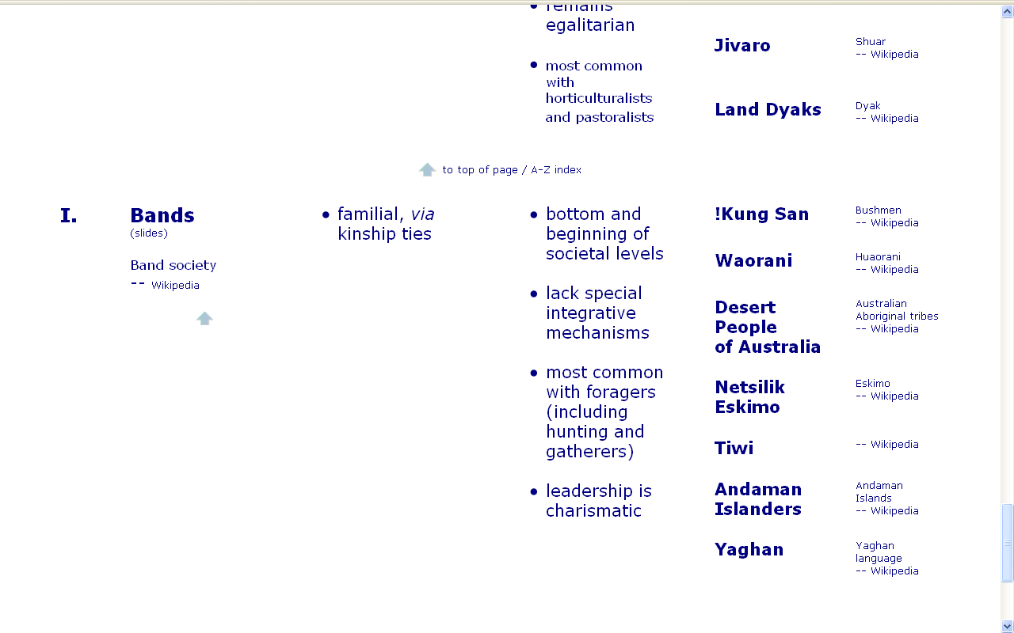
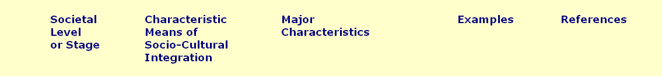

Slide 14
Societal Level or Stage | Characteristic Means of Socio-Cultural Integration | Major Characteristics | Examples

Slide 15
Political Organization and Leadership
  I. Bands
the political organization of foraging groups

Slide 16
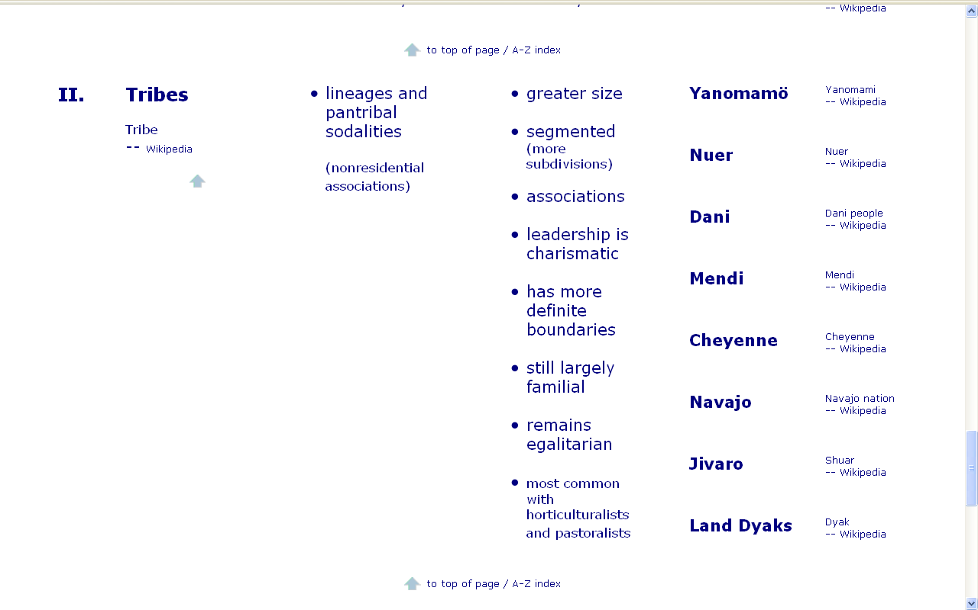
Societal Level or Stage | Characteristic Means of Socio-Cultural Integration | Major Characteristics | Examples

Slide 17
Political Organization and Leadership
  II. Tribes
a political group that comprises several bands or lineage groups
each with similar language and lifestyle
and occupying a distinct territory

Slide 18
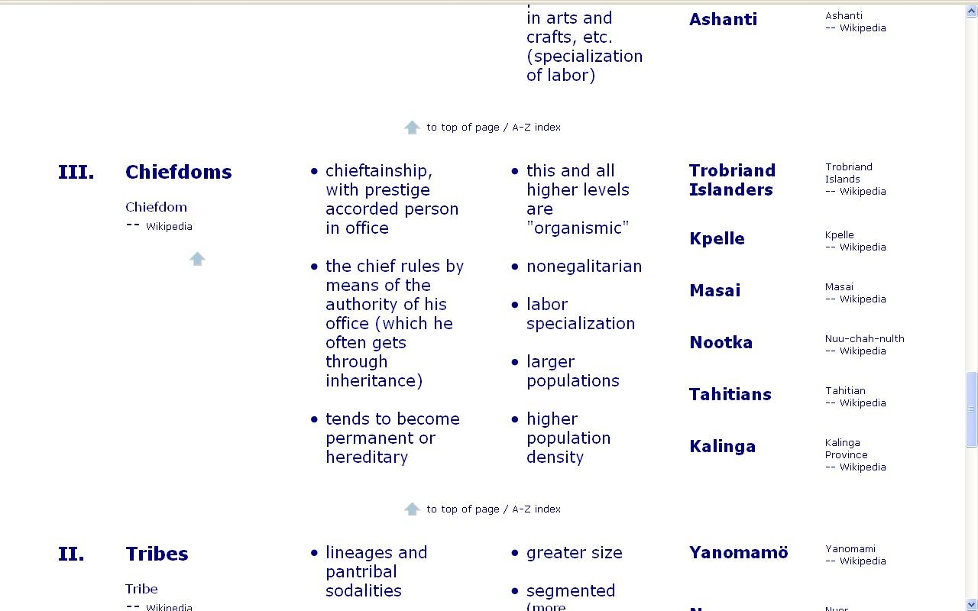
Societal Level or Stage | Characteristic Means of Socio-Cultural Integration | Major Characteristics | Examples

Slide 19
Political Organization and Leadership
  III. Chiefdoms
a political unit of permanently allied tribes and villages under one recognized leader

Slide 20
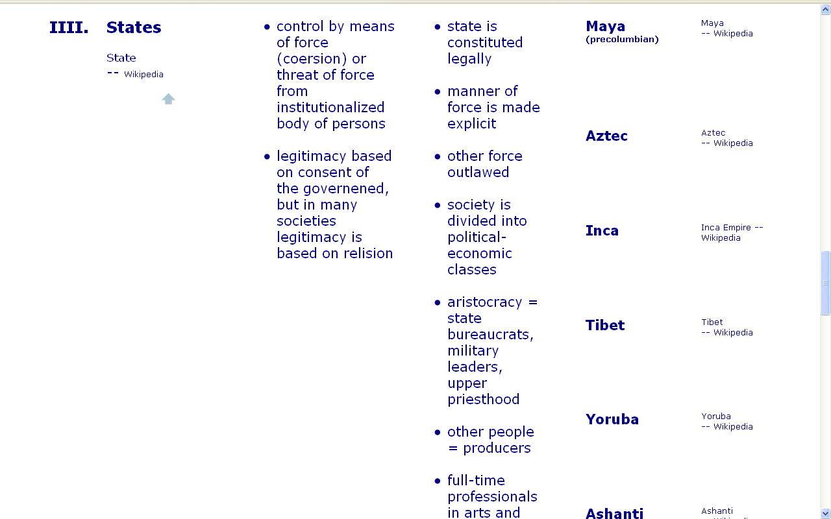
Societal Level or Stage | Characteristic Means of Socio-Cultural Integration | Major Characteristics | Examples

Slide 21
Political Organization and Leadership
  IIII. States
a centralized political unit encompassing many communities
and possessing legitimate coercive power

Slide 22
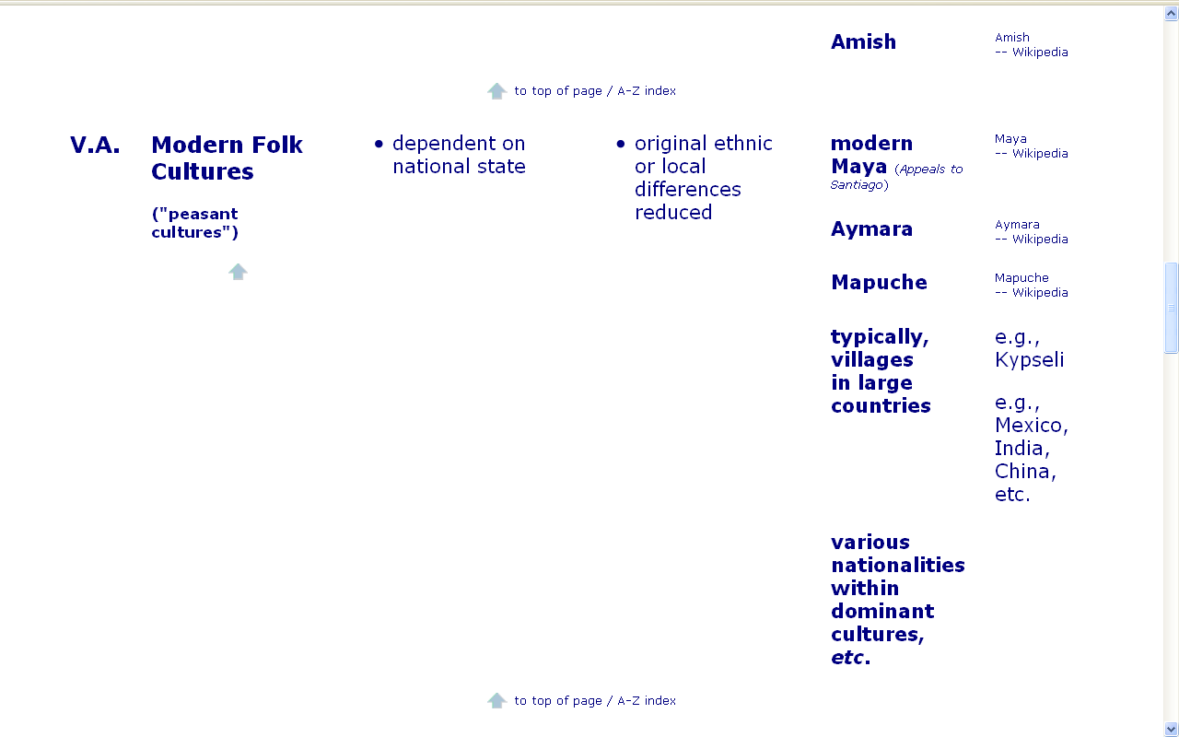
Societal Level or Stage | Characteristic Means of Socio-Cultural Integration | Major Characteristics | Examples

Slide 23
Political Organization and Leadership
  V.A. Modern Folk Societies
a social type of rural farmer associated with preindustrial civilization
dominated by the city and its culture
but marginal to both

Slide 24
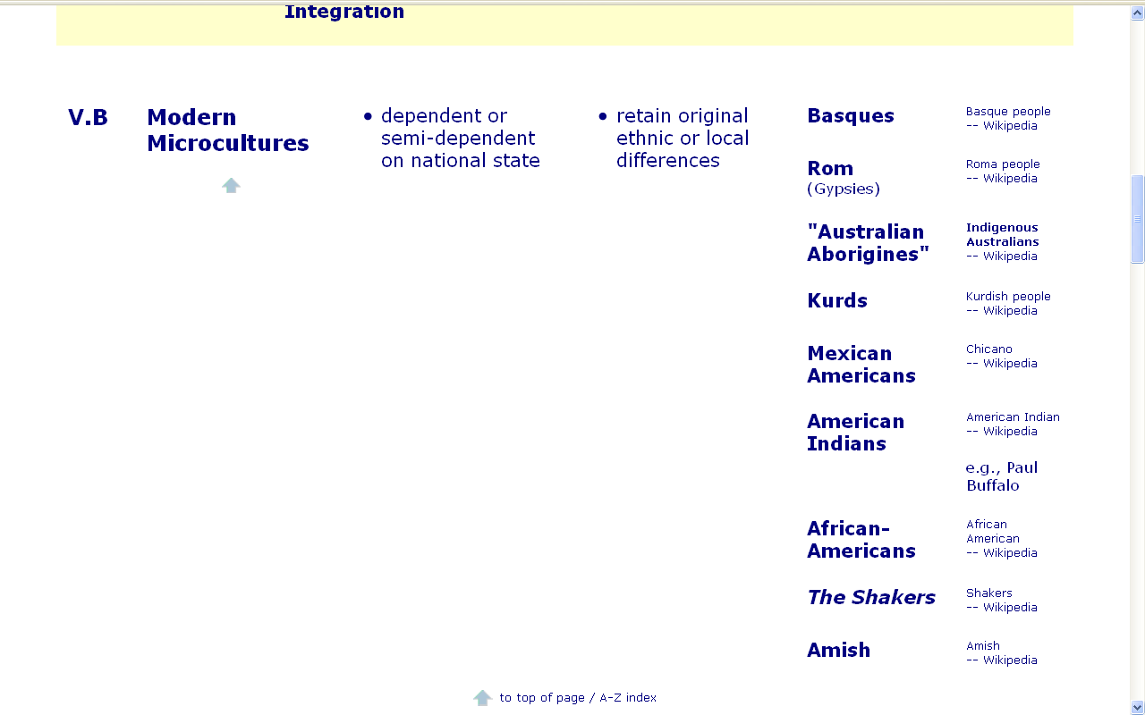
Societal Level or Stage | Characteristic Means of Socio-Cultural Integration | Major Characteristics | Examples

Slide 25
Political Organization and Leadership
  V.B. Modern Microcultures
a distinct pattern of learned and shared behavior and thinking
found within larger cultures such as ethnic groups, and institutional cultures

Slide 26
Political Organization and Leadership
  V.B. Modern Microcultures
  V.A. Modern Folk Societies
  IIII. States
  III. Chiefdoms
  II. Tribes
  I. Bands

Slide 28
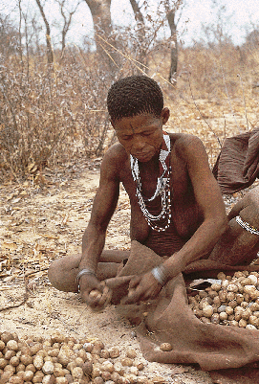
Bands

Slide 29
Political Organization and Leadership
  I. Bands
the political organization of foraging groups
small groups of households, between twenty and a few hundred people at most
related through kinship

Slide 30
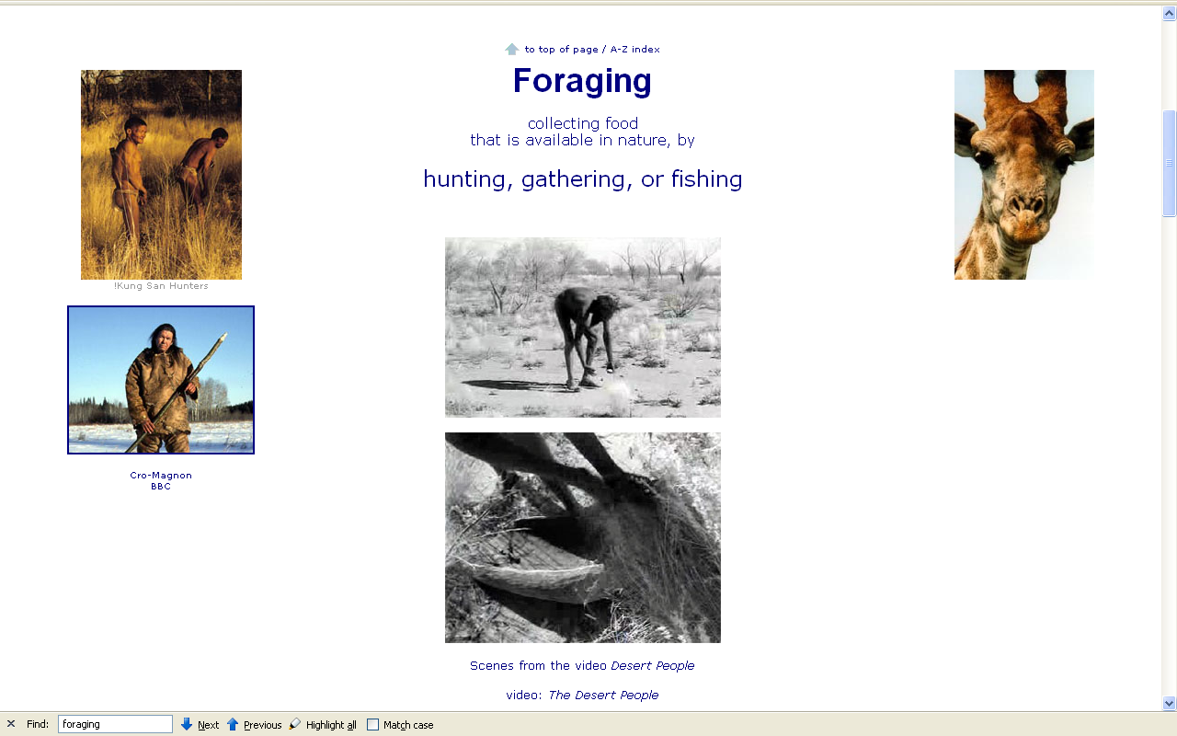

Slide 31
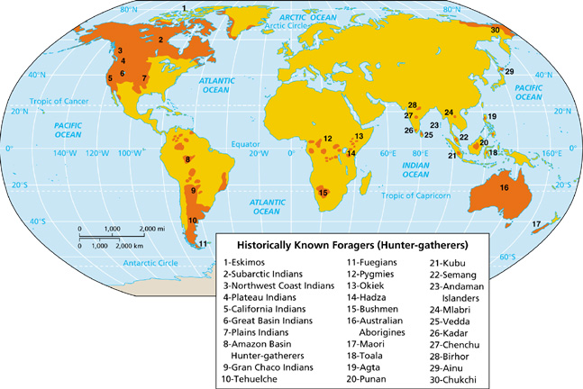
Band Societies

Slide 32
Hunting / Gathering
99% of human’s time has been that of a hunter-gatherer

Slide 33
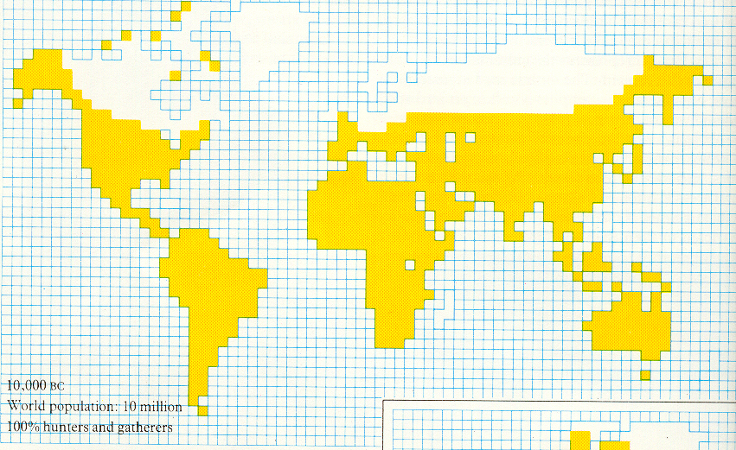
10, 000 B.C. – 100 % Foragers
Ascent to Civilization, p. 10.

Slide 34
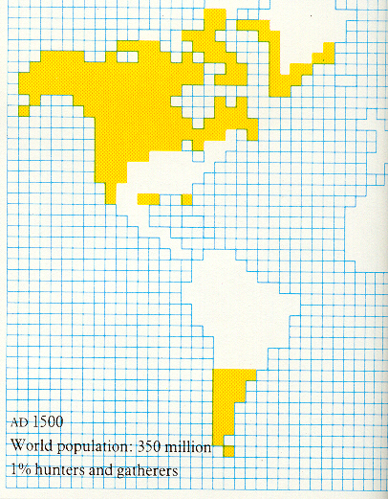
A.D. 1500 – 1 % Foragers
Ascent to Civilization, p. 10.

Slide 35
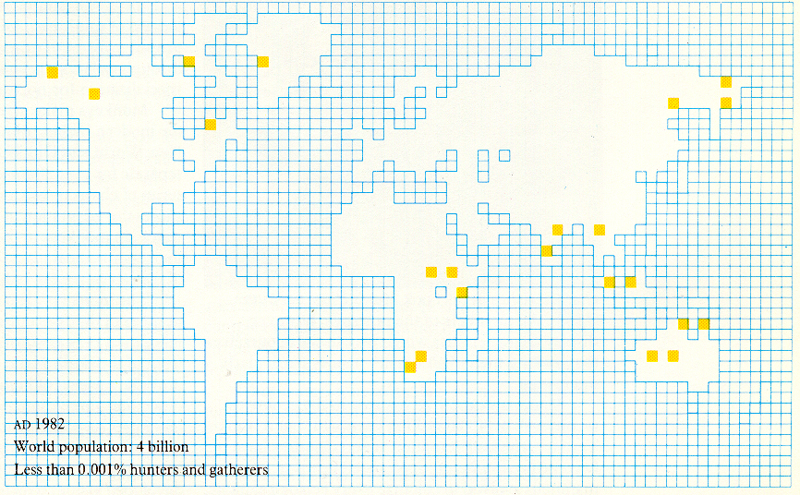
A.D. 1982 – < 0.001 % Foragers
Ascent to Civilization, p. 11.

Slide 37
Societal Level or Stage | Characteristic Means of Socio-Cultural Integration | Major Characteristics | Examples

Slide 40
Band Societies
Until the mid-1980s the !Kung model of the foraging lifeway dominated the band paradigm
(Science, May 1988)

Slide 41
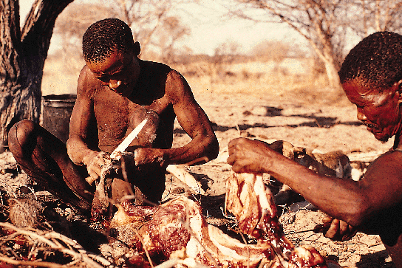

Slide 42
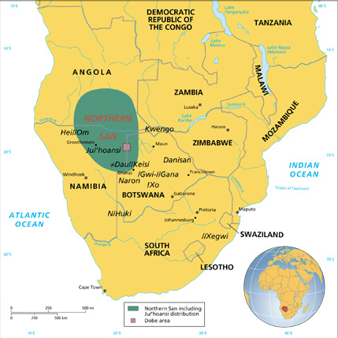
Map 12-3

Slide 43
Band Societies
Anthropologists no longer take the !Kung as the model of pre-agricultural band societies

Slide 44
Band Societies
Anthropologists now recognize a much greater variability among foraging bands
(Science, May 1988)

Slide 45
Band Societies
The Hunters are hunters, for example . . .
But The Desert People are not hunters

Slide 46
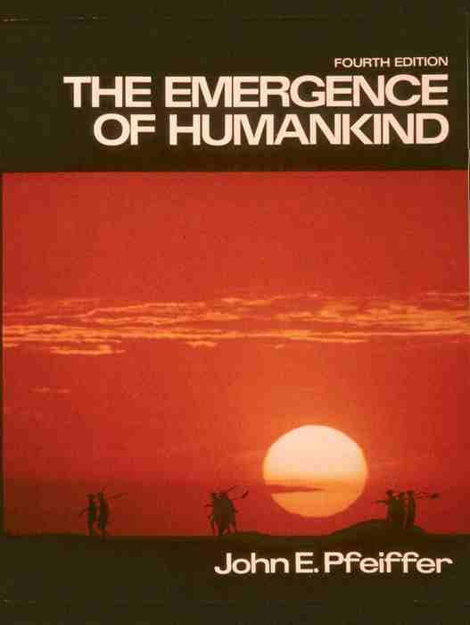

Slide 47
Band Societies
The Desert People
Pfeiffer, Ch. 15
The Hunters
Pfeiffer, Ch. 16

Slide 48
Hunting / Gathering
The Desert People
Australian “aborigines”
The Hunters
“Bushmen”
!Kung San
Khoisan
zhun/twasi
  (“ourselves”)

Slide 49
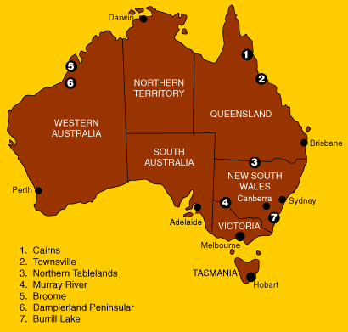
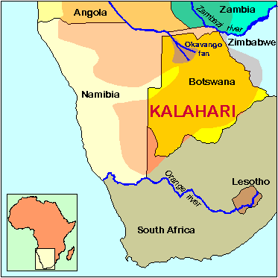
Hunting / Gathering
Aborigines of the
Western Australian Desert
!Kung San of the
Kalahari Desert
Map 12-3

Slide 50
desert dwellers
Aborigines of the
Western Australian Desert
!Kung San of the
Kalahari Desert

Slide 51
desert dwellers
Aborigines of the
Western Australian Desert
!Kung San of the
Kalahari Desert

Slide 52
Band Societies
The Desert People
simple material culture
The Hunters
simple material culture

Slide 53
Band Societies
The households come together
at certain times of the year, depending on their foraging patterns and ritual schedule

Slide 54
Band Societies
Moving puts a premium
on multi-purpose tools
e.g., digging stick, blade tools . . .

Slide 55
Hunting / Gathering
While foraging groups are usually bilineal in descent and inheritance, some early hunting groups may have been patrilineal bands . . .

Slide 56
Hunting / Gathering
The Desert People
“band” society
The Hunters
“band” society
and many hunting band societies
are still patrilineal

Slide 57
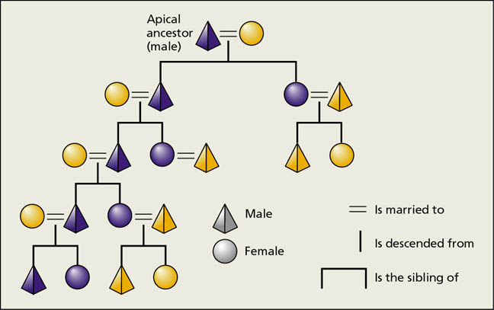
Hunting / Gathering
patrilineal kinship

Slide 58
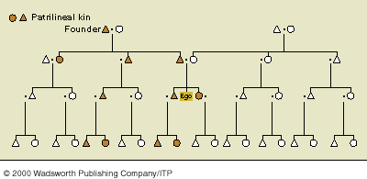
Hunting / Gathering
patrilineal kinship

Slide 59
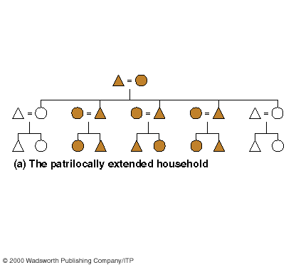
Hunting / Gathering
patrilineal societies are patrilocal
patrilocal residence

Slide 60
Band Societies
simplest level of social organization
small groups of families
  ca. 20 – 50 / group

Slide 61
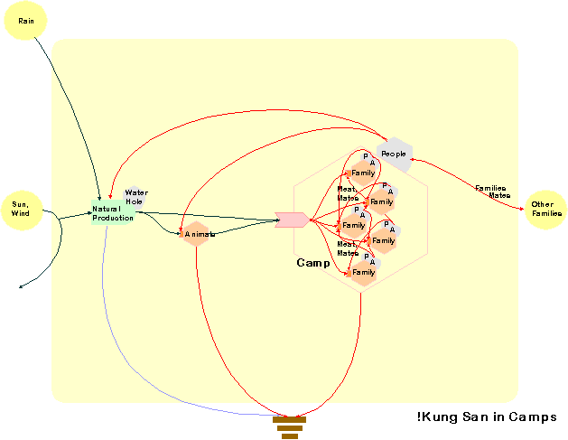
Band Societies
!Kung San in Camps

Slide 62
Band Societies
20 – 500 persons integrated by a shared language and a sense of common identity
  exact numbers depend on the carrying capacity of their geographic area

Slide 63
Band Societies
“magic numbers” are 25 and 500

Slide 64
Band Societies
External conflict between groups is rare since territories of different bands are widely separated and the population density is low

Slide 65
Band Societies
Band membership is flexible
Band composition is fluid as people shift residence frequently

Slide 66
Band Societies
If a person has a serious disagreement with another person or a spouse, one option is to leave that band and join another

Slide 67
Band Societies
Leadership is “charismatic”:
no official leaders
leadership is informal
leader has no power and only limited authority
position carries no rewards of power or riches

Slide 68
Band Societies
Leadership is based on the quality of the individual’s advice and personality

Slide 69
Band Societies
Band leaders have limited authority or influence, but no power

Slide 70
Band Societies
Age and sex
generally determine
who will exert influence:
strongly male dominated
but the old people -- male and female -- are respected and are influential

Slide 71
Band Societies
influence may dissolve or be created in an instant
a person may come to the fore as a leader for specific tasks or events

Slide 72
Band Societies
status positions are fluid from generation to generation

Slide 73
Band Societies
There is no social stratification between leaders and followers

Slide 74
Band Societies
Group decisions are made by consensus

Slide 75
Band Societies
Political activity in bands involves mainly decision making about migration, food distribution, and interpersonal conflict resolution

Slide 76
Band Societies
Marriages are through alliances with members of other bands
Video: N!ai, The Story Of A !Kung Woman

Slide 77
Hunting
Bands are often nomadic
hunting-gathering groups

Slide 78
Hunting
When bands are hunters,
male – male relationships
dominate
usually there are male associations

Slide 79
Hunting
Difference between
young males and old males
is intensified in hunting societies

Slide 80
Hunting
Ability to hunt signifies change of status and may be required for adulthood

Slide 81
Hunting
Hunting intensifies
differences between sexes . . .

Slide 82
Hunting
Hunting creates a “male world”
and a “world of the women and children”

Slide 83
Hunting
Hunting increases the division of labor between sexes

Slide 84
Hunting
But hunting thus also creates more need for
cooperating between sexes

Slide 85
Hunting
In hunting societies, sharing becomes important
for survival

Slide 86
Hunting
Females specialize
in collecting

Slide 87
Hunting
75 % of “hunters”
rely more heavily on collecting
than on hunting
(Martin and Voorhies, 1975)

Slide 88
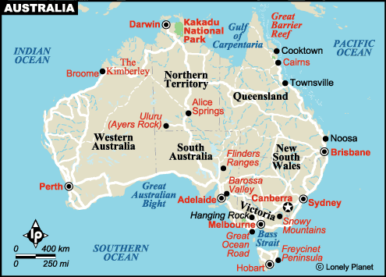
Hunting
In the Gibson Desert, for e.g.,
90 % of the time
women furnish at least
80 % of the food

Slide 89
Hunting
In hunting societies
females stay
in the home base more

Slide 90
Hunting
Female division of labor
by age

Slide 91
Hunting
Home base
changes socialization patterns

Slide 92
Hunting
Delayed maturity is related to home base
  emphasis is placed on learning

Slide 93
Hunting
From the child’s point of view
the home base
= a self-contained world

Slide 94
Hunting
Home base
allows sick to survive

Slide 95
Paleopathologists Wil Salo (left) and Art Aufderheide (right).
Understanding Physical Anthropology and Archaeology, 8th Ed., p. 117.

Slide 96
Political Organization and Leadership
  V.B. Modern Microcultures
  V.A. Modern Folk Societies
  IIII. States
  III. Chiefdoms
  II. Tribes
  I. Bands

