Slide 1
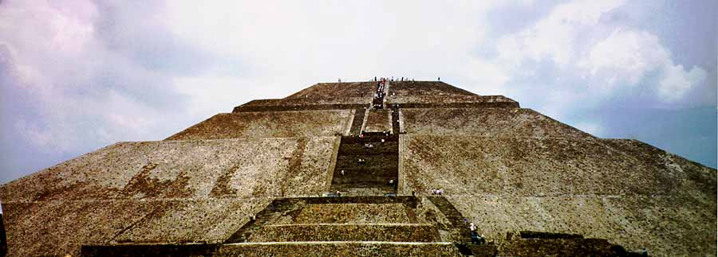
Ancient Middle America
The Classic
University of Minnesota Duluth
Tim Roufs’ ©2009-2019

Slide 2
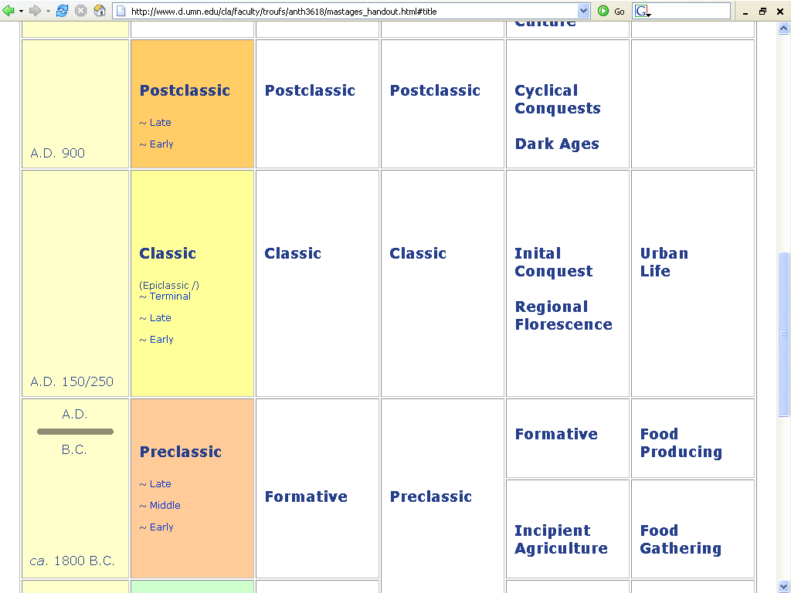

Slide 3
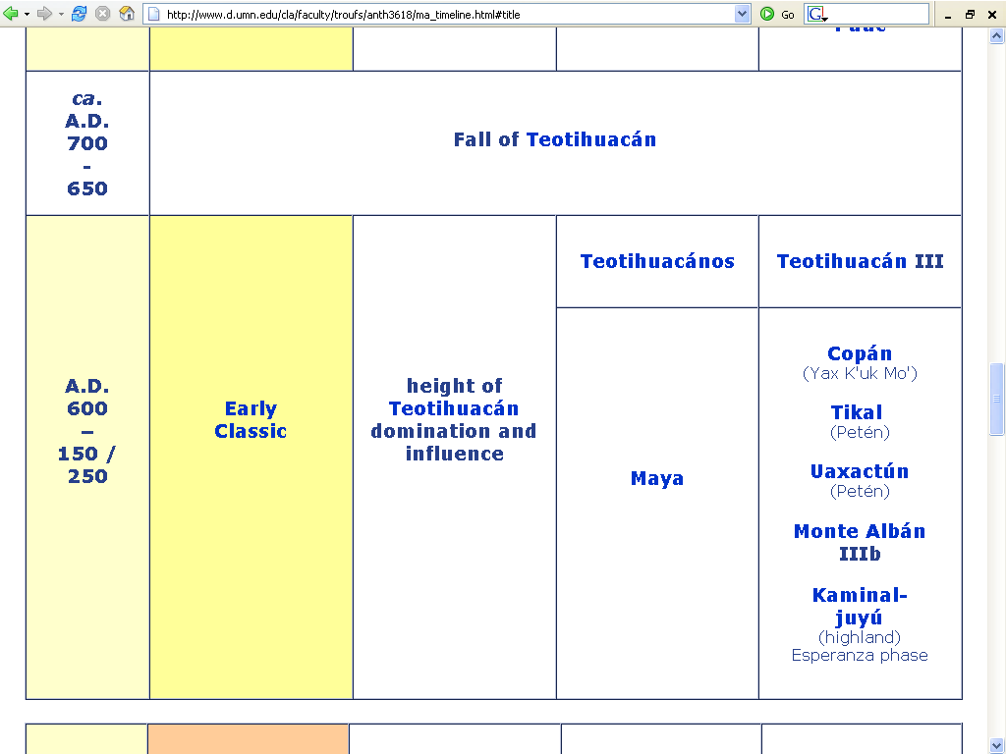

Slide 4
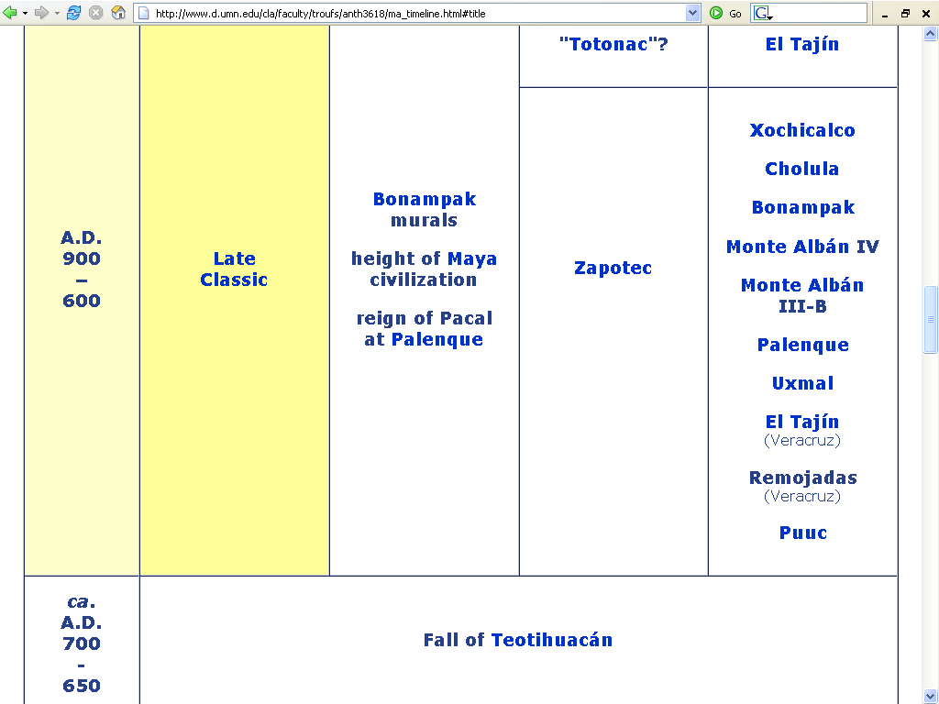

Slide 5
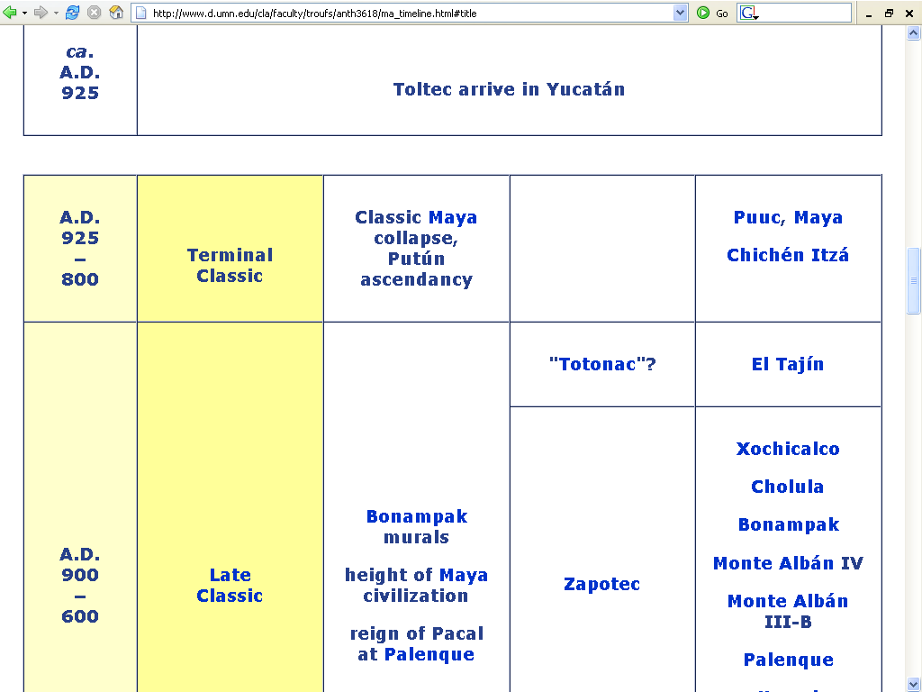

Slide 6
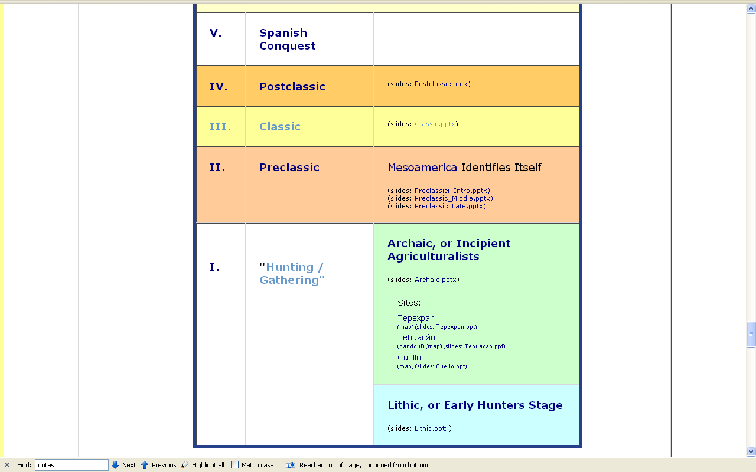

Slide 7
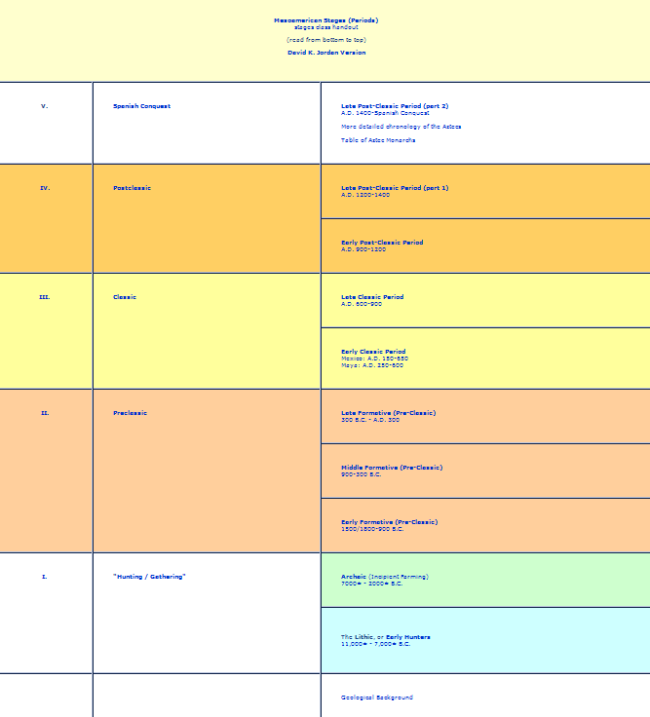

Slide 8
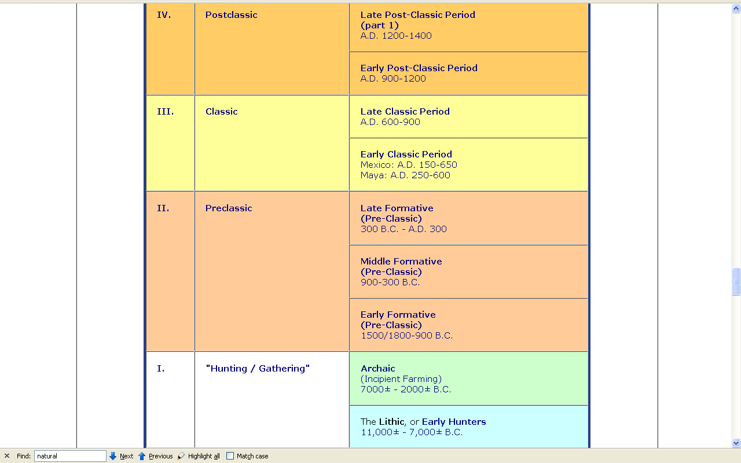

Slide 9
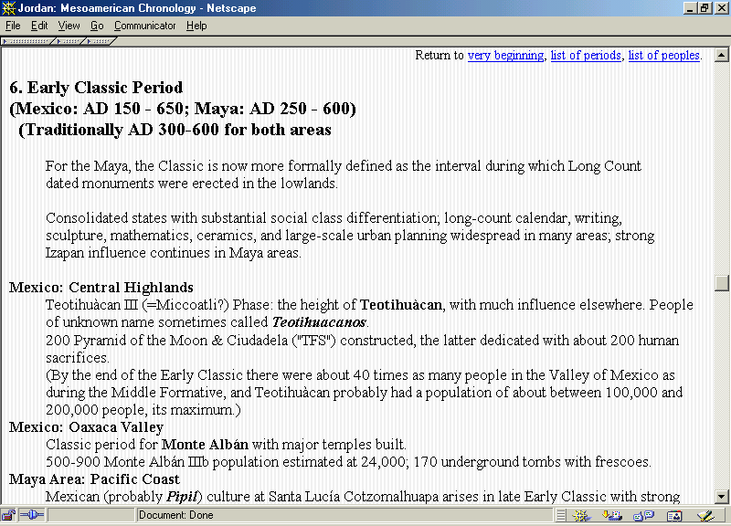

Slide 10
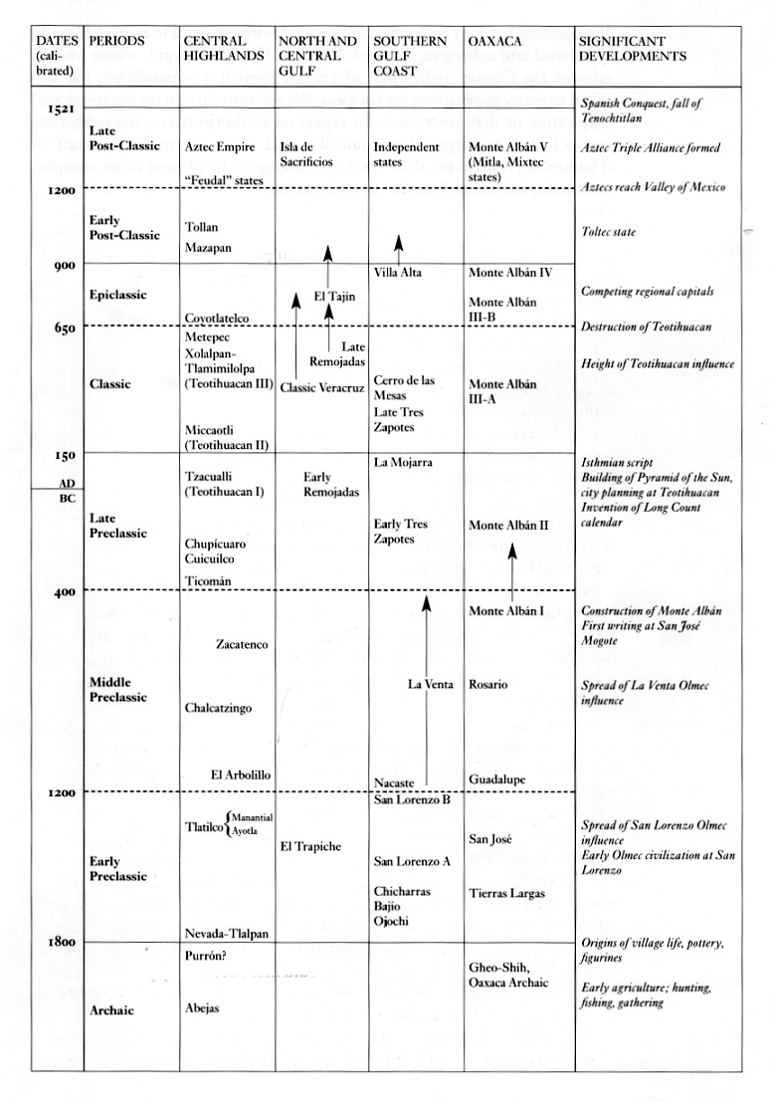
Coe and Koontz, Mexico: From the Olmecs to the Aztecs, 6th Ed., 2008, p. 236

Slide 11
Seven Important Points
for the Classic Stage
After Willey and Phillips, Method and Theory in American Archaeology. Chicago: University of Chicago Press, 1970.

Slide 12
Classic Stage
The Classic as usually defined is focused on
southern Mexico and adjacent upper Central America
“Mesoamerica”
Peru-Bolivian coast and highlands
“The Central Andean area”

Slide 13
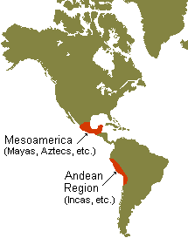
“Mesoamerica”
“The Central Andean area”

Slide 14
Classic Stage
. . . These are the two main centers of aboriginal American civilization
But many of these Classic patterns may also be found
along the Ecuadorian coast
and at Cahokia in Illinois

Slide 15
Cahokia
Ecuador

Slide 16
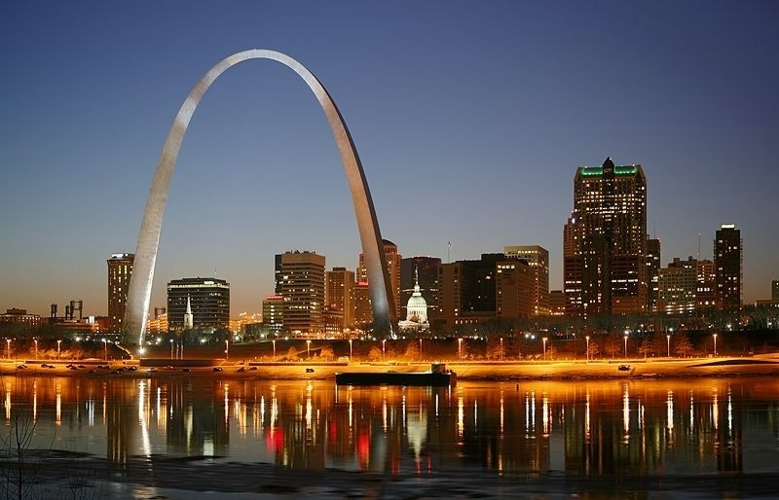
St. Louis on Mississippi River
http://commons.wikimedia.org/wiki/Category:Maps_of_the_history_of_Hungary

Slide 17
www.d.umn.edu/cla/faculty/troufs/anth1602/pcmississippian.html#title

Slide 18
Classic Stage
. . . Middle American and Peru-Bolivian Classic stages
are roughly contemporaneous
occupy most of the first millennium A.D.

Slide 19
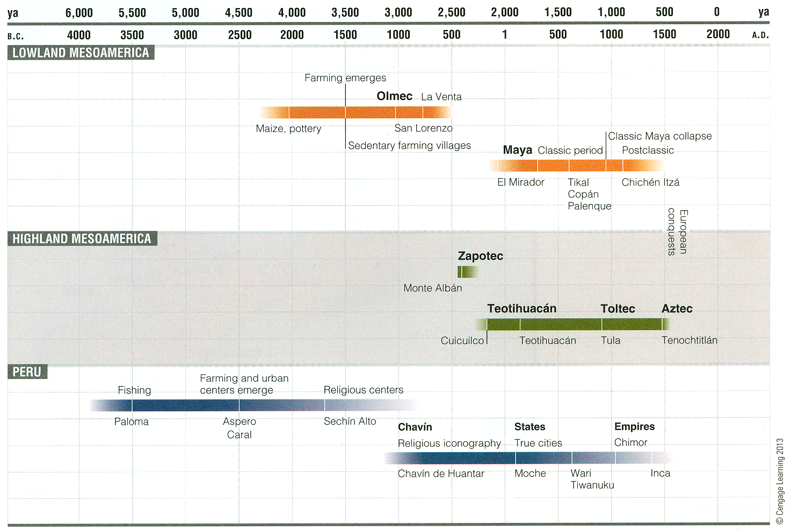
Understanding Physical Anthropology and Archaeology, 11th Ed., p. 393

Slide 20
Classic Stage
2. The Classic Stage marks the beginning of urban life in native America
the early New World cities were built around the temple pyramids and palace platforms of the ceremonial centers

Slide 21
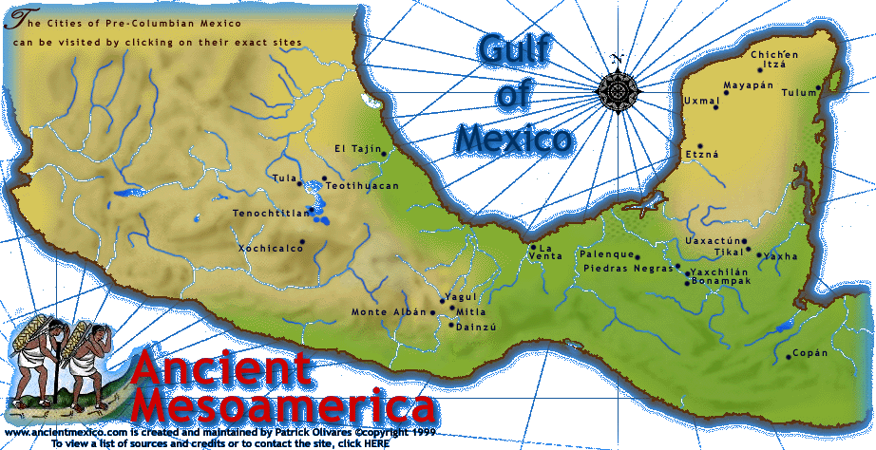
Teotihuacán

Slide 22
http://mayaruins.com/tikal/Tikal_map.html

Slide 23
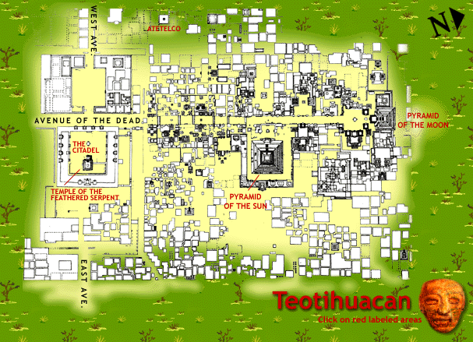
www.ancientmexico.com/content/map/teotihuacan.html

Slide 24
Classic Stage
the Classic sites would thus appear to be the logical developments out of such centers and towns of the Preclassic (“Formative”) Stage
in many instances they are the same sites
early Preclassic occupational and architectural levels are overlaid by later habitations and monuments of the Classic

Slide 25
Classic Stage
The Classic Stage cities were the nuclei of . . .
political and religious governments
of artistic and intellectual achievement
of commerce and craft

Slide 26
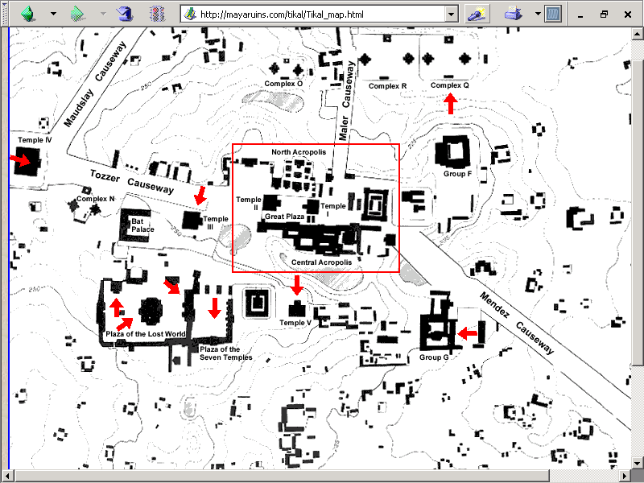
Tikal
http://mayaruins.com/tikal/Tikal_map.html

Slide 27
Classic Stage
4. The temples, palaces and other public buildings of the Classic are of great size and elaboration
these buildings attest to the planning, skill and labor organization of the builders

Slide 28
http://mayaruins.com/tikal/Tikal_map.html

Slide 29
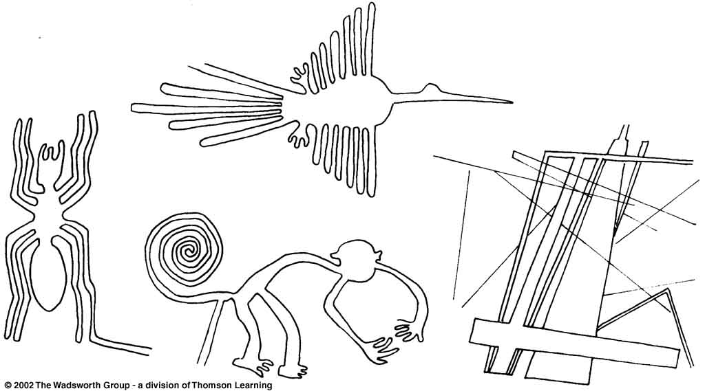
Nazca ground drawings as seen from the air included
both zoomorphic and linear motifs.
The monkey is longer than a football field.
Understanding Physical Anthropology and Archaeology, 8th Ed., p. 496

Slide 30
Classic Stage
The Classic Stage is also characterized by the appearance of great art styles
these styles tend to be limited to well-defined regions

Slide 31
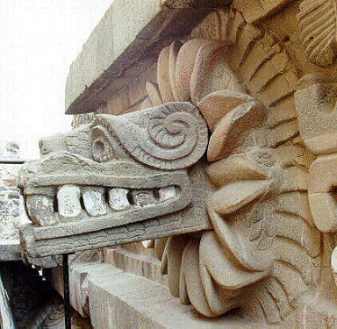
Quetzalcuatl, Teotihuacán
Notes:
31

Slide 32
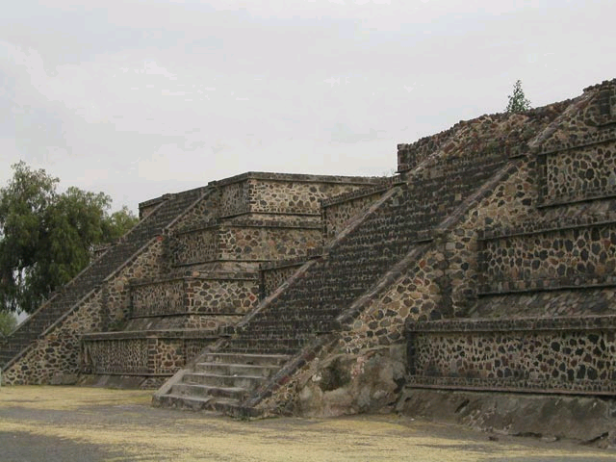
Talud-tablero style, Teotihuacán
http://en.wikipedia.org/wiki/Teotihuacan
Notes:
32

Slide 33
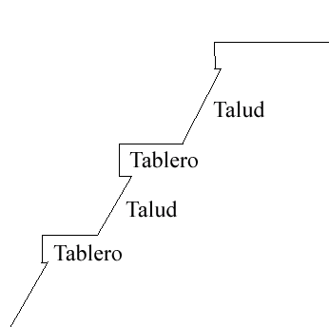
talud-tablero
http://en.wikipedia.org/wiki/Talud-tablero
Notes:
33

Slide 34
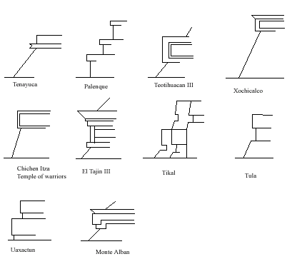
talud-tablero
http://en.wikipedia.org/wiki/Talud-tablero
Notes:
34

Slide 35
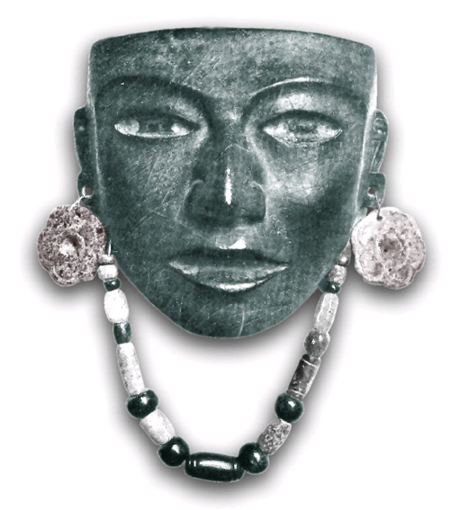
Obsidian mask, Teotihuacán Classic
www.arikah.net/enciclopedia-espanola/Per%C3%ADodo_cl%C3%A1sico_mesoamericano
Notes:
35

Slide 36
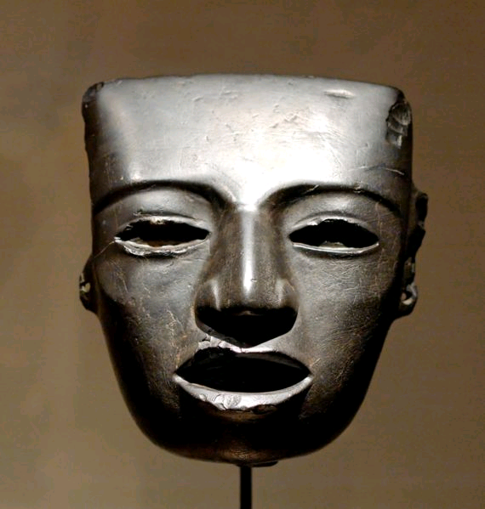
Stone mask , Teotihuacán, 3rd to 7th century A.D.
http://en.wikipedia.org/wiki/Teotihuacan
Notes:
36

Slide 37
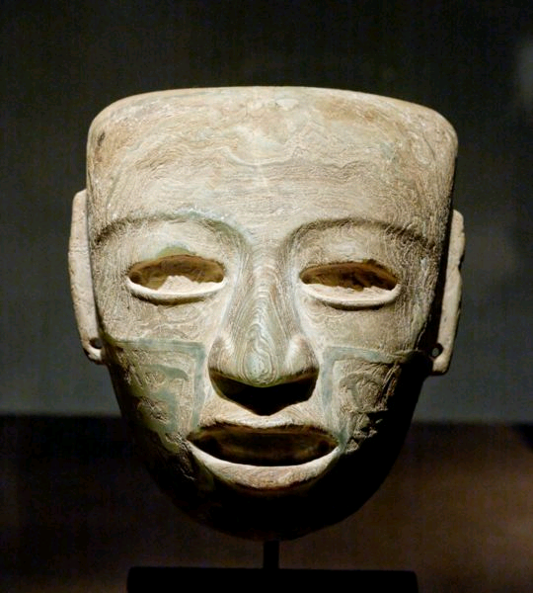
Marble mask , Teotihuacán, 3rd to 7th century A.D.
http://en.wikipedia.org/wiki/Teotihuacan
Notes:
37

Slide 38
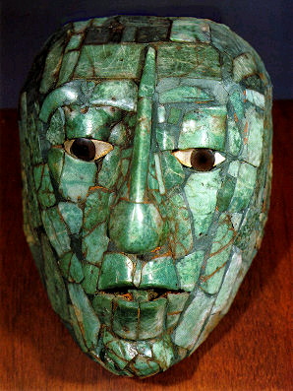
Pacal death mask, Palenque
www.delange.org/ArchMuseum2/ArchMuseum2.htm
Notes:
38

Slide 39
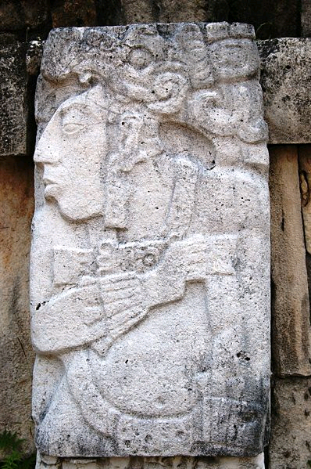
Pacal, Palenque, Chiapas, Mexico
http://en.wikipedia.org/wiki/Palenque
Notes:
39

Slide 40
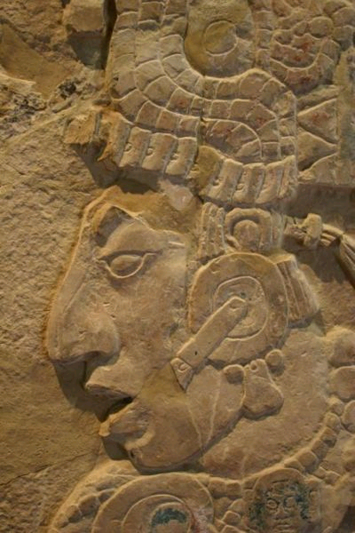
K'inich Kan B'alam II , Palenque, Chiapas, Mexico
(detail)
http://en.wikipedia.org/wiki/Palenque
Notes:
40

Slide 41
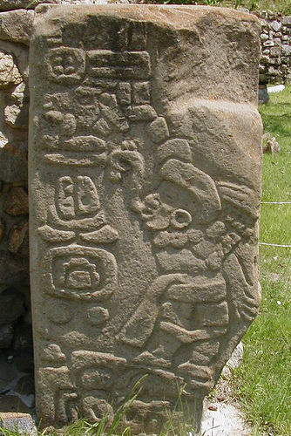
“Danzante,” Monte Albán
http://en.wikipedia.org/wiki/Monte_Alban
Notes:
41

Slide 42
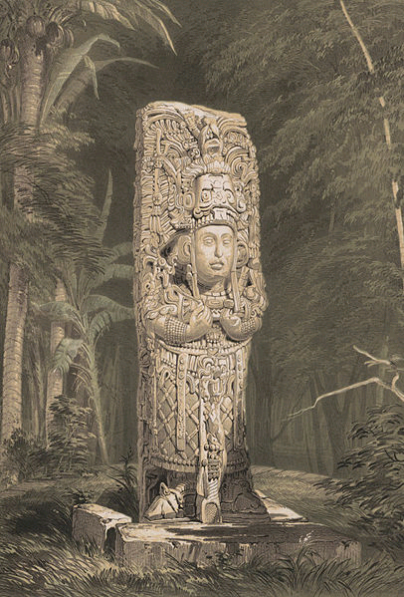
18 Rabbit, Copán, Honduras
Frederick Catherwood, 1844
http://en.wikipedia.org/wiki/Copan
Notes:
42

Slide 43
Bonampak

Slide 44
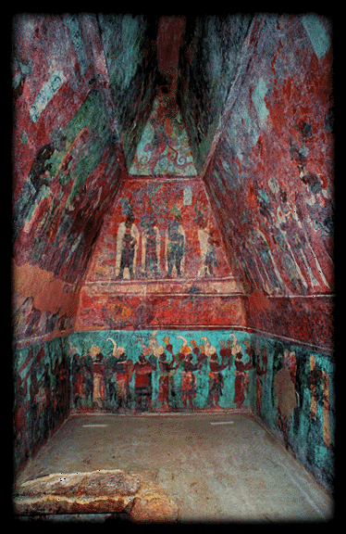
Murals , Bonampak, Chiapas, Mexico
www.ancientmexico.com/content/map/bonampak-mural.html
Notes:
44

Slide 45
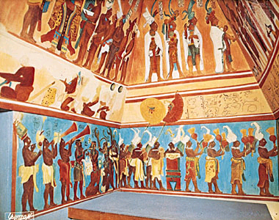
Reconstructed murals, Bonampak, Chiapas, Mexico
www.ancientmexico.com/content/map/bonampak-mural.html
Notes:
45

Slide 46
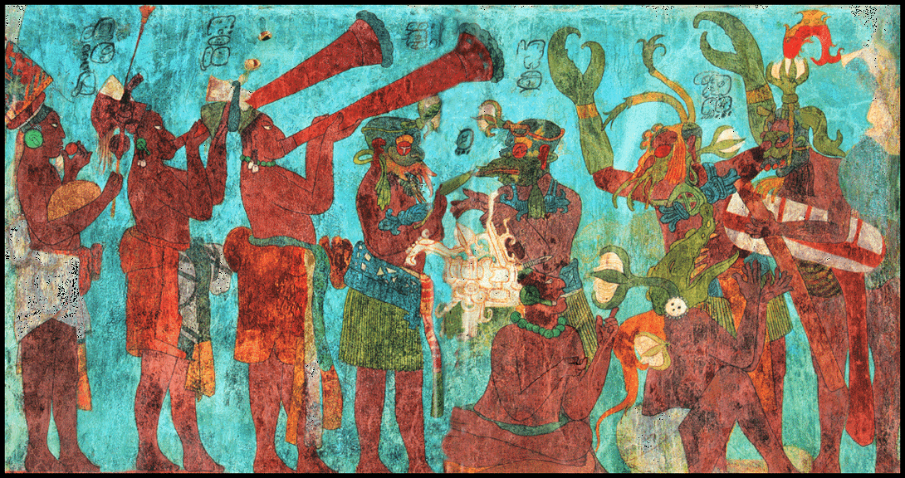
Murals, Bonampak, Chiapas, Mexico
www.ancientmexico.com/content/map/bonampak-mural.html
Notes:
46

Slide 47
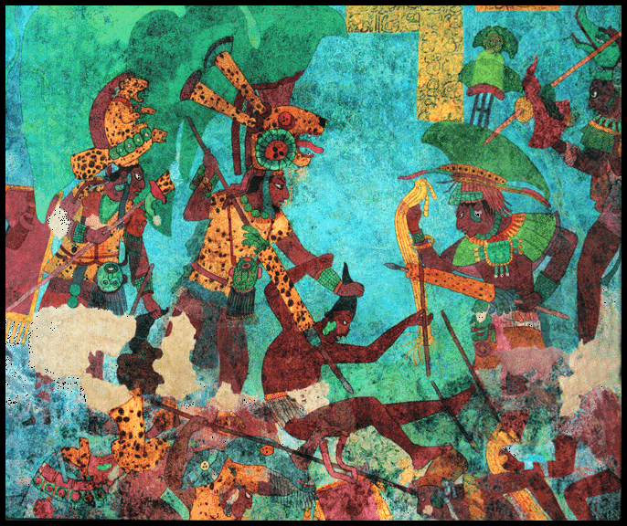
Murals, Bonampak, Chiapas, Mexico
www.ancientmexico.com/content/map/bonampak-mural.html
Notes:
47

Slide 48
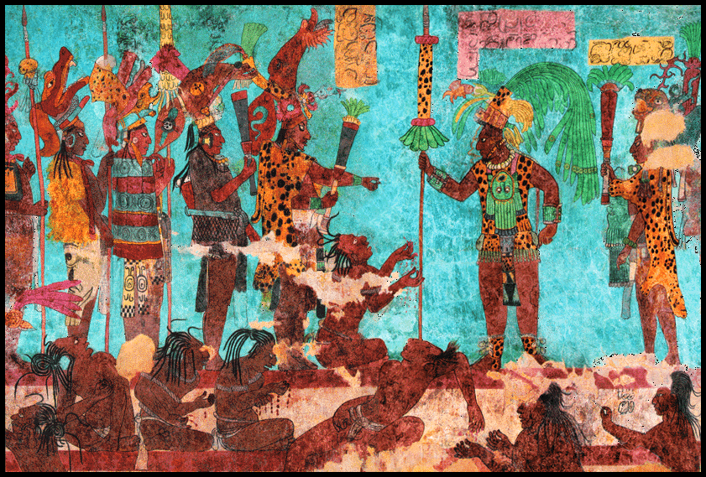
Murals, Bonampak, Chiapas, Mexico
www.ancientmexico.com/content/map/bonampak-mural.html
Notes:
48

Slide 49
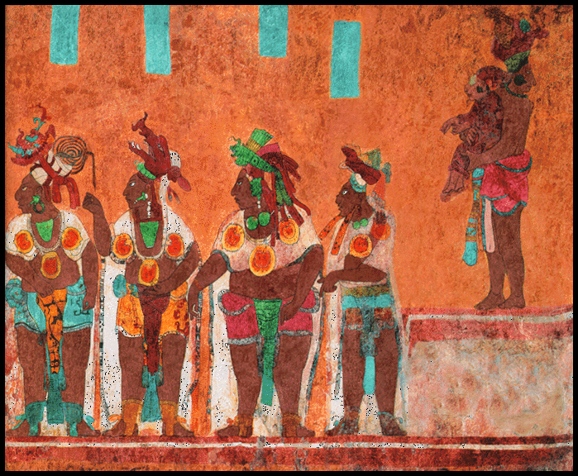
Murals, Bonampak, Chiapas, Mexico
www.ancientmexico.com/content/map/bonampak-mural.html
Notes:
49

Slide 50
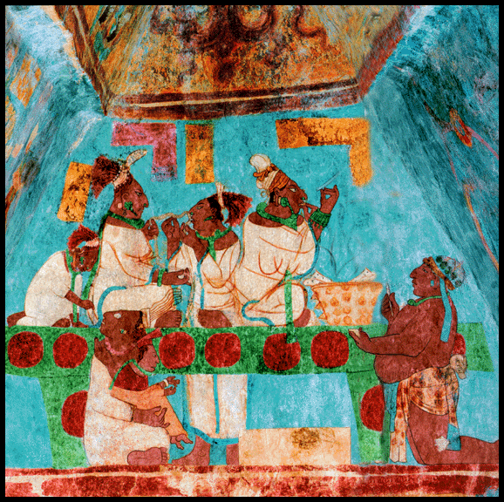
Murals, Bonampak, Chiapas, Mexico
www.ancientmexico.com/content/map/bonampak-mural.html
Notes:
50

Slide 51
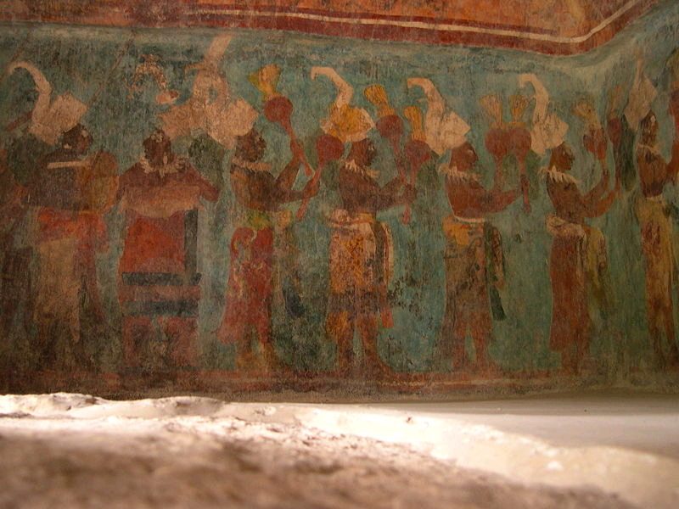
Murals, Bonampak, Chiapas, Mexico
http://en.wikipedia.org/wiki/Palenque
Notes:
51

Slide 52
Calakmul Campeche

Slide 53
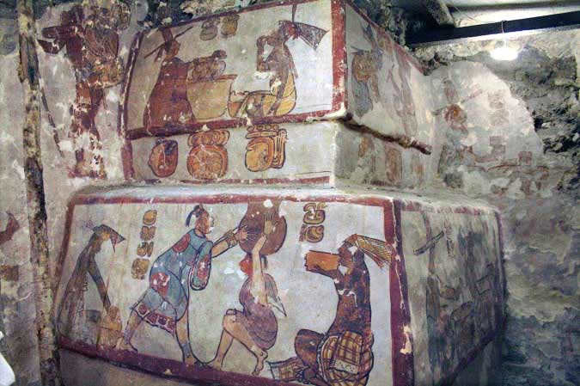
Murals, Calakmul, Campeche, Mexico
9 November 2009
http://news.nationalgeographic.com/news/2009/11/091112-maya-pictures-murals-pyramid-food.html
Notes:
53

Slide 54
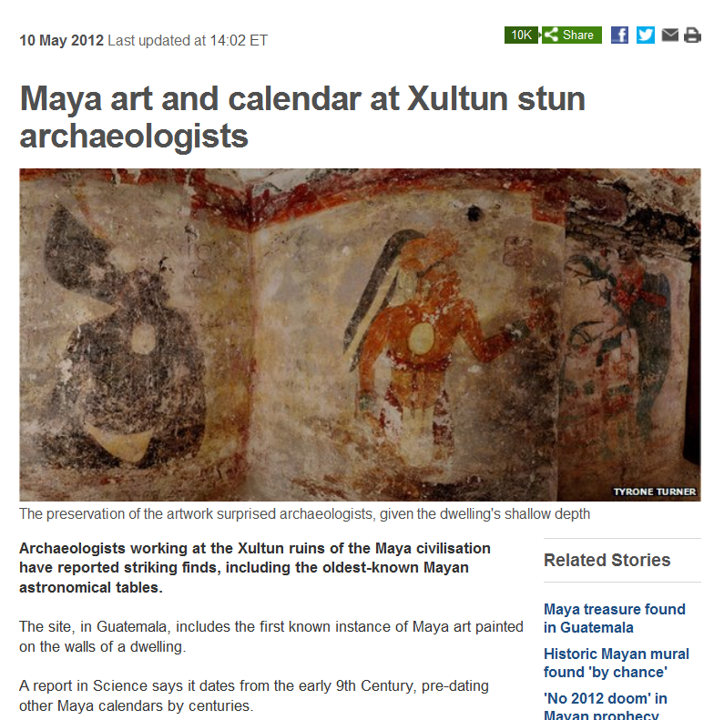
Xultun, Guatemala
12 May 2012
http://www.bbc.co.uk/news/science-environment-18018343
Notes:
54

Slide 55
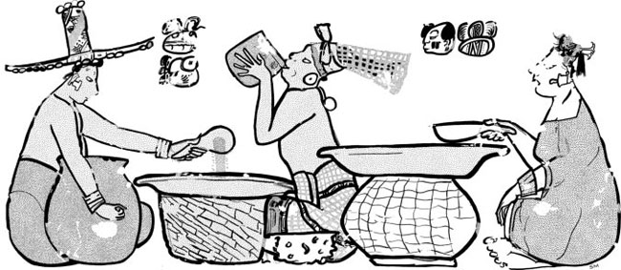
“Mural scene showing the serving and drinking of ‘ul,’ or maize-gruel. The hieroglyphic caption says ‘aj ul,’ or ‘maize-gruel person.’"
Carrasco Vargas et al./PNAS
Murals, Calakmul, Mexico
9 November 2009
http://www.livescience.com/history/091110-maya-pyramid-painting.html
Notes:
55

Slide 56
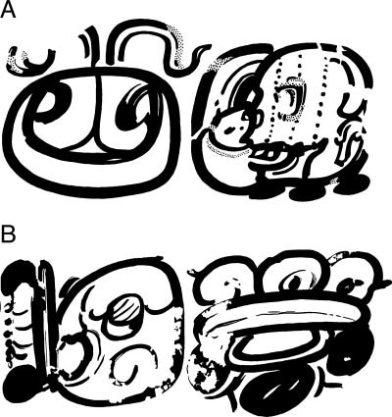
“Mayan hieroglyphic spelling of two titles from newly discovered ancient murals, ‘aj ix'im’ (maize-grain person) and ‘aj atz'aam’ (salt person). Despite the importance of these commodities to the Maya diet, the words for ‘maize’ and ‘salt’ were not previously known.”
Carrasco Vargas et al./PNAS
Murals, Calakmul, Mexico
9 November 2009
http://www.livescience.com/history/091110-maya-pyramid-painting.html
Notes:
56

Slide 57
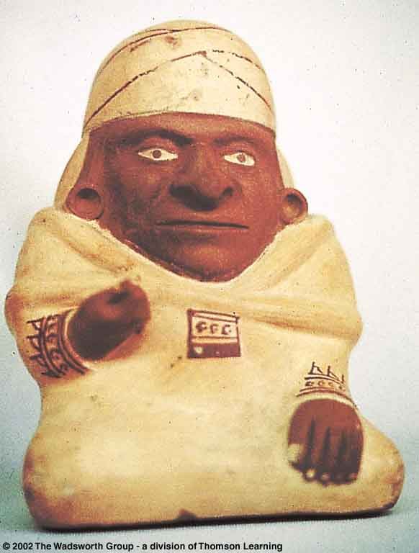
Moche portrait jar from northern Peru.
Understanding Physical Anthropology and Archaeology, 8t^{h} Ed., p. 495

Slide 58
Classic Stage
Craftsmanship in ceramics, weaving, stone-working, carving of all kinds, and in some places metallurgy is of a high order
craft specialization is a certainty in the Classic

Slide 59
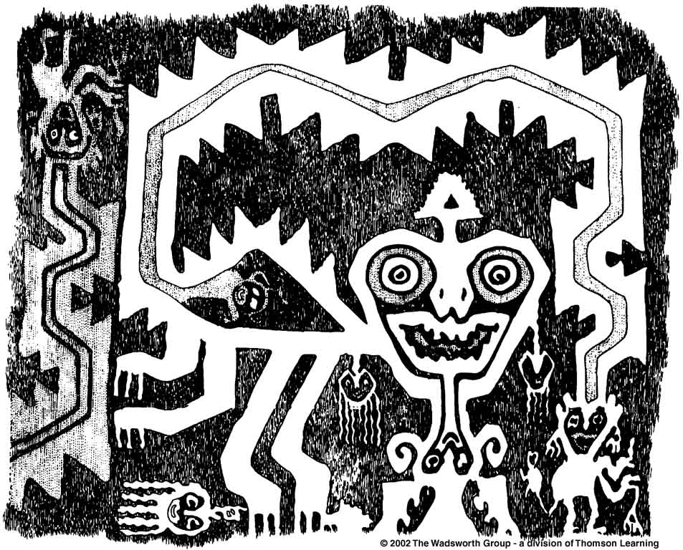
Detail of Paracas Textile, Nazca region of southern Peru.
Understanding Physical Anthropology and Archaeology, 8th Ed., p. 496

Slide 60
Classic Stage
Differentiation
. . . in burial goods
. . . in architecture
. . . and in the representations in art styles indicate the presence of a well-developed class stratification system

Slide 61
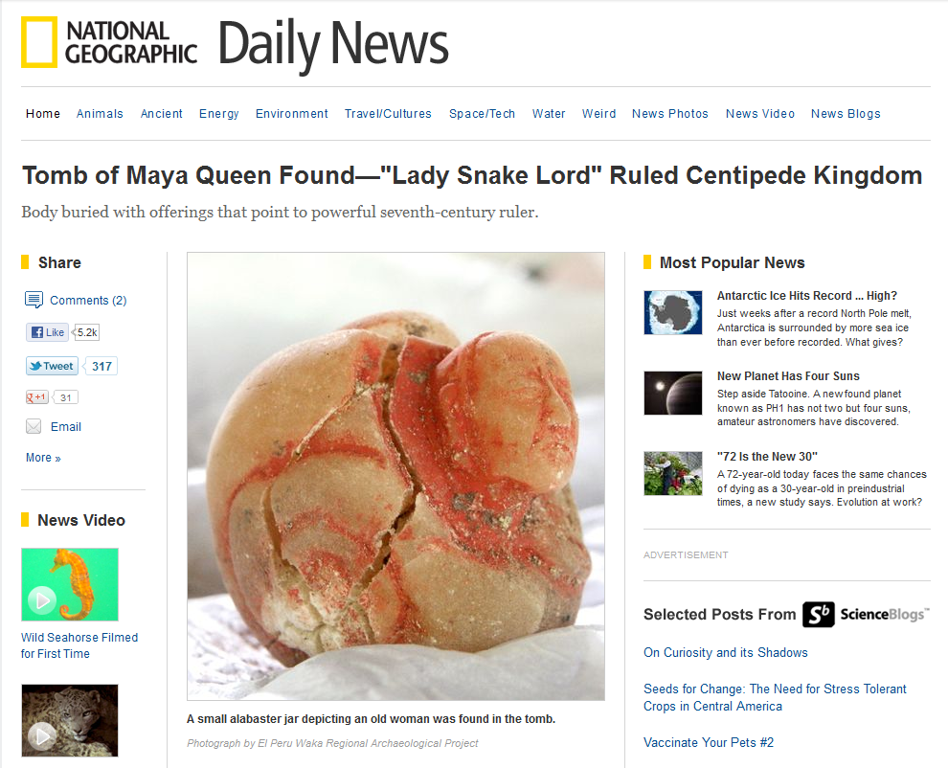
http://news.nationalgeographic.com/news/2012/10/121004-tomb-maya-warrior-queen-science-archaeology/
Notes:
61

Slide 62
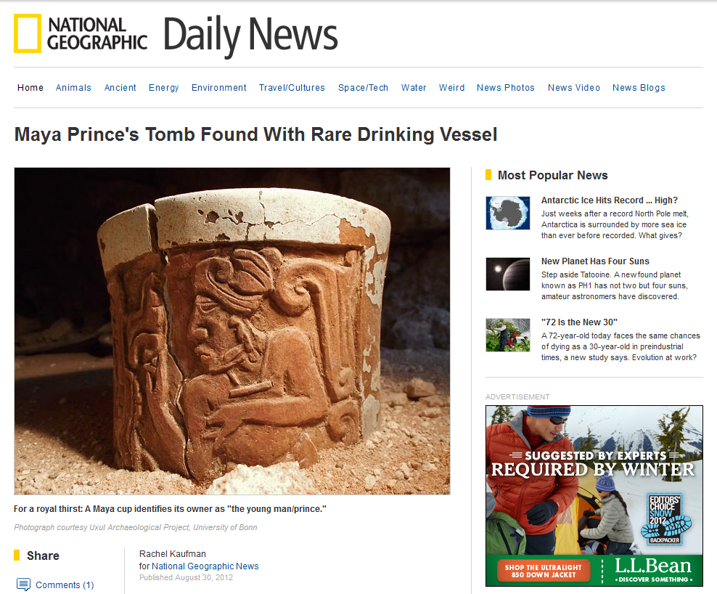
http://news.nationalgeographic.com/news/2012/08/120830-maya-prince-tomb-drinking-vessel-science/
Notes:
62

Slide 63
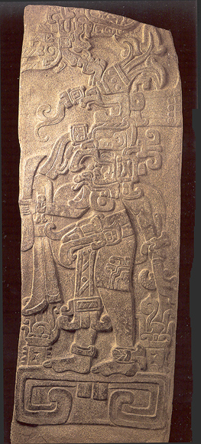
Stelae 11, Kaminaljuyú, Guatemala

Slide 64
Classic Stage
The most important aspect of the Classic Stage is the beginning of urbanism
this is the threshold of “civilization” insofar as “civilization” is defined as city life
“urbanism” and “urbanization”

Slide 65
Classic Stage
Many of the criteria for the Classic Stage are, to a large extent, qualitative and relative rather than quantitative and absolute
important things are . . .
excellence in the great arts
peak development in religious architecture
general florescence in material culture

Slide 66
Classic Stage
The Classic Stage in the New World, thus defined, is limited to
Middle America
Central Andes
Cahokia in Illinois . . .

Slide 67
Cahokia
Ecuador

Slide 68
Classic Stage
. . . there is evidence not only of the mastery of technologies and excellent arts, but these are also contained and integrated with single cultures and societies
the various and scattered inventions and innovations of the Preclassic (“Formative”) are now drawn together into rich, diverse, and yet unified patterns

Slide 69
Classic Stage
. . . the Classic is the stage of great artistic achievements insofar as greatness can be appraised not only subjectively but also by the evident time, care, and emotion devoted to the artistic products

Slide 70
Classic Stage
. . . the Classic is the stage of great artistic achievements insofar as greatness can be appraised not only subjectively but also by the evident time, care, and emotion devoted to the artistic products

Slide 71
Classic Stage
. . . it is the stage of monumental and ambitious architecture, in the form of pyramids and special buildings which seem to have been dedicated primarily to religious purposes

Slide 72
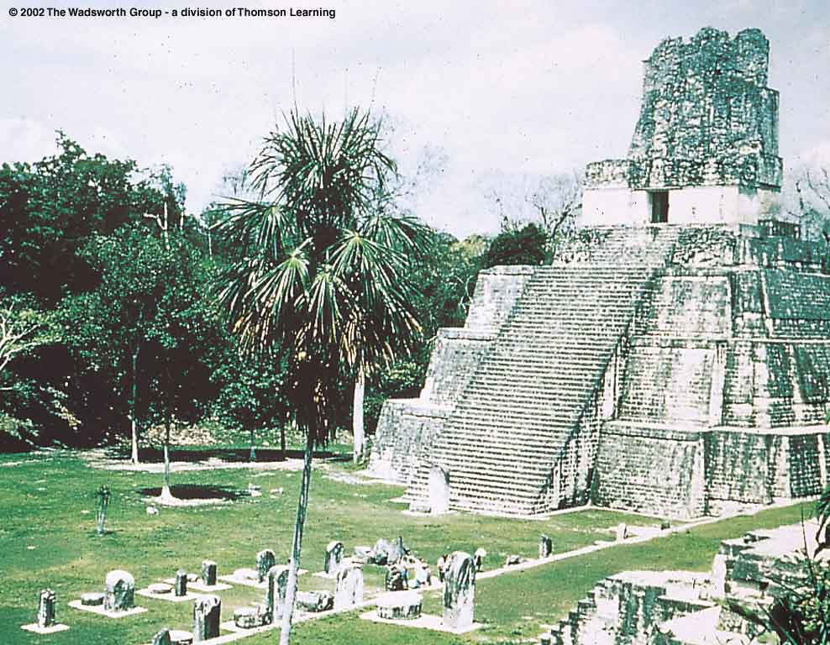
Temple pyramid, Tikál, Guatemala.
Understanding Physical Anthropology and Archaeology, 8th Ed., pp. 480, 485

Slide 73
Classic Stage
. . . fine specialized craft products designed as burial furniture, ceremonial objects, or luxury items were turned out in profusion

Slide 74
Palenque

Slide 75
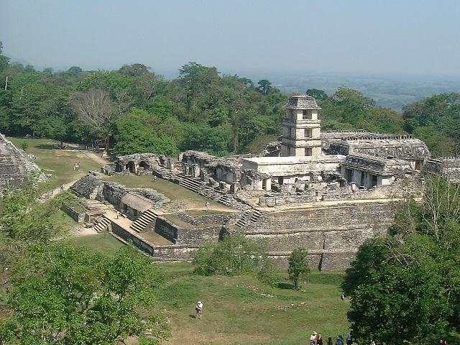
Palenque
El Palacio
http://en.wikipedia.org/wiki/Palenque

Slide 76
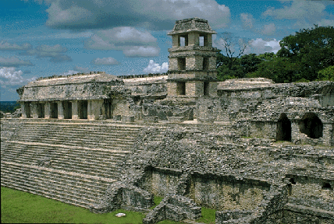
Palenque
El Palacio

Slide 77
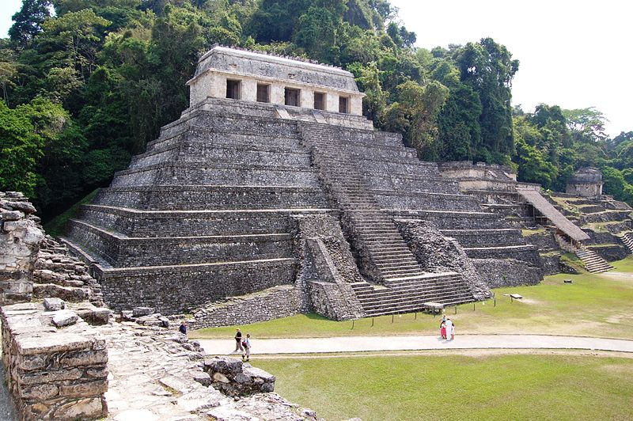
Palenque
Temple of the Inscriptions
http://commons.wikimedia.org/wiki/File:0150_Palenque.JPG

Slide 78
Tomb of Pacal, Palenque

Slide 79
Tomb of Pacal, Palenque

Slide 80
Death Mask of Pacal, Palenque
http://farm4.static.flickr.com/3622/3389197407_5226a14cf4.jpg

Slide 81
Death Mask of Pacal, Palenque

Slide 82
Upakal K'inich,
the son of K'inich Ahkal Mo' Naab III.
Palenque
http://en.wikipedia.org/wiki/File:Palenque_Relief.jpg

Slide 83
Tablet of the Sun
(cast)
Palenque
http://en.wikipedia.org/wiki/File:Palenque,_Tablet_of_the_Sun_%28Harvard_University%29.JPG

Slide 84
Palenque
http://commons.wikimedia.org/wiki/File:Mexico_palenque-temple_of_the_Count.jpg

Slide 85
Teotihuacán. Marble, Mexico Classical Period (3rd-7th century)
Wikipedia

Slide 86
Turquoise mask pendent, Mexico Classical Period (3rd-6th century)
Wikipedia

Slide 87
http://www.pasthorizonspr.com/index.php/archives/07/2012/el-zotz-masks-yield-insights-into-maya-beliefs
Notes:
87

Slide 88
Classic Stage
. . . in the Classic cultures of Middle America and Peru and Cahokia there is evidence of strong social class distinction and of heavy pomp and dignity surrounding the ruling classes

Slide 89
Maya noble, limestone relief carving, Palenque
Understanding Physical Anthropology and Archaeology, 8th Ed., p. 484

Slide 90
http://news.nationalgeographic.com/news/2005/11/1117_051117_maya_massacre.html
Notes:
90

Slide 91
Classic Stage
. . . with the perfection of writing, mathematics, and astronomy, intellectual interests as well as the arts flourished in Middle America

Slide 92
http://news.bbc.co.uk/2/hi/science/nature/5347080.stm

Slide 93
Because of its distinct elements, patterns of sequencing, and consistent reading order, the team says the text "conforms to all expectations of writing" (Image: Science)
http://news.bbc.co.uk/2/hi/science/nature/5347080.stm

Slide 94
www.livescience.com/history/080211-hs-writing.html
Notes:
94

Slide 95
www.d.umn.edu/cla/faculty/troufs/anth3618/video/Cracking_Maya_Code.html#title

Slide 96
Maya Mathematics
Understanding Physical Anthropology and Archaeology, 8th Ed., p. 487

Slide 97
Maya hieroglyphs on a stela at Copán, Honduras,
record the date and purpose of its dedication.
Understanding Physical Anthropology and Archaeology, 8th Ed., p. 486

Slide 98
Classic Stage
. . . there was also active trade between regional centers in ceremonial and luxury goods
in spite of this trade, however, it is noteworthy that a strong regional ethnocentrism is reflected in
sharply different art and architectural styles

Slide 99
Classic Stage
The Classic civilizations of Middle America were centered in
The Valley of Mexico
Oaxaca
The Guatemalan Highlands
The Petén-Usumacinta-Montagua Lowlands
Coastal Veracruz

Slide 100
Valley of Mexico
Coastal Veracruz
Petén
Maya
Oaxaca
Highland
Maya
• Kaminaljuyú

Slide 101
Classic Stage
The chronological span of the Middle American Classic Civilizations varies regionally . . . but the characteristic developments seem to have originated approximately around the beginning of the Christian era

Slide 102
Classic Stage
In short, and in general, the Classic Stages of Mesoamerica span the first Millennium A.D., or most of it . . .

Slide 103
Classic Stage
Gauging chronology by dated Maya monuments, A.D. 300 is frequently given as the starting point for the Maya Classic of the Petén
according to the 11.16.0.0.0 Goodman-Martinez-Thompson (GMT) correlations
the 12.9.0.0.0 Spinden correlation would place this date 260 years earlier
104 + 104 + 52

Slide 104
Classic Stage
Gauging chronology by dated Maya monuments, A.D. 300 is frequently given as the starting point for the Maya Classic of the Petén
according to the 11.16.0.0.0 Goodman-Martinez-Thompson (GMT) correlations
the 12.9.0.0.0 Spinden correlation would place this date 260 years earlier
104 + 104 + 52

Slide 106
Duluth Herald Tribune
Saturday, February 1, 2003, p. 2A

Slide 110
http://www.msnbc.msn.com/id/49224135/ns/technology_and_science-science/#.UH8JyGPzjgd

Slide 111
Sacred Ritual Calendar
Secular Calendar

Slide 115
Classic Stage
?
Radiocarbon dates favor the Spinden 12.9.0.0.0 correlation
(Kulp, Feely, and Tryon, 1951)

Slide 116
Classic Stage
Radiocarbon dates on the Late Preclassic phases in the valley of Mexico indicate that the Teotihuacán region had its Classic inception about contemporaneously
or only a little earlier than the A.D. 300 (11.6.0.0.0) correlation date
A.D. 150

Slide 117
Classic Stage
Radiocarbon dates on the Late Preclassic phases in the valley of Mexico indicate that the Teotihuacán region had its Classic inception about contemporaneously
or only a little earlier than the A.D. 300 (11.6.0.0.0) correlation date
A.D. 150

Slide 119
Classic Stage
“Comparisons with the Monte Albán sequences in Oaxaca and the Kaminaljuyú sequences of the Guatemalan highlands suggests that the high point of the Zapotecan culture in Oaxaca and the highland Maya traditions are roughly coeval with the central Mexican highland and the Maya lowland Classic cultures in the Petén.”
Read this . . .

Slide 120
Classic Stage
“Comparisons with the Monte Albán sequences in Oaxaca and the Kaminaljuyú sequences of the Guatemalan highlands suggests that the high point of the Zapotecan culture in Oaxaca and the highland Maya traditions are roughly coeval with the central Mexican highland and the Maya lowland Classic cultures in the Petén.”

Slide 121
Classic Stage
“Comparisons with the Monte Albán sequences in Oaxaca and the Kaminaljuyú sequences of the Guatemalan highlands suggests that the high point of the Zapotecan culture in Oaxaca and the highland Maya traditions are roughly coeval with the central Mexican highland and the Maya lowland Classic cultures in the Petén.”
What the heck does that mean?

Slide 122
Teotihuacán
Petén
Maya
Zapotec
Highland
Maya
• Kaminaljuyú

Slide 123
Classic Stage
El Tajín Totonac of central Veracruz is, perhaps, slightly later (A.D. 600 – 900) than the Mexican Highland area

Slide 124
Teotihuacán
El Tajín
Totonac
Petén
Maya
Zapotec
Highland
Maya
• Kaminaljuyú

Slide 125
Classic Stage
The Middle Tres Zapotes phase of the Olmec regional cultural tradition of southern Veracruz and Tabasco -- is earlier than some of the other Classic developments

Slide 126
Classic Stage
The Middle Tres Zapotes phase of the Olmec regional cultural tradition of southern Veracruz and Tabasco -- is earlier than some of the other Classic developments

Slide 127
Teotihuacán
El Tajín
Totonac
Petén
Maya
Zapotec
Olmec
Highland
Maya
• Kaminaljuyú

Slide 128
http://en.wikipedia.org/wiki/Teotihuacan

Slide 129
Classic Stage
The terminal dates of the Middle American Classic cultures coincide rather closely
the figure of A.D. 900 (11.16.0.0.0 correlation) is one postulated as the closing date for the Maya Lowland Classic
A.D. 650 (12.9.0.0.0) is another

Slide 130
Classic Stage
The terminal dates of the Middle American Classic cultures coincide rather closely
the figure of A.D. 900 (11.16.0.0.0 correlation) is one postulated as the closing date for the Maya Lowland Classic
A.D. 650 (12.9.0.0.0) is another

Slide 131
Classic Stage
The Tlamimilolpa phase of the Mexican Highland Classic may have closed prior to the collapse of the great Lowland Maya ceremonial centers, or it may have run contemporaneously with them
a reasonable estimate of the fall of Teotihuacán is about A.D. 700
(or A.D. 600)

Slide 132
Classic Stage
The Tlamimilolpa phase of the Mexican Highland Classic may have closed prior to the collapse of the great Lowland Maya ceremonial centers, or it may have run contemporaneously with them
a reasonable estimate of the fall of Teotihuacán is about A.D. 700 (or A.D. 600)

Slide 134
Classic Maya
The Classic Culture of the Maya begins with the occurrence of
the Maya corbelled vault
the initial series dates and stelae
the ornate and unique Maya art style as it is expressed in both sculpture and painted pottery

Slide 135
Classic Maya
The Classic Culture of the Maya begins with the occurrence of
the Maya corbelled vault
the initial series dates and stelae
the ornate and unique Maya art style as it is expressed in both sculpture and painted pottery

Slide 136
http://americanindian.net/mayac.html

Slide 138
“true arch”
has a “capstone”

Slide 139
Classic Maya
The Classic Culture of the Maya begins with the occurrence of
the Maya corbelled vault
the initial series dates and stelae
the ornate and unique Maya art style as it is expressed in both sculpture and painted pottery

Slide 140
http://www.halfmoon.org/calendar.html

Slide 141
Classic Maya
The Classic Culture of the Maya begins with the occurrence of
the Maya corbelled vault
the initial series dates and stelae
the ornate and unique Maya art style as it is expressed in both sculpture and painted pottery

Slide 142
This classic Maya cylindrical jar with bird motif and glyphs
^{was used in ceremonies.}
Understanding Physical Anthropology and Archaeology, 8th Ed., p. 486

Slide 143
Classic Maya
The first appearance of this complex is in the Petén
it probably evolved internally in this locality or in a nearby region

Slide 144
Classic Maya
During the early part of the Maya Classic (the Tzakol phase) ceremonial centers with stelae and characteristic art were first constructed in the central Petén (Uxactún, Yucatán)
from here the Classic features spread to other parts of Yucatán and then to Copán in Honduras

Slide 145
Classic Maya
During the early part of the Maya Classic (the Tzakol phase) ceremonial centers with stelae and characteristic art were first constructed in the central Petén (Uxactún, Yucatán)
from here the Classic features spread to other parts of Yucatán and then to Copán in Honduras

Slide 146
Petén
Maya
• Kaminaljuyú

Slide 147
Classic Maya
somewhat later, the great sites of Yaxchilán and Piedras Negras were established on the Usumacinta drainage area to the West

Slide 148
Classic Maya
somewhat later, the great sites of Yaxchilán and Piedras Negras were established on the Usumacinta drainage area to the West

Slide 149
Petén
Maya
• Kaminaljuyú

Slide 150
Petén
Maya
• Kaminaljuyú

Slide 155
Classic Monte Albán
At Monte Albán the first major development of Classic culture began with Monte Albán IIIa

Slide 156
Petén
Maya
IIIa
• Kaminaljuyú

Slide 157
Classic Highland Maya
In Guatemala City, Kaminaljuyú joined the Classic with the Esperanza phase

Slide 158
Petén
Maya
Esperanza
• Kaminaljuyú

Slide 159
Classic Stage
Except for some pottery and a few items of architectural detail
the Tzakol Maya Classic of the Petén
Classic Teotihuacán II-III
Monte Albán IIIa, and
the Classic Esperanza phase of Highland Guatemala
are alike only in that each expresses vigorous regional-cultural traditions at this time

Slide 160
Classic Stage
Except for some pottery and a few items of architectural detail
the Tzakol Maya Classic of the Petén
Classic Teotihuacán II-III
Monte Albán IIIa, and
the Classic Esperanza phase of Highland Guatemala
are alike only in that each expresses vigorous regional-cultural traditions at this time

Slide 161
Classic Maya
all of the art styles are unlike
certain gods, or god-themes, seem to have been held in common by some of these cultures, but the particular expressions are quite different

Slide 162
Classic Maya
all of the art styles are unlike
certain gods, or god-themes, seem to have been held in common by some of these cultures, but the particular expressions are quite different

Slide 163
Classic Maya
all of the art styles are unlike
certain gods, or god-themes, seem to have been held in common by some of these cultures, but the particular expressions are quite different

Slide 164
Quetzalcoatl
also known as the Feathered Serpent; a deity representing good, appears at Teotihuacán
Understanding Physical Anthropology and Archaeology, 8th Ed., p. 489

Slide 165
Teotihuacán

Slide 166
Classic Maya
Monte Albán and Mitla shared the trait of writing with the lowland Maya, but their glyphic system is distinct and less developed

Slide 167
Classic Maya
Monte Albán and Mitla shared
the trait of writing with the lowland Maya, but their glyphic system is distinct and less developed
Zapotec
Mixtec
Zapotec

Slide 168
Zapotec
Mixtec

Slide 169
Mixtec Codex
www.famsi.org/research/pohl/jpcodices/selden/scene_by_scene.htm

Slide 170
Eight Deer Ocelot Claw, Mixtec
www.newodysseyart.co.uk/mixtec_king_print.html

Slide 171
Eight Deer and Twelve Lizzard, Mixtec
http://pages.prodigy.net/gbonline/awmixtec.html

Slide 172
Classic Maya
competence in sculptural art was a feature of both the Maya and the Olmec, but was less characteristic of other Classic phases

Slide 173
Classic Stage
Two fundamental forces were at work in or among these Classic cultures
intercommunication existed among them and was an important factor in their growth
the cultures benefited from being a part of a larger community of ideas more than did the various cultures of the Mesoamerican Formative

Slide 174
Classic Stage
Two fundamental forces were at work in or among these Classic cultures
intercommunication existed among them and was an important factor in their growth
the cultures benefited from being a part of a larger community of ideas more than did the various cultures of the Mesoamerican Formative

Slide 175
Classic Stage
idea systems remained regionalized in spite of the exchange of technologies, elements, goods and ideas
that is, they continued to have stylistic regionalism

Slide 176
Classic Stage
idea systems remained regionalized in spite of the exchange of technologies, elements, goods and ideas
that is, they continued to have stylistic regionalism

Slide 177
Late Classic Lowland Maya
In the Late Classic of the Maya Lowlands (Tepeu phase) the number of active ceremonial centers increased greatly
they undertook huge building programs
as in the Earlier Classic (and the Late Formative) phases, the constructions were flat-topped pyramids and platforms grouped around rectangular courtyards or plazas

Slide 178
Late Classic Lowland Maya
In the Late Classic of the Maya Lowlands (Tepeu phase) the number of active ceremonial centers increased greatly
they undertook huge building programs
as in the Earlier Classic (and the Late Formative) phases, the constructions were flat-topped pyramids and platforms grouped around rectangular courtyards or plazas

Slide 179
Late Classic Lowland Maya
temples and palaces were elaborately carved and decorated with sculptures
in the Late Classic the “palace” type of building became somewhat more common than in earlier time
these palace type buildings generally contained more rooms and were situated upon a lower platform than a temple

Slide 180
Late Classic Lowland Maya
temples and palaces were elaborately carved and decorated with sculptures
in the Late Classic the “palace” type of building became somewhat more common than in earlier time
these palace type buildings generally contained more rooms and were situated upon a lower platform than a temple

Slide 181
Palace of the Governor, Uxmal
http://www.anthroarcheart.org/tblf37.htm

Slide 182
Uxmal

Slide 183
Late Classic Lowland Maya
the Maya centers were the integrating points in the network of Maya culture, including the focal points of ritual and ceremony

Slide 184
Late Classic Lowland Maya
the function of the Maya centers seems to have been largely religious and ceremonial
these centers were the integrating points in the network of Maya culture

Slide 185
Late Classic Lowland Maya
the peasantry of the agricultural societies gathered in these centers to be instructed and inspired by the priest-leaders

Slide 186
Late Classic Lowland Maya
the Maya aristocracy seemed to regulate agriculture, and were the guardians of the seasons of the year
some think they did this with mutual faith with the peasantry rather than by force

Slide 187
www.msnbc.msn.com/id/23374053/
Notes:
187

Slide 188
Late Classic Lowland Maya
the Maya aristocracy seemed to regulate agriculture, and were the guardians of the seasons of the year
this maintained the Maya culture, and when this mutual faith was destroyed or dissolved the Classic Maya society collapsed

Slide 189
http://news.nationalgeographic.com/news/2005/11/1117_051117_maya_massacre.html

Slide 190
Decline of the Classic
The decline and abandonment of the Classic Maya centers occurred about A.D. 900
it was probably preceded by the decline of the other regional Classic Cultures

Slide 191
Decline of the Classic
The decline and abandonment of the Classic Maya centers occurred about A.D. 900
it was probably preceded by the decline of the other regional Classic Cultures

Slide 193
Decline of the Classic
In A.D. 761 the king of Dos Pilas is captured and killed, and from that point on there are no more hieroglyphic inscriptions at Dos Pilas
A.D. 799 is the last written date at Palenque
A.D. 819, 20 years later, Copán falls silent
A.D. 859 Caracol stops recording
A.D. 879 Tikál stops recording

Slide 194
Decline of the Classic
In A.D. 761 the king of Dos Pilas is captured and killed, and from that point on there are no more hieroglyphic inscriptions at Dos Pilas
A.D. 799 is the last written date at Palenque
A.D. 819, 20 years later, Copán falls silent
A.D. 859 Caracol stops recording
A.D. 879 Tikál stops recording

Slide 195
Decline of the Classic
Only a handful of sites in the southern Mayan area survived into the 10th century A.D.
the northern cities of the Yucatán peninsula, places like Uxmal, Chichén Itzá . . . lasted a few hundred years longer, but they were no longer ruled by divine kings

Slide 196
Decline of the Classic
Only a handful of sites in the southern Mayan area survived into the 10th century A.D.
the northern cities of the Yucatán peninsula, places like Uxmal, Chichén Itzá . . . lasted a few hundred years longer, but they were no longer ruled by divine kings

Slide 197
Decline of the Classic
gradually the old way
of building, and writing,
and worshipping
slipped away

Slide 198
Decline of the Classic
Teotihuacán appears to have been destroyed in the second half of the first millennium A.D.,
about A.D. 650 or 700
probably by the invaders identified with the Tula – Toltec culture
bearers of the same Tula – Toltec culture moved into other parts of Mesoamerica at this same time or shortly after

Slide 199
www.eurekalert.org/pub_releases/2004-12/asu-sbd120204.php
Notes:
199

Slide 200
http://www.livescience.com/17474-ancient-offering-discovered-pyramid.html
Notes:
200

Slide 201
Decline of the Classic
The breakdown of the old Classic regional states may -- in part -- be attributed to
the invaders from the Tula – Toltec culture
or to the waves of social and political disruption and dislocation which they set in motion on the Chichimec frontier

Slide 202
Decline of the Classic
Or the breakdown may have been caused by
overpopulation
the presence of steadily increasing populations, coupled with . . .
soil depletion caused by over-farming

Slide 203
Decline of the Classic
At Teotihuacán, the population was more densely massed around it in the Teotihuacán IV phase than in the preceding Teotihuacán II and III phases

Slide 204
Decline of the Classic
At Teotihuacán, the population was more densely massed around it in the Teotihuacán IV phase than in the preceding Teotihuacán II and III phases

Slide 205
Coe and Koontz, Mexico: From the Olmecs to the Aztecs, 6th Ed., 2008, p. 236

Slide 206
Decline of the Classic
In the Maya Lowlands more ceremonial centers were constructed in the later part of the Classic than in the earlier centuries
this suggests an overall population increase for the Petén

Slide 207
Decline of the Classic
For whatever reason, the Classic
comes to an end about A.D. 900
with a breakdown of the greater traditions and shifting populations

Slide 208
Decline of the Classic
For whatever reason, the Classic
comes to an end about A.D. 900
with a breakdown of the greater traditions and shifting populations

Slide 209
Classic Stage
Terminal Classic
Late Classic
Early Classic

Slide 210
Classic Stage
Terminal Classic
Late Classic
Early Classic

Slide 212
Early Classic Stage
A.D. 250 – 600 (The Maya)
A.D. 150 – 600 (Mexico)
Characterized by. . .

Slide 214
Early Classic Stage
Central Highlands sites include:
Teotihuacán III (Xolalpan-Tlamimilolpa)
Teotihuacán II (Miccaotli)

Slide 215
Early Classic Stage
North and Central Gulf sites include:
Late Remojadas
Classic Veracruz

Slide 216
Early Classic Stage
Southern Gulf Coast sites include:
Cerro de las Mesas
Late Tres Zapotes

Slide 217
Early Classic Stage
Oaxaca sites include:
Monte Albán III-A

Slide 218
Early Classic Stage
Southern Pacific Coast sites include:
Tiquisate

Slide 219
Early Classic Stage
Southern Maya Highlands sites include:
Esperanza

Slide 220
Early Classic Stage
Central Maya sites include:
Tzakol III
Tzakol II
Tzakol I

Slide 221
Early Classic Stage
Northern Maya sites include:
Regional Styles, Acanceh

Slide 222
Late Classic Stage
Terminal Classic
Late Classic
Early Classic

Slide 223
Apocalypto
by Mel Gibson

Slide 224
Late Classic Stage
A.D. 600 – 800 (The Maya)
A.D. 600 – 900 (Mexico)
Characterized by. . .

Slide 226
Late Classic Stage
Central Highlands sites include:
Coyotlatelco
Metepec

Slide 227
Late Classic Stage
North and Central Gulf sites include:
El Tajín
Late Remojadas (continued)
Classic Veracruz (continued)

Slide 228
Late Classic Stage
Southern Gulf sites include:
Villa Alta

Slide 229
Late Classic Stage
Oaxaca sites include:
Monte Albán IV
Monte Albán III-B

Slide 230
Late Classic Stage
Southern Pacific Coast sites include:
NA

Slide 231
Late Classic Stage
Southern Maya Highlands sites include:
Amatle - Pamplona

Slide 232
Late Classic Stage
Central Maya sites include:
Tepeu 2
Tepeu 1

Slide 233
Late Classic Stage
Northern Maya sites include:
Early Koba

Slide 234
Terminal Classic Stage
Terminal Classic
Middle Classic
Early Classic

Slide 236
Terminal Classic Stage
A.D. 800 – 925 (The Maya)
NA (Mexico)
Characterized by . . .

Slide 238
Terminal Classic Stage
xxx
xxx

Slide 239
Terminal Classic Stage
Central Highlands sites include:
NA

Slide 240
Terminal Classic Stage
North and Central Gulf sites include:
NA

Slide 241
Terminal Classic Stage
Southern Gulf sites include:
NA

Slide 242
Terminal Classic Stage
Oaxaca sites include:
NA

Slide 243
Terminal Classic Stage
Southern Pacific Coast sites include:
Cotzumalhuapa

Slide 244
Terminal Classic Stage
Southern Maya Highlands sites include:
Quen Santo

Slide 245
Terminal Classic Stage
Central Maya sites include:
Bayal / Tepeu 3

Slide 246
Terminal Classic Stage
Northern Maya sites include:
Puuk
Maya Chichén Itzá

Slide 247
What happens next?

Slide 248
Class Handout:
Class Handout

Slide 249
And after that?

Slide 251
Class Handout:
Class Handout

Slide 252
And the next thing
you know . . .

Slide 253
www.cnn.com/2004/WORLD/americas/09/11/mexico.walmart.reut/
Notes:
253

Slide 254
Overall Review

Slide 255
Understanding Physical Anthropology and Archaeology, 11th Ed., p. 393

Slide 256
Understanding Physical Anthropology and Archaeology, 11th Ed., p. 393

Slide 257
Understanding Physical Anthropology and Archaeology, 11th Ed., p. 393

Slide 258
Understanding Physical Anthropology and Archaeology, 11th Ed., p. 393

Slide 259
Understanding Physical Anthropology and Archaeology, 11th Ed., p. 393

Slide 260
Understanding Physical Anthropology and Archaeology, 11th Ed., p. 393

Slide 261
Understanding Physical Anthropology and Archaeology, 8th Ed., p. 479

Slide 262
Understanding Physical Anthropology and Archaeology, 11th Ed., p. 393

