Slide 1
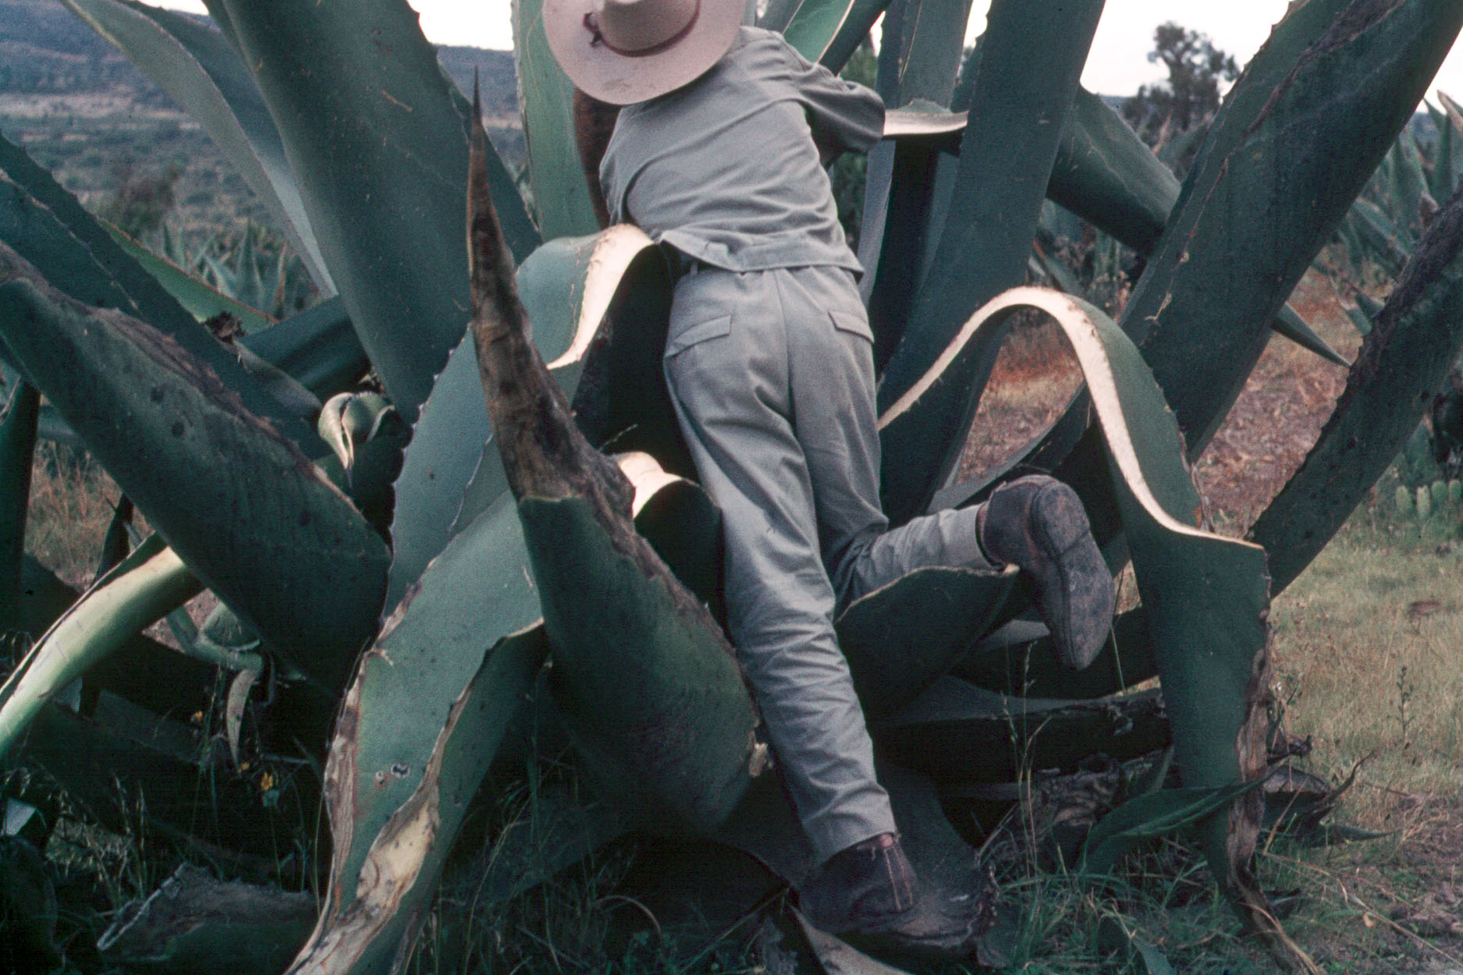
Tepeapulco,
Hidalgo
Tim Roufs
© 2010-2019
University of Minnesota Duluth

Slide 2
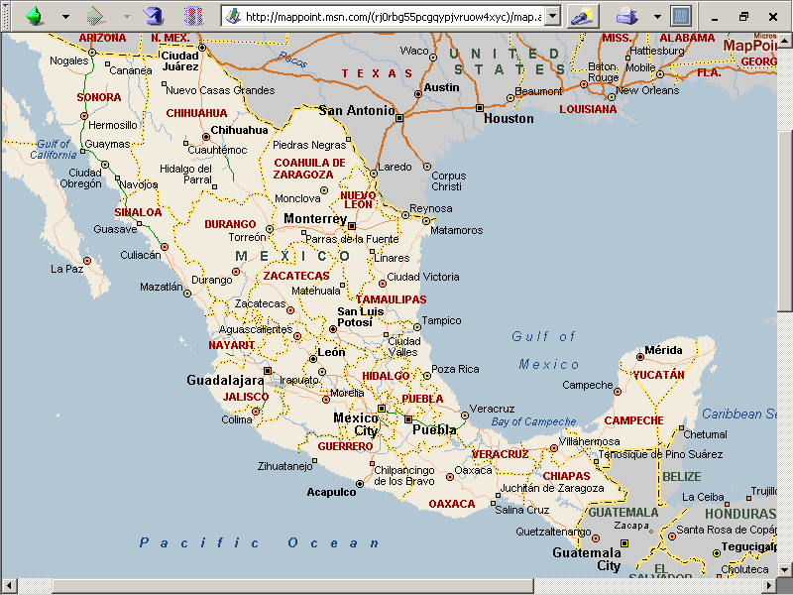
State of Hidalgo

Slide 3
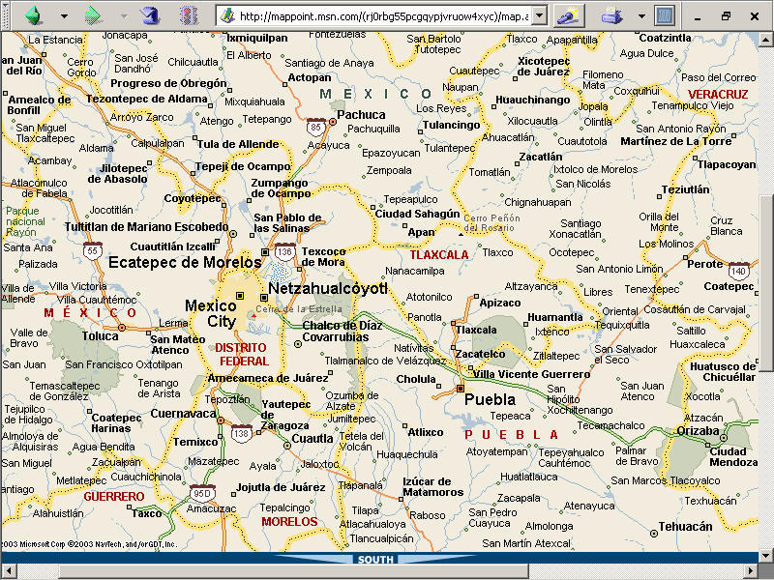

Slide 4
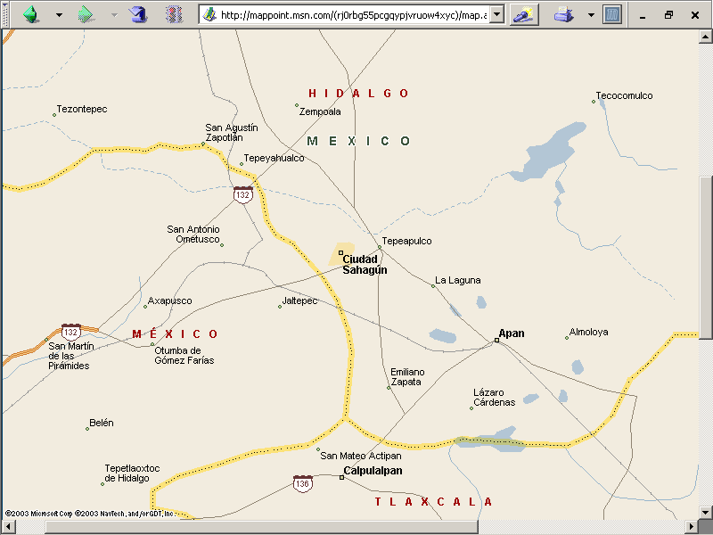


Slide 5
aka
“century
plant”
maguey
cactus
tlachiquero
(Soltero Dorantz)
Los Cides, Hidalgo, Mexico

Slide 6


Slide 7


Slide 8
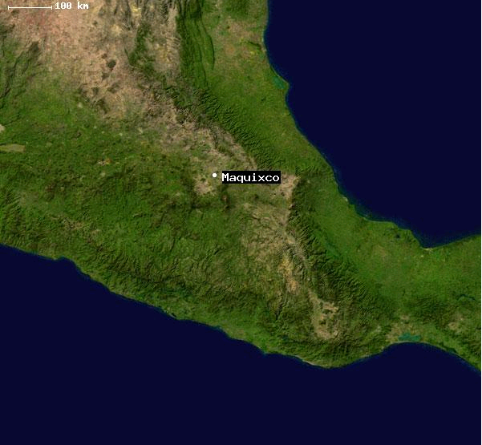
Santa Maria Maquixco, Mexico, Mexico
is situated in Temascalapa, Mexico, Mexico, its geographical coordinates are 19° 47' 0" North,
98° 50' 0" West and its original nameis Santa María Maquixco.

Slide 9
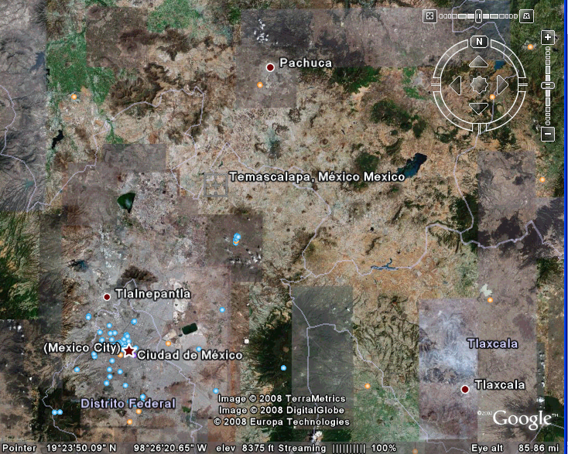
Santa Maria Maquixco, Mexico, Mexico
is situated in Temascalapa, Mexico, Mexico, its geographical coordinates are 19° 47' 0" North,
98° 50' 0" West and its original nameis Santa María Maquixco.

Slide 10
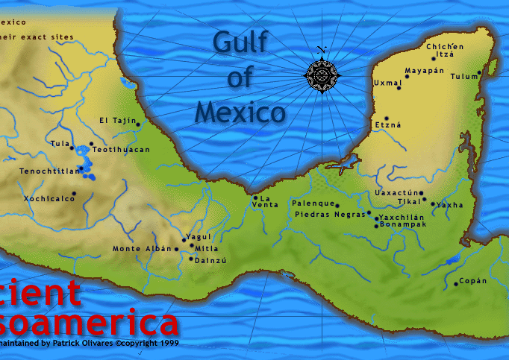

Slide 13
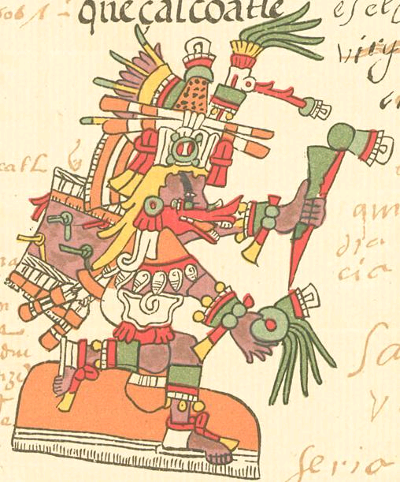
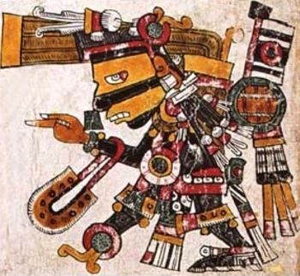
Quetzalcoatl
as depicted in the Codex Telleriano-Remensis
Tezcatlipoca
as depicted in the Codex Borgia.

Slide 14
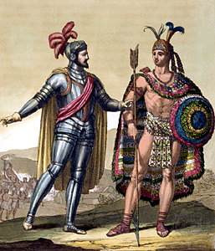
Quetzalcoatl
as depicted in the Codex Telleriano-Remensis
Hernán Cortés with Montezuma II

Slide 15
maguey
cactus
tlachiquero
(Soltero Dorantz)
Los Cides, Hidalgo, Mexico

Slide 16
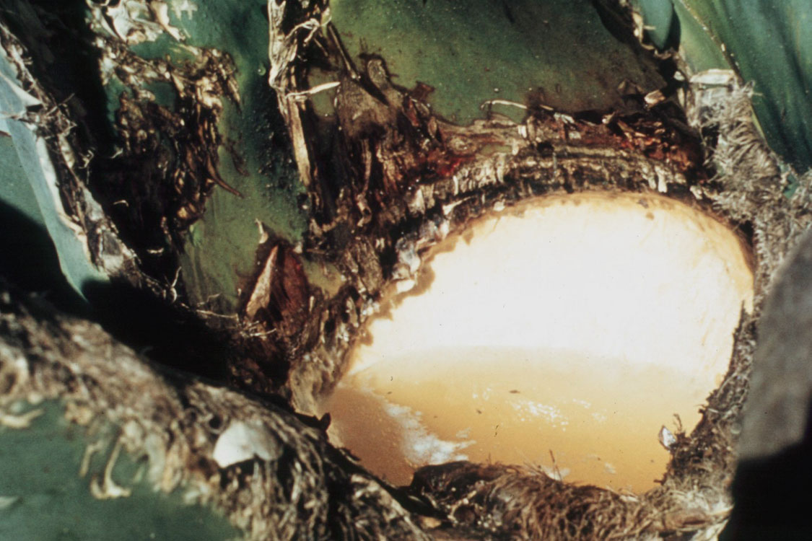
agua miel

Slide 17
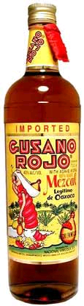
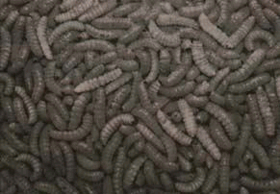
Gusanos de maguey

Slide 18
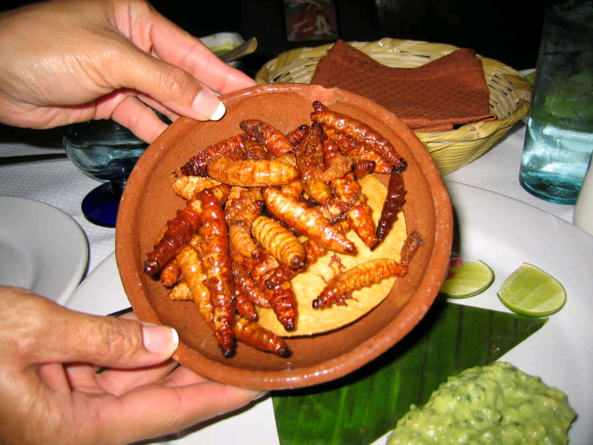
Gusanos de maguey

Slide 19
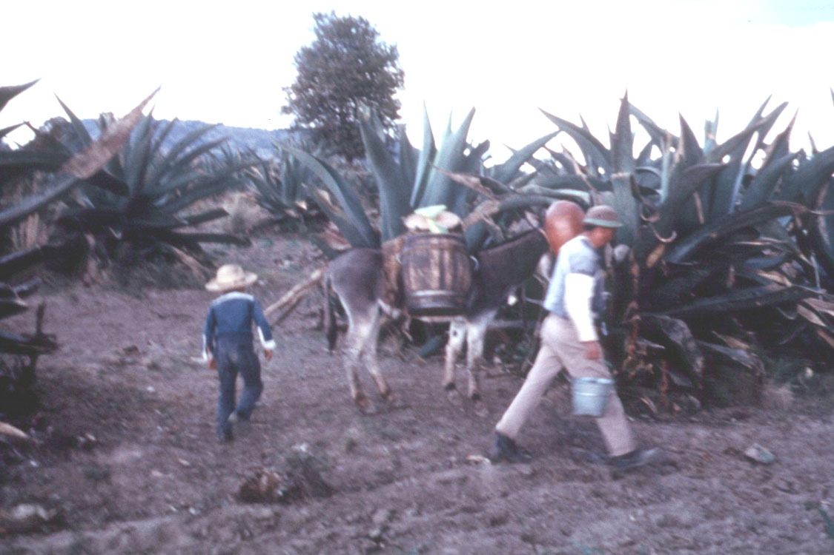
Los Cides, Hidalgo, Mexico

Slide 21
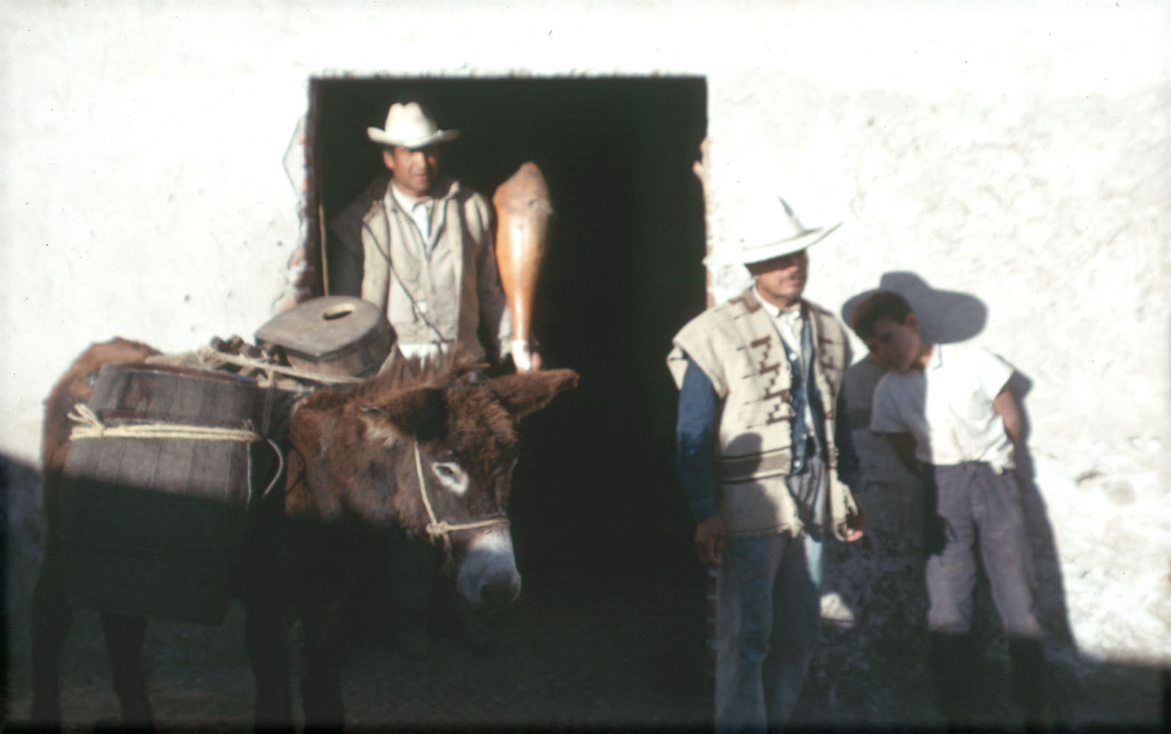
acocote
Los Cides, Hidalgo, Mexico

Slide 22
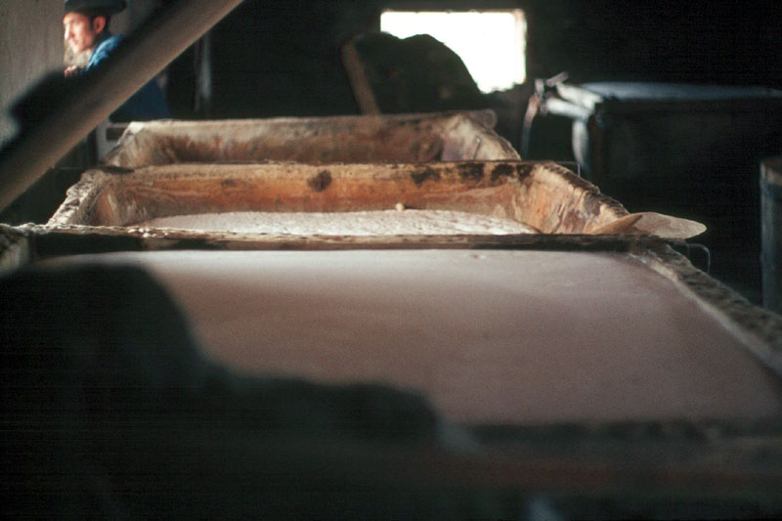
tinacal
tina
pulque
Tinacal at Los Cides, Hidalgo, Mexico

Slide 23
Maquixco, Edo. Méx.
Tinacal at Los Cides, Hidalgo, Mexico

Slide 24
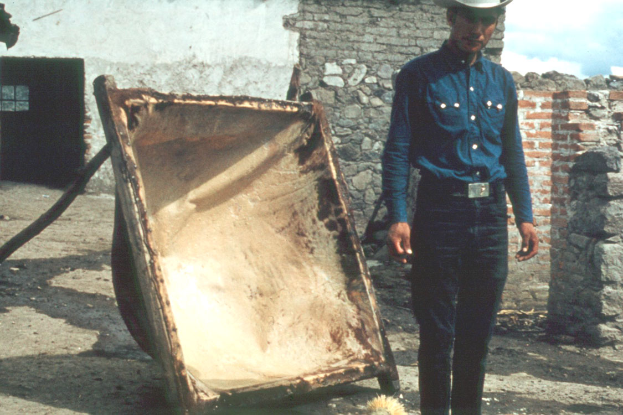
tina
Los Cides, Hidalgo, Mexico

Slide 25
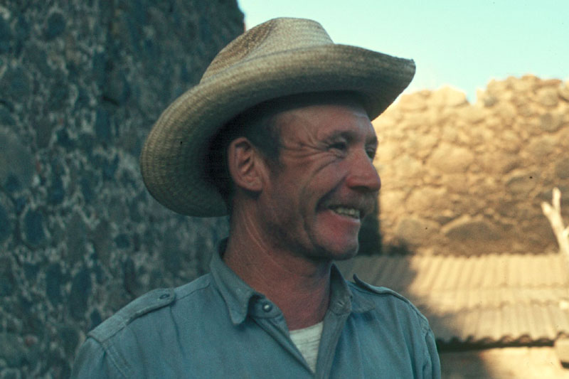
Tlachiquero, Los Cides, Hidalgo, Mexico

Slide 26
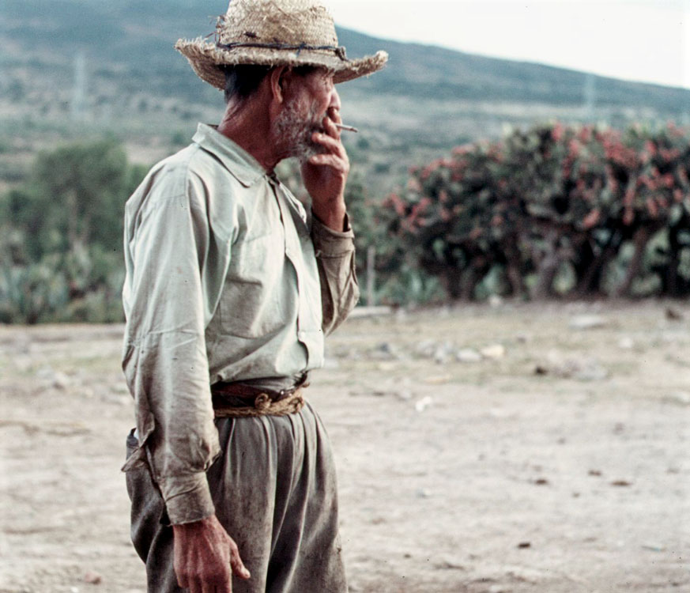
Tlachiquero, Los Cides, Hidalgo, Mexico

Slide 27
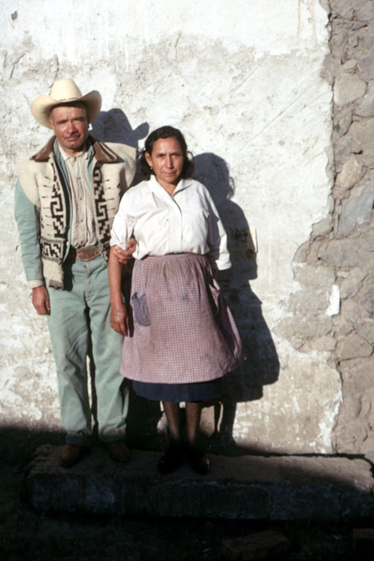
Tinacalero and Wife, Los Cides, Hidalgo, Mexico

Slide 28
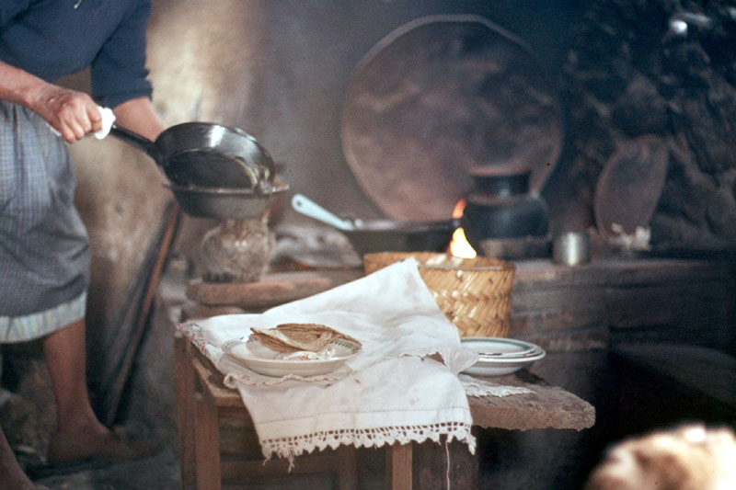
Tinacaleros, Los Cides, Hidalgo, Mexico

Slide 29
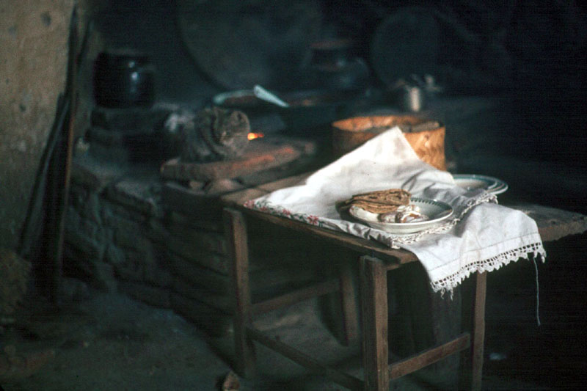
Tinacaleros, Los Cides, Hidalgo, Mexico

Slide 30
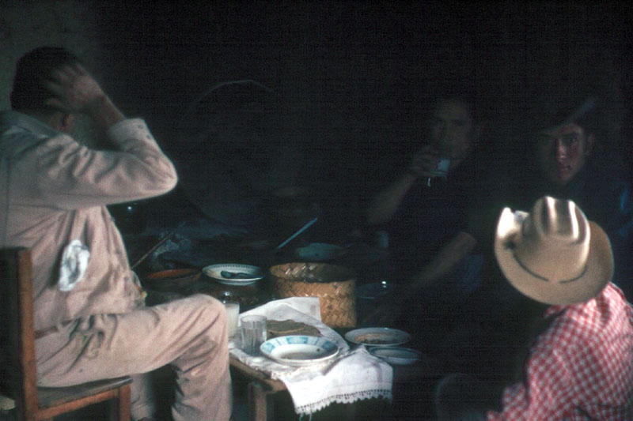
Tinacaleros, Los Cides, Hidalgo, Mexico

Slide 31
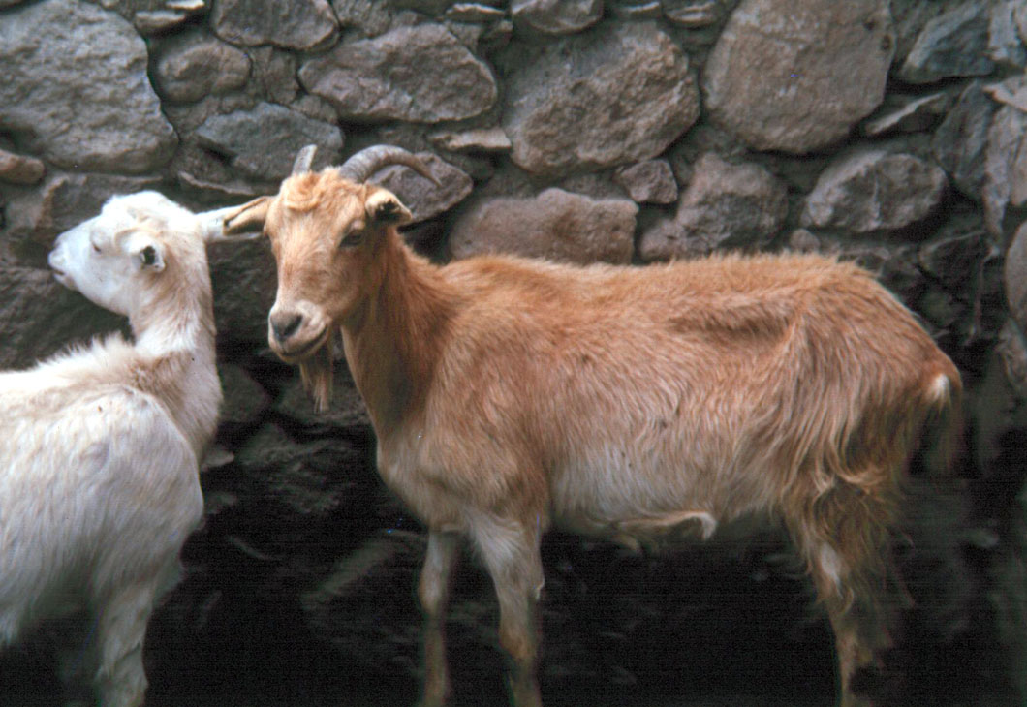
Los Cides, Hidalgo, Mexico

Slide 32
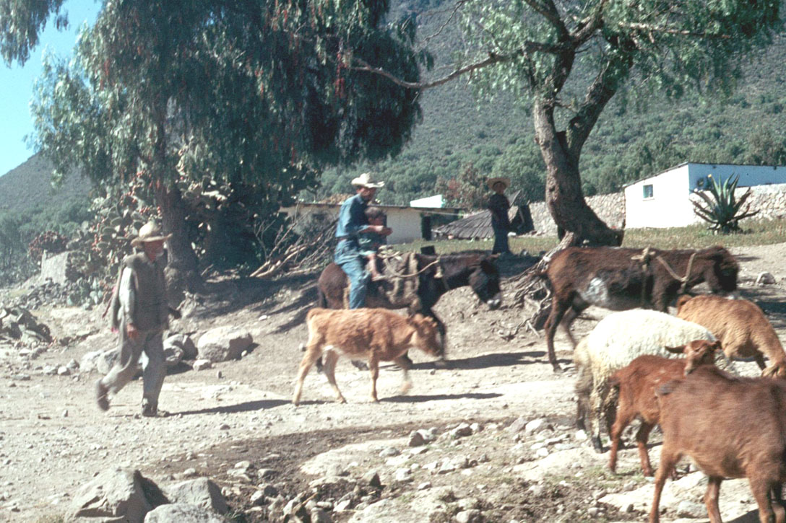
Tlachiqueros, Los Cides, Hidalgo, Mexico

Slide 33
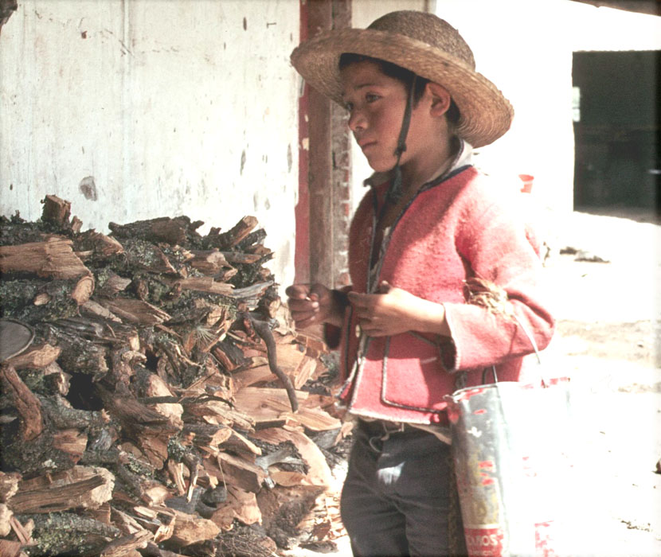
Los Cides, Hidalgo, Mexico

Slide 34
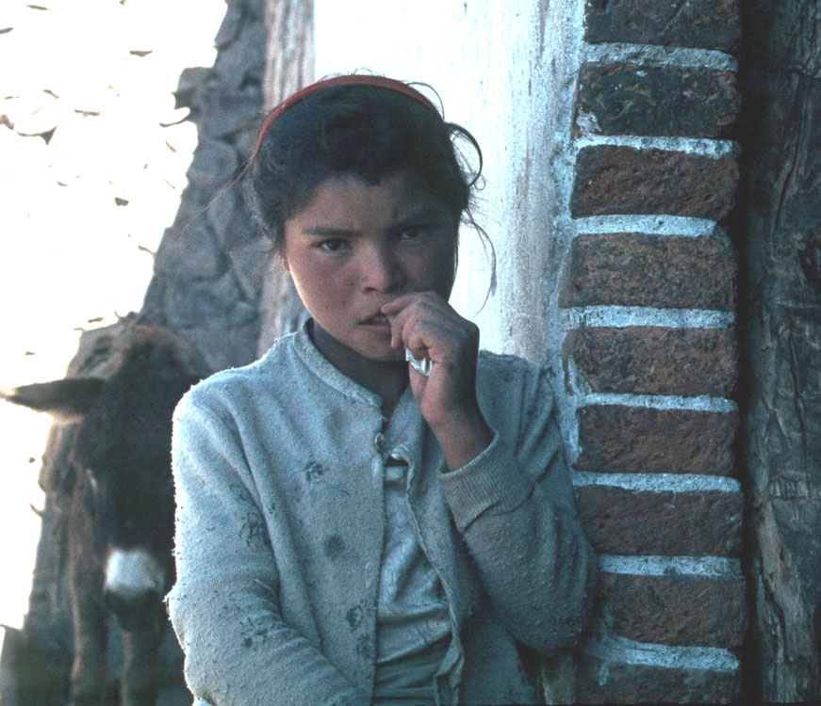
Los Cides, Hidalgo, Mexico

Slide 35
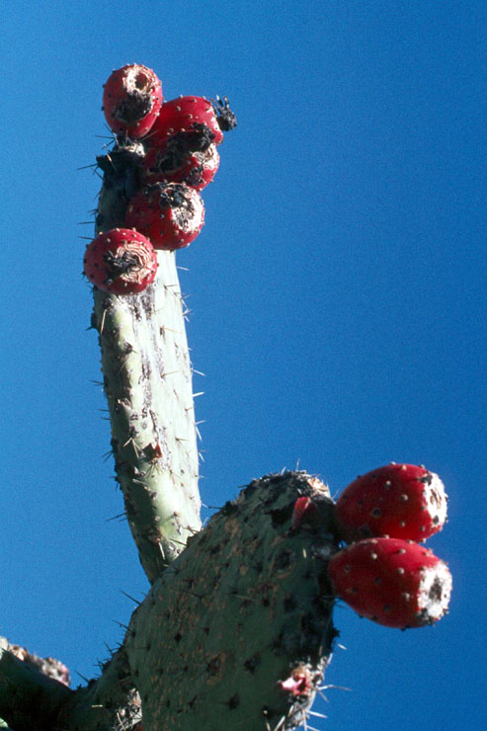
Nopale Cactus and Tunas, Hidalgo, Mexico

Slide 36
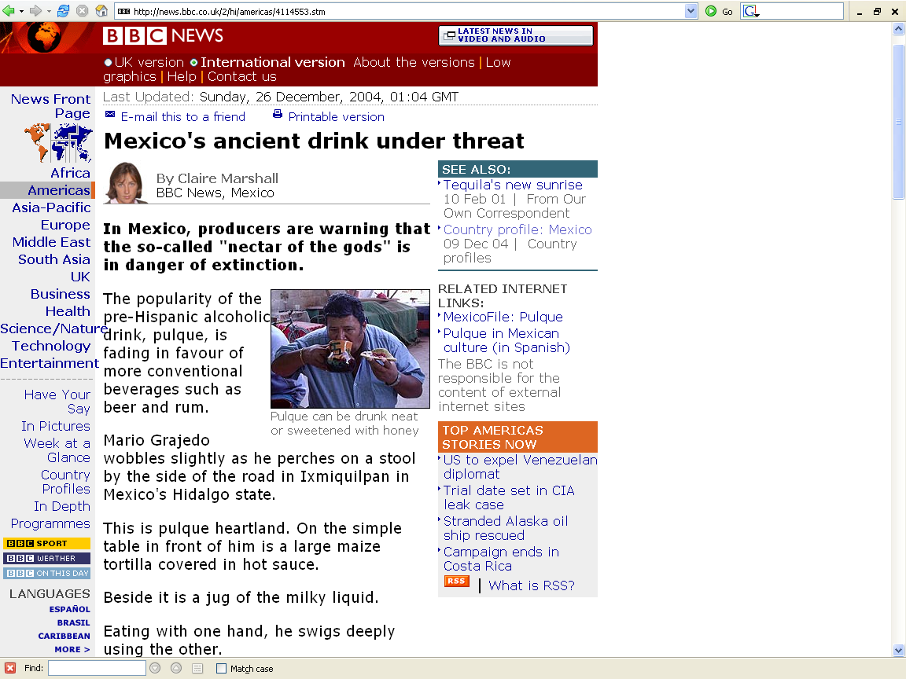
http://news.bbc.co.uk/2/hi/americas/4114553.stm

Slide 37
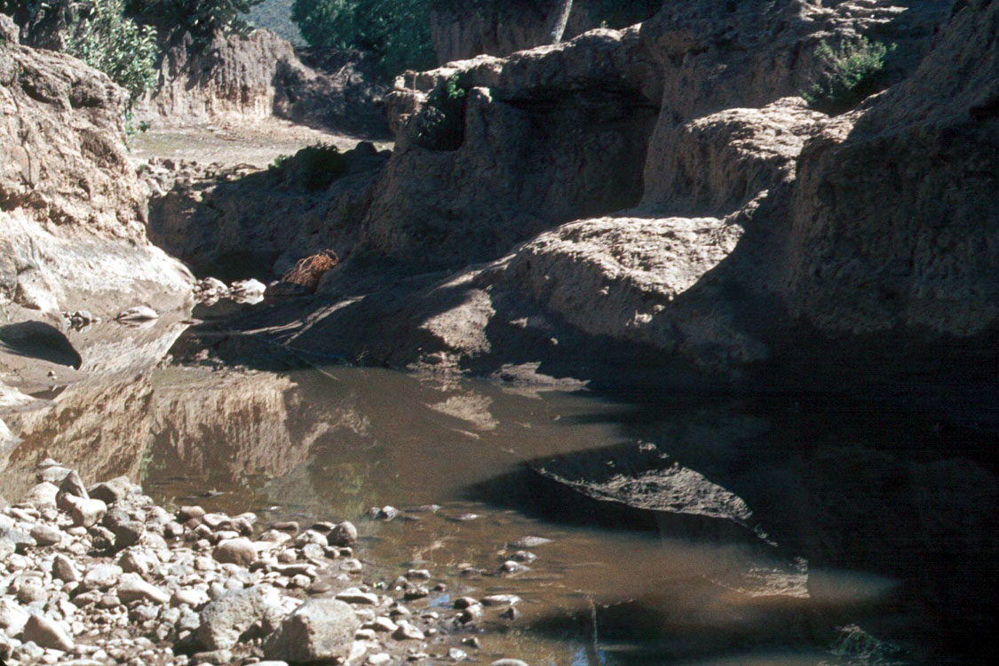
Los Cides, Hidalgo, Mexico

Slide 38
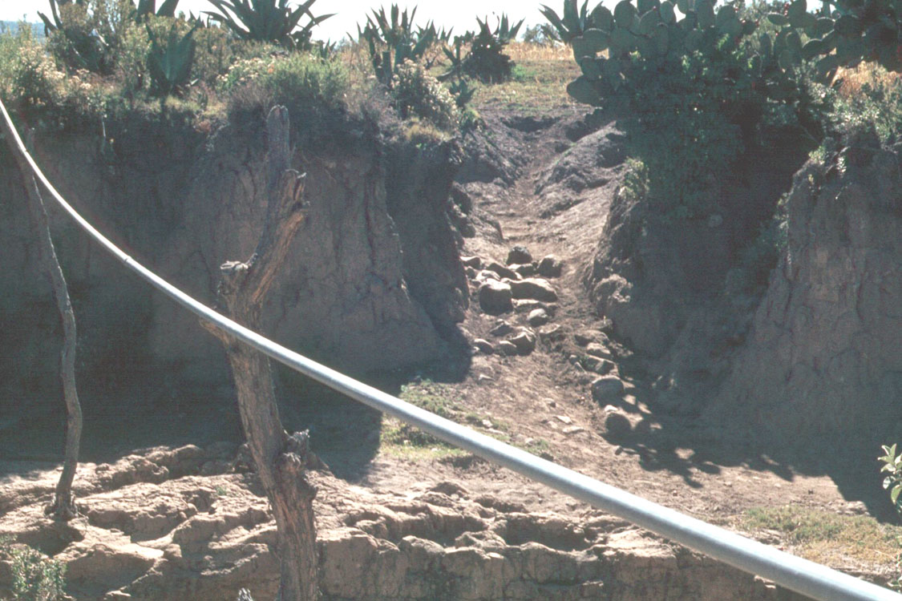
Los Cides, Hidalgo, Mexico

Slide 39
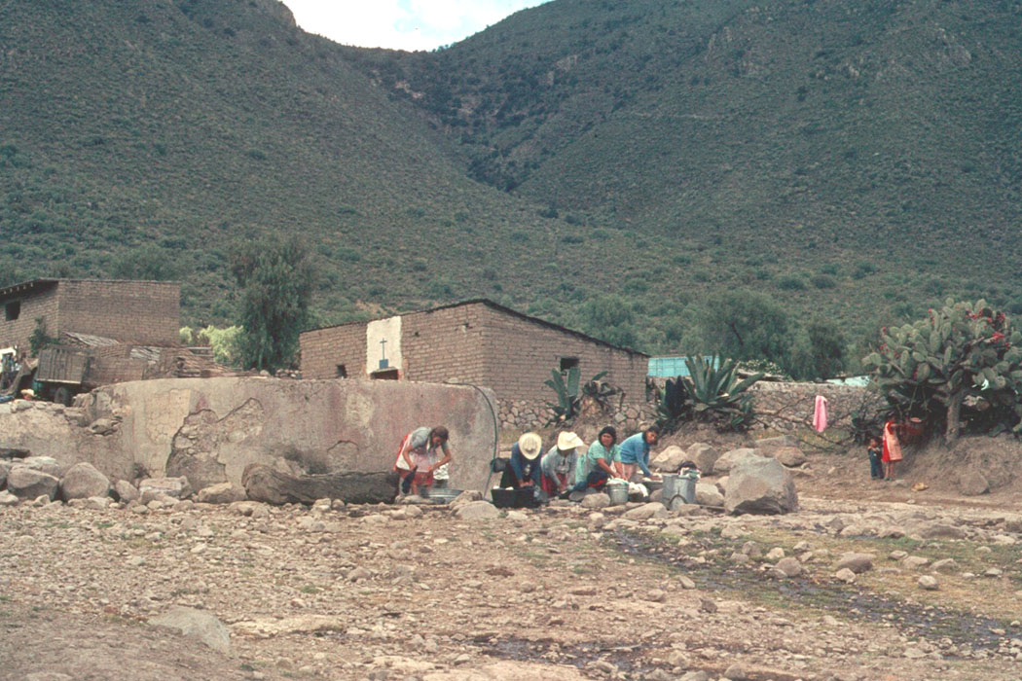
Los Cides, Hidalgo, Mexico

Slide 40
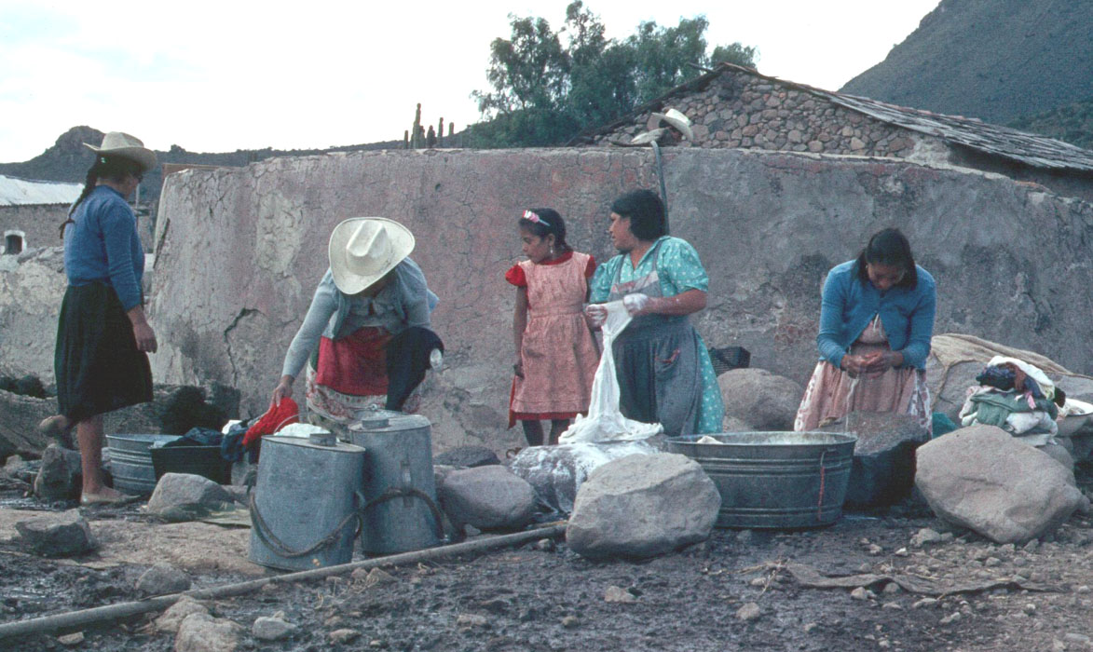
Los Cides, Hidalgo, Mexico

Slide 41
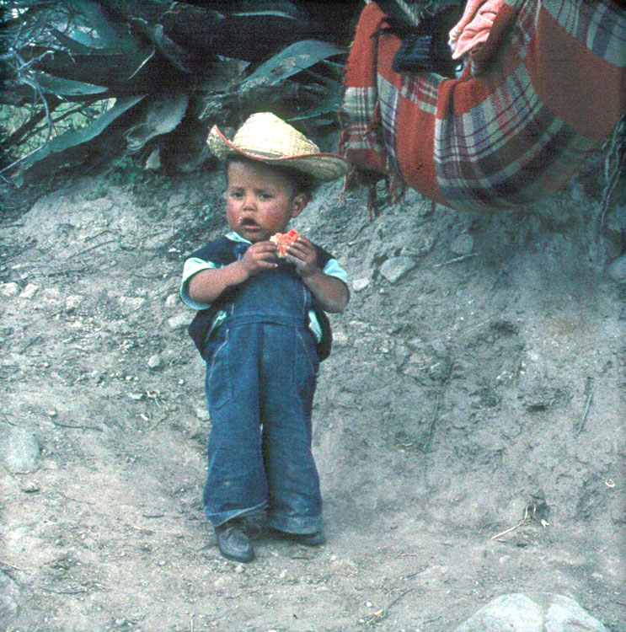
Los Cides, Hidalgo, Mexico

Slide 42
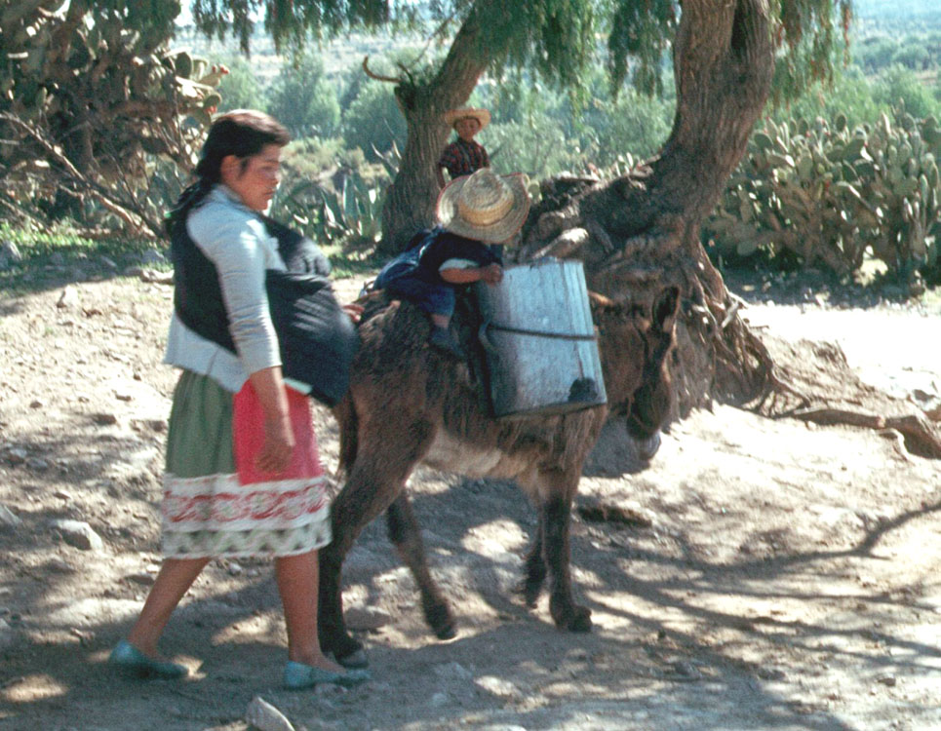
Los Cides, Hidalgo, Mexico

Slide 44
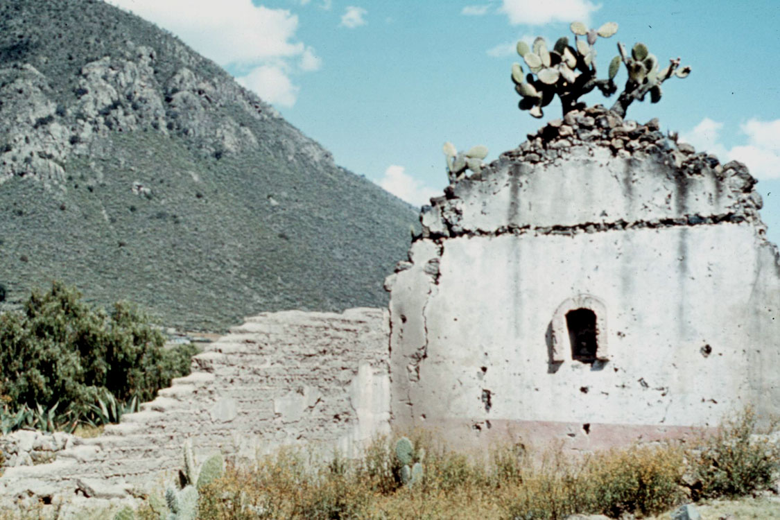
Abandoned Hacienda, Los Cides, Hidalgo, Mexico

Slide 45
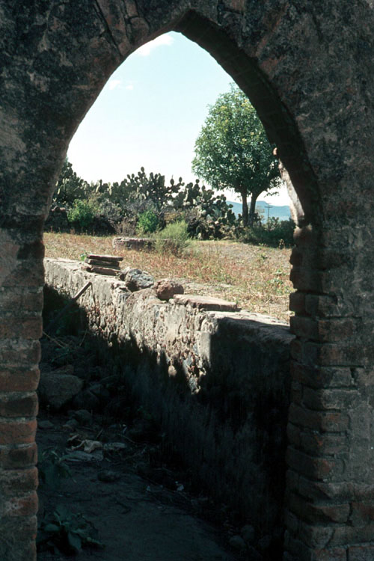
Los Cides, Hidalgo, Mexico

Slide 46
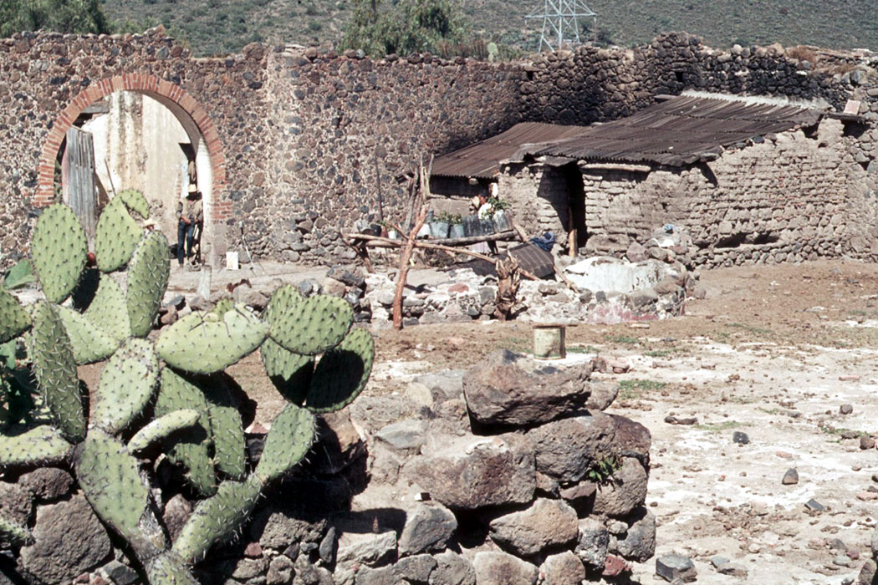
Tlachiquero’s Home, Los Cides, Hidalgo, Mexico

Slide 47
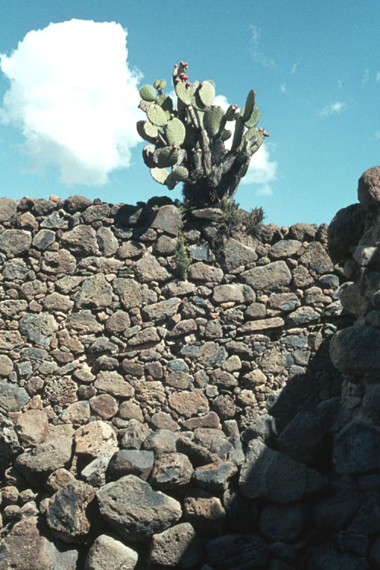
Los Cides, Hidalgo, Mexico

Slide 48
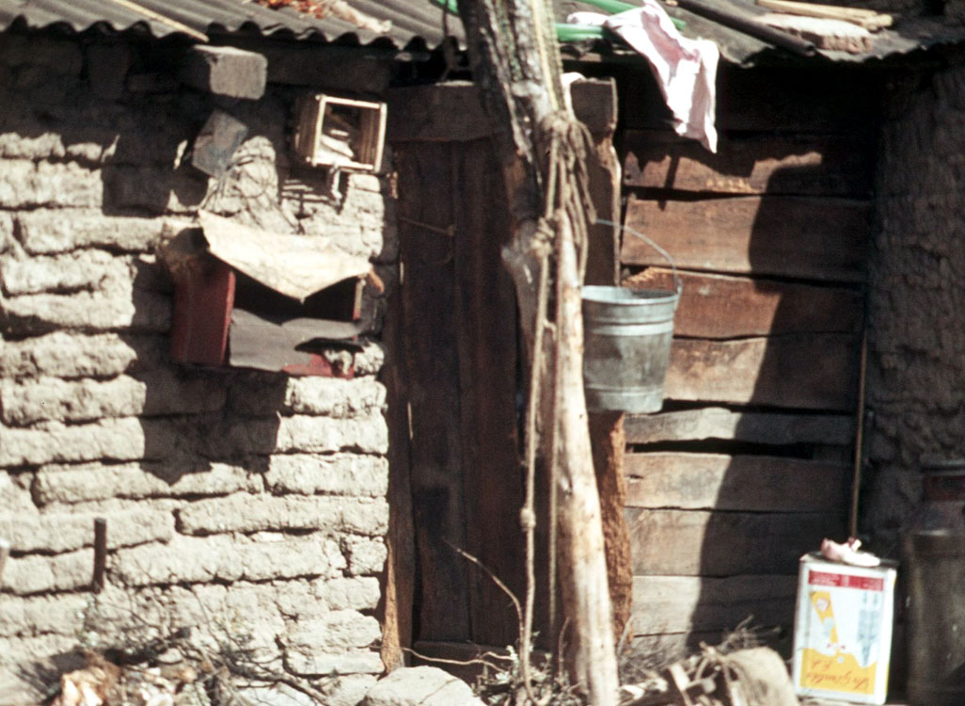
Tlachiquero’s Home, Los Cides, Hidalgo, Mexico

Slide 49
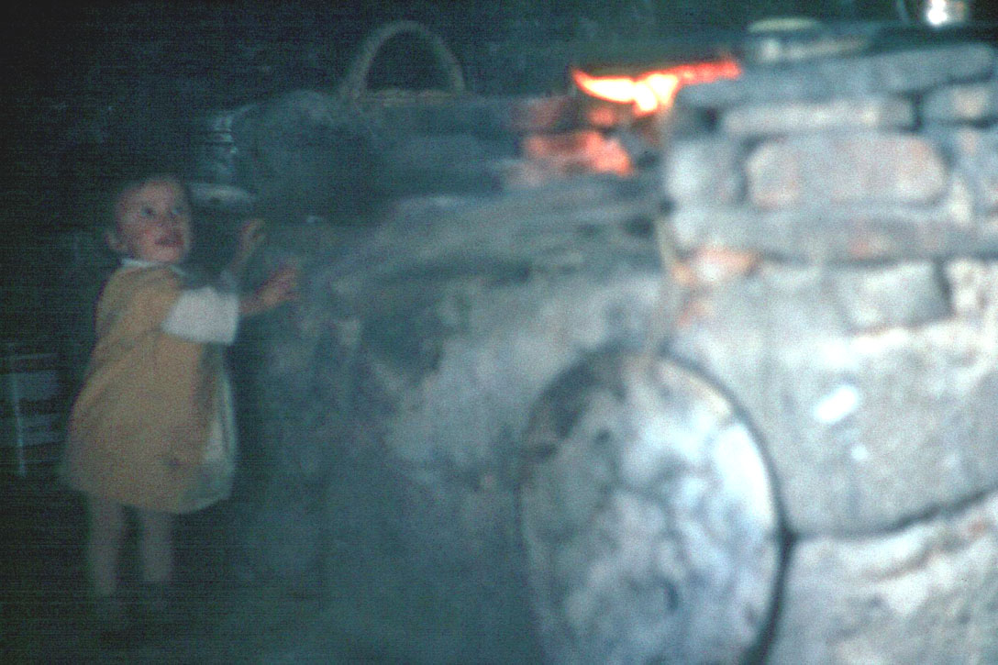
Tlachiquero’s Kitchen, Los Cides, Hidalgo, Mexico

Slide 50
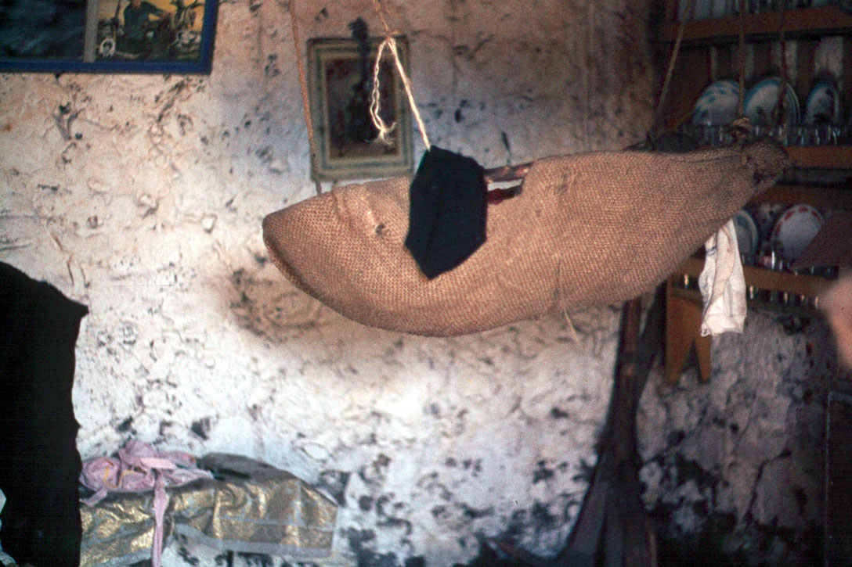
Tlachiquero’s Home, Los Cides, Hidalgo, Mexico

Slide 51
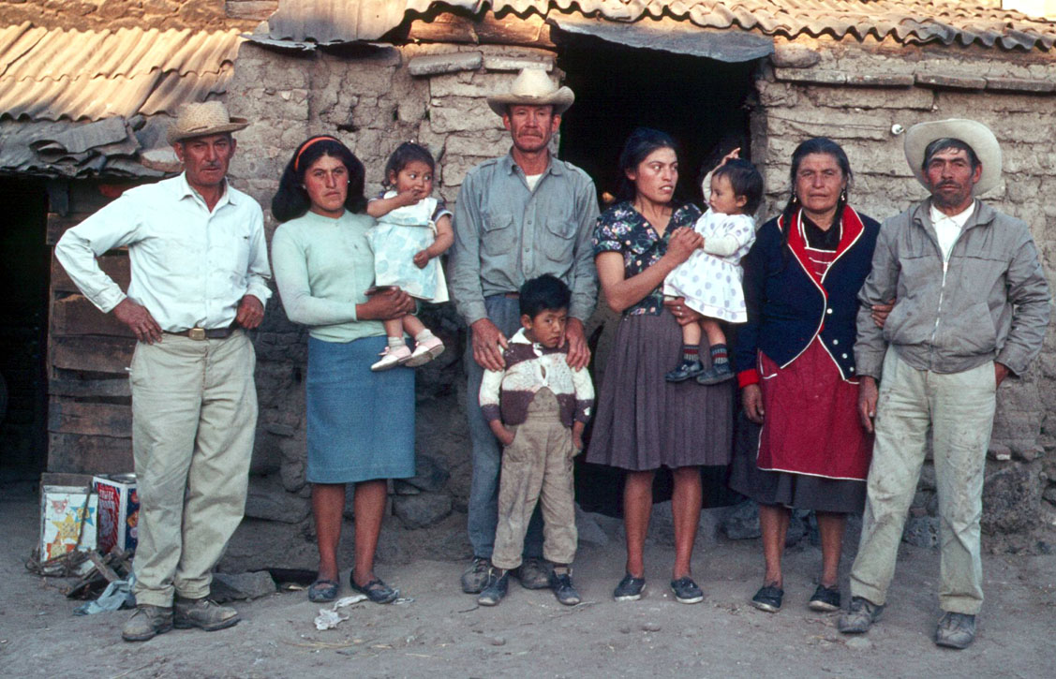
Tlachiquero’s Home, Los Cides, Hidalgo, Mexico

Slide 52
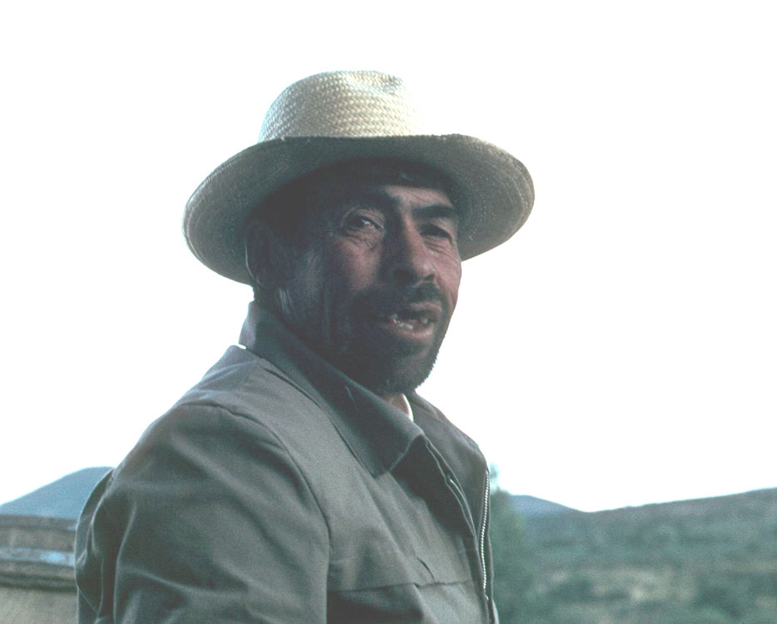
Tlachiquero, Los Cides, Hidalgo, Mexico

Slide 53
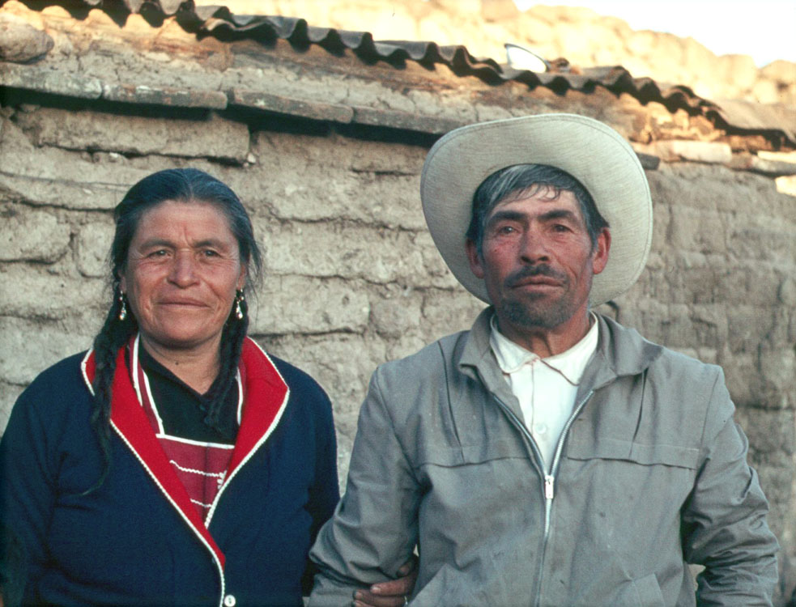
Tlachiquero’s Home, Los Cides, Hidalgo, Mexico

Slide 54
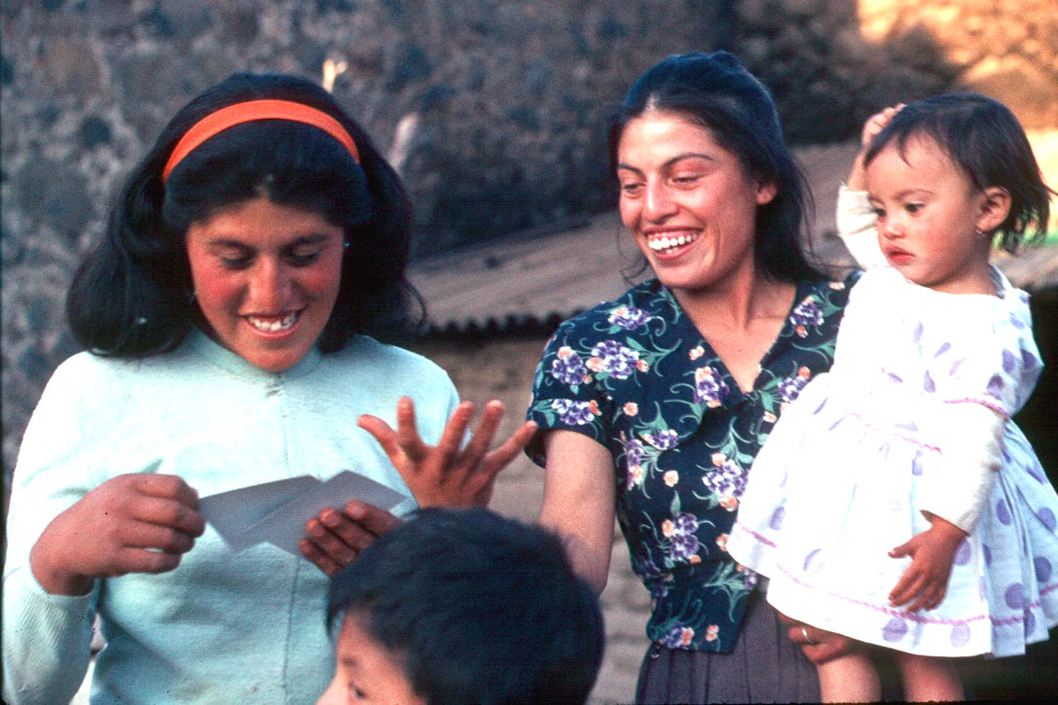
Tlachiquero’s Home, Los Cides, Hidalgo, Mexico

Slide 55
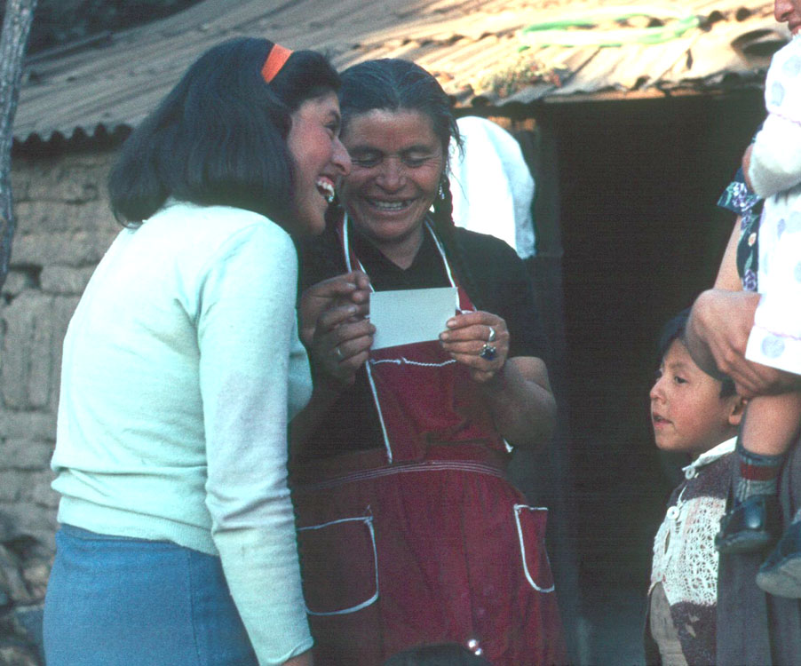
Tlachiquero’s Home, Los Cides, Hidalgo, Mexico

Slide 56
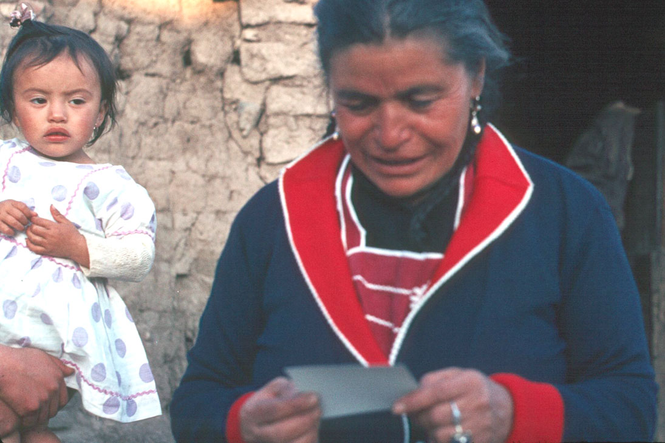
Tlachiquero’s Home, Los Cides, Hidalgo, Mexico

Slide 57
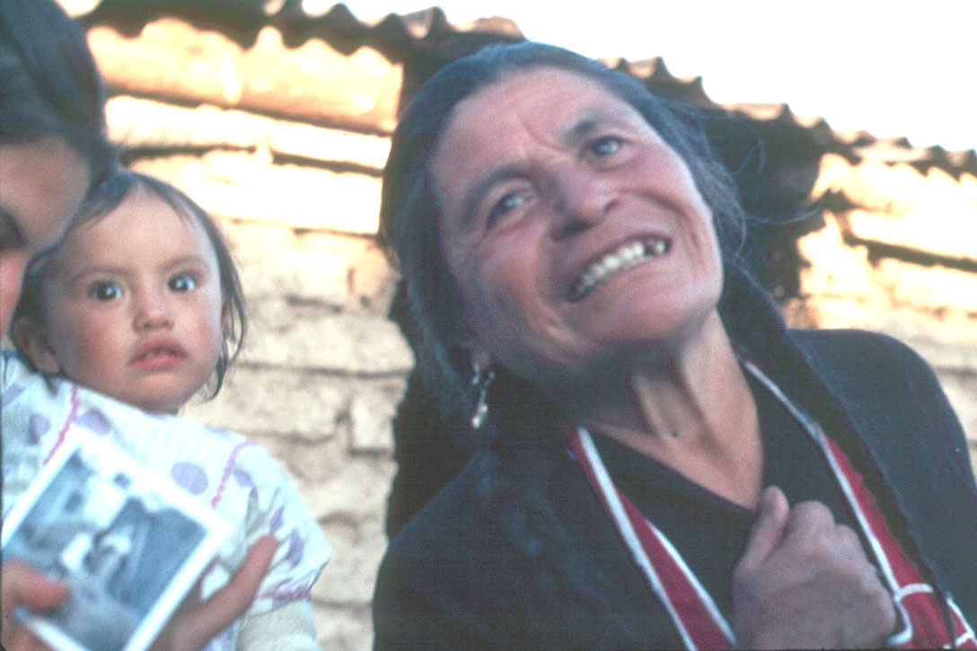
Tlachiquero’s Home, Los Cides, Hidalgo, Mexico

Slide 58

Tlachiquero’s Home, Los Cides, Hidalgo, Mexico

Slide 59

Tlachiquero’s Home, Los Cides, Hidalgo, Mexico

Slide 60

Pilgrims, Los Cides, Hidalgo, Mexico

Slide 61

Pilgrims, Los Cides, Hidalgo, Mexico

Slide 62


Slide 64


Slide 65


Slide 66


Slide 67


Slide 68


Slide 69


Slide 70


Slide 71


Slide 72


Slide 73


Slide 74


Slide 75


Slide 76


Slide 77


Slide 78


Slide 79


Slide 80


Slide 82


Slide 83


Slide 84


Slide 85


Slide 86


Slide 87


Slide 88


Slide 89


Slide 90


Slide 91


Slide 92


Slide 93


Slide 94


Slide 95


Slide 96


Slide 97


Slide 98


Slide 99


