Slide 1
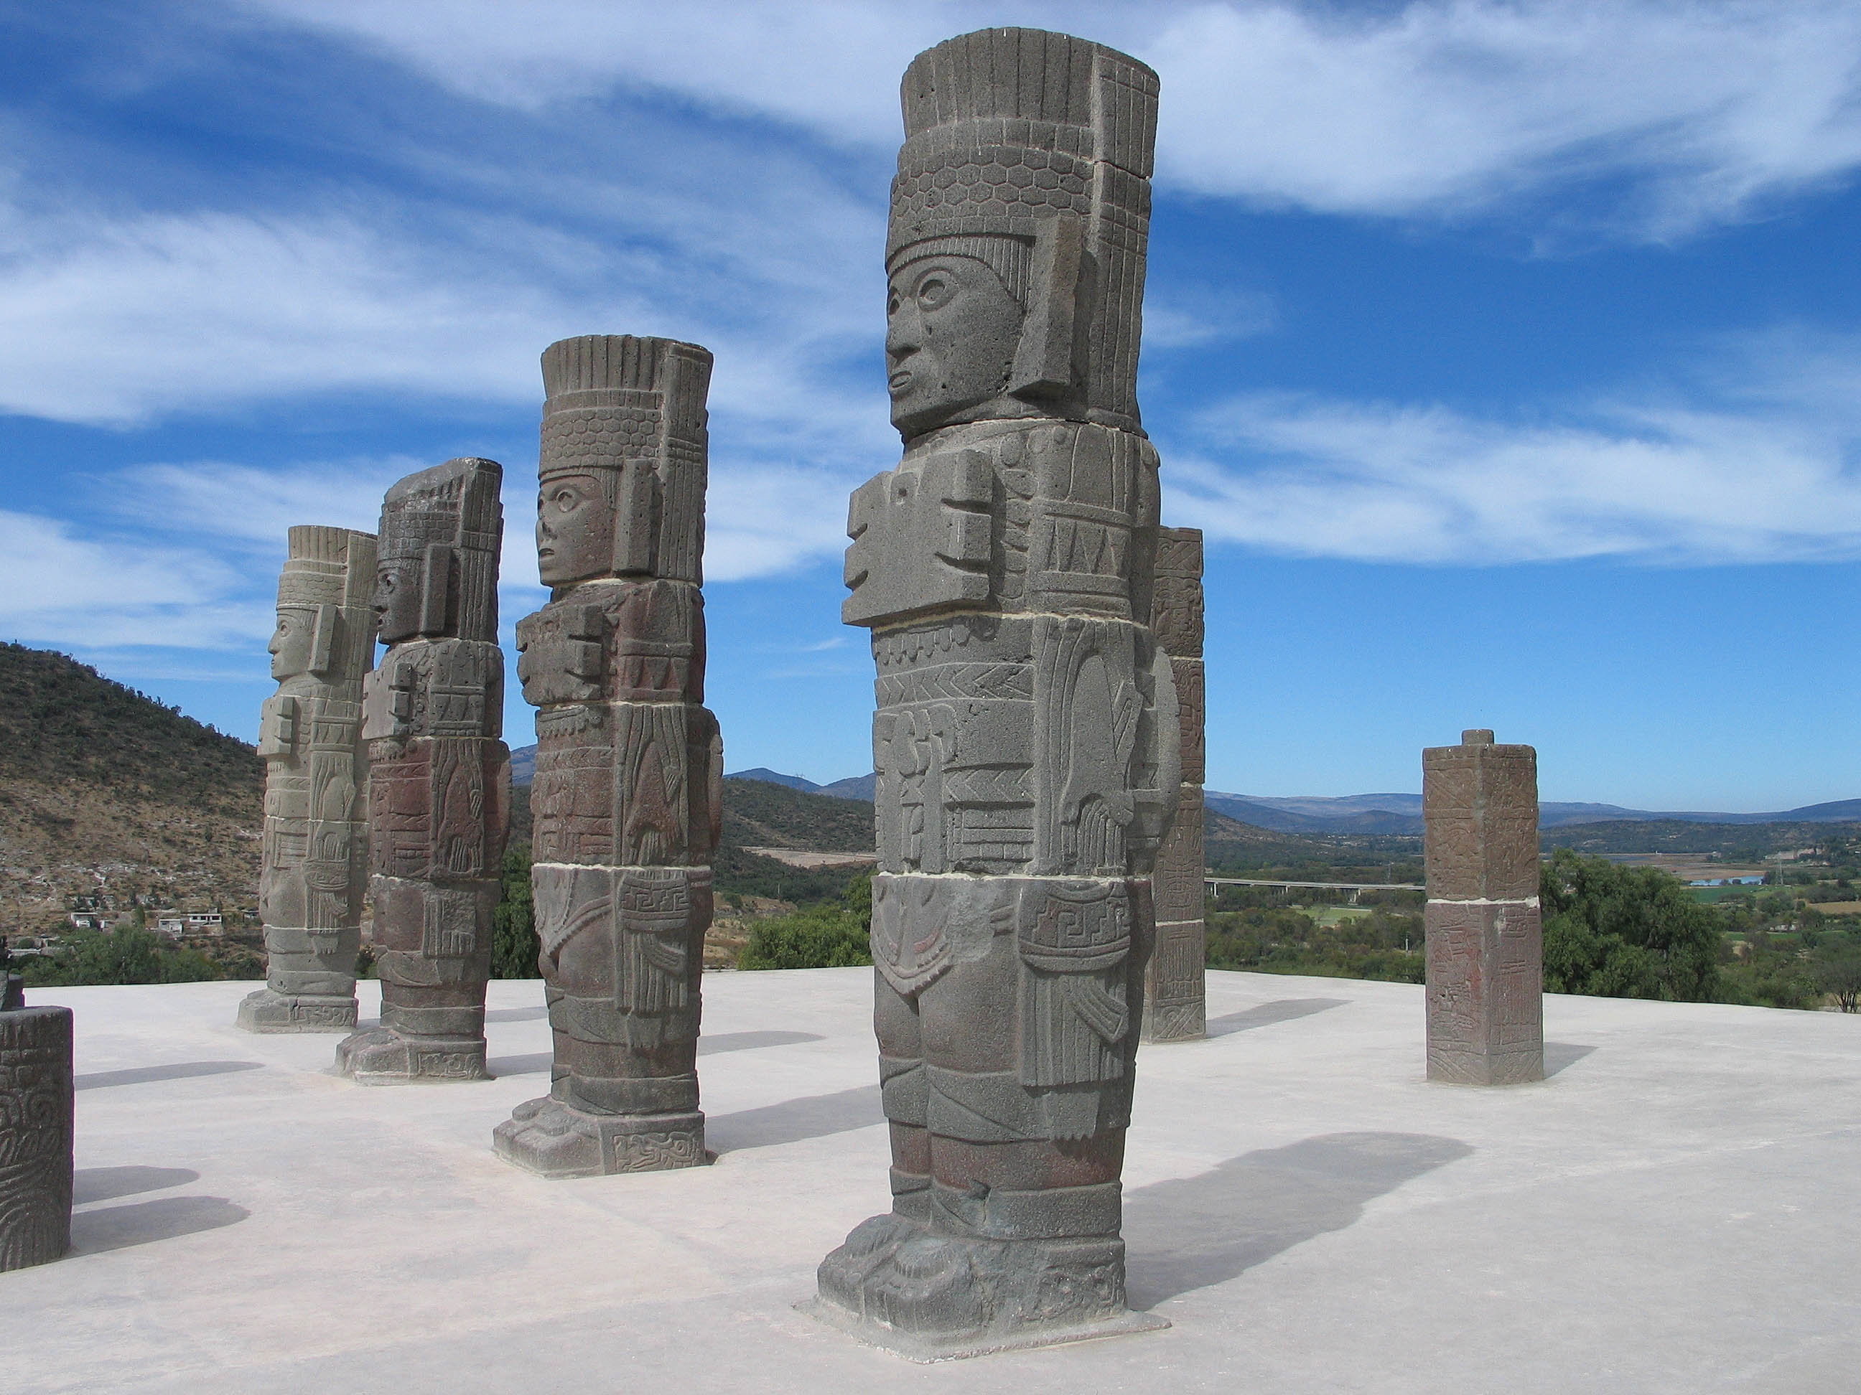
Ancient Middle America
The Postclassic
University of Minnesota Duluth
Tim Roufs’ ©2009-2019
http://en.wikipedia.org/wiki/Tula,_Hidalgo

Slide 2
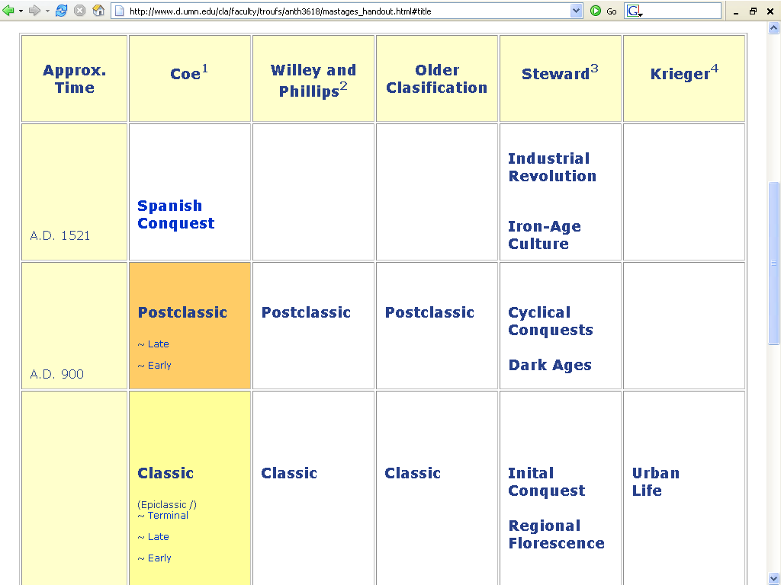
Middle

Slide 3
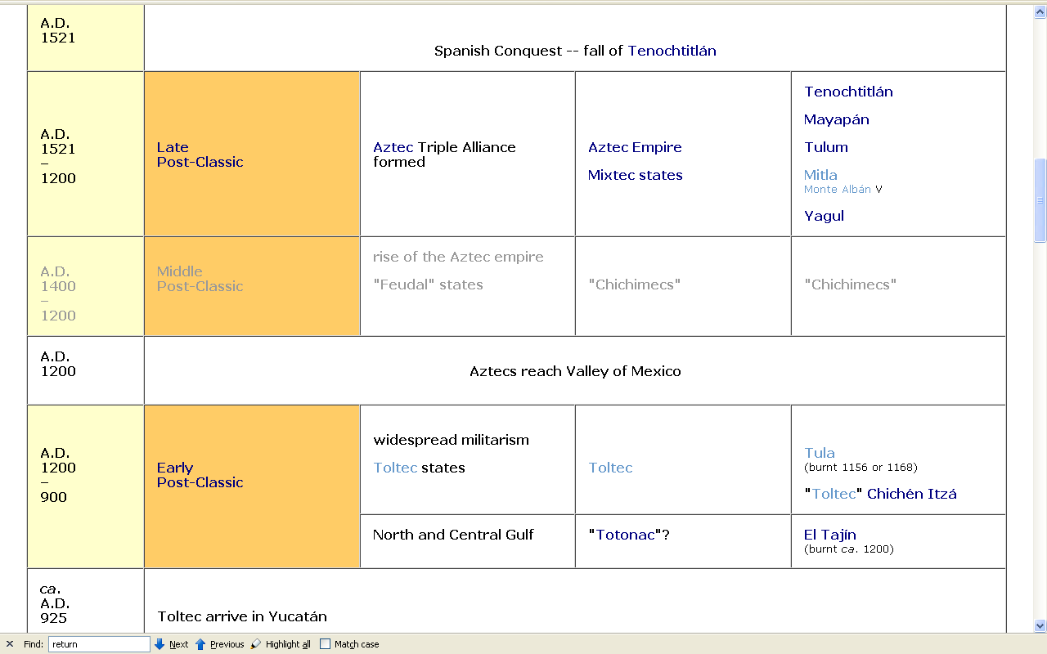
http://www.d.umn.edu/cla/faculty/troufs/anth3618/ma_timeline.html#Late_Postclassic

Slide 4
Tenochtitlán founded in 1325
http://www.d.umn.edu/cla/faculty/troufs/anth3618/ma_timeline.html#Late_Postclassic

Slide 5
http://www.d.umn.edu/cla/faculty/troufs/anth3618/ma_timeline.html#Late_Postclassic

Slide 6
http://www.d.umn.edu/cla/faculty/troufs/anth3618/ma_timeline.html#Late_Postclassic

Slide 7
http://www.d.umn.edu/cla/faculty/troufs/anth3618/ma_timeline.html#Late_Postclassic

Slide 8
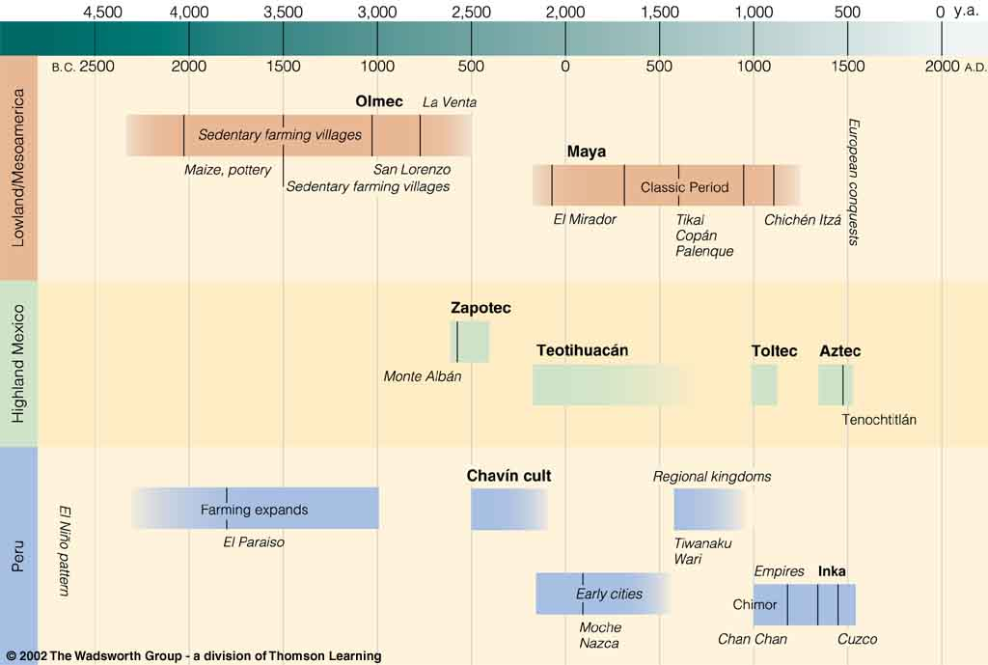
Colonial
Postclassic
Archaic
Pre-Classic
Classic
Understanding Physical Anthropology and Archaeology, 8th ed., p. 479

Slide 9
Colonial
Middle
Postclassic
Archaic
Pre-Classic
Classic
Understanding Physical Anthropology and Archaeology, 8th ed., p. 479

Slide 10
http://www.d.umn.edu/cla/faculty/troufs/anth3618/ma_timeline.html#Late_Postclassic

Slide 11
http://www.d.umn.edu/cla/faculty/troufs/anth3618/ma_timeline.html#Late_Postclassic

Slide 12
http://www.d.umn.edu/cla/faculty/troufs/anth3618/ma_timeline.html#Late_Postclassic

Slide 13
http://www.d.umn.edu/cla/faculty/troufs/anth3618/ma_timeline.html#Late_Postclassic

Slide 14
Tenochtitlán founded in 1325
http://www.d.umn.edu/cla/faculty/troufs/anth3618/ma_timeline.html#Late_Postclassic

Slide 15
http://www.d.umn.edu/cla/faculty/troufs/anth3618/ma_timeline.html#Late_Postclassic

Slide 16
http://www.d.umn.edu/cla/faculty/troufs/anth3618/ma_timeline.html#Late_Postclassic

Slide 17
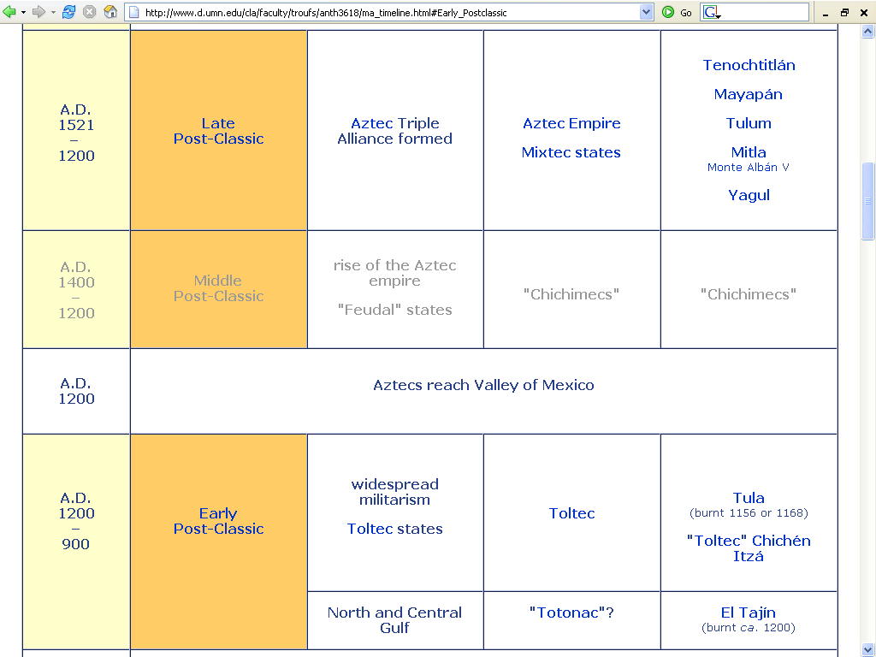

Slide 18
http://www.d.umn.edu/cla/faculty/troufs/anth3618/ma_timeline.html#Late_Postclassic

Slide 20
Five Important Points
for the
Post-Classic Stage
After Willey and Phillips, Method and Theory in American Archaeology. Chicago: University of Chicago Press, 1970.

Slide 21
Post Classic Stage
The Post-Classic is characteristically an urban phenomenon which is confined to Middle America and Peru
one exception is Cahokia in Illinois

Slide 22
Post Classic Stage
The Post-Classic is characteristically an urban phenomenon which is confined to Middle America and Peru
one exception is Cahokia in Illinois

Slide 23
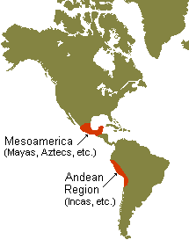
Middle America
Ecuador
Peru

Slide 24
Post Classic Stage
The Post-Classic is characteristically an urban phenomenon which is confined to Middle America and Peru
one exception is Cahokia in Illinois

Slide 25
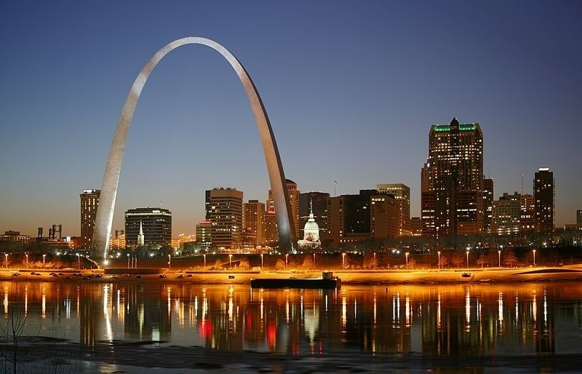
St. Louis on Mississippi River
http://commons.wikimedia.org/wiki/Category:Maps_of_the_history_of_Hungary

Slide 26
Cahokia
“Mississippi Moundbuilders”
Middle America
Ecuador
Peru

Slide 27
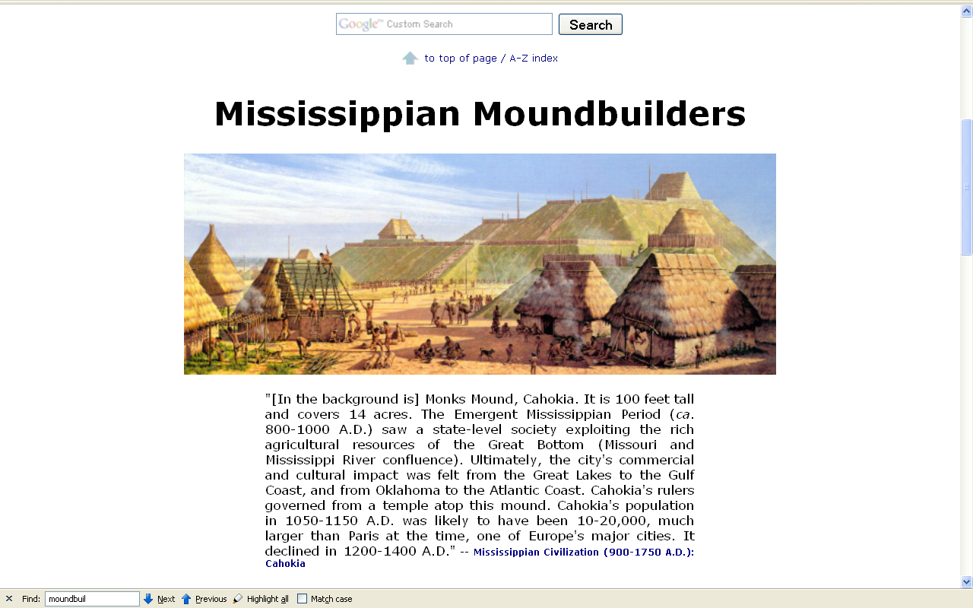
www.d.umn.edu/cla/faculty/troufs/anth1602/pcmississippian.html#title

Slide 28
Cahokia
.
Middle America
Ecuador
Peru

Slide 29
Cahokia
.
Aztec Tenochtitlán
is the major
Mesoamerican site
of the (Late)
Postclassic
Middle America
Ecuador
Peru

Slide 30
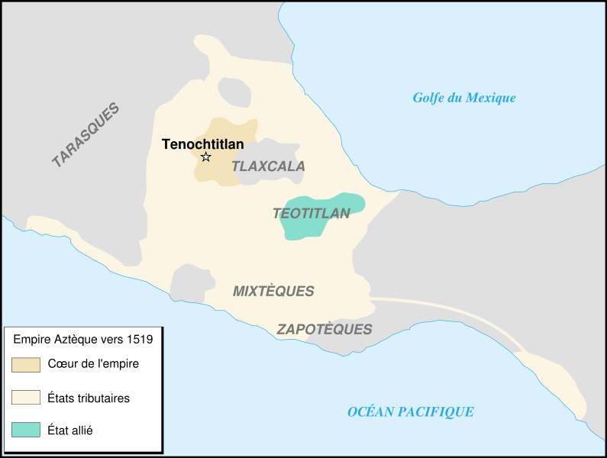
Pay some attention to the areas
that the Aztecs do not have in their “Empire” . . .
and note that some areas are just “Tributaries”
and “Allied States”
not part of the “Core Empire” per se
Aztec Empire ca. 1519
http://commons.wikimedia.org/wiki/Image:Aztec_empire_1519-fr.svg

Slide 31
Excluded are . . .
Tzintzuntzan
But included is . . .
Guerrero
Xoconosco
(Soconusco)
Aztec Empire ca. 1519
http://commons.wikimedia.org/wiki/Image:Aztec_empire_1519-fr.svg

Slide 32
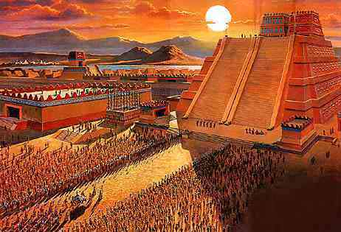
Temple Mayor
Aztec Tenochtitlán
http://www.crystalinks.com/mexico.html

Slide 33
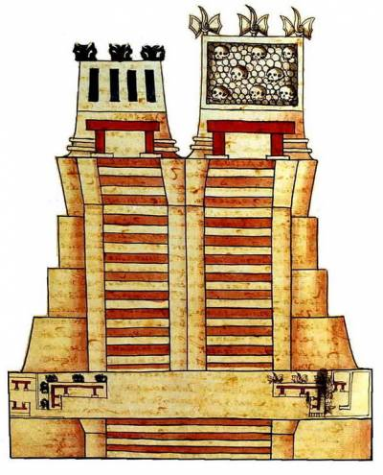
Tlaloc
Huitzilopochtli
Templo Major, Tenochtitlán
http://en.wikipedia.org/wiki/Templo_Mayor

Slide 34
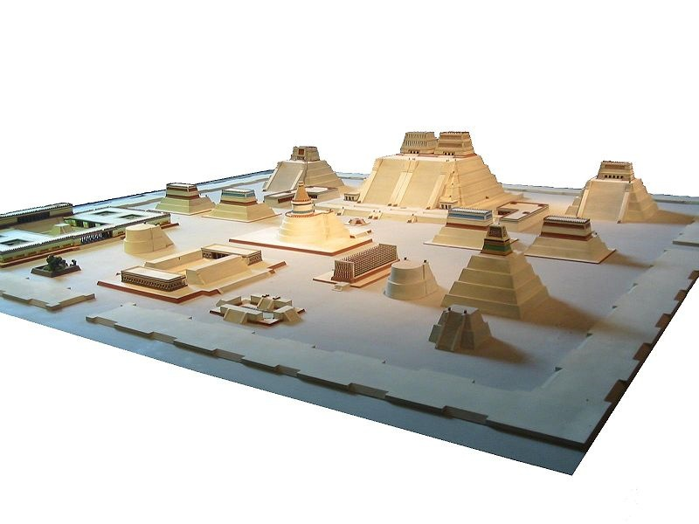
Tlaloc
Huitzilopochtli
Model of the temple district of Tenochtitlan at the National Museum of Anthropology
http://en.wikipedia.org/wiki/Tenochtitlan

Slide 35
Temple Mayor
Model of the temple district of Tenochtitlan at the National Museum of Anthropology
http://en.wikipedia.org/wiki/Tenochtitlan

Slide 36
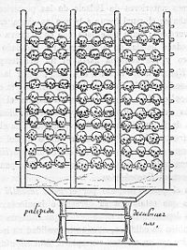
Temple Mayor
Tzompantli
Model of the temple district of Tenochtitlan at the National Museum of Anthropology
http://en.wikipedia.org/wiki/Tenochtitlan

Slide 37
Temple Mayor
Tzompantli
Tzompantli
Model of the temple district of Tenochtitlan at the National Museum of Anthropology
http://en.wikipedia.org/wiki/Tenochtitlan

Slide 38
Temple Mayor
Tzompantli
Ball Court
Model of the temple district of Tenochtitlan at the National Museum of Anthropology
http://en.wikipedia.org/wiki/Tenochtitlan

Slide 39
Calmecac
complex
Temple Mayor
Tzompantli
Ball Court
Model of the temple district of Tenochtitlan at the National Museum of Anthropology
http://en.wikipedia.org/wiki/Tenochtitlan

Slide 40
Eagle’s
House
Calmecac
complex
Temple Mayor
Tzompantli
Ball Court
Model of the temple district of Tenochtitlan at the National Museum of Anthropology
http://en.wikipedia.org/wiki/Tenochtitlan

Slide 41
Eagle’s
House
Calmecac
complex
Temple Mayor
Tzompantli
Ball Court
Quetzalcoatl
Temple
Model of the temple district of Tenochtitlan at the National Museum of Anthropology
http://en.wikipedia.org/wiki/Tenochtitlan

Slide 42
Eagle’s
House
Calmecac
complex
Temple Mayor
Tzompantli
Sun
Temple
Ball Court
Quetzalcoatl
Temple
Model of the temple district of Tenochtitlan at the National Museum of Anthropology
http://en.wikipedia.org/wiki/Tenochtitlan

Slide 43
Eagle’s
House
Calmecac
complex
Temple Mayor
Tezcatlipoca
Pyramid
Tzompantli
Sun
Temple
Ball Court
Quetzalcoatl
Temple
Model of the temple district of Tenochtitlan at the National Museum of Anthropology
http://en.wikipedia.org/wiki/Tenochtitlan

Slide 44
Palace of
Motecuhzoma II
(100 rooms,
each with its own bath)
Eagle’s
House
Calmecac
complex
Temple Mayor
Tezcatlipoca
Pyramid
Tzompantli
Sun
Temple
Ball Court
Quetzalcoatl
Temple
Model of the temple district of Tenochtitlan at the National Museum of Anthropology
http://en.wikipedia.org/wiki/Tenochtitlan

Slide 45
Palace of
Motecuhzoma II
(100 rooms,
each with its own bath)
Eagle’s
House
Calmecac
complex
Temple Mayor
Tezcatlipoca
Pyramid
Tzompantli
Sun
Temple
Ball Court
Quetzalcoatl
Temple
Model of the temple district of Tenochtitlan at the National Museum of Anthropology
http://en.wikipedia.org/wiki/Tenochtitlan

Slide 46
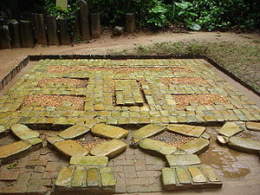
La Venta
Palace of
Motecuhzoma II
(100 rooms,
each with its own bath)
Eagle’s
House
Calmecac
complex
Temple Mayor
Tezcatlipoca
Pyramid
Tzompantli
Sun
Temple
Ball Court
Quetzalcoatl
Temple
Model of the temple district of Tenochtitlan at the National Museum of Anthropology
http://en.wikipedia.org/wiki/Tenochtitlan

Slide 47
Palace
of
Motecuhzoma II
(100 rooms,
each with its own bath)
Eagle’s
House
Calmecac
complex
Temple Mayor
Tezcatlipoca
Pyramid
Tompantli
Sun
Temple
Ball Court
Quetzalcoatl
Temple
Model of the temple district of Tenochtitlan at the National Museum of Anthropology
http://en.wikipedia.org/wiki/Tenochtitlan

Slide 48
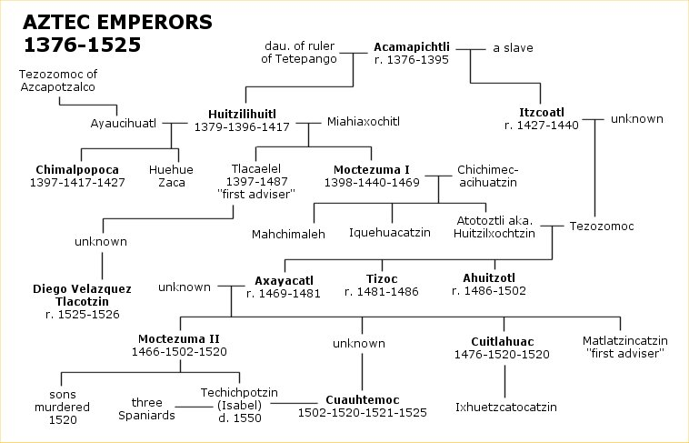
http://commons.wikimedia.org/wiki/File:Aztecs_ft.jpg

Slide 49
Huitzilopochtli
Tlaloc
Tezcatlipoca
Pyramid
Model of the temple district of Tenochtitlán at the National Museum of Anthropology
http://en.wikipedia.org/wiki/Tenochtitlan

Slide 50
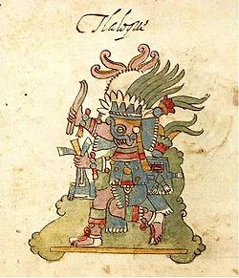
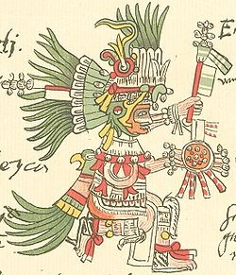
Tlaloc
Huitzilopochtli
Model of the temple district of Tenochtitlán at the National Museum of Anthropology
http://en.wikipedia.org/wiki/Tenochtitlan

Slide 51
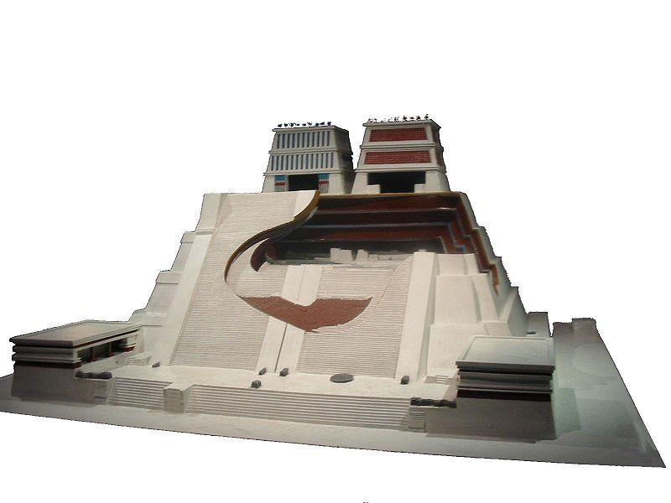
Huitzilopochtli
Tlaloc
Temple Mayor, Tenochtitlán
http://en.wikipedia.org/wiki/Tenochtitlan

Slide 52
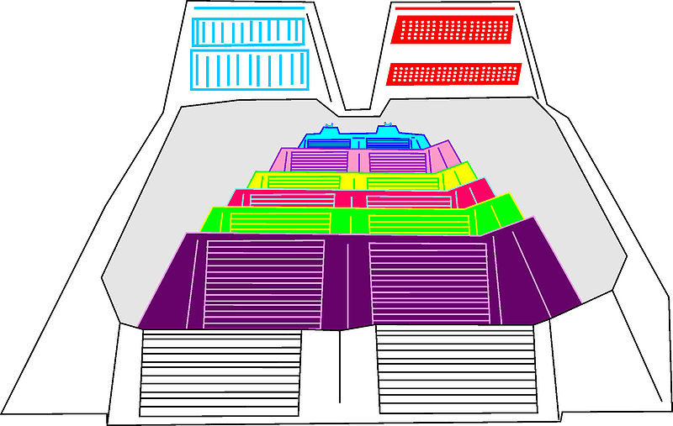
Tlaloc
Huitzilopochtli
Temple Mayor, Tenochtitlán
http://commons.wikimedia.org/wiki/File:Templo_mayor_capas.jpg

Slide 53
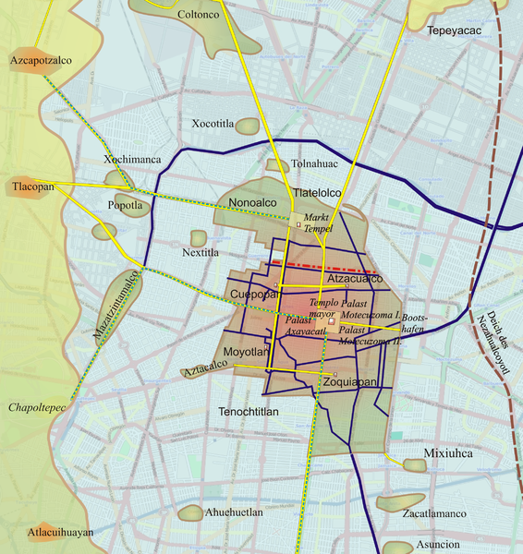
Texcoco
Tlaxcala
Tenochtitlán and Tlatelolco in Lake Texcoco
http://commons.wikimedia.org/wiki/File:Tenochtitlan-medium.png

Slide 54
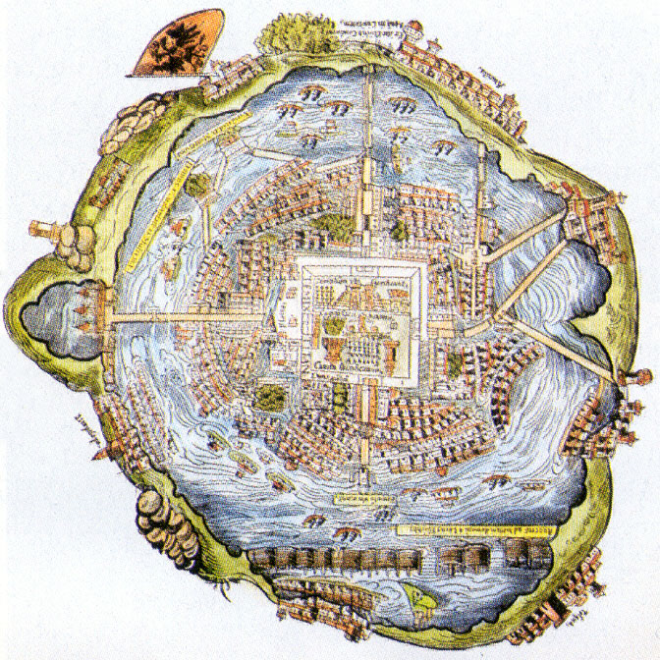
http://www.latinamericanstudies.org/aztecs1.htm

Slide 55
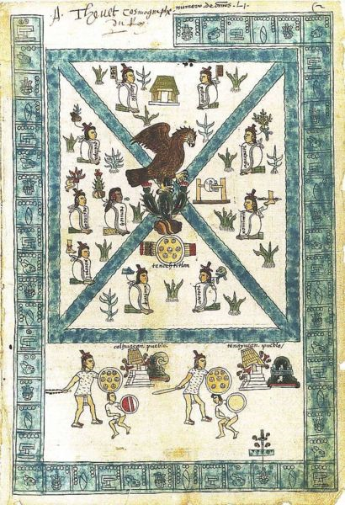
Folio 2r of the Codex Mendoza
http://commons.wikimedia.org/wiki/File:Fundacion_Mexico.jpg

Slide 56
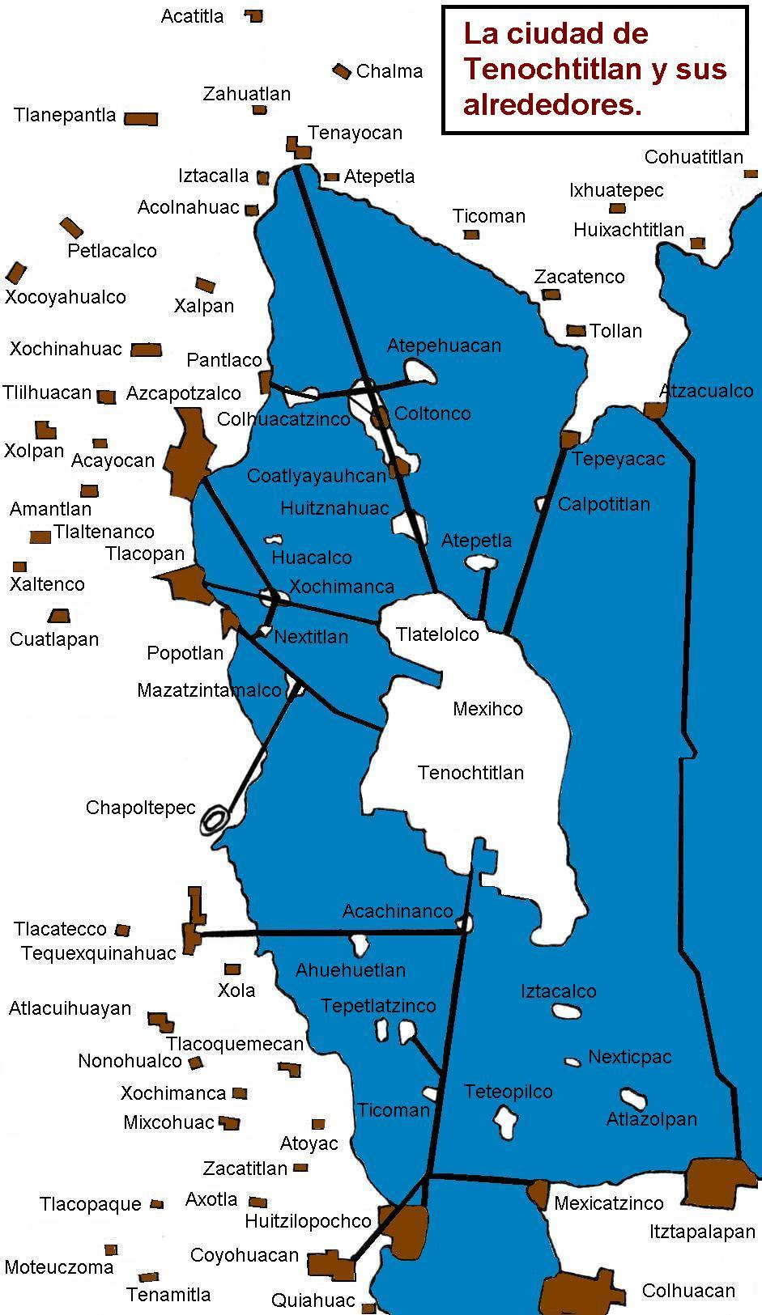
source: Wikimedia

Slide 57
2. The onset of the Post-Classic sees the breakdown of the greater regional art styles of the Classic in each region

Slide 58
2. The onset of the Post-Classic sees the breakdown of the greater regional art styles of the Classic in each region

Slide 59
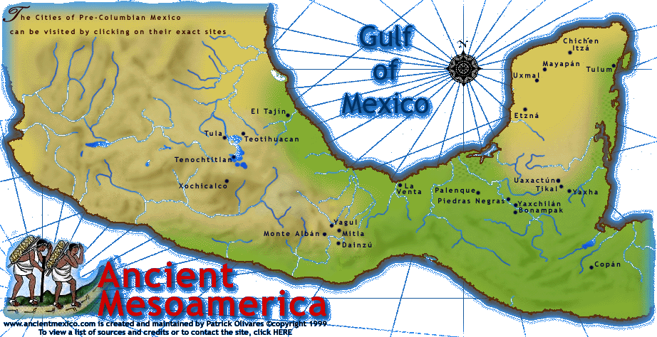
Petén
Maya
Teotihuacán
Zapotec
Highland
Maya
• Kaminaljuyú

Slide 60
Chichén Itzá
El Tajín
Mayapán
Tulúm
Tula
Tenochtitlán
Monte
Albán
Mitla
Kaminaljuyú

Slide 61
Chichén Itzá
El Tajín
Mayapán
Tulúm
Tula
Tenochtitlán
Mitla
Monte
Albán
Kaminaljuyú

Slide 62
There are evidences of population shiftings and migrations, and of war and troubled times

Slide 63
There are evidences of population shiftings and migrations, and of war and troubled times

Slide 64
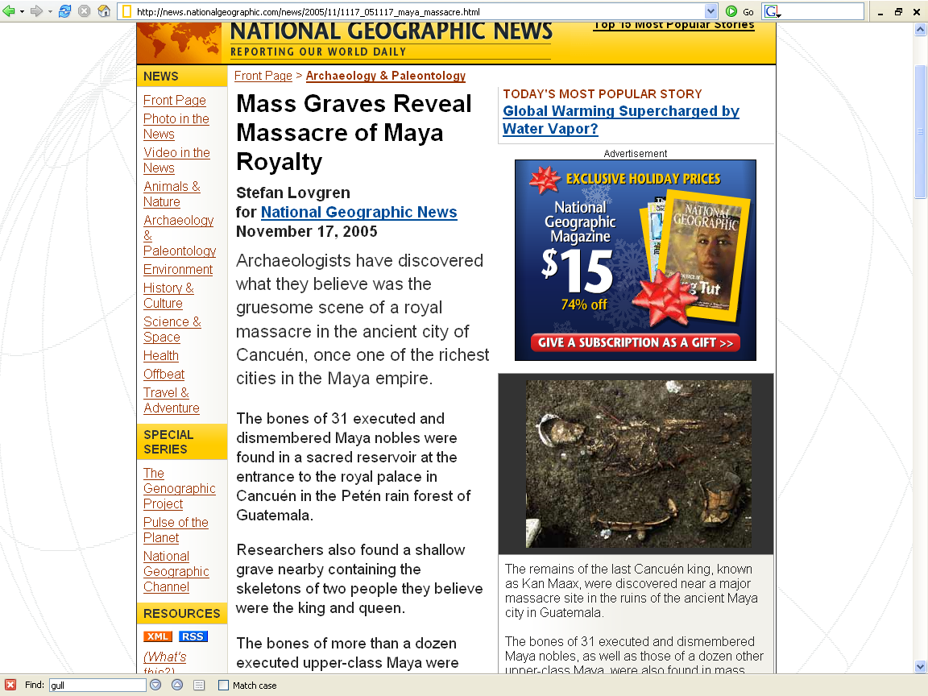
“The apparent executions—along with the discovery of unfinished defensive walls and houses—suggest that the city was wiped out by an invading force around A.D. 800, a critical moment at the beginning of the mysterious collapse of the great Maya empire.”
http://news.nationalgeographic.com/news/2005/11/1117_051117_maya_massacre.html

Slide 65
4. A decline in the aesthetic level of the Classic and in religious architecture suggests an increasing secularization of the society
an increase in fortifications and fortified cities or towns gives a militaristic cast to many of the Post-Classic cultures

Slide 66
4. A decline in the aesthetic level of the Classic and in religious architecture suggests an increasing secularization of the society
an increase in fortifications and fortified cities or towns gives a militaristic cast to many of the Post-Classic cultures

Slide 67
The Post-Classic civilizations are generally dated in the last 600 years or so preceding the Spanish Conquest
A.D. 925 -- 1530 (The Maya)
A.D. 900 -- 1521 (Mexico)

Slide 68
The Post-Classic civilizations are generally dated in the last 600 years or so preceding the Spanish Conquest
A.D. 925 -- 1530 (The Maya)
A.D. 900 -- 1521 (Mexico)

Slide 69
Postclassic
Classic
Understanding Physical Anthropology and Archaeology, 8th ed., p. 479

Slide 70
Classic
Postclassic
Understanding Physical Anthropology and Archaeology, 8th ed., p. 479

Slide 71
Understanding Physical Anthropology and Archaeology, 8th ed., p. 479

Slide 72
Postclassic
Understanding Physical Anthropology and Archaeology, 8th ed., p. 479.

Slide 73
Discussion

Slide 74
The Post-Classic stage is marked chiefly by three things
the breakdown of the old regional styles of the Classic stage
by a continued or increased emphasis on urban living
by tendencies toward increasing militarism and secularism

Slide 75
The Post-Classic stage is marked chiefly by three things
the breakdown of the old regional styles of the Classic stage
by a continued or increased emphasis on urban living
by tendencies toward increasing militarism and secularism

Slide 76
Diffusion occurred in Classic Mesoamerica, but it was not always easily detected

Slide 77
In the Post-Classic stage there occurred wide, interregional transferences of total art and architectural styles
the mechanisms behind these transferences are debatable, but it is reasonable to interpret many of them as actual movements of large groups of people and often accompanied by military force

Slide 78
In the Post-Classic stage there occurred wide, interregional transferences of total art and architectural styles
the mechanisms behind these transferences are debatable, but it is reasonable to interpret many of them as actual movements of large groups of people and often accompanied by military force

Slide 79
Trends toward increasing militarism and large-scale warfare are reflected in fortifications and fortified communities in the Late Post-Classic stages in many Mesoamerican regions

Slide 80
Trends toward increasing militarism and large-scale warfare are reflected in fortifications and fortified communities in the Late Post-Classic stages in many Mesoamerican regions

Slide 81
The implications for a gradually increasing secularization of the culture and society are less direct
the decrease in the number, size, and elaboration of pyramid mounds and other kinds of religious structures, however, suggests a waning of religious authority

Slide 82
The implications for a gradually increasing secularization of the culture and society are less direct
the decrease in the number, size, and elaboration of pyramid mounds and other kinds of religious structures, however, suggests a waning of religious authority

Slide 83
also, the aesthetic decline from high Classic standards suggests a loss of enthusiasm in the area of religious art and architectures
in some regions this tendency is seen in standardization and mass production of objects

Slide 84
also, the aesthetic decline from high Classic standards suggests a loss of enthusiasm in the area of religious art and architectures
in some regions this tendency is seen in standardization and mass production of objects

Slide 85
Warfare and non-religious authority were not absent from Mesoamerica in the Classic and Formative stages, but in the Post-Classic stage both militarism and secularism increased

Slide 86
Warfare and non-religious authority were not absent from Mesoamerica in the Classic and Formative stages, but in the Post-Classic stage both militarism and secularism increased

Slide 87
It is the Post-Classic stage which gives us both archaeological and ethnohistorical information about the native American city
these cities were formed around politico-religious nuclei including
pyramids
temples
palaces

Slide 88
It is the Post-Classic stage which gives us both archaeological and ethnohistorical information about the native American city
these cities were formed around politico-religious nuclei including
pyramids
temples
palaces

Slide 89
The urban zones contained
rulers
priests and their entourages
various craftspeople
handlers of produce

Slide 90
In sum, the native city in the New World
had large population aggregates either within the city itself or within reach of the city
was the seat of political and religious power
served as an economic and social center
maintained complex and diverse divisions of labor among its citizens

Slide 91
The Post-Classic centers of Middle America are those well known in the literature of the ethnohistorical period
Tenochtitlán (Aztec) in the Valley of Mexico
Mitla (Mixtec) in Oaxaca
Cempoala (Totonac) in Veracruz
Mayapán (Maya) in Yucatán
Tzintzúntzan (Tarascan) in Western Mexico

Slide 92
Post-Classic centers of Middle America
well known in the literature
of the ethnohistorical period
Mayapán
Tzintzúntzan –
Tarascan
Cempoala –
Totonac
Tenochtitlán –
Aztec
Mitla –
Mixtec

Slide 93
Most of these cities were seats of power in the later centuries up to the Spanish conquest

Slide 94
Somewhat earlier – in the centuries between A.D. 800 and 1200 – there was another set of such centers
Tula (Toltec) in Hidalgo
Chichén Itzá (“Toltecized” Maya) in Yucatán

Slide 95
Chichén Itzá
Tula

Slide 96
Atlantean Figures Tula, Hidalgo

Slide 97
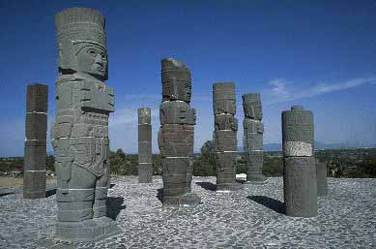
Atlantean Figures Tula, Hidalgo

Slide 98
Chichén Itzá
Tula

Slide 99
Vista panorámica de la Zona Arqueológica de Tula, Hidalgo
Wikipedia

Slide 100
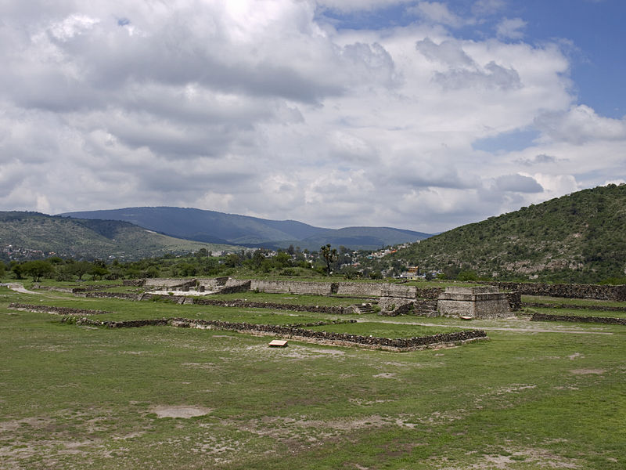
Tzompantli (middle) and Ball Court 2 (background), Tula, Hidalgo
Wikipedia

Slide 101
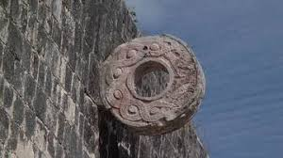
Tzompantli (middle) and Ball Court 2 (background), Tula, Hidalgo
Wikipedia

Slide 102
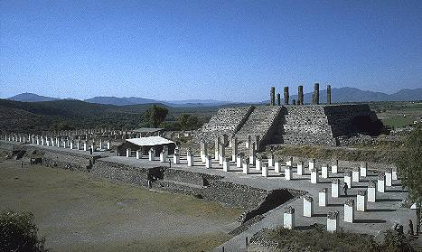
Tula Hidalgo
Wikipedia

Slide 103
Atlantean Figures Tula, Hidalgo
over 4.6 meters (15 ft.) tall

Slide 104
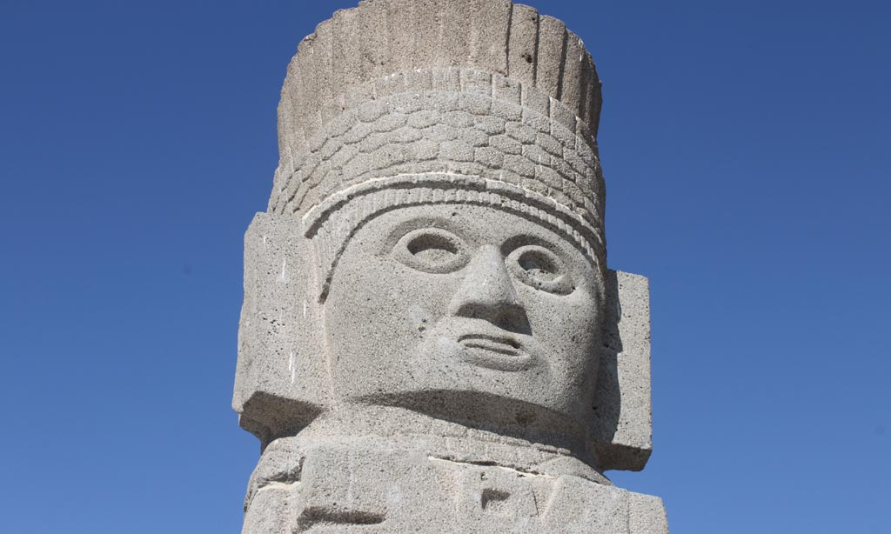
Atlantean Figures Tula, Hidalgo
www.travelbymexico.com/

Slide 105
“Toltec” face
Atlantean Figures Tula, Hidalgo
www.travelbymexico.com/

Slide 106
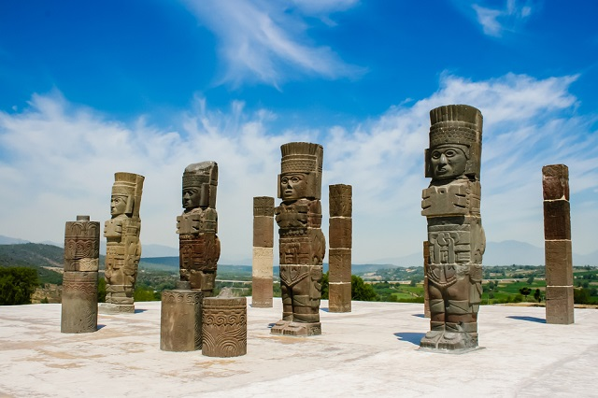
Atlantean Figures, Tula, Hidalgo
http://revista.volaris.com/

Slide 107
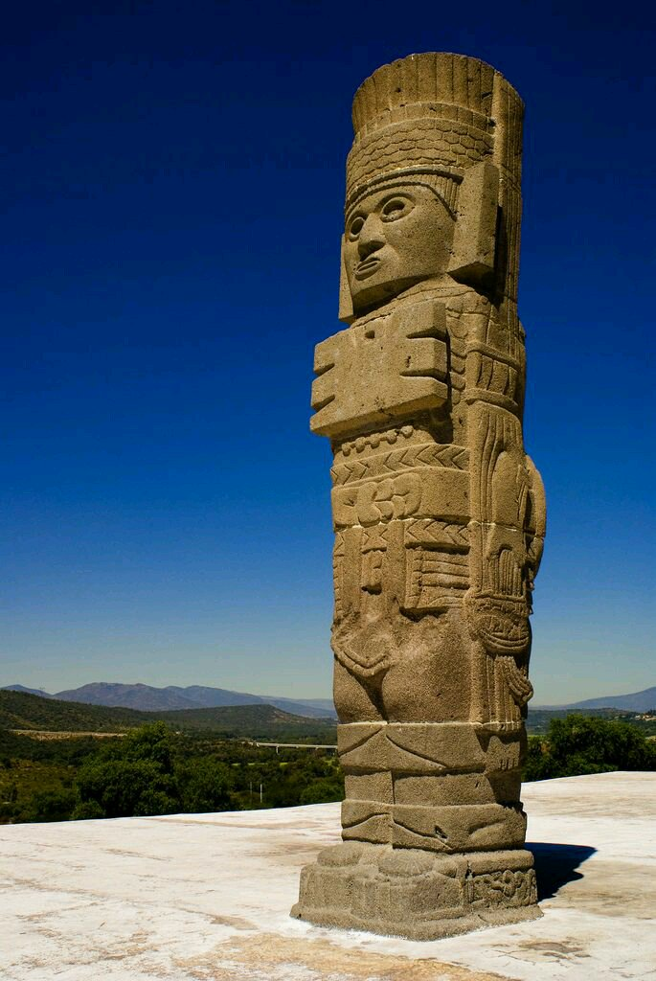
Atlantean Figures, Tula, Hidalgo
https://tuul.tv/

Slide 108
Feathered “pillbox” headdress
Atlantean Figures, Tula, Hidalgo
https://tuul.tv/

Slide 109
Feathered “pillbox” headdress
“Toltec” face
Atlantean Figures, Tula, Hidalgo
https://tuul.tv/

Slide 110
Feathered “pillbox” headdress
“Toltec” face
"stylized butterfly
breastplate”
Atlantean Figures, Tula, Hidalgo
https://tuul.tv/

Slide 111
Feathered “pillbox” headdress
“Toltec” face
"stylized butterfly
breastplate”
Toltec style kilt-like clothing
Atlantean Figures, Tula, Hidalgo
https://tuul.tv/

Slide 112
Feathered “pillbox” headdress
“Toltec” face
"stylized butterfly
breastplate”
Toltec style kilt-like clothing
Toltec style
leggings
Atlantean Figures, Tula, Hidalgo
https://tuul.tv/

Slide 113
Feathered “pillbox” headdress
“Toltec” face
"stylized butterfly
breastplate”
“sun disk”
on back
Toltec style kilt-like clothing
Toltec style
leggings
Atlantean Figures, Tula, Hidalgo
https://tuul.tv/

Slide 114
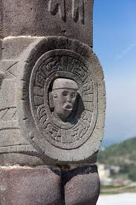
Feathered “pillbox” headdress
“Toltec” face
"stylized butterfly
breastplate”
“sun disk”
on back
Toltec style kilt-like clothing
Toltec style
leggings
Atlantean Figures, Tula, Hidalgo
https://tuul.tv/

Slide 115
Feathered “pillbox” headdress
“Toltec” face
"stylized butterfly
breastplate”
“sun disk”
on back
Toltec style kilt-like clothing
carrying atlatl and “darts” (spears),
and copal incense
Toltec style
leggings
Atlantean Figures, Tula, Hidalgo
https://tuul.tv/

Slide 116
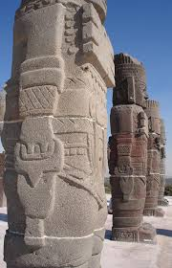
carrying
copal
incense
Atlantean Figures, Tula, Hidalgo
https://tuul.tv/

Slide 117
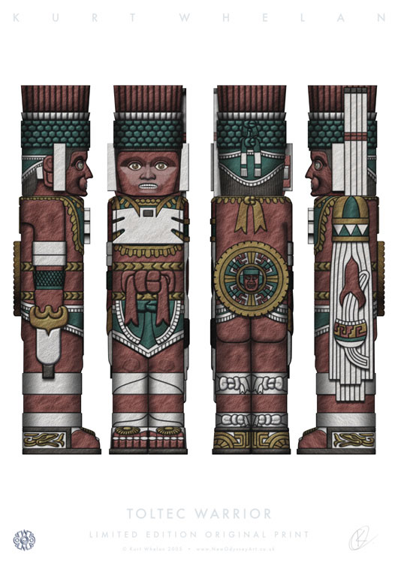
source

Slide 118
Column, Tula, Hidalgo
Wikipedia

Slide 119
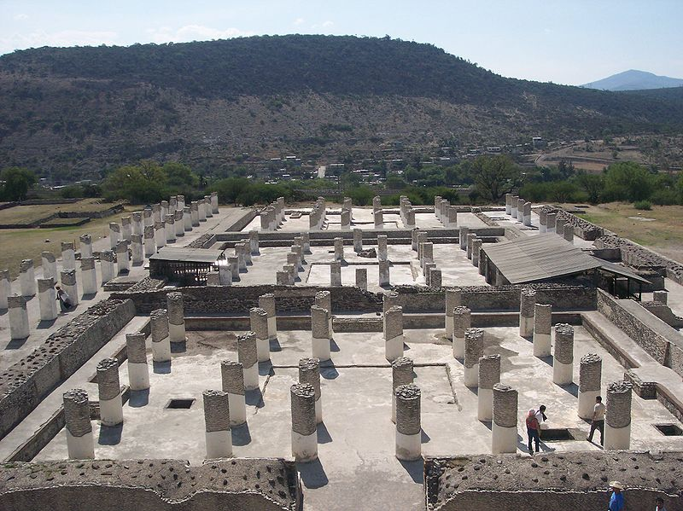
Place of Tollan-Xicocotitlan, Tula, Hidalgo
Wikipedia

Slide 120
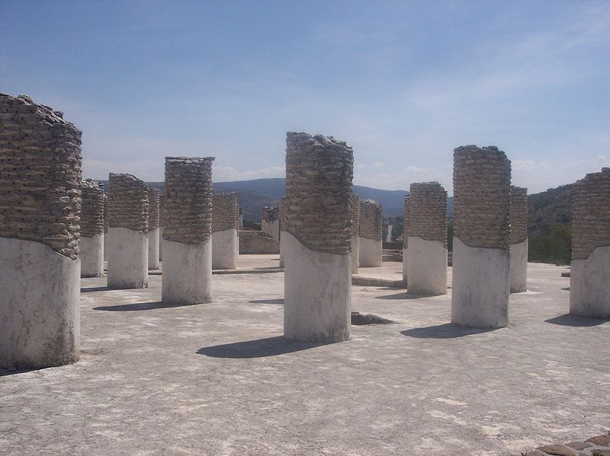
Place of Tollan-Xicocotitlan, Tula, Hidalgo
Wikipedia

Slide 121
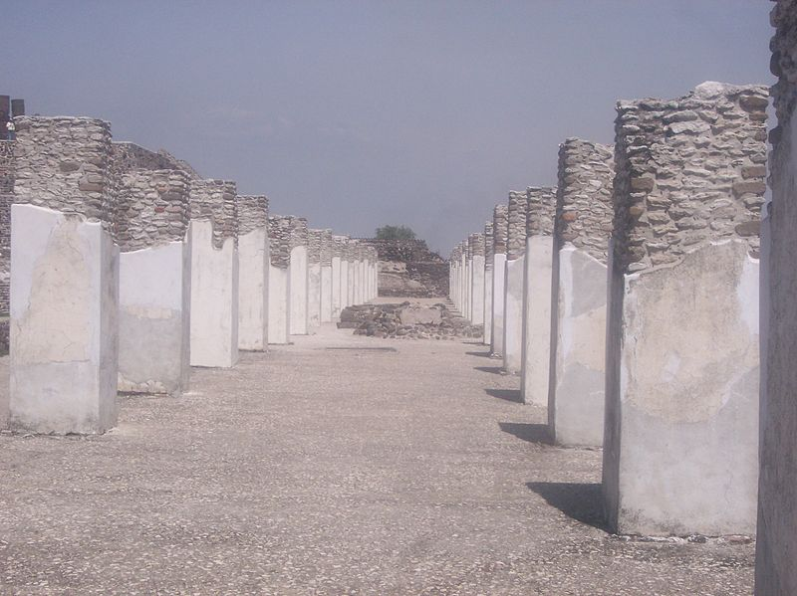
Place of Tollan-Xicocotitlan, Tula, Hidalgo
Wikipedia

Slide 122
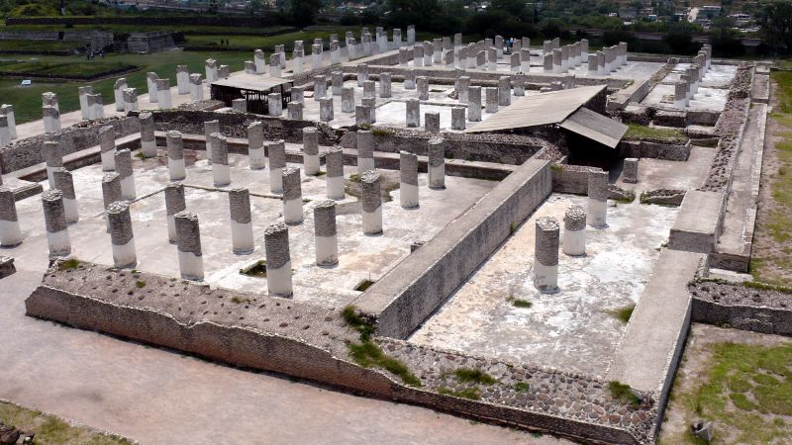
Place of Tollan-Xicocotitlan, Tula, Hidalgo
Wikipedia

Slide 123
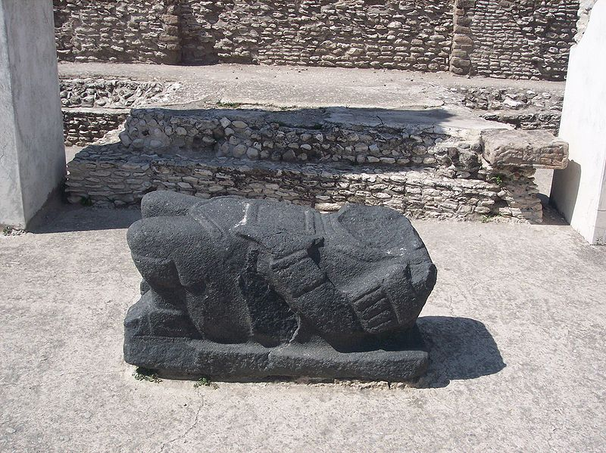
Chac Mool, Place Tollan-Xicocotitlan
Wikipedia

Slide 124
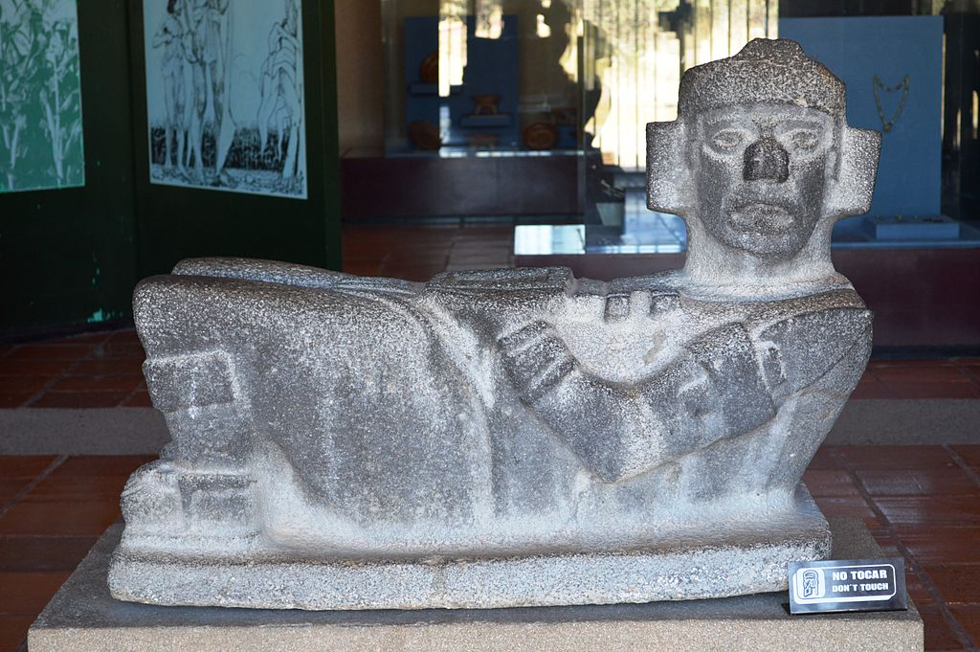
Chac Mool, Tula, Hidalgo
Wikipedia

Slide 125
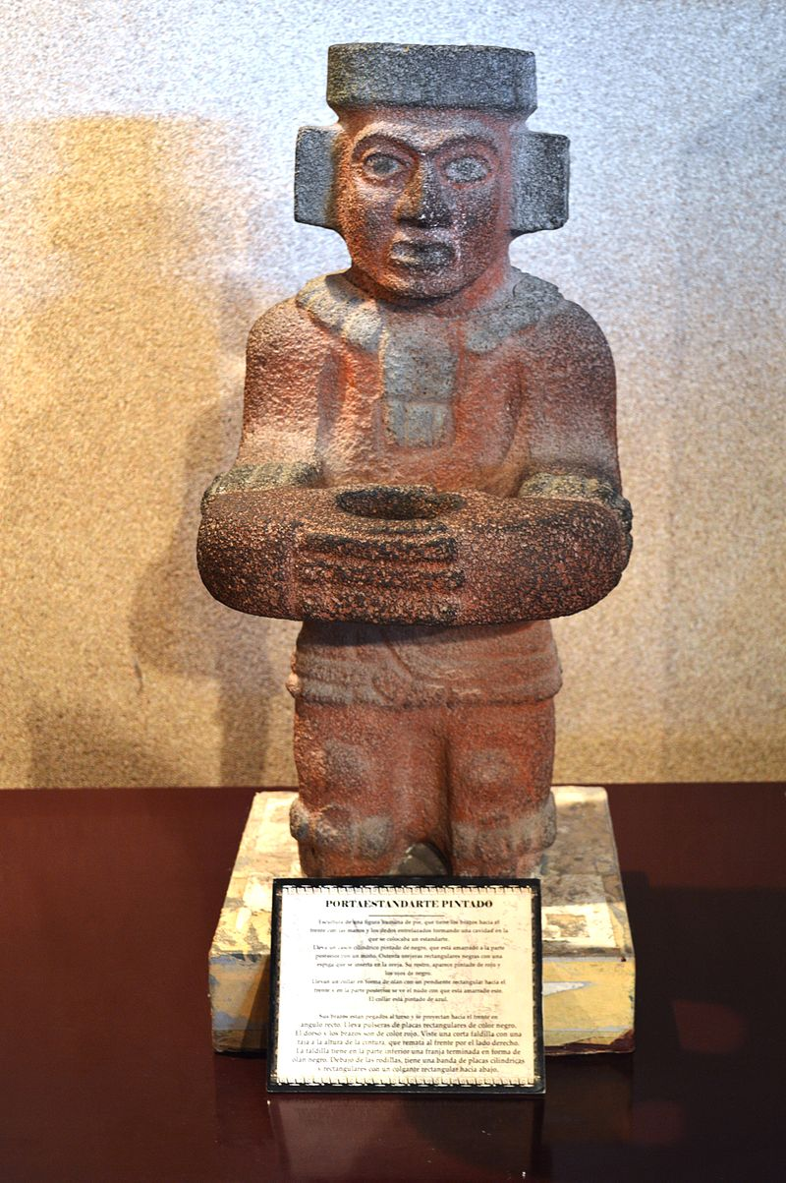
Standard Bearer, Tula, Hidalgo
Wikipedia

Slide 126
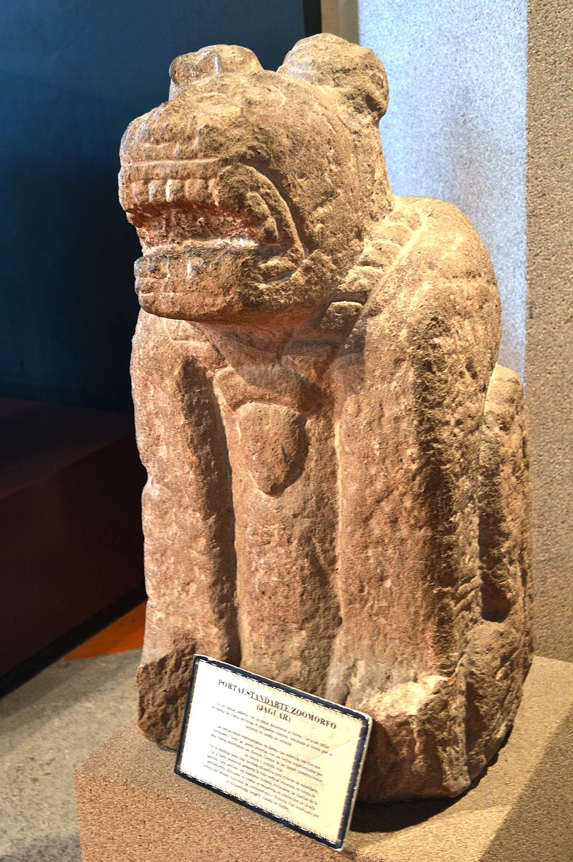
Standard Bearer, Tula, Hidalgo
Wikipedia

Slide 127
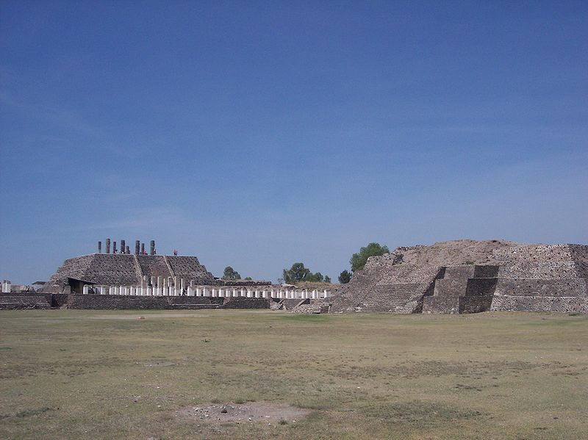
Place of Tollan-Xicocotitlan, Tula, Hidalgo
Pirámide de Tlahuizcalpantecuhtli, Tula, Hidalgo
(“House of the Morning Star”)
Wikipedia

Slide 128
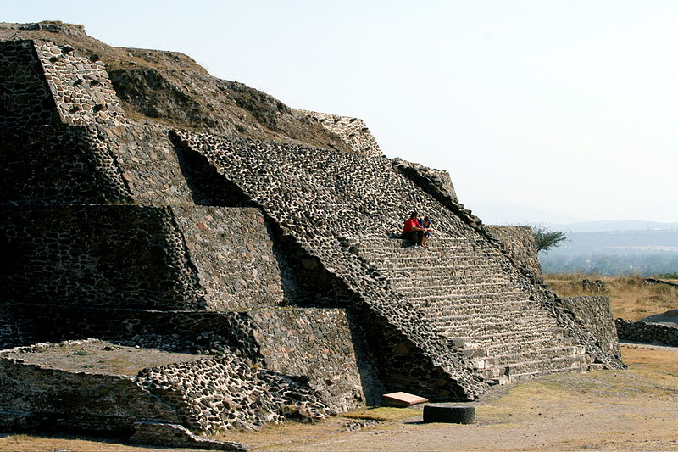
Tula, Hidalgo
Wikipedia

Slide 129
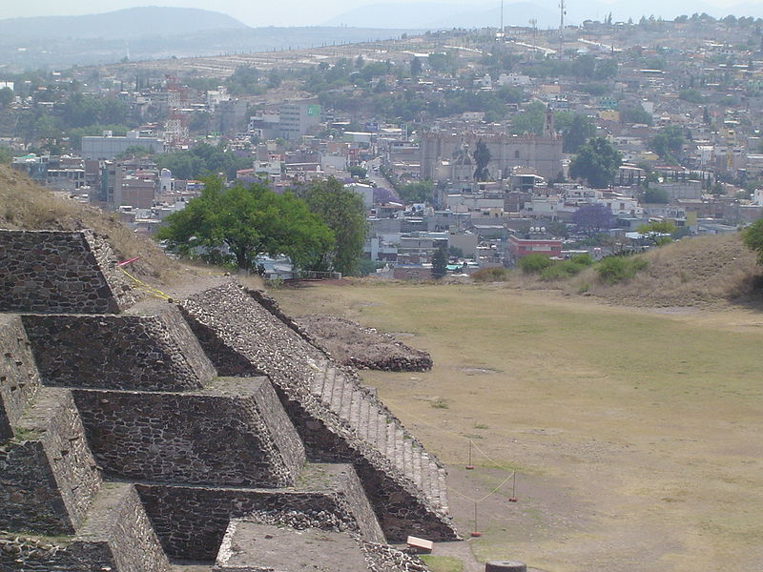
Tula, Hidalgo
Wikipedia

Slide 130
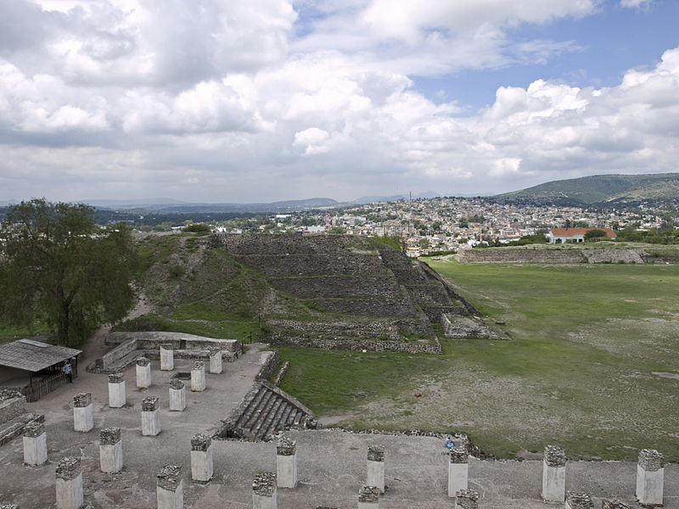
Tula, Hidalgo
Wikipedia

Slide 131
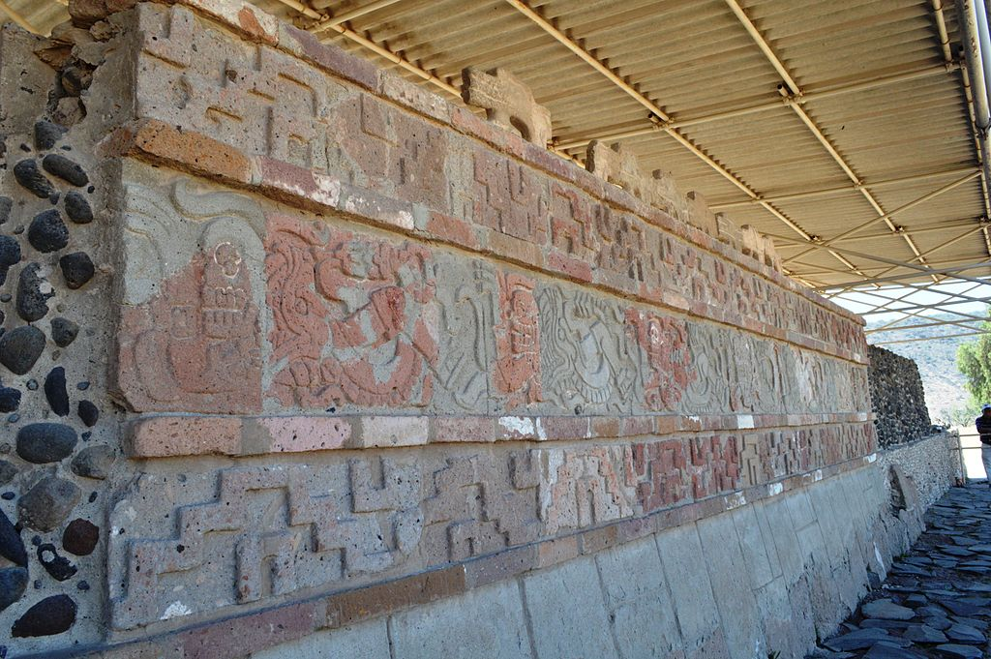
Tula, Hidalgo, Mexico: Coatepantli
Wikipedia

Slide 132
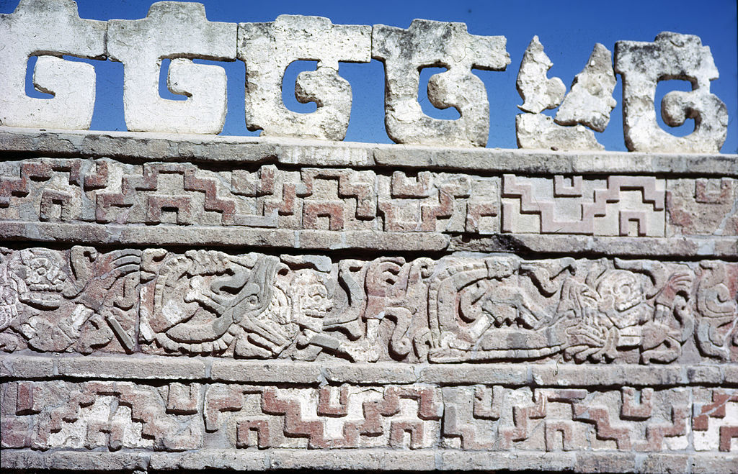
Tula, Hidalgo, Mexico: Coatepantli
Wikipedia

Slide 133
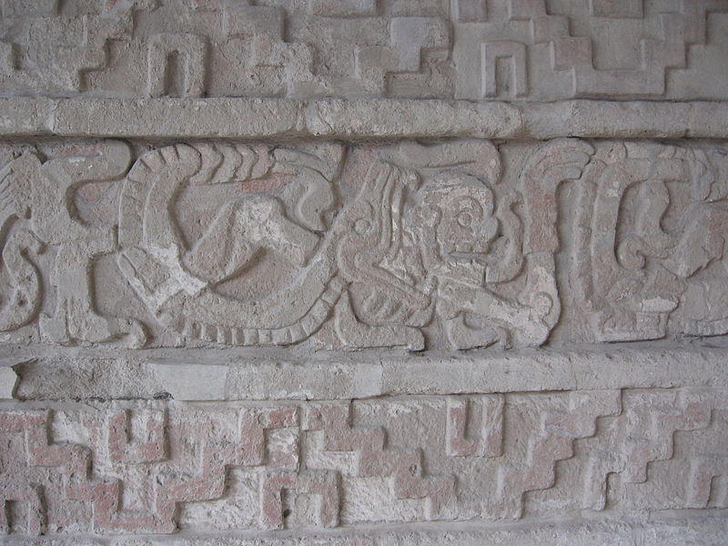
Tula, Hidalgo, Mexico: Coatepantli
Wikipedia

Slide 134
Tula, Hidalgo, Mexico: Pyramid of Tlahuizcalpanteuctli

Slide 135
Tula, Hidalgo, Mexico: Pyramid of Tlahuizcalpanteuctli

Slide 136
Tula, Hidalgo, Mexico: Coatepantli
Wikipedia

Slide 137
Place Tollan-Xicocotitlan, Tula, Hidalgo
Wikipedia

Slide 138
Toltec influence in the mid-tenth century
Wikipedia

Slide 139
Wikipedia

Slide 140
Pottery, Tula in Hidalgo
Wikipedia

Slide 141
"El descubrimiento del pulque" by José María Obregón,1869
Wikipedia

Slide 142
A Toltec Woman Spinning Cotton
Wikipedia

Slide 143
Atlantean Figures Tula, Hidalgo

Slide 144
Chichén Itzá
Tula

Slide 145
Chichén Itzá
©Edward Dawson

Slide 146
The middle Post-Classic varies regionally in total time range,
as did the Classic
in the central Mexican highlands its beginnings may be considered coincident with the fall of Teotihuacán IV culture
and the concomitant rise of Tula
(ca., A.D. 800 or 900)
elsewhere it may be a century or two later

Slide 147
The middle Post-Classic varies regionally in total time range,
as did the Classic
in the central Mexican highlands its beginnings may be considered coincident with the fall of Teotihuacán IV culture
and the concomitant rise of Tula
(ca., A.D. 800 or 900)
elsewhere it may be a century or two later

Slide 148
http://www.d.umn.edu/cla/faculty/troufs/anth3618/ma_timeline.html#Late_Postclassic

Slide 149
The end of the Post-Classic is marked by the early 16th century arrival of the Spanish, who found Tenochtitlán full of vigor and Mayapán abandoned

Slide 150
Mayapán
Tenochtitlán

Slide 151
The Aztec city of Tenochtitlán was a flourishing Postclassic city of 50,000 – 150,000 people at the time of the Conquest
it was supported by a thick fringe of chinampa farmers on its margins and around the shores of Lake Texcoco

Slide 152
The Aztec city of Tenochtitlán was a flourishing Postclasssic city of 50,000 – 150,000 people at the time of the Conquest
it was supported by a thick fringe of chinampa farmers on its margins and around the shores of Lake Texcoco

Slide 153
Aztec Chinampa Agriculture
Tenochtilán
1519
www.su.edu/faculty/steabo/twolford555/aztec_agriculture.htm

Slide 154
http://en.wikipedia.org/wiki/Chinampa

Slide 155
Aztec Chinampa Agriculture
Tenochtilán
1519
www.su.edu/faculty/steabo/twolford555/aztec_agriculture.htm

Slide 156
Modern-day Chinampa
2007
http://en.wikipedia.org/wiki/Chinampa

Slide 157
Xochimilco, Mexico City
http://wyntonsworld.com/mx.htm

Slide 158
Xochimilco, Mexico City
http://en.wikipedia.org/wiki/Xochimilco

Slide 159
water transportation
-- a mobility factor –
was almost certainly of importance in the maintenance of a community of such size

Slide 160
water transportation
-- a mobility factor –
was almost certainly of importance in the maintenance of a community of such size

Slide 161
the temple pyramids were dwarfed by the large and elaborate cities surrounding them

Slide 162
the temple pyramids were dwarfed by the large and elaborate cities surrounding them

Slide 163
the Tenochas rose to dominance in central Mexico during bitter intercity fighting following the collapse of Teotihuacán

Slide 164
the Tenochas rose to dominance in central Mexico during bitter intercity fighting following the collapse of Teotihuacán

Slide 165
Militarism, secularism, and urbanism do not exist evenly in all parts of the Mesoamerican area
there are some indications that the highland basin environments were more favorable for urban growth than the lowlands
thus the urban classification seems to fit better in western Mexico, Oaxaca, and the Guatemalan highlands than on the East coast or in the Maya lowlands

Slide 166
Militarism, secularism, and urbanism do not exist evenly in all parts of the Mesoamerican area
there are some indications that the highland basin environments were more favorable for urban growth than the lowlands
thus the urban classification seems to fit better in western Mexico, Oaxaca, and the Guatemalan highlands than on the East coast or in the Maya lowlands

Slide 167
Yet there are some significant variations among the highland regions
in the Guatemalan highlands some of the largest site zones date from the Formative
the Kaminaljuyú site offers evidence of a great occupation zone and politico-religious center outstripping in size anything that came later

Slide 168
Yet there are some significant variations among the highland regions
in the Guatemalan highlands some of the largest site zones date from the Formative
the Kaminaljuyú site offers evidence of a great occupation zone and politico-religious center outstripping in size anything that came later

Slide 169
Guatemalan highland late Post-Classic sites are well fortified, however, and attest to a period of widespread warfare and strife linked to the disruptions in Central Mexico

Slide 170
at Chichén Itzá, the Tula-Toltec art and the new constructions at an old Classic ceremonial center suggest that the long-distance conquest was a feature of the early Post-Classic in that region

Slide 171
at Chichén Itzá, the Tula-Toltec art and the new constructions at an old Classic ceremonial center suggest that the long-distance conquest was a feature of the early Post-Classic in that region

Slide 172
just how much of an urban center Chichén Itzá ever became is not clear
there are numerous house mounds around the center, but it is unlikely that the dwelling pattern here was comparable to that of Tenochtitlán

Slide 173
later, however, the Yucatecán Maya attempted an urban center at the walled site of Mayapán

Slide 174
later, however, the Yucatecán Maya attempted an urban center at the walled site of Mayapán

Slide 175
Mayapán

Slide 176
within the enclosing wall some two thousand household units have been mapped over an area of about two to three kilometers in extent
Mayapán is the most urbanized of any known Post-Classic Maya site, but whether the greater part of its inhabitants lived within the walls most of the year following non-farming occupations is not clear

Slide 177
within the enclosing wall some two thousand household units have been mapped over an area of about two to three kilometers in extent
Mayapán is the most urbanized of any known Post-Classic Maya site, but whether the greater part of its inhabitants lived within the walls most of the year following non-farming occupations is not clear

Slide 178
in any case, the urbanization was less successful in the Mayan Petén and northern Yucatán than in the Valley of Mexico

Slide 179
One important Post-Classic phenomenon that was not significant in the earlier stages . . .
the large-scale exportation and implementation of the Post-Classic features of militarism, secularism and urbanism into and upon other cultural traditions where they had been lacking

Slide 180
One important Post-Classic phenomenon that was not significant in the earlier stages . . .
the large-scale exportation and implementation of the Post-Classic features of militarism, secularism and urbanism into and upon other cultural traditions where they had been lacking

Slide 181
Mayapán
Mayapán, for example, may have been modified by such an implantation, deriving its Post-Classic patterns from central Mexico

Slide 182
Late Post-Classic
Middle Post-Classic
Early Post-Classic

Slide 183
Late Post-Classic
Middle Post-Classic
Early Post-Classic

Slide 184
A.D. 925 – 1200 (The Maya)
A.D. 900 – 1200 (Mexico)
Characterized by . . .

Slide 185
http://www.d.umn.edu/cla/faculty/troufs/anth3618/ma_timeline.html#Late_Postclassic

Slide 186
Central Highlands Early Post Classic sites/phases include
Tula (Tollán)
Teotihuacán
(Mazapán)

Slide 187
North and Central Gulf Early Post Classic sites/phases include
El Tajín
(continued)

Slide 188
Southern Gulf Coast Early Post Classic sites/phases include
Villa Alta
Kamialjuyú

Slide 189
Oaxaca Early Post Classic sites/phases include
Tulúm
Monte
Albán IV

Slide 190
Southern Pacific Coast Early Post Classic sites/phases include
Tohil
Plumbate

Slide 191
Southern Maya Highlands Early Post Classic sites/phases include
Mitla
Ayampuk

Slide 192
Central Maya Early Post Classic sites/phases include

Slide 193
Northern Maya Early Post Classic sites/phases include
Toltec Chichén Itzá

Slide 194
Late Post-Classic
Middle Post-Classic
Early Post-Classic

Slide 195
NA (The Maya)
NA (Mexico)
A.D. 1200 - 1400
Characterized by. . .

Slide 196
Central Highlands Middle Post Classic sites/phases include
Chichimec
“Feudal”
states

Slide 197
Late Post-Classic
Middle Post-Classic
Early Post-Classic

Slide 198
A.D. 1200 -- 1530 (The Maya)
A.D. 1200 -- 1521 (Mexico)
A.D. 1400 -- 1521
Characterized by. . .

Slide 201
http://www.d.umn.edu/cla/faculty/troufs/anth3618/ma_timeline.html#Late_Postclassic

Slide 202
http://www.d.umn.edu/cla/faculty/troufs/anth3618/ma_timeline.html#Late_Postclassic

Slide 204
Central Highlands Late Post Classic sites/phases include
Aztec
Empire

Slide 205
Aztec Empire ca. 1519
http://commons.wikimedia.org/wiki/Image:Aztec_empire_1519-fr.svg

Slide 206
North and Central Gulf Late Post Classic sites/phases include
Isla de Sacrificios

Slide 207
Southern Gulf Late Post Classic sites/phases include
Independent
states

Slide 208
Oaxaca Late Post Classic sites/phases include
Monte
Albán V
Mitla /
Mixtec states

Slide 209
Southern Pacific Late Post Classic sites/phases include
Aztec
Empire
Xoconochco
(Soconusco)

Slide 210
Xoconochco
(Soconusco)
Aztec Empire ca. 1519
http://commons.wikimedia.org/wiki/Image:Aztec_empire_1519-fr.svg

Slide 211
Southern Maya Highlands Late Post Classic sites/phases include
Mixco Viejo

Slide 212
Central Maya Late Post Classic sites/phases include
Tayasal

Slide 213
Northern Maya sites include
Independent States
Mayapán

Slide 214
Northern Maya Late Post Classic sites/phases include
Independent
States
Mayapán

Slide 215
End of the Post-Classic

