Slide 1
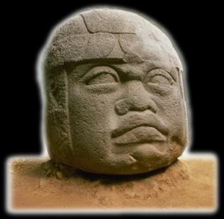
Ancient Middle America
The Preclassic
“Early Formative”
an introduction
University of Minnesota Duluth
Tim Roufs ©2009-2019

Slide 2
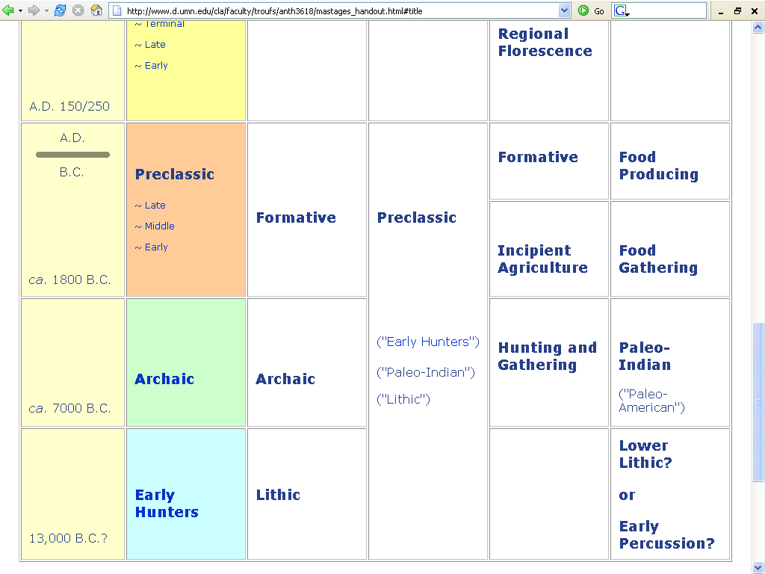

Slide 3
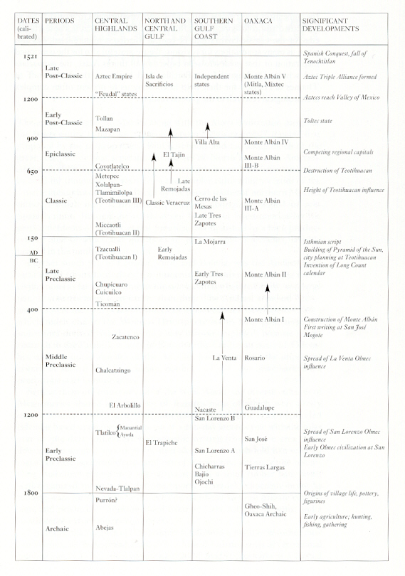
Mexico (7th ed)
Page 244
Mexico (7th ed.). Michael D. Coe and Rex Koontz. NY: Thames and Hudson, 2008, p. 236.

Slide 4
Mexico (7th ed)
Page 244
Mexico (7th ed.). Michael D. Coe and Rex Koontz. NY: Thames and Hudson, 2008, p. 236.

Slide 5
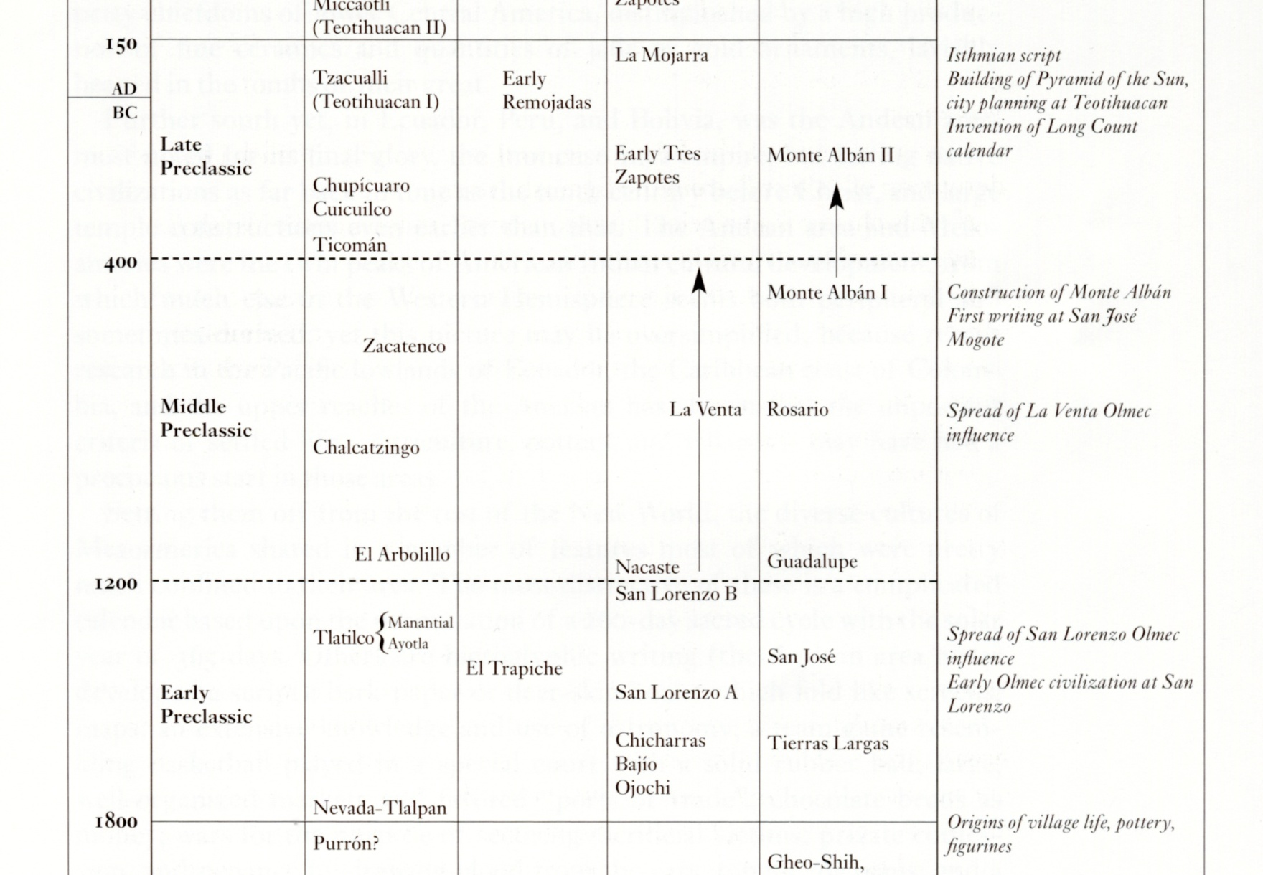
Mexico (7th ed.). Michael D. Coe and Rex Koontz. NY: Thames and Hudson, 2008, p. 236.

Slide 6
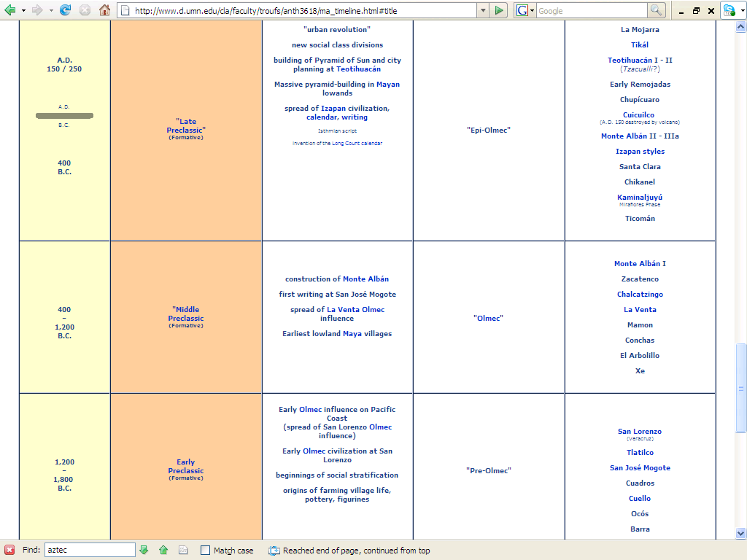
http://www.d.umn.edu/cla/faculty/troufs/anth3618/ma_timeline.html#Late_Preclassic

Slide 7
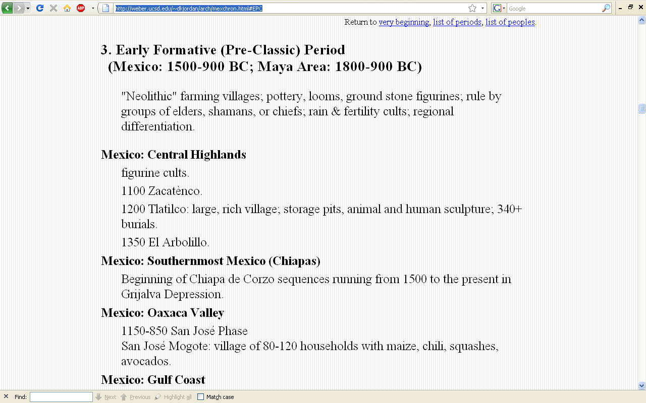
http://weber.ucsd.edu/~dkjordan/arch/mexchron.html#EPC

Slide 8
Nine Important Points
for the
Preclassic Stage
After Willey and Phillips, Method and Theory in American Archaeology. Chicago: University of Chicago Press, 1970.

Slide 9
Preclassic Stage
1. With the advent of the Preclassic there is, for most American areas, a fundamental economic shift from hunting-and-gathering to agricultural food production
this is the most profound change in the scheme of changes

Slide 10
Preclassic Stage
2. The geographical focus moves from North America to Middle America, and, perhaps, even farther south to the central Andes
one exception is Cahokia in Illinois

Slide 11
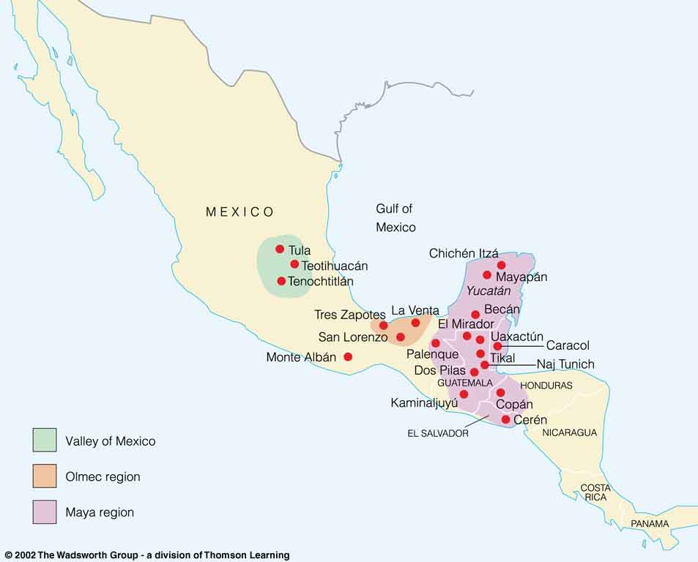
Olmec Region
La Venta
Mesoamerican archaeological sites.
Understanding Physical Anthropology and Archaeology, 8th ed., p. 481.

Slide 12
Preclassic Stage
The gradual steps by which a sedentary, village, “Formative” way of life was achieved are not yet clear
. . .

Slide 13
Preclassic Stage
. . . but it is likely that slow, steady experimentation by Archaic gathering peoples led to village life in which the primary dependence was upon crops like maize and beans
e.g., Tehuacán

Slide 14
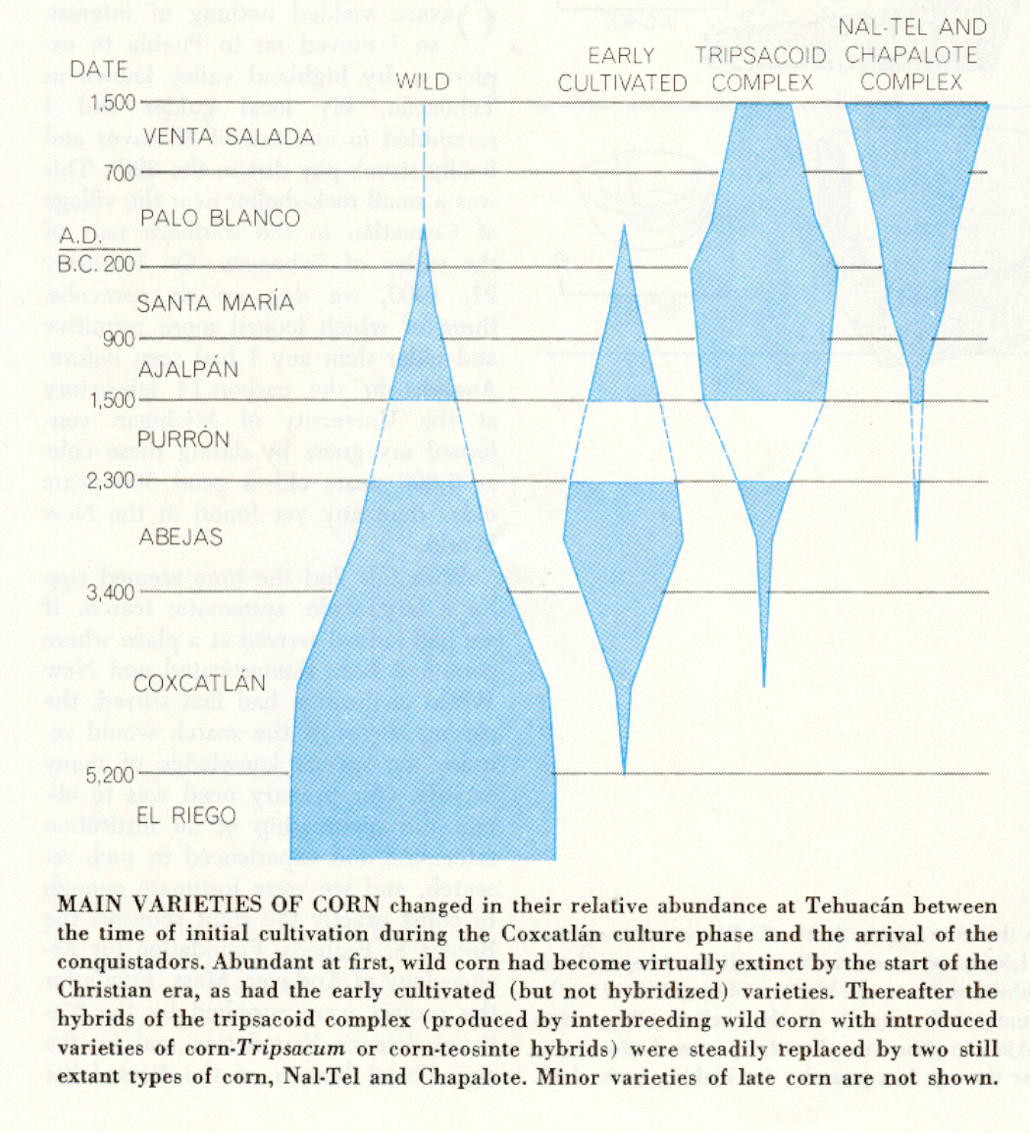
Tehuacán, Puebla

Slide 15
Preclassic Stage
Agricultural villages and towns appear in Middle America in the earliest phases of “Formative” sequences
in several regions of Middle America
villages probably date back to as early as the middle of the second millennium B.C.

Slide 16
Preclassic Stage
5. A stable village or town life, with its potentialities for cultural and social development may be made possible by economics other than the agricultural . . .

Slide 17
Preclassic Stage
5. A stable village or town life, with its potentialities for cultural and social development may be made possible by economics other than the agricultural . . .

Slide 18
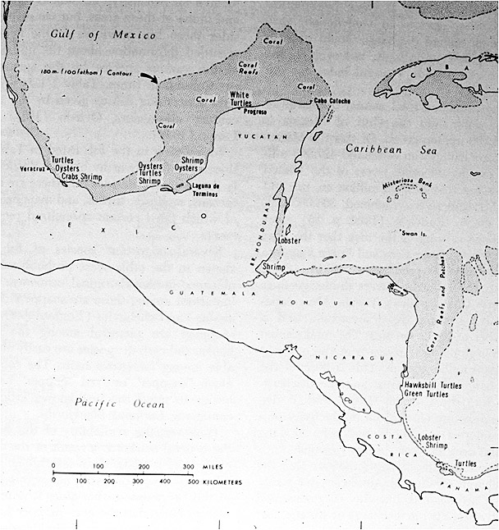
The Continental Shelf and Areas of Certain Fisheries

Slide 19
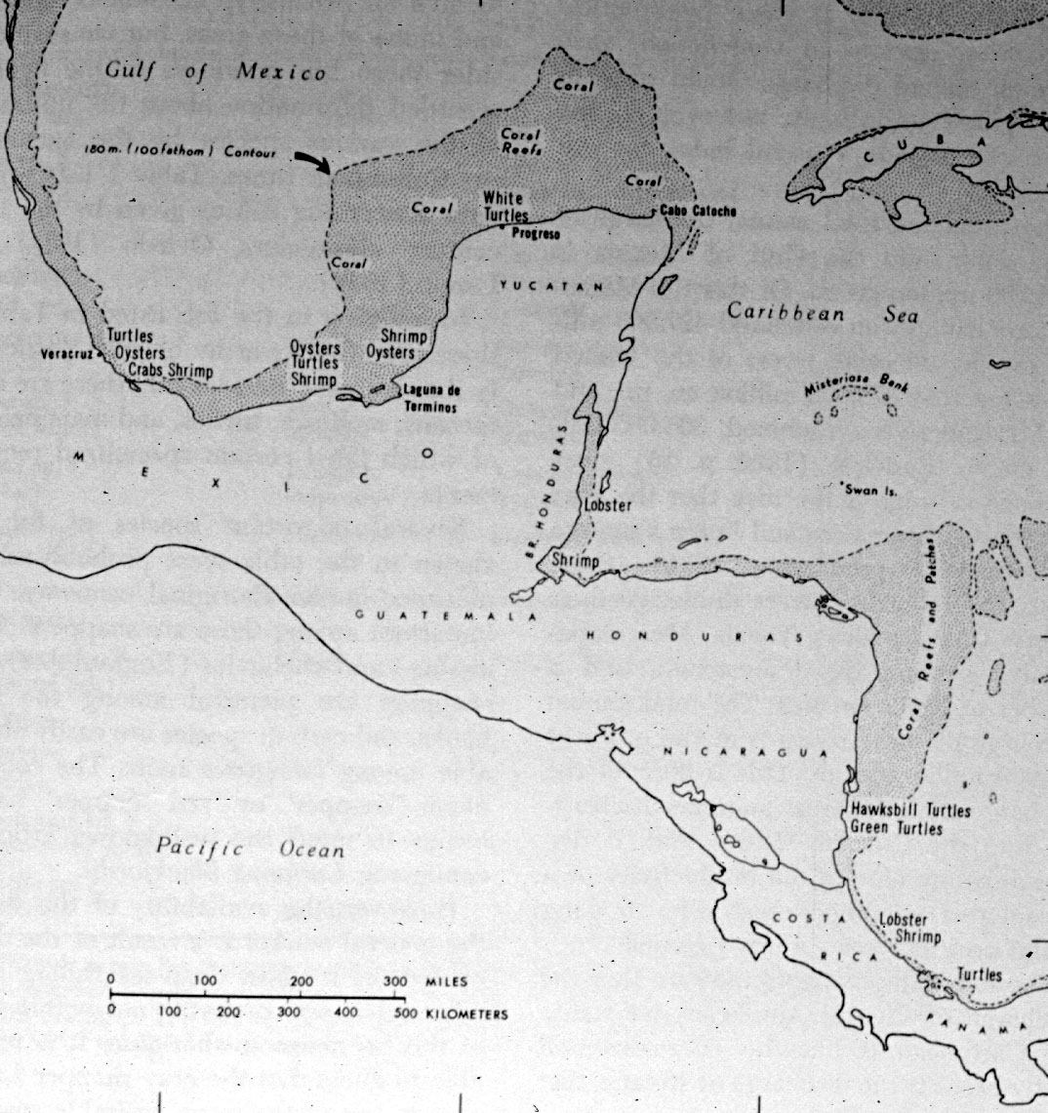
The Continental Shelf and Areas of Certain Fisheries

Slide 20
Preclassic Stage
. . . therefore, the emphasis on the Preclassic Stage definition is upon
settlement size
stability
the social and cultural implications which these carry
rather than upon agriculture per se

Slide 21
Preclassic Stage
. . . the Preclassic is therefore defined
“By the presence of agriculture, or any other subsistence economy of comparable effectiveness, and by the successful integration of such an economy into well-established sedentary village life”

Slide 22
Preclassic Stage
. . . the Preclassic is therefore defined
“By the presence of agriculture, or any other subsistence economy of comparable effectiveness, and by the successful integration of such an economy into well-established sedentary village life”

Slide 23
Preclassic Stage
. . . this definition emphasizes the fact that the economic potential for even the richest of the hunting-gathering societies was definitely limited in such a way that further development to the “New World Classic” stage was precluded

Slide 24
Preclassic Stage
development to the “New World Classic” stage was possible only with agriculture, or its equivalent, and only in certain natural environmental settings

Slide 25
Preclassic Stage
6. The agricultural-based cultures are characterized by the abundant use of ceramics . . .
and weaving is usually also well-developed

Slide 26
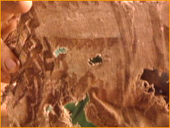
Zoque cloth
www.d.umn.edu/cla/faculty/troufs/anth3618/video/Lost_Cave_People.html#title

Slide 27
textiles
take on
important
symbolic
meanings
www.travelchiapas.com/huipils/huipils-history.php

Slide 28
Preclassic Stage
7. The competencies of the Lithic and Archaic stages in the chipping, grinding, and the polishing of stone are carried on into the Preclassic Stage

Slide 29
Preclassic Stage
8. Site occupation tends to be stable and of long duration
houses and other buildings are of permanent or “semi-permanent” quality

Slide 30
Preclassic Stage
The village is the basic sociopolitical unit
in some regions it is of town size

Slide 31
Preclassic Stage
specialized politico-religious architecture and/or sites are frequently features of the Preclassic Stage
these take the form of pyramidal mound-based temples within, or apart from, the village or town communities

Slide 32
Preclassic Stage
in many places these special buildings or sites imply a politico-religious organization and authority reaching beyond the confines of a single site or community

Slide 33
Preclassic Stage
Discussion

Slide 34
Preclassic Stage
REM: the settlement patterns, etc., not the simple presence of agriculture, are the effective criteria for classification . . .

Slide 35
Preclassic Stage
REM: the settlement patterns, etc., not the simple presence of agriculture, are the effective criteria for classification . . .

Slide 36
Preclassic Stage
. . . that is why the Preclassic Stage is defined by the presence of agriculture, or any other subsistence economy of comparable effectiveness, and by the successful integration of such an economy into well-established, sedentary village life

Slide 37
Preclassic Stage
. . . that is why the Preclassic Stage is defined by the presence of agriculture, or any other subsistence economy of comparable effectiveness, and by the successful integration of such an economy into well-established, sedentary village life

Slide 38
The Continental Shelf and Areas of Certain Fisheries

Slide 39
Preclassic Stage
but usually the basic sustenance came from the agriculture production of
maize
squash
beans
chili

Slide 40
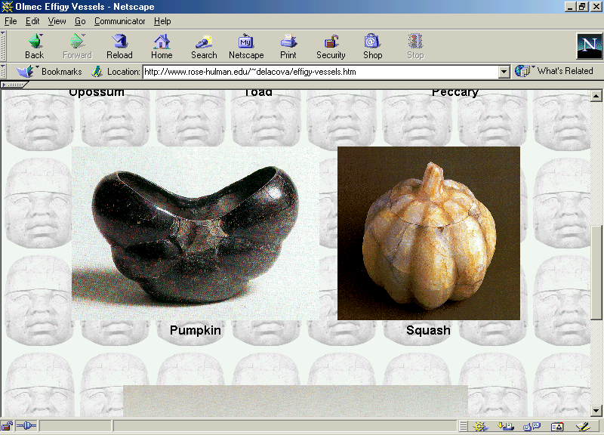
http://www.rose-hulman.edu/~delacova/fish-effigy-vessels.htm

Slide 41
Preclassic Stage
their vessels represent many of the important plants and animals of these people:
squashes rabbits
ducks frogs
turtles birds
fish and other animals

Slide 42
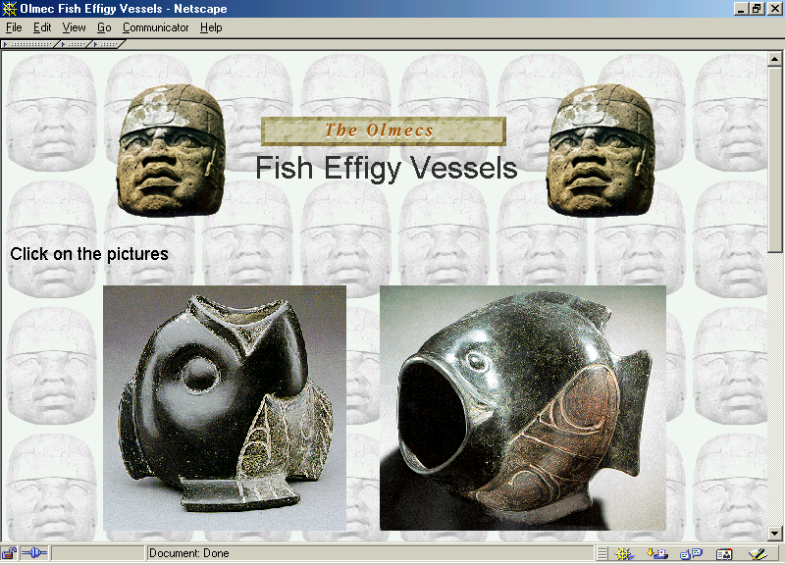
http://www.rose-hulman.edu/~delacova/fish-effigy-vessels.htm

Slide 43
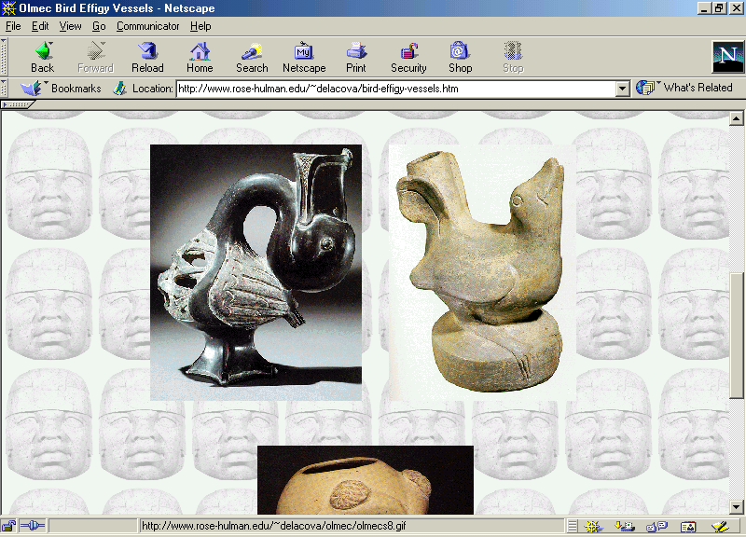
http://www.rose-hulman.edu/~delacova/fish-effigy-vessels.htm

Slide 44
Preclassic Stage
Because of their technologies these groups adapted themselves well to their environments. They had:
stone mortars, and manos and metates for pounding seeds and grinding maize
projectile points for hunting
bone awls and needles for making clothing
stone axes for clearing forests and working wood
scrapers and polishers

Slide 45
http://www.rose-hulman.edu/~delacova/everyday-use.htm

Slide 46
Preclassic Stage
the name “Formative” implies the formation of the New World agricultural village pattern
at the same time, it carries with it the connotation that this pattern was basic to and formational toward later and more advanced developments

Slide 47
Preclassic Stage
1800 B.C. – A.D. 250 (The Maya)
1800 B.C. – A.D. 150 (Mexico)
1600 – 200 (300) B.C.
but probably developed as early as 2000 B.C. in some areas . . .
and by 1500 farming villages were common

Slide 48
Preclassic Stage
the origins of the Preclassic Stage cultures are extremely complex and diverse
include the gradual assemblage of elements over considerable periods of time and over wide areas

Slide 49
Preclassic Stage
in Mesoamerica several different archaeological regions have Preclassic cultures
these include the earliest known pottery-and-agriculture phases

Slide 50
Preclassic Stage
the distinction between a purely village life and a village-life-plus- ceremonial-center-participation poses a problem in stage classification . . .

Slide 51
Preclassic Stage
the ceremonial center with its public works generally stands for multi-village cooperation and for the beginning of a relatively large-scale politico-religious organization

Slide 52
Preclassic Stage
the ceremonial center with its public works generally stands for multi-village cooperation and for the beginning of a relatively large-scale politico-religious organization

Slide 53
Preclassic Stage
the groups in the Valley of Mexico practiced a fertility cult
related to natural phenomena and fecundity
female figurines were modeled in clay with a view to propitiating gods who controlled harvests

Slide 54
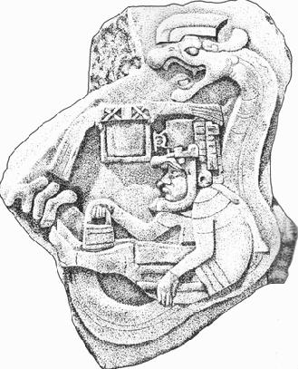
Preclassic Stage
Under Olmec influences Central Mexico adopted a jaguar deity related to the rain
this soon became fused with an
aquatic serpent and resulted in sort
of a celestial dragon that was later to
evolve into the god of water

Slide 55
Preclassic Stage
a burial at Tlatilco indicates that a cult of the dead was also being practiced . . .

Slide 56
Preclassic Stage
they wrapped the deceased in mats or blankets and placed them, in either an extended or flexed position, inside pits dug in the ground
they sprinkled the bodies with red ochre
bodies were accompanied with offerings of food and personal objects for use in the hereafter

Slide 57
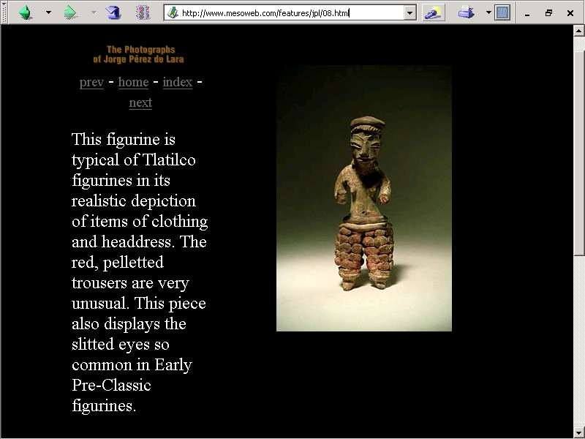

Slide 58
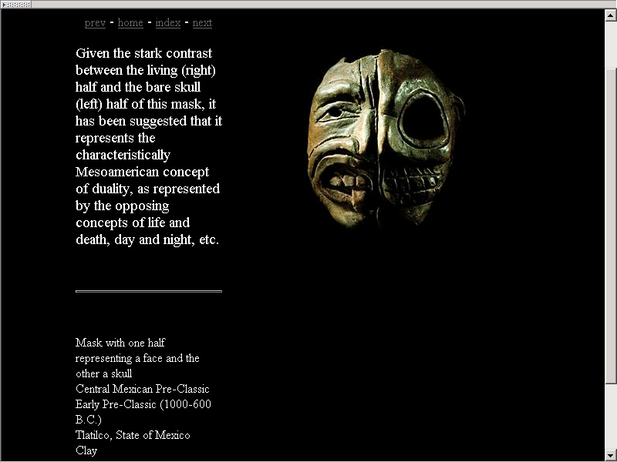

Slide 59
Preclassic Stage
Ceramics appear in abundance

Slide 60
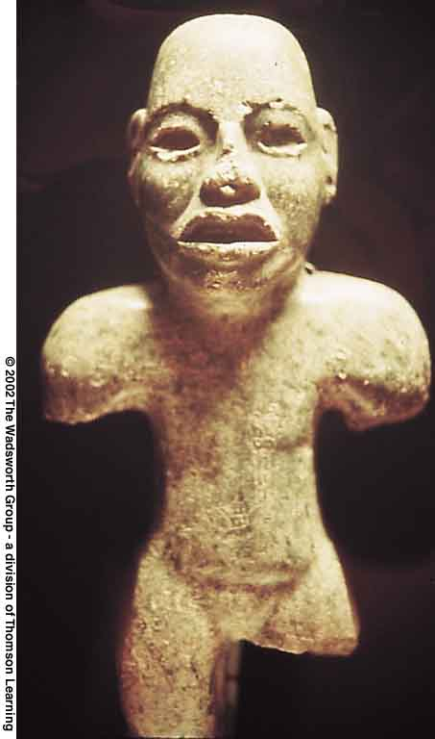
Olmec Figurine

Slide 61
Preclassic Stage
the Preclassic Stage can be broken down into three sub-stages . . .

Slide 62
Preclassic Stage
Late Preclassic
Middle Preclassic
Early Preclassic

Slide 63
Early Preclassic Stage
Late Preclassic
Middle Preclassic
Early Preclassic

Slide 64
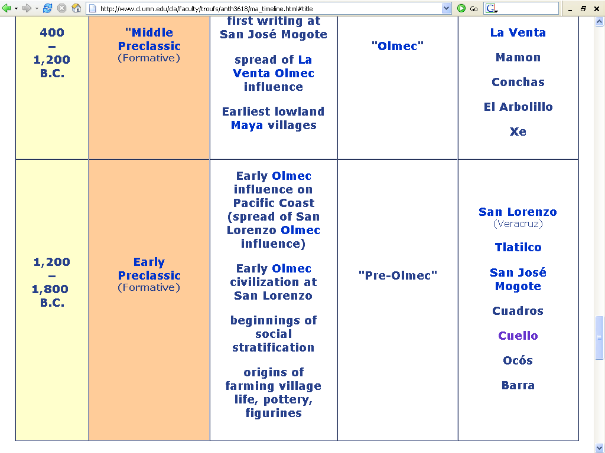

Slide 65
Early Preclassic Stage
Early Preclassic Stage
1800 – 1000 B.C. (The Maya)
1800 – 1200 B.C. (Mexico)
2500 – 1250 B.C.

Slide 66
Early Preclassic Stage
Early Preclassic Sites include:
San Lorenzo
Chiapa de Corzo
Cerros
Ocós
Cuello

Slide 67
Early Preclassic Stage
Early Preclassic Sites include:
El Arbolillo
Zacatenco
Tlatilco
Barra
Cuadros
San José Mogote

Slide 68
Early Preclassic Stage
Early Preclassic Sites include:
Ajalpan
Izucar

Slide 69
Early Preclassic Stage
Late Preclassic
Middle Preclassic
Early Preclassic

Slide 70
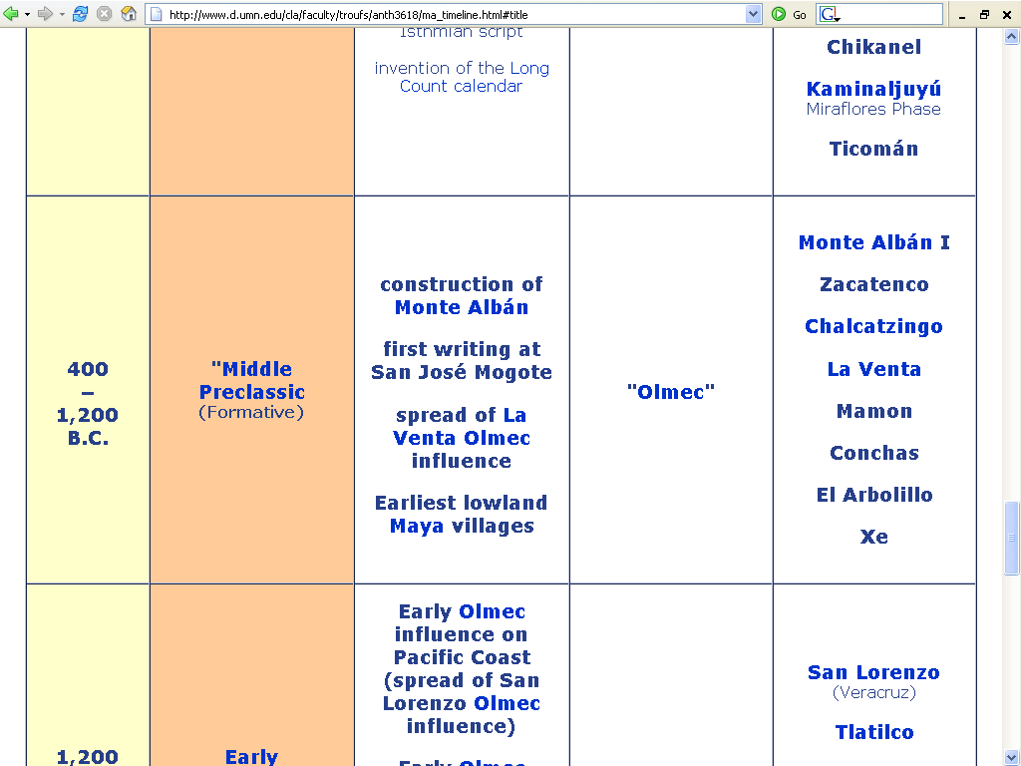

Slide 71
Middle Preclassic Stage
1000 - 300 B.C. (The Maya)
1200 - 400 B.C. (Mexico)

Slide 72
Olmec
Understanding Physical Anthropology and Archaeology, 8th ed., p. 481.

Slide 73
Middle Preclassic Stage
Middle Preclassic Sites include:
La Venta
Chalcatzingo
Monte Alban I
Copilco
Kaminaljuyú
Uaxactún

Slide 74
Middle Preclassic Stage
Middle Preclassic Sites include:
Gualupita
Mamon
Xe
El Arbolillo
Conchas
Mazatán

Slide 75
Middle Preclassic Stage
Middle Preclassic Sites include:
El Opeño
Zacatenco

Slide 76
Late Preclassic Stage
Late Preclassic
Middle Preclassic
Early Preclassic

Slide 77
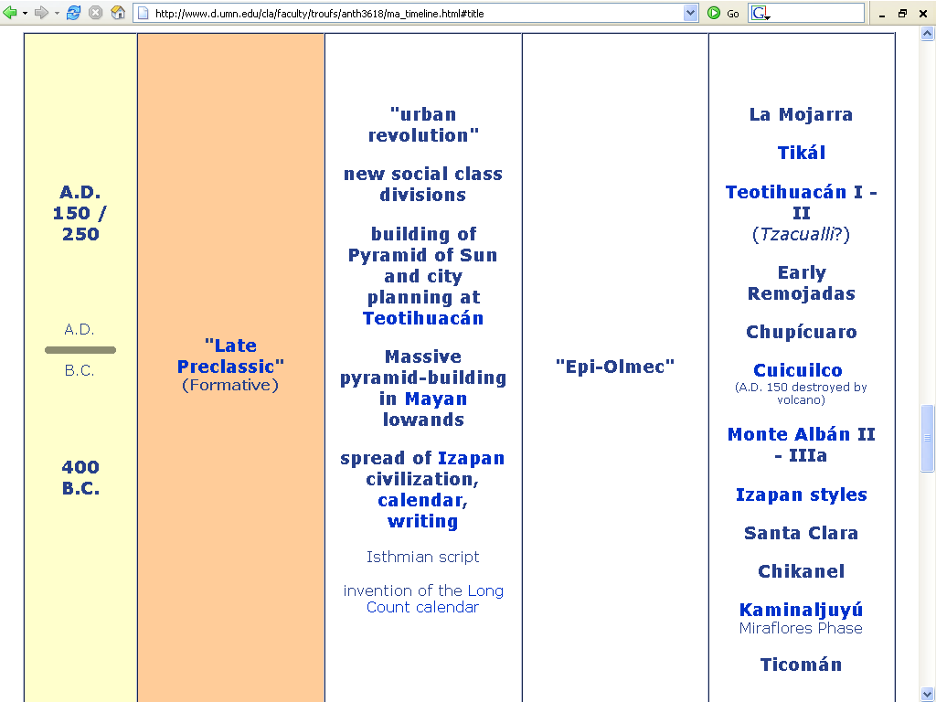

Slide 78
Late Preclassic Stage
300 B.C. - A.D. 250 (The Maya)
400 B.C. – A.D. 150 (Mexico)
300 B.C. – A.D. 1 / 150

Slide 79
Late Preclassic Stage
Late Preclassic Sites begin to multiply rapidly and include
Teotihuacán I (Tzacualli phase)
Monte Albán II
Chupicuaro
Cuicuilco
Early Tres Zapotes
Tikál
Dzibilchaltún

Slide 80
Late Preclassic Stage
Late Preclassic Sites include
La Mojarra
Tlapacoya
Izapan styles
Edzná
Early Remojadas
Ticomán
Miraflores

Slide 81
Late Preclassic Stage
Late Preclassic Sites include:
Miraflores
Chikanel
Santa Clara

Slide 82
Protoclassic Stage
Protoclassic ?
Late Preclassic
Middle Preclassic
Early Preclassic

Slide 83
Protoclassic Stage
200 B.C. – A.D. 200
In the stage which some call the “Protoclassic” a number of features which will later distinguish the major Mexoamerican civilizations can already be recognized . . .

Slide 84
Protoclassic Stage
200 B.C. – A.D. 200
These civilizations include . . .
Maya
Zapotec
Central Veracruz cultures (Totonac)
and perhaps the Huastec
and Teotihuacán

Slide 85
Protoclassic Stage
. . . among these are:
a precise technique of working stone
the erection of stelae and altars associated with them . . .

Slide 86
Protoclassic Stage
. . . among these are:
the calendar and a system of numbering using dots and bars
the god of rain with recognizable attributes

Slide 87
Protoclassic Stage
. . . among these are:
fresco-type painting on vessels and tombs
tetrapod vessels with mammiform legs
labial and basal moldings on pottery

Slide 88
What happens next?

Slide 89
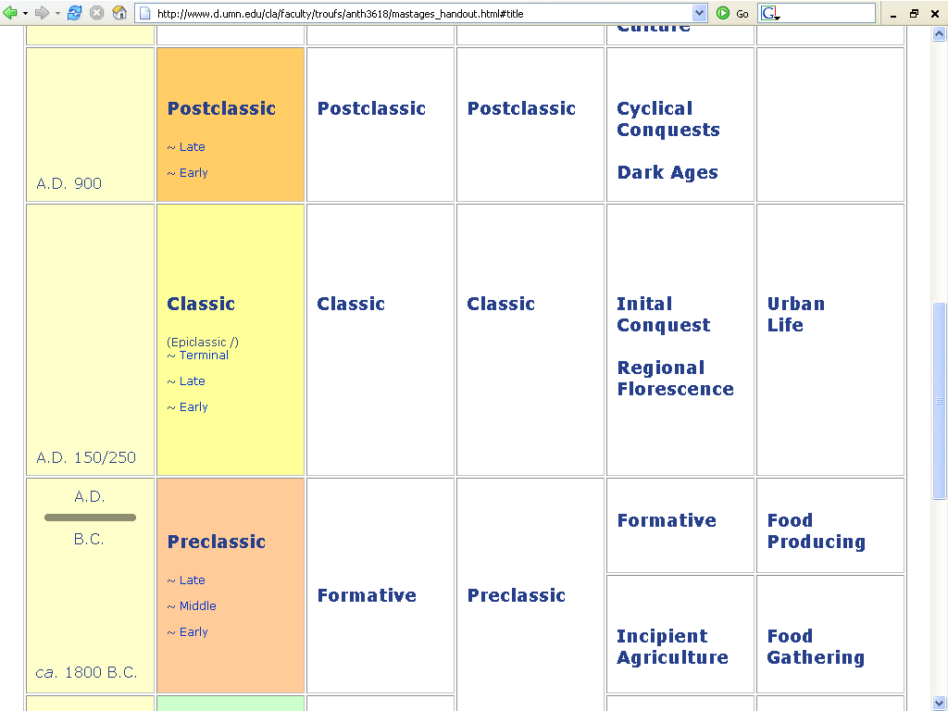

Slide 90
And after that?

Slide 91
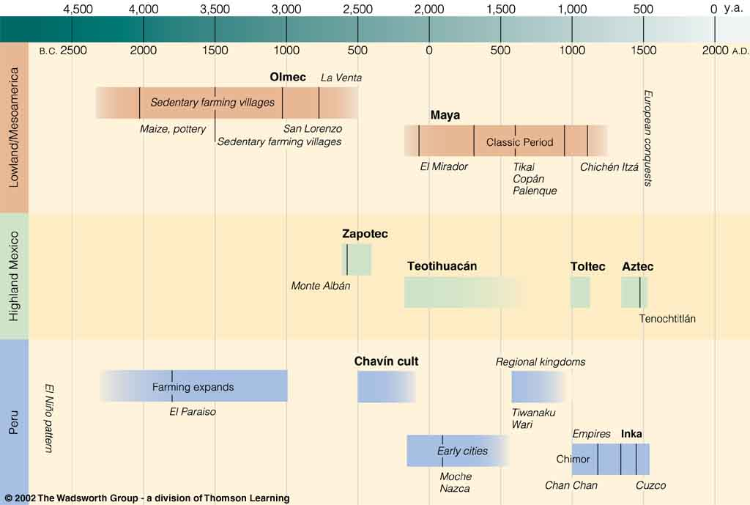
Time line of “New World Civilizations.”
Understanding Physical Anthropology and Archaeology, 8th ed., p. 479.

Slide 92
End of Introduction to the Preclassic
Continue on to The Classic

