Slide 1
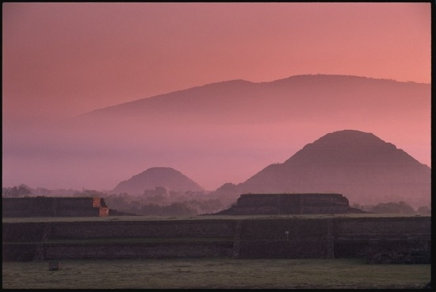
Ancient Middle America
Teotihuacán
University of Minnesota Duluth
Tim Roufs’ ©2009-2014
www.nationalgeographic.com/

Slide 2
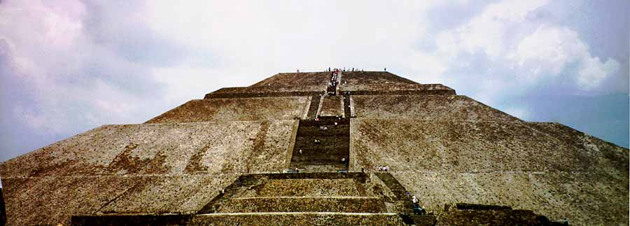
Ancient Middle America
Teotihuacán
University of Minnesota Duluth

Slide 3
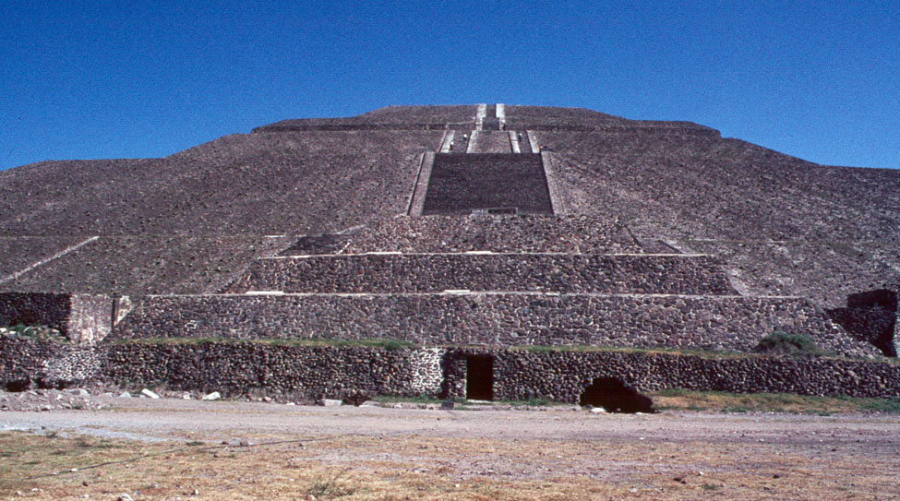
Pyramid of the Sun, 1967

Slide 4
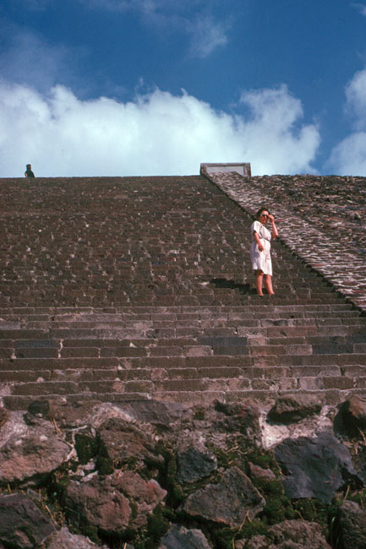
“Mixie” Campbell Roufs ascending the Pyramid of the Sun, 1967
aka Mary Magdalene Margaret Mary Juetta Campbell Roufs

Slide 5
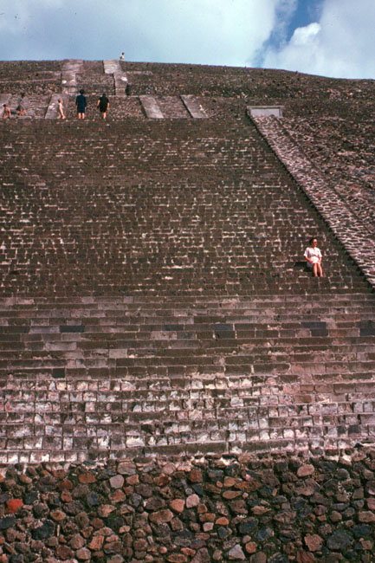
“Mixie” Campbell Roufs “at the top” of the Pyramid of the Sun, 1967

Slide 6
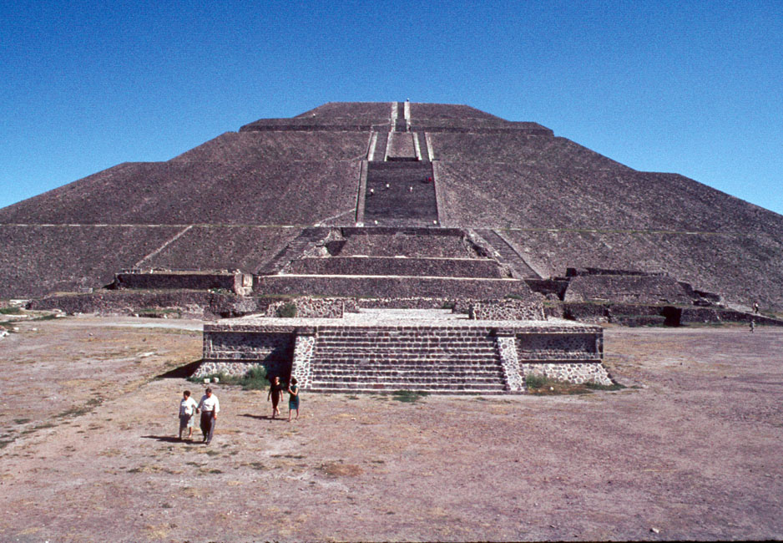
Pyramid of the Sun, 1967

Slide 7
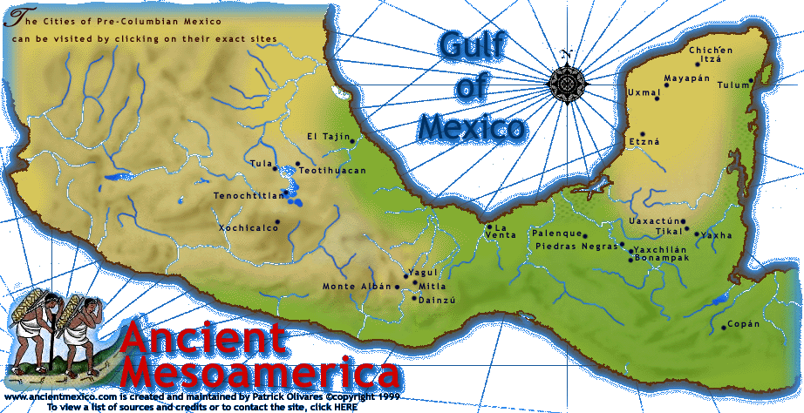

Slide 8
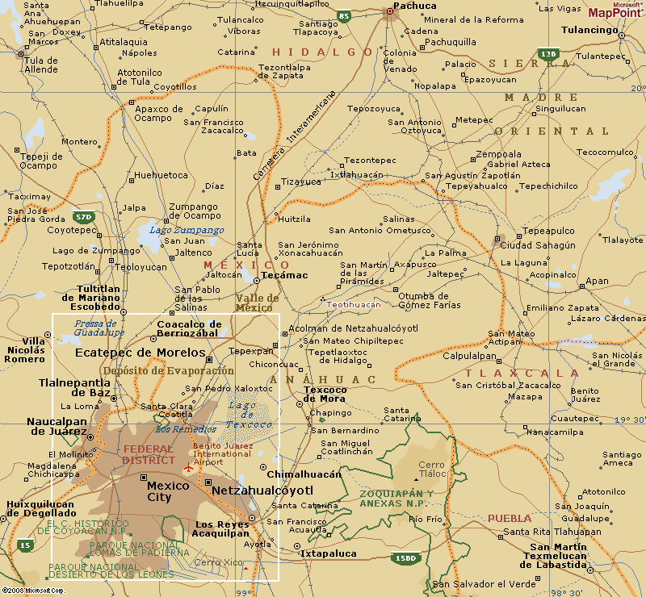
http://encarta.msn.com/map_701517005/teotihuac%C3%A1n.html

Slide 9
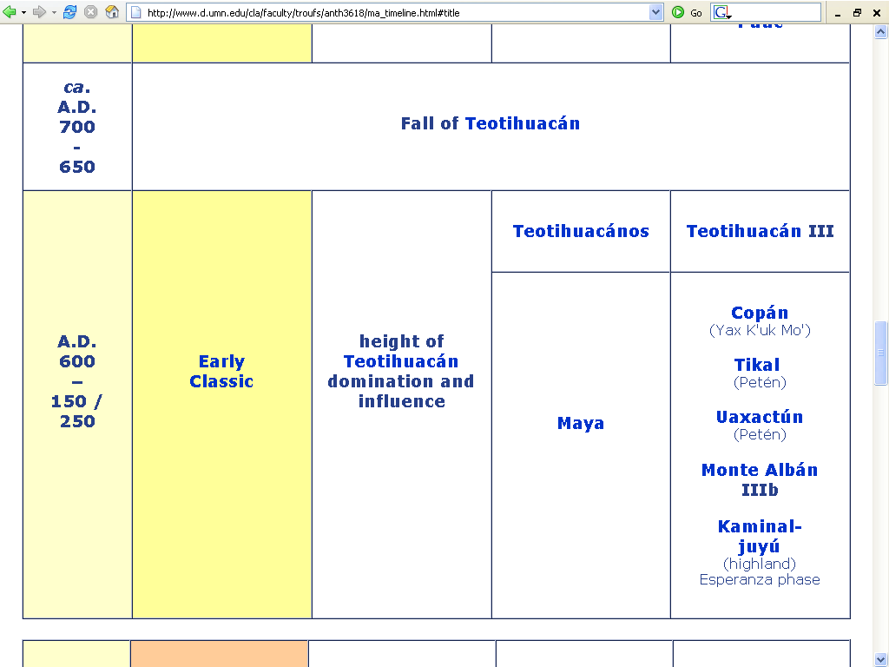

Slide 10
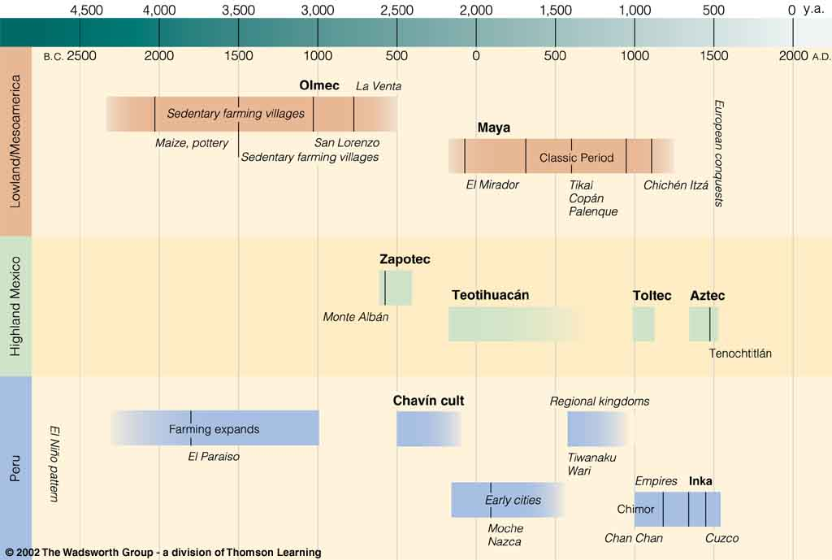
Colonial
Postclassic
Archaic
Pre-Classic
Classic
Understanding Physical Anthropology and Archaeology, 8th ed., p. 479

Slide 11
Colonial
Postclassic
Archaic
Pre-Classic
Classic
Understanding Physical Anthropology and Archaeology, 8th ed., p. 479

Slide 12
Cahokia
Ecuador
Understanding Physical Anthropology and Archaeology, 8th Ed., p. 479

Slide 13
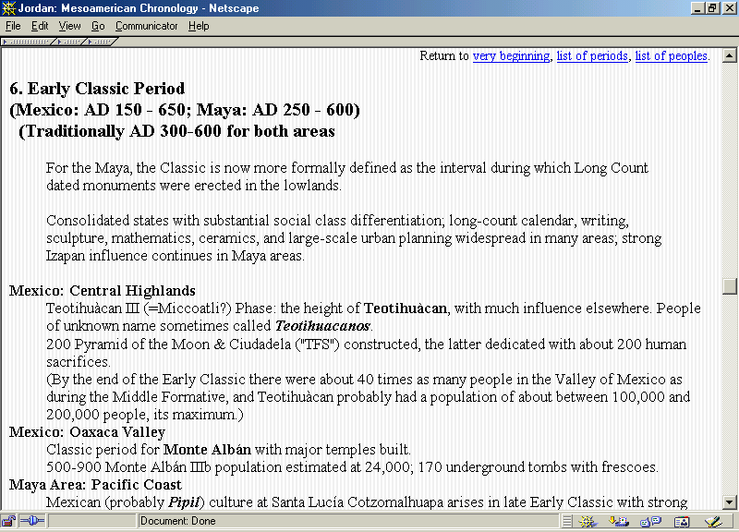

Slide 14
Classic Stage
2. The Classic Stage marks the beginning of urban life in native America
the early New World cities were built around the temple pyramids and palace platforms of the ceremonial centers

Slide 15
http://mayaruins.com/tikal/Tikal_map.html

Slide 16
Classic Stage
The Classic Stage cities were the nuclei of . . .
political and religious governments
of artistic and intellectual achievement
of commerce and craft

Slide 17
Classic Stage
4. The temples, palaces and other public buildings of the Classic are of great size and elaboration
these buildings attest to the planning, skill and labor organization of the builders

Slide 18
http://mayaruins.com/tikal/Tikal_map.html

Slide 19
Classic Stage
The Classic Stage is also characterized by the appearance of great art styles
these styles tend to be limited to well-defined regions

Slide 20
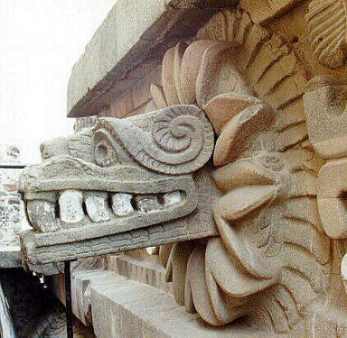
Quetzalcuatl, Teotihuacán
Notes:
20

Slide 21
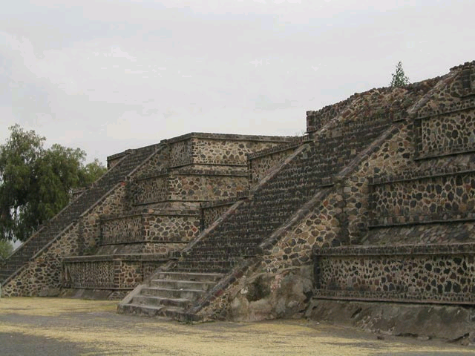
Talud-tablero style, Teotihuacán
http://en.wikipedia.org/wiki/Teotihuacan
Notes:
21

Slide 22
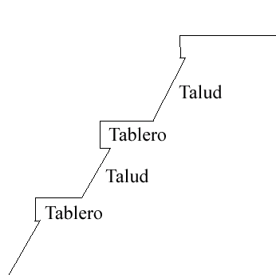
talud-tablero
http://en.wikipedia.org/wiki/Talud-tablero
Notes:
22

Slide 23
This method of construction is not well suited to a high-earthquake zone such as Mesoamerica
talud-tablero
http://en.wikipedia.org/wiki/Talud-tablero
Notes:
23

Slide 24
The tablero sections tend to break off during an earthquake and the facades then slide down the front of the pyramid, and need to be re-built . . .
talud-tablero
http://en.wikipedia.org/wiki/Talud-tablero
Notes:
24

Slide 25
Thus it is likely that this configuration was especially significant to the Teotihuacanos, and others. . .
talud-tablero
http://en.wikipedia.org/wiki/Talud-tablero
Notes:
25

Slide 26
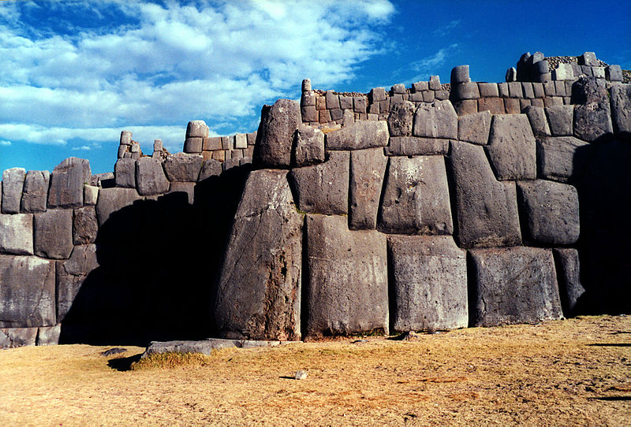
The Inca of Peru, by contrast, built structures to withstand earthquakes . . .
Sacsayhuamán near Cusco, Peru
http://en.wikipedia.org/wiki/Sacsayhuam%C3%A1n
Notes:
26

Slide 27
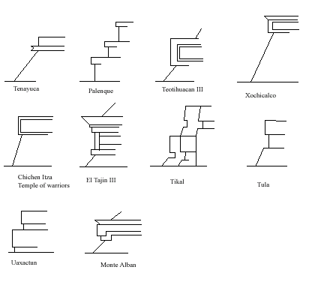
In spite of the structural vulunarability to earthquakes, the Teotihuacán style was widely imitated . . .
talud-tablero
http://en.wikipedia.org/wiki/Talud-tablero
Notes:
27

Slide 28
talud-tablero
http://en.wikipedia.org/wiki/Talud-tablero
Notes:
28

Slide 29
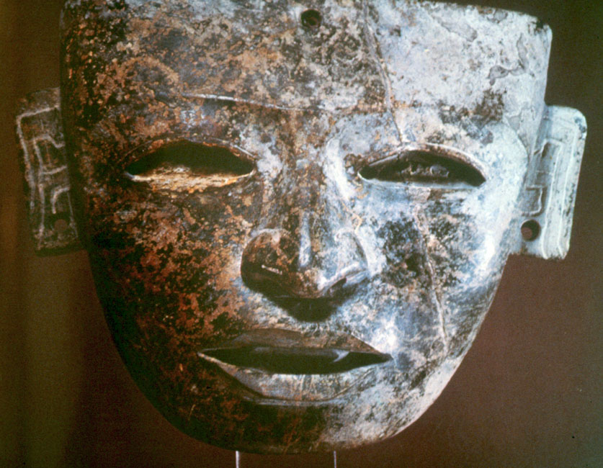
Teotihuacán Stone Mask, Classic Bernal-Groth, Ancient Mexico in Color, 1968, pl.10

Slide 30
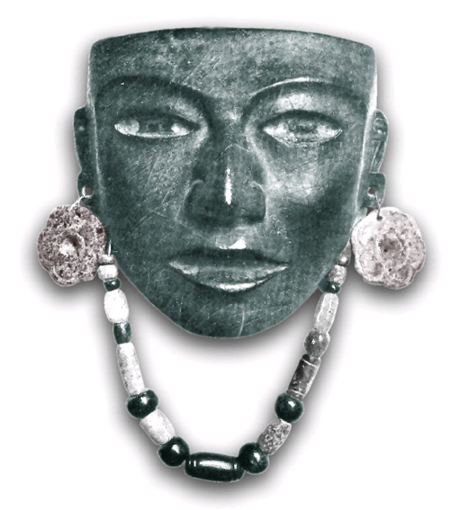
Obsidian mask, Teotihuacán Classic
www.arikah.net/enciclopedia-espanola/Per%C3%ADodo_cl%C3%A1sico_mesoamericano
Notes:
30

Slide 31
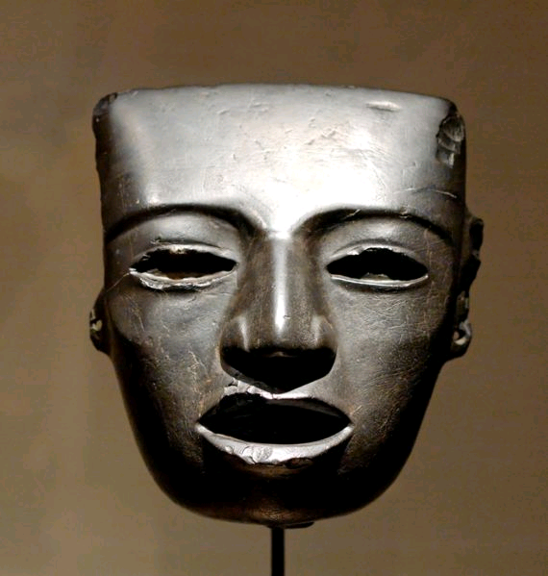
Stone mask, Teotihuacán, 3rd to 7th century A.D.
http://en.wikipedia.org/wiki/Teotihuacan
Notes:
31

Slide 32
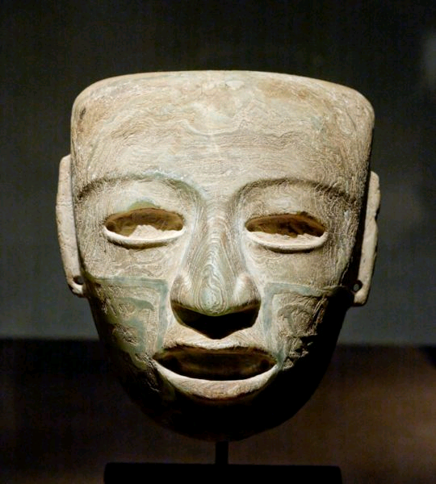
Marble mask, Teotihuacán, 3rd to 7th century A.D.
http://en.wikipedia.org/wiki/Teotihuacan
Notes:
32

Slide 33
Talud-tablero style, Teotihuacán
http://en.wikipedia.org/wiki/Teotihuacan
Notes:
33

Slide 34
Talud-tablero style, Teotihuacán
http://en.wikipedia.org/wiki/Teotihuacan
Notes:
34

Slide 35
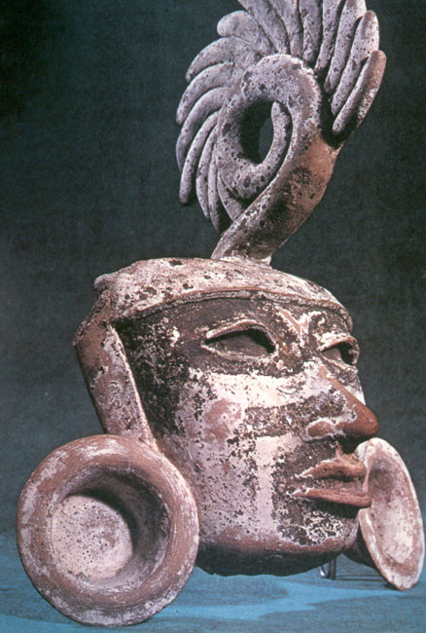
Mask of Teotihuacán Noble
Bradley Smith, Mexico, p. 77

Slide 36
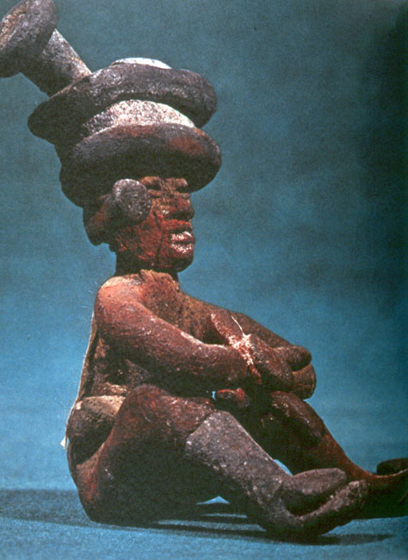
Teotihuacán Figure
Bradley Smith, Mexico, p. 70

Slide 37
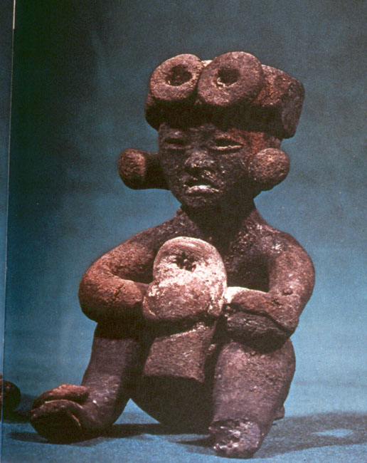
Teotihuacán Figure
Bradley Smith, Mexico, p. 71

Slide 38
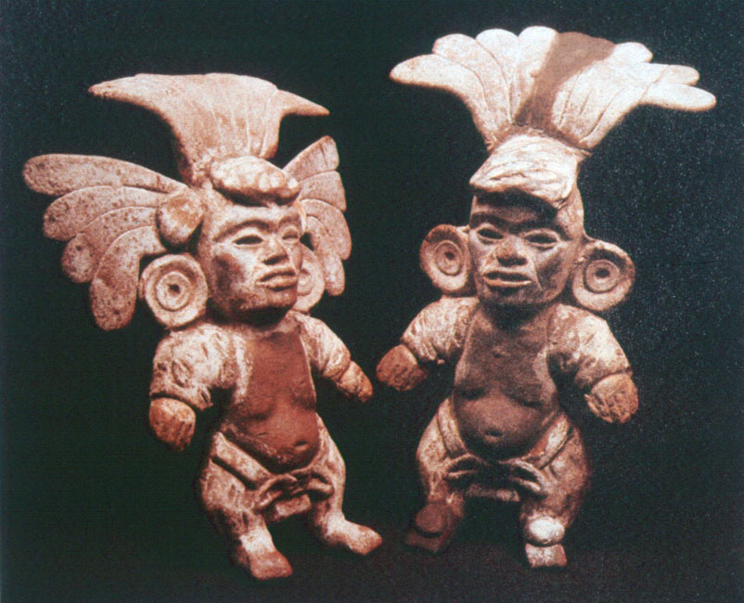
Teotihuacán Dwarfs
The Making of Civilization, p. 30

Slide 39
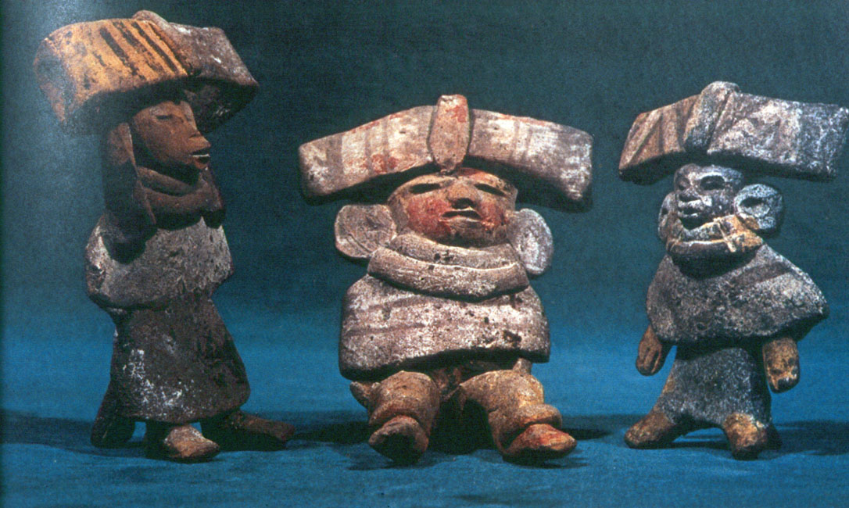
Teotihuacán figurines
Bradley Smith, Mexico, p. 67

Slide 40
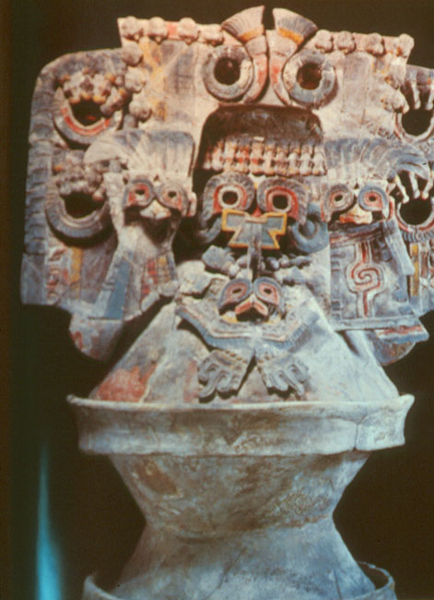
Brazier from Teotihuacán
Bernal and Growth, Ancient Mexico, p. 13

Slide 41
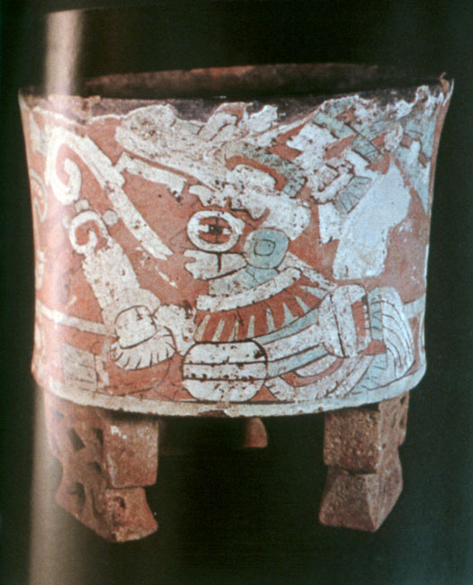
Cylindrical bowl with stuccoed and painted decorations, Teotihuacán
Van Winning, p. 177

Slide 42
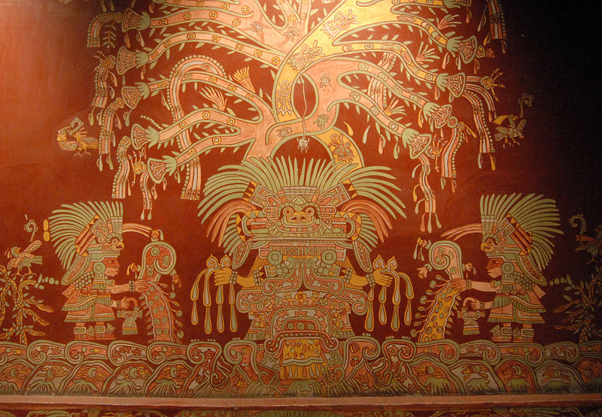
The Great Goddess of Teotihuacán,
Tepantitla apartment complex
http://en.wikipedia.org/wiki/Teotihuacan

Slide 43
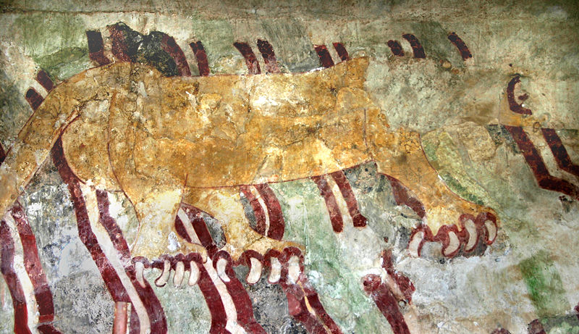
Jaguar mural located near the “Street of the Dead"
http://en.wikipedia.org/wiki/Teotihuacan

Slide 44
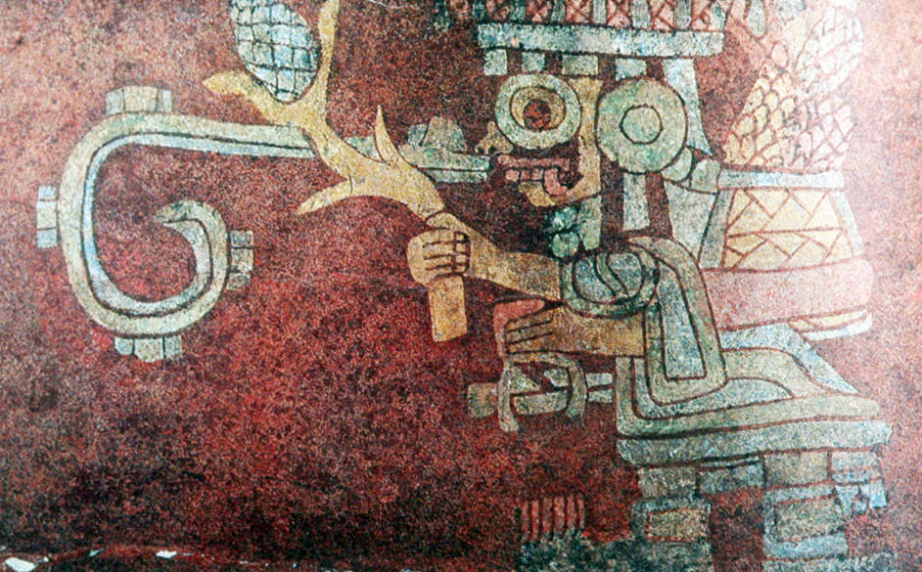
Yacatecuhtli, God of Commerce, carrying maize, Teotihuacán
Bradley Smith, Mexico, p. 76

Slide 45
The beginning of the
Teotihuacán Classic . . .
Notes:
45

Slide 46
Classic Stage
Radiocarbon dates on the Late Preclassic phases in the valley of Mexico indicate that the Teotihuacán region had its Classic inception about contemporaneously or only a little earlier than the A.D. 300 (11.6.0.0.0) correlation date
A.D. 150

Slide 47
Classic Stage
Radiocarbon dates on the Late Preclassic phases in the valley of Mexico indicate that the Teotihuacán region had its Classic inception about contemporaneously or only a little earlier than the A.D. 300 (11.6.0.0.0) correlation date
A.D. 150

Slide 49
Classic Stage
Except for some pottery and a few items of architectural detail
the Tzakol Maya Classic of the Petén
Classic Teotihuacán II-III
Monte Albán IIIa, and
the Classic Esperanza phase of Highland Guatemala
are alike only in that each expresses vigorous regional-cultural traditions at this time

Slide 50
Classic Stage
Except for some pottery and a few items of architectural detail
the Tzakol Maya Classic of the Petén
Classic Teotihuacán II-III
Monte Albán IIIa, and
the Classic Esperanza phase of Highland Guatemala
are alike only in that each expresses vigorous regional-cultural traditions at this time

Slide 51
Coastal Veracruz
Valley of Mexico
Petén
Maya
Oaxaca
Highland
Maya
• Kaminaljuyú
• Kaminaljuyú

Slide 52
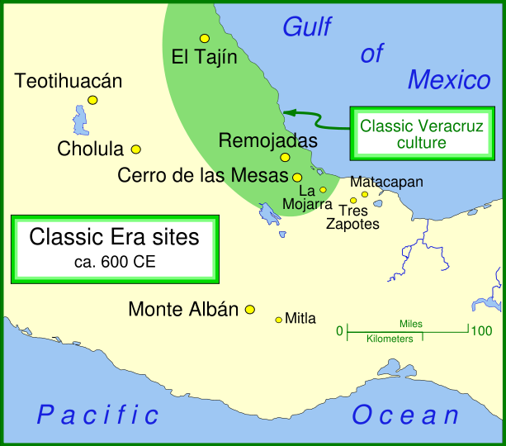
http://en.wikipedia.org/wiki/Teotihuacan

Slide 53
Classic Stage
idea systems remained regionalized in spite of the exchange of technologies, elements, goods and ideas
that is, they continued to have stylistic regionalism

Slide 54
Classic Stage
idea systems remained regionalized in spite of the exchange of technologies, elements, goods and ideas
that is, they continued to have stylistic regionalism

Slide 55
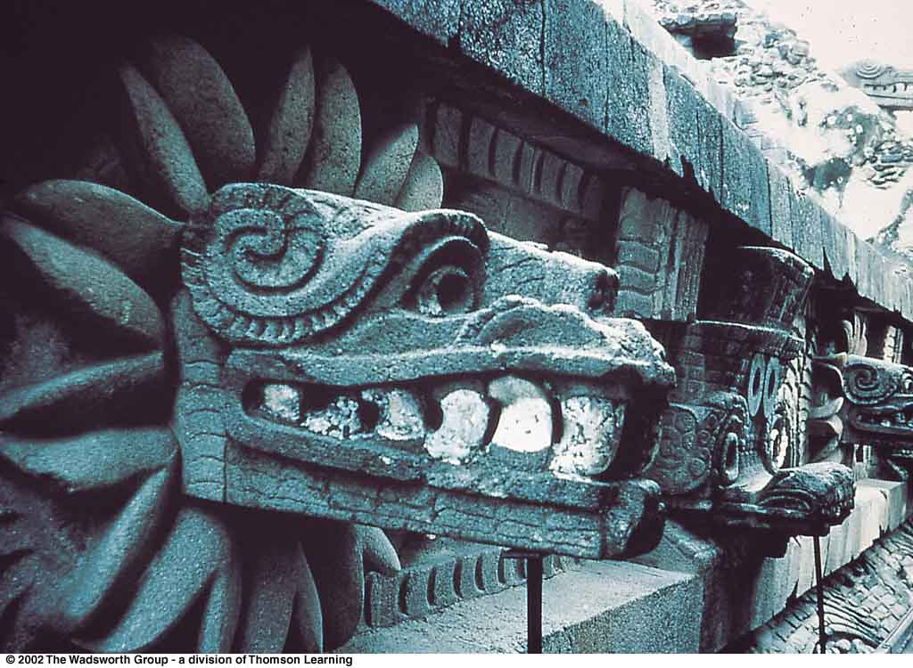
Quetzalcoatl
also known as the Feathered Serpent; a deity representing good, appears at Teotihuacán
Understanding Physical Anthropology and Archaeology, 8th ed., p. 489

Slide 56
The end of the
Teotihuacán Classic . . .
Notes:
56

Slide 57
Decline of the Classic
Teotihuacán appears to have been destroyed in the second half of the first millennium A.D.,
about A.D. 650 or 700
probably by the invaders identified with the Tula – Toltec culture
bearers of the same Tula – Toltec culture moved into other parts of Mesoamerica at this same time or shortly after

Slide 58
Classic Stage
The Tlamimilolpa phase of the Mexican Highland Classic may have closed prior to the collapse of the great Lowland Maya ceremonial centers, or it may have run contemporaneously with them
a reasonable estimate of the fall of Teotihuacán is about A.D. 700 (or A.D. 650)

Slide 59
Cahokia
Ecuador
Understanding Physical Anthropology and Archaeology, 8th ed., p. 479

Slide 60
www.eurekalert.org/pub_releases/2004-12/asu-sbd120204.php
Notes:
60

Slide 61
Decline of the Classic
The breakdown of the old Classic regional states may -- in part -- be attributed to
the invaders from the Tula – Toltec culture
or to the waves of social and political disruption and dislocation which they set in motion on the Chichimec frontier

Slide 62
Decline of the Classic
Or the breakdown may have been caused by . . .
overpopulation
the presence of steadily increasing populations, coupled with . . .
soil depletion caused by over-farming

Slide 63
Decline of the Classic
Or the breakdown may have been caused by . . .
in the case of Teotihuacán,
perhaps by erosion
following the loss of topsoil due to overcutting of trees
to process limestone into cement and lime plaster

Slide 64
Decline of the Classic
At Teotihuacán, the population was more densely massed around it in the Teotihuacán IV phase than in the preceding Teotihuacán II and III phases

Slide 65
Decline of the Classic
At Teotihuacán, the population was more densely massed around it in the Teotihuacán IV phase than in the preceding Teotihuacán II and III phases

Slide 66
Early Classic Stage
Central Highlands sites include:
Teotihuacán III (Xolalpan-Tlamimilolpa phases)
Teotihuacán II (Miccaotli phase)

Slide 67
The site . . .
Notes:
67

Slide 68
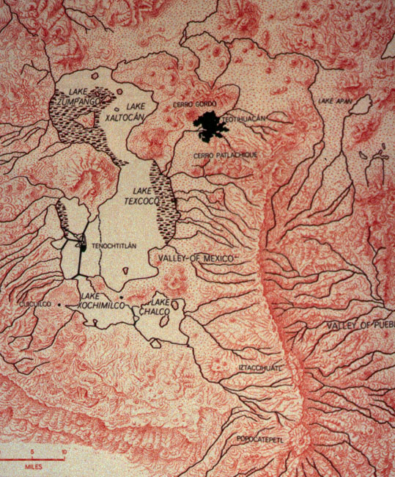
Valley of Mexico

Slide 69
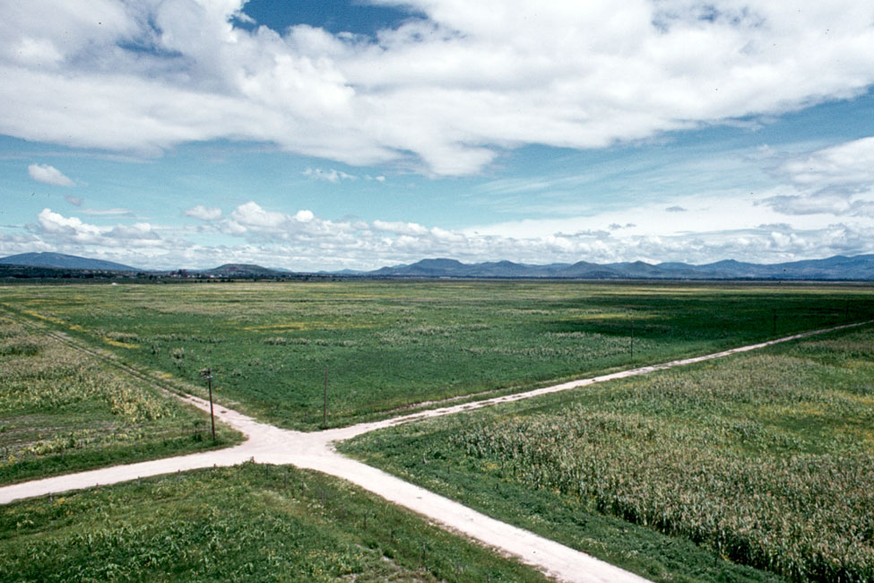
Teotihuacán

Slide 70
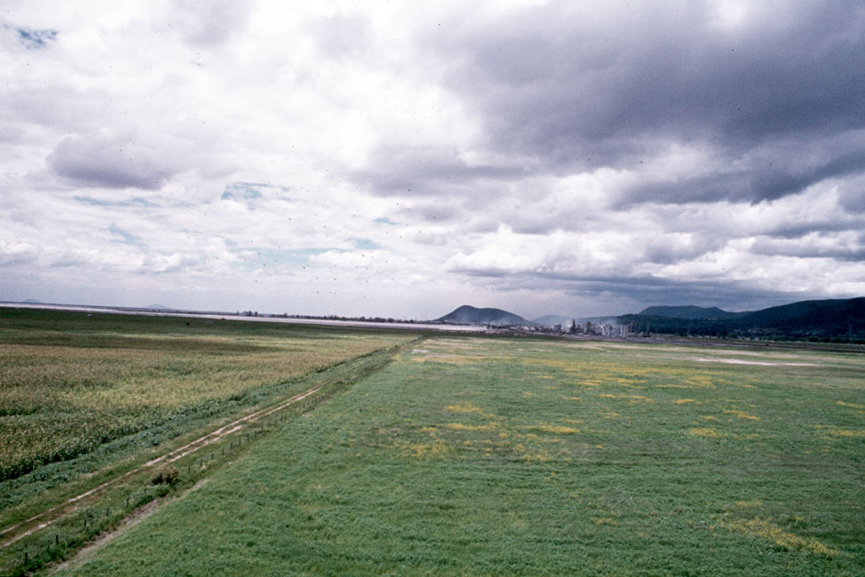
Northern “shore” of Lake Texcoco, facing Mexico City, 1969

Slide 71
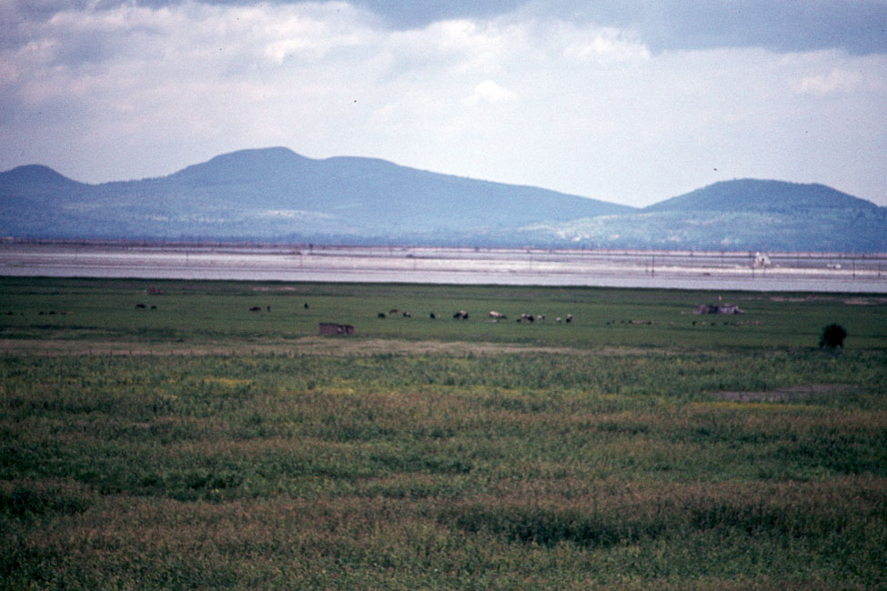
Northern “shore” of Lake Texcoco, facing Mexico City, 1969

Slide 72
Valley of Mexico

Slide 73
Valley of Mexico

Slide 74
Valley of Mexico

Slide 75
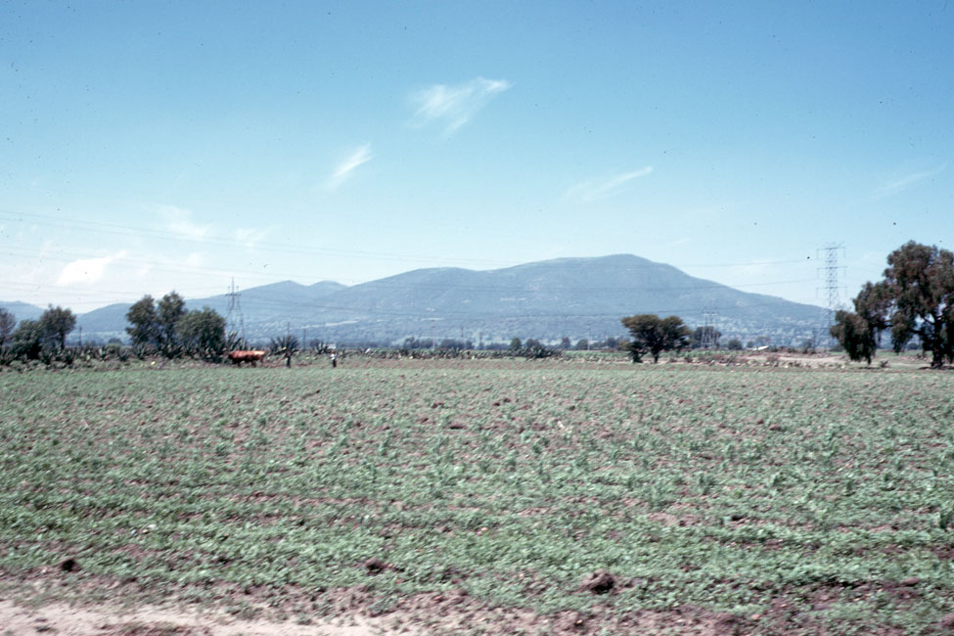
Teotihuacán field, south of the Pyramid of the Sun, 1969

Slide 76
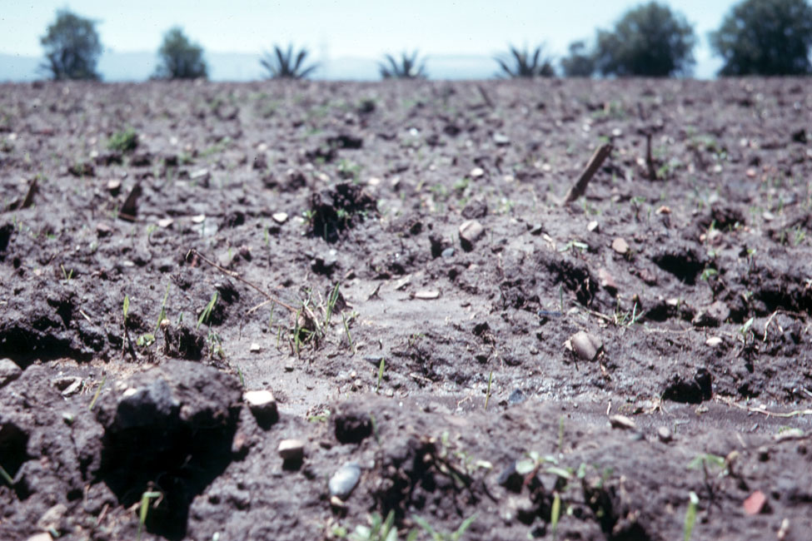
Teotihuacán field, south of the Pyramid of the Sun, 1969

Slide 77
A walk down the
“Street of the Dead . . .”
Notes:
77

Slide 78
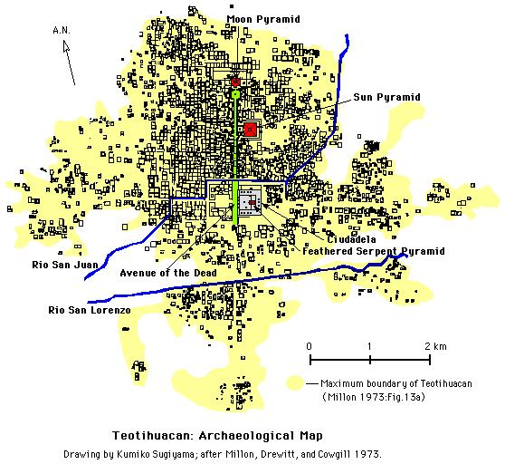
www.blatt.org/vacation/teotihuacan2002/map.jpg

Slide 79
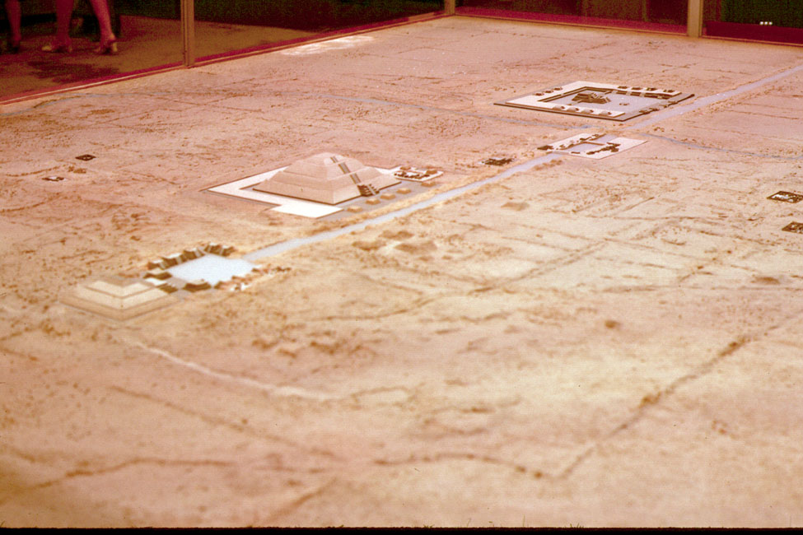
Teotihuacán museum model, 1967

Slide 80
Teotihuacán museum model, 1967

Slide 81
Teotihuacán museum model, 1967

Slide 82
Teotihuacán museum model, 1967

Slide 83
San Martín
de las
Pirámides
Teotihuacán museum model, 1967

Slide 84
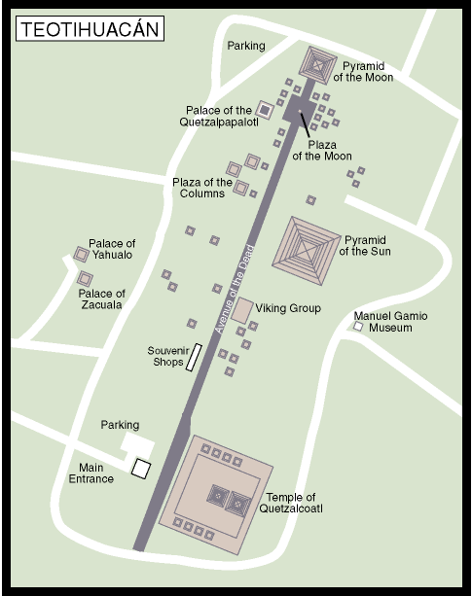
San Martín
de las
Pirámides
www.advantagemexico.com/

Slide 85
Teotihuacán museum model, 1967

Slide 86
Teotihuacán museum model, 1967

Slide 87
Teotihuacán museum model, 1967

Slide 88
Teotihuacán museum model, 1967

Slide 89
www.advantagemexico.com/

Slide 90
www.advantagemexico.com/

Slide 91
www.advantagemexico.com/

Slide 92
www.advantagemexico.com/

Slide 93
www.advantagemexico.com/

Slide 94
Teotihuacán field, south of the Pyramid of the Sun, 1969

Slide 95
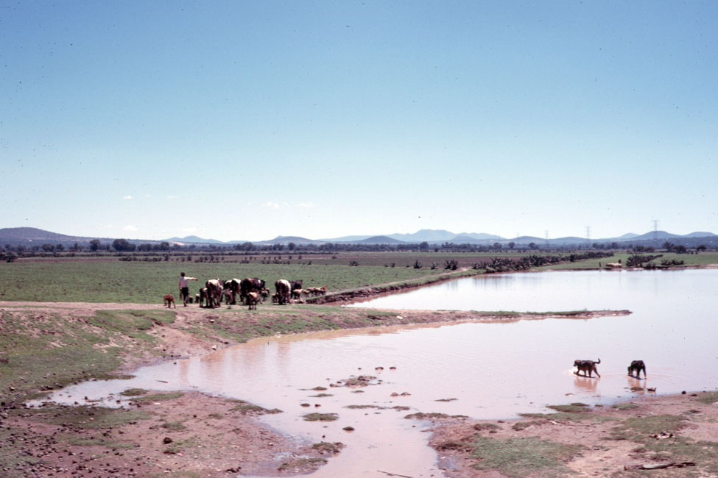
Teotihuacán field, at the “end” of the Street of the Dead, 1969

Slide 96
Teotihuacán field, at the “end” of the Street of the Dead, 1969

Slide 97
www.advantagemexico.com/

Slide 98
www.advantagemexico.com/

Slide 99
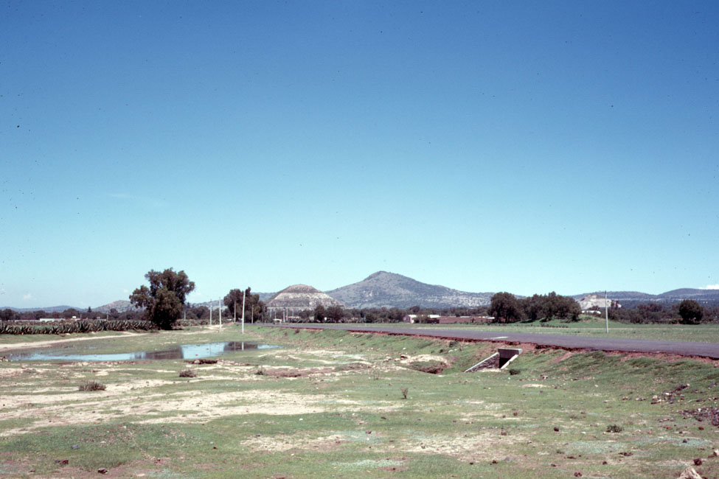
Teotihuacán with the Pyramid of the Sun in the background, 1969

Slide 100
www.advantagemexico.com/

Slide 101
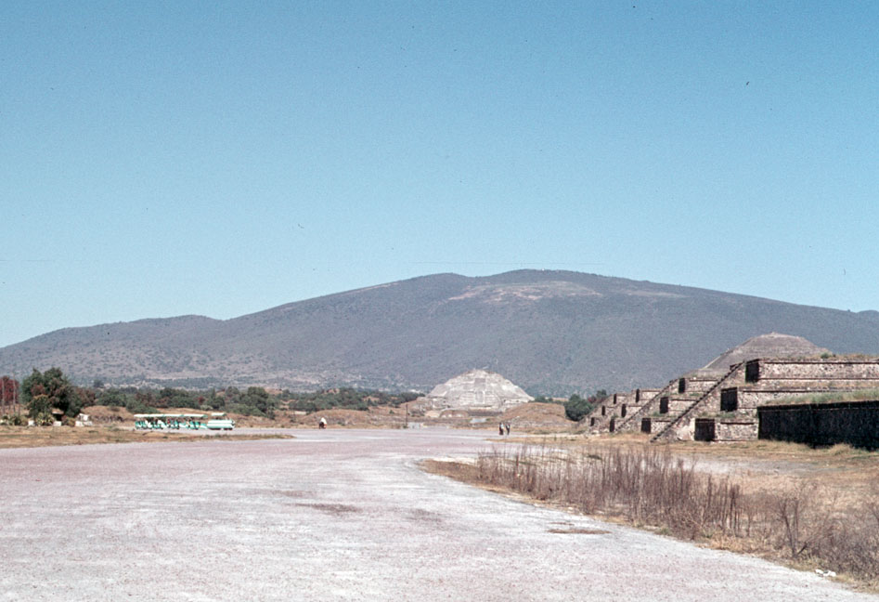
Teotihuacán, “Street of the Dead” from the Citadel,
with Pyramid of the Moon in background, 1967

Slide 102
www.advantagemexico.com/

Slide 103
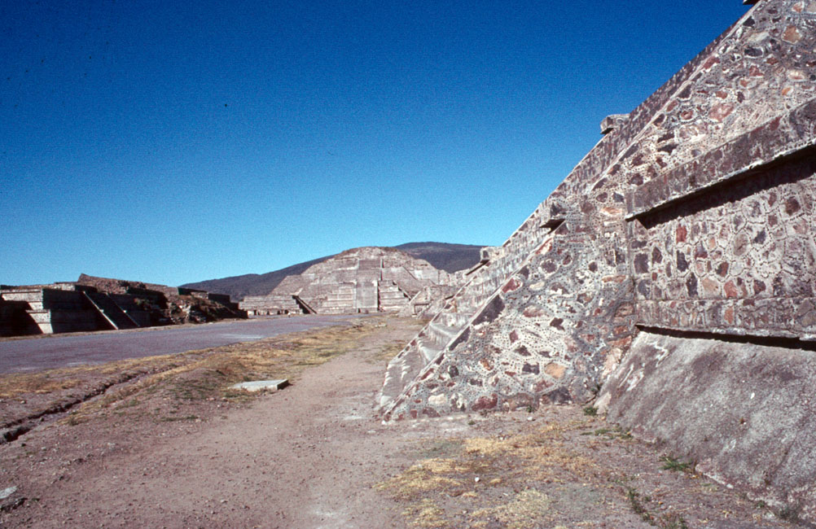
Street of the Dead from in front of the Pyramid of the Sun, 1967

Slide 104
Talud-tablero style, Teotihuacán
http://en.wikipedia.org/wiki/Teotihuacan
Notes:
104

Slide 105
Talud-tablero
http://en.wikipedia.org/wiki/Talud-tablero
Notes:
105

Slide 106
Talud-tablero
http://en.wikipedia.org/wiki/Talud-tablero
Notes:
106

Slide 107
The Ciudadela . . .
Notes:
107

Slide 108
www.advantagemexico.com/

Slide 109
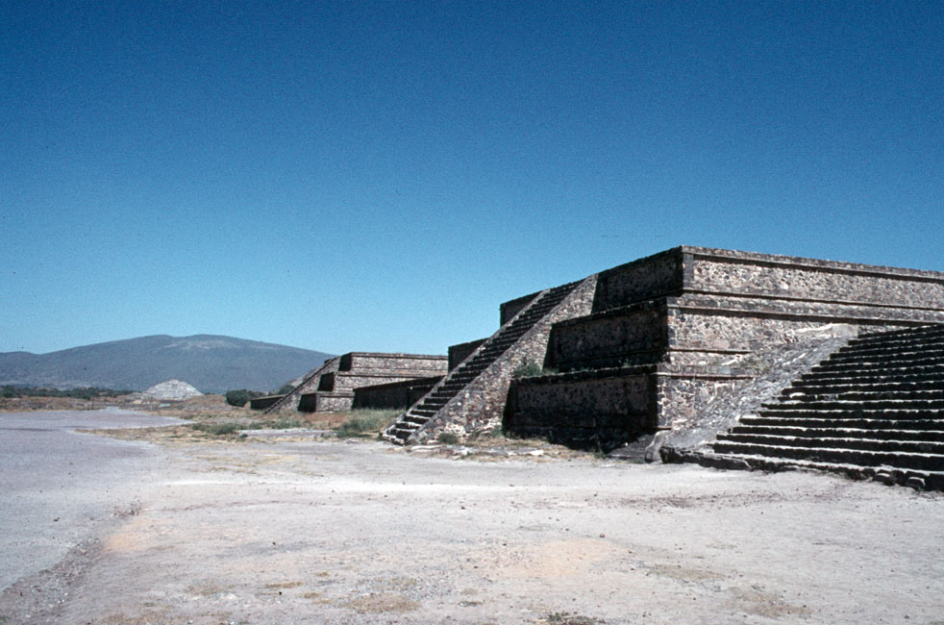
Teotihuacán, south side of the Citadel,
with Pyramid of the Moon in background

Slide 110
www.advantagemexico.com/

Slide 111
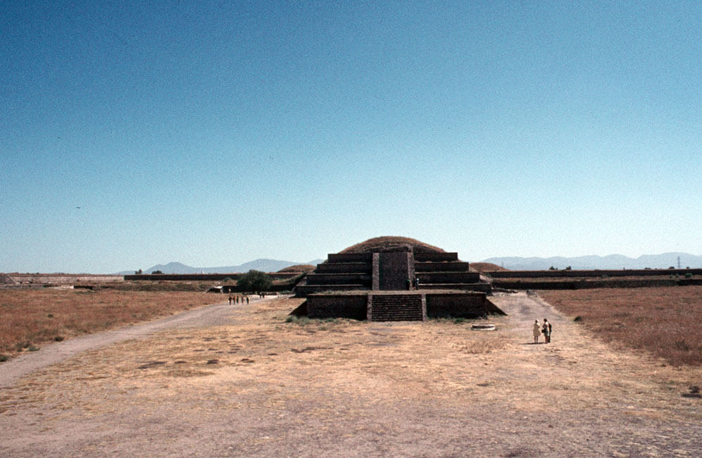
Temple-Pyramid of Quetzalcoatl, Ciudadela, 1967

Slide 112
www.advantagemexico.com/

Slide 113
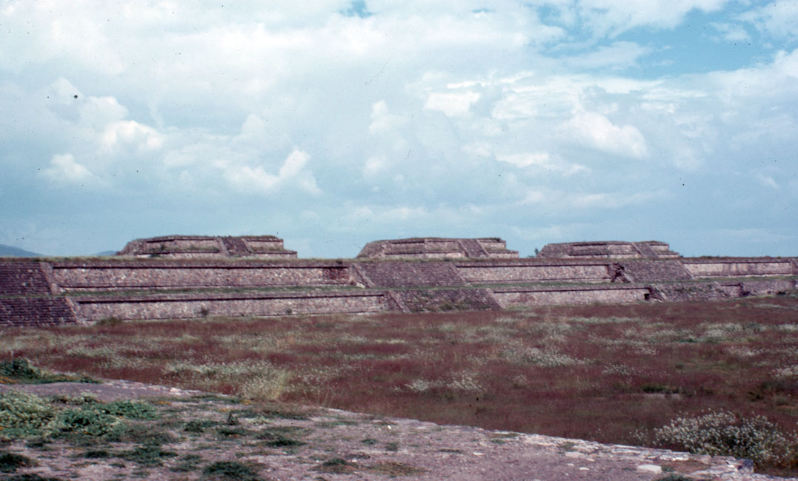
Ciudadela, 1967

Slide 114
www.advantagemexico.com/

Slide 115
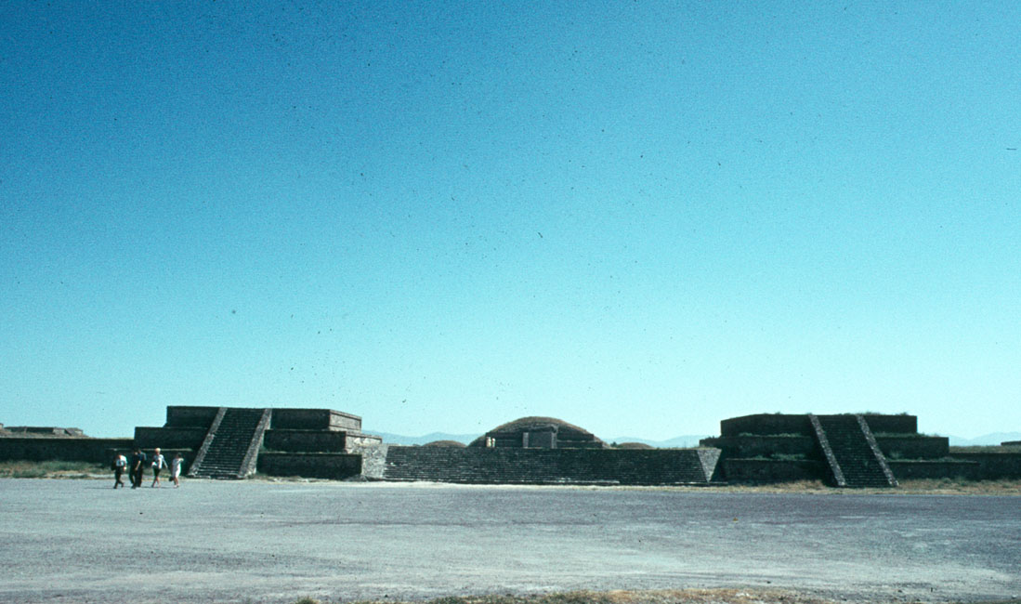
East side of the Ciudadella, Teotihuacán, 1967

Slide 116
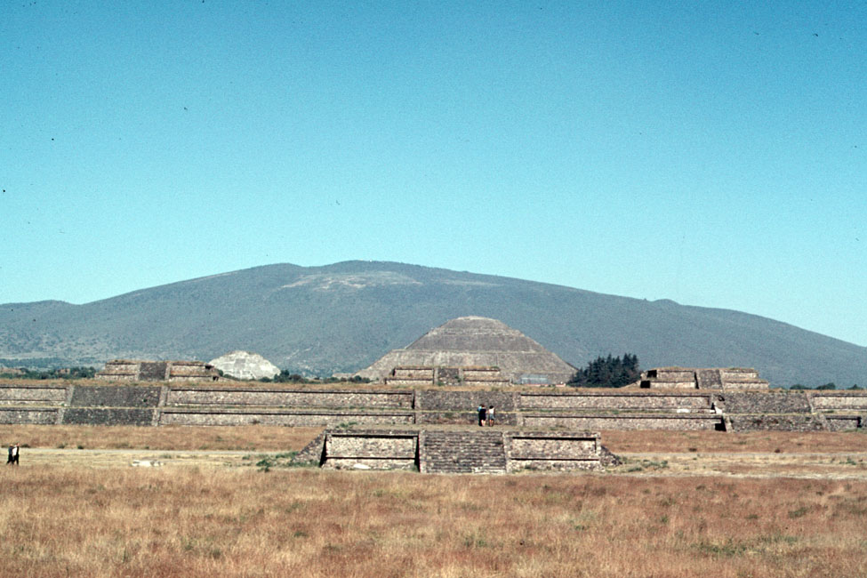
North side of the Ciudadela with pyramids in the background, 1967

Slide 117
Teotihuacán
www.nationalgeographic.com/

Slide 118
www.advantagemexico.com/

Slide 119
Temple-Pyramid of Quetzalcoatl, Ciudadela, 1967

Slide 120
www.advantagemexico.com/

Slide 121
Wall on North side of Temple-Pyramid of Quetzalcoatl, Ciudadela, 1967

Slide 122
Temple-Pyramid of Quetzalcoatl, Ciudadela, 1967

Slide 123
Talud-tablero
http://en.wikipedia.org/wiki/Talud-tablero
Notes:
123

Slide 124
Temple-Pyramid of Quetzalcoatl, Ciudadela, 1967

Slide 125
Temple-Pyramid of Quetzalcoatl, Ciudadela, 1967

Slide 126
www.advantagemexico.com/

Slide 127
Temple-Pyramid of Quetzalcoatl, Ciudadela, 1967
and Joaquin Fernandez Espinosa de los Monteros

Slide 128
Temple-Pyramid of Quetzalcoatl, Ciudadela, 1967

Slide 129
Temple-Pyramid of Quetzalcoatl, Ciudadela, 1967
and Joaquin Fernandez Espinosa de los Monteros

Slide 130
Temple-Pyramid of Quetzalcoatl, Ciudadela, 1967

Slide 131
Temple-Pyramid of Quetzalcoatl, Ciudadela, 1967
and Joaquin Fernandez Espinosa de los Monteros

Slide 132
Temple-Pyramid of Quetzalcoatl, Ciudadela, 1967

Slide 133
Temple-Pyramid of Quetzalcoatl, Ciudadela, 1967

Slide 134
Temple-Pyramid of Quetzalcoatl, Ciudadela, 1967

Slide 135
Temple of Quetzalcoatl, Teotihuacán
www.nationalgeographic.com/

Slide 136
www.advantagemexico.com/

Slide 137
Teotihuacán museum model, 1967

Slide 138
www.advantagemexico.com/

Slide 139
San Juan River
Teotihuacán museum model, 1967

Slide 140
San Juan River
Teotihuacán museum model, 1967

Slide 141
Rio San Juan, Teotihuacán, November 1967

Slide 142
The “Pyramid of the Sun” . . .
Notes:
142

Slide 143
Teotihuacán museum model, 1967

Slide 144
www.advantagemexico.com/

Slide 145
Pyramid of the Sun, 1967

Slide 146
“Mixie” Campbell Roufs ascending the Pyramid of the Sun, 1967
aka Mary Magdalene Margaret Mary Juetta Campbell Roufs

Slide 147
“Mixie” Campbell Roufs “at the top” of the Pyramid of the Sun, 1967

Slide 148
Pyramid of the Sun, 1967

Slide 149
http://news.bbc.co.uk/2/hi/in_pictures/4827456.stm

Slide 150
http://news.bbc.co.uk/2/hi/in_pictures/4827456.stm

Slide 151
http://news.bbc.co.uk/2/hi/in_pictures/4827456.stm

Slide 152
http://news.bbc.co.uk/2/hi/in_pictures/4827456.stm

Slide 153
www.advantagemexico.com/

Slide 154
Atop the Pyramid of the Sun, November 1967

Slide 155
www.advantagemexico.com/

Slide 156
View of the Ciudadela from atop the Pyramid of the Sun, November 1967

Slide 157
www.advantagemexico.com/

Slide 158
www.advantagemexico.com/

Slide 159
Panorama of the Avenue of the Dead from the Pyramid of the Sun
http://en.wikipedia.org/wiki/File:AvenueoftheDeadTeotihuacan.jpg

Slide 160
www.advantagemexico.com/

Slide 161
Pyramid of the Moon from atop the Pyramid of the Sun, November 1967

Slide 162
www.advantagemexico.com/

Slide 163
Looking down from the front of the Pyramid of the Sun, 1967

Slide 164
Mark Peter Roufs, in front of the Pyramid of the Sun, 1967

Slide 165
Looking down from the front of the Pyramid of the Sun, 1967

Slide 166
www.advantagemexico.com/

Slide 167
Reconstructed surface of the Pyramid of the Sun, 1967

Slide 168
Orientation of the
Pyramid of the Sun
is
15.25° east of north
The La Venta site, by comparison,
is oriented 8° west of north
Notes:
168

Slide 169
Teotihuacán

Slide 170
Teotihuacán
Teotihuacán
Notes:
170

Slide 171
Teotihuacán
Teotihuacán

Slide 172
La Venta
Teotihuacán
Teotihuacán

Slide 173
“The orientation of the structure may hold some anthropological significance. The pyramid is oriented slightly northwest of the horizon point of the setting sun on two days a year, August 12 and April 29, which are about one divinatory calendar year apart for the Teotihuacanos. The day of August 12 is significant because it would have marked the date of the beginning of the present era [in 3113 or 3114 B.C.E.] and the initial day of the Maya long count calendar.”
http://en.wikipedia.org/wiki/Pyramid_of_the_sun
Notes:
173

Slide 174
Along the “Street of the Dead” . . .
Notes:
174

Slide 175
www.advantagemexico.com/

Slide 176
Room in the Viking Group, Teotihuacán, 1967

Slide 177
Jaguar Temple, Teotihuacán, 1967

Slide 178
Room near underground buildings on the Street of the Dead, 1967

Slide 179
Teotihuacán

Slide 180
Teotihuacán

Slide 181
Teotihuacán

Slide 182
Teotihuacán

Slide 183
Teotihuacán

Slide 184
Teotihuacán

Slide 185
Teotihuacán

Slide 186
Talud-tablero
http://en.wikipedia.org/wiki/Talud-tablero
Notes:
186

Slide 187
Looking down near the Pyramid of the Sun, 1967

Slide 188
Reconstructed structures on the west side of the Viking Group, 1967

Slide 189
Unreconstructed structures near Viking Group on the Street of the Dead, 1967

Slide 190
Unreconstructed structures on the Street of the Dead, 1967

Slide 191
Buildings on the east side of the Street of the Dead, Teotihuacán, 1967

Slide 192
Buildings on the east side of the Street of the Dead, Teotihuacán, 1967

Slide 193
The “Pyramid of the Moon” . . .
Notes:
193

Slide 194
Teotihuacán museum model, 1967

Slide 195
www.advantagemexico.com/

Slide 196
Pyramid and Plaza of the Moon, 1967

Slide 197
Pyramid and Plaza of the Moon, 1967

Slide 198
Pyramid of the Moon

Slide 199
Plaza of the Pyramid of the Moon
http://terre.sans.frontiere.free.fr/

Slide 200
www.advantagemexico.com/

Slide 201
Pyramid of the Sun from the Pyramid of the Moon, November 1967

Slide 202
Street of the Dead from the Pyramid of the Moon, 1967

Slide 203
Street of the Dead from the Pyramid of the Moon, 1967

Slide 204
www.advantagemexico.com/

Slide 205
Wall near the Pyramid of the Moon, 1967

Slide 206
www.eurekalert.org/pub_releases/2004-12/asu-sbd120204.php
Notes:
206

Slide 207
The “Palace of Quetzal Mariposa” . . .
Notes:
207

Slide 208
Plaza of the Pyramid of the Moon
http://terre.sans.frontiere.free.fr/

Slide 209
Teotihuacán museum model, 1967

Slide 210
www.advantagemexico.com/

Slide 211
www.advantagemexico.com/

Slide 212
Palace of Quetzal Butterfly near the Pyramid of the Moon, 1967

Slide 213
Stairs, Palace of Quetzal Butterfly near the Pyramid of the Moon, 1967

Slide 214
Mural in Jaguar Palace near the Pyramid of the Moon, 1967

Slide 215
Courtyard, Palace of Quetzal Butterfly near the Pyramid of the Moon, 1967

Slide 216
Palace of Quetzal Butterfly near the Pyramid of the Moon

Slide 217
Palace of Quetzal Butterfly near the Pyramid of the Moon, 1967

Slide 218
Palace of Quetzal Butterfly near the Pyramid of the Moon, 1967

Slide 219
Palace of Quetzal Butterfly near the Pyramid of the Moon, 1967

Slide 220
Palace of Quetzal Butterfly near the Pyramid of the Moon, 1967

Slide 221
Palace of Quetzal Butterfly near the Pyramid of the Moon, 1967

Slide 222
Palace of Quetzal Butterfly near the Pyramid of the Moon
Notes:
222

Slide 223
Palace of Quetzal Butterfly near the Pyramid of the Moon, 1967

Slide 224
Palace of Quetzal Butterfly near the Pyramid of the Moon, 1967

Slide 225
The “Viking Group”
and the Subterráneos . . .
Notes:
225

Slide 226
Teotihuacán museum model, 1967

Slide 227
www.advantagemexico.com/

Slide 228
Subterráneos on the Street of the Dead, 1967

Slide 229
Subterráneos on the Street of the Dead, 1967

Slide 230
Subterráneos on the Street of the Dead, 1967

Slide 231
Subterráneos on the Street of the Dead, 1967

Slide 232
Subterráneos on the Street of the Dead, 1967

Slide 233
Subterráneos on the Street of the Dead, 1967

Slide 234
Subterráneos on the Street of the Dead, 1967

Slide 235
Subterráneos on the Street of the Dead, 1967

Slide 236
Unreconstructed pyramidal structure near Viking Group
on the Street of the Dead, 1967

Slide 237
Teotihuacán museum model, 1967

Slide 238
www.advantagemexico.com/

Slide 239
Reconstructing the Street of the Dead, November 1967

Slide 240
Algunos barrios . . .
Notes:
240

Slide 241
Teotihuacán museum model, 1967

Slide 242
Avenue of the Dead
www.ancientmexico.com/content/map/teotihuacan.html

Slide 243
Teotihuacán

Slide 244
Teotihuacán
Tikál
Teotihuacán

Slide 245
Teotihuacán
Tikál
Teotihuacán

Slide 246
Teotihuacán
Tikál
Teotihuacán

Slide 247
Tepantitla
www.advantagemexico.com/

Slide 248
The Great Goddess of Teotihuacán, Tepantitla apartment complex
http://en.wikipedia.org/wiki/Teotihuacan

Slide 249
The Great Goddess of Teotihuacán, Tepantitla apartment complex
http://en.wikipedia.org/wiki/Teotihuacan

Slide 250
Mountain Stream mural of Teotihuacán, Tepantitla
http://en.wikipedia.org/wiki/Teotihuacan

Slide 251
Paradise of Tlaloc, . . . Tepantitla apartment complex
http://en.wikipedia.org/wiki/Teotihuacan

Slide 252
Paradise Mural, Tepantitla, Teotihuacán
Bradley Smith, Mexico, p. 68

Slide 253
Tepantitla mural, Teotihuacán
http://en.wikipedia.org/wiki/Teotihuacan

Slide 254
Balllplayer, Tepantitla, Teotihuacán
http://en.wikipedia.org/wiki/Mesoamerican_ballgame

Slide 255
Balllplayer, Tepantitla, Teotihuacán
http://en.wikipedia.org/wiki/Mesoamerican_ballgame

Slide 256
Teotihuacán Ballplayers fight for Ball
Bradley Smith, Mexico, p. 68

Slide 257
Tetitla
www.advantagemexico.com/

Slide 258
Actual mural from the Tetitla compound showing a similar portrait
http://en.wikipedia.org/wiki/Great_Goddess_of_Teotihuacan

Slide 259
Teotihuacán fresco, Tetitla, Classic Bernal-Groth, Ancient Mexico in Color, 1968, p.11

Slide 260
Techinantitla
www.advantagemexico.com/

Slide 261
Techinantitla, Teotihuacán
www.bigbangmex.unam.mx/bigbangmex/IMAGENES/cuatro_natz_2/016.jpg

Slide 262
Teotihuacán museum model, 1967

Slide 263
Archaeological excavation, Teotihuacán, 1967

Slide 264
Archaeological excavation, Teotihuacán, 1967

Slide 265
Archaeological excavation, Teotihuacán, 1967

Slide 266
Archaeological excavation, Teotihuacán, 1967

Slide 267
Stone face in field at Teotihuacán, 1967

Slide 268
Algunos barrios . . .
modern day
Notes:
268

Slide 269
Teotihuacán museum model, 1967

Slide 270
Teotihuacán museum model, 1967

Slide 271
Restaurant
www.advantagemexico.com/

Slide 272
www.advantagemexico.com/

Slide 273
Modern Fountain in park by the Pyramid of the Sun, Teotihuacán, 1967

Slide 274
Cave Restaurant, San Juan Teotihuacán, November 1967

Slide 275
San Martín
de las
Pirámides
Teotihuacán museum model, 1967

Slide 276
San Martín
de las
Pirámides
www.advantagemexico.com/

Slide 277
Workers at Onyx “Factory,” San Juan Teotihuacán, 1967

Slide 278
Workers at Onyx “Factory,” San Juan Teotihuacán, 1967

Slide 279
Workers at Onyx “Factory,” San Juan Teotihuacán, 1967

Slide 280
Workers at Onyx “Factory,” San Juan Teotihuacán, 1967

Slide 281
Workers at Onyx “Factory,” San Juan Teotihuacán, 1967

Slide 282
And the hinterlands . . .
Notes:
282

Slide 283
And the next thing
you know . . .

Slide 284
www.cnn.com/2004/WORLD/americas/09/11/mexico.walmart.reut/
Notes:
284

Slide 285
http://news.bbc.co.uk/2/hi/americas/4881792.stm

Slide 286
What happens next?

Slide 287
And what happens
after the Classic ?

Slide 289
And after that ?

Slide 292
Overall Review

Slide 293
Understanding Physical Anthropology and Archaeology, 8th Ed., p. 479

Slide 294
Understanding Physical Anthropology and Archaeology, 8th Ed., p. 479

