Slide 1
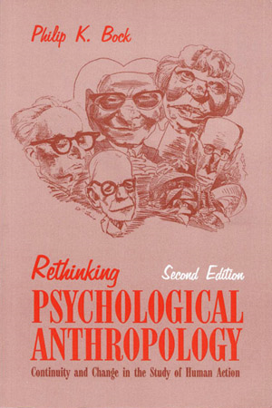
Three Major
Perennial
Debates
re Psychological Anthropology
University of Minnesota Duluth
University of Minnesota Duluth
Tim Roufs
© 2010-2018

Slide 2
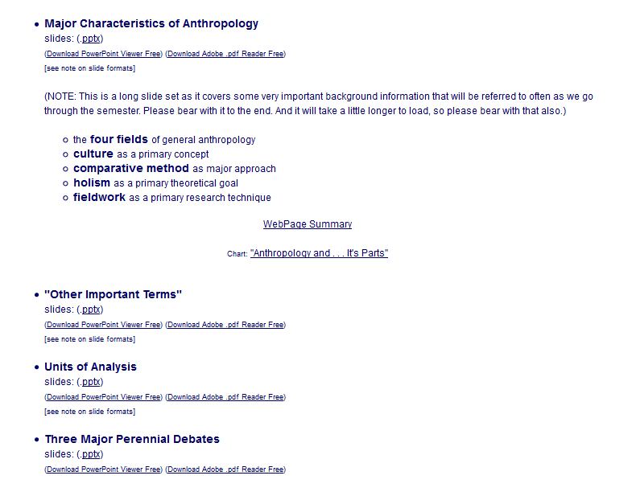

Slide 3
three major contemporary debates
Biological Determinism
vs. Cultural Constructionism
(“nature” vs. “nurture”)
Ideationism vs. Cultural Materialism
(ideas vs. things)
Individual Agency vs. Structuralism
(“free will” vs. “power structures”)

Slide 4
three major contemporary debates
Biological Determinism
vs. Cultural Constructionism
(“nature” vs. “nurture”)
Ideationism vs. Cultural Materialism
(ideas vs. things)
Individual Agency vs. Structuralism
(“free will” vs. “power structures”)

Slide 5
three major contemporary debates
Biological Determinism
vs. Cultural Constructionism
(“nature vs. nurture”)
(“inherited vs. learned”)
(“nativism” vs. “empiricism”)

Slide 6
three major contemporary debates
Biological Determinism
vs. Cultural Constructionism
(“nature vs. nurture”)
(“inherited vs. learned”)
(“nativism” vs. “empiricism”)

Slide 7
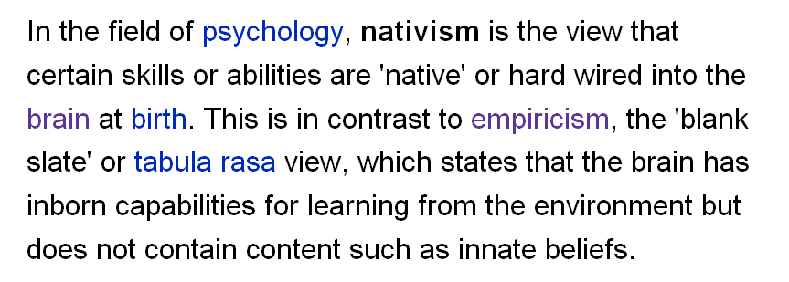
http://en.wikipedia.org/wiki/Psychological_nativism

Slide 8
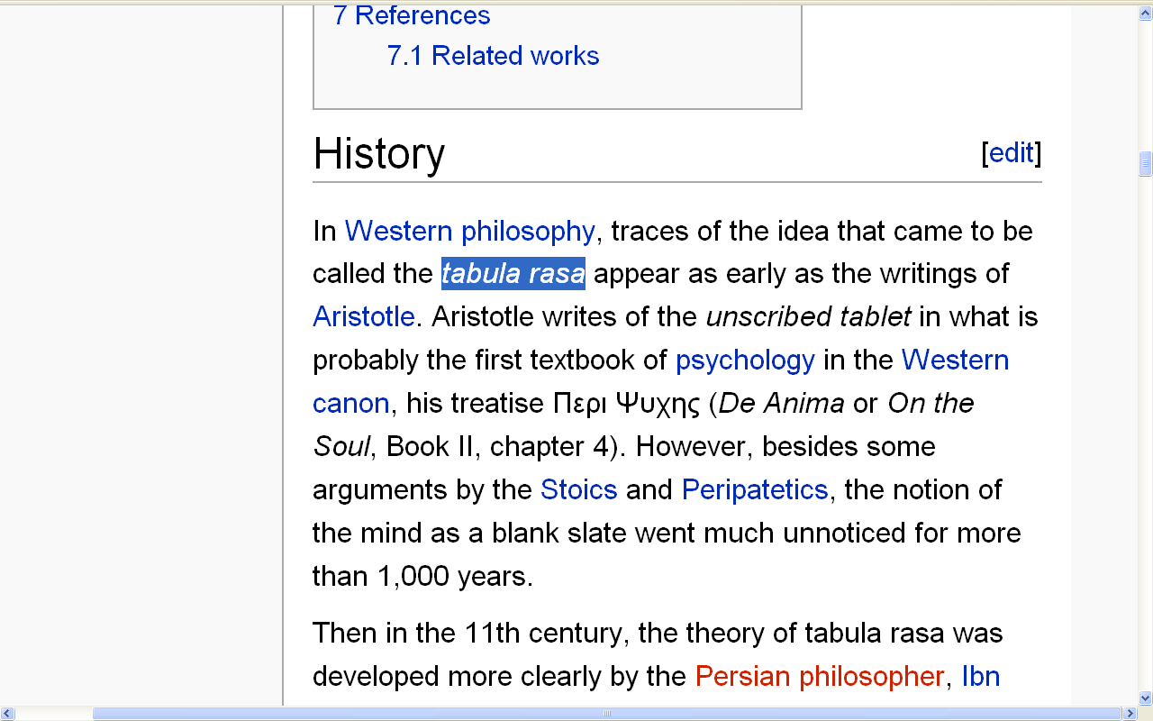
http://en.wikipedia.org/wiki/Tabula_rasa#History

Slide 9
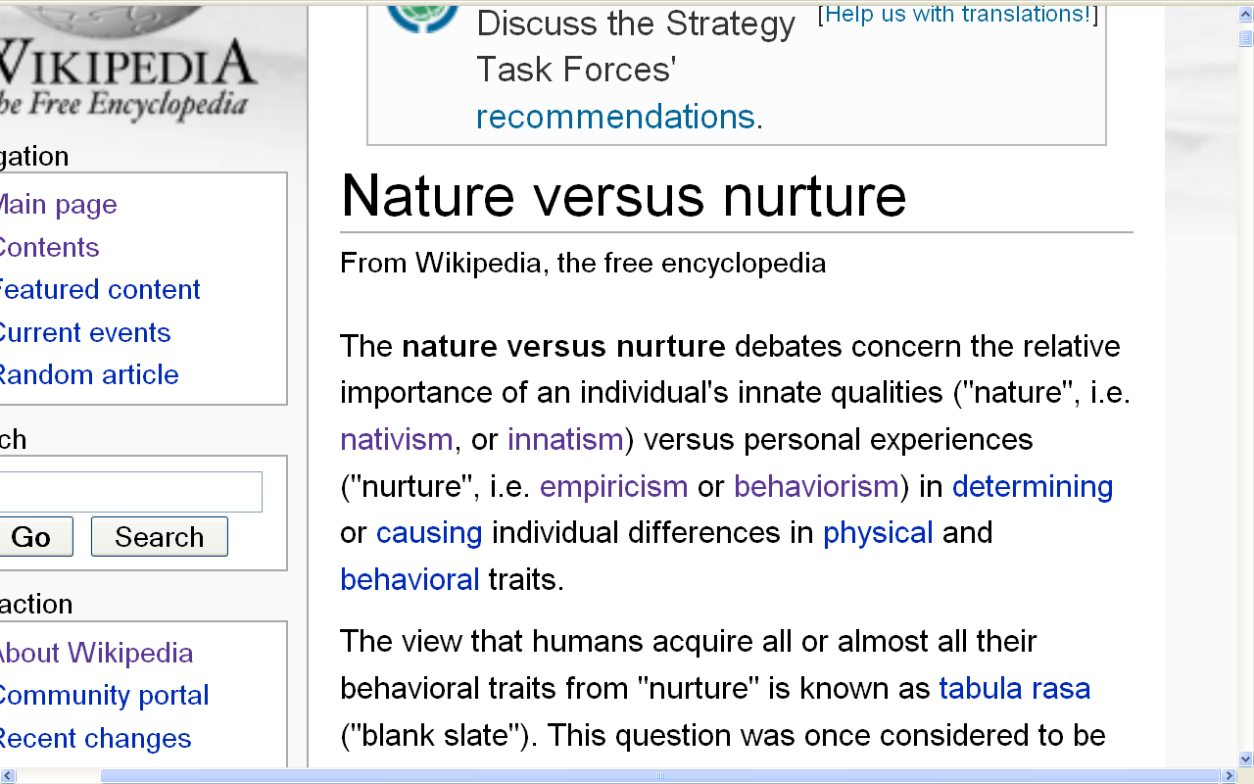
(“nature vs. nurture”)
(“inherited vs. learned”)
(“nativism” vs. “empiricism”)
http://en.wikipedia.org/wiki/Nature_versus_nurture

Slide 10
three major contemporary debates
NOTE: several of the following examples included non-culture-and-personality materials in an attempt to make the following points clearer by using situations and sources with which you may, at the current time, be a bit more familiar

Slide 11
three major contemporary debates
Biological Determinism
vs. Cultural Constructionism
(“nature vs. nurture”)
(“inherited vs. learned”)
(“nativism” vs. “empiricism”)

Slide 12
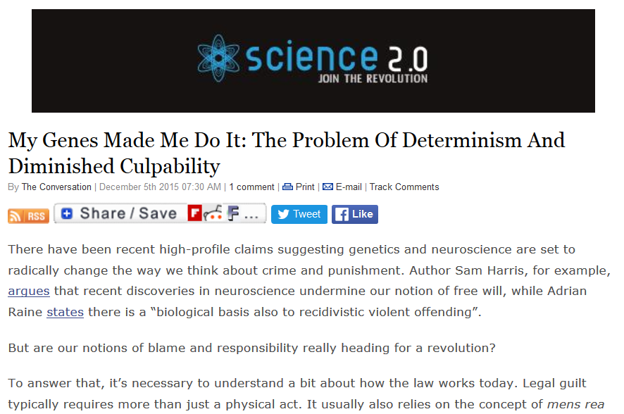
http://www.science20.com/the_conversation/my_genes_made_me_do_it_the_problem_of_determinism_and_diminished_culpability-161174

Slide 13
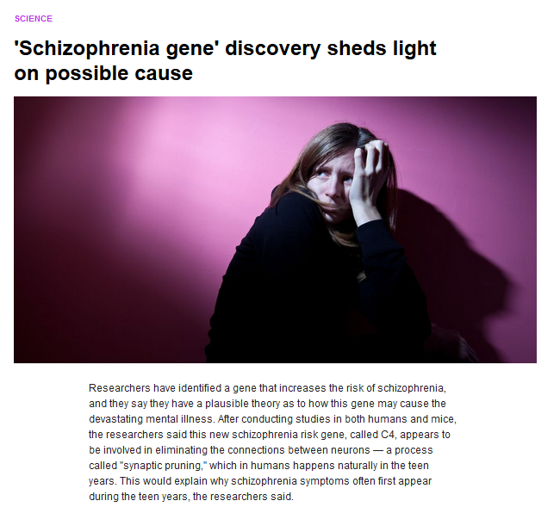

28 January 2016
https://www.yahoo.com/digest/20160128/schizophrenia-gene-discovery-sheds-light-possible-cause-10195055

Slide 14
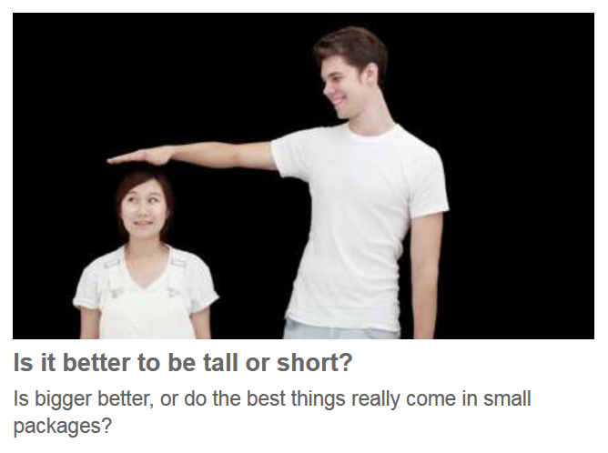

July 19, 2009
http://www.bbc.com/future/story/20150928-tall-vs-small-which-is-it-better-to-be
Notes:
14

Slide 15
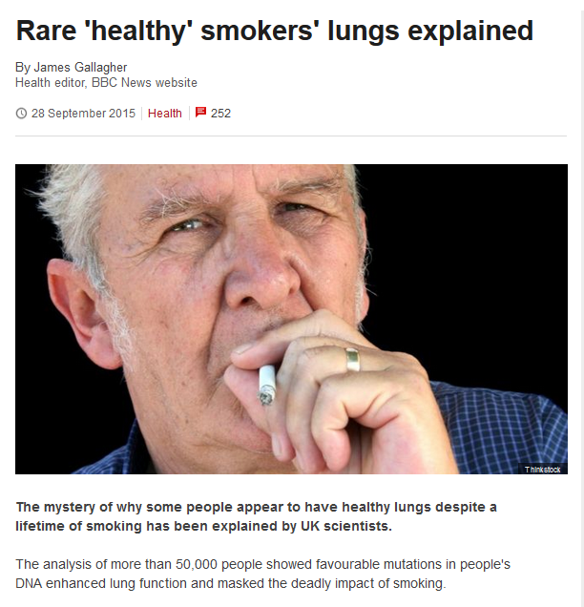
http://www.bbc.com/news/health-34360865
Notes:
15

Slide 16
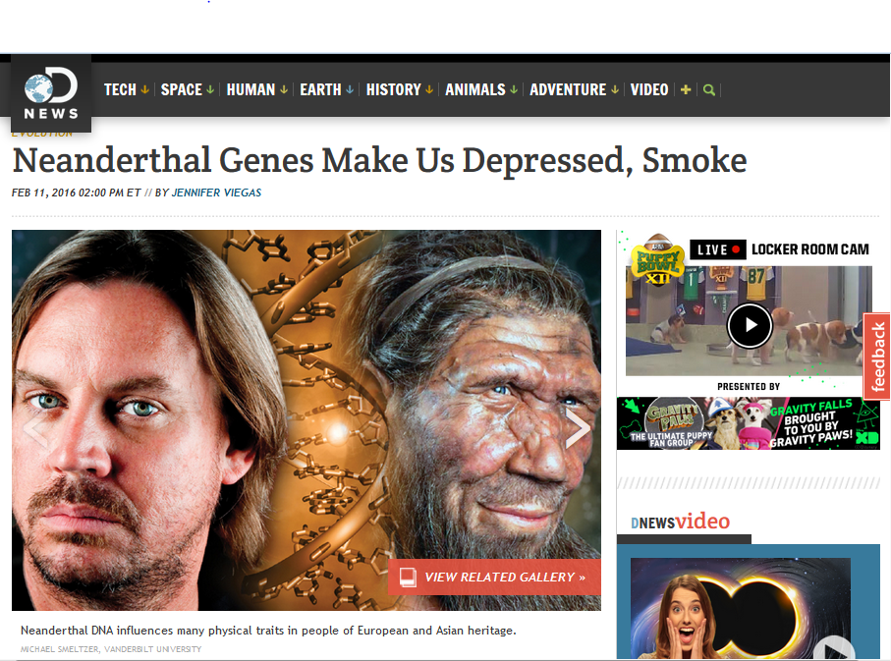
http://news.discovery.com/human/evolution/neanderthal-genes-make-us-depressed-smoke-160211.htm
Notes:
16

Slide 17

http://news.discovery.com/human/evolution/neanderthal-genes-make-us-depressed-smoke-160211.htm
Notes:
17

Slide 18
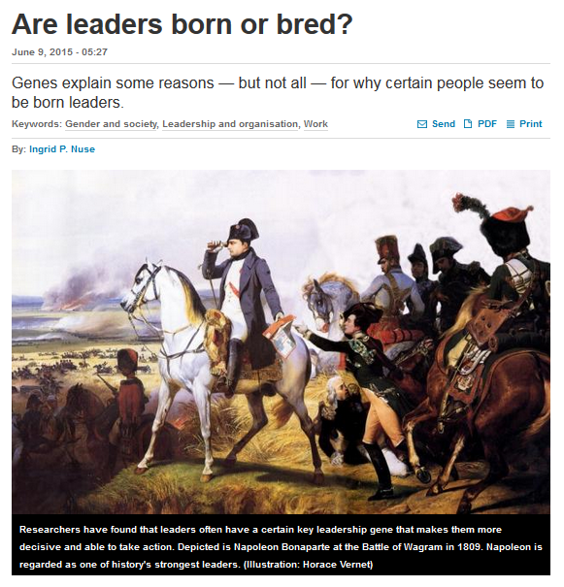
http://sciencenordic.com/are-leaders-born-or-bred
Notes:
¹⁸

Slide 19
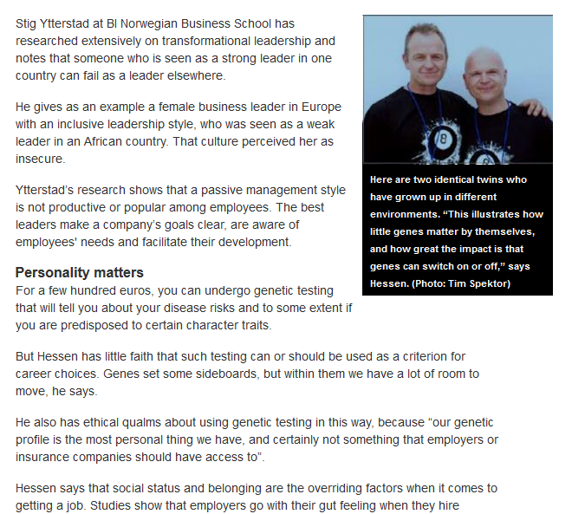
http://sciencenordic.com/are-leaders-born-or-bred
Notes:
¹⁹

Slide 20
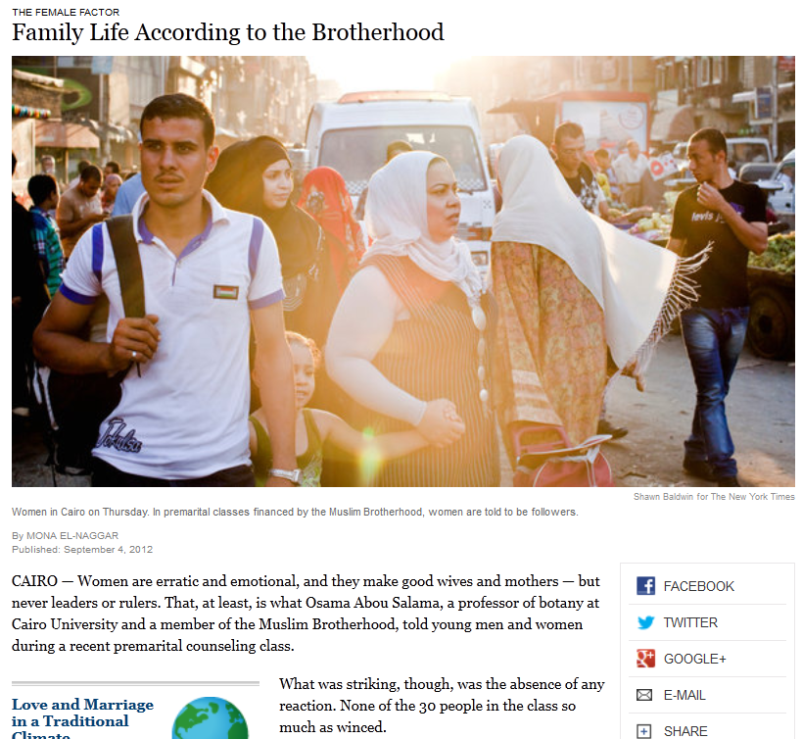
http://www.nytimes.com/2012/09/05/world/middleeast/05iht-letter05.html?pagewanted=all

Slide 21
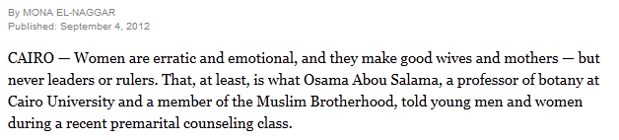
http://www.nytimes.com/2012/09/05/world/middleeast/05iht-letter05.html?pagewanted=all

Slide 22
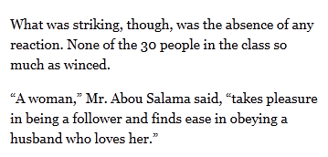
http://www.nytimes.com/2012/09/05/world/middleeast/05iht-letter05.html?pagewanted=all

Slide 23
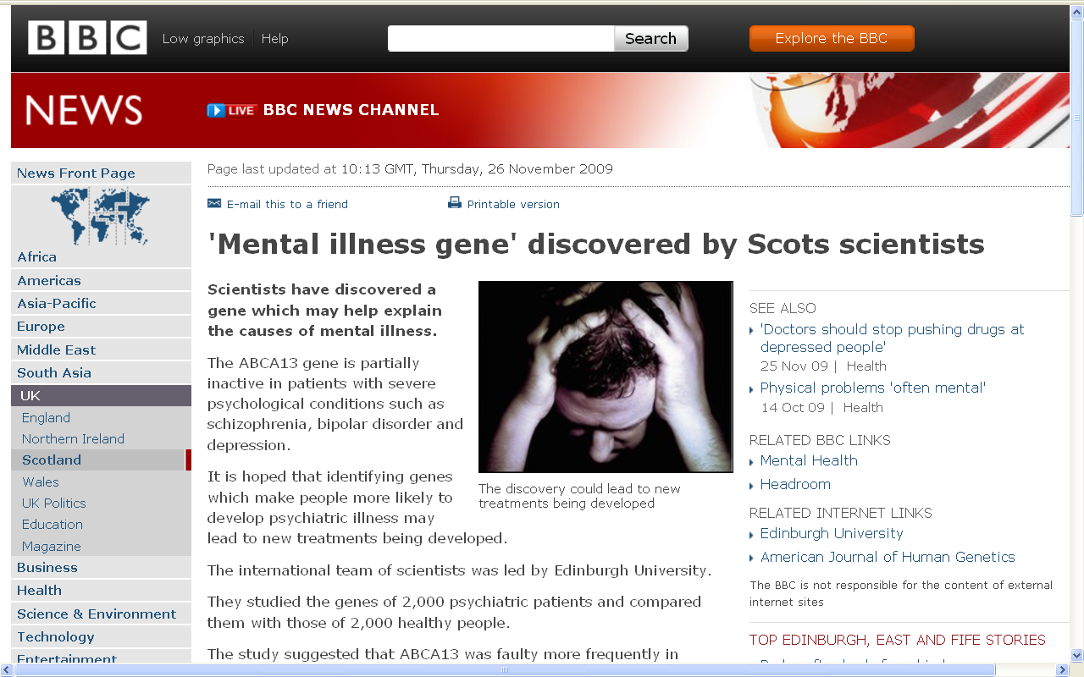
http://news.bbc.co.uk/2/hi/uk_news/scotland/edinburgh_and_east/8380341.stm

Slide 24
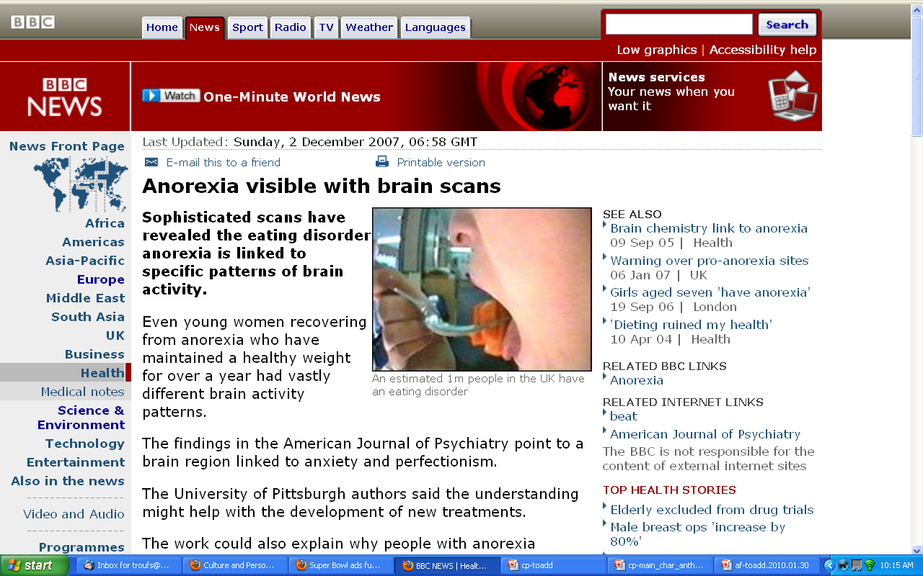
http://news.bbc.co.uk/2/hi/health/7120564.stm

Slide 25
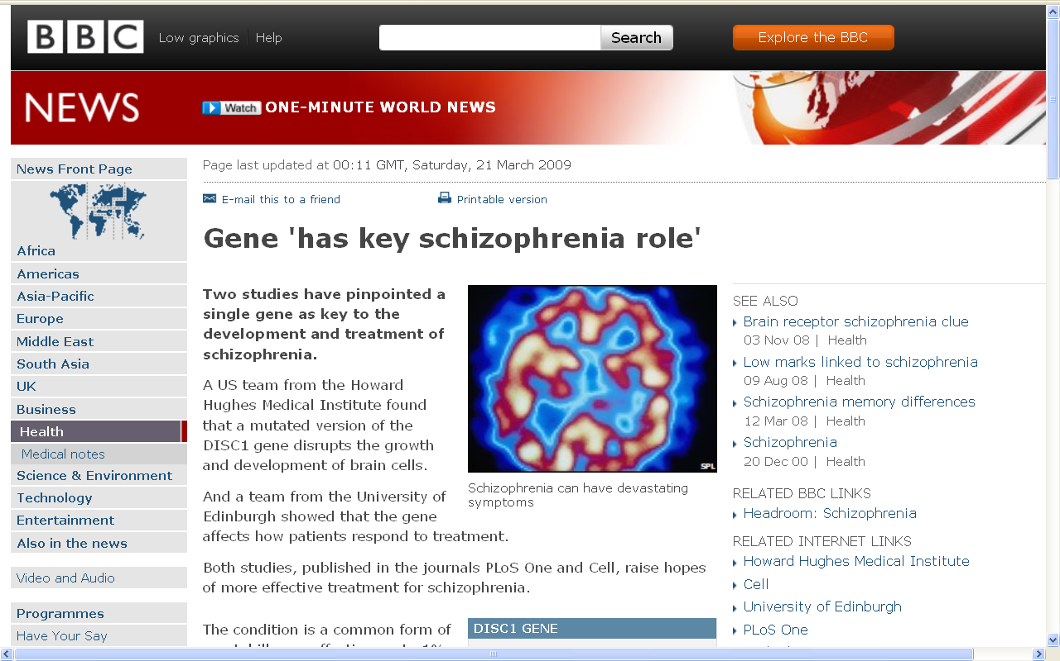
http://news.bbc.co.uk/2/hi/health/7954451.stm

Slide 26
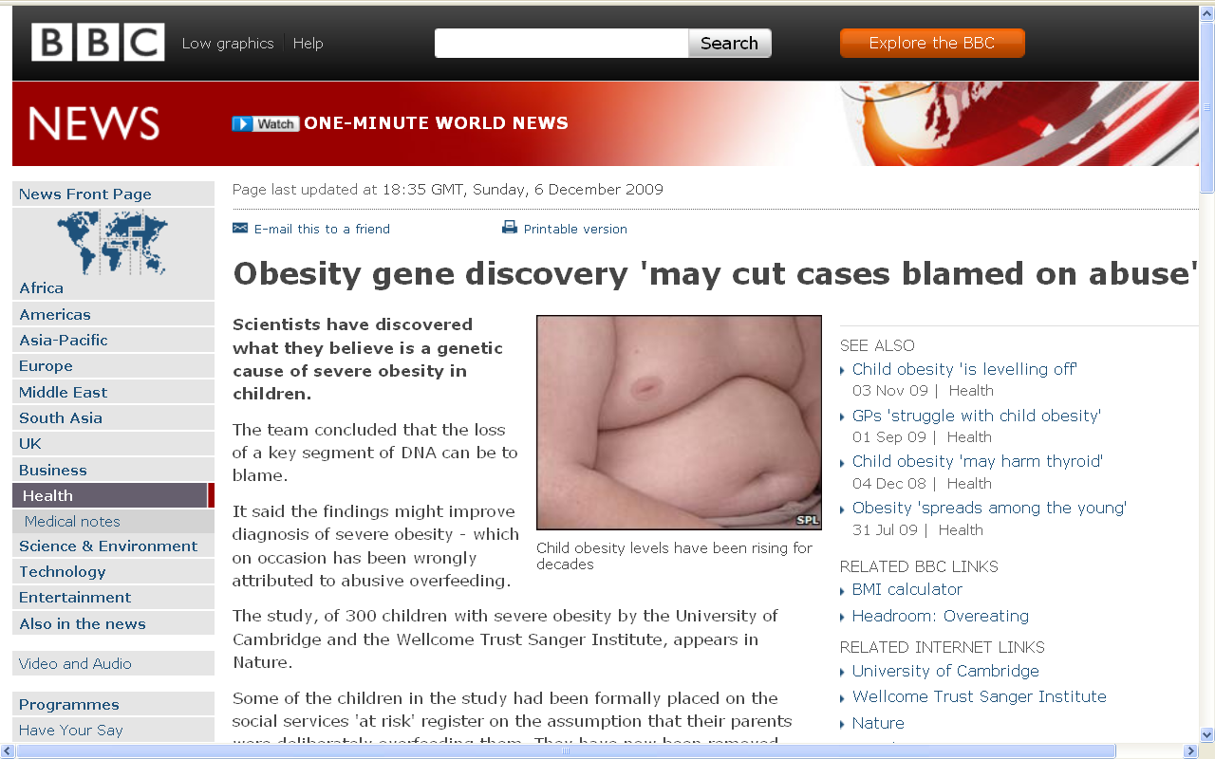
July 19, 2009
http://news.bbc.co.uk/2/hi/health/8394991.stm
Notes:
26

Slide 27
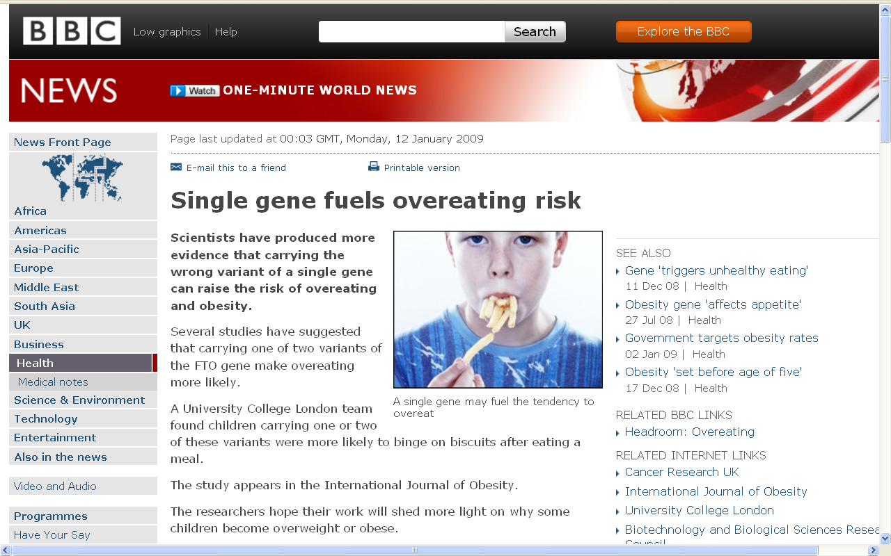
July 19, 2009
http://news.bbc.co.uk/2/hi/health/7820042.stm
Notes:
27

Slide 28
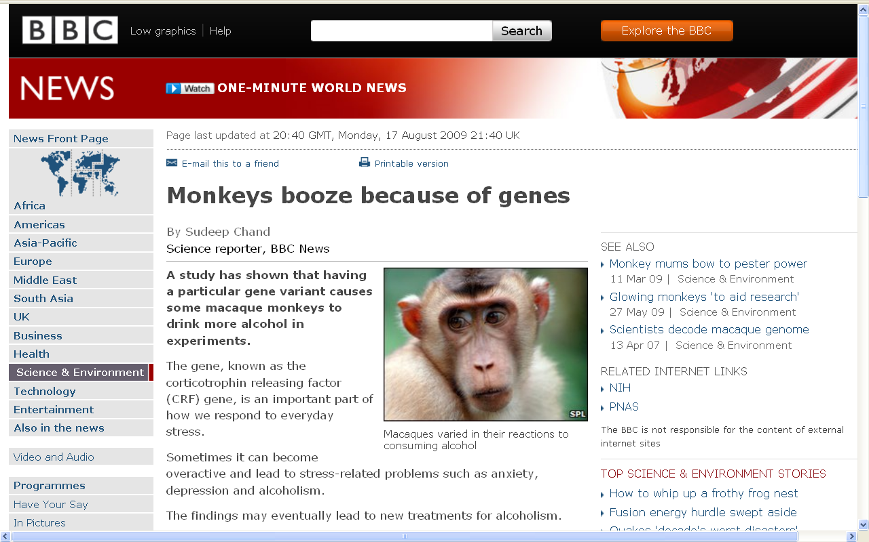
http://news.bbc.co.uk/2/hi/science/nature/8206151.stm

Slide 29
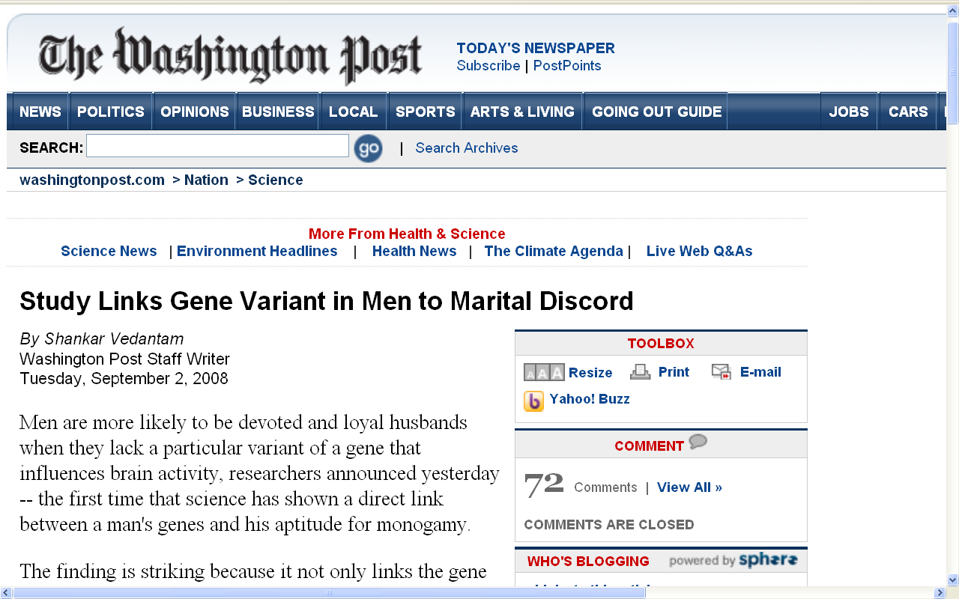
www.washingtonpost.com/wp-dyn/content/article/2008/09/01/AR2008090102087.html

Slide 30
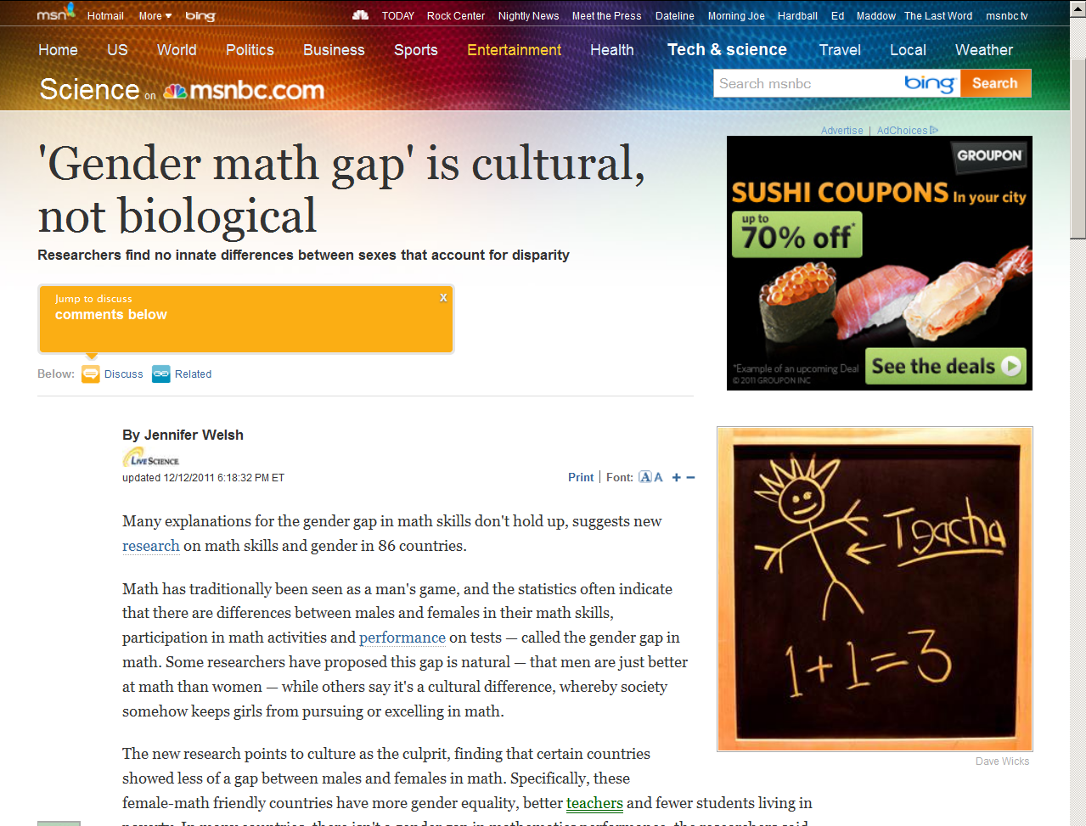
July 19, 2009
Notes:
30

Slide 31
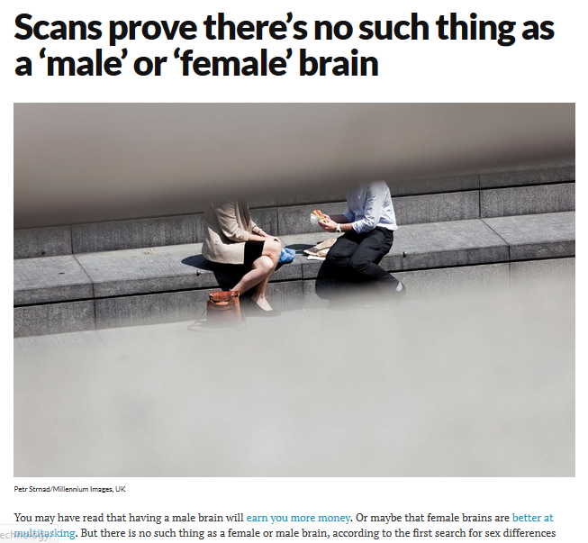

July 19, 2009
30 November 2015
https://www.newscientist.com/article/dn28582-scans-prove-theres-no-such-thing-as-a-male-or-female-brain/
Notes:
31

Slide 32
July 19, 2009
STRUCTURALLY SPEAKING . . .
But what about FUNCTION ? . . .
30 November 2015
https://www.newscientist.com/article/dn28582-scans-prove-theres-no-such-thing-as-a-male-or-female-brain/
Notes:
32

Slide 33
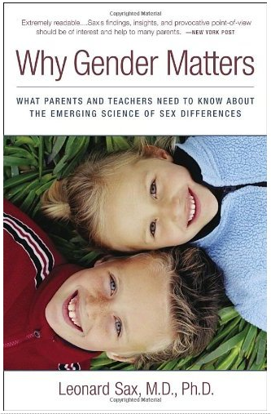
July 19, 2009
Three Rivers Press, 2006
Notes:
33

Slide 34
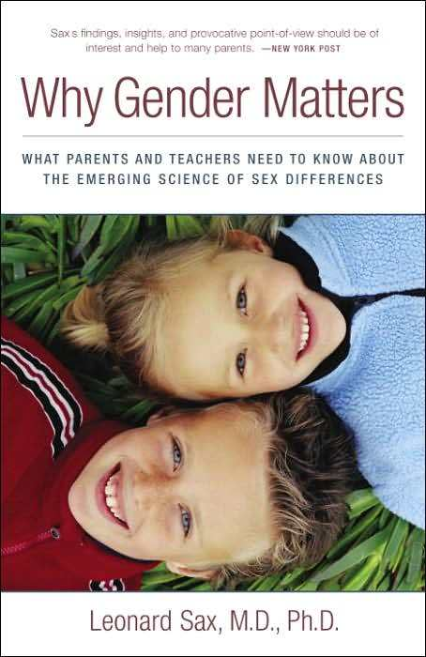
July 19, 2009
“nature vs. nurture”
boys and girls learn differently
Three Rivers Press, 2006
Notes:
34

Slide 35
three major contemporary debates
Biological Determinism
vs. Cultural Constructionism
(“nature vs. nurture”)
(“inherited vs. learned”)
(“nativism” vs. “empiricism”)

Slide 36
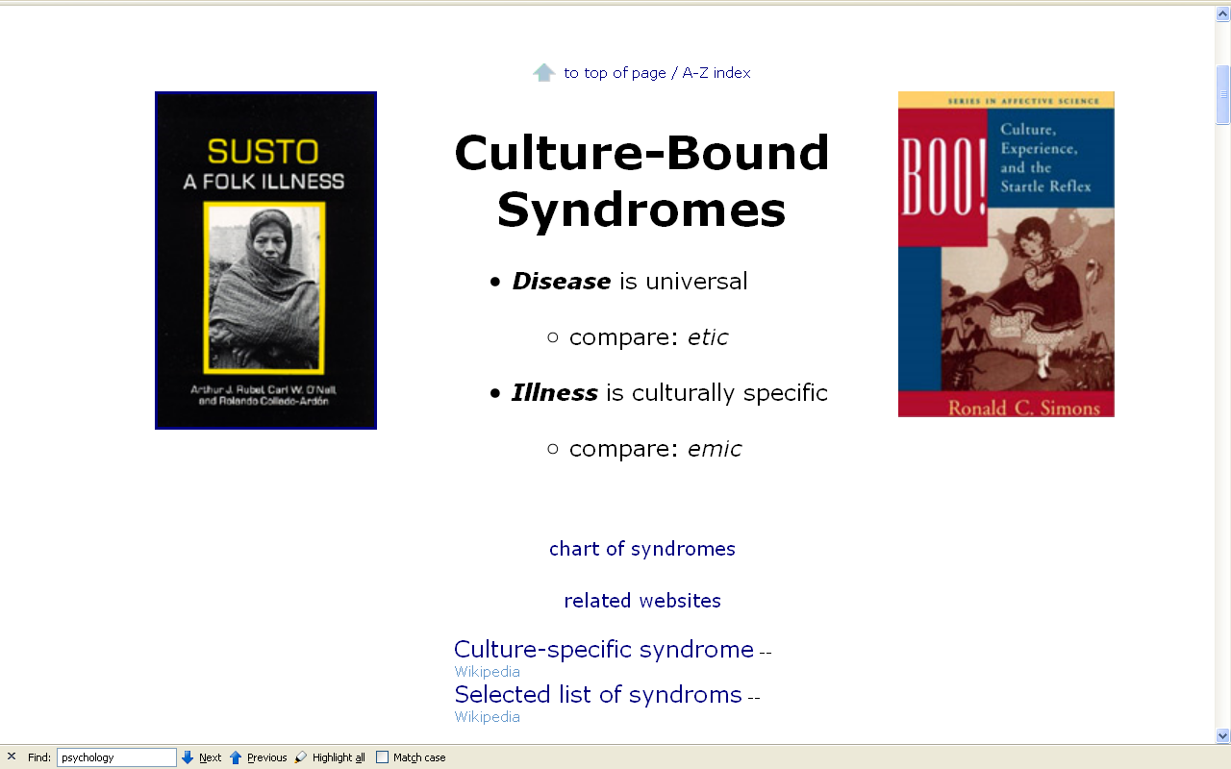
Notes:
36

Slide 37
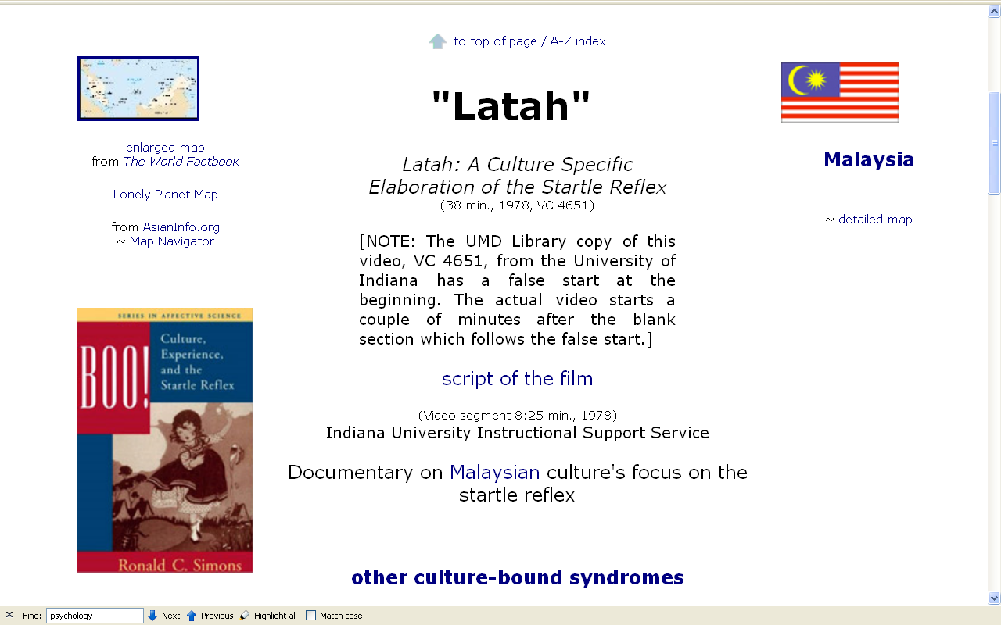
Notes:
37

Slide 38
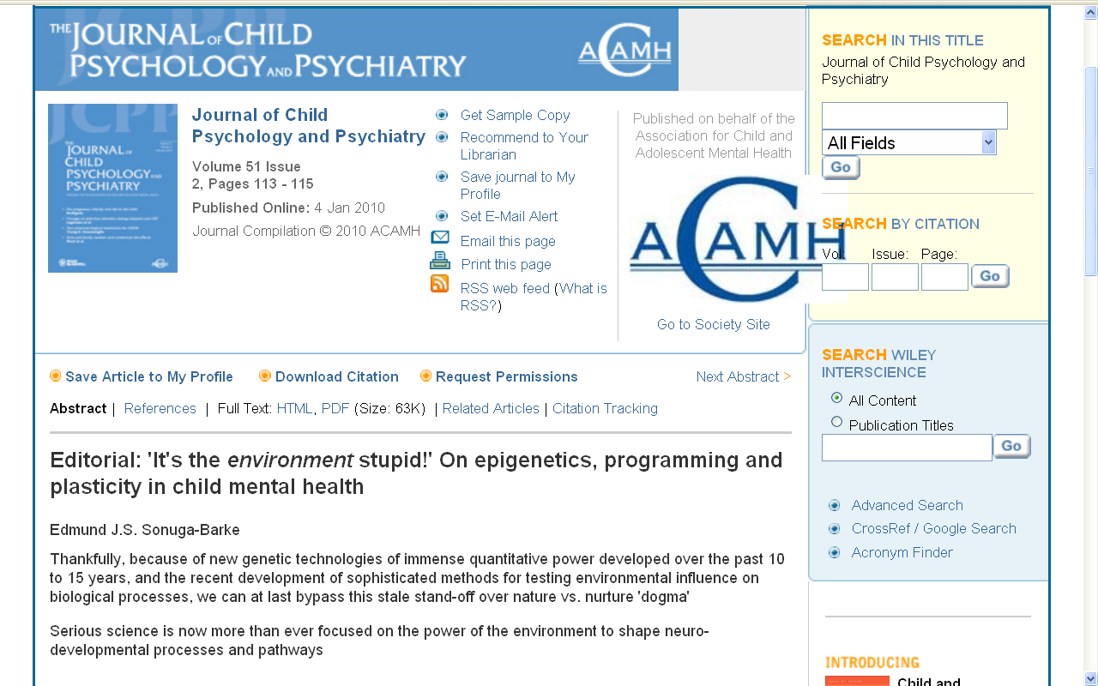
http://www3.interscience.wiley.com/journal/123232350/abstract

Slide 39
three major contemporary debates
Biological Determinism
and Cultural Constructionism
(“nature and nurture”)
(“inherited and learned”)
(“nativism” and “empiricism”)

Slide 40
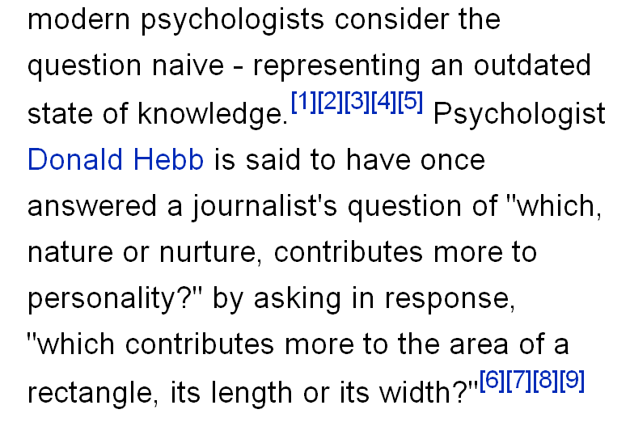
http://en.wikipedia.org/wiki/Nature_versus_nurture

Slide 41
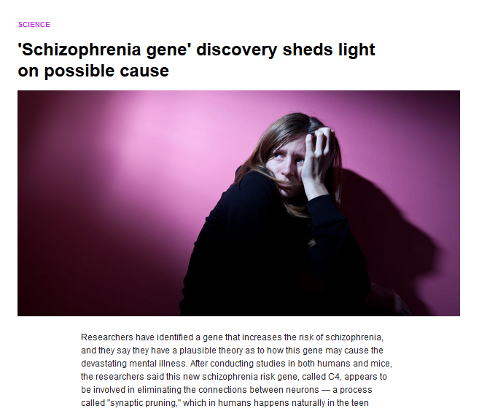
https://www.yahoo.com/digest/20160128/schizophrenia-gene-discovery-sheds-light-possible-cause-10195055

Slide 42
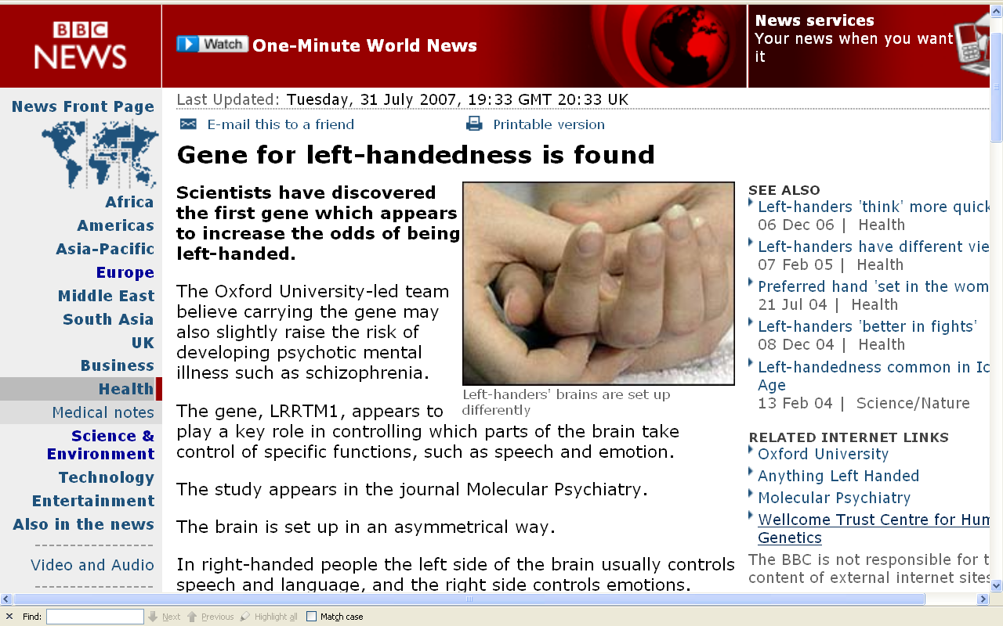
http://news.bbc.co.uk/2/hi/health/6923577.stm

Slide 43
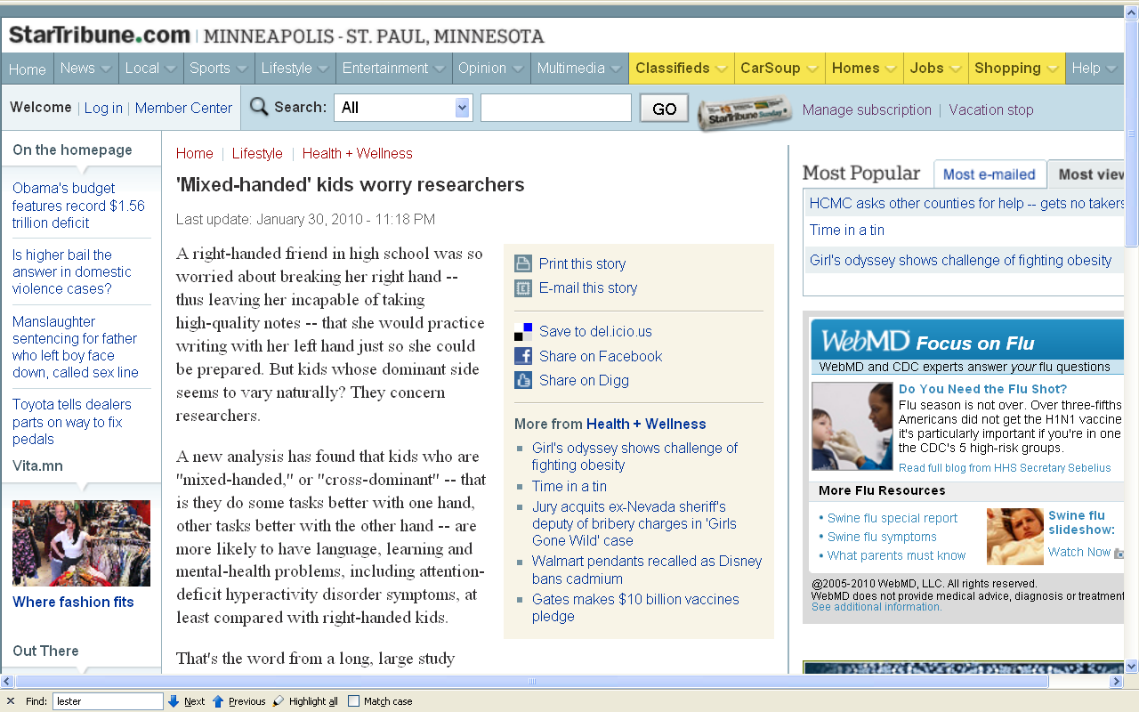
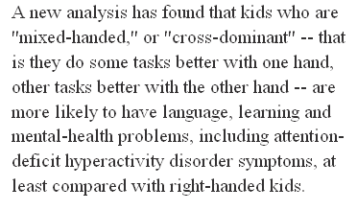
http://news.bbc.co.uk/2/hi/health/6923577.stm

Slide 44
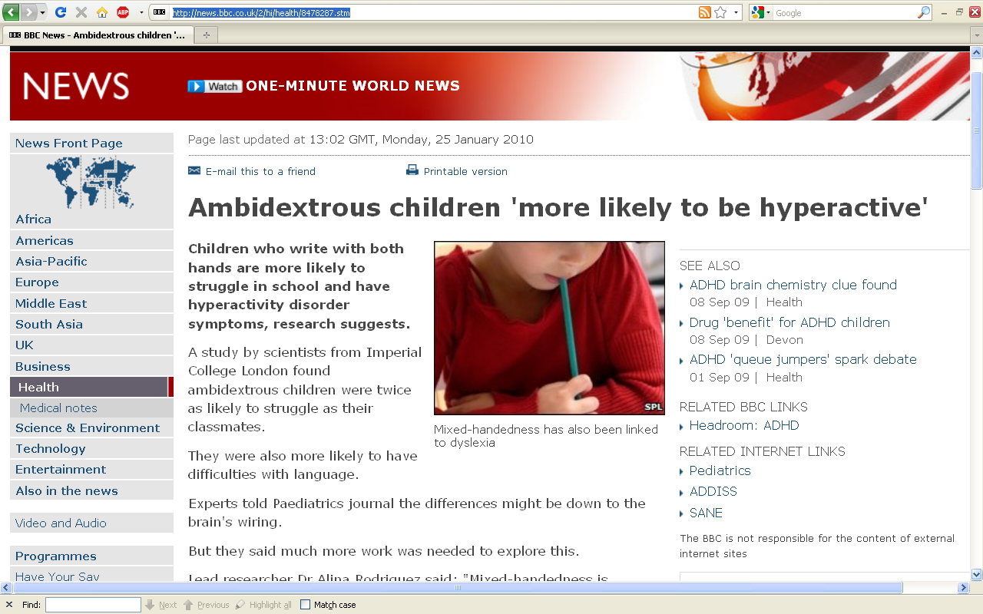
http://news.bbc.co.uk/2/hi/health/8478287.stm

Slide 45
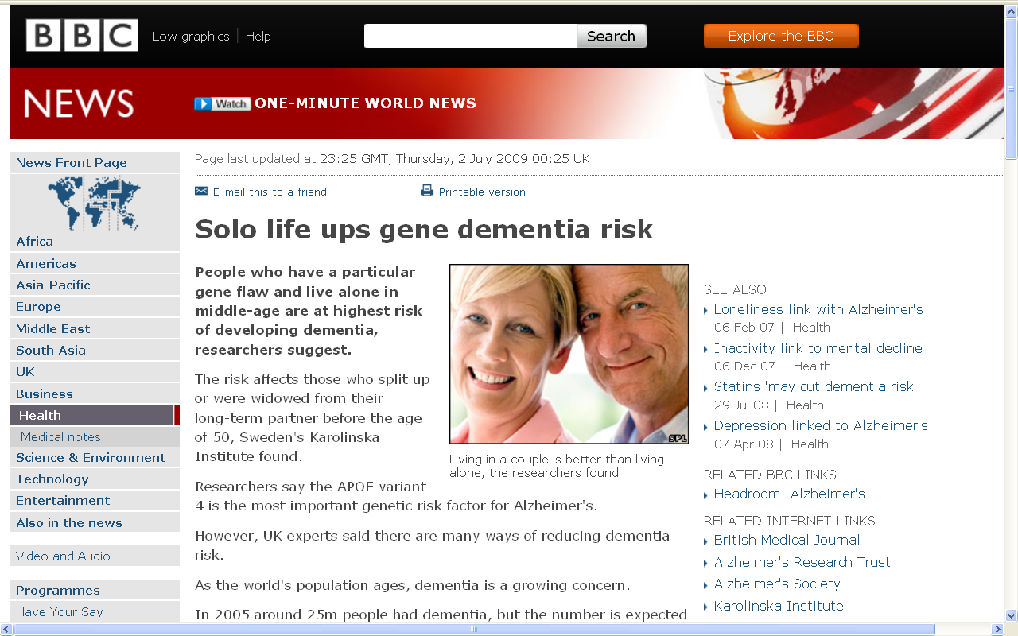
http://news.bbc.co.uk/2/hi/health/8130255.stm

Slide 46
“nature vs. nurture”
July 19, 2009
http://www.d.umn.edu/cla/faculty/troufs/anth4616/cpgender.html#title
Notes:
46

Slide 47
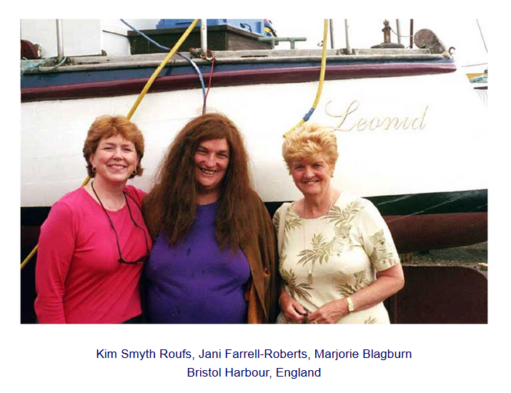
“nature vs. nurture”
July 19, 2009
http://www.d.umn.edu/cla/faculty/troufs/anth4616/cpgender.html#title
Notes:
47

Slide 48
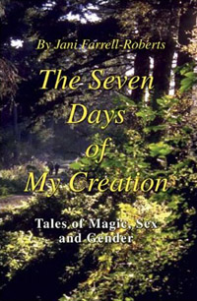
“nature vs. nurture”
July 19, 2009
http://www.d.umn.edu/cla/faculty/troufs/anth4616/cpgender.html#title
Notes:
48

Slide 49
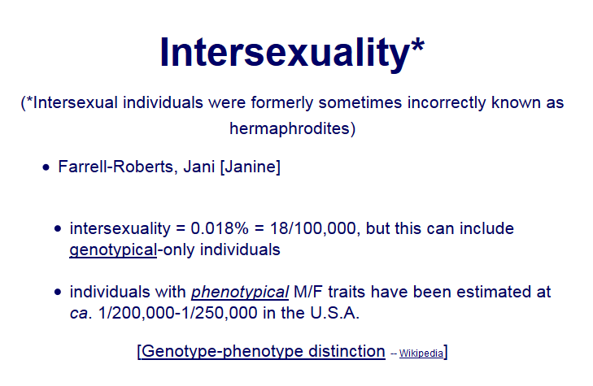
“nature vs. nurture”
July 19, 2009
http://www.d.umn.edu/cla/faculty/troufs/anth4616/cpgender.html#title
Notes:
49

Slide 50
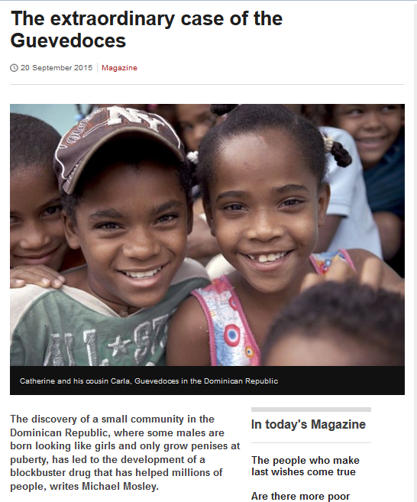

July 19, 2009
http://www.bbc.com/news/magazine-34290981
Notes:
50

Slide 51
three major contemporary debates
Biological Determinism
vs. Cultural Constructionism
Ideationism vs. Cultural Materialism
Individual Agency vs. Structuralism
(“free will” vs. “power structures”)

Slide 52
three major contemporary debates
Biological Determinism
vs. Cultural Constructionism
Ideationism vs. Cultural Materialism
Individual Agency vs. Structuralism
(“free will” vs. “power structures”)
Ideationism vs. Cultural Materialism
e.g., Aztecs must sacrifice and eat humans
in order to please the gods
in order that the gods allow
the sun to rise each day,
so that the world doesn’t end

Slide 53
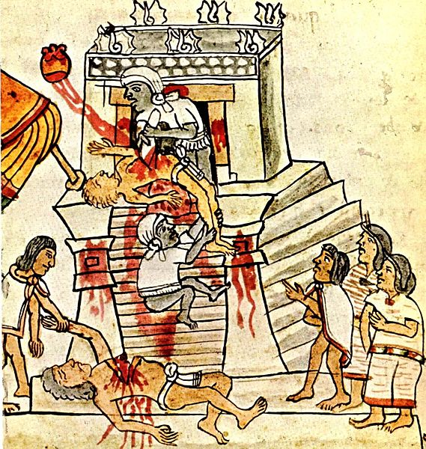
Aztec human sacrifice as shown in the Codex Magliabechiano
http://en.wikipedia.org/wiki/Image:Mendoza_HumanSacrifice.jpg

Slide 54
three major contemporary debates
Ideationism vs. Cultural Materialism
Biological Determinism
vs. Cultural Constructionism
Ideationism vs. Cultural Materialism
Individual Agency vs. Structuralism
(“free will” vs. “power structures”)
e.g., Aztecs sacrificed and ate humans
in order to control population size
in order to preserve their property,
to terrorize their neighbors
so they will continue to provide
goods and services as tribute,
and because they tasted good

Slide 55
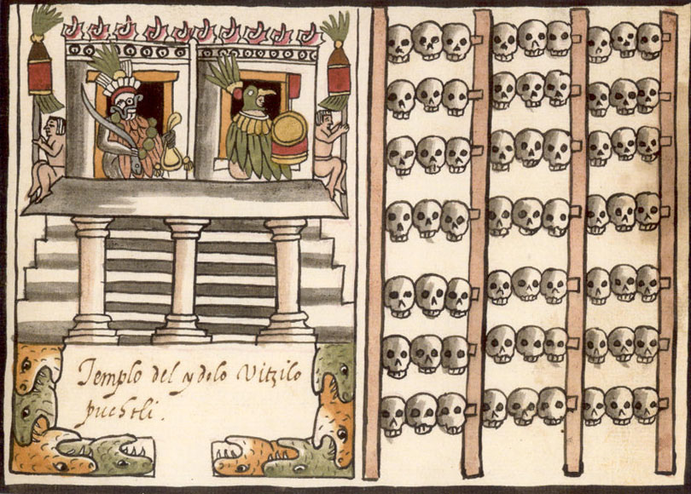
A tzompantli, or skull rack, as shown in the post-Conquest Ramirez Codex.
http://en.wikipedia.org/wiki/Image:Mendoza_HumanSacrifice.jpg

Slide 56
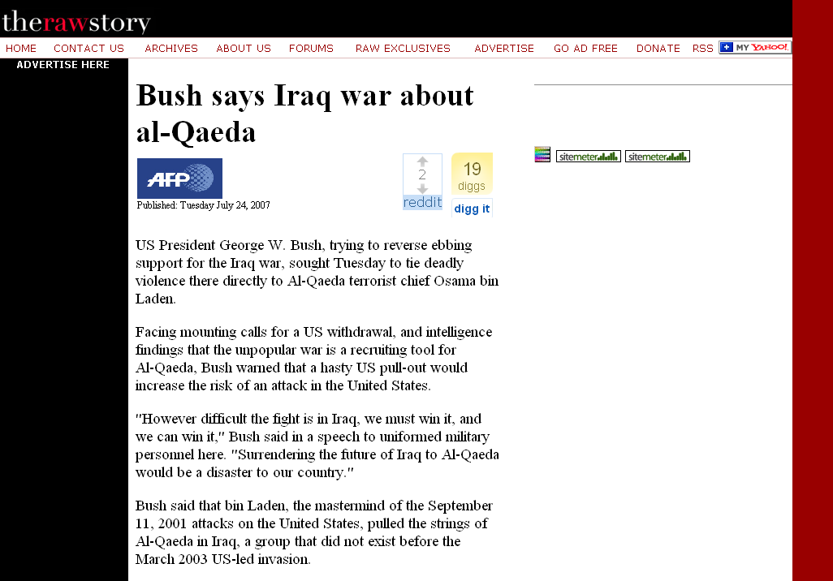
Peace
Justice
Security
Freedom
Honor
[God’s will / Allah’s will . . .]
Ideationism vs. Cultural Materialism
http://rawstory.com/news/afp/Bush_says_Iraq_war_about_al_Qaeda_07242007.html
Notes:
56

Slide 57
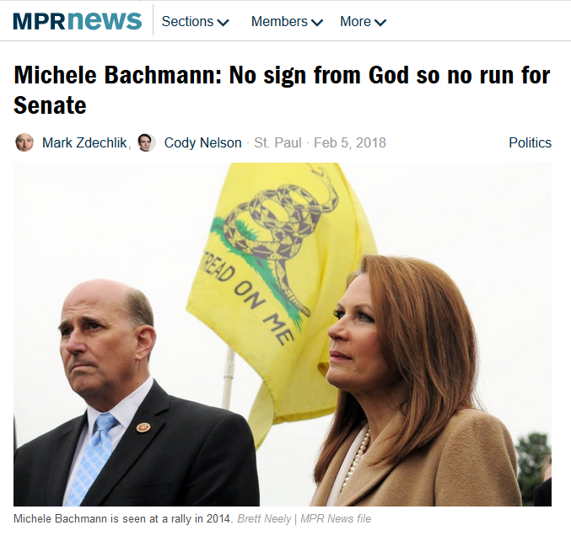
https://www.mprnews.org/story/2018/02/05/michele-bachmann-not-running-for-franken-senate-seat
Notes:
57

Slide 58
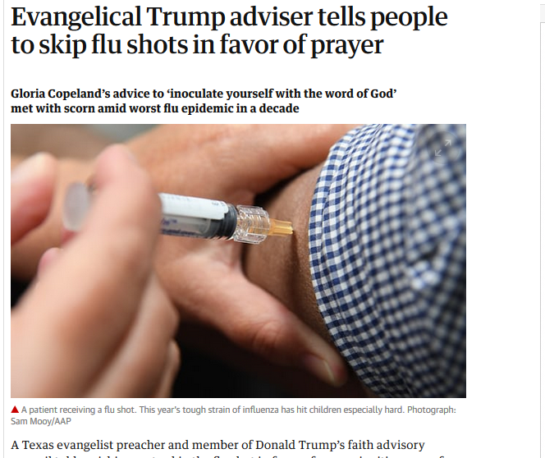


https://www.theguardian.com/society/2018/feb/07/evangelical-flu-shot-pray-donald-trump-gloria-copeland?CMP=Share_iOSApp_Other
Notes:
58

Slide 59
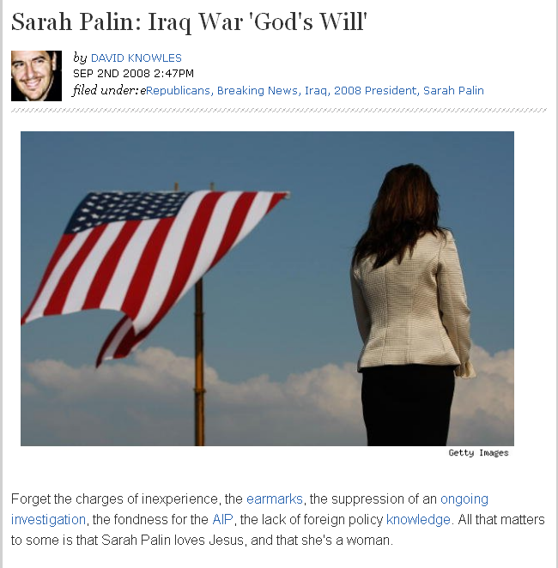
Ideationism vs. Cultural Materialism
http://news.aol.com/political-machine/2008/09/02/sarah-palin-iraq-war-gods-plan/
Notes:
59

Slide 60
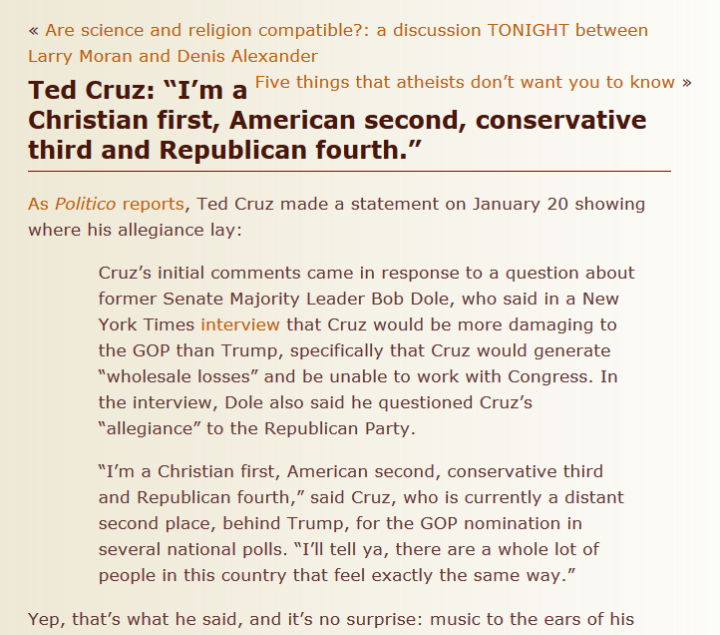
29 January 2016
Source
Notes:
60

Slide 61
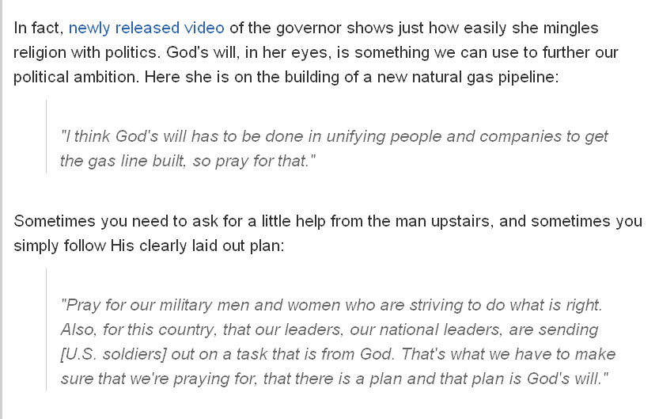
on building a new natural gas pipeline in Alaska . . .
Ideationism vs. Cultural Materialism
http://news.aol.com/political-machine/2008/09/02/sarah-palin-iraq-war-gods-plan/
Notes:
61

Slide 62

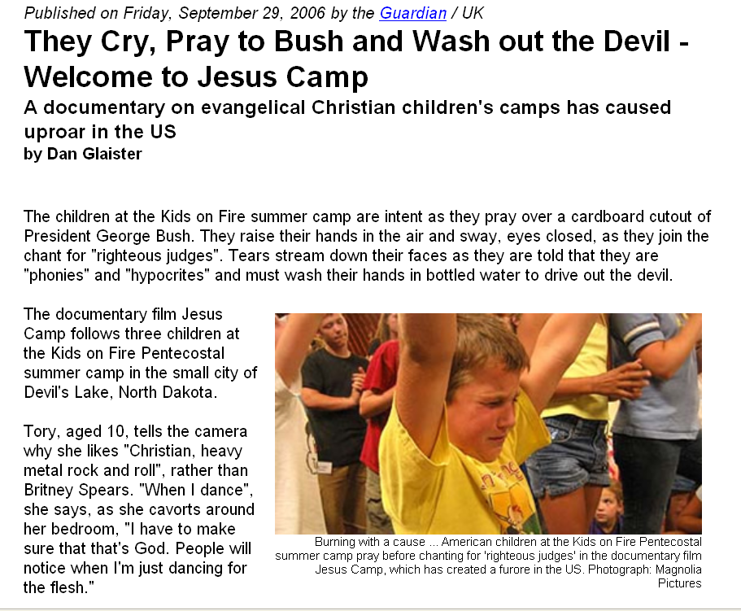
“At one point Pastor Fischer equates the preparation she is giving children with the training of terrorists in the Middle East. ‘I want to see young people who are as committed to the cause of Jesus Christ as the young people are to the cause of Islam," she tells the camera. "I want to see them radically laying down their lives for the gospel, as they are over in Pakistan and Israel and Palestine.’"
http://news.aol.com/political-machine/2008/09/02/sarah-palin-iraq-war-gods-plan/
Notes:
62

Slide 63
Ideationism vs. Cultural Materialism
http://news.aol.com/political-machine/2008/09/02/sarah-palin-iraq-war-gods-plan/
Notes:
63

Slide 64
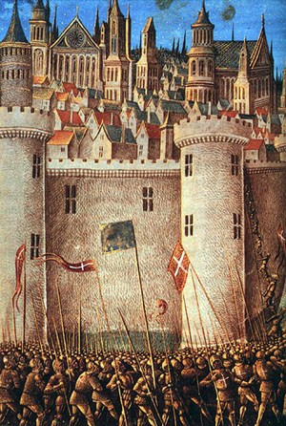
Ideationism vs. Cultural Materialism
The Siege of Antioch, from a medieval miniature painting, during the First Crusade.
http://en.wikipedia.org/wiki/Crusade
Notes:
64

Slide 65

Ideationism vs. Cultural Materialism
Saint Joan of Arc
Burned at the stake by an ecclesiastical court
For leading the French Armey by divine guidance
During the Hundred Years’ War (1337 to 1453)
http://en.wikipedia.org/wiki/Joan_of_arc
Notes:
65

Slide 66
three major contemporary debates
Biological Determinism
vs. Cultural Constructionism
Ideationism vs. Cultural Materialism
Individual Agency vs. Structuralism
(“free will” vs. “power structures”)

Slide 67

Ideationism vs. Cultural Materialism
www.abc.net.au/news/stories/2007/09/17/2034283.htm
Notes:
67

Slide 68
three major contemporary debates
Biological Determinism
vs. Cultural Constructionism
Ideationism vs. Cultural Materialism
Individual Agency vs. Structuralism
(“free will” vs. “power structures”)
this debate is related in part to
“THE ‘TWO-CULTURE’ PROBLEM”
— C.P. Snow

Slide 69

Rede lecture of 1959
Notes:
69

Slide 70
Marion Nestle
Food Politics, Revsed Ed.
Ch. 10 “Science versus Supplements: ‘A Gulf of Mutual Incomprehension’”
“THE ‘TWO-CULTURE’ PROBLEM”
  “belief-based” attitudes
vs.
  “science-based” attitudes

Slide 71

Marion Nestle
Food Politics, Revsed Ed.
Ch. 10 “Science versus Supplements: ‘A Gulf of Mutual Incomprehension’”
“THE ‘TWO-CULTURE’ PROBLEM”
  “belief-based” attitudes
vs.
  “science-based” attitudes
  University of California Press
  2007

Slide 72
Marion Nestle
Food Politics, Revised Ed.
Ch. 10 “Science versus Supplements: ‘A Gulf of Mutual Incomprehension’”
“THE ‘TWO-CULTURE’ PROBLEM”
  “belief-based” attitudes
vs.
  “science-based” attitudes
  Marion Nestle, Food Politics, Rev. Ed., 2007, pp. 230-233

Slide 73
C.P. Snow
“Two Cultures and the Scientific Revolution: The Rede Lecture.”
London, Cambridge University Press
1959

Slide 74

http://en.wikipedia.org/wiki/The_Two_Cultures
Notes:
74

Slide 75
Are dietary supplements needed ?

Slide 76

Are dietary supplements needed ?
http://en.wikipedia.org/wiki/Multivitamin

Slide 77
Are dietary supplements needed ?
  “belief-based” attitudes
vs.
  “science-based” attitudes
  Safety
  Need
  Efficacy
  after Marion Nestle, Food Politics, Rev. Ed., 2007, pp. 232

Slide 78
Are dietary supplements needed ?
  “science-based” attitudes
  Safety
  Excessive doses of many nutrients are demonstrably toxic
  High levels of single nutrients interfere with the functions of other nutrients
  The safety of many herbal products is untested and, therefore, unknown
  Herbal supplements vary in composition, potency, and quality
  after Marion Nestle, Food Politics, Rev. Ed., 2007, pp. 232

Slide 79
Are dietary supplements needed ?
  “belief-based” attitudes
  Safety
  Supplements are safe within a broad range of intake; safety problems are rare
  Herbal products have been used for thousands of years
  Supplements cause less harm than many prescription drugs
  after Marion Nestle, Food Politics, Rev. Ed., 2007, pp. 232

Slide 80
Are dietary supplements needed ?
  “science-based” attitudes
  Need
  Food is sufficient to meet nutritional needs
  Foods provide nutrients and other valuable substances not present in supplements
  People who take supplements are better educated and wealthier
    they are healthier whether or not they take supplements
  after Marion Nestle, Food Politics, Rev. Ed., 2007, pp. 232

Slide 81
Are dietary supplements needed ?
  “belief-based” attitudes
  Need
  Diets do not always follow dietary recommendations
  Foods grown on depleted soils lack essential nutrients
  Pollution and stressful living conditions increase nutrient requirements
  Cooking destroys essential nutrients
  after Marion Nestle, Food Politics, Rev. Ed., 2007, pp. 232

Slide 82
Are dietary supplements needed ?
  “science-based” attitudes
  Efficacy
  Research demonstrates health benefits of diets and foods, not of single nutrients
  Higher-than-recommended doses of few single nutrients improve health
  Health claims for many supplements often address issues (such as “stress”) that are difficult to evaluate scientifically
  The health benefits of most supplements are unproven
  Many “benefits” of supplements can be explained as placebo or other self-healing effects
  after Marion Nestle, Food Politics, Rev. Ed., 2007, pp. 232

Slide 83
Are dietary supplements needed ?
  “belief-based” attitudes
  Efficacy
  People who take supplements are healthier
  People feel better when they take supplements
  Studies demonstrate the health benefits of supplements
  Benefits are sometimes greater at amounts higher than can be obtained from food
  after Marion Nestle, Food Politics, Rev. Ed., 2007, pp. 232

Slide 84
DIETARY SUPPLEMENTS
  “science-
  based”
  “faith-
  based”
  Safe No/ Yes
  Unknown
  Need No Yes
  Efficacy No/ Yes
  Unknown
  Take No Yes
  after Marion Nestle, Food Politics, Rev. Ed., 2007, pp. 232

Slide 85

http://www.mocpages.com/moc.php/30406
Notes:
⁸⁵

Slide 86

http://www.reverbnation.com/data_public/artist/userfiles/97034/shine04.09.jpg
Notes:
⁸⁶

Slide 87
and, of course, there’s always the . . .

Slide 88

Notes:
⁸⁸

Slide 89
high priced placebos works better than the cheaper ones
Notes:
⁸⁹

Slide 90
high priced placebos works better than the cheaper ones
red ones work better than green ones
and they work even when people know they are placebos
Notes:
⁹⁰

Slide 91
high priced placebos works better than the cheaper ones
red ones work better than green ones
and they work even when people know they are placebos
Notes:
⁹¹

Slide 92
DIETARY SUPPLEMENTS
  Question:
  What percentage of Americans
  regularly take
  dietary supplements ?
  after Marion Nestle, Food Politics, Rev. Ed., 2007, pp. 232

Slide 93
DIETARY SUPPLEMENTS
  Question:
  Why do the science-based “people” take them ?
  after Marion Nestle, Food Politics, Rev. Ed., 2007, pp. 232

Slide 94

www.foxnews.com/story/0,2933,405765,00.html
Notes:
⁹⁴

Slide 95
does
“science based” vs. “belief based” decision making make any difference
in the “real” world ?

Slide 96


James Inhofe is in charge of the Senate Environment and Public Works Committee
Ted Cruz is the chair of the Subcommittee on Space, Science and Competitiveness which is in charge of NASA
13 January 2015
  http://bluenationreview.com/two-anti-science-senators-now-lead-two-science-committees/
  after Marion Nestle, Food Politics, Rev. Ed., 2007, pp. 232

Slide 97
James Inhofe is in charge of the Senate Environment and Public Works Committee
13 January 2015
  http://bluenationreview.com/two-anti-science-senators-now-lead-two-science-committees/
  after Marion Nestle, Food Politics, Rev. Ed., 2007, pp. 232

Slide 98
Global Warming
  “science-
  based”
  “faith-
  based”
  Real Yes No
  Mostly now
  caused by Yes No
  humans
  Action needed Yes No
  now

Slide 99

an excellent
review of the
problem
NY: Simon & Schuster, 2015.

Slide 100


http://www.bbc.com/news/world-us-canada-34341009
Notes:
100

Slide 101

http://www.bbc.com/news/science-environment-34342808
Notes:
101

Slide 102

http://www.bbc.com/news/science-environment-34342808
Notes:
102

Slide 103
http://www.bbc.com/news/science-environment-34342808
Notes:
103

Slide 104

http://www.bbc.com/news/science-environment-34342808
Notes:
104

Slide 105

http://www.bbc.com/news/world-us-canada-34337942
Notes:
105

Slide 106
Science Based
Faith Based
http://www.bbc.com/news/world-us-canada-34337942
Notes:
106

Slide 107


source
Notes:
107

Slide 108

Tenzin Gyatso
The 14th Dalai Lama
Science Based
Notes:
108

Slide 109

Tenzin Gyatso
The 14th Dalai Lama
Science Based
Notes:
109

Slide 110

Tenzin Gyatso
The 14th Dalai Lama
http://www.mprnews.org/story/2015/09/28/dalai-lama
Notes:
110

Slide 111

http://www.nationofchange.org/2015/10/31/ted-cruz-climate-change-is-not-science-its-religion/
Notes:
111

Slide 112

http://www.alternet.org/speakeasy/brucewilson/ted-cruzs-father-suggested-his-son-anointed-bring-about-end-time-transfer
Notes:
112

Slide 113


http://www.denverpost.com/nationworld/ci_29454397/cruz-runs-religious-campaign-but-tithing-is-not
Notes:
113

Slide 114
Ideationism or Cultural Materialism ?
http://www.denverpost.com/nationworld/ci_29454397/cruz-runs-religious-campaign-but-tithing-is-not
Notes:
114

Slide 115
and there are lots of other issues at stake . . .
for example . . .

Slide 116

www.dailypress.com/business/dp-biz_endangered_wheat_0528may28,0,3094328.story
Notes:
116

Slide 117


http://www.theguardian.com/world/2015/sep/26/blood-moon-mormon-church-apocalypse-warning
Notes:
117

Slide 118
Death Penalty
  “science-
  based”
  “faith-
  based”
  Failed
  Policy Yes No
  Confidence
  In the System No No
  Support No Yes

Slide 119
C.P. Snow
“Two Cultures and the Scientific Revolution: The Rede Lecture”
London, Cambridge University Press
1959

Slide 120
Marion Nestle
Food Politics, Revised Ed.
Ch. 10 “Science versus Supplements: ‘A Gulf of Mutual Incomprehension’”
“THE ‘TWO-CULTURE’ PROBLEM”
  “belief-based” attitudes
vs.
  “science-based” attitudes

Slide 121

Cultural Materialism
Marvin Harris.
The Rise of Anthropological Theory:
A History of Theories of Culture,
Updated Edition.
Lanham, MD: Altamira Press, 2000.
Notes:
121

Slide 122

http://en.wikipedia.org/wiki/Cultural_materialism_%28anthropology%29
Notes:
122

Slide 123

www.cultural-materialism.org/cultural-materialism/
Notes:
123

Slide 124
three major contemporary debates
Biological Determinism
vs. Cultural Constructionism
Ideationism vs. Cultural Materialism
Individual Agency vs. Structuralism
(“free will” vs. “power structures”)

Slide 125
three major contemporary debates
Biological Determinism
vs. Cultural Constructionism
Ideationism vs. Cultural Materialism
Individual Agency vs. Structuralism
(“free will” vs. “power structures”)

Slide 126
three major contemporary debates
Biological Determinism
vs. Cultural Constructionism
Ideationism vs. Cultural Materialism
Individual Agency vs. Structuralism
(“free will” vs. “power structures”)

Slide 127

http://www.bbc.com/news/world-us-canada-35808627?ocid=global_bbccom_email_15032016_top+news+stories

Slide 128


(“free will” vs. “power structures”)
www.wenatcheeworld.com/apps/pbcs.dll/article?AID=/20080122/FOOD/373497927/1030/rss1030
Notes:
128

Slide 129

(“free will” vs. “power structures”)
www.wenatcheeworld.com/apps/pbcs.dll/article?AID=/20080122/FOOD/373497927/1030/rss1030
Notes:
129

Slide 130

http://www.nydailynews.com/news/politics/track-palin-sarah-palin-adult-son-arrested-alaska-article-1.2502319

Slide 131

http://www.politico.com/story/2016/01/track-palin-domestic-violence-arrest-218028

Slide 132

sSource

Slide 133
“power structures”
“nature”
sSource

Slide 134

(“free will” vs. “power structures”)
www.cafepress.com/metalstar.71120928
Notes:
134

Slide 135

http://www.salon.com/2013/02/26/pat_robertson_there_could_be_demons_attached_to_your_thrift_store_finds/

Slide 136

Saint Francis Borgia performing an exorcism.
Francisco Goya
http://en.wikipedia.org/wiki/Exorcism
Notes:
136

Slide 137

http://news.bbc.co.uk/2/hi/uk_news/7999000.stm

Slide 138


http://news.bbc.co.uk/2/hi/uk_news/7999000.stm

Slide 139

http://news.bbc.co.uk/1/hi/world/europe/4272689.stm

Slide 140

http://www.dioceseduluth.org/index.php

Slide 141

http://www.dioceseduluth.org/index.php

Slide 142
and even the Diocese of Duluth
has an exorcist . . .
although he’s not listed on the Diocesan web page . . .
http://www.dioceseduluth.org/index.php

Slide 143
it’s Official Catholic doctrine . . .
http://news.bbc.co.uk/2/hi/uk_news/7999000.stm

Slide 144

The debates continue . . .
Plato

Slide 145
The debates continue . . .
They’re . . . Well . . .
They’re “perennial”
Plato

Slide 146
Three Major
Perennial
Debates
re Psychological Anthropology
University of Minnesota Duluth
University of Minnesota Duluth
Tim Roufs

