Slide 1
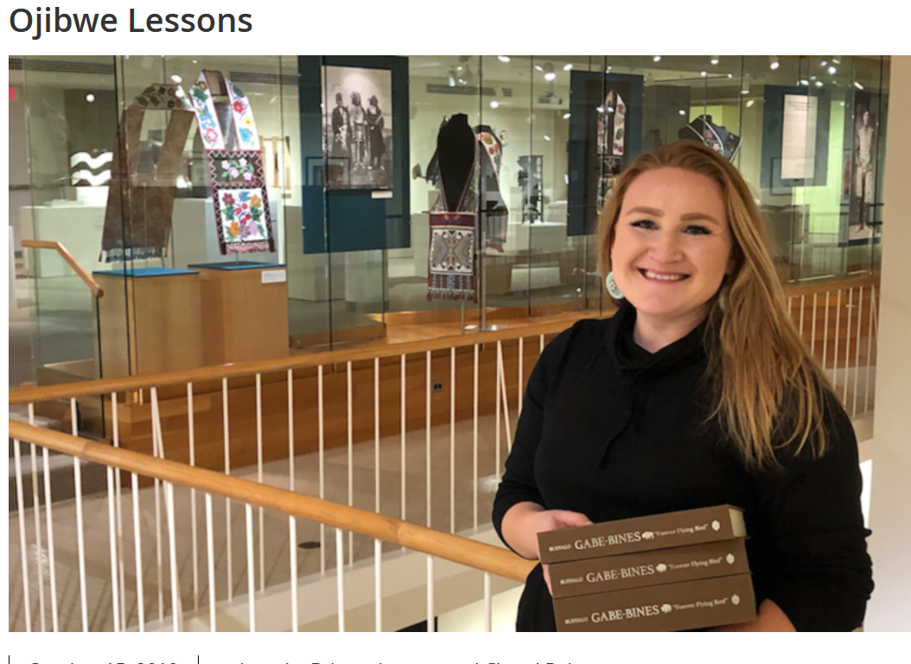
The Teachings of Paul Peter Buffalo,
Gabe-bines ("Forever-Flying-Bird“)
Tim Roufs © 2010-2019

Slide 2
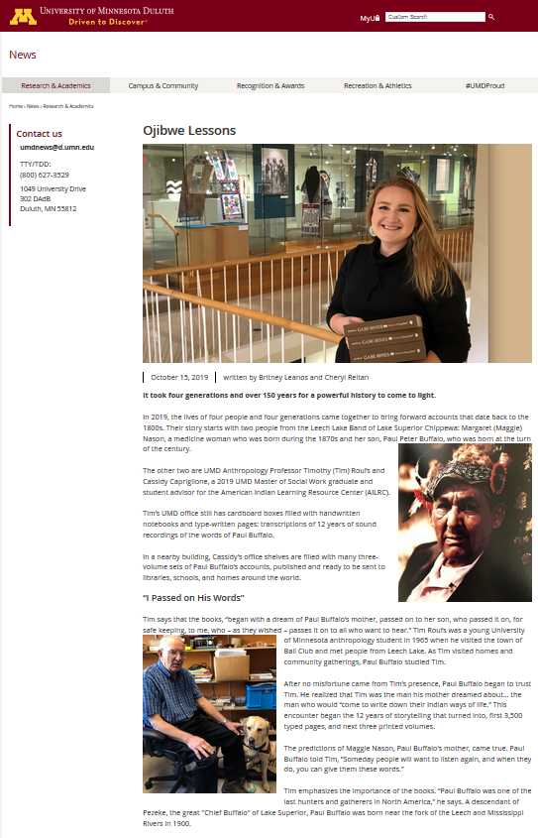
Tim Roufs © 2010-2019
https://news.d.umn.edu/news-and-events/news/paul-buffalo-2019

Slide 3
Cassidy Capriglione
UMD American Indian Learning Resource Center (AILRC)
Tim Roufs © 2010-2019

Slide 4
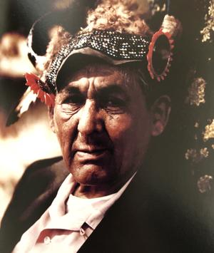
Paul Buffalo
(Gabe-bines)
Photographer: Joseph W. Boudreau

Slide 5
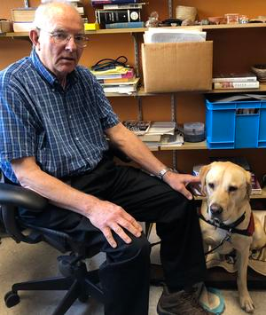
Tim and Bentley Roufs
UMD Anthropology-Sociology-Criminology
Tim Roufs © 2010-2019

Slide 6
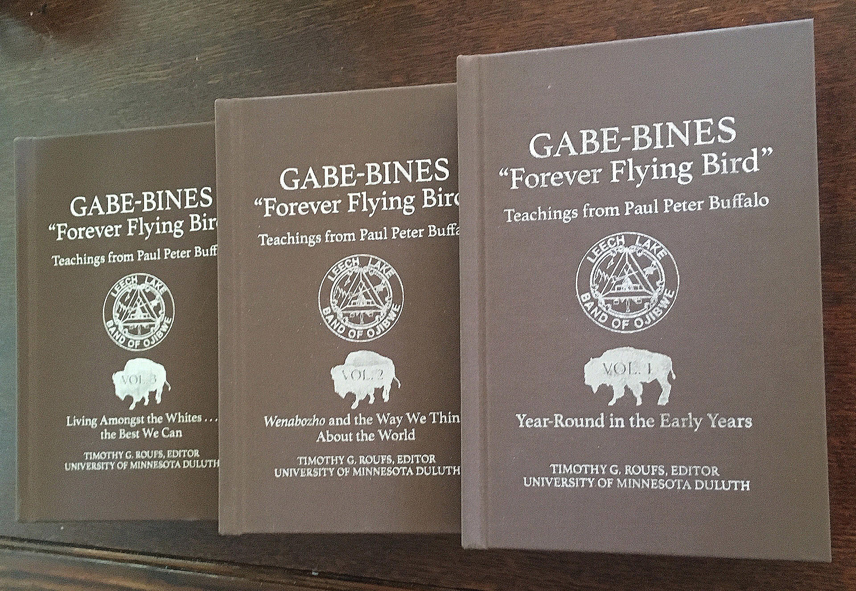
Tim Roufs © 2010-2019

Slide 7
When Everybody Called Me Gabe-bines, "Forever-Flying-Bird": Teachings from Paul Buffalo Volume I of the Paul Buffalo Trilogy: Year-Round in the Early Years Volume II of the Paul Buffalo Trilogy: Wenabozho and The Way We Think About the World Volume III of the Paul Buffalo Trilogy: Living Amongst the Whites . . . the Best We Can
Tim Roufs © 2010-2019

Slide 8
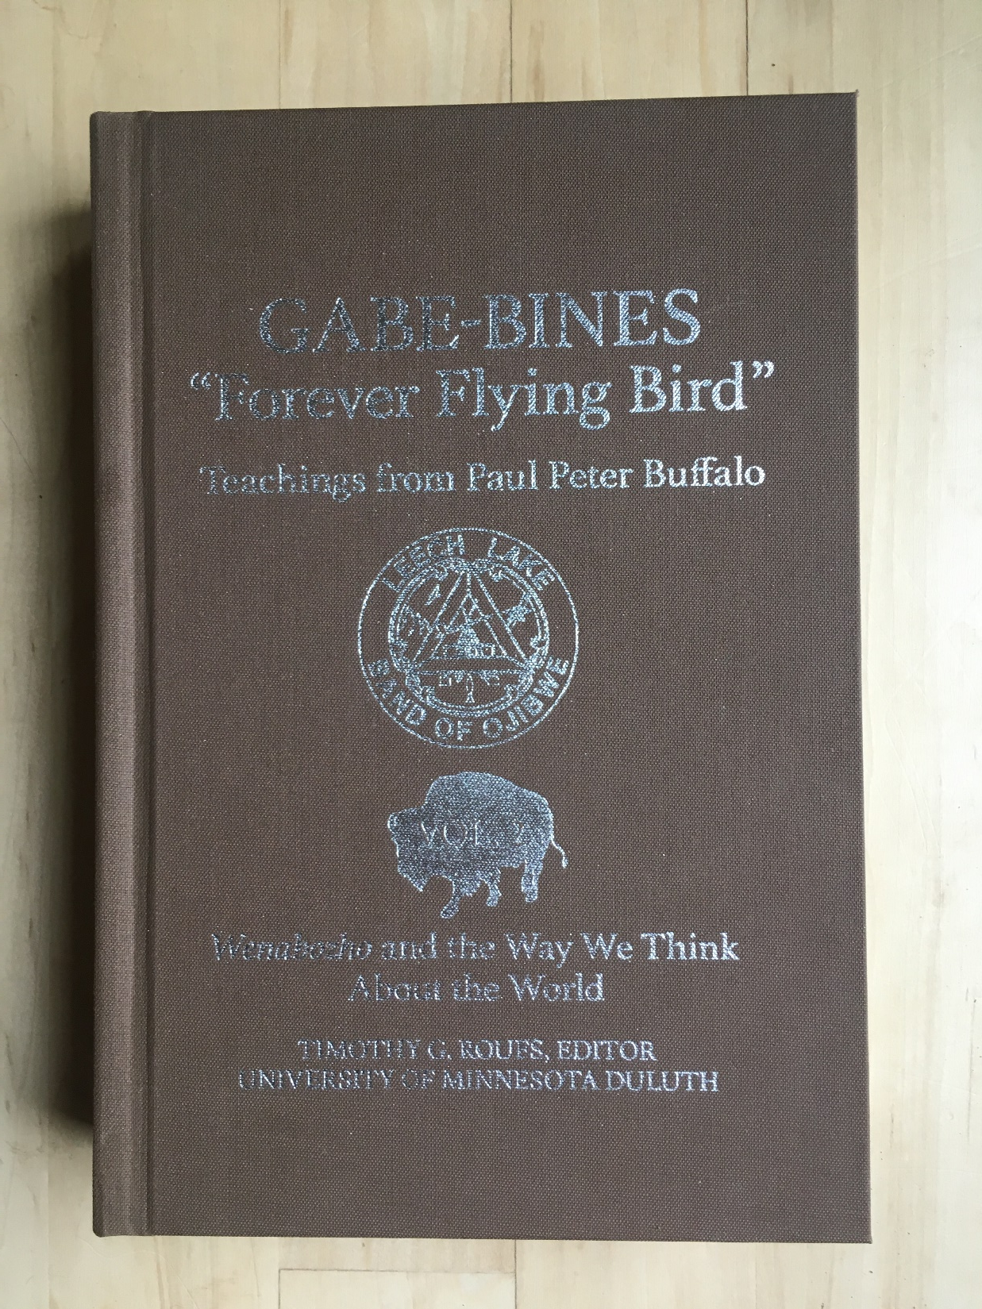
Tim Roufs © 2010-2019
Tim Roufs © 2010-2019

Slide 9
When Everybody Called Me Gabe-bines, "Forever-Flying-Bird": Teachings from Paul Buffalo Volume II of the Paul Buffalo Trilogy: Wenabozho and The Way We Think About the World Chapter 34 “Medicine Men / Medicine Women”
Tim Roufs © 2010-2019

Slide 10
When Everybody Called Me Gabe-bines, "Forever-Flying-Bird": Teachings from Paul Buffalo Volume II of the Paul Buffalo Trilogy: Wenabozho and The Way We Think About the World Chapter 34 “Medicine Men / Medicine Women”
Tim Roufs © 2010-2019

Slide 11
Anishinabe Healing
Tim Roufs
University of Minnesota Duluth
Tim Roufs © 2010-2019

Slide 12
Anishinabe Healing
or
Anishinabe Holistic Medicine
Tim Roufs
University of Minnesota Duluth
Tim Roufs © 2010-2019

Slide 13
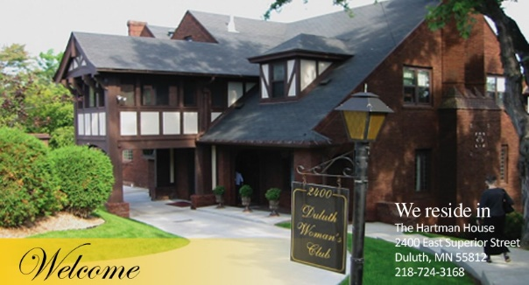
This presentation was first proposed under the title
“Why Paul Buffalo is a more successful healer than Physicians at the Duluth Clinic”
Tim Roufs © 2010-2019

Slide 14
What anthropologists call
“local cultures” (“microcultures”)
generally strive to preserve their cultural identity with . . .
food clothing
religion / beliefs
ritual
music, dance, and other arts
language
cultural symbols . . .

Slide 15
Chapter 34
“Medicine Men / Medicine Women”
Anishinabe medicine man singer with ceremonial turtle clan drum. Photograph Collection ca. 1900
Minnesota Historical Society, Negative No. 21120

Slide 16
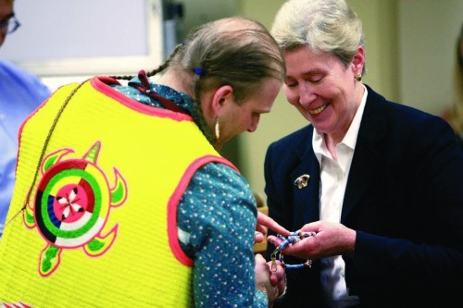
Chuck Branch (left) gives a beaded pen and lanyard to Dr. Deborah Powell, dean of the University of Minnesota Medical School, during a traditional American Indian feast and giveaway Tuesday at the University of Minnesota Medical School Duluth campus. The event was to recognize those who helped him during his two years at the school. He will finish at the University of Minnesota-Twin Cities campus. The pen has turtles in its design, representing his clan.
CLINT AUSTIN / NEWS TRIBUNE Wednesday, 16 April 2008
www.duluthnewstribune.com/articles/index.cfm?id=64520&section=None

Slide 17
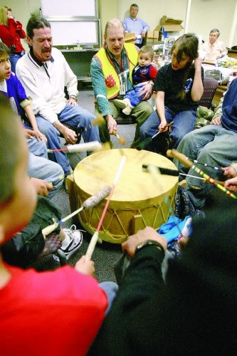
Chuck Branch holds his son, Marcus, while singing with the Onigamising Singers from Grant Language & Arts Magnet School during a traditional American Indian feast and giveaway Tuesday at the University of Minnesota Medical School Duluth campus. It was to recognize those who helped him during his two years there, before he moves to the Twin Cities campus of the medical school.
CLINT AUSTIN / NEWS TRIBUNE Wednesday,
16 April 2008
www.duluthnewstribune.com/articles/index.cfm?id=64520&section=None

Slide 18
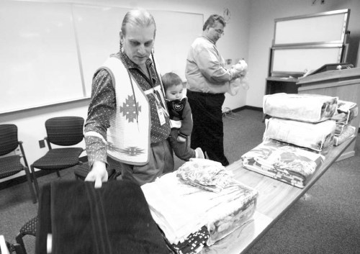
Chuck Branch holds his son, Marcus, while laying out gifts during a traditional American Indian feast and giveaway Tuesday at the University of Minnesota Medical School Duluth campus to recognize those who helped him during his two years there. He will finish at the University of Minnesota-Twin Cities campus.
CLINT AUSTIN / NEWS TRIBUNE Wednesday, 16 April 2008
www.duluthnewstribune.com/articles/index.cfm?id=64520&section=None

Slide 19
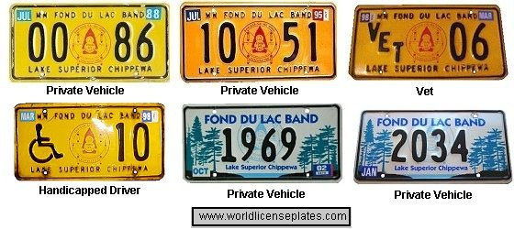
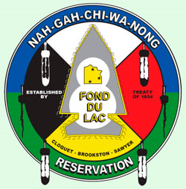
www.worldlicenceplates.com/usa/US_MNXX.html

Slide 20
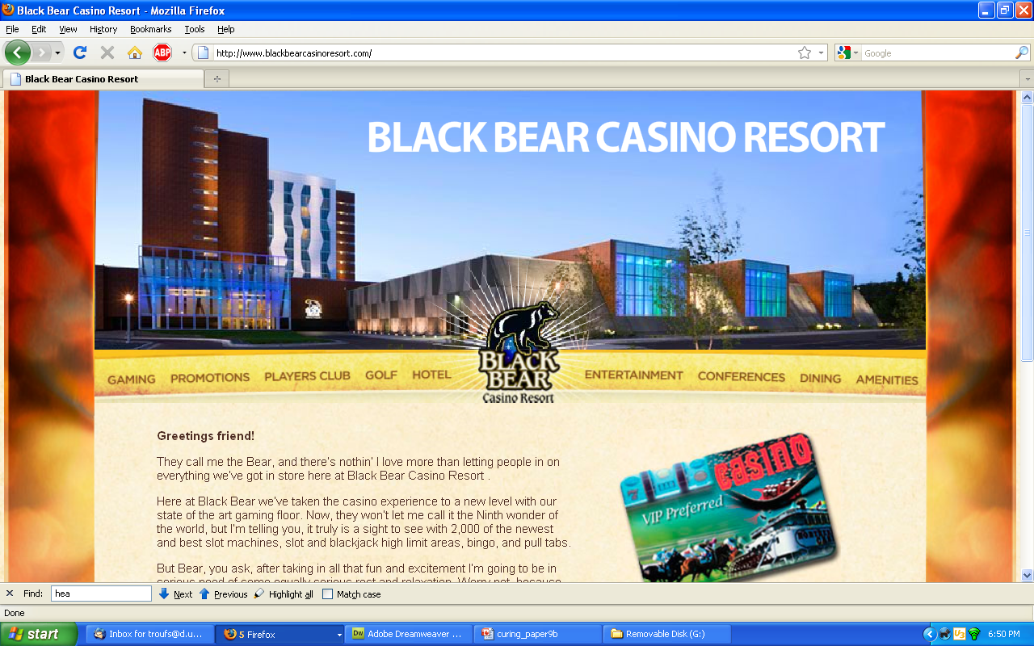
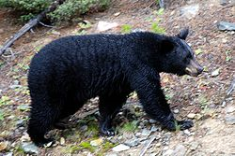
Wikipedia
://www.blackbearcasinoresort.com/

Slide 21
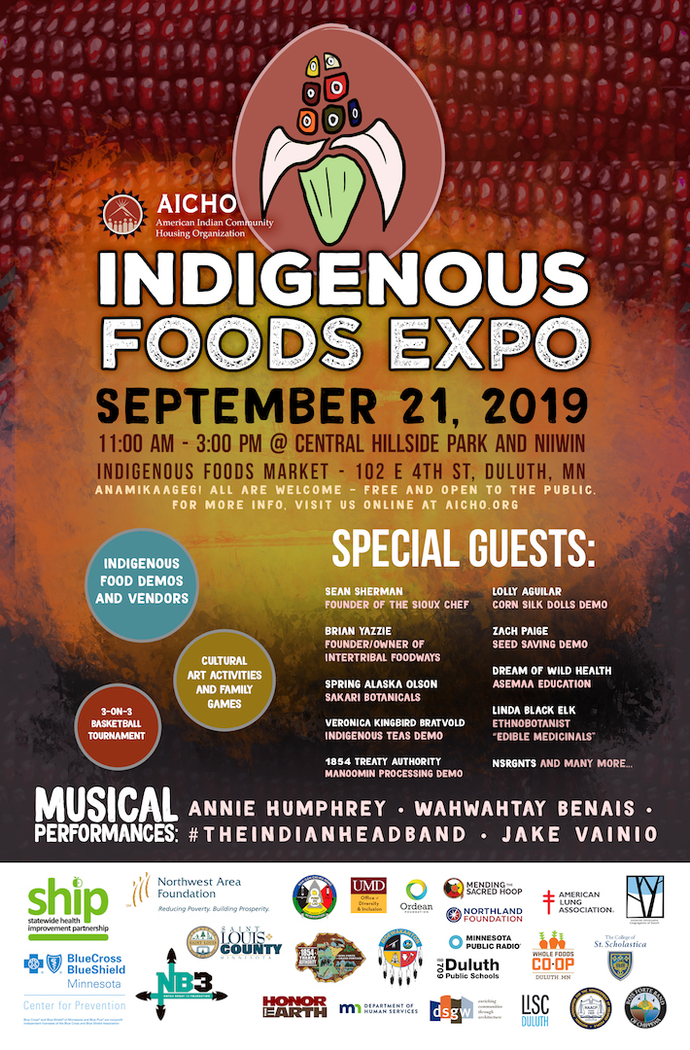
Notes:
21

Slide 22
Notes:
22

Slide 23
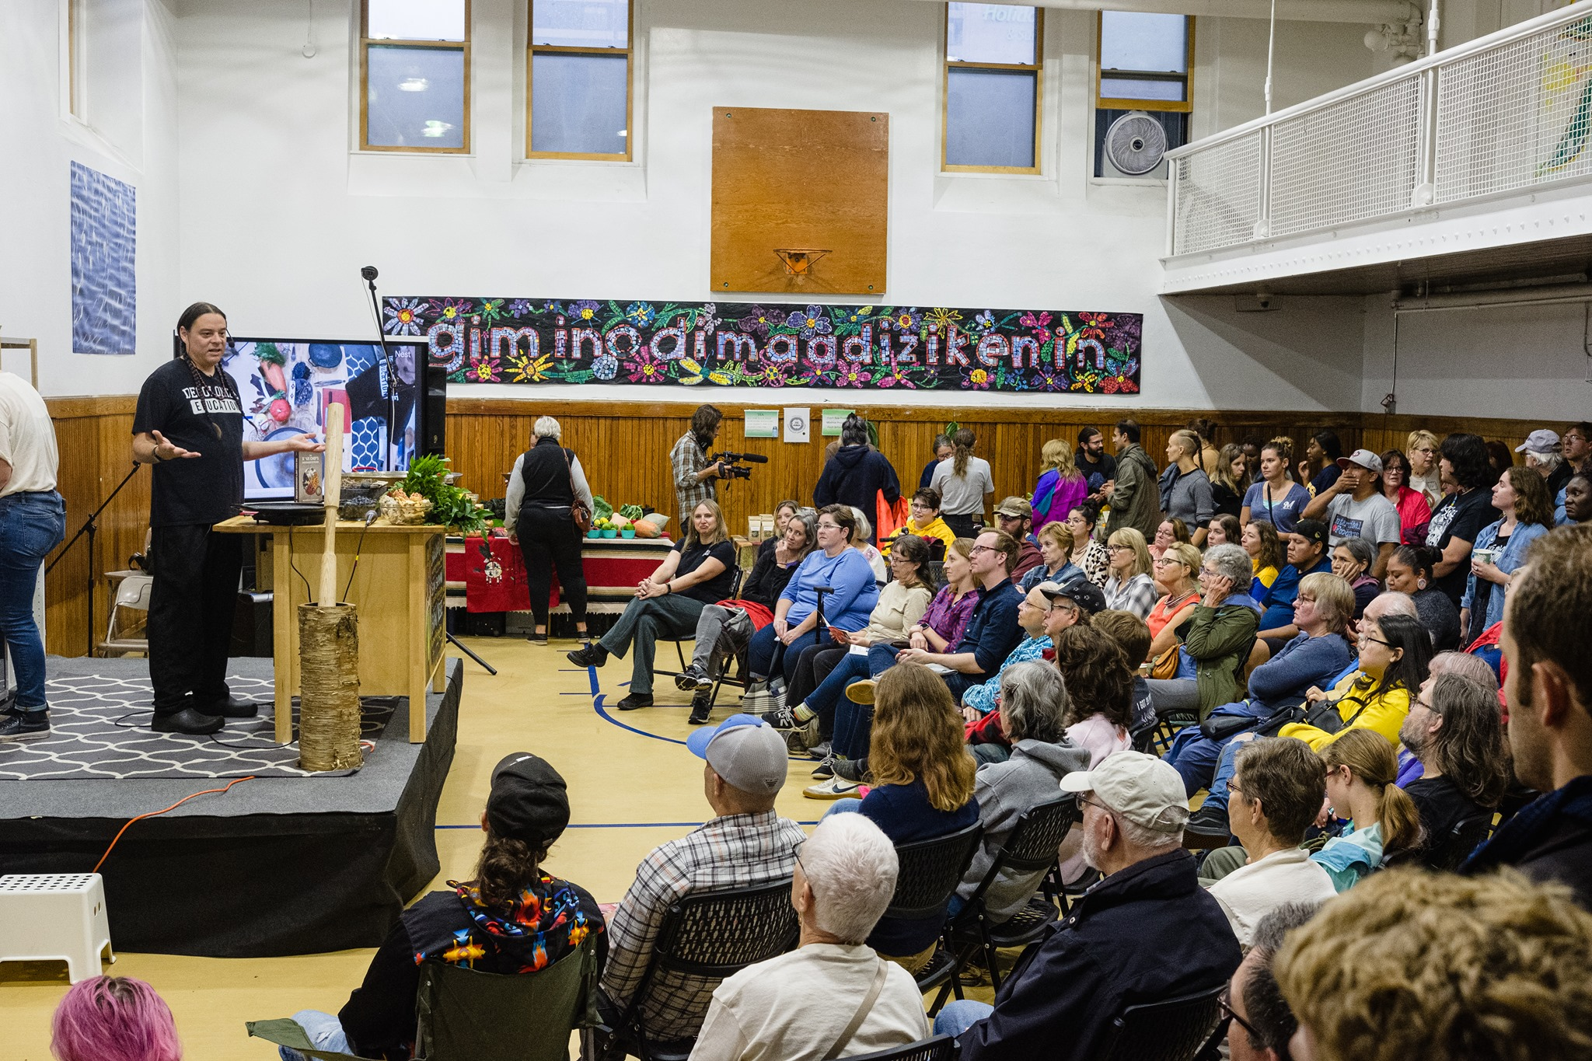
Food as Medicine
Indigenous Foods Expo 2019
Notes:
23

Slide 24
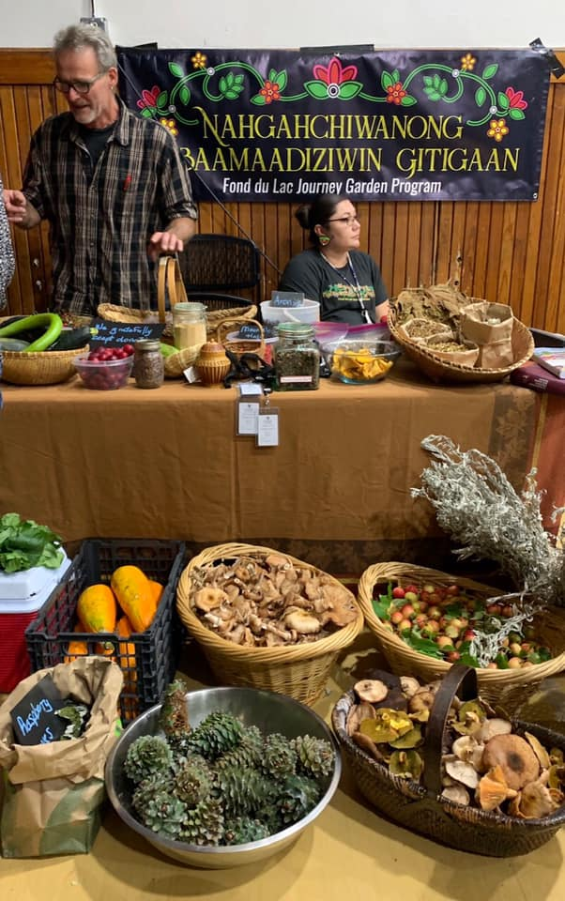
Food as Medicine
Indigenous Foods Expo 2019
Notes:
24

Slide 25
Minnesota Anishinabe

Slide 26
Minnesota Anishinabe

Slide 27
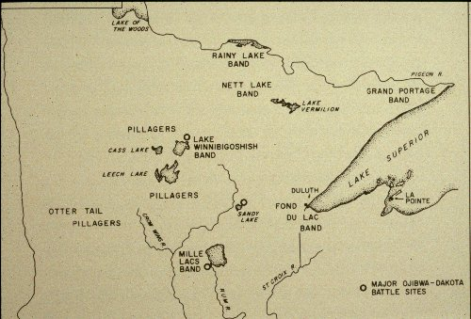
The Anishinabe of the Minnesota Chippewa Tribe.
(Phoenix : Indian Tribal Series, 1975.)
Timothy G. Roufs

Slide 28
Paul Buffalo’s home territory
The Anishinabe of the Minnesota Chippewa Tribe.
(Phoenix : Indian Tribal Series, 1975.)
Timothy G. Roufs

Slide 29
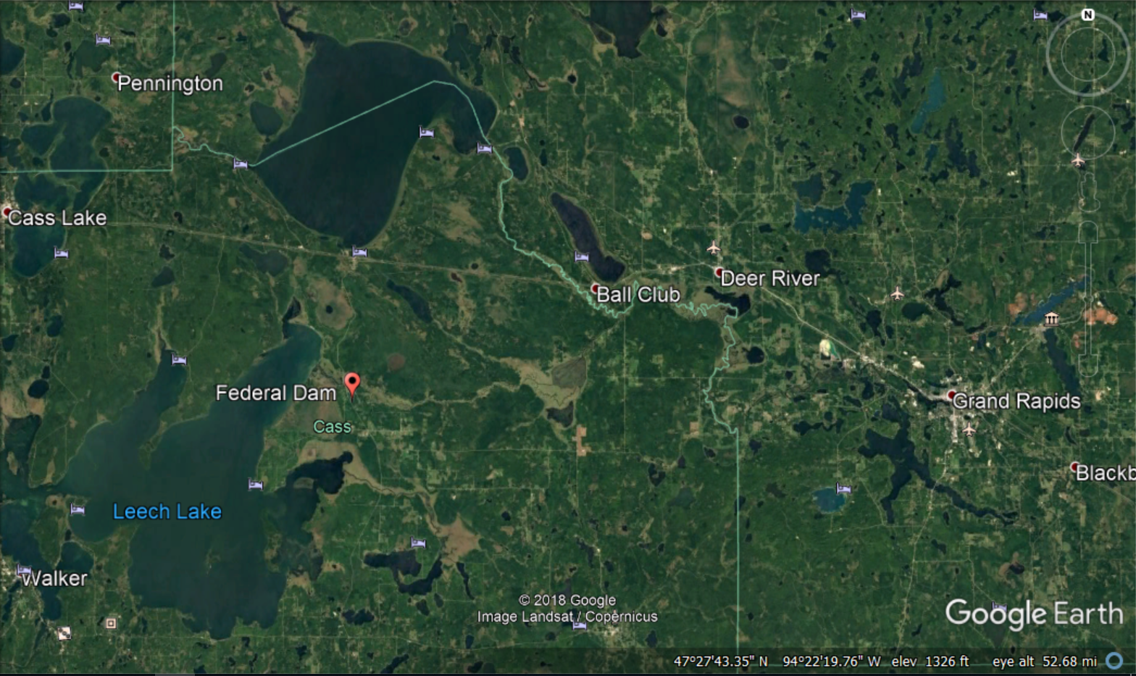

Slide 30
Red
Lake
The Anishinabe of the Minnesota Chippewa Tribe.
(Phoenix : Indian Tribal Series, 1975.)
Timothy G. Roufs

Slide 31
Anishinabe
James Jackson, Sr.
A Gift to One, a Gift to Many / James Jackson, Sr. (1913 – 1992)
(60 min., VC 2238, 1987)

Slide 32
http://www.d.umn.edu/cla/faculty/troufs/anth4616/video/Jimmy_Jackson.html#title

Slide 33
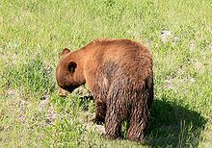
Wikipedia
dodaim (totem)
http://www.d.umn.edu/cla/faculty/troufs/anth4616/video/Jimmy_Jackson.html#title

Slide 34
Anishinabe
James Jackson, Sr.
A Gift to One, a Gift to Many / James Jackson, Sr. (1913 – 1992)
(60 min., VC 2238, 1987)

Slide 35
Anishinabe
James Jackson, Sr.
A Gift to One, a Gift to Many / James Jackson, Sr. (1913 – 1992)
(60 min., VC 2238, 1987)
Paul Buffalo
Excerpts from the An interview with Paul Buffalo (1900 – 1977)
(18 min., 1971, VC 266B)
excerpts transcript

Slide 36
http://www.d.umn.edu/cla/faculty/troufs/Buffalo/28power5.html#title

Slide 37
Tim Roufs © 2010-2019
Tim Roufs © 2010-2019

Slide 38
When Everybody Called Me Gabe-bines, "Forever-Flying-Bird": Teachings from Paul Buffalo Volume II of the Paul Buffalo Trilogy: Wenabozho and The Way We Think About the World Chapter 27 “Power”
Tim Roufs © 2010-2019

Slide 39
When Everybody Called Me Gabe-bines, "Forever-Flying-Bird": Teachings from Paul Buffalo Volume II of the Paul Buffalo Trilogy: Wenabozho and The Way We Think About the World Chapter 34 “Medicine Men / Medicine Women”
Tim Roufs © 2010-2019

Slide 40
The Anishinabe of the Minnesota Chippewa Tribe.
(Phoenix : Indian Tribal Series, 1975.)
Timothy G. Roufs

Slide 42
http://www.duluthsuperior.com/mld/duluthtribune/news/local/9149787.htm

Slide 43
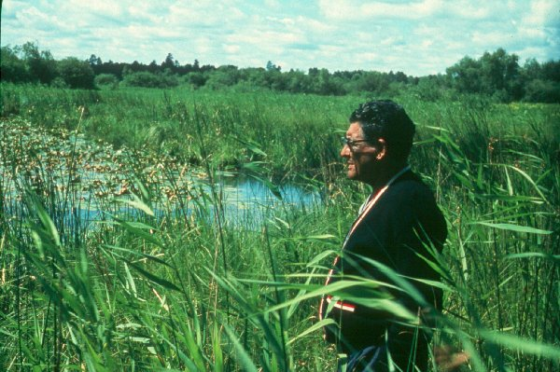
Paul Buffalo Meditating

Slide 44
Anishinabe
Culturally Constituted Behavioral Environment (CCBE)
A. Irving Hallowell
Culture and Experience
Contributions to Anthropology

Slide 45
Pre-Treatment Investigation
screening and referral

Slide 46
Pre-Treatment Investigation
screening and referral to different kinds of doctors
but you can only “work with” one doctor at a time

Slide 47
Pre-Treatment Investigation
screening and referral to different kinds of doctors
herbalists

Slide 48
Pre-Treatment Investigation
screening and referral to different kinds of doctors
herbalists
midwives

Slide 49
When Everybody Called Me Gabe-bines, "Forever-Flying-Bird": Teachings from Paul Buffalo Volume II of the Paul Buffalo Trilogy: Wenabozho and The Way We Think About the World Chapter 34 “Medicine Men / Medicine Women”
Tim Roufs © 2010-2019

Slide 50
Pre-Treatment Investigation
screening and referral to different kinds of doctors
herbalists
midwives
spiritualists
jessokid or “rabbit bone”

Slide 51
When Everybody Called Me Gabe-bines, "Forever-Flying-Bird": Teachings from Paul Buffalo Volume II of the Paul Buffalo Trilogy: Wenabozho and The Way We Think About the World Chapter 31 “Spiritual Doctoring,
Tipi-Shaking, and Bone-Swallowing Specialists”
Tim Roufs © 2010-2019

Slide 52
Pre-Treatment Investigation
screening and referral to different kinds of doctors
herbalists
midwives
spiritualists
jessokid or “rabbit bone”
MDs

Slide 53
Pre-Treatment Investigation
screening and referral to different kinds of doctors
herbalists
midwives
spiritualists
jessokid or “rabbit bone”
MDs
Grand Medicine (Midewiwin)

Slide 54
When Everybody Called Me Gabe-bines, "Forever-Flying-Bird": Teachings from Paul Buffalo Volume II of the Paul Buffalo Trilogy: Wenabozho and The Way We Think About the World Chapter 29 “Midewiwin: Grand Medicine”
Tim Roufs © 2010-2019

Slide 55
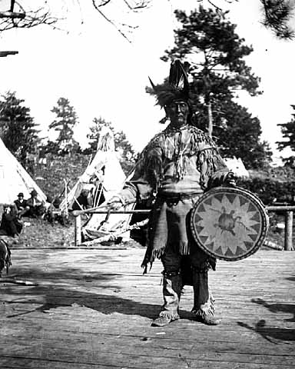
Anishinabe medicine man singer with ceremonial turtle clan drum. Photograph Collection ca. 1900
Minnesota Historical Society, Negative No. 21120

Slide 56
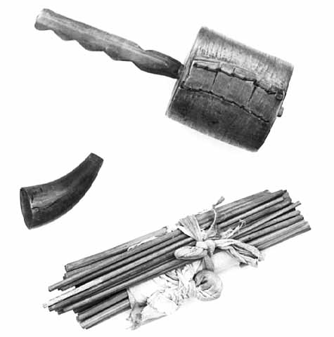
Mide (Medicine Man) rattle and sticks.
Photograph Collection ca. 1950.
Minnesota Historical Society, Negative No. 35594

Slide 57
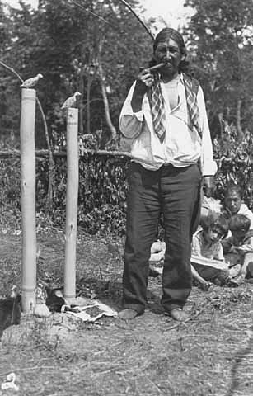
Ojibway Grand Medicine Ceremony at Squaw Point, Leech Lake, 1932. Minnesota Historical Society, Negative No. 35585

Slide 58
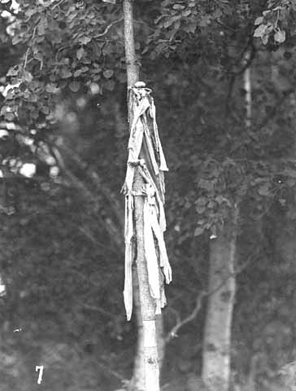
“Medicine” on pole near grave of Mrs. John Nett Lake.
Photograph Collection 9/1947.
Minnesota Historical Society, Negative No. 35601

Slide 59
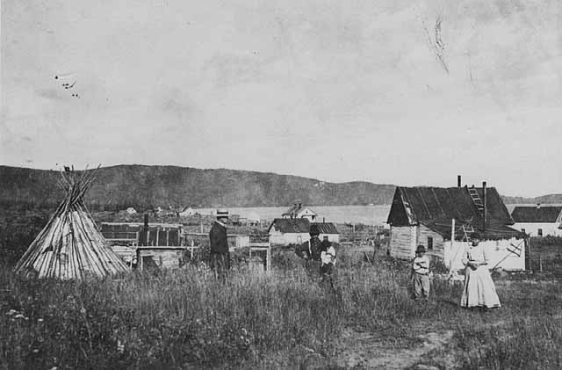
Grand Portage village, medicine man's home and tepee.
Photograph Collection 1925.
Minnesota Historical Society, Negative No. 44367

Slide 60
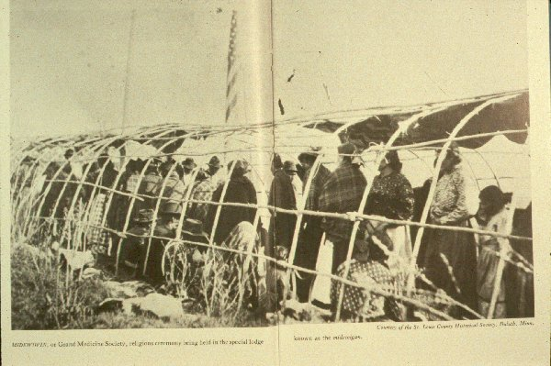
The Anishinabe of the Minnesota Chippewa Tribe.
(Phoenix : Indian Tribal Series, 1975.)
Timothy G. Roufs
From the St. Louis County Historical Society, Duluth, Minnesota.

Slide 61
Pre-Treatment Investigation
screening and referral to different kinds of doctors
herbalists
midwives
spiritualists
jessokid or “rabbit bone”
MDs
Grand Medicine (Midewiwin)

Slide 62
Pre-Treatment Investigation

Slide 63
Pre-Treatment Investigation
people have specific powers
(they’re “specialists”)

Slide 64
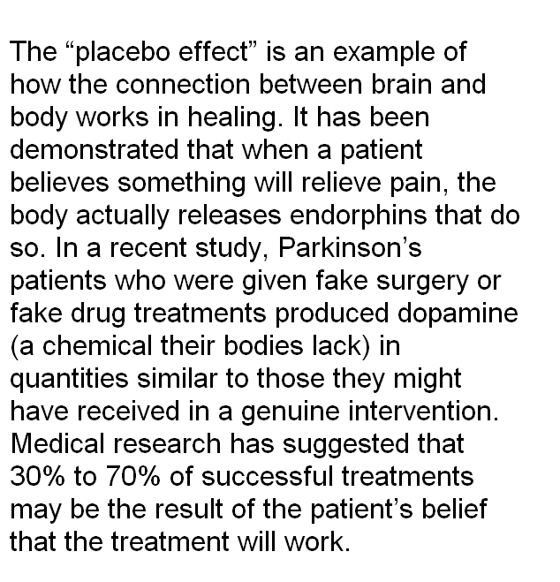
http://www.parade.com/articles/editions/2008/edition_03-09-2008/2Thoughts_Can_Heal
Notes:
11/9/2019
64
⁶⁴

Slide 65
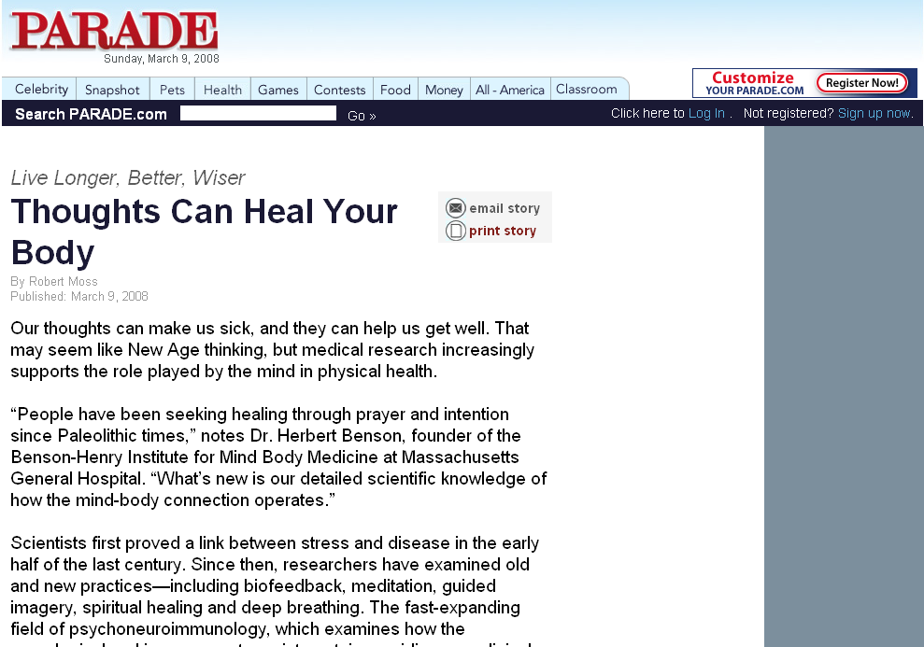
http://www.parade.com/articles/editions/2008/edition_03-09-2008/2Thoughts_Can_Heal
Notes:
11/9/2019
65
⁶⁵

Slide 66
Pre-Treatment Investigation
people have specific powers
(they’re “specialists”)
can lose power
(especially if you don’t practice)

Slide 67
Pre-Treatment Investigation
patients need to believe

Slide 68
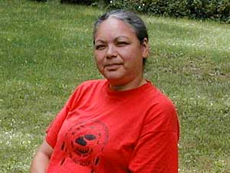
Wanda Baxter, an elder on the Red Lake Reservation, says a Native healer saved her life. She had cancer, but after three years of treatment by a tribal healer, she says she's healthy.
(MPR Photo/Tom Robertson)
http://news.minnesota.publicradio.org/features/2003/08/18_gundersond_spiritualityeigh/
Notes:
⁶⁸

Slide 69
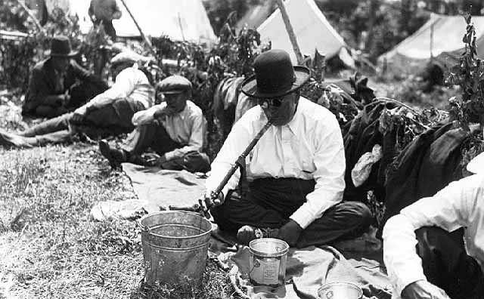
Pre-Treatment Investigation
give gifts to maintain power
Ojibway Grand Medicine Ceremony at Squaw Point, Leech Lake, 1932. Minnesota Historical Society, Negative No. 35600

Slide 70
Pre-Treatment Investigation
need power to help
the concept of power is central
See Paul Buffalo paper:
“Concept of Power among Mississippi and Lake Superior Ojibwa”

Slide 71
When Everybody Called Me Gabe-bines, "Forever-Flying-Bird": Teachings from Paul Buffalo Volume II of the Paul Buffalo Trilogy: Wenabozho and The Way We Think About the World Chapter 27 “Power”
Tim Roufs © 2010-2019

Slide 72
Causes of Illness
“disease” = universal

Slide 73
Causes of Illness
“disease” = universal
“illness” = culturally specific

Slide 74
Causes of Illness
living a bad life

Slide 75
Causes of Illness
living a bad life
relatives living in some bad way

Slide 76
Causes of Illness
living a bad life
relatives living in some bad way
jibik

Slide 77
Causes of Illness
living a bad life
relatives living in some bad way
jibik
soul loss (both souls)

Slide 78
Causes of Illness
living a bad life
relatives living in some bad way
jibik
soul loss (both souls)
unbalanced chemical orientation
to nature

Slide 79
Causes of Illness
living a bad life
relatives living in some bad way
jibik
soul loss (both souls)
unbalanced chemical
orientation to nature
or a combination of the above

Slide 80
Causes of Illness
living a bad life
relatives living in some bad way
jibik
soul loss (both souls)
unbalanced chemical
orientation to nature
or a combination of the above

Slide 81
Causes of Illness
may be a moral question . . .
as well as a medical question

Slide 82
Causes of Illness
may be a moral question . . .
as well as a medical question

Slide 83
Treatment
Involves the medicine itself
and -- always --
medicine with a lecture
(a “meditation”)

Slide 84
Treatment -- medicine

Slide 85
Treatment -- medicine
use a mixture (plus meditation)

Slide 86
Treatment -- medicine
use a mixture (plus meditation)
1st “shot” = “mild stuff”

Slide 87
Treatment -- medicine
use a mixture (plus meditation)
1st “shot” = “mild stuff”
you have to pick medicine in the right season, when it is ripe

Slide 88
Treatment -- medicine
use a mixture (plus meditation)
1st “shot” = “mild stuff”
you have to pick medicine in the right season, when it is ripe
you can’t go to the same place (location) for herbs, etc. twice
in a row

Slide 89
Treatment -- medicine
use a mixture (plus meditation)
1st “shot” = “mild stuff”
you have to pick medicine in the right season, when it is ripe
you can’t go to the same place (location) for herbs, etc. twice
in a row
you have to know how to meditate the medicine

Slide 90
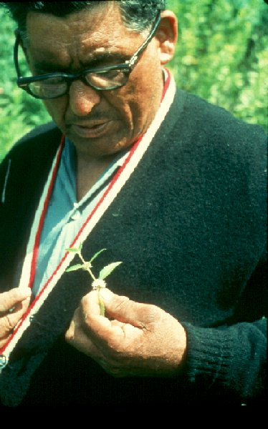
Paul Buffalo Meditating Medicine

Slide 91
Treatment -- medicine
Healing only works through the doctor
the doctor doesn’t cure,
the Manito does

Slide 92
Treatment -- medicine / lecture
Interpreter of the medicine interprets the medicine

Slide 93
Treatment -- medicine / lecture
Interpreter of the medicine interprets the medicine
all of that takes time

Slide 94
Treatment -- medicine / lecture
Interpreter of the medicine interprets the medicine
all of that takes time
realign life + lecture on good life

Slide 95
Treatment -- medicine / lecture
Interpreter of the medicine interprets the medicine
all of that takes time
realign life + lecture on good life
pimadezewĺn
bimadizewĺn

Slide 96
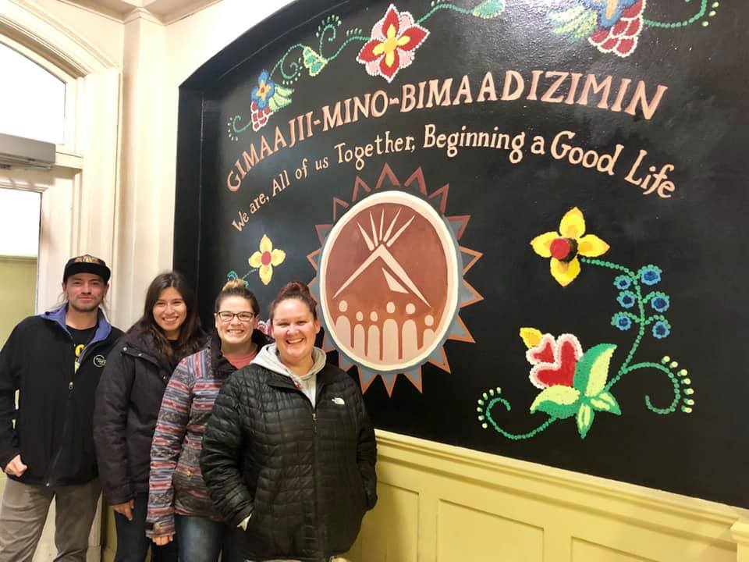
Niiwin Indigenous Foods Market‎Indigenous Foods Expo
Niiwin Indigenous Foods Market‎ Indigenous Foods Expo 2019
Notes:
96

Slide 97
Linda Grover
Sunday, 20 April 2008
“In traditional Native values and ways of living, mino-bimaadiziiwin is the Ojibwe word for the living of a good life. Mino-bimaadiziiwin involves standards of behavior that include modesty, respect, thankfulness, generosity and awareness of one’s ability and obligation to contribute to the well-being of others.”
www.duluthbudgeteer.com/

Slide 98
Treatment -- medicine / lecture
Interpreter of the medicine interprets the medicine
all of that takes time
realign life + lecture on good life
emphasizes that one “has to believe in it”

Slide 99
Treatment -- medicine / lecture
Interpreter of the medicine interprets the medicine
all of that takes time
realign life + lecture on good life
emphasizes that one “has to believe in it”
community support necessary
amount varies with the disease
Inger ceremony

Slide 100
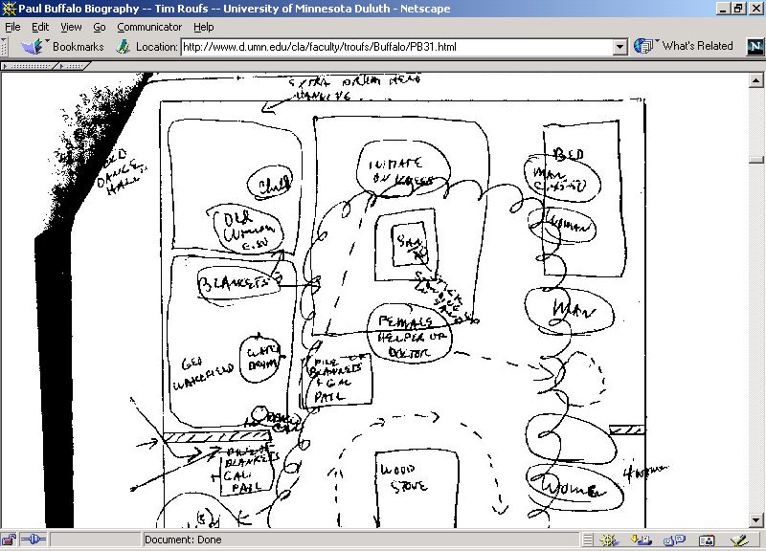

Slide 101
When Everybody Called Me Gabe-bines, "Forever-Flying-Bird": Teachings from Paul Buffalo Volume II of the Paul Buffalo Trilogy: Wenabozho and The Way We Think About the World Chapter 30 “An Indian Curing Ceremony”
Tim Roufs © 2010-2019

Slide 102
Treatment -- medicine / lecture
If you don’t believe, and/or are just “fooling around” your kids and relatives can be affected

Slide 103
Post 1st Treatment
cure
no-cure

Slide 104
Post 1st Treatment -- cure
medicine / manipulation does some good

Slide 105
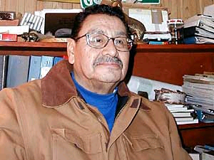
Larry Aitken is a Native healer on the White Earth Reservation. He says there are hundreds of plants found in the forest that can be used for medicine.
(MPR Photo/Tom Robertson)
http://news.minnesota.publicradio.org/features/2003/08/18_gundersond_spiritualityeigh/
Notes:
¹⁰⁵

Slide 106
Post 1st Treatment -- cure
medicine / manipulation does some good
placebo affect
including effect of belief in doctor’s power
and positive attitude

Slide 107
http://www.mayoclinic.org/spotlight/dalai-lama.html

Slide 108
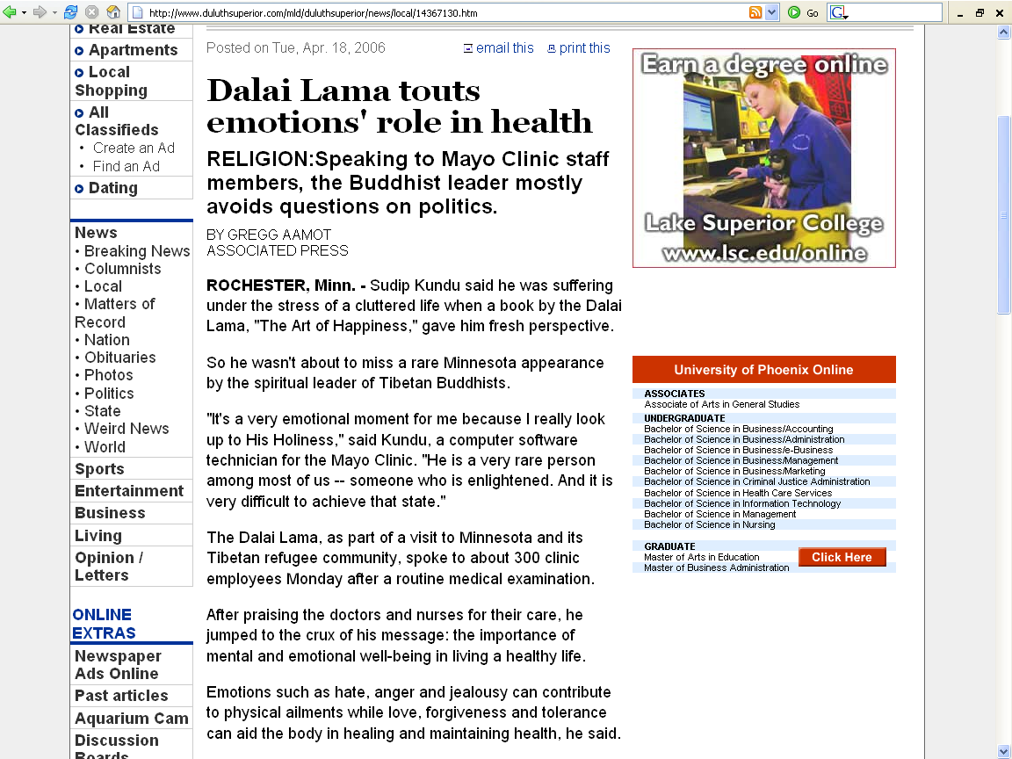
http://www.duluthsuperior.com/mld/duluthsuperior/news/local/14367130.htm

Slide 109
http://www.parade.com/articles/editions/2008/edition_03-09-2008/2Thoughts_Can_Heal
Notes:
¹⁰⁹

Slide 110
http://www.parade.com/articles/editions/2008/edition_03-09-2008/2Thoughts_Can_Heal
Notes:
¹¹⁰

Slide 111
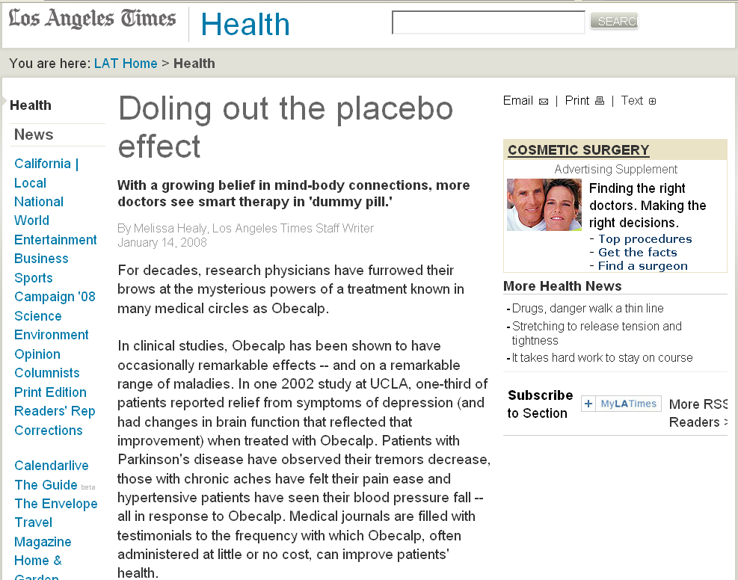
www.latimes.com/features/health/la-he-placebo14jan14,1,4887792.story
Notes:
111

Slide 112
www.latimes.com/features/health/la-he-placebo14jan14,1,4887792.story
Notes:
112

Slide 113
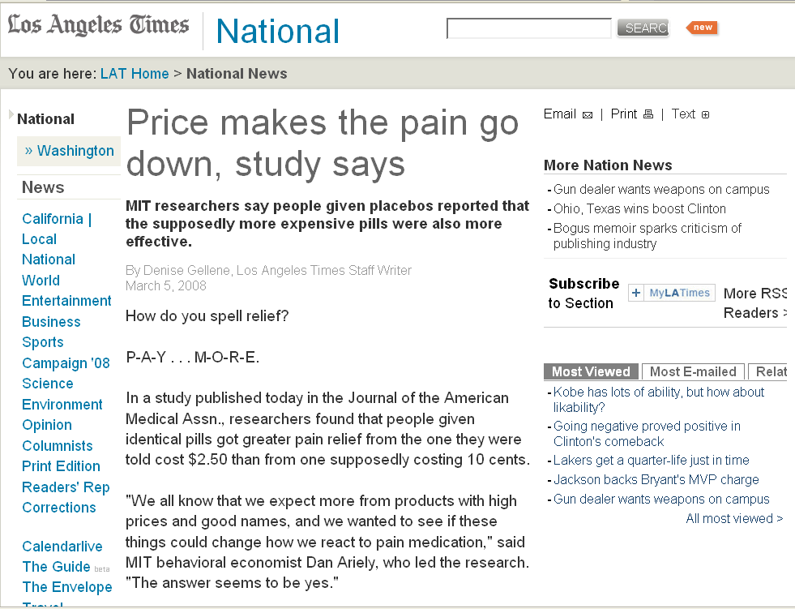
www.latimes.com/news/nationworld/nation/la-sci-pain5mar05,1,6333231.story
Notes:
¹¹³

Slide 114
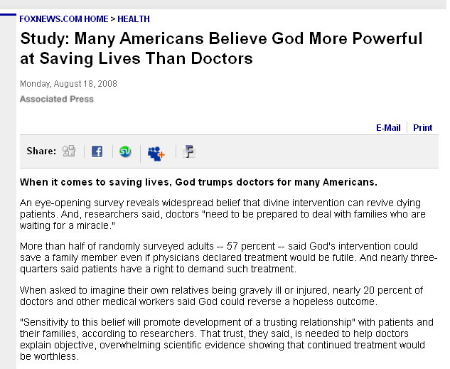
www.foxnews.com/story/0,2933,405765,00.html
Notes:
¹¹⁴

Slide 115
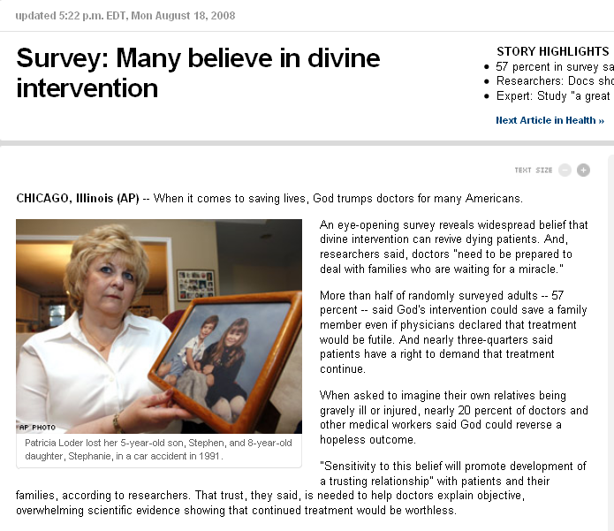
www.cnn.com/2008/HEALTH/08/18/god.vs.doctors.ap/index.html
Notes:
¹¹⁵

Slide 116
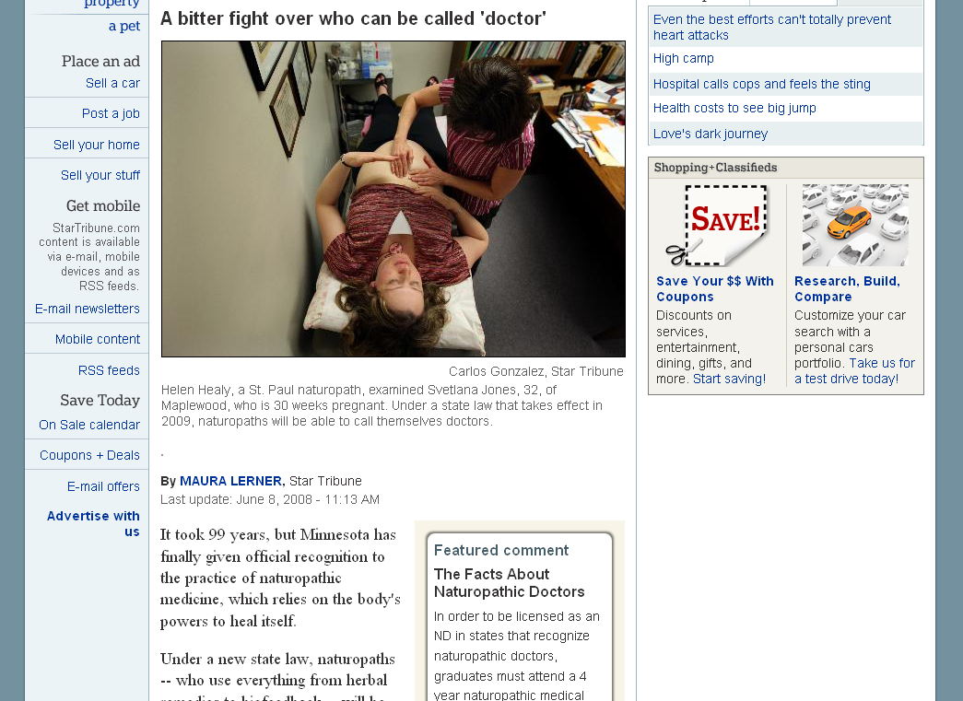
www.startribune.com/lifestyle/health/19632179.html
Notes:
¹¹⁶

Slide 117
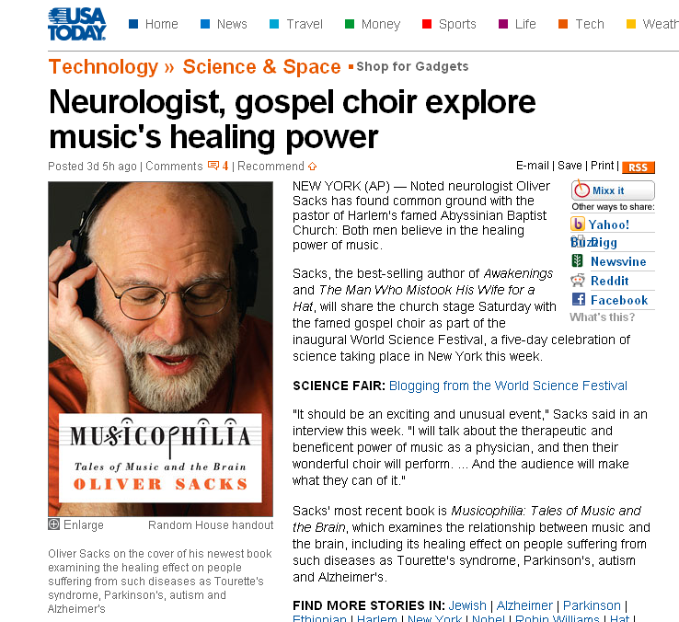
www.usatoday.com/tech/science/2008-05-30-worldfestival-music-brain_N.htm

Slide 118
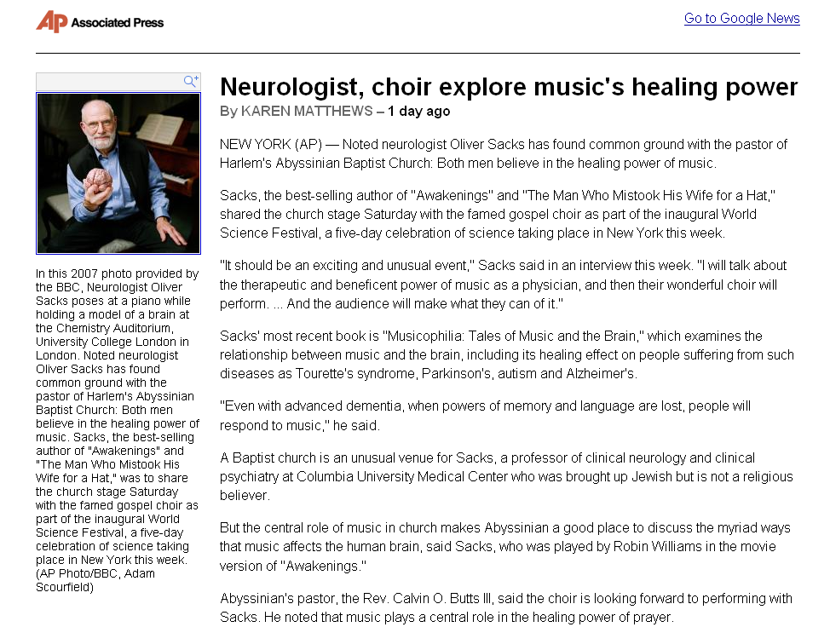
http://ap.google.com/article/ALeqM5ihrjui69QARvHuFo2GZ-z9cp9C0gD91119R80

Slide 119
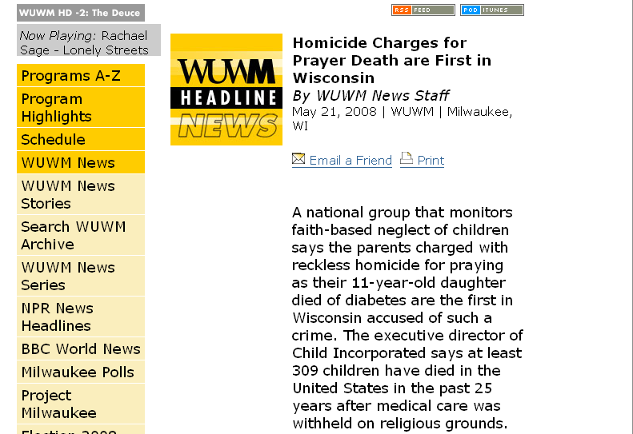
www.wuwm.com/programs/news/view_news.php?articleid=2242

Slide 120
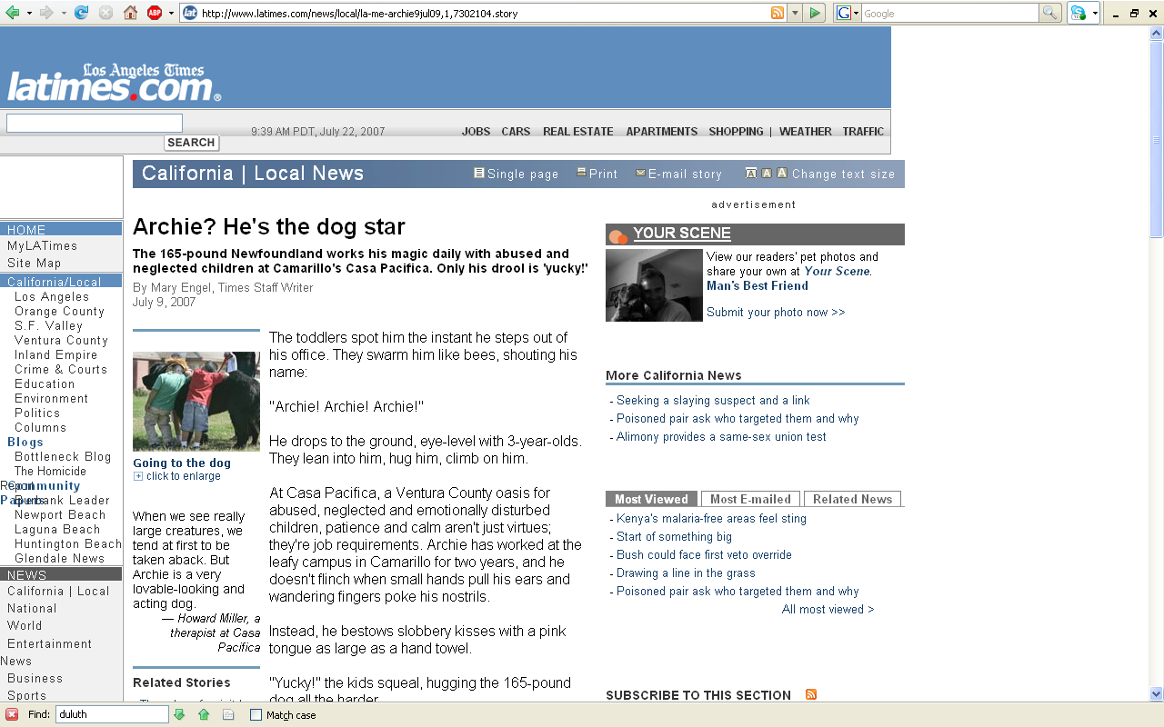
http://www.latimes.com/news/local/la-me-archie9jul09,1,7302104.story

Slide 121
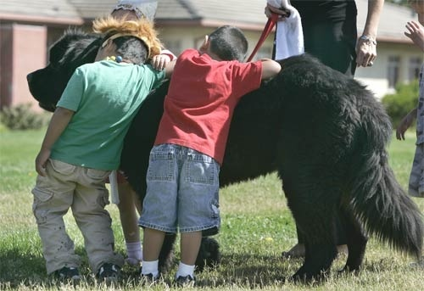
GOING TO THE DOG: Children hug and pet Archie at Casa Pacifica in Camarillo. Vicki Murphy, the facility’s director of operations and development, chose Archie after learning about Newfoundlands’ reputation for being natural baby-sitters.
(Ken Hively / LAT)
http://www.latimes.com/news/local/la-me-archie9jul09,1,7302104.story

Slide 122
http://www.ischool.washington.edu/robotpets/onlinediscussion/index.html

Slide 123
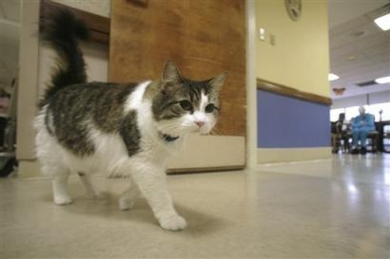
Oscar, a hospice cat at the Steere House Nursing and Rehabilitation Center in Providence, R.I., walks past an activity room at the facility Monday, July 23, 2007. Oscar the cat seems to have an uncanny knack for predicting when nursing home patients are going to die, by curling up next to them during their final hours.
(AP Photo/Stew Milne)
http://www.pantagraph.com/articles/2007/07/25/news/doc46a7c3771368d214063275.txt

Slide 124
“His accuracy, observed in 25 cases, has led the staff to call family members once he has chosen someone. It usually means they have less than four hours to live.”
“’He doesn't make too many mistakes. He seems to understand when patients are about to die,’" said Dr. David Dosa in an interview. He describes the phenomenon in a poignant essay in Thursday's issue of the New England Journal of Medicine.’
(AP Photo/Stew Milne)
http://www.pantagraph.com/articles/2007/07/25/news/doc46a7c3771368d214063275.txt

Slide 125
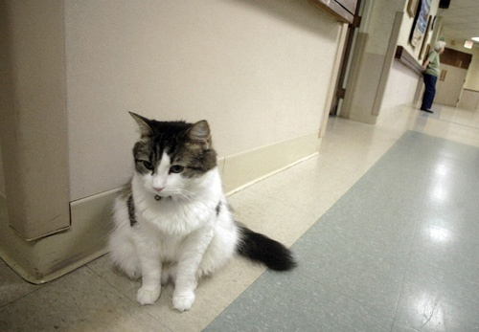
“Oscar is better at predicting death than the people who work there, said Dr. Joan Teno of Brown University, who treats patients at the nursing home and is an expert on care for the terminally ill.”
http://www.pantagraph.com/articles/2007/07/25/news/doc46a7c3771368d214063275.txt

Slide 126
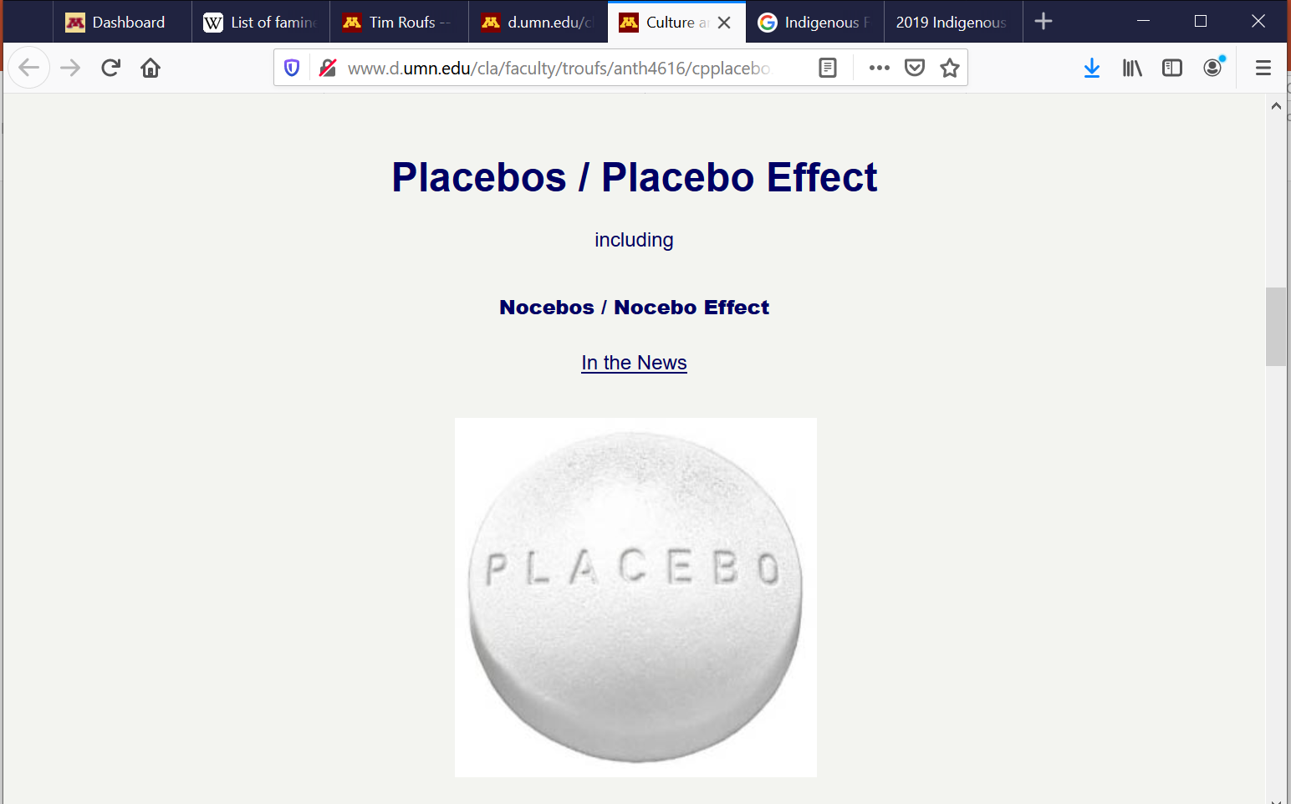
http://www.d.umn.edu/cla/faculty/troufs/anth4616/cpplacebo.html#title

Slide 127
Post 1st Treatment -- cure
passage of time
Nat Pallone

Slide 128
Post 1st Treatment -- cure
passage of time
Nat Pallone
naming in curing

Slide 129
When Everybody Called Me Gabe-bines, "Forever-Flying-Bird": Teachings from Paul Buffalo Volume I of the Paul Buffalo Trilogy: Year-Round in the Early Years Ch 2. “Bena Childhood”
Tim Roufs © 2010-2019

Slide 130
Post 1st Treatment -- cure
passage of time
Nat Pallone
naming in curing
“works if it ain’t too late”

Slide 131
Post 1st Treatment -- no cure

Slide 132
Post 1st Treatment -- no cure
medicine too weak
solution: stronger medicine

Slide 133
Post 1st Treatment -- no cure
medicine too weak
solution: stronger medicine
medicine from a location not good
solution: use medicine from a different location

Slide 134
Post 1st Treatment -- no cure
medicine too weak
solution: stronger medicine
medicine from a location not good
solution: use medicine from a different location
medicine picked in wrong seasons
solution: use different medicine

Slide 135
Post 1st Treatment -- no cure
Life (bad living) has not changed
solution: change life

Slide 136
Post 1st Treatment -- no cure
Life (bad living) has not changed
solution: change life
Life (bad living) of relative has not changed
solution: have relative or relatives change life

Slide 137
Post 1st Treatment -- no cure
Medicine “interpreted” incorrectly
solution: reinterpret or re-mix

Slide 138
Post 1st Treatment -- no cure
other’s power overriding or interfering
solution: talk with them about that

Slide 139
When Everybody Called Me Gabe-bines, "Forever-Flying-Bird": Teachings from Paul Buffalo Volume II of the Paul Buffalo Trilogy: Wenabozho and The Way We Think About the World Chapter 27 “Power”
Tim Roufs © 2010-2019

Slide 140
Post 1st Treatment -- no cure
need more time
solution: more time

Slide 141
Post 1st Treatment -- no cure
presence of somebody at the curing ceremony might have “interfered” with the cure
for e.g., a white person
or “nonbeliever”
or someone who “doesn’t know about it”
Inger ceremony
solution: redo ceremony

Slide 142
When Everybody Called Me Gabe-bines, "Forever-Flying-Bird": Teachings from Paul Buffalo Volume II of the Paul Buffalo Trilogy: Wenabozho and The Way We Think About the World Chapter 30 “An Indian Curing Ceremony”
Tim Roufs © 2010-2019

Slide 143
Post 1st Treatment -- no cure
presence of somebody at the curing ceremony might have “interfered” with the cure
for e.g., a white person
or “nonbeliever”
or someone who “doesn’t know about it”
Inger ceremony
solution: redo ceremony

Slide 144
Post 1st Treatment -- no cure
it could be that you are trying to “work with” more than one doctor at a time
solution: go work with the other doctor exclusively

Slide 145
Post 1st Treatment -- no cure
gifts given weren’t right
solution: new gifts
solution: gifts from different people

Slide 146
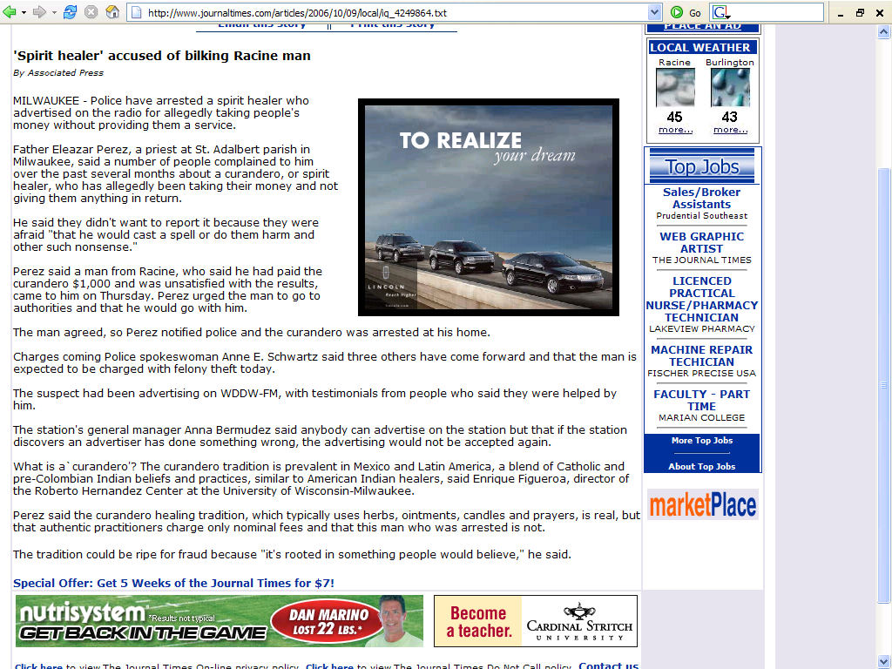
http://www.journaltimes.com/articles/2006/10/09/local/iq_4249864.txt

Slide 147
http://www.journaltimes.com/articles/2006/10/09/local/iq_4249864.txt

Slide 148
Post 1st Treatment -- no cure
lost power
solution: refer patient out

Slide 149
When Everybody Called Me Gabe-bines, "Forever-Flying-Bird": Teachings from Paul Buffalo Volume II of the Paul Buffalo Trilogy: Wenabozho and The Way We Think About the World Chapter 27 “Power”
Tim Roufs © 2010-2019

Slide 150
Post 1st Treatment -- no cure
maybe have started too late
solution: new procedure . . .
or fault may not be correctable

Slide 151
Post 1st Treatment -- no cure
if it doesn’t clear up then:
you know why directly, or
go to the jessokid (or MD) . . .
to find out why
and / or for further referral or work

Slide 152
The Curing Process

Slide 153
The Curing Process
The Manito heals,
only through the doctor
Therefore, the ultimate fate of the patient is attributed
to The Manito

Slide 154
The Curing Process
The concept of power is central
See Paul Buffalo paper:
“Concept of Power among Mississippi and Lake Superior Ojibwa”

Slide 155
When Everybody Called Me Gabe-bines, "Forever-Flying-Bird": Teachings from Paul Buffalo Volume II of the Paul Buffalo Trilogy: Wenabozho and The Way We Think About the World Chapter 27 “Power”
Tim Roufs © 2010-2019

Slide 156
Anishinabe Curing
Tim Roufs
University of Minnesota Duluth

Slide 157
http://www.mayoclinic.org/spotlight/dalai-lama.html

Slide 158
www.d.umn.edu/~troufs/

Slide 159
http://en.wikipedia.org/wiki/Loon

Slide 160
http://en.wikipedia.org/wiki/Loon

Slide 161
http://www.duluthsuperior.com/mld/duluthtribune/news/nation/10772181.htm

Slide 162
Tim Roufs © 2010-2019

Slide 163
Tim Roufs © 2010-2019

Slide 164
Tim Roufs © 2010-2019

Slide 165
When Everybody Called Me Gabe-bines, "Forever-Flying-Bird": Teachings from Paul Buffalo Volume II of the Paul Buffalo Trilogy: Wenabozho and The Way We Think About the World Chapter 34 “Medicine Men / Medicine Women”
Tim Roufs © 2010-2019

Slide 166
www.duluthnewstribune.com/articles/index.cfm?id=64520&section=None

