Slide 1
Start deck in “Slide Show” mode,
and use your up/down arrow keys and/or
your space bar to advance the slides
University of Minnesota Duluth
Tim Roufs
© 2010-2024

Slide 2
REM
indicates that the materials
are a REMinder
and are thus being repeated . . .
REMinder

Slide 3
What's with the A-B-Cs? . . .

Slide 4
Let’s have a look . . .

Slide 5
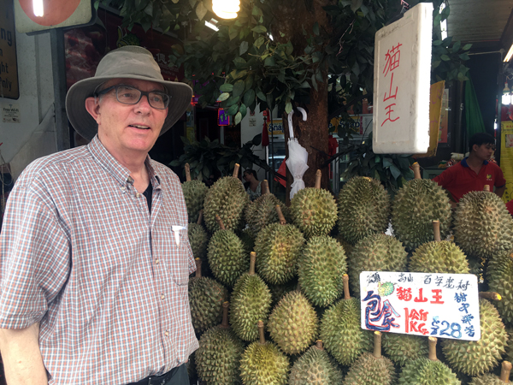
Using the A-Z Subject Index at the top of the
WebPages
University of Minnesota Duluth
Tim Roufs
© 2010-2024

Slide 6
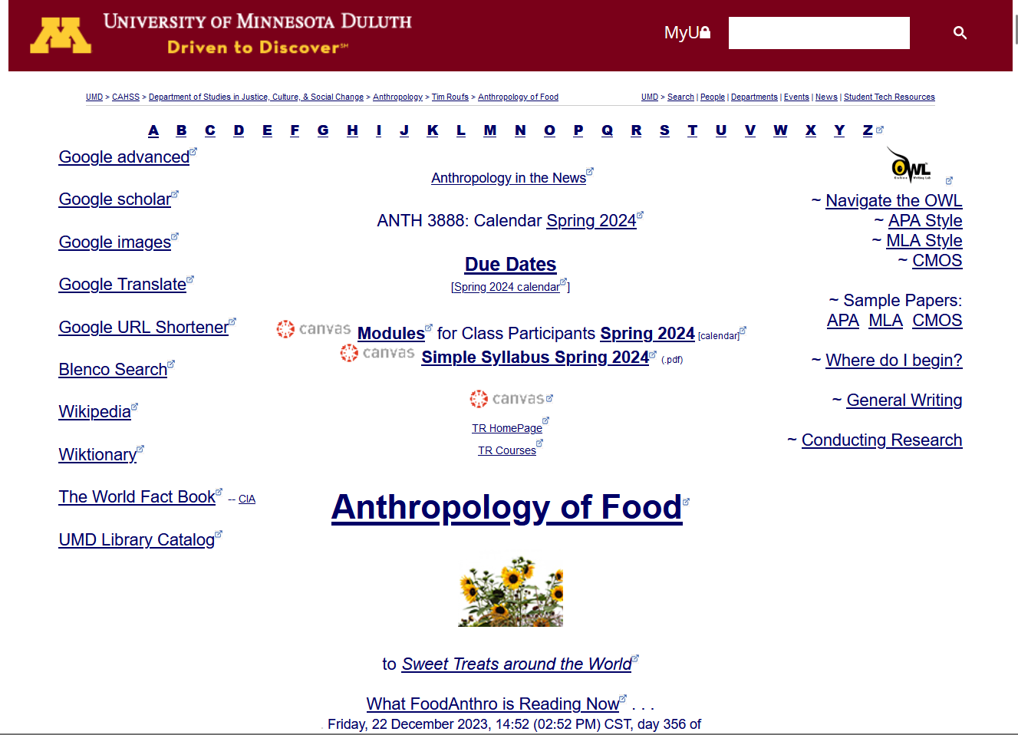
What’s this stuff?

Slide 7
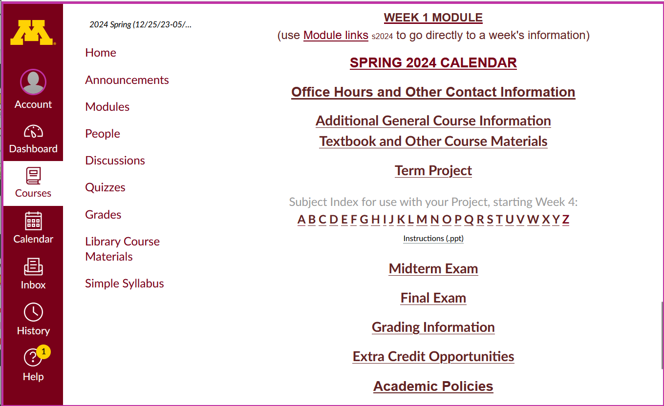
and this?

Slide 8
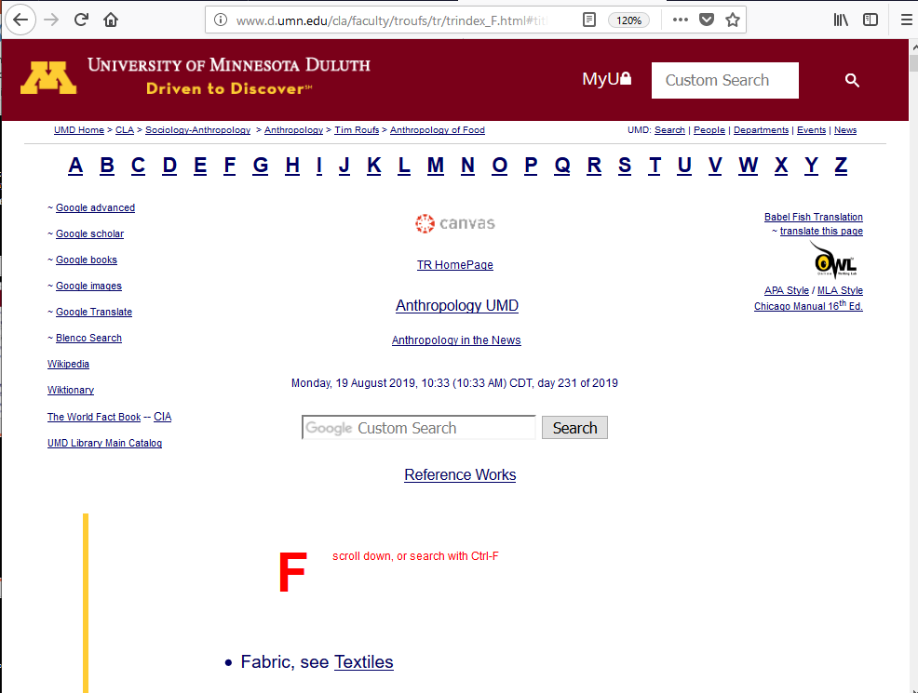
and this?

Slide 9
These "A-Z" links index hundreds of WebPages listing interesting and useful up-to-date sources of information related to this class, as well as other pertinent information in anthropology and related disciplines

Slide 10
They are handy to find out more information on any subject that is scheduled to be covered in the Anthropology of Food These can really be useful when you start looking for a topic for your term project

Slide 11
A-Z Subject Index links

Slide 13
Notice the A-Z Links
This information is very useful

Slide 14
Notice the A-Z Links
A-Z Subject Index links
On your Canvas “Home” page you will see an alphabet called “Subject Index”

Slide 15
Notice the A-Z Links
This information is very useful

Slide 16
to access a topic simply click on its first letter to go to an index page . . .

Slide 17
click on the letter C
Let’s see what’s available for “Chocolate” . . .

Slide 18
Let’s see what’s available for “Chocolate” . . .

Slide 19
click on the letter C
Let’s see what’s available for “Chocolate” . . .

Slide 20
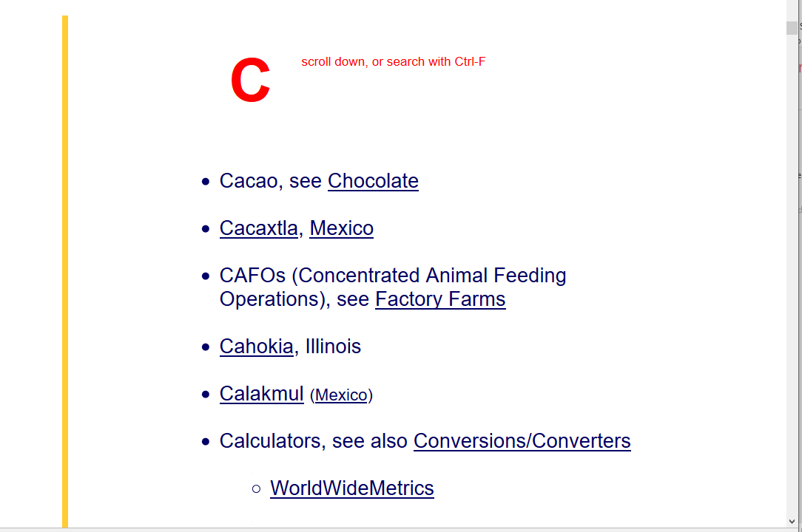
using “Chocolate” for an example

Slide 21
when you’re on the “C” A-Z Subject Index page, click on the item you want . . .
. . . for our example, it’s “Chocolate” . . .

Slide 22
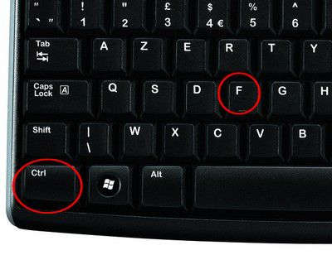
on the index page, on a PC search for item using Ctrl + F . . . ^f

Slide 23
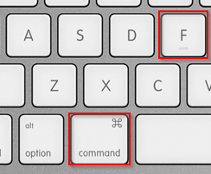
on a Mac, search for an item using Command + F . . .

Slide 24
on the index page, search for item using Ctrl + F / Command+F
or scroll down for the item

Slide 25
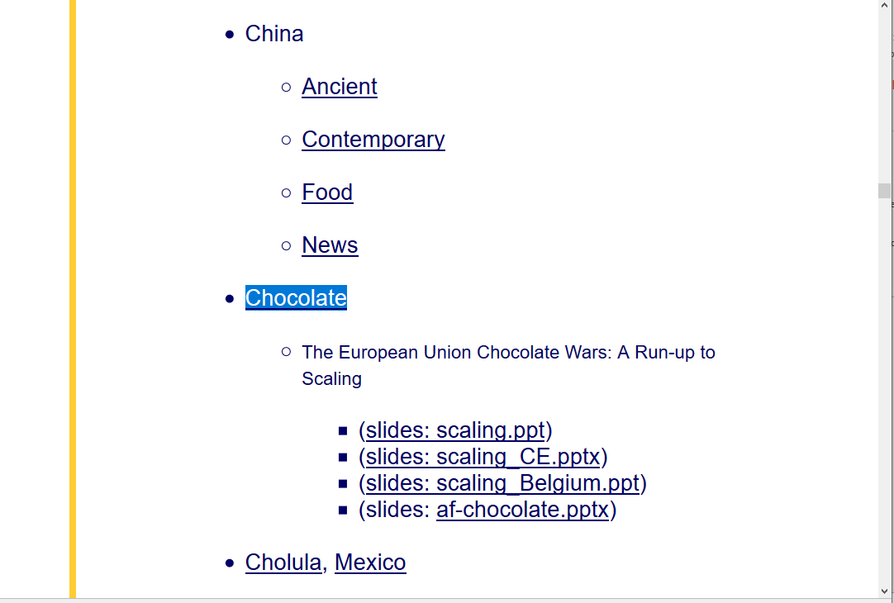
using “Chocolate” for an example
click on item . . .

Slide 26
et Voilá . . .

Slide 27
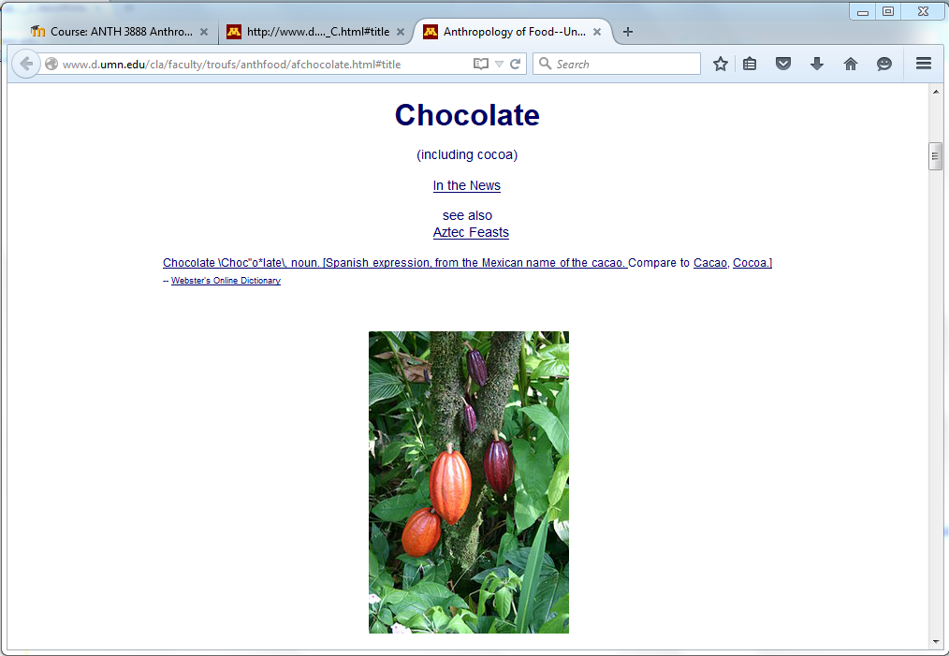

Slide 28
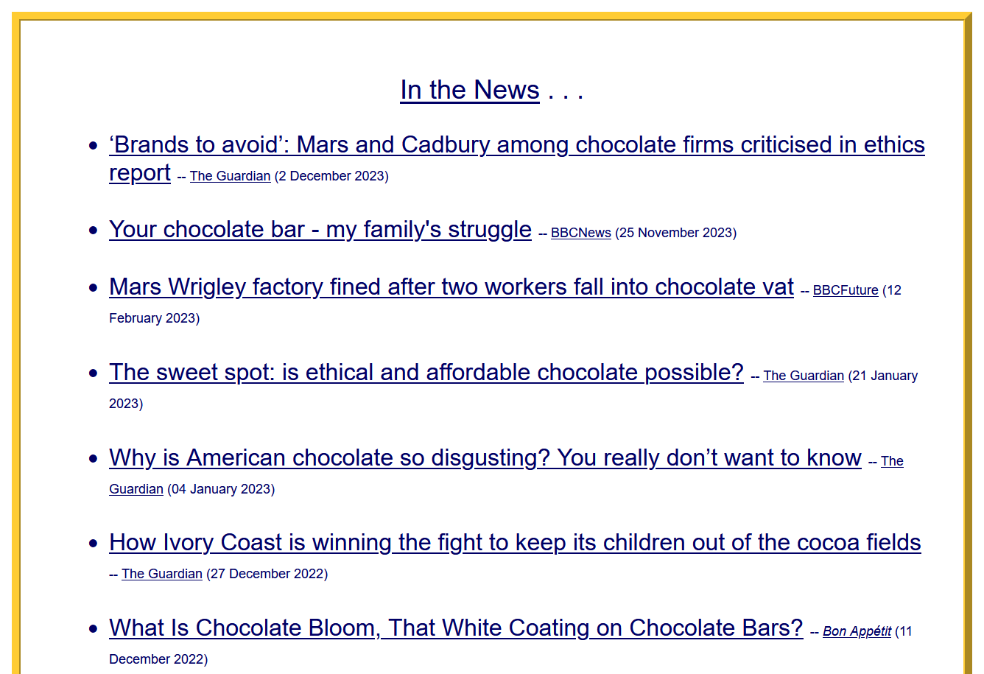
including instant links to up-to-date on-line sources relevant to Anthropology of Food . . .

Slide 29
Let’s see what’s available for France . . .

Slide 30
click on the letter F
Let’s see what’s available for France . . .

Slide 31
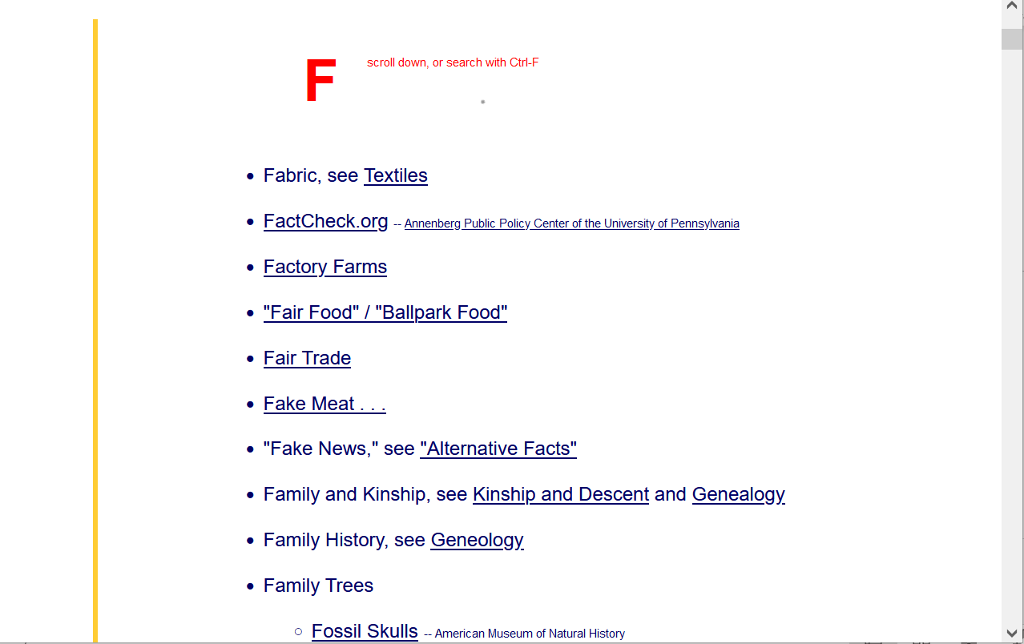
using “France” as an example

Slide 32
when you’re on the “F” A-Z Subject Index page, click on the item you want . . .
. . . for our example, it’s “France” . . .

Slide 33
on the index page, on a PC search for item using Ctrl + F . . . ^f

Slide 34
on a Mac, search for an item using Command + F . . .

Slide 35
on the index page, search for item using Ctrl + F / Command+F
or scroll down for the item

Slide 36
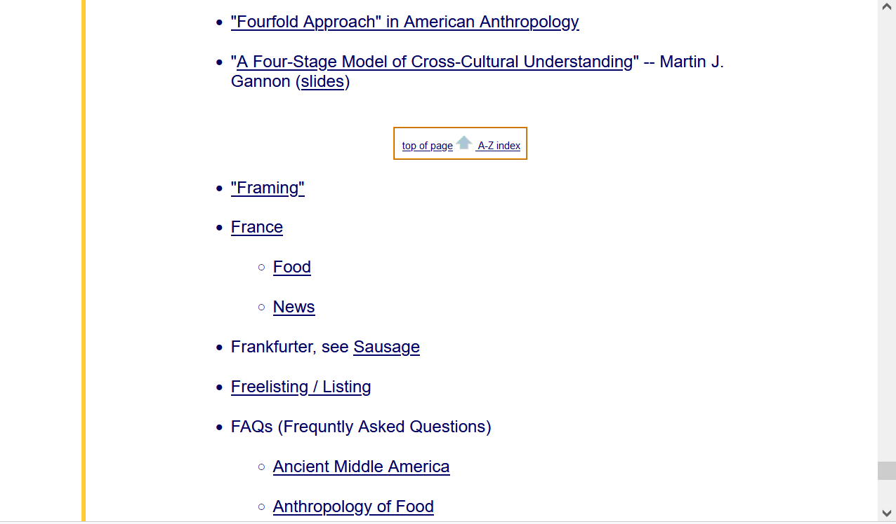
using “France” as an example
click on the item you want when you’re on the A-Z index page . . .
“France” . . . for our example . . .

Slide 37
et Voilá . . .

Slide 39
with the latest news links and basic reliable
on-line information on the topic that is relative to France and
Anthropology of Food . . .

Slide 40
The A - Z information should also be very useful when it comes time to start thinking about your class project

Slide 41
The A - Z information should also be very useful when it comes time to start thinking about your class project

Slide 43
Your Presentation and your Term Paper
are on the same subject . . .
but . . .
. . . they differ in major ways
in terms of . . . .
AUDIENCE
PURPOSE
STYLE

Slide 44
Your Presentation and your Term Paper
are on the same subject . . .
but . . .
. . . they differ in major ways
in terms of . . . .
AUDIENCE
PURPOSE
STYLE

Slide 45
Your Presentation and your Term Paper
are on the same subject . . .
but . . .
. . . they differ in major ways
in terms of . . . .
AUDIENCE
PURPOSE
STYLE

Slide 46
Your Presentation and your Term Paper
are on the same subject . . .
but . . .
. . . they differ in major ways
in terms of . . . .
AUDIENCE
PURPOSE
STYLE

Slide 47
Your Presentation and your Term Paper
are on the same subject . . .
but . . .
. . . they differ in major ways
in terms of . . . .
AUDIENCE
PURPOSE
STYLE

Slide 48
Your Presentation and your Term Paper
are on the same subject . . .
but . . .
. . . they differ in major ways
in terms of . . . .
AUDIENCE
PURPOSE
STYLE

Slide 49
AUDIENCE
PURPOSE
STYLE
Your Presentation and your Term Paper
are on the same subject . . .
but . . .
. . . they differ in major ways
in terms of . . . .

Slide 50
more about your class project on another day . . .

Slide 51
Anthropology of Food
University of Minnesota Duluth
Tim Roufs

Slide 52
http://www.d.umn.edu/cla/faculty/troufs/index.html
0

