Slide 1
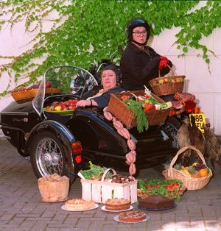
Two Fat?
Tim Roufs
© 2010-2024

Slide 2
Two Visionaries?
Two Fat Ladies
and Friends
Tim Roufs
© 2010-2024

Slide 3
Jennifer
Patterson
Clarissa
Dickson
Wright
Two Fat Ladies
and Friends
Tim Roufs
© 2010-2024

Slide 4
          The Two Fat Ladies
          authored dozens of texts
          as well as having starred in their
          international hit TV series . . .

Slide 5
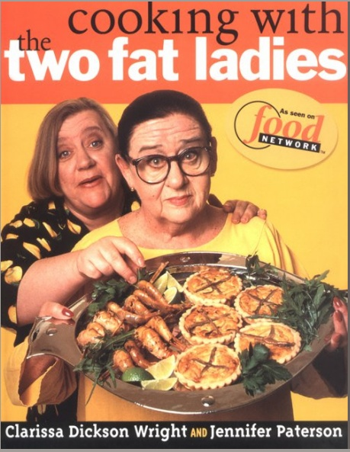
Clarissa
Dickson
Wright
Jennifer
Patterson
Cooking With the Two Fat Ladies, Clarkson Potter, 1998

Slide 6
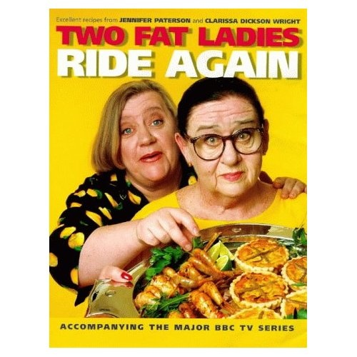
The Two Fat Ladies Ride Again, Clarkson Potter, 1997

Slide 7
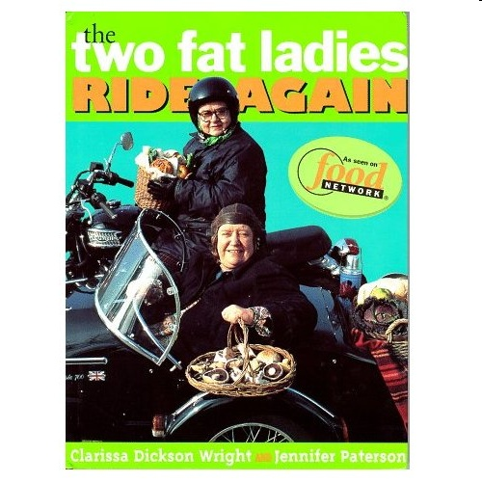
Two Fat Ladies Ride Again, Vintage Ebury, 1997

Slide 8
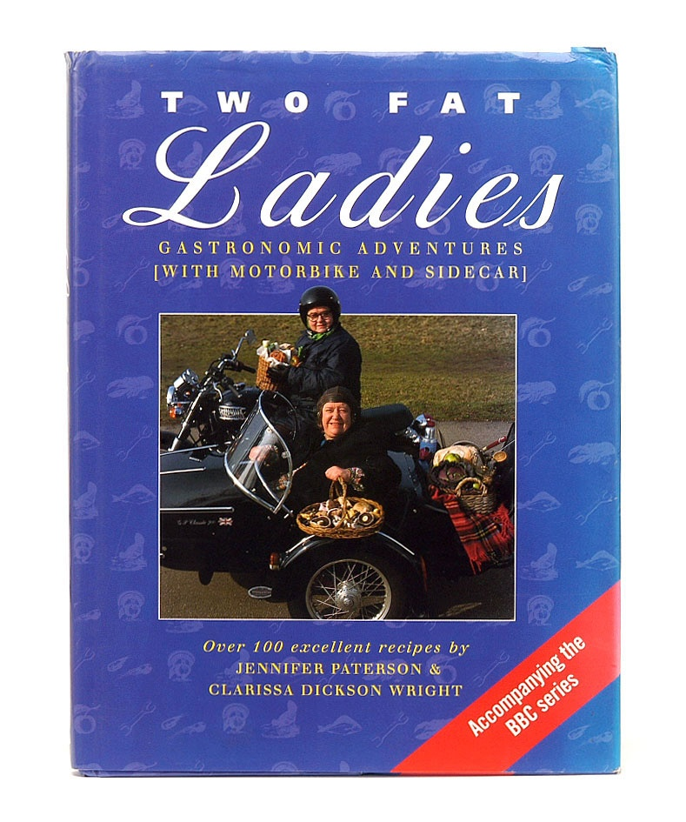
Two Fat Ladies: Gastronomic Adventures, Ebury Press, 1998

Slide 9
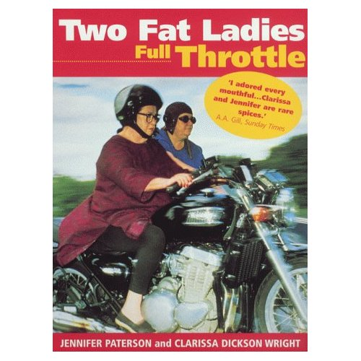
The Two Fat Ladies Full Throttle, Clarkson Potter, 1999

Slide 10
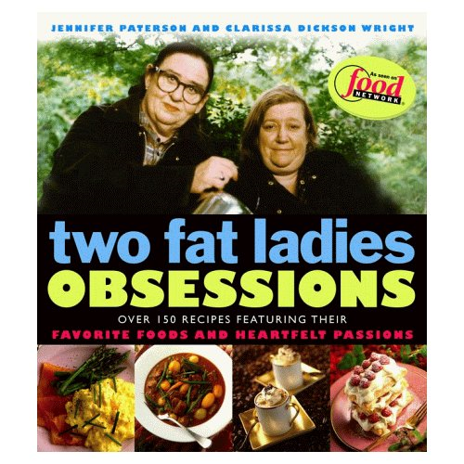
The Two Fat Ladies: Obsessions, Clarkson Potter, 1999

Slide 11

Jennifer Paterson's Seasonal Receipts, Headline Book Publishing, 1999

Slide 12
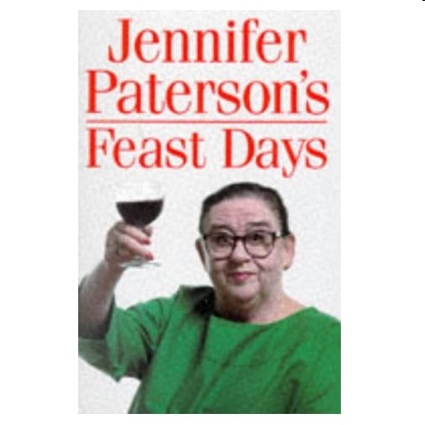
Jennifer Paterson's Feast Days: Over 150 Recipes from TV's Cookery Star, Vintage Ebury, 1997

Slide 13
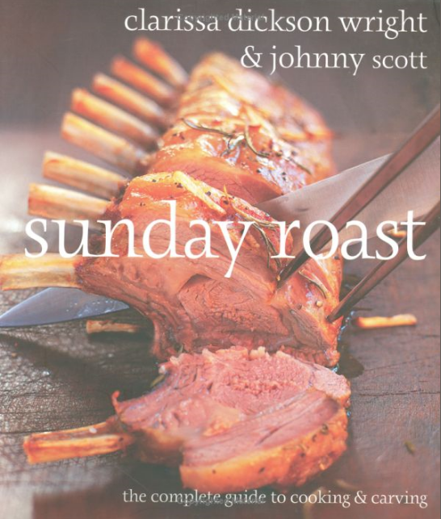
Sunday Roast: The Complete Guide To Cooking And Carving, Kyle Books, 2007

Slide 14
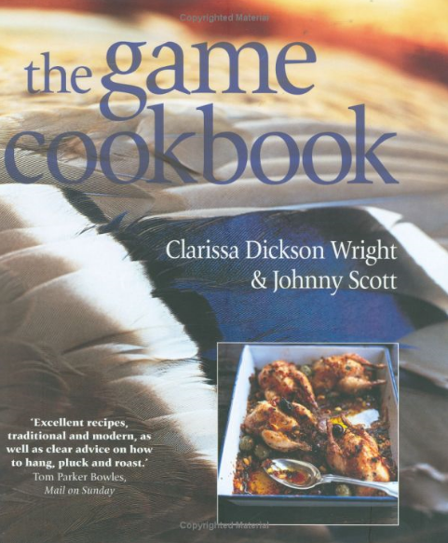
The Game Cookbook, Kyle Cathie, 2004

Slide 15

Hieland Foodie: A Scottish Culinary Voyage, National Museums of Scotland, 1990

Slide 16

The Haggis: A Little History, Pelican Publishing Company, 1998

Slide 17

Hodder & Stoughton, 2010

Slide 18
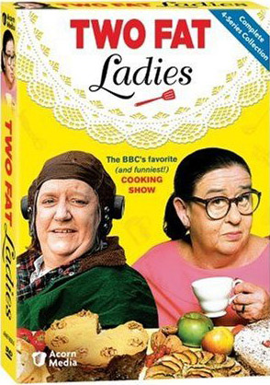
Two Fat Ladies, DVD, BBC 2008

Slide 19
          Sherri A. Inness
          features The Two Fat Ladies
          in Ch. 8 of Secret Ingredients,
          “Thin Is Not In: Two Fat Ladies and Gender Stereotypes on the Food Network”

Slide 20
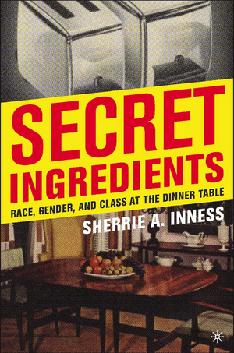
Sherrie A. Inness, Secret Ingredients, Palgrave Macmillan, 2006, p. 169

Slide 21
  Secret Ingredients examines how women from many backgrounds have used cooking literature to question society’s expectations about gender roles and other issues
Sherrie A. Inness, Secret Ingredients, Palgrave Macmillan, 2006, p. 169

Slide 22
  “Women have used cooking literature to voice their protests
  against a society where they are not always heard.”
Sherrie A. Inness, Secret Ingredients, Palgrave Macmillan, 2006, p. 169

Slide 23
  “This modern literature not only provides a place for discussing contemporary food issues but it also creates a place for women to debate other social issues.”
Sherrie A. Inness, Secret Ingredients, Palgrave Macmillan, 2006, p. 14

Slide 24
  Secret Ingredients “. . . also encourages readers to
  pay more critical attention to cooking culture in general, whether it be books, television shows, Internet sites, or magazine articles.”
Sherrie A. Inness, Secret Ingredients, Palgrave Macmillan, 2006, p. 169

Slide 25
  “If we wish to understand our American lives, one useful place to turn is the vast culinary universe and its varied messages.”
Sherrie A. Inness, Secret Ingredients, Palgrave Macmillan, 2006, p. 169

Slide 26
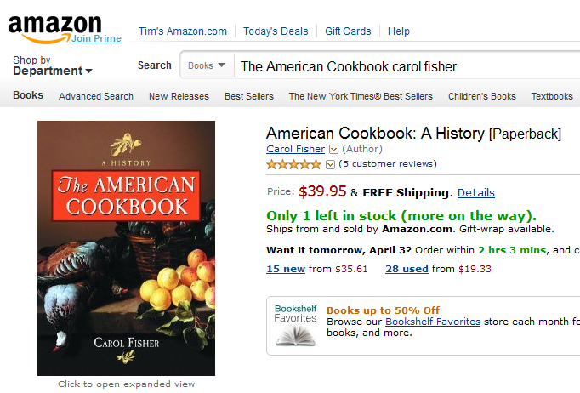

Slide 27
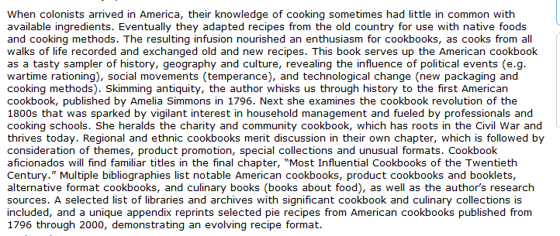

Slide 29
  Ch. 8 “Thin Is Not In: Two Fat Ladies and Gender Stereotypes on the Food Network”
Sherrie A. Inness, Secret Ingredients, Palgrave Macmillan, 2006, p. 169

Slide 30
  Ch. 1 "34,000,000,000 Work-Hours" Saved: Convenience Foods and Mom's Home Cooking”
  Ch. 2 "Unnatural, Unclean, and Filthy": Chinese-American Cooking Literature Confronting Racism in the 1950s”
  Ch. 3 "All Those Leftovers Are Hard on the Family Morale": Rebellion in Peg Bracken's I Hate to Cook Book”
  Ch. 4 "Boredom Is Quite Out of the Picture": Women's Natural Foods Cookbooks and Social Change”
  Ch. 5 "More American than Apple Pie": Modern African- American Cookbooks Fighting White Stereotypes”
  Ch. 6 "You Can't Get Trashier": White Trash Cookbooks and Social Class”
  Ch. 7 "Dining on Grass and Shrubs": Making Vegan Food Sexy”
  Ch. 8 “Thin Is Not In: Two Fat Ladies and Gender Stereotypes on the Food Network”
Sherrie A. Inness, Secret Ingredients, Palgrave Macmillan, 2006, p. 169

Slide 31
Clarissa
Dickson
Wright
Jennifer
Patterson
Cooking With the Two Fat Ladies, Clarkson Potter, 1998

Slide 32
          First watch the episode of
          The Two Fat Ladies
          show and things they
          talk about or mention that are not
          specifically related to
          the actual cooking of the meal
          in the kitchen . . .

Slide 34
Week 7
The episode:

Slide 35
Week 7
The episode:
Two Fat Ladies
"Timber!“
Series 4 Episode 23
(30 min., 2008, DVD 1698)

Slide 36
^{“freelisting”}
is simply making a list of things you are interested in looking at.
It is a technique commonly used by anthropologists when doing fieldwork

Slide 37

^{“freelisting”}
is best described in Weller and Romney’s text . . .
Sage, 1988

Slide 38
^{Assignment:}
List the things the Two Fat Ladies
talk about or mention that are not
^{specifically related to}
^{the actual cooking of the meal}
^{in the kitchen}
Sage, 1988

Slide 39
asks the question . . .
Sherrie A. Inness, Secret Ingredients, Palgrave Macmillan, 2006, p. 169

Slide 40
  Ch. 1 "34,000,000,000 Work-Hours" Saved: Convenience Foods and Mom's Home Cooking”
  Ch. 2 "Unnatural, Unclean, and Filthy": Chinese-American Cooking Literature Confronting Racism in the 1950s”
  Ch. 3 "All Those Leftovers Are Hard on the Family Morale": Rebellion in Peg Bracken's I Hate to Cook Book”
  Ch. 4 "Boredom Is Quite Out of the Picture": Women's Natural Foods Cookbooks and Social Change”
  Ch. 5 "More American than Apple Pie": Modern African- American Cookbooks Fighting White Stereotypes”
  Ch. 6 "You Can't Get Trashier": White Trash Cookbooks and Social Class”
  Ch. 7 "Dining on Grass and Shrubs": Making Vegan Food Sexy”
  Ch. 8 “Thin Is Not In: Two Fat Ladies and Gender Stereotypes on the Food Network”
  What kind of messages
  are the authors sending?
Sherrie A. Inness, Secret Ingredients, Palgrave Macmillan, 2006, p. 169

Slide 41
  Ch. 1 "34,000,000,000 Work-Hours" Saved: Convenience Foods and Mom's Home Cooking”
  Ch. 2 "Unnatural, Unclean, and Filthy": Chinese-American Cooking Literature Confronting Racism in the 1950s”
  Ch. 3 "All Those Leftovers Are Hard on the Family Morale": Rebellion in Peg Bracken's I Hate to Cook Book”
  Ch. 4 "Boredom Is Quite Out of the Picture": Women's Natural Foods Cookbooks and Social Change”
  Ch. 5 "More American than Apple Pie": Modern African- American Cookbooks Fighting White Stereotypes”
  Ch. 6 "You Can't Get Trashier": White Trash Cookbooks and Social Class”
  Ch. 7 "Dining on Grass and Shrubs": Making Vegan Food Sexy”
  Ch. 8 “Thin Is Not In: Two Fat Ladies and Gender Stereotypes on the Food Network”
  Ch. 8 “Thin Is Not In: Two Fat Ladies
  and Gender Stereotypes
  on the Food Network”
Sherrie A. Inness, Secret Ingredients, Palgrave Macmillan, 2006, p. 169

Slide 42
  Ch. 1 "34,000,000,000 Work-Hours" Saved: Convenience Foods and Mom's Home Cooking”
  Ch. 2 "Unnatural, Unclean, and Filthy": Chinese-American Cooking Literature Confronting Racism in the 1950s”
  Ch. 3 "All Those Leftovers Are Hard on the Family Morale": Rebellion in Peg Bracken's I Hate to Cook Book”
  Ch. 4 "Boredom Is Quite Out of the Picture": Women's Natural Foods Cookbooks and Social Change”
  Ch. 5 "More American than Apple Pie": Modern African- American Cookbooks Fighting White Stereotypes”
  Ch. 6 "You Can't Get Trashier": White Trash Cookbooks and Social Class”
  Ch. 7 "Dining on Grass and Shrubs": Making Vegan Food Sexy”
  Ch. 8 Thin Is Not In: Two Fat Ladies and Gender Stereotypes on the Food Network”
  The final chapter turns from cookbooks to cooking shows
Sherrie A. Inness, Secret Ingredients, Palgrave Macmillan, 2006, p. 169

Slide 43
  Ch. 1 "34,000,000,000 Work-Hours" Saved: Convenience Foods and Mom's Home Cooking”
  Ch. 2 "Unnatural, Unclean, and Filthy": Chinese-American Cooking Literature Confronting Racism in the 1950s”
  Ch. 3 "All Those Leftovers Are Hard on the Family Morale": Rebellion in Peg Bracken's I Hate to Cook Book”
  Ch. 4 "Boredom Is Quite Out of the Picture": Women's Natural Foods Cookbooks and Social Change”
  Ch. 5 "More American than Apple Pie": Modern African- American Cookbooks Fighting White Stereotypes”
  Ch. 6 "You Can't Get Trashier": White Trash Cookbooks and Social Class”
  Ch. 7 "Dining on Grass and Shrubs": Making Vegan Food Sexy”
  Ch. 8 “Thin Is Not In: Two Fat Ladies and Gender Stereotypes on the Food Network”
  “Increasingly,
  if one wishes to understand the changing nature of cooking literature and cooking culture in general, it is necessary to focus on television,
  where the Food Network’s popularity has created a new venue for the culinary arts.”
Sherrie A. Inness, Secret Ingredients, Palgrave Macmillan, 2006, p. 169

Slide 44
  Ch. 1 "34,000,000,000 Work-Hours" Saved: Convenience Foods and Mom's Home Cooking”
  Ch. 2 "Unnatural, Unclean, and Filthy": Chinese-American Cooking Literature Confronting Racism in the 1950s”
  Ch. 3 "All Those Leftovers Are Hard on the Family Morale": Rebellion in Peg Bracken's I Hate to Cook Book”
  Ch. 4 "Boredom Is Quite Out of the Picture": Women's Natural Foods Cookbooks and Social Change”
  Ch. 5 "More American than Apple Pie": Modern African- American Cookbooks Fighting White Stereotypes”
  Ch. 6 "You Can't Get Trashier": White Trash Cookbooks and Social Class”
  Ch. 7 "Dining on Grass and Shrubs": Making Vegan Food Sexy”
  Ch. 8 “Thin Is Not In: Two Fat Ladies and Gender Stereotypes on the Food Network”
  “Although popular televised cooking shows, including Julia Child’s The French Chef, existed in previous decades, they never had the societal influence of a television network that features nothing but
  food shows
  twenty-four hours a day.”
Sherrie A. Inness, Secret Ingredients, Palgrave Macmillan, 2006, p. 169

Slide 45
  Ch. 1 "34,000,000,000 Work-Hours" Saved: Convenience Foods and Mom's Home Cooking”
  Ch. 2 "Unnatural, Unclean, and Filthy": Chinese-American Cooking Literature Confronting Racism in the 1950s”
  Ch. 3 "All Those Leftovers Are Hard on the Family Morale": Rebellion in Peg Bracken's I Hate to Cook Book”
  Ch. 4 "Boredom Is Quite Out of the Picture": Women's Natural Foods Cookbooks and Social Change”
  Ch. 5 "More American than Apple Pie": Modern African- American Cookbooks Fighting White Stereotypes”
  Ch. 6 "You Can't Get Trashier": White Trash Cookbooks and Social Class”
  Ch. 7 "Dining on Grass and Shrubs": Making Vegan Food Sexy”
  Ch. 8 Thin Is Not In: Two Fat Ladies and Gender Stereotypes on the Food Network”
  Ch. 8 “Thin Is Not In: Two Fat Ladies
  and Gender Stereotypes
  on the Food Network”
  Christina Deyo
  Bobby Flay
  Emeril Legasse
  Rachel Ray
  Roccco DiSpirito
  Wolfgang Puck
Sherrie A. Inness, Secret Ingredients, Palgrave Macmillan, 2006, p. 169

Slide 46
  Ch. 1 "34,000,000,000 Work-Hours" Saved: Convenience Foods and Mom's Home Cooking”
  Ch. 2 "Unnatural, Unclean, and Filthy": Chinese-American Cooking Literature Confronting Racism in the 1950s”
  Ch. 3 "All Those Leftovers Are Hard on the Family Morale": Rebellion in Peg Bracken's I Hate to Cook Book”
  Ch. 4 "Boredom Is Quite Out of the Picture": Women's Natural Foods Cookbooks and Social Change”
  Ch. 5 "More American than Apple Pie": Modern African- American Cookbooks Fighting White Stereotypes”
  Ch. 6 "You Can't Get Trashier": White Trash Cookbooks and Social Class”
  Ch. 7 "Dining on Grass and Shrubs": Making Vegan Food Sexy”
  Ch. 8 “Thin Is Not In: Two Fat Ladies and Gender Stereotypes on the Food Network”
  “Some of these celebrities and their shows seem well known primarily for their
  sleek, sophisticated gloss,
  but not all are equally glossy.”
Sherrie A. Inness, Secret Ingredients, Palgrave Macmillan, 2006, p. 169

Slide 47
  Ch. 1 "34,000,000,000 Work-Hours" Saved: Convenience Foods and Mom's Home Cooking”
  Ch. 2 "Unnatural, Unclean, and Filthy": Chinese-American Cooking Literature Confronting Racism in the 1950s”
  Ch. 3 "All Those Leftovers Are Hard on the Family Morale": Rebellion in Peg Bracken's I Hate to Cook Book”
  Ch. 4 "Boredom Is Quite Out of the Picture": Women's Natural Foods Cookbooks and Social Change”
  Ch. 5 "More American than Apple Pie": Modern African- American Cookbooks Fighting White Stereotypes”
  Ch. 6 "You Can't Get Trashier": White Trash Cookbooks and Social Class”
  Ch. 7 "Dining on Grass and Shrubs": Making Vegan Food Sexy”
  Ch. 8 “Thin Is Not In: Two Fat Ladies and Gender Stereotypes on the Food Network”
  The Two Fat Ladies
Sherrie A. Inness, Secret Ingredients, Palgrave Macmillan, 2006, p. 169

Slide 48
        “Stars of the late 1990s hit television series Two Fat Ladies, Jennifer Patterson and Clarissa Dickson Wright,
        broke a major social taboo by being fat.”
          this was a first for food television,
          to depict fat women positively
          Why is this unusual?
Sherrie A. Inness, Secret Ingredients, Palgrave Macmillan, 2006, p. 169

Slide 49
        “Stars of the late 1990s hit television series Two Fat Ladies, Jennifer Patterson and Clarissa Dickson Wright,
        broke a major social taboo by being fat.”
          this was a first for food television,
          to depict fat women positively
          Why is this unusual?
          . . . cooking is an industry where
          fat or heavy-set men have been embraced . . .
Sherrie A. Inness, Secret Ingredients, Palgrave Macmillan, 2006, p. 169

Slide 50
        “It has always been acceptable for a male cook to be fat,
        and this does not prevent him from becoming a culinary superstar.”
          James Beard
          Chef Paul Prudhomme
          Mario Batali
Sherrie A. Inness, Secret Ingredients, Palgrave Macmillan, 2006, p. 169

Slide 51
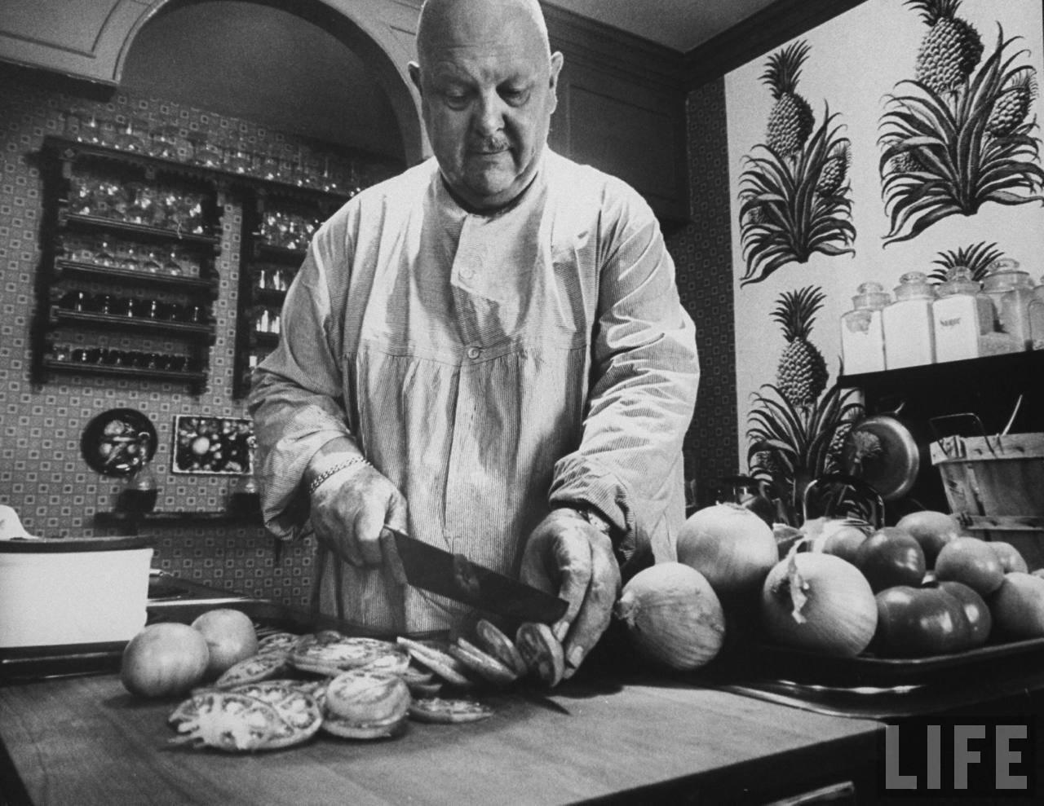
          James Beard
image link

Slide 52
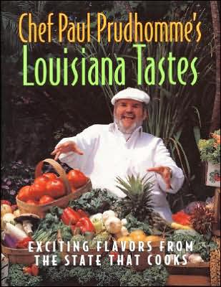
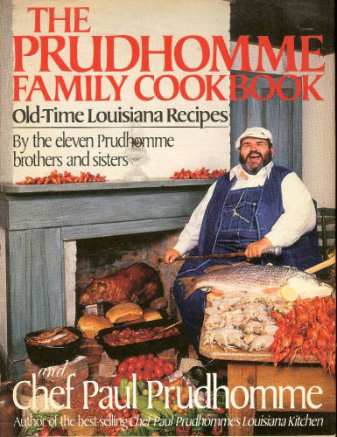
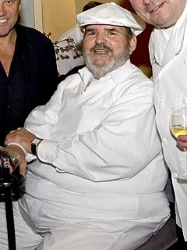
www.spice-work.com/2006.front.page.ended.May.31.2006..html

Slide 53
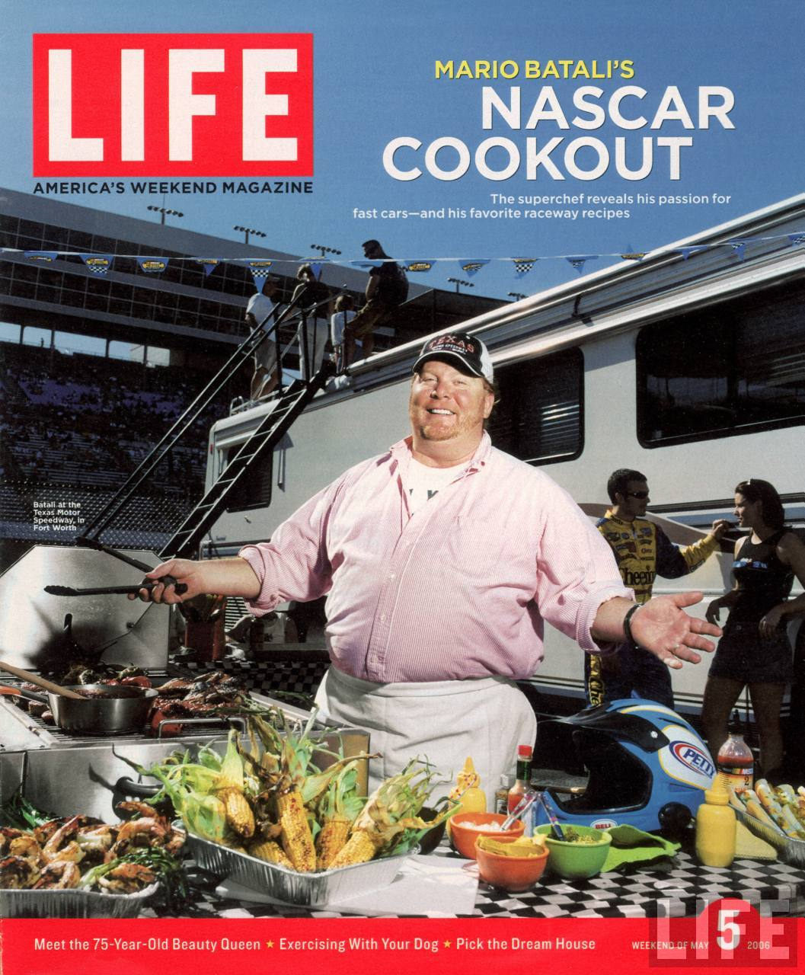
          Mario Batali
image link

Slide 54
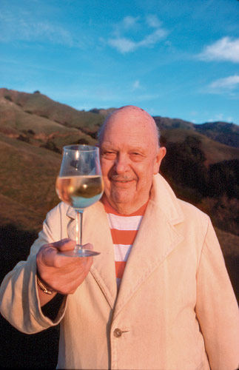
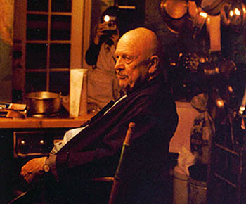
          James Beard
www.spice-work.com/2006.front.page.ended.May.31.2006..html

Slide 55
        “In this context,
        [the male cook’s] extra pounds are proof of his success.”
Sherrie A. Inness, Secret Ingredients, Palgrave Macmillan, 2006, p. 169

Slide 56
        “It has always been acceptable for a male cook to be fat, and this does not prevent him from becoming a culinary superstar.”
        “This situation, however, is different for women.”
        “This reflects a society in which the ultimate sin is for women to grow fat, but men do not face the same pressure.”
Sherrie A. Inness, Secret Ingredients, Palgrave Macmillan, 2006, p. 169

Slide 57
        “[The Two Fat] women did not try to conceal their fatness but, instead, reveled in it. . . .”
        “Rebelling against a culture that assumes women have to be thin
        in order to star in the media,
        the Fat Ladies delighted in their fatness.”
Sherrie A. Inness, Secret Ingredients, Palgrave Macmillan, 2006, p. 169

Slide 58
        “Unlike Oprah and her repeated attempts to slim down,
        the Ladies did not try any drastic weight reduction plans,
        and they were definitely
        not feasting on carrots and celery sticks for dinner.”
Sherrie A. Inness, Secret Ingredients, Palgrave Macmillan, 2006, p. 169

Slide 59
        “One reason for the Fat Ladies’ popularity was that their showed originally aired
        at a time when Americans,
        including women, were becoming noticeably heavier. . . .”
Sherrie A. Inness, Secret Ingredients, Palgrave Macmillan, 2006, p. 170

Slide 60
        “The Fat Ladies
        enjoyed their stocker figures,
        sending out a message
        that being heavy was acceptable, despite what most other female stars look like.”
Sherrie A. Inness, Secret Ingredients, Palgrave Macmillan, 2006, p. 170

Slide 61
        “For millions of women, this was reassuring and revolutionary.”
        “In addition,
        the Ladies challenged the stereotype that it is taboo on television to be
        middle aged or older.”
          Jennifer Patterson was in her 60s
          Clarissa Dickson Wright was in her 50s
Sherrie A. Inness, Secret Ingredients, Palgrave Macmillan, 2006, p. 170

Slide 62
        “They questioned a society
        that expects women to be
        young, thin, and glamorous
        and showed how unrealistic such standards are.”
Sherrie A. Inness, Secret Ingredients, Palgrave Macmillan, 2006, p. 170

Slide 63
        “The Ladies, however,
        accomplished more
        than just suggesting that it was acceptable for women, including media stars, to be fat and older.”
        “In their TV show and cookbooks,
        the Ladies spoke out about a number of important social issues related to food and the people who provide it. . . .”
Sherrie A. Inness, Secret Ingredients, Palgrave Macmillan, 2006, p. 170

Slide 64
        “First,
        Clarissa and Jennifer emphasized that
        it was acceptable to enjoy food, even if it was rich and high in calories and cholesterol.”
          They condemned a society that seemed to have forgotten the delights attached to old-fashioned cooking
          In the land of nouvelle cuisine, this was a radical message
Sherrie A. Inness, Secret Ingredients, Palgrave Macmillan, 2006, p. 170

Slide 65
        “Second,
        the Ladies suggested it was important to remember the past and its food traditions . . .”
          so they repeatedly focused on cooking traditional English meals
Sherrie A. Inness, Secret Ingredients, Palgrave Macmillan, 2006, p. 170

Slide 66
        “Second, the Ladies suggested it was important to remember the past and its food traditions. . .”
          although some people might perceive this
          as a conservative move,
          the Ladies had a more progressive reason for their reliance on historical British recipes. . . .
Sherrie A. Inness, Secret Ingredients, Palgrave Macmillan, 2006, p. 170

Slide 67
        “Second, the Ladies suggested it was important to remember the past and its food traditions. . .”
          they sought to remember and preserve a culinary past that helped make Britain’s culture unique
          in this way, the Ladies questioned a world where everything, especially food, had grown increasingly homogeneous and bland
Sherrie A. Inness, Secret Ingredients, Palgrave Macmillan, 2006, p. 170

Slide 68
        “Third,
        the Ladies stressed
        the significance of recognizing where various foods originate, as well as patronizing small local suppliers.”
          they questioned how large agribusinesses have taken over supplying food because it is profitable, not because it is best for consumers
Sherrie A. Inness, Secret Ingredients, Palgrave Macmillan, 2006, p. 170

Slide 69
        “Third,
        the Ladies stressed
        the significance of recognizing where various foods originate, as well as patronizing small local suppliers.”
          they questioned how large agribusinesses have taken over supplying food because it is profitable, not because it is best for consumers
locavores
Sherrie A. Inness, Secret Ingredients, Palgrave Macmillan, 2006, p. 170

Slide 70
        “’A Moral Panic’:
        Anti-Fat Attitudes
        in the United States”
Sherrie A. Inness, Secret Ingredients, Palgrave Macmillan, 2006, p. 170

Slide 71
        “The Fat Ladies rebelled against a society that despises fatness.”
Sherrie A. Inness, Secret Ingredients, Palgrave Macmillan, 2006, p. 171

Slide 72
        “The Fat Ladies rebelled against a society that despises fatness.”
          “The American Mainstream hates fat people and seems to feel little or not need to hide that emotion.”
          “U.S. society belittles fat people of all genders, socioeconomic backgrounds, races, ethnicities, and ages.”
Sherrie A. Inness, Secret Ingredients, Palgrave Macmillan, 2006, p. 171

Slide 73
        “The Fat Ladies rebelled against a society that despises fatness.”
          American culture scapegoats fat people in much the same way that it scapegoats white trash.”
Sherrie A. Inness, Secret Ingredients, Palgrave Macmillan, 2006, p. 171

Slide 74
        “The Fat Ladies rebelled against a society that despises fatness.”
          American culture scapegoats fat people in much the same way that it scapegoats white trash.”
            Redneck jokes reassure the middle class that they have not fallen that low
            Similarly,
            jokes about fat people reassure less-fat individuals that they have not gained as much as heavier people
Sherrie A. Inness, Secret Ingredients, Palgrave Macmillan, 2006, p. 171

Slide 75
        “In this environment,
        the Fat Ladies showed
        that overweight people deserve the same respect as everyone else does.”
Sherrie A. Inness, Secret Ingredients, Palgrave Macmillan, 2006, p. 171

Slide 76
        “Along with disparaging fatness, Americans are scared of fatness because it can sneak up on anyone.”
Sherrie A. Inness, Secret Ingredients, Palgrave Macmillan, 2006, p. 171

Slide 77
        “Along with disparaging fatness, Americans are scared of fatness because it can sneak up on anyone.”
          “Our culture depicts fatness as something that demands constant vigilance, so that one does not become fat oneself.”
          “In 2004 in the New York Times, Sander L. Gilman wrote, ‘We are in a moral panic about obesity.’”
Sherrie A. Inness, Secret Ingredients, Palgrave Macmillan, 2006, p. 171

Slide 78
        “Along with disparaging fatness, Americans are scared of fatness because it can sneak up on anyone.”
          “It is nearly impossible to read a newspaper or watch a TV program without hearing something new about the growing rates of obesity in the United States.”
Sherrie A. Inness, Secret Ingredients, Palgrave Macmillan, 2006, p. 171

Slide 79
        “Along with disparaging fatness, Americans are scared of fatness because it can sneak up on anyone.”
          “Why are we scared?”
          “Why is it such a phobia
          to gain weight?”
Sherrie A. Inness, Secret Ingredients, Palgrave Macmillan, 2006, p. 171

Slide 80
        “Many reasons exist for this fear . . .”
          health concerns. . .
            excess weight has been shown to be a reason that both women and men live shorter lives
            so, we wish to lose weight to be healthy
Sherrie A. Inness, Secret Ingredients, Palgrave Macmillan, 2006, p. 171

Slide 81
        “Many reasons exist for this fear . . .”
          America is based on action, and to succeed in our economy, we believe that we have to appear slender and fit
            “Americans esteem the lean-and-hungry look, so we fear gaining weight, which society perceives as a sign of failure.”
            “For women, especially if they are upper or middle class, this is particularly true.”
Sherrie A. Inness, Secret Ingredients, Palgrave Macmillan, 2006, p. 171

Slide 82
        “Women are supposed to feel guilty if they gain a few pounds because it is a sign that they, at least according to social stereotypes,
        lack discipline and willpower.”
          “’In affluent Western societies,
          slenderness is usually associated with happiness, success, youthfulness, and social acceptability. . . .’”
          – Sarah Grogan, Body Image: Understanding body Dissatisfaction in Men, Women, and Children (1999)
Sherrie A. Inness, Secret Ingredients, Palgrave Macmillan, 2006, p. 172

Slide 83
        “Women are supposed to feel guilty if they gain a few pounds because it is a sign that they, at least according to social stereotypes,
        lack discipline and willpower.”
          “’In affluent Western societies, slenderness is usually associated with happiness, success, youthfulness, and social acceptability. . . .’”
          – Sarah Grogan, Body Image: Understanding body Dissatisfaction in Men, Women, and Children (1999)
Sherrie A. Inness, Secret Ingredients, Palgrave Macmillan, 2006, p. 172

Slide 84
        “Women are supposed to feel guilty if hey gain a few pounds because it is a sign that they, at least according to social stereotypes, lack discipline and willpower.”
          “Being overweight is linked to laziness, lack of will power, and being out of control. . . .’”
          – Sarah Grogan, Body Image: Understanding body Dissatisfaction in Men, Women, and Children (1999)
Sherrie A. Inness, Secret Ingredients, Palgrave Macmillan, 2006, p. 172

Slide 85
        “In a culture that emphasizes a vision of attractiveness that is unobtainable for countless women,
        they are supposed to feel guilty about each bite they consume because it could lead to extra pounds.”
Sherrie A. Inness, Secret Ingredients, Palgrave Macmillan, 2006, p. 172

Slide 86
        “Every nibble is suspect.”
          “American society teaches women that food is potentially dangerous, so they must never relax for a moment.”
Sherrie A. Inness, Secret Ingredients, Palgrave Macmillan, 2006, p. 172

Slide 87
        “The Ladies fought the social stereotype that women were supposed to feel guilty about everything they consumed.”
          “The television show hosts declared that
          one did not have to feel guilty about eating, even if the foods were high in fat and calories. . . .”
Sherrie A. Inness, Secret Ingredients, Palgrave Macmillan, 2006, p. 172

Slide 88
        “The Ladies fought the social stereotype that women were supposed to feel guilty about everything they consumed.”
          “. . . and instead,
          [one] should glory in such food and enjoy it
          as one of life’s joys.”
Sherrie A. Inness, Secret Ingredients, Palgrave Macmillan, 2006, p. 172

Slide 89
        “The Fat Ladies rebelled against a culture that assumed every woman had to be slender.”
Sherrie A. Inness, Secret Ingredients, Palgrave Macmillan, 2006, p. 172

Slide 90
        “Fantasy, Fatness, and Females:
        Media Images”
Sherrie A. Inness, Secret Ingredients, Palgrave Macmillan, 2006, p. 172

Slide 91
        “It is odd that women who are food celebrities on television are typically slender because,
        like some of the famous male chefs with their extra pounds,
        one would expect some of the women to show a few pounds around their middles.”
          “No matter how elaborate, fanciful, and rich the meals are that they prepare, not an ounce appears on the women’s bodies.”
Sherrie A. Inness, Secret Ingredients, Palgrave Macmillan, 2006, pp. 172-173

Slide 92
        For some reason Inness downplays the most famous female food personality of all times . . .
Sherrie A. Inness, Secret Ingredients, Palgrave Macmillan, 2006, p. 172

Slide 93
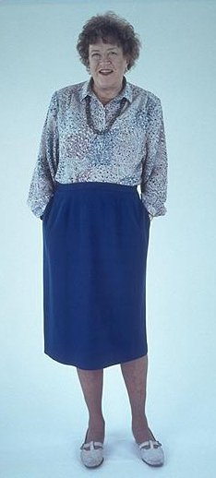
        For some reason Inness consistently downplays the most famous female food personality of all times. . .
Sherrie A. Inness, Secret Ingredients, Palgrave Macmillan, 2006, p. 172

Slide 94
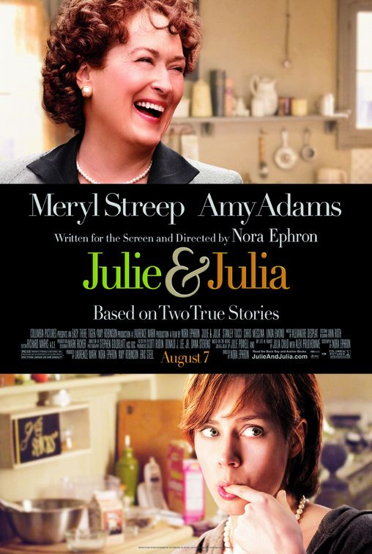
        For some reason Inness consistently downplays the most famous female food personality of all times. . .
Sherrie A. Inness, Secret Ingredients, Palgrave Macmillan, 2006, p. 172

Slide 95
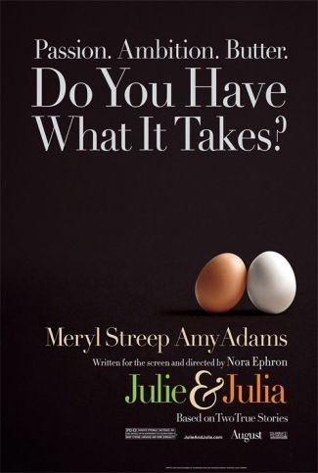
        For some reason Inness consistently downplays the most famous female food personality of all times. . .
Sherrie A. Inness, Secret Ingredients, Palgrave Macmillan, 2006, p. 172

Slide 96
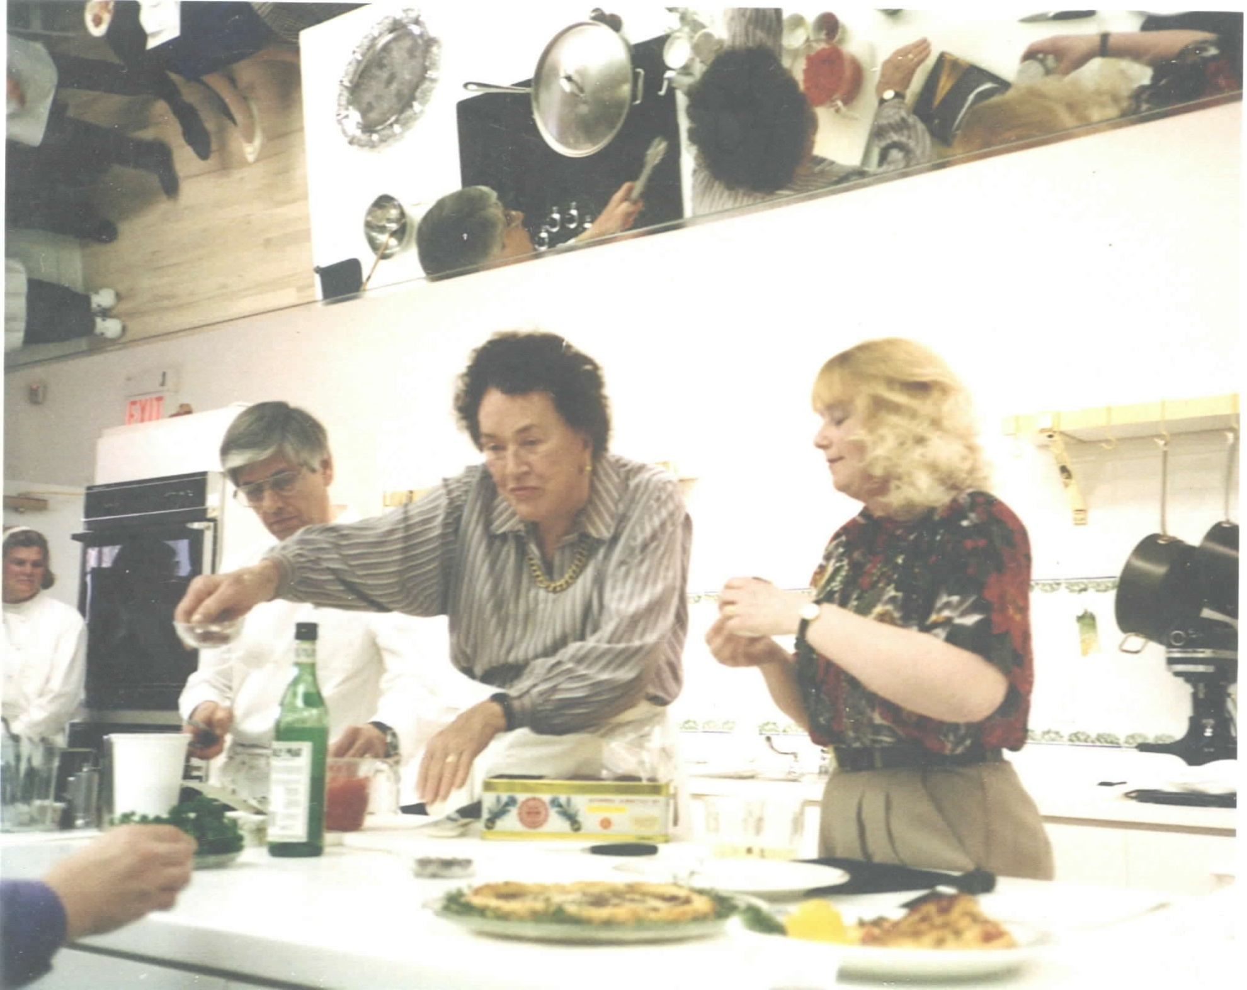
www.spice-work.com/2006.front.page.ended.May.31.2006..html

Slide 97
        “Food television is
        popular with women because
        it creates a fantasy universe
        where eating that éclair does not mean you have to spend another hour on the treadmill.”
Sherrie A. Inness, Secret Ingredients, Palgrave Macmillan, 2006, p. 173

Slide 98
        “The fact that
        few fat women appear in the world of cooking-culture stardom
        is one example of a popular culture phenomenon [Inness] refers to as
        ‘the missing fat woman’”
Sherrie A. Inness, Secret Ingredients, Palgrave Macmillan, 2006, p. 173

Slide 99
        “The fact that
        few fat women appear in the world of cooking-culture stardom
        is one example of a popular culture phenomenon [Inness] refers to as
        ‘the missing fat woman’”
          “Despite . . . millions of real [fat] women, fat women rarely appear in the media and, in some cases, vanish entirely.”
Sherrie A. Inness, Secret Ingredients, Palgrave Macmillan, 2006, p. 173

Slide 100
        “[The] fantasy world where no woman carries any extra weight impacts how real women perceive their bodies.
        They see so many unrealistically slender bodies that they begin to assume that their bodies should be similarly thin.
        This feeling is aggravated because American culture is inundated with ways to slenderize,
        many focused on women.”
Sherrie A. Inness, Secret Ingredients, Palgrave Macmillan, 2006, p. 173

Slide 101
        “Every diet book possible
        fills bookstores.
        Health clubs and gymnasiums
        inundate cities and towns
        from coast to coast.
        TV shows and tabloids
        are replete with ways to diet.”
Sherrie A. Inness, Secret Ingredients, Palgrave Macmillan, 2006, p. 173

Slide 102
        “Losing weight obsesses our culture . . . so [women] feel that they must strive for thinness, whatever the cost.”
          anorexia and bulimia
          are rampant because women feel such a desire to lose weight
          even if a woman is not anorexic, she is still apt to wish to lose five or ten pounds
Sherrie A. Inness, Secret Ingredients, Palgrave Macmillan, 2006, p. 173

Slide 103
        “Losing weight obsesses our culture . . . so [women] feel that they must strive for thinness, whatever the cost.”
          anorexia and bulimia are rampant because women feel such a desire to lose weight
          even if a woman is not anorexic, she is still apt to wish to lose five or ten pounds
Sherrie A. Inness, Secret Ingredients, Palgrave Macmillan, 2006, p. 173

Slide 104
        “In this universe where no female carries an added ounce, let alone a pound,
        the Fat Ladies rebelled against the culture of thinness.
        Like Roseanne Barr, they were fat and unapologetic about it.”
Sherrie A. Inness, Secret Ingredients, Palgrave Macmillan, 2006, p. 174

Slide 105
        “In this universe where no female carries an added ounce, let alone a pound,
        the Fat Ladies rebelled against the culture of thinness.
        Like Roseanne Barr, they were fat and unapologetic about it.”
        Such women provide a needed corrective to the scores of shows that star thin leggy beauties
        –although a caveat is that
        the Ladies and Roseanne are allowed to be fat because they are funny, so they are not supposed to be taken too seriously.”
Sherrie A. Inness, Secret Ingredients, Palgrave Macmillan, 2006, p. 174

Slide 106
        “In this universe where no female carries an added ounce, let alone a pound,
        the Fat Ladies rebelled against the culture of thinness.
        Like Roseanne Barr, they were fat and unapologetic about it.”
        Such women provide a needed corrective to the scores of shows that star thin leggy beauties
        –although a caveat is that
        the Ladies and Roseanne are allowed to be fat because they are funny, so they are not supposed to be taken too seriously.”
Sherrie A. Inness, Secret Ingredients, Palgrave Macmillan, 2006, p. 174

Slide 107
        “It is difficult to understand the Ladies’ fame
        unless one also discusses
        the Food Network’s popularity.”
            The Fat Ladies
            Martha Stewart
            The Iron Chef
            Paul Deen
            Emeril
            The Naked Chef . . .
Sherrie A. Inness, Secret Ingredients, Palgrave Macmillan, 2006, p. 174

Slide 108
        “There is no question that the network is an important part of American popular culture, which is a major accomplishment since the network had a modest start, beginning in 1933 with 6 million subscribers.”
            by 1998 there were 33 million
            by 2000 there were 50 million
            by 2004 there were 80 million
Sherrie A. Inness, Secret Ingredients, Palgrave Macmillan, 2006, p. 174

Slide 109
        “There is no question that the network is an important part of American popular culture, which is a major accomplishment since the network had a modest start, beginning in 1933 with 6 million subscribers.”
            by 1998 there were 33 million
            by 2000 there were 50 million
            by 2004 there were 80 million
Sherrie A. Inness, Secret Ingredients, Palgrave Macmillan, 2006, p. 174

Slide 110
        “Food television is ‘hot.’”
Sherrie A. Inness, Secret Ingredients, Palgrave Macmillan, 2006, p. 174

Slide 111
        “’The Network has managed to take food and turn it into a glamorous hobby. . . .”
        —Robert Thompson,
        Director of the Center for the Study of Popular Television,
        Syracuse University
            the appeal has been far-reaching
            ‘There’s been a
            ‘Hollywoodization of food TV’
            recipes and their creation have become ‘hot’ and sexy
Sherrie A. Inness, Secret Ingredients, Palgrave Macmillan, 2006, pp. 174-175

Slide 112
        “With the Food Network’s focus on Hollywood glamour,
        the Fat Ladies’ success was more surprising.
        The British duo provided a much-needed corrective to the large numbers of slender female bodies crowding other cooking shows.”
Sherrie A. Inness, Secret Ingredients, Palgrave Macmillan, 2006, p. 175

Slide 113
        “Despite its nontraditional female stars, Two Fat Ladies was a great success when if first aired.”
          they developed a cult following among those who have an innate fondness for British eccentrics. . . .”
            they “made the Food Network worth watching”
            the program was a hit in other countries, including Australia and Canada
Sherrie A. Inness, Secret Ingredients, Palgrave Macmillan, 2006, p. 175

Slide 114
        “’Squeeze over Spice Girls,
        make room for the Two Fat Ladies.’”
        “When the Ladies visited Australia,
        they were treated like
        a ‘mixture of the Queen Mother and the Beatles.’”
Sherrie A. Inness, Secret Ingredients, Palgrave Macmillan, 2006, p. 175

Slide 115
        “What explains the women’s appeal
        around the globe?”
Sherrie A. Inness, Secret Ingredients, Palgrave Macmillan, 2006, p. 175

Slide 116
        “What explains the Two Fat Ladies’ appeal
        around the globe?”
        “One reason was that their shows and cookbooks allowed the audience to look at rich and decadent food.”
Sherrie A. Inness, Secret Ingredients, Palgrave Macmillan, 2006, p. 175

Slide 117
        “What explains the Two Fat Ladies’ appeal
        around the globe?”
          The Ladies provided
          what Inness and others refer to as
          “food pornography”
              In a culture where such food is taboo to consume, especially for women, we like to look at food
              Even if we do not cook or seldom do, we still enjoy looking at images and reading descriptions of food that fill the media
Sherrie A. Inness, Secret Ingredients, Palgrave Macmillan, 2006, p. 175

Slide 118
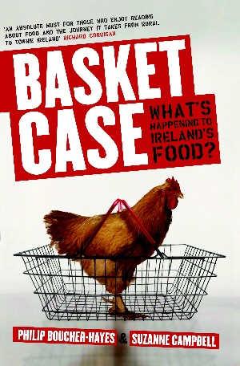
          Boucher-Hayes and Campbell call it
          “gastro-porn”
Gill & Macmillan, 2010, pp. 199-201, et passim

Slide 119
        “What explains the Two Fat Ladies’ appeal
        around the globe?”
          The Ladies provided what Inness refers to as “food pornography”
              In a culture where such food is taboo to consume, especially for women, we like to look at food
              Even if we do not cook or seldom do, we still enjoy looking at images and reading descriptions of food that fill the media
Sherrie A. Inness, Secret Ingredients, Palgrave Macmillan, 2006, p. 175

Slide 120
        “What explains the Two Fat Ladies’ appeal
        around the globe?”
        “food pornography”
              images of food saturate our culture
                television
                films
                newspapers
                cooking articles
                cookbooks
              much of the food imagery is glamorous and upscale,
              depicting meals that few real people would actually make and serve
Sherrie A. Inness, Secret Ingredients, Palgrave Macmillan, 2006, p. 175

Slide 121
        “What explains the Two Fat Ladies’ appeal
        around the globe?”
        “food pornography”
              elaborate recipes are accompanied by photographs that show equally perfect images
              “These lush words and pictures are literally food pornography, created to be gazed at by the audience but not actually consumed.”
Sherrie A. Inness, Secret Ingredients, Palgrave Macmillan, 2006, pp. 175-176

Slide 122
        “What explains the Two Fat Ladies’ appeal
        around the globe?”
        “food pornography”
              “Like traditional pornography, food pornography is about desire but never allowing that desire to be fulfilled, so the viewers wish to have more.”
Sherrie A. Inness, Secret Ingredients, Palgrave Macmillan, 2006, p. 176

Slide 123
        “What explains the Two Fat Ladies’ appeal
        around the globe?”
        “food pornography”
              “We seem to enjoy gazing at food as much as eating it, which is a reason that food pornography has grown so popular, especially with the women viewers it targets.”
Sherrie A. Inness, Secret Ingredients, Palgrave Macmillan, 2006, p. 176

Slide 124
        “What explains the Two Fat Ladies’ appeal
        around the globe?”
        “The Ladies’ show was a classic example of food pornography, as the two created innumerable rich recipes for their viewers’ pleasure.”
          However, they challenged the food pornography stereotype that a beautiful slender woman prepares decadent dishes but, obviously, never Indulges herself with anything more fattening than half a
          Ry-Krisp cracker.”
Sherrie A. Inness, Secret Ingredients, Palgrave Macmillan, 2006, p. 165

Slide 125
        “What explains the Two Fat Ladies’ appeal
        around the globe?”
        “The Ladies’ show was a classic example of food pornography, as the two created innumerable rich recipes for their viewers’ pleasure.”
          they indulged their recipes and suggested that it was acceptable for women to do the same
Sherrie A. Inness, Secret Ingredients, Palgrave Macmillan, 2006, p. 176

Slide 126
        “What explains the Two Fat Ladies’ appeal
        around the globe?”
        “Another reason for the Ladies’ success is that they questioned a society where being thin and young are considered essential attributes if a woman wishes to be successful.”
          The Ladies fought the stereotype that a woman’s happiness is directly related to how beautiful, youthful, and slender she is.
Sherrie A. Inness, Secret Ingredients, Palgrave Macmillan, 2006, p. 176

Slide 127
        “What explains the Two Fat Ladies’ appeal
        around the globe?”
        “The Ladies fought the stereotype that a woman’s happiness is directly related to how beautiful, youthful, and slender she is.”
          They possessed none of these [“desirable”] traits and, more importantly, they did not strive to appear as though they did
          They took pleasure in their fat older bodies and displayed them proudly as the two roared around the countryside on their motorcycle
Sherrie A. Inness, Secret Ingredients, Palgrave Macmillan, 2006, p. 176

Slide 128
        “What explains the Two Fat Ladies’ appeal
        around the globe?”
        “They conveyed a subversive message that being fat was not as negative as the popular media suggested.”
Sherrie A. Inness, Secret Ingredients, Palgrave Macmillan, 2006, p. 176

Slide 129
        “What explains the Two Fat Ladies’ appeal
        around the globe?”
        “. . . the Ladies were
        resolutely anti-diet. . . .”
        “In their world, one did not have to worry about following the latest diet.”
Sherrie A. Inness, Secret Ingredients, Palgrave Macmillan, 2006, p. 176

Slide 130
        Writing about the death of Robert Atkins,
        “the diet guru”
        Clarissa wrote . . .
            “The legacy of today’s ultra-thin
            ‘heron chic’ models
            — and of celebrity diet gurus —
            is anorexia . . .”
Sherrie A. Inness, Secret Ingredients, Palgrave Macmillan, 2006, p. 177

Slide 131
        Writing about the death of Robert Atkins,
        “the diet guru”
        Clarissa wrote . . .
            “The legacy of today’s ultra-thin
            ‘heron chic’ models
            — and of celebrity diet gurus —
            is anorexia . . .”
            “The popularity . . . of our TV food program
            . . . and our cookery books may point to an era where people worry more about inner well-being than their outer image. . . .”
Sherrie A. Inness, Secret Ingredients, Palgrave Macmillan, 2006, p. 177

Slide 132
        “It’s the last taboo, isn’t it—fat?”
        —Jennifer
Sherrie A. Inness, Secret Ingredients, Palgrave Macmillan, 2006, p. 177

Slide 133
        “It’s all the fault
        of the Duchess of Windsor.
        She came up with that stupid line,
        ‘You can never be too rich nor too thin.’
        And America took it to their heart.”
        —Jennifer
Sherrie A. Inness, Secret Ingredients, Palgrave Macmillan, 2006, p. 177

Slide 134
        “’Cream, Bacon, Grease,
        and
        Other Shocking Ingredients’:
        The Fat Ladies Rebel”
Sherrie A. Inness, Secret Ingredients, Palgrave Macmillan, 2006, p. 170

Slide 135
        “One way that the Ladies found
        joy in eating was by being
        proponents of rich and
        high-calorie cooking.”
Sherrie A. Inness, Secret Ingredients, Palgrave Macmillan, 2006, p. 177

Slide 136
        “It takes more than a stick of butter
        to scare Jennifer Patterson
        and Clarissa Dickson Wright.”
        —Tara Mack, Montreal Gazette
Sherrie A. Inness, Secret Ingredients, Palgrave Macmillan, 2006, p. 177

Slide 137
        “What explains the Two Fat Ladies’ appeal
        around the globe?”
        “A reason for the Ladies’ appeal
        was that bacon and cream have become ‘shocking’ ingredients in a society obsessed with eating food because it is healthy, even if it is not that tasty.”
Sherrie A. Inness, Secret Ingredients, Palgrave Macmillan, 2006, pp. 177-178

Slide 138
        “What explains the Two Fat Ladies’ appeal
        around the globe?”
        “A reason for the Ladies’ appeal
        was that bacon and cream have become ‘shocking’ ingredients in a society obsessed with eating food because it is healthy, even if it is not that tasty.”
          the Ladies questioned a culture based on eating food merely because it is healthy
Sherrie A. Inness, Secret Ingredients, Palgrave Macmillan, 2006, pp. 177-178

Slide 139
        “The Ladies were staunch believers in the emotional and psychological benefits
        of high-fat cooking.”
          “The Ladies laugh in the face of the fat-fearing fanatic and are proud to share some decadent gems such as spareribs and whiskey chocolate pie.”
          —back cover of their book The Two Fat Ladies Ride Again
Sherrie A. Inness, Secret Ingredients, Palgrave Macmillan, 2006, p. 178

Slide 140
        “The Ladies were staunch believers in the emotional and psychological benefits
        of high-fat cooking.”
          “The Ladies laugh in the face of the fat-fearing fanatic and are proud to share some decadent gems such as spareribs and whiskey chocolate pie.”
          —back cover of their book The Two Fat Ladies Ride Again
Sherrie A. Inness, Secret Ingredients, Palgrave Macmillan, 2006, p. 178

Slide 141
        “Repeatedly, the Ladies emphasized the importance of taking pleasure in
        high-calorie recipes and foods.”
Sherrie A. Inness, Secret Ingredients, Palgrave Macmillan, 2006, p. 178

Slide 142
        “Patterson was resolutely
        against healthy desserts:
        “I like my puddings
        [i.e., desserts]
        to be lavish.
        Not for me the insipidity of a fruit salad made with tasteless ‘nuked’ tropical fruit, or some healthy concoction based on yogurt.”
Sherrie A. Inness, Secret Ingredients, Palgrave Macmillan, 2006, p. 178

Slide 143
        “Both the Ladies were pro-cream, bacon, an other high-fat ingredients.”
          “Forget all that health and hygiene nonsense. Real cream is far better than tasteless pasteurized rubbish you get in supermarkets. The antidote to stress is serotonin, and dairy fats stimulate natural serotonin production. . . . Half a pint of double cream will do you more good than a Prozac tablet.”
          —qtd. in Jeremy Lee, Guardian
Sherrie A. Inness, Secret Ingredients, Palgrave Macmillan, 2006, p. 178

Slide 144
        “Both the Ladies were pro-cream, bacon, an other high-fat ingredients.”
          “Forget all that health and hygiene nonsense. Real cream is far better than tasteless pasteurized rubbish you get in supermarkets. The antidote to stress is serotonin, and dairy fats stimulate natural serotonin production. . . . Half a pint of double cream will do you more good than a Prozac tablet.”
          —qtd. in Jeremy Lee, Guardian
Sherrie A. Inness, Secret Ingredients, Palgrave Macmillan, 2006, p. 178

Slide 145
        “Both the Ladies were pro-cream, bacon, an other high-fat ingredients.”
          “The women demonstrated that such cooking should not be abolished, despite what medical doctors argue, because it is one of life’s great pleasures.”
Sherrie A. Inness, Secret Ingredients, Palgrave Macmillan, 2006, p. 179

Slide 146
        “Both the Ladies were pro-cream, bacon, an other high-fat ingredients.”
          “The women demonstrated that such cooking should not be abolished, despite what medical doctors argue, because that kind of cooking is one of life’s great pleasures.”
Sherrie A. Inness, Secret Ingredients, Palgrave Macmillan, 2006, p. 179

Slide 147
        “. . .The Ladies demonstrated that it was
        a mistake to simply eat whatever is new [and fashionable and trendy].”
          they included many hearty and old-fashioned recipes in their program and books
          they showed that some recipes, albeit old-fashioned, still deserve recognition and resurrection
Sherrie A. Inness, Secret Ingredients, Palgrave Macmillan, 2006, p. 179

Slide 148
        “. . .The Ladies demonstrated that it was
        a mistake to simply eat whatever is new [and fashionable and trendy].”
          “This was a subversive reworking of the much contemporary culinary writing, which commonly features whatever is in vogue, whether it tastes delicious or not.”
Sherrie A. Inness, Secret Ingredients, Palgrave Macmillan, 2006, p. 179

Slide 149
        “. . .The Ladies also include many [recipes] that emphasized meat and game.”
          meat and game are foods typically thought of as “for men,” but the Ladies suggested that they are equally for women
Sherrie A. Inness, Secret Ingredients, Palgrave Macmillan, 2006, p. 179

Slide 150
        “. . .The Ladies also include many [recipes] that emphasized meat and game.”
          “In this fashion, the Ladies called into question how society constructs women’s light and feminine eating as the antithesis of men’s hearty and masculine eating.”
Sherrie A. Inness, Secret Ingredients, Palgrave Macmillan, 2006, p. 179

Slide 151
        “One way that the Ladies questioned the ideology that a woman’s eating should be light, delicate, and feminine was by being staunchly pro-beef,
        despite social pressures for women not to eat such heavy fare.”
          “One of the great mysteries of life is why so many people refuse to eat beef because of the BSE [Mad Cow disease] scare . . .”
Sherrie A. Inness, Secret Ingredients, Palgrave Macmillan, 2006, p. 179

Slide 152
        “One way that the Ladies questioned the ideology that a woman’s eating should be light, delicate, and feminine was by being staunchly pro-beef, despite social pressures for women not to eat such heavy fare.”
          “One of the great mysteries of life is why so many people refuse to eat beef because of
        the BSE [Mad Cow disease] scare . . .”
Sherrie A. Inness, Secret Ingredients, Palgrave Macmillan, 2006, p. 179

Slide 153
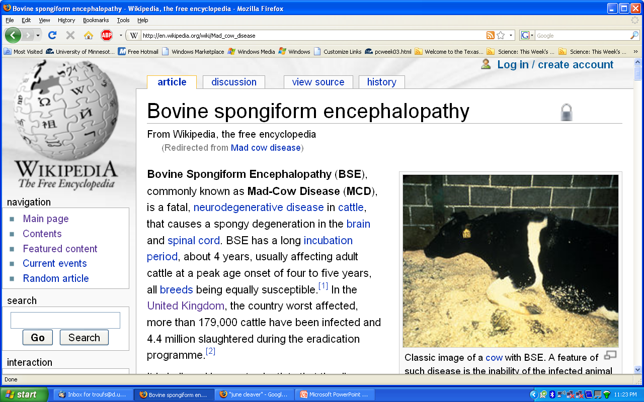

Slide 154
        “In the UK, the Labour government banning of beef on the bone in 1998 not only hardened [our] stance against Mr. Blair’s. . .government, but
        it also made [us] realize how important beef on the bone was. . . .
        Buying beef on the bone is now rather more difficult than buying heroin.”
Sherrie A. Inness, Secret Ingredients, Palgrave Macmillan, 2006, pp. 179-180

Slide 155
        “In the UK, the Labour government banning of beef on the bone in 1998 not only hardened [our] stance against Mr. Blair’s. . .government, but
        it also made [us] realize how important beef on the bone was. . . .
        Buying beef on the bone is now rather more difficult than buying heroin.”
Sherrie A. Inness, Secret Ingredients, Palgrave Macmillan, 2006, pp. 179-180

Slide 156
        “This pro-beef attitude rebelled against the notion that women should not eat it because it is unhealthy.”
        “The Ladies suggested that women should eat meat, game, and other heavy, decadent fare even though the ‘nutrition police’ might frown.”
Sherrie A. Inness, Secret Ingredients, Palgrave Macmillan, 2006, p. 180

Slide 157
        “The Ladies demonstrate that they could still be ‘ladies’ even though they took pleasure in food. In addition, they also undermined the cultural stereotype that associates all women with eating habits that are light, refined, and delicate and suggest that the image has little to do with real women, who struggle to adhere to a cultural stereotype that does more damage than good.”
Sherrie A. Inness, Secret Ingredients, Palgrave Macmillan, 2006, p. 180

Slide 158
        “If it is taboo for women to eat meat,
        it is equally taboo to be anti-vegetarian,
        when women are supposed to enjoy such
        light dining.”
        “But the Ladies had
        little patience with vegetarians,
        and attitude that the freely express in their books and show.”
Sherrie A. Inness, Secret Ingredients, Palgrave Macmillan, 2006, p. 179

Slide 159
        “It has always fascinated me that
        . . . vegetarians [have] . . . rather strange habits of making vegetable and grain products look like meat. . . .”
        –Obsessions (84)
Sherrie A. Inness, Secret Ingredients, Palgrave Macmillan, 2006, p. 179

Slide 160
        “It has always fascinated me that
        . . . vegetarians [have] . . . rather strange habits of making vegetable and grain products look like meat. . . .
        The most horrible of cheap meat products is probably safer.”
        –Obsessions (84)
Sherrie A. Inness, Secret Ingredients, Palgrave Macmillan, 2006, p. 179

Slide 161
        Despite their different perspectives, however,
        both [the Ladies and the vegetarians] were attempting something similar:
        they wanted to use their writing
        to alter how we think about our diets
        and, ultimately,
        to change how we eat.
Sherrie A. Inness, Secret Ingredients, Palgrave Macmillan, 2006, p. 181

Slide 162
        Despite their different perspectives, however,
        both [the Ladies and the vegetarians] were attempting something similar:
        they wanted to use their writing
        to alter how we think about our diets
        and, ultimately,
        to change how we eat.
Sherrie A. Inness, Secret Ingredients, Palgrave Macmillan, 2006, p. 181

Slide 163
        “Nostalgia
        and
        Social Commentary”
Sherrie A. Inness, Secret Ingredients, Palgrave Macmillan, 2006, p. 181

Slide 164
        “As well as questioning a society where women are not supposed to indulge themselves with heavy eating because it might detract from their pursuit of slender, toned bodies,
        the Ladies also fought other aspects of society.”
Sherrie A. Inness, Secret Ingredients, Palgrave Macmillan, 2006, p. 181

Slide 165
        “As well as questioning a society where women are not supposed to indulge themselves with heavy eating because it might detract from their pursuit of slender, toned bodies,
        the Ladies also fought other aspects of society.”
        “The women were antimodern . . .”
Sherrie A. Inness, Secret Ingredients, Palgrave Macmillan, 2006, p. 181

Slide 166
        “The women were antimodern . . .
        because, for them,
        being modern meant
        that one had to purchase tasteless groceries at huge stores
        that care little about what is best for the customer.”
Sherrie A. Inness, Secret Ingredients, Palgrave Macmillan, 2006, p. 181

Slide 167
        “The women were antimodern . . .
        “The ladies
        viewed this modern system with disdain and demonstrated how it has negatively impacted small food purveyors.”
Sherrie A. Inness, Secret Ingredients, Palgrave Macmillan, 2006, p. 181

Slide 168
        “The women were antimodern . . .
        “Along with focusing on
        the delights of eating old-fashioned, substantial meals,
        the show was about recapturing a vanishing way of life,
        one that is disappearing rapidly.”
Sherrie A. Inness, Secret Ingredients, Palgrave Macmillan, 2006, p. 181

Slide 169
        “The women were antimodern . . .
        “The Fat Ladies used their cooking show and cookbooks
        to re-create an almost lost way of life and try to preserve its remnants.”
Sherrie A. Inness, Secret Ingredients, Palgrave Macmillan, 2006, p. 181

Slide 170
        “The women were antimodern . . .
        “It was a universe where everything was fresh and natural
        because it was just pulled from the garden or fished out of the sea.”
Sherrie A. Inness, Secret Ingredients, Palgrave Macmillan, 2006, p. 181

Slide 171
        “The women were antimodern . . .
        “The Fat Ladies wished to save these small producers, showing how much better tasting their food supplies were than those available at major grocery stores.”
Sherrie A. Inness, Secret Ingredients, Palgrave Macmillan, 2006, p. 181

Slide 172
        “The women were antimodern . . .
        “By purchasing supplies at such small shops, the Fat Ladies sent a subversive message to viewers that
        fought the notion that bigger is always better.”
        “The Ladies showed that smaller is sometimes better.”
Sherrie A. Inness, Secret Ingredients, Palgrave Macmillan, 2006, p. 181

Slide 173
        “The women were antimodern . . .
        “The Fat Ladies’
        message is relevant beyond the kitchen.”
        “
Sherrie A. Inness, Secret Ingredients, Palgrave Macmillan, 2006, p. 181

Slide 174
        “The women were antimodern . . .
        “The Fat Ladies’
        message is relevant beyond the kitchen.”
        “They were also concerned with how our large-scale modern culture makes us strive for whatever is new.”
Sherrie A. Inness, Secret Ingredients, Palgrave Macmillan, 2006, p. 181

Slide 175
        “The women were antimodern . . .
        “The Fat Ladies’ suggested to their audience that they have to reflect on their relationship to mass society in general.”
Sherrie A. Inness, Secret Ingredients, Palgrave Macmillan, 2006, pp. 181-182

Slide 176
        “The women were antimodern . . .
        “Whether we are in the kitchen or another arena, the Ladies wished for us to slow down and take pleasure in our daily lives and not just rush through them with the aid of newfangled conveniences.”
Sherrie A. Inness, Secret Ingredients, Palgrave Macmillan, 2006, p. 182

Slide 177
        “The women were antimodern . . .
        “Whether we are in the kitchen or another arena, the Ladies wished for us to slow down and take pleasure in our daily lives and not just rush through them with the aid of newfangled conveniences.”
slow food
Sherrie A. Inness, Secret Ingredients, Palgrave Macmillan, 2006, p. 182

Slide 178
        “The women were antimodern . . .
        “Cooking one of the Ladies’ meals demands more time than popping a frozen dinner into the microwave,
        but it is more pleasurable;
        they are interested in making us embrace both the process of cooking
        and the end results.”
Sherrie A. Inness, Secret Ingredients, Palgrave Macmillan, 2006, p. 182

Slide 179
        “The women were antimodern . . .
        “Cooking one of the Ladies’ meals demands more time than popping a frozen dinner into the microwave,
        but it is more pleasurable;
        they are interested in making us embrace both the process of cooking
        and the end results.”
Sherrie A. Inness, Secret Ingredients, Palgrave Macmillan, 2006, p. 182

Slide 180
        “The women were antimodern . . .
        “Ironically, the Ladies’ philosophy shared some similarities
        with the 1970s natural foods activists.”
          both wanted people to utilize small food suppliers and though this was a healthy move for consumers
Sherrie A. Inness, Secret Ingredients, Palgrave Macmillan, 2006, p. 182

Slide 181
        “The women were antimodern . . .
        “Ironically, the Ladies’ philosophy shared some similarities with the 1970s natural foods activists.”
          both thought that larger was not always better when it came to the places where people purchase food and other supplies
Sherrie A. Inness, Secret Ingredients, Palgrave Macmillan, 2006, p. 182

Slide 182
        “The women were antimodern . . .
        “Ironically, the Ladies’ philosophy shared some similarities with the 1970s natural foods activists.”
          both wished that people would slow down and embrace the process of making food
            although the natural foods fans would have been kneading a loaf of homemade whole-wheat bread while Clarissa and Jennifer would be preparing roasted pheasant
locavores
Sherrie A. Inness, Secret Ingredients, Palgrave Macmillan, 2006, p. 182

Slide 183
        “The women were antimodern . . .
        “Ironically, the Ladies’ philosophy shared some similarities with the 1970s natural foods activists.”
          they shared similar belief systems about how the modern food system needed to be changed
Sherrie A. Inness, Secret Ingredients, Palgrave Macmillan, 2006, p. 182

Slide 184
        “The women were antimodern . . .
        “Ironically, the Ladies’ philosophy shared some similarities with the 1970s natural foods activists.”
          “More broadly, they thought that society needed change, too, and that people’s embrace of all that was new was not always the best strategy for their own benefit or the world’s.”
Sherrie A. Inness, Secret Ingredients, Palgrave Macmillan, 2006, p. 182

Slide 185
        “The women were antimodern . . .
        “Ironically, the Ladies’ philosophy shared some similarities with the 1970s natural foods activists.”
          But having said all that, “they would not be ideal dinner guests at the same party. . . .”
Sherrie A. Inness, Secret Ingredients, Palgrave Macmillan, 2006, p. 182

Slide 186
        “The women were antimodern . . .
        “One aspect of modern culture that the Ladies rejected was the huge supermarket.”
          instead, they wholeheartedly supported small suppliers and used their TV program to promote them
Sherrie A. Inness, Secret Ingredients, Palgrave Macmillan, 2006, p. 182

Slide 187
        “The women were antimodern . . .
        “One aspect of modern culture that the Ladies rejected was the huge supermarket.”
          instead, they wholeheartedly supported small suppliers and used their TV program to promote them
locavores
Sherrie A. Inness, Secret Ingredients, Palgrave Macmillan, 2006, p. 182

Slide 188
        “The women were antimodern . . .
        “One aspect of modern culture that the Ladies rejected was the huge supermarket.”
          the gathering of the ingredients was equally as important as the cooking, and the Ladies demonstrated that this was part of the pleasure of cooking
Sherrie A. Inness, Secret Ingredients, Palgrave Macmillan, 2006, p. 182

Slide 189
        “The women were antimodern. . .
        “One aspect of modern culture that the Ladies
        rejected was the huge supermarket.”
          “Visiting myriad local shops for local ingredients is a radically different approach to shopping than simply taking a single trip to the closest major supermarket. Therefore, the Ladies gloried in visiting a vast range of farms, fisheries, and butchers, and showed that such experiences are part of the pleasure of cooking and eating.”
Sherrie A. Inness, Secret Ingredients, Palgrave Macmillan, 2006, p. 183

Slide 190
        “The women were antimodern . . .
        “One aspect of modern culture that the Ladies
        rejected was the huge supermarket.”
          “Although visiting local shops might take more time, the Ladies demonstrated that it added immeasurably to the recipes that they later prepared from freshly gathered ingredients.”
Sherrie A. Inness, Secret Ingredients, Palgrave Macmillan, 2006, p. 183

Slide 191
        “The women were antimodern . . .
        “One aspect of modern culture that the Ladies
        rejected was the huge supermarket.”
          “The Ladies’ visits to small suppliers were designed to make viewers rethink whether a grocery trip to the nearest mega-superstore was always the best idea.”
Sherrie A. Inness, Secret Ingredients, Palgrave Macmillan, 2006, p. 183

Slide 192
        “The women were antimodern . . .
        “One aspect of modern culture that the Ladies
        rejected was the huge supermarket.”
          “I don’t sell out. . . . I have turned down hundreds of thousands of pounds [to promote supermarkets]. My attitude has always been resolutely anti-supermarket.”
          —Paul McCann Times
Sherrie A. Inness, Secret Ingredients, Palgrave Macmillan, 2006, p. 183

Slide 193
        “The women were antimodern . . .
        “One aspect of modern culture that the Ladies
        rejected was the huge supermarket.”
          “She disliked the [supermarket chains’] ‘greedy’ attitude towards the farmers who provided them with goods.”
Sherrie A. Inness, Secret Ingredients, Palgrave Macmillan, 2006, p. 183

Slide 194
        “The women were antimodern . . .
        “One aspect of modern culture that the Ladies
        rejected was the huge supermarket.”
          “Not only did the Ladies demonstrate that small farmers, fishmongers, and others provide healthier food, the two women also suggested how much more fun and interesting it was for consumers to speak with and buy from such small suppliers rather than hunt for food in sanitized aisles of a large corporation.”
Sherrie A. Inness, Secret Ingredients, Palgrave Macmillan, 2006, p. 183

Slide 195
        “The women were antimodern . . .
        “One aspect of modern culture that the Ladies
        rejected was the huge supermarket.”
          “The Ladies did not only use their culinary skills to argue for the importance of buying food form small local providers; they also critiqued agribusiness in general and how it has had a negative impact on our food supply in countless ways.”
Sherrie A. Inness, Secret Ingredients, Palgrave Macmillan, 2006, p. 183

Slide 196

You can see that in . . .

Slide 197

And . . .

Slide 198

And . . .

Slide 199
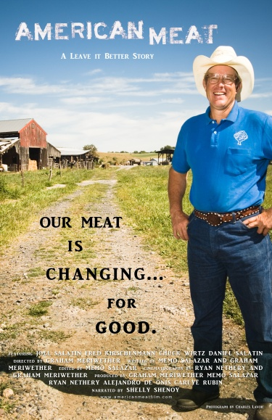
And . . .

Slide 200
        “The women were antimodern . . .
        “One aspect of modern culture that the Ladies
        rejected was the huge supermarket.”
          “For example, the Ladies discussed problems of over-fishing around the globe and suggested stores that did not know how to sell fish properly should be banned from selling it.”
Sherrie A. Inness, Secret Ingredients, Palgrave Macmillan, 2006, pp. 183-184

Slide 201
        “The women were antimodern . . .
        “One aspect of modern culture that the Ladies
        rejected was the huge supermarket.”
          “They also observed:
          ‘Mass-produced frozen fish concoctions should be banned too, to prevent waste of this diminishing asset.’”
          —Obsessions 1999 40
Sherrie A. Inness, Secret Ingredients, Palgrave Macmillan, 2006, pp. 183-184

Slide 202
        “The women were antimodern . . .
        “In addition, the Ladies
        condemned the corporate greed that has made food flavorless.”
          “A piece of polystyrene has a better taste than the average supermarket chicken.”
Sherrie A. Inness, Secret Ingredients, Palgrave Macmillan, 2006, p. 184

Slide 203
        “The women were antimodern . . .
        “In addition, the Ladies
        condemned the corporate greed that has made food flavorless.”
          “A piece of polystyrene has a better taste than the average supermarket chicken.”
Sherrie A. Inness, Secret Ingredients, Palgrave Macmillan, 2006, p. 184

Slide 204
        “The women were antimodern . . .
          “Throughout their cooking show and cookbooks,
          the Ladies were openly disdainful of the food produced for the majority of large grocery stores.”
Sherrie A. Inness, Secret Ingredients, Palgrave Macmillan, 2006, p. 184

Slide 205
        “The women were antimodern . . .
          “. . .The Ladies lamented about how much apples have changed
          and blame it on the Americans . . .”
Sherrie A. Inness, Secret Ingredients, Palgrave Macmillan, 2006, p. 184

Slide 206

for more on this
have a look at . . .
Frank Browning, Apples, North Point Press, 1998

Slide 207
          “It’s extraordinary how they breed flavor out of apples,” Clarissa observes.
          “The breed flavor out of everything the can lay their hands on now-a-days,” Jennifer comments.
          “I blame the Americans. They seem afraid of strong flavors. Strong flavors. Strong emotions.”
Sherrie A. Inness, Secret Ingredients, Palgrave Macmillan, 2006, p. 184

Slide 208
        “The women were antimodern . . .
        “The Ladies sought to change how large corporations have taken over the food system in Britain and the United States, resulting in the flavorless apples about which they complained.”
Sherrie A. Inness, Secret Ingredients, Palgrave Macmillan, 2006, p. 184

Slide 209
        “In this industrial setting,
        no one cares about the flavor
        of an apple or a tomato;
        all that corporations are concerned with is designing food that will increase their profits.”
          “If these foods are tasteless, it does not make a difference as long as profits stay the same or increase.”
Sherrie A. Inness, Secret Ingredients, Palgrave Macmillan, 2006, p. 184

Slide 210
        “The Ladies showed that consumers could make a difference by rejecting such flavorless foods and by visiting small suppliers who care that their foods are bursting with flavor.”
          “The Ladies wanted their audience to nostalgically recall how they used to buy foods in the past and to return to such shopping patterns.”
Sherrie A. Inness, Secret Ingredients, Palgrave Macmillan, 2006, p. 184

Slide 211
        “The Ladies showed that consumers could
        make a difference by rejecting such
        flavorless foods and by visiting small
        suppliers who care that their foods are
        bursting with flavor.”
          “Even if viewers were too young to remember such experiences, the Ladies resorted to their loving and nostalgic encounters with small suppliers to encourage everyone to change the way they shop.”
Sherrie A. Inness, Secret Ingredients, Palgrave Macmillan, 2006, p. 184

Slide 212
        “The Fat Ladies resorted to nostalgia for more than making readers rethink how they purchased foods.”
          “They used it to recall a way of life that has nearly vanished.”
          “Food does not exist in a vacuum, so consuming it recalls memories of the past.”
          “For different people, different foods convey varied messages about the past.”
Sherrie A. Inness, Secret Ingredients, Palgrave Macmillan, 2006, p. 184

Slide 213
        “The writer who best expressed the close link between food and memory
        was Marcel Proust.
        In the first volume,
        Swann’s Way (1913),
        of the seven-volume
        autobiographical account
        Remembrance of Things Past (1913-1927),
        he is transported back to his childhood days by a bit of a madeleine
        [a traditional sweet cake from France]
        dipped in tea. . . .”
Sherrie A. Inness, Secret Ingredients, Palgrave Macmillan, 2006, pp. 184-185

Slide 214
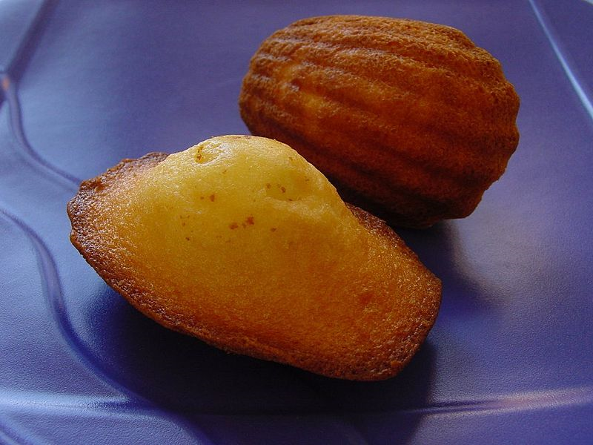
Madeleines de Commercy, Lorraine, France
-- Wikepedia

Slide 215
        “I raised to my lips a spoonful of . . . tea in which I had soaked a morsel of . . . cake. No sooner had the warm liquid, and the crumbs with it, touched my palate than a shudder ran through my whole body, and I stopped, intent upon the extraordinary changes that were taking place. An exquisite pleasure had invaded my senses. . .. I was conscious that it was connected with the taste of tea and cake, but that it infinitely transcended those savours.”
Sherrie A. Inness, Secret Ingredients, Palgrave Macmillan, 2006, p. 184

Slide 216
        “The bite of small cake led Proust [to] think of his childhood, and then what followed was an epic stream-of-consciousness account of his life.”
        “It is a book not just about Proust but also about the passage of time.”
        “For him, it was impossible to separate the taste of food from one’s experiences.”
Sherrie A. Inness, Secret Ingredients, Palgrave Macmillan, 2006, p. 185

Slide 217
        “In a similar fashion, the Ladies used food to conjure memories of the past, reminding people that food is not only about nutrition;
        it is also an intimate connection to our individual and
        collective human past.”
Sherrie A. Inness, Secret Ingredients, Palgrave Macmillan, 2006, p. 185

Slide 218
        “For [the Two Fat Ladies]
        food served as a bridge to past experiences that deserved to be remembered, so it is not surprising that their TV program was filled with accounts of their younger lives and historical accounts of earlier times.”
Sherrie A. Inness, Secret Ingredients, Palgrave Macmillan, 2006, p. 185

Slide 219
        “They wanted us to remember that
        one of the joys of food is that it helps us
        to connect to the past.”
Sherrie A. Inness, Secret Ingredients, Palgrave Macmillan, 2006, p. 185

Slide 220
        “Was
        the Duchess of Windsor Right?
        Fat Ladies Fight Back”
Sherrie A. Inness, Secret Ingredients, Palgrave Macmillan, 2006, p. 170

Slide 221
        “The Ladies rebelled against
        how women and their appetites
        are stereotyped in mass culture.”
        “In American society,
        it is a moral sin [sic] for a woman to have a generous appetite.”
        “Men are expected to have large appetites because this confirms their masculinity.”
Sherrie A. Inness, Secret Ingredients, Palgrave Macmillan, 2006, p. 185

Slide 222
        “It is also a widespread cultural assumption, however, that such gargantuan meals are reserved for men.”
        “Women are expected to excuse themselves when it comes to eating huge ‘man-sized’ meals.”
        “No matter how hungry a woman is, she is supposed to shun such feasting in favor of dainty and more ‘feminine’ fare, such as a salad or a piece of quiche.”
Sherrie A. Inness, Secret Ingredients, Palgrave Macmillan, 2006, p. 185

Slide 223
        “A woman is expected to eat lightly; this assumption is especially believed to be strong if she is on a date with a man.”
        “If she eats heartily or, even worse, polishes off more food than he does, their relationship might be doomed, at least according to a widely held stereotype.”
        “Women are supposed to hide their hearty appetites.”
Sherrie A. Inness, Secret Ingredients, Palgrave Macmillan, 2006, pp. 185-186

Slide 224
        “In a society where women’s eating is constantly under scrutiny, one of the tragic end results is
        anorexia and bulimia.”
Sherrie A. Inness, Secret Ingredients, Palgrave Macmillan, 2006, p. 186

Slide 225
        “In a society where women’s eating is constantly under scrutiny, one of the tragic end results is
        anorexia and bulimia.”
Sherrie A. Inness, Secret Ingredients, Palgrave Macmillan, 2006, p. 186

Slide 226
        “Fighting the stereotype that women should not eat heavily,
        the Ladies showed that it was acceptable to eat generously.”
Sherrie A. Inness, Secret Ingredients, Palgrave Macmillan, 2006, p. 186

Slide 227
        “They prepared big meals and did not fear that they seemed ‘unladylike.’”
        “They talked openly about the pleasure of eating and delighted in it,
        subverting a society
        where such eating
        for women is taboo.”
Sherrie A. Inness, Secret Ingredients, Palgrave Macmillan, 2006, p. 186

Slide 228
        “Not only did the Ladies eat hearty meals, they also ate ones that were rich and high in calories.”
        “The women showed no fear of cream, butter, bacon, and other fattening or high-cholesterol foods,
        but, instead,
        found great pleasure in them.”
Sherrie A. Inness, Secret Ingredients, Palgrave Macmillan, 2006, p. 186

Slide 229
        “Modern culture condemns such ingredients as unhealthy and shuns them in favor of less fattening ingredients.”
        “The Ladies suggested that part of life’s pleasure was to delight in rich and high-calorie cooking,
        despite what nutrition counselors might suggest.”
Sherrie A. Inness, Secret Ingredients, Palgrave Macmillan, 2006, p. 186

Slide 230
        “The British women scoffed
        at a culture where
        the pleasure of eating has been forgotten in favor of good nutrition.”
Sherrie A. Inness, Secret Ingredients, Palgrave Macmillan, 2006, p. 186

Slide 231
        “In addition,
        the Ladies demonstrated that it is fine to be fat
        and still enjoy life.”
Sherrie A. Inness, Secret Ingredients, Palgrave Macmillan, 2006, p. 186

Slide 232
        “American society is obsessed with being slender, fit, beautiful, and young.”
        “This is especially true for women, who are taught at an early age that the only desirable body is slender and young.”
        “This result in a society in which women labor endlessly to be fit and thin or feel guilty if they are not.”
Sherrie A. Inness, Secret Ingredients, Palgrave Macmillan, 2006, p. 186

Slide 233
        “The obsession only worsens because sleek young females overwhelmingly dominate the popular media.”
        “Fat women have literally vanished from television shows, movies, and other media genres,
        unless added to provide comic relief or depicted losing that weight.”
Sherrie A. Inness, Secret Ingredients, Palgrave Macmillan, 2006, p. 186

Slide 234
        “This absence creates the idea that the only acceptable female body must be toned, and slender, which many women cannot achieve. . . .”
Sherrie A. Inness, Secret Ingredients, Palgrave Macmillan, 2006, p. 186

Slide 235
        “But the Fat Ladies were not apprehensive about their bodies and still enjoyed life.”
        “The Ladies suggested that women should stop agonizing about a few extra pounds, a radical notion in a society obsessed with losing weight.”
Sherrie A. Inness, Secret Ingredients, Palgrave Macmillan, 2006, p. 186

Slide 236
        “Finally, the Ladies used their culinary shows and books to question more than the way society perceives women's bodies.”
        “The two also critiqued
        a whole food culture
        that has increasingly grown homogeneous and bland
        as large supermarkets
        and multinational corporations
        have taken over supplying foods.”
Sherrie A. Inness, Secret Ingredients, Palgrave Macmillan, 2006, pp. 186-187

Slide 237
        “The Ladies showed the importance of preserving earlier food traditions in order to preserve humanity’s cultural past.”
Sherrie A. Inness, Secret Ingredients, Palgrave Macmillan, 2006, p. 187

Slide 238
        “In a world dominated by fast food chains and massive supermarkets, the women demonstrated that the real shame is
        that such corporations,
        which are primarily concerned with the bottom line, have taken over.”
Sherrie A. Inness, Secret Ingredients, Palgrave Macmillan, 2006, p. 187

Slide 239
        “The Ladies urged their audience to fight large food companies by visiting small suppliers, including local butchers, fishmongers, dairies, and farmers.”
            “Such small suppliers, the Ladies suggested, actually provide far healthier foods than those that are available in large stores.”
Sherrie A. Inness, Secret Ingredients, Palgrave Macmillan, 2006, p. 187

Slide 240
        “The Ladies urged their audience to fight large food companies by visiting small suppliers, including local butchers, fishmongers, dairies, and farmers.”
            “Such small suppliers, the Ladies suggested, actually provide far healthier foods than those that are available in large stores.”
locavores
Sherrie A. Inness, Secret Ingredients, Palgrave Macmillan, 2006, p. 187

Slide 241
        “Ultimately, the women sought to change people’s thoughts about eating and help make them aware that it is impossible to separate food from those who supply it, a message very similar to what 1970s natural foods writers believed.”
Sherrie A. Inness, Secret Ingredients, Palgrave Macmillan, 2006, p. 187

Slide 242
        “Both [the Two Fat Ladies and the natural foods writers of the 1970s] tried to encourage people to question their diets and recognize that large-scale agribusiness did not always have the consumers’ best interests in mind.”
Sherrie A. Inness, Secret Ingredients, Palgrave Macmillan, 2006, p. 187

Slide 243
        NEXT: What . . .
        “Both [the Two Fat Ladies and the natural foods writers of the 1970s] tried to encourage people to question their diets and recognize that large-scale agribusiness did not always have the consumers’ best interests in mind.”
Sherrie A. Inness, Secret Ingredients, Palgrave Macmillan, 2006, p. 187

Slide 244
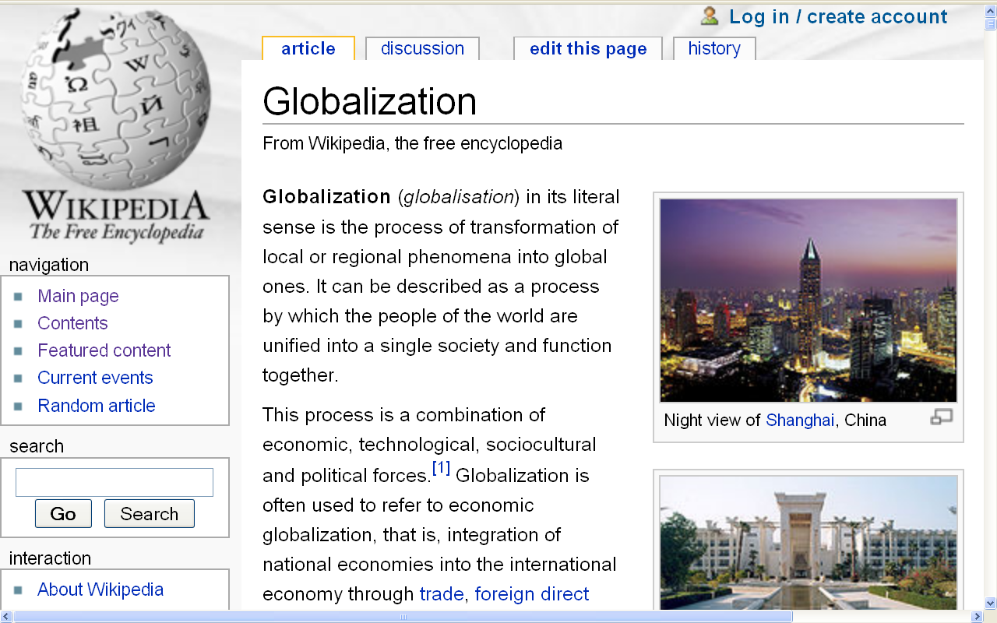
http://en.wikipedia.org/wiki/Globalization

Slide 245
          Repeat:
          First watch the episode of
          The Two Fat Ladies
          show and things they
          talk about or mention that are not
          specifically related to
          the actual cooking of the meal
          in the kitchen . . .

Slide 246
the episode:
Two Fat Ladies
"Timber!“
Series 4 Episode 23
(30 min., 2008, DVD 1698)

Slide 247
^{“freelisting”}
is simply making a list of things you are interested in looking at.
It is a technique commonly used by anthropologists when doing fieldwork.

Slide 248
^{“freelisting”}
is best described in Weller and Romney’s text . . .
Sage, 1988

Slide 249
^{Assignment:}
List the things the Two Fat Ladies
talk about or mention that are not
^{specifically related to}
^{the actual cooking of the meal}
^{in the kitchen}
Sage, 1988

Slide 250
Two Visionaries?
Two Fat Ladies
and Friends
Tim Roufs
© 2010-2024

