Slide 1
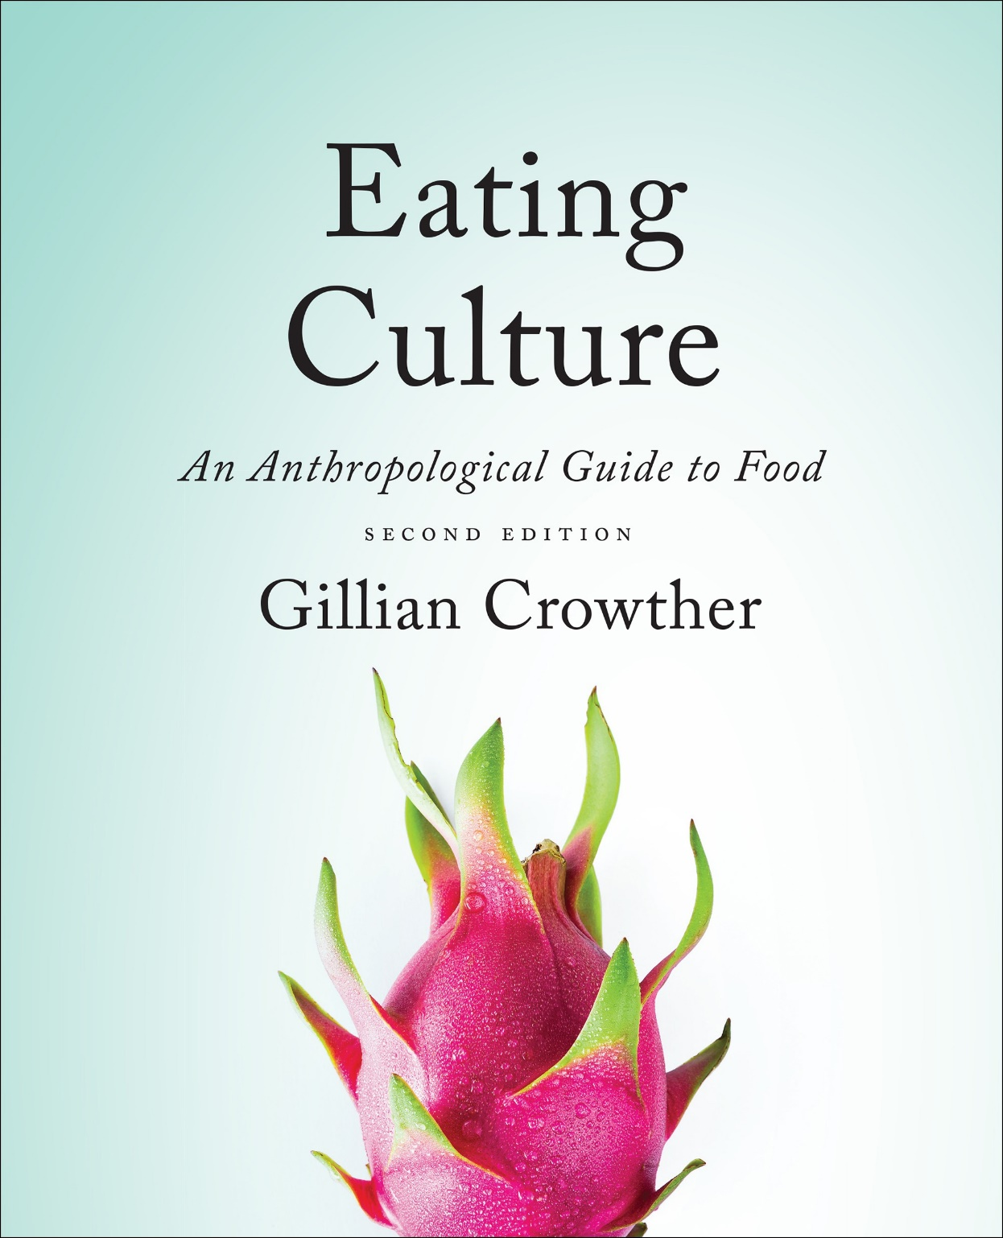
“Setting the Anthropological
Table”: The Biocultural Framework
use your up/down arrow keys and/or
your space bar to advance the slides
Tim Roufs
© 2010-2024

Slide 2
“Setting the Anthropological
Table”: The Biocultural Framework
Tim Roufs
© 2010-2024

Slide 3
Tim Roufs
© 2010-2024
www.d.umn.edu/cla/faculty/troufs/anthfood/aftexts.html#title

Slide 4
“Setting the Table”
“Setting the Table”
is a good metaphor
for the beginning
of the course

Slide 5
“Setting the Table”
and the “Prologue” of the text
does a good job of doing just that . . .

Slide 6
“Setting the Table”
As you go through the semester
there are some fundamental things to look at . . .

Slide 7
“Setting the Table”
and, being “fundamental”,
they, by definition, lay
at the foundation of
studies of the
Anthropology of Food . . .

Slide 8
“Setting the Table”
and the major components are brought together by the diagram
“Biocultural Framework for the Study of Diet and Nutrition” . . .
(Figure 1.1.)

Slide 9
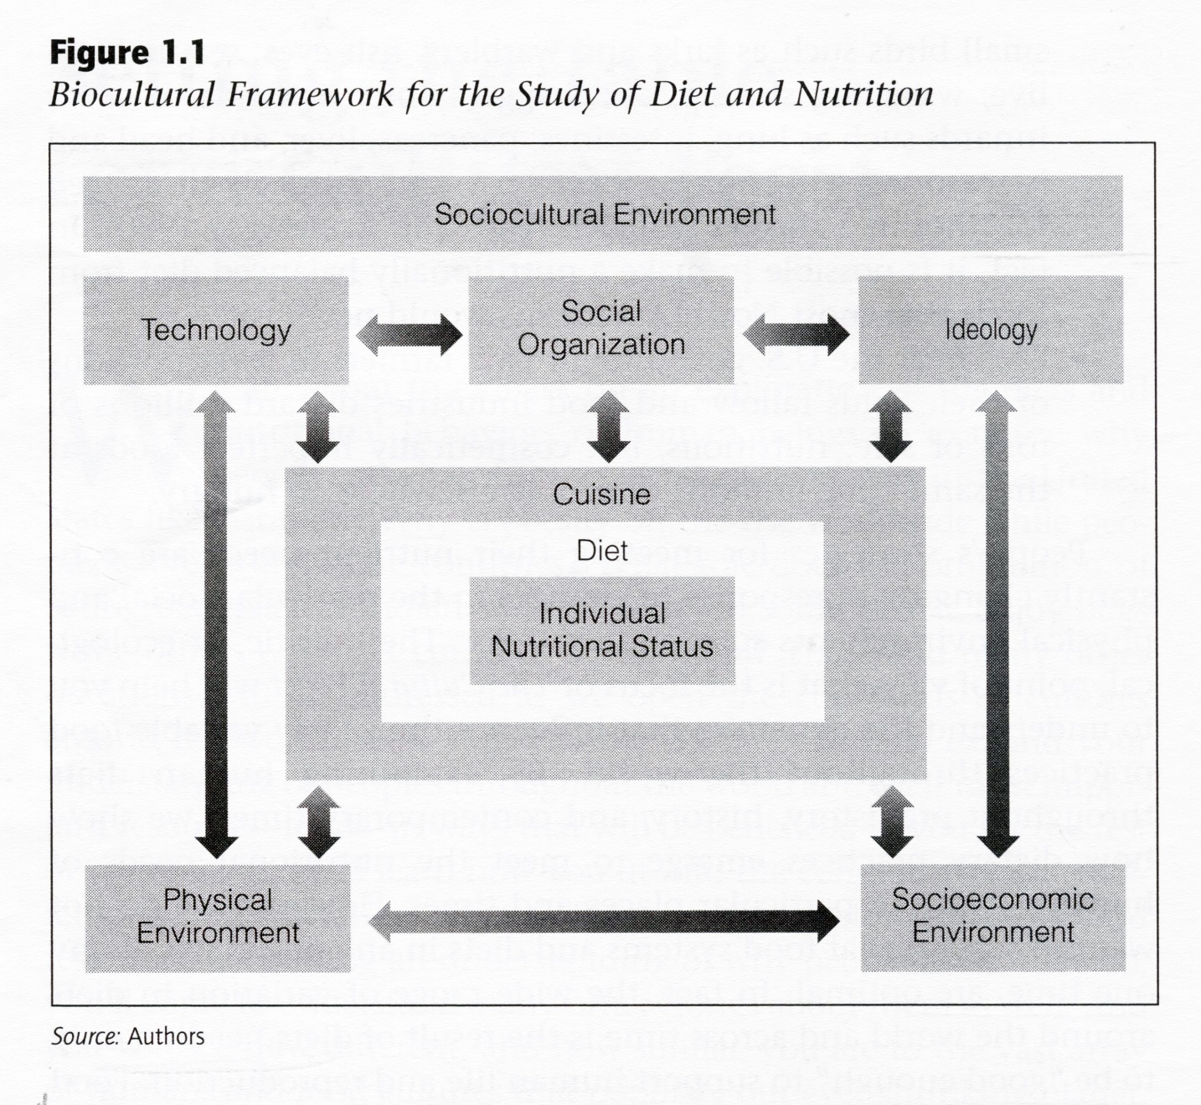
The Cultural Feast, 2nd Ed., p. 4

Slide 10
“Setting the Table”
“Setting the Table”
introduces those
fundamental ideas
arranged in three areas . . .

Slide 11
“Setting the Table”
Biocultural Framework
for the Study of Diet and Nutrition
Food Systems
Next Steps

Slide 12
“Setting the Table”
Biocultural Framework
for the Study of Diet and Nutrition
Food Systems
Next Steps
we will look at each of these items separately, and revisit them throughout the course . . .
and here we have, basically, a
preview/re-view of coming attractions . . .

Slide 13
Nutritional Status
Biological Makeup
Human Nutrient Needs
Diet
Cuisine
The Environment
Physical Environment
Sociocultural Environment
Economic and Political Environment
the
Biocultural Framework
for the Study of Diet and Nutrition
is based on the work of
Gretel H. Pelto
and her colleagues

Slide 14
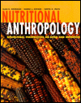
Gretel H. Pelto
Nutritional Anthropology
2007 Malinowski Award SfAA

Slide 15
Pelto, G. H., Goodman, A.H., & Dufour, D.L. (2000). “The biocultural perspective in nutritional anthropology.” In A.H. Goodman, D. Dufour, & G. H. Pelto (Eds.), Nutritional anthropology: Biocultural perspectives on food and nutrition (pp. 1-9). Mountain View, CA: Mayfield.
Jerome, N., Pelto, G.H., & Kandel, R. (1980).
“An ecological approach to nutritional anthropology.”
In N. Gerome, R. Kandel, & G. Pelto (Eds.),
Nutritional Anthropology: Contemporary Approaches to Diet and Culture.
Pleasantville, NJ: Redgrave.

Slide 16
Sobal, J., Khan, L.K. & Bisogni, C. (1998).
“A conceptual model
of the food and nutrition system. Social Science and Medicine 47(4), 853-863.

Slide 17
“Setting the Table”
the
Biocultural Framework
for the Study of Diet and Nutrition
Food Systems
Next Steps
. . . is the “dinner plate”
of the table setting . . .
(so to speak)
. . . so note the features that are highlighted in the following slides . . .

Slide 18
“Setting the Table”
the
Biocultural Framework
for the Study of Diet and Nutrition
Food Systems
Next Steps
. . . is the “dinner plate”
of the table setting . . .
(so to speak)
. . . so note the features that are highlighted in the following slides . . .

Slide 19
the
Biocultural Framework
for the Study of Diet and Nutrition
includes
Nutritional Status
Biological Makeup
Human Nutrient Needs
Diet
Cuisine
The Environment
Physical Environment
Sociocultural Environment
Economic and Political Environment

Slide 20
the
Biocultural Framework
for the Study of Diet and Nutrition
includes
Nutritional Status
Biological Makeup
Human Nutrient Needs
Diet
Cuisine
The Environment
Physical Environment
Sociocultural Environment
Economic and Political Environment

Slide 21
the
Biocultural Framework
for the Study of Diet and Nutrition
includes
Nutritional Status
Biological Makeup
Human Nutrient Needs
Diet
Cuisine
The Environment
Physical Environment
Sociocultural Environment
Economic and Political Environment

Slide 22
the
Biocultural Framework
for the Study of Diet and Nutrition
includes
individual
nutritional
needs
Nutritional Status
Biological Makeup
Human Nutrient Needs
Diet
Cuisine
The Environment
Physical Environment
Sociocultural Environment
Economic and Political Environment

Slide 23
the
Biocultural Framework
for the Study of Diet and Nutrition
includes
individual
nutritional
needs
Nutritional Status
Biological Makeup
Human Nutrient Needs
Diet
Cuisine
The Environment
Physical Environment
Sociocultural Environment
Economic and Political Environment
“Individual Nutritional Status”
forms the core of the model
NOTE: the unit of analysis is the individual
(see “Units of Analysis” slides for details)

Slide 24
The Cultural Feast, 2nd Ed., p. 4

Slide 25
the
Biocultural Framework
for the Study of Diet and Nutrition
includes
individual
nutritional
needs
Nutritional Status
Biological Makeup
Human Nutrient Needs
Diet
Cuisine
The Environment
Physical Environment
Sociocultural Environment
Economic and Political Environment
“Individual Nutritional Status”
is set within
“Diet”
but as you will see, “diet” can take on different meanings . . .

Slide 26
Biocultural Framework
for the Study of Diet and Nutrition
Nutritional Status
Biological Makeup
Human Nutrient Needs
Diet
Cuisine
The Environment
Physical Environment
Sociocultural Environment
Economic and Political Environment
individual
nutritional
needs

Slide 27
diet
“refers to the actual foods that individuals or groups consume to meet their nutrient needs”
The Cultural Feast, 2nd Ed., p. 9

Slide 28
diet
in the biocultural model
diagrammed,
human nutritional requirements and nutritional status are found in the box labeled “diet”
The Cultural Feast, 2nd Ed., p. 9

Slide 29
The Cultural Feast, 2nd Ed., p. 4

Slide 30
“diet”
. . . at times the authors use “diet” in the collective sense
. . . and at other times they are concerned with how the foods and dishes in a particular cultural and physical context affect the specific food intake of individuals living in that setting
The Cultural Feast, 2nd Ed., p. 9

Slide 31
“diet”
at times the authors use “diet” in the collective sense
and at other times they are concerned with how the foods and dishes in a particular cultural and physical context affect the
specific food intake of individuals living in that setting
The Cultural Feast, 2nd Ed., p. 9

Slide 32
KEEP IN MIND:
“units of analysis”

Slide 33
units of analysis may include:
one person
the family
the community
a region
a “culture area”
a culture / “subculture”
a nation
the world
an item or action itself
a “cultural metaphor”

Slide 34
units of analysis may include:
one person
the family
the community
a region
a “culture area”
a culture / “subculture”
a nation
the world
an item or action itself
a “cultural metaphor”

Slide 35
units of analysis may include:
one person
the family
the community
a region
a “culture area”
a culture / “subculture”
a nation
the world
an item or action itself
a “cultural metaphor”
in the following case the item is . . .
“Cuisine”

Slide 36
Biocultural Framework
for the Study of Diet and Nutrition
Nutritional Status
Biological Makeup
Human Nutrient Needs
Diet
Cuisine
The Environment
Physical Environment
Sociocultural Environment
Economic and Political Environment
individual
nutritional
needs

Slide 37
cuisine
“refers to the foods, food preparation techniques, and taste preferences that are shared by the members of a group of people”
applies only to groups of people that share a culture
The Cultural Feast, 2nd Ed., p. 9

Slide 38
cuisine
“refers to the foods, food preparation techniques, and taste preferences that are shared by the members of a group of people”
applies only to groups of people
that share a culture
The Cultural Feast, 2nd Ed., p. 9

Slide 39
diet
in the biocultural model diagrammed,
diet is nested within cuisine
to demonstrate that a given set of preferred preparation techniques and dishes that characterize a particular culture group has an important impact on the diets of the individual members
The Cultural Feast, 2nd Ed., p. 10

Slide 40
diet
in the biocultural model diagrammed,
diet is nested within cuisine
to demonstrate that a given set of preferred preparation techniques and dishes that characterize a particular culture group has an important impact on the diets of the individual members
The Cultural Feast, 2nd Ed., p. 10

Slide 41
The Cultural Feast, 2nd Ed., p. 4

Slide 42
diet
“It is important to note that while acquired food preferences and tastes that are common among any particular group are power influences on diet,
people also eat novel food or, at times, simply deviate from the group’s preferences”
The Cultural Feast, 2nd Ed., p. 10

Slide 43
diet
“It is important to note that while acquired food preferences and tastes that are common among any particular group are power influences on diet, people also eat novel food or,
at times,
simply deviate from the group’s preferences”
The Cultural Feast, 2nd Ed., p. 10

Slide 44
cuisines
“It is also worth noting that
a society’s cuisine interacts with its members’ biological makeup and nutrient requirements”
The Cultural Feast, 2nd Ed., p. 10

Slide 45
cuisines
“are influenced by the sociocultural and physical environments in which they develop”
the physical/biological environment and the social/cultural environment provide opportunities and constraints for human food consumption
The Cultural Feast, 2nd Ed., p. 10

Slide 46
cuisines
“are influenced by the sociocultural
and physical environments in which they develop”
it may be more correct to say that
people “like what they eat”
than to say that
they “eat what they like”

Slide 47
The Cultural Feast, 2nd Ed., p. 4

Slide 48
cuisines
Where do they come from?
The Cultural Feast, 2nd Ed., p. 10

Slide 49
cuisines
Where do they come from?
we’ll have a further look at cuisine(s) as we go through the semester
The Cultural Feast, 2nd Ed., p. 10

Slide 50
and finally, a quick look at . . .
The Environment

Slide 51
Biocultural Framework
for the Study of Diet and Nutrition
individual
nutritional
needs
Nutritional Status
Biological Makeup
Human Nutrient Needs
Diet
Cuisine
The Environment
Physical Environment
Sociocultural Environment
Economic and Political Environment

Slide 52
more specifically, and conceptually . . .
Three Environments . . .

Slide 53
Biocultural Framework
for the Study of Diet and Nutrition
individual
nutritional
needs
Nutritional Status
Biological Makeup
Human Nutrient Needs
Diet
Cuisine
The Environment
Physical Environment
Sociocultural Environment
Economic and Political Environment

Slide 54
The Cultural Feast, 2nd Ed., p. 4

Slide 55
each of these environments provides important opportunities and constraints for human food consumption
The Cultural Feast, 2nd Ed., p. 10

Slide 56
we’ll see how this works as we go through the semester
each of these environments provides important opportunities and constraints for human food consumption
The Cultural Feast, 2nd Ed., p. 10

Slide 57
we’ll look at
Food Systems . . .

Slide 58
“Setting the Table”
Biocultural Framework
for the Study of Diet and Nutrition
Food Systems
Next Steps

Slide 59
“Setting the Table”
Food System
“A chain of interconnected activities that take place in order to get food from the environment into the mouths of people”
The Cultural Feast, 2nd Ed., p. 14

Slide 60
“Setting the Table”
Food System
includes . . .
food production
processing
distribution
marketing
preparation . . .
The Cultural Feast, 2nd Ed., p. 14

Slide 61
“Setting the Table”
Food System
also includes . . .
the knowledge and customs that surround food and food consumption
The Cultural Feast, 2nd Ed., p. 14

Slide 62
“Setting the Table”
Food System
“. . . it is convenient to view the components in our model as a food system —
a set of mutually interacting components.”
The Cultural Feast, 2nd Ed., p. 14

Slide 63
The Cultural Feast, 2nd Ed., p. 4

Slide 64
The Cultural Feast, 2nd Ed., p. 4

Slide 65
“Setting the Table”
Food System
“If change occurs in one component, the others must change in order for the system to maintain balance.”
e.g., pigs and pork in the Scottish
cuisine
The Cultural Feast, 2nd Ed., p. 14

Slide 66
“Setting the Table”
Food System
“If change occurs in one component, the others must change in order for the system to maintain balance.”
e.g., pigs and pork in the Scottish cuisine
The Cultural Feast, 2nd Ed., p. 14

Slide 67
“The rise and fall of pig raising and pork consumption
[in Scotland from prehistoric times to the present]
and the changing value place on pork as a food in Scottish cuisine, suggests the important interactions between several factors . . .”
The Cultural Feast, 2nd Ed., p. 15

Slide 68
the physical environment
the technologies used to exploit the environment
the relationship between colonizers and the colonized
the meanings and values placed on foods
The Cultural Feast, 2nd Ed., p. 15

Slide 69
no one factor alone
accounts for the presence or absence of pork on the dinner plates of Scots either currently or in the past
The Cultural Feast, 2nd Ed., p. 15

Slide 70
however,
all factors have contributed
to patterns of food production, distribution, and consumption that influence Scottish diets
The Cultural Feast, 2nd Ed., p. 15

Slide 71
finally, a brief look at our
“Next Steps” . . .

Slide 72
“Setting the Table”
Biocultural Framework
for the Study of Diet and Nutrition
Food Systems
Next Steps

Slide 73
I. “Evolutionary and Historical Roots of Human Dietary Practices”
looks at the evolutionary and historical roots of human dietary practices
The Cultural Feast, 2nd Ed., p. 15

Slide 74
we’ll look at the
primate and hominid diets and their implications
for diet and health today
The Cultural Feast, 2nd Ed., p. 15

Slide 75
we’ll look at
contemporary food systems within a historical context,
focusing on the impact of a series of dramatic changes in
the ways people interact with the environment to obtain food
The Cultural Feast, 2nd Ed., p. 15

Slide 76
II. “Food and Culture”
covers modern human populations
and how the technology, social organization, and ideology related to
food production, distribution, and consumption form a set of interacting phenomena that both influence and are influenced by the foods and diets that people consume
The Cultural Feast, 2nd Ed., p. 15

Slide 77
we’ll look at
modern human populations
and how the technology, social organization, and ideology related to
food production, distribution, and consumption form a set of interacting phenomena that both influence and are influenced by the foods and diets that people consume
The Cultural Feast, 2nd Ed., p. 15

Slide 78
we’ll look at the
concept of culture and the influence it has on food practices,
including what is considered edible and how groups select certain items
to make up their diet
The Cultural Feast, 2nd Ed., p. 15

Slide 79
we’ll have
a more detailed examination of
the major components of culture:
technology
social organization
ideology
The Cultural Feast, 2nd Ed., p. 16

Slide 80
The Cultural Feast, 2nd Ed., p. 4

Slide 81
III. Looking at “Strategies for Addressing Nutrition Challenges”
we’ll move beyond the concept of culture to explore the need for and processes of change in contemporary nutrition
it examines some of the important issues in hunger and dietary change and examines issues and various ways to improve human dietary patterns
The Cultural Feast, 2nd Ed., p. 15

Slide 82
we’ll look at
the world food situation and the numerous factors that contribute to
. . .
undernourishment
undernutrition
micronutrient malnutrition
hunger
The Cultural Feast, 2nd Ed., p. 16

Slide 83
we’ll examines
the types of solutions that can be implemented at the
international
national
household levels
to improve the food supply and make appropriate food available to families and individuals
The Cultural Feast, 2nd Ed., p. 16

Slide 84
and the units of analysis
with these latter topics,
topics which will be covered towards the end of the semester,
are . . .

Slide 85
units of analysis may include:
one person
the family
the community
a region
a “culture area”
a culture / “subculture”
a nation / several nations
the world
an item or action itself
a “cultural metaphor”

Slide 86
“The Table
is Set”
Tim Roufs
© 2010-2024

Slide 87
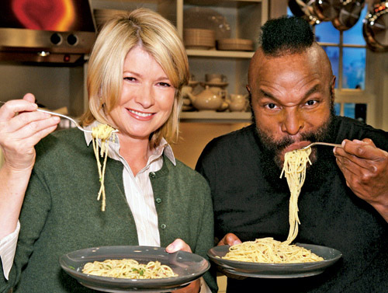
Bon Appétit . . .

