Slide 1
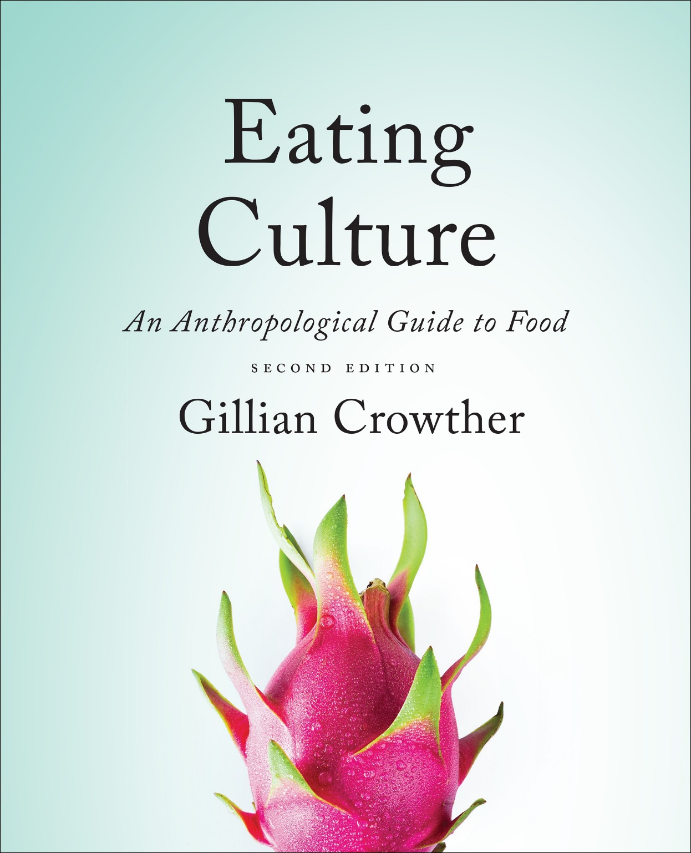
Biological Makeup
use your up/down arrow keys and/or
your space bar to advance the slides
Tim Roufs
© 2010-2022

Slide 2
Biological Makeup
Tim Roufs
© 2010-2022

Slide 3
Tim Roufs
© 2010-2022
www.d.umn.edu/cla/faculty/troufs/anthfood/aftexts.html#title

Slide 4
the
Biocultural Framework
for the Study of Diet and Nutrition
includes
  Nutritional Status
  Biological Makeup
  Human Nutrient Needs
  Diet
  Cuisine
  The Environment
    Physical Environment
    Sociocultural Environment
    Economic and Political Environment
individual
nutritional
needs

Slide 5
nutrients . . .
“essential nutrients” . . .
that’s what it’s all about

Slide 6
nutrients . . .
“essential nutrients” . . .
that’s what it’s all about

Slide 7
nutrients . . .
“essential nutrients” . . .
that’s what it’s all about

Slide 8
. . . and it all starts with the individual . . .

Slide 9
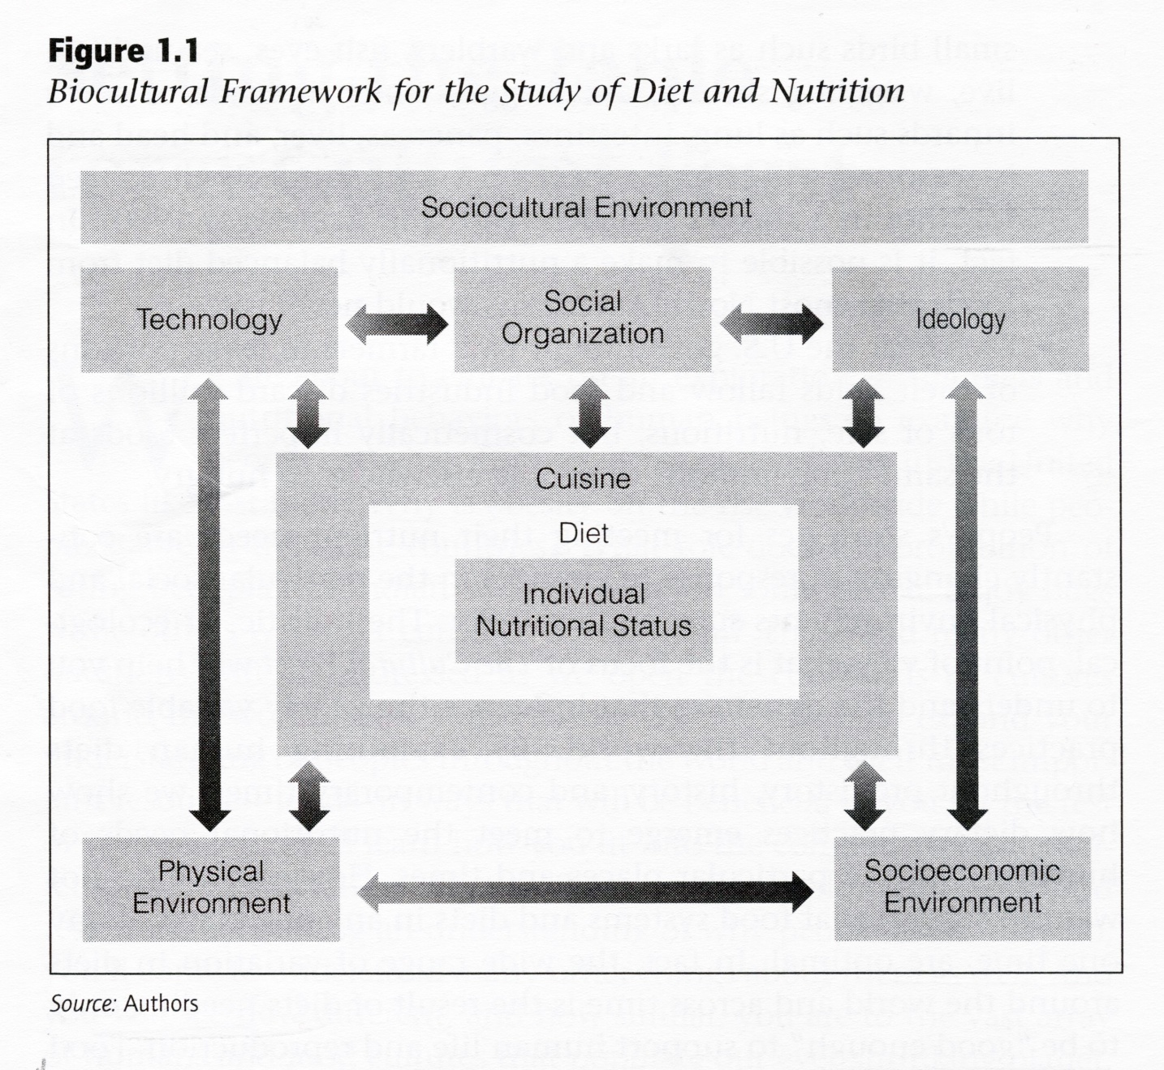
The Cultural Feast, 2nd Ed., p. 4

Slide 10
essential nutrients
“nutrients that are indispensable for health and cannot be synthesized by
the human body, but must be ingested”
The Cultural Feast, 2nd Ed., p. 5

Slide 11
essential nutrients
“nutrients that are indispensable for health and cannot be synthesized by the human body, but must be ingested”
The Cultural Feast, 2nd Ed., p. 5

Slide 12
essential nutrients
that’s why you hear the word
“nutrition”
so often
(to the point where you don’t even pay much attention to it any more)
The Cultural Feast, 2nd Ed., p. 5

Slide 13
essential nutrients
“nutrients that are indispensable for health and cannot be synthesized
by the human body,
but must be ingested”
you MUST get them from the food you eat
(if you want to remain alive / healthy)
The Cultural Feast, 2nd Ed., p. 5

Slide 14
in theory
it’s as
simple as that . . .
(at least for the bio-physical intake part)
The Cultural Feast, 2nd Ed., p. 5

Slide 15
. . . but later on you will also see that you need to get all “48 or so” essential nutrients without exceeding about* a 2,000,000-2,300,000 calorie per day limit
*it’s “about a 2,000,000-2,300,000 calorie per day limit” as individual needs and situations vary. This is the number commonly used in discussions for illustration purposes. More on this later on.
The Cultural Feast, 2nd Ed., p. 5

Slide 16
for e.g., humans
(and a few other primates and other animals)
do not have the ability
to synthesize vitamin C . . .
probably due to a mutation that changed the enzyme synthesizing
ascorbic acid (vitamin C)
from blood sugar (glucose)
(more on enzymes with “Human Nutrient Needs”)
The Cultural Feast, 2nd Ed., p. 5

Slide 17
for e.g., humans
(and a few other primates and other animals)
do not have the ability
to synthesize vitamin C . . .
probably due to a mutation that changed the enzyme which synthesizes
ascorbic acid (vitamin C)
from blood sugar (glucose)
(more on enzymes with “Human Nutrient Needs”)
The Cultural Feast, 2nd Ed., p. 5

Slide 18
The following table lists
Nutrients That Are Essential
for Human Health . . .
48 of them
(Wikipedia has 3 “pages” of them . . .)
The Cultural Feast, 2nd Ed., p. 7

Slide 19
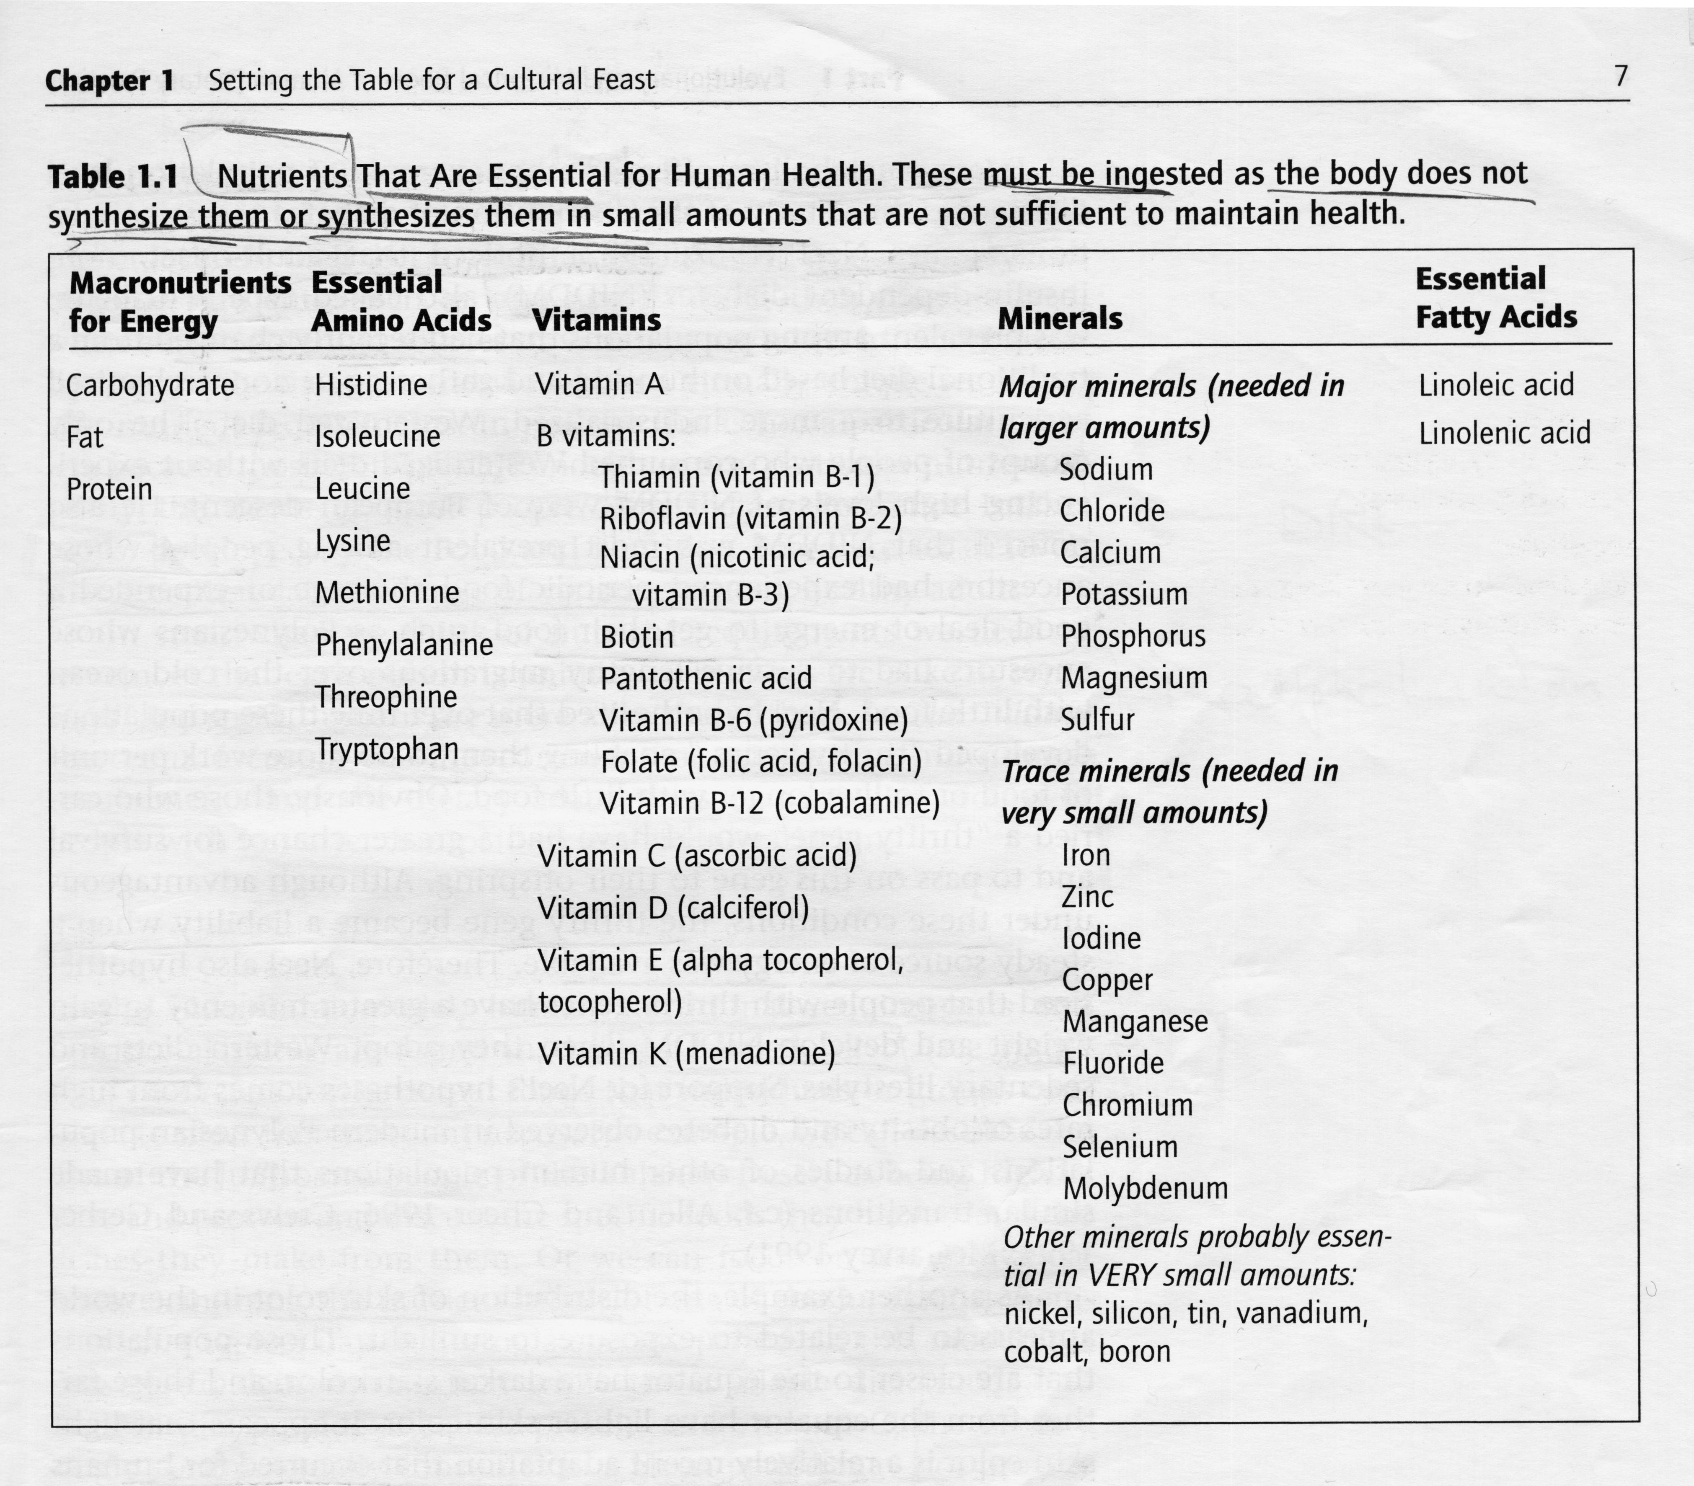
The Cultural Feast, 2nd Ed., p. 7

Slide 20
“Setting the Table”
The following table lists
Nutrients That Are Essential
for Human Health . . .
48 of them
(Wikipedia has 3 “pages” of them . . .)
The Cultural Feast, 2nd Ed., p. 7

Slide 21
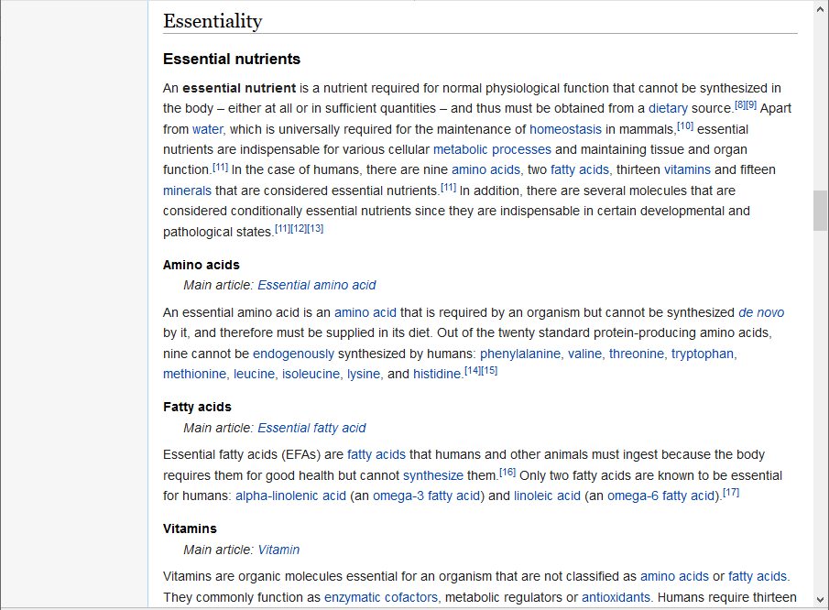
https://en.wikipedia.org/wiki/Nutrient#Essential_nutrients
Wikipedia

Slide 22
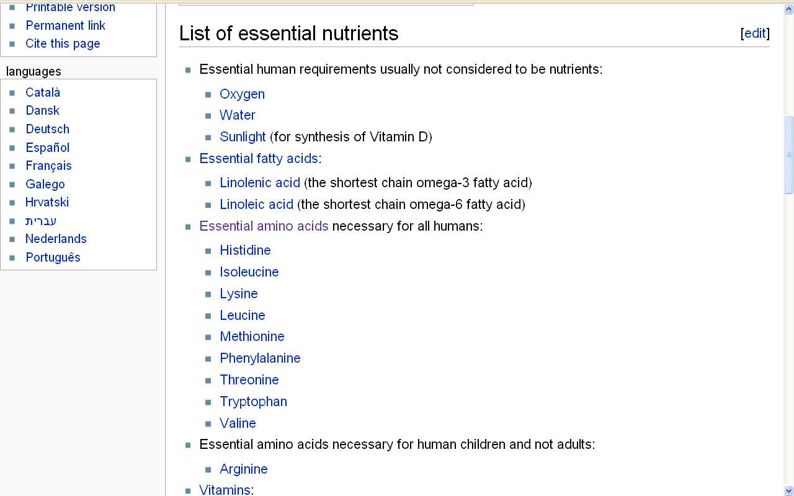
Wikipedia

Slide 23
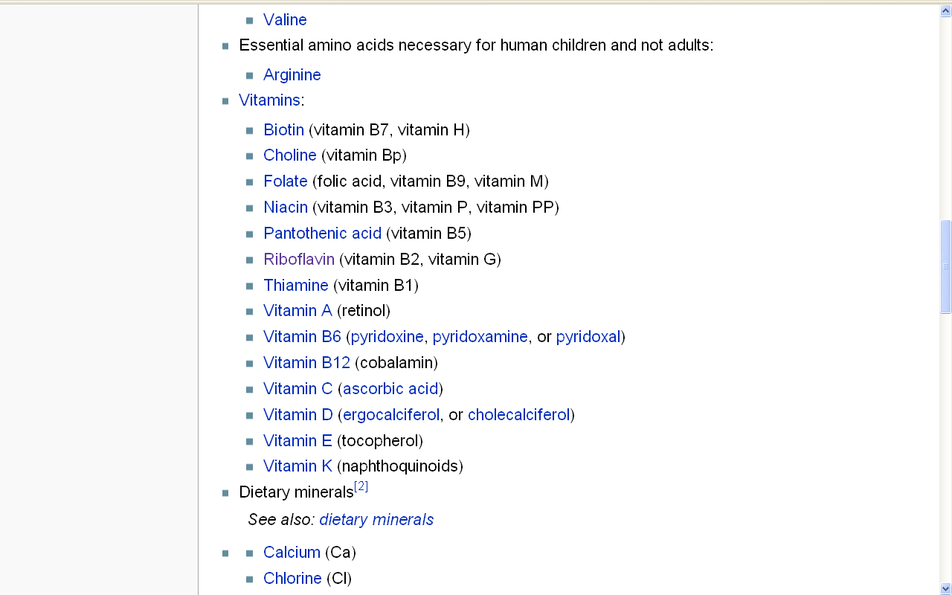
Wikipedia

Slide 24
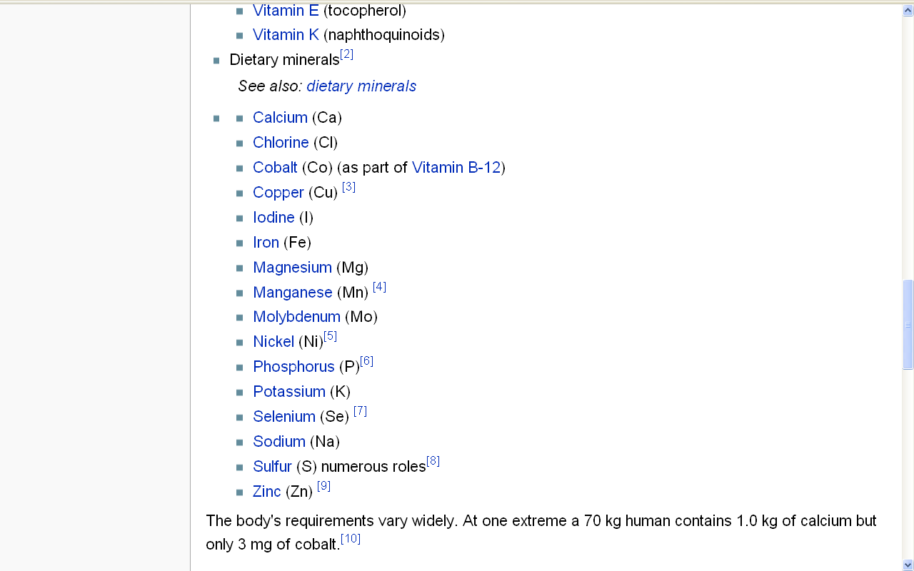
Wikipedia

Slide 25
and humans can eat
almost anything*
to get essential nutrients . . .
*That is almost anything that’s not poison. But even then, humans regularly eat poisonous things, but usually only after processing them—using some culturally invented process. In other words, culture allows humans to even eat poisonous food, and to do that on a regular basis. But, read on, there is . . . a dilemma . . .
The Cultural Feast, 2nd Ed., p. 5

Slide 26
that’s why we’re called
omni – vores
. . .
The Cultural Feast, 2nd Ed., p. 5

Slide 27
but
“almost anything”
means we have . . .
we have a dilemma . . .
The Cultural Feast, 2nd Ed., p. 5

Slide 28
but
“almost anything”
means we have . . .
we have a dilemma . . .
The Cultural Feast, 2nd Ed., p. 5

Slide 29
but
“almost anything”
means we have . . .
we have a dilemma . . .
the now-well-known . . .
Omnivore’s Dilemma
The Cultural Feast, 2nd Ed., p. 5

Slide 30
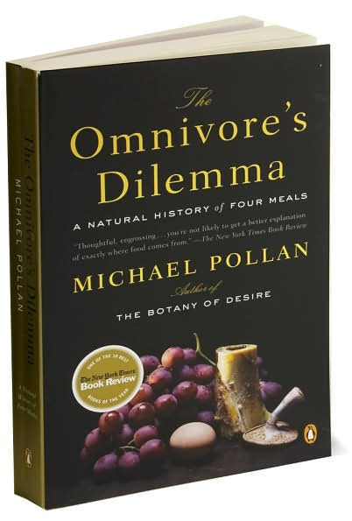

Slide 31
“Setting the Table”
Biocultural Framework
for the Study of Diet and Nutrition
  Nutritional Status
  Biological Makeup
  Human Nutrient Needs
  Diet
  Cuisine
  The Environment
    Physical Environment
    Sociocultural Environment
    Economic and Political Environment
individual
nutritional
needs
nowadays, we often see the word
carnivorous (chiefly meats)
omnivorous

Slide 32
let’s have a look at that word . . .
(REM: One of the four main areas of anthropology is linguistics)

Slide 33
Diet classifications:
herbivorous (plants)
insectivorous (insects)
  frugivorous (fruits)
  graminivorous (grasses)
carnivorous (chiefly meats)
omnivorous

Slide 34
Diet classifications:
herbivorous (plants)
insectivorous (insects)
  frugivorous (fruits)
  graminivorous (grasses)
carnivorous (chiefly meats)
omnivorous

Slide 35
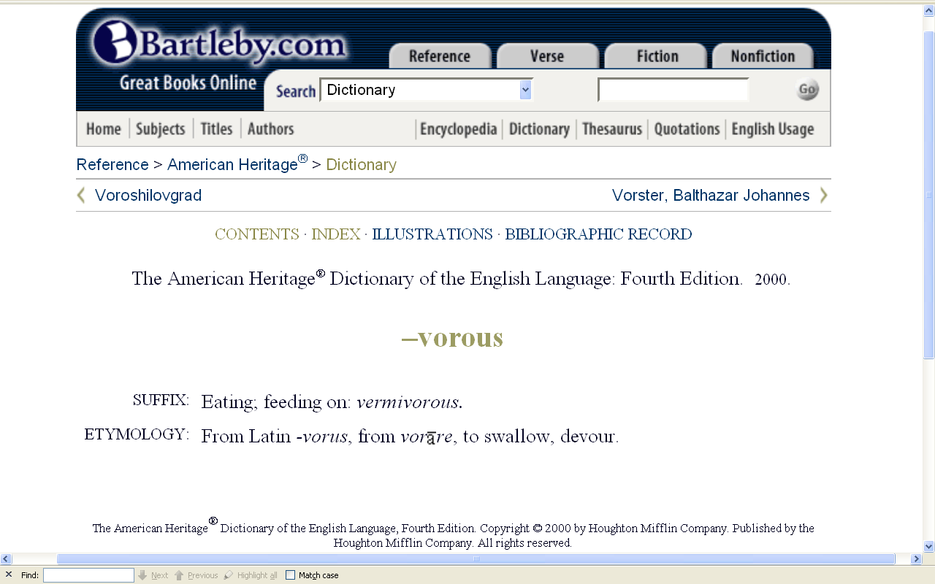

Slide 37
comes from

Slide 38
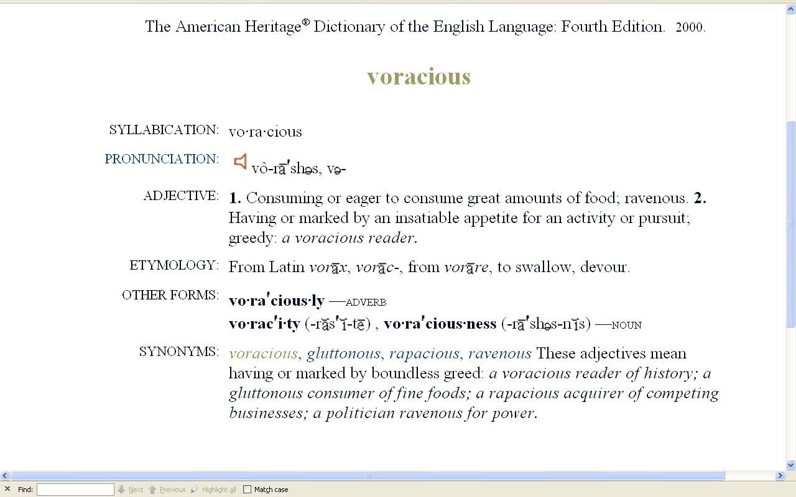
as in

Slide 39
as in
comes from

Slide 40
as in
comes from
meaning

Slide 41
as in
comes from
meaning

Slide 42
as in
comes from
meaning

Slide 43


Slide 44
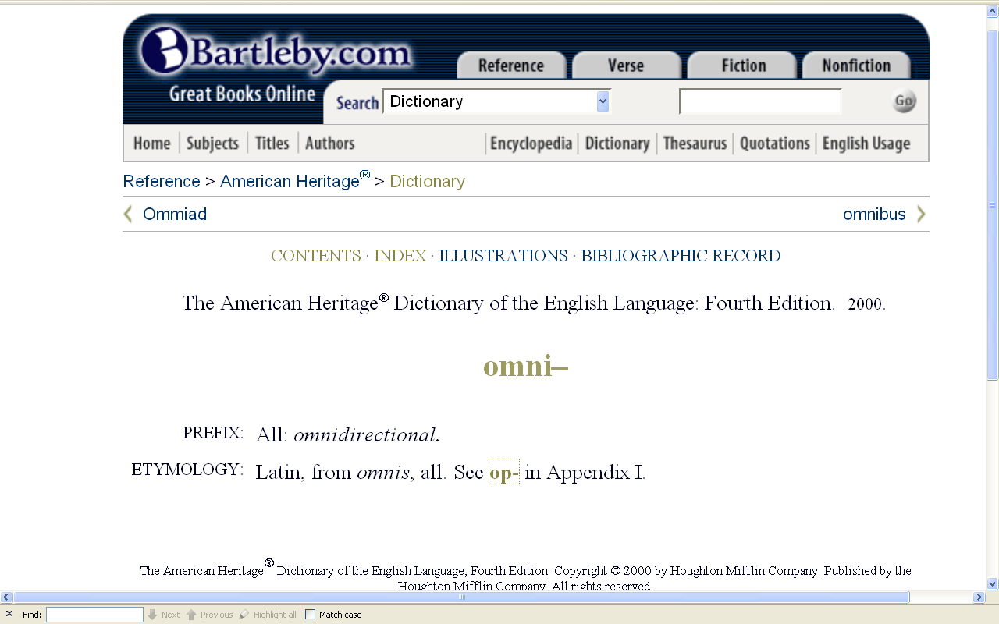

Slide 46
diet classifications
herbivorous (principally plants)
insectivorous (principally insects)
frugivorous (principally fruits)
graminivorous (principally grasses)
folivorous (principally leaf eating)
proteinivorous (principally protein eating)
carnivorous (chiefly meats)
omnivorous (“devours” “all”)
locavore (principally locally available foods)
and from that we get

Slide 47
diet classifications
herbivorous (principally plants)
insectivorous (principally insects)
frugivorous (principally fruits)
graminivorous (principally grasses)
folivorous (principally leaf eating)
proteinivorous (principally protein eating)
carnivorous (chiefly meats)
omnivorous (“devours” “all”)
locavore (principally locally available foods)
that’s just one
diet classification,
there are many . . .

Slide 48
diet classifications
herbivorous (principally plants)
insectivorous (principally insects)
frugivorous (principally fruits)
graminivorous (principally grasses)
folivorous (principally leaf eating)
proteinivorous (principally protein eating)
carnivorous (chiefly meats)
omnivorous (“devours” “all”)
locavore (principally locally available foods)

Slide 49
diet classifications
herbivorous (principally plants)
insectivorous (principally insects)
frugivorous (principally fruits)
graminivorous (principally grasses)
folivorous (principally leaf eating)
proteinivorous (principally protein eating)
carnivorous (chiefly meats)
omnivorous (“devours” “all”)
locavore (principally locally available foods)
these six are the classifications most often used in the four areas of Anthropology

Slide 50
diet classifications
herbivorous (principally plants)
insectivorous (principally insects)
frugivorous (principally fruits)
graminivorous (principally grasses)
folivorous (principally leaf eating)
proteinivorous (principally protein eating)
carnivorous (chiefly meats)
omnivorous (“devours” “all”)
locavore (principally locally available foods)
and the two below are the diet classifications seen most often in the Anthropology of Food . . .

Slide 51
diet classifications
herbivorous (principally plants)
insectivorous (principally insects)
frugivorous (principally fruits)
graminivorous (principally grasses)
folivorous (principally leaf eating)
proteinivorous (principally protein eating)
carnivorous (chiefly meats)
omnivorous (“devours” “all”)
locavore (principally locally available foods)
the newest one is . . .

Slide 52
locavore
2007 New Oxford American Dictionary
Word of the Year

Slide 53
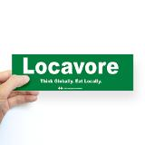

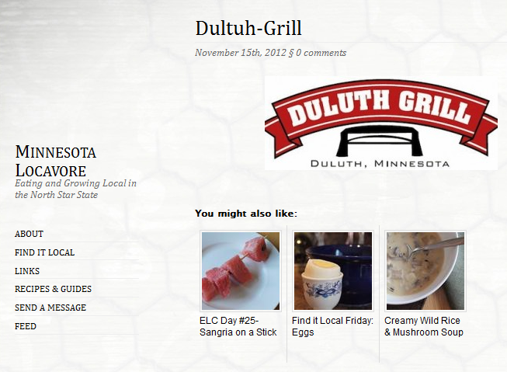
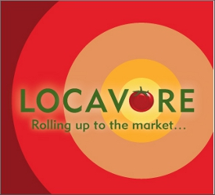
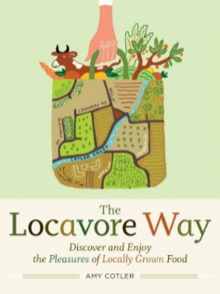
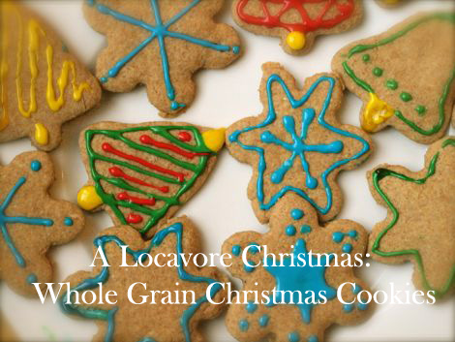
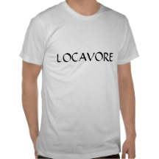
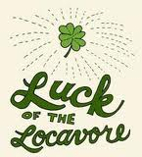

http://www.mnlocavore.com/2012/11/locavore-on-the-road-duluth-grill/dultuh-grill/

Slide 54
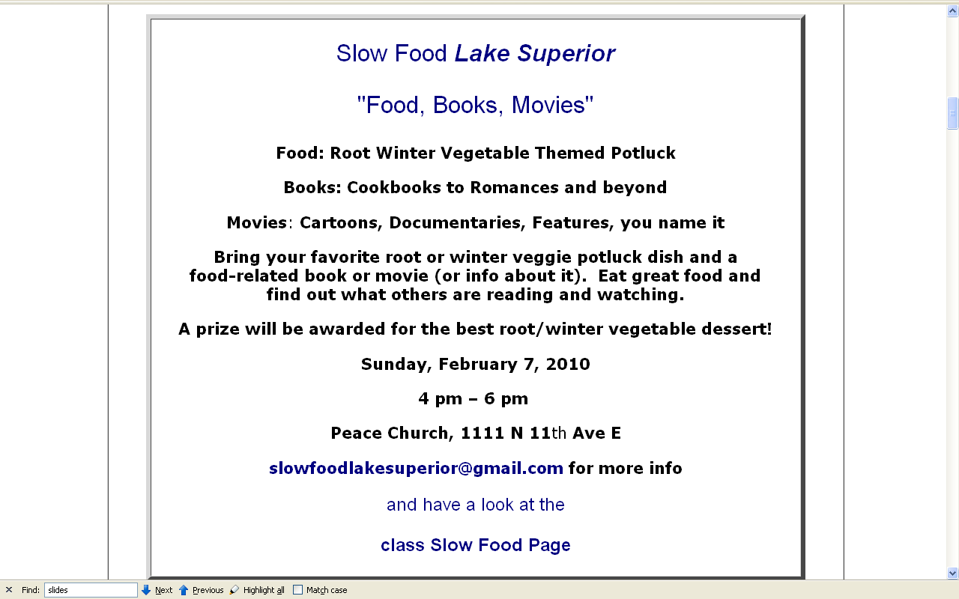
(Slow Food people
are generally
locavores)

Slide 55
diet classifications
herbivorous (principally plants)
insectivorous (principally insects)
frugivorous (principally fruits)
graminivorous (principally grasses)
folivorous (principally leaf eating)
proteinivorous (principally protein eating)
carnivorous (chiefly meats)
omnivorous (“devours” “all”)
locavore (principally locally available foods)
the other diet classification term
you hear most is . . .

Slide 56
diet classifications
herbivorous (principally plants)
insectivorous (principally insects)
frugivorous (principally fruits)
graminivorous (principally grasses)
folivorous (principally leaf eating)
proteinivorous (principally protein eating)
carnivorous (chiefly meats)
omnivorous (“devours” “all”)
locavore (principally locally available foods)
as in . . .

Slide 58
“omnivores’ paradox”
“. . . humans’ interest in new and varied food sources (neophilia) is balanced by their fear of new food items (neophobia), especially those that taste different from foods already determined to be safe.”
The Cultural Feast, 2nd Ed., p. 6

Slide 59
Biocultural Framework
for the Study of Diet and Nutrition
  Nutritional Status
  Biological Makeup
  Human Nutrient Needs
  Diet
  Cuisine
  The Environment
    Physical Environment
    Sociocultural Environment
    Economic and Political Environment
individual
nutritional
needs
we’ll have a closer look at
the omnivore’s dilemma
in the context of a closer look at
“Human Nutrient Needs” . . .

Slide 60
Biological Makeup
Tim Roufs
© 2010-2022

