Slide 1
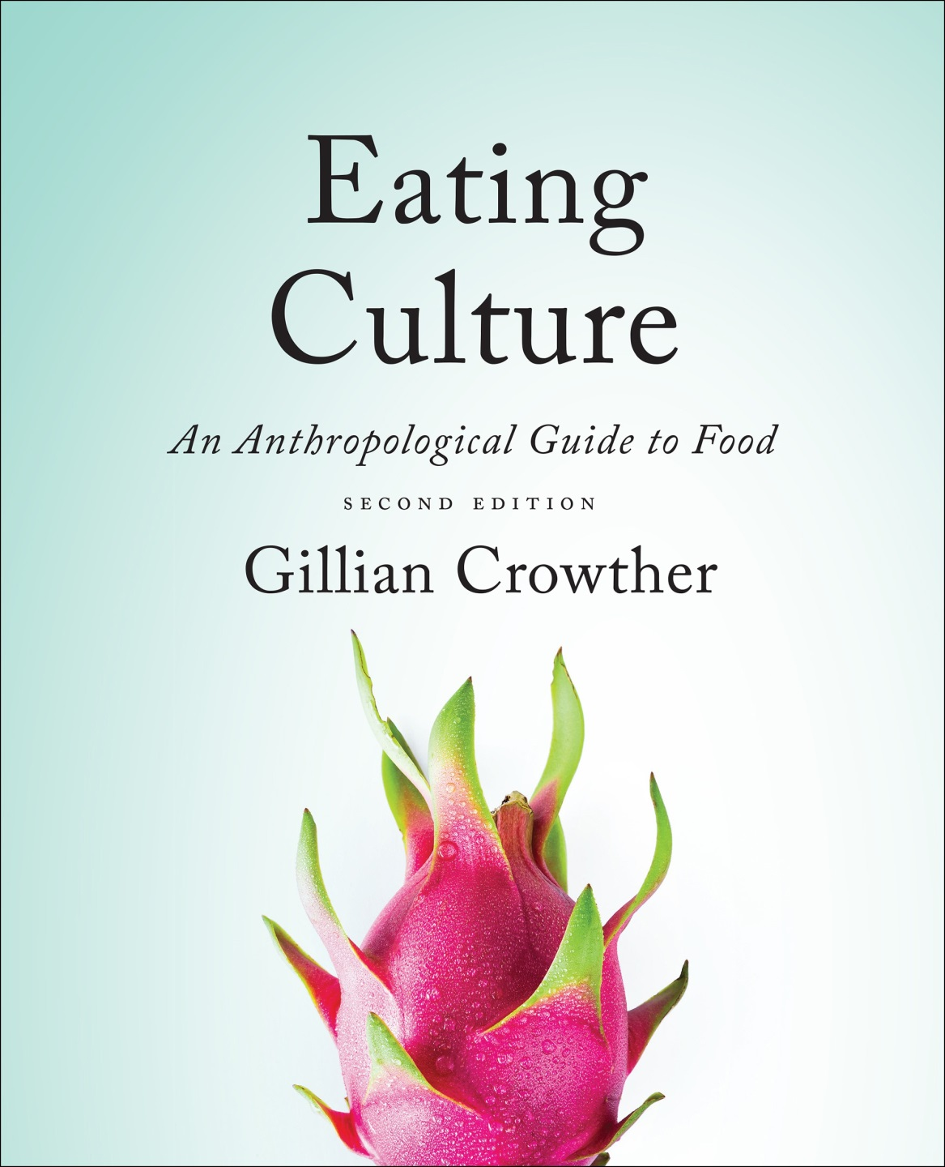
Cf. , Chapter 8
”GASTRO-ANOMIE
Global Indigestion?”:
Body Image
Use your up / down arrow keys and / or
your space bar to advance the slides
Tim Roufs
© 2010-2024
www.d.umn.edu/cla/faculty/troufs/anthfood/aftexts.html#title

Slide 2
Cf. , Chapter 8
”GASTRO-ANOMIE
Global Indigestion?”:
Body Image
Tim Roufs
© 2010-2024
www.d.umn.edu/cla/faculty/troufs/anthfood/aftexts.html#title

Slide 3
Tim Roufs
© 2010-2024
www.d.umn.edu/cla/faculty/troufs/anthfood/aftexts.html#title

Slide 4
“Eating is a Cultural Affair” — Body Image and Health
The Obesity Epidemic
Disordered Body Image and Eating Behaviors
Eating Disorders
Anorexia nervosa
Bulimia nervosa
Binge eating
Orthorexia nervosa
Selective Eating Disorder (SED)
Pica
Others
What Causes Eating Disorders?
Applications

Slide 5
“Eating is a Cultural Affair” — Body Image and Health
“As more and more North Americans gain excess weight, it is not surprising that the proportion of people dissatisfied with their bodies’ size and shape has also increased.”
The Cultural Feast, 2nd ed., p. 109

Slide 6
“Eating is a Cultural Affair” — Body Image and Health
Very young children are rarely concerned about their weight . . .
By 6 or 7 many children start worrying about how they look and want to be thinner . . .
The Cultural Feast, 2nd ed., p. 109

Slide 7
Although that might be changing . . .

Slide 8
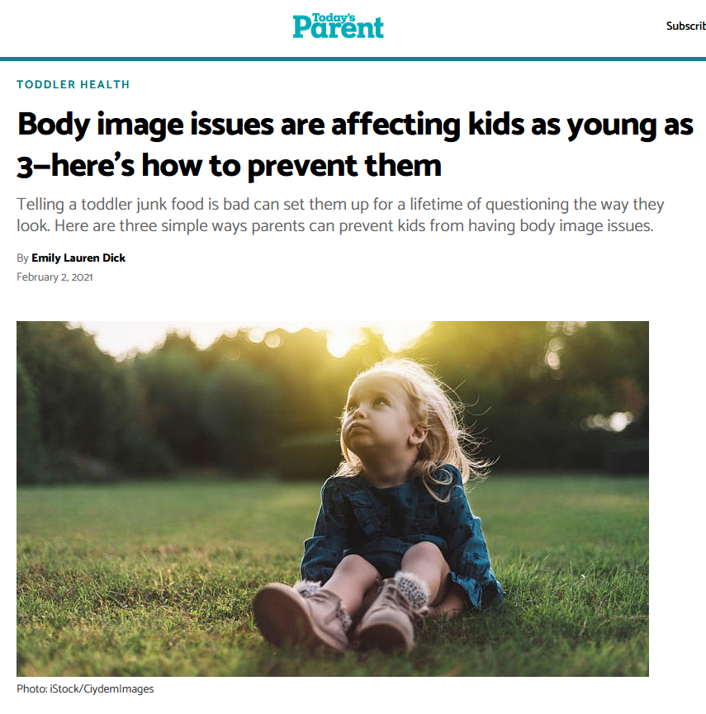
2 February 2021
https://www.todaysparent.com/toddler/toddler-health/ways-to-prevent-kids-body-image-issues/

Slide 9
“Eating is a Cultural Affair” — Body Image and Health
Body discontent typically increases with the onset of bodily changes during adolescence . . .
. . . even already in the early 1990s between 50% and 80% of teen girls in the U.S. were dissatisfied with how their bodies look
(Mossavar-Rahmani et al. 1996; Parker et al. 1995)
The Cultural Feast, 2nd ed., p. 109

Slide 10
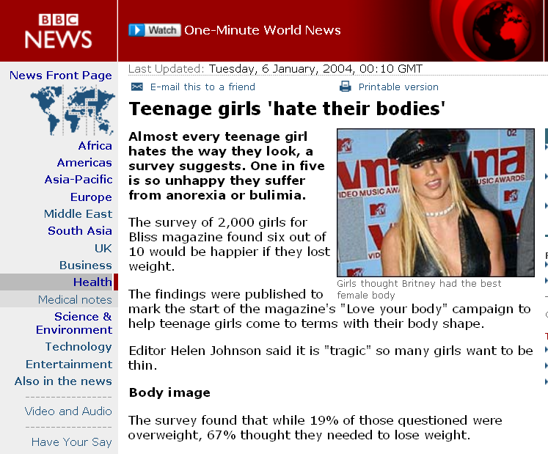
http://news.bbc.co.uk/2/hi/health/3368833.stm

Slide 11
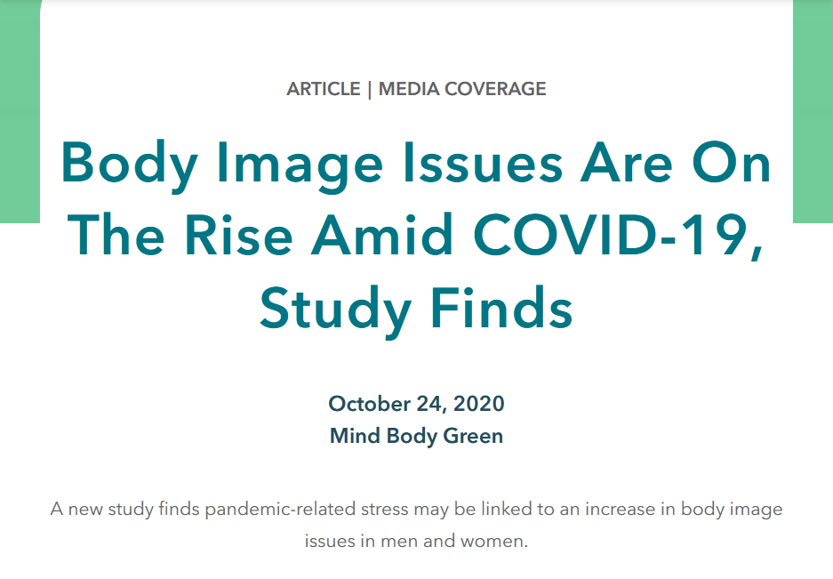
https://www.eatingrecoverycenter.com/article/pandemic-body-image

Slide 12
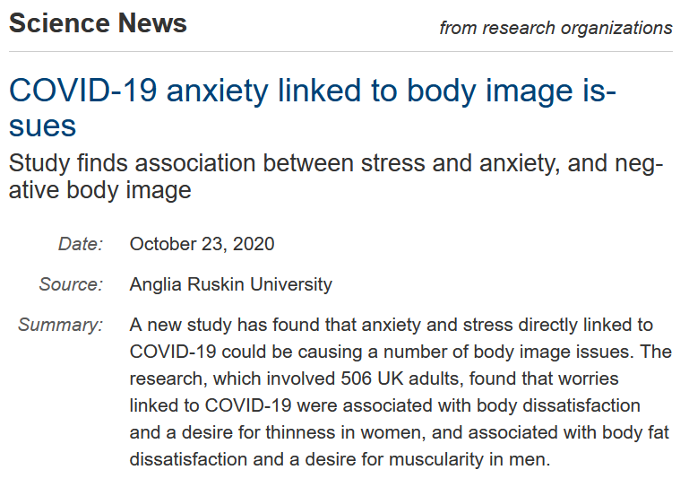
https://www.sciencedaily.com/releases/2020/10/201022201407.htm

Slide 13
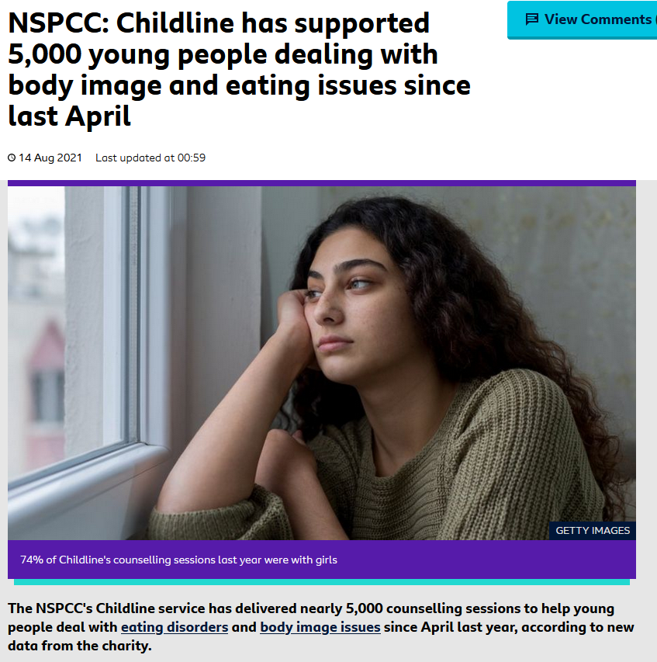
The UK children's charity | NSPCC
14 Aug 2021
https://www.bbc.co.uk/newsround/58197895

Slide 14
“Eating is a Cultural Affair” — Body Image and Health
girls worry about looking fat . . .
. . . boys tend to be more concerned that they don’t appear big and strong enough. . . .
(Sobal 1955b)
The Cultural Feast, 2nd ed., p. 109

Slide 15
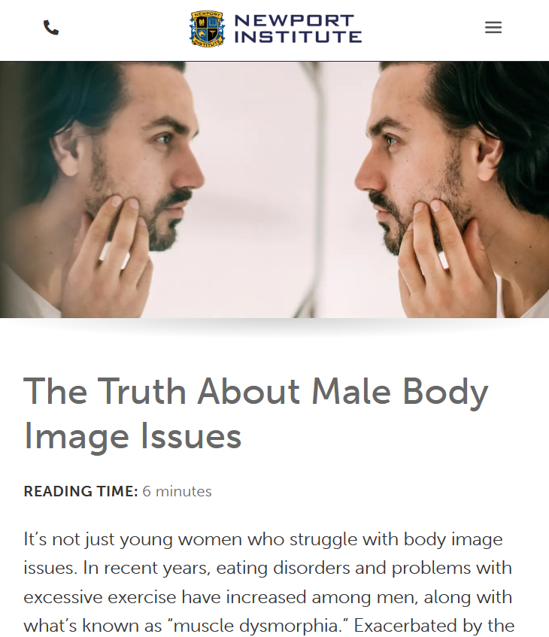
14 Aug 2021
17 May 2021
https://www.newportinstitute.com/resources/mental-health/male-body-issues/

Slide 16
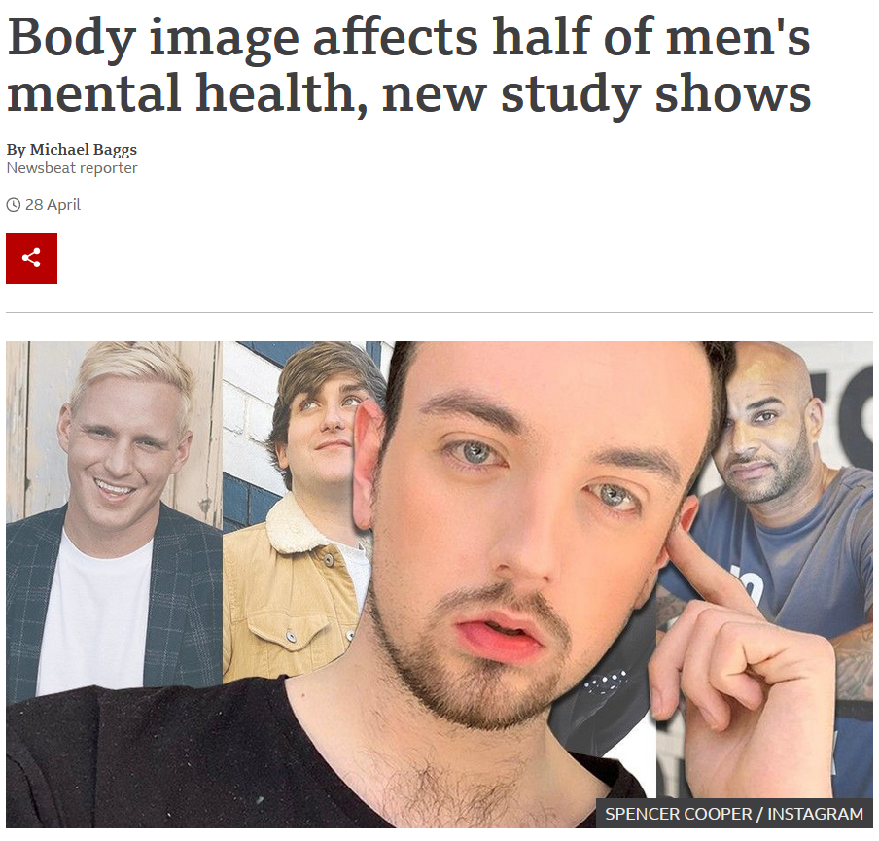
28 April 2021
https://www.bbc.com/news/newsbeat-56904488

Slide 17
“Eating is a Cultural Affair” — Body Image and Health
This dissatisfaction usually continues throughout adulthood, and eventually declines during the later years when it is replaced with concerns about overall health
The Cultural Feast, 2nd ed., p. 109

Slide 18
“Eating is a Cultural Affair” — Body Image and Health
many people are dissatisfied with their appearance because they overestimate how much they weigh
The Cultural Feast, 2nd ed., p. 109

Slide 19
“Eating is a Cultural Affair” — Body Image and Health
In a study of female college students, only one-third of the girls who thought they were fat actually exceeded healthy weight limits
(Centers for Disease Control and Prevention 1997)
The Cultural Feast, 2nd ed., p. 109

Slide 20
“Eating is a Cultural Affair” — Body Image and Health
. . . only about half of the adults who perceive themselves as overweight actually are
(Centers for Disease Control and Prevention 1997)
The Cultural Feast, 2nd ed., p. 109

Slide 21
“Eating is a Cultural Affair” — Body Image and Health
Unfortunately body dissatisfaction often leads to unhealthy eating practices . . .
chronic dieting
“yo-yo” dieting
use of diet pills and laxatives
vomiting
The Cultural Feast, 2nd ed., p. 109

Slide 22
“Eating is a Cultural Affair” — Body Image and Health
Important ethnic differences exist
in perceptions of the ideal body size and responses to believing that one is overweight
but in the United States these differences may be decreasing as the cult of thinness is adopted by many Hispanic, Native American, and, to a lesser extent African American youth
The Cultural Feast, 2nd ed., p. 109

Slide 23
“Eating is a Cultural Affair” — Body Image and Health
In general,
Euro-Americans are the most likely to overestimate their bodies’ weights
They score substantially lower than
Afro-Americans and Native Americans on numerous measures of body satisfaction and self-perception
(Parker et. al. 1995)
The Cultural Feast, 2nd ed., p. 109

Slide 24
“Eating is a Cultural Affair” — Body Image and Health
Research findings are mixed but it appears women of Hispanic descent are more accepting of a larger body ideal . . .
However, as Hispanics acculturate into U.S. society, they too begin to adopt thinner body ideals and disordered eating practices . . .
(Harris, Walters, and Waschull 1991; Miller et. al. 2000)
The Cultural Feast, 2nd ed., p. 110

Slide 25
“Eating is a Cultural Affair” — Body Image and Health
Native Americans have also been thought to prefer a larger body size than Euro-Americans . . .
However, research suggests Native American children may be adopting mainstream ideals for thinness . . .
(Davis and Lumbert 2000; Davis et. al. 1999; Stevens et al. 1999)
The Cultural Feast, 2nd ed., p. 110

Slide 26
“Eating is a Cultural Affair” — Body Image and Health
as a group, African Americans enjoy the highest level of satisfaction with how they look . . .
(Miller et al. 2000)
The Cultural Feast, 2nd ed., p. 110

Slide 27
“Eating is a Cultural Affair” — Body Image and Health
African Americans are also less likely to be preoccupied with weight loss, even if they are moderately overweight . . .
focus group interviews with African American teens reveal that their ideals of beauty are more flexible than those of other groups . . .
(Miller et al. 2000)
The Cultural Feast, 2nd ed., p. 110

Slide 28
“Eating is a Cultural Affair” — Body Image and Health
focus group interviews with African American teens reveal that their ideals of beauty are more flexible than those of other groups, with less emphasis on body size and shape and more concern with projecting confidence, positive attitude,
and style. . . .
(Parker et al. 1995)
The Cultural Feast, 2nd ed., p. 110

Slide 29
“Eating is a Cultural Affair” — Body Image and Health
despite higher levels of satisfaction with their bodies, similar proportions of African American girls try to lose weight as Euro-Americans and Hispanic Americans . . .
increasing numbers of African American teens are using laxatives and diuretics to control their weight
(MDConsult 2002)
The Cultural Feast, 2nd ed., p. 110

Slide 30
Early on, the girls from New Moon
in Duluth
focused on the problem . . .

Slide 31
Duluth, Minnesota
https://newmoongirls.com/free-digital-new-moon-girls-magazine/

Slide 32
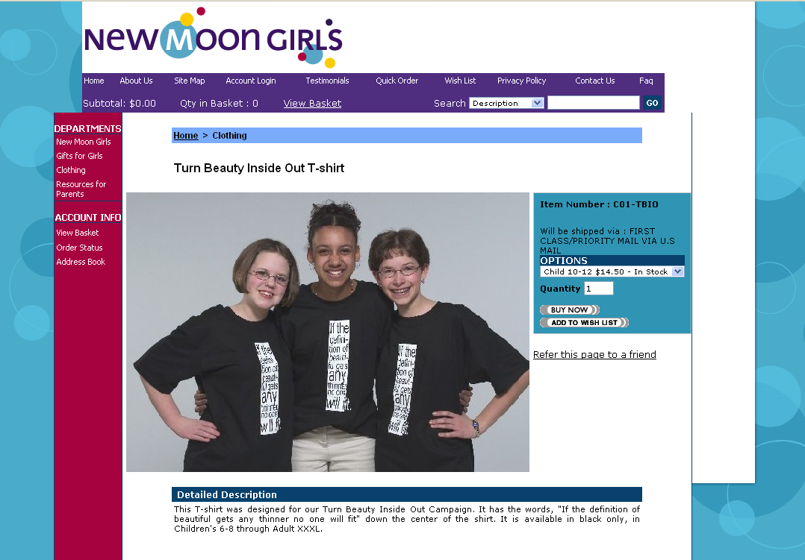
Duluth, Minnesota
http://www.newmooncatalog.com/prodinfo.asp?number=C01-TBIO

Slide 33
Duluth, Minnesota
If the definition of beautiful gets any thinner no one will fit“
http://www.newmooncatalog.com/prodinfo.asp?number=C01-TBIO

Slide 34
“Eating is a Cultural Affair” — Body Image and Health
Widespread body dissatisfaction and chronic dieting have drawn concern from health professionals, psychologists, educators, and sports administrators because of the impact they have on people’s emotional and physical health
The Cultural Feast, 2nd ed., p. 110

Slide 35
“Eating is a Cultural Affair” — Body Image and Health
Body dissatisfaction is associated with . . .
obsessive-compulsiveness
anxiety disorders
depression
The Cultural Feast, 2nd ed., pp. 110-111

Slide 36
“Eating is a Cultural Affair” — Body Image and Health
Chronic or yo-yo dieting not only is ineffective in controlling excess weight, but also increases the chances of . . .
dying from cardio-vascular disease
osteoporosis
and cancer
(Cogan and Ernsberger 1999)
The Cultural Feast, 2nd ed., p. 111

Slide 37
“Eating is a Cultural Affair” — Body Image and Health
Many weight-loss methods have short- as well as long-term risks . . .
muscle depletion
mood disorders
heart problems
increased risk for more serious eating disorders
anorexia nervosa
bulimia . . .
The Cultural Feast, 2nd ed., p. 111

Slide 38
“Eating is a Cultural Affair” — Body Image and Health
Many weight-loss methods have short- as well as long-term risks . . .
muscle depletion
mood disorders
heart problems
increased risk for more serious eating disorders
anorexia nervosa
bulimia . . .
The Cultural Feast, 2nd ed., p. 111

Slide 39
Finally, there is some suggestion that body image concerns may be partly genetic . . .

Slide 40
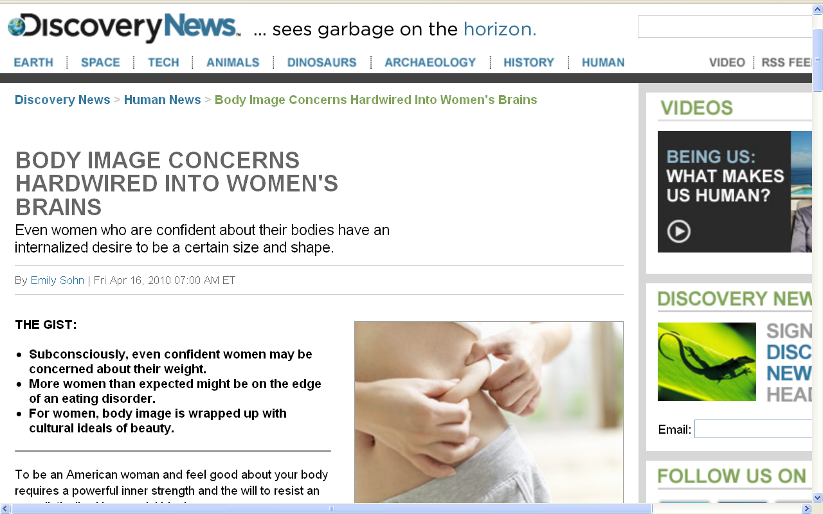
http://news.discovery.com/human/women-body-image.html

Slide 41
Finally, there is some recent suggestion that body image concerns may be partly genetic . . .
which makes it an even better subject for anthropological holistic analysis

Slide 42
more on body image
with the discussion of eating disorders . . .

Slide 43
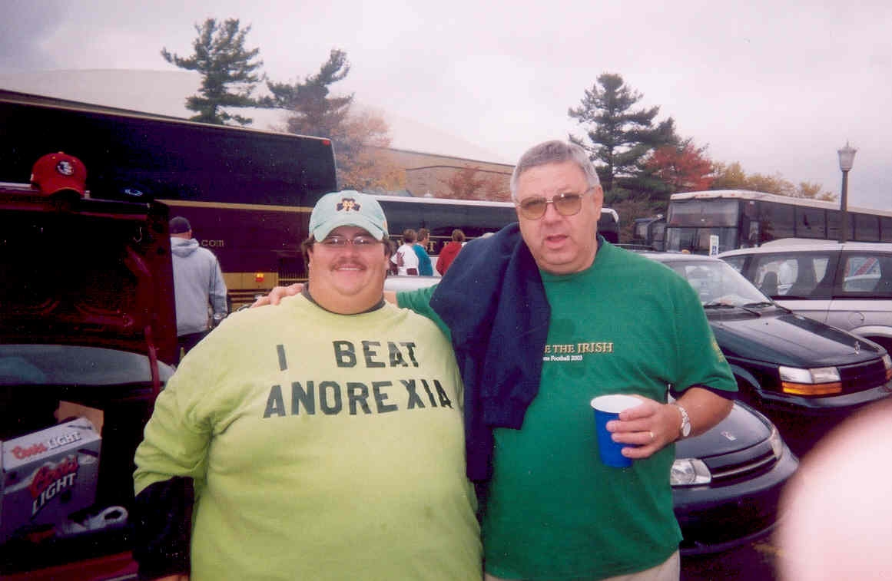
http://funnycoolvideos.wordpress.com/2007/11/08/how-to-beat-anorexia/

Slide 44
Cf. , Chapter 8
”GASTRO-ANOMIE
Global Indigestion?”:
Body Image
Tim Roufs
© 2010-2024
www.d.umn.edu/cla/faculty/troufs/anthfood/aftexts.html#title

