Slide 1
The EU
Thirty-Year Chocolate War:
A Run-up to Scaling
1973-2003
Tim Roufs
© 2010-2024

Slide 2
First
The News
and a little
chocolately background
Tim Roufs
© 2010-2024

Slide 3
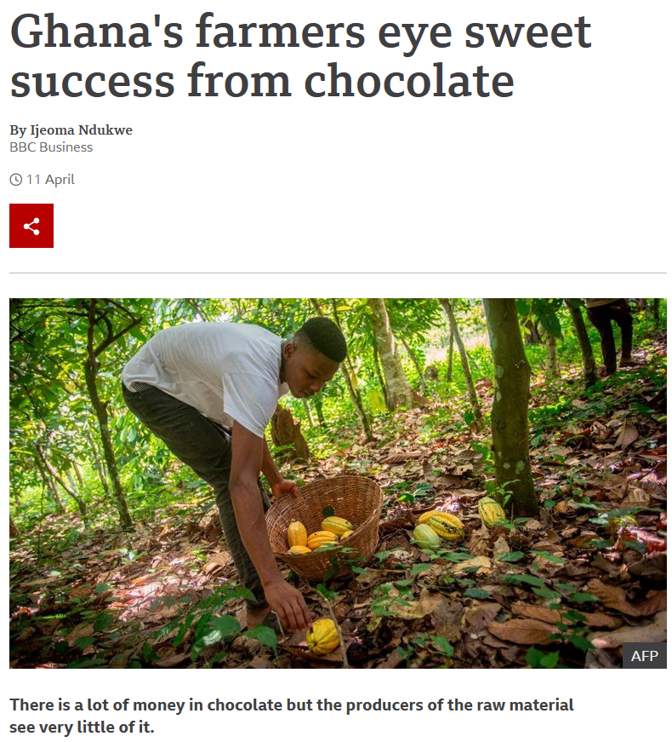

10 April 2021
https://www.bbc.com/news/world-africa-56687427akv

Slide 4
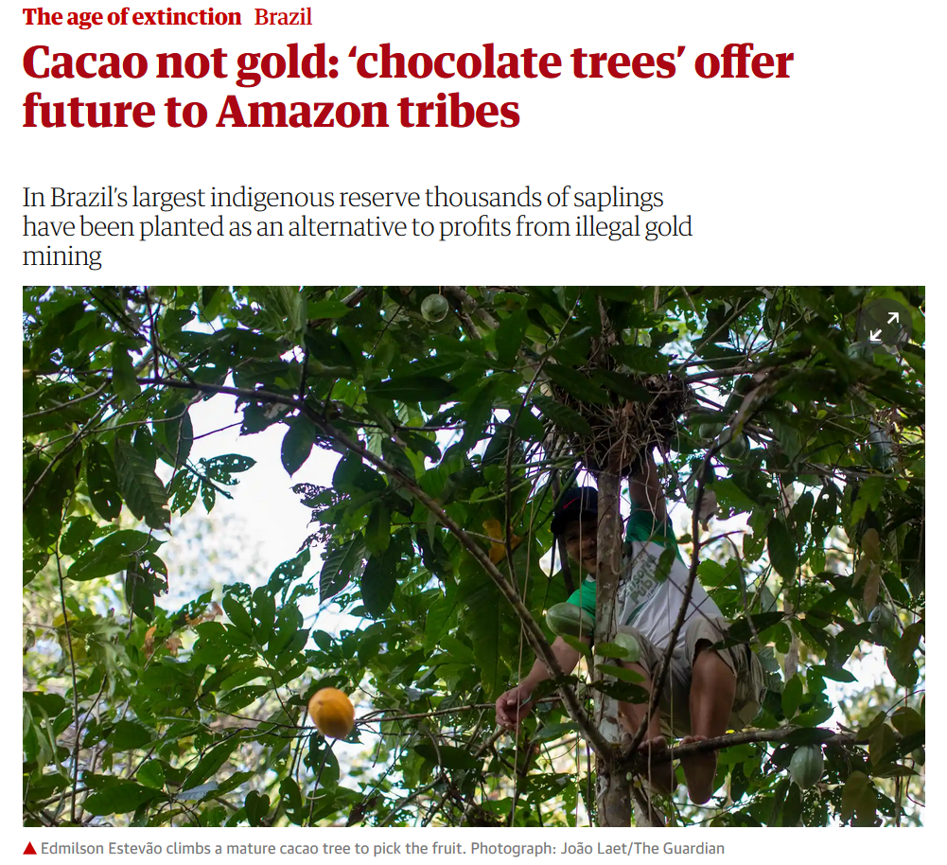

25 January 2020
https://www.theguardian.com/environment/2020/jan/25/cacao-not-gold-chocolate-trees-offer-future-to-amazon-tribes-aoe?CMP=Share_iOSApp_Other

Slide 5
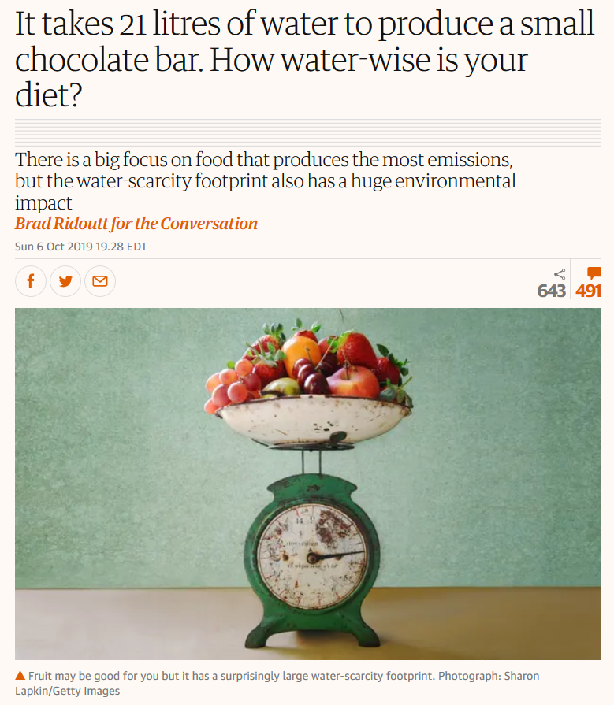
https://www.theguardian.com/commentisfree/2019/oct/07/it-takes-21-litres-of-water-to-produce-a-small-chocolate-bar-how-water-wise-is-your-diet?CMP=Share_iOSApp_Other

Slide 6
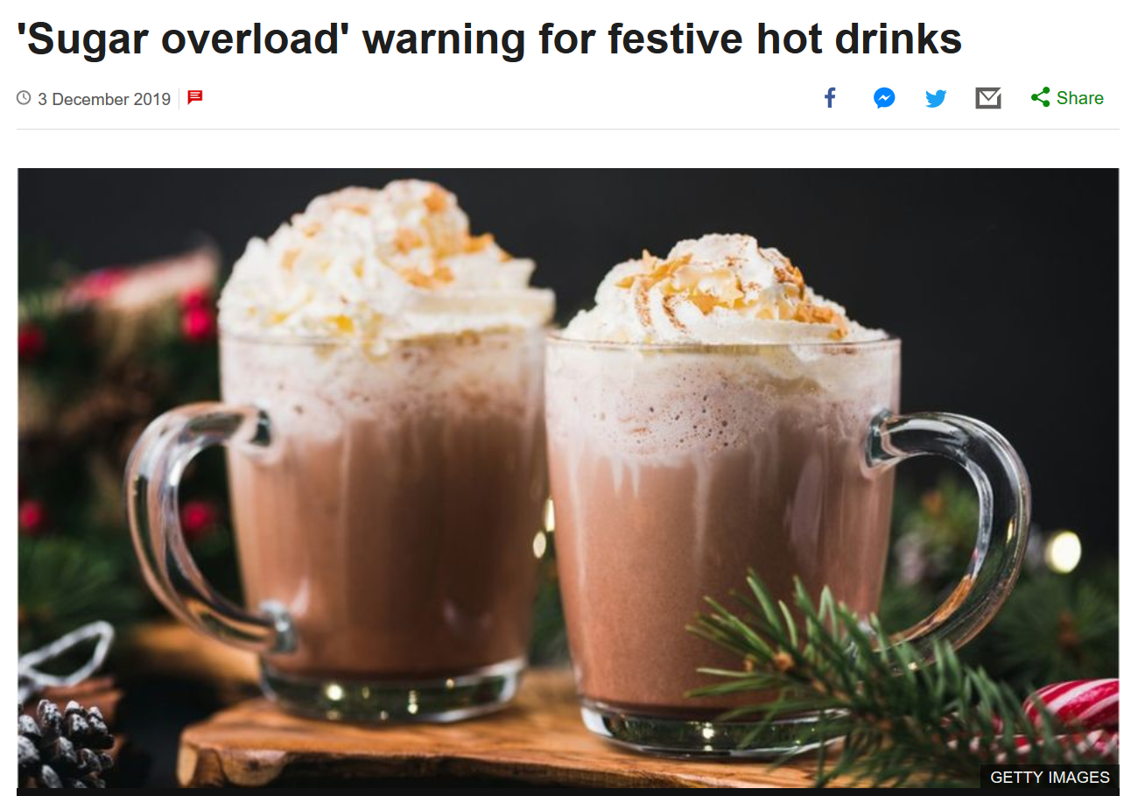
https://www.bbc.com/news/health-50628962

Slide 7
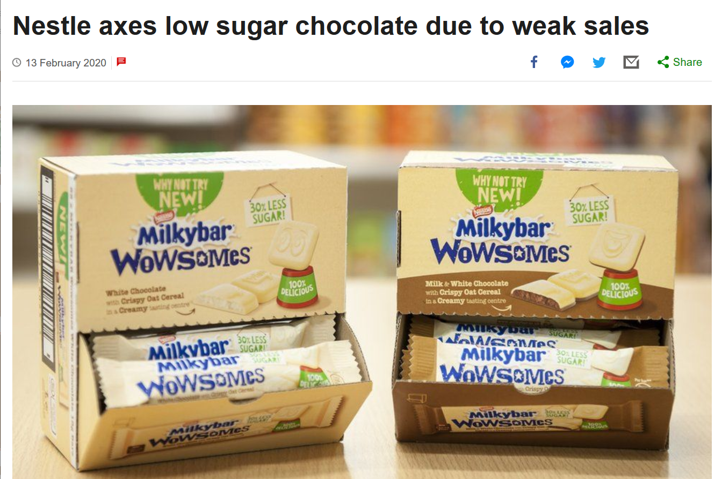
https://www.bbc.com/news/business-51439407

Slide 8
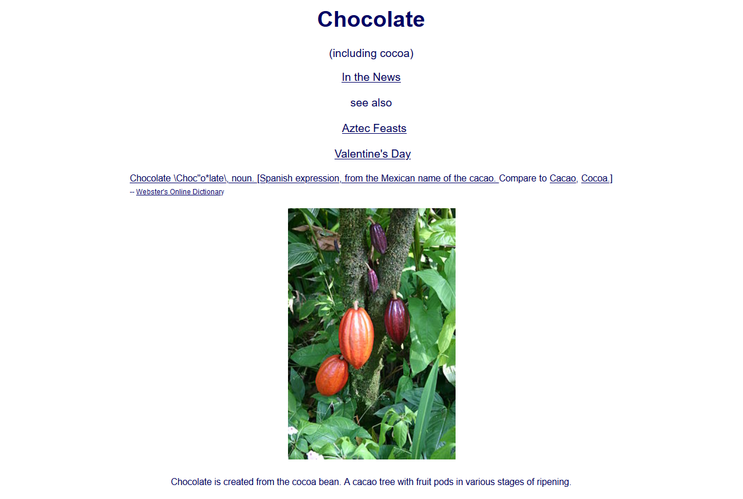
More News at http://www.d.umn.edu/cla/faculty/troufs/anthfood/afchocolate.html#news
http://www.d.umn.edu/cla/faculty/troufs/anthfood/afchocolate.html#title

Slide 9
More Chocolate at http://www.d.umn.edu/cla/faculty/troufs/anthfood/afchocolate.html#news
http://www.d.umn.edu/cla/faculty/troufs/anthfood/afchocolate.html#title

Slide 10
Chocolate Origins . . .

Slide 11

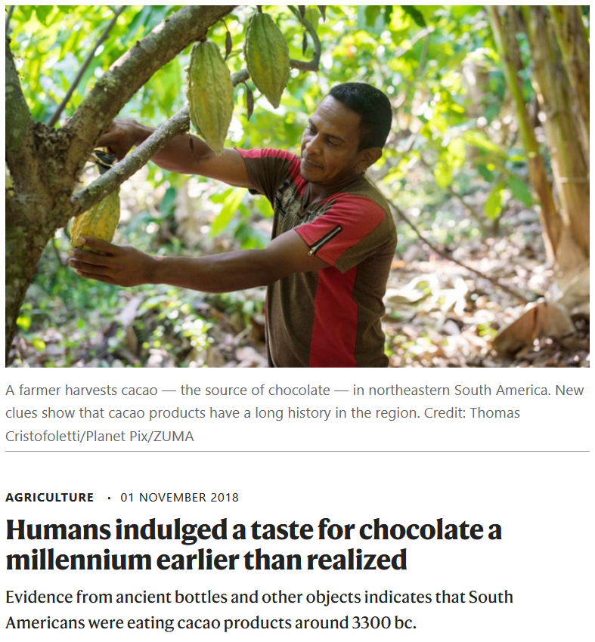
01 November 2018
ca., 3,300 years B.C.
https://www.nature.com/articles/d41586-018-07226-y

Slide 12
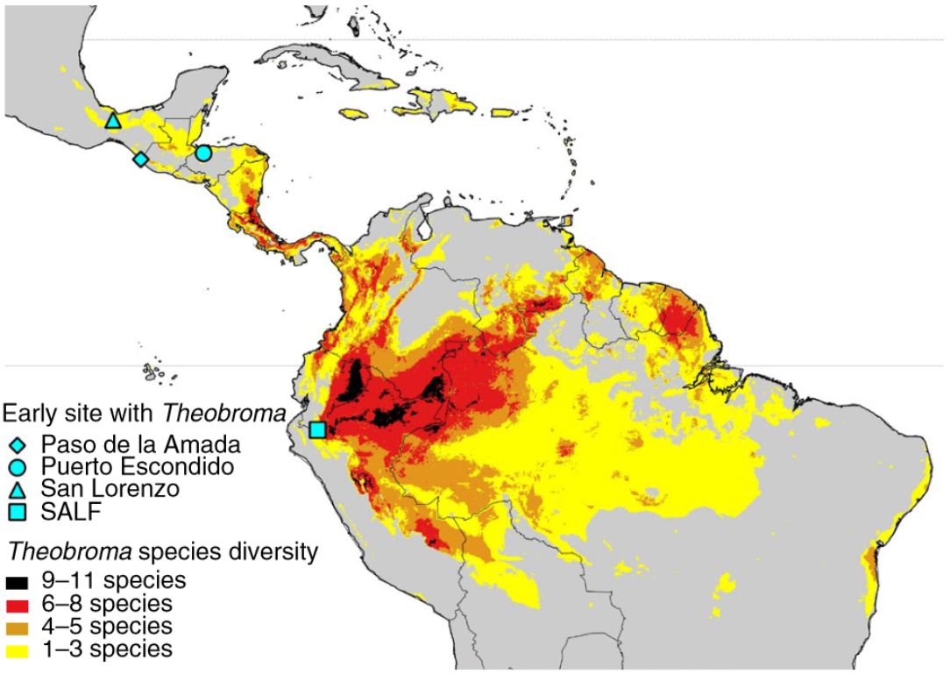
Chocolate Origins
Puerto Escondido
Santa Ana-La Florida (SALF)
ca., 3,300 years B.C.
Source

Slide 13
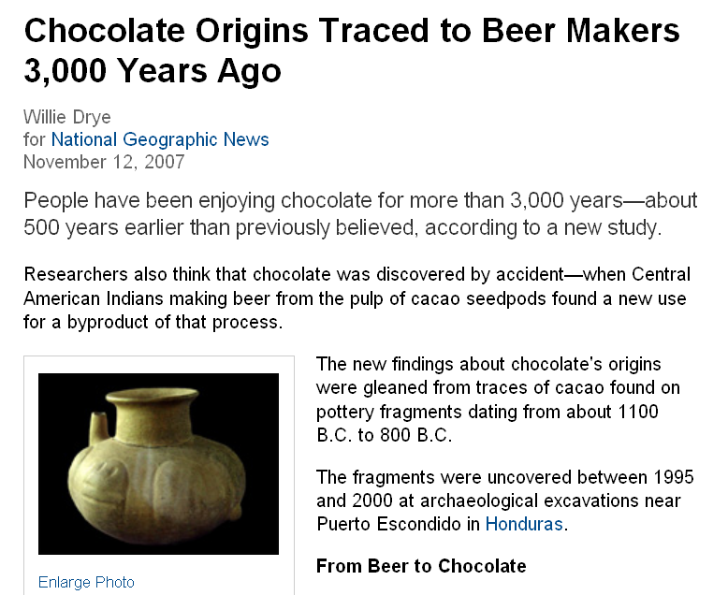
http://news.nationalgeographic.com/news/2007/11/071112-chocolate.html

Slide 14
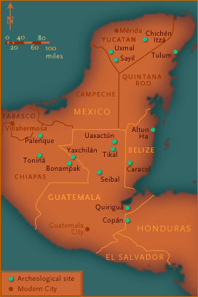
Puerto Escondido
1100 – 800 B.C.
www.pbs.org/wgbh/nova/maya/worl_sans1.html#map

Slide 15
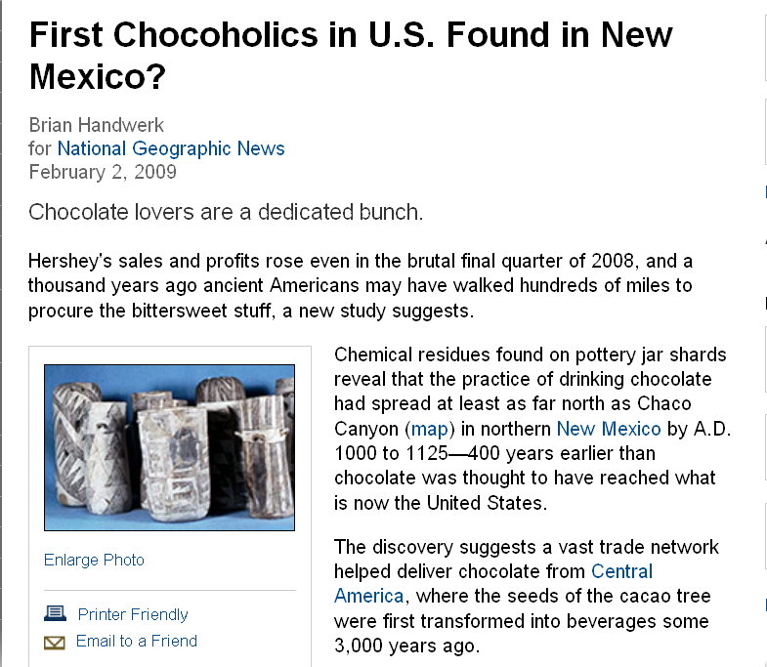
http://news.nationalgeographic.com/news/2009/02/090202-ancient-chocolate.html?source=rss

Slide 16
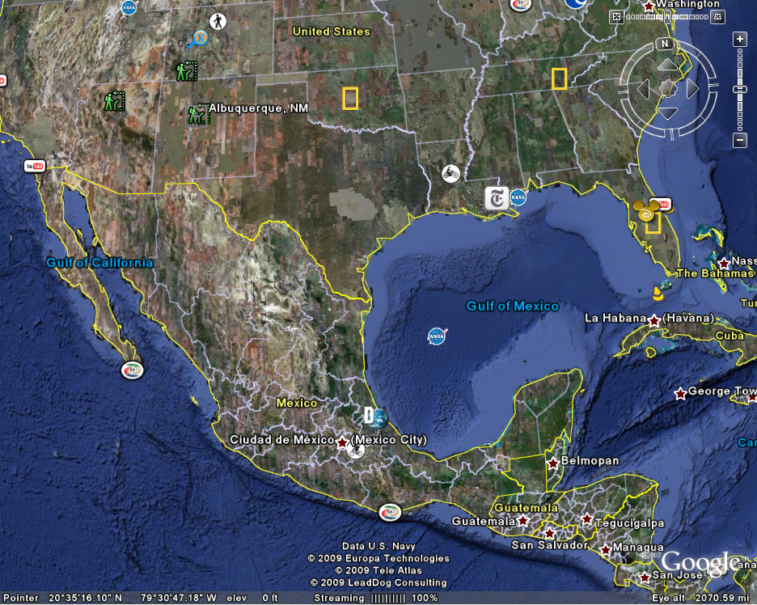
Albuquerque,
New Mexico
A.D. 1000. – 1125
chocolate traded long distances prehistorically
Puerto Escondido,
Honduras
1100 – 800 B.C.

Slide 17
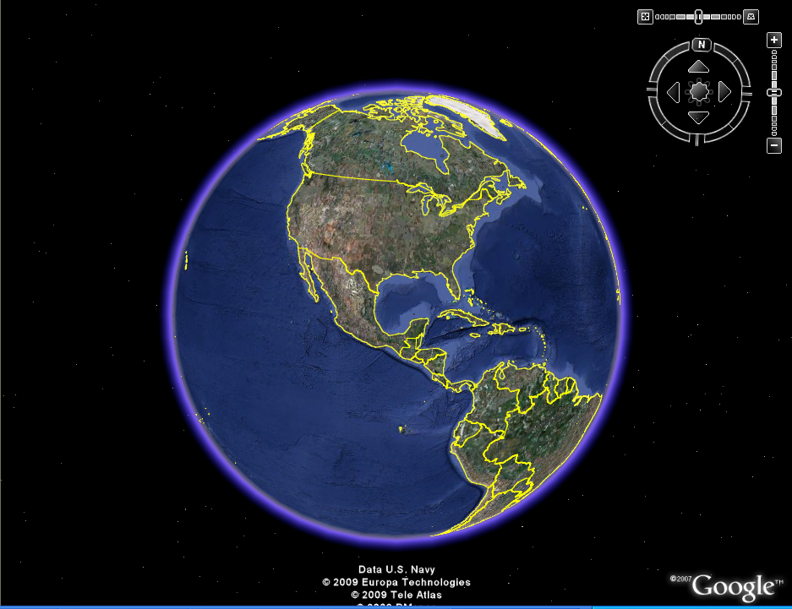
Albuquerque,
New Mexico
A.D. 1000. – 1125
chocolate traded long distances prehistorically
Puerto Escondido,
Honduras
1100 – 800 B.C.

Slide 18
Albuquerque,
New Mexico
major chocolate producing area,
very important to the Aztecs and Maya
Puerto Escondido,
Honduras
Soconusco
(Xoconocho)

Slide 19
major chocolate producing area,
very important to the Aztecs and Maya
Soconusco
(Xoconocho)
www.pbs.org/wgbh/nova/maya/worl_sans1.html#map

Slide 20
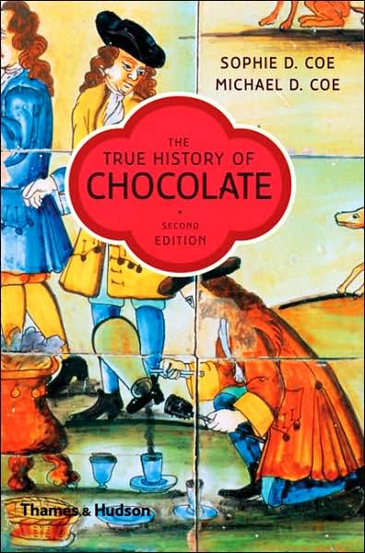
best anthropology work on Chocolate . . .
http://www.d.umn.edu/cla/faculty/troufs/anthfood/afchocolate.html#title

Slide 21
Older Important News http://www.d.umn.edu/cla/faculty/troufs/anthfood/afchocolate.html#news
http://www.d.umn.edu/cla/faculty/troufs/anthfood/afchocolate.html#title

Slide 22
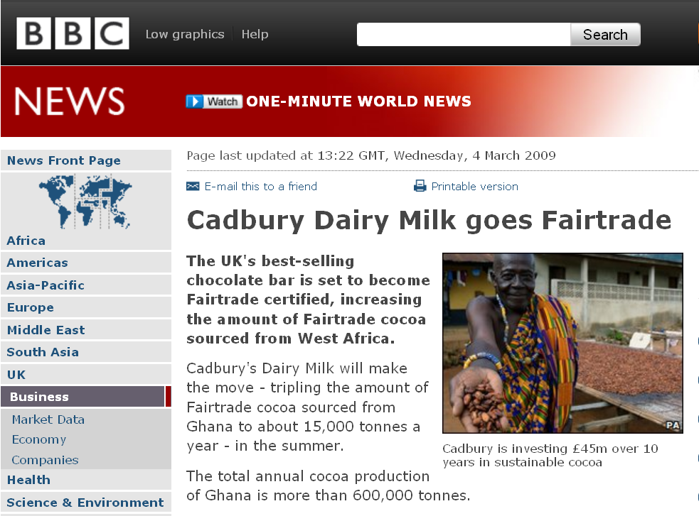
http://news.bbc.co.uk/2/hi/business/7923385.stm

Slide 23
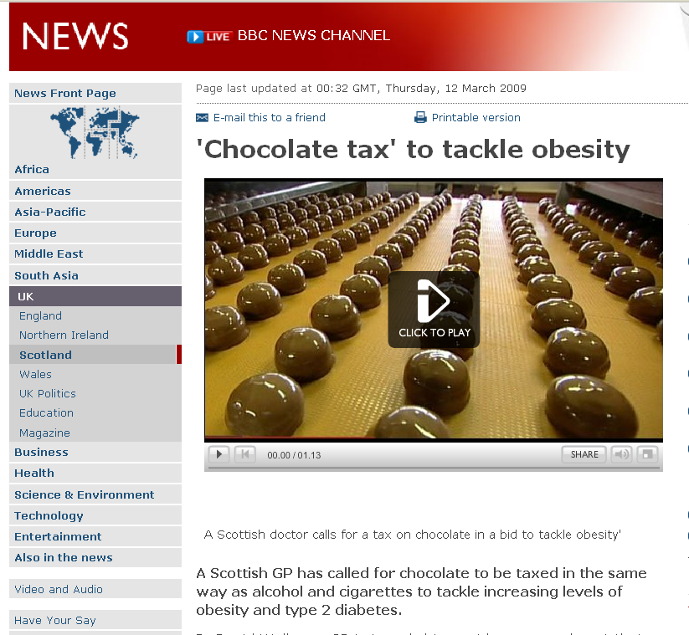
http://news.bbc.co.uk/2/hi/uk_news/scotland/glasgow_and_west/7938282.stm

Slide 24
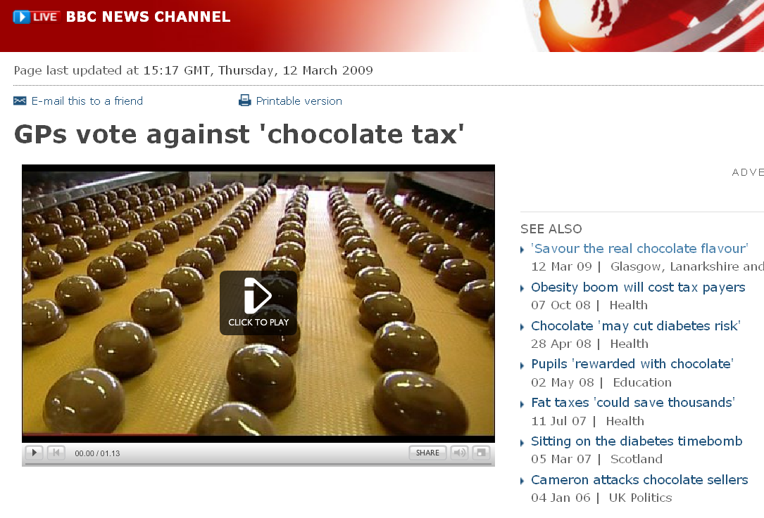

http://news.bbc.co.uk/2/hi/uk_news/scotland/glasgow_and_west/7938282.stm

Slide 25
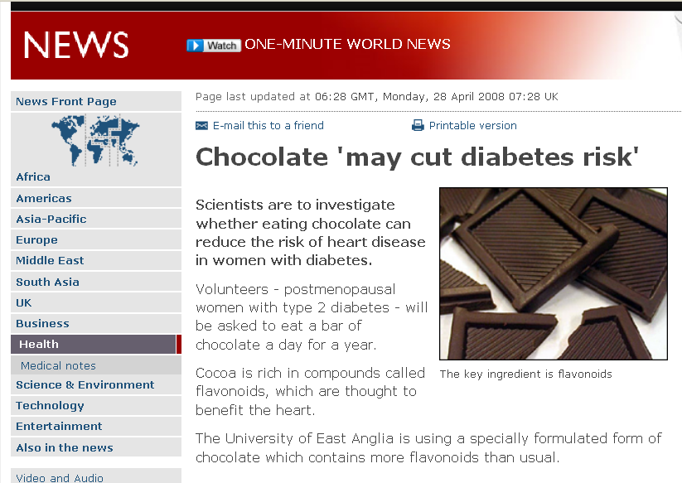
http://news.bbc.co.uk/2/hi/health/7363004.stm

Slide 26
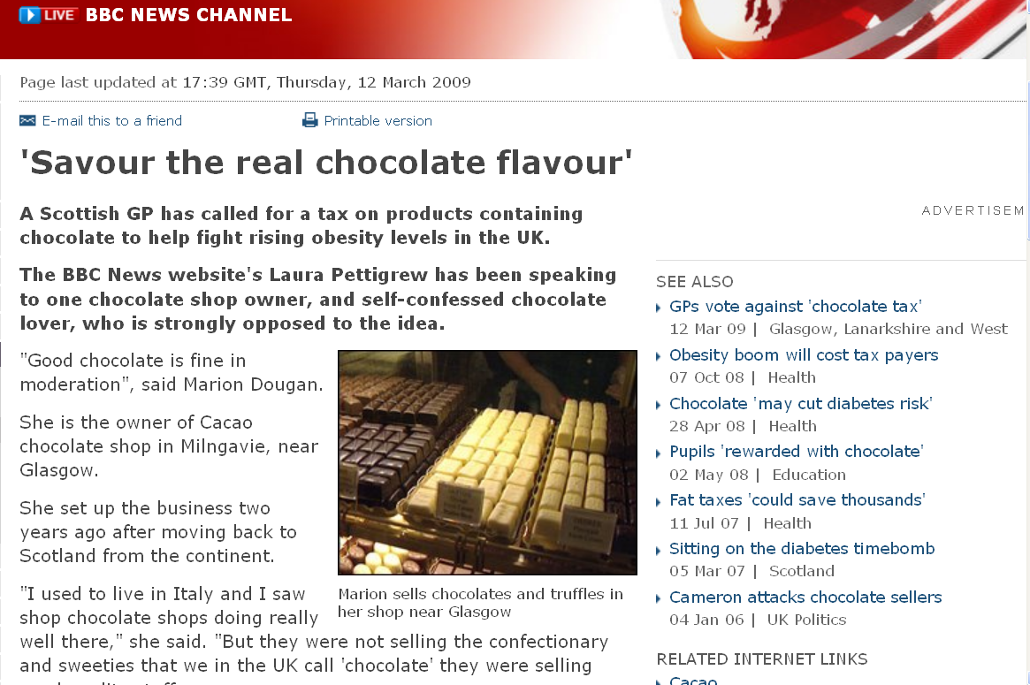
http://news.bbc.co.uk/2/hi/uk_news/scotland/glasgow_and_west/7940393.stm

Slide 27
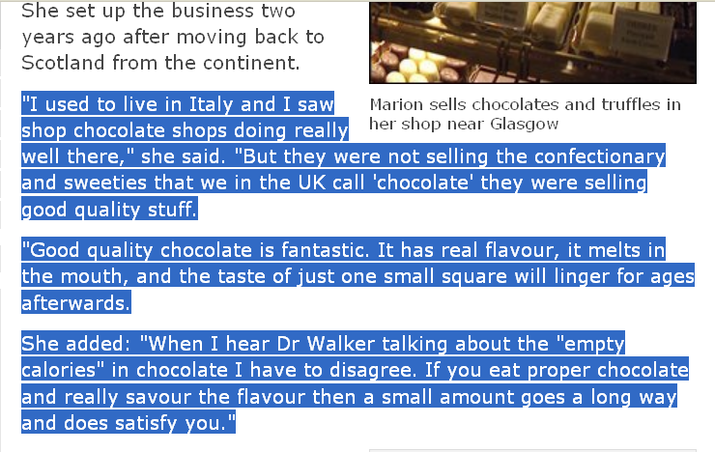
http://news.bbc.co.uk/2/hi/uk_news/scotland/glasgow_and_west/7940393.stm

Slide 28
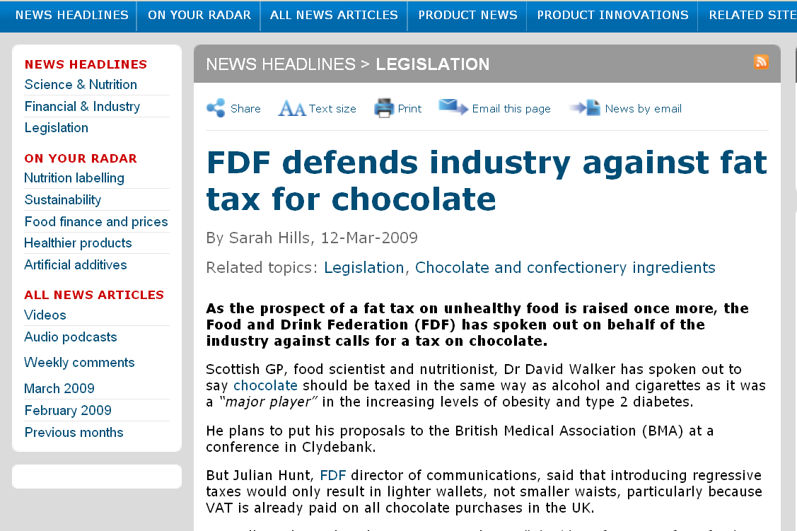
Foodnavigator.com

Slide 29
The
European Union
“Chocolate Wars”
1973-2003
a run-up to
Scaling
http://www.davidsumberg.com/new_page_17.htm

Slide 30
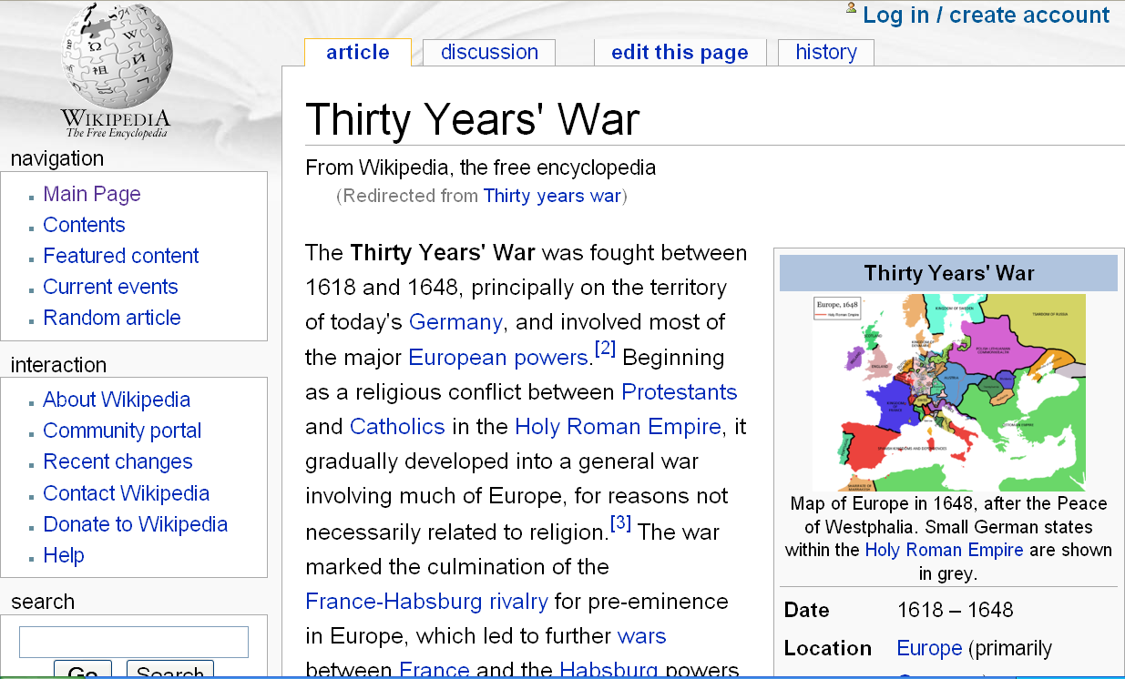
http://en.wikipedia.org/wiki/Thirty_years_war /

Slide 31
The real “Thirty Years’ War”
was fought in London and Europe
but it ended in
2003
Not in 1648 . . .
or did it?
http://www.davidsumberg.com/new_page_17.htm

Slide 32
Thursday, 16 January 2003,
the Chocolate War
officially ends . . .
Notes:
32

Slide 33
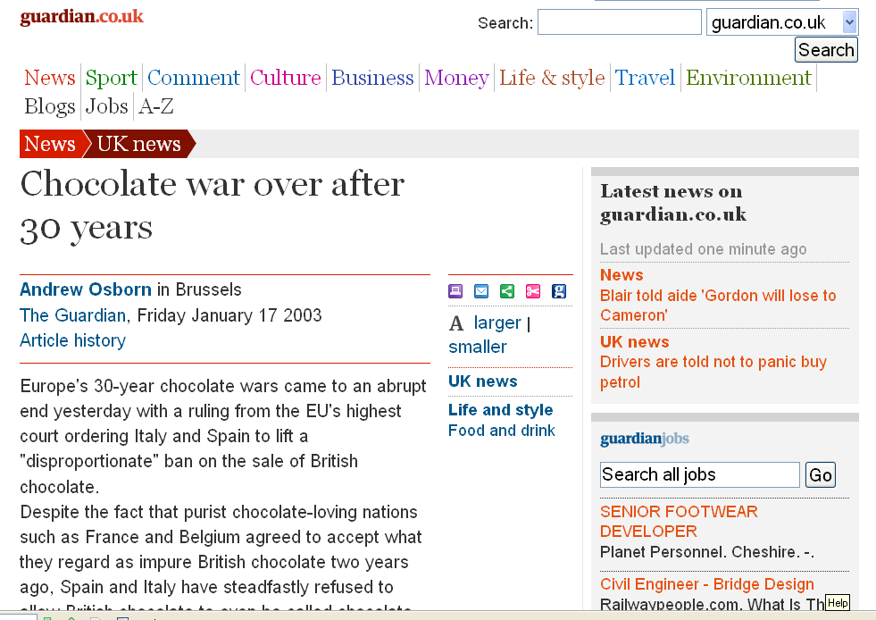
www.guardian.co.uk/uk/2003/jan/17/foodanddrink

Slide 34
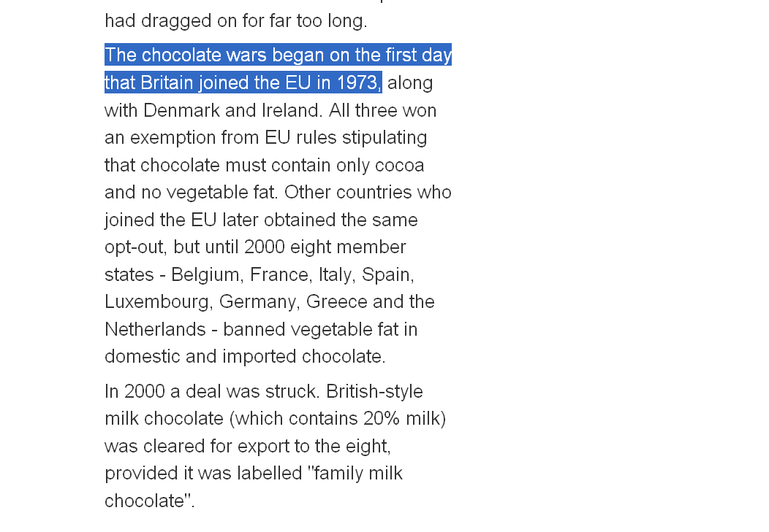
Cadbury’s
is was British
www.guardian.co.uk/uk/2003/jan/17/foodanddrink

Slide 35
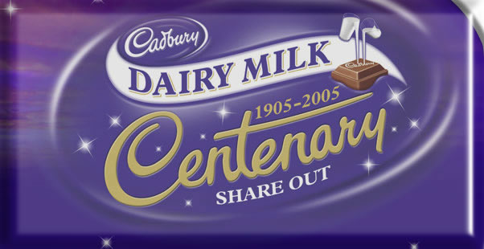
http://www.cadbury.co.uk/EN/CTB2003/about_chocolate/history_cadbury/
Notes:
35

Slide 36
2008:
The Confection War
flaring up again . . .
2008
The Chocolate War
may be flaring up again …
Notes:
36

Slide 37
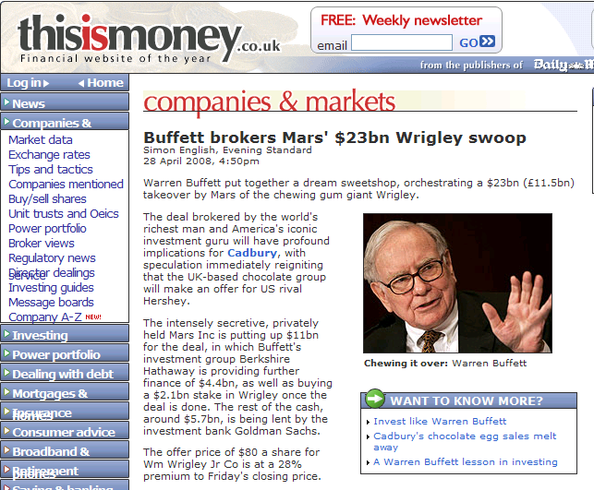
www.thisismoney.co.uk/investing-and-markets/article.html?in_article_id=440876&in_page_id=3&position=moretopstories
Notes:
37

Slide 38
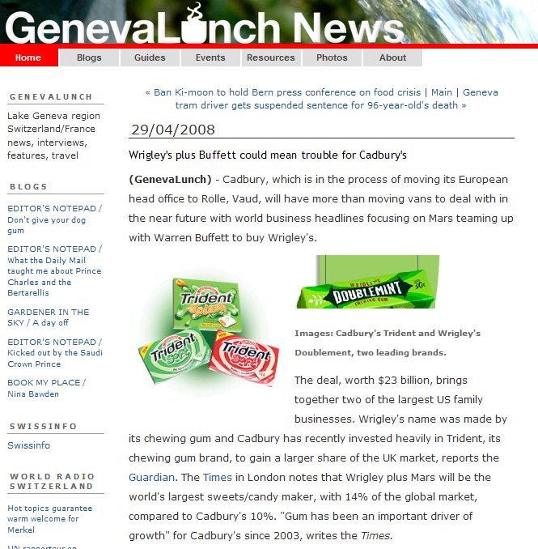
www.genevalunch.com/genevalunchrethink/2008/04/wrigleys-plus-b.html
Notes:
38

Slide 39
2000:
The Chocolate War
“ends” early . . .
Back to the war …
Notes:
39

Slide 40
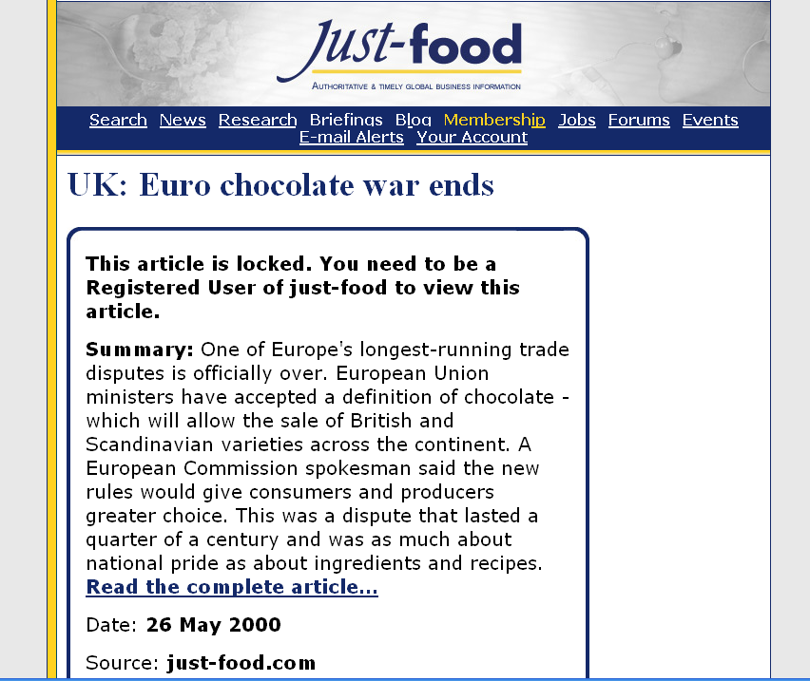
www.just-food.com/article.aspx?ID=88892/

Slide 41
2003:
The Chocolate War
ends again . . .
. . . well, actually,
the “battle” ends . . .
Notes:
41

Slide 42
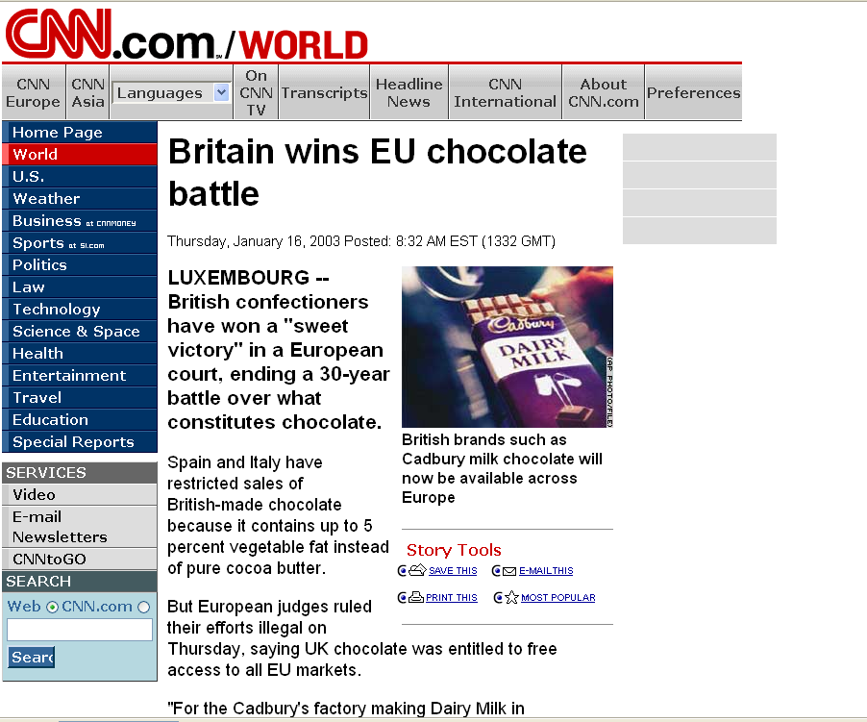
www.cnn.com/2003/WORLD/europe/01/16/chocolate.war/

Slide 43
Britain may have won the battle,
but they were soon
to lose the war . . .
at least
the high-stakes war . . .
Notes:
43

Slide 44

And, of course, it all changed again on 31 January 2020, with BREXIT . . .
Wikipedia
Notes:
44

Slide 45
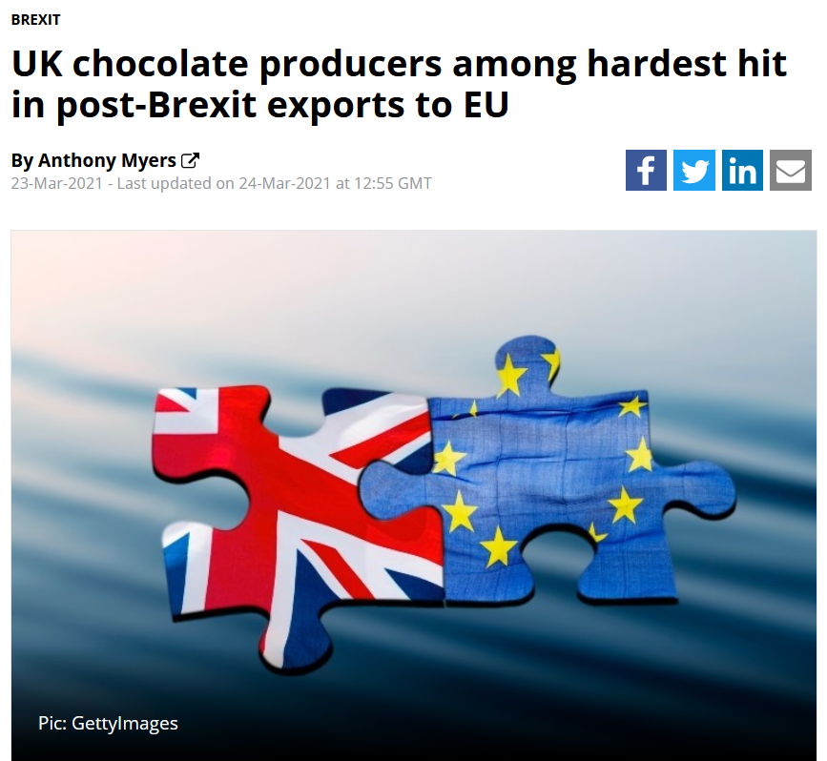

24 March 2021
https://www.confectionerynews.com/Article/2021/03/23/UK-chocolate-producers-among-hardest-hit-in-post-Brexit-exports-to-EU
Notes:
45

Slide 46
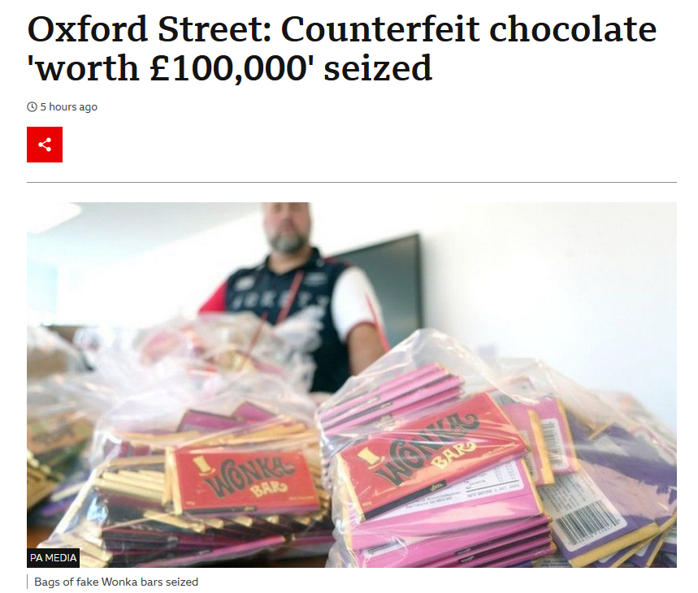
The battle lingers on (in a way)
on 15 June 2022, with as the UK cracks down . . .
https://www.bbc.com/news/uk-england-london-61810743
Notes:
46

Slide 47
15 June 2022
https://www.bbc.com/news/uk-england-london-61810743
Notes:
47

Slide 48
Much has been written
about
the “Chocolate War” . . .
http://www.davidsumberg.com/new_page_17.htm
Notes:
48

Slide 49
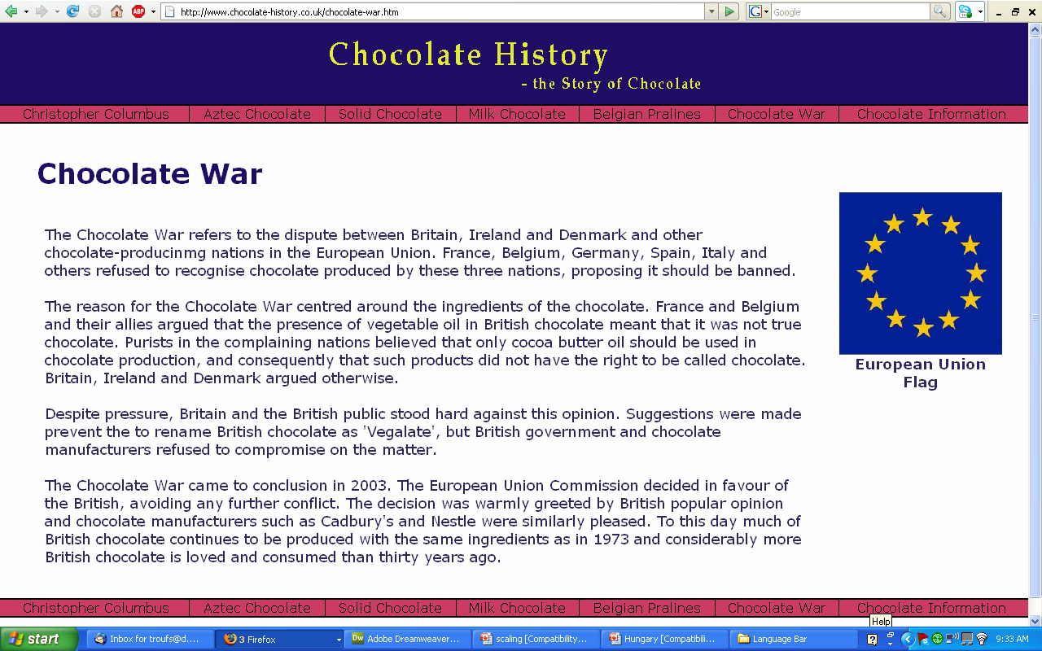
www.chocolate-history.co.uk/chocolate-war.htm

Slide 50
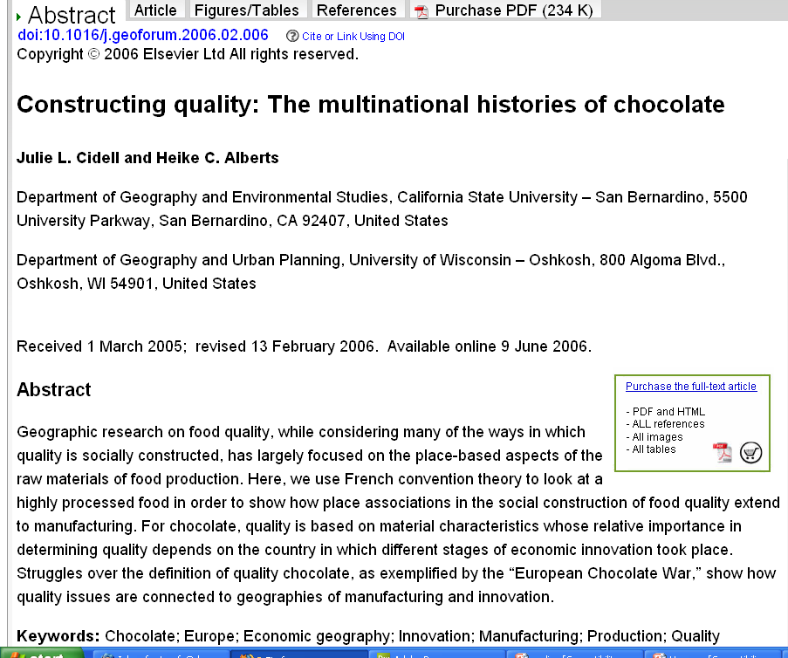
Geoforum, Volume 37, Issue 6, November 2006, pp. 999-1007/

Slide 51
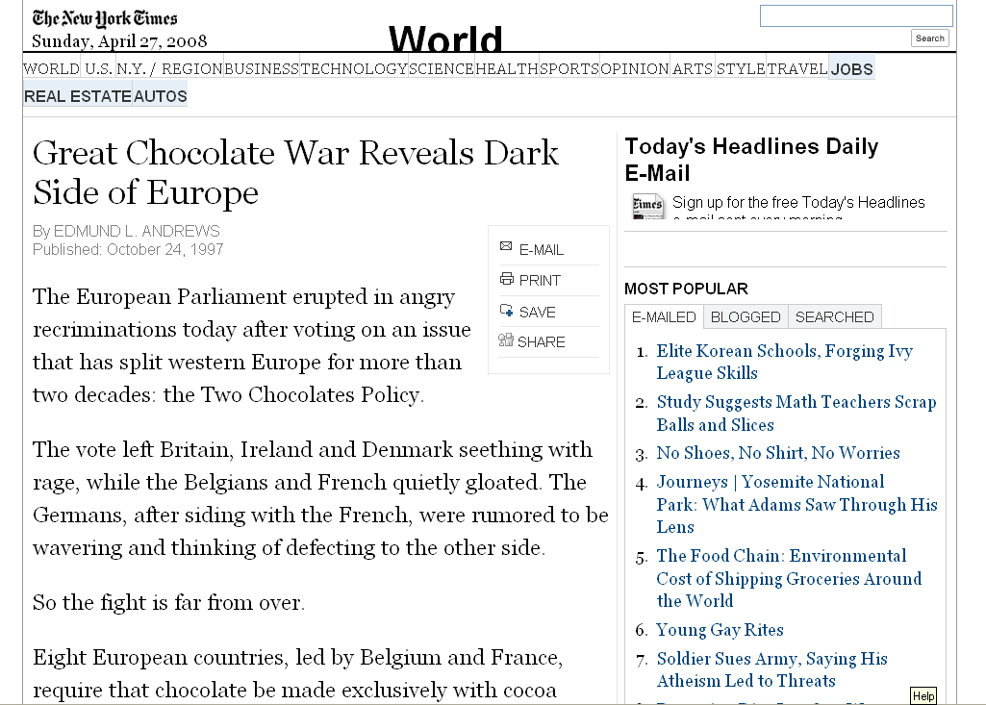
http://query.nytimes.com/gst/fullpage.html?res=9B01E1DF113EF937A15753C1A961958260&sec=&spon=&pagewanted=all

Slide 52
In 2007 the
chocolate hostilities
flared up
in a former British Colony . . .
http://www.davidsumberg.com/new_page_17.htm

Slide 53
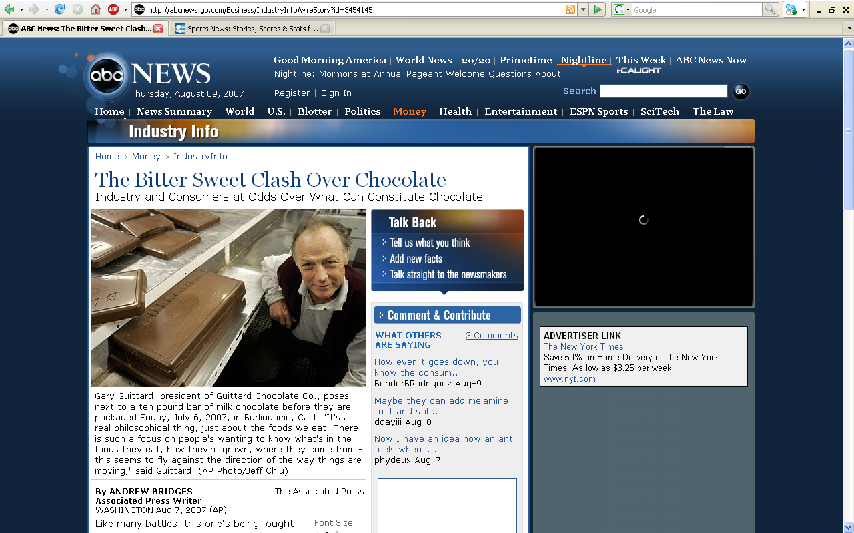
The question is
“Just exactly what is ‘chocolate’”?
http://abcnews.go.com/Business/IndustryInfo/wireStory?id=3454145

Slide 54
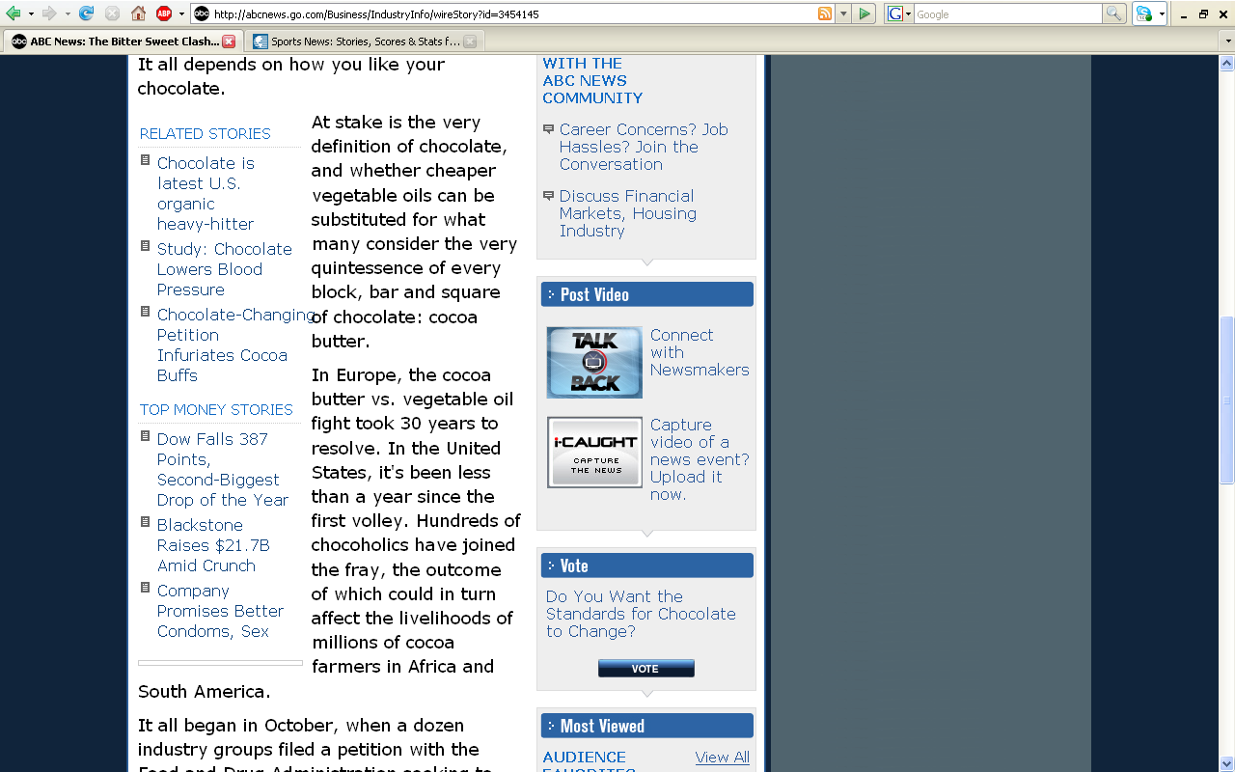
http://abcnews.go.com/Business/IndustryInfo/wireStory?id=3454145

Slide 55
European food products often include . . .
European Union
“protected geographical indications”
http://www.davidsumberg.com/new_page_17.htm

Slide 56
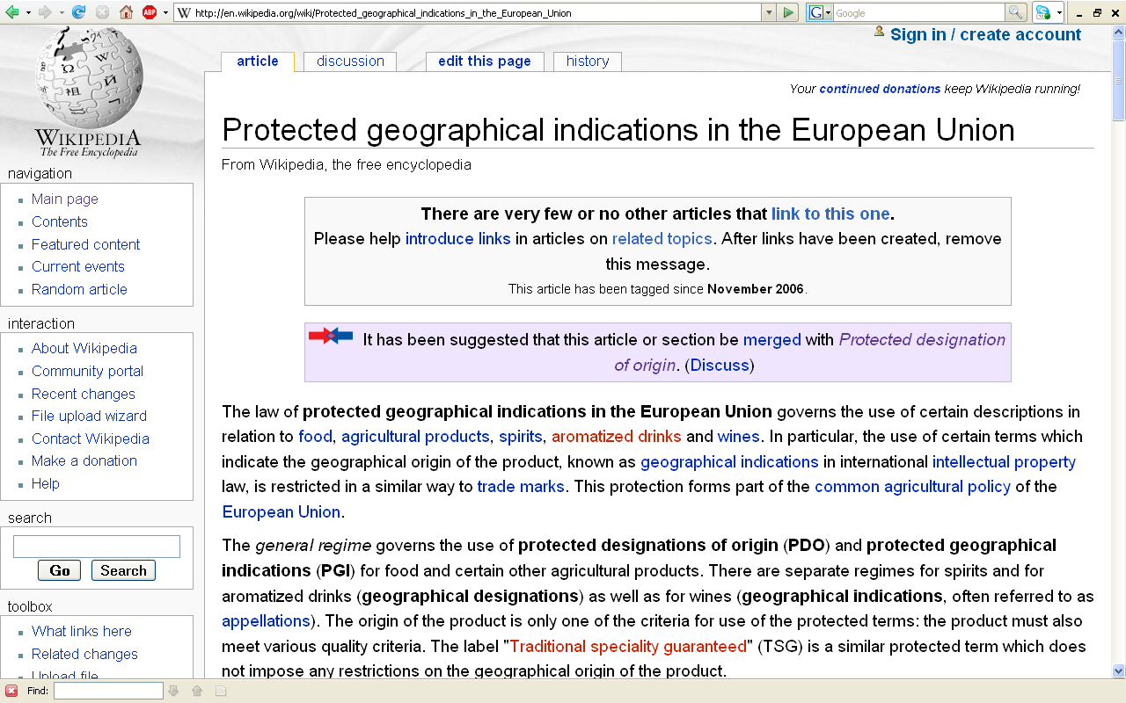
http://en.wikipedia.org/wiki/Protected_geographical_indications_in_the_European_Union

Slide 57
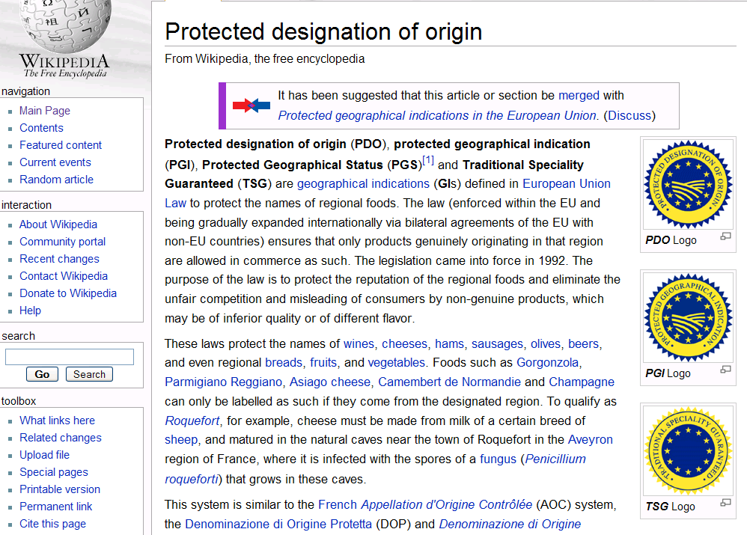
“Protected Designation of Origin”
“Protected Geographical Indication”
“Traditional Specialty Guaranteed”
http://en.wikipedia.org/wiki/Protected_designation_of_origin
Notes:
57

Slide 58
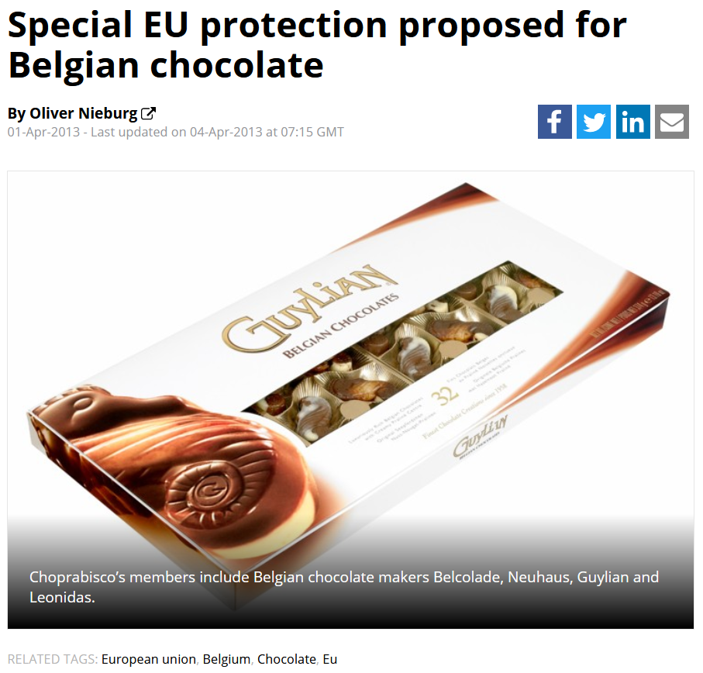
04 April 2013
https://www.confectionerynews.com/Article/2013/04/02/Belgian-chocolate-special-protection-proposal
Notes:
58

Slide 59
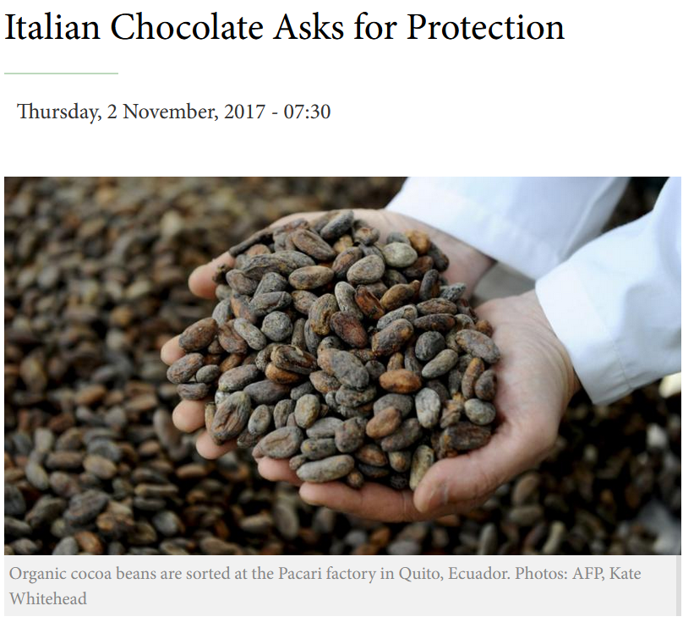

02 November 2017
https://english.aawsat.com//home/article/1071176/italian-chocolate-asks-protection
Notes:
59

Slide 60
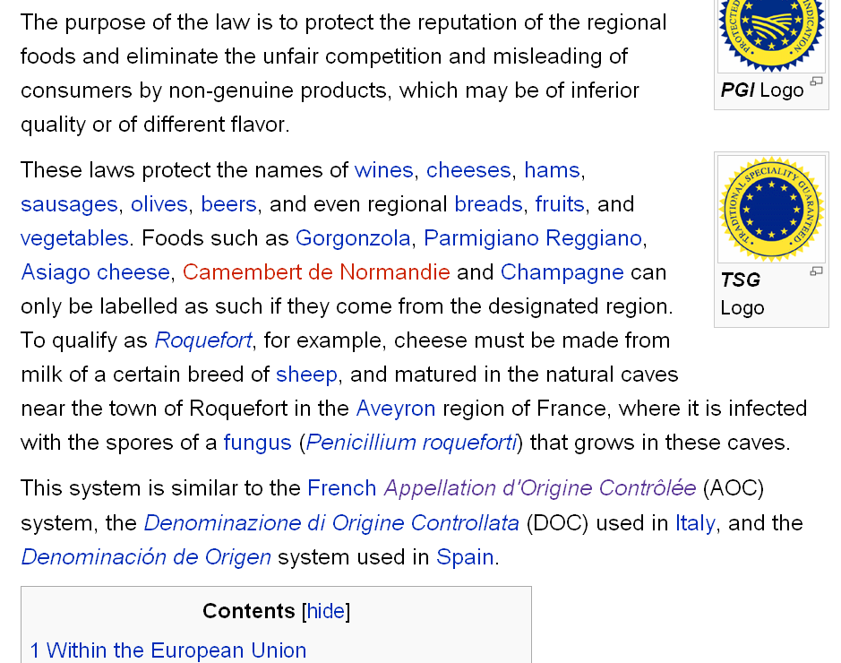
http://en.wikipedia.org/wiki/Protected_designation_of_origin

Slide 61
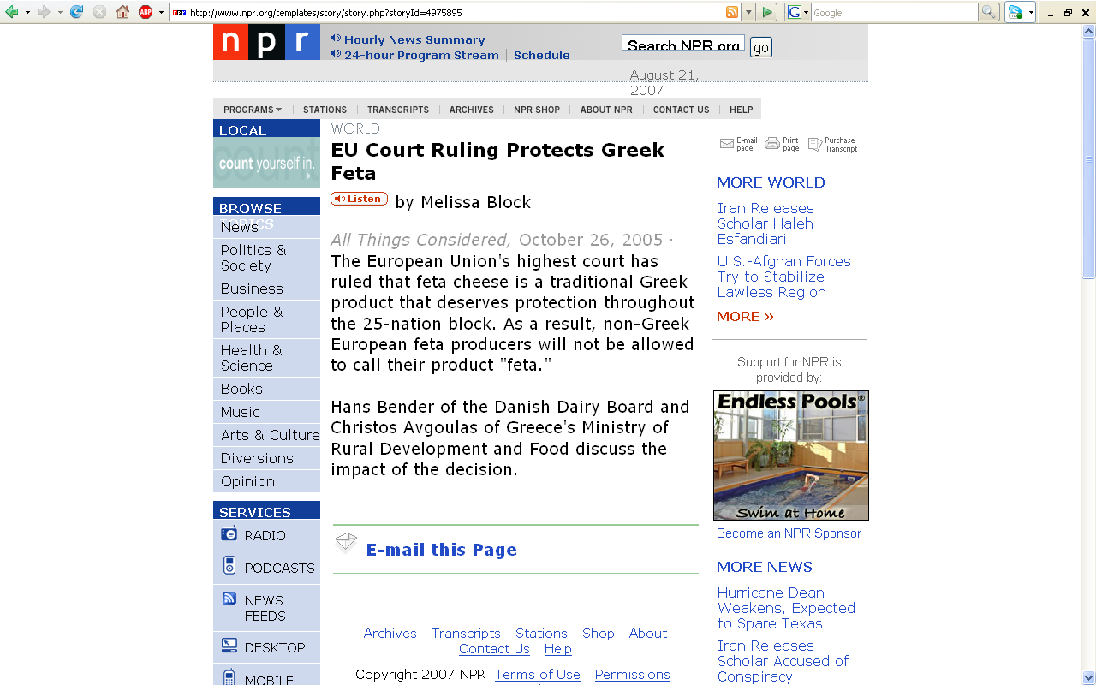
http://www.npr.org/templates/story/story.php?storyId=4975895

Slide 62
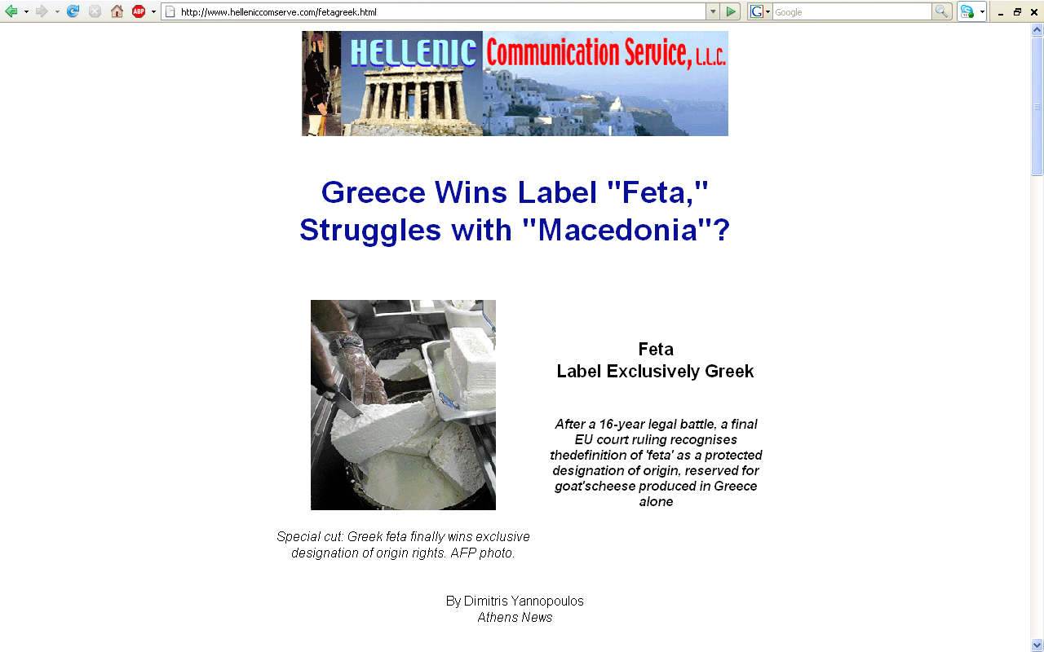
http://www.helleniccomserve.com/fetagreek.html

Slide 63
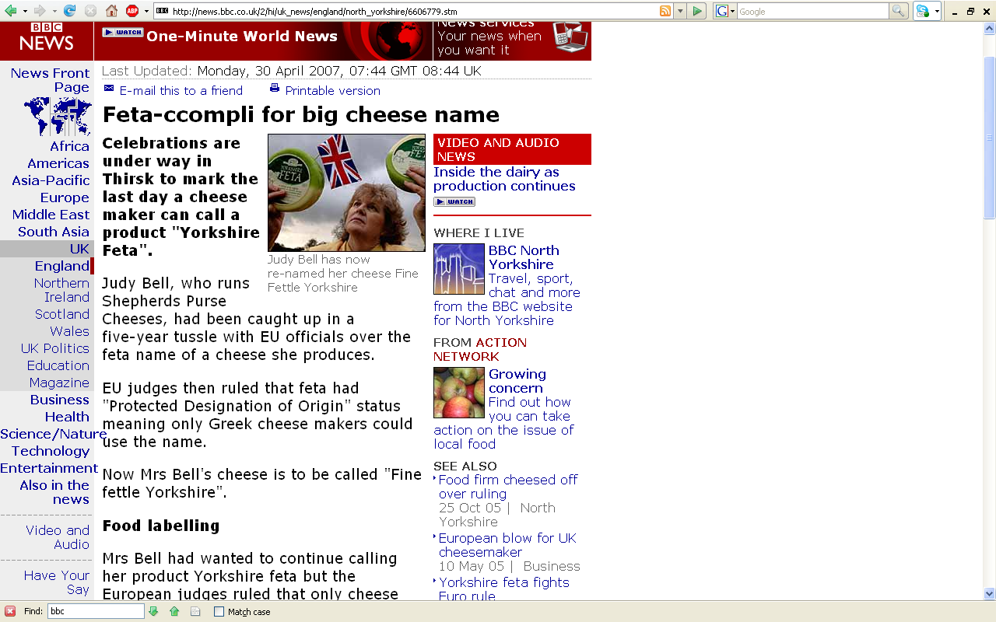
http://news.bbc.co.uk/2/hi/uk_news/england/north_yorkshire/6606779.stm

Slide 64
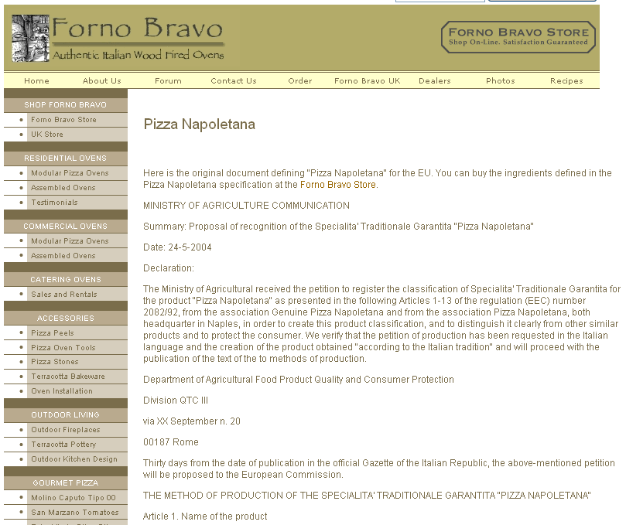
http://www.fornobravo.com/vera_pizza_napoletana/VPN_spec.html

Slide 65
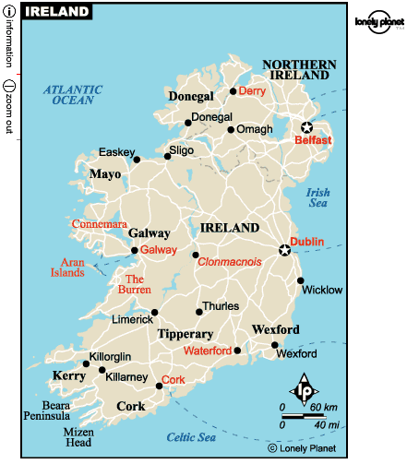
Other special products also have protected status . . .

Slide 66
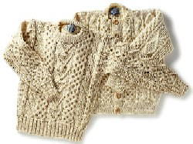
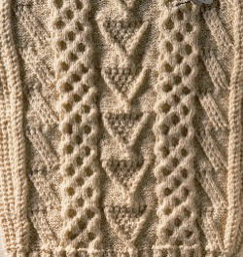
Other special products also have protected status . . .
like, for e.g., Irish Fishermen’s sweaters from the
Aran Islands
http://www.savilerowclub.com/annai/knit.htm

Slide 67
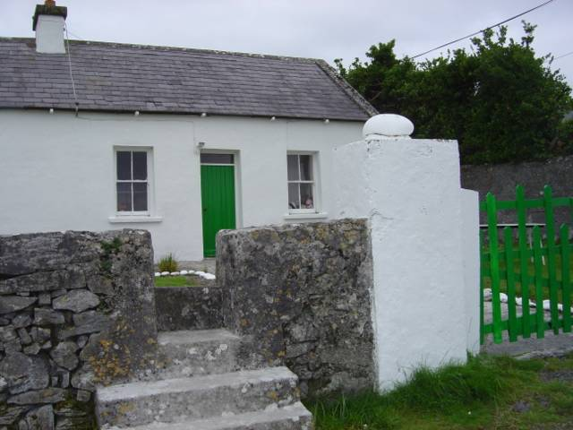
Mairead's cottage where a knitting workshop takes place on Inish Oirr
http://beknitted.blogspot.com/2004_08_01_beknitted_archive.html

Slide 68
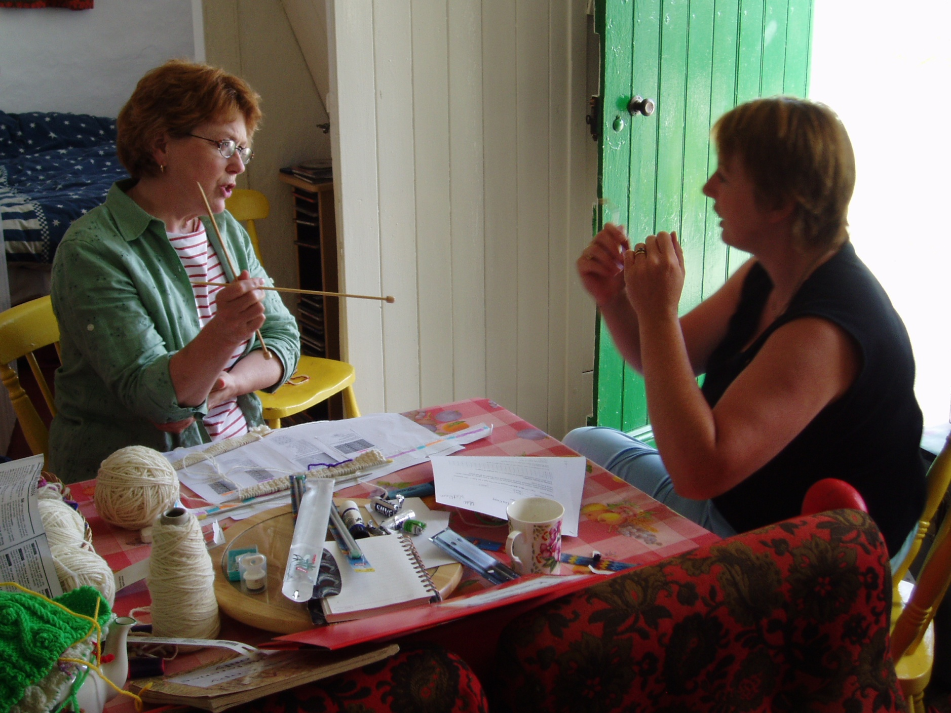
Kim Roufs apprenticing at Mairead's cottage on Inish Oirr

Slide 69


Other special products also have protected status . . .
Bordeaux wine, for e.g.

Slide 70

1994
http://www.davidsumberg.com/new_page_17.htm

Slide 71
Scaling
chocolates
“In 1994 the European Union was establishing Europe-wide food standards. When they came around to Chocolate, Belgium and France and Germany supported the idea of creating a standard that said only something that was in excess of 50% Cacao could be called Chocolate. England (home of Cadbury which manufactures tons of candy that contains less than 10% Cacao) opposed the idea.” . . .
http://www.mrkland.com/fun/xocoatl/bars.htm

Slide 72
Scaling
chocolates
“In 1994 the European Union was establishing Europe-wide food standards. When they came around to Chocolate, Belgium and France and Germany supported the idea of creating a standard that said only something that was in excess of 50% Cacao could be called Chocolate. England (home of Cadbury which manufactures tons of candy that contains less than 10% Cacao) opposed the idea.” . . .
http://www.mrkland.com/fun/xocoatl/bars.htm

Slide 73
Scaling
chocolates
“In 1994 the European Union was establishing Europe-wide food standards. When they came around to Chocolate, Belgium and France and Germany supported the idea of creating a standard that said only something that was in excess of 50% Cacao could be called Chocolate. England (home of Cadbury which manufactures tons of candy that contains less than 10% Cacao) opposed the idea.” . . .
http://www.mrkland.com/fun/xocoatl/bars.htm

Slide 74



Scaling
chocolates
“In 1994 the European Union was establishing Europe-wide food standards. When they came around to Chocolate, Belgium and France and Germany supported the idea of creating a standard that said only something that was in excess of 50% Cacao could be called Chocolate. England (home of Cadbury which manufactures tons of candy that contains less than 10% Cacao) opposed the idea.” . . .
http://www.mrkland.com/fun/xocoatl/bars.htm

Slide 75
Scaling
Chocolates and “The Chocolate War”
“After months of arguments and threatened trade wars, Germany switched sides -- they have several large milk-chocolate-candy manufacturers and supposedly there was pressure from Switzerland, which is not in the EU, but manufactures huge quantities of milk-chocolate-candy. So England, and Cadbury won. Anything can be called Chocolate in the EU, as long as it contains at least 1% Chocolate. (In the USA the FDA minimum is 10%.) However -- the EU said that each bar must state on the label the percentage of Cacao that it contains.” . . .
http://www.mrkland.com/fun/xocoatl/bars.htm

Slide 76
Scaling
Chocolates and “The Chocolate War”
“After months of arguments and threatened trade wars, Germany switched sides -- they have several large milk-chocolate-candy manufacturers and supposedly there was pressure from Switzerland, which is not in the EU, but manufactures huge quantities of milk-chocolate-candy. So England, and Cadbury won. Anything can be called Chocolate in the EU, as long as it contains at least 1% Chocolate. (In the USA the FDA minimum is 10%.) However -- the EU said that each bar must state on the label the percentage of Cacao that it contains.” . . .
http://www.mrkland.com/fun/xocoatl/bars.htm

Slide 77


Scaling
Spain and Italy
Banned “Chocolate”
chocolates
“In 1994 the European Union was establishing Europe-wide food standards. When they came around to Chocolate, Belgium and France and Germany supported the idea of creating a standard that said only something that was in excess of 50% Cacao could be called Chocolate. England (home of Cadbury which manufactures tons of candy that contains less than 10% Cacao) opposed the idea.” . . .
http://www.mrkland.com/fun/xocoatl/bars.htm
Spain
Italy

Slide 78
1994
http://www.davidsumberg.com/new_page_17.htm

Slide 79
Scaling
Chocolates and “The Chocolate War”
“After months of arguments and threatened trade wars, Germany switched sides -- they have several large milk-chocolate-candy manufacturers and supposedly there was pressure from Switzerland, which is not in the EU, but manufactures huge quantities of milk-chocolate-candy. So England, and Cadbury won. Anything can be called Chocolate in the EU, as long as it contains at least 1% Chocolate. (In the USA the FDA minimum is 10%.) However -- the EU said that each bar must state on the label the percentage of Cacao that it contains.” . . .
http://www.mrkland.com/fun/xocoatl/bars.htm

Slide 80
Scaling
Chocolates and “The Chocolate War”
“After months of arguments and threatened trade wars, Germany switched sides -- they have several large milk-chocolate-candy manufacturers and supposedly there was pressure from Switzerland, which is not in the EU, but manufactures huge quantities of milk-chocolate-candy. So England, and Cadbury won. Anything can be called Chocolate in the EU, as long as it contains at least 1% Chocolate. (In the USA the FDA minimum is 10%.) However -- the EU said that each bar must state on the label the percentage of Cacao that it contains.” . . .
http://www.mrkland.com/fun/xocoatl/bars.htm

Slide 81
Scaling
Chocolates and “The Chocolate War”
“After months of arguments and threatened trade wars, Germany switched sides -- they have several large milk-chocolate-candy manufacturers and supposedly there was pressure from Switzerland, which is not in the EU, but manufactures huge quantities of milk-chocolate-candy. So England, and Cadbury won. Anything can be called Chocolate in the EU, as long as it contains at least 1% Chocolate. (In the USA the FDA minimum is 10%.) However -- the EU said that each bar must state on the label the percentage of Cacao that it contains.” . . .
http://www.mrkland.com/fun/xocoatl/bars.htm

Slide 82
Scaling
Chocolates and “The Chocolate War”
“That last bit was crucial, and the reaction was predictable. Consumers flocked to the few bars that were rich & pure, 70% or more. So the milk-chocolate-candy prints the percentages in teeny tiny print on the back, and the pure bars print it in huge print on the front. The pure bars were so popular that new brands and varieties are introduced every day! Galler claims to have been the first to sell a bar with 70% Cacao in Belgium in 1993. Even Cadbury has one (in late 1997 they raised the Cacao content from 64% to 76%), called 1898 -- but they do not put their own name anywhere on it, for fear of hurting sales!!! .” . . .
http://www.mrkland.com/fun/xocoatl/bars.htm

Slide 83
Scaling
Chocolates and “The Chocolate War”
“That last bit was crucial, and the reaction was predictable. Consumers flocked to the few bars that were rich & pure, 70% or more. So the milk-chocolate-candy prints the percentages in teeny tiny print on the back, and the pure bars print it in huge print on the front. The pure bars were so popular that new brands and varieties are introduced every day! Galler claims to have been the first to sell a bar with 70% Cacao in Belgium in 1993. Even Cadbury has one (in late 1997 they raised the Cacao content from 64% to 76%), called 1898 -- but they do not put their own name anywhere on it, for fear of hurting sales!!! .” . . .
http://www.mrkland.com/fun/xocoatl/bars.htm

Slide 84
Scaling
Chocolates and “The Chocolate War”
“That last bit was crucial, and the reaction was predictable. Consumers flocked to the few bars that were rich & pure, 70% or more. So the milk-chocolate-candy prints the percentages in teeny tiny print on the back, and the pure bars print it in huge print on the front. The pure bars were so popular that new brands and varieties are introduced every day! Galler claims to have been the first to sell a bar with 70% Cacao in Belgium in 1993. Even Cadbury has one (in late 1997 they raised the Cacao content from 64% to 76%), called 1898 -- but they do not put their own name anywhere on it, for fear of hurting sales!!! .” . . .
http://www.mrkland.com/fun/xocoatl/bars.htm

Slide 85
Scaling
Chocolates and “The Chocolate War”
“That last bit was crucial, and the reaction was predictable. Consumers flocked to the few bars that were rich & pure, 70% or more. So the milk-chocolate-candy prints the percentages in teeny tiny print on the back, and the pure bars print it in huge print on the front. The pure bars were so popular that new brands and varieties are introduced every day! Galler claims to have been the first to sell a bar with 70% Cacao in Belgium in 1993. Even Cadbury has one (in late 1997 they raised the Cacao content from 64% to 76%), called 1898 -- but they do not put their own name anywhere on it, for fear of hurting sales!!! .” . . .
http://www.mrkland.com/fun/xocoatl/bars.htm

Slide 86
Scaling
Chocolates and “The Chocolate War”
“In late 1998 and early 1999, before I went to Europe, I started to notice a very few pure bars at specialty stores in Seattle, but they were outrageously expensive. In 29 countries in Europe, I discovered that every country has at least ONE, 70%+ Chocolate bar, and most countries have several. In France and Belgium, even the grocery store brands have a 70%+ pure Chocolate bar! France, Belgium, Germany and Poland were the best countries for good pure Chocolate bars. Switzerland, Hungary and Finland, were the worst. I didn't go to Spain, but I did notice that although it is often hard to find, the Spanish Chocolate I did find was excellent. I suspect Spain is probably a great country for pure, real Chocolate, which is historically understandable. ” . . .
http://www.mrkland.com/fun/xocoatl/bars.htm

Slide 87
Scaling
Chocolates and “The Chocolate War”
“Even more exciting, I found several brands that market bars with identical recipes but the Cacao is from different plant varieties and/or from different parts of the world. It is amazing to compare! Toward the end of my trip I saw several more of the series -- even Nestle has a series of three bars from three different countries!!! However, it contains the artificial flavor Vanillin, which is a silly thing to add to a bar for trying to compare Chocolate subtleties! The French brand Chocolat Bonnat was certainly the best of these. Their line of seven (now eight) 75% Cacao bars, each from a different part of the world is amazing: No Vanilla, no lecithin, just Chocolate and a little sugar. I cannot read the French on the label very well, but they do not appear to note which varieties each bar consists of. There was also a Spanish brand, Chocovic, of which I had only small tasters, that was from different varieties and was very good.” . . .
http://www.mrkland.com/fun/xocoatl/bars.htm

Slide 88
Scaling
Chocolates and “The Chocolate War”
“There are even a couple of US manufacturers! One, Chocolate made in Belgium and packaged in the US under the absolutely horrible brand name ChocoLove has different bars ranging from 25% (the richest milk chocolate you will ever find) to 77% (YUM!) (and also 100% baking Chocolate). Despite the awful name, the Chocolate is pretty good. They recently introduced a couple of Organic bars too, 61% & 73%. Sharfen-Berger appears to actually make their 70% bars in the US. …”
http://www.mrkland.com/fun/xocoatl/bars.htm

Slide 89
Scaling
Chocolates and “The Chocolate War”
“Between late 2000 and mid 2001 it was fairly difficult to find pure bars here in Seattle, but things are changing very fast. In April of 2003 I did a couple of tastings with about 20 of the best bars in the world. As recently as November of 2001 I could not have purchased ANY of those bars here in Seattle, and yet now I am able to get ALL of them here! Pure bars are becoming almost COMMON -- the important talent is now determining the best pure bars, not just finding any! ” . . .
http://www.mrkland.com/fun/xocoatl/bars.htm

Slide 90
Scaling
Chocolates and “The Chocolate War”
“I will not buy any bar with less than 70% Cacao, and generally will not eat any Chocolate that is less than 60% -- I just don't like it.”
Mark’s entire list
mrk.'s Chocolate site
http://www.mrkland.com/fun/xocoatl/#SEL
Real Chocolate Bars
http://www.mrkland.com/fun/xocoatl/bars.htm www.xocoatl.org/bars.htm

Slide 91

Scaling

Slide 92
Scaling
Chocolate Wars 12/1/02
Guardian Unlimited | The Guardian | Chocolate war over after 30 years
  <http://www.guardian.co.uk/uk_news/story/0,3604,876445,00.html>
Big Chocolate - Wikipedia, the free encyclopedia
  http://en.wikipedia.org/wiki/Big_Chocolate

Slide 93
“Anything can be called Chocolate in the EU, as long as it contains at least 1% Chocolate.
In the USA the FDA minimum is 10%.”
http://www.mrkland.com/fun/xocoatl/barlist.htm

Slide 94
In Belgium . . .

Slide 95

Dolfin Chocolat Noir 88% De Cacao
Dolfin's darkest Belgian chocolate bar
very intense, very delightful!
70g/2.47 oz, 88% Cocoa.

Slide 96
In Italy . . .

Slide 97

Amedei

Slide 98
In France . . .

Slide 99

Chocolat Weiss Dark Kacinkoa 85% Bar
A blend of Criollos, Forasteros and Trinitarios cocoa beans.
The taste is that of elegance:
The finesse of tannins, a fruity aroma, a sustained flavor,
and a quite surprising sweetness toward the end
of tasting for an 85% cocoa-content bar.
Net wt. 3.5oz/100g.

Slide 100

Pralus Madagascar Dark Chocolate 75%
Net wt. 3.5oz/100g.
$7.99 (27 April 2008)

Slide 101




Slide 102

“Le cent”
“THE one-hundred”
Pralus “Le 100%”
Net wt. 3.5oz/100g.
$8.29 (27 April 2008)

Slide 103
In Germany . . .

Slide 104

Pralus Madagascar Dark Chocolate 75%
Hachez 88% "Premier Cru" with Cocoa Nibs Bar
Net wt. 3.5oz/100g.
$4.49 (27 April 2008)

Slide 105
In Spain . . .

Slide 106

Chocovic 71% Guyave

Slide 107


Slide 108
In Ireland . . .

Slide 109




Slide 110



Notes:
110

Slide 111
Notes:
111

Slide 112
In Denmark . . .

Slide 113




Slide 114
In England . . .

Slide 115
http://www.cadbury.co.uk/EN/CTB2003/about_chocolate/history_cadbury/

Slide 116


16 June 2018
https://www.irishtimes.com/life-and-style/food-and-drink/what-s-really-inside-your-bar-of-cadbury-dairy-milk-1.3535947

Slide 117
16 June 2018
  23% cocoa solids in the UK
  (in the U.S.A. it is different)
  Sugar: up to half of the finished product
https://www.irishtimes.com/life-and-style/food-and-drink/what-s-really-inside-your-bar-of-cadbury-dairy-milk-1.3535947

Slide 118

http://members.shaw.ca/b.bogdan/caramilk/cadbury.htm

Slide 119



xxx

Slide 120

Selly Manor House
http://www.virtualbrum.co.uk/heritage/page6.htm

Slide 121

Bournville Carillon
Bournville Junior School
http://www.virtualbrum.co.uk/heritage/page6.htm

Slide 122

http://www.publications.bham.ac.uk/birmingham_magazine/b_magazine1996-99/b99_22.htm

Slide 123

Dame Elizabeth Cadbury School and Sixth Form College
Birmingham, Warwickshire, United Kingdom
http://www.dectc.bham.sch.uk/form_gallery.html

Slide 124

Bournville Shops around the Green
http://en.wikipedia.org/wiki/Bournville

Slide 125

The Quaker Meeting House
Selly Manor Museum and Bournville Village Trust
http://www.virtualbrum.co.uk/heritage/page6.htm

Slide 126
In the United States . . .

Slide 127


Slide 128

What does Hershey say about
its cocoa content?
Well . . . (usually) exactly nothing
but we know it is
at least 10%
because that’s the law in America
but it is said to be 11%

Slide 129
Scaling

Slide 130
Scaling
    nominal
    ordinal
    interval
    ratio
  After H. Russell Bernard, Research Methods in Anthropology, 1994

Slide 131
Scaling
    nominal
    ordinal
    interval
    ratio
  After H. Russell Bernard, Research Methods in Anthropology, 1994

Slide 132
Scaling
  nominal scaling
  naming something

Slide 133
Scaling
  nominal scaling
  a nominal variable is an item on a list of things
    the variables are mutually exclusive
    but they do not exhaust the possibilities

Slide 134
Scaling
religion
      Hindu
      Moslem
      Buddhist
      Christian
      Druid
      “Other”

Slide 135
Scaling
chocolates
      Belgian
      Godiva
      Ghirardelli
      Whitman
      Cadbury
      Hershey
      Nestle
      Brachs

Slide 136

https://www.d.umn.edu/cla/faculty/troufs/anth1095/fstext.html#text
Notes:
136

Slide 137
Scaling
  Understanding Global Cultures: Metaphorical Journeys Through 34 Nations, Clusters of Nations, Continents, and Diversity, Sixth Edition
  Martin J. Gannon and Rajnandini (Raj) Pillai
  SAGE Publications, Thousand Oaks, CA, 2015

Slide 138
Scaling
“Horizontal Collectivism / Community Sharing”
  nominal scaling
  only names are given to entities
    in-group vs. out-group

Slide 139
Fig. 1.1. Process, Goals, and Expression of Emotions (p. 12)
Open Expression of Emotions and Feelings
Degree to which process must be emphasized before goals can be discussed |  | Lower | Higher
 | Lower
 | Higher

Slide 140
Fig. 1.1. Process, Goals, and Expression of Emotions (p. 12)
Open Expression of Emotions and Feelings
Degree to which process must be emphasized before goals can be discussed |  | Lower | Higher
 | Lower | England, Ireland, and Scotland | United States and Germany
 | Higher | China, Japan, and India | Mexico, Spain, and Italy
More on the “Four-Stage Model” later, time permitting

Slide 141
Fig. 1.2. Four Generic Types of Cultures (p. 13)
POWER DISTANCE | INDIVIDUALISM COLLECTIVISM
 | Low (horizontal) High (vertical) | Equality Matching (interval) | Community Sharing (nominal)
 |  | Market Pricing (ratio) | Authority Ranking (ordinal)

Slide 142
Scaling
    nominal
    ordinal
    interval
    ratio
  After H. Russell Bernard, Research Methods in Anthropology, 1994

Slide 143
Scaling
  ordinal scaling
  putting things in order

Slide 144
Fig. 1.2. Four Generic Types of Cultures (p. 15)
POWER DISTANCE | INDIVIDUALISM COLLECTIVISM
 | Low (horizontal) High (vertical) | Equality Matching (interval) | Community Sharing (nominal)
 |  | Market Pricing (ratio) | Authority Ranking (ordinal)

Slide 145
Fig. 1.2. Four Generic Types of Cultures (p. 13)
POWER DISTANCE | INDIVIDUALISM COLLECTIVISM
 | Low (horizontal) High (vertical) | Equality Matching (interval) | Community Sharing (nominal)
 |  | Market Pricing (ratio) | Authority Ranking (ordinal)
Poland
Turkey

Slide 146


Scaling
Vertical Collectivism / Authority Ranking Cultures
  ordinal scaling
  individual A may be more important than individual B, and individual C may be more important than individual B, but there is no common unit of measurement

Slide 147
Scaling
  ordinal scaling
  ordinal variables are exhaustive and mutually exclusive
  and their values can be rank ordered

Slide 148
Scaling
  ordinal scaling
    high
    medium
    low

Slide 149
Scaling
socioeconomic class (SES)
    upper class
    middle class
    lower class

Slide 150
Scaling
  types of political organization
    “peasant society”
    “primitive state”
    “chiefdom”
    “tribe”
    “band”

Slide 151
Scaling
chocolates
      Belgian best
      Godiva better
      Ghirardelli better
      Cadbury good
      Whitman good
      Brachs good
      Hershey (orig.) fair
      Nestle fair

Slide 152
Scaling
  ordinal scaling
  in general, concepts are measured at the ordinal level

Slide 153
Scaling
level of acculturation
    very acculturated
    somewhat acculturated
    unacculturated

Slide 154
Scaling
  ordinal scaling
  what ordinal variables do not tell us is how much more
  the most important characteristic of ordinal measure is that there is no way to tell how far apart the attributes are from one another

Slide 155
Scaling
    nominal
    ordinal
    interval
    ratio
  After H. Russell Bernard, Research Methods in Anthropology, 1994

Slide 156
Scaling
  interval scaling
  putting items at fixed intervals

Slide 157
Fig. 1.2. Four Generic Types of Cultures (p. 15)
POWER DISTANCE | INDIVIDUALISM COLLECTIVISM
 | Low (horizontal) High (vertical) | Equality Matching (interval) | Community Sharing (nominal)
 |  | Market Pricing (ratio) | Authority Ranking (ordinal)

Slide 158
Fig. 1.2. Four Generic Types of Cultures (p. 13)
POWER DISTANCE | INDIVIDUALISM COLLECTIVISM
 | Low (horizontal) High (vertical) | Equality Matching (interval) | Community Sharing (nominal)
 |  | Market Pricing (ratio) | Authority Ranking (ordinal)
Germany
Sweden
Ireland
Denmark
France
Poland
Turkey

Slide 159

www.d.umn.edu/cla/faculty/troufs/anth1095/index.html#text
Notes:
159

Slide 160
Scaling
Horizontal Individualism / Equality Matching Cultures
  interval scale
  culture does have a common unit of measurement, but it does not make value judgments about individual worth
    there are too many dimensions along which individuals can be measures

Slide 161
Scaling
  interval scaling
  concrete, observable things are often measured at the interval level
    but not always

Slide 162
Scaling
  interval scaling
  interval variables are exhaustive and mutually exclusive
  and their values can be rank ordered

Slide 163
Scaling
  interval scaling
  and the distances between the attributes are meaningful

Slide 164
Scaling
  interval scaling
    30° Fahrenheit
    40° Fahrenheit
    70° Fahrenheit
    80° Fahrenheit

Slide 165
Scaling
  interval scaling
    40° F - 30° F = 10° F
    80° F - 70° F = 10° F

Slide 166
Scaling
  interval scaling
    but there is no “zero point”
    i.e., 80° Fahrenheit is not twice as warm as 40° Fahrenheit

Slide 167
Scaling
  There could be a zero point,
  and there is with Kelvin system temperatures

Slide 168
Scaling
  “The Kelvin scale is a thermodynamic (absolute) temperature scale, and zero kelvin (0 K) is defined as absolute zero
  (-273.15 degrees Celsius)
  which is the coldest possible temperature.”
  http://en.wikipedia.org/wiki/Kelvin

Slide 169
Scaling
  “The Kelvin scale is a thermodynamic (absolute) temperature scale, and zero kelvin (0 K) is defined as absolute zero
  (-273.15 degrees Celsius)
  which is the coldest possible temperature.”
  and that means the Kelvin scale is ratio rather than interval scaling
  http://en.wikipedia.org/wiki/Kelvin

Slide 170
Scaling
    nominal
    ordinal
    interval
    ratio
  After H. Russell Bernard, Research Methods in Anthropology, 1994

Slide 171
Scaling
  ratio scaling
  interval variables that have a zero point

Slide 172
Fig. 1.2. Four Generic Types of Cultures (p. 15)
POWER DISTANCE | INDIVIDUALISM COLLECTIVISM
 | Low (horizontal) High (vertical) | Equality Matching (interval) | Community Sharing (nominal)
 |  | Market Pricing (ratio) | Authority Ranking (ordinal)

Slide 173
Fig. 1.2. Four Generic Types of Cultures (p. 13)
POWER DISTANCE | INDIVIDUALISM COLLECTIVISM
 | Low (horizontal) High (vertical) | Equality Matching (interval) | Community Sharing (nominal)
 |  | Market Pricing (ratio) | Authority Ranking (ordinal)
Germany
Sweden
Ireland
Denmark
France
Poland
Turkey
Britain
U.S.A.

Slide 174
www.d.umn.edu/cla/faculty/troufs/anth1095/index.html#text
Notes:
174

Slide 175
Scaling
Vertical Individualism / Market Pricing Cultures
  scale is ratio
  there is a common unit of measurement
  and a true zero point
    allows members of the culture to transform every other dimension and compare them monetarily

Slide 176
Scaling
Vertical Individualism / Market Pricing Cultures
  scale is ratio
  there is a common unit of measurement
  and a true zero point
    allows members of the culture to transform every other dimension and compare them monetarily

Slide 177
Scaling
  ratio scaling
  a 40-year-old is 10 years older than a 30-year-old
  a 40-year-old is twice as old as a 20-year-old

Slide 178
Scaling
  ratio scaling
  in the social sciences there are few interval variables that are not also ratio variables
  it is common practice in the social sciences to refer to ratio variables as interval variables

Slide 179
Scaling
  ratio scaling
    years of education
    income in dollars, Euros . . .
    years spent migrating
    population size
    # doctors / 100,000
    # violent crimes / 100,000

Slide 180
Scaling
X cases per Y number
(X / Y)
are
“rates”
and can be compared
  ratio scaling
    years of education
    income in dollars, Euros . . .
    years spent migrating
    population size
    # doctors / 100,000
    # violent crimes / 100,000

Slide 181
Scaling
non-ratio data
that are not rates
often can not be compared
  ratio scaling
    years of education
    income in dollars, Euros . . .
    years spent migrating
    population size
    # doctors / 100,000
    # violent crimes / 100,000

Slide 182
Scaling
chocolates
      Belgian 70+% cacao
      Godiva 70% cacao
      Ghirardelli 40% cacao
      Cadbury 08% cacao
      Whitman xx% cacao
      Brachs xx% cacao
      Hershey (orig.) 10% cacao
      Nestle 10% cacao

Slide 183

www.mrkland.com/fun/xocoatl/barlist.htm

Slide 184
REM:
“Anything can be called Chocolate in the EU, as long as it contains at least 1% Chocolate.
In the USA the FDA minimum is 10%.”
http://www.mrkland.com/fun/xocoatl/barlist.htm

Slide 185
Scaling
The Chocolate Wars
“In 1994 the European Union was establishing Europe-wide food standards. When they came around to Chocolate, Belgium and France and Germany supported the idea of creating a standard that said only something that was in excess of 50% Cacao could be called Chocolate. England (home of Cadbury which manufactures tons of candy that contains less than 10% Cacao) opposed the idea.”
www.mrkland.com/fun/xocoatl/bars.htm

Slide 186

http://www.parade.com/articles/editions/2006/edition_11-12-2006/Chocolate

Slide 187

http://www.thehersheycompany.com/

Slide 188

xxx
http://www.hersheys.com/whatsnew/products.asp

Slide 189

http://www.hersheys.com/cacaoreserve/

Slide 190

http://www.thehersheycompany.com/news/release.asp?releaseID=901574

Slide 191
"Consumers today are searching for new, premium experiences," said Chris Baldwin, Senior Vice President, President, U.S. Commercial Group, The Hershey Company. "Cacao Reserve by Hershey's meets this rapidly growing demand by offering consumers an indulgent chocolate made with carefully chosen, slowly roasted cacao beans, blended with the finest all-natural ingredients. . . ."
“The Cacao Reserve by Hershey's line includes a broad range of premium chocolate products that will let consumers explore different subtleties and intensities of chocolate while learning more about the flavors they prefer. Available in single-serve and take-home bars, truffles and drinking cocoa, the initial line of chocolate bars includes. . . .”
http://www.thehersheycompany.com/news/release.asp?releaseID=901574

Slide 192
The initial line of Cacao Reserve by Hershey's chocolate bars included:
-- Premium Milk (35% cacao): Premium European-style milk chocolate with a smooth, velvety texture
-- Premium Milk with Hazelnuts (35% cacao): Carefully chopped, premium- grade hazelnuts for great taste and texture
-- Extra Dark (65% cacao): Slowly roasted beans and a higher cacao level bring out the rich, indulgent flavor of this selection
-- Extra Dark with Nibs (65% cacao): Includes "the heart of the cacao bean" for crunch and a flavor that is truly unique.
http://www.thehersheycompany.com/news/release.asp?releaseID=901574

Slide 193
The line will [also] include four premium chocolate bars made with cacao beans from individual countries of origin. Cacao Reserve by Hershey's Country of Origin bars encourage consumers to explore their different nuances of flavor and aroma. The single origin collection includes:
-- Java, Indonesia (32% cacao): Fine milk chocolate, caramel taste and a light, tart accent
-- Arriba (50% cacao): Dark milk blend with a hint of herbal notes
-- Santo Domingo (67% cacao): Rich dark chocolate with an intriguing wine and spice character
-- Sao Tome (70% cacao): A blend of rich aromas and subtle spices for a dark, distinct taste
http://www.thehersheycompany.com/news/release.asp?releaseID=901574

Slide 194

www.slashfood.com/2007/02/13/russell-stover-goes-upscale/

Slide 195

Started by the uncle of
Duluth Minnesota’s own
Russell Stover . . .
www.slashfood.com/2007/02/13/russell-stover-goes-upscale/

Slide 196

http://profile.myspace.com/index.cfm?fuseaction=user.viewprofile&friendID=127403281

Slide 197
Scaling
chocolates
      Belgian
      Godiva
      Ghirardelli
      Cadbury
      Whitman
      Brachs
      Hershey (orig.)
      Nestle
In summary

Slide 198
“Nominal”
scaling
naming something
only names are given to entities
a nominal variable is an item on a list of things
http://www.davidsumberg.com/new_page_17.htm

Slide 199
Scaling
chocolates
      Belgian
      French
      Italian
      Spanish
      German
      Swiss
      American
      British
      Venezuelan
      Ecuadorian

Slide 200

www.seventypercent.com/chocop/bars.asp

Slide 201
“Ordinal”
scaling
  simply putting things in order
“A” may be better than “B”, and “C” better than B, but there is no common unit of measurement
  So “A” may or may not be twice as good as “C”, for example
http://www.davidsumberg.com/new_page_17.htm

Slide 202
Scaling
chocolates
      Belgian best
      French best
      Italian best
      Spanish better
      German better
      Swiss better
      American good
      British good
      Venezuelan unknown
      Ecuadorian unknown

Slide 203
Scaling
chocolates
      Belgian best
      French best
      Italian best
      Spanish better
      German better
      Swiss better
      American good
      British good
      Venezuelan unknown
      Ecuadorian unknown

Slide 204

www.seventypercent.com/chocop/bars.asp

Slide 205
Italy
France
France
Swiss
Italy
France
France
Franco-American, using French methods
Venezuela
Venezuela
www.seventypercent.com/chocop/bars.asp

Slide 206
Scaling
chocolates
      Belgian 70+% cacao
      Godiva 70% cacao
      Ghirardelli 40% cacao
      Cadbury 08% cacao
      Whitman xx% cacao
      Brachs xx% cacao
      Hershey (orig.) 10% cacao
      Nestle 10% cacao

Slide 207
www.seventypercent.com/chocop/bars.asp

Slide 208

www.seventypercent.com/chocop/bars.asp

Slide 209

www.seventypercent.com/chocop/bars.asp

Slide 210

If something was ranked and listed as a 4.5
would that mean that it was only half as good
as a 9.0 chocolate?
www.seventypercent.com/chocop/bars.asp

Slide 211
If something was ranked and listed as a 4.5
would that mean that it was only half as good
as a 9.0 chocolate?
Or would an
8.0 compared to an 9.0
be the same difference as a
5.0 compared to a 6.0?
(one unit)
www.seventypercent.com/chocop/bars.asp

Slide 212
If something was ranked and listed as a 4.5
would that mean that it was only half as good
as a 9.0 chocolate?
For that to be the
case you would have
to have an
“Interval”
or
“Ratio”
scale
No
Or would a
8.0 compaFred to an 9.0
be the same difference as a
5.0 compared to
a 6.0?
No
www.seventypercent.com/chocop/bars.asp

Slide 213
“Interval”
scaling
  putting items at fixed intervals
  and their values can be rank ordered
  and the distances between the attributes are meaningful

Slide 214
“Interval”
scaling
  there are few interval variables that are not also ratio variables
  it is common practice in the social sciences to refer to ratio variables as interval variables

Slide 215
“Ratio”
scaling
  there is a common unit of measurement
  and a true zero point
  allows members of the culture to transform every other dimension and compare them monetarily

Slide 216
“Ratio”
scaling
  there is a common unit of measurement
  and a true zero point
  allows members of the culture to transform every other dimension and compare them monetarily

Slide 217
“Ratio”
scaling
  interval variables that have a zero point
  there are few interval variables that are not also ratio variables
  it is common practice in the social sciences to refer to ratio variables as interval variables

Slide 218
Scaling
chocolates
      Belgium $1.62
      Godiva $1.08
      Ghirardelli $ .69
      Cadbury $ .41
      Whitman $ .29
      Brachs $ .28
      Hershey $ .24
      Nestle $ .23

Slide 219
The winner . . .
http://www.davidsumberg.com/new_page_17.htm

Slide 220


18 August 2021
https://www.theyucatantimes.com/2021/08/ticul-yucatan-wins-a-gold-medal-for-having-the-best-chocolate-in-the-world/

Slide 221
The winner . . .
According to
The Academy of Chocolates, London
https://academyofchocolate.org.uk/

Slide 222

https://academyofchocolate.org.uk/

Slide 223

2020 Winners
https://academyofchocolate.org.uk/

Slide 224

http://findarticles.com/p/articles/mi_m4PRN/is_2008_Feb_14/ai_n24263172

Slide 225
And perennial favorites . . .
http://www.davidsumberg.com/new_page_17.htm

Slide 226
Scaling
chocolates
      Belgian best
      French best
      Italian best
      Spanish better
      German better
      Swiss better
      American good
      British good
      Venezuelan unknown
      Ecuadorian unknown

Slide 227

http://ghirardelli.com/products/chocbars_intense_twilight.aspx

Slide 228

http://ghirardelli.com/products/chocbars_intense_twilight.aspx

Slide 229
And what do the
critics say?

Slide 230

www.seventypercent.com/chocop/bars.asp

Slide 231

www.seventypercent.com/chocop/bars.asp

Slide 232
Have a go at a taste test
and see what you think . . .
but try
the “Belgian,” “French”, or “Italian” chocolate first

Slide 233
Of course, one could ask questions like
What is
“Italian”
Country of origin of the finished product?
Chocolate style/recipe?
Country of corporate owner?
Location of factory/division of the company?
Country of origin of the key raw materials?
Does globalization matter?

Slide 234

http://en.wikipedia.org/wiki/Ghirardelli

Slide 235
And anyway,
Xocolatl
(the original “choco-atl”)
is really
Nahuatl (Aztec)
[but they just drank it
as a liquid ( -atl)]

Slide 236

www.d.umn.edu/cla/faculty/troufs/anthfood/afchocolate.html#title

Slide 237
More Chocolate at http://www.d.umn.edu/cla/faculty/troufs/anthfood/afchocolate.html#news
http://www.d.umn.edu/cla/faculty/troufs/anthfood/afchocolate.html#title

Slide 238
What’s Next
In EU Wars?

Slide 239
Coming Attraction?
European Union
“Vodka Wars”
November 2006 -?
http://www.duluthnewstribune.com/

Slide 240

http://en.wikipedia.org/wiki/Vodka_war

Slide 241

Does this labeling
“compromise”
sound familiar?
http://en.wikipedia.org/wiki/Vodka_war

Slide 242

http://news.bbc.co.uk/2/hi/europe/5332432.stm

Slide 243

http://www.duluthnewstribune.com/

Slide 244

http://www.duluthnewstribune.com/

Slide 245

http://www.duluthnewstribune.com/

Slide 246

http://www.duluthnewstribune.com/

Slide 247

http://news.bbc.co.uk/2/hi/business/7322033.stm
Notes:
247

Slide 248
Coming Attraction?
“The Coca Cola Wars”
Sidney Mintz
http://www.duluthnewstribune.com/

Slide 249

http://www.telegraph.co.uk/fashion/fashionpicturegalleries/7547669/Chocolate-Fashion-at-Salon-Du-Chocolat-in-Cairo-Egypt.html?image=6
Notes:
249

Slide 250
The United Kingdom-
European Union
“Sausage War”
2021

Slide 251


09 June 2021
https://www.msn.com/en-gb/news/uknews/what-is-the-brexit-sausage-war-all-about/ar-AAKRvRI
Notes:
251

Slide 252


09 June 2021
https://www.businesslive.co.za/bd/world/europe/2021-06-09-uk-eu-mistrust-deepens-as-sausage-war-talks-fail-to-find-a-breakthrough/
Notes:
252

Slide 253


30 June 2021
https://wsau.com/2021/06/30/eu-agrees-ceasefire-with-britain-in-sausage-war/
Notes:
253

Slide 254
The United Kingdom-
European Union
“Trawler Wars”
2021

Slide 255


7 May 2021
https://www.euractiv.com/section/agriculture-food/news/trawler-wars-europes-fights-over-fish/
Notes:
255

Slide 256

12 Dec 2020
https://www.theguardian.com/politics/2020/dec/12/brexit-fishing-row-evokes-memories-of-cod-wars-with-iceland
Notes:
256

Slide 257
The EU
Thirty-Year Chocolate War:
A Run-up to Scaling
1973-2003
Tim Roufs
© 2010-2024

