Slide 1
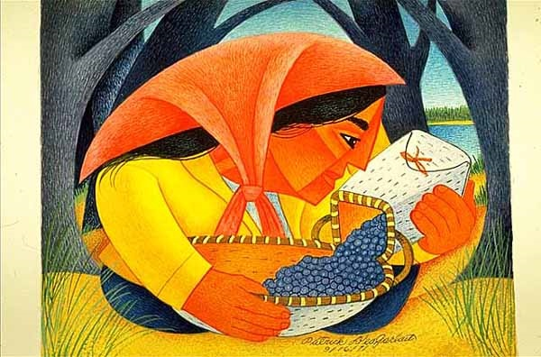
Start deck in “Slide Show” mode,
and use your up/down arrow keys and/or
your space bar to advance the slides
University of Minnesota Duluth
Tim Roufs
© 2010-2024

Slide 2
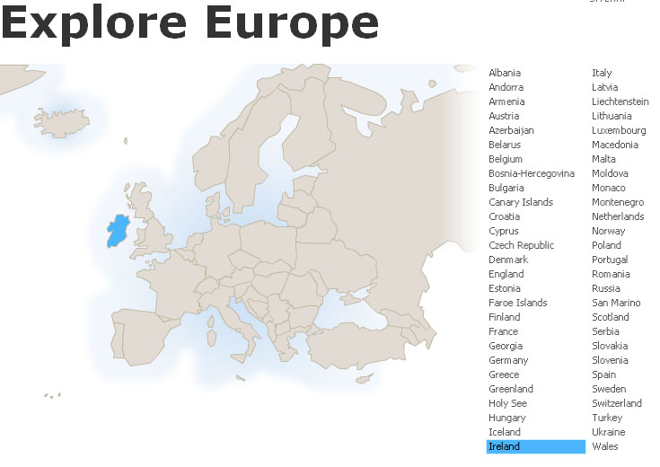
How to find links to
Food Information
on
Countries . . .
and Cuisines . . .
Anthropology of Food
University of Minnesota Duluth
Tim Roufs © 2010-2024

Slide 3
REM
indicates that the materials
are a REMinder
and are thus being repeated . . .
REMinder

Slide 4
there are many links to
food information on “countries, cultures, regions, areas and territories . . .” and cuisines on the course WebPages

Slide 5
and one or more of these
might prove interesting, and useful with your class project

Slide 6
In addition, the A - Z information should also be very useful when it comes time to start thinking about your class project

Slide 7
you can just click on
the A-Z index in your Canvas home to find the country or culture you’re interested in . . .
click “A” for “Afghanistan” . . . “W” for “Wallonia (Belgium)”

Slide 8
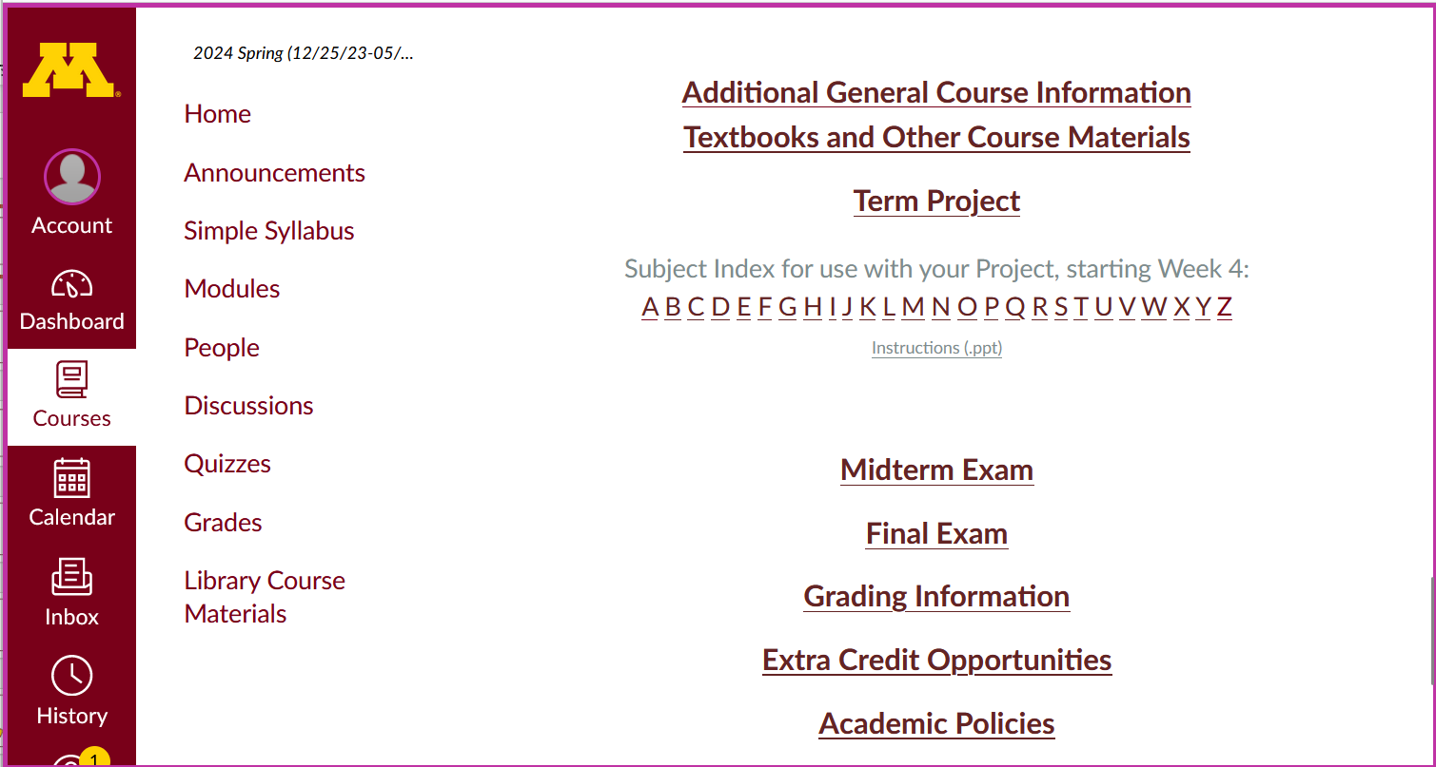
They will be useful later on with your project . .
A-Z Subject Index links

Slide 9
click “A” for “Afghanistan” . . .

Slide 10
click “W” for “Wallonia” (in Belgium) . . .

Slide 11
and so forth . . .

Slide 12
or you can click on “C” and then go to lists of countries . . .

Slide 13
and there is a course WebPage listing all of the countries, cultures and areas available for this course . . .

Slide 14
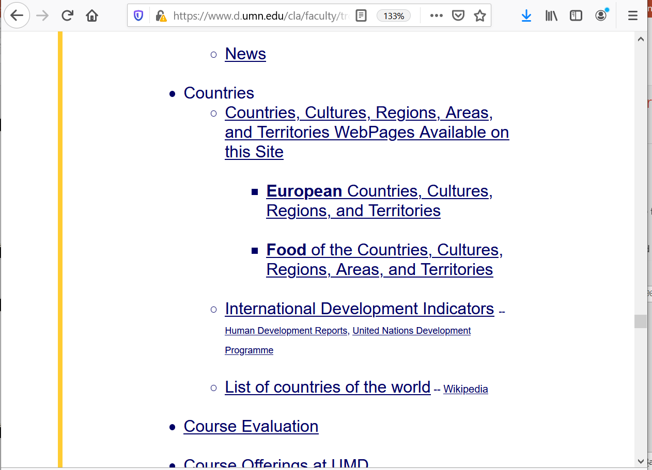
If you click on “C” and go to “Countries” you have three options:
ALL countries that are available
EUROPEAN countries
FOOD LINKS on countries

Slide 15
for this course use the
third list,
the FOOD LINKS list . . .

Slide 17
to get to that course WebPage just click on the
“Cuisines of Countries / Cultures . . .” link in the middle section
of your Canvas Home Page . . .

Slide 18
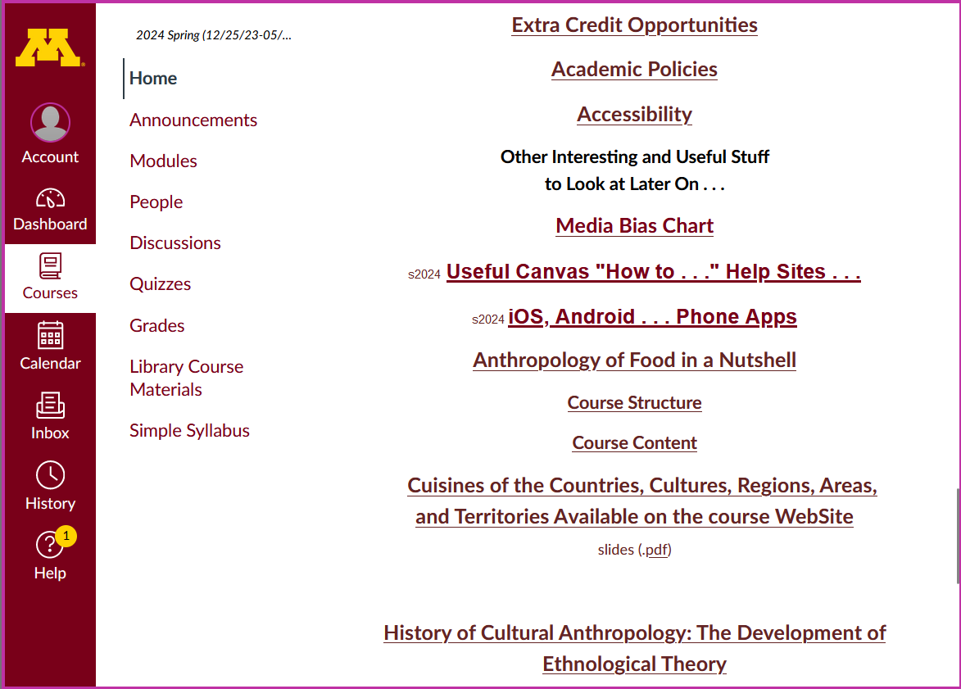

Slide 19
the countries . . . page looks like this

Slide 20
scroll down for the individual countries . . .
or use the page A-Z . . .
the countries . . . page looks like this

Slide 21
scroll down for the individual countries . . .
or use the page A-Z . . .

Slide 22
where to go?

Slide 23
where to go?

Slide 24
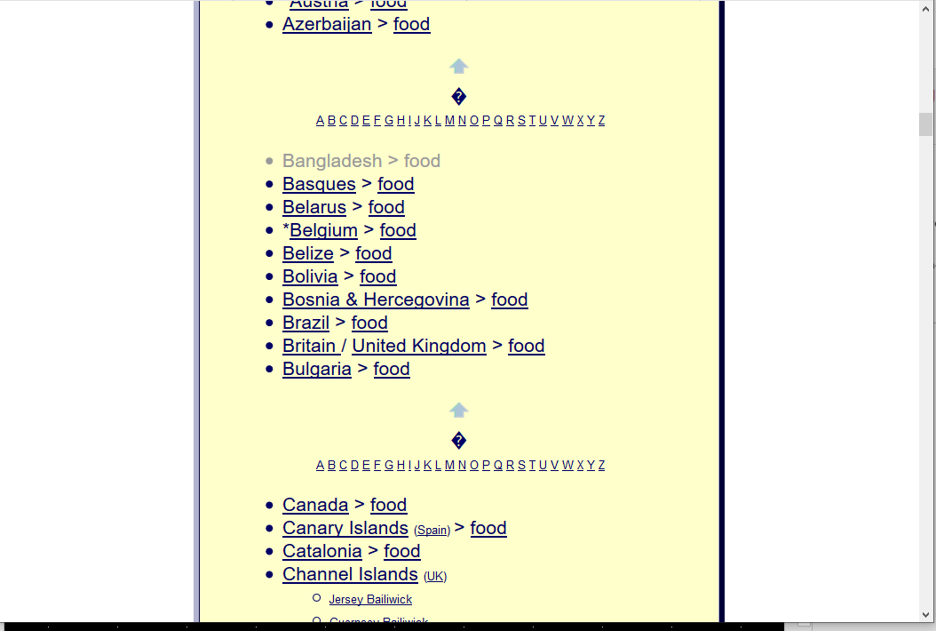
how about Belgium?

Slide 25
the first horse meat that I (knowingly) ate was in Belgium
the best restaurant meal that I have ever eaten was in
Bruges, Belgium
(“the most romantic city in the world”)
[these two events are unrelated]

Slide 26
the first horse meat that I (knowingly) ate was in Belgium
the best restaurant meal that I have ever eaten was in
Bruges, Belgium
(“the most romantic city in the world”)
[these two events are unrelated]

Slide 27
so let’s go to Belgium . . .

Slide 29
Belgium is divided (some say “split”) into three major cultural groups . . .

Slide 30
Waloons
Flemish
People in Brussels
Belgium is divided (some say “split”) into three major cultural groups . . .

Slide 31
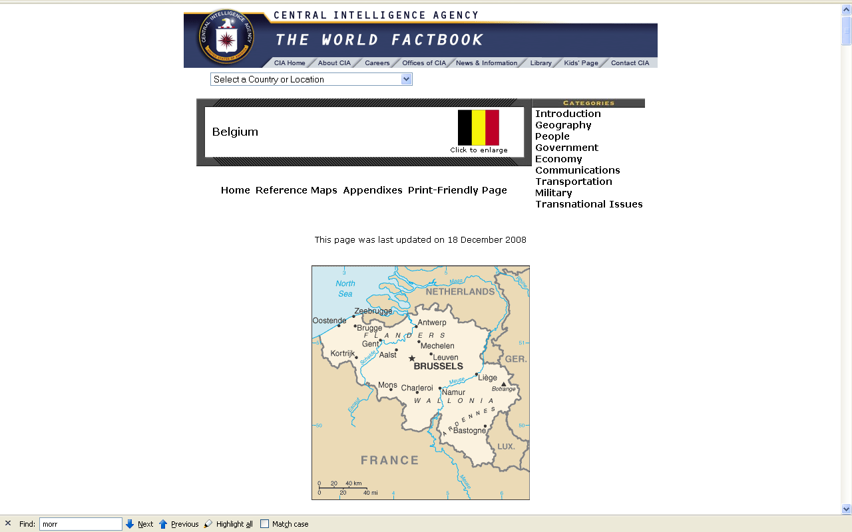
Waloonia
(French Speaking)
(Catholic)

Slide 32
Flanders
(Flemish Speaking)
(Catholic)

Slide 33
Brussels tends to operate as a separate “region”
(Multilingual)
(Catholic)

Slide 34
click on “Belgium” to start your trip

Slide 36
note the three divisions:
Belgium (the country)
Flanders
Wallonia

Slide 37
Belgium, as well as the rest of the sites listed in the textbook have a list of primary resources (useful for your class project) listed prominently towards the top of their pages . . .

Slide 38
Towards the top of a country’s listings there is a handy set of links to food, news, maps, and profiles . . .

Slide 39
And there are a lots of interesting and fun things to learn about the countries.
In Belgium, for e.g. . . .

Slide 40
Food Trivia 1:
in Belgium there is no such thing as a “Belgian waffle”

Slide 41
Food Trivia 2:
but there is a “Brussels sprout”

Slide 42
“Brussels sprouts as we now know them were grown possibly as early as the 1200s in what is now Belgium”.
Wikipedia

Slide 43
Format Factoid: This is the way most Europeans punctuate a “full stop” at the end of a sentence with a quotation mark
in the U.S.A. it is conventionally just the reverse
“Brussels sprouts as we now know them were grown possibly as early as the 1200s in what is now Belgium”.
Wikipedia

Slide 44
Food Trivia 3:
“french fries”
are
French-speaking
Belgium fare,
not French . . .

Slide 45
Food Trivia 3:
“french fries”
are
French-speaking
Belgium fare,
not French . . .
Format Factoid:
“french fries” is not capitalized

Slide 46
Food Trivia 3:
“french fries”
are
French-speaking
Belgium fare,
not French . . .

Slide 47
(. . . a fact most American national politicians apparently were ignorant of when they once voted to serve only “freedom fries” in Washington when France wouldn’t support the second war in Iraq . . .)

Slide 48
. . . but more to the point, speaking of “french” fries, what’s in a name anyway?
Some folks love “escargot”, aka “snails”,
but wouldn’t think of eating “slugs”, even if they were “freedom slugs” . . .

Slide 49
. . . but more to the point, speaking of “french” fries, what’s in a name anyway?
some folks love “escargot”, aka in English as “snails”,
but wouldn’t think of eating “slugs”, even if they were “freedom slugs” . . .

Slide 50
. . . but more to the point, speaking of “french” fries, what’s in a name anyway?
some folks love “escargot”, aka in English as “snails”,
but wouldn’t think of eating “slugs”, even if they were “freedom slugs” . . .

Slide 51
. . . back to the other items on the Belgium page . . .

Slide 52
the food information is indexed on the WebPage page . . .
if you click on “food” from the index page that will take you directly there . . .

Slide 53
click on “food” to go
directly to the food section of the country’s class WebPage

Slide 54
have a look at some of the other items on the page as you’re looking for the food section
they tell you a lot about the country
for e.g., note that Belgium has
three national anthems as well as three flags

Slide 55
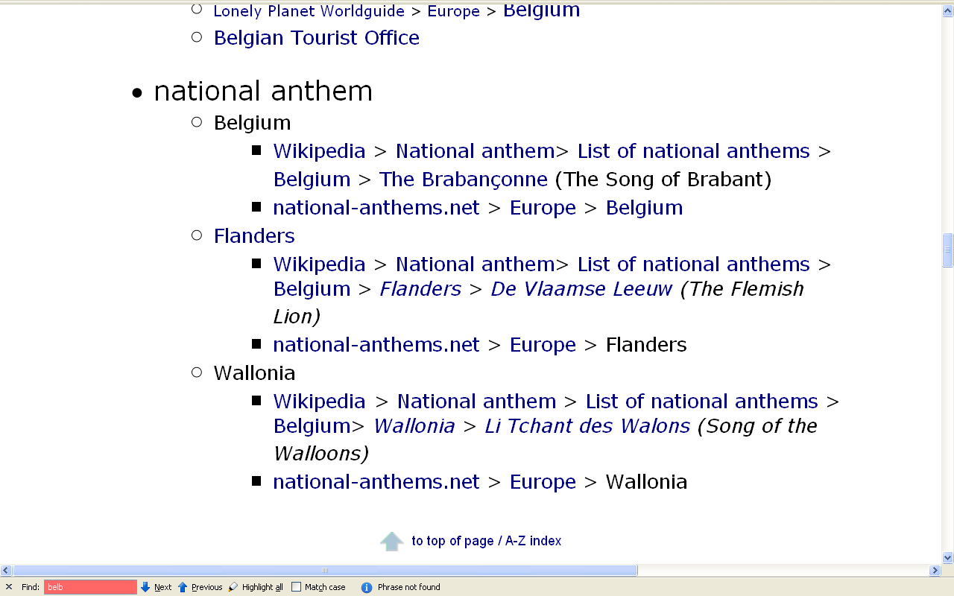
. . . the major regions . . .

Slide 56
. . . about news and the media . . .

Slide 57
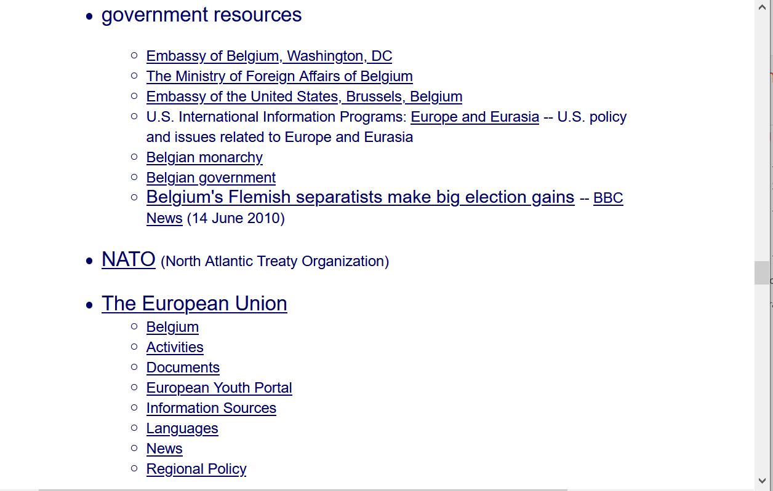
. . . about government and politics . . .

Slide 58
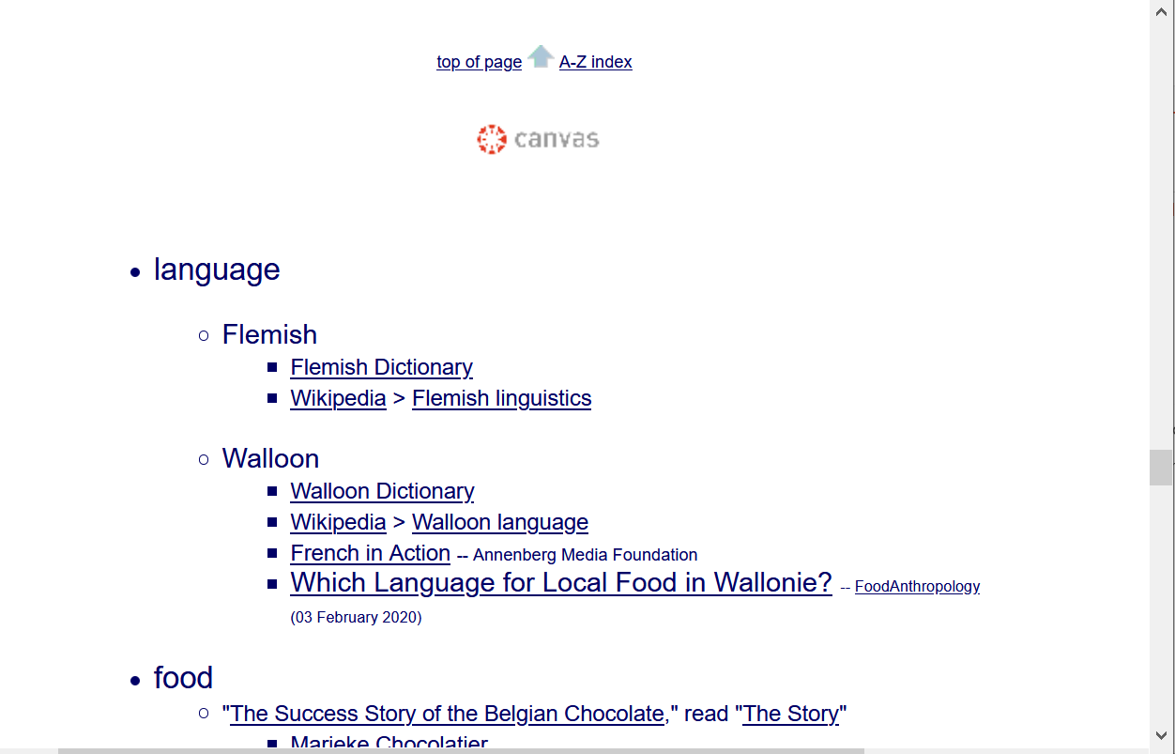
. . . about language . . .

Slide 59
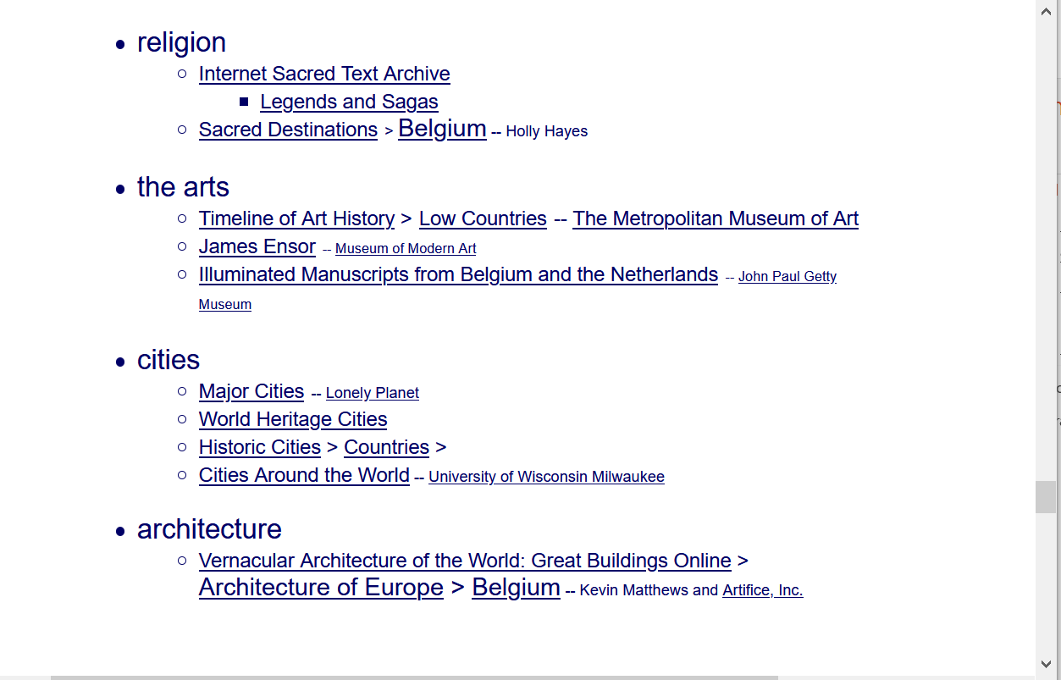
. . . about religion, the arts, and more . . .

Slide 60
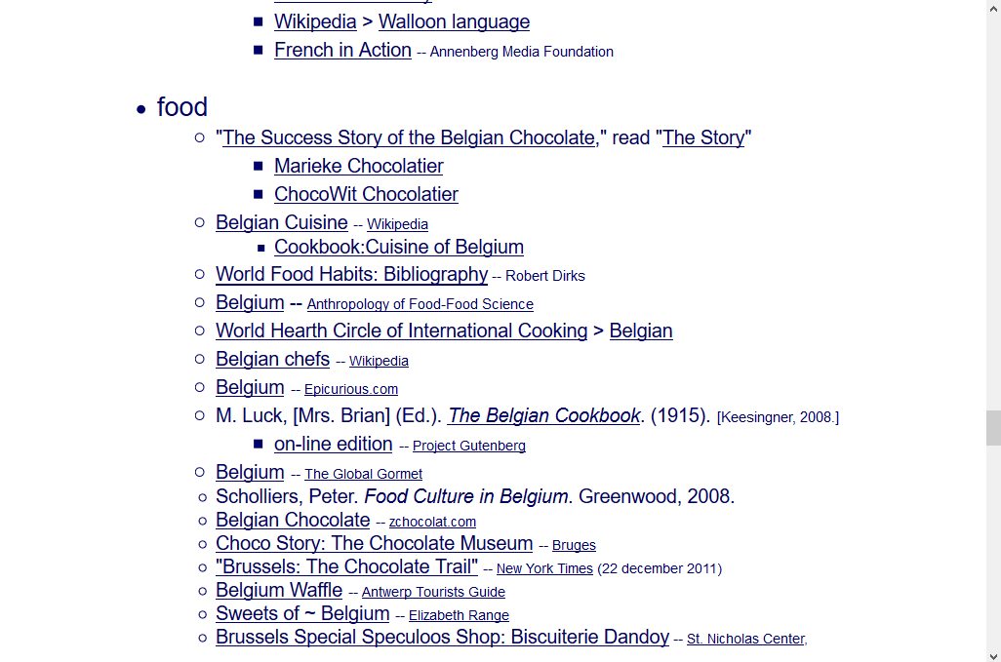
this is the food section of the Belgian class WebPage . . .
. . . about food . . .

Slide 61
this is the food section of the Belgian class WebPage . . .
in the food section, for e.g., you can find a lot of information on Belgium cuisine . . .
and you might even note that they have some of the best chocolate in the world . . .
and that they DO love waffles (but each region has their own style and name – what we call the “Belgium Waffle” is a “Brussels Waffle”)

Slide 62
this is the food section of the Belgian class WebPage . . .
in the food section, for e.g., you can find a lot of information on Belgium cuisine . . .
and you might even note that they have some of the best chocolate in the world . . .
and that they DO love waffles (but each region has their own style and name – what we call the “Belgium Waffle” is a “Brussels Waffle”)

Slide 63
this is the food section of the Belgian class WebPage . . .
in the food section, for e.g., you can find a lot of information on Belgium cuisine . . .
and you might even note that they have some of the best chocolate in the world . . .
and that they DO love waffles (but each region has their own style and name – what we call the “Belgium Waffle” is a “Brussels Waffle”)

Slide 64
this is the food section of the Belgian class WebPage . . .
what we call the “Belgian Waffle” is what they call the “Brussels Waffle” and it’s the style eaten in the Brussels area
other areas of Belgium have their own styles

Slide 65
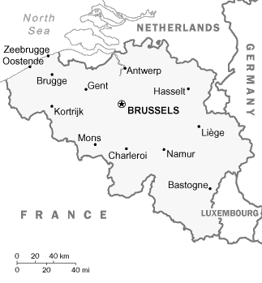
this is the food section of the Belgian class WebPage . . .
what we call the “Belgian Waffle” is what they call the “Brussels Waffle” and it’s the style eaten in the Brussels area
other areas of Belgium have their own styles

Slide 66
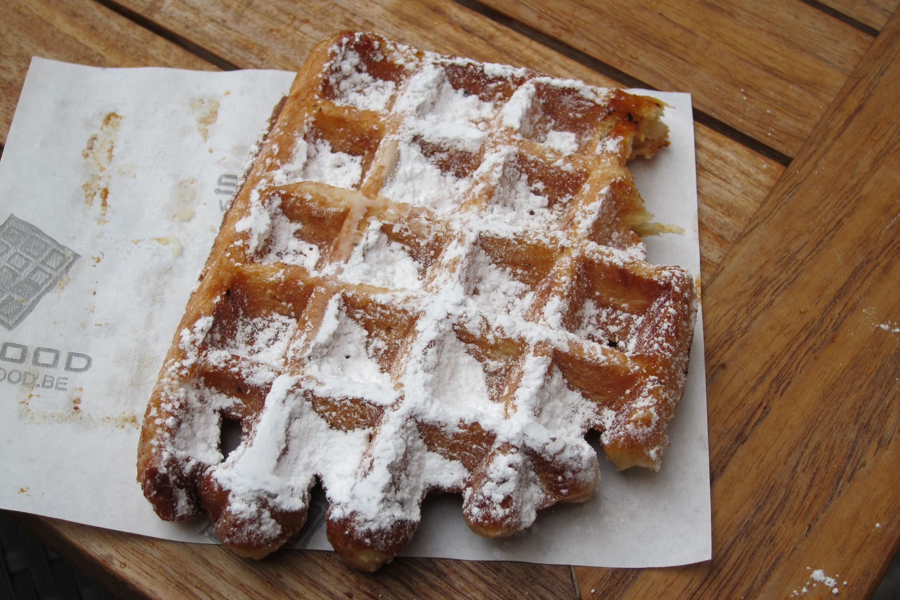
source

Slide 67
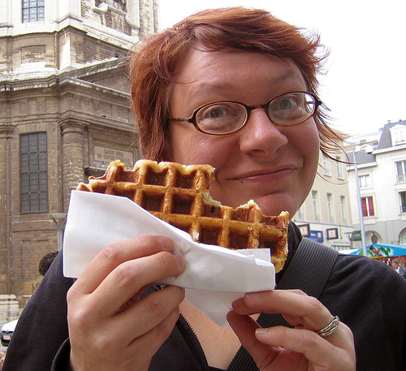
Eaten as you might eat a donut
source

Slide 68
this is the food section of the Belgian class WebPage . . .
what we call the “Belgian Waffle” is what they call the “Brussels Waffle” and it’s the style eaten in the Brussels area
other areas of Belgium have their own styles . . .

Slide 69
Liège waffle
(From the Walloon Region, Belgium’s most popular)

Slide 70
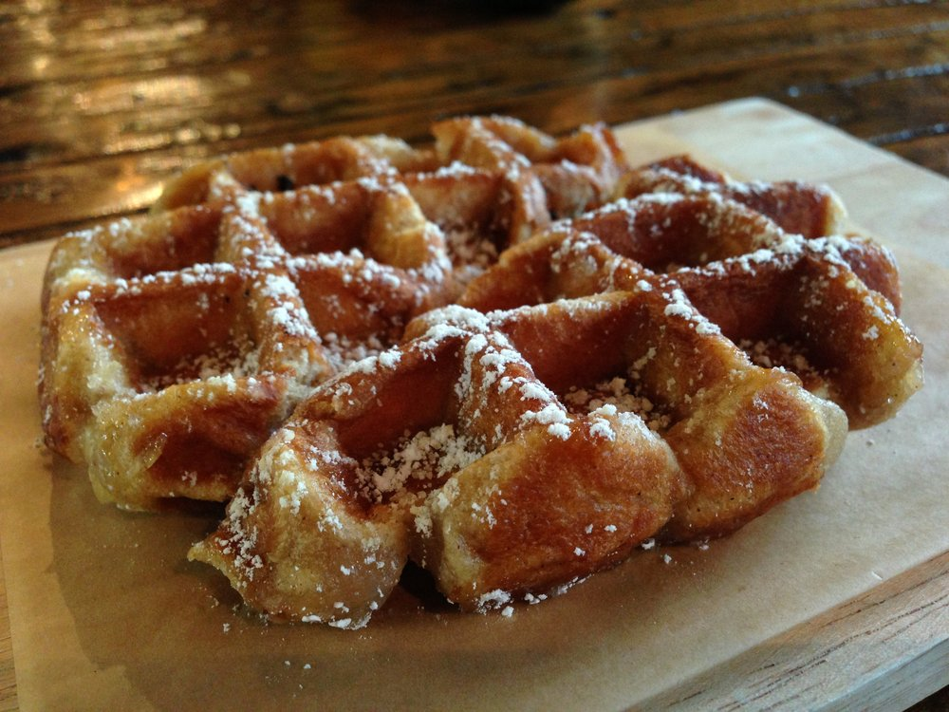
Liège waffle
(From the Walloon Region, Belgium’s most popular)
source

Slide 71
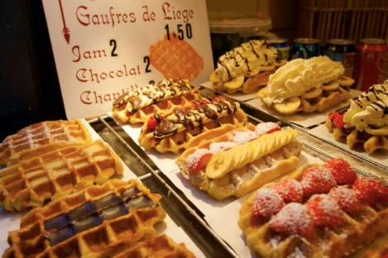
Source: Roufs and Roufs, Sweet Treats

Slide 72
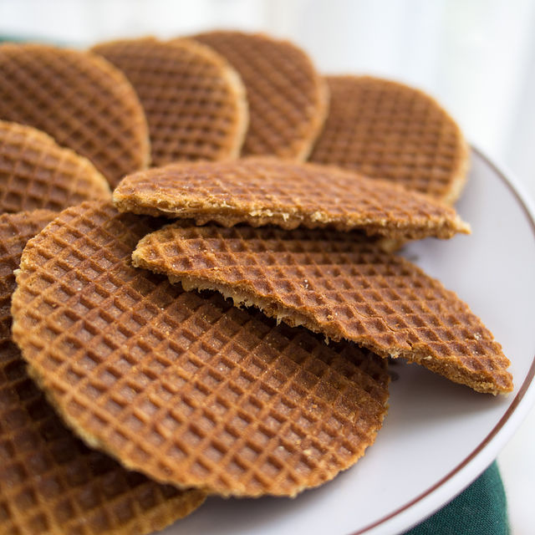
the popular Stroopwafels (syrup waffles)
were first made in Gouda, The Netherlands,
which is also famous for its cheese . . .
Source Wikipedia

Slide 73
Gouda
the popular Stroopwafels (syrup waffles)
were first made in Gouda, The Netherlands,
which is also famous for its cheese . . .

Slide 74
the term “Belgium Waffle” was invented as a marketing ploy to sell waffles to Americans at a World’s in America

Slide 75
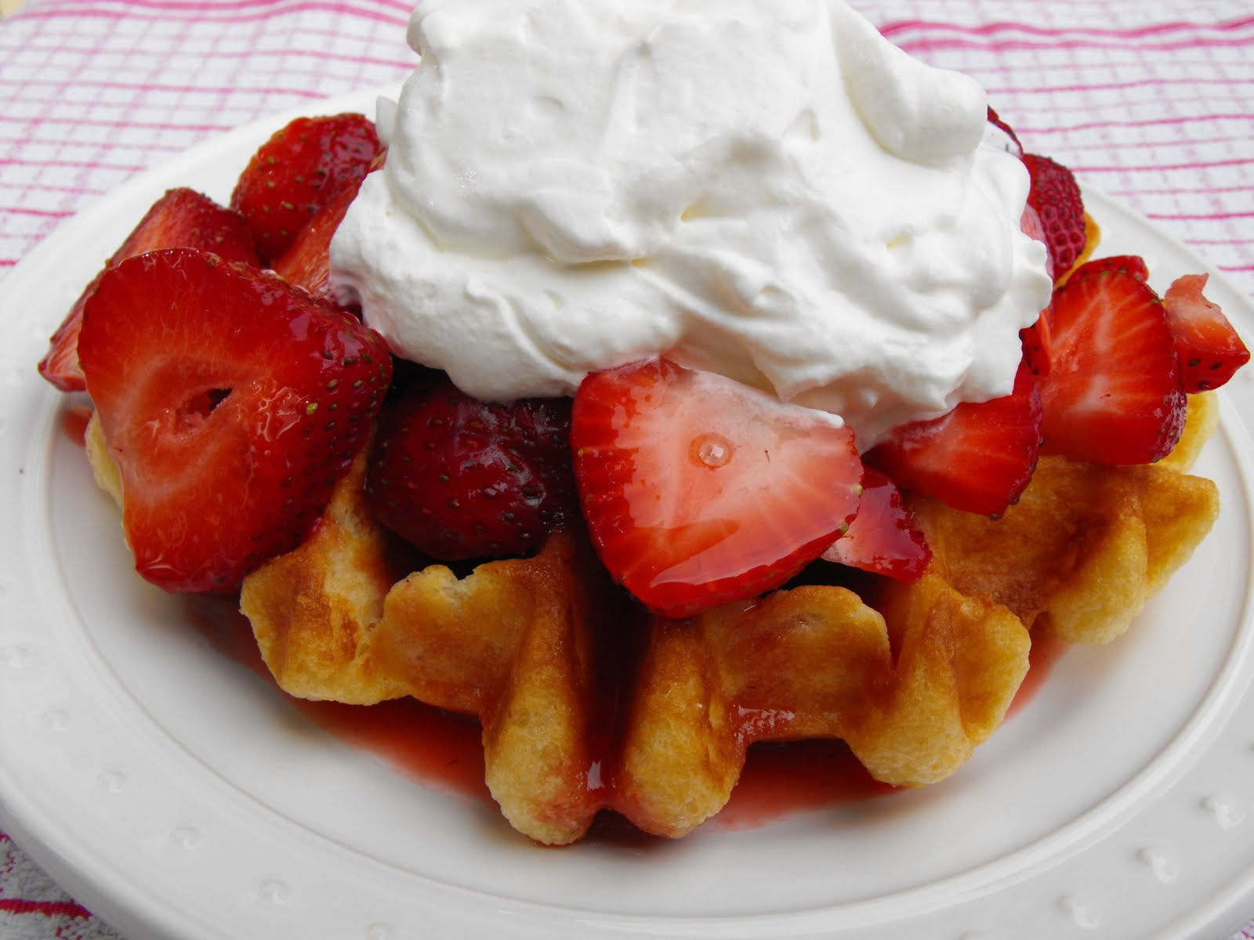
the term “Belgium Waffle” was invented in American
as a (very successful) marketing ploy . . .
source

Slide 76
this is the food section of the Belgian class WebPage . . .
you probably will not find too much on-line about it, but the horsemeat sausages are really wonderful . . .
Really . . .
wonderful.

Slide 77
this is the food section of the Belgian class WebPage . . .
you probably will not find too much on-line about it, but the horsemeat sausages are really wonderful . . .
really . . .
wonderful.

Slide 78
this is the food section of the Belgian class WebPage . . .
you probably will not find too much on-line about it, but the horsemeat sausages are really wonderful
really . . .
wonderful . . .

Slide 79
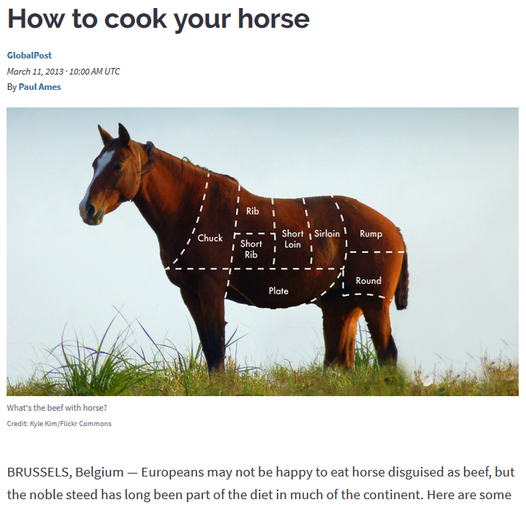
https://www.pri.org/stories/2013-03-11/how-cook-your-horse

Slide 80
REM: to go directly to a country’s food section just click on “food” from the index page . . .
or go to the country from you’re
A-Z index on your Canvas page . . .

Slide 81
this is the food section of the Belgian class WebPage . . .
. . . and that will get you there directly

Slide 82
. . . and at the bottom of each country page there is a collection of WebSites that could be useful for things like your class project . . .

Slide 83
. . . links to other useful WebSites . . .

Slide 84
They will be useful later on with your project . .
or go to the country from you’re
A-Z index on your Canvas pages . . .

Slide 85
REM
A-Z links

Slide 86
REM:
To go to any country (or region, or subject matter) simply go to the A-Z index at the top of any WebPage click on the first letter of the items you want . . . and “Bob’s your Uncle. . . .”
REM

Slide 87
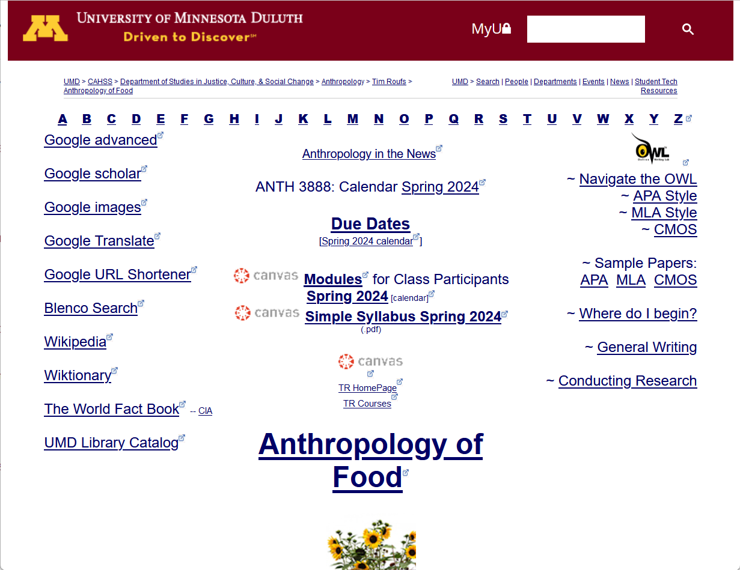
REM
A-Z Subject Index Links

Slide 88
Bon Appétit!

Slide 89
Bon Appétit!
The French-speaking Wallonians like to hear you talk like that

Slide 90
Use your imagination and
Explore
Cuisines
around the World . . .

