Slide 1
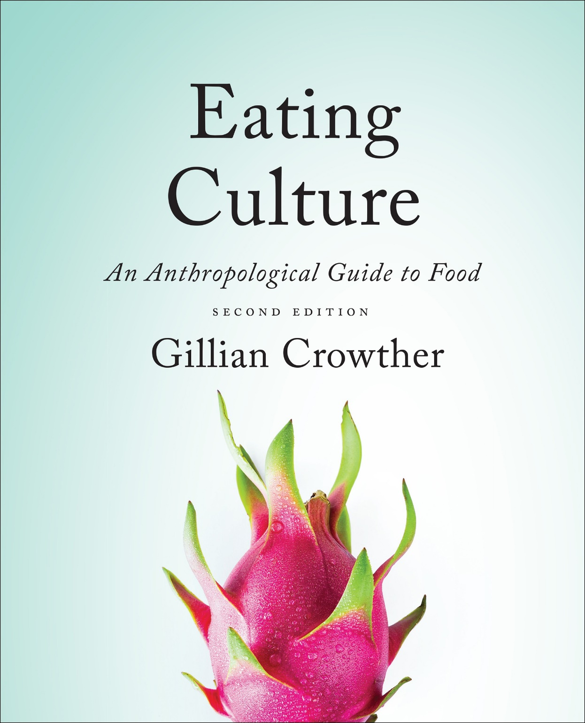
Diet
use your up/down arrow keys and/or
your space bar to advance the slides
Tim Roufs
© 2010-2024

Slide 2
Diet
Tim Roufs
© 2010-2024

Slide 3
Tim Roufs
© 2010-2024
www.d.umn.edu/cla/faculty/troufs/anthfood/aftexts.html#title

Slide 4
the
Biocultural Framework
for the Study of Diet and Nutrition
includes
Nutritional Status
Biological Makeup
Human Nutrient Needs
Diet
Cuisine
The Environment
Physical Environment
Sociocultural Environment
Economic and Political Environment
individual
nutritional
needs

Slide 5
in food studies
diet
is not a dreaded word . . .
it simply “refers to the actual foods that individuals or groups consume to meet their nutrient needs”
The Cultural Feast, 2nd ed., p. 9

Slide 6
“diet”
BUT at times authors use “diet” in the collective sense
and at other times they are concerned with how the foods and dishes in a particular cultural and physical context affect the specific food intake of individuals living in that setting
The Cultural Feast, 2nd ed., p. 9

Slide 7
“diet”
at times authors use
“diet” in the collective sense
and at other times they are concerned with how the foods and dishes in a particular cultural and physical context affect the
specific food intake of individuals
living in that setting
The Cultural Feast, 2nd ed., p. 9

Slide 8
“diet”
at times authors use
“diet” in the collective sense
and at other times they are concerned with how the foods and dishes in a particular cultural and physical context affect the
specific food intake of individuals
living in that setting
but more often than not,
the term refers to . . .
The Cultural Feast, 2nd ed., p. 9

Slide 9
thus the box labeled
“diet”
diagrammed in the biocultural model
contains
“individual nutritional status”
The Cultural Feast, 2nd ed., p. 9

Slide 10
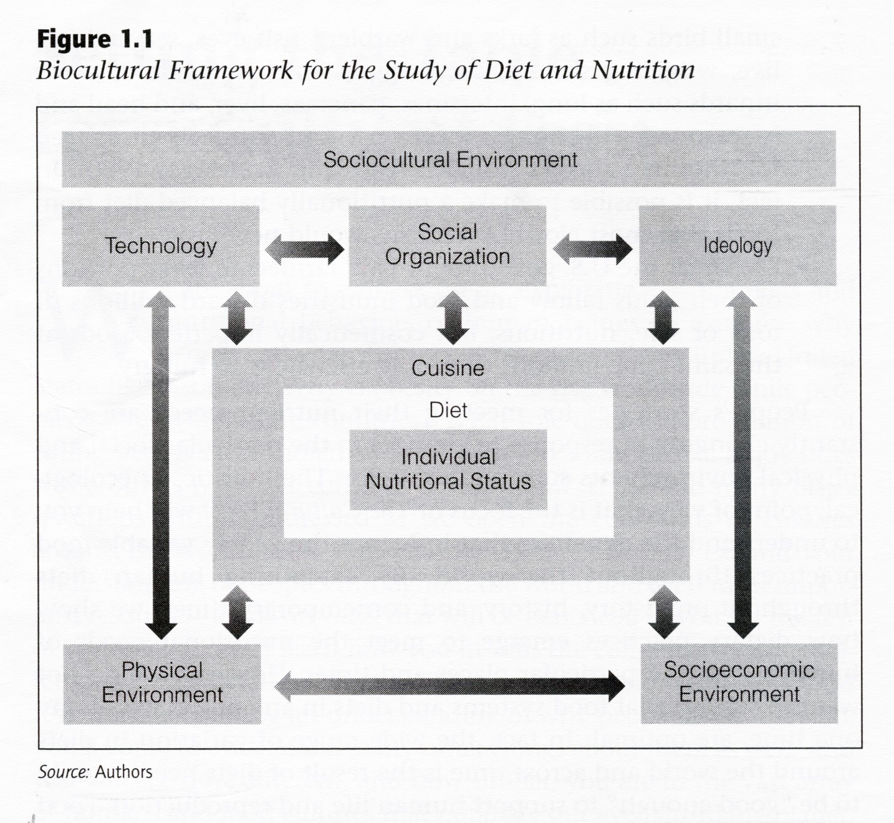
The Cultural Feast, 2nd ed., p. 4

Slide 11
so in terms of the
“units of analysis”
“diet”
will usually be the focus of inquiry as
an item itself
or
it may be part of
a focus on the individual(s)
as in, for e.g., “the Atkins Diet” or “the Keto Diet”

Slide 12
so in terms of the
“units of analysis”
“diet”
will usually be the focus of inquiry as
an item itself
or
it may be part of
a focus on the individual(s)

Slide 13
thus the “diet” . . .
“units of analysis” usually includes:
one person
the family (occasionally)
the community
a region
a “culture area”
a culture / “subculture”
a nation
an item or action itself
a “cultural metaphor”

Slide 14
if the focus of inquiry is
something having to do with
a group
then, in food research,
that is known as . . .

Slide 15
Biocultural Framework
for the Study of Diet and Nutrition
Nutritional Status
Biological Makeup
Human Nutrient Needs
Diet
Cuisine
The Environment
Physical Environment
Sociocultural Environment
Economic and Political Environment
individual
nutritional
needs

Slide 16
“cuisine”
“refers to the foods, food preparation techniques, and taste preferences that are
shared by the members of a group of people”
The Cultural Feast, 2nd ed., p. 9

Slide 17
so
“cuisine”
“refers to the foods, food preparation techniques, and taste preferences that are shared by the members of a group of people”
applies only to groups of people
that share a culture
The Cultural Feast, 2nd ed., p. 9

Slide 18
in the biocultural model
“diet” is nested within “cuisine”
to demonstrate that
a given set of preferred preparation techniques and dishes that characterize
a particular culture group
has an important impact
on the diets of the individual members
The Cultural Feast, 2nd ed., p. 10

Slide 19
The Cultural Feast, 2nd ed., p. 4

Slide 20
so in terms of the “units of analysis”
“cuisine”
may be the focus of inquiry with
any unit that pertains to a group
and is usually reserved for
a culture, subculture,
and, but only occasionally, a nation
usually a “community” would not have its own “cuisine” apart from a possible identity
with a microcultural group
but a “cuisine” could be part of a metaphorical analysis . . .

Slide 21
thus the “cuisine” . . .
“units of analysis” may include:
one person
the family
the community
a region
a “culture area”
a culture / “subculture”
a nation
an item or action itself . . .
a “cultural metaphor”

Slide 22
thus the “cuisine” . . .
“units of analysis” may include:
one person
the family
the community
a region
a “culture area”
a culture / “subculture”
a nation
an item or action itself
a “cultural metaphor”
and, as mentioned,
a cuisine could also be considered as

Slide 23
with regard to diet
“It is important to note that while acquired food preferences and tastes that are common among any particular group are power influences on diet,
people also eat novel food or,
at times, simply deviate from the group’s preferences”
The Cultural Feast, 2nd ed., p. 10

Slide 24
with regard to diet
“It is important to note that while
acquired food preferences and tastes that
are common among any particular group
are power influences on diet,
people also eat novel food or,
at times,
simply deviate from the group’s preferences”
The Cultural Feast, 2nd ed., p. 10

Slide 25
cuisines
“It is also worth noting that
a society’s cuisine interacts with its members’ biological makeup and nutrient requirements”
The Cultural Feast, 2nd ed., p. 10

Slide 26
so basically,
as a rule of thumb
“diet”
refers to individuals or an item
“cuisine”
refers to groups
(with the exceptions noted above)

Slide 27
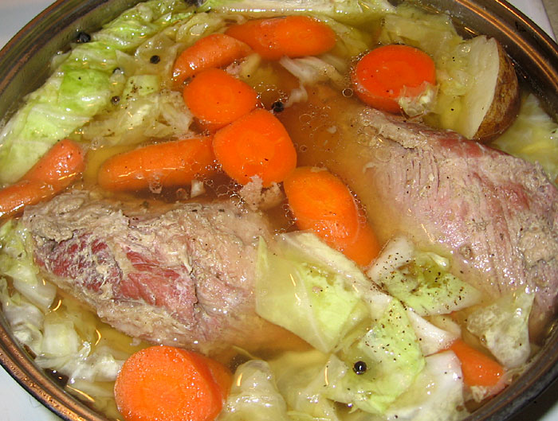
have a look at . . .
Cuisine
Anthropology of Food
University of Minnesota Duluth
Tim Roufs
© 2010-2024
Irish corned beef and cabbage
http://s184.photobucket.com/albums/x318/RennyBA/StPatricksDayOslo2008/IrishStew.jpg

Slide 28
Diet
Tim Roufs
© 2010-2024

